Slide 1
School Health Index Training
April 3, 2017
Indiana Action for Healthy Kids
Notes:
Hello everyone. Thank you for joining the Indiana Action for Healthy Kids Team today for our School Health Team Training.

Slide 2
Agenda
Welcome and Introductions
Introduction to Game On
Step 2: Assess & Track Progress
School Health Index Overview & Practice
Notes:
[Review agenda for the day. Link back to what attendees shared about what they hope to get out of today.]

Slide 3
Who Are We?
Action for Healthy Kids® (AFHK) mobilizes school professionals, families and communities across the U.S. to take actions that lead to healthy eating, physical activity and healthier schools where kids thrive.
Notes:
Let’s get started. First I’d like to give you a little background on AFHK.
Action for Healthy Kids® mobilizes school professionals, families and communities across the U.S. to take actions that lead to healthy eating, physical activity and healthier schools where kids thrive.
We are moms, dads, teachers, students, school and community leaders and school wellness experts who have banded together to create healthier learning environments for our children.
We believe that everyone has a part to play in ending the nation’s childhood obesity epidemic. Our programs, tools and resources make that possible.

Slide 4
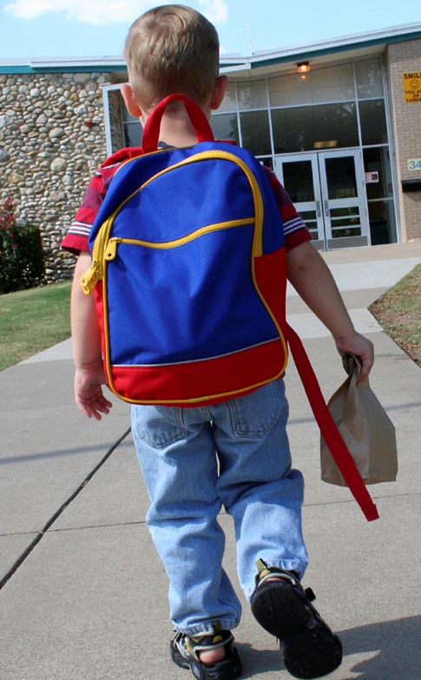
Who Are We?
Our goal is to create school communities where children learn how to make healthy choices from the minute they walk in the front door to the minute they leave at the end of the school day.
Notes:
We were founded in 2002 by former Surgeon General David Satcher. Today we have more than 110,000 members and constituents in our network. We also partner with dozens of professional associations, government agencies and corporations at the national and local level.

Slide 5
What is Game On?
Game On supports America’s schools, their staff, students, and families to incorporate healthy food choices and physical activity into their daily lives and school environment, with the ultimate goal of getting nationally recognized as a health-promoting school.
Notes:
Now that we’ve set the context and made the case for why we are all here today, I’d like to introduce you to a resource
that I will be referring to throughout the training to help guide you in your efforts to create healthier schools.
Action for Healthy Kids has an online tool that can be used to help your school minimize conflicting messages by supporting you school in developing (or maintaining) a successful school health and wellness program. Game On supports America’s schools, their staff, students, and families to incorporate healthy food choices and physical activity into their daily lives and school environment, with the ultimate goal of getting nationally recognized as a health-promoting school. It doesn’t matter where your school is with school wellness – Whether you are just starting a school health team or you have been implementing wellness initiatives for years – Game On can serve as a tool to provide you with resources and ideas to continually improve your wellness programming. Game On can also be used to compliment other programs your school may already have in place.

Slide 6
Goals of Game On
Help students learn about and practice the habits of sound nutrition and physical activity
Provide schools with a framework and access to tools to integrate health concepts and activities throughout the school year
Engage educators, school staff, families and community members in helping students eat better and move more
Support long-term school wellness policies by promoting sound nutrition and physical activity throughout the school campus
Notes:
Game On strives to:
Help students learn about and practice the habits of sound nutrition and physical activity. Game On engages students in making better food choices – including fruits, vegetables, whole grains and low-fat and fat-free milk products – at school and home. It also focuses on engaging students in getting more physical activity before, during, and after school. You’ll find more than 80 Eat Better and Move More Activity ideas that include resources, ideas and tips for implementing at your school.
Provide schools with a framework and access to tools to integrate health concepts and activities throughout the school year. This framework can be used to compliment other wellness initiatives or programs your school has in place.
Engage educators, school staff, families and community members in helping students eat better and move more – Everyone has a role in school wellness!
Support long-term school wellness policies by promoting sound nutrition and physical activity throughout the school campus. Game On provides strategies and ideas to help you put your school district’s local school wellness policy in action.

Slide 7
How Long Does the Program Run?
Implementation time and strategies vary to meet school needs and resources.
Use Game On activities:
When just starting a school wellness program
To enhance long-standing school wellness programs
Daily with announcements or brain breaks
One or more times per week
As part of a month-long project
Before, during, after school, at home and for special events
By teacher, by grade or by school-wide participation
By selecting activities that best meet school goals and capacity
Indoors or outdoors depending on available facilities
Notes:
7
Game On is flexible to meet your school’s needs. On your screen, you’ll see several examples of how you can use Game On to inform your school wellness program. [Read all or a few activities on screen.]

Slide 8
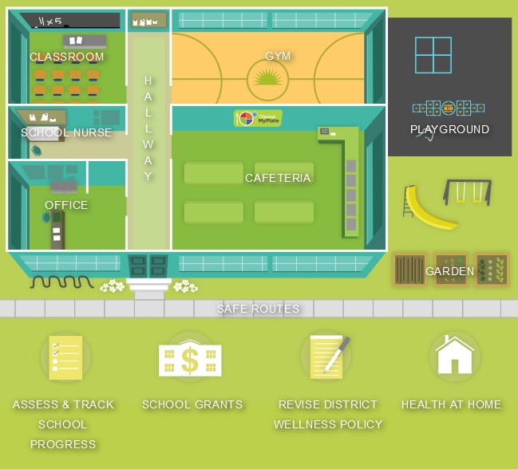
It’s Fun, Easy, Free and Online!
http://www.actionforhealthykids.org/game-on
Notes:
As I’ve mentioned, Game On has more than 80 Eat Better and Move More Activities such as “Host a Taste Test”, “Family Fun Days”, “Brain Breaks”, “Rethink Your Drink”. Each of these Activities are organized into a School Blueprint so you can search for activities based on which area of school you want to make healthier. For example, if you are a classroom teacher, you can click on the “Classroom” on the School Blueprint to find the Eat Better and Move More Activity ideas we recommend for making classrooms healthier.

Slide 9
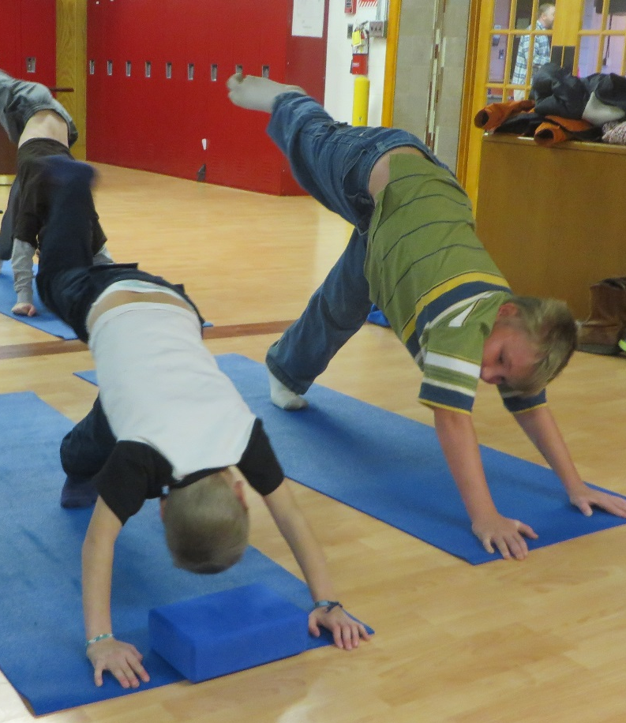
Organized in Six Steps
Step 1: Gather Your Team — Identify volunteers from school staff to parents to community members to serve on the team.
Step 2: Assess & Track Progress —Assess the health of the school environment using the School Health Index to identify areas of needed improvement.
Step 3: Create & Implement an Action Plan — A clear action plan will serve as a road map for the wellness team and outline priorities and goals.
Notes:
9
Game On is organized into 6 steps – We recommend following these 6 steps to ensure you build a strong, sustainable school health and wellness program. This is where the flexibility comes in – If you already have a diverse school health team in place, you can skip Step 1 and start right with Step 2. It’s designed to meet you where you are!
The first 3 steps are listed on your screen. [Review steps.]

Slide 10
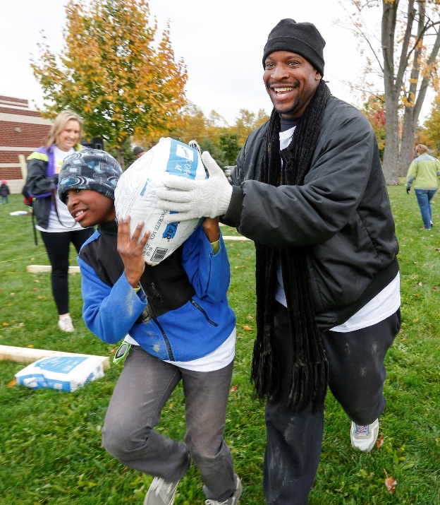
Organized in Six Steps
Step 4: Find Activities — Use the Game On school blueprint to identify activities and resources that line up with school needs.
Step 5: Engage Families & Community —Partner with parents, volunteers and community organizations on school wellness initiatives to promote consistent messages and ensure sustainability.
Step 6: Receive Recognition — Apply for recognition through the HealthierUS School Challenge: Smarter Lunchrooms initiative.
Notes:
10
Here are steps 4, 5 and 6. {Review steps.]
The training today mirrors the Game On Process – We’ll take you through each of these 6 steps in detail throughout the remainder of the training.
At the end of the training today, we’ll take a few minutes to walk you through the online Game On program so you can get a better feel for how your school can use the program to compliment your school wellness initiatives.

Slide 11
Steps of Game On
Step 1: Gather Your Team
Step 2: Assess & Track Progress
Step 3: Create & Implement an Action Plan
Step 4: Find Activities
Step 5: Engage Families & Community
Step 6: Receive Recognition
Notes:
11

Slide 12
Why Do a Wellness Assessment?
Develop relationships with key staff.
Determine your school’s strengths and weaknesses.
Define goals that suit your school’s needs.
Justify your decision to make changes.
Document starting points to show progress over time.
Notes:
So why do a wellness assessment? Although it can be tempting to jump right in and start a project, there are many good reasons to start with an assessment. It will enable your team to:
First, develop relationships with key staff. Hopefully you have already been doing this, but the assessment provides another reason to communicate and work together.
Second, it will help you determine your school’s strengths and weaknesses
Third, it will help you define goals that really suit your school’s needs. Hopefully, at some point, these goals will go into the school wellness policy or School Improvement Plan.
Next, it will help you justify your decision to make changes
And finally, it will help you document starting points in order to show progress over time. This will be very important down the road, as it will enable you to show that your efforts have achieved measureable results and will help to create sustainability for the long-term. Also, data is always useful to have for funding requests, especially grants.

Slide 13
Keep in Mind
Conduct your wellness assessment annually so you can measure your progress over time.
Notes:
Keep in mind that your team should conduct a wellness assessment, ideally the same one, annually so that you can measure your progress over time.

Slide 14
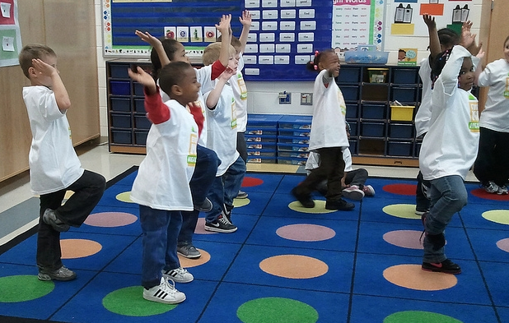
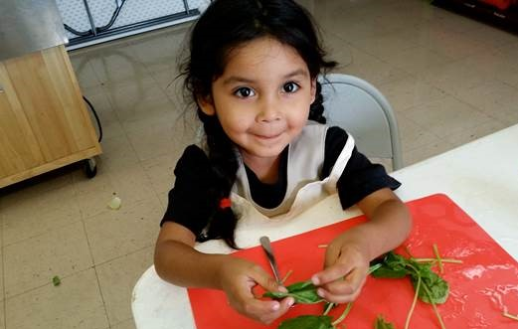
Assess & Track Progress with the School Health Index
“The only man who behaves rationally is my tailor; he takes my measurements anew every time he sees me, while all the rest go on with their old measurements and expect me to fit them.”
– George Bernard Shaw
Playwright and Winner of the Nobel Prize in Literature, 1925
Notes:
Action for Healthy Kids recommends that you use the School Health Index (SHI) as your assessment tool.
Action for Healthy Kids (AFHK) has adopted School Health Index (SHI), an online assessment tool developed by the Centers for Disease Control (CDC). The 2014 SHI guides school-based obesity prevention and health promotion efforts. Action for Healthy Kids has worked closely with the Centers for Disease Control and Prevention (CDC) to offer an abbreviated online version of the SHI to schools as a unified assessment tool to guide school-based obesity prevention and health promotion efforts. We’ll show you how to use this online tool during the training today. We’ll also dedicate some time for you to complete a SHI module for your own school before the end of the training.

Slide 15
School Health Index (SHI)
Notes:
Before we explore the SHI technology, I want to give you a little background on the School Health Index. There are eight modules in the 2014 School Health Index [read slide]. Each module has a number of questions that assess how well your school is implementing that particular module. As I mentioned, Action for Healthy Kids’ version of the School Health Index is shorter than the CDC’s SHI, as we have adopted only specific questions from all 8 modules. These questions focus on the following topic areas:
Physical activity
Healthy eating
Tobacco-use prevention
Unintentional injury and violence prevention (safety)
Asthma
Sexual health, including HIV, other STDs and pregnancy prevention

Slide 16
Step 2: Assess & Track Progress
How can Game On: Step 2 help?
Outlines why it’s helpful to complete an assessment
Links to AFHK’s School Portal, where you can complete AFHK’s modified School Health Index
Provides a step-by-step guide for how to complete the AFHK’s online School Health Index
Notes:
Step 2 of Game On can help your school assess and track progress by:
Outlining why it’s helpful to complete an assessment, so you can secure the buy-in and support from other school health team members and stakeholders
Linking to AFHK’s school portal, an online portal where you can complete AFHK’s modified School Health Index
Providing a step-by-step guide for how to complete AFHK’s online School Health Index

Slide 17
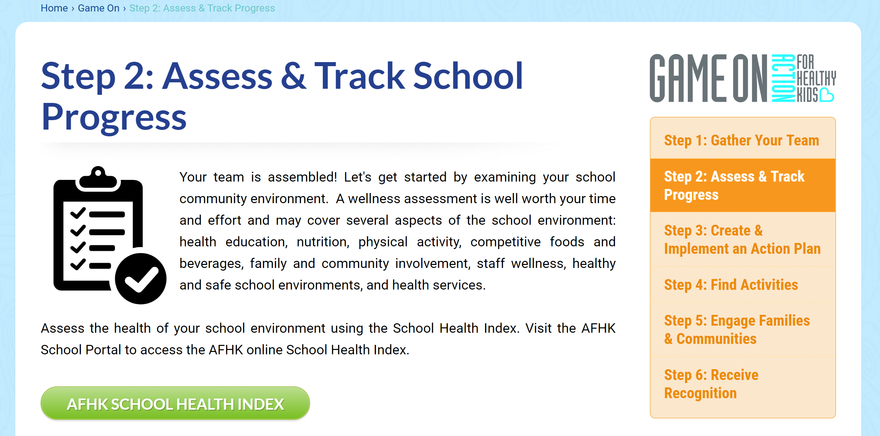
Step 2: Assess & Track Progress
Notes:
To use Action for Healthy Kids’ online version of the SHI, simply go to Step 2 of Game On where you’ll click on “Access the Action for Healthy Kids School Health Index”. This will take you to Action for Healthy Kids’ School Portal, where you’ll be prompted to log-in. It’s completely free to create a log-in and multiple people from your school health team can access the portal. This means you can divide and conquer!
The AFHK School Health Index is available free to any school that wishes to use it. Today, you’ll have the opportunity to complete one of the School Health Index modules so you can start to feel comfortable with the technology.

Slide 18
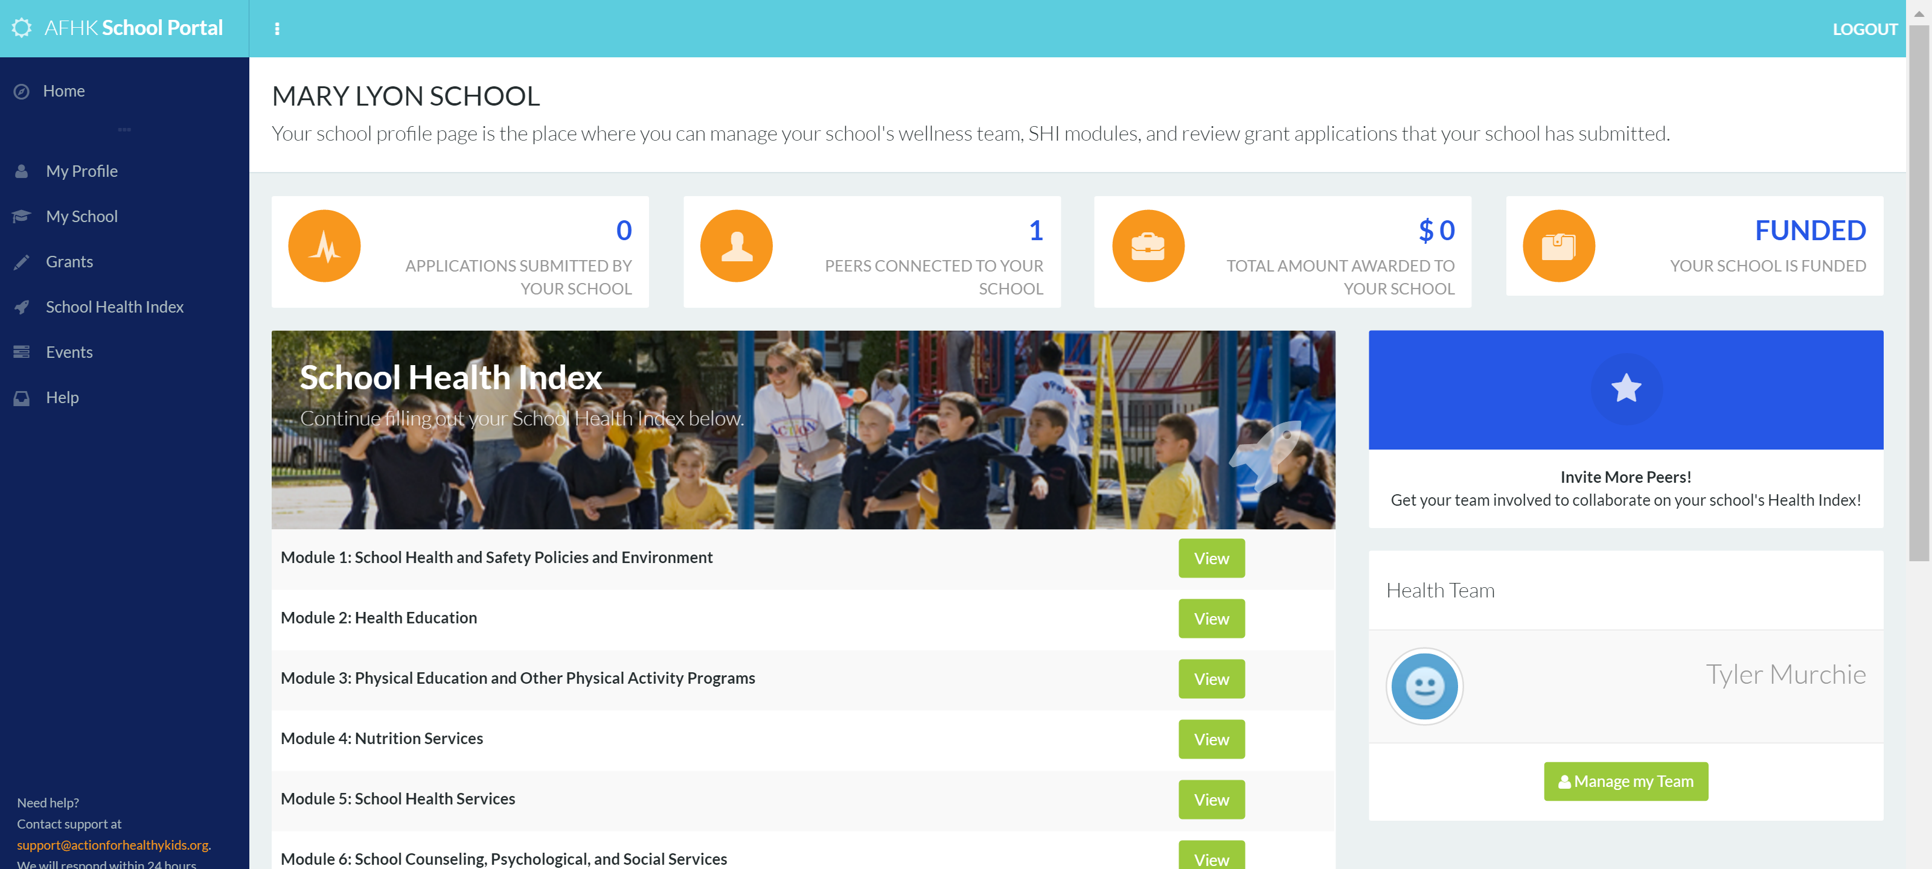
Step 2: Assess & Track Progress
Step 2: Assess & Track Progress
Notes:
To use the AFHK’s online version of the SHI, a member of your school health team will log on to the Action for Healthy Kids website and set up an account on our school portal. From this portal it will also be possible to complete grant applications and recruit volunteers for health and wellness events.
Here’s what the portal looks like when you log on. You’ll click on School Health Index on the left-hand side of the screen, and that will take you to the page where you can begin completing the tool.

Slide 19
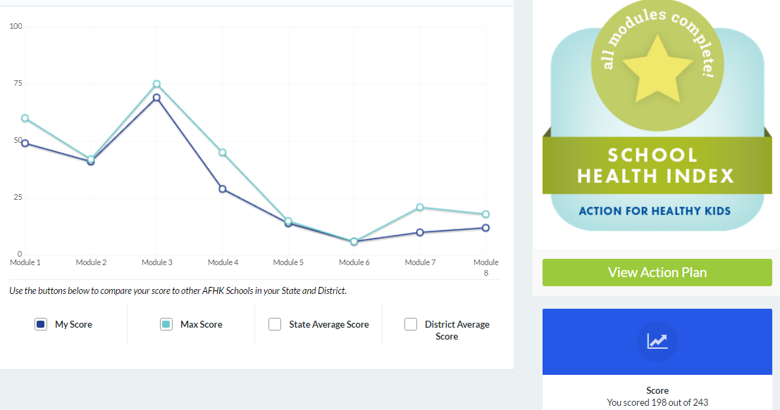
Step 2: Assess & Track Progress
Notes:
After your school completes the AFHK SHI modules, you will receive a report and links to online resources, based on your answers. Here is an example of a report [Walk through key features of the report.] You also receive a report for each individual module, which looks similar to this report.

Slide 20
Step 3: Create & Implement an Action Plan
Notes:
After completing all modules of the AFHK School Health Index, your school will receive an auto-generated action plan, in addition to the reports. The screenshots on this screen show you how you can access the Action Plan. Keep in mind that you’ll only be able to use the Action Plan feature if you complete all of the SHI modules.

Slide 21
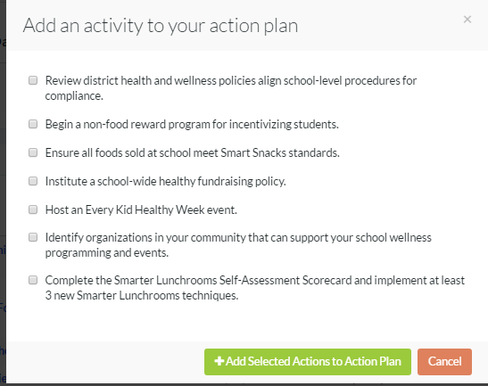
Step 3: Create & Implement an Action Plan
Notes:
Specific action items, based on your SHI responses, will pre-populate in the “pending actions” button which will help your school wellness team focus on areas where you could improve. For example, if your school scores low on the physical activity module, you will receive a number Game On Activity ideas to help increase physical activity opportunities at school. This can help your school stay focused on the needed areas of improvement. Here is an example of what the action plan will look like [review key components of action plan]. This action plan can also be customized with additional action items that your school wants to add to the plan.
We are going to walk through this process step by step so you can be familiar with the technology, the reports and the action plan so you can use it for your own school’s assessment. First, let’s talk about why an action plan is so important.

Slide 22
Step 3: Create & Implement an Action Plan
Notes:
Once you accept your pending actions, you can edit them to have a start and end date, owner (person responsible), measure of success, etc. Simply click on the edit button to modify this. In addition, you can customize the action plan with your own actions, like the first one listed on this screen Host an Annual Health Fair.
We encourage schools to log into their action plan regularly to check off items that have been completed and add new items.

Slide 23
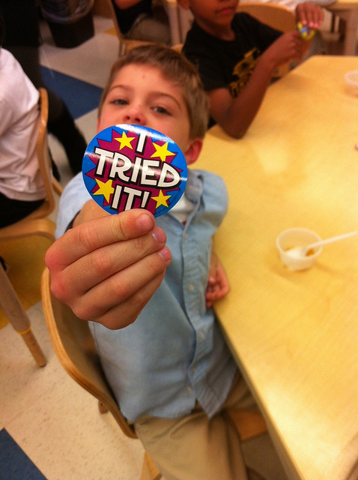
Game On Steps 2 & 3
Let’s practice using the School Health Index!
Notes:
We’ll devote the remainder of this section to practice using AFHK’s online School Health Index with a test school. This will give you a chance to see how the technology works and give you the opportunity to complete one module of the School Health Index. Then, you can take the information back to your school and complete the rest of the assessment with your school health team. We will also walk through the auto-generated action plan. Keep in mind, action plans are considered a working document and should be used as a guide for your school wellness initiatives. It’s a great tool to measure and evaluate your progress. I recommend using it at every school health team meeting to stay focused and organized.
[Before participants work on their own SHI modules, demonstrate how to use the portal. Pull up the AFHK school portal testing site and use your test school log-in information to walk through a SHI module, report and action plan. See the School Portal Guide for Test Schools for step-by-step instructions. After you demonstrate how to use the portal, allow 10-15 minutes for participants to complete one of the SHI modules. Provide participants with the Instructions for Completing AFHK’s School Health Index to guide them step-by-step.]
[Steps:
Click on “School Health Index” on the left side in the dark blue.
There is a drop down box to select schools that do not have a SHI started. Find your school and select it.
If a SHI is already started, a list of all your affiliated schools will appear.
You will be able to find your school. Then you can view action plans and SHI modules not started, started and completed. Click on the school name to view any SHI modules that have been started (orange box) or completed (blue box with check mark).
When you click on the school name, you will see the SHI modules listed and the status of each module.
Click on the module box to enter the module to either start, edit or finish and submit. Once a module is submitted it will be marked as completed and will not be able to be edited. To complete the SHI, click on the appropriate response for each question. The responses are explained in the text with each question. Responses are listed in a drop down box under the answer descriptions.]

Slide 24
Reminders
Complete AFHK’s SHI prior to attending wellness workshop.
Email Maggie school’s SHI when complete (mschabel@doe.in.gov).
Attend one of the wellness policy workshops and specifically Breakout Session 2 –presentation on Smarter Lunchrooms and School Health Index.

Slide 25
Next Steps for SHI
work with you one-on-one after the wellness policy workshops have concluded to provide further guidance and when we will conduct additional conference calls, webinars, and in-person meetings
work one-on-one with Maggie and Hannah to implement wellness policy changes during school year 2017-2018
Will need to resubmit the SHI by June 2018
Notes:
Wanted to close with some next steps/reminders.
You will need to complete the SHI prior to attending the wellness workshop. Jason (Brown County) & Gayla (Batesville) are registered for the wellness workshop on Wednesday. If you could please email me your completed SHI anytime prior to you attending the workshop that would be great!
Jason – Hannah informed me that Brown County Schools has already completed the SHI, so if you just want to double check the info and update anything, as needed, that would work.
Next steps:
Complete SHI
I will be able to view your completed SHI – the only ones who will have access to view your SHI results are you, Hannah and myself.
Attend wellness workshop, specifically session 2: in depth overview on SHI and Smarter Lunchrooms
After the workshops are over, we will begin the conversation about when we can visit you for the one-on-one guidance to help you meet your goals. So please start thinking about how you want this to look – do you prefer Allie, Hannah and myself to all come on one day or do you prefer separate visit. Let us know what works best for you and your wellness team.
After we help you work on implementing some of your goals you submitted in your application, we will have you resubmit the SHI by June 2018. Again, the nice perk about using the AFHK’s SHI is that your answers will be saved, so when it comes time to resubmit, all you will need to do is update answers on an as needed basis.
To help with sustainability for this project, I will be creating a best practice document/fact sheet with Indiana specific information such as one a pager of wellness policy goals that were implemented by the you, our 5 schools, and pictures.
Please let me know if you need anything from us! Again, we are excited to work with you towards making your wellness projects come to life!

