Slide 1
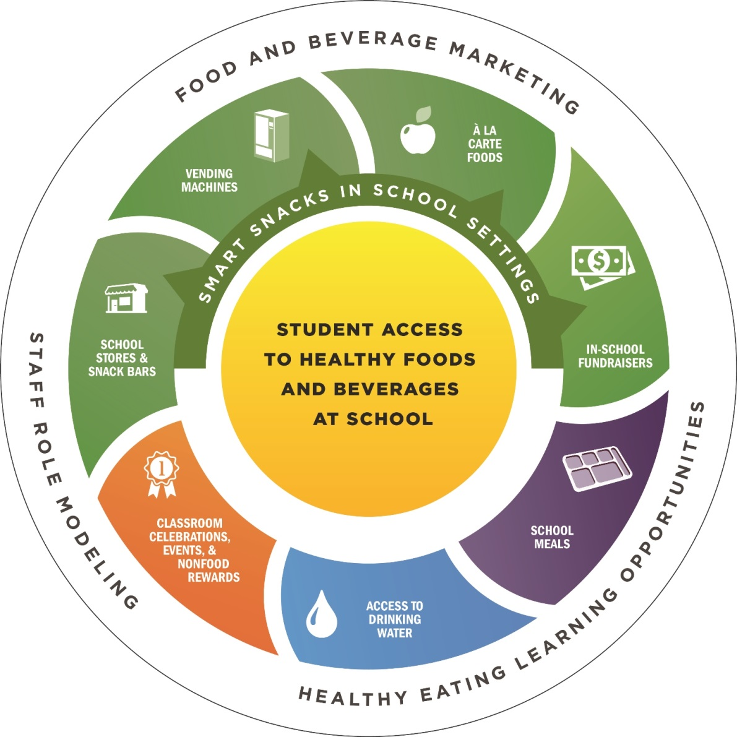
Nutrition and Healthy Eating in Schools
Notes:
1) What does nutrition and healthy eating in schools encompass?
2) There are a number of different opportunities for students’ to access healthy foods and beverages at schools. These include the following:
a) School Meals (the Food & Nutrition Service Department controls)
b) Smart Snacks which in Maryland is the Maryland Nutrition Standards for All Foods Sold in School. These include a la carte foods (food service department has control), in school fundraisers, school stores & snack bars, and vending machines.
c) Classroom celebrations, events, and non-food rewards: Your wellness policy may or may not have information about county level guidance around classroom celebrations, etc.
3) On the outside of the circle it lists several key areas that affect children’s decisions to access healthy foods and beverages that are available to them in the school.
a) Staff role modeling
b) Food and beverage marketing
c) Healthy eating learning opportunities: these include anything in curriculum, taste testing in school, outside speakers, etc.

Slide 2
Nutrition and Healthy Eating in Schools
Explain the School Meal requirements and their alignment with the Dietary Guidelines for Americans and MyPlate recommendations.
Describe the school nutrition environment and Maryland’s Smart Snack standards.
Identify resources to support families and children in healthy food decision making.

Slide 3
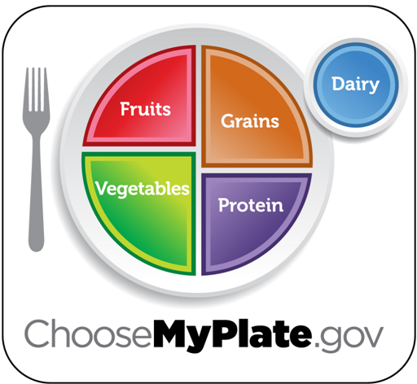
Dietary Guidelines for Americans: Key Recommendations
Consume a variety of healthy foods & beverages
within an appropriate calorie level.
Fat-Free
or
Low-Fat
Choose a variety, mostly whole fruit!
Whole Grain-Rich!
Choose a variety:
dark green,
red orange, & beans/peas!
Choose a Variety!
Limit: Saturated fats and trans fats, added sugars, and sodium

Slide 4
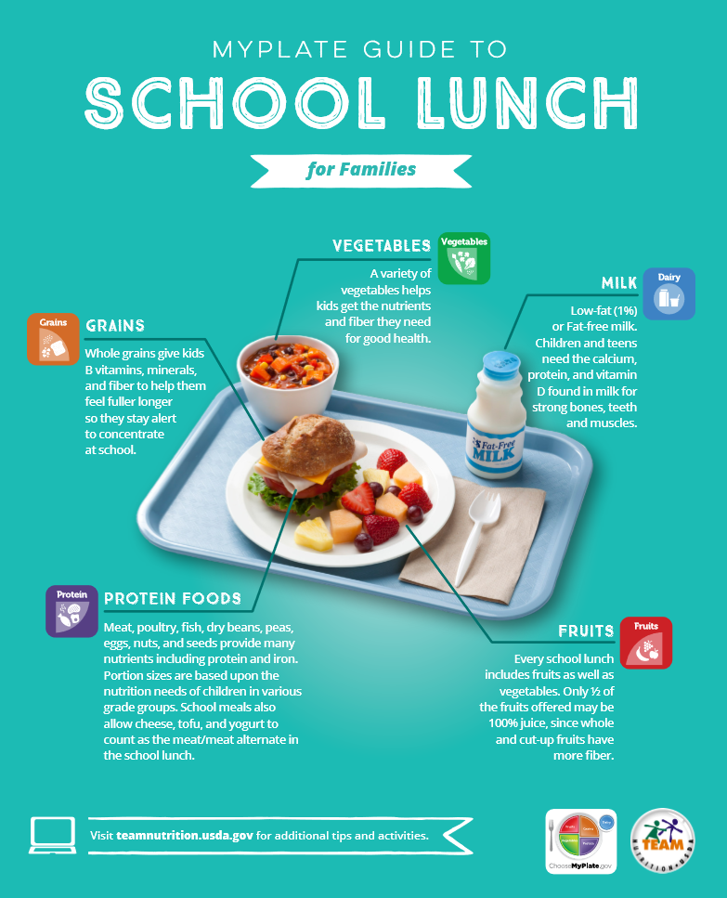
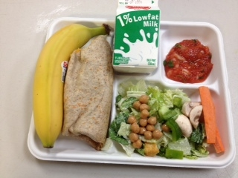
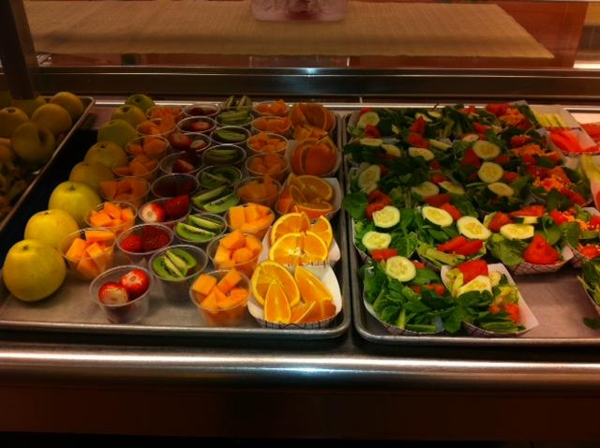
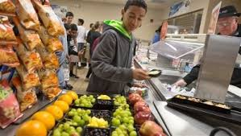
School Meals: The DGA in Action!
Notes:
Review and reference handout!

Slide 5
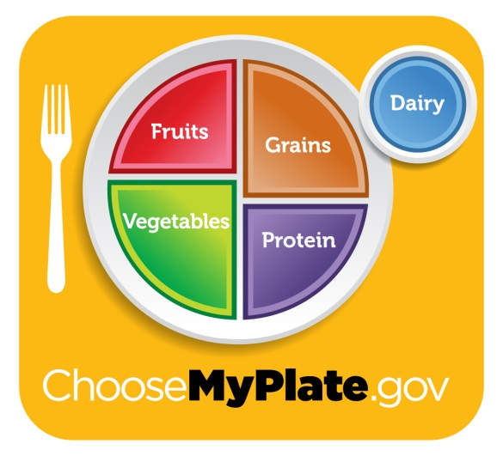
How are nutrition standards for School Meals established?
Meals planned according to:
A specified Meal Pattern
Dietary Guidelines for Americans (DGA)
ChooseMyPlate.gov
Strict nutrition standards
Regular Federal & State Reviews
Notes:
There are strict nutrition standards.
We have to go through regular federal and state reviews to make sure that we are in compliance with the program.
According to the DGA, a healthy eating pattern includes:
A variety of vegetables from all of the subgroups—dark green, red and orange, legumes (beans and peas), starchy, and other
Fruits, especially whole fruits
Grains, at least half of which are whole grains
Fat-free or low-fat dairy, including milk, yogurt, cheese, and/or fortified soy beverages
A variety of protein foods, including seafood, lean meats and poultry, eggs, legumes (beans and peas), and nuts, seeds, and soy products
Oils
A healthy eating pattern limits:
Saturated fats and trans fats, added sugars, and sodium

Slide 6
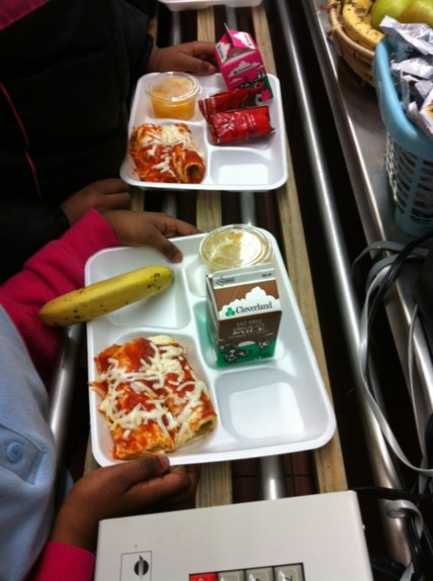
Federal Nutrition Requirements
More fruits and vegetables, including servings of leafy greens, red/orange vegetables, and legumes
More whole grains
Fat-free or 1% milk
Lean Meats, Beans, & Legumes
Age-appropriate limits on:
Calories
Sodium
Trans and saturated fat

Slide 7
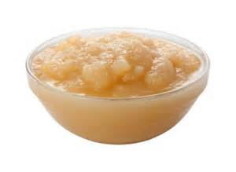
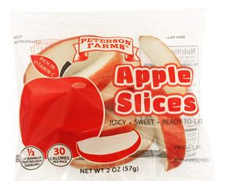
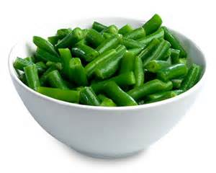
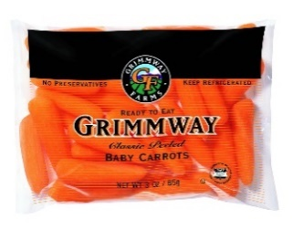
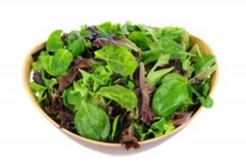
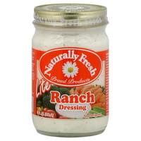
School Lunch Meal Comparison Before & After 2012
The Tray of Yesterday
The Tray of Today
Traditional Enriched Flour Pizza
Sweetened Applesauce (¼ cup)
Whole Grain Rich Pizza
Unsweetened Applesauce (½ cup) or Fresh Apple (1 whole) or Fresh Apple Slices (½ cup)
Green Beans (½ cup)
Low Sodium Green Beans (½ cup)
Fresh Baby Carrots (¼ cup)
Fresh Mixed Greens (½ cup Hand Mixed Selection of Romaine, Spinach & 3-Way Iceberg Blend)
Naturally Fresh Lite Ranch Dressing (2 Tbsp.)
Notes:
This is a Before & After look at meals prior to the changes in 2012 that were part of the Healthy, Hunger-Free Kids Act. What is the different in the applesauce? The milk? The pizza

Slide 8
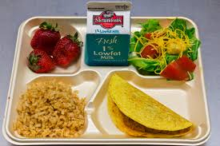
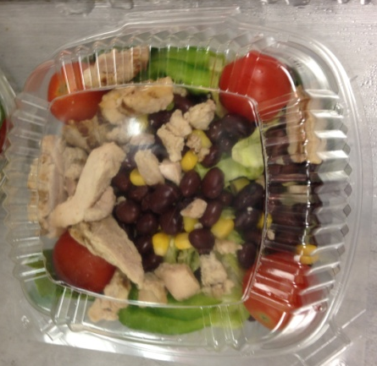
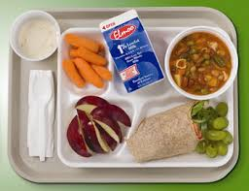
A Typical School Lunch
Food Groups (components)
Protein (Meat/Meat Alt)
Grain (Whole Grain)
Vegetable
Fruit
Fluid Milk
Translates to:
Entrée item
Pizza, Chicken Nuggets/ Tenders, Meat w/Rice Dishes
Hot/Cold Sandwiches
Entrée Salads
Side Items
Garden Salad, Steamed Vegetable, Veggies w/Dip
Fresh Fruit, Fruit Cup, 100% Fruit Juice
Milk Choices
Low-Fat Plain Milk or Flavored Mik
NF Plain or Flavored Milk
Notes:
We offer popular foods that are lower in fat and made with whole grains – our pizza crusts, breading on nuggets/tenders and corn dogs, buns/bread on sandwiches are all made with whole grains.
Students are required to choose a fruit or vegetable serving as part of their meal. So, we offer a variety of fruits and vegetable daily, which include fresh fruit and a fresh garden salad every day – in addition to the other fruit and vegetable offerings.
Fluid milk is a requirement of the program, and we offer several different milk choices.
So, you can see that the meals we offer are always balanced and nutritious. However, what we offer is different from what is actually taken and eaten. That’s where nutrition education takes place, which hopefully you are getting in school courses, and you are given the opportunity to practice it at meal time.

Slide 9
Changing School Lunch Nutrient Profile (Elementary)
Nutrient | Today | Yesterday | Change
Calories | 565 | 601 | ↓ 6%
Total Fat | 15g | 22g | ↓ 32%
Saturated Fat | 4.5g | 8.5g | ↓ 47%
Trans Fat | 0g | Not Available on All Items | Unknown Reduction
Protein | 24g | 28.5g | ↓ 16%
Carbohydrate | 85g | 76g | ↑ 12%
Fiber | 9g | 3g | ↑ 200%
Whole Grains | 18g | 0.5g | ↑ 1500%
Vitamin A | 10,479 IU | 1483 IU | ↑ 600%
Vitamin C | 8mg | 4mg | ↑ 100%
Sodium | 1073mg | 1257mg | ↓ 15%
Calcium | 675mg | 800mg | ↓ 16%
Iron | 5mg | 4mg | ↑ 25%
Significant Changes (>30%)
are highlighted in
yellow.
Notes:
This slide compares the nutritional information of a school lunch before and after the HHFKA Meal Pattern Changes in 2012.

Slide 10
Food and Nutrition Services Departments
Manages the Child Nutrition Programs for the County
Some Counties have a team of Child Nutrition Professionals
Registered Dietitians
Professional Chef
ServSafe Certified Managers
Programs are financially self-supporting
Reimbursement from USDA per meal plus revenue from paid meals and a la carte help keep the department staffed and stocked with food.

Slide 11
How are menus developed?
There are many considerations that are taken into account.
Some describe it like putting together a jigsaw puzzle.

Slide 12
Commodity Foods
Storage Space
Vendor Bid Items
Nutrition
Staffing
Transportation
Time Constraints
Menu
Delivery Schedule
Equipment
Student Acceptance
State Regulations
Cost of Foods
Federal Regulations
Price of Meals
Food Safety Concerns

Slide 13
Other Areas of the School Nutrition Environment
Maryland’s Smart Snack Standards (includes federal Smart Snack standards) includes all foods and beverages sold to students to students during the school day (12:01am to 30 minutes after school day) on the school campus
vending machines
school stores
fundraising
a la carte in cafeteria (School Meals staff controls)
https://www.youtube.com/watch?v=ffOH4Nazdf8&feature=emb_title
Notes:
Watch the video and discuss Maryland Smart Snack Standards. Reference MSDE’s Maryland Nutrition Standards for All Food Sold in School.

Slide 14
Other Areas of School Nutrition Environment
Celebrations, Birthdays, Events, and Rewards!
What does your School System’s Wellness Policy say?
INSERT LOCAL SCHOOL SYSTEM SPECIFIC LANGUAGE HERE
Implement celebrations that support Child Health: Handout from Alliance for Healthier Generation

Slide 15
Resources for Families
Locate the lunch and breakfast menus for your local school system: INSERT LINK
MyPlate Be A Healthy Role Model for Children: See Handout
MyPlate Make Celebrations Fun, Healthy and Active: See Handout

