Slide 1
Fall Regional Meetings
Converting Grains to Ounce Equivalents in the CACFP
Notes:
Good afternoon everyone! And welcome to Converting Grains to Ounce Equivalents in the CACFP

Slide 2
OVERVIEW
Ounce Equivalent Overview
Implementation Timeline
Monitoring
Team Nutrition Grains Measuring Chart
Food Buying Guide – Exhibit A Grains Tool
Food Buying Guide – Recipe Analysis Workbook
Notes:
Here is a brief overview of the topics Lisa and I will cover with you today,

Slide 3
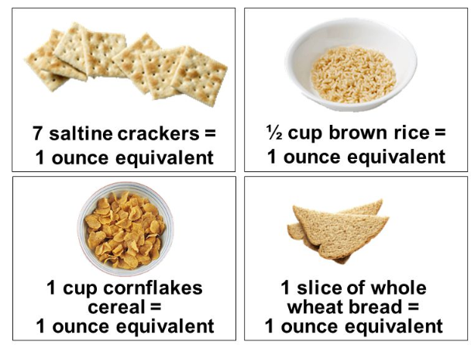
WHAT ARE OUNCE EQUIVALENTS?
Moving from servings to ounce equivalents
One ounce equivalent = 16 grams of grain
Notes:
Say: Ounce equivalents are a method to credit grains. Historically, program operators have credited grains served as part of a reimbursable meal or snack based on cups or “servings” of breads and other grain-based foods. To make compliance easier, under the updated meal pattern, program operators will be moving from crediting grains as servings to crediting grains as ounce equivalents. One ounce equivalent equals 16 grams of a grain, and you can get an idea of what that looks at from these examples.

Slide 4
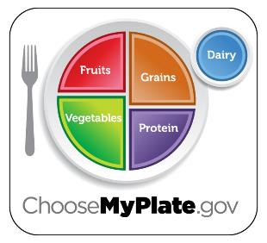
WHY SWITCH TO OUNCE EQUIVALENTS?
Provide portion sizes that more closely align with the needs of participants
Consistency with School Meal Programs, Dietary Guidelines and ChooseMyPlate
Does not mean all grains will need to be weighed!
Notes:
Say: Making the switch to ounce equivalents increases consistency between CACFP and other Child Nutrition Programs, such as the National School Lunch and School Breakfast Programs, and ensures that children and adults are served the recommended amount of grains, and it ensures standardized portion sizes across the program.
Additionally, using ounce equivalents aligns more closely with the Dietary Guidelines for Americans and the USDA MyPlate Food Guidance System, which provide grain recommendations in ounce equivalents.
It’s important to note that using ounce equivalents does not mean that all grains will need to be weighed in order to convert them, and we’ll talk more about that in a bit.

Slide 5
IMPLEMENTATION
July 1, 2019
Proposed rule to delay implementation
Nearly 700 comments
Vast majority supported delay
September 25, 2019
Delayed until October 1, 2021
Leniency and support for early implementers
Notes:
Say: The switch to grains being credited using ounce equivalents was originally slotted for implementation by October 1, 2017, but was delayed until October 1, 2019 when USDA recognized the significant operational changes for CACFP sponsors.
On July 1, 2019, a proposed rule to delay implementation again was widely support, and 84 FR 31227 granted a two-year extension to allow adequate time for USDA to develop training resources and technical assistance to support sponsors and assure nationwide compliance.

Slide 6
EARLY IMPLEMENTERS
Notes:
Say: However, you certainly do NOT need to wait! USDA has granted leniency and support for any early adopters, and does encourage sponsoring organizations to implement ounce equivalents as soon as they are confident and have the training and technical assistance they need to be compliant. Sponsors who implements prior to October 1, 2021 will be provided with technical assistance in lieu of fiscal action for any findings related to grain ounce equivalents.

Slide 7
MONITORING
Same process as meeting “servings” of grains
Monitoring Goals
Identify needs for technical assistance
Help sponsors be successful in meeting the requirement
Ensure participants receive the right amount of food to support health and growth
Notes:
Say: You may be wondering how grain ounce equivalents will be monitored, and should be happy to hear that it’ll be the same process as meeting “servings” of grains under the previous meal pattern requirements. The main goal is to identify needs for technical assistance and provide support for sponsors to be successful. Additionally, monitoring will ensure that every participant is receiving the optimal amount of food.

Slide 8
HOW TO CONVERT GRAINS
Team Nutrition Grains Measuring Chart
Food Buying Guide Exhibit A Grains Tool
Food Buying Guide Recipe Analysis Workbook
Notes:
Say: The USDA made good on their promise to develop resources, and now there are multiple methods and tools to support conversion of grains into ounce equivalents. Following this conference, we will be releasing an online training video that walks through each of these tools in detail and provides guidance on when to use different methods. We will briefly discuss each of these resources now, to give you an idea of the different methods you may choose to implement.

Slide 9
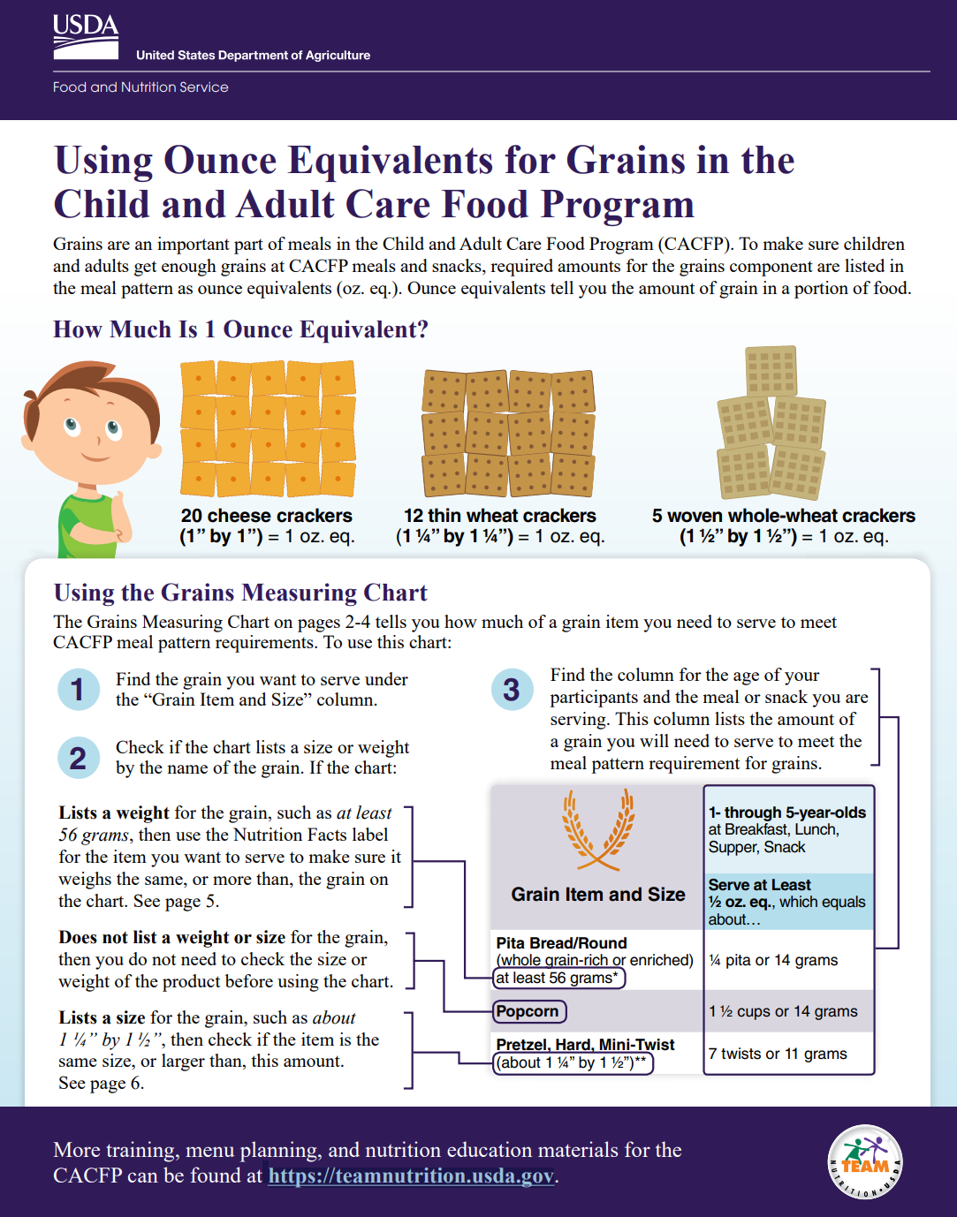
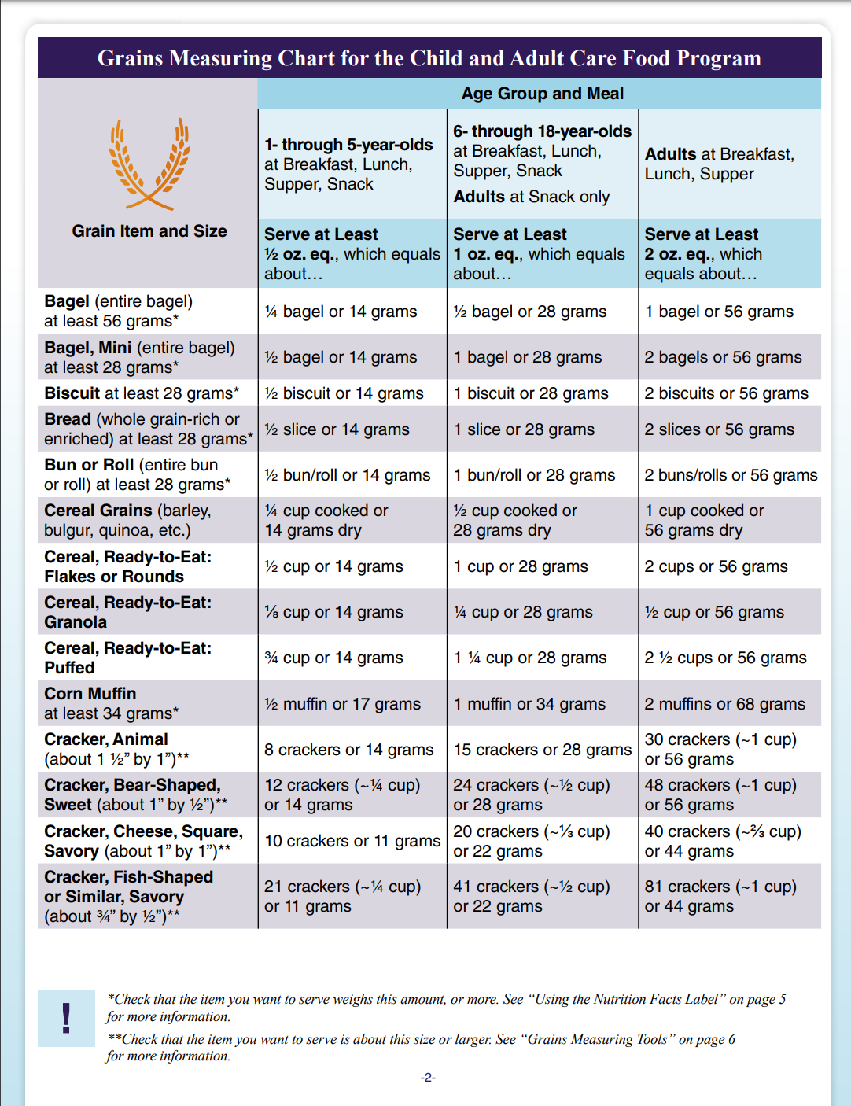
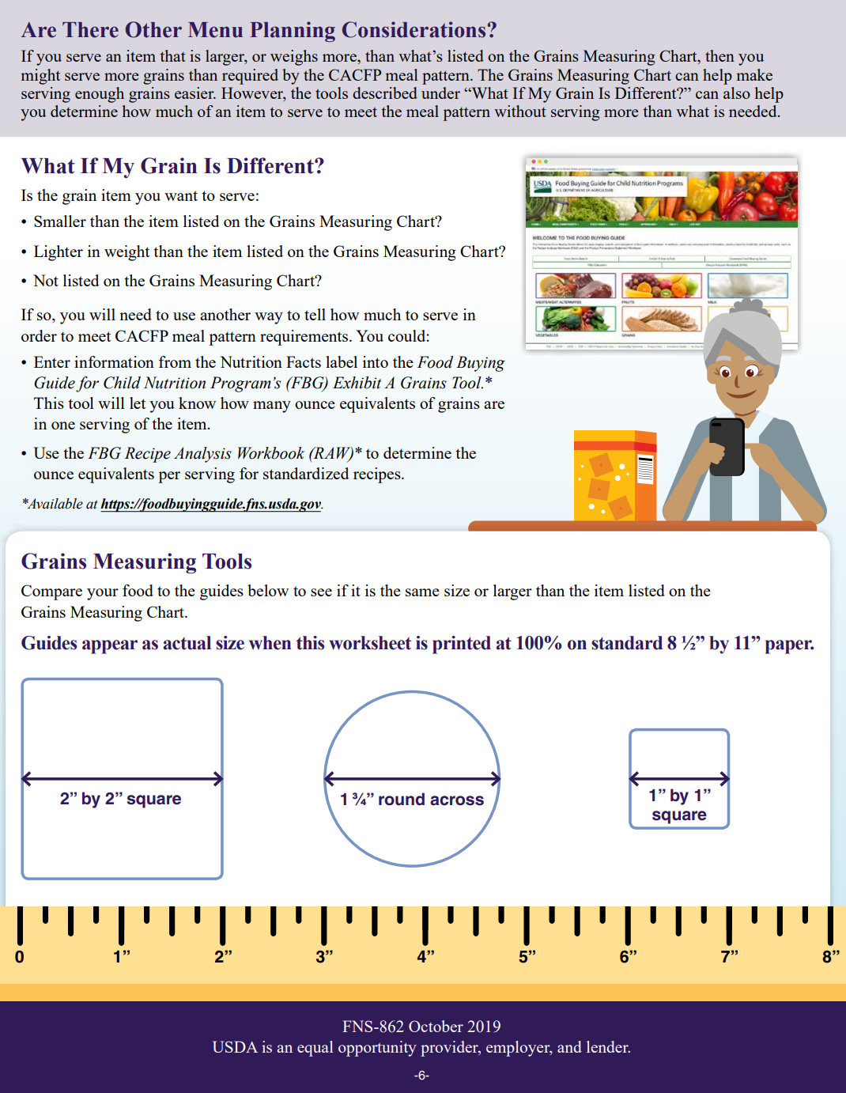
TEAM NUTRITION GRAINS CHART
Notes:
Say: The Team Nutrition Grains Chart is the first method that can be used to convert your grains. The chart is located in the Using Ounce Equivalents for Grains in the Child and Adult Care Food Program worksheet, which can be found at https://teamnutrition.usda.gov.

Slide 10
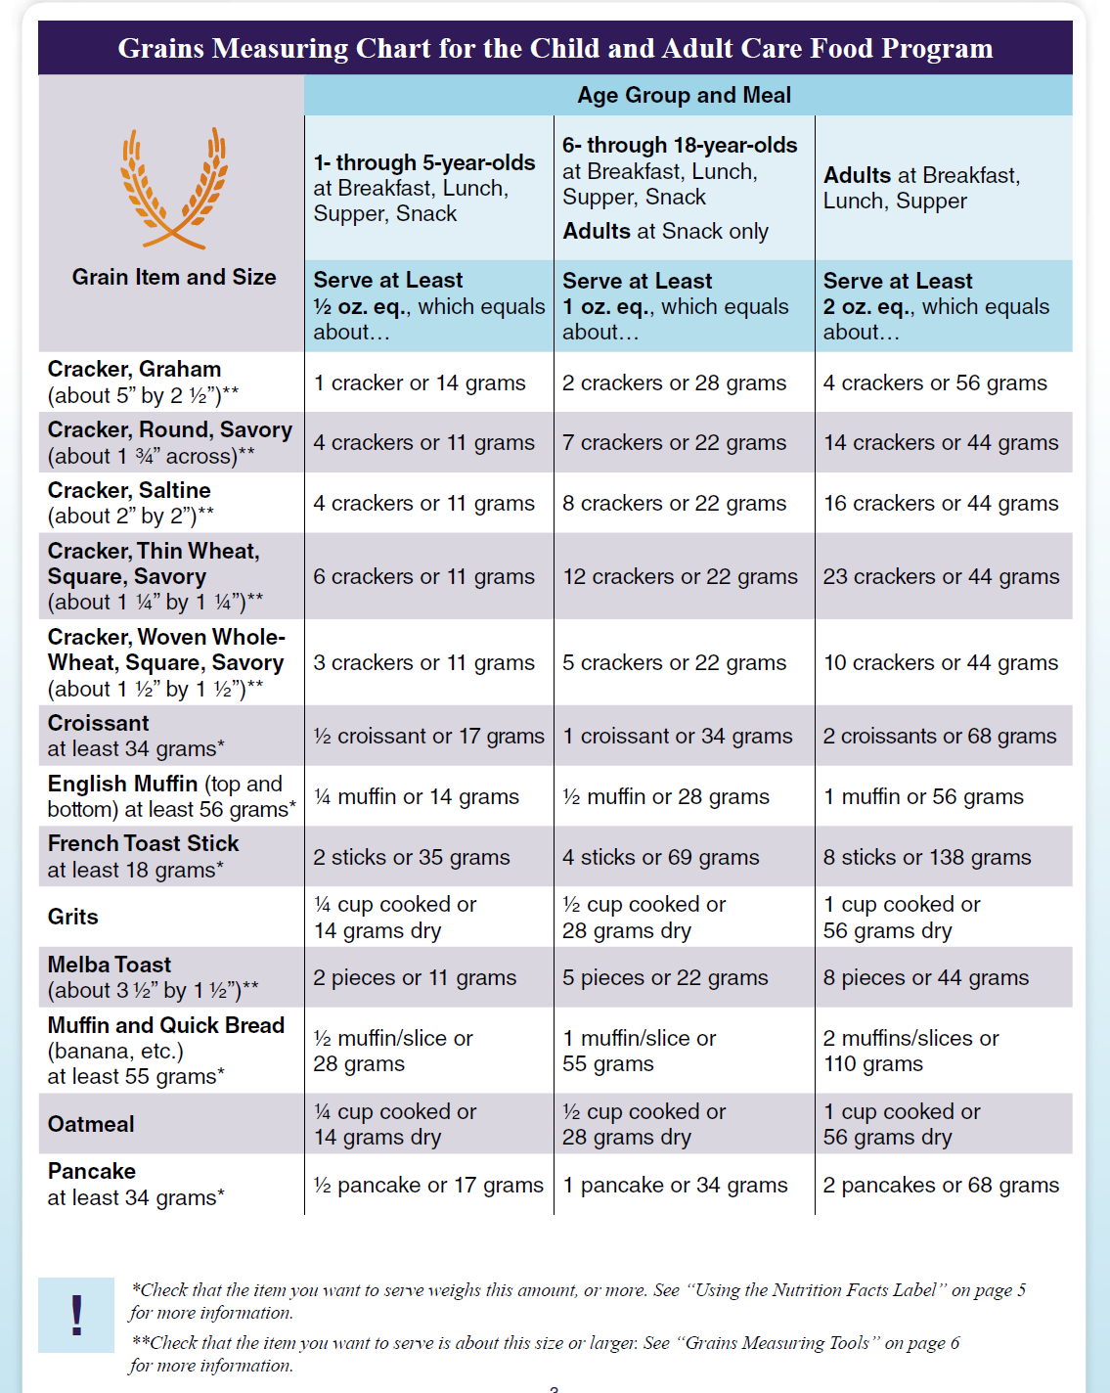
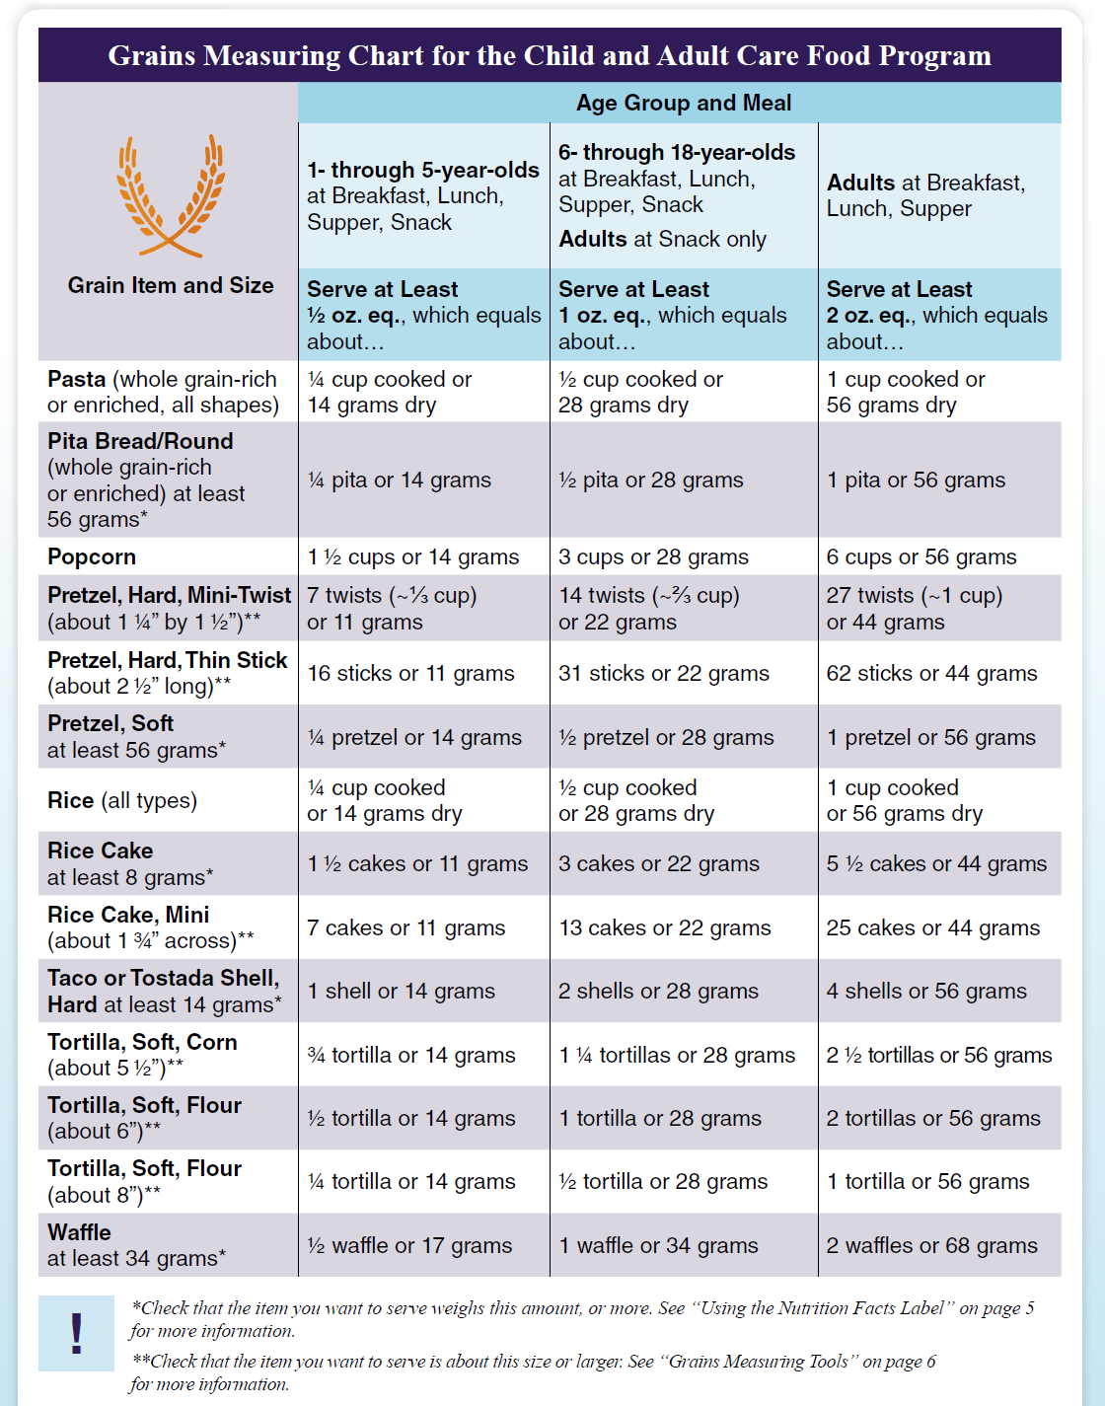
TEAM NUTRITION GRAINS CHART
Notes:
Say: The worksheet contains three pages of the full Grains Measuring Chart. The first column is where you identify your grain item and size.

Slide 11
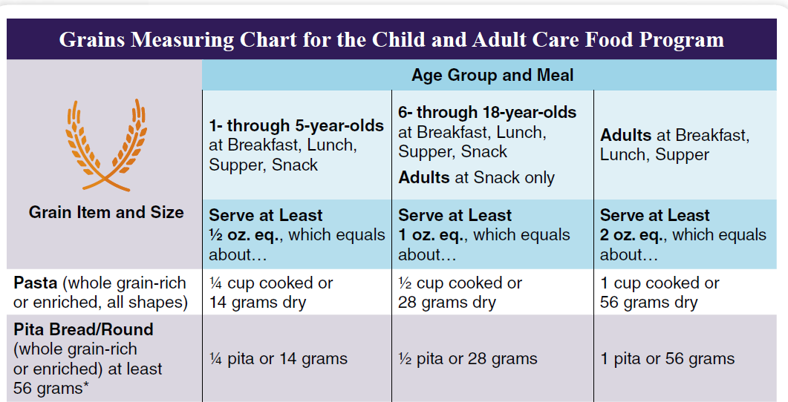
TEAM NUTRITION GRAINS CHART
Notes:
Say: The Age Group and Meal sections are located at the top of each page and lists the amount to serve in ounce equivalents for your specific grain.

Slide 12
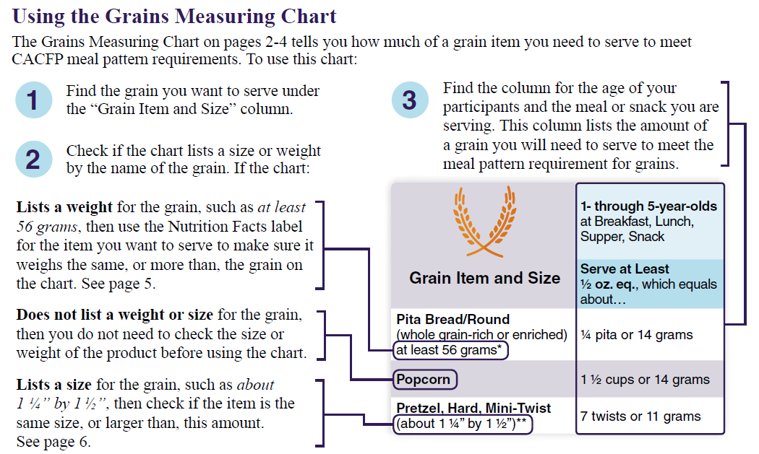
USING THE GRAINS MEASURING CHART
Notes:
Say: Using the Grains Measuring Chart is a simple, 3-step process and is detailed in the worksheet. Let’s walk through it together in more detail.

Slide 13
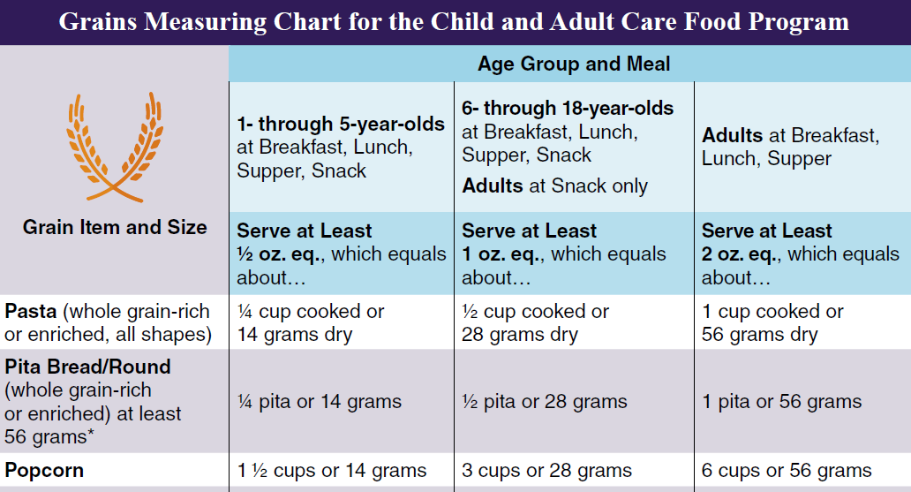
USING THE GRAINS MEASURING CHART
Step 1
Notes:
Say: First, locate your grain item from the Grain Item and Size column. Let’s say we’re looking for popcorn.

Slide 14
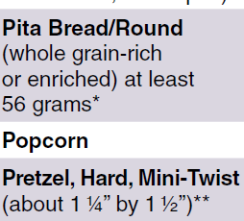
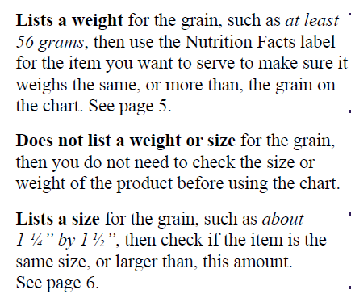
USING THE GRAINS MEASURING CHART
Step 2
Notes:
Say: Next, check the chart to see if your item lists a size or weight. If the grain you want to serve does not list a weight or size, like our popcorn, then you do not need to check the size or weight of your product before using the chart, so we can proceed to step 3.

Slide 15
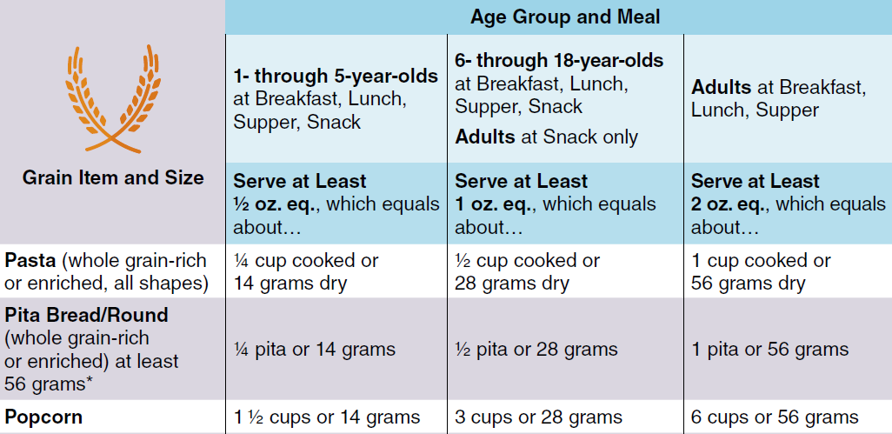
USING THE GRAINS MEASURING CHART
Step 3
Notes:
Say: For our final step, we’ll find the column that corresponds to the age of our participants and the relevant meal being served.
Follow the column down to the grain item….
[Click to have the circle animate in showing the correct amount]
…and in our popcorn example we find that we need to serve 3 cups or 28 grams of popcorn to meet the meal pattern requirement for grains.

Slide 16
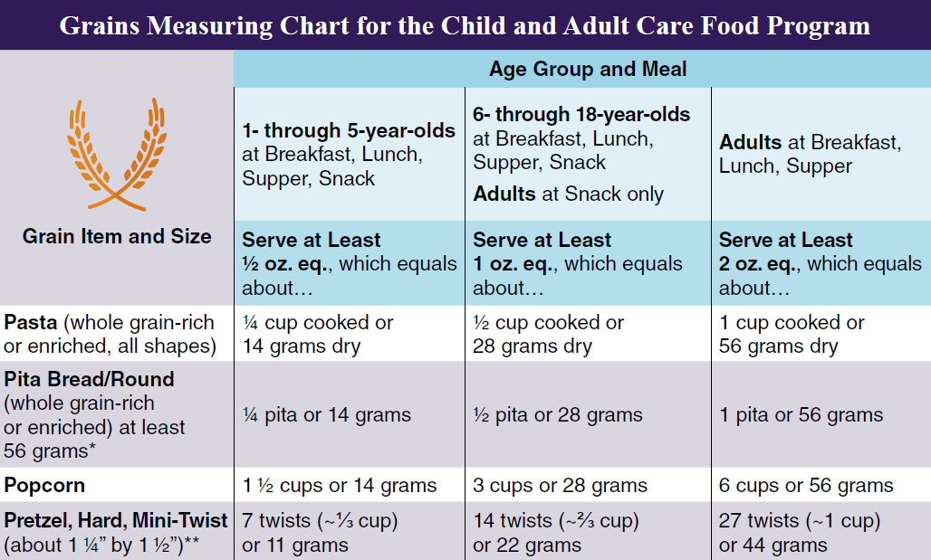
USING THE GRAINS MEASURING CHART
Step 1
Notes:
Say: Now let’s look at what happens when we have a grain item that lists a size. In this example, we’re looking for mini-twist pretzels.

Slide 17
USING THE GRAINS MEASURING CHART
Step 2
Notes:
Say: For Step 2, since pretzels list a size - 1 ¼ by 1^{1/2} inches – we must check to ensure our pretzels are the same size, or larger than, this size.

Slide 18
USING THE GRAINS MEASURING CHART
Step 2
Notes:
Say: To assist in checking item sizes, the Worksheet also contains measuring tools to use as a guide. Here, place the pretzels on the shapes to determine if they are the same or larger in size. You can also use the ruler to get an accurate size. Just keep in mind that to use these tools to scale, you need to print the worksheet at 100% on 8 ½” x 11”paper.

Slide 19
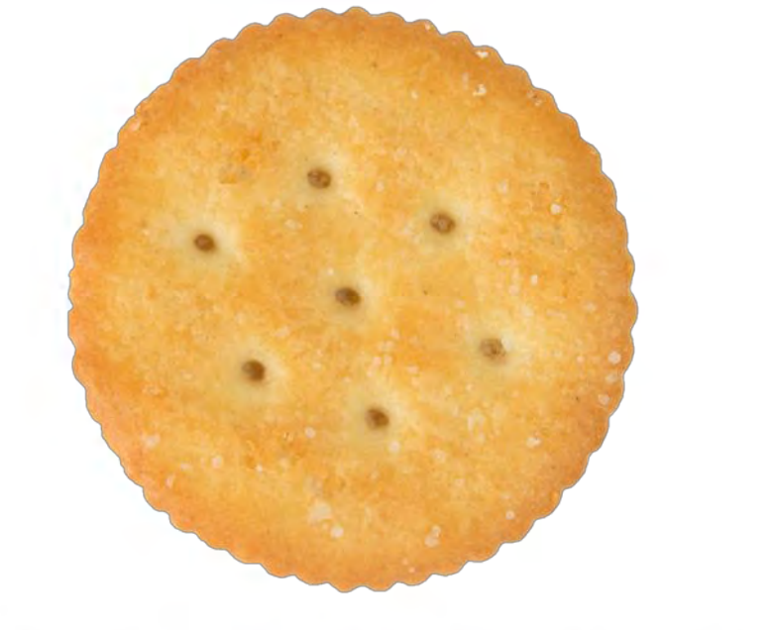
USING THE GRAINS MEASURING CHART
Step 2
Notes:
Say: Let’s look at a few examples. Here, this cracker is smaller than the 2” x 2” square, but it’s just about the same size as the 1 ¾ round across so that’s the measurement we would use. Again, the item must be the same or larger than the size listed on the chart.

Slide 20
USING THE GRAINS MEASURING CHART
Step 2
~1 ½” across
Notes:
Say: For these pretzels, we can use the ruler to measure their size, and we see that it is about 1 ½” across.

Slide 21
USING THE GRAINS MEASURING CHART
Step 2
~1 ½” tall
Notes:
Say: Then we flip the pretzel to measure its height at about 1 ½” tall.

Slide 22
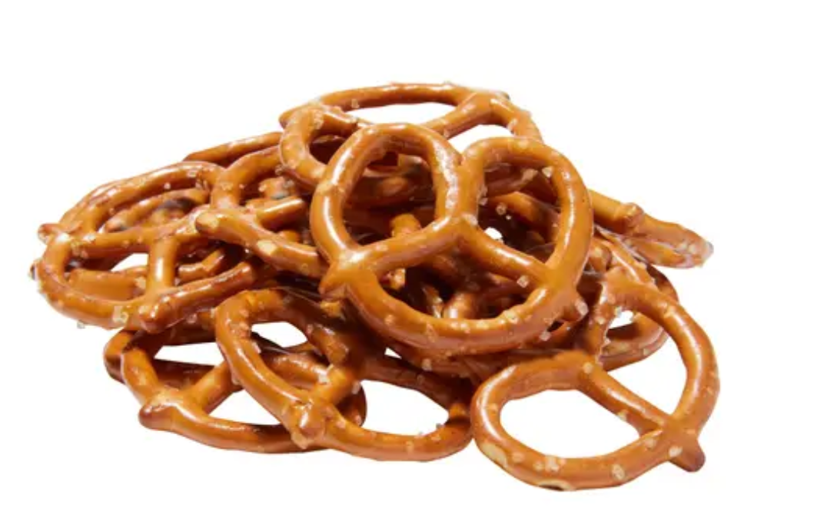
USING THE GRAINS MEASURING CHART
Are these pretzels the same size or larger than the mini pretzel listed on the Grains Measuring Chart? Again, they are 1 ½” by 1 ½”.
Step 2
Notes:
Say: So, what do you think? Are the pretzels we measured at 1 ½” by 1 ½” the same size or larger than the ones on the Grains Measuring Chart?
[click to reveal the chart and answer]
They are! They are slightly larger, but very close to this size, so we can proceed with using the chart to find the correct amount to serve.

Slide 23
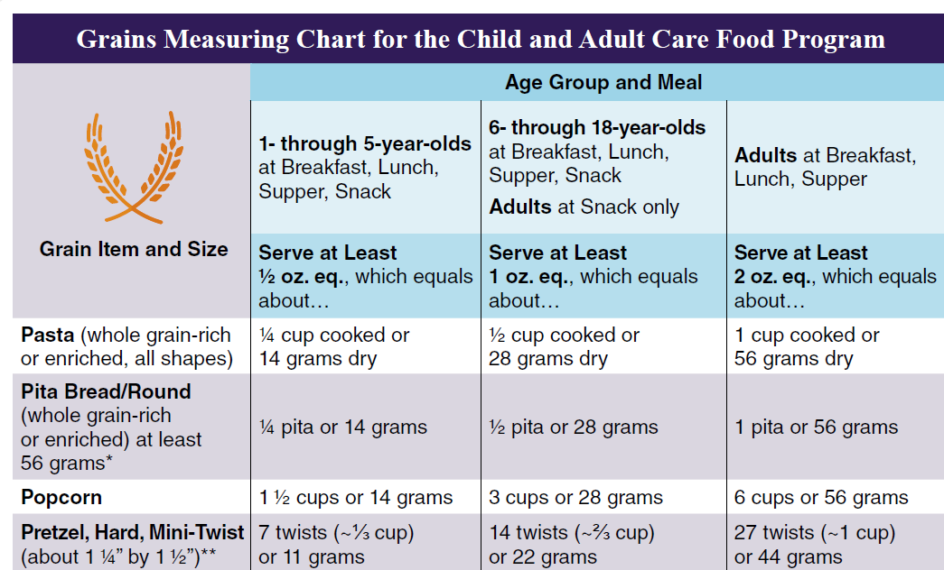
USING THE GRAINS MEASURING CHART
Step 3
Notes:
Say: Again, in Step 3, we need to find our grain item and the column that corresponds to the age of our participants and the relevant meal being served.

Slide 24
USING THE GRAINS MEASURING CHART
You want to serve pretzels to adult participants as a snack. How many mini-twist pretzels do you need to serve to meet the minimum required grains at snack in the CACFP?
Notes:
Say: Say you want to serve pretzels to adult participants as a snack. How many mini-twist pretzels do you need to serve to meet the minimum required grains at snack in the CACFP?
[click to reveal the chart and answer]
Locate the age and meal – Adults at snack only – scroll down to the mini-twist pretzels, and find that we need to serve 14 twists or approximately 2/3 cup to meet the requirement.

Slide 25
USING THE GRAINS MEASURING CHART
Step 1
Notes:
Say: The last item to review are grain items that list a weight. In this example, pita bread rounds must be at least 56 grams.

Slide 26
USING THE GRAINS MEASURING CHART
Step 2
Notes:
Say: When items list a weight, we can use the Nutrition Facts Label of our grain item to ensure it weighs the same, or more than, the grain on the chart.

Slide 27
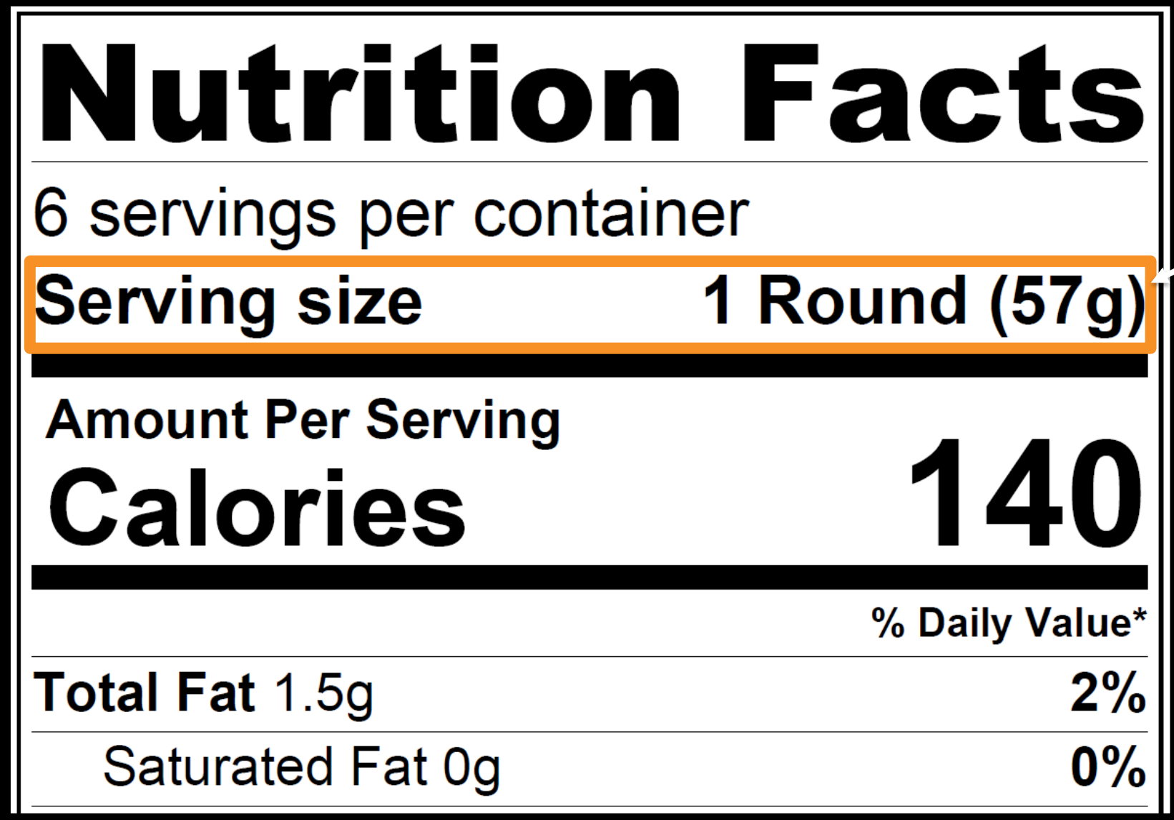
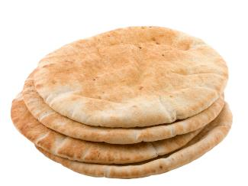
USING THE GRAINS MEASURING CHART
Brand B Pita Rounds
Notes:
Say: Here’s the Nutrition Facts label for Brand B Pita Rounds. We can see that they have 57 grams in one serving, which is 1 round.

Slide 28
USING THE GRAINS MEASURING CHART
Brand B Pita Rounds
Does one Brand B Pita Round weigh the same or more than the pita bread listed on the Grains Measuring Chart?
Notes:
Say: Now we compare this weight to the chart. Does one Brand B Pita Round weigh the same or more than the pita bread listed on the Grains Measuring Chart?

Slide 29
USING THE GRAINS MEASURING CHART
Brand B Pita Rounds
Notes:
Say: Yes! Since the Brand B Pita Rounds weigh just 1 gram over the chart’s weight, we can continue using the chart for Step 3.

Slide 30
USING THE GRAINS MEASURING CHART
Step 3
Notes:
Say: If we wanted to serve Brand B Pita Rounds to adults at supper, we would locate the column for adults at supper, and connect it to the Pita Bread/Round row…
[click to reveal answer]
….we find that we need to serve 1 pita round to meet the minimum grain requirements.

Slide 31
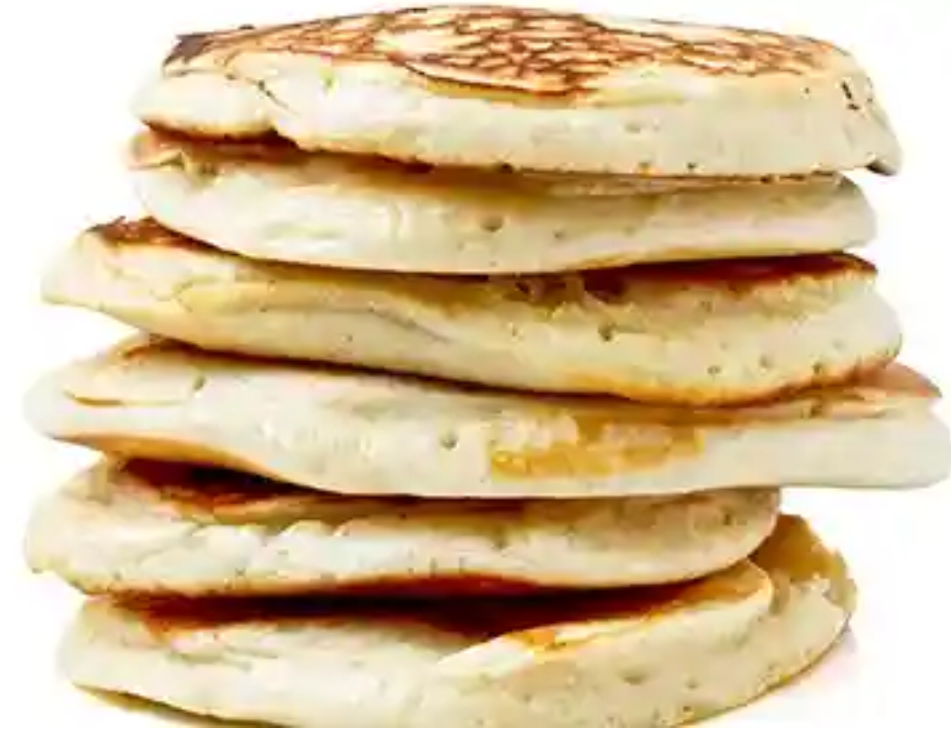
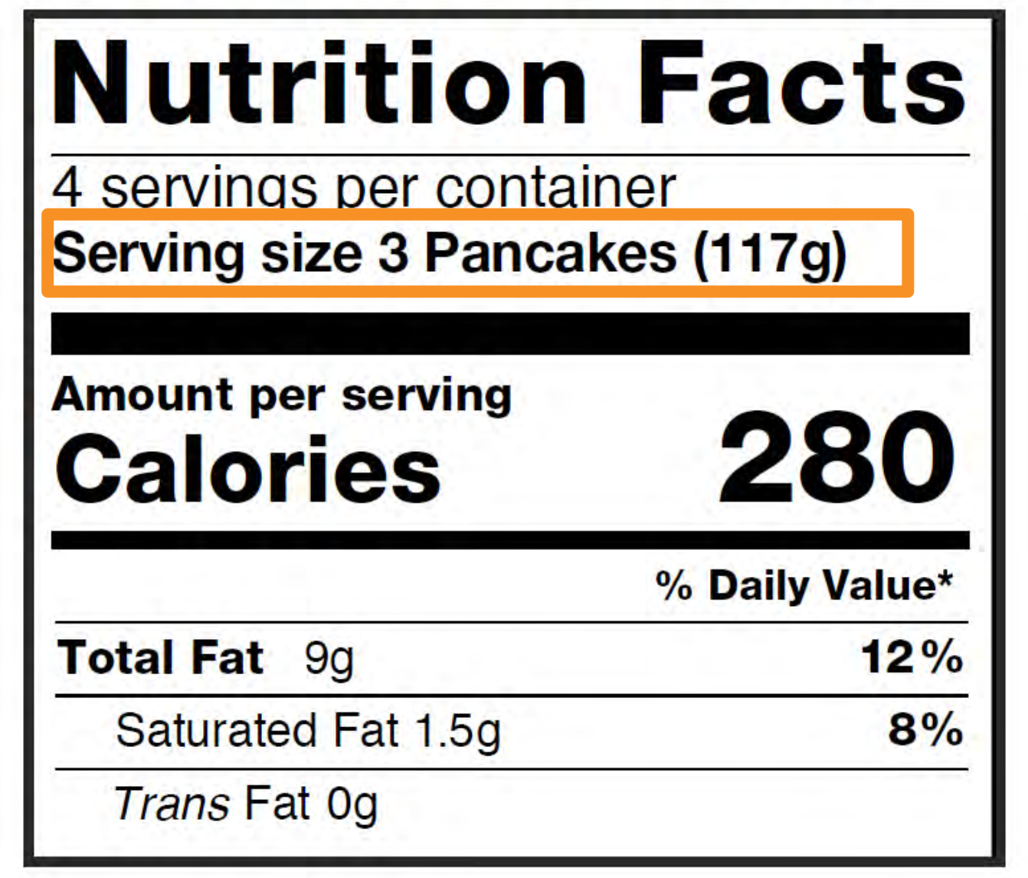
USING THE GRAINS MEASURING CHART
Brand B Pancakes
Notes:
Say: When looking at weight and serving size, there may be some instances where you’ll need to do quick calculations to find the weight for one single item. For example, these Brand B pancakes show a serving size of 3 pancakes, and we want to know how much just 1 pancake weighs.

Slide 32
USING THE GRAINS MEASURING CHART
Notes:
Say: This will help us determine if we can use the Grains Measuring Chart to find out how much to serve. The chart has the weight listed by single pancake, so we’ll do some quick math.

Slide 33
USING THE GRAINS MEASURING CHART
Brand B Pancakes
Weight of 1 serving = 117 g
Notes:
Say: Step two in this case would be to look at our Nutrition Facts Label, and find the weight of 1 serving size. Here we can see that it is 117 grams.

Slide 34
USING THE GRAINS MEASURING CHART
Brand B Pancakes
1 serving = 3 pancakes
Notes:
Say: In Step 3, we find how many items are in 1 serving. Here we can see there are 3 pancakes per serving.

Slide 35
USING THE GRAINS MEASURING CHART
1 serving = 3 pancakes
Notes:
Say: Since we have more than 1 item per serving, we’ll divide the serving weight by the number of items in one serving to find the weight of each item. In our example, 117 grams divided by 3 pancakes per serving = 39 grams per pancake.

Slide 36
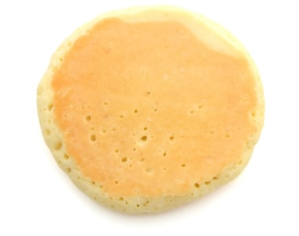
USING THE GRAINS MEASURING CHART
1 serving = 3 pancakes
39 grams per pancake
Notes:
Say: Now we can compare our per-pancake weight to the chart. Our single pancake is 39 grams, and the chart says a single pancake must be 34 grams or more, so we can use the chart to determine how many to serve!

Slide 37
USING THE GRAINS MEASURING CHART
1 serving = 3 pancakes
Notes:
Say: Again, we locate the age of our participants and the meal being served, and determine that we need to serve 1 pancake to meet the minimum grain requirements

Slide 38
KNOWLEDGE CHECK – QUICK POLL
True or False: The first step in using the Grains Measuring Chart is to check if the chart lists a size or weight by the name of the grain.
Notes:
False – Step 1 is to find the grain you want to serve under the “Grain item and size column.”

Slide 39
KNOWLEDGE CHECK – QUICK POLL
True or False: If there is more than one item in a serving, the Nutrition Facts Label can assist in finding the weight of each item.
Notes:
True – Divide the serving weight by the number of items in one serving to find the weight of each item. (Remember we did that with the pancakes)

Slide 40
UN “CHARTED” TERRITORY
Use a different tool if:
Your item is not listed or
Your item is smaller or lighter than what’s listed on the Grains Measuring Chart or
You don’t know the size of an item or
You are serving a grain item to meet part of the grains requirement
Notes:
Say: There may be instances when the Grains Measuring Chart will not be the best tool to use. Such as, if your item is not listed on the chart, or it’s smaller or lighter than what’s on the chart, or if you don’t know the size of an item. Additionally, the chart can not be used if you’re serving a grain item to meet only part of the grains requirement.
I’ll turn you over to Lisa, and she’ll guide you through the un”charted” territory.

Slide 41
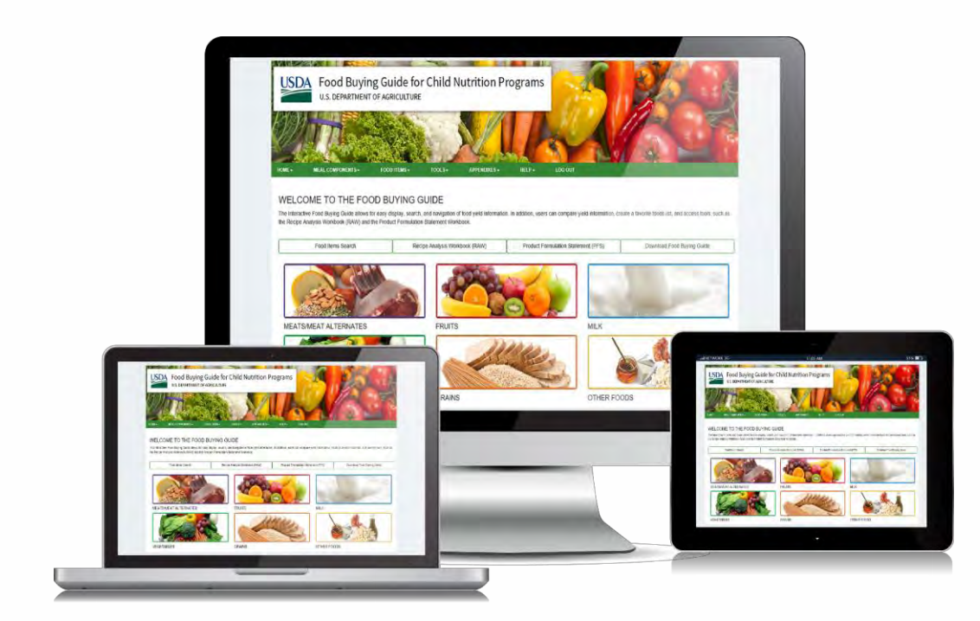
FOOD BUYING GUIDE
Exhibit A Grains Tool
Recipe Analysis Workbook (RAW)
https://foodbuyingguide.fns.usda.gov/
Notes:
Say: For any of those situations, The Food Buying Guide is a web-based interactive tool that can be used to determine grain ounce equivalents when the Grains Measuring Chart doesn’t work for your item or calculation goals.
The Food Buying Guide has many resources, but most relevant for converting grains are the Exhibit A Grains Tool and the Recipe Analysis Workbook, or RAW.

Slide 42
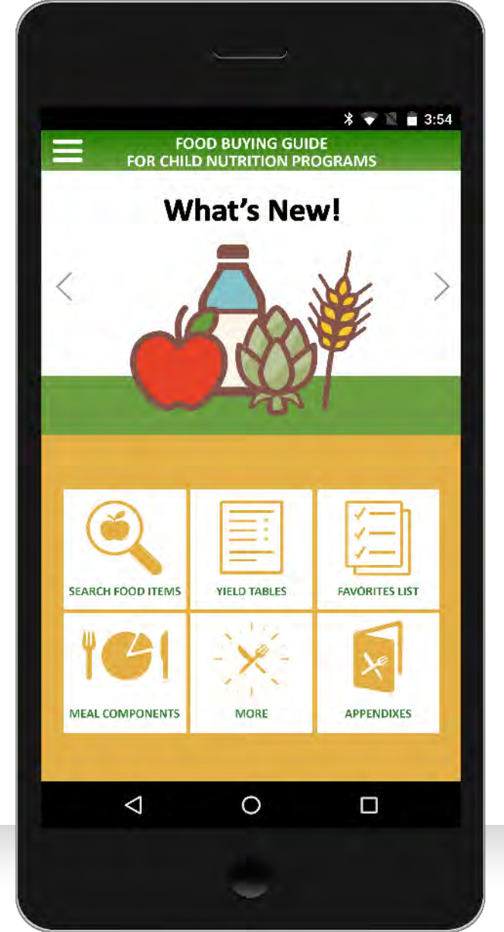
FOOD BUYING GUIDE - EXHIBIT A GRAINS TOOL
Download the Food Buying Guide Mobile App
Notes:
Say: We’ll start by looking at the Exhibit A Grains Tool. For this tool, there is a user-friendly mobile app that can be downloaded to your phone or device, or you can visit the FBG website.
The Exhibit A Grains Tool can calculate:
the ounce equivalent grains or the grains/breads servings for your grains product,
the amount of a grain product to serve in order to provide a specific ounce equivalent grain, and
the amount of a grain product to serve in order to meet Minimum Grains Requirements as appropriate for a specific age or grade group.

Slide 43
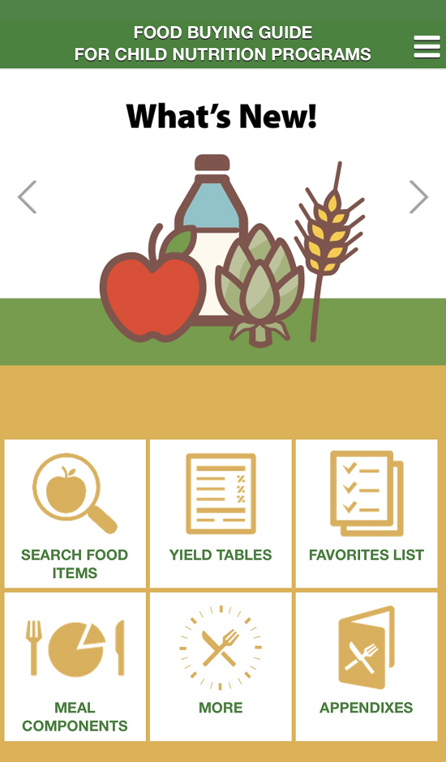
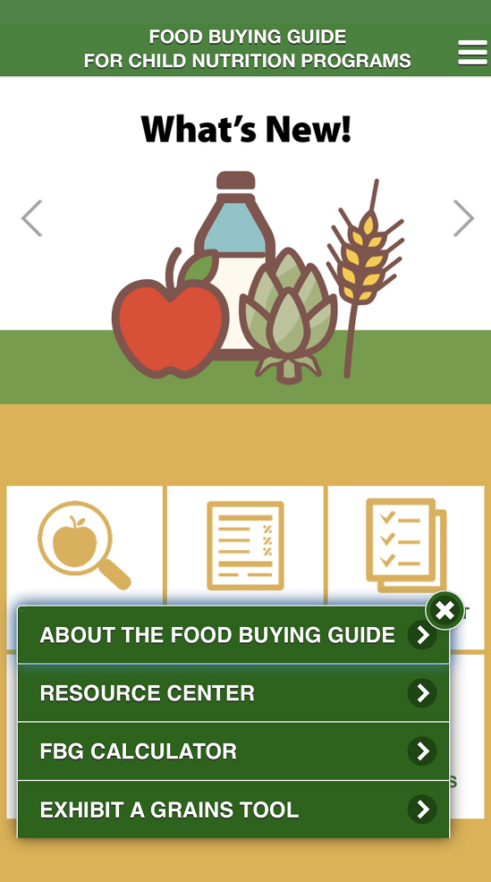
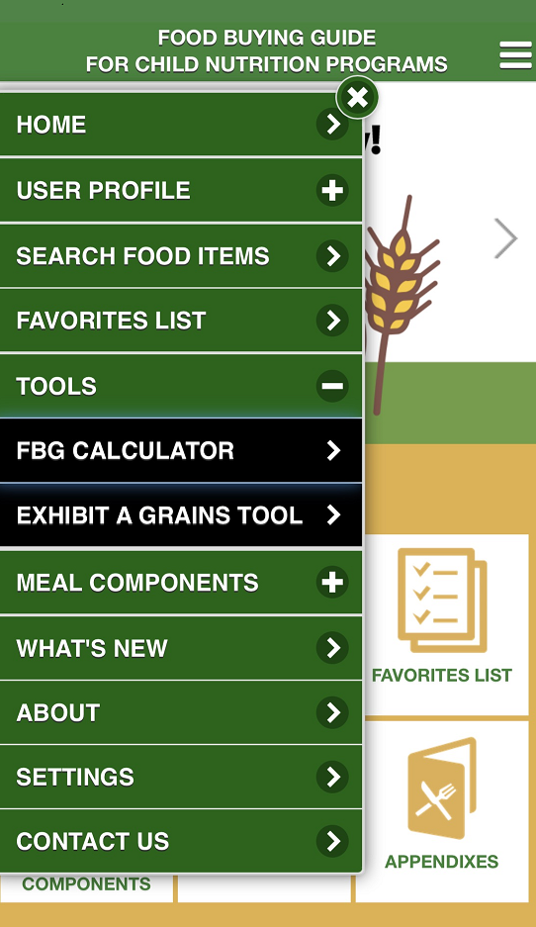
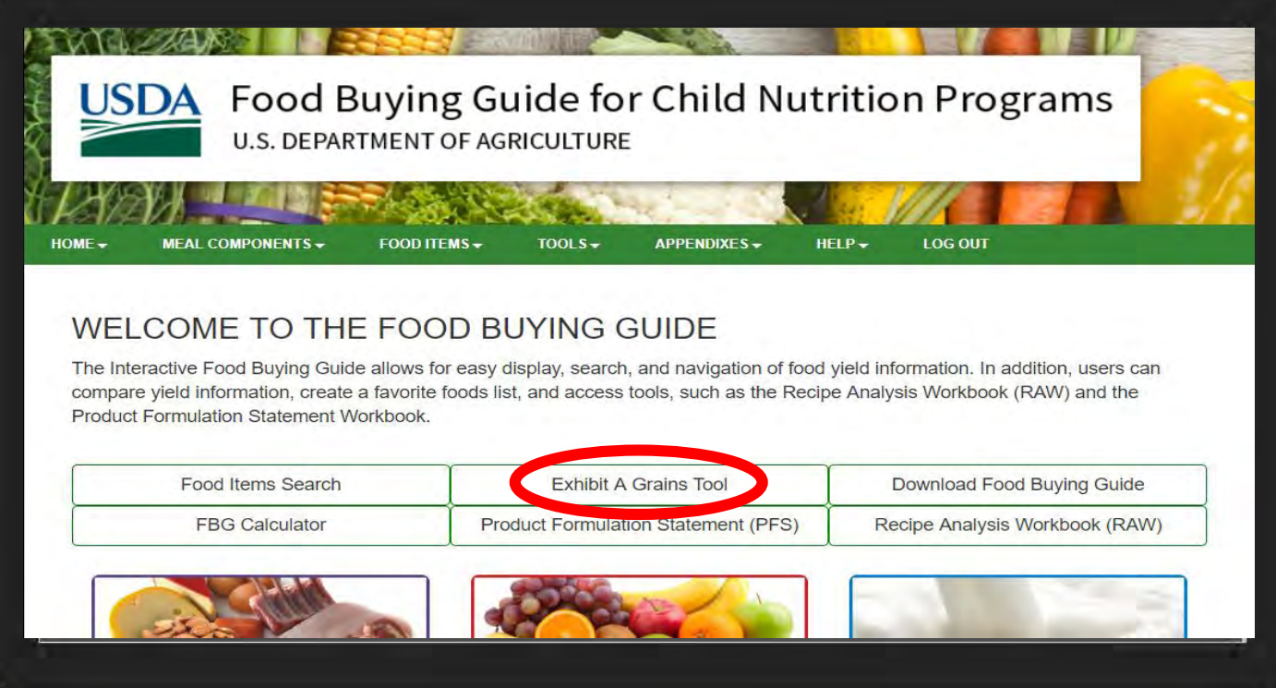
FOOD BUYING GUIDE - EXHIBIT A GRAINS TOOL
Website
Mobile App
Notes:
Say: The Exhibit A Grains Tool can be accessed from the homepage of the food buying guide, or by clicking “More” in the mobile app after you’ve downloaded it to your device. [Click] Whether you choose to use the FBG website or the mobile app, you’ll need to create a free eAuthentication account to access the tools.
Today we’ll walk you through how to use the Exhibit A Grains tool through the mobile app, and the training we’ll be releasing shortly after this conference will show you how to use the tool directly from the FBG website.
In the mobile app, you can also access the tool by clicking on the Main Menu on the top right of the screen [Click]

Slide 44
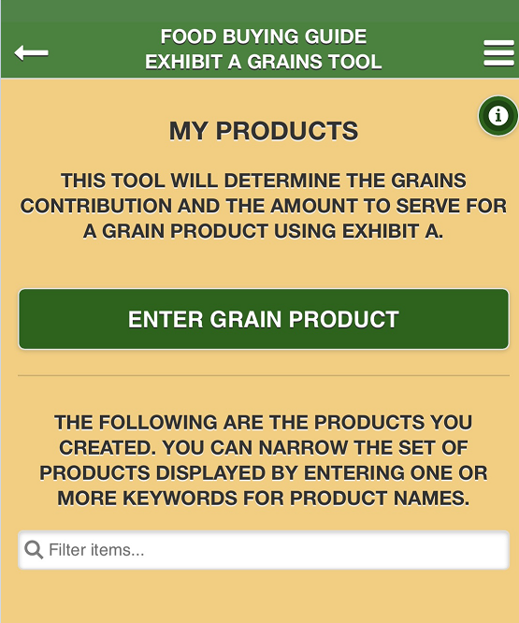
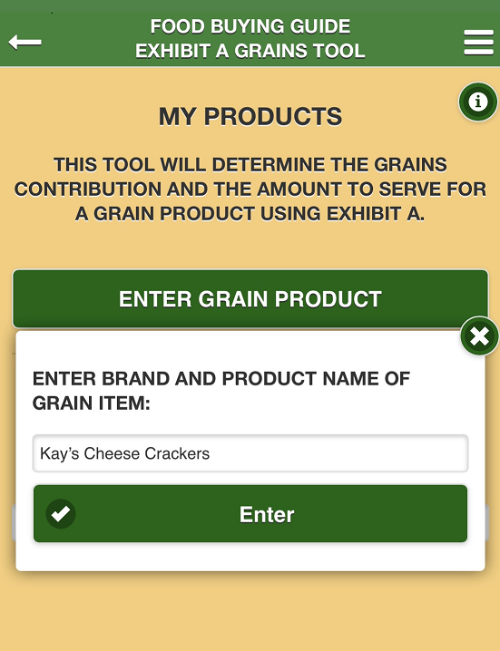
FOOD BUYING GUIDE - EXHIBIT A GRAINS TOOL
Notes:
Say: Once inside the tool on the mobile app, select “Enter Grain Product” [Click] and type in your product. [Click] In our example, we’re trying to find the grains contribution and amount to serve for Kay’s Cheese Crackers.

Slide 45
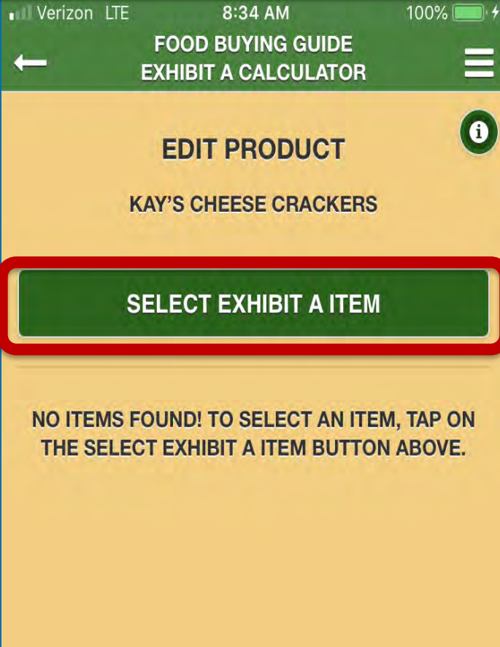
FOOD BUYING GUIDE - EXHIBIT A GRAINS TOOL
Notes:
Say: Click on “Select Exhibit A Item” to search for the food item in the FBG.

Slide 46
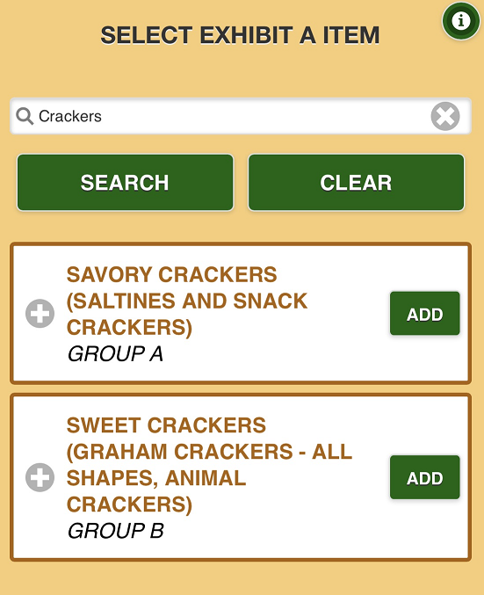
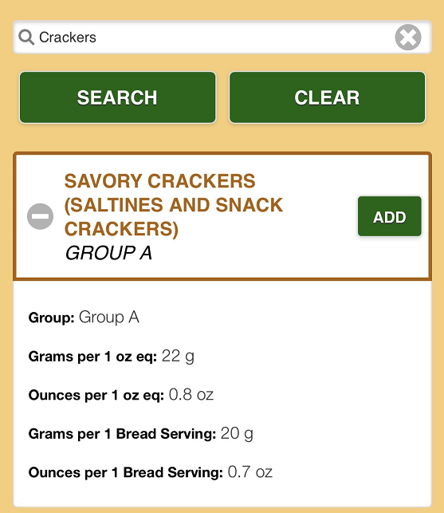
FOOD BUYING GUIDE - EXHIBIT A GRAINS TOOL
Notes:
Say: And search for one or more keywords – in this case we’ll try “crackers” and hit SEARCH [Click]
Two cracker options appear below – one savory and one sweet. Since we have cheese crackers, we want the savory category so we’ll click “Add” [Click]
Note: If you want more information on either of the items, click on the plus button [Click] to expand the item and view the details so you can determine which item is closest to yours.

Slide 47
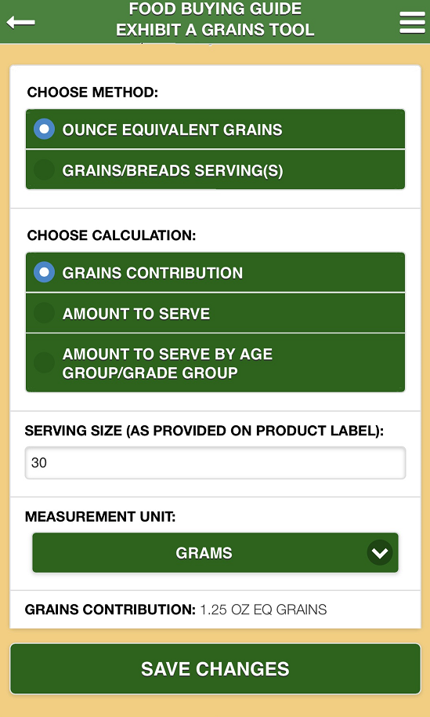
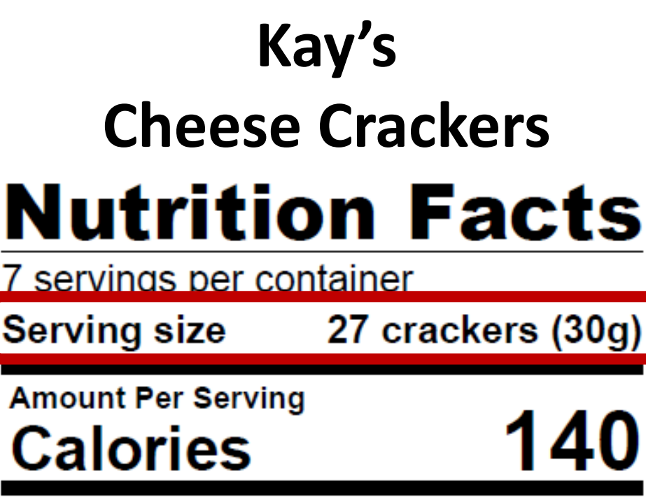
FOOD BUYING GUIDE - EXHIBIT A GRAINS TOOL
Notes:
Say: We’ll need to pull up our Nutrition Facts Label in order for the next few steps. On the mobile app, we’re being prompted to select the method we want the tool to output. In this case, we want to see ounce equivalent grains. So under “Choose Method” select Ounce Equivalent Grains. [Click to Highlight].
As mentioned earlier, there are three different ways the tool can output a calculation – the grains contribution in ounce equivalents, the amount to serve based on a desired ounce equivalent, and the amount to serve by age or grade group to meet minimum grains requirements. We’ll walk through all 3 options, so let’s start by selecting the grains contribution. [Click to Highlight]
For the serving size of Kay’s Cheese Crackers, refer to the product label and type in 30 and select grams as the measurement unit. [Click to Highlight]
[Click to Highlight]
At the bottom, the grains contribution has been calculated at 1.25 ounce equivalents. [Click]
Click save to keep the information for future reference.

Slide 48
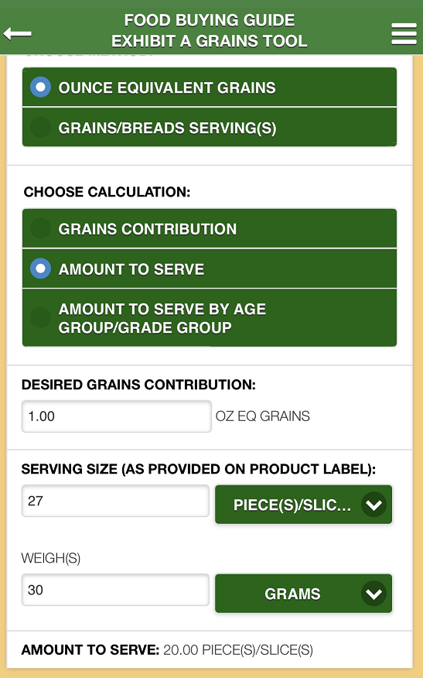
FOOD BUYING GUIDE - EXHIBIT A GRAINS TOOL
Notes:
Say: Next, if we want to determine the amount to serve based on a specific desired grains contribution, we simply change our calculation method to “Amount to Serve”.
[Click to Highlight]
Then enter the desired grains contribution – in this case, let’s say we want to see what we need to serve in order to meet 1 ounce equivalent. [Click to Highlight]
Again, enter the serving size and measurement unit, and the weight and measurement unit, directly from the product label… [Click to Highlight]
and the amount to serve calculates at 20 pieces to meet 1 ounce equivalent. [Click to Highlight]

Slide 49
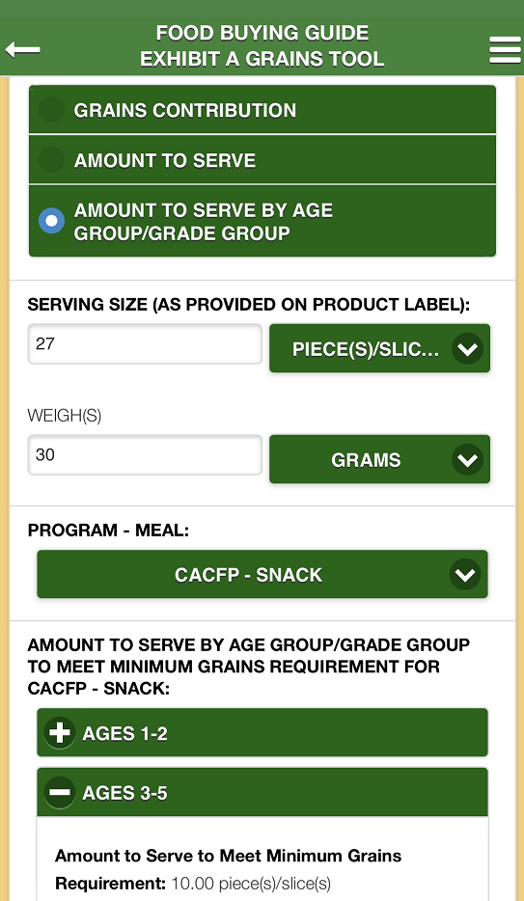
FOOD BUYING GUIDE - EXHIBIT A GRAINS TOOL
Notes:
Say: The last calculation the tool can output is the Amount to Serve by Age Group/Grade Group.
[Click to Highlight]
Again, enter the serving size, weight and their measurement units directly from the product label. [Click to Highlight]
Then, select the Program-Meal combination from the drop-down menu. We’ve selected CACFP Snack in our example. [Click to Highlight]
Each age groups will populate underneath, and clicking the plus button expands each age group to reveal the amount to serve to meet minimum grains requirements. [Click to Highlight]

Slide 50
FOOD BUYING GUIDE - EXHIBIT A GRAINS TOOL
Notes:
Say: Once the information has been saved, click the back button at the top left-hand side of the screen. [Click]

Slide 51
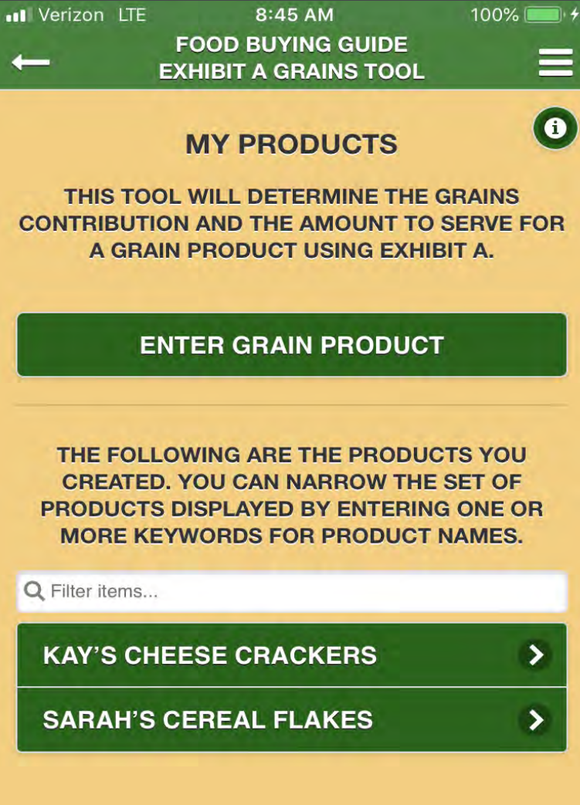
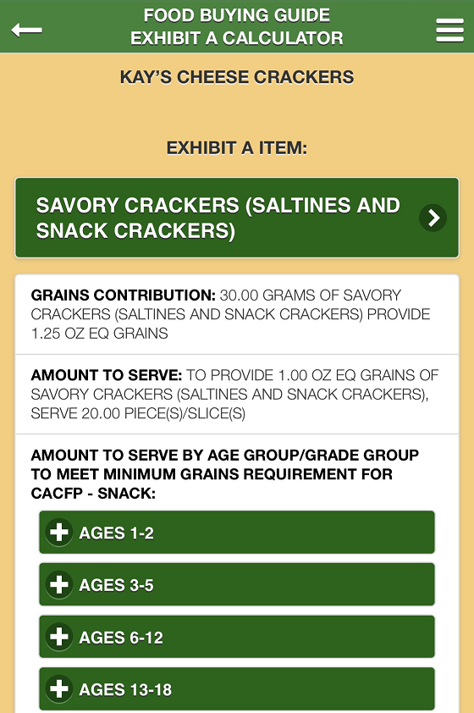
FOOD BUYING GUIDE - EXHIBIT A GRAINS TOOL
Notes:
Say: Hitting the back button brings up the My Products page. This houses all saved items and allows you to go back in to review and/or edit each one at any time. Here we can see that the Grains Contribution, Amount to Serve, and Amount to Serve by Age Group show each output we just calculated. This makes it easy to refer back at any time.
I hope this demonstrated how easy the Exhibit A Grains Tool is to use! The online format is very similar, but the mobile app is a quick and easy way to check grains contributions and amounts to serve when you’re on the go and may not have a computer right in front of you.

Slide 52
KNOWLEDGE CHECK – QUICK POLL
True or False: The Food Buying Guide can be used if ANY of the following occur.
Grain not listed on measuring chart
Grain lighter in weight than item listed
Smaller than item listed
Serving an item to meet part of the grain requirement
Notes:
True – The Food Buying Guide has many resources that can be used to determine grain ounce equivalent when the Grains Measuring Chart doesn’t work for your calculations.

Slide 53
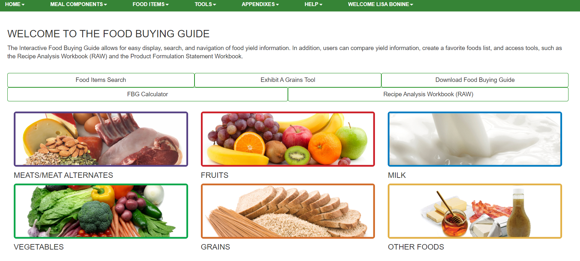
FOOD BUYING GUIDE - RAW
https://foodbuyingguide.fns.usda.gov/
Notes:
Say: The last tool we’ll review is the Recipe Analysis Workbook which I’ll refer to as the RAW. The RAW is a tool to help determine your recipe’s expected meal pattern contributions. The workbook can also be accessed from the homepage of the food buying guide at https://foodbuyingguide.fns.usda.gov.
We also walk through this process in our Grain Ounce Equivalent training that will be available following this conference.

Slide 54
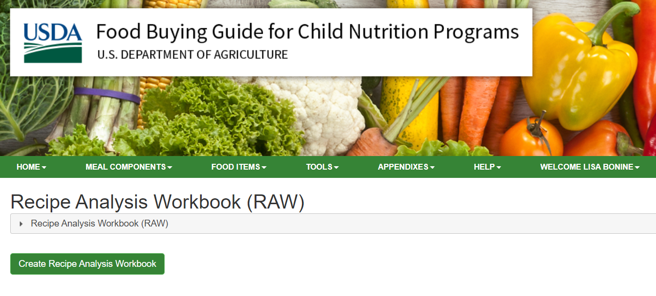
FOOD BUYING GUIDE - RAW
Notes:
Say: Once you’re inside the tool, select “Create Recipe Analysis Workbook”

Slide 55
FOOD BUYING GUIDE - RAW
Notes:
Say: Enter the Recipe Name, Servings per Recipe, and Serving Size of the recipe you want to calculate. You must enter these fields in order to save your recipe.

Slide 56
FOOD BUYING GUIDE - RAW
Notes:
Say: A RAW can include ingredient(s) for one or more meal components, and each meal component has a separate tab in the RAW. You’ll notice that for grains, there are 3 different tabs, and it’s important to note that there are three methods to calculate the meal pattern contribution for grains:
• Method A – based on Exhibit A – Go to this tab to search and select ingredients from Exhibit A
• Method B – based on Food Buying Guide – This tab will automatically populate if food ingredients are selected from the search below.
• Method C – based on Grams of Creditable Grains – Go to this tab to manually enter grain ingredients.
We’ll walk through each of these methods.

Slide 57
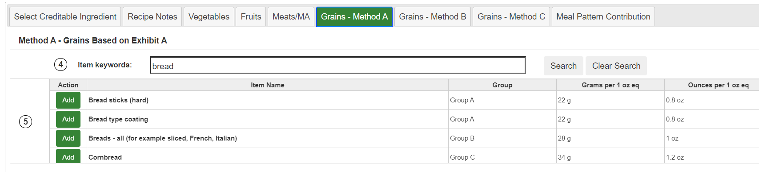
RECIPE ANALYSIS WORKBOOK - METHOD A
Notes:
Say: Method A is based on the Exhibit A Grains Tool – Go to this tab to search and select ingredients from Exhibit A, the same way we just reviewed together. However, this will utilize the web-based platform versus the mobile app version we just reviewed. Use the search function the same way and type in a keyword for the grain item in your recipe.
Once the food item has been located, click the corresponding “Add” button [Click] to populate that food item into the RAW.

Slide 58
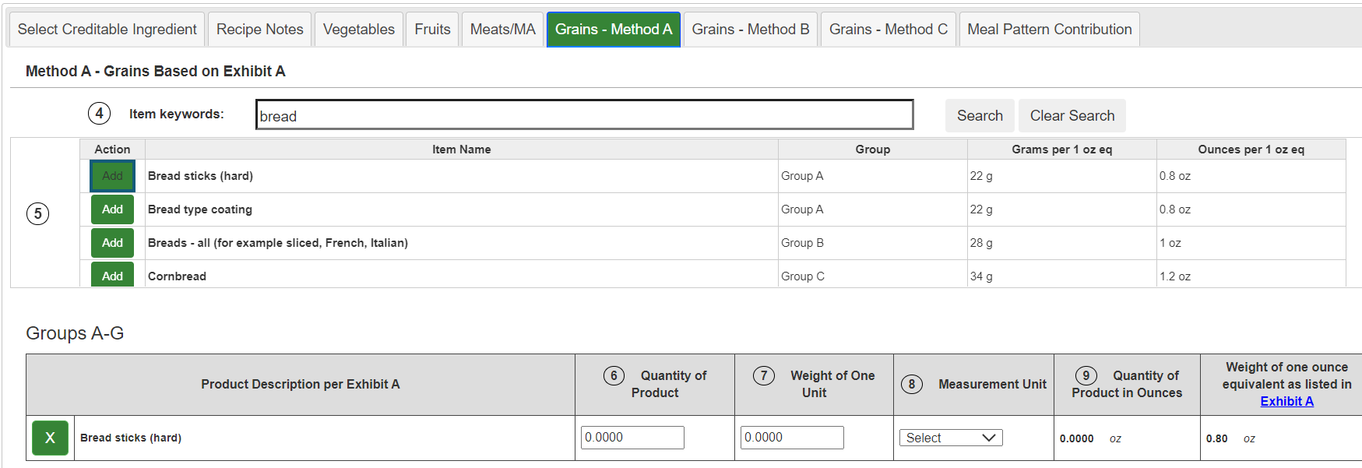
RECIPE ANALYSIS WORKBOOK - METHOD A
Notes:
Say: The product will populate underneath the search section. Here, only Product Description will be pre-populated from the Exhibit A, and you will need to edit the other fields – enter the Quantity of Product and Weight of One Unit, and select the appropriate Measurement Unit from the drop-down menu.

Slide 59
RECIPE ANALYSIS WORKBOOK - METHOD A
Notes:
Say: Once those fields have been entered, the Quantity of Product in Ounces and the Weight of One Ounce Equivalent as listed in Exhibit A will automatically calculate.
The Meal Pattern Contribution value will calculate automatically as all appropriate fields are filled in

Slide 60
RECIPE ANALYSIS WORKBOOK - METHOD C
Notes:
Say: Let’s jump now to Method C. Method C is based on Grams of Creditable Grains. The Method C tab is based on grains food items entered manually. You can add food items using “Add New Ingredient” button.

Slide 61
RECIPE ANALYSIS WORKBOOK - METHOD C
Notes:
Say: Enter the description of creditable grain ingredient and quantity of ingredient, then select the measurement unit. The Meal Pattern Contribution value will calculate automatically.

Slide 62
RECIPE ANALYSIS WORKBOOK - METHOD B
Notes:
Say: Method B is based on Food Buying Guide – The Grains – Method B tab will automatically populate if food ingredients are selected from the “Select Creditable Ingredient” tab. This is the same method that is used for the other food components.
The Select Creditable Ingredient tab has search controls that allow the user to locate food items within Vegetables, Fruits, Meats/Meat Alternatives, and Grains.
.
Search and select only the recipe food ingredients that contribute to the meal pattern. It is important to select the correct form of the ingredient (fresh, frozen, etc.) from the Food Buying Guide (FBG). If an exact match is not available, choose a food item in the FBG that closely matches your recipe ingredient.
[Click] Search for food items by entering one or more keywords, and/or selecting a Meal Component and/or Category.

Slide 63
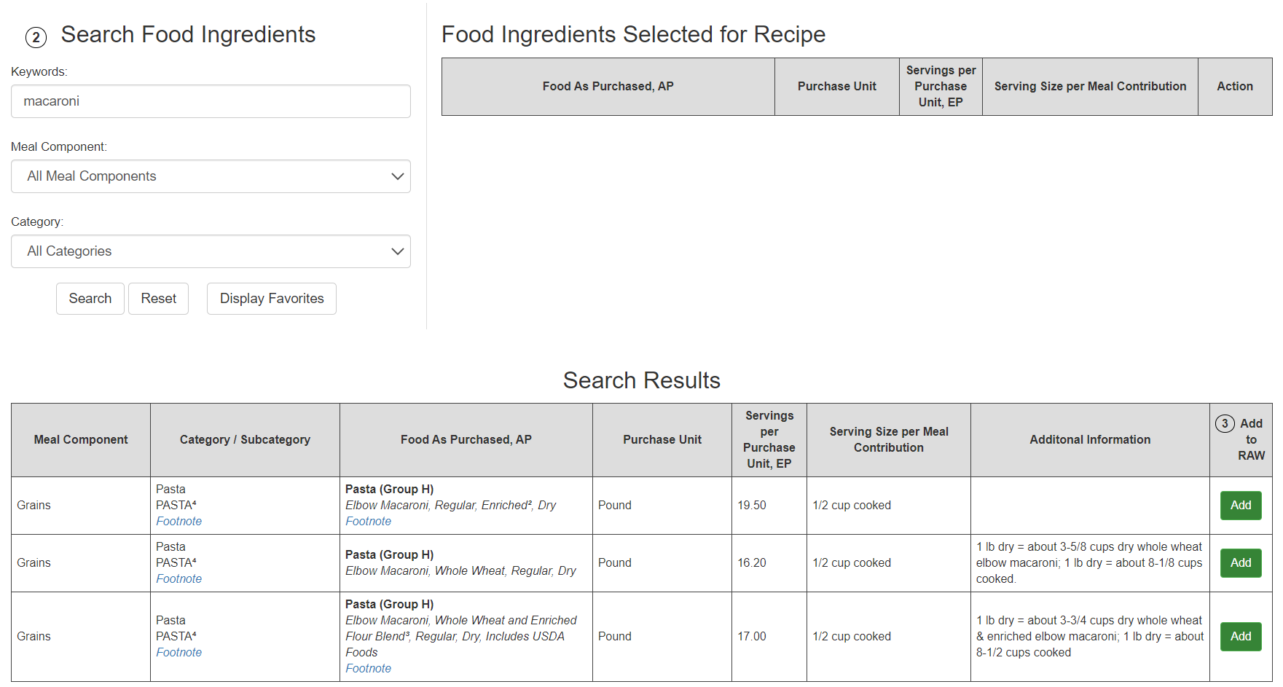
RECIPE ANALYSIS WORKBOOK - METHOD B
Notes:
Say: Search results are displayed in a table below. Once the food item has been located, click the corresponding “Add” button [Click] to populate that food item into the RAW. [Click] You will see the item populate under “Food Ingredients Selected for Recipe”.

Slide 64
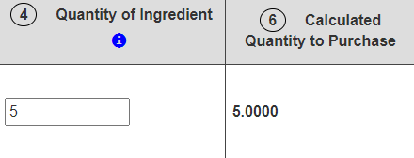
RECIPE ANALYSIS WORKBOOK - METHOD B
Notes:
Say: Once the ingredients have been added, they can be viewed on the corresponding tabs of the RAW. Here, we’re looking at the Grains Exhibit B tab.
Some of the food item information will be pre-populated from the Food Buying Guide such as the Purchase Unit, and some of the pre-populated information will be editable. You may edit certain fields as necessary. [Click] The Calculated Quantity to Purchase will calculate automatically for each food item once Quantity of Ingredient is entered.

Slide 65
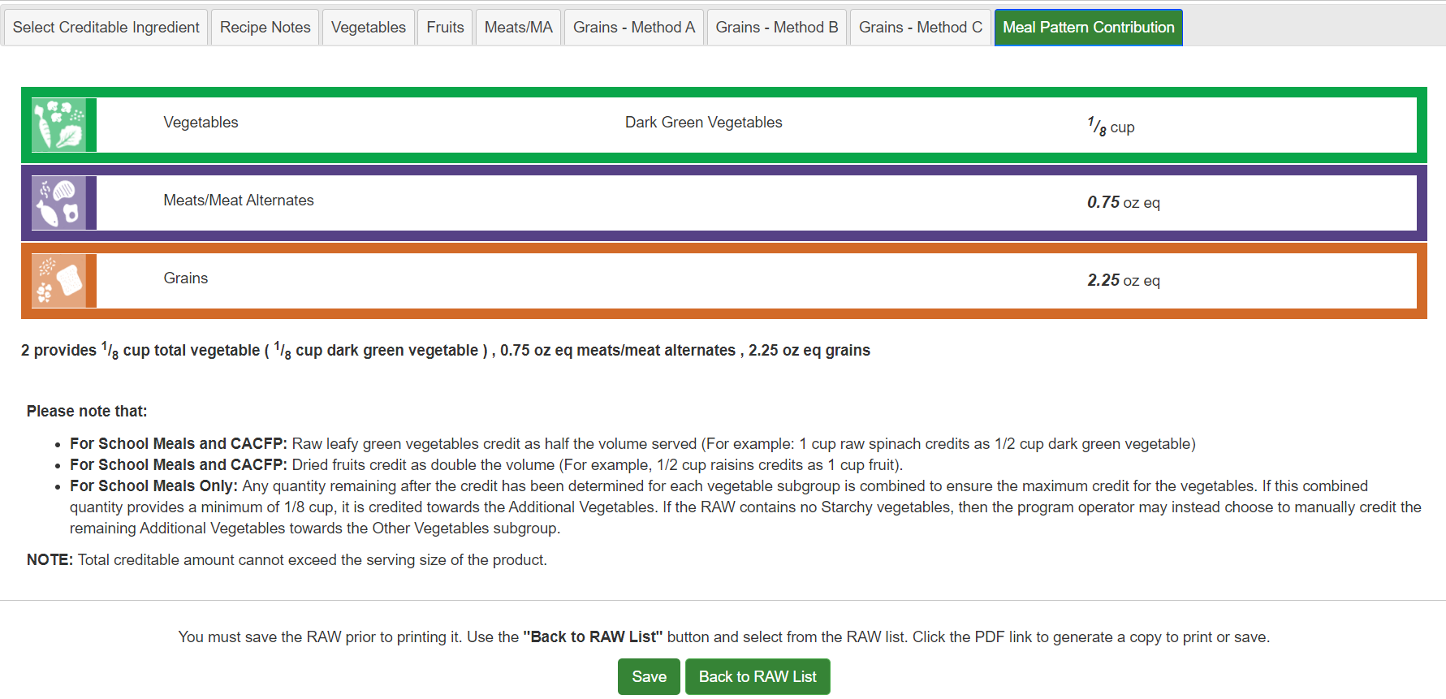
RECIPE ANALYSIS WORKBOOK – MEAL PATTERN CONTRIBUTION
Notes:
Say: Once you’ve added and saved each of your meal components, the Meal Pattern Contribution tab of the RAW will automatically generate a meal patterns contribution statement for the products based on the information entered, so you can determine not only your grains contribution, but the entire recipe.
[Click] Once finished, click Save to keep the recipe information for future reference. Clicking “Back to RAW List” takes you to your saved recipes.

Slide 66
RECIPE ANALYSIS WORKBOOK
Notes:
Say: For any of your saved recipes, you can edit, copy, delete, or export as a PDF or text file.

Slide 67
KNOWLEDGE CHECK – QUICK POLL
True or False: The Food Buying Guide (RAW) can be used to determine the ounce equivalents per serving for standardized recipes.
Notes:
True – This workbook can be accessed from the home page of the Food Buying Guide.

Slide 68
KNOWLEDGE CHECK – QUICK POLL
Which of these resources can NOT be used to convert grains into ounce equivalents?
Recipe Analysis Workbook
Team Nutrition Food Buying Workbook
Grains Measuring Chart
Exhibit A Grains Tool
Notes:
2. Team Nutrition Food Buying Workbook

Slide 69
KNOWLEDGE CHECK – QUICK POLL
If the Grains Measuring Chart lists an item by size, check to see if the item is the same size or larger by using the:
FBG Size/Weight Indicator Tool
Grains Measuring Tool
Notes:
B. Grains Measuring Tool

Slide 70
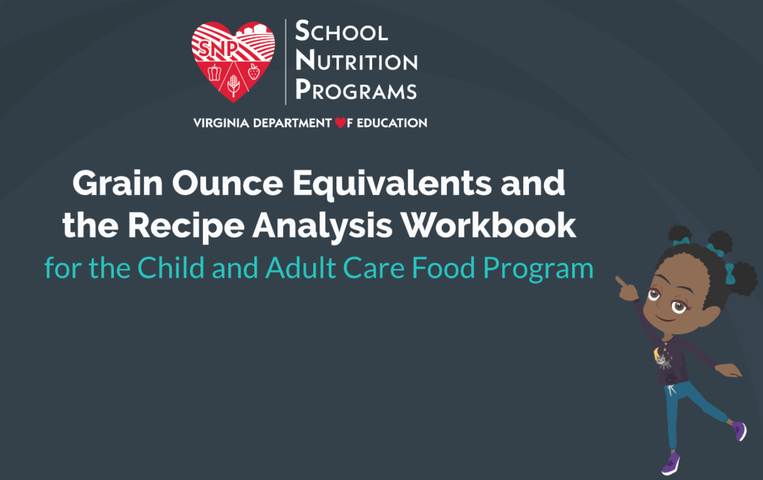
ONLINE TRAINING
Coming soon!
Notes:
Say: That’s a wrap, everyone! Thanks for walking through the different tools used to convert grains to ounce equivalents. As we mentioned, you’ll get a notification when the Grains Ounce Equivalent Online Training is available. The training walks through the same tools we reviewed today, but allows you to pause as needed and go back any time. These slides will also be sent out for your reference.

Slide 71
QUESTIONS?
Regions 1 and 8 CNP Specialist:
Lisa.Bonine@doe.virginia.gov
Regions 2 and 3 CNP Specialist:
Maureen.Thomas@doe.virginia.gov
Regions 4 and 5 CNP Specialist:
RaShae.Royster@doe.virginia.gov
Regions 6 and 7 CNP Specialist:
Sonya.Kibler@doe.virginia.gov
Erica.Davis@doe.virginia.gov
CNP Supervisor:
Maggie.Parker@doe.virginia.gov
Visit our Website:
VDOE School Nutrition
Follow Us on Twitter, FB, and Instagram: @VDOESNP
Notes:
Does anyone have any questions?
VDOE-SNP web address:
http://www.doe.virginia.gov/support/nutrition/index.shtml

