Slide 1
CACFP Meal Pattern Webinar The Food Buying Guide Recorded: February 25, 2020 Edited: December 9, 2020 Funded with a grant from the USDA
Notes:
Hello, and welcome to the CACFP Meal Pattern Webinar on the Food Buying Guide. This training was funded by the USDA. My name is Shirley Wu and I am a Child Nutrition Specialist and today, I will be guiding you through the functions available in the electronic Food Buying Guide.

Slide 2
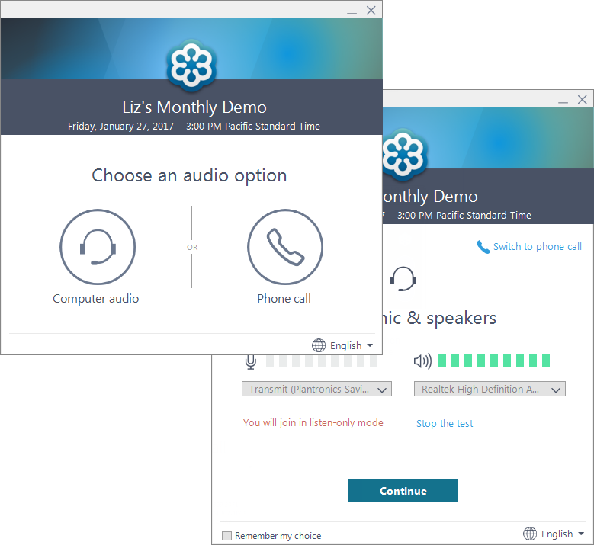
Using GoToWebinar
If you can’t hear me right now, call in using the Phone Call option
Use the “Questions/Chat” Box for any questions
Notes:
Before we get into the training though, let’s go through some basics on using GoToWebinar. (click) If you are having trouble with the audio, you can choose the phone call option and call in or vice versa, if you are having trouble with your phone line, you can try your computer speaker and choose the computer audio option instead. There will be a pop-up window showing a volume indicator. Since you do not have an option to verbally ask questions, (click) you can type in questions in the Questions or Chat box instead. I will be checking the chat box or questions tab at the end of the training and will answer your questions then.

Slide 3
Certificate of Completion
Certificates will be sent within 1 week to the registered attendee
Only attendees who viewed the entire session will be provided with a certificate
Questions: ODE.CommunityNutrition@state.or.us
Notes:
All registered attendees will receive a certificate from ODE within 1 week from today. This means that if you have multiple people viewing on one computer, only the person who signed up for the training will receive the certificate. Only the attendees who viewed the entire session will be provided with a certificate – this is tracked by GoToWebinar. The certificate will be sent from the ODE Community Nutrition Inbox. If you have questions, please e-mail ODE.CommunityNutrition@state.or.us.

Slide 4
Overview
Learning Objectives
Food Crediting in Child Nutrition Programs
The Food Buying Guide
Food Items Search
Exhibit A Grains Tool
Recipe Analysis Workbook
The FBG Calculator
Appendixes
Questions
Notes:
Let’s get into our training. Today, we will be quickly looking at our learning objectives, then we will have a short review of what it means to credit food in all Child Nutrition Programs before we get into the meat of our webinar, which is the Food Buying Guide. The Food Buying Guide has multiple tools and we will go over pretty much all the functions, including the Food Items Search, the Exhibt A Grains Tool, the Recipe Analysis Workbook, and the Food Buying Guide Calculator. At the end of the session, we will briefly go over the appendixes that are available.
As always, we will have some time at the end for your questions.

Slide 5
Learning Objectives
Participants will understand the purpose of the Food Buying Guide
Participants will know what functions are available from the electronic Food Buying Guide
Notes:
After you are done with this webinar today, our goal is for you to understand the purpose of the Food Buying Guide AND know what functions are available from the electronic version of the Food Buying Guide.

Slide 6
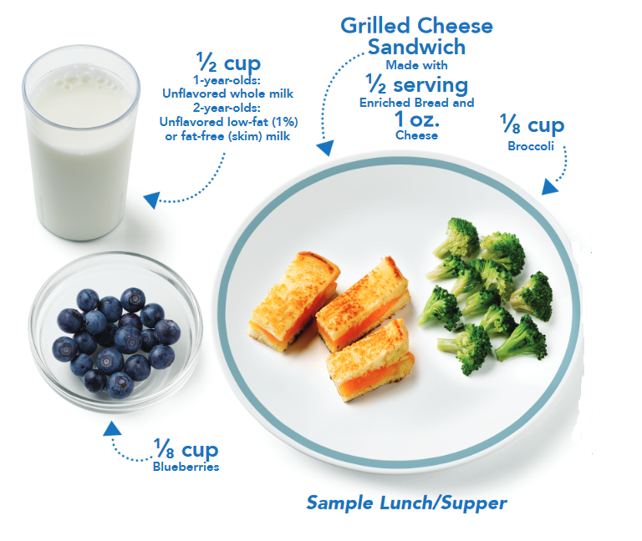
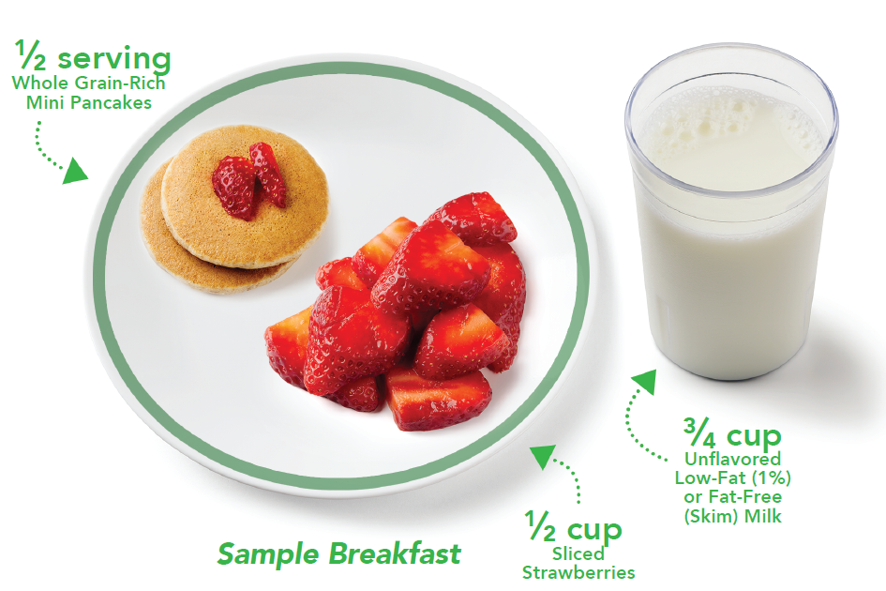
Food Crediting in CACFP
Understanding food crediting is important to CACFP: Must meet minimum serving sizes for all reimbursable meals
Supporting documentation is needed
Food crediting is not always obvious
Notes:
To do that though, you first have to understand why food crediting is important to not just CACFP but all Child Nutrition Programs. Food crediting is essential because you have to know whether your meals and snacks are meeting the minimum serving sizes for the age group you are serving. Your CACFP meal pattern is not only about serving the appropriate and creditable foods, but serving them with at least the minimum serving sizes.
To help support your meal pattern claims, you will always want to save supporting documentation on serving sizes and portion sizes. Sometimes, food crediting amounts is not obvious – if you buy 1 pound of meat from your vendor, most of the time, it won’t translate to 1 pound of creditable meat. This is true especially with combination foods where you combine at least two different components.

Slide 7
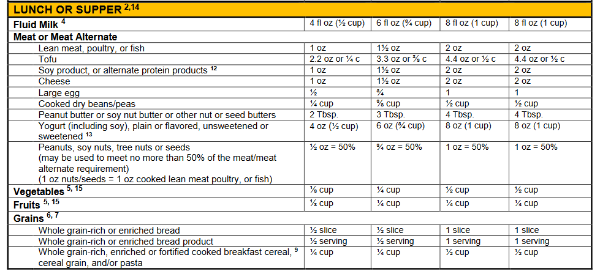
CACFP Meal Pattern Chart
Notes:
It is always a good idea to be familiar with our CACFP Meal Pattern Chart and refer to it for information on meal pattern crediting. Here is a clipped version of our meal pattern chart for children for the lunch and supper meals.
If you wanted to serve lunch to a 3-5 year old (click), you will want to check the column with the right age group and make sure that you have at least 6 ounces of fluid milk, 1.5 ounces of meat or meat alternates, ¼ cup of vegetables, and ¼ cup of fruits, and ½ serving of grains.
You might notice that (click) the meat and meat alternate items have a longer list of items. This is because different meat alternates credit differently due to the different nutrient composition. This means that items like tofu will need 3.3 oz or 3/8 cup in order to meet minimum portion sizes.

Slide 8
Am I Meeting Minimum Portion Sizes?
For the fruit, vegetable, and milk components: typically easy to tell if you are meeting minimum portion sizes
Grains and Meat/Meat Alternates (M/MA) are components that are harder to credit
Can only count the creditable portion of an item
Grains: Creditable portion = whole grains, enriched grains, bran and germ only
M/MA: Creditable portion = cooked, lean meats (or check the Food Buying Guide for creditable percentage)
Notes:
As you can see from our meal pattern chart, most of the time, it’s fairly easy to tell if you are meeting minimum portion sizes for fruits, vegetables, and milk. With fruits and vegetables, it typically credits based on the volume served. ¼ cup of fruit will meet ¼ cup of the fruit component. There are some exceptions with leafy green crediting for only half the volume that’s served – so 1 cup of spinach will only credit for ½ cup of the vegetable component. Dried fruits and vegetables on the other hand credit for twice the volume served – where ¼ cup of raisins will credit for ½ cup of fruits.
However, grains and meats and meat alternates are the two components where it becomes harder to credit, because these are items where the entire volume or weight of the product is not always creditable for CACFP or other Child Nutrition Programs.
For the grains component, the creditable portion of the grain item will only include whole grains, enriched grains, bran, and germ.
For the M/MA component, the creditable portion of the item will only contain cooked, lean meats – or if it is a meat alternate, there is a formula for calculating how much of the item will be needed to meet minimum portion sizes.

Slide 9
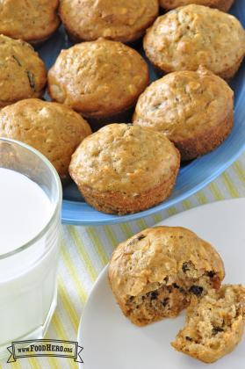
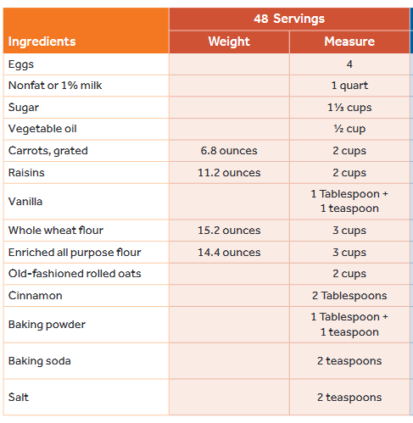
Crediting Grains: Muffins
Only the creditable grains (whole grains, enriched grains, bran, and germ will can be counted towards the minimum portion size
Notes:
Let’s take a look at an example for grains and an example for meats so you can see what we mean.
Here we have a muffin – and if you were creating a muffin from scratch, you would know exactly how much grains are in each muffin, because your recipe indicates the weight of the grain ingredients. In this case, to credit your grains component, you would (click) ignore all the non-grain ingredients like eggs, milk, sugar, vegetable oil, carrots, raisins, and spices. (click) Taking the creditable grains ingredients only , you would be able to calculate out how many grains are in each muffin.
However, what if you weren’t making your own muffin? How would you be able to tell how much of the muffin you purchased was grains and how much was other ingredients like eggs, milk, and sugar?

Slide 10
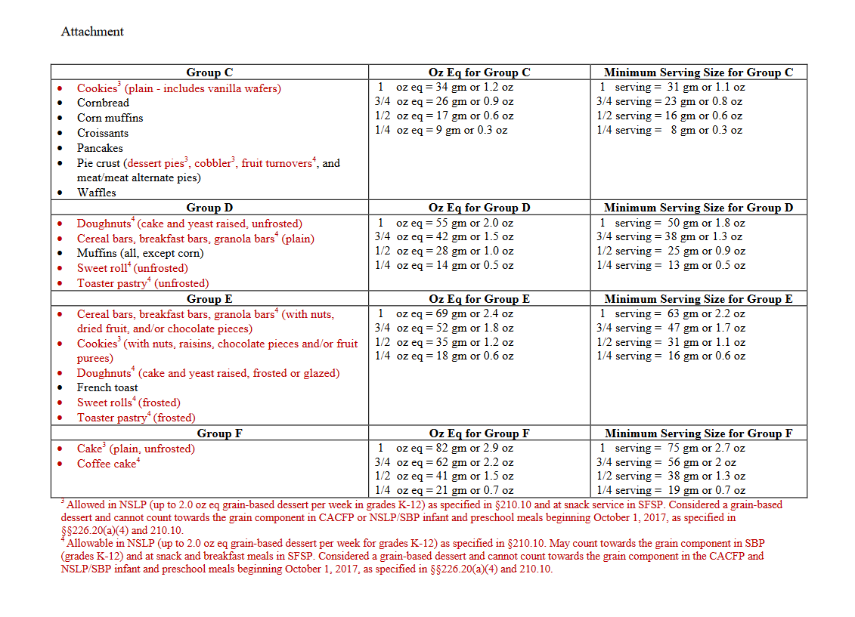
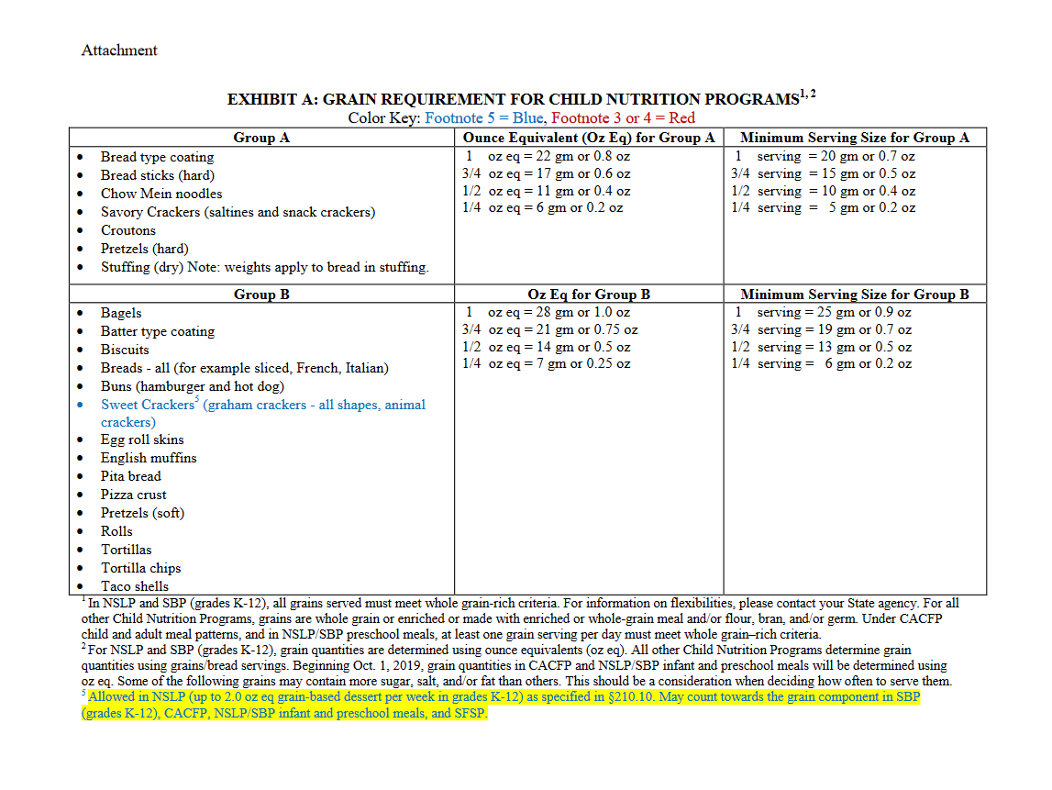
Exhibit A
Notes:
For grains, we have something called Exhibit A – and this is a chart that provides the serving size that is required for common grain items that are served. The chart provides both ounce equivalents which you can use and will be required starting Oct 1, 2021 or the minimum serving size portions, which can be used currently, but will not be allowed after Oct 1, 2021. Ounce equivalents and minimum serving sizes are fairly similar and you can compare the two charts and see that ounce equivalents is barely larger.
Exhibit A takes common grain items and provides an estimate for the amount of grain ingredients that is in the item by weight. (click) Let’s look at the second page of Exhibit A and let’s say we wanted to serve some muffins that we purchased in the stores. You will find (click) Muffins under Group D. (click) Next, you will look at either the ounce equivalents or the minimum serving size columns, and see that to get 1 ounce equivalent of the grains component, you would need 55 grams or 2.0 ounces by weight of muffins. If you were using the minimum serving size instead of ounce equivalents, you would get 1 serving for 50 grams of muffins. The reason why you would only credit half the weight of the muffin is because this total weight also includes eggs, oil, sugar, and milk, which are not creditable grain components.

Slide 11
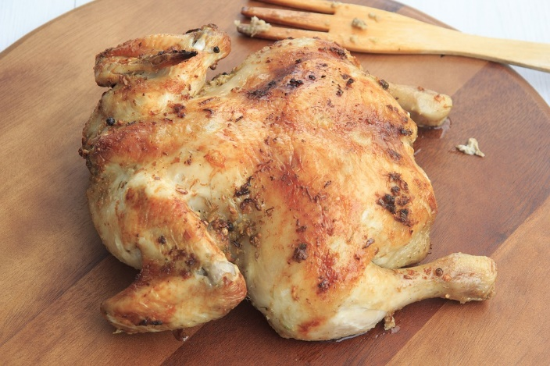
Crediting Meats: Chicken
When crediting meats, 1 ounce purchased does not equal 1 ounce of creditable meat
Need to take into account:
Only the lean, cooked meat can be counted towards the creditable Meat Component
Bones and Cartilage
Skin
Fat
Notes:
Moving on to the meat and meat alternate component then, you have items like chicken. With almost all meats, when you credit the meat, 1 ounce will generally not equal 1 ounce of creditable meat unless you are buying completely lean, fully cooked meats.
Instead, 1 ounce of meat that is purchased will likely equal less than 1 ounce of creditable meat because you have to take into account (click) the bones and the cartilage, the skin, and also the fat. With non-cooked foods, you also have to account for moisture loss. (click) With the meat component, only the lean, cooked meat can be counted towards the creditable meat component.

Slide 12
Do I have to weigh all my meals?
No: Use the Food Buying Guide to determine your creditable portions, or yield
The Food Buying Guide has yield data for many common foods and is the main source of crediting information for all Child Nutrition Programs
The electronic Food Buying Guide can be accessed online at http://foodbuyingguide.fns.usda.gov or through the Food Buying Guide App (Mobile)
Notes:
So knowing what we know about crediting the grains and the meat and meat alternate components, does this mean that you need to weigh all your meals before you serve it? No. Weighing all foods is not a requirement – although you can choose to do so. What we use instead is the Food Buying Guide – which you all signed up to learn about today.
The Food Buying Guide helps all Child Nutrition Programs determine the creditable portions, which is also known as “yield” for common foods served. This guide is our main source of crediting for CACFP and all other Child Nutrition Programs. Way back when, this used to be a physical folder with listings of different foods and information on their typical serving sizes and yields. The yield data that is provided is collected from averages of foods that have been measured by USDA.
Now, it has been converted into an electronic version that is searchable and can be accessed either through your web browser or through a mobile app. We will look at the internet version, since it has all available functions. (click on link and start navigating from website)

Slide 13
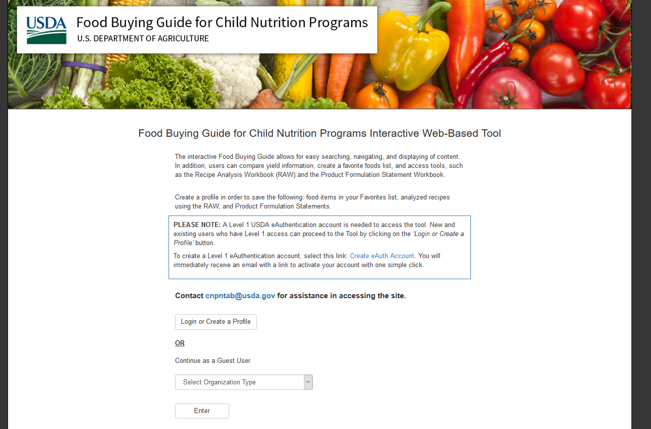
Signing In
Notes:
We will start at the main page and it will ask you to either login or create a profile. You can also login as a guest user. However, if you do that, you will notice that there are some areas that you can’t access, like the Recipe Analysis Workbook. If you wanted to save any of the information in the Food Buying Guide, you will need to have a login. We will use my login today, however, it’s easy to create an account. There’s a create account button right under the Login forms. You will answer a few questions and get access within a day.

Slide 14
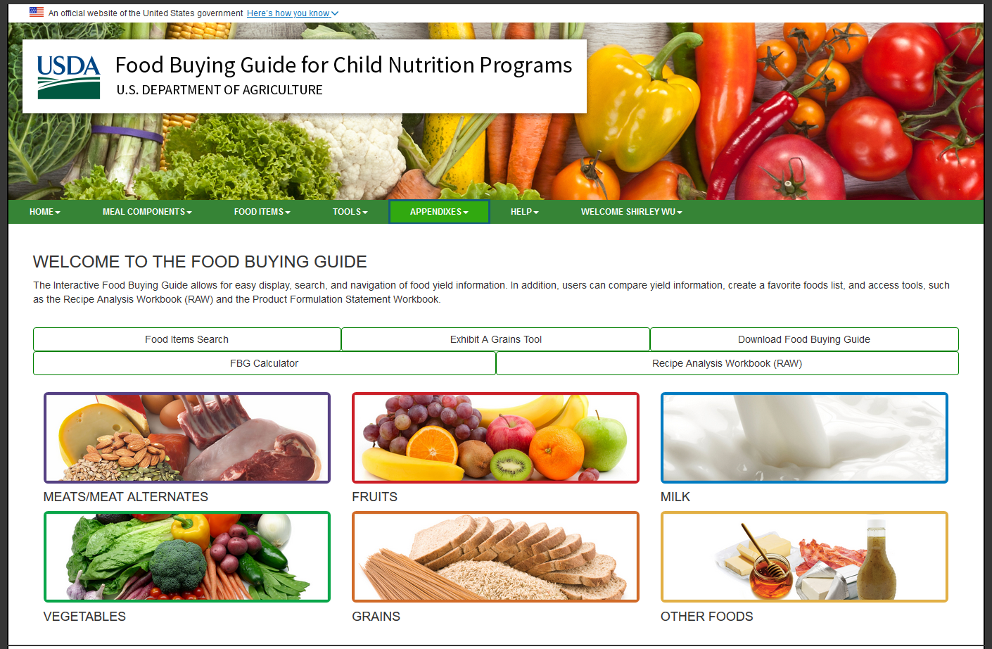
Food Item Search
Use for figuring out crediting for food items from all components
Notes:
Now we are at our home page. Note that you can navigate using either the green tabs near the top of the page, or by using the buttons available on the home page. We have 4 different tools we will go through today and I will explain the purpose for each tool and how it can help you manage your menus.
Let’s go to the Food Items Search first. You can click on the Food Items Search Button, or click on Food Items on the Green Tabs above and click Search. Both will take you to the same place. You can do a keyword search, but if you wanted to search through an entire component, you can enter in one component, and just search without adding any keywords. Here I am adding Meats/Meat Alternates under Meal Components and leaving the keywords blank, and it will return all the different meat and meat alternate items in the Food Buying Guide. If you are ever searching for inspiration for your menus, this can be a fun way to discover different creditable items for different food components.
However, most of the time, this will be pretty hard to dig through for what you really want. For example, let’s say you purchased some chicken tenders and you want to figure out how much you need to serve to your participants in order to meet minimum serving size requirements, you can type in Chicken and it will come back with several pages of results.

Slide 15
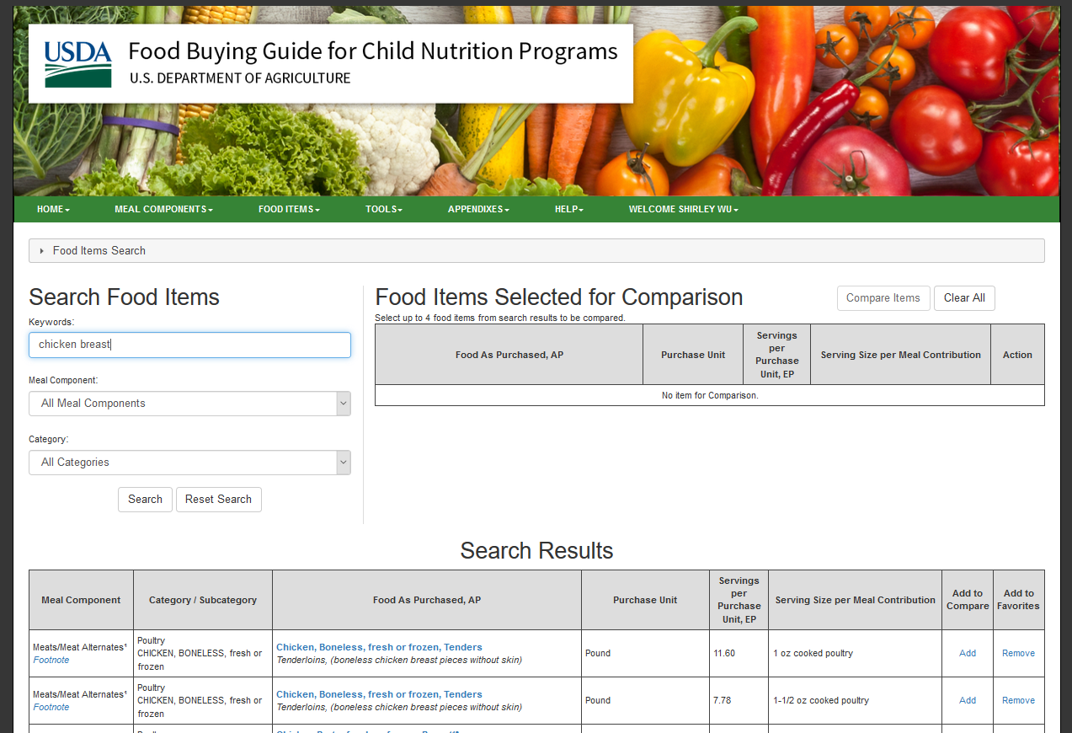
Food Items Search
Notes:
We are going to want to help ourselves narrow it down. It’s always a good idea to add more key words so you can get better, more targeted results. Let’s add “tender” to our keywords search. Like most search engines, it doesn’t matter if you put it in the right order or not. I put in tender before chicken and it will still give you the same results. So now we are narrowed down to two results. So what’s the difference between these two items? It’s actually the same item, but one is for 1 ounce meal serving sizes and one is for 1.5 ounce meal serving sizes. This can be helpful so you don’t have to do quite as many calculations, but if you click into each food item entry, you will see that the crediting information is fairly similar with the exception of servings per purchase unit. Let’s look at the one for 1 ounce meal serving size on top.

Slide 16
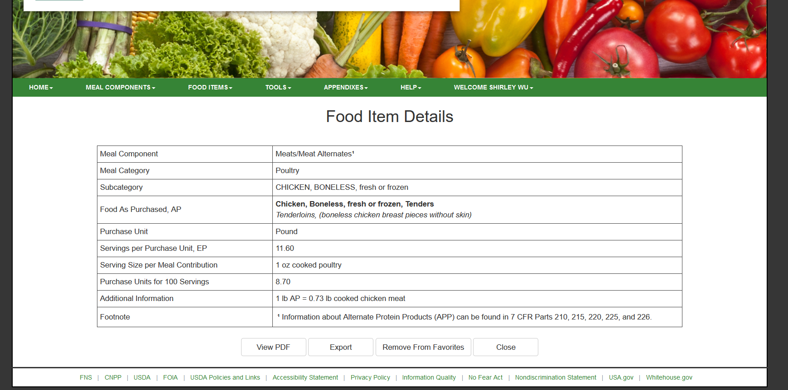
Food Item Details: Chicken
Notes:
In each food item detail entry, you get the meal component it credits for up top, the subcategories – the meal category and subcategories does not matter for CACFP. What does matter though, is the purchase unit, the servings per purchase unit, the serving size per meal contribution, and the additional information. Your purchase unit is just the unit that is being used – and it be either a weight or volume. For chicken, since we buy it by the pound typically, the purchase unit is in pounds. Next, you see servings per purchase unit, EP – EP stands for edible portion. This means that for every pound of chicken tenders, you get 11.60 servings of edible chicken. What is one serving? One serving is 1 ounce of cooked poultry, which you can see directly under the 11.60 servings per purchase unit. The Food Items detail also helpfully provides you with information on the amount of chicken you would need to buy if you wanted to buy enough to serve 100 1-ounce equivalent servings of chicken and that is 8.70 pounds.
In the second row from the bottom, you see “additional information” – this provides you with another way to calculate ounce equivalents. What is says is that 1 pound of chicken tenders as purchased, that’s what AP stands for – as purchased, will result in 0.73 pounds of cooked chicken meat.
If chicken tenders is an item you use a lot, you can add it to your favorites, or print it out using the View PDF button at the bottom of the page. If you are done with it, you can close it.
Use this tool to compare different ingredients for your recipes. After looking at your ingredients and comparing pricing, including staff time for processing the chicken, you can make a decision. Most of the time, you will find that your staff may prefer saving some time by buying chicken tenders. There’s no ‘right’ answer, everyone will need to decide which item works best for their own site.

Slide 17
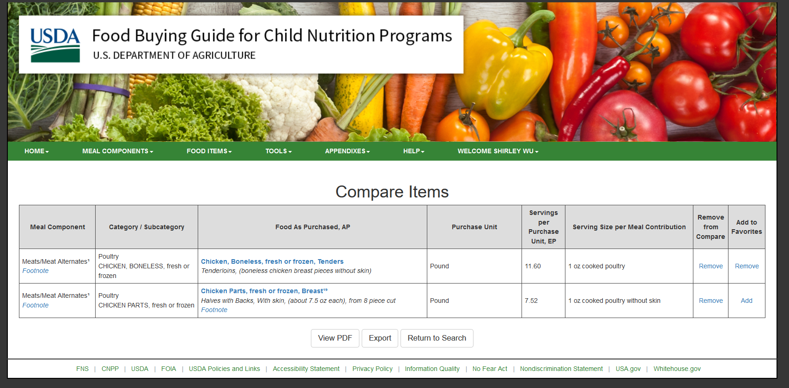
Comparing Items on the FBG
Notes:
One interesting thing you can do is to use the Add button to compare it to another food item. When you click Add under the Add to Compare column, it shows up above next to the search section. Then, you can search for another item.
This comparison is usually more helpful when you are trying to decide between two similar items. Let’s say you want to compare between the chicken tenders and a cheaper chicken breast with skin and backs. You can search for chicken breast, add the items, and compare and see if it makes sense. You can see that even if the chicken tenders are more expensive, you will get a lot more creditable meat per pound than the chicken breast. When you compare the items, do make sure you are comparing like items with like and that the serving size is the same.
The Food Items Search can be used to search for all different meal pattern components, however, what we have found is that it’s most helpful for the meat/meat alternate component in determining portion sizes. When it comes to grains, you might find that it’s more helpful to use the Exhibit A Grains Tool instead.

Slide 18
Exhibit A Grains Tool
Use for figuring out portion sizes for grain items
Notes:
Let’s go to the home page and let’s click on the Exhibit A Grains Tools button. You can also find it under the Tools Tab under the Green header. What the Exhibit A Grains Tool does is help us determine if the serving size on the ingredient label meets minimum portion size requirements. Think back a little while ago to our Exhibit A Handout – Exhibit A tells us the serving size for the common grain items out there. What this calculator does is help you make conversion calculations and see if your packages meet minimum serving sizes.
If you took our CACFP Annual Training last year, we went through the calculations you can do to figure out whether your serving sizes for your grain items are adequate for the new ounce equivalent portions. Now you don’t have to do it yourself, since this tool will do it for you.

Slide 19
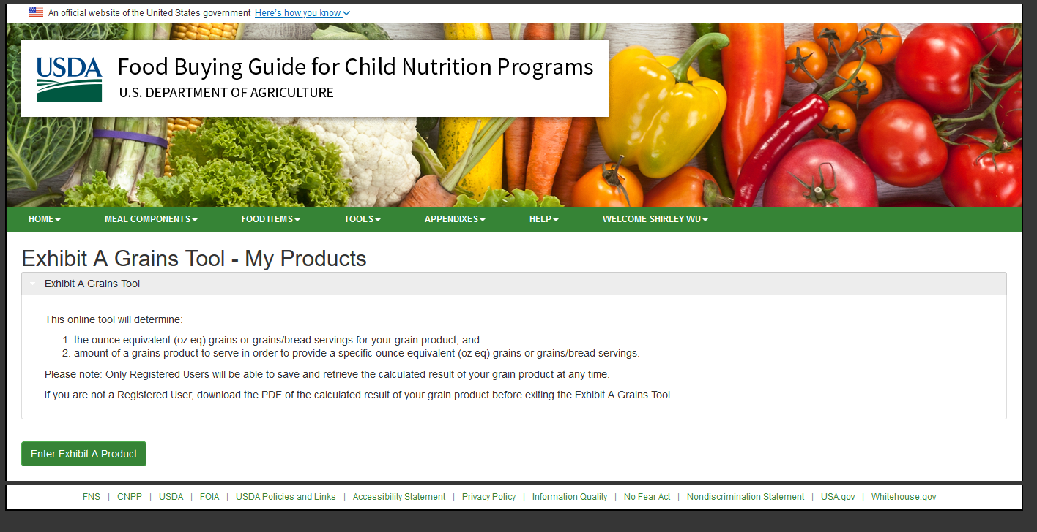
Exhibit A Grains Tool
Notes:
Looking at the Exhibit A Grains Tool, you can either add a new product, OR, you can enter a new Exhibit A Product. While I have one item listed already, let’s create a new item first. Click on the Enter Exhibit A Product green button.

Slide 20
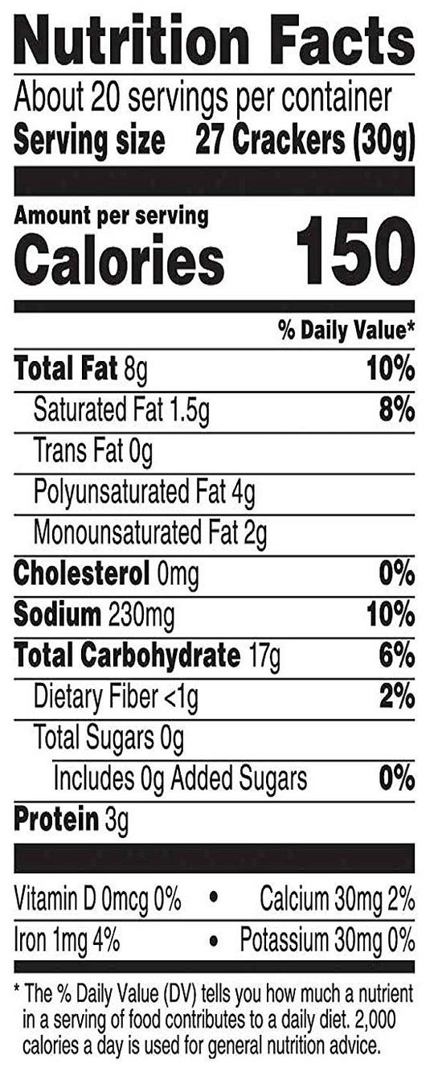
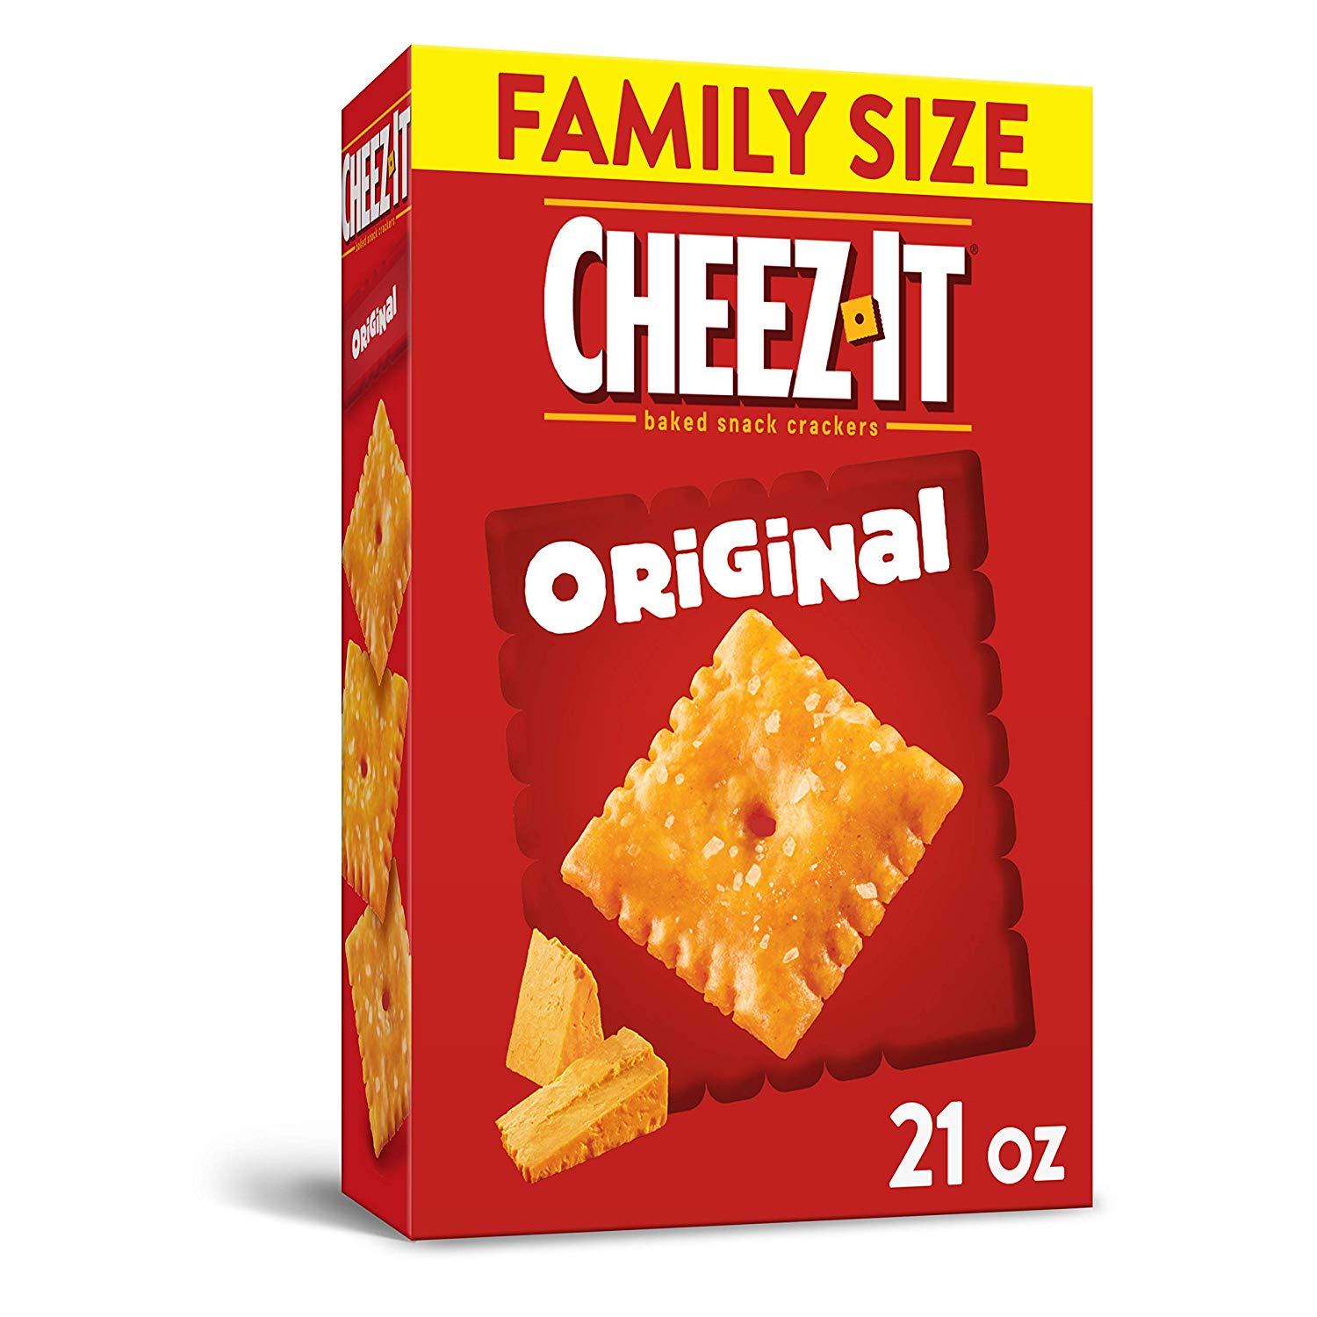
Checking Ounce Equivalent Contributions
Notes:
Next, let’s go back to our slides and look at a sample product that we have. Here, we have Cheez Its. What we want to do first is to look at its Serving Size. (click) You can see the serving size near the top of the Nutrition Facts label. A serving size is 27 crackers, or 30 grams. Let’s keep that in mind and move back to our Exhibit A Grains Tool.

Slide 21
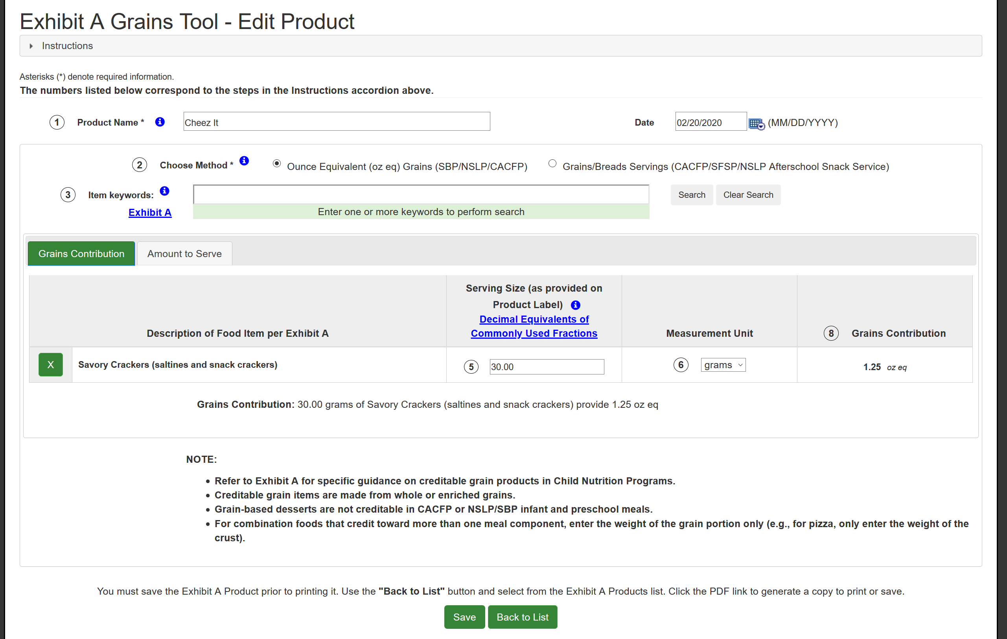
Entering in Your Data
Notes:
On our Exhibit A Grains Tool, we will enter in the Product Name, today’s date, and then under Item Keywords, add in the type of product that Cheez Its would match from Exhibit A and if you forget which categories are available in Exhibit A, you can always click on the Exhibit A link that’s available in this tool. Cheez Its are a type of cracker, so we will type in “Cracker” click search. Here you see that savory crackers and sweet crackers both show up. You will click “Add” on the Savory Crackers, because that’s what this is. Once you click add, a window shows up underneath with an area to put in serving size.
At this point, remember that your serving size was 30 grams, which made up 27 crackers. What we will want is an unit that is consistent, so we will want to use the weight, which is the grams. Type in 30 under the “serving size” column. Add in the measurement unit, which is grams. And the tool will provide you with the grains contribution. In this case, 1 serving of cheez its with 27 crackers will equal 1.25 ounce equivalents.
If this is something you would like to use in the future, click save and this will be saved on your list. You can only save if you are logged into your account. Let’s do Back to List and you can see it there.

Slide 22
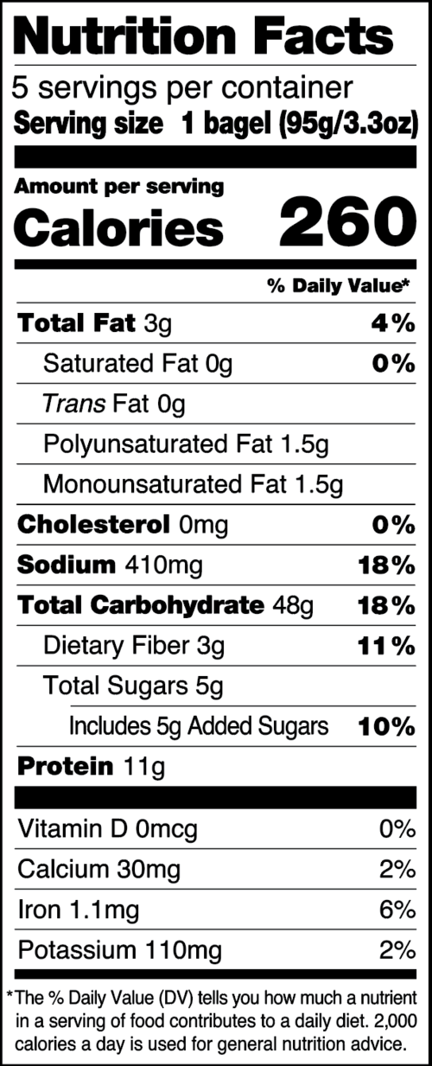
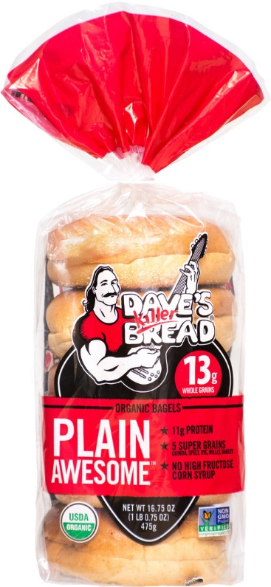
Checking Ounce Equivalent Contributions
The Exhibit A Grains Tool will help you convert your serving size to Ounce Equivalents
Notes:
If you ever want to edit one of your items – let’s say, you were looking at your Bagels and noticed that your bagels changed serving sizes, you can click on “edit” and go in. So right now, we have the serving size as 98 grams. If we go and take a look at our most recent nutrition facts label and one bagel is now 95 grams, we can go into the serving size and change it to 95 grams.

Slide 23
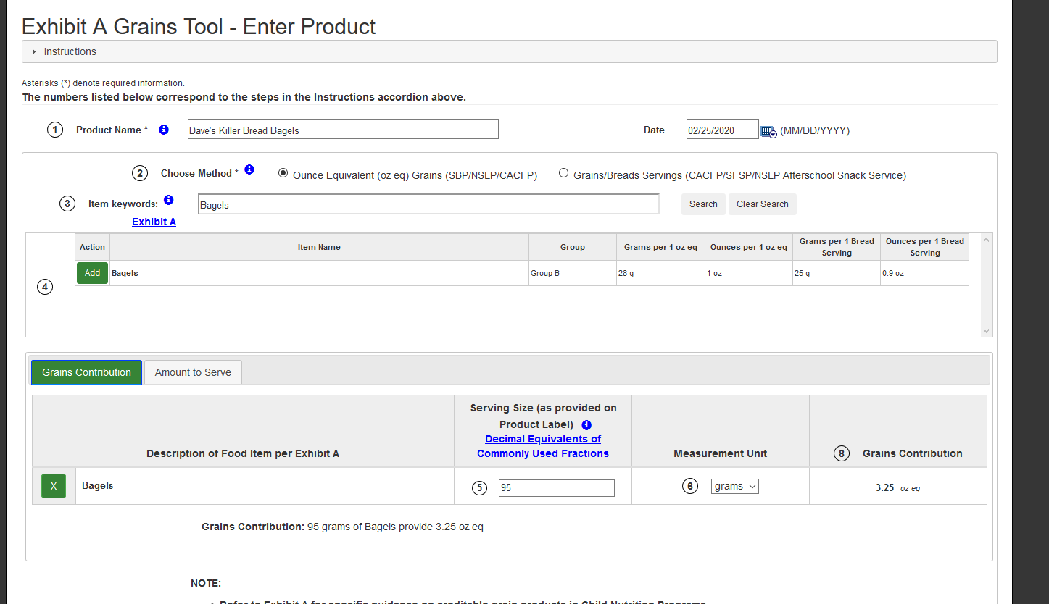
Entering in Your Data
Notes:
And you can see, by changing it, 1 bagel now contributes to 3.25 ounce equivalents instead of 3.5 ounce equivalents. This is a small difference and for CACFP meal pattern, if you are serving 1 whole bagel to all your participants, it would not matter anyway, since 3.25 and 3.5 ounce equivalents are both far greater than the minimum serving size required for any age group.
Once you are done, you can click save and go back to your list. Again, you can always choose to delete, save as PDF, or e-mail the information to yourself.
So again, Exhibit A Grains Tool helps you figure out whether your packaged grain items meet minimum serving size requirements.

Slide 24
Recipe Analysis Workbook
Use for crediting recipes
Notes:
What if the item you are trying to credit is not packaged, but instead is a recipe that you created? In that case, you can use the Recipe Analysis Workbook. Let’s go back to the home page and you can find the Recipe Analysis Workbook button on the right side, right above the image of milk. You can also get to it from the Tools drop down tab. This function will only be available if you have a login.

Slide 25
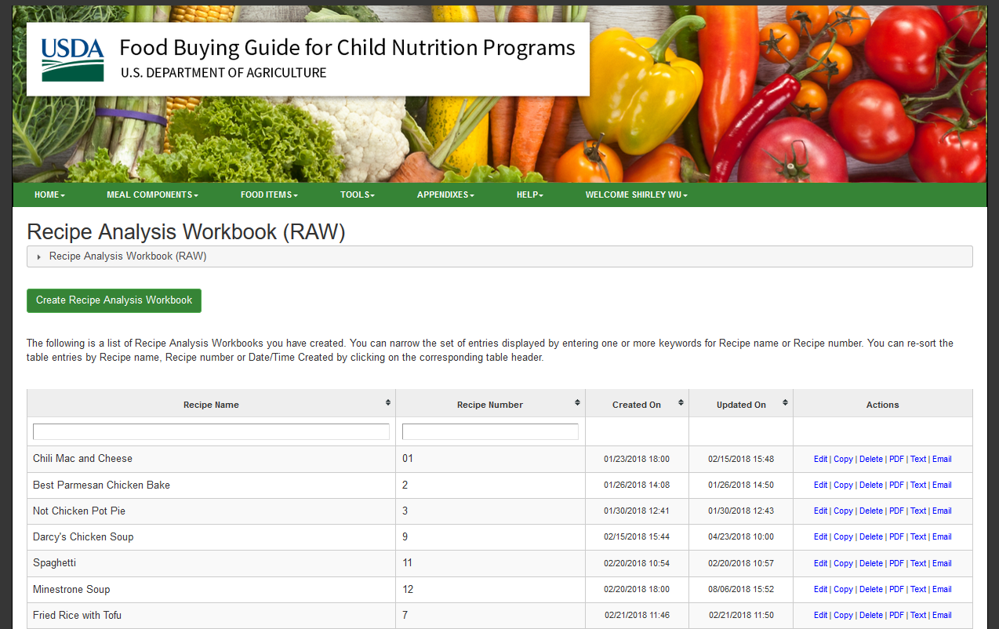
The Recipe Analysis Workbook
https://foodbuyingguide.fns.usda.gov
Notes:
Here in our Recipe Analysis Workbook, you can either Create a new Recipe Analysis Workbook, also known as a RAW, or you can look at all the recipes you have credited in the past. We can look at our Fried Rice with Tofu Recipe.
You can save recipe crediting through this tool and edit them as you change portion sizes, ingredients, or the number of servings. In order to save your RAW, you will need to make sure all sections up top are completed, including the recipe name, the servings per recipe, a recipe number, and the serving size. Make sure the servings per recipe is accurate since that will be the number that will be used to divide your creditable ingredients. All of the information are already completed, so let’s look at our recipe.
When we click on our already created RAW, you can see we have a list of ingredients that are on the Food Ingredients Selected for Recipe already. If you go to the Meal Pattern Contributions Tab, this section provides you with the crediting information for each component. This information is based on the quantities you list in each of the component tabs. Grains have 3 different tabs, and you will use Method A if you are using packaged grain items and Method B if you are using items listed in the Food Items List in the Food Buying Guide. For method C, you would only use this if you are using ingredients that you know will credit and cannot be entered in using methods A and B.
So, going to our Meal Pattern Contribution, you notice that the meat/meat alternates only credit for 0.75 ounce equivalent per serving and you want to change the tofu to chicken since it’s been a little difficult for you to buy enough tofu for your center. Looking at the age group that you serve, you want to make sure that each serving has at least 1.5 ounce equivalent of meat. You will go back to the Select Creditable Ingredient tab, and add in an alternate meat/meat alternate ingredients.

Slide 26
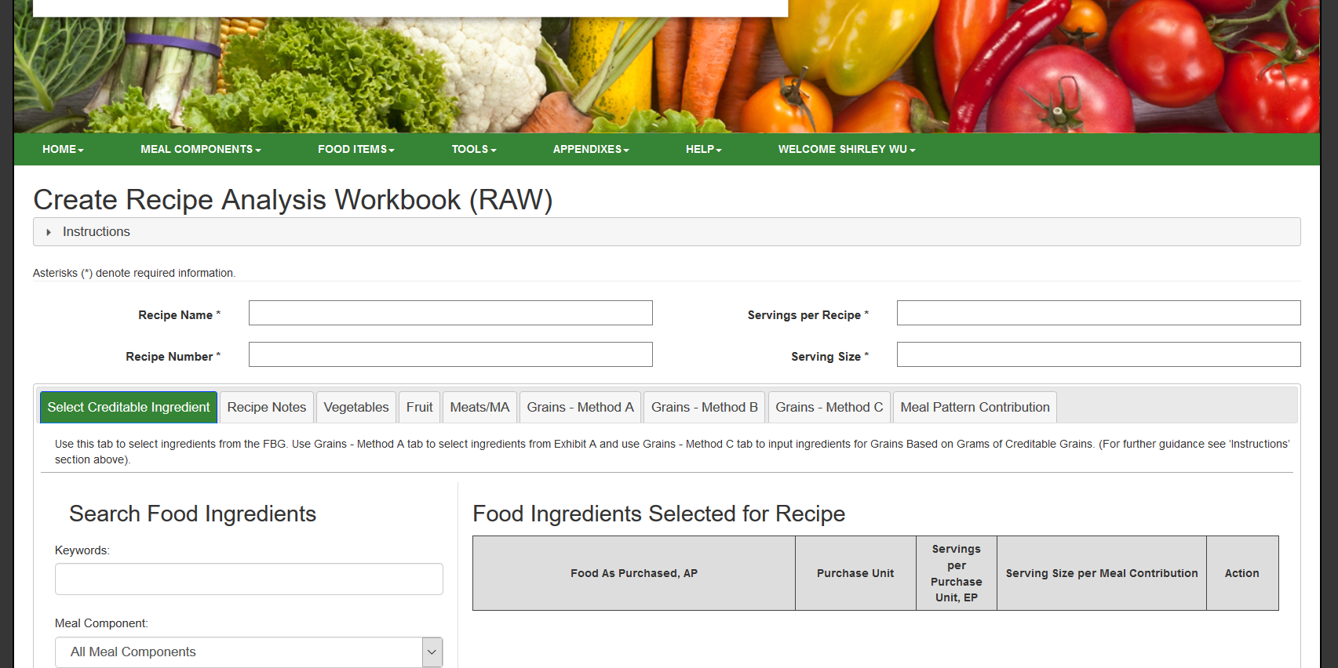
Creating RAW
Notes:
Maybe you decide that you want to add chicken instead. Delete out the tofu. Then add in the chicken. Just like with the food items search, it brings up a lot of different ingredients. Find the one that’s the best match – chicken tenders. Then go to the Meats/MA tab and you can add in the amount that you want to add to this recipe. In this case, maybe you want to add 10 lbs of chicken tenders. Doing that, you can see that your meal pattern contribution is now 1.5 oz eq for the M/MA section.
Once you are done with all of the changes, you can hit save – although the tool will actually save each time you switch tabs. You can click “Back to RAW list” and you can download the PDF, or e-mail it to anyone else.
The RAW is not a recipe creator, but what it can do is help you credit your already-created recipe and possibly help you edit your recipes so that it credits for the minimum serving sizes.

Slide 27
FBG Calculator
Use for creating a shopping list
Notes:
Now we are going to look at our final tool, which is the FBG Calculator. Let’s go to the home page first. The FBG Calculator can be found right above the image of the meats and meat alternates on the left side of the page. Like all the other tools, you can also reach it by using the Tools Tab above.
Let’s take a look at this. The FBG Calculator creates shopping lists for you. This can be a very helpful tool if you have a consistent cycle menu and you purchase items on a set schedule.

Slide 28
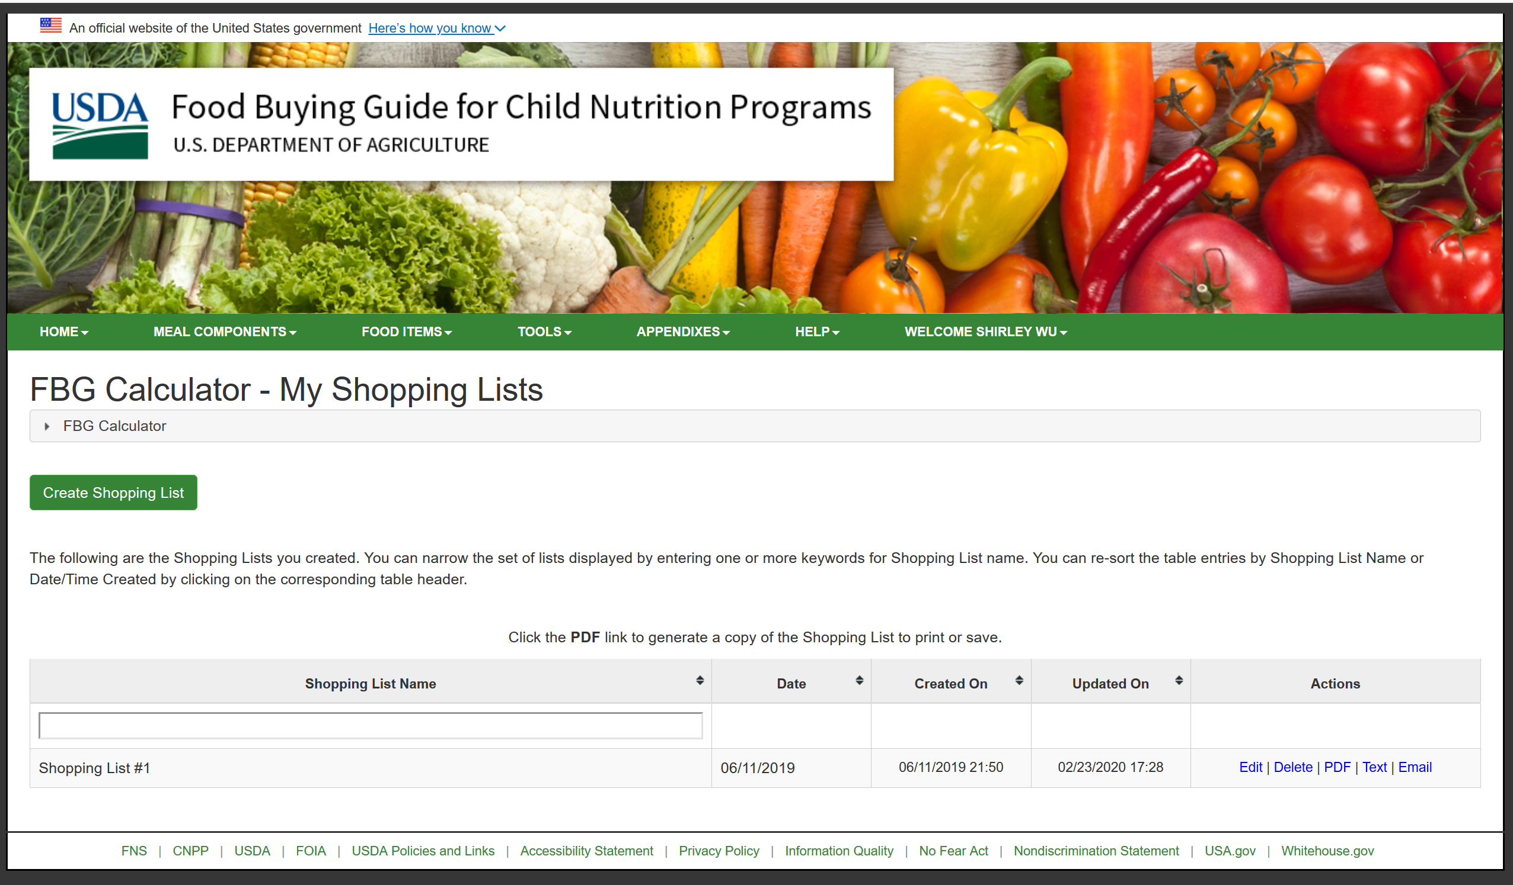
Using the FBG Calculator
Notes:
Let’s create a shopping list. First, click on Create Shopping List. Give your shopping list a name – we will go with Shirley’s Shopping List.
Next, start adding in keywords for food items we need under each of the tabs for each component. Let’s try this for our fried rice ingredients. We will add in chicken. Once you searched for the item, add the item that most closely matches the one you are purchasing. Next, scroll down, and see that the item is now listed and ready for you to enter in more information. First, check your storage and fridge and see how much of each item you have on hand – this will be based off purchase units. Unfortunately, purchase units must be whole numbers, so if you have half a pound of chicken, just round down – the idea is to make sure you do not end up with less than you need.
Next, click on Add Serving Size for each item. This adds another row and in this row, you will want to add the number of servings you will need for your recipe. Your recipe made 75 servings, with each serving making up 1.5 ounce equivalents of meat. Add in those details.
Let’s do the same with our vegetables – we will add in carrots and celery, and rice as well. Click on add serving size for the carrots and celery. With the celery and carrots, they both made up about 1/8 cup based on our RAW for each serving, so that’s the amount you will put in for the serving sizes. Finally, we will go to the grains component, and add in the serving size and the number of servings.
One thing you might notice is that this requires you know the serving size contribution for the items you are serving. If you have combination foods where multiple vegetables or multiple meats make up a creditable amount, this tool might require a little more additional calculation on your part.
However, where the Food Buying Guide Calculator really shines is for calculating the milk component. Sometimes, if you have multiple age groups that you are serving, it can be hard to figure out exactly how much milk you should be purchasing.
Let’s say you are a child care center that also has an afterschool at-risk site. You serve children who are 1-2 years old who need ½ cup of milk at each meal, 3-5 year olds who need ¾ cup of milk at each meal and children 6-12 who need a full cup at each meal. The purchase unit is Gallon and you know you still have 2 gallons of milk left. So we will put in 2 under number of purchase units on hand. And because you have 3 age groups, you can click add serving size 3 times. For the first serving size, you put in ½ cup for the 1-2 year olds. You know you have 20 1-2 year olds and for the full week for breakfast and lunch, you will need 10 meals worth, so 10 x 20 = 200 servings. Next, you have your 3-5 year olds who need ¾ cup of milk at each meal. You have 40 3-5 year olds. So again, you need 10 meals for the week for breakfast and lunch each day, so 40 x 10 equals 400 meals. Finally, you have your afterschool kids – you have 10 of those kids and you serve them suppers afterschool, so you have 5 suppers and you serve milk at one of your snacks too. So that’s 6 meals and snacks for the week. 6 x 10 kids = 60 servings.
Once you’re done, take a look at the number of servings needed and the exact quantity – you can see you need 660 servings, and altogether, they make up 28.75 gallons. Since you have 2 gallons on hand already, you only need to buy 27 more gallons.
When you are all done, take a look at your shopping list tab. The column on the left tells you how many units to buy. It will always round up to the nearest ¼ pound and the nearest gallon. And you can see that you will need 27 gallons total of milk along with all the other ingredients that we looked at for our fried rice.
The FBG Calculator has its limitations – you will need to know your serving sizes before you can create an accurate list and this can be hard for combination foods, but if you are trying to figure out how much to buy for individual food items and items that require different serving sizes based on age group, you may find this to be a good tool to use prior to buying your food items.

Slide 29
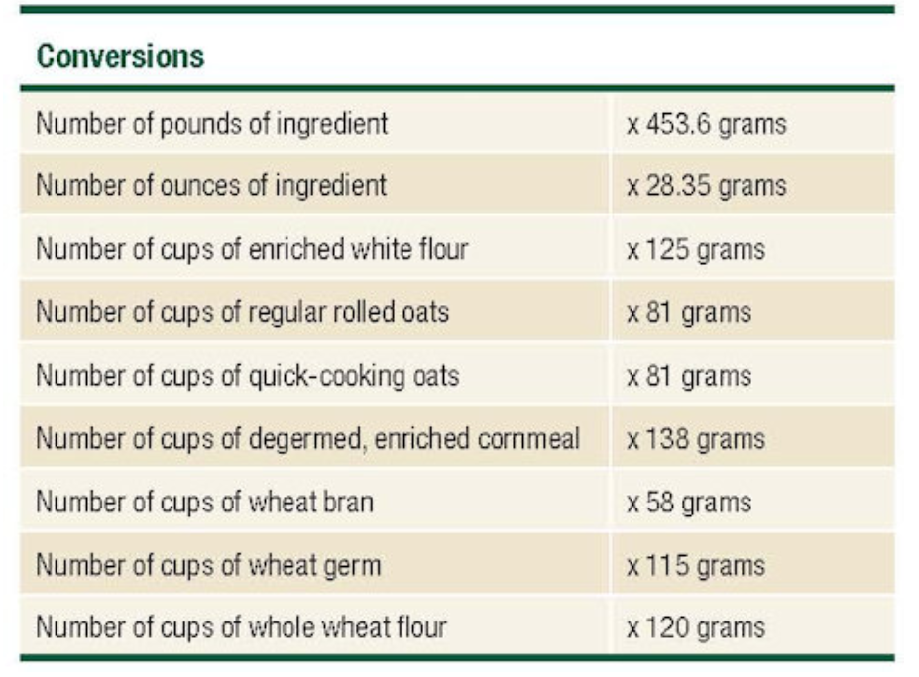
Appendixes
Appendix E: Worksheet for Calculating Grains/Breads Contribution for the Types of Food Products in Groups A-G, Using Grams of Creditable Grains
Useful for cooks who bake from scratch
Conversion of weight or volume to grams
Notes:
Now that we discussed all the different tools that are out there, I did want to point out that there is a section called the Appendixes which you can access on the Green Tabs section. Most of the appendixes won’t have too much information that you will need – many of them are holdovers from the days when we used to calculate everything out by hand. However, for those of you who bake fresh bread or other grain items from scratch, you will want to refer to Appendix E. Under Appendix E, there is a Worksheet for Calculating Grains/Bread Contributions for the Types of Food Products in Groups A-G, Using Grams of Creditable Grains. This list has conversions from volume to weight for common flours. This may be helpful if you are using the Method C tab when crediting flour ingredients in raw.
I also have the conversion chart available on the slides that are attached to the Handout Tab. You can refer to it instead of going to the FBG.

Slide 30
Discussion
Get to know the electronic Food Buying Guide – this is used for crediting in ALL Child Nutrition Programs
Have a login if you want to access all features
The tools can save time and money – but understanding meal pattern basics is necessary
Notes:
Hopefully, out of all the tools we looked at today, there is at least one or two there that might make your life a little easier as you plan your menus. Remember that the Food Buying Guide is the ultimate crediting reference for all child nutrition programs. This means that when we are looking at your menus, recipes, and other supporting documentation, we will be using the Food Buying Guide as the reference data. Become familiar with this tool, at the very least to look up ingredients you want to use in your menus.
Remember that if you want access to the RAW and to save your lists and favorite items, you will need a login – it’s free and easy to get. If those are not important features to you, you can always login as a guest too.
The Food Buying Guide is a lot of things, but it is not magic. You still need to have a basic understanding of the meal pattern, including the minimum serving sizes that are required for each age group you are serving. However, when used correctly, it has the potential to save you some time and money by reducing waste and time spent on creating menus.

Slide 31
Overview
Learning Objectives
Food Crediting in Child Nutrition Programs
The Food Buying Guide
Food Items Search
Exhibit A Grains Tool
Recipe Analysis Workbook
The FBG Calculator
Appendixes
Questions
Notes:
So today, we went over our (click) learning objectives, which is to understand what the FBG is and what functions it has. (click) Next, we went over what food crediting means in child nutrition programs. Then (click) we went over the food buying guide and looked at (click) food items search, the exhibit A grains tool, the recipe analysis workbook, the FBG Calculator, and finally, a little of the appendixes.
(click) Now, we have ___ for question.s

Slide 32
Questions?
More Questions?
Contact your assigned Child Nutrition Specialist
Notes:
I am going to take a minute to look at the questions that were sent in through the question and chat box during our lesson today. After I review the questions, I will read the questions and then provide an answer. (Answer chat box questions, once those are complete, ask if there are any additional questions. If there are too many questions to answer in the time frame, silence the microphone and take 1 minute to pick and choose the best questions to answer).
If you still have questions or if your question was not answered, please contact your assigned child nutrition specialist.

Slide 33
In accordance with Federal civil rights law and U.S. Department of Agriculture (USDA) civil rights regulations and policies, the USDA, its Agencies, offices, and employees, and institutions participating in or administering USDA programs are prohibited from discriminating based on race, color, national origin, sex, disability, age, or reprisal or retaliation for prior civil rights activity in any program or activity conducted or funded by USDA. Persons with disabilities who require alternative means of communication for program information (e.g. Braille, large print, audiotape, American Sign Language, etc.), should contact the Agency (State or local) where they applied for benefits. Individuals who are deaf, hard of hearing or have speech disabilities may contact USDA through the Federal Relay Service at (800) 877-8339. Additionally, program information may be made available in languages other than English. To file a program complaint of discrimination, complete the USDA Program Discrimination Complaint Form, (AD-3027) found online at the USDA complaint resolution page, and at any USDA office, or write a letter addressed to USDA and provide in the letter all of the information requested in the form. To request a copy of the complaint form, call (866) 632-9992. Submit your completed form or letter to USDA by: (1) mail: U.S. Department of Agriculture Office of the Assistant Secretary for Civil Rights 1400 Independence Avenue, SW Washington, D.C. 20250-9410; (2) fax: (202) 690-7442; or (3) email: program.intake@usda.gov This institution is an equal opportunity provider.
Notes:
Have a great day.

