Slide 1
CACFP Meal Pattern Success Webinar Meal Pattern Crediting January 29, 2020, 10 AM
Funded by the US Department of Agriculture
Notes:
Hello and welcome to the Meal Pattern Success Webinar on CACFP Meal Pattern Crediting. My name is Shirley Wu and I will be presenting the webinar today. Today’s webinar will be focused on updates to the CACFP Meal Pattern within the last year. This training was made possible by a meal pattern grant from the USDA.
Before we get started, note that all the microphones are muted, but we will be accepting questions through the tab on the navigation panel titled “Chat or Questions”. At the end of the session, we will have some time to answer any questions you may have. All questions you submit during this session will be answered at that time.
We also have handouts available under the Handouts tab. This includes the slides for today’s trainings.

Slide 2
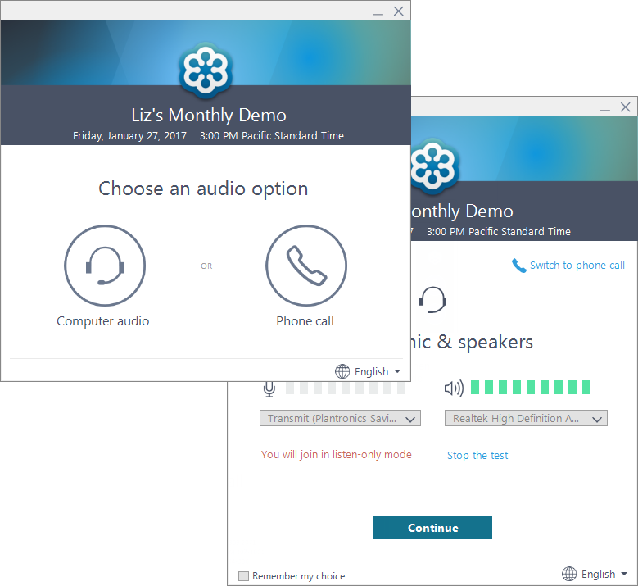
Using GoToWebinar
If you can’t hear me right now, call in using the Phone Call option
Use the “Questions/Chat” Box for any questions
Notes:
(click) If you are having trouble with the audio, you can choose the phone call option and call in or vice versa, if you are having trouble with your phone line, you can try your computer speaker and choose the computer audio option instead. There will be a pop-up window showing a volume indicator. Since you do not have an option to verbally ask questions, (click) you can type in questions in the Questions or Chat box instead. I will be checking the chat box or questions tab at the end of the training and will answer your questions then.

Slide 3
Certificate of Completion
Certificates will be sent within 1 week to the registered attendee
Only attendees who viewed the entire session will be provided with a certificate
Questions: ODE.CommunityNutrition@state.or.us
Notes:
Before we get started today – all registered attendees will receive a certificate from ODE within 1 week from today. This means that if you have multiple people viewing on one computer, only the person who signed up for the training will receive the certificate. Only the attendees who viewed the entire session will be provided with a certificate – this is tracked by GoToWebinar. If you have questions, please e-mail ODE.CommunityNutrition@state.or.us.

Slide 4
Overview
Learning Objectives
CACFP Meal Pattern Overview
Crediting Updates
Additional Meal Pattern Updates
Questions
Notes:
Today, I am going to go over what ODE CNP hopes you will learn from our session then go through a quick review of some CACFP meal pattern basics. Then, we will go through the main section of our training, which is on Crediting Updates. I will also go over some additional meal pattern updates that were sent out recently and finally go through any questions that have come in through the chat box.

Slide 5
Learning Objectives
Participants will understand which new food items are creditable for CACFP
Participants will know where to find information on crediting foods for CACFP
Notes:
Here are the two learning objectives for our lesson: First, after this training, participants will understand which new food items are creditable for CACFP and second, that even if you don’t remember everything from this one hour session, you will know where to find information on crediting foods for CACFP.

Slide 6
Question 1: How long have you been involved with CACFP?
Less than 1 year
1 to 3 years
3 to 5 years
6 to 10 years
More than 10 years
Notes:
Before we dive into the meal pattern though, I want to learn a little more about those of you who are taking this training. (launch question 1) Our first question for today is: How long have you been involved with CACFP? Is it A) less than 1 year, B) 1 to 3 years, C) 3 to 5 years, D) 6 to 10 years, or E) more than 10 years. Please take 15 seconds to answer the questions.
Thank you, everyone. It looks like…..
For those of you in the less than 1 year category, while you don’t need to be an expert in the CACFP meal pattern to understand the training today, we will want to make sure you have a little bit of understanding of CACFP before we go into the updates that were implemented in the past year. For those of you who have been working with CACFP for longer, don’t worry, we are not going to spend too much time on this, but there’s a few resources that we will want to go over for your reference.

Slide 7
CACFP Meal Pattern Overview
CACFP Meal Pattern had a major update October 1, 2017
Major Changes:
Included Whole Grain-Rich Requirements
Made Grain-Based Desserts non-creditable
Breakfast Cereals and Yogurts have a sugar limit
Allowed breastfed infant meals to be reimbursed
Divided the Fruits and Vegetables into two separate components for Lunch and Supper
Notes:
First, as a reminder for those of you who have been on the program more than 5 years, it’s probably good to think about changes in the last few years in CACFP. In fact, we had a major meal pattern overhaul in 2017. Some of these changes include adding a Whole Grain-Rich requirement, making grain-based desserts non-creditable, adding a sugar limit to breakfast cereals and yogurts, and allowing infant meals to be reimbursed when the infants are breastfed by their mothers. Finally, we also divided the fruits and vegetables into two separate components for the Lunch and Supper meals.
All of these changes were made with the purpose of creating healthier meals for participants of the CACFP.

Slide 8
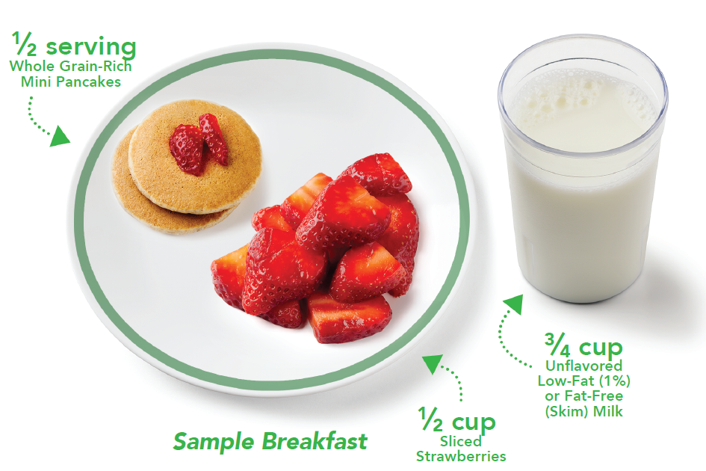
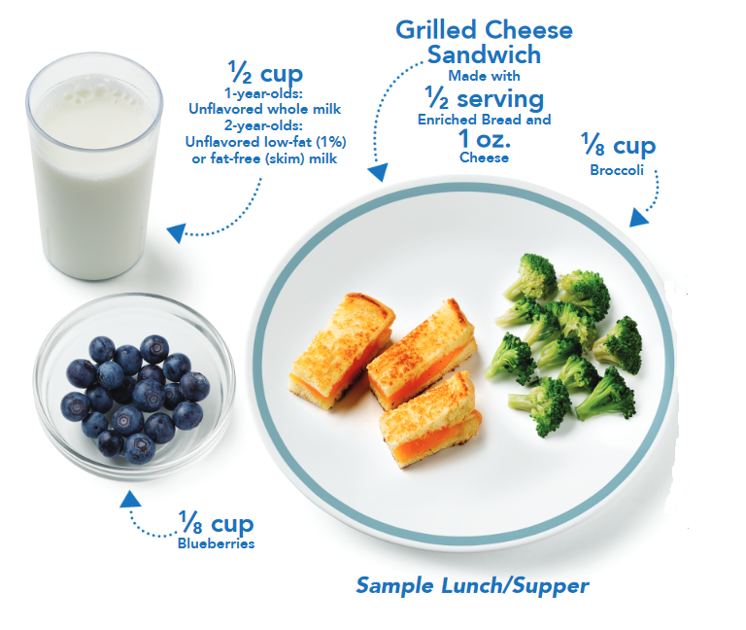
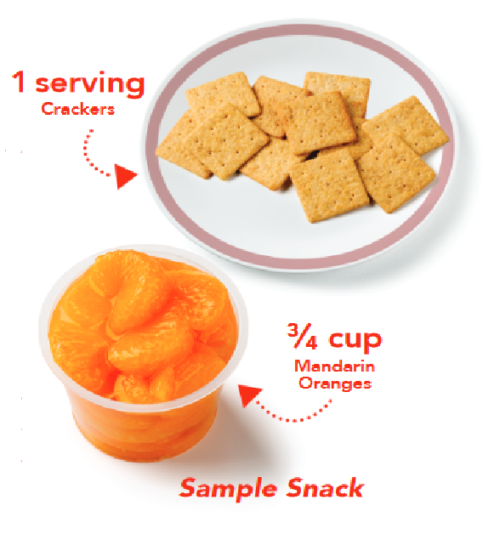
Meals and Snacks
Breakfast
Lunch/Supper
Snack
Posters available on the Team Nutrition Ordering Website
Notes:
You can see some of the sample healthy meals that would be served in CACFP. This includes a grain, fruit and milk component served at breakfast. A milk, fruit, grain, and vegetable component served at lunch or supper, and two components of your choosing for snack. At different age groups, there are different portion sizes to make sure that participants are receiving enough nutrients for each meal.
If you like these graphics and would like some posters with these graphics to put on your classroom or café, there is a link to the website on the slides you can download from the Handouts tab in GoToWebinar.

Slide 9
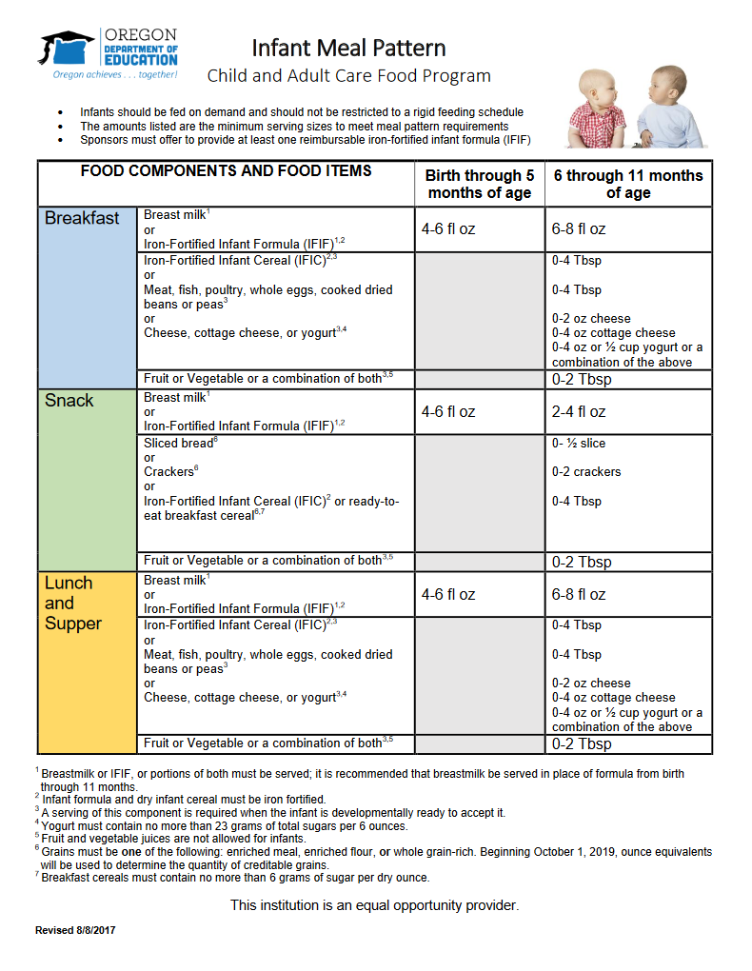
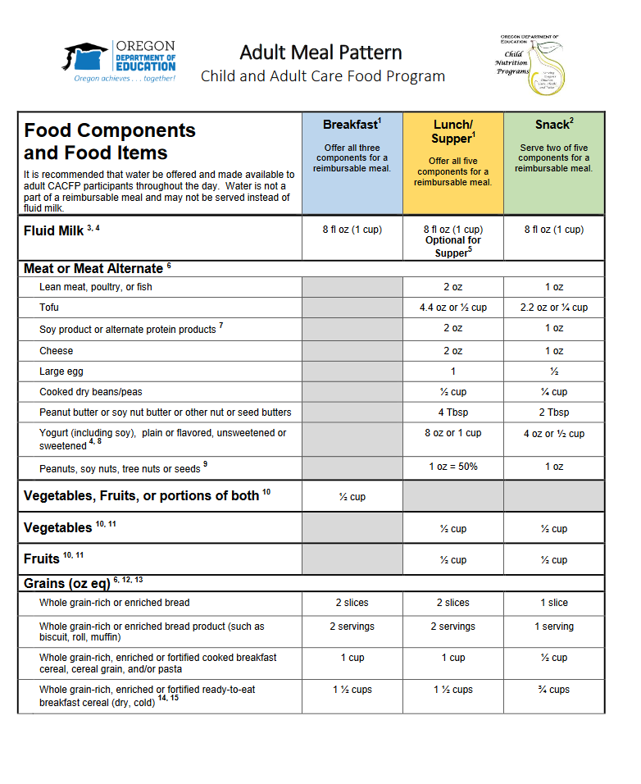
Meal Pattern Charts
Notes:
For a detailed list of all requirements for each age group by meal or snack, we have our meal pattern charts. We have a different chart for the infant, child, and adult age groups. In each of these charts, you can see the component requirements for each meal or snack and the portion size requirements of each meal or snack by age group. We don’t have time to go over the details for each component in detail today, but our ODE CNP CACFP training page includes Meal Pattern videos that go over the meal pattern in-depth. We also have the meal pattern charts for download from our CACFP meal pattern webpage. You have a link to it from your PDF slides as well.

Slide 10
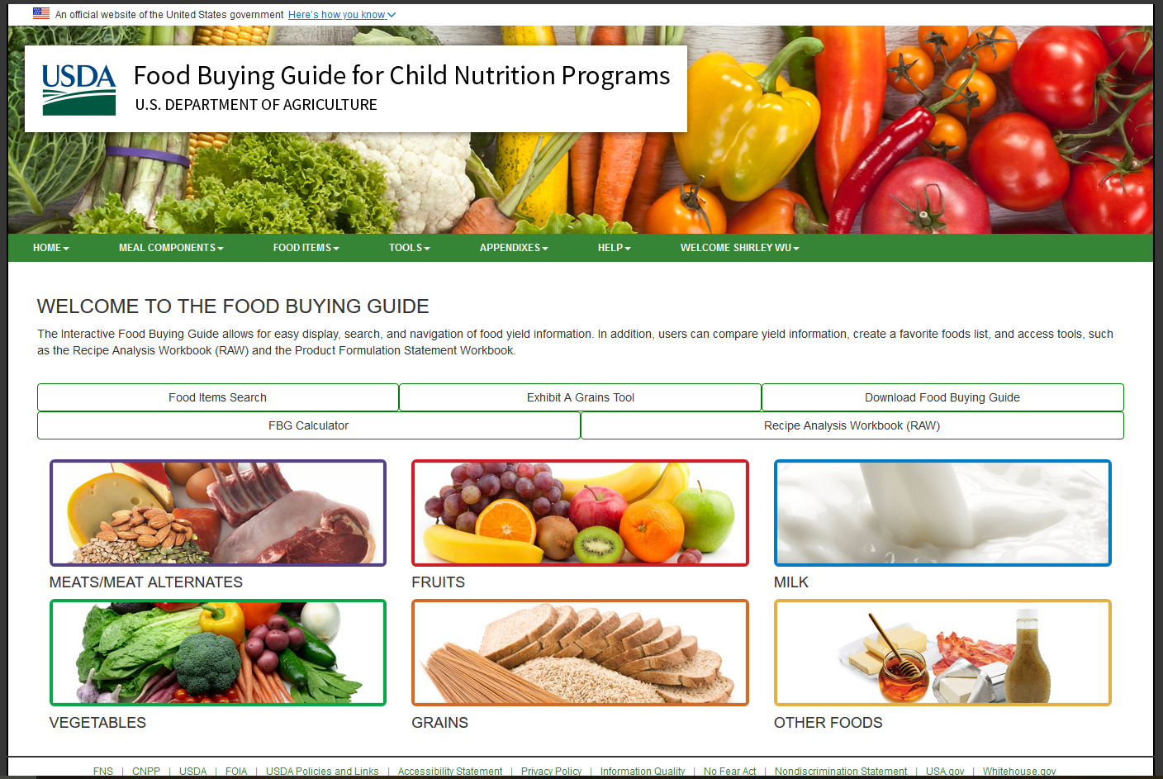
The Food Buying Guide
Main source of crediting information for CACFP
http://foodbuyingguide.fns.usda.gov
Notes:
One resource that everyone who runs a CACFP operation needs to be familiar with is the Food Buying Guide. Those of you who have been operating CACFP for more than 10 years probably remember when this information came in a large binder, but everything is now electronic and the Food Buying Guide is now available online at the website link listed at the bottom of the page. This is also a clickable link in your PDF slides.
The Food Buying Guide is a resource that helps you figure out how to credit portions. While sometimes it’s easy to figure out how much to portion individual items, do you know how much lean meat is in those 2 pounds of chicken legs you just purchased? How about the 10 pounds of pork tenderloins? What if you wanted to create a recipe for meatballs – how would you know how much ground beef you would need to purchase to make sure that each participant receives their full minimum portion size?
The Food Buying Guide can help you in all these situations. They have multiple resources, including some new ones that they added this year, to their website. You can even use the website as a guest, but signing up for a login is easy and having a login provides you with access to more tools since you can save recipes and food item information. We have an upcoming webinar on Thursday, February 20, 2020 that goes over using the Food Buying Guide and learning about some of the new tools that are now available.
(click) For today’s lesson though, the Food Buying Guide is important because this is your main source for information if you ever have a question about how and whether a food item credits for CACFP.

Slide 11
Updates since January 2019
Food Crediting Updates
Additional Meal Pattern Updates
Menu Documentation Reminder
Notes:
Now that you know some of the resources that are out there, we can get into some of the updates to CACFP that have been put into place since January 2019. I will go over the group of 6 memos that make up our food crediting updates and then go over some additional meal pattern updates and some menu documentation reminders at the end.

Slide 12
Crediting Updates: 6 Memos
Memos: Find on the ODE CNP CACFP Memo Page
CACFP 08-2019: Crediting Shelf-Stable, Dried and Semi-Dried Meat, Poultry, and Seafood Products in the Child Nutrition Programs
CACFP 10-2019: Crediting Popcorn in the Child Nutrition Programs
CACFP 11-2019: Crediting Surimi Seafood in the Child Nutrition Programs
CACFP 12-2019: Crediting Tempeh in the Child Nutrition Programs
CACFP 13-2019: Crediting Pasta Products Made of Vegetable Flour in the Child Nutrition Programs
CACFP 15-2019: Crediting Coconut, Hominy, Corn Masa, and Corn Flour in the Child Nutrition Programs (replaced CACFP 09-2019)
Notes:
This series of 6 crediting memos will make up the bulk of our training today and together, they provide guidance on multiple foods that were previously NOT creditable and are now considered to be creditable products in all Child Nutrition Programs. You can see the list of all six memos here and the link to them. ODE CNP sent out the six memos in May of 2019.
Those eagled eyed amongst you may have noticed that the memo numbering is a little strange since it skips memo number 9 and instead has memo 15 at the bottom. This is because USDA updated the memo on coconut, hominy, corn masa, and corn flour, which was CACFP memo 09-2019, with a new version numbered 15-2019. This new version supersedes and replaces memo 09-2019, which is why it’s not listed on this page. Again, all links on this page are clickable in the PDF handout available in your handout tab.
I am going to go over each of these memos and provide information on crediting highlights for each memo.

Slide 13
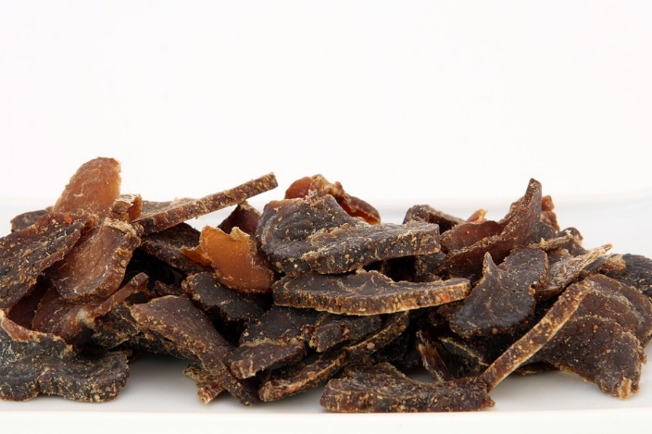
CACFP 08-2019
Crediting Shelf-Stable, Dried, and Semi-Dried Meat, Poultry and Seafood Products
Shelf-stable, dried, and semi-dried meat, poultry, and seafood are now creditable as Meat in the Child Nutrition Programs
Includes: Snack sticks made of beef and chicken, and meat, poultry, and seafood jerky
Not listed in the Food Buying Guide: Industry standards vary
Notes:
Let’s start off with memo 08-2019 – this is the one titled Crediting Shelf-Stable, Dried, and Semi-Dried Meat, Poultry, and Seafood Products. This memo states that shelf-stable, dried, and semi-dried meats, poultry, and seafood can now be creditable as part of the Meat Component in the Child Nutrition Programs. This includes basic items such as snack sticks that are made from beef and chicken, beef jerkies, and even seafood jerkies.
And while I mentioned the Food Buying Guide earlier, since there isn’t an industry standard for jerkies and snack sticks, there isn’t a product description for them in the Food Buying Guide.

Slide 14
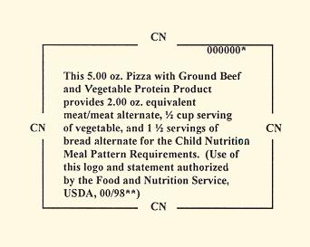
CACFP 08-2019
Crediting Shelf-Stable, Dried, and Semi-Dried Meat, Poultry and Seafood Products
Must have Child Nutrition (CN) Label or Product Formulation Statements (PFS) to be creditable – not listed in the Food Buying Guide for Child Nutrition Programs
Meat ingredient in PFS must have a similar description to a food item in the Food Buying Guide
The creditable amount cannot exceed the finished weight of the product
Notes:
Instead, if you want to use beef jerkies or meat sticks as part of a creditable meal, you would need to have either a Child Nutrition Label or a Product Formulation Statement. On the slide, there’s a sample Child Nutrition label – CN labels are usually only available from vendors that work with school districts and are rare to find in grocery stores. The alternative to a CN label is a Product Formulation Statement, also known as a PFS.
A valid PFS needs to include a meat ingredient that has a similar description to a food item in the Food Buying Guide – for example, Beef Round Roast, and the creditable amount cannot exceed the finished weight of the product. This means that even though you may need 1.5 pounds of beef to create 1 pound of beef jerky, you can’t credit for more than 1 pound of Meat.

Slide 15
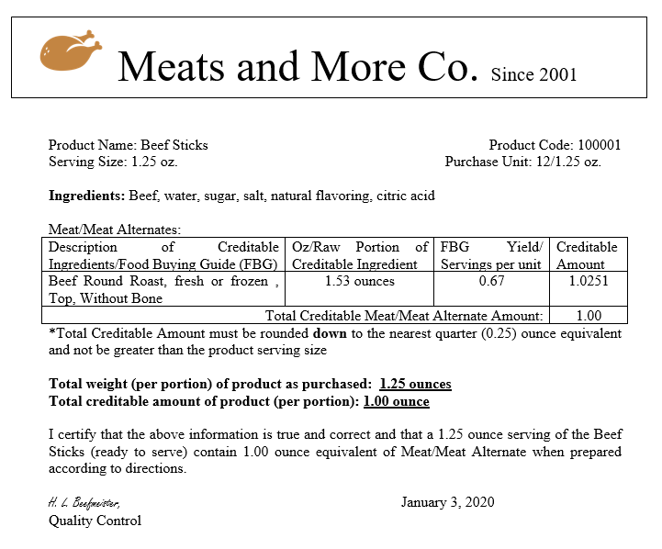
Sample Dried Meat PFS
Ingredient description matches item from the Food Buying Guide
Creditable amount does not exceed the finished weight of product
Notes:
Let’s look at a sample dried meat PFS. Remember that all PFS’s require that the letter be on a manufacturer’s letterhead, a list of ingredients, the ingredient weight per serving, the weight of creditable ingredients, the crediting amount per serving, and the signature of the manufacturer’s representative verifying that the information is correct in order to be complete. This is true for all PFSs, not just ones for dried meats. This example for Beef Sticks include all the required components for a complete PFS.
Because it is a dried meat product, it has (click) an ingredient description that matches with a food item from the Food Buying Guide and it has (click) the creditable amount listed, which (click) does not exceed the finished weight of the product. In this case, even though the product weighs 1.25 ounces, there is only 1.00 ounces of creditable lean meat per serving.
Remember – in order for any beef jerky or other dried meats to be creditable, you will need to have either a CN label, or more likely, a PFS in order for it to be creditable for the CACFP.

Slide 16
CACFP 10-2019
Crediting Popcorn in the Child Nutrition Programs
Popped popcorn is now creditable as a whole grain
This information can be found on the Food Buying Guide
Notes:
Moving on to our next memo, we have Crediting Popcorn in the Child Nutrition Programs. This is one item that many CACFP sponsors have been asking for in the past. We know that popcorn can be a very popular food, and USDA heard your requests. In memo 10-2019, it made popped popcorn into a creditable grain, and not only a creditable grain, it is now creditable as a whole grain. This makes sense since popcorn kernels include the entire grain with the bran, germ, and endosperm included. It is also a good source of fiber.
Before you celebrate too early though, take a look at this food item description on the screen. (click) This was downloaded from the Food Buying Guide and you can see next to Serving Size per Meal Contribution, (click) that it takes 3 cups of popped popcorn to provide 1 ounce equivalents of grains. If you are familiar with serving sizes, you know the minimum portion size for children ages 1-5 is ½ ounce equivalent of Grains for all meals and snacks and for children ages 6-18, it is 1 ounce equivalent of Grains and for adults it is 2 ounce equivalent at all meals and 1 ounce equivalent for snacks. This would mean that even a 1 year old would need 1.5 cups of popcorn in order to meet their minimum portion size requirement. To serve an adult participant popcorn at lunch and have it credit, you will need 6 cups of popcorn! That would be a movie theater sized container of popcorn for the minimum portion size!

Slide 17
Crediting Popcorn
Volume required to meet portion size may be too large
3 cups = 1 ounce equivalent
May not be suitable for younger children and older adults – choking hazard
Limit unhealthy toppings that add salt, sugar, or saturated fats
Popcorn in combination foods will require either a Product Formulation Statement or a recipe to be creditable
Be wary of popcorn shaped products – many are not made of popcorn but cornmeal
Notes:
So keep in mind that while popcorn is now creditable, the minimum portion served may not be realistic for your program or certain participants in your program. In addition to portion size issues, think about your younger and older participants – popcorn may pose a choking hazard for your younger children as well as older adults who may have problems with chewing and swallowing.
When you are serving popcorn, it may be tempting to add lots of butter, salt, or even caramel as a treat for your participants. USDA does not restrict toppings to popcorn, but know that popcorn treats that are commonly considered desserts would not be creditable for CACFP. In all cases, it is best practice to limit unhealthy toppings for your popcorn.
Popcorn that is in combination foods, for example trail mixes or processed “popcorn”-like products, will require a PFS in order to be creditable.
And remember to always read the ingredient label. There are a lot of popcorn shaped products out there that look like popcorn, but instead is a mix of cornmeal, rice flour, and oil. Those would not be creditable popcorn.

Slide 18
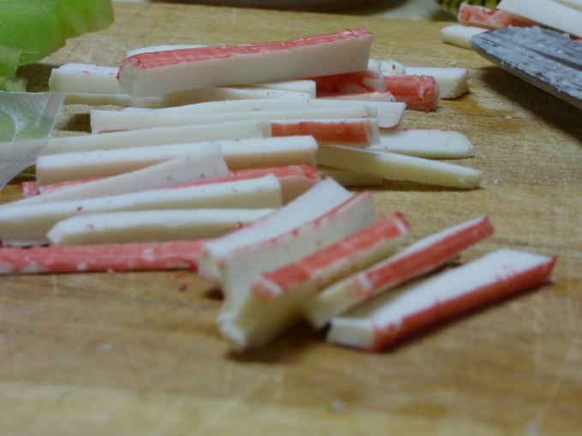
CACFP 11-2019
Crediting Surimi Seafood in the Child Nutrition Programs
Surimi is also called imitation crab/fish
Creditable as a Meat/Meat Alternate
Often served in seafood salads and sushi-style rolls
Available in different shapes and textures – most popular in sticks
Surimi most likely include other ingredients
Notes:
Moving on to Surimi. This is memo 11-2019 and this memo allows surimi, which is also known as imitation crab, imitation fish, or sometimes just imitation seafood, to be creditable as a meat. Often, you will find surimi in seafood salads or sushi-style rolls. They come in a lot of different shapes and textures although the most popular version are the red and white sticks, which you can see on this slide. Surimi is a combination food, meaning that it includes multiple ingredients, some which credit for CACFP and some which do not. Because of that, crediting surimi will require a higher volume.

Slide 19
CACFP 11-2019
Crediting Surimi Seafood in the Child Nutrition Programs
Surimi Portion Size | M/MA Crediting
3 ounces | 1.0 M/MA
4.4 ounces | 1.5 M/MA
6 ounces | 2.0 M/MA
Notes:
Here is the food item description for surimi from the Food Buying Guide. Under the Serving Size per Meal Contribution (click) you can see that it takes 3 ounces of surimi to credit for 1 ounce equivalent of Meat. There is a chart underneath that shows how surimi credits. Again, 3 ounces of surimi credits for 1 ounce equivalent of Meat, it takes 4.4 ounces of surimi to credit for 1.5 ounce equivalents of Meat and finally 6 ounces of surimi to get 2.0 ounce equivalent of Meat. If you are wondering why 4.4 ounces is the portion size instead of 4.5 ounces for the 1.5 ounce equivalent portion size, it is because of rounding.

Slide 20
CACFP 11-2019
Crediting Surimi Seafood in the Child Nutrition Programs
Surimi Portion Size | M/MA Crediting
3 ounces | 1.0 M/MA
4.4 ounces | 1.5 M/MA
6 ounces | 2.0 M/MA
To credit a different amount of M/MA per portion size, a PFS will be required
Surimi can be a high cost item – with the portion sizes required, it may be cost-prohibitive to serve a minimum portion size for all participants
Notes:
If you feel strongly that your surimi actually credits for more than stated in the Food Buying Guide, you can request a product formulation statement from the manufacturer. Without a PFS however, it defaults to the baseline that is set by the Food Buying Guide. This baseline is reflected in the table seen on this slide and in the previous slide.
If you have purchased surimi recently or are interested in buying surimi, know that it can be a high cost item. While it is cheaper than some seafood out there, the cost is still often significantly higher than other meat or meat alternate products. This is because it is a highly processed food and because the portions required will result in high volumes being purchased.

Slide 21
CACFP 12-2019
Crediting Tempeh in the Child Nutrition Programs
Tempeh is now creditable as a Meat Alternate
Tempeh is a fermented soybean cake
Tempeh can also be made from other ingredients, such as flax seed, beans, barley, and oat
Can be used as a meat alternate in sandwiches, salads, wraps, and stir-fries
Notes:
Staying in the realm of meat and meat alternates, we also have Tempeh. In memo 12-2019, tempeh was allowed as a creditable Meat Alternate. If you are not familiar with tempeh, it is traditionally a fermented soybean cake, but now can be made out of fermented flax seeds, beans, barleys, and oats. Tempeh is very versatile and can be used as a meat alternate in sandwiches, salads, wraps, and stir fries. On the screen is an image of packaged tempeh – they are usually sold in small blocks of 8 to 12 ounces in the grocery stores.

Slide 22
CACFP 12-2019
Crediting Tempeh in the Child Nutrition Programs
1 ounce of tempeh = 1 ounce equivalent of Meat Alternate for tempeh with ingredients limited to: soybeans (or other legumes), water, tempeh culture, and vinegar, seasonings, and herbs
Notes:
To credit tempeh made from soybeans and other legumes, you would credit it 1 to 1 by volume. 1 ounce of tempeh is equal to 1 ounce equivalent of Meat Alternate. On the slide, you have the food item description for tempeh from the Food Buying Guide, and it shows the serving size per meal contribution. Note that this crediting only applies to tempeh made from soybeans and other legumes AND only includes ingredients such as water, tempeh culture, vinegar, seasonings, and herbs.
If you have tempeh made with other ingredients or is a combination food item, other crediting requirements will apply.

Slide 23
CACFP 12-2019
Crediting Tempeh in the Child Nutrition Programs
Tempeh created from brown rice, sunflower seeds, sesame seeds, flax seeds, etc, may also credit as meat alternates, grains, and/or vegetables.
Creditable ingredients must be present in the minimum creditable quantities (1/8 cup or ¼ ounce equivalents)
Must have either a CN Label or PFS to credit
Notes:
For those tempeh that is made from brown rice, sunflower seeds, sesame seeds, flax seeds, and any other ingredients or have multiple ingredients, these products may credit for several different components depending on the ingredients in the product. In order to credit these items for ANY components, remember that the creditable ingredients must have a minimum creditable quantity – which is at least 1/8 cup or ¼ ounce equivalents. For example, if your tempeh had brown rice, but the amount of brown rice per serving is less than 1/8 cup, then it won’t be creditable towards the grain component.
For tempeh made with multiple ingredients, like the example on the bottom of this slide, a CN label or a PFS must be on file in order for the item to be creditable. Without a CN label or a PFS, there is no way to tell exactly what quantities for each ingredient are in the products.

Slide 24
CACFP 13-2019
Crediting Pasta Products Made of Vegetable Flour in the Child Nutrition Programs
Pastas made of 100% vegetable flour can credit 1:1
½ cup of 100% vegetable flour pasta credit as ½ cup Vegetable
Pastas made of vegetable flours AND other non-vegetable ingredients must have a PFS
Pastas made of 100% legume flours can credit as a Meat Alternate (or as Vegetable)
½ cup of 100% legume flour pasta credit as 2 ounce equivalents Meat Alternate
Notes:
Now for something a little different – we have memo 13-2019, which is on crediting pasta products made of vegetable flour. With this memo, pastas that are made of 100% vegetable flour can credit by volume. This means ½ cup of 100% vegetable flour pasta credits as ½ cup Vegetable.
If you have pastas that are a mix of vegetable flours AND other non-vegetable ingredients, the pasta is a combination food and will need to have a PFS.
For pastas made of 100% legume flours, such as red lentil pastas, these can credit as either a meat alternate or a vegetable. A ½ cup of 100% legume flour pasta will credit as 2 ounce equivalents of Meat Alternates.

Slide 25
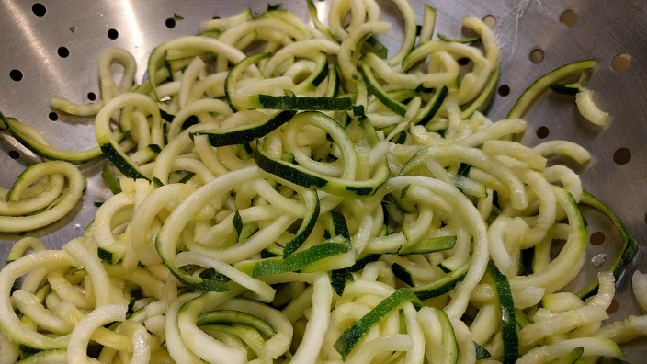
CACFP 13-2019
Crediting Pasta Products Made of Vegetable Flour in the Child Nutrition Programs
Grain-based pasta products that contain small amounts of vegetable powder for color (ex. Spinach, sun-dried tomatoes) do not credit as a Vegetable
Whole vegetables cut into noodles or spirals continue to credit based on volume served
Ex. 1 cup of zucchini noodle (“zoodles”) = 1 cup Vegetable component
Notes:
A while back, zucchini and other squashes cut into noodle shapes were very popular and these “zoodles” like the ones shown on this slide can continue to credit as a Vegetable based on the volume that is served.
Note that grain-based pastas that only contain a small amount of vegetable powder for color – such as the spinach pastas or sun-dried tomato pastas, do not credit as a Vegetable, but can credit as a Grain.

Slide 26
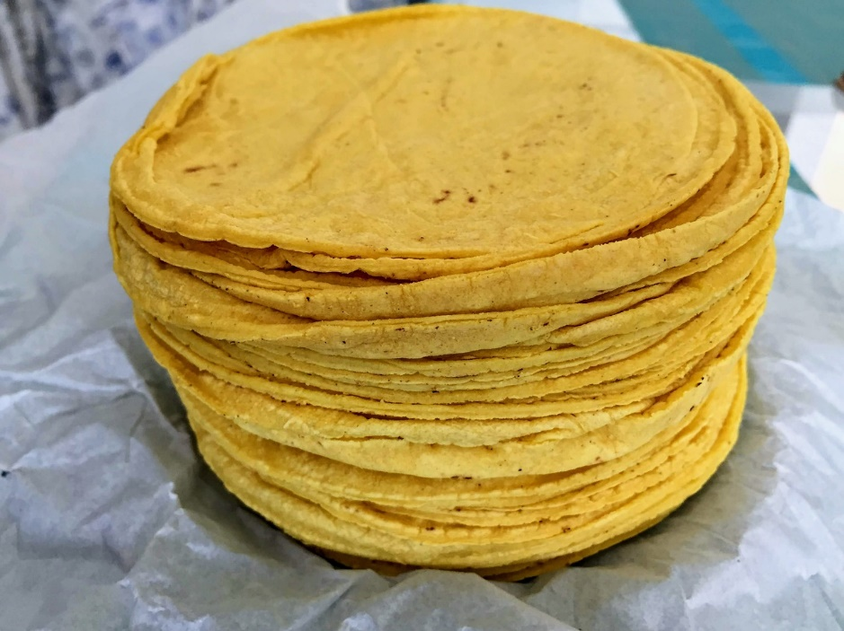
CACFP 15-2019
Crediting Coconut, Hominy, Corn Masa, and Corn Flour in the Child Nutrition Programs
Replaces CACFP 09-2019
CACFP 09-2019 provided crediting information for Coconut, Hominy, Corn Masa, and Corn Flour
CACFP 15-2019 provided additional guidance on creditable hominy and grits and allowed dried coconuts to be creditable
Notes:
Finally, we have our last memo out of the 6 memos we discussed. Memo 15-2019 replaced memo 09-2019. They both have the same title, Crediting Coconut, Hominy, Corn Masa, and Corn Flour. Memo 15-2019 was released by ODE CNP in September 2019 and provided additional guidance on creditable hominy and grits. It also allowed dried coconuts to also be creditable.

Slide 27
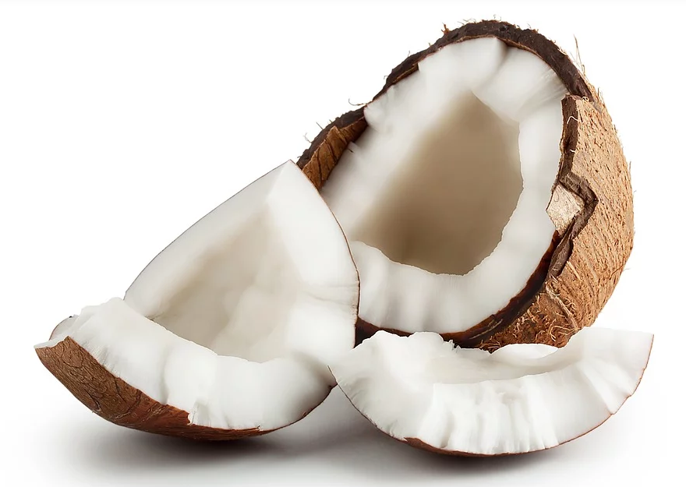
CACFP 15-2019
Crediting Coconut, Hominy, Corn Masa, and Corn Flour in the Child Nutrition Programs
Coconut:
Fresh, frozen, and dried coconut are creditable as a Fruit
Fresh and frozen coconut credit based on the volume served
¼ cup of fresh coconut = ¼ cup of Fruit
Dried coconut credits at twice the volume served
1/8 cup of dried coconut = ¼ cup of Fruit
100% Coconut Juice can credit as a Fruit Component – it will count towards the once per day juice limit
¼ cup of coconut juice = ¼ cup of Fruit
Coconut flour and coconut oil are NOT creditable
Notes:
Since this memo had so many items, we will go through the crediting for each item one by one. We will start with coconuts. With this memo, coconuts now credit as part of the Fruit component. Fresh and frozen coconuts credit based on the volume served – so ¼ cup of fresh coconut will equal ¼ cup of Fruit. If you have dried coconuts, like all dried fruits, they credit for twice the volume service. This means that 1/8 cup of dried coconut will equal ¼ cup of Fruit.
If you have 100% coconut juice – and it has to be 100% juice – this can credit as the Fruit component as well, but will count towards your once per day juice limit for CACFP. 100% juice credits for the volume that is served, so ¼ cup of juice will equal ¼ cup of Fruit. Sometimes coconut juice is also marketed as coconut water – it means the same thing and both are creditable as long as they are 100% coconut juice or coconut water.
There are some popular coconut products out there that will not credit though – this includes coconut flour and coconut oil.

Slide 28
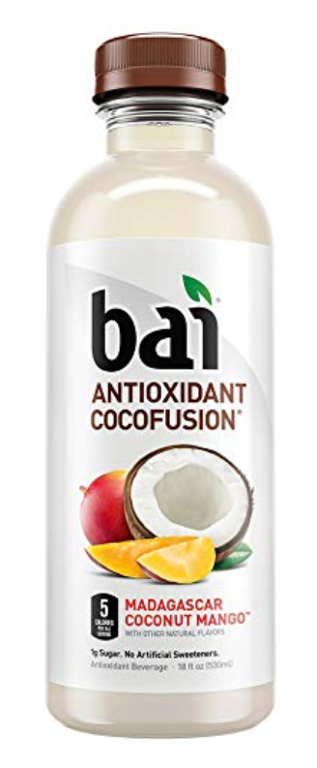
Which Coconut Water is Creditable?
Ingredients: 100% Coconut Water
Ingredients: Filtered water, proprietary sweetener blend (Erythritol, Stevia Leaf Extract), coconut water concentrate, natural flavors, potassium citrate, citric acid, white tea extract, sea salt, coffeefruit extract, malic acid, vitamin D
Notes:
Take a look at these two coconut waters and their ingredient lists. Which of the two would be creditable? The one on the left has 100% coconut water as the only ingredient while the one on the right has filtered water as the first ingredient, a sweetener blend as the second ingredient, and coconut water concentrate as the third ingredient.
(click) If you said the one on the left is creditable, you are correct! You will ALWAYS want to check to make sure that your items are 100% coconut juice or coconut water. The item on the right may be shelved with the other coconut juices, but the ingredients indicate that it is not 100% juice. If in doubt, check the label and if you are not sure after checking the label, the safest route is to not use that particular item.

Slide 29
CACFP 15-2019
Crediting Coconut, Hominy, Corn Masa, and Corn Flour in the Child Nutrition Programs
Hominy:
Canned or cooked whole hominy credits as a Vegetable
¼ cup will credit as ¼ cup Vegetable
Dry Hominy Grits will credit as a Whole Grain
½ cup cooked or 1 ounce of dry hominy credit as 1 ounce equivalent Whole Grain
Products labeled “enriched grits” credit as an enriched grain
Products labeled only as “grits”, “stone ground corn” or “degermed corn” are not creditable
Notes:
Next, let’s go to hominy. Hominy is a corn kernel that is nixtamalized – this means that the product was soaked in a lime or lye solution, which releases some of the nutrients. The canned hominy is often made of whole corn and they are often puffed up and twice the size of a normal corn kernel. Canned and cooked whole hominy will credit as a Vegetable by volume. ¼ cup of canned or cooked whole hominy will credit as ¼ cup of Vegetable.
Dry hominy or dry hominy grits is when the nixtamalized corn kernel is dried and then ground up. Dry hominy grits will credit as a whole grain since it includes the full grain kernel. ½ cup of cooked hominy grits or 1 ounce of dry hominy will credit as 1 ounce equivalent whole grains.
Grocery stores and food vendors often have both hominy grits and enriched grits or even products labeled simply as “grits” – these are all different products. While hominy grits can credit as a whole grain, enriched grits will only credit as an enriched grain since it’s a processed product that does not include the whole kernel, but includes added nutrients. Products labeled only as “grits” or “stone ground corn” or “degermed corn” are not creditable since they use processed corn that does not include the whole kernel and do not have added nutrients to make them enriched.

Slide 30
CACFP 15-2019
Crediting Coconut, Hominy, Corn Masa, and Corn Flour in the Child Nutrition Programs
Corn Masa and Masa Harina
Corn Masa and Masa Harina are nixtamalized – soaked and cooked in an alkaline solution to increase nutrient availability – and are considered whole grains
Nixtamalized corn can be labeled as “ground corn with trace of lime” or “ground corn treated with lime”
Use Exhibit A to credit Corn Masa and Masa Harina (Cereal Grains) – ½ cup cooked or 1 ounce dry = 1 ounce equivalent
Notes:
Corn masa and masa harina is very similar to hominy. Like hominy, they are made of nixtamalized corn, meaning it is soaked in an alkaline solution, and the products are now considered whole grains. Sometimes masa harina is labeled as “ground corn with a trace of lime” or “ground corn treated with lime” – this is the definition of nixtamalized and makes the product a whole grain. To credit corn masa or masa harina, ½ cup cooked is equal to 1 ounce dry which is equal to 1 ounce equivalent. This crediting is the same as dry hominy grits.

Slide 31
CACFP 15-2019
Crediting Coconut, Hominy, Corn Masa, and Corn Flour in the Child Nutrition Programs
Corn Flour and Cornmeal
Corn flour and cornmeal crediting will vary:
Use Exhibit A to credit Corn Flour and Cornmeal (Cereal Grains) – ½ cup cooked or 1 ounce dry = 1 ounce equivalent
“Whole corn flour”, “whole cornmeal”, and “nixtamalized corn flour” will be considered Whole Grain-Rich
“Enriched corn flour”, “enriched cornmeal”, or “yellow corn flour (folic acid, riboflavin, niacin, and thiamine)” will be considered Creditable, but not Whole Grain-Rich
“Corn flour”, “corn meal”, “stone ground corn flour” will not credit as a grain because it is not enriched or whole grain-rich
Notes:
To round out the corn family and this memo, we have corn flour and cornmeal. Unlike hominy or corn masa, corn flour and cornmeal is not typically nixtamalized, although you may find products that use nixtamalized corn flour. Like the grits example, corn flour and corn meal have multiple varieties and some are whole grains, some are enriched, and some are not creditable at all. It is always important to read the ingredient list.
Items listed with the word “whole” in front of the first ingredient will be whole grain-rich. For example, whole corn flour or whole cornmeal. If you see nixtamalized corn flour – that is also a whole grain-rich item. Anytime you see the words nixtamalized with a corn product, it is a whole grain-rich item.
Items listed with the words “enriched” or with added vitamins like folic acid, riboflavin, niacin, and thiamine will be considered Creditable, but NOT whole grain-rich.
Finally, items that does not have the words whole or enriched, but instead only lists itself as “corn flour”, “corn meal”, or “stone ground corn flour” will NOT be creditable since it is not enriched or whole grain-rich.
Remember, if in doubt, look at the ingredient list – if it does not have the word “whole” or “enriched” or a list of vitamins next to the corn ingredient, the corn flour or corn meal will not be creditable.

Slide 32
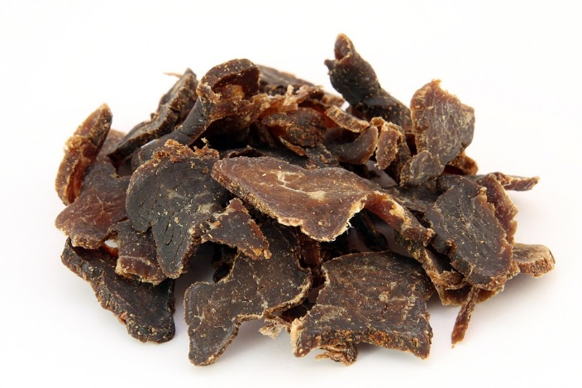
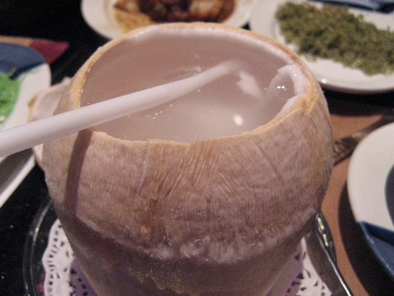
Mix and Match
Could you serve the following?
Need a PFS or CN Label
Lunch
Need 1.5-6 cups for a creditable portion
Need $1/8$– ½ cup for a creditable portion
Notes:
So with this information about newly creditable items in CACFP, let’s do a thought exercise. Would you be able to serve your CACFP participants a lunch with milk, beef jerky, coconut juice, popcorn, and zoodles? Let’s assume that they are all served in the correct minimum portion sizes. I will give you a few seconds to think about this.
You actually could, because the beef jerky would credit as the Meat, the coconut juice would credit for the fruit – as long as you didn’t serve juice at another meal or snack that day, the popcorn would credit as a grain, and the zoodle would credit as a vegetable.
There’s a few things to keep in mind though, before you rush out to create a new menu. (click) First, the beef jerky MUST have a PFS or a CN label in order to be creditable and you must serve enough to credit for the minimum portion sizes for the age group. (click) Second, you will likely need to buy a popcorn maker, since you will need at least 1.5 cups to 6 cups of popcorn for each participant depending on the age group that you serve. Finally, (click), if you are serving coconut juice, make sure that it is measured, and that the minimum portion size of 1/8 cup for children 1-2 years old and ¼ cup for children ages 3-18 and ½ cup for adults are served.

Slide 33
Things to Keep In Mind
Just because you could doesn’t mean you should
Remember to keep nutrition quality in mind:
Does the minimum portion require more volume than a participant can consume?
How much added salt or fat is this adding to the meal?
Cost considerations: How much will this cost?
Supporting documentation is required to make many of the items discussed creditable
Notes:
All of this is to say that just because you could, doesn’t mean you should. USDA had considered these food items we discussed to be non-creditable for many years for a variety of reasons related to nutritional quality and practicality. While USDA is allowing these foods to be served as part of a creditable meal now, it is still important to keep nutrition quality in mind when you are creating your menus.
Is your average participant able to consume the full minimum portion? Are the foods added to the menus increasing the amount of salt and fat to your meal?
Besides nutrition quality though, you will also want to keep in mind food costs – a few of the items listed can be pricier than other CACFP meal pattern options.
And, as always, make sure that you are keeping all supporting documentation that is required to prove that you are serving creditable items in their minimum serving sizes.

Slide 34
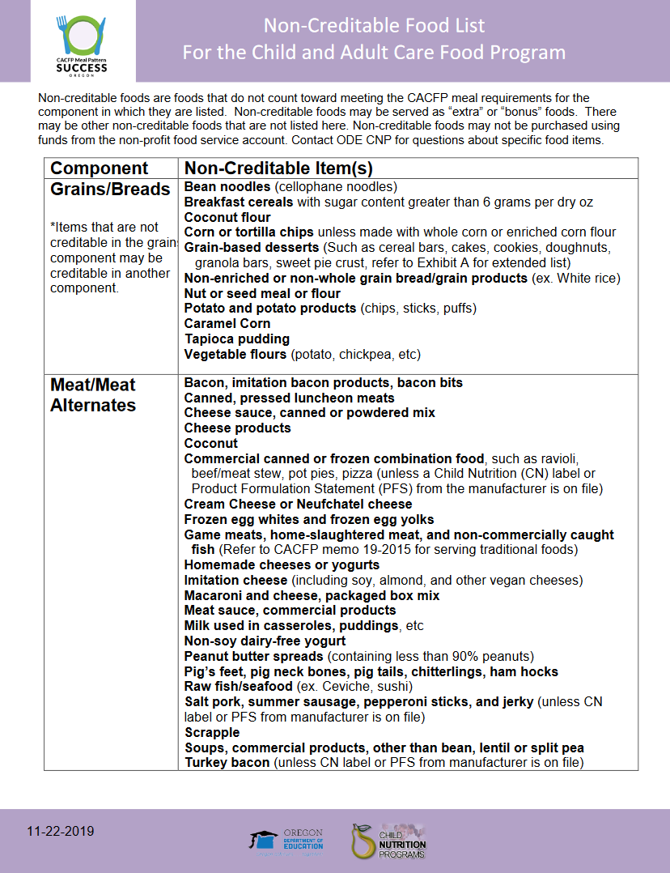
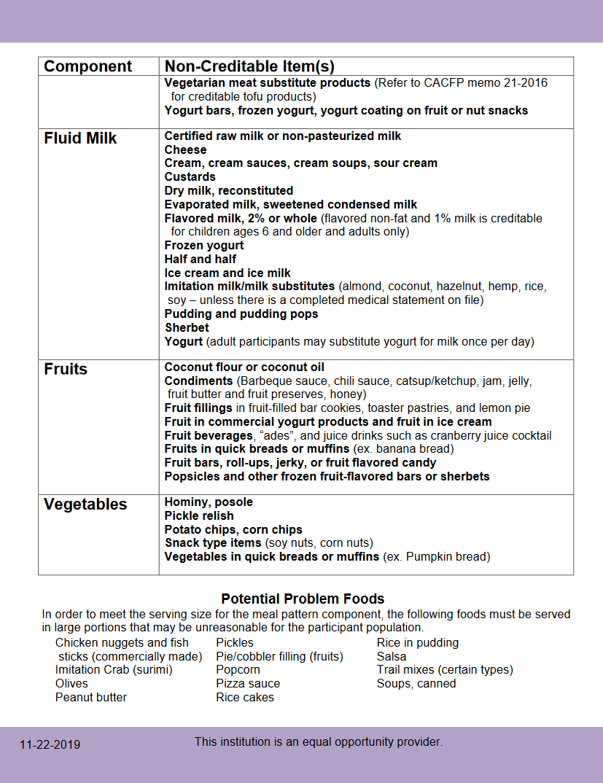
Updated ODE CNP Resources
Non-Creditable Food List
Notes:
Due to the changes in crediting, ODE CNP has updated our Non-Creditable Food List to remove many of these items, including popcorn and beef jerky from our list. You can click on the link to be directed to our new version.

Slide 35
Question 2: Would the following pasta be creditable for the Vegetable Component?
Yes
No
Notes:
Let’s test your knowledge and see how much you have learned from this training. Taking a look at the ingredient list, would the following pasta be creditable for the vegetable component? Yes or No? I will leave up the screen for 10 seconds and then I will launch the question in GoToWebinar.

Slide 36
Question 2: Would the following pasta be creditable for the Vegetable Component?
Yes
No
Notes:
Great job everyone. The answer is No. Why is the pasta not creditable for the vegetable component? (click) Because this is a regular pasta with wheat as the main ingredient and a little bit of vegetable puree added to give it color. Despite having “veggie” in its name, it is not a 100% vegetable flour pasta. This is why it is always important to read the labels before you purchase a product.

Slide 37
Question 3: It’s Movie Day at your Center – how much popcorn would you need to make for 10 participants if they all needed 1 ounce servings for snack?
10 Cups
20 Cups
30 cups
40 Cups
Notes:
Let’s try another question. It’s movie day at your center – how much popcorn would you need to make for 10 participants if they all needed 1 ounce servings for snack? Is it A) 10 Cups, B) 20 Cups, C) 30 cups, or D) 40 cups? Let’s launch the poll and you will have 20 seconds to answer.

Slide 38
Question 3: It’s Movie Day at your Center – how much popcorn would you need to make for 10 participants if they all need 1 ounce servings for snack?
10 Cups
20 Cups
30 cups
40 Cups
Calculation:
1 ounce equivalent Grains = 3 cups
10 participants = 10 ounce equivalents
10 oz. eq. X 3 Cups = 30 Cups
Notes:
Very nice, everyone. The answer is C) 30 cups. If you are wondering why it’s 30 cups, (click) here is the calculation. We know from the Food Buying Guide that 1 ounce equivalent of grains requires 3 cups of popcorn. With 10 participants, you needed to have 10 ounce equivalents of Grains. 10 x 3 cups = 30 cups of popcorn.
That’s quite a bit of popcorn! Would this be an amount of popcorn you can make and serve at your site? Again, think before you update your menus.

Slide 39
Additional Meal Pattern Related Memos
CACFP 16-2019: Questions and Answers on the Final Rule Child Nutrition Programs: Flexibilities for Milk, Whole Grains, and Sodium Requirements
CACFP 17-2019: Smoothies Offered in Child Nutrition Programs
Notes:
Besides those 6 memos however, we also had two memos that were released in October of 2019. The first is a follow-up memo with Questions and Answers on the rule related to flexibilities for milk, whole grains, and sodium requirements. The second is one on smoothies in child nutrition programs.

Slide 40
CACFP 16-2019
Questions and Answers on the Final Rule Child Nutrition Programs: Flexibilities for Milk, Whole Grains, and Sodium Requirements:
Most of the memo relates to the National School Lunch Program (NSLP) and School Breakfast Program (SBP) only
Only the Milk Flexibility applies to CACFP: 1% Flavored Milk has been creditable for participants 6 years old and older since July 1, 2019
While 1% Flavored Milk is allowed, it is often hard to find in stores
Notes:
For the first memo, it mostly relates to the National School Lunch Program and School Breakfast Program. The one piece that relates to CACFP is the milk flexibility, which allowed 1% flavored milk to be creditable for participants 6 years and older since July 1, 2019. Note that 1% flavored milk is often hard to find in stores, and most flavored milks are either non-fat or whole milk. This Q&A memo does not add too much for CACFP sponsors, but if you are with a school district, this would probably be helpful in answering any questions you have related to flexibilities for the NSLP and SBP.

Slide 41
CACFP 17-2019
Smoothies offered in Child Nutrition Programs:
Commercially prepared smoothies may be creditable IF a Product Formulation Statement or Child Nutrition Label is on file
Yogurt in smoothies may credit as a Meat Alternate (MA)
4 ounces of yogurt = 1 ounce equivalent MA
No other meats or meat alternates will credit for the Meat/Meat Alternate Component
Vegetables and Fruits blended in a smoothie credit as juice and are subject to the once per day limit for all juices
Dry beans and peas credit towards the Vegetable component when served in a smoothie
Nutritional supplements are not allowed in smoothies for CACFP
Notes:
The smoothie memo is an update on previous smoothie memos. The main change in this memo is that commercially prepared smoothies can now be creditable IF there is a product formulation statement or child nutrition label on file. Previously, only homemade smoothies were allowed. Now commercial smoothie mixes are also allowed as long as a PFS or CN label is on file.
This memo also reiterated some of the older rules. This included the rule that the only ingredient that can credit as a Meat/Meat Alternate is yogurt, including both soy and cow’s milk yogurt. Like before, 4 ounces of yogurt is equal to 1 ounce equivalent of Meat Alternate. Even though nut butters are a popular choice to add to smoothies, it won’t credit as a meat alternate since no other meats or meat alternates will credit for the M/MA component.
Remember that any vegetables and fruits blended in a smoothie will credit as a juice and is subject to the once per day limit for all juices.
If you are one of those people that enjoy blending everything possible, know that dry beans and peas will only credit towards the vegetable component when served in a smoothie and NOT for the meat alternate component.
Finally, remember that nutritional supplements are not allowed in smoothies for CACFP.

Slide 42
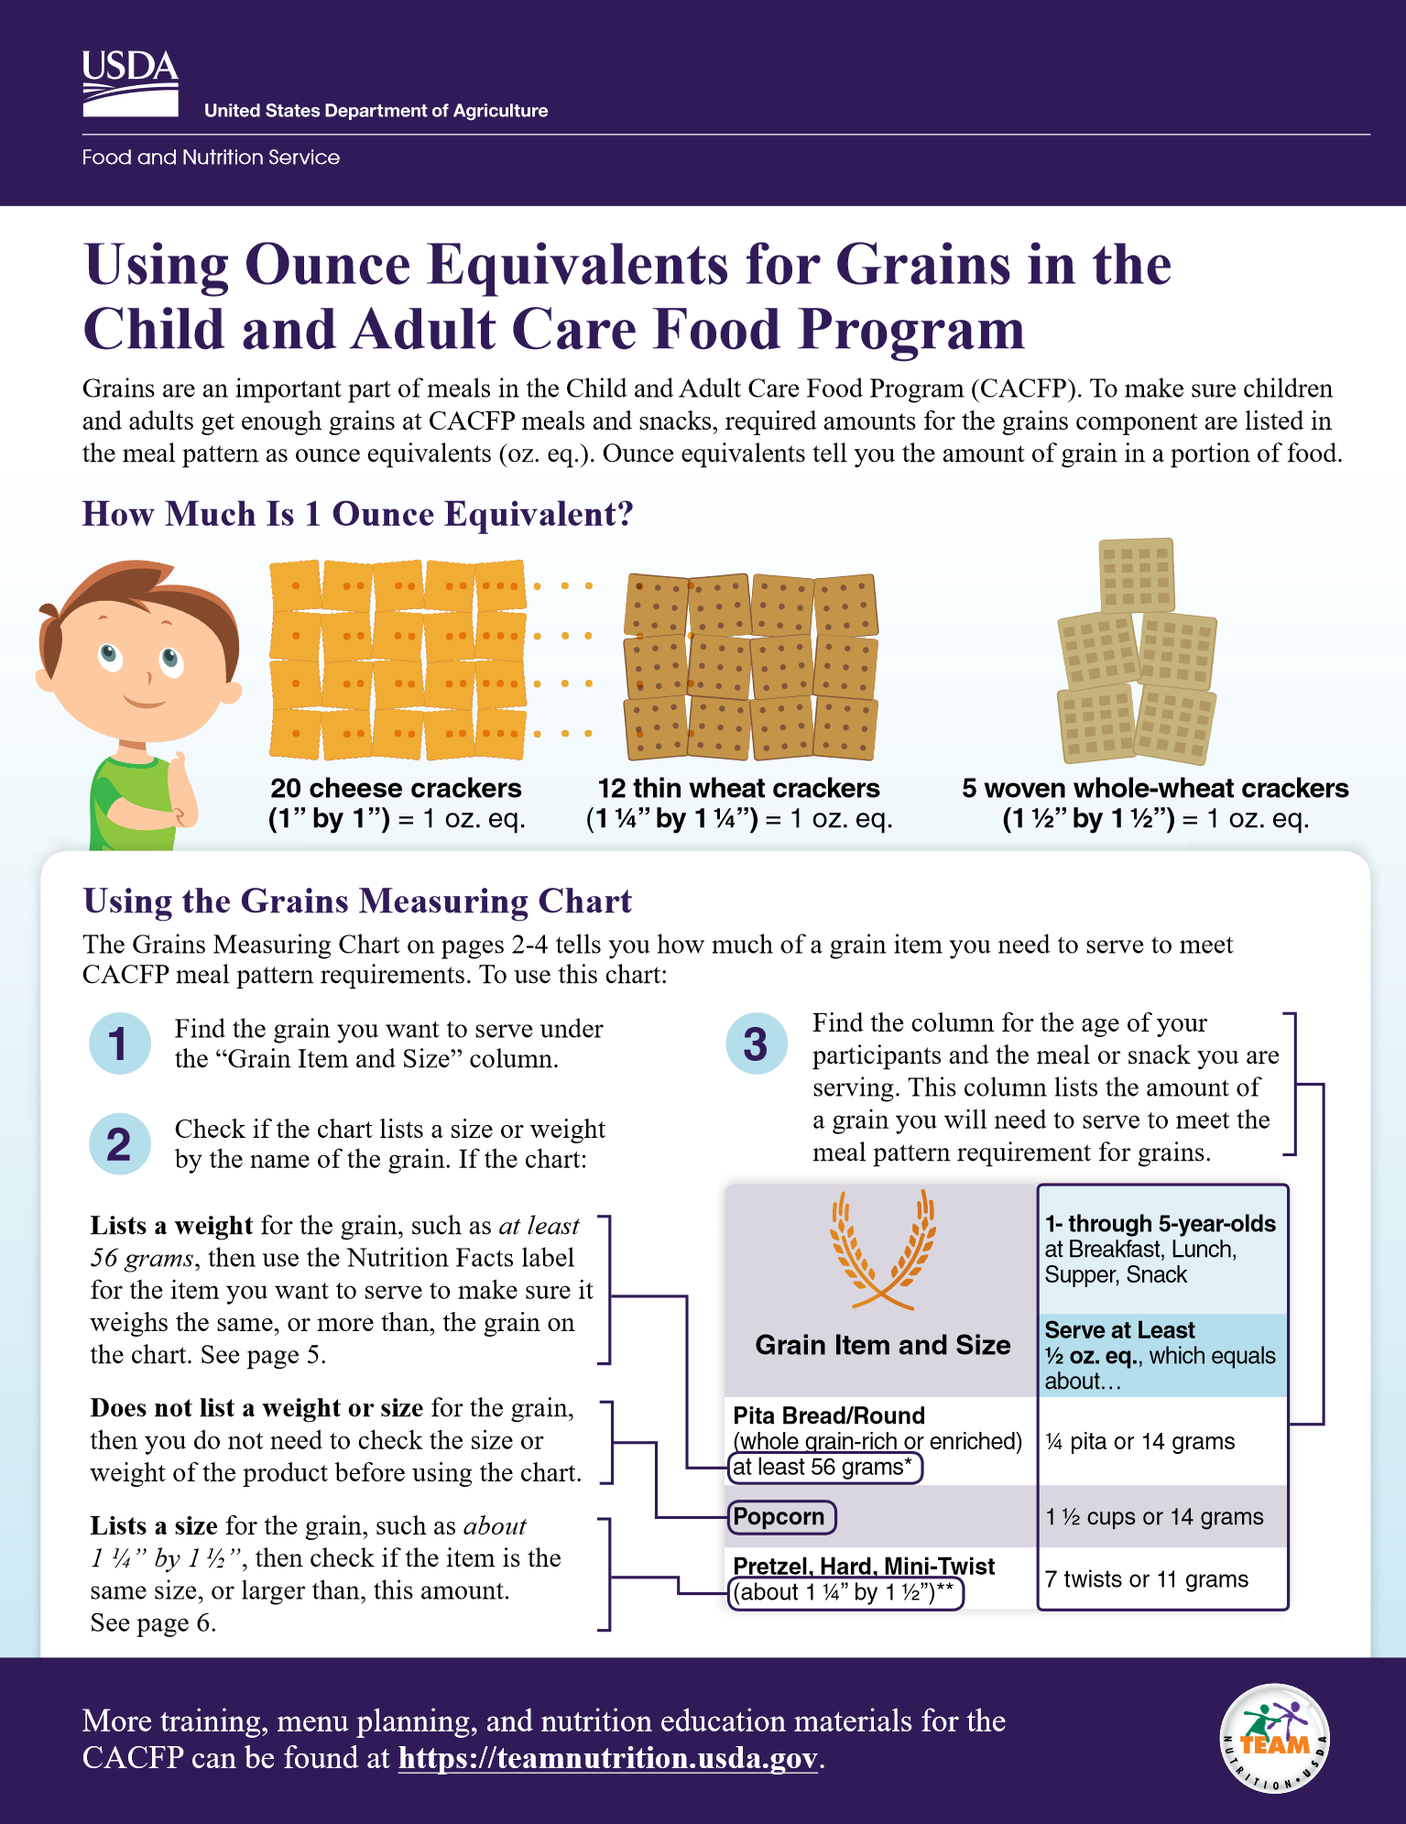
Additional Meal Pattern Updates
Ounce Equivalent Portion Sizing for Grains: Final Rule
Ounce Equivalent implementation for the Grains Component delayed until October 1, 2021
USDA Resources: Using Ounce Equivalents for Grains in the CACFP: English and Spanish
Notes:
Last fall, ODE CNP also sent out a memo on the ounce equivalent portion size rule update. On Sept 25, 2019, USDA delayed the implementation of the ounce equivalent portion sizing requirement for the grains component until Oct 1, 2021. ODE CNP already trained all Sponsors on ounce equivalents in April 2019 and the information is still valid, however, you don’t need to worry about implementing the ounce equivalent serving sizes until October 1, 2021. If you have already started implementing ounce equivalents at your site, you are welcome to continue and USDA has released some resources in both English and Spanish that details out ounce equivalent serving sizes for common grain products. You can click on the link in your PDF handout.

Slide 43
Reminders on Menu Documentation
Refer to the memo: Required CACFP Menu Documentation REVISED sent January 16, 2019
Highlights:
Menus must list the actual food items served
Whole Grain-Rich items must be labeled
Cereals must include the name of the cereal
Yogurts must include the flavor of the yogurt
Milk type must be included for each age group
Infant meals (<1 year) must be documented on the correct infant menu record form
Notes:
Now that we have gone over all the CACFP meal pattern memos in the last year, here’s a quick reminder on how you should be documenting your menus.
In ODE’s January 16, 2019 memo, we listed out the required CACFP menu documentation. Here are the highlights: Menus must list the actual food items served. This helps verify that the food served are creditable. Whole Grain-Rich items must be labeled. This helps you check that you are serving at least 1 whole grain-rich item each day. Cereals must include the name of the cereal so it can be matched to the nutrition fact label showing your items are low in sugar. Similarly, yogurts have to include the flavor of the yogurt so that it can be matched to the nutrition fact label too – this is because the same brand of yogurt can have different sugar levels for different flavors. Your milk type must be listed for each age group since different age groups require different types of milk. And finally, infant meals, meaning meals for children younger than 1 year of age, must be documented on the correct infant menu record form.
To read the memo, click on the link in your PDF slides.

Slide 44
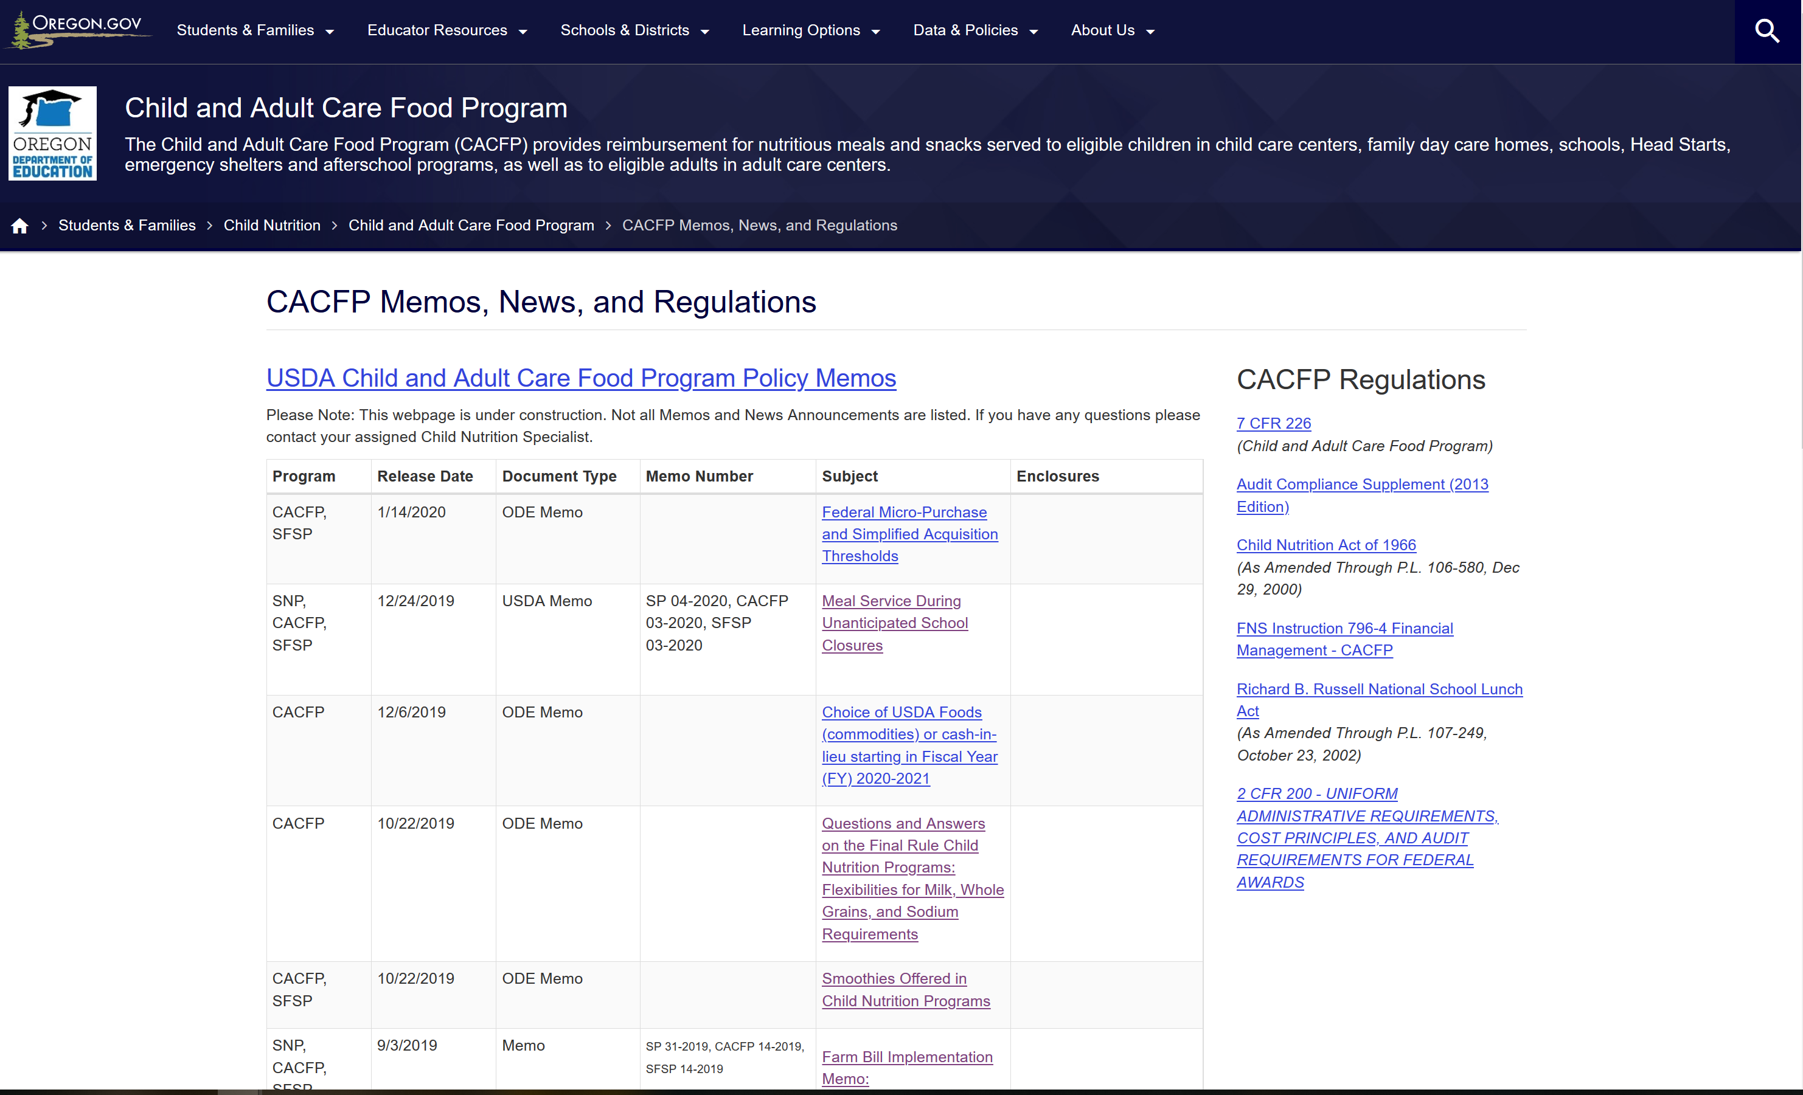
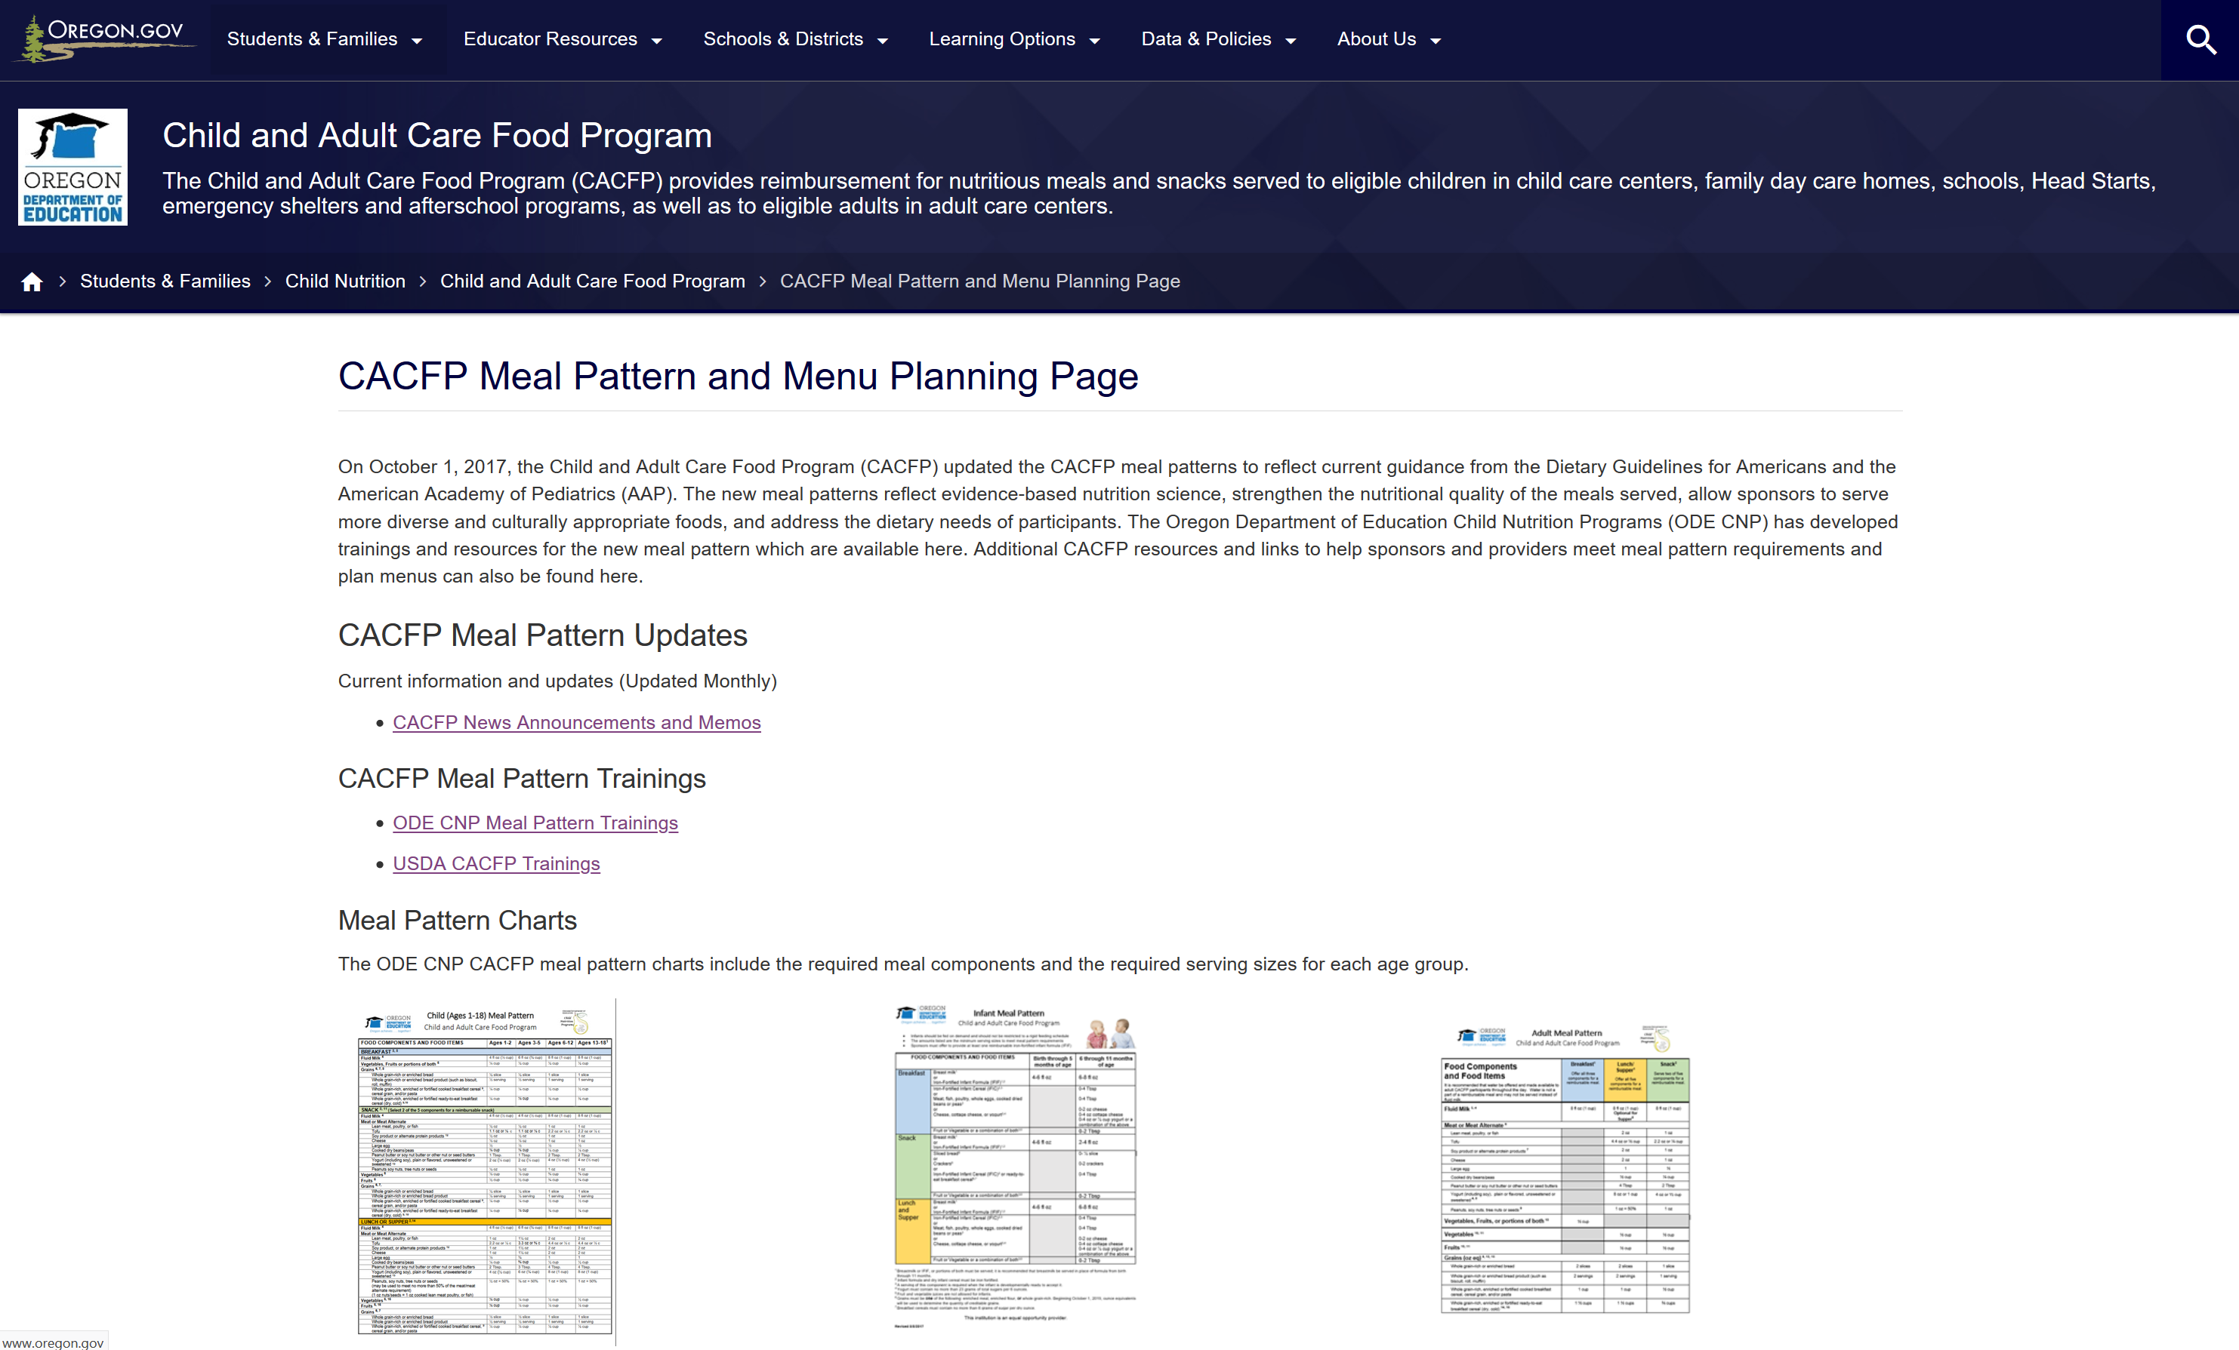
Where can I find more information?
ODE CNP’s CACFP Memo Page
ODE CNP’s CACFP Meal Pattern and Menu Planning Page
The Food Buying Guide
Notes:
If you want to see all the memos sent out by ODE, you can go to our ODE CNP CACFP Memo Page. All memos are listed on the page and are in reverse chronological order.
Charts, handouts, and tools related to the CACFP meal pattern can be found on our CACFP meal pattern and menu planning page.
And again, there’s the Food Buying Guide which will be the basis for crediting for all Child Nutrition Programs. Links are available on this slide in your PDF.

Slide 45
Overview
Learning Objectives
CACFP Meal Pattern Overview
Crediting Updates
Additional Meal Pattern Updates
Questions
Notes:
That wraps up our training today on meal pattern crediting. (click) We went over the learning objectives, where you learned which new food items are creditable for CACFP and where you learned which online pages had information on crediting foods for CACFP. (click) Next, we went over a quick overview of the CACFP meal pattern. (click) Then the bulk of our training was on crediting updates via the 6 memos that allowed for new food items to be creditable. (click) We finally ended with some additional reviews of other meal pattern memos. Now, (click) it’s time for questions!

Slide 46
Questions?
More Questions?
Contact your assigned Child Nutrition Specialist
Notes:
We have ____ minutes and I am going to take a minute to look at the questions that were sent in through the question and chat box during our lesson today. After I review the questions, I will read the questions and then provide an answer. (Answer chat box questions, once those are complete, ask if there are any additional questions. If there are too many questions to answer in the time frame, silence the microphone and take 1 minute to pick and choose the best questions to answer).
If you still have questions or if your question was not answered, please contact your assigned child nutrition specialist.

Slide 47
In accordance with Federal civil rights law and U.S. Department of Agriculture (USDA) civil rights regulations and policies, the USDA, its Agencies, offices, and employees, and institutions participating in or administering USDA programs are prohibited from discriminating based on race, color, national origin, sex, disability, age, or reprisal or retaliation for prior civil rights activity in any program or activity conducted or funded by USDA. Persons with disabilities who require alternative means of communication for program information (e.g. Braille, large print, audiotape, American Sign Language, etc.), should contact the Agency (State or local) where they applied for benefits. Individuals who are deaf, hard of hearing or have speech disabilities may contact USDA through the Federal Relay Service at (800) 877-8339. Additionally, program information may be made available in languages other than English. To file a program complaint of discrimination, complete the USDA Program Discrimination Complaint Form, (AD-3027) found online at the USDA complaint resolution page, and at any USDA office, or write a letter addressed to USDA and provide in the letter all of the information requested in the form. To request a copy of the complaint form, call (866) 632-9992. Submit your completed form or letter to USDA by: (1) mail: U.S. Department of Agriculture Office of the Assistant Secretary for Civil Rights 1400 Independence Avenue, SW Washington, D.C. 20250-9410; (2) fax: (202) 690-7442; or (3) email: program.intake@usda.gov This institution is an equal opportunity provider.
Notes:
Thank you everyone for your time today. Have a great day.

