Slide 1
CACFP Meal Pattern Success Webinar
Serving Ounce Equivalents for Grains
August 26, 2020
This training was funded by a grant from USDA
Notes:
Hello and welcome to the CACFP Meal Pattern Webinar on Serving Ounce Equivalents for Grains. This series has been funded by a grant from USDA.

Slide 2
Using GoToWebinar
Poll Question #1: Can you hear the audio?
If you can’t hear me right now, you may need to change your audio option:
  Computer Audio
  Phone Call: 1-951-384-3421 + Access Code: 355-219-853
All attendee lines are muted
Use the “Questions/Chat” Box for any questions
Notes:
We had some audio issues with a webinar last time, so I wanted to do a quick poll to see if you can all hear me.
Ok, sounds great!/Let me change my audio option.
If you are having trouble with the audio, check to see if your setting is on computer audio or phone call. This is available under Settings. To switch over to a phone call, use the number on the screen and type in the access code when prompted. All attendee lines will be muted, so you can type in questions in the Questions or Chat box instead. I will be checking the chat box and questions tab at the end of the training and will answer your questions at that time.

Slide 3
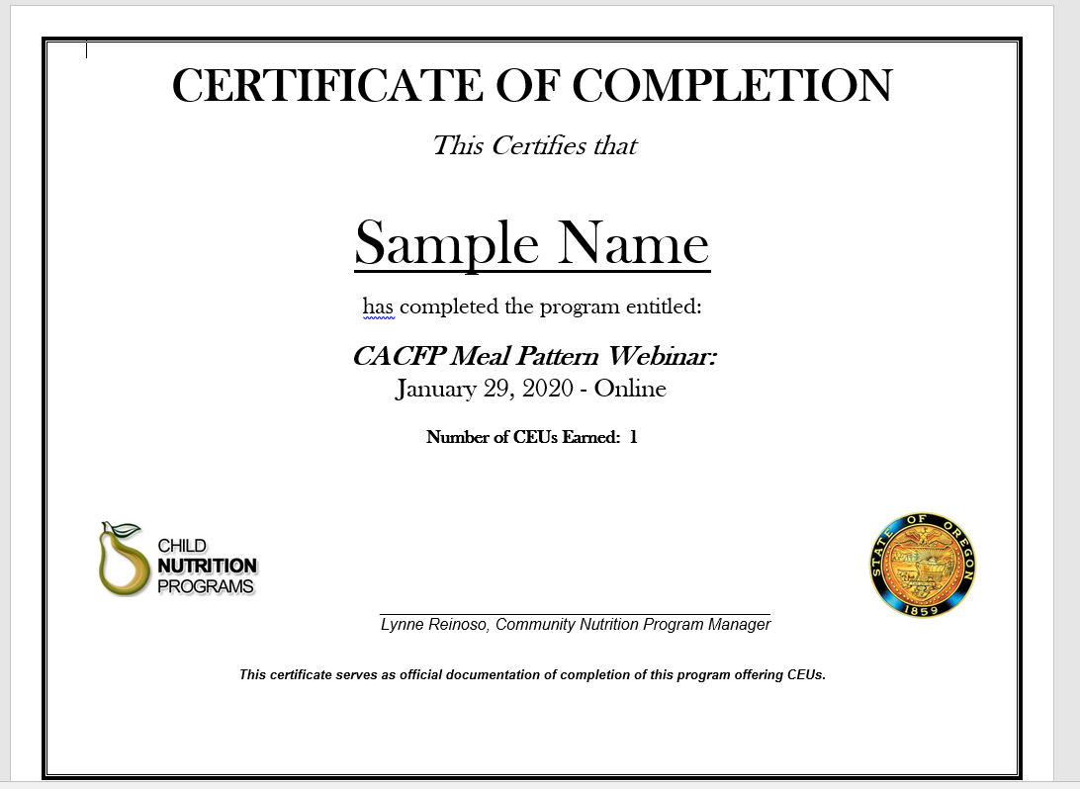
Certificate of Completion
Certificates will be sent within 1 week to the registered attendee
Only attendees who viewed the entire session will be provided with a certificate
Questions? E-mail ODE.CommunityNutrition@state.or.us
Notes:
Before we get into our lesson today, I wanted to let you all know that you will receive a certificate from ODE within 1 week from today if you are registered for this webinar and attend the full session. Attendance is tracked by GoToWebinar using your unique registration link. This means that if you have multiple people viewing on one computer, only the person who signed up for the training will receive the certificate. If you have questions, please e-mail ODE.CommunityNutrition@state.or.us. Slides for today along with other resources are available as a download from your Handouts tab.

Slide 4
Poll #2
Are you currently using ounce equivalents to determine portion sizing for your Grains Component?
Yes
No
Notes:
We will be going through a few poll questions during our training today – these questions are meant to see if you are following along, so just answer as best you can. (launch poll) Our current question though is regarding ounce equivalents – are you currently using ounce equivalents to determine portion sizing for your grains component? Yes or No?
(close poll, share poll) Looks like….

Slide 5
Overview
What is Ounce Equivalents?
Understanding Ounce Equivalent Serving Sizes for Grains
Ounce Equivalent Resources
  Exhibit A
  Team Nutrition’s: Using Ounce Equivalents for Grains in the Child and Adult Care Food Program
  The Food Buying Guide Exhibit A Grains Tool
Questions and Answers
Notes:
Thanks for taking part in that poll everyone. For those of you who have already started ounce equivalents, hopefully this webinar will help reassure you that you are on the right path. For those of you who have not started on ounce equivalents yet, hopefully this webinar will provide you with the confidence to start planning for the change over to using ounce equivalents in the grains component.
We will go over the definition of ounce equivalents, then we will go over understanding ounce equivalent serving sizes and their use in the grains component. Finally, we will go over in depth three different resources that can be used to determine whether your grain items are meeting ounce equivalent serving size requirements. They are Exhibit A, Team Nutrition’s Using Ounce Equivalents for Grains in the CACFP Handout, and the Food Buying Guide Exhibit A Grains Tool. With each resource, we will go over an example and show you how to figure out if it meets ounce equivalent serving sizes.
At the end, we will have a few minutes as always for Questions and Answers.

Slide 6
Learning Objectives
Learn the definition of ounce equivalents
Know whether grain products meet minimum ounce equivalent portion sizes using available resources
Know where to find ounce equivalent resources
Notes:
After you finish this webinar today, you will learn the definition of ounce equivalents, know whether grain products meet minimum ounce equivalent portion sizes using the available resources out there, and know where to find those resources.

Slide 7
What is Ounce Equivalents (oz. eq.)?
Definition: A method of measurements for the grains and meat/meat alternate components in the Child Nutrition Programs
Oz. eq. measurement has been in use for the meat/meat alternate component
Starting October 1, 2021, ounce equivalents will be the required method of measurement/portion sizing for the grains component in CACFP
  It is the current method of measurement for the National School Lunch Program
Notes:
So what is ounce equivalents anyway? The definition of ounce equivalents is: a method of measurement for the grains and meat/meat alternate components in the Child Nutrition Programs.
You are likely already familiar with ounce equivalents as it’s used in the meat/meat alternate component. You use ounce equivalents because only the lean meats can be counted in Child Nutrition Programs, so ounce equivalents allow you to figure out the portion of the meat that is lean meat only and whether the portion of meat served will meet minimum portion size requirements.
Starting on October 1, 2021, you will also be required to use ounce equivalents for the grains component in CACFP as well if you are not currently doing so already. Sponsors who are on the National School Lunch Program have all switched over to ounce equivalents for their grains component.

Slide 8



Understanding Ounce Equivalents
Ounce equivalents allows you to credit for the amount of grains in any given grain product
  Amount of grains in a product can vary from item to item
  Size of grain products may vary from item to item
Bread Roll
100% Grain
38 grams/roll
Waffle
?? % Grain
45 grams each
Waffle
?? % Grain
86 grams each
1.25 oz. eq.
1.25 oz. eq.
2.5 oz. eq.
Notes:
So what does ounce equivalents in the grains component look like?
Ounce equivalents will allow you to credit for the amount of grains that is in any given grain product. Many grain products have additional ingredients in them like oil, milk, and eggs that can increase the weight of the final products. Because of that, the amount of grains in a product can vary from item to item. Take a bread roll and compare that to a waffle – while a bread roll might be smaller than the waffle, (click) the amount of creditable grain flour in the product might be the same because it is mostly grains, while waffles include other ingredients.
In addition, grain products may vary in sizes. Waffles come in many different sizes (click) with some crediting for far larger portions than the minimum.
The takeaway is that using ounce equivalents will help you figure out whether your portion sizes are meeting minimum serving size requirements.

Slide 9
Understanding Oz. Eq. Cont’d
Waffle
?? % Grain
45 grams each
1.25 oz. eq.
Bread Roll
100% Grain
38 grams/roll
1.25 oz. eq.
INGREDIENTS: Whole wheat flour, water, salt, instant yeast, vegetable oil
INGREDIENTS: Enriched flour, water, vegetable oil, eggs, baking soda, sugar, salt
Notes:
Let’s explore our bread roll and waffle examples a little more closely.
Here we have both products’ ingredient lists. You can see that the bread contains mostly whole wheat flour, water, salt, instant yeast, and vegetable flour. All ingredients except for the water and flour are probably in very small amounts. In contrast, the waffle includes enriched flour, water, vegetable oil, eggs, baking soda, sugar, and salt. This is not only more ingredients than the bread roll, but the proportion of non-flour ingredients is probably higher compared to the bread roll. When you take into account the other ingredients, you can see how both items may have the same amount of creditable flour, but the addition of the other ingredients result in a heavier weight for the waffles.

Slide 10
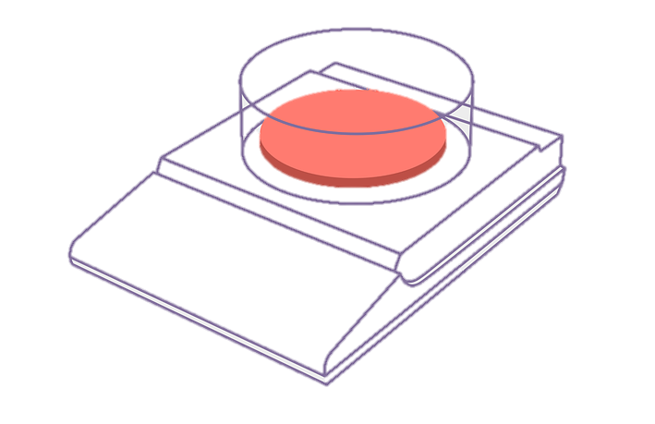
Why use Ounce Equivalents?
More precise method of measurement
Standardization with the National School Lunch Program and with the Dietary Guidelines for Americans
Ounce equivalents is simply another way to measure grains.
In practice, there will not be many changes.
Notes:
So why do we use Ounce Equivalents? We use it because ounce equivalents allow us to be more precise with our measurements. And also, since it’s already in use in the National School Lunch Program and in the Dietary Guidelines for Americans, it helps Sponsors to have one standard across programs.
For those of you who aren’t familiar with ounce equivalents though, don’t worry – it’s simply another way to measure grains and in practice, there won’t be many changes, if at all, to your programs.

Slide 11

Comparing Minimum Serving Sizes and Ounce Equivalents
Current serving sizes = 1 slice/serving
1 slice/serving = 1 ounce equivalent (oz. eq.)
Ex. Adam is 4 years old. Currently, a serving size of Grains is ½ slice for a meal or snack.
Under Oz. Eq., a minimum serving size will be ½ oz. eq.
Notes:
With that in mind, let’s compare ounce equivalents to our current minimum serving sizes:
With ounce equivalents, we will be simply shifting the language from slice or serving to ounce equivalent. 1 slice or serving is equal to 1 ounce equivalent.
So if you had a child, Adam, who is 4 years old – under the current minimum serving size, Adam’s minimum serving size will be ½ a slice for any meal or snack. Under ounce equivalents though, a minimum serving size will be ½ ounce equivalent. Instead of serving Adam ½ a slice or ½ a serving, you are now serving Adam ½ ounce equivalent for his grains component.
Not much change there.

Slide 12
Required Minimum Serving Sizes Chart
Using Ounce Equivalents
Child Meal Pattern: Grains Component Minimum Serving Sizes by Age Group
Meals | Ages 1-2 | Ages 3-5 | Ages 6-12 | Ages 13-18
Breakfast | ½ oz eq | ½ oz eq | 1 oz eq | 1 oz eq
Snack | ½ oz eq | ½ oz eq | 1 oz eq | 1 oz eq
Lunch/Supper | ½ oz eq | ½ oz eq | 1 oz eq | 1 oz eq
Adult Meal Pattern: Grains Component Minimum Serving Sizes
Meals | Minimum Portion Sizes
Breakfast | 2 oz eq
Snack | 1 oz eq
Lunch/Supper | 2 oz eq
Notes:
Looking at all the age groups, you can see that it’s a simple shift from serving size to ounce equivalent.
Children ages 1-2 and 3-5 all will receive at least ½ ounce equivalents for all meals and snacks.
Children ages 6-12 and 13-18 will receive at least 1 ounce equivalent for all meals and snacks.
Adults will receive 2 ounce equivalents for all meals and 1 ounce equivalent for all snacks.
Notice that infants are missing – because infants consume such small portions, their serving sizes have not converted to ounce equivalents, but are staying with tablespoons as the unit of measurement.

Slide 13
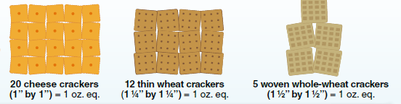



1 Ounce Equivalent Portions
1 slice of toast or 28 g
= 1 oz. eq.
1 croissant or 34 g
= 1 oz. eq.
½ cup cooked rice or 28 g dry = 1 oz. eq.
Notes:
So what does a one ounce equivalent portion look like? Here are 6 different examples. 1 ounce equivalent looks like 20 cheese crackers, 12 thin wheat crackers, 5 woven whole-wheat crackers, or one small slice of toast, or 1 croissant, or ½ cup of cooked rice.
This probably looks very similar to your current minimum serving sizes for grains. In fact, if you compare the ounce equivalent minimum serving sizes to the serving sizes in use now, there probably is very little practical difference.
Let’s look at Exhibit A to explore this further.

Slide 14
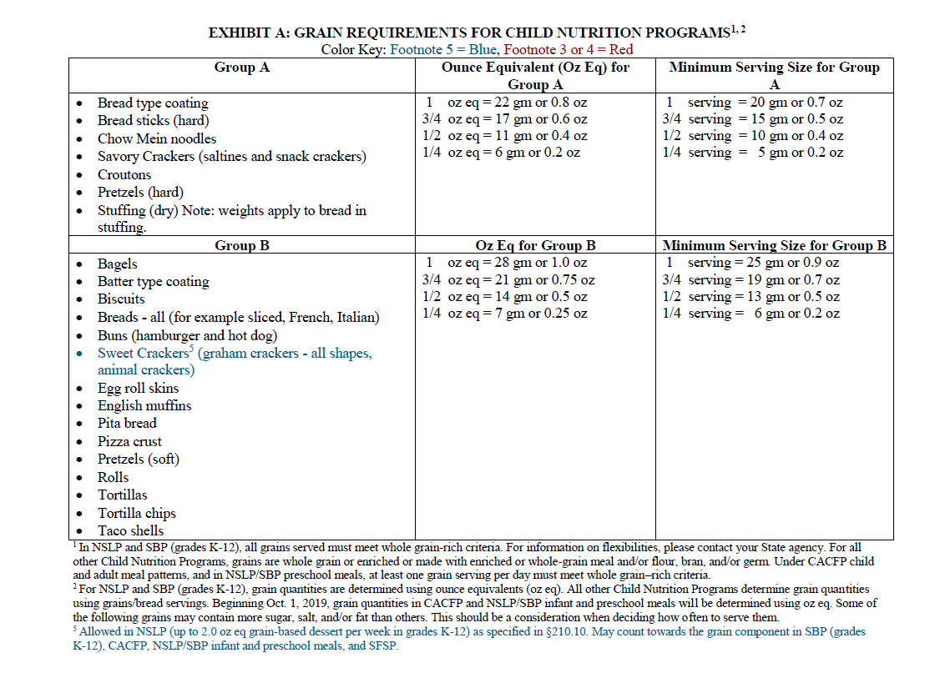
Exhibit A
Column provides the conversion for product weight to ounce equivalents. 22 grams of bread sticks = 1 oz. eq.
Notes:
You might be familiar with Exhibit A already for grain-based desserts, but it’s actually a great multi-tasking tool. The original purpose for Exhibit A was to help Child Nutrition Sponsors and Providers figure out serving sizes for different types of grains. With the switch over to ounce equivalents, Exhibit A is now even more handy, because it shows you both ounce equivalent minimum serving sizes and the current minimum serving sizes so you can compare the differences.
Looking at this first page of Exhibit A, if you look at the middle column (click) highlighted here in the blue box, you will see a series of numbers with ounce equivalents equaling another number in grams or ounces. This is a conversion factor. (click) Essentially, for all products in Group A, 1 ounce equivalent serving size is equal to 22 grams or 0.8 grams in weight for the product. If you look at all the ingredients in Group A – and if you can’t read the words on my screen, you can download the Exhibit A file from the Handouts Tab – you will notice that they are all very similar products with similar ingredients - not too much water or other non-grain ingredients added. Similarly, if you move down to Group B and look at the ounce equivalent column, you will see that all items from Group B can have 1 ounce equivalent serving size for every 28 grams weight or 1 ounce of weight.
What’s interesting is that if you compare this column to the minimum serving size column on the right-most column (click) now highlighted in the red box, you will notice that 1 ounce equivalent and 1 serving only has a slight difference in gram weight. For Group A, 1 ounce equivalent is equal to 22 grams. For Minimum Serving Size in use right now, 1 serving is equal to 20 grams. 22 grams versus 20 grams. That is a difference of 2 grams only.
In fact, if you go through all 3 pages of Exhibit A, you will notice that ounce equivalents and our current minimum serving sizes only vary between 2-10 grams.

Slide 15
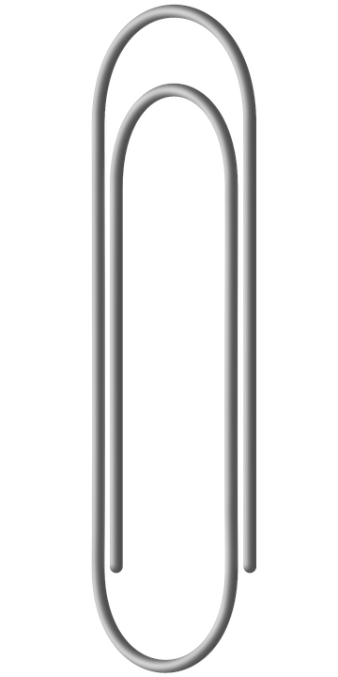


How heavy is 2 to 10 grams?
2 Paperclips = 2 grams
Credit Card = 5 grams
The difference between current serving sizes and ounce equivalents is small.
Very small.
USB Drive = 7-9 grams
Notes:
If you are not familiar with how heavy a gram is, here are a few common examples you might have lying around. 2 paperclips would equal 2 grams. A credit card would weigh about 5 grams, and a USB drive would weigh between 7-9 grams.
So as you are preparing yourself to move over to ounce equivalents understand that this shift to ounce equivalents represent a very small practical difference to your day to day service. 2-10 grams is a small difference. Very small. I would bet there there’s some kids out there who drops more than 2-10 grams in crumbs alone every meal and snack time.

Slide 16
Exhibit A
Notes:
So why does ounce equivalents matter at all? It matters because ounce equivalents will be the new standard measurement, and as Sponsors, you need to understand what standard you will be expected to follow.
This is why Exhibit A is such an important tool for anyone that needs to understand whether they are meeting minimum serving sizes for their grains component. While Exhibit A does not contain all grain items that are available, they cover a large swath of common grain products that are served today. There are 9 different groups in Exhibit A, and while we won’t have time to go through all the different groups today, I do want to focus on one group, Group I.

Slide 17
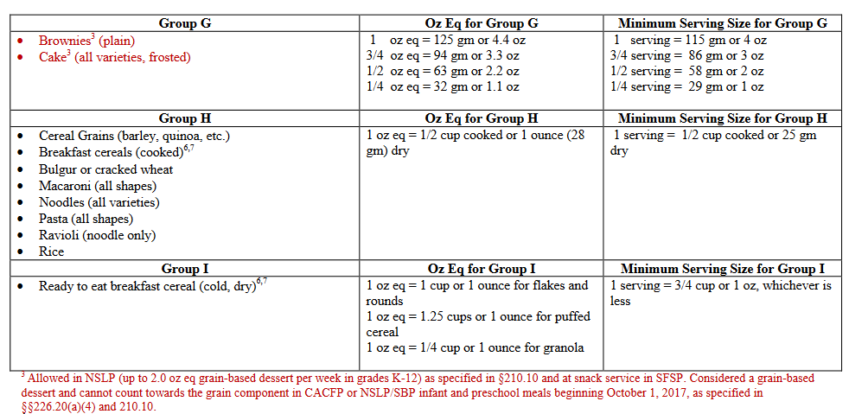
Exhibit A, Page 3
Portions for breakfast cereals will change based on type of cereal
3 categories: 1) Flakes and Rounds 2) Puffed 3) Granola
Notes:
Group I is listed under Page 3 of Exhibit A, and this group only contains ready-to-eat breakfast cereals (click). I am highlighting it here so you can all see where it’s located. Breakfast cereals have probably the largest difference compared to the previous minimum serving size. If you can see the middle column, you will see that the ounce equivalent measurements are broken up into 3 distinct groups for cereals. One for flakes and rounds, one for puffed cereal, and one for granola. The reason why they are broken up into three different groups is because cereal is often hard to measure by weight, instead, it is often served using volume. However, because cereal has so many different shapes and densities, using 1 volume measure might result in having too much variations in creditable grains. So it was broken out into the 3 different groups.
In general, flakes and rounds include cereals like cornflakes and cheerios – the cheerios would fall under the rounds category. Puffed cereals would include cereals like Kix and Chex. Sometimes people think that Kix is a round instead of a puff – remember that rounds are more for donut-shaped cereals like Cheerios. Instead, because Kix has a lot of air in between, it would be considered a puff instead. Granola is fairly self-explanatory.

Slide 18
How to Use Exhibit A
Kyle is 8 years old and you want to serve him a sandwich for his afterschool Supper.
How can you use Exhibit A to figure out if his meal meets ounce equivalent portion size requirements?
Step 1: Find the grain item – Bread – on the Exhibit A list
Notes:
So now that you know what type of information is on Exhibit A – how do we use it to figure out if we are meeting our ounce equivalent portion size requirements?
Let’s take an example – we have Kyle who is 8 years old and you would like to serve him a sandwich for his afterschool Supper. How can you use Exhibit A to figure out if his meal meets ounce equivalent portion size requirements?
(click) The first step is to find the grain item on your Exhibit A list. In this case, Bread is on Group B of Exhibit A.

Slide 19
Exhibit A
For adult participants at Breakfast, Lunch, and Supper, use the 1 oz. eq. and multiply by 2
Step 2: Locate the Oz Eq column for the Group
Step 3: Look at the gram or ounce weight for 1 or ½ oz. eq (depending on age group) – this is the required minimum serving size for the Grains Component – 1 oz eq = 28 gm
Notes:
Let’s pull up Exhibit A again, and (click) here you can see Breads under Group B.
Once you find the Group, you will (click) take a look at the Ounce Equivalent Column. (click) Here it is – the middle column.
Next, (click) look at the gram or ounce weight for 1 or ½ ounce equivalent – this will depend on the age group that you are serving. Kyle is 8, so (click) 1 ounce equivalent will be his minimum serving size for the grains component and the weight will be 28 grams.
(click) If you are serving adults, you will notice that there isn’t a 2 ounce equivalents option – if serving breakfast, lunch or supper for adults, just use the 1 ounce equivalent numbers and multiple the gram weight by 2.

Slide 20
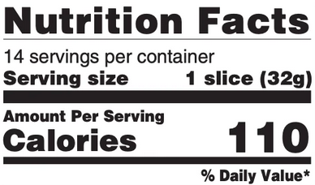
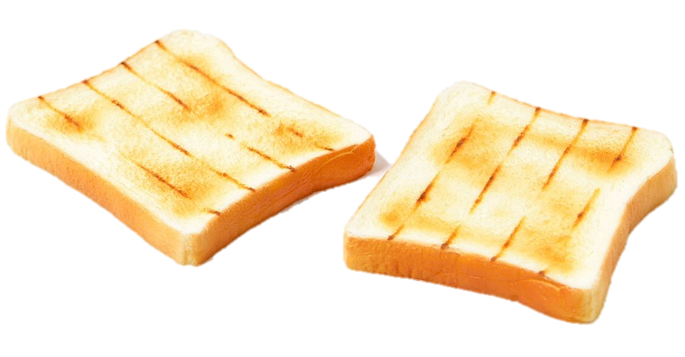
How to Use Exhibit A Cont’d
Step 4: Find the the Serving Size weight of your Grain product (32 g)
Step 5: Consider your Portion Size (2 slices for 1 sandwich) served and compare to the Serving Size (1 slice) on the label and calculate the total weight for the Portion Size (2 slices x 32 g = 64 grams total)
Step 6: Evaluate – does the Portion Size meet or exceed the oz. eq. minimum serving size? (64 g vs. 28 g)
Notes:
Once you know your required minimum serving size for your grain item, you will want to compare it to the serving size listed on the Nutrition Facts label. This will be (click) step 4. Looking at your nutrition facts label, look for the (click) Serving Size at the top of the label. It will always have a weight in grams or ounces. In our example, it lists 1 slice as 32 grams.
When you are reviewing the Nutrition Fact Label though, you will want to consider the portion size that you serve your participants. This is step 5 (click). A full-size sandwich typically contains 2 slices of bread, so if you serve 2 slices of bread to Kyle, you will want to take the Serving Size on the label and double it. 32 grams times 2 equals 64 grams total. The total weight of the item served will be 64 grams.
Our final step (click) requires you to evaluate the portion that will be served – 64 grams to the minimum serving size – 28 grams. Does this meet your minimum serving size?

Slide 21

How to Use Exhibit A Cont’d
64 grams is > 28 grams
It exceeds the minimum serving size requirements under ounce equivalents!
Note: Most grain products and grain portions served will exceed the minimum serving size.
Sponsors are allowed to serve larger portions in CACFP
Notes:
Yes! It does. Since 64 grams is greater than 28 grams, it exceeds the minimum serving size requirements under ounce equivalents.
You will notice as you review your grain products that most of the grain products and portions you serve will exceed the minimum serving size. CACFP does not have a ceiling on the portion sizes served, just a minimum, so servings can be larger.

Slide 22
Poll #3
Question: You are serving Kix to a group of 4-year olds. What is the minimum portion size for each child?
0.25 cups
0.5 cups
0.625 cups
0.85 cups
Notes:
Now that you know how to use Exhibit A to determine whether your grain items are meeting minimum ounce equivalent serving sizes, let’s try a question. (launch poll)
The question is: You are serving Kix to a group of 4 year olds. What is the minimum portion size for each child? Is it 0.25 cups, 0.5 cups, 0.625 cups, or 0.85 cups?
This will take a few steps to figure out. So download Exhibit A if you haven’t already and take a look at the group that contains breakfast cereal. You will also need to know the minimum serving size for 4 year olds under ounce equivalents. You can also look at the slides for this lesson.
Give it your best guess and we will go through our answer together.
Ok, what did everyone think? It looks like the majority chose….

Slide 23
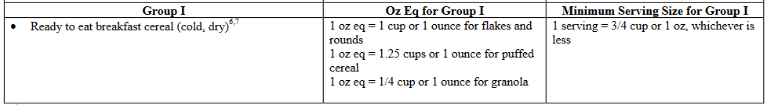
Poll #3
Question: You are serving Kix to a group of 4-year olds. What is the minimum portion size for each child?
0.25 cups
0.5 cups
0.625 cups
0.85 cups
Serving Sizes for 4-year olds = ½ oz. eq.
Kix is a puffed cereal
1.25 ÷ 2 = 0.625 cups
Recommend using 2/3 cup or ¾ cup measurement for closest portions
Notes:
And the answer is 0.625 cups.
How did we get this answer? Like I said before, there’s a few pieces of information you need to know.
First, what is the minimum serving size for a 4 year old? (click) It’s ½ ounce for all meals and snacks.
Next, we need to know what kind of cereal Kix falls under. (click) Even though Kix is a round-shaped cereal, because it has a lot of air inside the cereal, it is considered a puffed cereal.
The next step is to look at Exhibit A – (click) and you can find Ready to eat breakfast cereals under Group I. And in the middle column (click) you can find 1 oz eq is equal to 1.25 cups for 1 ounce for puffed cereal.
But you only need ½ ounce equivalent. So we need to do a little bit of math – (click) 1.25 divided by 2 equals 0.625. And that is how we got our answer.
So 0.625 is a really awkward measurement, since there’s not really any easy measuring cups to use if you are scooping out the cereal yourself. In this case, you can (click) choose to use a 2/3 cup measurement, which is the closest standard measurement. Or, if you don’t have 2/3 cup measurements, you can also use ¾ cup measurements. Remember that if you are using approximate measurements, you always want to round up, not down so you can make sure that you are meeting a full minimum serving.

Slide 24
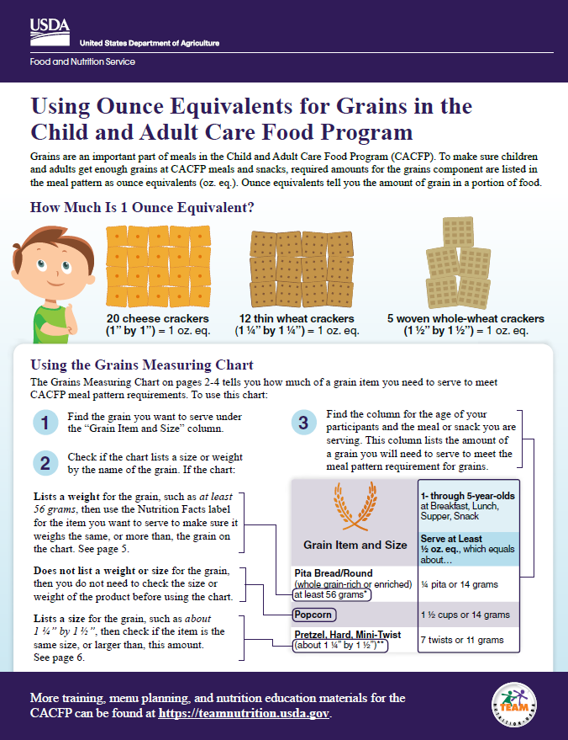
Using Ounce Equivalents for Grains in the Child and Adult Care Food Program
USDA Team Nutrition resource
Provides practical serving sizes for common grain items based on age groups
No calculations required
Also contains links to helpful tools for grains not listed on this handout
Highly recommended – similar to the Easy to Use Grains Chart
Notes:
What if using Exhibit A seems like a lot of work and you want something a little easier?
Well you’re in luck, because we have a handout from USDA’s Team Nutrition titled Using Ounce Equivalents for Grains in the Child and Adult Care Food Program. This 6-page handout provides practical serving sizes for common grain items based on age groups. There’s no calculations required, and the handout contains links to helpful tools for grain items that you don’t find listed on this handout.
We highly recommend that you use this chart – if you are familiar with the ODE Easy to Use Grains Chart, it’s pretty much the same format. Let’s take a look at their Grains Measuring chart so you can see how it works. If you want to follow along and you cannot read all the small print on this webinar – I would highly recommend that you download this handout from the Handouts tab right now.
If you click on the link in your slides, you can go directly to Team Nutrition’s webpage to download the file. They also have a Spanish version and you can order print copies as well.

Slide 25
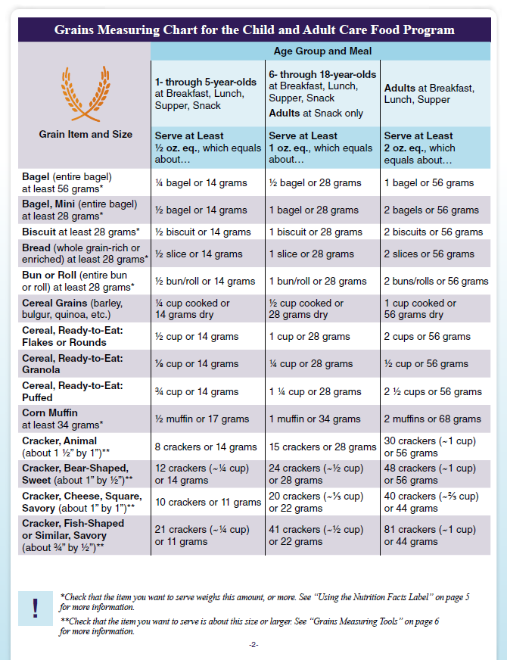
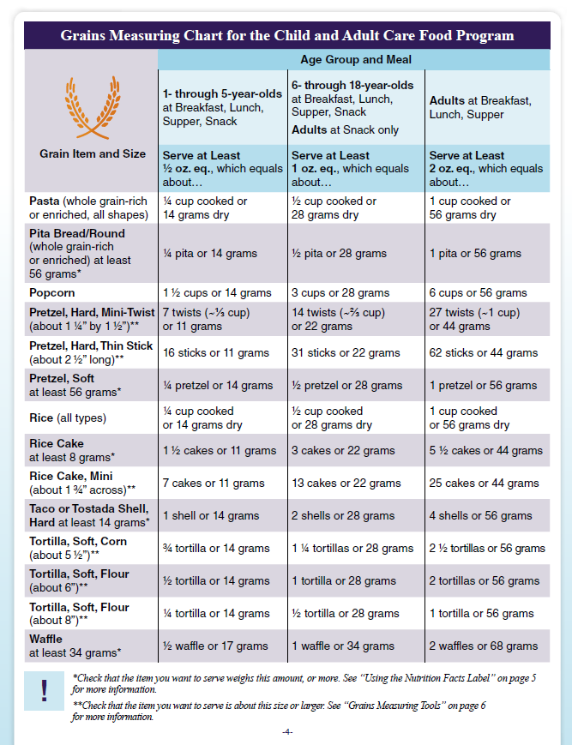
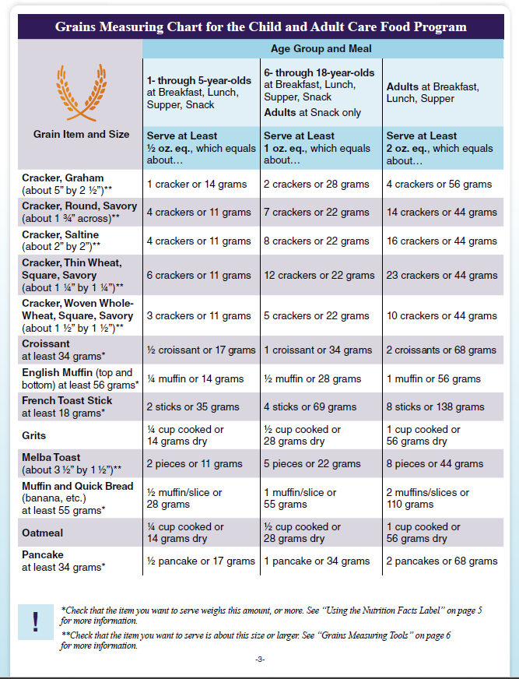
Pages 2-4 include the Grains Measuring Chart for CACFP
Notes:
Here is what the Grains Measuring Chart looks like. It goes from pages 2 to 4 of the handout and it lists all the most common Exhibit A items and the appropriate serving sizes for the age group served. Let’s look at an example and see how it works.

Slide 26
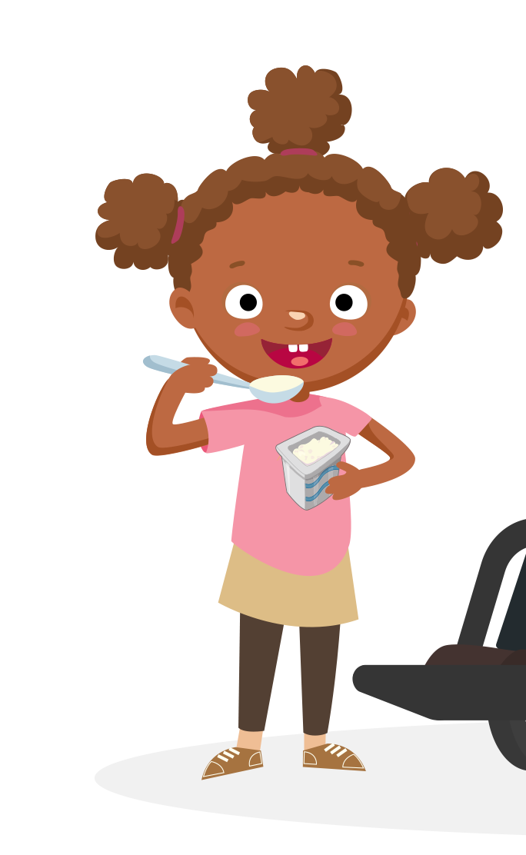
Using the Grains Measuring Chart
Addison is 5 years old and you are serving her oatmeal. What is the minimum portion size that must be served?
The minimum portion is ¼ cup cooked
Notes:
You have Addison who is 5 years old. You want to serve her oatmeal. Using the Grains Measuring Chart, what would be the minimum portion size that must be served? You can see the measuring chart on the screen, and it’s hard to read, but at the very bottom, (click) you can see oatmeal there. (click) Let’s make it a little bigger. There we go. Looking at the chart, the 2nd column from the left lists the minimum serving size for ages 1-5 years (click). Addison is 5 years old, so she would fall in this category. For this age group, the minimum serving size for oatmeal is ¼ cup cooked or 14 grams dry. (click) So that would be your answer.
Pretty easy right?

Slide 27
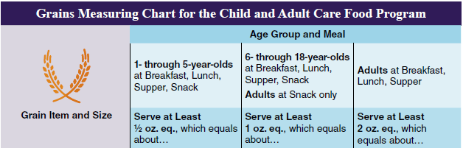
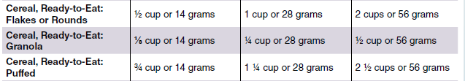
Puffed cereal portion size for ages 1-5 years is ¾ cup instead of 0.625 cups because USDA rounds up to the next quarter cup
Never round down because it won’t meet minimum serving size requirements
Notes:
I do want to point out that cereal is listed on the Grains Measuring Chart as well and you might notice that it states puffed cereal requires ¾ cups or 14 grams instead of 0.625 cups like we had as an answer in our poll earlier. This is because USDA knows most people won’t be using 0.625 cups and they round up in increments of a quarter cup.
And remember – never round down. If you round down to ½ cup, then your grains will not meet minimum serving size requirements.

Slide 28
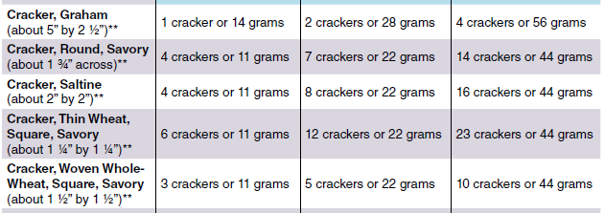
Poll #4
Question: Based on the chart on the screen, what is the minimum number of saltine crackers that must be served to an adult participant at snack.
4 crackers
8 crackers
14 crackers
16 crackers
Notes:
Let’s have you try out one example by yourself. I’m not going to launch the poll yet, because I want to give you a chance to review the chart on the screen. If you can’t read the numbers on the screen, download the handout titled Using Ounce Equivalents and the items on the chart is on page 3.
The question is – based on the chart on the screen, what is the minimum number of saltine crackers that must be served to an adult participant at snack. Is it 4 crackers, 8 crackers, 14 crackers, or 16 crackers?
I’ll give you a little more time to review this. Ok, time to launch the poll (launch). If you still want to look at the chart, download the handout to review it.
Ok, what did everybody choose?

Slide 29
Poll #4
Question: Based on the chart on the screen, what is the minimum number of saltine crackers that must be served to an adult participant at snack.
4 crackers
8 crackers
14 crackers
16 crackers
Notes:
The answer is 8 crackers.
Why is it 8 crackers? Remember that adults at snack only require 1 ounce equivalent for their minimum serving size. So we will look at the (click) middle column. And you can see (click) adults at snack only listed under the age group. Then you scroll down to saltine crackers about 3 rows down (click) and you see 8 crackers.
So it’s all about looking in the right place for the right answer. This handout is very useful if you are using a common grain item, however, what if the item you are wanting to use is on Exhibit A, but not on this list, and you are not wanting to attempt any calculations yourself?

Slide 30
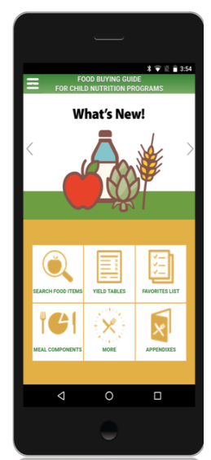
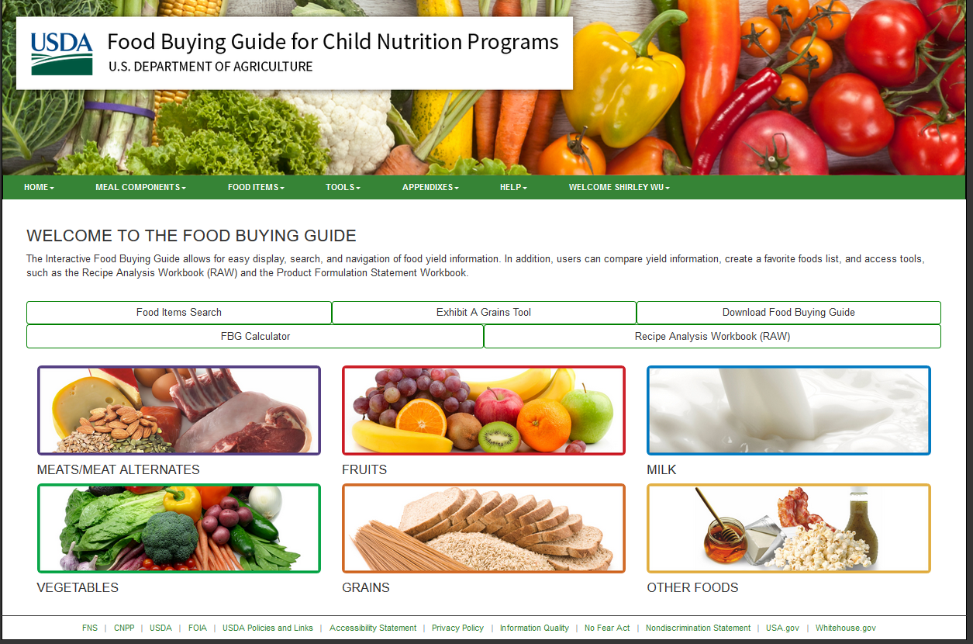
USDA’s Exhibit A Grains Tools
If the grain item you are using is not on the handout:
Go to: https://foodbuyingguide.fns.usda.gov/ or the Food Buying Guide Mobile App
Notes:
That’s where the Exhibit A Grains Tool comes in. If the grain item you are wanting to portion out is not on the handout, go to the Food Buying Guide and take a look at the Exhibit A Grains Tool.
This is available on both the desktop webpage and their Food Buying Guide Mobile App.
On the webpage, once you sign into the Food Buying Guide, you can (click) find it listed in the middle of the page. For the mobile app, it’s located on the bottom row (click).

Slide 31
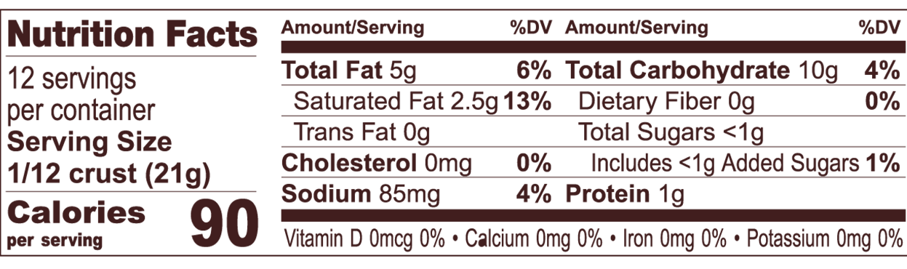
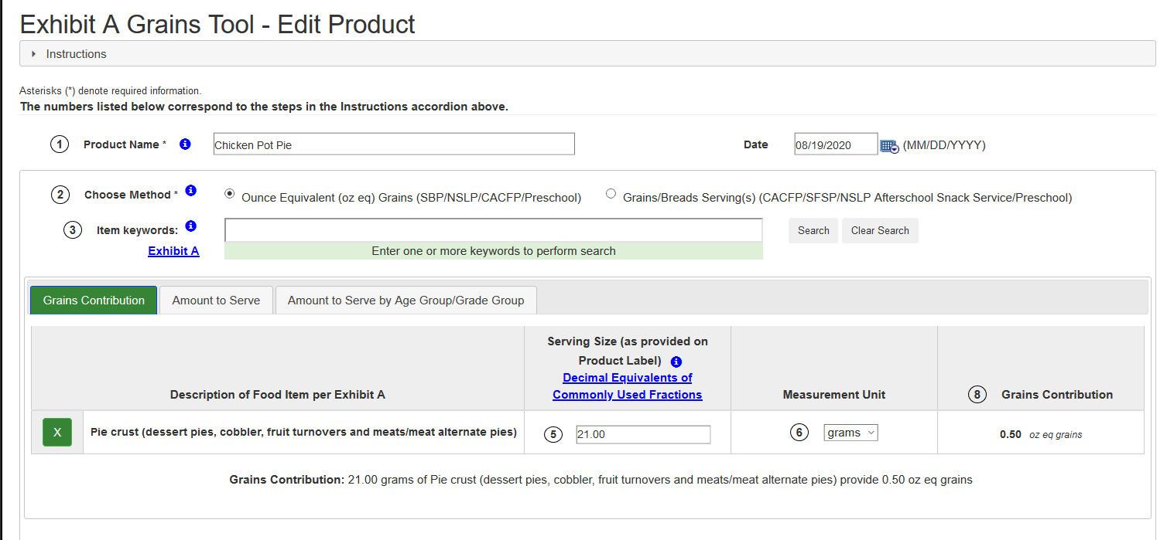
Using the Exhibit A Grains Tool
Product name or name of dish
Enter grain item
Enter Serving Size from Nutrition Label
Add unit
Answer
Notes:
When you click into the Exhibit A Grains Tool, it will look like the image on the bottom that says ‘Exhibit A Grains Tool – Edit Product’ – and all you have to do is enter in your (click) Product Name, (click) type in the keyword for the grain item – for example Pie Crust, and then some items matching the name will pop up at the bottom. Pick the one you want, and then (click) enter in the serving size from the nutrition label (click) and then (click) add the unit (grams or ounces). The Exhibit A Grains Tool will then give you an (click). And in this case, our pie crust with a serving size of 21 grams per serving will result in 0.5 ounce equivalents of grains.
0.5 ounces will be good for children ages 1 through 5, but based on the tool, if you were serving ages 6-18 year olds, you would need to double the suggested portion. And if you were serving adults, you would need to quadruple the suggested portions.
This tool does have some limitations – it only includes grains that are listed in Exhibit A, so there’s really only a handful of items that are not listed on the Handout, but would be listed here. Know that if you ever get stuck on crediting a grain item though, reach out to your assigned Child Nutrition Specialist and they can help you figure it out.

Slide 32
Additional Notes on Ounce Equivalents
Processed combination foods will still require Product Formulation Statements or Child Nutrition Labels – make sure the portion size provided is in ounce equivalents
Single component grain products will not need additional supporting documentation beyond what is required for sugar limit thresholds and whole grain-rich documentation
Notes:
We don’t have time today to go over processed combination foods today, but know that anytime you have a processed combination food, they will need either a product formulation statement or a Child Nutrition Label in order to be creditable. The product formulation statement or child nutrition label will also conveniently include the portion sizes. Most of the time, these portion sizes will already be in ounce equivalents, but if not, you may need to convert it yourself based on the weight that is provided per serving.
For all single component grain products though, you do not need to collect any additional supporting documentation beyond what is required for your sugar limit thresholds – these are your breakfast cereals, or your whole grain-rich items.

Slide 33
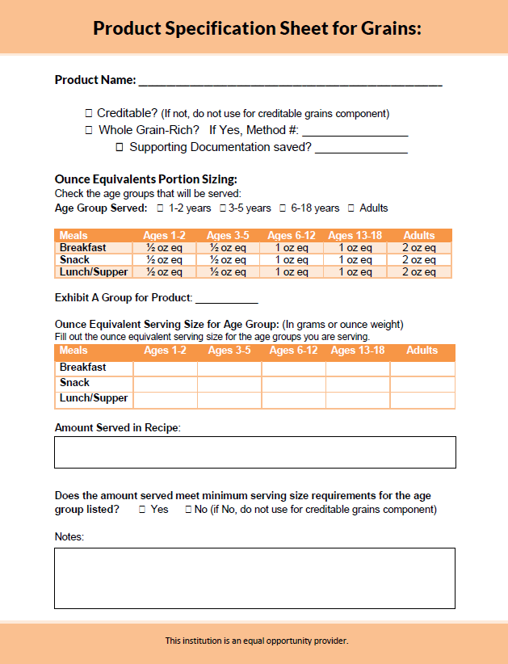
Product Specification Sheets
Helpful tool to organize grain products for CACFP
Not required
Serving larger portions than the minimum serving size is allowed
Document calculations under the Notes section
Notes:
If you need help with organizing your grain items, ODE has created a handy Product Specification Sheet. This is not a required form, but if you have a lot of different grain items and want a form that can help you organize both creditability status and serving size requirements. Remember that serving a portion size that is larger than the minimum serving is allowed. There’s also notes section at the bottom for any additional information you want to add.

Slide 34
Preparing for Ounce Equivalents
Review your current grain products
Find out what portions are being served to your participants
Figure out your minimum serving size for each age group served
  ½ oz. eq. for children 1-5
  1 oz. eq. for children 6-18
  2 oz. eq. at meals and 1 oz. eq. at snacks for adults
Compare portion sizes served to the Grains Measuring Chart on the Using Ounce Equivalents for Grains in the CACFP Handout
  If the item is NOT on the handout, use the Exhibit A Grains Tool on the Food Buying Guide or reach out to your specialist
If portions served meets or exceeds the minimum serving sizes listed for the age group and meal/snack, the item will meet minimum serving sizes for grains
Notes:
To put it all together, as you are preparing for the move to ounce equivalents, here are the steps you should take.
First, review what grain products you are currently serving. It’s always a good idea to review your menus at least once a year and see what’s working and what’s not. For example, checking creditability.
Next, figure out how much your participants are receiving – what are the portion sizes for each of your grain items that are served.
Once you have that information, you will want to know if this meets minimum ounce equivalent serving sizes for each of the age groups that you serve.
Compare your portions to the Grains Measuring Chart on the Using Ounce Equivalents for Grains handout. If your item is not on the handout, you can use the Exhibit A Grains Tool on the Food Buying Guide or reach out to your specialist if the item is not on either tool.
Finally, if all portions serve meets or exceeds the minimum serving sizes for the age groups and meal or snack type, then your item will be all set for ounce equivalents. Again, don’t be surprised if most of your items far exceed minimum serving sizes.

Slide 35
Poll #5
Question: What resources can be used to figure out minimum oz. eq. serving size for your grain item? (check all that applies)
Exhibit A
Using Ounce Equivalents for Grains in the CACFP Handout
Exhibit A Grains Tool in the Food Buying Guide
Your friendly Child Nutrition Specialist
Notes:
Ok, so we talked through the available resources. Let’s answer one last poll question. (launch poll)
What resources can be used to figure out minimum ounce equivalent serving size for your grain item? Check all that applies.
Is it Exhibit A, Using the Oz Eq for Grains in the CACFP handout, Exhibit A Grains Tools in the Food Buying Guide, or your friendly child nutrition specialist?

Slide 36
Poll #5
Question: What resources can be used to figure out minimum oz. eq. serving size for your grain item? (check all that applies)
Exhibit A
Using Ounce Equivalents for Grains in the CACFP Handout
Exhibit A Grains Tool in the Food Buying Guide
Your friendly Child Nutrition Specialist
It’s all of the above!
Notes:
And you got it. It’s all of the above!
Use the tools that are available to you, but if you do have questions beyond what they can provide, do reach out to us. We want to make sure that you feel comfortable with ounce equivalents as we start this transition.

Slide 37
Ounce Equivalents (oz eq.) Summary
Effective: October 1, 2021
Method of crediting serving sizes for the grains component
Purpose: To move towards a more consistent system of measurement that also matches the National School Lunch Programs and the Dietary Guidelines for Americans
Food Chart Conversion:
  1 oz eq = 1 serving/slice
Resources: Exhibit A, Team Nutrition’s Ounce Equivalents Handout, the Food Buying Guide Exhibit A Grains Tool, Product Specification Sheet, your specialist
No additional documentation required
Notes:
Let’s do a quick summary of what we have learned about ounce equivalents.
We know it will become effective October 1, 2021.
We also know that ounce equivalents is a method of crediting serving sizes for the grains component that is going to replace our current method of determining serving sizes.
The reason why we are moving to ounce equivalents is because this will be a more consistent system of measurement that will align CACFP with the National School Lunch Program and also the current Dietary Guidelines for Americans.
In effect, what used to be 1 serving of grains will now be 1 ounce equivalent and that the actual different in grams between 1 serving and 1 ounce equivalent is very very small.
There’s several different resources available which will help you figure out your portion sizes under ounce equivalents – I would highly recommend using the Team Nutrition Handout since it provides almost everything you need in an easy to use format.
And finally, know that we are not requiring any additional documentation for single grain components showing ounce equivalents.

Slide 38

Questions?
More Questions?
Contact your assigned Child Nutrition Specialist
Notes:
I know we went over quite a bit of information today. We have ____ minutes and I am going to take a minute to look at the questions that were sent in through the question and chat box during our lesson today. I will mute my line while I go through them. (Answer chat box questions, once those are complete, ask if there are any additional questions. If there are too many questions to answer in the time frame, silence the microphone and take 1 minute to pick and choose the best questions to answer).
If you still have questions or if your question was not answered, please contact your assigned child nutrition specialist.

Slide 39

Oregon Department of Education
“Our Why”
Equity and Excellence for Every Learner
The Oregon Department of Education works in partnership with school districts, education service districts and community partners;
Together, we serve over 580,000 K-12 students;
We believe every student should have access to a high-quality, well-rounded learning experience;
We work to achieve the Governor’s vision that every student in Oregon graduates with a plan for their future.
Notes:
Thank you for taking part in our webinar on ounce equivalents in the grains component. ODE is committed to equity and excellence for every learner.

Slide 40
Oregon Department of Education
Education Equity Stance
Education equity is the equitable implementation of policy, practices, procedures, and legislation that translates into resource allocation, education rigor, and opportunities for historically and currently marginalized youth, students, and families including civil rights protected classes. This means the restructuring and dismantling of systems and institutions that create the dichotomy of beneficiaries and the oppressed and marginalized.
Notes:
And we want to make sure that our communities are supported in their goal to reach equitable implementation of policy, practices, procedures, and legislation.

Slide 41
In accordance with Federal civil rights law and U.S. Department of Agriculture (USDA) civil rights regulations and policies, the USDA, its Agencies, offices, and employees, and institutions participating in or administering USDA programs are prohibited from discriminating based on race, color, national origin, sex, disability, age, or reprisal or retaliation for prior civil rights activity in any program or activity conducted or funded by USDA.
Persons with disabilities who require alternative means of communication for program information (e.g. Braille, large print, audiotape, American Sign Language, etc.), should contact the Agency (State or local) where they applied for benefits. Individuals who are deaf, hard of hearing or have speech disabilities may contact USDA through the Federal Relay Service at (800) 877-8339. Additionally, program information may be made available in languages other than English.
To file a program complaint of discrimination, complete the USDA Program Discrimination Complaint Form, (AD-3027) found online at the USDA complaint resolution page, and at any USDA office, or write a letter addressed to USDA and provide in the letter all of the information requested in the form. To request a copy of the complaint form, call (866) 632-9992.
Submit your completed form or letter to USDA by:
(1) mail: U.S. Department of Agriculture
Office of the Assistant Secretary for Civil Rights
1400 Independence Avenue, SW
Washington, D.C. 20250-9410;
(2) fax: (202) 690-7442; or
(3) email: program.intake@usda.gov
This institution is an equal opportunity provider.
Notes:
For more CACFP meal pattern videos, take a look at the ODE CNP YouTube channel. This institution is an equal opportunity provider.

