Slide 1
Meal Pattern Success Webinar
Offer Versus Serve in CACFP
For Afterschool At-Risk and Adult Day Care Sponsors Only
Sept 19, 2019
Notes:
Hello and welcome to the Meal Pattern Success Webinar on Offer Versus Serve in the CACFP. This session will only be relevant for afterschool at-risk sponsors and adult day care sponsors only since they are the only sponsor types who are eligible to use offer versus serve in CACFP. My name is ___________ and I’ll be presenting the webinar today. Before we get started, since this is a webinar, we will be muting all microphones, but will be accepting questions through the chat box. At the end of the session, we’ll have around 5 minutes to answer any questions you might have. Questions you submit will be answered at that time.

Slide 2
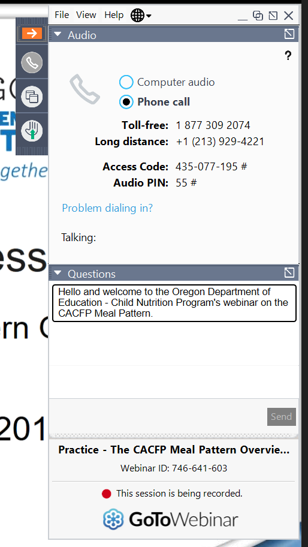
Using GoToWebinar
Notes:
If you’re new to GoToWebinar, you might have noticed that there’s a small navigation panel (click) that’s available when you first opened GoToWebinar. You will want to click on the orange box with the arrow to expand or minimize the navigation panel. The image on the screen shows the navigation panel when it is expanded. When you expand the panel, you’ll be able to change audio options or ask questions in the Questions Tab (click).

Slide 3
Overview
What is Offer Versus Serve (OVS)?
OVS Requirements
Common Questions about OVS
Q&A
Notes:
We’ll be going over the definition and requirements of offer versus serve, also known as OVS. We’ll also look at some common questions about OVS and at the end answer any additional questions you might have.

Slide 4
What is Offer Versus Serve (OVS)?
An optional style of meal service that allows participants to decline some of the food offered in a reimbursable breakfast, lunch, or supper
Not allowed at snack
It helps save money by reducing food waste
Increases satisfaction for participants
Notes:
So what is offer versus serve? Offer versus serve is an optional style of meal service for afterschool at-risk sponsors and adult day care sponsors that allows participants to decline some of the food offered in a reimbursable breakfast, lunch, or supper. It is not allowed at snack since there’s not enough components to offer enough choice while still allowing for enough nutrition. The benefits of OVS is that it helps save money by reducing food waste since participants get a choice of what they want to eat, and increased amounts of choice also increases satisfaction for participants.

Slide 5
Definitions
Food Component: One of the food categories that comprise a reimbursable meal, Ex: fluid milk, fruits, grains, meat/meat alternates, vegetables
Food Item: A specific food offered within the food components, Ex: carrots, toast, chicken, grapes
Combination Food: A food item that contains two or more food components
Notes:
We will need to know a few different terms before we get into how to use OVS. The first term to know is food component. A food component is a food category that makes up a reimbursable meal for CACFP. There are 5 different food components in CACFP and they are fluid milk, fruits, grains, meat or meat alternates, and vegetables. The next term to know is food item. A food item is different from a food component, because while the food component is a category of foods, a food item is a specific food within the food component. So a carrot is a food item that is within the vegetable food component. Peanuts are a food item within the meat alternate category. The definition of a food item in CACFP and other Child Nutrition Programs is a little different to how you might understand food items. You might think that a whole apple is a different food item compared to applesauce, but since both are apples, they are considered the same food item.
Finally, let’s define combination foods. A combination food is a food item that contains two or more food components. A peanut butter and jelly sandwich would be a combination food since it has peanut butter, which is a food item within the meat alternate food component and it has bread, which would be a food item within the grains food component.

Slide 6
OVS Requirements at Breakfast
Offer four food items in the minimum serving size from the following food components:
Participants must take at least 3 different food items
Notes:
Now that we know what a food component, a food item, and a combination food are, let’s look at the requirements for offer versus serve at breakfast. If you wanted to use the OVS meal service style for breakfast, you would need to offer four different food items in the minimum serving size from the fluid milk component, the grains component, a combined vegetable and fruit component, and then one additional food component from either the meat/meat alternate component, the fruit or vegetable component, or the grains component. While the fruit and vegetable components are separate components for lunch, supper, and snacks, at breakfast, they are still one component. This means if you serve milk, pancakes, oranges, and apples for breakfast, you would have four different food items from three different food components.
From the four different items that are served, your participants must take 3 different food items. So if you had your milk, pancakes, oranges, and scrambled eggs out on the meal service area and a participant takes milk, oranges, and apples, that would count as 3 different food items. It’s only from two different food components, but for breakfast, as long as the food items served covers the requirement of four food items from the meal components shown on the screen, then the meal will be reimbursable. Sometimes you may have participants who take two servings of 1 item, if for example, you had a participant who took milk and two servings of pancakes, that will only count as 2 items, not 3.

Slide 7
Sample Menu
Breakfast 1
Waffles
Strawberries
Oranges
Fluid Milk
Notes:
Here’s a sample menu of waffles, strawberries, oranges, and fluid milk. This meets the ‘offer’ requirements of OVS. If you had a participant who took (click) waffles, strawberries, and fluid milk, (click) this would be a reimbursable meal. Similarly, if a participant wanted (click) strawberries, oranges, and fluid milk, that is still 3 different items, and (click) would also be a reimbursable meal.

Slide 8
Sample Menu
Breakfast 2
Breakfast Burrito
Hash Brown
Fluid Milk
Notes:
Sometimes a few of the food items may be offered using combination foods. A breakfast burrito that contains scrambled eggs and sausages wrapped around a tortilla would be considered a combination food and would be considered 2 food items. This meal would meet the “offer” requirements because it has a grain component, a meat and meat alternate component, a vegetable or fruit component, and the fluid milk component. Our first participant takes (click) all the offered food items, and this would be a creditable meal (click) since participants can take more than the minimum of 3 items. What if a participant comes through and only takes (click) the hash brown and fluid milk? Would this be a creditable meal? (click) No. This is because the hash brown and fluid milk makes up only two food items. If the participant had taken the breakfast burrito and either the hash brown or fluid milk, they would have had 3 food items, but not taking the breakfast burrito meant that they only had 2 food items.
When combination foods are offered at breakfast and only two additional food items are offered along with it, this will require the participants to take the combination food AND another food item in order to claim a reimbursable meal. If you’re serving a combination food item at breakfast and you know that you have a large percentage of the participants who may not want to take the item for whatever reason, a good way to make sure that there’s enough items for all participants to get a reimbursable meal would be to add an additional food item to the menu. While this will increase the number of food items you’re serving and increase costs a little, depending on the additional food item offered, it can earn you more reimbursements since more of the meals taken will be reimbursable while increasing participant satisfaction. In addition, the cost increase might actually be minimal or there might not be a cost increase at all, since you might ‘sell’ less of the costlier combination foods.

Slide 9
Poll 1: Would this breakfast meet the ‘offer’ requirements for OVS breakfast?
Yes. This would meet the ‘offer’ requirements of OVS breakfast because it has 4 items (the two cereals count as 1 item)
Notes:
Let’s do a quick poll. Let’s say you wanted to serve fluid milk, kiwis, eggs, and two different types of cereal for breakfast. Would this meet the ‘offer’ requirements for OVS breakfast? (Open poll, wait 1 minute or until at least 80% of participants have answered) The answer is (click) yes! This would meet the offer requirements of OVS breakfast, because it has 4 items with the two cereals counting as 1 item.

Slide 10
Poll 2: A participant chooses the following items. Would this breakfast be reimbursable?
No, because a participant must choose at least 3 items, and the two cereals are considered 1 item
Notes:
Here’s another poll. What if you had a participant who chooses fluid milk, and the two cereals for his breakfast. Would his breakfast be reimbursable? (Open poll, wait 1 minute or until at least 80% of participants have answered) Right, the answer would be no (click), because a participant must choose at least 3 items and the two cereals are considered 1 item. In these situations, site staff should encourage (but never force) the participant to go back and choose one more item. An easy solution would be to have a basket full of kiwis at the end of the line so participants can quickly grab it and have a fully reimbursable meal.

Slide 11
OVS Requirements at Lunch or Supper
Offer at least one item from each of the 5 food components in the minimum serving sizes
Participants must take at least 3 different food components
Notes:
Now that we understand OVS for breakfast, let’s move on to OVS requirements for lunch or supper. The requirements are the same for lunch and supper. The lunch or supper must have at least one item from each of the five different food components in the minimum serving sizes. This means you need at least one item from the fluid milk component, the grains component, the fruit component, the vegetable component, and the meat or meat alternate component. Note that the fruit component and the vegetable components are separate components for the lunch and supper meals. A lunch of BBQ pork sandwich with coleslaw, oranges, and fluid milk would have all five components. Out of these five components, a participant must take at least 3 of the components. So a participant who takes the BBQ sandwich and the coleslaw would have taken 3 components, since they are taking a meat component, a grain component, and a vegetable component. This would be a reimbursable meal.

Slide 12
Sample Menu
Supper 1
Roast Chicken
WW Bun
Steamed Carrots
Pineapple Tidbits
Peaches
Fluid Milk
Notes:
Let’s look at a sample menu. In this supper, you have roast chicken, whole wheat bun, steamed carrots, pineapple tidbits, and fluid milk. This would meet the offer requirements and then some of serving at least one item from all 5 food components. If you had a participant who takes (click) roast chicken, the bun, and the carrots, then this would be (click) a reimbursable meal. What if you had a participant who wanted (click) steamed carrots, pineapple tidbits, and peaches instead? (click) This would NOT be a reimbursable meal, because even though the participant took 3 items, it does not cover 3 different food components. The pineapples and peaches are both in the fruit component, and the carrots is in the vegetable component. This is only 2 components and for lunch and supper, the participants need to take at least 3 food components, not just 3 food items. In this situation, just like in the situation before with breakfast, encourage the participant to take one more item so they will have at least 3 food components.

Slide 13
Sample Menu
Supper 2
Meat Lasagna
Roasted Green Beans
Apple Slices
Fluid Milk
Notes:
Here’s another supper menu that includes a combination food. Again, all five meal components are available so it meets the offer requirements for an OVS supper. If a participant took (click) the meat lasagna and the fluid milk, this would be a reimbursable meal (click) since it includes 3 components. The meat lasagna will cover the meat component and the grains component and the fluid milk will cover the fluid milk component. If you had a second participant who takes (click) roasted green beans, apple slices, and fluid milk, that would also be a reimbursable meal (click) since this includes 3 components even though the participant didn’t take the combination food item. The roasted green beans will be the vegetable component, the apple slices will be the fruit component, and the fluid milk will be the fluid milk component. As you can see, OVS rules are different for breakfast and lunch or supper, so make sure that all staff are aware of the differences between the meals if you serve both breakfast and lunch or supper.

Slide 14
Poll 3: Would this lunch meet the ‘offer’ requirements of OVS lunch?
Yes, because all 5 components are offered.
Notes:
Let’s try another poll. Would a lunch with fluid milk, cheese pizza, pineapples, and a green salad meet the ‘offer’ requirements for OVS lunch? (Open poll, wait 1 minute or until at least 80% of participants have answered) (click) The answer is yes, because you are offering all 5 components. The pizza includes both the grains and meat alternate component.

Slide 15
Poll 4: A participant chooses the following items. Would this be a reimbursable lunch?
Yes, because the participant took 3 food components, the fluid milk, M/MA, and grains components
Notes:
Let’s try one more example. You have a participant who chooses fluid milk and the pizza for their OVS lunch. Would this be a reimbursable lunch? (Open poll, wait 1 minute or until at least 80% of participants have answered) (click) Yes this would. The participant took 3 different food components, the fluid milk, the meat alternate, and the grain component. Remember that for breakfast, participants must take 3 food items, but for lunch, they must take 3 food components.

Slide 16
Instructions or Signs
If combination foods or two or more food items from one component is offered, instructions or signs must be available
This helps participants select enough components for a reimbursable meal
Notes:
As you can see, things can get complicated when you have combination foods or if you offer two or more items from the same component. For example, if you wanted to provide strawberries and oranges, your participants will need to know that taking the strawberries and oranges will only count as 1 component for lunch or supper. To help cut down on confusion, when you have combination foods or two or more food items from the same component, you must provide some instructions or signs to help participants select a reimbursable meal.

Slide 17
If you take a main dish today Take at least 1 more item for a full meal! If you did not take a main dish today Take at least 3 items for a full meal!
Notes:
Here’s a sample sign for serving combination foods at lunch or supper. The sign only needs to be put out when you have combination foods and helps your participants know how many items they need to have. It’s a simple and visual way to help your participants out and make your meal time staff’s life a little easier as well.

Slide 18
Common Questions about OVS
Notes:
When it comes to OVS, there’s a lot of different ways you can serve OVS and so there’s a lot of different questions that come up regarding what’s allowed and not allowed for OVS. We’ll go through a few of the common questions we get.

Slide 19
Question: Do participants need to take a fruit or vegetable for a reimbursable OVS meal?
Answer: No. CACFP OVS does not require participants to take any specific components for the meal to be reimbursable. Participants can take a minimum of any 3 food items for breakfast and a minimum of any 3 food components for lunch or supper.
Notes:
The first question is one we get from a lot of school districts since the requirements are different for CACFP and NSLP. The question is, do participants need to take a fruit or vegetable for a reimbursable OVS meal? And the answer is (click) no, since CACFP OVS does not require participants to take any specific components for the meal to be reimbursable. The only requirement is for participants to take a minimum of 3 food items for breakfast and a minimum of 3 food components for lunch or supper. So a participant at lunch time can take just the grains, meat, and fluid milk component and have a fully reimbursable meal.

Slide 20
Question: Can I substitute a vegetable for the fruit component at lunch or supper in OVS?
Answer: No, while there is flexibility to serve two vegetables in the CACFP lunch and supper meal pattern, OVS lunch and supper requires all five components to be offered to provide a variety of nutrients.
Notes:
This is another question about fruits and vegetables in OVS. The question is, can I substitute a vegetable component for the fruit component at lunch or supper in OVS? This question comes up because there is a flexibility in the regular lunch and supper meal pattern in CACFP to substitute a second vegetable component for the fruit component at those meals. For OVS however, (click) the answer is no, because in OVS, you need to offer all five components, fluid milk, grains, meat or meat alternates, vegetables, AND fruits. This allows participants to get more choices and higher nutrition intake. Since you are always allowed to serve more items in OVS, there’s nothing that would prevent you from offering an additional vegetable with the meal if you know that your participants prefer having extra vegetables.

Slide 21
Question: Does the 3 times a week limit for substituting grains with meat/meat alternates at breakfast apply to OVS?
Answer: No. Offer versus serve already allows meat or meat alternates to be served at breakfast in addition to the grains component so this flexibility will not apply. A meat or meat alternate item may be served as the fourth item at breakfast without any weekly limitations.
Notes:
Next question, does the 3 times a week limit for substituting grains with meat or meat alternates at breakfast apply to OVS? If you’re not familiar with this new flexibility, sponsors are now allowed to substitute the grains component with a meat or meat alternate at breakfast up to 3 times a week. So a breakfast with oatmeal, banana, and milk would also be creditable if you had a sausage patty, banana, and milk. This is allowed up to three times a week only. However, (click) if you are serving an OVS breakfast, this flexibility does not apply since you already can serve meat or meat alternates as the fourth item at breakfast without any restrictions. This means that sausage patty, banana, and milk offered at breakfast would not be creditable as an OVS breakfast, but offering oatmeal, sausage patty, banana, and milk at breakfast would be a creditable OVS breakfast and participants may choose any 3 of those four items.

Slide 22
Question: If I’m serving supper and I’m providing multiple grain options, do all the grain options have to be whole grain-rich?
Answer: If this is the only meal with a whole grain-rich item served that day, then all grain options offered will have to be whole grain-rich.
Notes:
Here’s the next question: if you are serving supper and providing multiple grain options, do all the grain options have to be whole grain-rich? For example, you are serving toast, rice, green beans, a hamburger patty, and peaches. The toast is whole grain-rich, but the rice is just enriched white rice. Would this meet the whole grain-rich requirements of serving 1 whole grain-rich grain component each day? The answer is (click) no. If this is the only meal with a whole grain-rich item served that day, then all the grain options served will have to be whole grain-rich. If you did have a participant take the enriched rich with the hamburger and peaches, they would not be getting a whole grain-rich grain. The intention of requiring whole grain-rich items once per day is so that participants will be exposed to more nutritious grain options. For sponsors offering multiple grain options during an OVS meal, make sure that all grain options are whole grain-rich if the meal is being used to meet the daily whole grain-rich requirements.

Slide 23
Question: A lot of my participants want to take ALL the available components for their OVS meal and it’s making my costs go sky-high. Can I limit the number of items or components taken per participant?
Answer: No. The concept of OVS is that the sponsor gets to decide what to offer, but the participant gets to choose what they take and the only limit is on the minimum amount of food items or components to take. There is no maximum amount of food items they can take.
Notes:
Here is our last question and this one is about costs. A lot of my participants want to take ALL the available components for their OVS meal and it’s making my costs go sky-high. Can I limit the number of items or components taken per participant? The answer is (click) no. While we understand that cost considerations are a big part of any food service operation, the concept of OVS is that you, as the sponsor, get to decide what to offer, but the participant gets to choose what they take and the only limitation for them is that they need to take at least a minimum amount of food items for breakfast and a minimum amount of food components for lunch or supper to make sure they get enough nutrients. There is no limitation on the maximum amount of food they can take. If this is an issue that is causing high cost overruns, you can consider offering the minimum amount of food items for breakfast or a minimum amount of food components for lunch or supper. While it might be nice to offer participants 6 different items for supper, sponsors are only required to offer 5 components and if you can meet all 5 components in the minimum serving size with 5 or less items (if you have combination food items), then that will be enough to meet the ‘offer’ requirements of OVS.
Another way to balance your budget would be to mix high cost items with low cost items for meals. While participants may take all the components, the overall cost of the meal may be lightened.
Finally, another way to fight cost issues is to switch away from OVS to a standard meal service. If your participants are taking all options offered already, then it might make more sense to have a standard meal service where you have 3 components offered for breakfast and 5 components for lunch or supper. In the standard meal service there’s more predictability in inventory and costs and potentially one less item to serve for breakfast.

Slide 24
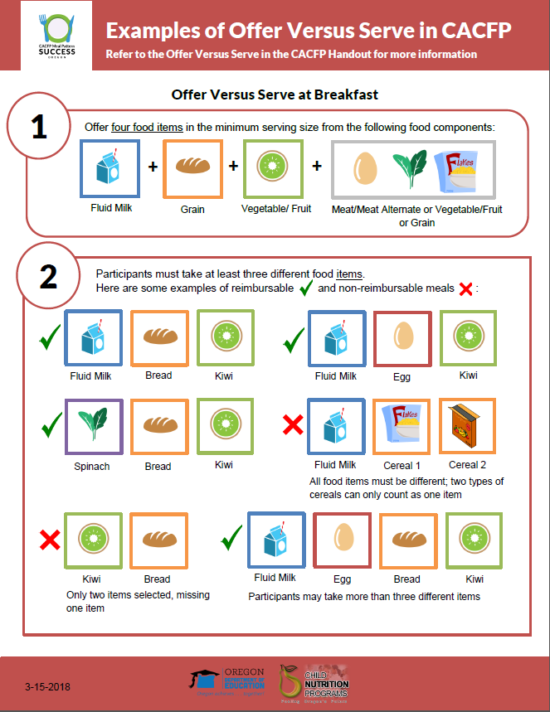
Resources
Notes:
If you still have questions or want to review some of the information you learned today, we have two handouts on OVS. The first, on the left, provides some basic definitions and the requirements of OVS for breakfast and lunch. The second handout, on the right, provides illustrated examples of reimbursable and non-reimbursable meals for breakfast and for lunch and supper. This can be downloaded from the CACFP meal pattern and menu planning page.

Slide 25
Review
What is Offer Versus Serve (OVS)?
OVS Requirements
Common Questions about OVS
Notes:
Today, we looked at what OVS is and the requirements for OVS, we also discussed some common questions that we’ve seen related to OVS.

Slide 26
Questions
More Questions?
Contact your assigned Child Nutrition Specialist
Notes:
Now we’re going to open it up to any additional questions you might have. We have ____ minutes and we’ll take a look first at the questions that were sent in through the chat box during our sessions. (Answer chat box questions, once those are complete, ask if there are any additional questions. If there are too many questions to answer in the time frame, silence the microphone and take 1 minute to pick and choose the best questions to answer)
If you still have questions, please contact your assigned child nutrition specialist.

Slide 27
Thank You!
Notes:
Thank you, everyone for your time today. A certificate will be sent to the e-mail you used to sign up for this lesson along with a survey.

Slide 28
In accordance with Federal civil rights law and U.S. Department of Agriculture (USDA) civil rights regulations and policies, the USDA, its Agencies, offices, and employees, and institutions participating in or administering USDA programs are prohibited from discriminating based on race, color, national origin, sex, disability, age, or reprisal or retaliation for prior civil rights activity in any program or activity conducted or funded by USDA. Persons with disabilities who require alternative means of communication for program information (e.g. Braille, large print, audiotape, American Sign Language, etc.), should contact the Agency (State or local) where they applied for benefits. Individuals who are deaf, hard of hearing or have speech disabilities may contact USDA through the Federal Relay Service at (800) 877-8339. Additionally, program information may be made available in languages other than English. To file a program complaint of discrimination, complete the USDA Program Discrimination Complaint Form, (AD-3027) found online at the USDA complaint resolution page, and at any USDA office, or write a letter addressed to USDA and provide in the letter all of the information requested in the form. To request a copy of the complaint form, call (866) 632-9992. Submit your completed form or letter to USDA by: (1) mail: U.S. Department of Agriculture Office of the Assistant Secretary for Civil Rights 1400 Independence Avenue, SW Washington, D.C. 20250-9410; (2) fax: (202) 690-7442; or (3) email: program.intake@usda.gov This institution is an equal opportunity provider.
Notes:
Thank you for all you do to feed Oregon! Have a great day.
(Save all questions from the chat box before closing the training.)

Slide 29
Thank You!
Questions?
E-mail: Shirley.Wu@state.or.us
ODE Child Nutrition Programs CACFP Page

