Slide 1
Meal Pattern Success Webinar
Family Style Meals
Insert Date Here
Notes:
Hello and welcome to the Meal Pattern Success Webinar on the __________. My name is ___________ and I will be presenting the webinar today with assistance from _________. Before we get started, since this is a webinar, we will be muting all microphones, but will be accepting questions through the questions tab on your navigation panel. At the end of the session, we’ll have a few minutes to answer any questions you might have. Questions you submit will be answered at that time.

Slide 2
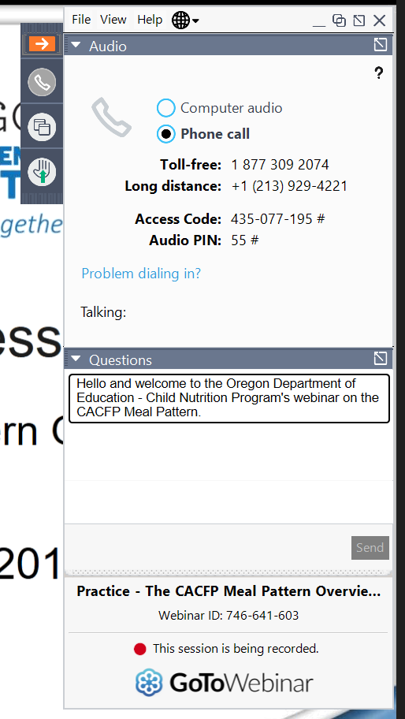
Using GoToWebinar
Notes:
If you’re new to GoToWebinar, you might have noticed that there’s a small navigation panel (click) that’s available when you first opened GoToWebinar. You will want to click on the orange box with the arrow to expand or minimize the navigation panel. The image on the screen shows the navigation panel when it is expanded. When you expand the panel, you’ll be able to change audio options or ask questions in the Questions Tab (click).

Slide 3
Overview
Family Style Meal Service Handout
What is Family Style Meal
Benefits of Family Style Service
Requirements
Starting Family Style Meals
Scenario and Common Questions
Best Practices
Resources
Q&As
Notes:
Today, we’ll be taking a quick look at the Family Style Meal Service Handout that was developed by ODE and then going over the basics of why family style meal service is beneficial, the requirements for family style meal service, and how to start family style meals if you are not already doing so. Next, we’ll take a look at a common scenario and some common questions. We’ll end the training with some best practice tips and time for your questions.

Slide 4
Poll
At this time, does your center or site use Family Style Meal Service?
Yes, we use it for all meals
Only for some meals or age groups
No, we don’t use family style meal service
Not Applicable
Notes:
Let’s do a quick poll first. We want to know whether your center or site use family style meal service right now. The answers can vary from yes, you use it for all meals, to only for some meals or age groups, or no you don’t use family style meal service. If you do not know or if you are not a sponsor, you can click not applicable. (launch poll. Wait 1 min or until 80% of participants have responded. Close poll. Show results. Check Audience View to make sure it’s visible.)
Thank you everyone for your responses. (Lead: talk a little about the results.) (Assistant: Close poll. Return to slides)
Whether you serve family style meals or not, it’s always a good idea to know what it is and how to implement it successfully just in case.

Slide 5
Family Style Meal Service Handout
Notes:
Here is the Family Style Meal Service Handout. You can find this on our CACFP Meal Pattern and Menu Planning Page on the ODE CNP CACFP site. You can also download it under the Handouts tab on the navigation panel. This handout provides a brief overview of Family Style Meal Service, and the back of the page gives step by step instructions for a complete family style meal along with a checklist you can use to make sure your family style meal service is meeting all the requirements.

Slide 6
What is Family Style Meals?
A style of meal service where participants are allowed to serve themselves from communal bowls, pitchers, and platters
Participants sit at a table with a supervising adult and serve themselves from the communal dishes on the table
Notes:
Family style meal service is one of the styles of meal service that is allowed in CACFP. In contrast to restaurant style, where meals are served fully portioned to participants, family style allows participants to serve themselves from communal bowls, pitchers, and platters. In this style of service, all the participants sit at a table where a supervising adult is seated. Communal dishes are set on the table along with tableware and serving-ware, and once all the food is on the table and everyone is seated, the participants are allowed to serve themselves. We see this style in Head Starts and child care centers very frequently.

Slide 7
Benefits of Family Style Service
Ability to choose how much food to take and what to eat
Learn self-regulation and hunger signals
Development of multiple social and motor skills
Promotes conversation and learning
Fosters a sense of community
Notes:
The reason why it’s used so much is because it has many benefits. Participants are allowed to choose how much food they want to take and how much they want to eat from the choices that are available. This helps participants to self-regulate their food intake and learn how to listen to their hunger signals. Some participants may be hungrier one day and not so hungry the next and they can take the amount that suits them. In addition, in child care settings, having children at the table with a supervising adult during meal times can help develop many social and motor skills, such as saying “please” or “thank you”, learning to share with friends, and learning how to pour milk or use tongs. Through passing bowls and making decisions, family style meal service encourages conversations between participants and the supervising adult. In child care settings, supervising adults may act as a role model by taking small portions and talking about the food. Just remember that if a supervising adult is eating as well to increase the portions provided. Overall, family style meal service builds a sense of community and reinforces the idea of meal times as a positive time.

Slide 8
Requirements
All required meal components are on the table at the same time
Each food item must provide at least the minimum portions for each participant and supervising adult served
The point-of-service meal count must be taken when all participants are seated with all required components placed on table
A supervising adult is seated at the table
Notes:
There are a few requirements for serving family style meal service and they are necessary to ensure that participants have a chance to get the full minimum portion. First, all required meal components must be on the table at the same time. You cannot serve some of the components first and then some of the components later. Second, all food items must be served with enough quantity to provide minimum portions for each participant and supervising adult served. This means all participants could get a full serving if they wanted. Some centers serve the supervising adult as well, since having teachers or caretakers eat can role model good eating behavior. In this case, make sure to add an extra portion that will be adequate for the supervising adult. Next, only take the point-of-service meal count after everyone is seated with all the required components on the table. It can be easy to forget to take the meal count during this time, so staff should have a system in place to take meal counts as soon as everyone is seated and ready to eat. It’s also very important that there is a supervising adult at each table. A supervising adult needs to be present to make sure that the meal service is running smoothly and participants are passing food around. In addition, they can help if spills or other problems occur.

Slide 9
Requirements
Participants must serve themselves
If participants don’t take the full serving, the supervising adult must offer the food again later
All items served by staff must contain the minimum portion size for the component
Notes:
Once everyone is seated and the meal count has been taken, participants must serve themselves if they are able. If participants decide not to take any component or only take a small portion, the supervising adult must offer the food again to them later. The supervising adult can offer, but must not force the participant to take the food. For example, asking the participant “I see that you didn’t take any green beans, would you like some?” later during the meal would be sufficient. In some cases, you may have a child who says “Yuck, I don’t like green beans.” And this would be a great opportunity for the supervising adult to discuss why they like green beans (if they do), or the color, texture, or even how it’s grown. While the child may not take any green beans this time, by talking about it without forcing the child to take the green beans, it may encourage the child to take more green beans in the future. In situations where a participant is not coordinated enough to serve themselves, a supervising adult may help the participant, but when serving, the supervising adult must serve the participant the full minimum portion size for the component. When a supervising adult helps out a participant, this is considered a combination restaurant/family style meal service. Any component served restaurant style must be served with the full minimum portion size.

Slide 10
Start Family Style with Success!
Make sure the serving ware is the appropriate size for the age group served
Ex. Smaller tongs and serving bowls may be necessary for younger children
Communicate with the kitchen on the number of participants each day
Water should be available to participants but should not displace fluid milk
N/A for adult day care centers
Notes:
If you are planning on starting family style meal service, you will want to set yourself up for success. Here are some tips to make sure that your family style meal service runs smoothly: It starts with the equipment you buy. Make sure that any serving ware you choose is appropriate for the age group served. For toddlers and wobblers, smaller tongs and bowls may be needed to prevent spills. Next, make sure that classrooms or sites are communicating with the kitchen each day about their attendance numbers so you can minimize waste. Remember that for all sponsors except adult day care centers, water needs to be offered throughout the day. There needs to be a balance however, since you will want to make sure that the water served doesn’t displace fluid milk.

Slide 11
Start Family Style with Success!
Participants should wash their hands before coming to the table
Having participants help set-up the table and clean up after a meal can be a great learning experience
Know who is taking the point-of-service meal count and complete before the end of the meal
Notes:
During the meal service, make sure that participants are washing their hands before coming to the table. It’s also very helpful to have participants help out with setting up tables and cleaning up. This can teach responsibility and help younger children develop fine motor skills as well. Most importantly though, make sure that the staff knows who is responsible for taking the point-of-service meal count. Remember that point-of-service meal counts can only be taken once all the food is on the table and all the participants are seated.

Slide 12
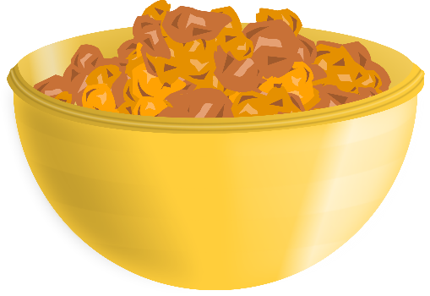
Scenario
You are getting ready for lunch and your assistant is making sure the children are washing their hands when you notice that you are missing your fruit component.
What do you do?
Notes:
Now that you have a primer on how to start family style meals, let’s look into a common scenario. In this scenario, you are getting ready for lunch and your assistant is doing a great job of making sure the kids are washing their hands and getting ready to sit down when you notice that you are missing the fruit component for your lunch. You have your meat, your milk, your grain, and your vegetable, but no fruits. What do you do?

Slide 13
Scenario: Answer
Have a procedure in place and train staff
If meals are prepared on site – call kitchen staff and have the missing component sent immediately
If meals are sent from a satellite kitchen, call kitchen staff and check with other rooms to see if they have extras
Check to see if you have back-up supplies to complete the meal
If not, serve meal as-is, but do not claim meals.
Notes:
There’s a lot of different actions you could do in this scenario and the right answer will depend on how your center is set up. Your main goal will be to make sure that participants are supervised and that they are getting a meal with all required components in the minimum serving sizes. Success in these situations will often depend on how much planning has been put into place long before the situation occurs. In our ideal situation, there would be a procedure in place for this situation and the staff will be trained to know exactly what to do.
Here are some successful ways we’ve seen this situation handled: If the kitchen is on site, it makes life a little easier. The staff can call the kitchen and have them send additional portions of the missing component over immediately. Kitchen staff should send over the food as quickly as possible because all components must be on the table before a reimbursable meal can be counted. The classroom staff should wait until the fruit component arrives to start the meal.
If the kitchen is not on site and the food is delivered from a satellite kitchen, then call the kitchen as well to see if there’s anything they can do, but also check with nearby classrooms to see if they mistakenly were provided with your fruit components as well. The delivery person should also be notified that there’s an issue. If this is a common occurrence, then kitchen procedures should include a double check before meals are delivered. If only the fruits are missing, then see if there’s any back-up supplies at the site to complete the meal. Sometimes, sites may keep an emergency supply of shelf-stable fruits or grains. If they are available in the minimum required portions, then the staff should serve the back-up fruits and continue with point-of-service meal counts.
If after checking around and knowing there are no fruits available to complete the meal, the next step will be to serve the meal as you have it with the missing component, but make sure not to claim those meals. If meal time staff are not trained on what is allowed or disallowed, then a procedure must be in place for the meal time staff to notify the kitchen and a system must be in place to disallow those meals before monthly claims are submitted.

Slide 14
Common Questions
Question 1: I like family style meals but I’m worried about sanitation – especially during cold and flu season. How do I prevent spreading germs while implementing family style dining?
Answer:
Washing hands before and after meals
Have strong “sick child” policies
Use more bowls to prevent passing through too many hands.
Have staff serve sick participant
Notes:
Let’s look at some common questions that come up with family style meals. In our first question, we have a sponsor who is worried about sanitation, especially during the dreaded cold and flu season. How can you prevent spreading germs while implementing family style dining? (click) The answer starts with good hand washing practices. Of course, kitchen staff should always practice good sanitation practices, but it’s also necessary for participants to wash their hands before a meal since they will be touching the same serving ware. In addition, centers should have strong “sick child” or “sick adult” policies in place – these are policies on when your center will send a participant home due to illness. During cold and flu seasons though, additional serving bowls and pitchers should be used to cut down on the number of times bowls are passed around. If a participant is very ill and needs to be present for meal time, this would be a good time to use combination restaurant and family style dining and have the staff serve them instead of having them serve themselves. As always, when staff serve participants, they must serve the full minimum portions.

Slide 15
Common Questions
Question 2: We can’t fit all the food in the minimum required portions on the table! Or the minimum required portions make the bowls too heavy for the children to pass around. What can we do?
Answer:
Have a table extender – make sure all food is within arm’s reach
Use smaller bowls or plates and have multiple bowls/plates per table
Notes:
Next question, there’s just too much food! We can’t fit all the minimum required portions on the table! Or the minimum required portions make the bowls too heavy for the children to pass around. What can we do?
(click) The answer is to think creatively. Sometimes, smaller bowls can work for both problems. If you don’t have enough space, having slightly smaller bowls can help. Other times, you might have a very small table and there’s no way for everything to fit. In these cases, you can consider having a table extender. This can be a side table that can be set next to the main table or a rolling tray that is next to the table. Ideally, all the food would be at the same height so participants can see all the food that’s available. If similar height side tables or trays are not available, make sure it is within arm’s length and available to pass around by the children. If you have younger children who find the larger serving ware to be too heavy, it might be time to invest in smaller bowls. For example, a table of 8 children and 1 teacher may have 3 bowls of chicken to meet the portion sizes for all the children. These bowls each contain 3 servings and are small enough for children to pass around. In addition, this can also help during cold and flu season to prevent germs from spreading.

Slide 16
Common Questions
Question 3: We have a child who takes very large portions and there’s not enough for everyone else at the table. How do we make sure that every participant get enough to eat?
Answer: Check with the child to see why they are taking such large portions. Some children are not aware of how much they are taking. Depending on the answer, it may be necessary to increase portion sizes or move the food so that the child is not getting the food item in question first.
Notes:
Here’s one last question that we get frequently. In this one, you have a child or participant who is taking more than their fair share and this means everyone else does not get enough. In these cases, (click) we would encourage you to have the classroom staff speak with the child and observe whether the child is finishing the large portions. In rare cases, the child may be very hungry and is needing extra food. In these cases, we would encourage staff to increase portion sizes to make sure that everyone is getting sufficient portions. Most of the time though, it’s because a child has a favorite food item or the child is unaware of how much they are taking. In those cases, this can be a learning experience for the child. Remind them that they should leave enough for others and that they can get more when the bowl or plate comes around again. If this is a consistent issue with a child, it may be necessary to switch around the table seating or change how bowls are passed so that the child is getting the bowls or plates with the preferred foods after other participants have had their chance to take their portions. Each situation is unique, and this is a good time to work with the families to see what strategies might work at home.

Slide 17
Best Practices
Practice family style dining skills with participants using empty bowls and plates
Use age-appropriate serving ware, including lidded pitchers and small tongs
Measuring cups can be used to serve portions
Have participants help set-up and clean up tables
Encourage staff to role model good meal time behavior and provide a meal for staff members as well
Connect the meals to lessons and activities
Notes:
Family style can look very different from center to center, but there are some best practices that all centers can use. First, if you have young children that are new to family style and you’re worried about spills, it’s always a good idea to practice family style dining skills with participants using empty bowls and plates first. Practice passing water, toys, and even sand in cups and bowls. Make sure to sanitize the cups and bowls before using it for food. Another great tip is to use age-appropriate serving ware. They have small lidded pitchers that hold 2 to 3 cups and small tongs that are easier to manipulate for small hands. Another great idea is to use measuring cups when serving portions. Measuring cups are cheap to buy and you can see right away if a child is getting enough food for a full portion. While it’s OK if a child does not get a full portion when they are serving themselves, it can help the supervising adult know when to ask the participants if they would like more.
We discussed having participants set up and clean tables a few times, and while it’s not required, it can develop a sense of responsibility and teamwork and based on meal time observations, the children love to help out. One thing you always want to stress to your classroom or site staff is that meal time should be a positive experience. When supervising adults are at the table, they act as the role model for good meal time behavior and children often eat more when they see adults eating as well. Finally, meal times are learning times as well. Bring in the day’s lesson to the meal or incorporate the meal into lessons on courtesy, sharing, colors, flavors, numbers, and a whole bunch more.

Slide 18
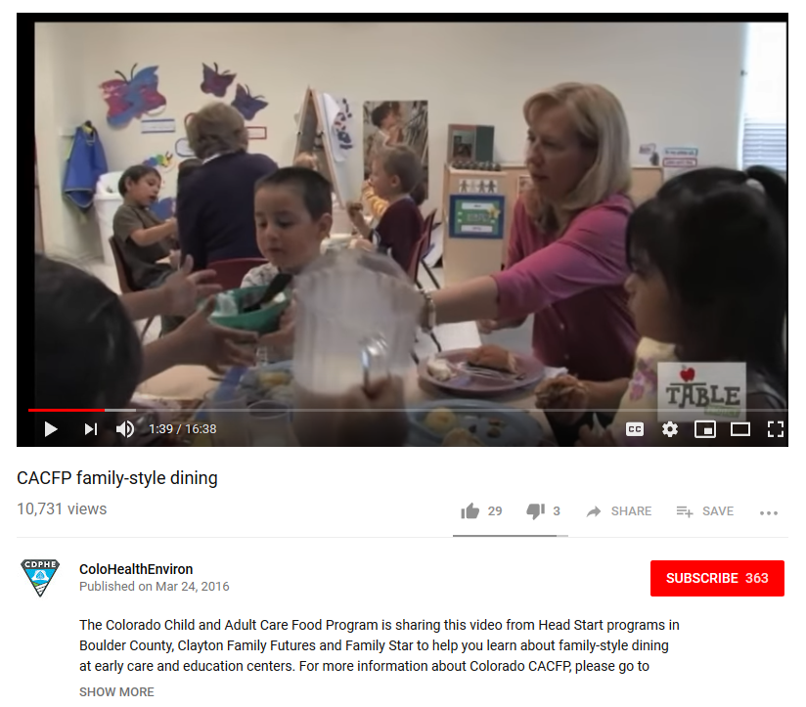
Resources
CACFP Memo 05-2017, sent Jan 5, 2017
Family Style Meal Service Handout
Table Talk: CACFP Family-Style Dining
Notes:
Most of the basic information we discussed today can be found in the CACFP Memo 05-2017. This was sent out January 5, 2017. We also have the Family Style Meal Service Handout that we went over earlier which provides the information in short lists. If you would like to see what family style dining looks like at a real site, this video from Colorado Head Start provides three great examples of family style dining. This link is available from our website and you can follow the link from your PDF slides.

Slide 19
Review
Family Style Meal Service Handout
What is Family Style Meal
Benefits of Family Style Service
Requirements
Starting Family Style Meals
Scenario and Common Questions
Best Practices
Resources
Notes:
Today, we looked at the family style meal service handout that was created by ODE CNP. We defined family style meal service and went over the benefits and requirements of this meal style. We also looked at some of the requirements of starting family style meals. To round out our training today, we looked at a common scenario with family style meals and looked at 3 frequently asked questions as well as some best practices to incorporate into your family style meal program. Finally, we took a quick look at a few of the resources out there.

Slide 20
Questions
More Questions?
Contact your assigned Child Nutrition Specialist
Notes:
Now we’re going to open it up to questions. We have ____ minutes and we’ll take a look first at the questions that were sent in through the chat box during our sessions. (Answer chat box questions, once those are complete, ask if there are any additional questions. If there are too many questions to answer in the time frame, silence the microphone and take 1 minute to pick and choose the best questions to answer)
If you still have questions, please contact your assigned child nutrition specialist.

Slide 21
Thank You!
Notes:
Thank you, everyone for your time today. A certificate will be sent to the e-mail you used to sign up for this lesson along with a survey.
If you’re trying to use these hours for your OCC licensing crediting hours through ORO, you will need to keep all your certificates and then turn them into ODE CNP in September 2019 for conversion into a combined certificate. This is because ORO does not accept trainings less than 1 hour in length. For example, if you take 4 webinars, you can turn in the certificates in September 2019 and we will issue a new certificate for 2 hours of training credit. This is not required unless you want these hours to be credited for ORO. In September 2019, we will send out a memo to all sponsors with further detail on this.

Slide 22
In accordance with Federal civil rights law and U.S. Department of Agriculture (USDA) civil rights regulations and policies, the USDA, its Agencies, offices, and employees, and institutions participating in or administering USDA programs are prohibited from discriminating based on race, color, national origin, sex, disability, age, or reprisal or retaliation for prior civil rights activity in any program or activity conducted or funded by USDA. Persons with disabilities who require alternative means of communication for program information (e.g. Braille, large print, audiotape, American Sign Language, etc.), should contact the Agency (State or local) where they applied for benefits. Individuals who are deaf, hard of hearing or have speech disabilities may contact USDA through the Federal Relay Service at (800) 877-8339. Additionally, program information may be made available in languages other than English. To file a program complaint of discrimination, complete the USDA Program Discrimination Complaint Form, (AD-3027) found online at the USDA complaint resolution page, and at any USDA office, or write a letter addressed to USDA and provide in the letter all of the information requested in the form. To request a copy of the complaint form, call (866) 632-9992. Submit your completed form or letter to USDA by: (1) mail: U.S. Department of Agriculture Office of the Assistant Secretary for Civil Rights 1400 Independence Avenue, SW Washington, D.C. 20250-9410; (2) fax: (202) 690-7442; or (3) email: program.intake@usda.gov This institution is an equal opportunity provider.
Notes:
Thank you for all you do to feed Oregon! Have a great day.
(Close out navigation window to close session. Convert video to MP4. Save into dated folder for session.)

Slide 23
Thank You!
Questions?
E-mail: Shirley.Wu@state.or.us
ODE Child Nutrition Programs CACFP Page

