Slide 1
Brain Breaks in the Classroom and Beyond
Welcome to
Notes:
Display this slide prior to start of the class.
Note to trainer: The Slide File Handout with be emailed to participants along with their certificate for attending. Participants will complete the attendance survey at the end of the training.
Welcome participants as they enter the session.
Perform periodic sound checks prior to the start of the class.
At the designated starting time, thank participants for coming, introduce yourself, and welcome them to the class.

Slide 2
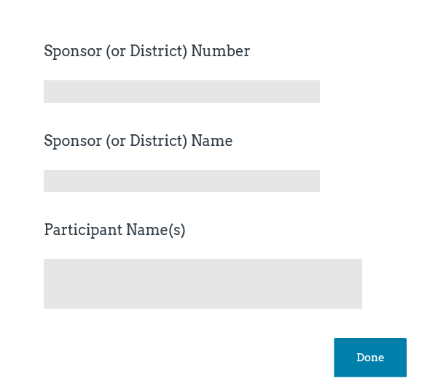
Class Logistics
Class ending time
Participant materials
Recorded class
Mute and unmute features
Q&A protocol
Attendance
Notes:
Inform participants this is a two hour class and will end by (insert time that is two hours from planned start time).
Explain that the Slide File is available upon request as an email attachment. Add contact information to chat box by copying and pasting from title slide.
Let participants know that the class will be recorded, if applicable. (record class to the Cloud).
Inform participants that they can mute and unmute their audio. When in “unmute” mode, their conversations and background noise can be heard.
Encourage participants to ask questions and provide comment as appropriate to the class content. Explain that participants may ask questions or provide input by unmuting their audio or typing in the chat box.
Attendance will be taken at the end of class via a Survey Monkey survey. It is important to complete the Attendance Survey in order to receive a Certificate of Completion for the class. The Attendance Survey will ask for three pieces of information, Sponsor Number, Sponsor Name, and Names of Attendees. For example, Sponsor Number for a public school is the USD designation. Sponsor Name for a public school is the name of the school district. As an added note regarding the Attendance Survey, multiple attendees from one Sponsor can be included in a single Attendance Survey.

Slide 3
Objectives
Define brain breaks.
Discuss the benefits of brain breaks.
Learn how to implement brain breaks.
Discover brain break ideas for the classroom.
Explore tools and resources for schools.
Notes:
Classrooms are a great place to promote lifelong healthy habits, such as being physically active. This training provides information on the importance and benefits of incorporating brain breaks in the classroom and provides examples, tools and resources that will assist schools with developing and implementing brain breaks.
By the end of this class, participants will be able to…Read Slide.

Slide 4
What are Brain Breaks?
Notes:
Brain breaks are quick and effective activities used to change or focus the physical or mental state of learners. Brain breaks energize, stimulate and activate the brain.

Slide 5
Roll the Dice to Break the Ice
Adapted from Prodigy.com
Notes:
Lets begin this class with a brain break that could be incorporated into classroom learning and will help us to activate our brains and get us ready todays training. Advance to next slide.

Slide 6
Roll the Dice to Break the Ice Activities
Skip 1 circle around the room you are in.
Complete 2 desk push ups.
Pat your head and rub your stomach 3 times.
Do 4 jumping jacks.
Complete 5 toe touches.
Do 6 sit ups.
Do 7 bicep curls.
March with high knees for 8 seconds.
Complete 9 chair squats.
Wave your arms over your head 10 times.
Jog in place for 11 seconds.
Take 12 deep breaths.
Notes:
Activity: Warm-Up Ice Breaker
Supplies:
1 pair of dice
12 activities found on slide
Procedure:
Instructor to display the “Roll the Dice to Break The Ice” activities on slide.
Instructor will roll the pair of dice and add together whatever numbers they land on ask the participants to engage in the activity that coincides with the number on the dice.
Encourage participants to turn their videos on so we can see everyone in action!
Roll dice 5-6 times and ask participants to participate in corresponding activities. Explain that this can also be a way to reinforce simple addition for younger elementary students as they can help add up the sum of the two dice.
Estimated Time:
5 minutes

Slide 7
Brain Breaks
Mental breaks that help students stay focused and attentive
Usually active in nature
Gets students up and blood circulating to the brain
Designed to energize or relax
Helps students process what they are learning in class
Notes:
Brain breaks are quick mental pauses taken regularly throughout the day. Brain breaks can be whole-class or individual activities that provide opportunities to escape from classroom instruction, homework or any other long duration endeavor to move, and interact in safe, structured ways. For example, students can stand up and stretch behind their chair while listening to an inspiring or calming song that helps them refocus. Students can act out different characters, places, or objects to help them recharge. Brain breaks only take a few minutes and then students should be redirected to their next task.

Slide 8
Forms of Brain Breaks
Physical
Relaxing
Sensory
Skill-building
Notes:
Typically brain breaks are considered active in nature, however, not all brain breaks need to be physical in nature unless the target is to get students blood flowing and increase the amount of physical activity they obtain during the day. Brain breaks can include relaxing activities or sensory activities. All provide a positive outcome for students.
Brain Breaks can come in many different forms including:
Physical Brain Breaks such as dancing, singing, jumping pope, running in place, shadow boxing
Relaxing Brain Breaks including breathing exercises, yoga, meditation or watching a calming video
Sensory Brain Breaks can be conducted using sensory bins, going on a nature walk or a scavenger hunt
Skill-Building Brain Breaks that utilize puzzles, juggling, spelling

Slide 9
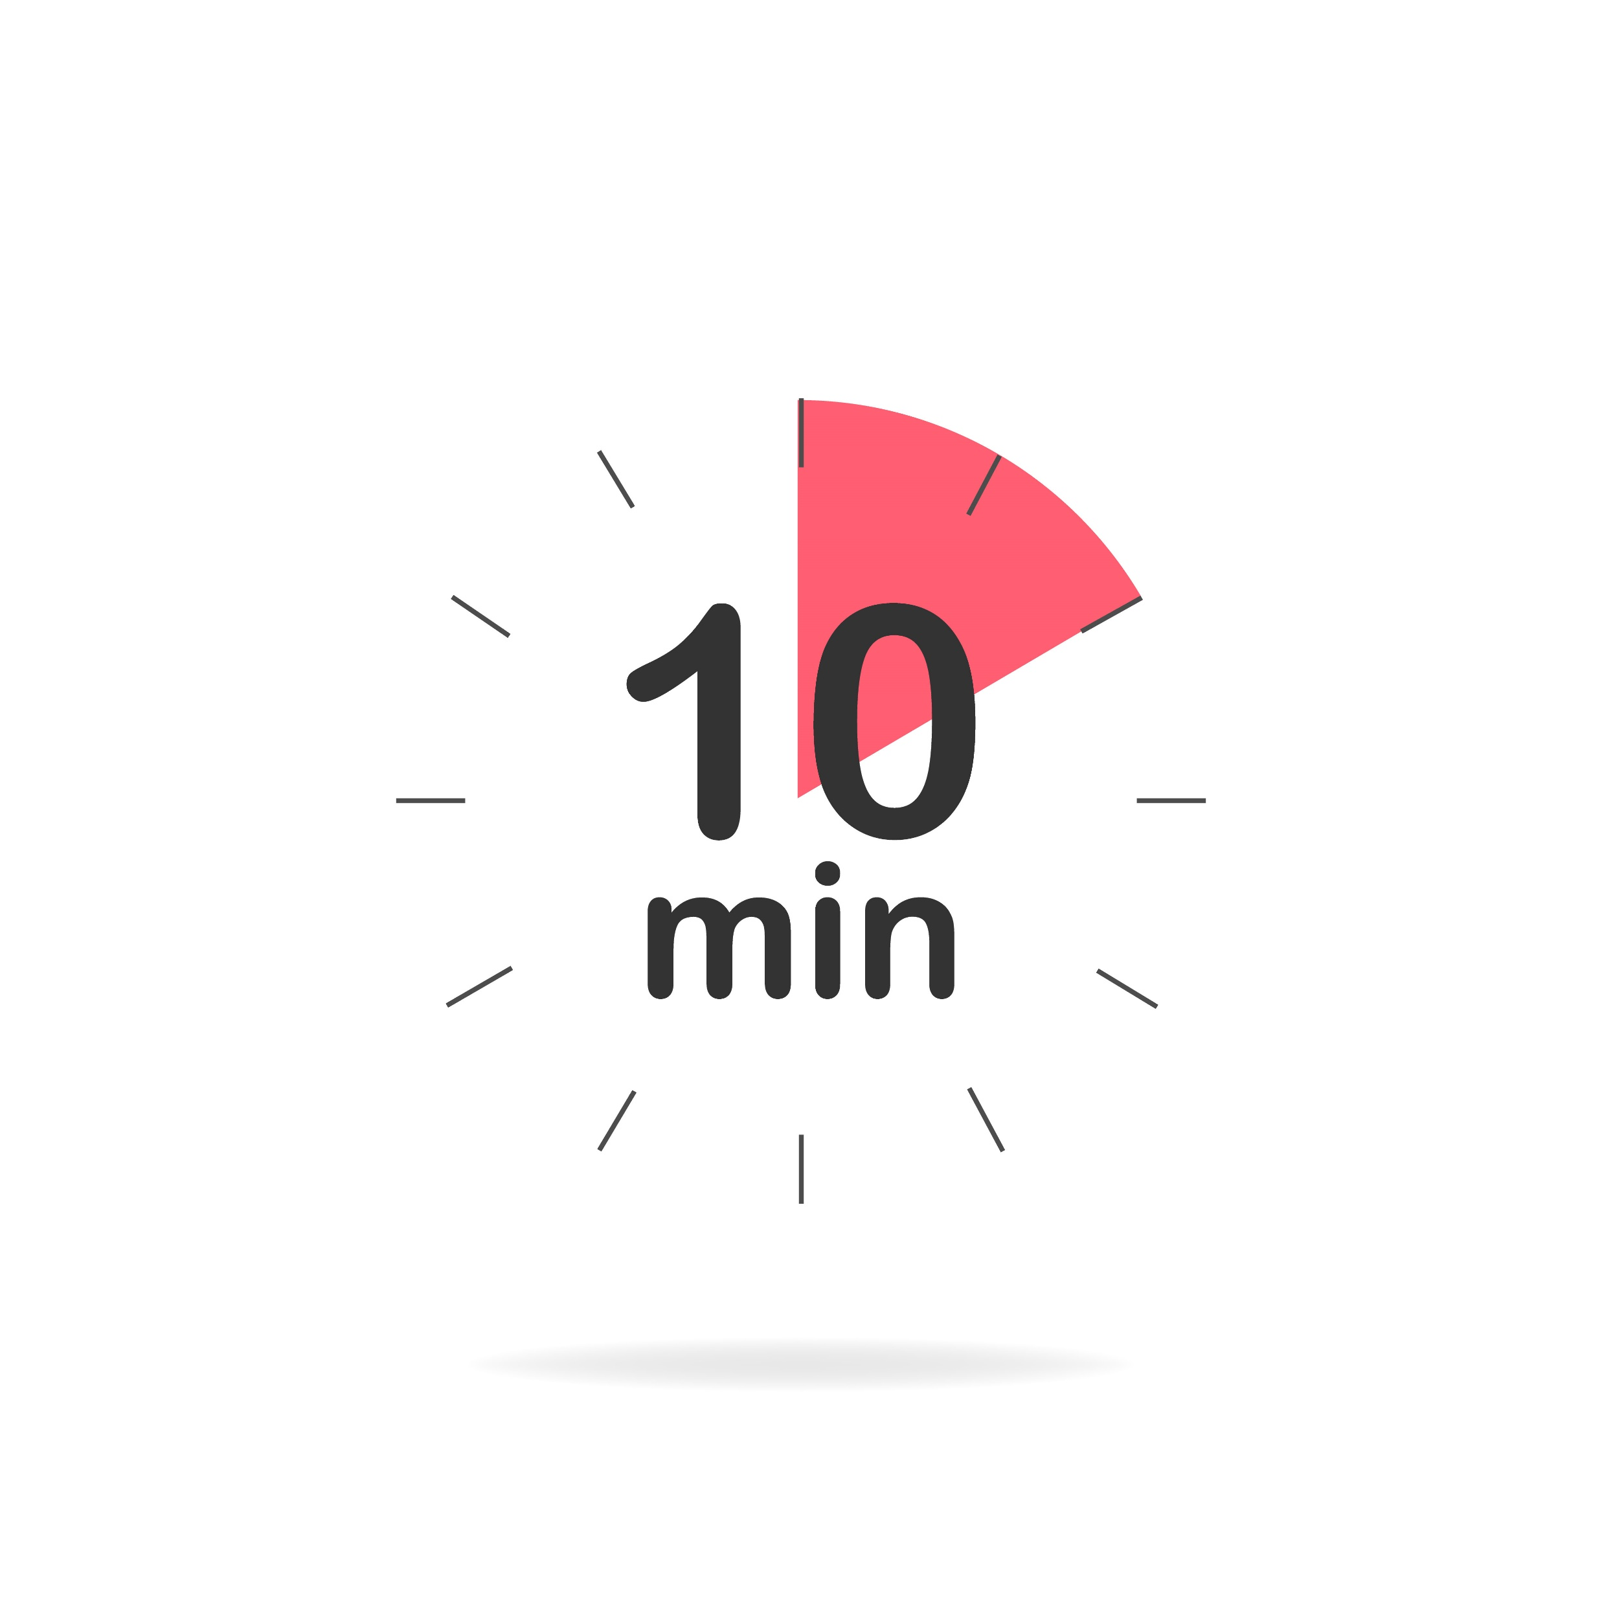
Types of Brain Breaks
Structured = Planned
Unstructured = Free Play
Timed breaks
Ratio breaks
Notes:
Breaks can be taken during any part of the day and can be in different forms. Start the day off right with a simple warm up to get the blood flowing or some deep breathing exercises to relax before jumping into a lesson. When a class gets chatty try a talking type of brain break that allows students to visit informally for a pre-determined amount of time. When test time roles around, longer more vigorous activities can do the trick to help students focus. Let’s take a look at different types of brain breaks:
Structured physical activities are planned activities that may be incorporated into core and non-core curriculum.
Unstructured or free play time provides an opportunity for creativity. This allows children to practice alternative thinking and the freedom to explore new ideas without fear of failure or the stress of grades. Regular exposure to new skills can increase students cognitive flexibility and help prepare them for academic challenges.
Younger students tend to benefit from taking breaks at timed intervals. For instance, students might work for ten minutes and then take a two-minute break. You can use a timer to help students understand how much time is passing. It helps kids learn what they can do in a set amount of time. Give specific instructions about how long the break will last, and explain the activity. Then start the timer. The timer provides a built-in warning that the break is winding down. You can also use verbal reminders like, “Wasn’t that fun? Now it’s time to get back to Math!”
Older kids tend to benefit from taking breaks that are tied to a certain number of behaviors. For instance, once the math assignment is complete, students might take a five-minute brain break before moving on to English. Or after completing five out of 10 math problems.

Slide 10
Classroom Physical Activity
Any physical activity that takes place in the classroom, occurring at any time throughout the school day and may or may not be incorporated into academic instruction.
Notes:
The Center for Disease Control (CDC) defines classroom physical activity as any physical activity done in the classroom.1-4 It can take place at any time and occur in one or several brief periods during the school day. 1-4 It includes integrating physical activity into academic instruction as well as providing breaks from instruction specifically designed for physical activity.1-4 The CDC recommends classroom physical activity be offered in addition to physical education and recess and at all school grade levels (elementary, middle, and high school)
https://www.cdc.gov/healthyschools/physicalactivity/classroom-pa.htm

Slide 11
Five Finger Breathing
https://youtu.be/DSgOW879jjA
Notes:
We just talked about different forms of brain breaks and how not all brain breaks are physical brain breaks. Let’s try our hand at a relaxing brain break that uses a video to practice a calming exercise.
Activity: Five Finger Breathing
Supplies:
YouTube Video Five Finger Breathing
Procedure:
Click on the Brain Break graphic to launch the video or go to: https://youtu.be/DSgOW879jjA and ask participants to participate as the video leads them through the exercises.
Once the video is done, lead participants in a short discussion about how they felt after completing this exercise. Did they feel relaxed? Did they feel refocused? How do the participants see this activity working in a classroom?
Estimated Time:
5 minutes

Slide 12
Benefits of Brain Breaks
Notes:
There are numerous benefits for students and teachers when brain breaks are incorporated throughout the school day.

Slide 13
Benefits of Brain Breaks
Reduces stress and frustration
Increases attention and productivity
Re-energizes students and get them refocused
Assists students develop social skills
Boosts student activity
Notes:
A brain break is just what it sounds like—a break from whatever kids are focusing on.
Students learn better when they have breaks because their brain gets a chance to reset. Some people say it’s the oxygen flowing to the brain when students move, but there’s more to it than that. There’s a lot going on in the brain and too much of one activity can lead to stress or overload. Classroom teachers can help reduce overload and assist students with being more receptive to new learning when they use brain breaks. If a teacher notices students are starting to act out or lose focus, it might be time for a brain break. Ideally, brain breaks are used before students have lost focus, but they can be implemented at any time when a class needs to refocus or re-energize.
Brain breaks involve the whole class. Many take the form of games or get students interacting in some way—working together to keep a ball off the floor, forming groups of a certain size upon a signal, lining up in alphabetical order or by height. Activities like this make students work together. That means teachers are helping to develop social skills at the same time they are getting kids ready for more learning.
Kids need to move, but they are often sitting for the majority of their day at school. Most kids (grown-ups, too) don’t get enough physical activity in the day. While the amount of activity students get during brain boosts isn’t going to qualify as enough activity for the day, it does work more movement in their day.

Slide 14
Brain Breaks and the Body
Exercise increases blood flow to the brain and body
Boosts neural connectivity in the brain
Stimulates nerve cell growth
Utilize stored excess energy
Feel good chemicals or endorphins are released
Improves attention, memory and overall cognitive function
Notes:
There are many physiological processes that occur with movement and exercise. When a person moves, blood flow increases to the brain as well as to the rest of the body. Stored energy is utilized and endorphins or feel good chemicals are released. Engaging in physical activity increases blood flow and oxygen to the brain which can boost neural connectivity and stimulate nerve cell growth. Which in turn impacts learning and memory. Exercise in a sense changes the structure of the brain improving attention, memory and overall cognitive function. The endorphins that are released during exercise seem to help improve mood and help people cope with stress.

Slide 15
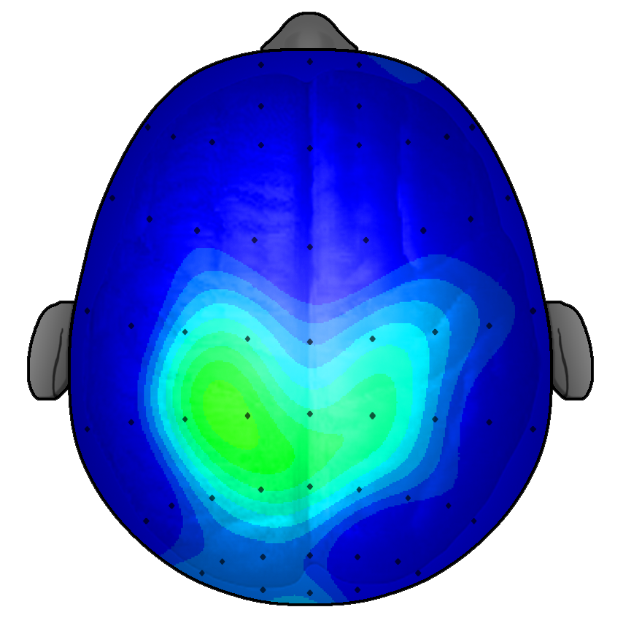
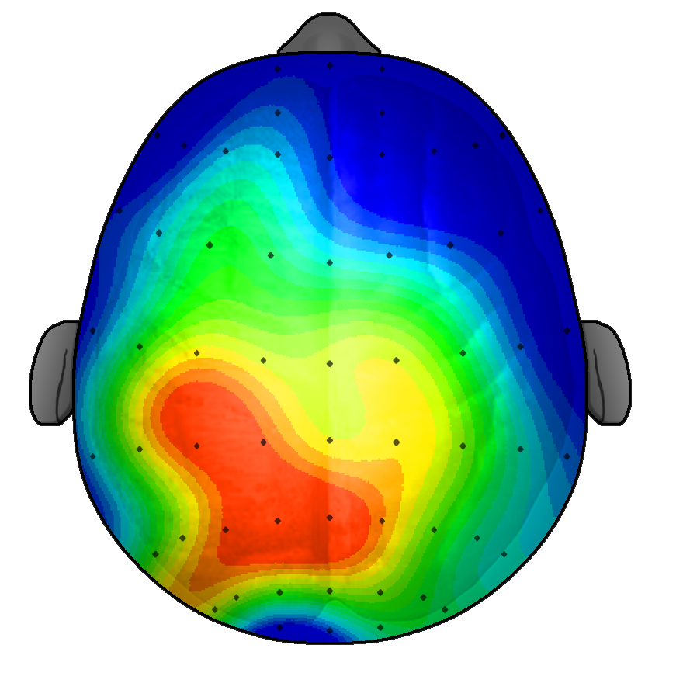
How Does Physical Activity Affect Our Brain
3
µV
8
After 20 minutes of Sitting Quietly
After 20 minutes of Walking
Notes:
Research conducted by Chuck Hillman at the University of Illinois showed that kids learn more quickly after exercise. Their study demonstrated that students were 20 percent faster at learning vocabulary words after they had exercised as compared to when they had not. The pictures in this slide demonstrate how a simple 20-minute walk activates and stimulates the brain. Although most brain breaks in school do not last 20 minutes, multiple short bouts of physical activity are still beneficial.

Slide 16
Classroom Brain Breaks Benefits Students
Improving concentration and the ability to stay on-task in the classroom.
Reducing disruptive behavior, such as fidgeting, in the classroom.
Improving motivation and engagement in the learning process.
Helping to improve academic performance (higher grades and test scores).
Increasing the amount of overall daily physical activity achieved by student’s.
Notes:
In addition, classroom brain breaks can benefit students by:
Read Slide…

Slide 17
Brain Breaks and Academic Achievement
Research demonstrates improvements on academic performance.
Students who are active tend to have better grades and higher attendance
Better cognitive performance
Improved behaviors
Engages different learning styles and child temperaments
Enhances student teacher relationships
Notes:
Do brain breaks really work? Physical activity and its relationship to Academic Achievement has been widely researched. It has been determined that students who are physically active tend to have better grades, higher school attendance, increased cognitive performance with memory and concentration, and improved classroom behaviors for example being less jittery or noisy and remaining on-task.
Brain breaks can engage all students especially those with different learning styles or varied temperament. Overall brain breaks can enhance the student teacher relationship.

Slide 18
Regular, “playful” breaks during intense,
sustained cognitive work, maximizes learning
and achievement gains.
(Journal of Experimental Child Psychology, 51, 123-13)
Notes:
The academic achievement benefits resulting from brain breaks was included in The Journal of Experimental Child Psychology which stated that “Regular, “playful” breaks during intense, sustained cognitive work, maximizes learning and achievement gains!”

Slide 19
Freeze Frame
Notes:
Activity: Freeze Frame
Supplies:
Freeze Frame music (J. Geiles Band) https://www.youtube.com/watch?v=wHo43B6nu60
Procedure:
Let participants know that you are going to play some music and that you’d like them to turn on their videos and move to the music. Participants could dance, sway their arms, jog in place, side step, clap, drum, play air guitar, etc. to the music. Instruct the participants to freeze when the music stops.
Share screen, click on Brain Break icon on screen, and select the box that allows audio to be shared with participants. (This video may start with ads, so after a few seconds, click on skip ad.)
Start and stop the music intermittently for the entirety of the song.
Estimated Time:
Song is about 3:30 minutes total activity should last only about 4 min.

Slide 20
Implementing Brain Breaks
Notes:
Implementing brain breaks in the classroom can be fun and easy. It is essential for schools to develop physical activity programs that include brain breaks.
In the Shape of the Nation 2016 Report it states physical education programs are a meaningful contributor to the development of healthy, active children and provide the safe, supervised, structured environment children need to learn and practice physically active behaviors.
During this training you have participated in three different brain breaks that could be incorporated into classroom and even virtual learning! Let’s explore how brain breaks can be implemented throughout the school day.

Slide 21
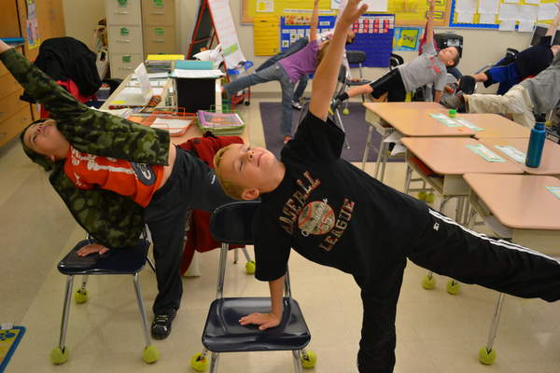
Physical Activity During School
Daily Routine
Create Active Environments
Use Active Instructional Strategies
Brain Boost
Flexible Seating
Notes:
We’ve learned today that by adding physically active brain breaks throughout the school day, it can make classwork seem less daunting for students. Next, let’s discuss some tips that will assist with incorporating physical activity during the school day:
Incorporate Brain Breaks into the classroom routine (i.e. at predetermined times, during transitions, etc.) so that they are ingrained into the daily schedule.
Create active environments within the classroom by including opportunities to move such as having students walk to a predetermined spot to pick up and/or turn in worksheets instead of handing worksheets out to students or going around to gather assignments from students once they are complete.
Use active instructional strategies. Rather than asking students to raise their hand to answer a question, ask them to stand up instead. Other active instructional strategies include having a scavenger hunt to locate rhyming words or setting up stations throughout the room in order to have students complete a worksheet.
Use activities that integrate movement into instruction. For example: during classroom language arts instruction when students are working on vocabulary words you could use a balloon or ball that the students can throw around to one another in the classroom while the student who catches the ball can put the next letter in the vocabulary word they are trying to spell.
Flexible seating can also provide opportunities for brain breaks for students. Examples of flexible seating include stand up desks and exercise balls.

Slide 22
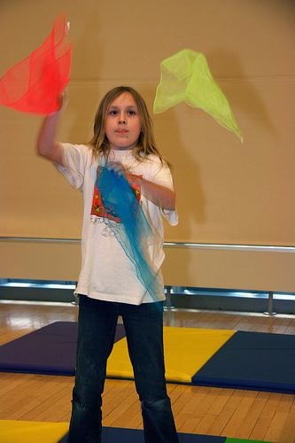
How to Implement Brain Breaks
Prioritize and plan for movement throughout the day
Have a list of brain break ideas ready for when the need arises!
Timing
Provide opportunities for brain breaks every 25-30 minutes
Work them into lesson plans
Notes:
Have brain break ideas ready to go when the need arises! Having a “list”, jar, bowl, popsicle sticks, and/or task cards with different brain breaks to choose from will make it easier to spontaneously incorporate a brain break when students are showing signs of needing a break.
Timing and frequency of brain breaks is important and should take place prior to distraction, fatigue or inattention setting in. Students should have a movement type brain break every 25-30 minutes. Brain breaks can take 1-3 minutes of class time to complete. Brain breaks can also be integrated as part of classroom learning activities and instruction.
Structuring brain breaks will depend on the children’s ages, abilities, focus development, and learning styles and can be seamlessly worked into lesson plans.
Brain breaks aren’t only refreshing students…but for teachers too! Teachers are also encouraged to participate!

Slide 23
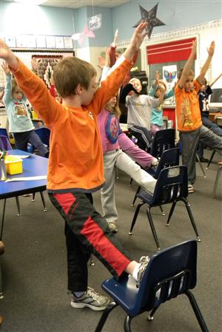
Simple Steps for Implementing Brain Breaks
Set behavior expectations before beginning.
Provide instruction for the brain break.
Set a timer for the activity if there isn’t a naturally occurring end to the activity.
Pay compliments to students during the brain break.
Let students provide feedback about the activity.
Notes:
Let’s explore some simple steps for implementing brain breaks.
First, its important to set class expectations for participating in brain breaks. Remind students that everyone is encouraged to participate and give their best effort. Set a time limit for the activity and share with students. Remind students of the rules and the stop and respond signals. Develop a technique for getting students to resume work such as a 10-second count-down cue or play a short 10-second musical clip cue. It is important to decide ahead of time what is an acceptable level of noise and devise a signal to let students know when the volume is reaching the maximum level.
Make sure that the area is safe for the brain break. Move objects out of the way for safe movement.
Provide instruction for the brain break. If needed display the written directions, explain them, and demonstrate the task.
Pay compliments to students during the brain break – value their participation so they will want to participate again.
Let students provide feedback about the activity and whether they liked the activity.

Slide 24
How to Bring the Students Back?
Attention getters
Call and Respond
Notes:
It is important that once the brain beak is over that students bring their focus back to the lesson or classroom task. How can students be refocused after a brain break?
Attention Getters may include: hand-clappers, silly whistles, a train whistle or a duck call. Or use a Call & Respond technique, for example, teacher says something like “Active Kids” and the students respond with “Do Better”. Unlimited variations are possible like using the school mascot or a favorite teacher saying.
Another way to bring students back is to use the “Give me a hand” technique - Tell the kids, “give me a hand” means students stop and raise one hand in the air. Other variations could include “Give me a clap” and students clap, “Give me a stomp” and students stomp one foot, or may ask any combination such as “Give me three claps and a stomp” and the students’ attention is focused back on the tasks at hand.
Have live music you can play and stop when you want students to freeze.

Slide 25
Classroom Items to Use for Brain Breaks
Ruler
Pencil
Chair
Wall
Desk
Floor
Paper
Radio
Ball
Tape
Phones
Timers
Cups
Sticky Notes
Note Cards
Chalk
Notes:
What types of classroom items can be used for brain breaks? Be creative and use items found in the classroom. For example, students can use their desk to do desk pushups! Students chairs can be used to do chair squats or dips. A wall can be used to do wall sits or wall pushups. Ask students to place a pencil on the floor and ask them to jump over the pencil a designated number of times. Have students attempt to balance a book on top of their head!
Scraps of paper from the recycle bin can be used for a fun brain break called “Keep it Clean” where a teacher can create a line using tape or an imaginary line can be drawn the middle of the room. Give students several pages of paper from the recycle bin. Students can begin throwing objects across the line—the object is to keep objects off of your side of the room. When you call “time” the cleanest side (the one with the fewest objects) wins.
Brain breaks can even be taken outside. Have students use sidewalk chalk to write spelling words, practice sentence writing or math facts.
How have you used items in your classroom to conduct brain breaks? Ask participants to unmute or type in the chat box.

Slide 26
Brain Breaks that Require No Materials or Prep
Write Your Name
Shake It
Animal Instincts
Calm Down
Walk and Talks
Rainstorm
5-4-3-2-1
Find it Fast
Simon Says
Jump Skip Counting
Notes:
Brain Break can also be conducted with no materials or preparation! Here are a few ideas to consider!
Write Your Name: Have students use their index finger as an imaginary pencil, ask them to write their name in huge cursive in the air. Now repeat using different body parts as your pencil — elbow, knee, toe, belly button, head. Don’t forget to make sure all your i’s are dotted and t’s are crossed! This could be used to practice spelling words or sight words as well!
Shake It: Have students remain seated and ask them to raise their hands in the air. Have them start by shaking their right hand 10 times, left hand 10 times, left foot 10 times and right foot 10 times. Repeat counting down the number of shakes from 9-1. Speed up or slow down the counting to keep it interesting.
Animal Instincts: Pick one student to call out an animal and have everyone mimic how that animal moves. Go around the room until every student has an opportunity to call out an animal and the class has mimicked that animal.
Calm Down: Lead students in stretches to help loosen up tension. Have students each hold for 15-20 seconds each: reach for the sky, touch toes, arm circles, neck circles, knee to chest, etc.
Walk and Talk: Break students into groups of 2 or 3, and assign a topic related to a current lesson plan that students need to discuss while taking a 5-minute walk. They should report their discussion back to the class.
Rainstorm: Have a rainstorm in your classroom. Have students follow your lead; begin by having students very lightly rubbing their hands together, then lightly snap, slap their thighs, slap their thighs and stomp their feet (the rainstorm is at its peak!). Then stop stomping their feet, just slap their thighs, return to lightly snapping, rubbing their hands and stop. Do each action for 20 seconds.
5-4-3-2-1. In this simple game, students stand up and the teacher (or leader) has them do five different movements in descending order. For example the teacher would say: "Do five jumping jacks, spin around four times, hop on one foot three times, walk all the way around the classroom two times, give your neighbor one high-five (pausing in between each task for students to do it).
Find it Fast Call out a color or other trait (something round, something made of wood), and students must find an object in the room that fits the trait and get to it quickly.
Simon Says. An oldie but a goody!
Jump Skip Counting Have students count by twos, fives, tens etc. while jumping with each count. You could also practice spelling words this way.

Slide 27
Alphabet Scavenger Hunt
Notes:
Activity: Alphabet Scavenger Hunt
Supplies:
Timer
Letters for instructor to call out. (C, O, P, B, G, N, W, J, S)
Procedure:
Instructor explains to the participants that they will be getting up and out of their seats for a movement brain break. Participants will be competing in an alphabet scavenger hunt.
Explain that the instructor will provide a letter of the alphabet and that the participant will have 30 seconds to find an object that begins with that letter and display it on their screen.
Instructor will randomly select a letter of the alphabet and provide 30 seconds for participants to locate an object beginning with that letter. Participants should have the chance to find at least 8 objects. (C, O, P, B, G, N, W, J, S)
Ask participants how they feel after completing the activity? Are they more energized? Happy?
Estimated Time:
5 minutes

Slide 28
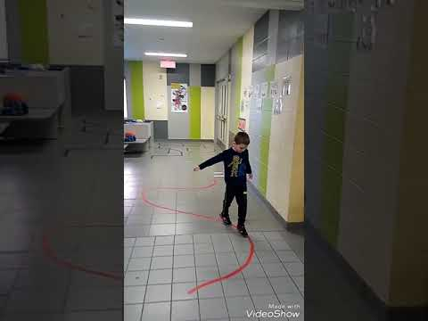
Brain Breaks for Elementary School Students
Exercise Balls
Flexible Seating
Balloon Volleyball
Riddles
Drawing pages
Whole Class Brain Breaks
Boogie (Dance) Breaks
Notes:
Elementary students have shorter attention spans and may get restless more quickly, for example they may max out with an activity after 10 minutes. Therefore, breaking school work up with frequent brain breaks can help keep students stay on task. Elementary students may do well on equal ratios of school work followed by the same amount of activity.
Brain break activities that may be fun for elementary school age include: Read slide…
Let’s watch a video of a hallway in a school that has been turned into a means in which elementary students can have fun and be physically active. Click on the photo on the slide to watch the video or use the following link - https://www.youtube.com/watch?app=desktop&v=laos8VosF0U

Slide 29
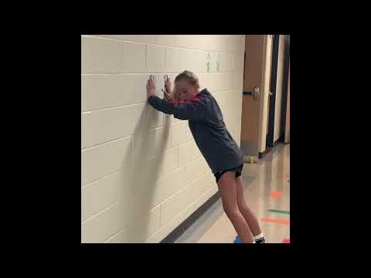
Brain Breaks for Middle School Students
Talent Show
Recess or Outside Time
Pick an object
Skip Counting
Brain Teasers
Notes:
Middle schoolers have a longer attention span than compared to elementary students so they may be able to stay focused on an academic task longer. However, allowing for longer brain breaks can be helpful as middle school students typically do not have the opportunity to participate in recess like elementary students.
Middle schoolers may enjoy participating in a talent show or going outside for a brain break. Another idea for middle schoolers is allowing students to pick an object or bring one from home. The student can hide the object and then describe the object allowing students the opportunity to try and guess what it is. Try having middle schoolers skip count around the room or work in groups to decipher brain teasers.
Let’s watch a video of an active hallway in a middle school. Click on the photo on the slide to watch the video or use the following link - https://www.youtube.com/watch?app=desktop&v=gNiL7R4LOk4

Slide 30
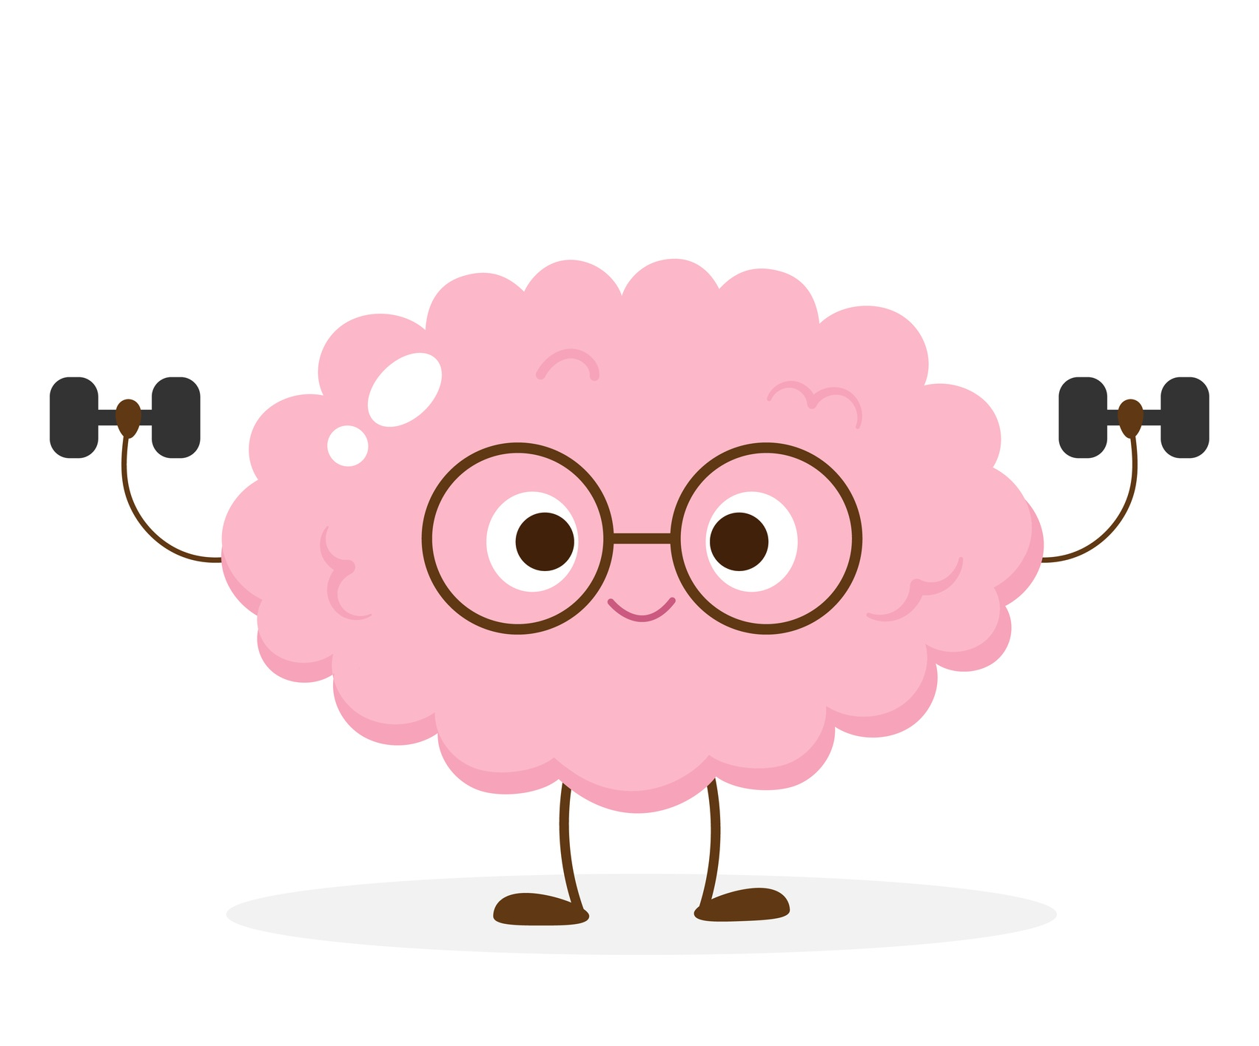
Brain Breaks for High School Students
Hallway Obstacle course
Nature Walk
Free Unstructured Breaks
Dance Party
Independent Brain Breaks
Notes:
Older students typically have a longer attention span and can last up to 30 minutes or more on an activity. Highschool students could very easily last an hour doing school work and then taking a short 3-5 minute break.
Allow for more flexibility with older students by letting them come up with their own brain breaks or allowing them to take brain breaks at unstructured times on an individual basis.
While breaks can help reset student focus, an alternative, especially for older students may be to change teaching strategies throughout a lesson. For instance, try having students team up on a think-pair-share activity or allow them to work in groups. These activities can help break up any restlessness or boredom from a long lesson.
Ideas for brain breaks with older students can include: read slide…

Slide 31
Virtual Brain Breaks
Charades
Virtual PE class
GoNoodle.com
Dance Videos – YouTube
Virtual Scavenger Hunt
Notes:
Social distancing and virtual learning should not deter teachers and schools from developing and incorporating brain breaks throughout the school day.
Implementing brain breaks throughout the day can help make learning less stressful in both in-person and virtual learning modalities. Brain breaks can be just as effective in a virtual world adding structure to the day, giving students and teachers a break from staring at a screen and providing needed physical activity to recharge the brain.
Many of the same implementation strategies and brain break ideas that are used in the physical classroom can be used in a virtual format or can be slightly adapted to work with remote learning. One could argue that remote learners may benefit even more from physical activity breaks in order to keep students engaged and give them a break from sitting in front of a screen!
Having students participate in brain breaks during remote learning allows for students to freely socialize and get physically activity during the school day…something many are desperately missing while learning remotely.
Ideas for virtual brain breaks may include… Read Slide…
Charades
Virtual PE class
GoNoodle.com
Dance Videos – YouTube
Virtual Scavenger Hunt

Slide 32
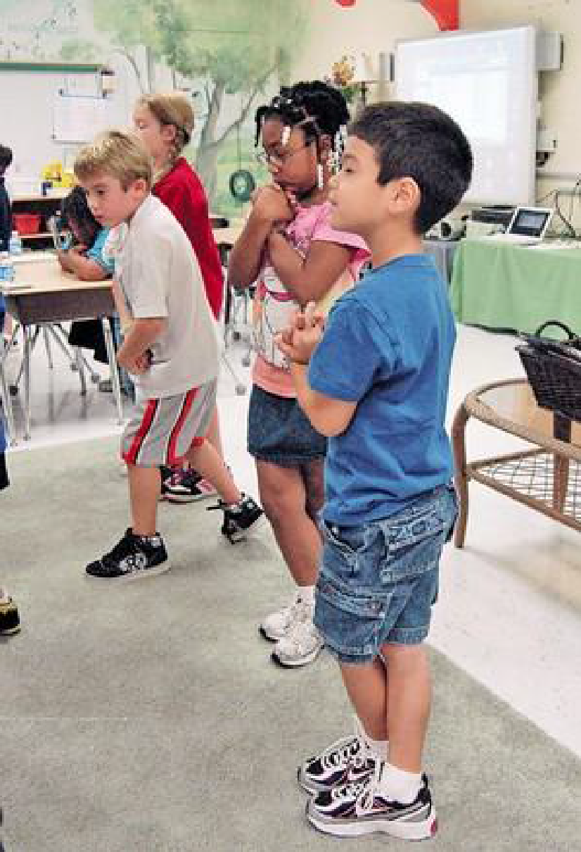
Tips and Hints
Play age appropriate music
Use age appropriate movements
Make adaptations or modify for students where needed
Let students choose the activity
Vary the activities and equipment and body parts
Most of all make it fun!
Notes:
Consider these tips and hints as you consider incorporating brain breaks into the school day. Read Slide.

Slide 33
Tips and Hints
Activities should allow for maximum participation of students.
Accommodations are made for students with disabilities.
Be sure to not use exercise as punishment.
Encourage participation but do not force participation.
Use valid, reliable assessment and evaluation strategies.
Emphasize student learning, fair play and personal health & wellness.
Provide a culture and atmosphere of safety.
Notes:
Some other tips and hints include:
Activities should allow for maximum participation of students.
Accommodations are made for students with disabilities.
Be sure to not use exercise as punishment.
On the flip side, encourage participation but do not force participation. Brain breaks ask students to move or perform a skill that some students may not be comfortable doing in front of others. Brain breaks should be seen as safe and not as a stressor for students. If a student chooses not participate in a brain break, teachers should encourage participation, but if the student remains calm and is not disruptive, students should not be forced to participate.
Use valid, reliable assessment and evaluation strategies
Emphasize student learning, fair play and personal health & wellness.
Provide a culture and atmosphere of safety.

Slide 34
Brain Break Sharing
What are your student’s
favorite brain breaks?
Notes:
Activity: Brain Break Sharing
Procedure:
Ask participants to share some of their student’s favorite brain breaks, either by unmuting and sharing or typing in the chatbox.
Estimated Time:
5 minutes

Slide 35
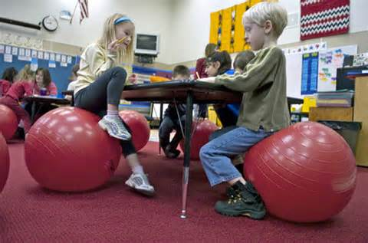
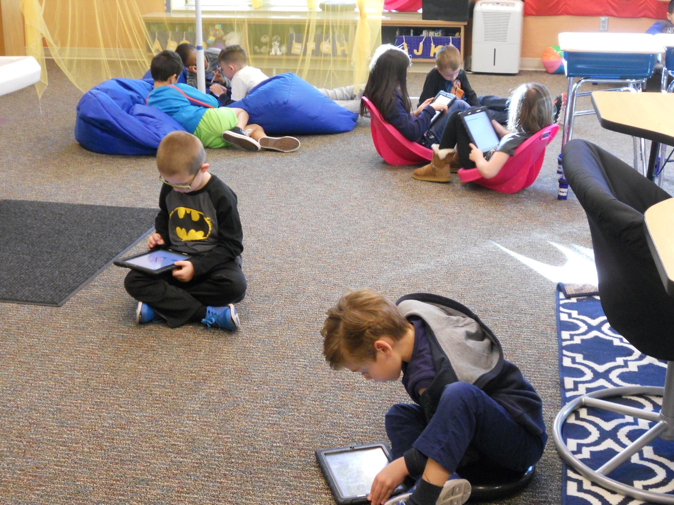
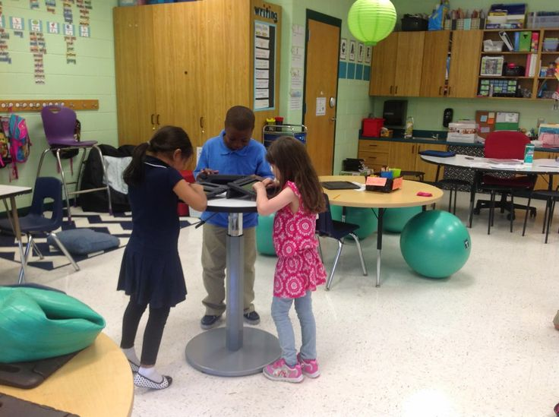
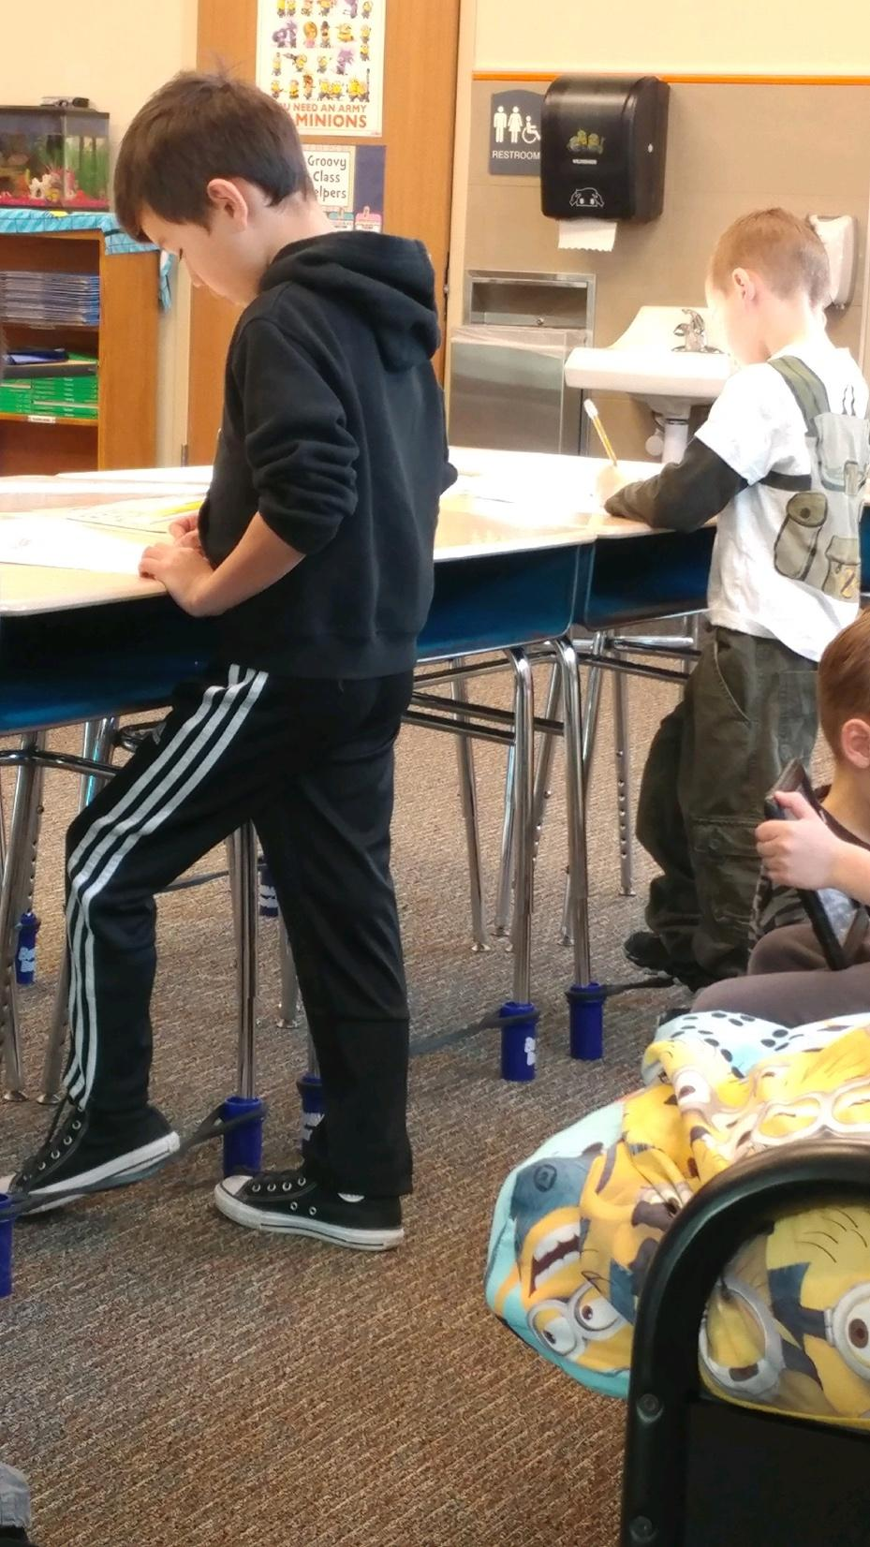
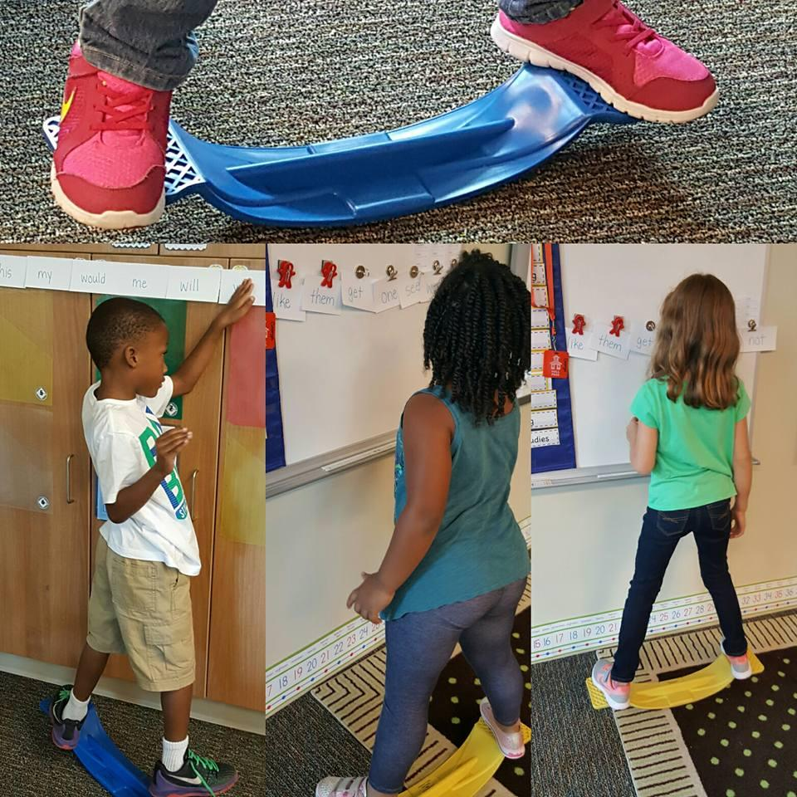
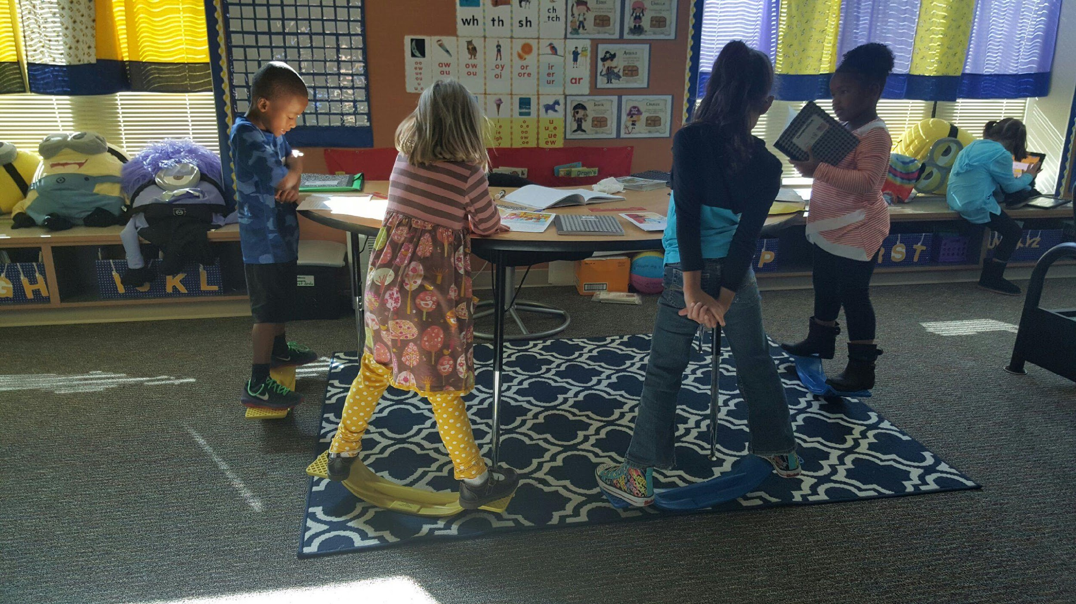
Active Classrooms
Notes:
Another means in allowing students to be active in the classroom is through flexible seating. Flexible seating is the practice of allowing and providing many seating options for students. This means having different types of seats like yoga balls, chairs, couches, stools, etc. ... Flexible seating works similar to fidget toys and allows students to fidget by bouncing on a ball, standing, balancing on a wobble chair.
Here are some pictures of active classrooms! As you can see there are different types of seating, standing desks, balance boards, wooble stools, modular seating, floor seats, and balance boards.

Slide 36
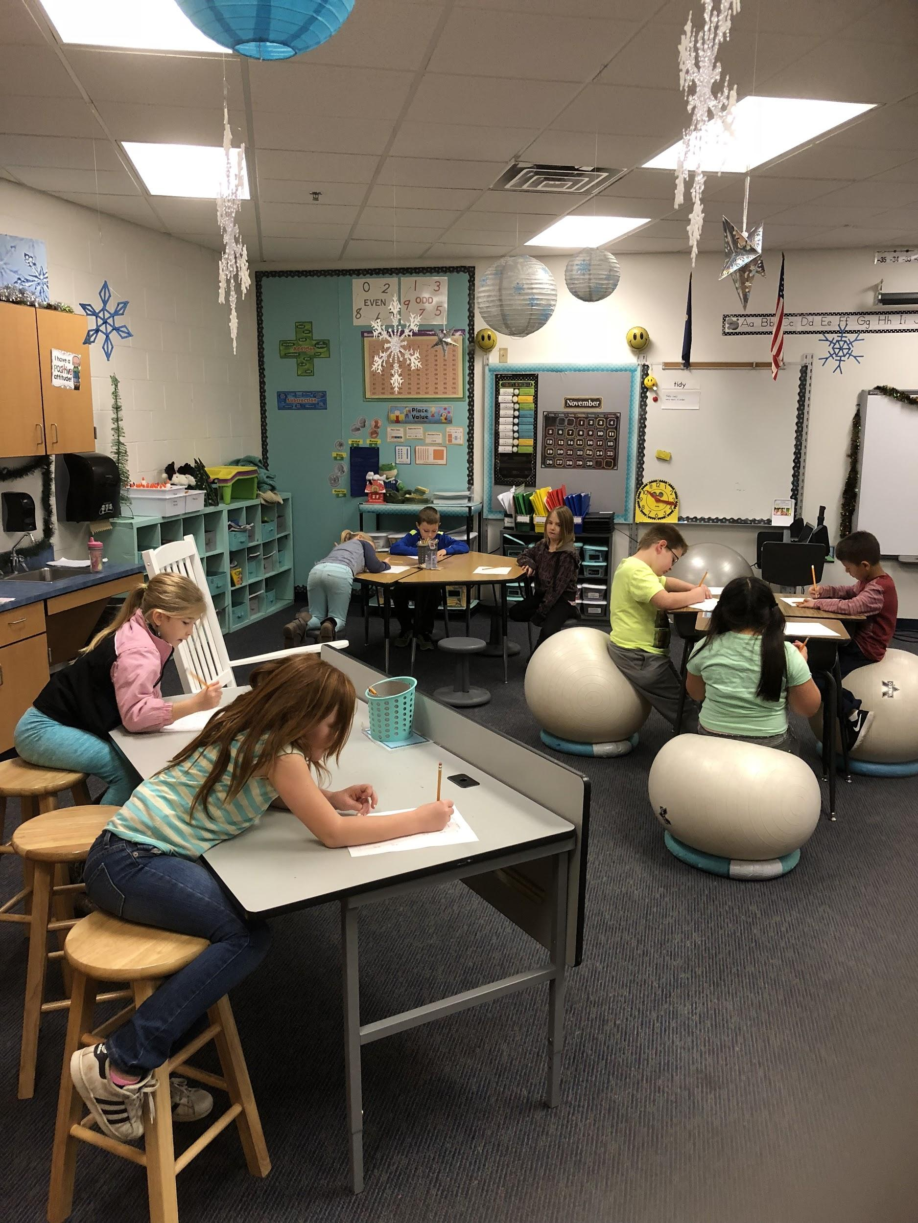
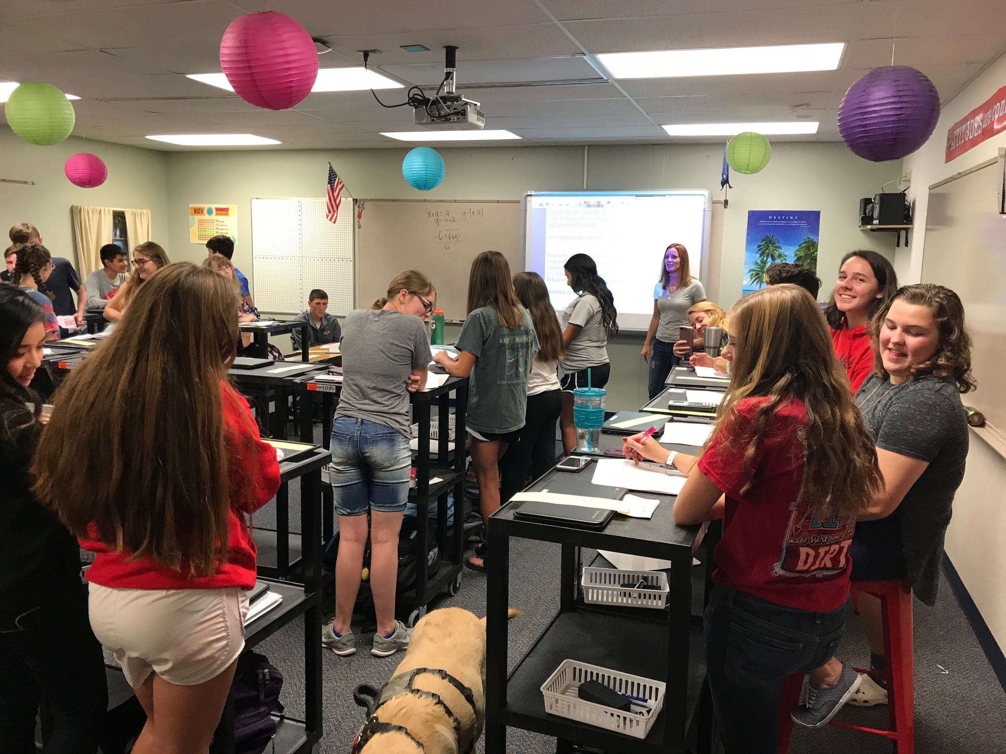
Examples of Flexible Seating in the Classroom
Notes:
Flexible seating provides a break from sitting on a standard chair and adds variety in the classroom. As shown in these pictures, raised tables/carts with the option of stools give students the choice to stand or sit while learning. Notice the carts are on wheels which would allow for movability around the classroom. Schools may utilize stability balls in replacement of chairs or wobble chairs or even couches.
The ideas for seating are endless…
Bean bags
Couches
Exercise/Stability Balls
Wobble chairs,
Options of sitting on the floor.
Balance Discs
Stools
Cushions
Crates
Mats
Standing desks
Pillows
Scoop chairs etc.

Slide 37
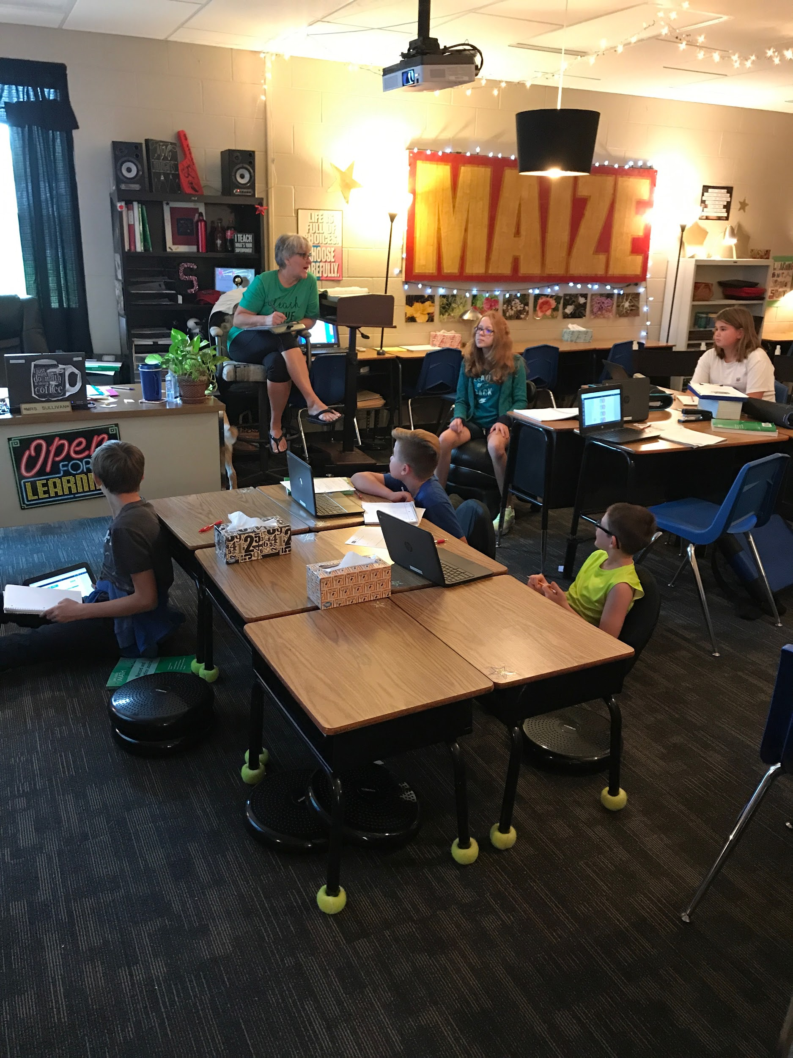
Flexible Seating – Implementation
Research different ways of acquiring flexible seating:
Purchasing
School Made
Requesting Donations
Grant Funding
Establish expectations for use and behavior:
Share the plan for sharing and how students may choose a type of seat.
Let students know that the teacher can move anyone at anytime.
Notes:
When implementing flexible seating it is important to consider the following:
Read Slide…

Slide 38
Supporting Brain Breaks in Schools
Notes:
Let’s explore some valuable tools and resources that schools can use to promote a healthy school environment and encourage physical activity throughout the school day.

Slide 39
Create Wellness Policies Focused on Physical Activity
A written document that guides a local education agency (LEA) or school district’s efforts to establish a school environment that promotes students’ health, well-being, and ability to learn.
Federal and State Law requires that local educational agencies participating in the school meal programs establish a local school wellness policy.
Notes:
Schools can ensure that brain breaks are implemented by creating and executing wellness polices that include physical activity throughout the day and beyond. Wellness policies are a written document that guides a local education agency or school district’s efforts to establish a school environment that promotes students’ health, well-being and ability to learn. Research has shown that well-designed, well-implemented school wellness programs and policies can effectively promote healthy habits. Promoting healthier school environments supports students’ learning and behavior.
Federal and state law requires that local educational agencies participating in the school meal programs establish a local school wellness policy.
Local educational agencies are required to establish local school wellness policies which, at a minimum, include goals for nutrition, nutrition promotion and education, physical activity, and integrated school-based activities that promote student wellness.
Kansas law supports the federal requirement for local wellness policies by directing the Kansas State Board of Education to “develop nutrition guidelines for all foods and beverages made available to students in Kansas public schools during the school day…In developing such guidelines, particular attention shall be given to providing healthful foods and beverages, physical activities and wellness education with the goals of preventing and reducing childhood obesity.” The state law also requires that “When establishing the wellness policy of the school district, the board of education of each district shall take into consideration the guidelines developed by the state board…” The Kansas State Board of Education recently approved an updated version of the Kansas School Model Wellness Policy Guidelines in fall 2020.
Let’s explore the Kansas School Model Wellness Policy Guidelines…

Slide 40
Kansas School Wellness Policy Model Guidelines
Categories:
Nutrition
Nutrition Promotion and Education
Physical Activity
Integrated School Based Wellness
Levels:
Implementing
Transitioning
Modeling
Notes:
The Kansas School Wellness Policy Model Guidelines were developed to assist Sponsors in establishing and implementing local school wellness policies that meet minimum standards designed to support a school environment that promotes sound nutrition and student health, reduces childhood obesity and provides transparency to the public on school wellness policy content and implementation.
State law requires that each school board consider these guidelines when developing local wellness policies. The model guidelines are divided into four categories of policy statements:
1) Nutrition 2) Nutrition Promotion and Education 3) Physical Activity and 4) Integrated School Based Wellness.
Each policy statement falls within one of three levels:
The policy statements at the IMPLEMENTING level meet all requirements of current federal and state laws, regulations and policies.
The policy statements at the TRANSITIONING level show growth from the implementing level.
The policy statements at the MODELING level reflect highly effective practices.

Slide 41
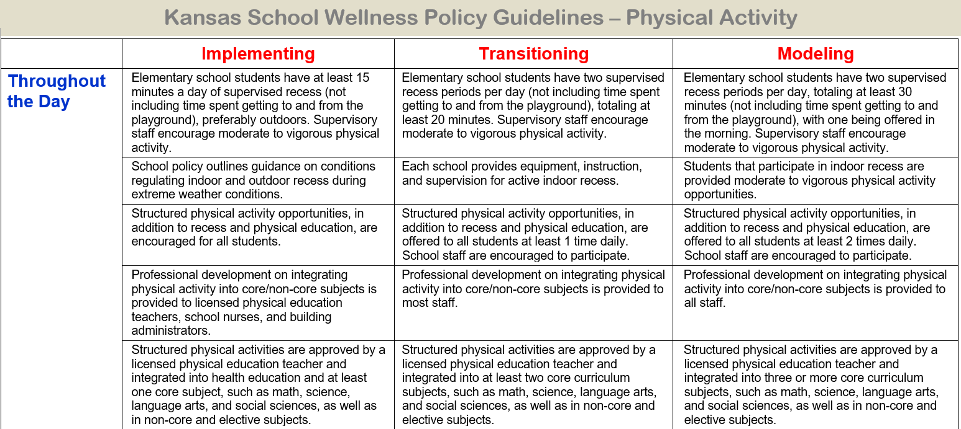
Notes:
Within the Physical Activity Category there are a number of recommendations regarding physical activity throughout the school day at the implementing, transitioning and modeling levels.
At the modeling level, which reflects highly effective practices the guidelines state the following regarding brain breaks:
Structured physical activity opportunities (i.e. Brain Breaks) in addition to recess and physical education, are offered to all students at least 2 times daily. School staff are encouraged to participate.
Structured physical activity are approved by a licensed physical education teacher and integrated into 3 or more core curriculum subjects such as math, language arts, and social studies as well as non-core and elective subjects.
Professional development on integrating physical activity into core/non-core subjects is provided to staff.
Lets do a poll to see how many of your districts meet the modeling level policy regarding offering students the opportunity to participate in structured physical activity opportunities (i.e. Brain Breaks) 2 times daily, in addition to recess and physical education.
Launch Poll: Does your School offer the opportunity for structured physical activity at least 2 times daily, in addition to recess and PE?

Slide 42
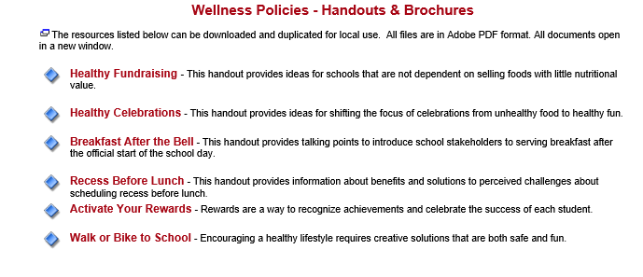
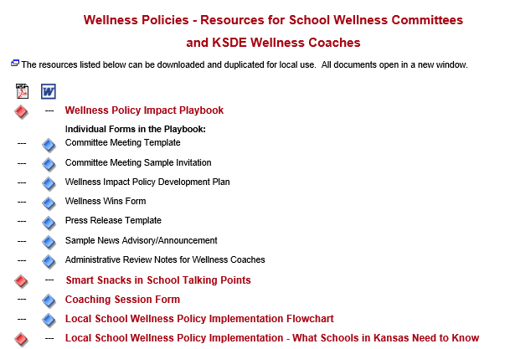
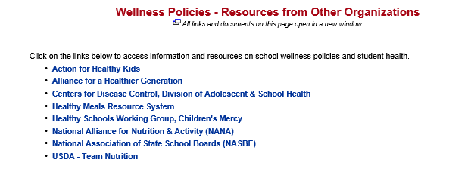
www.kn-eat.org, School Wellness Policies
Notes:
There are several tools on the Child Nutrition & Wellness website, designed to assist with assessing a district’s current situation, setting wellness policy goals, and implementing activities to support established goals. Access to these tools is through the Kansas State Department of Education, Child Nutrition & Wellness website at www.kn-eat.org, School Wellness Policies
Under Creating Healthier Schools Handouts and Brochures find handouts and brochures to assist in creating a healthier school environment
Under "Resources From Other Organizations, there are links to Action for Healthy Kids, Alliance for a Healthier Generation, Centers for Disease Control and Prevention, and other reputable organizations.
Under Resources for School Wellness Committees and KSDE Wellness Coaches, there are downloadable documents in the Wellness Policy Impact Playbook, and links to more online school wellness resources, such as Kansas Team Nutrition.

Slide 43
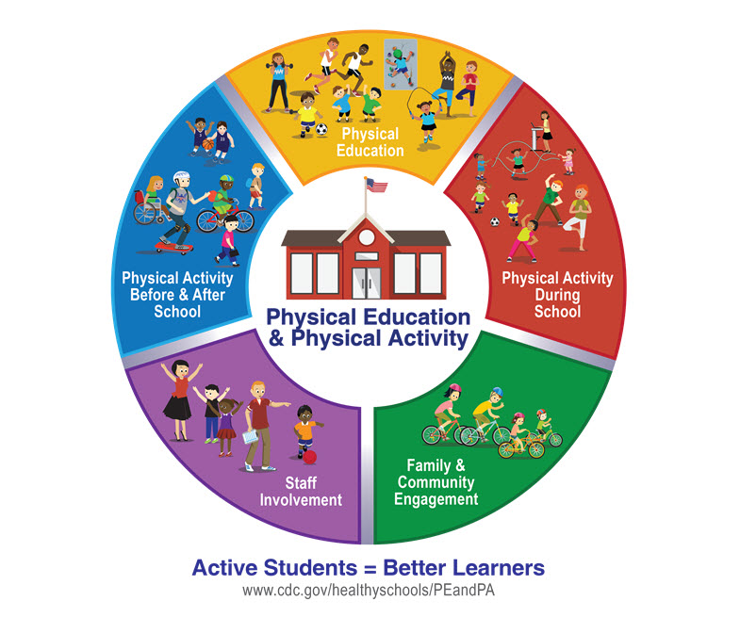
CDC Resources
Comprehensive School Physical Activity Program
Notes:
The national recommendation for schools is to have a comprehensive approach for addressing physical education and physical activity in schools.10–12 This approach is called Comprehensive School Physical Activity Programs.13
Utilize the Comprehensive School Physical Activity Program or the Strategies for Classroom Physical Activity in Schools developed by the CDC to assist with planning for physical activity in the classroom.

Slide 44
CDC Classroom Physical Activity Promotion Kit
Notes:
The CDC has developed a helpful tool for implementing physical activity in the classroom. The Classroom Physical Activity Promotion Kit. The ten steps include:
Identify who will help in planning for classroom physical activity.
Identify classrooms where physical activity practices already exist.
Provide professional development/in-services.
Identify approaches to incorporate classroom physical activity.
Identify opportunities and appropriate times for classroom physical activity.
Identify materials, technology and resources to promote classroom physical activity.
Identify ways to create and use classroom space.
Ensure that classroom physical activity is appropriate and safe for all students and communicate expectations.
Collect information on classroom physical activity.
Share best practices, challenges and lessons learned.

Slide 45
Kansas Association for Health, Physical Education,
Recreation & Dance
Mission: Seek to promote and advocate for
healthy, active Kansans.
www.kahperd.org
Notes:
The Kansas Association for Health, Physical Education, Recreation and Dance website, www.kahperd.org provides access to numerous resources and physical activity programs that can be helpful to schools in creating active schools!

Slide 46
Tools and Resources for Schools
BAM! Body and Mind
https://www.cdc.gov/healthyschools/bam/teachers.htm
Nutrition Based Physical Activity Games - Action for Healthy Kids
https://www.actionforhealthykids.org/activity/nutrition-based-physical-activity-games/
Active Schools Movement
https://www.activeschoolsus.org/
GoNoodle
https://www.gonoodle.com/
PE with Joe
https://www.thebodycoach.com/blog/pe-with-joe
Notes:
A quick google search will reveal hundreds of physical activity breaks that can be incorporated throughout the school day! Here are a few websites that can assist in providing ideas for brain breaks during the school day.
As time allows, click on the links and explore the resources with participants so they can become familiar with the listed resources.

Slide 47
Summary
Brain Breaks can be easy and fun to implement!
Numerous resources are available to assist schools in integrating brain breaks into the daily routine.
Physical activity may improve school performance and achievement.
Healthy students are better performing students!
Notes:
Ensuring that students have the opportunity to participate in physical activity throughout the school day results in many benefits to students, teachers and the school community. Schools have a responsibility to ensure students and staff work in a healthy environment. Schools can do this by encouraging physical activity which enhances a students’ readiness to learn in turn making it easier for teachers to instruct.
Brain Breaks can be easy and fun to implement! There are different types of brain breaks for every situation and every type of learner. Brain breaks can occur in the classroom, at home or virtually anywhere. Numerous resources are available to assist schools in integrating brain breaks into the daily routine.
Physical activity breaks whether short bouts, PE class or recess help promote fitness and boost brain health and support cognitive development. Decades of research demonstrates physical activity may improve school performance and achievement.
Healthy students are better performing students!

Slide 48
USDA Nondiscrimination Statement
In accordance with Federal civil rights law and U.S. Department of Agriculture (USDA) civil rights regulations and policies, the USDA, its Agencies, offices, and employees, and institutions participating in or administering USDA programs are prohibited from discriminating based on race, color, national origin, sex, disability, age, or reprisal or retaliation for prior civil rights activity in any program or activity conducted or funded by USDA. Persons with disabilities who require alternative means of communication for program information (e.g. Braille, large print, audiotape, American Sign Language, etc.), should contact the Agency (State or local) where they applied for benefits. Individuals who are deaf, hard of hearing or have speech disabilities may contact USDA through the Federal Relay Service at (800) 877-8339. Additionally, program information may be made available in languages other than English. To file a program complaint of discrimination, complete the USDA Program Discrimination Complaint Form, (AD-3027) found online at: https://www.usda.gov/oascr/how-to-file-a-program-discrimination-complaint, and at any USDA office, or write a letter addressed to USDA and provide in the letter all of the information requested in the form. To request a copy of the complaint form, call (866) 632-9992. Submit your completed form or letter to USDA by: (1) Mail: U.S. Department of Agriculture Office of the Assistant Secretary for Civil Rights 1400 Independence Avenue, SW Washington, D.C. 20250-9410; (2) Fax: (202) 690-7442; or (3) Email: program.intake@usda.gov. This institution is an equal opportunity provider.

Slide 49
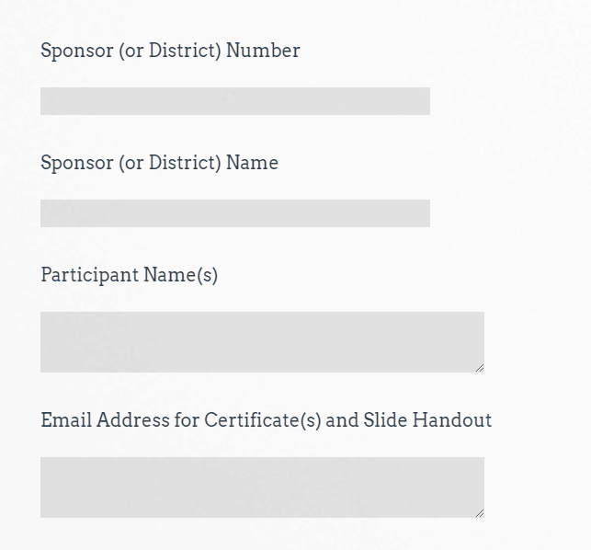
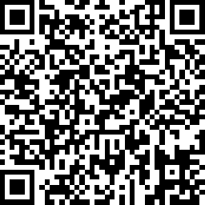
Attendance
Sample
https://www.surveymonkey.com/r/FGDVZ7V
Thank you for Attending!
Please contact us whenever you need assistance.
785-296-2276
Child Nutrition & Wellness
www.kn-eat.org
Brain Breaks
Notes:
Class attendance will be conducted electronically through Survey Monkey. Participants must complete the survey to receive a certificate of completion. Participants may use their phones, laptops, or nutrition program computer to access the survey electronically. Enter the link provided into the address bar of preferred web browser. If using a mobile device with a QR Code reader, scan the QR code that will be provided on the screen at the end of the session.
The attendance survey set up so that a lead person, such as the Director, can enter multiple names on the comment line of the attendance survey in Survey Monkey. This should make it easier to track group participation in the electronic delivery of these classes.
Certificates and the slide handout will be sent via email.

Slide 50
Thank you for attending!
Thank you for Attending!
Please contact us whenever you need assistance.
785-296-2276
Child Nutrition & Wellness
www.kn-eat.org

