Slide 1
Nutrition and Brain Function
Welcome to
Notes:
Display this slide prior to start of the class.
Add Slide File Handout contact information to the session’s chat box by copying and pasting from the title slide. Announce availability of the slide file aloud.
Welcome participants as they enter the session.
Perform periodic sound checks prior to the start of the class.
At the designated starting time, thank participants for coming, introduce yourself, and welcome them to the class.

Slide 2
Class Logistics
Class ending time
Participant materials
Recorded class
Mute and unmute features
Q&A protocol
Attendance
Notes:
Inform participants this is a two hour class and will end by (insert time that is two hours from planned start time).
Explain that the Slide File is available upon request as an email attachment. Add contact information to chat box by copying and pasting from title slide.
Let participants know that the class will be recorded, if applicable. (record class to the Cloud).
Inform participants that they can mute and unmute their audio. When in “unmute” mode, their conversations and background noise can be heard.
Encourage participants to ask questions and provide comment as appropriate to the class content. Explain that participants may ask questions or provide input by unmuting their audio or typing in the chat box.
Attendance will be taken at the end of class via a Survey Monkey survey. It is important to complete the Attendance Survey in order to receive a Certificate of Completion for the class. The Attendance Survey will ask for three pieces of information, Sponsor Number, Sponsor Name, and Names of Attendees. For example, Sponsor Number for a public school is the USD designation. Sponsor Name for a public school is the name of the school district. As an added note regarding the Attendance Survey, multiple attendees from one Sponsor can be included in a single Attendance Survey.

Slide 3
Objectives
Describe brain basics: development, structures and functions related to learning.
Explain the role of nutrients in the brain and key food sources.
Discuss nutrition’s impact on academic achievement.
Understand consequences of poor nutrition on brain function.
Explore ways schools can optimize nutrition to maximize academic achievement.
Notes:
Nutrition is a key environmental component that can impact the growth, and development of the brain and ultimately impact the learning success of students. This class provides information about the development, structures and the cognitive functions of the brain, while highlighting nutrition’s impact on cognition and academic achievement. This class also covers best practices on how to play a role in optimizing child nutrition status to improve brain function, leading to successful academic performance. By the end of this class, participants will be able to… read slide.

Slide 4
Brain Basics
Notes:
The brain is one of the largest and most intricate organs, performing many complex functions, and regulating all bodily processes.

Slide 5
Brain Development
Formation begins during pregnancy.
Accelerated development through the age of 3.
Most development complete by early adulthood.
Notes:
Brain formation begins during pregnancy, accelerates during early childhood and reaches approximately 90% of adult volume by age 6. Brain development continues at a slower pace during adolescent years with some parts of the brain continuing to develop into early adulthood and throughout the remaining lifespan.

Slide 6
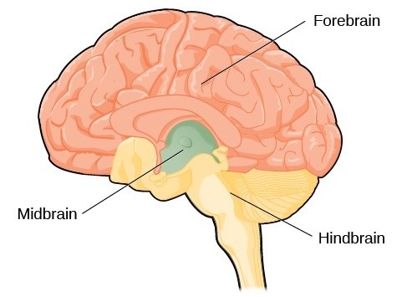
Brain Structure
Three Basic Units
Forebrain
Midbrain
Hindbrain
Notes:
The brain is structured into three basic “units” read slide…
The forebrain hosts the largest and most advanced part of the brain including the cerebrum and cerebral cortex where intellectual activities occur.
The midbrain houses the uppermost part of brain stem and is the relay station for sensory and motor information that controls reflexes, eye movements and voluntary movement.
The hindbrain includes the cerebellum, brain stem, upper part of the spinal cord including the medulla oblongata and pons; controlling the body’s vital functions such as breathing, heart rhythm, digestion and coordinating body movements and posture.

Slide 7
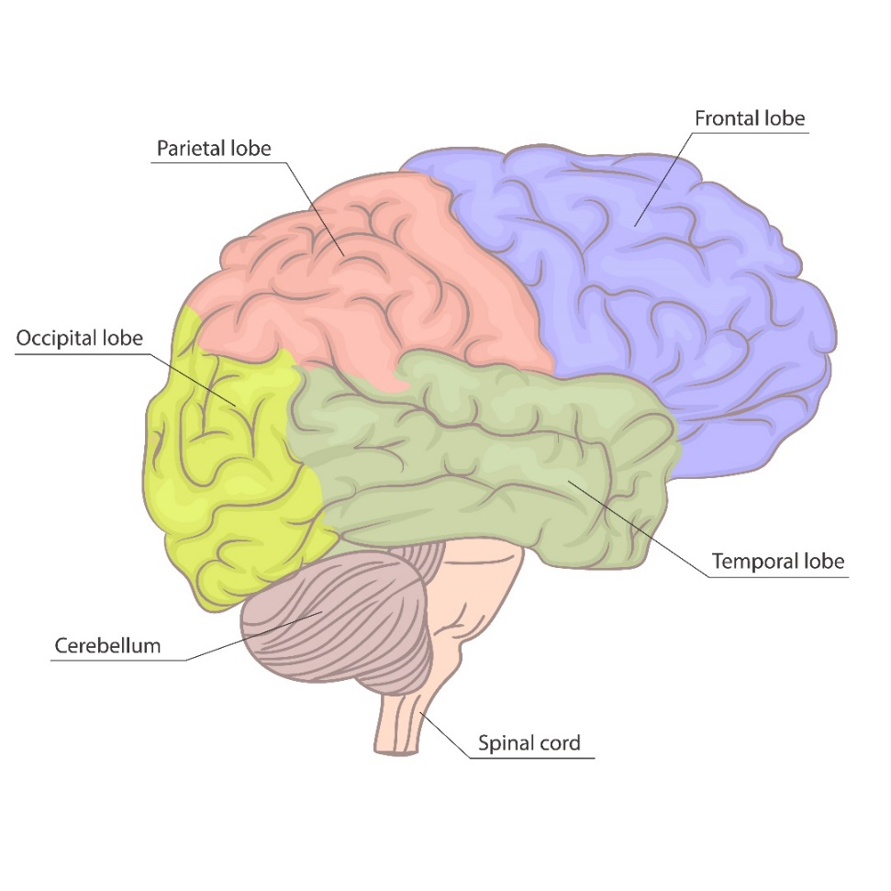
Brain Structure
Cerebral Cortex and Cerebrum – Information Processing
Frontal Lobe
Parietal Lobe
Occipital Lobe
Temporal Lobe
Notes:
The cerebral cortex and cerebrum, the outer most layer of the brain, primarily make up the forebrain. This is a vital and advanced part of the brain where a majority of information processing and cognitive functioning occurs. The cerebrum is constructed of multiple lobes and is further broken into two hemispheres that communicate with each other controlling intellectual activities.
The lobes of the cerebrum include… read slide.

Slide 8
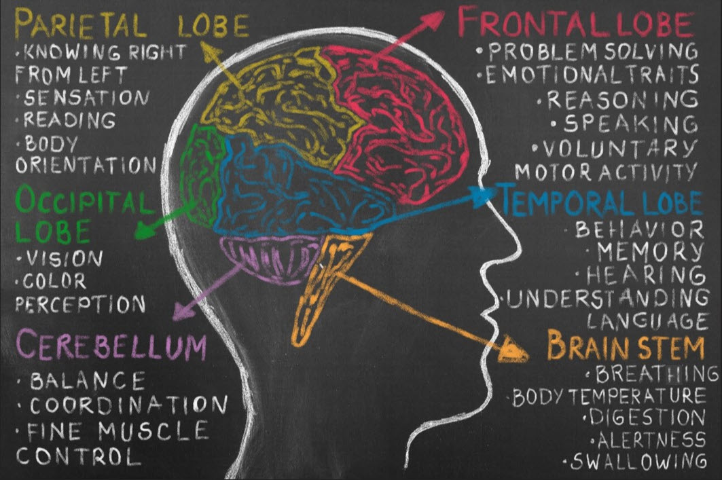
Functional Areas of the Brain
Notes:
This diagram shows some of the cognitive functions that occur in the different lobes of the cerebrum. Cognitive function refers to higher order mental processes that help us gather and integrate information; encompassing self-control, cognitive flexibility, working memory and attention.
The frontal lobe is responsible for emotions, reasoning, planning, speech, judgement, and problem solving. The frontal lobe also contains a motor area that assists in voluntary movements.
The parietal lobe is responsible for primary processing of nerve impulses from sensory data. In addition, some language function such as reading occurs in this area of the brain.
The occipital lobe is responsible for vision and recognizing objects.
The temporal lobe is responsible for hearing, behavior, accessing memories, and understanding language. This area also plays a role in emotion.

Slide 9
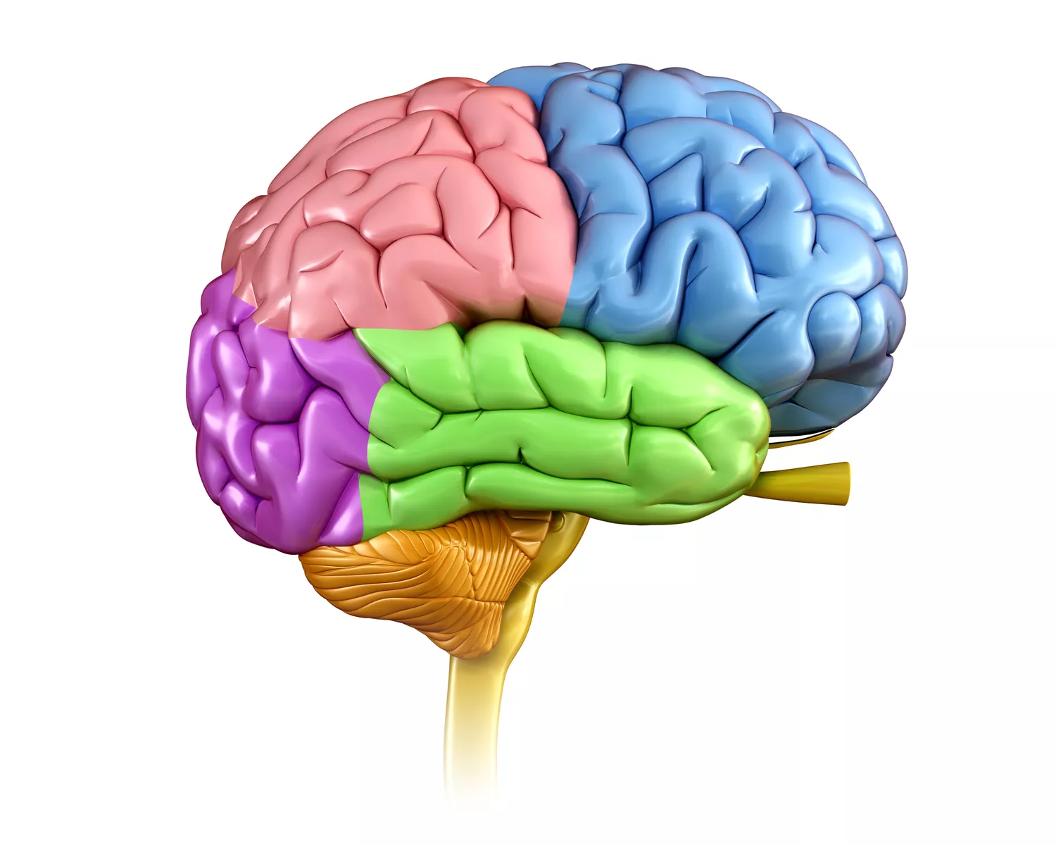
“Lobes of Fun!”
A
C
D
B
Notes:
Poll Activity: Lobes of Fun!
Let’s have “Lobes of Fun!” See if you can remember the lobes of the brain.
Poll Questions
Question #1: What is lobe A?
Frontal Lobe
Parietal Lobe
Occipital Lobe
Temporal Lobe
Remember the frontal lobe is responsible for emotions, reasoning, planning, speech, judgement, and problem solving. The frontal lobe also contains a motor area that assists in voluntary movements.
Question #2: What is lobe B?
Frontal Lobe
Parietal Lobe
Occipital Lobe
Temporal Lobe
The temporal lobe is responsible for hearing, behavior, accessing memories, and understanding language. This area also plays a role in emotion.
Question #3: What is lobe C?
Frontal Lobe
Parietal Lobe
Occipital Lobe
Temporal Lobe
The parietal lobe is responsible for primary processing of nerve impulses from sensory data. In addition, some language function such as reading occurs in this area of the brain.
Question #4: What is lobe D?
Frontal Lobe
Parietal Lobe
Occipital Lobe
Temporal Lobe
The occipital lobe is responsible for vision and recognizing objects

Slide 10
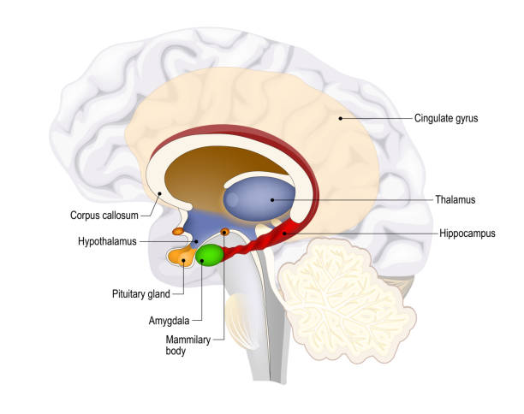
Additional Brain Structures and Function
Hippocampus
Thalamus
Hypothalamus
Basal Ganglia
Pituitary Gland
Amygdala
Notes:
The forebrain also contains additional structures such as the… read slide.
These structures assist with transmission of messages between the spinal cord and the cerebrum. Each having unique and vital roles including:
determination of emotional state,
sleep states,
initiation of movement,
control of endocrine system, and hormones,
memory transmission,
perception,
digestion,
and conversion of food to energy.

Slide 11
Role of Nutrients in the Brain
Notes:
Nutrition and diet quality over the lifespan can have a direct impact on the development, structure and cognitive activity of the brain.

Slide 12
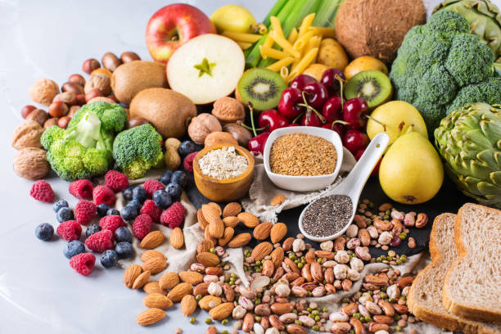
Nutrients
Macronutrients
Carbohydrates
Protein
Fat
Micronutrients
Vitamins
Minerals
Water
Notes:
In order for the brain to develop and operate properly it requires an array of quality nutrients coming from macronutrients or substances needed in relatively large amounts; (carbohydrates, protein, fat), and micronutrients, typically chemical elements needed in smaller amounts; (vitamins, minerals), and water. Additionally, fiber, prebiotics and probiotics have notable roles in the gastrointestinal tract, that may further impact brain function.
Research has demonstrated that special attention to diet should be taken early, during pregnancy and especially through the age of three where the brain is undergoing its most rapid and vulnerable development period.

Slide 13
Carbohydrates
Glucose - primary fuel for the brain
Carbohydrates sources
Whole grains, fruit, starchy vegetables, milk, beans, nuts and seeds, added sugars
Notes:
Carbohydrates consumed in the diet provide glucose, the primary and preferred fuel for the brain. The brain needs a constant supply of energy, accounting for more than 20%-30% of the body’s entire energy requirement. Glucose is used for nerve cell transmission and communication and to maintain brain cell vitality. The human brain is always on, therefore, continually requiring this fuel source.
Carbohydrates in the diet come from … read slide.

Slide 14
Proteins
Amino Acids - primary component of neurotransmitters
Quality Protein sources
Lean red meat, poultry, seafood, eggs, dairy, soybeans, quinoa, buckwheat, and chia seeds
Notes:
Proteins consumed in the diet provide amino acids, the building blocks necessary for growth, repair and optimal brain function. There are 20 different amino acids, 9 of them classified as essential, which means they can not be made by the body. Amino acids make up part of cell membranes and aid in formation of neurotransmitters. Neurotransmitters are the chemical messengers assisting with brain cell communication. Amino acids also help in the important task of transporting glucose into the brain. Proteins play a major role in early brain development and everyday brain functions.
It is important to consume quality protein sources in the diet to obtain amino acids. Quality proteins come mainly from animal sources which supply the body with the 9 essential amino acids, however, there are some plant based proteins that do contain amino acids. Most plant protein sources, however, do not contain all of the essential amino acids, so it is beneficial to eat other complementary protein sources during meals or throughout the day, such as rice and beans.
Sources of quality proteins include… read slide.

Slide 15
Fats
Fatty Acids - primary component of brain neurons structure and function, cell membranes, neurotransmitters, hormones
Fat sources
Omega 3
Oily fish (such as salmon, herring, mackerel, tuna and sardines), fish oil, flaxseed oil, flaxseeds, walnuts, and chia seeds
Omega 6
Peanut oil, olive oil, safflower oil, sunflower oil, corn oil, soybean oil, sunflower seeds, eggs, walnuts, pumpkin seeds
Notes:
Consuming unsaturated fats, commonly known as “healthy” fats, can provide the body with the essential fatty acids omega 3; alpha-linolenic acid (ALA) and omega 6; linoleic acid (LA). These fats are considered essential because they are not made in the body and must be obtained through the diet. Essential fatty acids are a main structural component of the brain. The brain is comprised of about 50% fat. Fatty acids play a key role in nerve formation and are needed for the development of and primary functions of neurotransmitters, hormones and immune molecules as well as play vital roles in structure and function of brain neurons and how well they communicate with one another.
Omega 3 and Omega 6 fatty acids have been researched extensively in relation to brain development, cognition, attention and overall health and can be beneficial for optimal brain development and function.
It is important to note, even though both omega 3 and omega 6 are essential, it is still recommended to consume more omega 3 fatty acids than omega 6 fatty acids.
Omega 3 food sources include… read slide.
Omega 6 food sources include… read slide.

Slide 16
Vitamins
Micronutrients – function as cofactors in chemical reactions in the brain
Water Soluble Vitamins
B-complex and C
Fat Soluble Vitamins
A, D, E, and K
Notes:
Vitamins, one type of micronutrient, are essential organic compounds obtained from eating a variety of animal and plant foods. There are 13 major vitamins including water soluble vitamins; B-complex and C, and fat soluble vitamins; A,D,E, and K. While vitamins are only needed in small amounts, they are required for proper brain function. Vitamins function as cofactors in chemical reactions in the brain. They play a role in nerve conduction and cellular activity in the brain, acting as co-enzymes in breakdown and synthesis reactions, including energy production, protection of brain cells from oxidation, and the creation of neurotransmitters and hormones.
The brain is highly susceptible to oxidative damage due to it’s vulnerable fatty acid cell membranes, therefore, it is important to make sure the diet includes the right amount of vitamin rich, nutrient dense foods to maintain proper brain function.

Slide 17
Minerals
Micronutrients – function as cofactors in chemical reactions in the brain
Minerals
Sodium, potassium, calcium, phosphorus, chloride, magnesium, sulfur, iron, manganese, copper, iodine, zinc, cobalt, fluoride, selenium
Notes:
Minerals another type of micronutrient, are essential inorganic compounds that can not be made by the body and must be obtained from food. They are typically needed in small amounts, yet still are required for proper brain function. Minerals play a similar role like vitamins do in cellular activity in the brain. Minerals aid in cellular metabolism and central nervous system cell division. Research has shown that iron, iodine and zinc specifically can have a profound effect on cognitive development.
Minerals include… read slide.
Deficiencies in any micronutrients - vitamins, minerals can have negative consequences on brain development and functioning.

Slide 18
Water
Vital for life - transport of nutrients to the brain and cushions brain tissue.
Brain is approx. 75% water
Body is approx. 60% water
Fluids
80% from fluids consumed
20% from foods consumed
Notes:
Water is critical for life and is one of the most necessary components of the brain. The brain is comprised of approximately 75% water and the body is approximately 60% water, therefore, survival does not continue long without consuming it.
Water is essential for carrying out many brain functions, including transporting nutrients and cushioning the brain. Water is obtained from more than just drinking water. Foods consumed, and other fluids can provide water.
Approximately 80% of fluid intake comes from consuming beverages and about 20% comes from consuming foods.
It is important to note that brain function decreases without proper hydration. Even mild dehydration, a body water loss of 1%, has been shown to cause cognitive impairments. Detrimental effects from dehydration include: poor concentration, fatigue, slower reaction time, memory problems as well as moodiness and anxiety.

Slide 19
Fiber
Fiber – keeps the gut healthy; affects digestion and nutrient absorption, may help reduce body and brain inflammation
Two categories of fiber
Soluble and insoluble
Fiber sources
Whole fruits, vegetables, whole-grain foods (breads, cereals, oats, wheat bran), beans, peas and lentils, nuts and seeds
Notes:
Consuming a fiber-rich diet helps maintain a healthy gastrointestinal tract and some research is showing that this can have positive impacts on brain function.
Fiber is an edible, but non-digestible part of carbohydrates and plant foods. There are two categories of dietary fiber, soluble and insoluble. Insoluble fiber goes through the digestive tract virtually unchanged. It’s role is to provide a “feeling of fullness”, assist in waste transit through the digestive system by creating bulk in the stool and helping to relieve constipation. Soluble fiber absorbs water in the gastrointestinal tract forming a gel that softens waste, and binds to cholesterol and sugar, which has a positive effect of slowing absorption of these nutrients into the blood stream.
Dr. Keith Ayoob, nutrition expert, provides evidence of the benefits of a high fiber diet on human behavior. He believes a healthier gut equals less depression, less anxiety, improved focus/attention and multitasking. Additionally, researchers at the University of Illinois, concluded soluble fiber, in particular, is beneficial to the brain; influencing cognitive control in children.
High fiber foods, include… read slide.

Slide 20
Prebiotics and Probiotics
Probiotics – aid in digestion, absorption and immune function.
Prebiotics – food for probiotics.
Prebiotic foods
Whole fruits, vegetables, beans, oats, whole grains, onions, garlic
Probiotic/fermented foods
Yogurt, tempeh, raw sauerkraut, cottage cheese
Notes:
There has been some research providing evidence that a healthful diet including foods that contain prebiotics and probiotics can keep the gastrointestinal tract and brain functioning effectively. Millions of probiotics or “good” bacteria inhabit the gut, making up the microbiome. Probiotics play an important role maintaining a proper balance in the gut. These tiny microorganisms aid in digestion and absorption, contribute to immune function, and ultimately help the body and brain function correctly. In order for probiotics to flourish in the intestines they need prebiotics, which can come from insoluble fiber. Prebiotics are the fuel source or sugars that feed the “good” bacteria.
Although, the gastrointestinal tract does not directly participate in cognitive functioning, recent research indicates a healthy microbiome may have a positive effect on the brain.
Gut healthy prebiotic foods include … read slide.
Probiotic foods include… read slide.
Instructor note. Tempeh is a fermented soy product. Not all fermented foods or cottage cheese brands for example contain probiotics. Check ingredient labels to look for the words live active cultures.

Slide 21
Nutrition’s Impact on Academic Achievement
Notes:
A large body of scientific evidence suggests a strong connection between nutrition and cognitive function resulting in a positive effect on academic achievement.

Slide 22
Cognitive Functioning
Mental processes that help gather and integrate information occurring in different parts of the brain.
Executive Functions
Working Memory
Problem Solving
Reasoning and Planning
Notes:
As mentioned earlier cognitive function refers to a variety of mental processes that occur throughout different parts of the brain. The brain’s executive functions, those critical to learning, include… read slide.

Slide 23
Optimize Cognition with Nutrition
Optimizing brain functions with nutrition = better students
creative thinking and decision making
planning and organizing
reasoning and trouble shooting
multitasking
Notes:
Research has demonstrated that cognitive functions such as:
creative thinking and decision making
planning and organizing
reasoning and trouble shooting and
multitasking
…are optimized through consuming healthy, nutrient dense foods. Thus, helping students perform better academically.

Slide 24
Academic Achievement
CDC describes academic achievement as:
Academic performance (class grades, standardized tests, and graduation rates).
Education behavior (attendance, dropout rates, and behavioral problems at schools).
Students’ cognitive skills and attitudes (concentration, memory, and mood).
Notes:
So how is academic achievement or success defined?
The CDC defines academic achievement as… read slide.

Slide 25
CDC Core Messages
Healthy students are better learners.
Schools can influence eating and physical activity behaviors.
Healthy, successful students help build strong communities.
All students deserve the opportunity to be healthy and successful.
Notes:
The CDC’s core messages to help improve the health of students is as follows.
Healthy students are better learners
Healthy students are better on all levels of academic achievement.
2. Schools can influence eating and physical activity behaviors.
Students spend much of their time at school and may eat as many as 2 out
of 3 meals per day and may get much of their physical activity at school as well.
3. Healthy, successful students help build strong communities
Investing in the health of students contributes to healthy communities in the future.
4. All students deserve the opportunity to be healthy and successful.
Providing access to healthy foods and physical activity plays an important role in
the academic achievement of students.
The CDC has great resources for promoting healthy school environments available at www.cdc.gov/healthyschools.

Slide 26
Importance of Academic Success
Higher student attendance
Improved grades and standardized testing score
Increased graduation rates
Students better prepared for college, workforce, or military
Money saved by students, families, schools
Overall positive future for local businesses and community
Notes:
It pays dividends to promote nutrition and support a healthy school environment to maximize students academic success.
When students are healthier, academic success may be easier to accomplish. It is important for students to succeed academically, as there are many benefits for students, schools, businesses, communities, and the nation including:
Higher student attendance. Children who are in school, versus being absent, are learning.
Improved grades and standardized test scores.
More productive students, positively affecting graduation rates.
Students are better prepared for college, workforce or the military.
Money is saved by students, families, and schools. Schools specifically spend less staff time tending to and supporting underperforming students who may have medical issues associated with obesity or behavioral issues.
Less money is spent on chronic diseases and health care.
Academic success can have an overall powerful and positive effect on the future of local businesses and the community as a whole.

Slide 27
Outcomes of Good Nutrition
Faster learning and advanced retention
Increased attentiveness and engagement
Greater comprehension of information
Better problem-solving abilities
Improved memory
Enhanced decision making
Positive behaviors
Notes:
Studies show that children who eat healthy foods learn more quickly and retain what they are learning. Reports from academic institutions demonstrate that students are more engaged and comprehend information better when they are properly fed.
Outcomes of good nutrition on cognitive function include… read slide.

Slide 28
“Total Recall”
Notes:
Activity: Total Recall
Let’s do a fun activity to challenge our brains. The average person’s short-term memory can hold about 7 pieces of information. This test will help determine your limit.
Ask participants to grab a sheet of paper and a writing utensil. Explain that you will be pulling up a website and 15 words will flash on the screen. Once all 15 words have cycled through, ask participants to write down all of the words that they remember.
Click the picture on the slide to pull up the Word List Recall website. It can also be accessed at https://Brainconnection.brainhq.com/brain-teasers/word-list-recall/play. (KSDE staff double check that this site has not been blocked before teaching the class. If it is blocked email, KSDE IT to have the website unblocked). Click “Start” to begin.
Give participants a minute or two to write as many of the words as they can remember. Once you’ve given everyone time to jot down the words they remembered, click on “Answers” on the website.
Ask participants to raise their hands if they averaged less than 5 words. Ask participants if any of them were hungry while playing this game? Ask participants to raise their hands if they averaged more than 5 words. Of those who answered greater than 5 words correctly“ ask how many have had breakfast and or lunch?” (this will depend on the time class is held AM/PM) Lead a brief discussion on what the participants think the benefits of food have on memory and cognitive function?
Estimated Time:
7-10 minutes
Additional Instructor Notes: https://Brainconnection.brainhq.com - word list recall game. The average 20 year old will recall 7 of the 15 words and an average 80 year old will recall 4.
Try other games or brain teasers on www.Braingle.com and continue to test and train your short term memory. The average person's short-term memory can hold about 7 pieces of information. This test will help determine your limit.
https://Brainconnection.brainhq.com/brain-teasers/word-list-recall/play

Slide 29
Consequences of Poor Nutrition
Notes:
There can be detrimental effects to brain development and function and to the body of children and adults when there is a deficiency in one or multiple nutrients.

Slide 30
Nutrition Deficiency and Early Brain Development
Protein, carbohydrate and unsaturated fat
Vitamins and Minerals
Iron
Zinc
B vitamins
B 6 and 12
Folate
Vitamin D
Iodine (Iodide)
Copper
Choline
Selenium
Notes:
Nutritional deficiencies specifically during times of rapid brain development prior to birth, infancy and early childhood, can lead to negative long-term effects on the brain, such as cognition and behavior, which could potentially affect overall academic achievement. Some nutrients of concern during periods of rapid brain development include: the macronutrients - protein, carbohydrates and unsaturated fats, and the micronutrients iron, zinc, Vitamins B 6,12 and folate, Vitamin D, iodine, copper, choline and selenium.
Because is not easily determined which nutrient could be lacking in the diet it is necessary to consume appropriate amounts of ALL nutrients to avoid potential cognitive deficits or compromising children’s brain health. The Dietary Guidelines for Americans recommends to focus on a healthy eating pattern including a variety of nutrient dense foods in the right amounts, while limiting added sugar, salt and saturated fat intake.
Instructor Notes
Poor intake of Protein and Carbohydrates or Protein-Energy malnutrition - may result in growth failure of the fetus as well as postnatal growth affecting neurodevelopment.
Fat and essential fats play vital roles in the development of the structure and function of brain neurons and are important for improved attention and cognition.
Iron is necessary for formation of hemoglobin. This enables red blood cells to carry oxygen throughout the body and to the brain.
Zinc is a mineral in high demand in the body and is used for nutrient metabolism, growth and repair and maintaining the immune system.
B Vitamins are essential for early brain development, energy production mainly in the metabolism of carbohydrates, neurological function, and DNA synthesis. B Vitamins play a role in managing homocysteine levels in the body and brain. When homocysteine levels are high in the body and brain, it can cause inflammation and possibly cause detrimental affects on the brain.
In addition, the B vitamin folate specifically plays a key role in formation of genetic material, formation of red and white blood cells and also management of homocysteine levels.
Vitamin D, plays a role in the regulation of dopamine and serotonin neurotransmitters in the brain. Vitamin D deficiency has been scientifically linked as possible contributor of depression and mood disorders.
Iodine or Iodide is a necessary component of the thyroid hormones, which control metabolism. Iodine is also needed for proper bone and brain development during pregnancy and infancy. Although it is uncommon to see a deficiency in the general population in the US, according to NHANES 2001-2006 data, it did indicate a substantial number of pregnant women in the US were consuming insufficient amounts of iodine and were at risk for deficiency. Low intake of iodine increases the risk of severe, irreversible brain deficits in an unborn child. Low iodine in infants and children is linked to ADHD and a reduction in IQ.

Slide 31
Consequences of Poor Nutrition
Increased nutrient deficiencies
Delayed growth and mental development
Reduced energy
Decreased focus and concentration
Poor grades and testing scores
Chronic diseases and conditions
Tooth decay
Psychological disturbances - depression, anxiety
Negative behavior
Notes:
Poor nutritional status including inadequate dietary intake or over consumption can have consequences on brain functions such as cognitive processes, emotions, behavior, and neuroendocrine functions.
Some of the consequences of poor nutrition, that may affect the cognitive function of school aged children, include... read slide.

Slide 32
Higher Risk Populations
Food Insecure
Overweight/Obese
Disabled and Chronic Illness
Mental illness and Social/Emotional disturbance
Notes:
Close attention should be paid to those individuals in high risk populations, such as those who are food insecure or malnourished(lacking proper nutrition), whether they are underweight or overweight, as well as, the disabled, chronically ill and socially and emotionally disturbed. All of these individuals may be at an increased risk for experiencing nutritional deficiencies which could potentially contribute to cognitive deficits.

Slide 33
Food Insecurity in Kansas
One in five Kansas children live in a food insecure household.
Food insecurity rate in Kansas is 12.7% (2018 data).
Notes:
Far too many children go without food on a daily basis. One out of 5 Kansas children are living in a food insecure household. 2018 Feeding America data shows the food insecurity rate in Kansas is 12.7%. The data also shows that 18.4% of Kansas kids live in a food insecure household.
According to No Kid Hungry statistics three out of 4 American teachers see children who are hungry from not getting enough food at home. 80% of teachers see hungry students lose the ability to concentrate. 46% of students say hunger hurts their performance in school and distracts them from doing homework.
Research has demonstrated students who experience food insufficiency may have lower math scores. Another study also indicated regular weight or overweight children at nutritional risk have lower math scores, poorer attendance and more behavior problems.
For this at-risk population, food insecurity, hunger, poverty and stress can have a significant effect on brain development and academic success.

Slide 34
Physical Signs of Hunger
Stomach Growling, gurgling - “Hunger pangs”
Nausea
Yawning/sleepiness
Headache
Dizziness or light headedness
Irritability
Shaky
Cravings
Notes:
There are cognitive consequences when children suffer from the physical symptoms of hunger or poor nutrition.
Hunger symptoms can cause distractions, behavioral issues, multiple nurse visits, and absenteeism; ultimately keeping children from learning.
Be aware of the physical signs of hunger which include… read slide.

Slide 35
Obesity
Nutritional deficiencies possible
Lower levels of student academic achievement
Dietary intake in excess can cause cognitive deficits
Poor standardized test scores
Increased risk of low self-esteem
Overweight may experience earlier onset of chronic disease
Notes:
Obesity also continues to be a health and academic issue. It is important to note that even in an obese state, nutritional deficits may still be present.
According to the NHANES Data for 2015-2016, the incidence of obesity among children continues to increase in the United States. “Nearly 1 in 5 school aged children and young people (6 to19 years) has obesity“.
Obesity is directly associated with lower levels of student achievement according to the Wellness Impact Resource 2014.
Dietary intake in excess can cause cognitive function deficits and research has demonstrated that obesity has been linked with poor standardized test performance and reduction of test scores.
In addition, researchers Datar and Strum, 2006 state specifically children who become overweight between kindergarten and the end of third grade show reduction in test scores.
It is critical to maintain a healthy weight in order to promote proper brain function and to reduce the risk of nutritional deficiencies, chronic disease and mental illness.

Slide 36
Consequences of High Sugar Intake
High Sugar Intake
Increased insulin secretion
Hormone imbalance
Increased fat storage
More cravings for sugar
Leads to obesity
Decreased Academic Performance
Notes:
Glucose or “sugar” is the primary energy source for the brain, however, too much can cause detrimental effects to cognitive function and memory. The US Dietary Guidelines for Americans specifically recommends no more than 10% of daily calories come from added sugars. Unfortunately, when added sugars are consumed it may leave less room for more nutrient dense foods in the diet.
High sugar intake may be a key contributor to obesity. There is a cascade of physiological responses in the body when high levels of sugar are consumed regularly. High levels of sugar intake can cause an imbalance of the hormone insulin, over time affecting the hormone leptin causing leptin resistance, which in turn may cause difficulty in regulating the feeling of fullness. The brain eventually stops hearing the message to stop eating, therefore, promoting and contributing to obesity.
In a 2016 article in Today’s Dietitian, American children get an average of 16% of their total daily calories from added sugars. According to a 2014 article in Today’s Dietitian, sodas are the number one source of added sugar in children’s diets. Followed by fruit drinks. Most sugary beverages provide little nutrient value in the diet and on average contribute to 8% of the daily calorie intake in children. Although the 2017 Youth Risk Behavior Survey has demonstrated a downward trend in soda consumption among Kansas High school students, other surveys have correlated higher soda intake with decreased academic performance.
Instructor Notes: One teaspoon of sugar = 4 grams of sugar
12 oz. can regular soda
Contains 140-165 calories
35-42 grams of sugar (approximately 8-10 teaspoons of sugar)
20 oz. regular soda
Contains 220-295 calories
51-65 grams of sugar (approx. 13-16 teaspoons of sugar)
8 oz 100% fruit juice
Contains about 110 calories
20-26 grams of sugar (approximately 5-7 teaspoons of sugar)

Slide 37
Nutrition Risks: Children with Disabilities
Digestive or malabsorption disorders
Lack eating or hunger ques, refusing to eat
Compulsive and addictive behaviors
Notes:
Early damage to the brain during development can cause issues with being able to digest and absorb nutrients or cause consumption issues that disrupt brain function, learning and ultimately academic achievement. Children with physical, emotional and learning disabilities are at even greater nutritional risk due to some experiencing digestion or malabsorption disorders, lack of eating or hunger cues, or compulsive and addictive behaviors. Certain disabilities may play a major role in how a child feels on a daily basis.
Instructor may provide some examples –
Gastrointestinal Diseases such as Chron’s Disease, Celiac Disease, Eosinophilic gastroenteritis also including severe food allergies
Learning disabilities such as Autism, where an individual may be unable to learn how to eat or eats selectively.
Physical disabilities where an individual is unable chew or swallow.
Mental disorders including emotional disorders, and eating disorders where an individual may refuse to eat, overeat, or compulsively eat a single food.

Slide 38
Social and Emotional Wellbeing
Poor nutrition may be associated with:
Depression and anxiety
Low self-esteem and self blame
Other mood disorders
Behavioral problems
Aggression
Notes:
Poor nutrition may be associated with…read slide.
Social and emotional wellness of students is a top priority for schools and is a very important public health issue.
There is a large body of research demonstrating the link between nutritional deficiencies and mental health disorders such as depression and anxiety. There seems to be a link between dietary consumption during early life stages and mental health outcomes in children. Keep in mind that good health and proper nutrition in general can positively effect the way one feels and thinks. For example an obese child who is subject to the stigma of being overweight may develop low-self esteem or self-blame which can manifest in impairments to cognitive functioning. Simply eating the right balance of nutrients can help with how one feels, positively affecting overall cognitive function, and social function contributing to academic success.
Additionally, research by Brown et al 2008 has demonstrated that eating breakfast, can enhance a student’s psychosocial well-being, reduce aggression and school suspensions, and decrease discipline problems.

Slide 39
“Sugar Shockers”
Notes:
Activity: Sugar Shockers
Let’s begin this activity with a poll question.
Poll Question: What potential problems can arise when “added” sugars are consumed in excess?
Lower standardized test scores.
Leaves little room for more nutrient dense foods in the diet.
Development of insulin resistance over time.
Contributes to obesity.
All of the above
It has not always been easy to tell by a nutrition label whether or not sugar is an “added” ingredient. Some products that typically contain natural sugars may have extra sugar “added” to improve taste. For example, tart dried fruit or juice may have sugar added to make it more palatable.
The new Nutrition Facts Label does make it easier to identify “added” sugars. FDA's definition of added sugars includes sugars that are either added during the processing of foods such as sucrose or dextrose, foods packaged as sweeteners such as table sugar, sugar from syrups and honey and sugars from concentrated fruit or vegetable juices. This does not include naturally occurring sugars found in milk, fruit or vegetables.
Let’s take a look at some common foods and drinks and determine how much sugar is added to each of the products. You may be surprised by some of the added sugar in popular foods and drinks. For your reference, 4 grams of sugar = 1 teaspoon of sugar = 1 sugar cube.

Slide 40
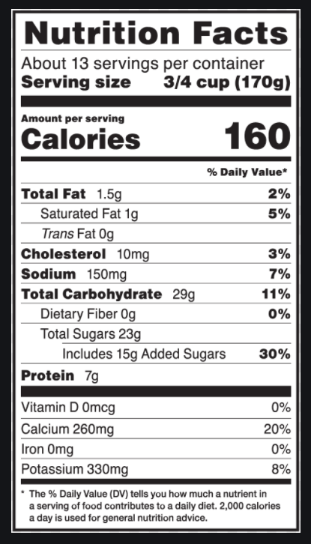
Yogurt
Notes:
Activity: Sugar Shockers - Yogurt
How much “added sugar” is in this yogurt? Click to reveal arrow pointing towards 15 grams of added sugar.
If 4 grams of sugar = 1 teaspoon of sugar = 1 sugar cube. How much added sugar, in teaspoons/sugar cubes, are in this one serving of yogurt. Ask participants to type their answer into the chat box. Click to reveal answer, 3 ¾ teaspoons/cubes of sugar.

Slide 41
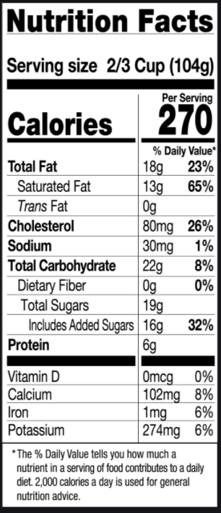
Ice Cream
Notes:
Activity: Sugar Shockers - Ice Cream
How much “added sugar” is in this ice cream? Click to reveal arrow pointing towards 16 grams of added sugar.
How much added sugar, in teaspoons/sugar cubes, are in this one serving of ice cream. Ask participants to type their answer into the chat box. Click to reveal answer, 4 teaspoons/cubes of sugar.

Slide 42
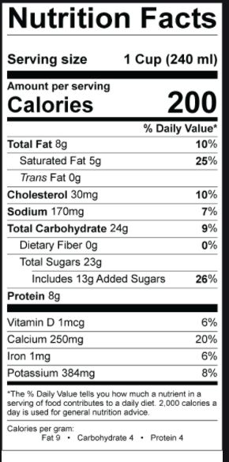
Chocolate Milk
Notes:
Activity: Sugar Shockers - Chocolate Milk
How much “added sugar” is in this chocolate milk? Click to reveal arrow pointing towards 13 grams of added sugar.
How much added sugar, in teaspoons/sugar cubes, are in this one serving of chocolate milk? Ask participants to type their answer into the chat box. Wait for answers. Reveal that there are 3.25 teaspoons of added sugar.

Slide 43
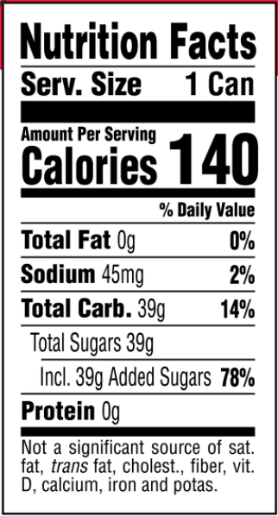
Soda
Notes:
Activity: Sugar Shockers - Soda
How much “added sugar” is in this soda? Click to reveal arrow pointing towards 39 grams of added sugar.
How much added sugar, in teaspoons/sugar cubes, are in this one serving of soda? Ask participants to type their answer into the chat box. Wait for answers. Reveal that there are 9.75 teaspoons of added sugar.

Slide 44
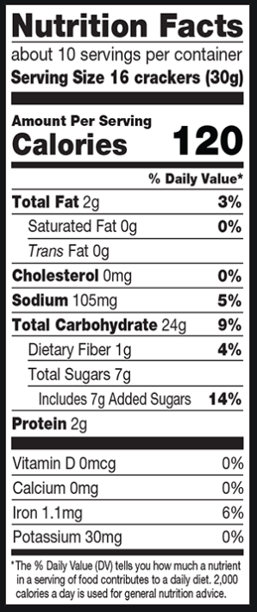
Animal Crackers
Notes:
Activity: Sugar Shockers - Animal Crackers
How much “added sugar” are in these animal crackers? Click to reveal arrow pointing towards 7 grams of added sugar.
How much added sugar, in teaspoons/sugar cubes, are in one serving of these animal crackers? Ask participants to type their answer into the chat box. Wait for answers. Reveal that there are 1.75 teaspoons of added sugar.

Slide 45
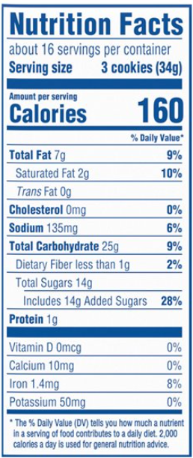
Cookies
Notes:
Activity: Sugar Shockers - Animal Crackers
How much “added sugar” are in these cookies? Click to reveal arrow pointing towards 14 grams of added sugar.
How much added sugar, in teaspoons/sugar cubes, are in one serving of these cookies? Ask participants to type their answer into the chat box. Wait for answers. Reveal that there are 3.5 teaspoons of added sugar.

Slide 46
Explore Ways to Optimize Nutrition and Maximize Academic Achievement
Notes:
Educational institutions in particular can have a profound effect on the health and wellness of their students. Think about how many hours a child is in school through their prime developmental years. Students spend much of each day in school, and may consume 2-3 meals while in school. Let’s explore ways schools can optimize the nutrition status of students and positively impact academic success.

Slide 47
The Role of Schools
“Schools have the unique opportunity - even the responsibility - to teach and model healthy eating and physical activity, both in theory and practice. Improving children’s health likely improves school performance, and it may even help a school’s bottom line.”
Dr. Satch, former US Surgeon General and
founding chair of Action for Healthy Kids
http://www.actionforhealthykids.org
Sept. 23, 2004 news release
Notes:
Read slide… This is a statement made by Dr. Satch former US Surgeon General in 2004, and still holds true today. Schools have the potential for creating a culture of wellness for children. Schools can successfully promote nutrition and healthy eating behaviors throughout the school day and beyond.
The academic achievement and overall physical well-being of students in Kansas today will impact the success of our communities, our state and the nation in the future. It is critical that schools provide quality nutrition and nutrition education; those tools students need to succeed.

Slide 48
Vision for Kansas
State Level Outcomes will drive Vision!
High School Graduation Rates
Post Secondary Completion/Attendance
Remedial Rate of Students Attending Post-Secondary
Kindergarten Readiness
Individual Plan of Study Focused on Career Interest
Social/Emotional Growth Measured Locally
Notes:
At the beginning of the 2017-18 school year, KSDE launched the Kansans Can School Redesign Project in support of Kansas’ vision for education. State Level Outcomes drive that vision!
The Kansas State Board of Education recognizes the link between nutrition and academic achievement, which further supports districts to continue a more student-focused system that provides nutrition support to enhance success. Kansas schools are in a great position to implement Wellness policies to create a healthier school environment through expanding access to nutrition education and implementing innovative school meal programs as part of school redesign.
Good nutrition can have a positive impact on all of these state focused outcomes including… read slide.
High School Graduation Rates
Post Secondary Completion/Attendance
Remedial Rate of Students Attending Post-Secondary
Kindergarten Readiness
Individual Plan of Study Focused on Career Interest
Social/Emotional Growth Measured Locally

Slide 49
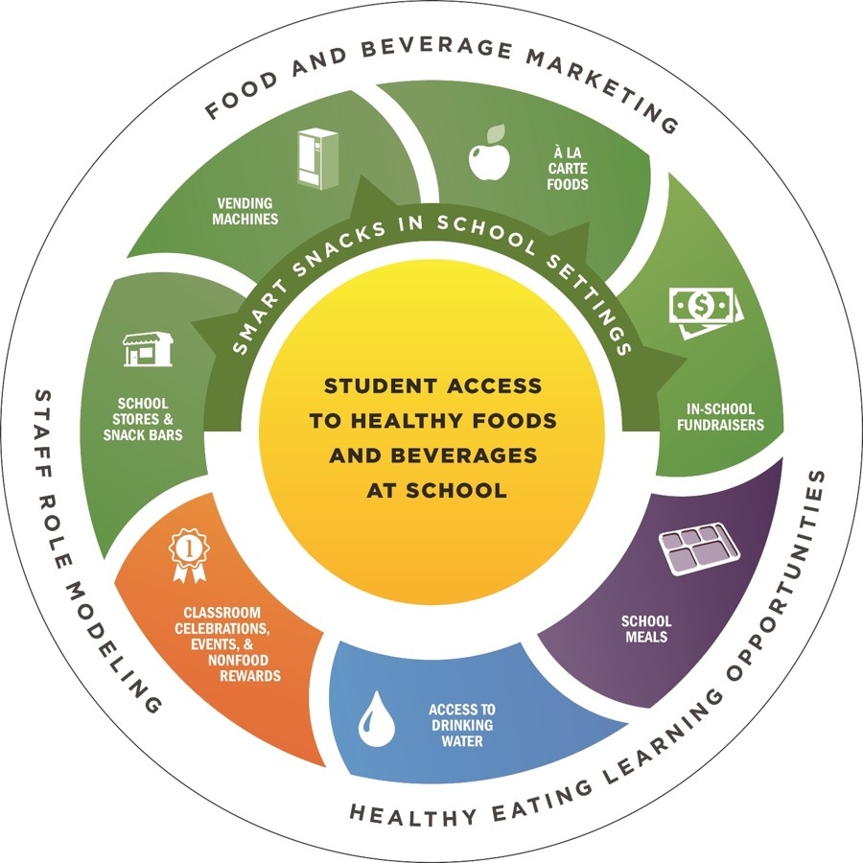
CDC’s Framework
Components of the School Nutrition Environment and Services Model
Notes:
The CDC’s Components of the School Nutrition Environment and Services Model serves as a comprehensive framework for addressing school nutrition. The figure above illustrates the different parts of the school nutrition environment and how they influence students’ access to healthy foods and beverages. The CDC provides a resource guide to support healthy school nutrition environment.
https://www.cdc.gov/healthyschools/nutrition/pdf/School_Nutrition_Framework_508tagged.pdf

Slide 50
Maximize Academic Achievement
Implementing Modeling Level School Wellness Policies
Promote school meal programs
Improving nutrition quality
Notes:
There are many ways schools can make an impact on students nutrition status, cognitive function, and academic potential through:
Implementing Modeling Level School Wellness Policies
Promoting School Meal Programs such as:
Providing Innovative Breakfast options
Increasing variety in School Lunch
Applying for the Fresh Fruit and Vegetable Program
Offering After School and Summer Meal Programs
Improving Nutrition Quality
Consider buying fresh local foods and/or implementing Farm to Plate initiatives, following Smart Snacks standards and providing nutrient dense foods.

Slide 51
Maximize Academic Achievement
Hold staff/parent nutrition education and wellness programs
Encourage staff, student and parent engagement
Partner with organizations
Teach nutrition education during childbearing years
Conduct screening and identification of At-Risk populations
Offer programs to help hungry families
Notes:
Schools can also…
Hold Staff/Parent Nutrition Education and Wellness Programs
Inspire school teachers/staff and parents to be role models.
Encourage Staff, Student and Parent Engagement
This could include nutrition newsletters, health and nutrition focused social media posts to families, staff and family wellness challenges, inviting parent volunteers into the classroom or cafeteria.
Use a coordinated school health framework to partner with local and national organizations – for example developing relationships with the local hospitals and businesses, county extension offices, health departments, and national nutrition and wellness organizations such as anti-hunger organizations. Schools can benefit from a targeted effort of connecting with businesses, communities, parents, higher education, and elected officials.
Provide nutrition education focused on childbearing years, early childhood and beyond.
Conduct timely screening and identification of At-Risk populations.
Offer programs to help hungry families – for example backpack and food pantry programs and/or provide connections with local food banks and Women infants and Children (WIC) programs.
With schools’ important role to improve student wellness it only makes sense to keep nutrition top priority. Quality meals and programs, teaching nutrition education and promoting staff and family wellness, favorably compliment schools’ wellness efforts and help achieve Modeling Level Wellness Policies.

Slide 52
Wellness Policy – Modeling Success
A written document that guides a local education agency (LEA) or school district’s efforts to establish a school environment that promotes students’ health, well-being, and ability to learn.
Modeling Level Wellness Policies reflect highly effective practices!
Notes:
Wellness polices are written documents that guide sponsors in promoting a healthy school environment.
How effectively school wellness policies are developed and executed directly impacts children’s success and future growth. Research has shown that well-designed, well-implemented school programs and policies can effectively promote healthy eating habits. Committing to helping students cultivate life-long proper eating habits will help support positive cognitive development. Promoting healthier school environments support students’ learning and behavior.
Modeling Level Wellness policies reflect highly effective practices!

Slide 53
Modeling Level Wellness Policies
Participate in two or more of the four child nutrition programs.
At-Risk Afterschool Meals, Afterschool Snack Program, Fresh Fruit and Vegetable Program, or Summer Food Service Program
At least five different fruits are offered each week at breakfast. At least two fruits per week are served fresh.
District has implemented alternative “2nd Chance Breakfast Service” options.
All foods and beverages sold in schools are in compliance with USDA Smart Snacks in School.
Notes:
Several Kansas Modeling Level Wellness Policies focused on nutrition that could be implemented to improve nutritional needs of students include… Read Slide.
Instructor Notes:
Instructor may provide several additional policy examples:
Integrate age appropriate nutrition education into three or more core subjects such as math, science, language arts or social sciences as well as three or more non-core and elective subjects.
Student focused advisory council who meet with foodservice and school administration twice per year to provide input.
Provide active learning experiences to students including food preparation or hands-on nutrition activities at least once per quarter.
Fundraising activities support nutrition, nutrition education, and physical activity messaging.
Teachers or other school personnel participate in nutrition education-related professional development at least once per year.

Slide 54
Promote School Meals = Many Benefits!
Reduced absenteeism and tardiness
Higher standardized test scores and improved academic achievement
Healthier environment
Money saved
Reduced illness and visits to the nurse
Reduced obesity
Promote proper growth and development
Improvements in brain function
Overall better students
Notes:
There are big benefits from eating school breakfast and lunch including...read slide.
School meal programs provide students with wholesome meals consisting of whole grains, fat free or low fat milk options, a variety of fruits and vegetables and lean proteins. The required meal pattern standards are age appropriate, provide specific calorie minimums and maximums, and limit unhealthy fat and sodium, which helps support obesity prevention, improve students health and reduce food insecurity.

Slide 55
School Nutrition and Meal Cost Study Findings
USDA’s Findings:
School meals are much healthier.
Schools are complying with the updated standards.
Student participation rates are associated with healthier meals.
The amount of food students throw away has not increased since the healthier standards took effect.
Notes:
Recently, The School Nutrition and Meal Cost Study was published. The comprehensive assessment of school meal programs, concluded…
School meals are much healthier. The nutritional quality of school lunches and breakfasts increased by 41 percent and 44 percent, respectively, between school years 2009-10 and 2014-15.
Schools are complying with the updated standards. More than 80 percent of daily lunch menus meet the daily National School Lunch Program meal pattern requirements.
Student participation rates are associated with healthier meals. Rates of student participation in school lunch programs are considerably higher in schools that offer healthier meals.
The amount of food students throw away has not increased since the healthier standards took effect. “Plate waste” is also lower in schools that give students choices in food items, such as a variety of whole fruits.

Slide 56
Breakfast is Brain Fuel!
Notes:
Breakfast is Brain Fuel! Eating breakfast serves a vital purpose, whether is eaten at home or school. School breakfasts must provide one-fourth (1/4) of the daily recommended levels for protein, calcium, iron, vitamin A, vitamin C and calories. Therefore, providing the necessary calories, protein, carbs, fats and right amount of vitamins and minerals, fiber and water to start the day out right!
Breakfast eaters tend to get more of the required macro and micronutrients such as protein, calcium, fiber, and folate for proper brain function. Children who eat school breakfast consume more fruit, and milk and have more variety in their diet. Children who eat breakfast also tend to have lower BMI’s and a reduced risk for obesity, diabetes and other metabolic syndromes.
Serving breakfast in schools can be a cost-effective and direct way to improve students nutrition and wellness and overall academic performance. Research regarding the relationship between academic performance and breakfast has consistently confirmed that fueling the body before learning is what matters most! Breakfast eaters perform better academically than children who do not eat breakfast, allowing them to reach higher levels of achievement in reading and math. Breakfast eaters have demonstrated better problem-solving abilities, enhanced memory, and improved scores on standardized tests.
Unfortunately, many students skip breakfast. Young children particularly do not do well when they don’t have fuel and hungry students have difficulty concentrating. Schools can make a difference by promoting innovative breakfast programs to fill in the gaps. Innovative School breakfasts can include, Second Chance Breakfasts, Breakfast in the Classroom, or Grab and Go Breakfast. This helps those students who may have not been hungry at home or did not have any food available to eat.
A modeling level wellness policy that districts can implement is offering innovative or alternative breakfast service for example Breakfast in the Classroom, Second Chance or Grab and Go.
Poll: What innovative breakfast delivery models has your school or district implemented?
Grab and Go Breakfast
Second Chance Breakfast
Breakfast in the Classroom
None

Slide 57
Examples of Quality Breakfasts
Whole wheat bagel with toppings, fresh strawberries, milk
Fruit, yogurt and granola parfait, apple juice
Whole grain assorted cereal, string cheese, fruit
Western omelet quesadilla, 100% fruit juice, milk
Biscuit sandwich, fruit, milk
From KSDE Healthier Kansas Menus – Innovative School Breakfast Options
Notes:
Examples of healthy breakfast meals can be found in the KSDE’s Healthier Kansas Menus – Innovative School Breakfast Options. Some ideas include: …read slide.

Slide 58
School Lunch Highlights
Eating School Lunch provides benefits to students:
Meals meet The Dietary Guidelines
Consume over twice as many servings of vegetables
Learn about food choices and healthful eating
Drink four times as much milk
Intake of substantially less added sugars and fat
Recognize and experience a variety of different foods
Helps maintain a healthy weight
Notes:
The National School Lunch Program provides students with nutritious meals consisting of whole grains, fat free or low fat milk options, a variety of fruits and vegetables and lean proteins. School meals are age appropriate, provide specific calorie minimums and maximums, and limit unhealthy fat and sodium, which helps support obesity prevention, improve students health and reduce food insecurity.
There are many benefits to eating school lunch including… read slide.

Slide 59
Fresh Fruit and Vegetable Program
What is it?
Why is the program beneficial?
Encourages students to try new fruits and vegetables.
Increases acceptance of fruits and vegetables.
Enhances nutrition education in schools.
Promotes a healthier school environment.
https://www.fns.usda.gov/ffvp/fresh-fruit-and-vegetable-program
Notes:
A great way to provide additional quality foods and nutritious opportunities to students is through The Fresh Fruit and Vegetable Program, which is a USDA federal assistance program that provides funds to eligible schools to offer fresh fruit and vegetables throughout the school day to elementary students.
This program is beneficial because it… read slide.
This program helps increase fruit and vegetable consumption, contributing to increased intake of vitamins, minerals, and fiber, as well as, helping children meet the recommended intake of a variety of fruits and vegetables per day.
For more information on this program visit:
https://www.fns.usda.gov/ffvp/fresh-fruit-and-vegetable-program

Slide 60
Afterschool Snack and Meals Programs
Afterschool Snack Program
CACFP At-Risk Afterschool Meals Program
Summer Food Service Program
Notes:
The Afterschool Snack Program was first implemented in 1999 as a result of the 1998 reauthorization of the Child Nutrition Act. This program provides funds for the service of nutritious snacks for children enrolled in eligible after school care programs.
The CACFP At-Risk Afterschool Meals Program is a federal program that provides reimbursement for healthful meals and snacks served to at-risk children and adults. Meals can be provided to qualified after school care sites that provide programming and snacks for low-income school age children and youth.
The Summer Food Service Program can be sponsored by school districts and community organizations throughout the summer in low income areas because the need for good nutrition does not end with the school year.

Slide 61
Farm to Plate Initiatives
Wide variety of local products can be found in Kansas.
Encourages and teaches children and their families.
Strengthens the local economy.
Children are more likely to eat local foods!
Notes:
Farm to plate initiatives connects schools with local communities, provides fresh, healthy food options and supports local farming and food producers. Students gain access to healthy, local foods as well as engage in educational opportunities such as school gardens and food preparation activities. Farm to plate teaches children and their families to make informed food choices and strengthens the local economy. Incorporating local food into school meals encourages children to experience more healthy foods.
When schools hear Farm to Plate, fruits and vegetables typically come to mind. The growing season in Kansas can make it challenging to incorporate local fruits and vegetables only, but Kansas has many other products like local beef and pork, milk and whole wheat flour that can be served weekly, year-round!
The Kansas School Wellness Policy Guidelines support incorporating local food products into school meals. A Modeling Level Wellness Policy can be met through serving a Kansas product in the school meals program at least one time per week.

Slide 62
Improve Nutrient Quality
Nutrient Dense = Nutrients : Calories
The most concentrated amount of nutrients for the amount of calories in the food item.
Examples of nutrient dense foods served in school settings: whole grains, eggs, fat-free (skim) and low-fat (1%) milk, lean meats and poultry, seafood, beans and peas, fruits, vegetables, unsalted nuts and seeds.
Notes:
There is a variety of ways to improve nutrition quality in school meals; such as following the National School Meal and Smart Snacks standards, utilizing scratch cooking and baking techniques, using fresh local foods often and identifying nutrient dense foods to serve.
Nutrient density was briefly discussed earlier and can be simply defined as the ratio of nutrients to calorie content. In other words, the most concentrated amount of healthy nutrients relative to the food’s calorie content. The Dietary Guidelines for Americans recommend choosing foods that are nutrient dense and further defines nutrient density, as foods and beverages that contain vitamins, minerals, dietary fiber, and other beneficial substances that may have positive health effects. They are also naturally lean or low in saturated fat and have little or no added saturated fat, sugars, refined starches, and sodium.
Read slide… Examples of nutrient dense foods served in school settings include: whole grains, eggs, fat-free (skim) and low-fat (1%) milk, lean meats and poultry, seafood, beans and peas, fruits, vegetables, unsalted nuts and seeds.

Slide 63
“This or That”
Notes:
Activity: This or That
When making a food or beverage choice consider nutrient density. Think of nutrient density this way: You are wanting a snack and it is a few hours until dinner so you decide between whole grain crackers or sandwich cookies. Which do you choose?
A whole grain cracker made with whole grain flour would be more nutrient dense than the sandwich cookie made with white flour and the first ingredient being sugar.

Slide 64
“This or That”
Notes:
Activity: This or That
Which is more nutrient dense, an orange or orange juice? Ask participants to type their guess in the chat box.
An orange is more nutrient dense than orange juice. Fiber is found in the pulp of the fruit. When juice is made, the pulp is usually removed, and unfortunately the fiber goes with it!

Slide 65
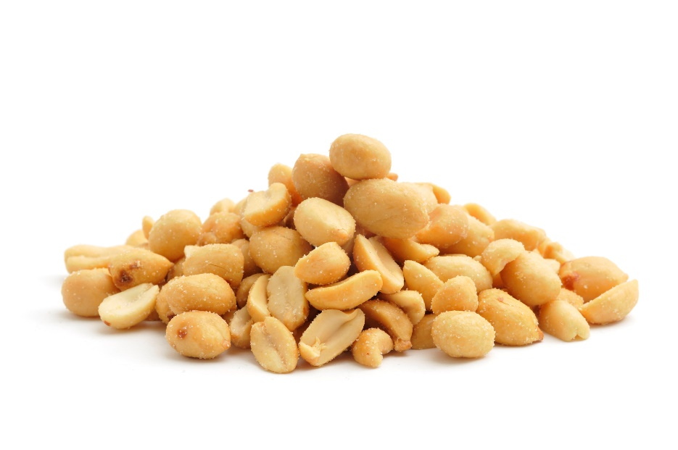
“This or That”
Notes:
Activity: This or That
Which is more nutrient dense, pretzels or peanuts? Ask participants to type their guess in the chat box.
Peanuts are more nutrient dense than pretzels. Peanuts will provide a source of protein that pretzels will not. Protein helps keep us full longer! Pretzels are made with refined white flour.

Slide 66
Activity: “This or That”
Notes:
Activity: This or That
Which is more nutrient dense, veggie straws or popcorn? Ask participants to type their guess in the chat box.
Popcorn is more nutrient dense than veggie straws. Some people are tricked by veggie straws as they have vegetable in the name and often times are promoted as natural or organic. The first ingredient in veggie straws is potato flour, an unenriched starch. Popcorn is a whole grain, fiber-rich snack option, making it the more nutrient dense choice.

Slide 67
Summary – What You Eat Matters!
Quality nutrition linked to brain health and how children perform in school.
A variety of foods is important for growth and development.
The key is promotion of overall diet quality.
Enhancing brain functions through proper nutrition can be a simple way for students to optimize academic achievement.
Creating healthy school environments takes a school-wide approach. Now is the time for schools to impact children’s health and see positive benefits.
Notes:
There are many known factors that affect brain function. Nutrition is one of those factors and research continues to demonstrate what you eat matters!
Quality nutrition can be linked to the health of the brain and specifically how children
perform in school.
An array of nutrients like carbs, fat and protein and water plus vitamins and minerals are essential for a healthy brain. The key is promotion of overall diet quality rather than isolated micronutrients or dietary components consumed by children and adolescents.
Enhancing brain functions through proper nutrition can be a simple way for student to
enhance academic achievement.
Creating healthy school environments takes a school-wide approach. Schools can play an important role in addressing the nutritional needs of children. It is vital to create a healthier school environment so children are ready to learn.
Now is the time for schools to impact children’s health and see positive benefits.

Slide 68
Resources for Schools
Kansas School Wellness Policies – https://www.kn-eat.org/
CDC – https://www.cdc.gov/healthyschools/nutrition/pdf/School_Nutrition_Frame work_508tagged.pdf
USDA and Team Nutrition
https://www.fns.usda.gov/school-meals/tools-schools
ChooseMyPlate – choosemyplate.gov
Smart Snack Guidelines – https://www.fns.usda.gov/tn/guide-smart-snacks-school
Alliance for a Healthier Generation – https://www.healthiergeneration.org/
Child Nutrition Sharing Site – https://theicn.org/cnss/resources/
Action for Healthy Kids – https://www.actionforhealthykids.org/
The Wellness Impact Report – https://www.genyouthnow.org/reports/the-wellness-impact-report
Notes:
Here is a list of helpful resources and tools. Read slide…

Slide 69
USDA Nondiscrimination Statement
In accordance with Federal civil rights law and U.S. Department of Agriculture (USDA) civil rights regulations and policies, the USDA, its Agencies, offices, and employees, and institutions participating in or administering USDA programs are prohibited from discriminating based on race, color, national origin, sex, disability, age, or reprisal or retaliation for prior civil rights activity in any program or activity conducted or funded by USDA. Persons with disabilities who require alternative means of communication for program information (e.g. Braille, large print, audiotape, American Sign Language, etc.), should contact the Agency (State or local) where they applied for benefits. Individuals who are deaf, hard of hearing or have speech disabilities may contact USDA through the Federal Relay Service at (800) 877-8339. Additionally, program information may be made available in languages other than English. To file a program complaint of discrimination, complete the USDA Program Discrimination Complaint Form, (AD-3027) found online at: https://www.usda.gov/oascr/how-to-file-a-program-discrimination-complaint, and at any USDA office, or write a letter addressed to USDA and provide in the letter all of the information requested in the form. To request a copy of the complaint form, call (866) 632-9992. Submit your completed form or letter to USDA by:
(1) Mail: U.S. Department of Agriculture
Office of the Assistant Secretary for Civil Rights
1400 Independence Avenue, SW
Washington, D.C. 20250-9410;
(2) Fax: (202) 690-7442; or
(3) Email: program.intake@usda.gov. This institution is an equal opportunity provider.

Slide 70
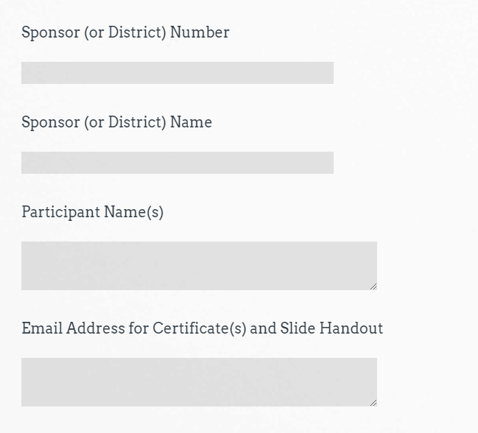
Attendance
Sample
https://www.surveymonkey.com/r/FFT5Q7M
Thank you for Attending!
Join us tomorrow from 9:00-11:00 am for
Brain Breaks and a message from
Dr. Randy Watson, Commissioner, KSDE.
785-296-2276
Child Nutrition & Wellness
www.kn-eat.org
Nutrition & Brain Function
Notes:
Class attendance will be conducted electronically through Survey Monkey. Participants must complete the survey to receive a certificate of completion. Participants may use their phones, laptops, or nutrition program computer to access the survey electronically. Enter the link provided into the address bar of preferred web browser. If using a mobile device with a QR Code reader, scan the QR code that will be provided on the screen at the end of the session.
The attendance survey set up so that a lead person, such as the Director, can enter multiple names on the comment line of the attendance survey in Survey Monkey. This should make it easier to track group participation in the electronic delivery of these classes.

Slide 71
Thank you for Attending!
Please contact us whenever you need assistance.
785-296-2276
Child Nutrition & Wellness
www.kn-eat.org

