Slide 1
CACFP Meal Pattern Webinar Creditable and Whole Grain-Rich Grains Recorded: August 11, 2020 Edited: August 26, 2020
This training was funded by a grant from USDA
Notes:
This CACFP Meal Pattern Webinar on Creditable and Whole Grain-Rich Grains was recorded on August 11, 2020 and presented to a Family Day Care Provider Audience. The information presented in this training will be applicable to all Child and Adult Care Food Program Sponsors and Day Care Home Providers. The version you are currently viewing has been edited and shortened from the original.
Handouts for the training are available as a link below the video.
This training series was funded by a grant from the USDA.

Slide 2
Overview
Grain Requirements
Key Terms
Creditable Grains
Non-Creditable Grains
Whole Grain-Rich Grains
Documentation Requirements
Grain Resources
Notes:
In this webinar, we will be going over the grain component only. This will be a general overview of the grains component. While the basics of the grains component is fairly simple, it requires a bit of background knowledge on grains and the implementation of it can be complicated. Since we only have a limited amount of time to talk about grains, we will start with a general overview of the grain requirements, including some key terms that you will need to be familiar with, and then go into 3 broad categories of grains: Creditable Grains, Non-Creditable Grains, and Whole Grain-Rich Grains. In each of these 3 sections, we will go over what makes a grain creditable or not creditable, provide some examples in each category, and talk about documentation requirements.
Throughout this training, there will be references to downloading handouts from the handouts tab. For this online video, resources can be downloaded from the links available below the video.

Slide 3
Learning Objectives
Learn what is required for the CACFP grains component
Understand which grains are creditable
Know which grains are whole grain-rich (WGR)
Notes:
After you finish this webinar today, you will know the basics of the CACFP grains component, understand which grains are creditable and which grains are whole grain-rich.

Slide 4
Grains: CACFP Requirements
Grains must be served at breakfast, lunch, and supper
Can substitute meat/meat alternate for grains at breakfast up to 3 times a week
One of the five components that can be served at snack
All grains served must be creditable in CACFP
At least once per day, the grain component must be whole grain-rich
Starting Oct 1, 2021, serving sizes for grains will use ounce equivalents (more info to come in 2021)
Notes:
In the CACFP child and adult meal patterns, the grains component must be served at breakfast, lunch, and supper. To allow for more flexibility, CACFP providers can substitute a meat/meat alternate item for the grains component at breakfast up to 3 times a week. For snack, grains are one of the five different food components you can choose from. Note that this webinar will focus on the grains component as related to the child and adult meal pattern. Infant meal patterns have slightly different requirements.
Any time you serve a grains component as part of a reimbursable meal, the grain item must be creditable. In addition, at least once per day, the grains component must be whole grain-rich. On the screen, creditable and whole grain-rich are underlined because these are specific terms that are used in the Child Nutrition Programs. Before we get into their definitions, we need to first understand a few key terms for grains.

Slide 5
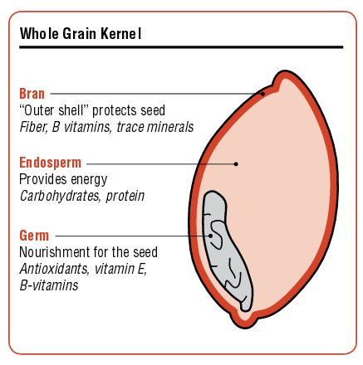
Key Terms
Whole grains contain the whole kernel including bran, germ, and endosperm
Refined grains are milled
Processed to remove key nutrients
Enriched grains undergo processing where some key nutrients are added back to the grain
Notes:
You have probably heard of the terms whole grains, refined grains, and enriched grains before and probably know that whole grains are healthier for you. The reason why whole grains are healthier is because they contain the whole grain kernel, including the bran, endosperm, and germ. The bran provides fibers, vitamins, and minerals, the endosperm provides the bulk of the calories with starchy carbohydrates and protein, and the germ provides antioxidants and vitamins. Whole grains contain all 3 components – the bran, endosperm, and the germ.
In refined grains, the bran and the germs are removed and only the starchy endosperm remains. This is why refined grains contain less nutrients.
There are some products that use refined grains and add in vitamins and minerals back into the grain. These are called enriched grains.

Slide 6
Example: Rice
Brown Rice
White Rice
Enriched White Rice
Germ and bran included
B-Vitamins and Iron
Whole Grain
Refined Grain
Enriched Grain
Notes:
Think about the grains you eat – do you eat more whole grains, refined grains, or enriched grains? For example, if you eat brown rice, you are eating a whole grain. (click) The rice is brown because it contains the bran on the outside of the grain. You don’t see the germ on the inside, but it’s still there too. If you eat white rice, (click) the bran and germ have been removed so you are only left with the white endosperm. This is a refined grain and contains less nutrients. Finally, if you eat enriched white rice, you are eating a refined grain (click) that has B-vitamins and iron added back into it.

Slide 7
Poll #2
Corn flour has been processed to remove the bran and germ. No additional vitamins or minerals have been added. What type of grain product is this?
Whole Grain
Refined Grain
Enriched Grain
Whole Grain-Rich Grain
Notes:
So keeping in mind the definitions of a whole grain, a refined grain, and an enriched grain, think about this question: (launch poll) Corn flour has been processed to remove the bran and the germ. No additional vitamins or minerals have been added. What type of grain product is this? Is a whole grain, refined grain, enriched grain, or a whole grain-rich grain?
Take a few seconds to think about this. If you have the slide handouts, you can go back and review your key terms slide if you’re not sure. Just a few more seconds….
(close poll, share poll) So here’s what everyone thought….

Slide 8
Poll #2
Corn flour has been processed to remove the bran and germ. No additional vitamins or minerals have been added. What type of grain product is this?
Whole Grain
Refined Grain
Enriched Grain
Whole Grain-Rich Grain
Notes:
And the answer is that Corn Flour – as described here, is a refined grain. The reason why this is a refined grain is because it has the bran and germ removed. Once you remove part of the whole kernel, the product becomes a refined grain. If you have a corn flour that adds vitamins and minerals back in, you would get an enriched grain, but in this case, no additional enrichment is added back in, so you have a refined grain.
Nice job, everyone!

Slide 9
Creditable Grains
Creditable Grains: Grains that can be used as part of a reimbursable meal or snack in CACFP
Whole Grains
Enriched Grains: Definition:
Labeled as enriched
First ingredient on the food’s ingredient is listed as enriched
Has sub-listing of nutrients such as folic acid, niacin, etc
Bran
Germ
Fortified Breakfast Cereals (meet sugar limit thresholds)
Notes:
Now that you know the key terms for grains, let’s define Creditable Grains for CACFP. Creditable grains are nutritious grains that can be served in CACFP as part of a reimbursable meal or snack. A creditable grain can be one of five types of grains. It can be either 1) a whole grain, 2) an enriched grain, 3) bran, or 4) germ. It can also be 5) a fortified breakfast cereal that meets a sugar limit threshold.
Notice that refined grains is not on this list? Unlike refined grains, all of these grains either contain both the bran or germ or they have additional vitamins added back in. We want to make sure that the grains served as part of your CACFP meals are nutritious, and making sure that your grain products meet one of these 5 categories will help make sure that your grains are contributing important B-vitamins and fiber to your participants’ diet.
Most grocery stores and vendors will have lots of great creditable grain options to choose from. Again, all grain items served as part of a reimbursable CACFP meal or snack must be creditable grains.
Let’s explore some of the common creditable grains you may find out in the world by going through each type of creditable grain in more depth.

Slide 10
1. Common Whole-Grain Ingredients
Amaranth
Amaranth flour
Brown Rice
Brown Rice flour
Buckwheat
Buckwheat flour
Buckwheat groats
Bulgur
Corn Masa/Masa harina
Cracked wheat
Graham flour
Instant oatmeal
Millet
Millet flour
Oats
Oat groats
Old fashioned oats
Quick cooking oats
Quinoa
Rye groats
Sorghum
Sorghum flour
Spelt berries
Sprouted brown rice
Sprouted buckwheat
Sprouted spelt
Sprouted whole rye
Sprouted whole wheat
Steel cut oats
Teff
Teff flour
Triticale
Triticale flour
Wheat berries
Wheat groats
White whole wheat flour
Whole corn
Whole durum flour
Whole grain corn flour
Whole grain oat flour
Whole grain spelt flour
Whole grain wheat
Whole grain wheat flakes
Whole grain wheat flour
Whole rye flour
Whole wheat flour
Notes:
The first category of creditable grains are whole grains. As we discussed during our key terms, whole grains is a term for grains that contain all parts of the grain kernel, with the bran, endosperm, and germ all included. All whole grains are creditable grains and can be used in the CACFP. On the screen, you can see some of the whole grains you might find in a grocery story or vendor page. You can find this full list on the USDA Handout titled “Identifying Whole Grain-Rich Foods for the CACFP”. This handout is available to download under the handouts tab. Some of the most common items include brown rice, corn masa, graham flour, oatmeal, and whole wheat flour.
Note that the term “whole grains” is not the same as “whole grain-rich” which is a term specific to USDA. We will talk more about “whole grain-rich” later on and define the difference between whole grains versus whole grain-rich.

Slide 11
2-4. Common Enriched Grain Ingredients and Bran and Germ Ingredients
Enriched Grains
Enriched bromated flour
Enriched corn flour
Enriched durum flour
Enriched durum wheat flour
Enriched farina
Enriched rice
Enriched rice flour
Enriched rye flour
Enriched wheat flour
Enriched white flour
Any grains with “enriched”
Bran or Germ Ingredients
Corn bran
Oat bran
Rice bran
Rye bran
Wheat bran
Wheat germ
Enriched products may also include a list of vitamins in parenthesis instead. For example: Durum flour (niacin, iron, riboflavin, folic acid, thiamin)
Notes:
The 2nd, 3rd, and 4th categories of creditable grains are enriched grains, bran, and germ. While not as nutritious as whole grains, enriched grains are refined grains that have extra nutrients added back in and the bran and germ are both nutritious parts of a grain kernel. The “Identifying Whole Grain-Rich Foods” Handout includes a list of common enriched grains and common bran and germ ingredients. Some common ones include enriched corn flour, enriched durum flour, enriched rice, and enriched wheat flour. While you typically won’t see bran or germ served by themselves, corn bran, oat bran, and wheat bran are common ingredients in many cereals and bread products.

Slide 12
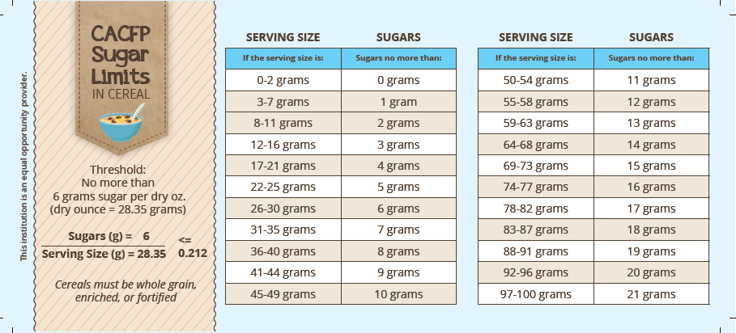
5. Fortified Breakfast Cereals
Fortification: Adding vitamins and minerals – check the Nutrition Facts Label
Sugar Limit Threshold: All breakfast cereals (including granola) must contain no more than 6 grams of sugar per dry ounce of cereal
Notes:
The last category of creditable grains include fortified breakfast cereals which meet the sugar limit of having no more than 6 grams of sugar per dry ounce of cereal. There are 2 qualifications to this category.
First, it needs fortification. Fortification is like enrichment, except instead of adding vitamins and minerals to an ingredient, it’s added to the whole product.
Second, it needs to meet a sugar limit threshold of no more than 6 grams of sugar per dry ounce of cereal. This is unique to breakfast cereals.
Let’s go over both qualifications.

Slide 13
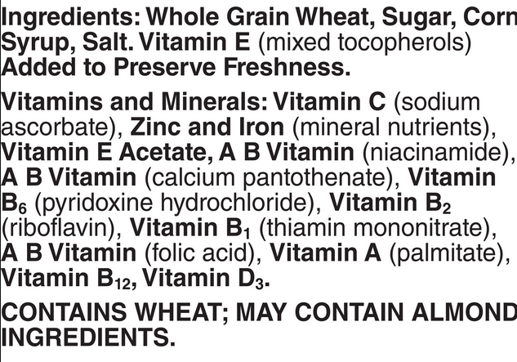
Fortification
Fortification in breakfast cereals generally include a list of vitamins and minerals below all other ingredients
Notes:
First, let’s look first at an example of fortification found on an ingredient list. The section highlighted by the blue box on the screen shows the vitamins and minerals that were added to this cereal. This fortification is typically listed below all the other ingredients. This is what you will want to look for.

Slide 14
Sugar Limit Threshold
All breakfast cereals must have sugar levels below the threshold of 6 grams per dry ounce of cereal.
1 dry ounce is approximately 28 grams
This converts to a sugar limit of 21.2 grams of sugar per 100 grams of cereal
No calculations are required, 2 methods to figure out if cereals meet the sugar limit threshold:
Use the WIC Breakfast Cereal List
Use the CACFP Sugar Limit Wallet Card
Notes:
The second part of determining a creditable breakfast cereal is the sugar limit threshold. Again, all breakfast cereals must have sugar levels below the threshold of 6 grams per dry ounce of cereal. Since 1 dry ounce is approximately 28 grams, you can convert this to 6 grams of sugar allowed per 28 grams of cereal or if you want to increase the amounts to serving sizes that are typically seen on a cereal box, it would be about 21.2 grams of sugar per 100 grams of cereal.
While you can calculate out the math yourself, you really don’t need to do any math at all with the 2 methods that I will show you. They are – 1. using the WIC Breakfast Cereal List or 2. Using the CACFP sugar limit wallet card.

Slide 15
WIC Breakfast Cereal List
Notes:
The Women, Infant, and Children Program or WIC, has a sugar limit threshold that is the same as CACFP. So all of the cereals that are allowed on their program is allowed on CACFP too. This is very convenient, since they work with actual products that are easily found and purchased in stores. Any cereals you see on this list is a creditable cereal. There is a link to this handout on the slide, click on the link in the title of the slide.
The WIC list is updated in Oregon about once every two years. You will notice that this list was last updated in March 2019, so be on the lookout in the next year for an updated list.
Note that cereals that are not on this list may still qualify – the WIC list is not inclusive of all creditable cereals sold out there, it only includes select cereals that are allowed as part of the WIC program in Oregon. You can also use WIC lists from other states. All states use the same criteria for their WIC Breakfast Cereals.

Slide 16
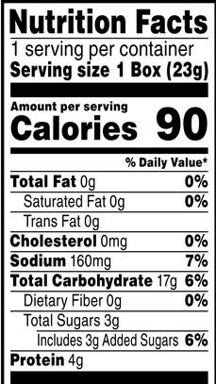
CACFP Sugar Limit Wallet Card
For directions: How to Use the CACFP Sugar Limit Wallet Cards
Notes:
If the cereal you want to use is not on the WIC list, then you can determine whether it qualifies by looking at the CACFP Sugar Limit Wallet Card. The link to this card is available on your slides. Click on the title of the slide. To use the card, you will need to have the Nutrition Facts Label and compare the serving size and total sugars to the columns on the card.
Let’s take a look at a sample nutrition facts label (click). Looking at the label, you will want to search for the serving size first (click). Look for the serving size in grams. In this example, it is 23 grams.
Next, find 23 grams on the serving size column of the Sugar Limit Wallet Card. (click) There it is in the middle of the left column. Look at the column directly next to it (click). You see 5 grams. This is the maximum amount of sugar allowed for cereals with 23 grams per serving. Go back to the Nutrition Facts Label and look for Total Sugars (click). At 3 grams it is below the 5 gram threshold, so this cereal would meet the sugar limit threshold and would be creditable.
If you want step by step written instructions, they are available with our How to Use the CACFP Sugar Limit Wallet Cards Handout. Quick note that this handout was developed prior to the Nutrition Facts format update, so you will see Sugars listed on the handout instead of Total Sugars. You will want to look at Total Sugars.

Slide 17
Documenting Breakfast Cereals
Documentation kept needs to show that cereals meet sugar limit thresholds
Menus must list name of cereal
When using the WIC Breakfast Cereals: Keep
The WIC Breakfast Cereal List
The packaging of the cereal showing the name that matches a cereal from the list
When using the Sugar Limit Wallet Card: Keep
The packing of the cereal
The Nutrition Facts Label showing the Serving Size and Total Sugar
Notes:
If you have a creditable breakfast cereal that you want to use for CACFP, there are some additional documentation required.
First, on your menu, the name of the cereal has to be listed. For example, instead of listing ‘cereal’, you have to add in Cheerios or Corn Flakes.
Then, for all the cereals listed on the menu, you have to keep supporting documentation that proves the cereals meet the threshold.
If you are using a cereal listed on the WIC Breakfast Cereal list, keep the current WIC Breakfast Cereal List AND the packaging of the cereal with the name matching the cereal from the list as supporting documentation.
If you are using a non-WIC breakfast cereal, show that it meets the limit defined on the sugar limit wallet card by keeping the packaging of the cereal AND the nutrition facts label from the packaging showing the serving size and total sugar. Always double check that the total sugar is within the threshold.
Breakfast cereals are the only items that require additional documentation in the creditable grains category.

Slide 18
Poll #3
Which one of these items is NOT a creditable grain?
White rice
Whole wheat bread
Oatmeal
Wheat bran
Cheerios (on the WIC list)
Notes:
Time for another poll! Now that you know the 5 categories of creditable grains, which one of these items would not be a creditable grain? (launch poll) Is it white rice, whole wheat bread, oatmeal, wheat bran, or cheerios, a cereal on the WIC list?
If you need a refresher, take a look on your Creditable Grains slide handouts.
Ok, a few more seconds and then we are closing the poll. (close poll, share poll) What did everyone think?
It looks like….

Slide 19
Poll #3
Which one of these items is NOT a creditable grain?
White rice
Whole wheat bread
Oatmeal
Wheat bran
Cheerios (on the WIC list)
Notes:
The answer is white rice. <insert comment about answers> White rice is not in one of the 5 categories of creditable grains. It is not a whole grain, it is not an enriched grain, and it is not bran or germ, or a fortified breakfast cereal meeting sugar limit requirements. If it had been enriched white rice, it would be a creditable grain, but without the words enriched or a list of vitamins added to the white rice, it is a refined grain and NOT creditable.
White rice is a non-creditable grain.

Slide 20
Non-Creditable Grains
Refined grain products (non-enriched)
Ex. White rice, farina, non-enriched pasta, non-enriched corn meal
Alternative flours and ingredients
Ex. Bean, nut, vegetable flours
Grain-based desserts
Includes granola bars, cereal bars, cakes, cookies, sweet rolls, toaster pastries
Breakfast cereals with sugar content greater than 6 grams per dry ounce and/or are not fortified, whole grain, or enriched
Notes:
Let’s talk some more about non-creditable grains. You know that all grains served in CACFP has to be creditable, and you know what makes up a creditable grain. Now let’s delve a little more deeply into the non-creditable side. When we say non-creditable, it means that if these grain items are served in a CACFP meal or snack as the grain component, the meal or snack will not be reimbursable.
Non-creditable grains include refined grains that have not been enriched, like the white rice example earlier. It also includes alternative flours and ingredients such as bean, nut, and vegetable flours, and grain-based desserts, such as granola bars, cereal bars, cakes, cookies, sweet rolls, and toaster pastries. Of course, it also includes breakfast cereals that have a sugar content greater than 6 grams per dry ounce and/or are not fortified, whole grain, or enriched.
Let’s go over each category in a little more detail.

Slide 21
Refined Grain Products
Refined grains do not have the same level of nutrients as whole grains or enriched grains
Check ingredient lists
INGREDIENT: WHITE BASMATI RICE
Most grain products in stores are enriched, so this is not something that will be encountered too frequently. More common with specialty items
INGREDIENTS: ORGANIC SEMOLINA (WHEAT), DURUM WHEAT FLOUR
INGREDIENTS: WHEAT FLOUR, DEGERMINATED YELLOW CORN MEAL, SUGAR, ANIMAL SHORTENING, BAKING SODA, SALT, WHEAT STARCH
Notes:
At this point, you probably have a pretty good idea what is a refined grain and you probably already know that refined grains do not have the same level of nutrients as either whole grains or enriched grains.
While refined grains are not quite as common currently in the marketplace, you may encounter it sometimes, especially with specialty items. Always check your ingredient lists first before you purchase an item. Take a look at these 3 ingredient list examples on the screen. The first is white basmati rice – rice is one of the most common refined grain products out there. When buying rice, if it is white rice and does not have the words enriched in it or if it does not have a list of vitamins added to it, then the rice is refined. The second example is organic semolina and durum wheat flour – these are ingredients often seen with pastas. While many name-brand pastas as enriched, there’s enough products out there that are not, so always check your ingredients. Finally, you have the last example with wheat flour and degerminated yellow corn. These are both refined grains and if there are no vitamins and minerals added behind the grain ingredients, then the flour is considered refined and non-creditable.

Slide 22
Alternative Flours and Ingredients
Commonly found in gluten-free products
Common items include: Almond flour, chickpea flour, tapioca flour, soy flour, potato flour, and red lentil flour
Includes all bean, nut, and vegetable flours
Not creditable for the grains component, but some may be creditable for the vegetable or meat alternate component
Mixed Dishes and Flour Blends:
If the alternative flour is the first ingredient, the product will not be creditable for the grain component.
While the individual ingredient may not be creditable, alternative flours may be found in small quantities in creditable or whole grain-rich products
If alternative fours are found in large quantities in a grain product, a product formulation statement will be needed
Notes:
A growing category of non-creditable grains is alternative flours and ingredients. It’s common to find these ingredients in gluten-free products.
Some of the more common products include almond flour, chickpea flour, tapioca flour, soy flour, potato flour, and red lentil flour. It includes all bean, nut, and vegetable flours. It might seem obvious to many of you that beans, nuts, and vegetables are not grains, but by milling it into flour, these ingredients are incorporated into products we typically associate with the grain component, like breads and pastas. While these flours will not credit for the grain component, some of these flours, like potato flour and red lentil flour may be creditable for the vegetable component. Red lentil flour and chickpea flour may also be creditable for the meat alternate component.
Most of the time, these alternative flours won’t be the only flour ingredients in your product and instead, are mixed in with other ingredients and are sometimes presented as a flour blend. There’s some general rules to follow when you see alternative flours in your ingredient mixes. If the alternative flour is the first ingredient listed on your ingredient list, the product will not be creditable for the grain component, at least not without a product formulation statement.
If you see the alternative flours in small amounts on in an ingredient list, the product may still be creditable or whole grain-rich depending on the rest of the ingredients.
If however, the alternative flours are found in large quantities, and by large quantities, I mean that they are one of the first 3 flour or grain ingredients on the label, then you will need a product formulation statement showing that the item has sufficient creditable grains in order to serve the item.
We will talk more about alternative flours when we talk about Whole Grain-Rich items later on.

Slide 23
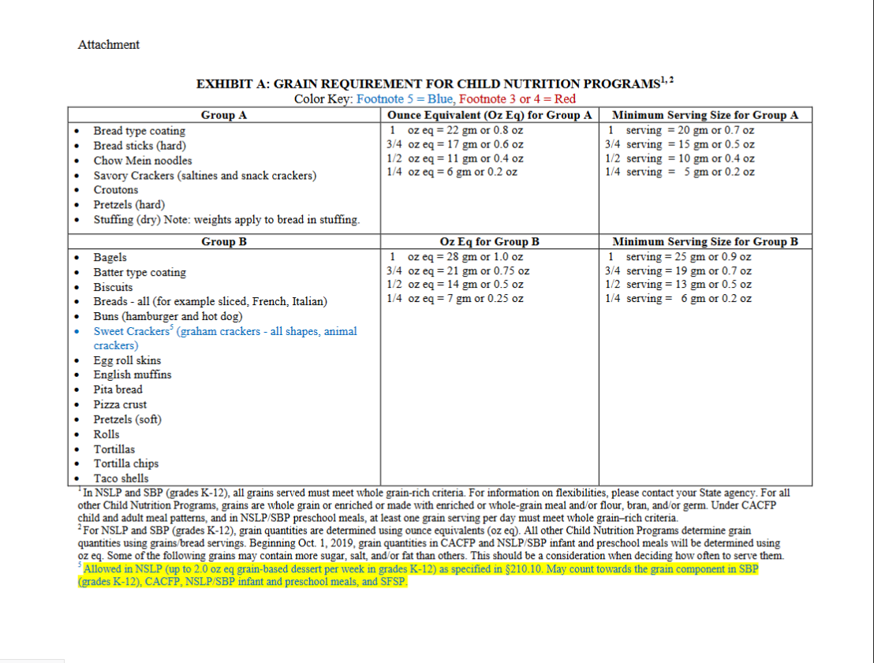
Grain-Based Desserts
Source of added sugars and saturated fats
Determined categorically using Exhibit A
Items not listed on Exhibit A will be determined using general consensus
Common Grain-Based Desserts:
Breakfast bars
Brownies
Cakes
Cereal bars/Granola bars
Cookies
Sweet pie crusts
Sweet rolls
Toaster pastries
Notes:
Grain-based desserts is the next category of non-creditable grains. The reason why it’s not creditable is because they are a source of added sugars and saturated fats. Thankfully, we don’t make you figure out fat or sugar content, and instead, desserts are just categorically non-creditable. To determine which products are considered grain-based desserts, check out Exhibit A. This is shown on the screen. While you might not be able to read it, you can click on the link on your slides handout and go to the handout itself. All items listed in Red or with a footnote 3 or 4 will be considered a grain-based dessert. Some common grain-based desserts include breakfast bars, brownies, cakes, cereal bars and granola bars, cookies, sweet pie crusts, sweet rolls, and toaster pastries. If the item you are wanting to buy or make is not on this list, you’re always welcome to reach out to your assigned Child Nutrition Specialist. In general, the way that grain-based desserts are determined is by looking at general consensus. If you would typically consider this a dessert or a treat, then it would be a grain-based dessert and not creditable for CACFP.

Slide 24
Breakfast Cereals Exceeding Sugar Limits
All breakfast cereals must have sugar levels below the sugar limit threshold of 6 grams per dry ounce of cereal.
If served, breakfast cereals exceeding sugar limits will not be creditable and can result in non-reimbursable meals and snacks
Notes:
Again, remember that breakfast cereals that exceed the sugar limit will not be creditable and if served, will result in non-reimbursable meals and/or snacks.

Slide 25
Creditable Vs. Non-Creditable Grains
Creditable
Non-Creditable
Whole Grains
Enriched Grains
Bran
Germ
Fortified Breakfast Cereals below the sugar limit threshold
Refined Grains (non-enriched)
Alternative Flours and Ingredients
Grain-based desserts
Breakfast cereals that are non-fortified, non-enriched, or non-whole grain and/or above the sugar limit threshold
Notes:
Now that we went through creditable and non-creditable grains – you can see the broad categories here side by side. On the creditable side, you have whole grains, enriched grains, bran, germ, and fortified breakfast cereals that are below the sugar limit threshold. On the non-creditable side are non-enriched refined grains, alternative flours and ingredients, grain-based desserts, breakfast cereals that are not fortified, enriched, or whole grain and/or with sugar content above the sugar limit threshold.
As a reminder - All grains that are served in CACFP must be creditable.

Slide 26
Poll #4
Which of the following items would be non-creditable in the grains component for CACFP? (Select all that applies)
Granola Bar
Enriched Grain Waffles
Red Lentil Pasta
White Rice, non-enriched
Almond Cookies
Notes:
Now that you have a good idea of which grains are creditable and which grains are NOT creditable, try our next poll (launch poll). Out of the 5 items listed, which of the following items would be non-creditable in the grains component for CACFP? In this poll, you will select all that applies. The five items are granola bar, enriched grain waffles, red lentil pasta, white rice, non-enriched, and almond cookies. Which of them are non-creditable? Hint, there’s more than 1 choice.
Ok, just a few more seconds. (close poll, share poll)
Survey says….

Slide 27
Poll #4
Which of the following items would be non-creditable in the grains component for CACFP? (Select all that applies)
Granola Bar
Enriched Grain Waffles
Red Lentil Pasta
White Rice, non-enriched
Almond Cookies
Grain-Based Dessert
Alternative flour
Refined grain
Grain-Based Dessert
Notes:
And the answer is that granola bars, red lentil pasta, white rice, and almond cookies are all non-creditable.
The Granola bar because (click) it’s a grain-based dessert, red lentil pasta (click) because it is an alternative flour, white rice (click) because it not enriched and is a refined grain, and almond cookies (click) because it’s also a grain-based dessert.
Great job!

Slide 28
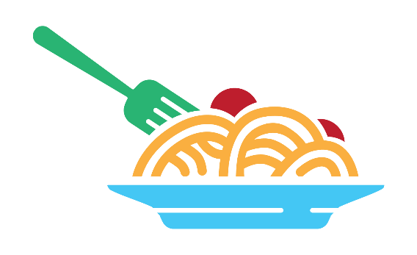
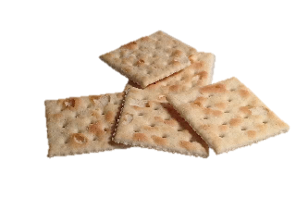
Whole Grain-Rich (WGR) Grains
Grain products that contain at least 50% whole grains and the remaining grains in the food are creditable.
At least one serving of grains per day must be whole grain-rich
Creditable & WGR
Creditable
Creditable
Notes:
Now that we know what is a creditable and non-creditable grain, we are going to move into our third big category of grains - whole grain-rich grains. As we said earlier, the definition of whole grain-rich is specific to USDA and the definition of whole grain rich is a grain product that contains at least 50% whole grains and the rest of the grains in the food are creditable grains.
This is important to know, because in CACFP, when serving grain products, you must serve at least one whole grain-rich component each day. This means that if you are serving breakfast, lunch, and snack, while all grains must be creditable, (click) only one of the grains have to be whole grain-rich.
For those of you who are newer to CACFP and may not have everything all organized in your head about grains just yet, know that whole grain-rich grains are always creditable, but not all creditable grains will be whole grain-rich.

Slide 29
Whole Grain-Rich vs. Whole Grains
WGR
Whole Grains
Grain products that contain at least 50% whole grains and the remaining grains in the food are creditable
Grain ingredient that contains the whole kernel (bran, endosperm, and germ)
Ex. Whole wheat bread
Ex. Whole wheat
Notes:
Previously we talked about whole grains as a category of creditable grains. So what’s the difference between whole grain-rich and whole grains? They are very similar, but whole grain-rich is a term specifically for Child Nutrition Programs while whole grains is a general food term to refer to grain ingredients that contain the whole kernel as we defined in the key terms at the beginning of this webinar.
So for example, whole wheat would be a whole grain, and when you make whole wheat into 100% whole wheat bread, you get a whole grain-rich product. A product like oatmeal however, can be both a whole grain-rich product that is served in CACFP and a whole grain all by itself.

Slide 30
Whole Grain-Rich vs. Whole Grains
Whole grain ingredients can be used to create a whole grain-rich product
Whole grain-rich products can also include other types of creditable grains as well, including enriched grains, bran, and germ
Typical usage can conflate the two terms
Usually only an issue when packages market items as “containing Whole Grains!” but whole grains do not make up at least 50% of the product
Notes:
In general, you might refer to specific ingredients in CACFP as being a whole grain, but whole grain-rich will generally refer to a grain product that is served in a CACFP meal or snack.
And this distinction is important, because whole grain-rich products is only mostly made of whole grains, the rest of the grains in their products can be other creditable grains like enriched grains, bran, and germ.
For most people though, when we talk, we typically say that we are serving whole grains or that we have lots of whole grain products on our menus when we mean to say that we are serving whole grain-rich products or that we have lots of whole grain-rich products on our menus. This is fine as long as everyone has the same understanding.
It’s easy to think well, whole grains are whole grains, right? But when it comes to marketing, whole grains on the package does not always mean that whole grain-rich requirements are met. The main times where this will be an issue is when you or your staff buy items that says “Made with Whole Grains” or “Contains Whole Grains” on the package, but a closer inspection shows that the first ingredient on the ingredient list is not even a whole grain. They may have whole grains down in the middle of the ingredient list, but the product won’t meet the definition of whole grain-rich.
If you’re not familiar with whole grain-rich yet, a quick look into methods of determination and documentation will help sort it out.

Slide 31
Whole Grain-Rich Products
Foods that meet the whole grain-rich criteria are items that contain at least 50% whole grains and the remaining grains in the food are creditable.
Notes:
Let’s look at the definitions of whole grain-rich again. Whole grain-rich products are items that contain at least 50% whole grains and the remaining grains in the food are creditable.
How then do you figure out if your products are whole grain-rich? Especially if you can’t trust the marketing on the package?
There are 6 different methods of determining if an item is whole grain-rich or not. You can see all 6 methods on the screen and later on, we will link to a flowchart that will show you how to determine if your item meets any of the 6 methods. However, in the interest of time today, we are only going to focus on the 2 methods that we see used the most frequently, Method 1 (click) the WIC whole grain list. And (click) Method 6, the Rule of three.

Slide 32
The WIC Whole Grain List
All items on this list are WGR
Notes:
The first method is to use the WIC Whole Grain List. Every state has a WIC list and while each state may have a slightly different list, (click) all the whole grain foods on there will meet the definition of whole grain-rich. These lists are helpful since they include specific brand names that can be easily found in stores. The image on the screen is the Oregon WIC Whole Grain list. Like the WIC Breakfast Cereal list, these lists are updated about once every 2 years, so look for an updated list in the upcoming year.

Slide 33
The WIC Cereal List
Only items with this icon is WGR on this list
Only items with this icon is WGR on this list
Notes:
And speaking of the WIC Breakfast List, in Oregon, WIC Breakfast Cereals that are listed with a “W” icon can also be considered whole grain-rich. About 50% of breakfast cereals on WIC lists must be whole grain-rich, so (click) look for the purple circle with the “W” inside. It’s very important to note that while all cereals on the Breakfast Cereals list meet sugar limit requirements and are creditable for CACFP, ONLY the ones with the W icon will meet whole grain-rich requirements.

Slide 34
The Rule of Three
Also known as the Ingredient List Method
To meet the Rule of Three:
The first ingredient (or second after water) on the ingredient list must be a whole grain
The next two grain ingredients (if any) on the ingredient list must be creditable grains
With this rule, we are ONLY looking at grain ingredients
Can disregard grain derivatives (corn starch and tapioca starch) and ingredients that are less than 2% of product weight
Notes:
What happens if you want to use a cereal or grain product that is not on a WIC list? Most of the time, you will be using Method 6, also known as the rule of three, and which I like to call the ingredient list method.
In this method, all you need to do is look at your ingredient list on your grain item’s package and look for the first three grain ingredients that are listed. If the first ingredient (or second ingredient after water) is a whole grain and then the next two grain ingredients, if there are any, are creditable grains, then the grain is whole grain-rich.
You only need to look at the grain ingredients, not any of the other ingredients and there’s certain ingredients that may seem like grain ingredients that can be disregarded. This include grain derivatives and ingredients that are less than 2% of product weight.

Slide 35
Ingredient List: Corn Tortilla
First ingredient: “Corn masa flour” is a Whole Grain ingredient
Ingredients: Corn Masa Flour (Ground White Corn Masa Flour, Cellulose Gum, Guar Gum, Trace of Lime), Water, Corn Starch, Dextrose, to Maintain Freshness (Sorbic Acid, Calcium Proprionate, Fumaric Acid, Sodium Proprionate), Enzymes
Grain Derivative - disregard
No additional grain ingredients
This item is WGR
Notes:
So now that we know what the rule of three is and what we can disregard, let’s look at an example from a corn tortilla. We have our ingredient list, (click) and you see that the first ingredient is Corn Masa Flour. Corn Masa is a whole grain ingredient, so it meets the first part of the rule of three. Next, we will look to see if there are any other grain ingredients. (click) There’s a grain derivative with corn starch, but you can disregard that. And looking at the other ingredients, you can see that (click) there’s no other grain ingredients. So since the only grain ingredient is a whole grain, this product (click) is considered whole grain-rich.
Why is this whole grain-rich? With only corn masa on the ingredient list, this product is 100% whole grains and meets the definition of whole grain-rich.

Slide 36
Flour Blends and the Rule of Three
Ingredients: Whole grain flour (whole wheat flour, brown rice flour, whole grain oat flour), water, flour blend (graham flour, enriched wheat flour, enriched corn flour, wheat bran), yeast, salt.
Flour blends are ingredients that have a list of sub-ingredients shown in parenthesis.
If the flour blend is the first ingredient, then the entire blend must be made with whole grain ingredients
If the flour blend is the second or third grain ingredient, then the blend must be made with either whole grains or a mix of creditable grains
Flour blends with non-creditable flours or grains (ex. alternative flours such as tapioca flour) would make the blend non-creditable and the item would not meet the Rule of Three
Notes:
So that was an easy example. What if you have a more complicated example like this one? In this example, you have an ingredient that is immediately followed by a list of sub-ingredients in a parenthesis. This is known as a flour blend. In cases like this, if the flour blend is the first ingredient then the entire blend like the example on the slide, must be made with whole grain ingredients.
If the flour blend is the second or third grain ingredient, for example, the second flour blend on the example on the screen, then the blend must be made with either whole grains or a mix of creditable grains to meet the rule of three.
If your flour blends have any non-creditable flours at all, and the flour blend is one of the first 3 grain ingredients, then this would make the blend non-creditable and your item would not meet the rule of three and thus, would not be considered whole grain-rich using this method.

Slide 37
Documenting Whole Grain-Rich Requirements
Menus must indicate which grain items are whole grain-rich
If all grain items are whole grain-rich, a blanket statement can be used on the menu
Supporting Documentation must be saved showing how the product meets whole grain-rich requirements
When using the WIC Whole Grain or Breakfast Cereal List: Keep
The WIC Whole Grains/Breakfast Cereal List
Packaging with name matching the WIC List
When using the Rule of Three: Keep
Packaging showing the name of product
Ingredient list
Notes:
For whole grain-rich items, additional documentation needs to be saved.
First, make sure that your menus indicate which grain items are whole grain-rich with an easily identifiable notation. Generally, we see WG or WGR. If you are dedicated to serving only whole grain-rich items, then you can have a blanket statement saying that all grains served are whole grain-rich. However, this will mean that you need to keep supporting documentation for ALL grain items that you serve.
Supporting documentation is needed for all whole grain-rich items. So if you are using the WIC Food List, then make sure you are saving the WIC List and also saving the packaging showing that the name of the product matches the WIC list. Remember that it has to be the current WIC list.
If you are using the Rule of Three, then keep the packaging again and also the ingredient list. The ingredient list must show that the item meets the Rule of Three. We like to see the packaging with the name because there’s usually no product name right next to the ingredient list and this is a good way to ensure you know which ingredient list matches which product.

Slide 38
Poll #5
Is this six-grain bread whole grain-rich?
Ingredients: Whole Wheat Flour, Flour Blend (enriched wheat flour, oat flour, graham flour, enriched corn flour, enriched barley flour, brown rice flour), wheat bran, sesame seeds, yeast, salt.
Yes
No
Notes:
Now that you got a good overview of whole grain-rich grains, here’s our final poll today on this topic. I’m going to hold off on launching the poll for now so you can review the ingredient list, but look at the ingredient list and answer whether this six-grain bread would be considered whole grain-rich or not?
The ingredients are whole wheat flour for the first ingredient. Flour blend for the second with enriched wheat, flour, oat flour, graham flour, enriched corn flour, enriched barley flour, and brown rice flour, and the third ingredient is wheat bran. Take a look at your slide handouts and look at the common whole grain and common enriched grain ingredients and see if you see all the items there.
Answer Yes or No. I’m going to launch the poll now (launch poll).
(close poll, share poll)
It looks like most people said….

Slide 39
Poll #5
First Grain: Whole Grain
Second Grain: Flour Blend
Flour blend grains are all creditable
Is this six-grain bread whole grain-rich?
Ingredients: Whole Wheat Flour, Flour Blend (enriched wheat flour, oat flour, graham flour, enriched corn flour, enriched barley flour, brown rice flour), wheat bran, sesame seeds, yeast, salt.
Third Grain: Creditable Grain
Yes
No
Notes:
And the answer is yes.
Why is this a whole grain-rich item? Using the rule of three, the first ingredient must be a whole grain. (click) Whole wheat flour is a whole grain. Then you need to make sure the second and third grain ingredients are also creditable grains. This means they need to be whole grain, enriched grains, bran or germ. Let’s look at the second grain ingredient – (click) Flour blend. Remember what we said about flour blends – you have to make sure that all the grains in the flour blend are creditable if it is the second or third grain. Let’s check – enriched wheat flour – enriched and creditable, oat flour - whole grain and creditable, enriched corn flour – enriched and creditable, enriched barley flour – enriched and creditable, brown rice flour – whole grain and creditable. (click) Great! All items in the flour blend are creditable. Let’s go to our third grain now – is wheat bran a creditable grain? (click) Yes, bran are creditable grains.
So this item meets the rule of three and it is a whole grain-rich item.

Slide 40
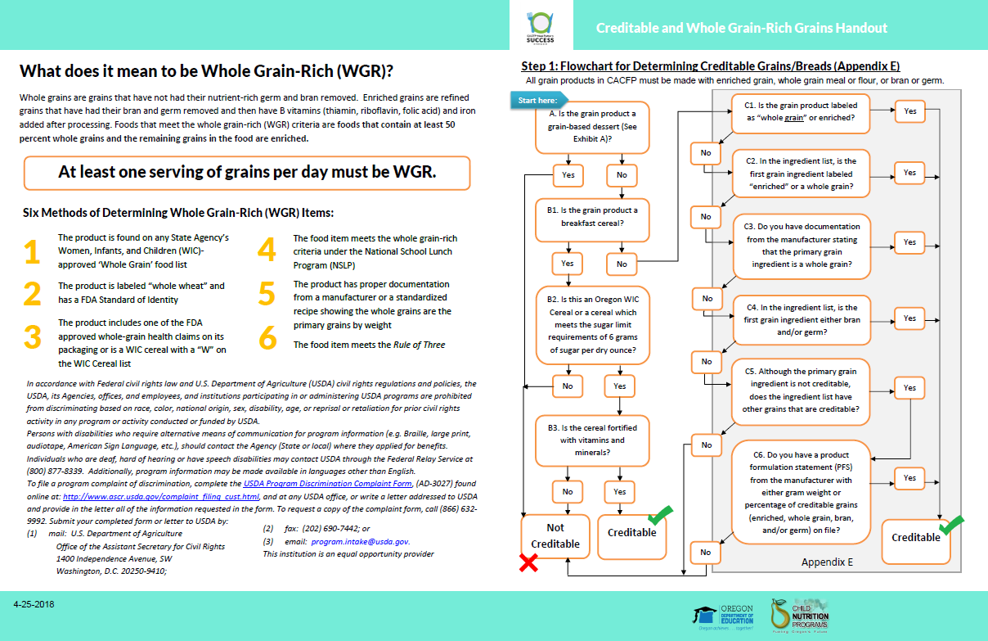
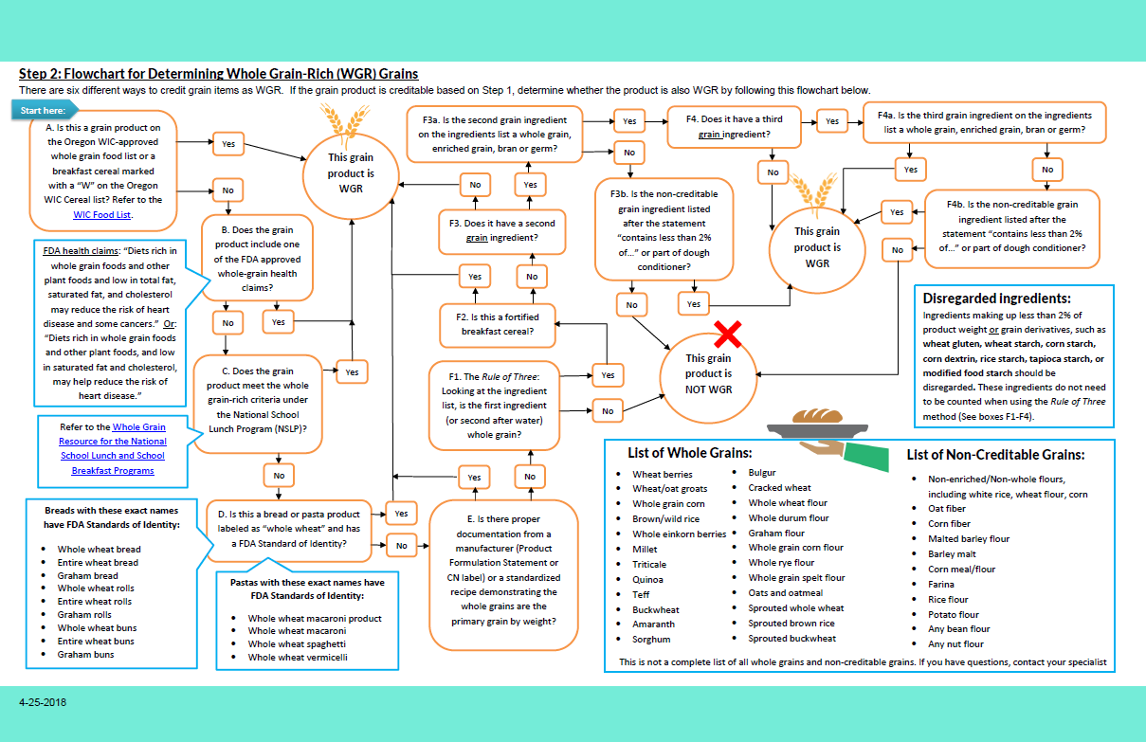
Grains Resources
Flowchart for Creditable and WGR Grains
Determine if your grain product is creditable
Determine if your grain product is whole grain-rich
Notes:
If you want to walk through the steps and for determining creditable and whole grain-rich items at your own pace, you can use ODE”s flowchart for Creditable and Whole Grain-Rich Grains. This is the handout that includes all 6 methods of determining whole grain-rich products. It also has the flowcharts that help you determine if your grain products are 1) Creditable and 2) whole grain-rich. The link is available on the slide handout.

Slide 41
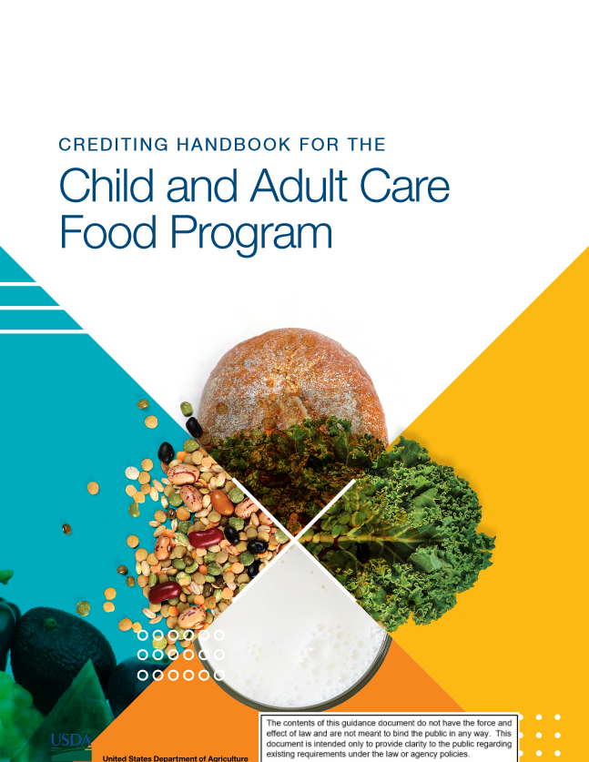
CACFP Crediting Handbook
Great source of overview information on grains (Pages 74-111)
Explanation of creditable and whole grain-rich grains
Includes list of common whole grains and enriched grains
Chart on common grain items and whether it is creditable
Notes:
For a good overview of the grain component, take a look at the CACFP Crediting Handbook. This was released in Spring 2020 and provides a detailed explanation of creditable and whole grain-rich grains. It also has lists of common whole grains and enriched grains and a very useful chart on common grain items and whether they are creditable or not. Link is available in the slides handout.

Slide 42
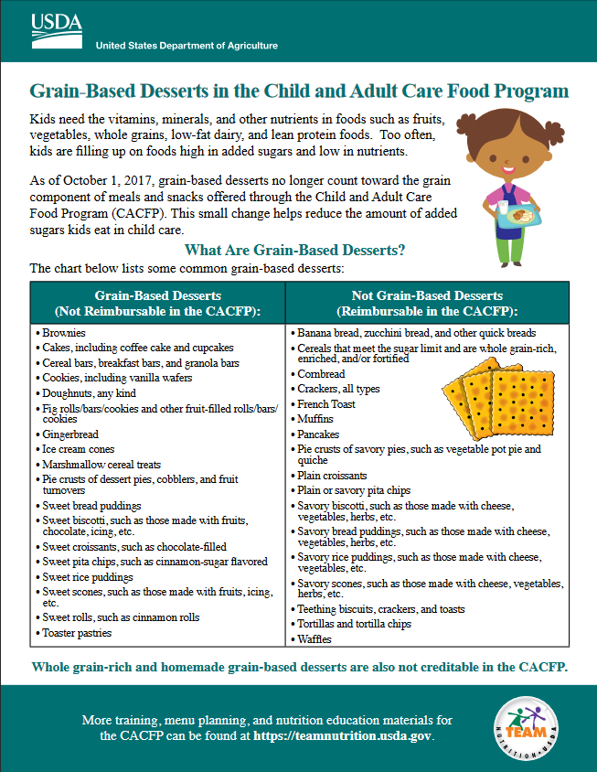
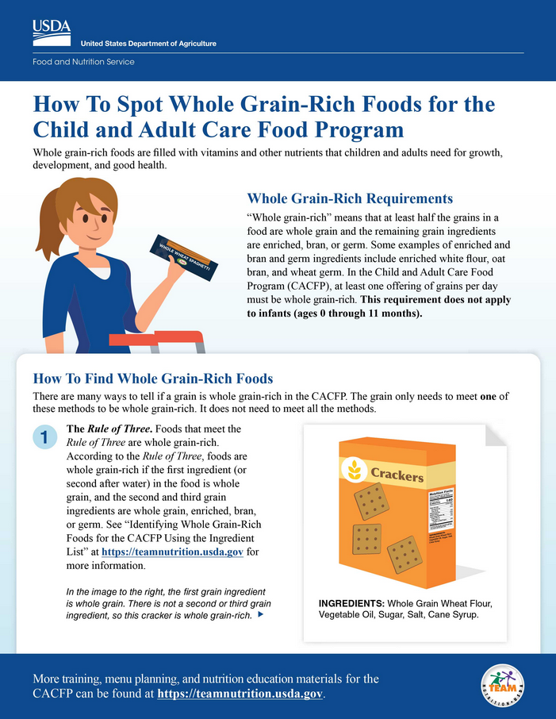
Team Nutrition CACFP Worksheets
Notes:
And finally, if you are looking for resources that are easy to digest and helpful for kitchen or purchasing staff, Team Nutrition has a series of handouts. I included the Identifying Whole Grain-Rich Handout from Team Nutrition in the Handouts Tab, but they have several more grain-related handouts, including one on grain-based desserts and spotting whole grain-rich foods. All of their handouts are available in English and Spanish and print versions are available for several of the handouts.

Slide 43
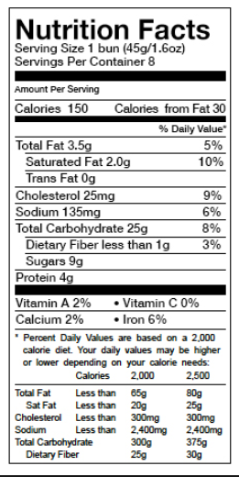
Ounce Equivalents: Exhibit A
Ounce equivalents will be required starting October 1, 2021.
Notes:
I mentioned early in the webinar that ounce equivalent serving sizes will be required starting Oct 1, 2021. We will have more information later on in 2021, but know that you are allowed to use ounce equivalents instead of the current serving sizes now. In practicality, ounce equivalents is not too different from what you are serving now – the difference is an increase in 3 grams of grain per serving. If you are familiar with grams, that’s not a lot for a serving of grains at all. And in fact, most grain portions we serve are larger than both ounce equivalents and the current serving sizes.
The difference is that ounce equivalents is more precise. So instead of saying I am serving 1 slice of bread where the bread can be a Texas Toast slice of bread or a little diet slice of bread, instead, it says I am serving 1 ounce equivalent of bread, or about 28 grams worth of grains.
Exhibit A, which you can see on the screen, and which you might be familiar with for grain-based desserts, has the portion size differences for ounce equivalents versus minimum serving sizes. In fact, this is the main purpose for Exhibit A! (click) You can see the ounce equivalent serving sizes in the middle column, highlighted in red now, and the current serving sizes (click) are listed in the right-most column, now highlighted in blue.
You can take a look at your nutrition facts labels (click) and look at the (click) serving size, and look for the grams or ounces. Then you find the item on Exhibit A, and compare it to their ounce equivalent by group to see if it meets serving size requirements. Most of the time, the item will exceed ounce equivalent serving sizes, and that’s OK for CACFP – portions can be larger, they just have to meet a minimum serving.
More to come in 2021!

Slide 44
Grains: CACFP Requirements
Grains must be served at breakfast, lunch, and supper
Can substitute meat/meat alternate for grains at breakfast up to 3 times a week
One of the five components that can be served at snack
All grains served must be creditable in CACFP
At least once per day, the grain component must be whole grain-rich
Starting Oct 1, 2021, serving sizes for grains will use ounce equivalents (more info to come in 2021)
Notes:
To recap our lesson: All grains that are served in CACFP must be creditable and creditable grains include whole grains, enriched grains, bran, germ, and fortified breakfast cereals meeting sugar limit thresholds.
Once a day, the grain component must also be whole grain-rich and that means that the grain must contain at least 50% whole grains and the remaining grains in the item must be creditable.
Be on the lookout for more information on ounce equivalents in 2021!

Slide 45
Questions?
More Questions?
Contact your assigned Child Nutrition Specialist
Notes:
We have ____ minutes and I am going to take a minute to look at the questions that were sent in through the question and chat box during our lesson today. I will mute my line while I go through them. (Answer chat box questions, once those are complete, ask if there are any additional questions. If there are too many questions to answer in the time frame, silence the microphone and take 1 minute to pick and choose the best questions to answer).
If you still have questions or if your question was not answered, please contact your assigned child nutrition specialist.

Slide 46
Oregon Department of Education “Our Why”
Equity and Excellence for Every Learner
The Oregon Department of Education works in partnership with school districts, education service districts and community partners;
Together, we serve over 580,000 K-12 students;
We believe every student should have access to a high-quality, well-rounded learning experience;
We work to achieve the Governor’s vision that every student in Oregon graduates with a plan for their future.
Notes:
Thank you for watching this CACFP Meal Pattern Webinar of Creditable and Whole Grain-Rich Grains. ODE is committed to equity and excellence for every learner.

Slide 47
Oregon Department of Education Education Equity Stance
Education equity is the equitable implementation of policy, practices, procedures, and legislation that translates into resource allocation, education rigor, and opportunities for historically and currently marginalized youth, students, and families including civil rights protected classes. This means the restructuring and dismantling of systems and institutions that create the dichotomy of beneficiaries and the oppressed and marginalized.
Notes:
And we want to make sure that our communities are supported in their goal to reach equitable implementation of policy, practices, procedures, and legislation.

Slide 48
In accordance with Federal civil rights law and U.S. Department of Agriculture (USDA) civil rights regulations and policies, the USDA, its Agencies, offices, and employees, and institutions participating in or administering USDA programs are prohibited from discriminating based on race, color, national origin, sex, disability, age, or reprisal or retaliation for prior civil rights activity in any program or activity conducted or funded by USDA. Persons with disabilities who require alternative means of communication for program information (e.g. Braille, large print, audiotape, American Sign Language, etc.), should contact the Agency (State or local) where they applied for benefits. Individuals who are deaf, hard of hearing or have speech disabilities may contact USDA through the Federal Relay Service at (800) 877-8339. Additionally, program information may be made available in languages other than English. To file a program complaint of discrimination, complete the USDA Program Discrimination Complaint Form, (AD-3027) found online at the USDA complaint resolution page, and at any USDA office, or write a letter addressed to USDA and provide in the letter all of the information requested in the form. To request a copy of the complaint form, call (866) 632-9992. Submit your completed form or letter to USDA by: (1) mail: U.S. Department of Agriculture Office of the Assistant Secretary for Civil Rights 1400 Independence Avenue, SW Washington, D.C. 20250-9410; (2) fax: (202) 690-7442; or (3) email: program.intake@usda.gov This institution is an equal opportunity provider.
Notes:
This institution is an equal opportunity provider.

Slide 49
Thank You!
Questions?
E-mail: Shirley.Wu@state.or.us
ODE Child Nutrition Programs CACFP Page

