Slide 1
Trainer Notes Only
Notes:
Collaborating with Community Health Professionals
Instructor Notes

Slide 2
Trainer Notes Only
Notes:
Collaborating with Community
Health Professionals
Instructor Notes
________________________________________________________________
Child Nutrition & Wellness
Kansas State Department of Education
________________________________________________________________

Slide 3

Collaborating with
Community Health Professionals
Welcome to
To receive the Participant Booklet for this class:
Email: Sarah Bruschi at sbruschi@ksde.org
Subject: Collaborating with CHP Handout
Notes:
Display this slide prior to start of the class.
Welcome participants as they enter the session.
Perform periodic sound checks prior to the start of the class.
Announce availability of the participant file aloud. Refer participants to the contact information on the slide to request Participant Booklet for this class. Copy and paste the contact information for the Participant Booklet to the chat box.
At the designated starting time, thank participants for coming, introduce yourself, and welcome them to the class.

Slide 4
Class Logistics
Class ending time
Participant materials and supplies
Recorded class
Mute/unmute and chat box features
Q&A protocol
Attendance
Notes:
Inform participants this is a two hour class and will end by (insert time that is two hours from planned start time).
Explain that the class slides are available upon request. To receive the slide handout, email _______________ (add contact information to chat box by copying and pasting from title slide). Explain that the document will be sent as an email with an attached file.
Let participants know that the class will be recorded, if applicable. (record class to the Cloud).Inform participants that they can mute and unmute their audio. Remind them that when in “unmute” mode, their conversations and background noise can be heard.
Let’s practice the mute/unmute features of Zoom. Allow time for practice. Let’s practice communicating through the chat box in Zoom by sharing your favorite fruit. Allow time for practice.
Encourage participants to ask questions and provide comment as appropriate to the class content. Explain that participants may ask questions or provide input by unmuting their audio or typing in the chat box.
Attendance will be taken at the end of class via a Survey Monkey survey. To receive a Certificate of Completion for the class, complete the Attendance Survey. The Attendance Survey will ask for Sponsor Number, Sponsor Name, and Names of Attendees. For example, Sponsor Number for a public school is the USD designation. Sponsor Name for a public school is the name of the school district. As an added note regarding the Attendance Survey, multiple attendees from one Sponsor can be included in a single Attendance Survey.

Slide 5
Objectives
By the end of the class, participants will be able to…
Understand importance of collaborating with community health professionals.
Identify health professional partners.
Learn methods for connecting with community health professionals.
Discover ways to collaborate with community health professionals to create healthier school environments.
Notes:
Impacting the health of children in a positive way is the focal point of school wellness initiatives. Community health professionals can help support schools in collaborative efforts to promote health and wellness.
By the end of the class, participants will…
Understand importance of collaborating with community health professionals.
Identify health professional partners.
Learn methods for connecting with community health professionals.
Discover ways to collaborate with community health professionals to create healthier school environments.

Slide 6
Understand Importance of Collaborating with Community Health Professionals
Notes:
Community involvement, including the involvement of community health professionals, works to advance the education, social emotional development, and general health of students.
When school administrators, school nutrition personnel, students, parents, and community health professionals collaborate to put effective wellness policies in place, it can encourage positive, widespread community health outcomes and student success.

Slide 7
Collaboration
Purposeful relationship between two or more people, working together to achieve a common goal.
Encourages people with different perspectives to come together to get things done.
Taps into the intellect, skills, and talents of those involved.
Contribute in ways that best suit strengths.
Notes:
Collaboration is a purposeful relationship between two or more people, working together to achieve a common goal.
Collaborative efforts encourage people with different perspectives to come together to get things done by tapping into the intellect, skills, and talents of those involved.
Collaboration allows different partners to contribute in ways that best suit their strengths.

Slide 8

Popular Partnerships
In complementary relationships, the partners have better results when working together than when working alone.
Who or what are your dynamic duos?
Notes:
Collaboration works when complementary relationships are formed. In complementary relationships, the partners have better results when working together than when working alone.
Who or what are your dynamic duos? Think of popular partnerships or things that work better together. It can be people, such as Mickey Mouse and Minnie Mouse, or things, such as salt and pepper!
Encourage participants to share their dynamic duos in the chat box or by unmuting their audio.
Popular Partnerships Possible Responses: Batman/Robin; Macaroni/Cheese; Bert/Ernie; Peanut Butter/Jelly; Sonny/Cher; Bagel/Cream Cheese; Ben/Jerry; Simon/Garfunkel; Scooby Doo/Shaggy; Mario/Luigi; Sherlock Holmes/Watson; Vinegar/Oil

Slide 9
Collaborating with Health Professionals
Collaborating with community health professionals can be a great way to support and advance school wellness initiatives.
Community health professionals may welcome opportunities to connect with the school community and with students.
Notes:
As demonstrated in the activity, when there is a shared purpose within the partnership, the results can be extraordinary! Similar extraordinary results can be realized when collaborating with community partners who have a shared vision on the welfare of community children.
More specifically, collaborating with community health professionals can be a great way to support and advance school wellness initiatives. Community health professionals are often an untapped resource and may welcome opportunities to connect with the school community.

Slide 10
Advantages to Collaborating with Community Health Professionals
Interests align with school wellness program initiatives
Sustainable resource to the school wellness program
Established relationships with community families
Respected and considered a credible source of information
Access to current materials and resources
Possible connections to grant opportunities
Notes:
There can be great advantages to collaborating with community health professionals to advance the health and wellness of school-age children.
The interests of community health professionals align nicely with school wellness program initiatives. Community health professionals are community based, making them a more sustainable resource to the school wellness program.
Community health professionals have established relationships with community families and can extend their passion for caring to the school community.
Community health professionals are respected and considered a credible source of information. They have access to current materials and resources on health and wellness. They may also have connections to grant opportunities that support wellness initiatives.

Slide 11
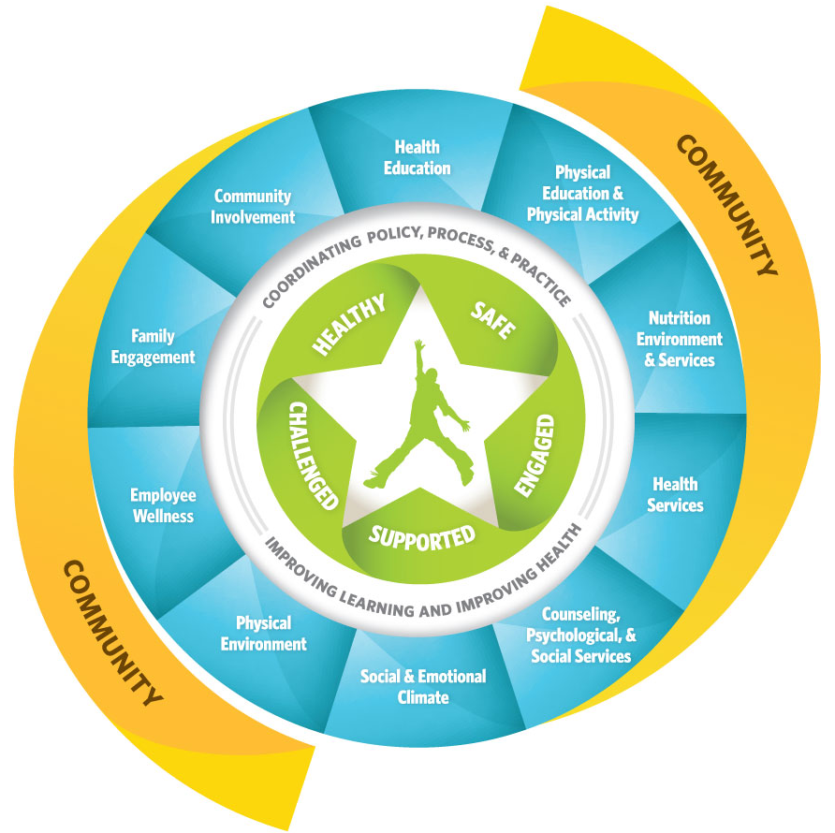
Whole School, Whole Child,
Whole Community Model
Center for Disease Control (CDC)
Association for Supervision and Curriculum (ASCD)
Notes:
The Whole School, Whole Child, Whole Community Model supports community involvement in school wellness programs.
The Whole School, Whole Child, Whole Community Model was created by Center for Disease Control (CDC) and Association for Supervision and Curriculum (ASCD) for the purpose of demonstrating the involvement of the entire community in the wellness of the school-aged child.
The student-centered model emphasizes the important role of the community in supporting the healthy physical, social, and emotional development of school-aged children. It demonstrates the connections between health and academic achievement and the importance of evidence-based school policies and practices.
As shown in the model, a community health professional can have a significant impact in several areas of a community-based health and wellness program.

Slide 12
Identify Health Professional Partners
Notes:
The first step in promoting involvement of health professionals is to identify who they are, where they are, and what resources are available to them. It is important to reach out to professional partners through credible and trusted community organizations.

Slide 13
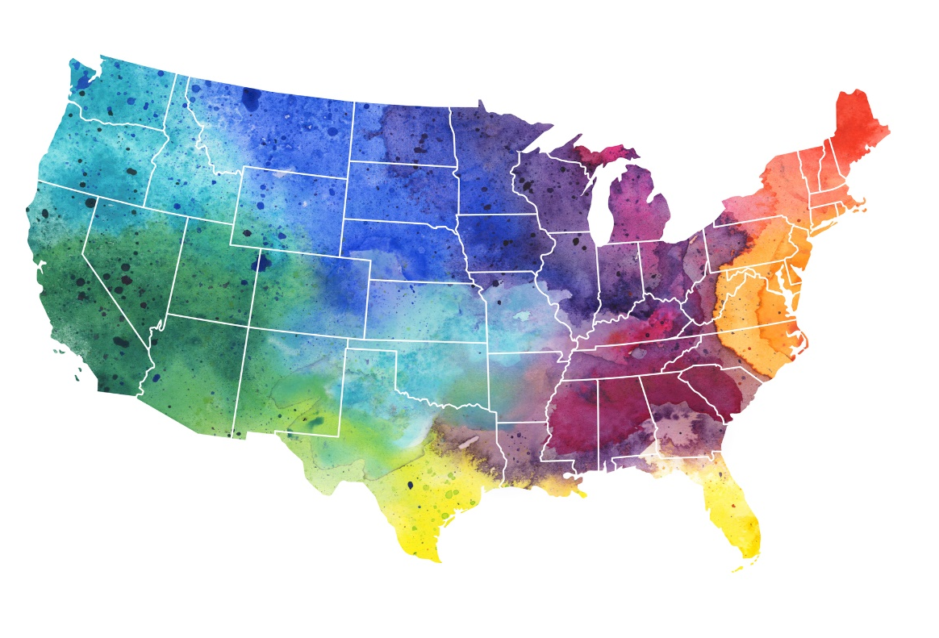
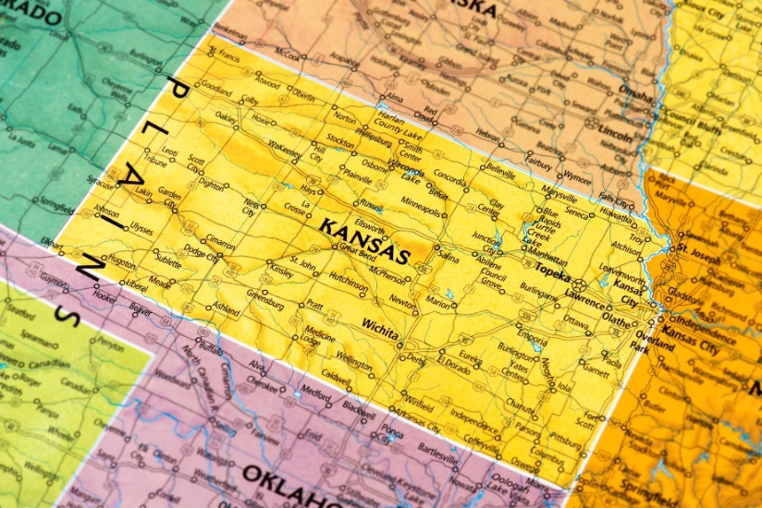
Health Professional Partners
National Partners
State Partners
Local Partners
Notes:
Health professional partners and wellness resources are available at the national, state and local levels.
National partners provide access to credible information on health and wellness, along with research data to support initiatives. National partners can provide access to customizable activities and goal setting assessment tools.
State partners provide guidance and resource support. They have connections to local health professionals who may be willing to collaborate with schools. State partners also hold wellness events and, often, have access to educational displays and materials.
Local partners are those found within your community and can provide sustainable support to a school wellness program.
Refer participants to the handout, Health Professional Partners and Resources, in the Participant Booklet.

Slide 14
National Partners
Public health organizations
Health and fitness agencies
Health foundations
United States Department of Agriculture
Notes:
National partners can include public health organizations, such as the Centers for Disease Control, National Institute of Health, American Heart Association, American Medical Association, American Diabetes Association, American Cancer Society, and the Academy of Nutrition and Dietetics.
National partners can include health and fitness credentialing agencies, such as the American College of Sports Medicine or American Council on Exercise.
National partners can include health foundations, that often have a community focus and, sometimes, have access to grant opportunities.
The United States Department of Agriculture has developed wellness tool kits, event ideas booklet, library resources, and educational outreach tools to support community efforts.

Slide 15
State Partners
Kansas State Department of Education
Kansas Department of Health and Environment
Kansas Department of Children and Families
Kansas Public Health Association
Kansas Association for Health, Physical Education, Recreation and Dance
Notes:
State level associations and organizations can help identify community health professionals and resources to support health and wellness efforts.
State partners include ….read slide.

Slide 16
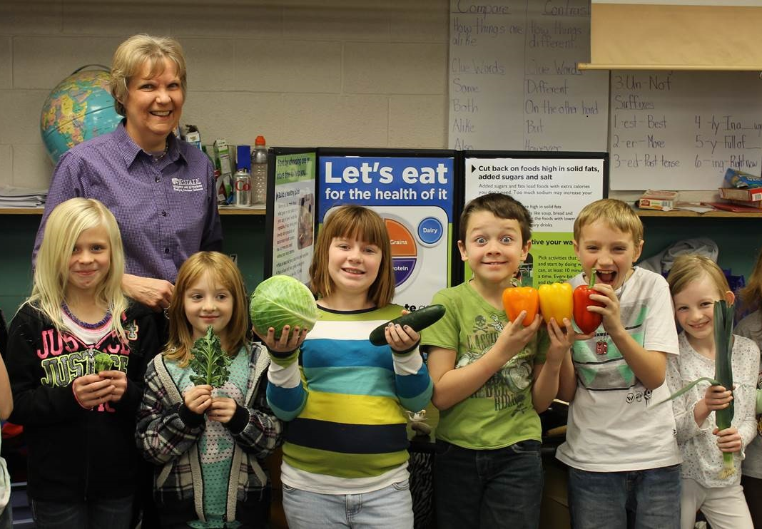

State Partners, cont.
Kansas Hospital Association
Kansas State Nurses Association
Kansas Academy of Nutrition and Dietetics
Kansas Universities
County Extension Offices
State Health Insurance Companies
Kansas Governor’s Council on Fitness
Notes:
The Kansas Hospital Association, the Kansas State Nurses Association, and the Kansas Academy of Nutrition and Dietetics have health and wellness professionals who may have community outreach interests.
Kansas universities often have educators and graduate students who are passionate about childhood nutrition and want to collaborate on projects.
County extension offices have credible resources, handouts, and displays that can support district wellness agendas. They have programs, such as the Master Food Volunteer program and Master Gardeners Program to advance wholesome lifestyle initiatives. County extension offices can also connect schools with county personnel who educate on health and nutrition.
State Health Insurance Companies sometimes participate in community outreach activities and may have personnel who can assist with student and staff wellness programs.
The Kansas Governor’s Council on Fitness addresses issues of physical inactivity, poor nutrition and tobacco use. The Council offers valuable links to health survey data, nutrition education, and food policy resources.

Slide 17
Local Partners
County health departments
Community hospitals and medical centers
Family practice groups and specialty clinics
YMCA Associations
Parks & recreation departments
Community sports programs
Student family members who are health professionals
Notes:
Local partners are those found within your community and will be unique to your program. Local organizations are often looking for ways to partner and participate in school sponsored activities.
State level organizations have access to local level resources and personnel. Local health departments sometimes offer health screenings; conduct healthy lifestyle programs; or hold events to educate at the community level.
Community health clinics have medical personnel who may be willing to act as a wellness champion in a school wellness program. If active involvement is not possible, perhaps, they can connect schools to existing community focused wellness workgroups, sponsored by medical centers or hospitals.
Family practice groups and specialty clinics have exercise specialists, personal trainers, dietitians, and physical therapists on staff. YMCA Associations, Parks & Recreation Departments, and community sports programs may offer access to fitness facilities, parks, and other community sports platforms.
Students could have family members who are professionals in health, wellness, nutrition, or physical fitness. The possibilities are extensive!

Slide 18

Health Professionals in Your Community
Who are the health professionals in your community?
Notes:
Who are the health professionals in your community? Think of health professionals in your community that could offer support to the child nutrition program initiatives of health and wellness.
Encourage participants to share their thoughts in the chat box or by unmuting their audio.
Discuss possibilities as a class. Examples include doctors, nurses, dietitians, social workers, pharmacists, psychologists, dentists, physical therapists, optometrist, etc.

Slide 19
Learn Methods for Connecting with Community Health Professionals
Notes:
Now that community health professionals have been identified, the next step is to learn methods for connecting with them. It is important to know how to engage with community health professionals in order to motivate them to want to participate in school wellness initiatives.
The first step is to create awareness of the opportunities to participate. A community health professional will be much more likely to get involved if they have an understanding of the school’s wellness initiatives and see value in the activities planned by the school’s wellness committee.

Slide 20

Targeted Messages
School meals and physical exercise helps students by…
Improving Student Health
  Reduce illness, absenteeism and visits to the school nurse
  Reduce obesity, and onset of preventable diseases
  Proper growth and development
Improving Academic Performance
  Improves Brain Function
  Show gains in standardized testing scores
Notes:
School personnel and members of the school wellness committee already have an understanding of the values and benefits of healthy school meals and time for physical activity. Community health professionals, however, may not always recognize the benefits of school wellness programs, and more specifically, school nutrition program meals.
Educate prospective community partners on school nutrition programs and school wellness initiatives. As an advocate for healthy school environment initiatives, it is helpful to have targeted messages ready to share with community health professionals. Targeted messages, not only educate community members, but can work to recruit community health professionals who may to support school programs in some way.
The examples shown on the slide are targeted messages that grab attention and are supported by research. Read slide examples.

Slide 21

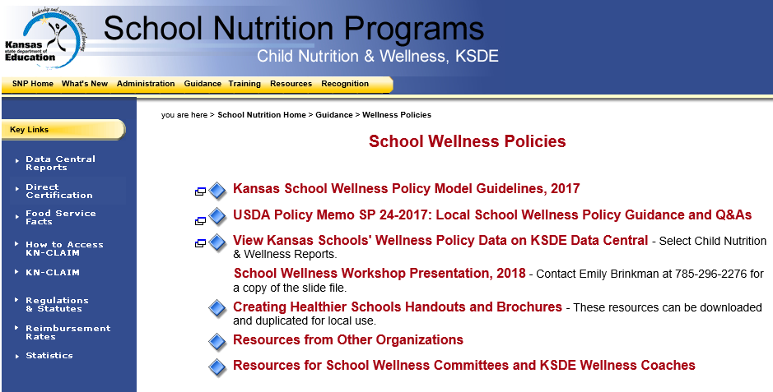
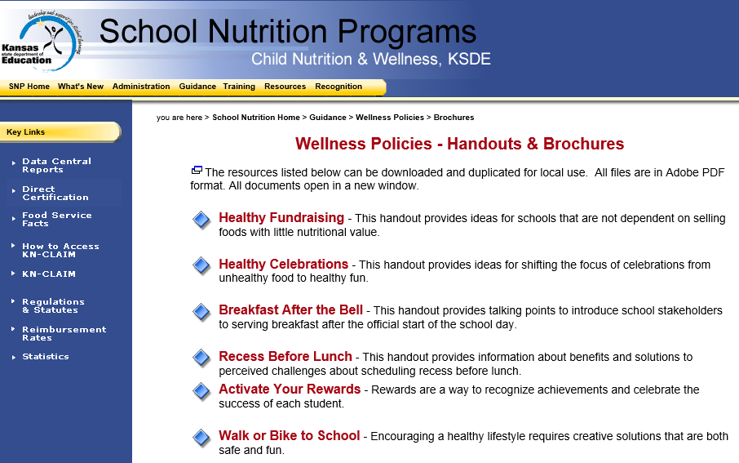
KSDE School Wellness Policy Resources
Notes:
Additional targeted messages that promote health and wellness within the school community are available on the KSDE Child Nutrition & Wellness website at www.kn-eat.org, School Wellness Policies, Creating Healthier Schools Handouts and Brochures.

Slide 22
Making Connections
Face-to-face interactions
Printable materials
Traditional media venues
Online tools
Notes:
Targeted messages can be shared through face-to-face interactions, printable materials, traditional media venues, and online tools.

Slide 23

Connect Through Face-to-Face Interactions
Meetings
Roundtable events
Networking experiences
Presentations
Elevator pitches
Notes:
Connections can be made through face-to-face interactions, such as meetings, roundtable events, networking experiences, presentations, and/or elevator pitches.
Face-to-face connections are much more personal than phone calls, texts, emails, or letters. When meeting with a community health professional in person, be concise and accurate. Share the visions and goals of the overall school wellness program and highlight any projects that align with the interests of the community health professional.

Slide 24
Face-to-Face Meetings and Roundtable Events
May be a group meeting or one-on-one meeting.
Provide an opportunity to share about school wellness programs and projects.
First impressions matter, be prepared.
Show excitement on how the wellness program is making a difference in the lives of students.
Notes:
Meetings and roundtable events are a great way to make face-to-face connections.
A meeting may be assembled to discuss a specific school health and wellness initiative. Health and wellness can be included in the conversation of other meetings that involve the best interests of children. A meeting can also be a formal request to meet one-on-one with a community health professional to discuss school wellness projects. Meetings in whatever form provide an opportunity to share about school wellness programs and projects.
Invite community members to a community roundtable to showcase healthy school meals and discuss community partnerships. When showcasing the program, first impressions matter. Be prepared and show excitement on the ways the wellness program is making a difference in the lives of students.
Refer participants to Participation Booklet, Connect Through Face-to-Face Interactions, for note taking.

Slide 25
Face-to-Face Networking Experiences
Share messages with multiple stakeholders at one time.
Offer opportunities to discuss school wellness initiatives in a more casual conversational style.
Can occur during meetings, workshops, seminars, conferences, and social get-togethers.
Notes:
Networking experiences are a great way to share messages with multiple stakeholders at one time. Networking offers face-to-face opportunities to discuss school wellness initiatives in a more casual conversational style. Networking can occur during meetings, workshops, seminars, conferences, and social get-togethers.

Slide 26

Face-to-Face Presentations
Like-minded community health professionals
Allocated time to focus on your topic
Targeted messages shared with a captive audience
Content aligned to interests
Notes:
Face-to-face connections with community health professionals can occur through presentations.
Presentations provide a way to reach out to like-minded community health professionals, at an allocated time when they are focused on your topic. It is much easier to share targeted messages on health and wellness when there is a captive audience and the content is aligned to their interests.

Slide 27
Face-to-Face Elevator Pitches
Share an overview of your program and its purpose.
Make it memorable by highlighting key points and hot topics of interest.
Use action statements to engage interest.
Ensure their potential role is clearly stated.
Tie in a win-win statement sharing how participation can benefit them, as well as, the students.
Notes:
An elevator ride can provide an opportunity to share about school wellness initiatives in a face-to-face moment. Be ready to share a very short targeted message in an elevator pitch!
An elevator pitch is a brief 20-30 second, influential pitch that is used to spark interest in your organization or program.
Tips for making an impact in a very short period of time include… read slide.

Slide 28
Elevator Pitch Sample – Parent Committee Member
Hello I’m (name), parent of a child and member of our school wellness committee at (identify school). I am concerned about (insert concern, such as the growing obesity rate among children and its health impacts).
Our school wellness committee is looking for community health professionals, like you, to assist in advancing the health and wellness of school-aged children. Would you like to become an active committee member and/or participate in a school wellness event?
Notes:
Here is an example of an elevator pitch that a parent member of the school wellness committee could use to recruit a community health professional. Read example on the slide and discuss format. Encourage other ideas for parent committee member.

Slide 29
Elevator Pitch Sample – Nurse Committee Member
Hello! I’m (name), a school nurse at (identify school). Our school would like to invite you to attend our Family Health and Wellness Kickoff on (insert date).
We are reaching out to community health professionals, like you, who have an interest in making community connections and in advancing the health and wellness of community families. Would you like to participate in our Family Health and Wellness Kickoff or support the event in some way?
Notes:
Here is an example of an elevator pitch that a school nurse member of the school wellness committee could use to recruit a community health professional. Read example on the slide and discuss format. Encourage other ideas for nurse committee member.
Inform participants that other sample elevator pitches are provided in the Participant Booklet.

Slide 30


“Are You Pitch Perfect?”
What would your 30 second elevator pitch sound like for a back-to-school student “Wild Over Wellness (W.O.W.)” event?
What key points would you want to cover to encourage a community health professional to participate in your event?
Notes:
As a school nutrition program team member, what would your 30 second elevator pitch sound like for a back-to-school student “Wild Over Wellness (W.O.W.)” event?
What key points would you want to cover to encourage a community health professional to participate in your “Wild Over Wellness (W.O.W.)” event?
Encourage participants to share their thoughts in the chat box or by unmuting their audio.
Possible responses could include:
Number of students that will be impacted
Grade groups of students that will be impacted
Types of activities that will be offered
Date and time of event
Value of their contribution to event success

Slide 31

Connect Using Printable Materials
Personalized letters or invitations
One-page infographics
Business cards
Wild
Over
Wellness
Notes:
Connections can be made using printable materials, such as letters, invitations, infographics, and business cards. Printable materials should have an identifiable logo that aligns with other forms of communication on the district’s wellness initiatives.
Personalized printable materials may include letters and invitations that target specific individuals. A personalized printable invitation can be delivered and tracked through popular event invitation sites, such as Evite.com. The handouts, Sample Template of a Personalized Letter and Other Wellness Research Bullets are included in the Participant Booklet.
Printable communication in the form of infographics delivers key information in a collection of engaging images, graphs, charts and easy-to-understand text. Infographics should be vivid, informational, and suitable for both print delivery and electronic delivery.
Printable materials can includes business cards. Business cards are small and easy to leave behind. To maximize the effectiveness of a business card, include a concise targeted message on the reverse side.

Slide 32
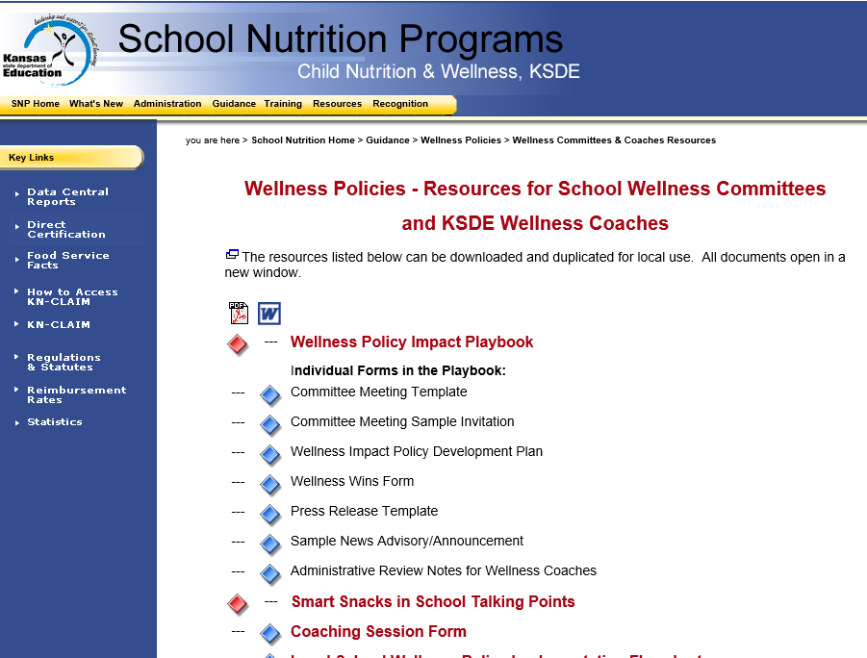
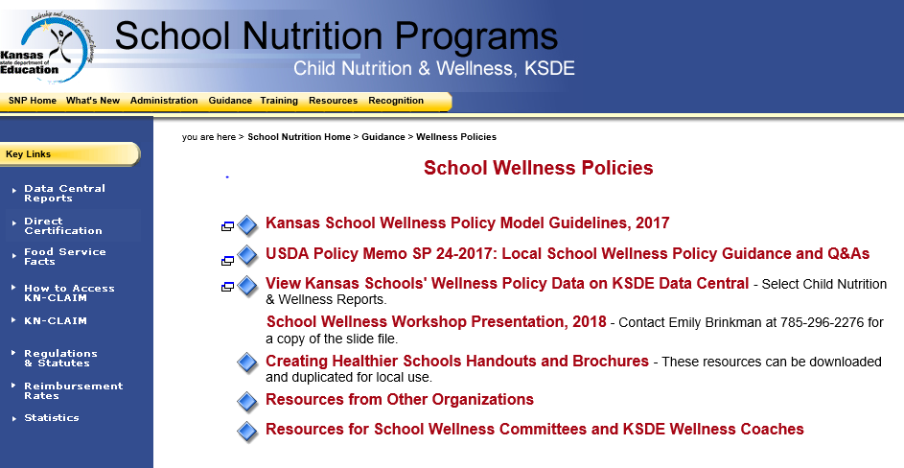
Wellness Policy Impact Playbook
www.kn-eat.org
Notes:
Sample letters of invitation, templates for a press release, talking points, and other helpful outreach tools are available in the Wellness Policy Impact Playbook on the KSDE Child Nutrition & Wellness website.

Slide 33
Connecting Through Traditional Media
Wild
Over
Wellness
Email
Newspaper
Radio
Television
Billboards
Notes:
Connections can be made through traditional media, such as email, newspaper, radio, television, and/or billboards. Connections, made through media outlets, should work as part of a multi-step approach to engaging and recruiting community health professionals. Media communications must be factual and professional.
Emails can be delivered as a personal invite or as a global outreach effort. Emails are quick, cost effective ways to share information and recruit community health professionals. Emails should be concise, well written, and use proper sentence structure.
Newspaper articles should be short and well-written with an attention capturing headline.
Local radio and television public service announcements or interviews can help capture the attention of community health professionals. Participation in a radio podcast discussion provides a great opportunity to share about community wellness initiatives and generate interest in local school health programs.
School billboards, either traditional or electronic, allow connection in a more subtle form. For example, a school billboard can highlight an upcoming school wellness activities or announce current opportunities for participation in wellness events. Billboards should be changed often to remain relevant and effective.

Slide 34
Connecting Using Online Tools
Wild
Over
Wellness
School website
Social media platforms
Electronic survey tools
Notes:
Online tools, such as a school website, social media platforms, and electronic surveys, are convenient ways to connect with a broader group of people at once.
School websites can highlight a school’s health and wellness activities, as well as, serve as a tool to connect with community health professionals. Sharing about the events and activities that promote healthy lifestyle changes for students and their families is in itself, a form of recruitment. For example, when a community health professional is invited to participate in a single event, it can lead to more extensive involvement on a school wellness committee.
Social media is another way people connect and build relationships. Instant invitations, for example, can be sent through social media forums, quickly and easily. Social media tools, such as Facebook and Twitter, deliver information and allow others to interact with that information in a public forum.
Electronic online surveys also encourage participation in the information, and are an efficient way to gauge interest, identify health objectives, and get feedback.

Slide 35

How Socially Connected Is Your Wellness Program?
How could your school wellness program use social media to reach out to health professionals in your community?
Notes:
Refer participants to the Participant Booklet worksheet, How Socially Connected Is Your Wellness Program?
Encourage participants to share their thoughts on the first discussion question shown on the slide. Read discussion question on the slide. Ask participants to share about their experiences using social media to reach out to others or ideas they have seen others do.
Participants can share in the chat box or by unmuting their audio.
Possible responses: Facebook invite, email, hashtags, tweet, etc.

Slide 36
How Socially Connected Is Your Wellness Program?
Using social media, what are your ideas for collaborating with community health professionals on school wellness activities and projects?
Notes:
Encourage participants to share their thoughts on the second discussion question shown on the slide. Read discussion question on the slide. Participants can share in the chat box or by unmuting their audio.
Ask participants to share about their experiences using social media to reach out to others or ideas they have seen others do.
Possible responses: Asking community health professionals to post nutrition program hashtags on their social media platforms; sharing links, etc.

Slide 37
How Socially Connected Is Your Wellness Program?
What is one social media activity that you (or someone else) could reasonably do in your program when you return?
Notes:
Encourage participants to share their thoughts on the third discussion question shown on the slide. Read discussion question on the slide. Participants can share in the chat box or by unmuting their audio.
Ask participants to share about their experiences using social media to reach out to others or ideas they have seen others do.

Slide 38
Discover Ways to Collaborate with Community Health Professionals
Notes:
Now that community health professionals have been identified and outreach ideas have been shared, let’s explore the many ways school wellness program members can collaborate with community health professionals.

Slide 39

Ways to Collaborate
Resource support to the wellness program
Participation in a school sponsored wellness event
Sponsoring of a community wellness activity
Active involvement on the school wellness committee
In whatever way a community health professional chooses to collaborate, make it easy for them to partner with you and your wellness program.
Notes:
Collaboration can come in the form of resource support to the school wellness program; participation in a school sponsored wellness event; sponsoring of a community wellness activity; and/or active involvement on the school wellness committee.
In whatever way a community health professional chooses to collaborate, make it easy for them to partner with you and your wellness program.

Slide 40

Resource Support
Provision of research data
Family friendly educational activities and curriculum
Colorful displays
Handouts
Notes:
Resource support can range from provision of research data on the benefits of living a wholesome lifestyle; to development of family friendly educational activities and curriculum. Supporting organizations may also have colorful displays and handouts to share at no cost or minimal cost.

Slide 41
Participation in School Wellness Event
Schools are able to assemble a large crowd of students, parents, and other community members.
Schools have the physical facilities and support staff.
Community professionals have the expertise and educational resources to support a wellness event.
Notes:
Collaboration in the form of participation in a school wellness event is quick and easy way to partner with community health professionals.
Schools are able to assemble a large crowd of students, parents, and other community members in one place, and at one time. Schools have the physical facilities and support staff needed to hold a large event.
Community health professionals have the expertise and educational resources needed to support a school wellness event.

Slide 42


School Wellness Event Ideas
Invitation to be a guest speaker
Booth participation in a school health fair
Oversight of a Body Venture exhibit station
Provision of safe passage and companionship during a Walk to School Day event
Participation in a Family Fun Fitness Night
Sponsoring of a health screening event
Notes:
Examples of how a community health professional can contribute to a school wellness event include...read slide.

Slide 43
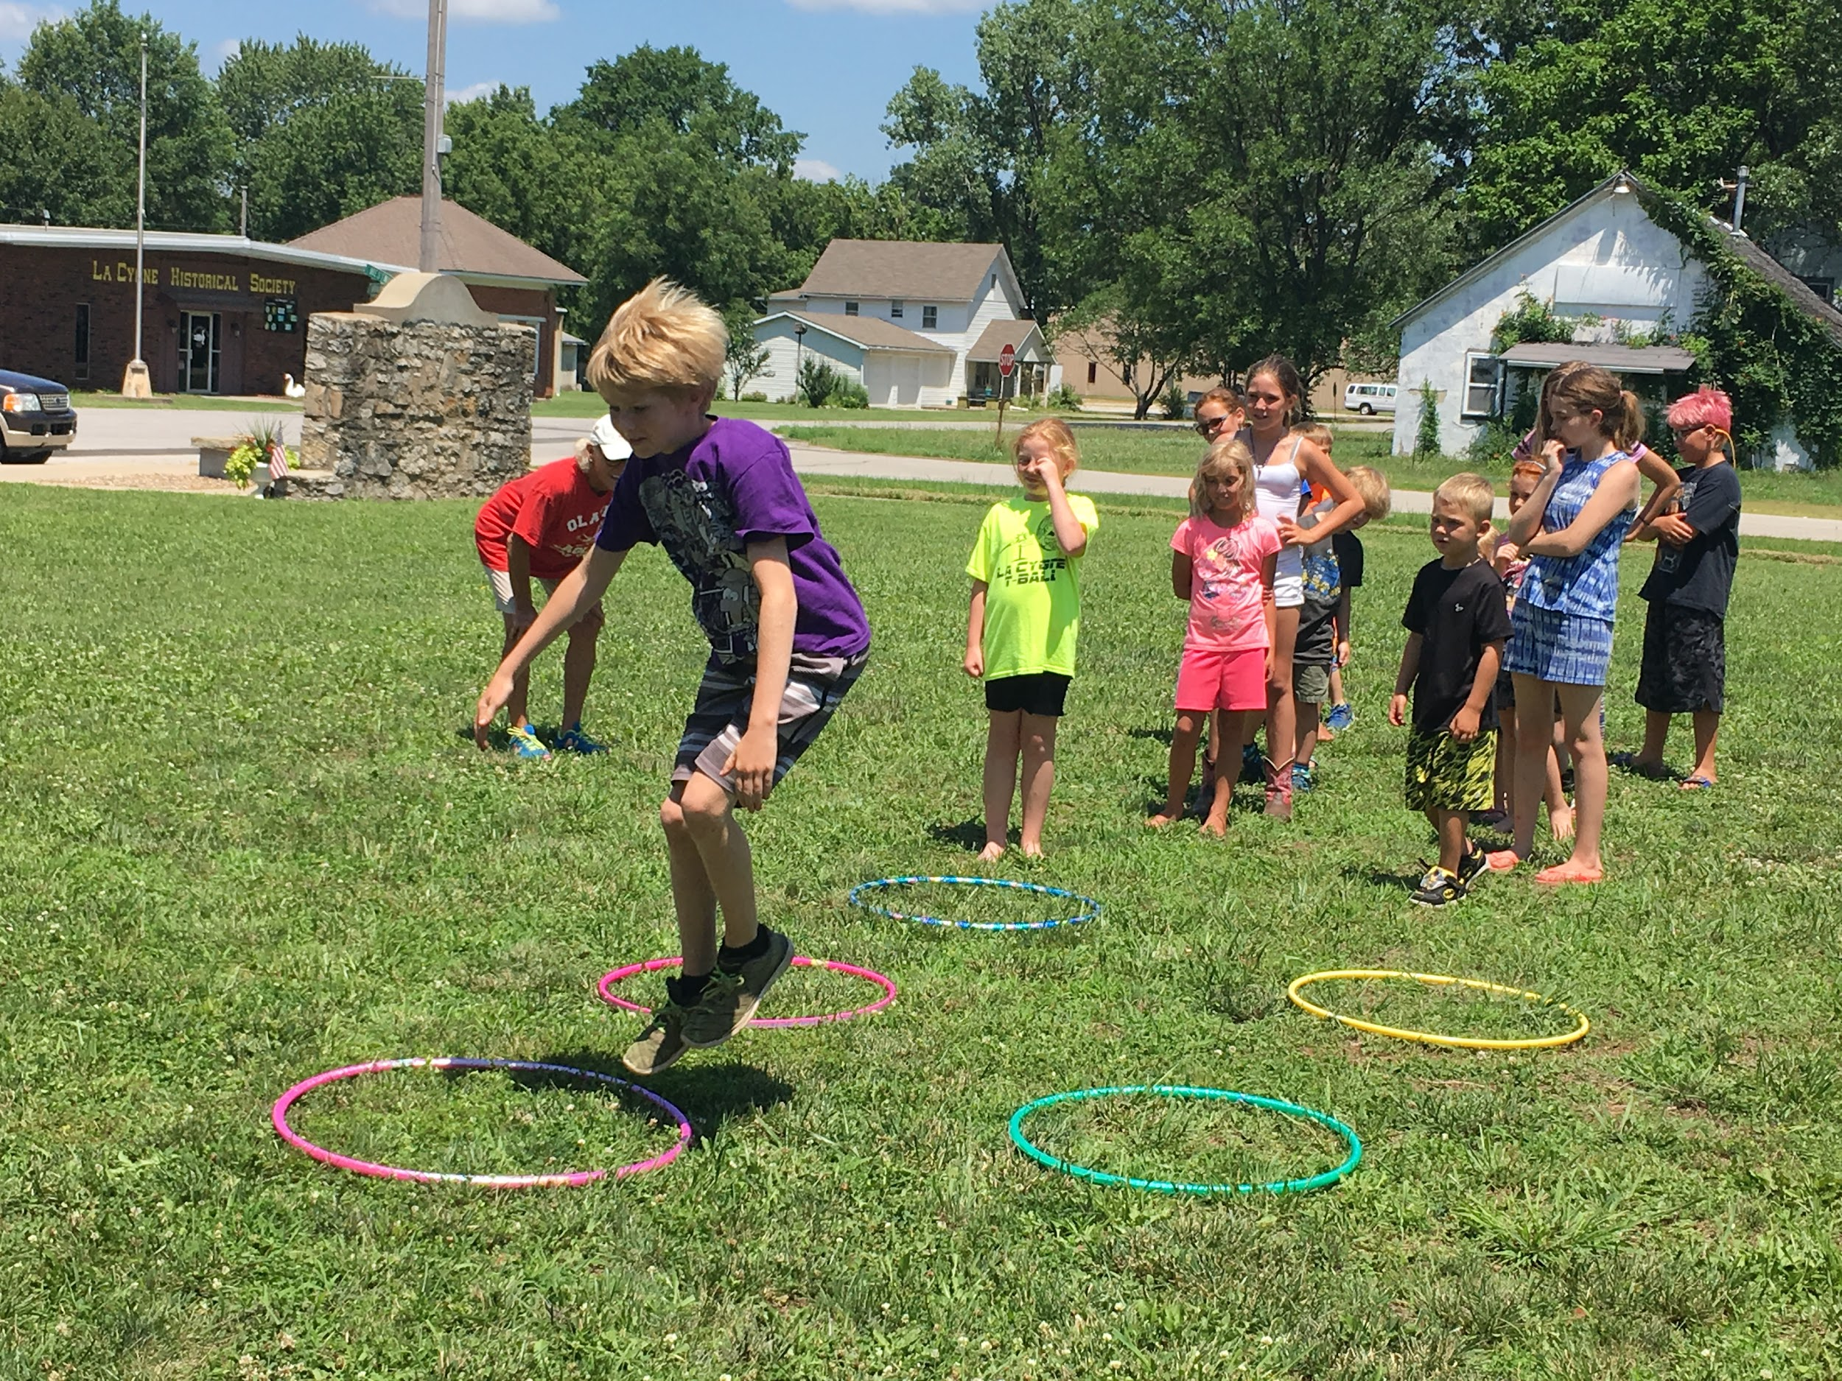
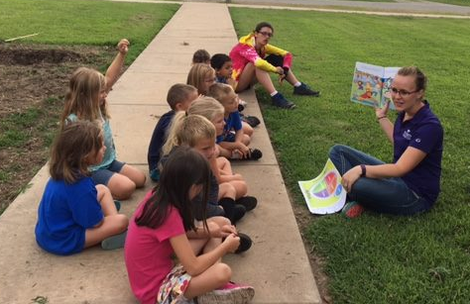
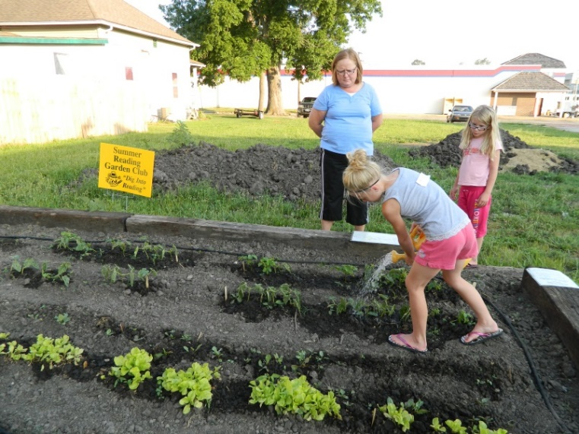
Sponsoring of a Community Wellness Activity
Workplace wellness program
Fitness challenge
Wellness presentation
Mini healthy lifestyle course
Community wellness event
Community garden
Notes:
Collaborative efforts can build on what is already happening in the community.
When school wellness initiatives align with existing community initiatives, it is easier for all parties to work together to get things done.
Collaboration in community activities can involve a…read slide.

Slide 44

Involvement on School Wellness Committee
Having input on policy development
Having active involvement in event planning
Assessing levels of achievement
Advancing wellness initiatives by setting short-term and long-term goals
Notes:
Community health professionals who want to have input on policy development and have active involvement in event planning could be invited to join the School Wellness Committee.
The School Wellness Committee is responsible for evaluating the levels of achievement in certain areas of health and wellness in the school environment. The committee, then, identifies ways to advance wellness initiatives by setting both short-term and long-term goals. Oftentimes, the involvement of a health professional in the community will depend on the wellness goals identified as part of the Wellness Policy Builder process.

Slide 45

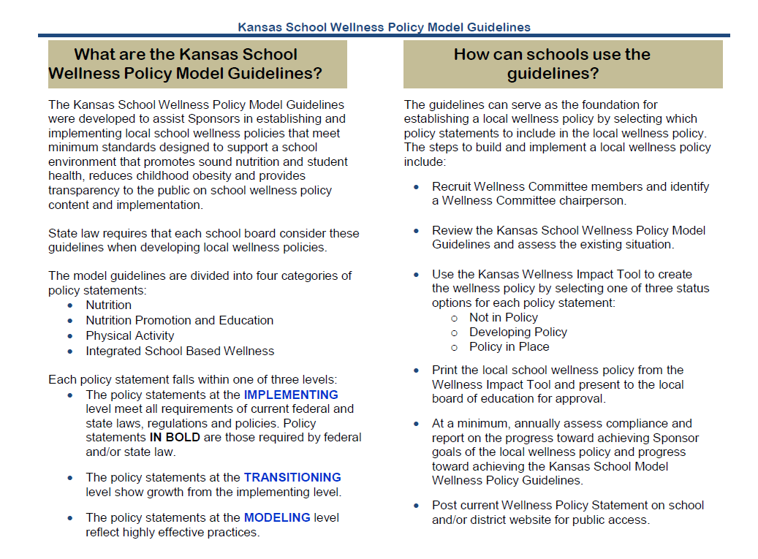
Kansas School Wellness Policy Model Guidelines
Notes:
The Wellness Policy Builder process involves completion of an assessment of the district’s status in four main categories, Nutrition, Nutrition Promotion and Education, Physical Activity, and Integrated School Based Wellness.

Slide 46
Kansas School Wellness Policy Levels
Notes:
The Kansas School Wellness Policy Model Guidelines assist school districts with establishing wellness policies that support a healthy school environment. Using the guidelines, the school wellness committee members make decisions on which policy statements to include in local wellness initiatives.
Each policy statement falls within one of three levels:
Implementing level, in which policy meets all requirements of federal/state laws, regulations and policies
Transitioning level, in which policies show growth from the implementing level
Modeling level, in which policies reflect highly effective practices

Slide 47
Annually, partner with local health agencies and community organizations.
Notes:
For example, in the General Guidelines section of the Wellness Policy Builder, to meet the “Implementing” level, the district should partner with local health agencies and community organizations on an annual basis. To meet “Transitioning” and “Modeling” levels, the collaboration with community health professionals would occur more often. The committee could, then, set a goal for collaborative efforts to occur more regularly than once per year.

Slide 48
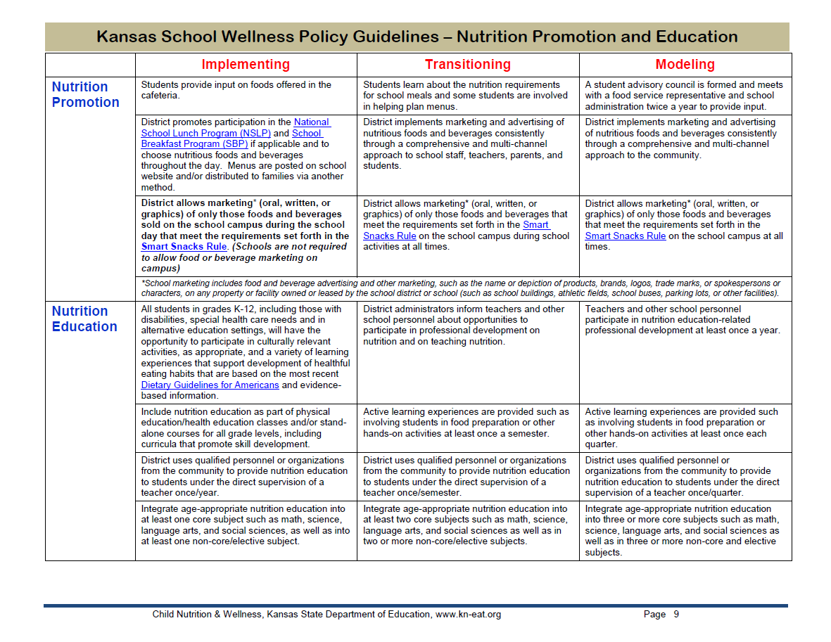
District uses qualified personnel or organizations from the community to provide nutrition education …once/semester.
Notes:
In completion of the Nutrition Promotion and Education section of this district’s Wellness Policy Builder, the committee has determined this school district meets the “Transitioning” level for providing nutrition education to students. The committee could, then, decide that “Transitioning” is a good place to be for now, and setting a goal for the “Modeling” level is something they could consider at another time.

Slide 49
Community members are encouraged to access the district’s indoor and outdoor physical activity facilities at specified hours.
Notes:
In the completion of the Physical Activity section of this district’s Wellness Policy Builder, the wellness committee has determined the school district meets the “Modeling” level for making both indoor and outdoor physical activity facilities available to the community at certain times. Since “Modeling” level is going above and beyond, it should be celebrated and no further goal setting is needed.

Slide 50

Taking a Closer Look!
Notes:
Let’s take a closer look at ways your program has promoted health and wellness in your school community and neighborhood community. Encourage participants to share ways they have promoted health and wellness in their communities.
Examples from other school districts in Kansas to share if time allows:
Joe Handlos from USD475 Geary County. Discussion of Fort Riley Wellness Fair Community Health Professional involvement. Pathways Grant and Greenhouses Farm to School Grant.
Palco USD 269 partners with local youth center to increase wellness activity options for middle school and high school students.
Plainville USD 270 district partners with Extension to provide Farm Olympics for K-3 students. This activity moved them from “Implementing” to “Modeling” level in the section, “Extracurricular physical activity programs, such as a physical activity club or intramural programs, are offered through partnerships with community organizations and resources.”
The Chef in You Cooking competition encouraged students to engage in cooking healthy recipes. This activity moved them from “Implementing” to “Modeling” level policy in the section on “Active learning experiences are provided such as involving students in food preparation or other hands on activities at least once per quarter.”
A Start your Day on the Right Foot – Walk to Breakfast program recruited local health and fitness professionals to join the students in a fitness activity. This activity aligned with the section on “The school has implemented a walk and/or bike to school plan or implemented an alternative plan based on safety and feasibility assessment and has communicated it to the community.”

Slide 51
Wellness Policy Tools and Assistance
Kansas School Wellness Policy Model Guidelines
Creating Healthier Schools Handouts and Brochures
Resources from Other Organizations
Resources for School Wellness Committees and KSDE Wellness Coaches
www.kn-eat.org
Notes:
There are several tools on the Child Nutrition & Wellness website, designed to assist with assessing a district’s current situation, setting wellness policy goals, and implementing activities to support established goals. Access to these tools is through the Kansas State Department of Education, Child Nutrition & Wellness website at www.kn-eat.org.

Slide 52
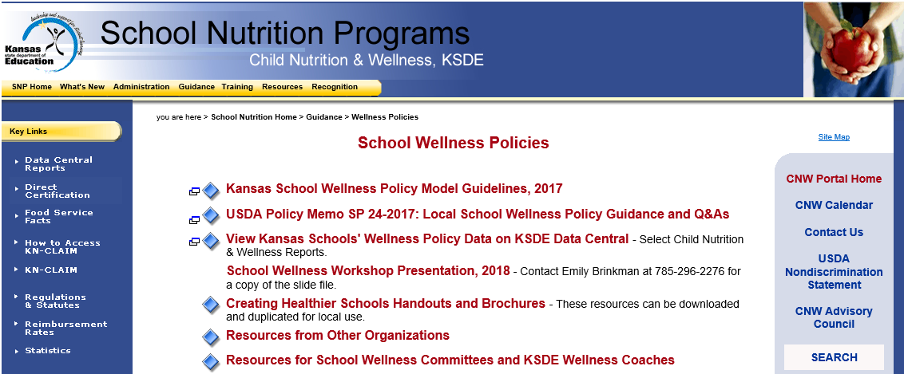
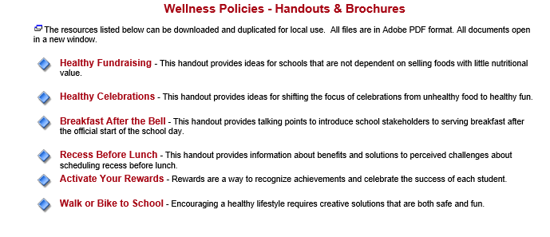
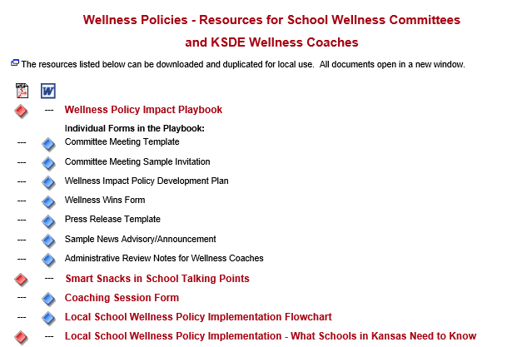
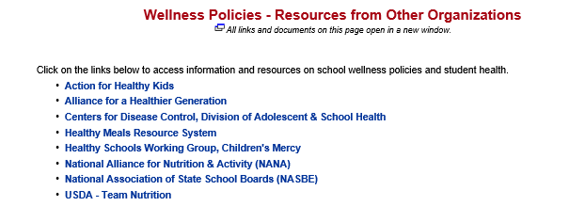
Notes:
The Kansas School Wellness Policy Model Guidelines can help with identifying the current situation and establishing policy.
Under Creating Healthier Schools Handouts and Brochures, there are handouts and brochures on topics such as healthy fundraising, healthy celebrations, breakfast after the bell, and recess before lunch.
Under "Resources From Other Organizations, there are links to Action for Healthy Kids, Alliance for a Healthier Generation, Centers for Disease Control and Prevention, and other reputable organizations.
Under Resources for School Wellness Committees and KSDE Wellness Coaches, there are downloadable documents in the Wellness Policy Impact Playbook, and links to more online school wellness resources, such as Kansas Team Nutrition.

Slide 53

"Coming together is a beginning, staying together is progress, and working together is success."
– Henry Ford
Notes:
There is much to do to advance wholesome lifestyles, but the involvement of many hands better assures ongoing success.
In the words of Henry Ford… read quote on the slide.

Slide 54
Sustaining Efforts
Make it easy to participate in wellness activities.
Make it a “win-win” experience.
Show appreciation.
Ask for feedback.
Continue to assess and engage in ongoing action planning.
Reach out to other community health professionals.
Allow access to school facilities at certain times.
Notes:
Sustainability is best achieved when both parties benefit from the relationship and are able to energize each other.
To sustain wellness policy efforts,
Make it easy for community health professionals to participate in wellness activities.
Make it a “win-win” experience. Ensure there is a benefit to the community health professional.
Show appreciation to all collaborators with sincere tokens of appreciation.
Ask for feedback.
Continue with assessing current status of wellness initiatives and follow through with ongoing action planning.
Reach out to other community health professionals.
Allow access to both indoor and outdoor school facilities at certain times. When families, community members, and community health professionals have access to school facilities, it deepens community connections and inspires ongoing support of wellness initiatives.

Slide 55
Summary
Significantly improve nutrition, encourage physical activity, and enhance a students’ readiness to learn.
Community health professionals can enhance the quality and sustainability of school wellness policies and programs.
Collaboration can encourage more positive, widespread community health outcomes and student success.
Notes:
School wellness initiatives can significantly improve nutrition, encourage physical activity, and enhance a students’ readiness to learn.
Including community health professionals in school wellness initiatives can greatly enhance the quality and sustainability of school wellness policies and programs. Community health professionals share similar goals to those involved in school wellness projects and their expertise in health aligns nicely with efforts to motivate wholesome lifestyles in both the school population and the greater community.
Collaboration among school administrators, school nutrition personnel, students, parents, and community health professionals can not only help schools put effective wellness policies in place, but can encourage more positive, widespread community health outcomes and student success.

Slide 56
Conclusion
Schools have a responsibility to ensure students are in a healthy school environment.
Good nutrition supports cognitive development.
Physical activity may improve school performance and achievement.
Healthy students are better performing students!
Notes:
Schools have a responsibility to ensure students are in a healthy school environment. The well-being of Kansas students affects their academic potential and future physical fitness.
Good nutrition supports cognitive development. Physical activity, regardless of whether it’s during recess, in the classroom or in physical education class, advances school performance and achievement. Proper nutrition and student fitness have been linked to higher test scores, lower absenteeism, and improved behavior in schools.
The school, the community, and the state all benefit when students have the tools they need to achieve and succeed. Students with health-promoting behaviors perform better academically than those with poor health behaviors. Simply put healthy students are better performing students!

Slide 57

USDA Nondiscrimination Statement
In accordance with Federal civil rights law and U.S. Department of Agriculture (USDA) civil rights regulations and policies, the USDA, its Agencies, offices, and employees, and institutions participating in or administering USDA programs are prohibited from discriminating based on race, color, national origin, sex, disability, age, or reprisal or retaliation for prior civil rights activity in any program or activity conducted or funded by USDA.
Persons with disabilities who require alternative means of communication for program information (e.g. Braille, large print, audiotape, American Sign Language, etc.), should contact the Agency (State or local) where they applied for benefits. Individuals who are deaf, hard of hearing or have speech disabilities may contact USDA through the Federal Relay Service at (800) 877-8339. Additionally, program information may be made available in languages other than English.
To file a program complaint of discrimination, complete the USDA Program Discrimination Complaint Form, (AD-3027) found online at http://www.ascr.usda.gov/complaint_filing_cust.html, and at any USDA office, or write a letter addressed to USDA and provide in the letter all of the information requested in the form. To request a copy of the complaint form, call (866) 632-9992. Submit your completed form or letter to USDA by:
Mail: U.S. Department of Agriculture
Office of the Assistant Secretary for Civil Rights
1400 Independence Avenue, SW
Washington, D.C. 20250-9410;
Fax: (202) 690-7442; or
Email: program.intake@usda.gov.
This institution is an equal opportunity provider.
Notes:
The USDA Nondiscrimination Statement lets participants know how they can file a complaint.

Slide 58
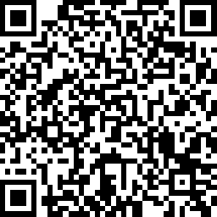
Class Attendance
https://www.surveymonkey.com/r/6QDBZS2
Thank you for Attending!
Please contact us whenever you need assistance.
785-276-2276
Child Nutrition & Wellness
www.kn-eat.org
Collaborating with Community Health Professionals QR Code
Notes:
Thank you for your interest in hearing more about how to collaborate with community health professionals.
Class attendance will be conducted electronically through Survey Monkey. Participants must complete the survey to receive a certificate of completion. Participants may use their phones, laptops, or nutrition program computer to access the survey electronically. Enter the link provided into the address bar of preferred web browser. If using a mobile device with a QR Code reader, scan the QR code that will be provided on the screen at the end of the session.
The attendance survey is set up so that a lead person, such as the Director, can enter multiple names on the comment line of the attendance survey in Survey Monkey. This should make it easier to track group participation in the electronic delivery of these classes.
An active link can be copied and pasted into the chat to assist participants:
https://www.surveymonkey.com/r/6QDBZS2

