Slide 1
CACFP Menu Planning and Records
Idaho State Department of Education
Child Nutrition Programs
August 2, 3,7, 9,10, and 14
8:00 am – 5:00 pm 8 hours
Regional Trainings in Coeur d Alene, Lewiston,
Nampa, Boise, Twin Falls, Idaho Falls and Pocatello
Notes:
SAY:
Good Morning and Welcome to the Child and Adult Care Food Program Menu Planning and Records training. I am (name of trainer) a Child Nutrition Coordinator in the Idaho State Department of Education. In todays training you will learn the ins and outs of menu planning and menu records for the CACFP. The course is from 8 a.m. to 5 p.m. with a one hour lunch on your own.
This training is funded using U.S. Department of Agriculture 2018 training grant funds awarded to our state agency to provide training to sponsoring organizations, center CACFP employees and day care home providers. In the training there are several group activities and each table will work as a team to complete the activities. There is a sheet of name tags at each table. Let’s take a few minutes to write your name on a tag and introduce your self to everyone at your table. (provide a few minutes for this introduction)
DO: Set up registration table with sign in sheet and calendar poster. Place participant packets at each table with menu planning binder, activity packet and name tag sheets. Set up projector, WIFI and Power Point presentation before participants arrive. Greet participants and make sure they sign in.

Slide 2

Housekeeping
Restroom location
Breaks
Bike rack for questions
Participants packet
Notes:
SAY:
It is important that we create an environment that allows everyone to participate freely and work together to accomplish the training objectives without fear of criticism. To accomplish this goal, let’s review some housekeeping items and ground rules for today’s training.
First, the location of the restrooms is located (state where) and water service available in training room.
We will take a few breaks during this training and a one hour lunch from approximately 12:00 – 1:00 pm. Of course, please be sure to return on time, as starting and ending breaks on time will allow us to cover all the training information and activities within the time allotted.
Although I will try to answer questions throughout the training, sometimes a question requires research or a longer answer than time allows. Because your questions are important, I posted a “Bike Rack” flip chart. Feel free to write any questions on a sticky note and post it to the “Bike Rack.” I will aim to provide answer to all questions during the class but may need to take back for clarification and answer from USDA.
Each of you have a training packet for today and on the table are more training resources for activities.

Slide 3


Ground Rules
Be a team player
Be respectful of everyone
Share ideas with the class
Be on time for all sessions
Stand up when your mind goes on vacation
Always ask for clarification if you do not understand
Turn your mind on and your electronic devices to silent
Notes:
SAY:
Some ground rules for today’s training include:
Be a team player.
Be respectful of everyone.
Share ideas with the class.
Be on time for all sessions.
Additionally, it is ok to stand up when your mind goes on vacation and always ask for clarification if you do not understand. Finally, turn your mind on and your electronic devices (cell phones) to silent. If you need to take a call please step out of the room into the lobby or hall so you don’t interrupt the class.

Slide 4
Training Topics
Topic 1: Menu planning and using cycle menus
Topic 2: How to standardize a recipe
Topic 3: Determining creditable foods and serving sizes
Topic 4: Menu records and documentation
Topic 5: Weights and measures
Topic 6: Special dietary accommodations
Topic 7: Meal service styles
Topic 8: Knife skills
Notes:
SAY:
In this training you will develop your menu planning skills, learn how to create and use cycle menus and practice working with the menu records and tools used in the CACFP .
You will learn the components of a standardized recipe, how to standardize a recipe, credit a standardized recipe to the meal pattern and adjust the number of servings (yield) for your recipes. We will use the interactive Food Buying Guide tools to determine meal contribution of foods in your menus and how to determine the serving size by age groups. Hopefully someone at each table brought their smart phone or tablet for some of the interactive training activities in the Food Buying Guide.
We will review each menu record that supports your meals and snacks claimed for reimbursement and how to document the meals and snacks on or with the records. Examples of records we will review are daily menu records for homes and centers, CN labels, product formulation statements, grain labels, and standardized recipes.
After lunch we will review weights and measures, special dietary accommodations requirements and meal service styles for offering the meals to participants. Finally we will wrap it up with testing our knife skills and learn how to safely use your knives.

Slide 5

Menu Planning and Using Cycle Menus
Notes:
SAY:
Let’s get starting with menu planning and using cycle menus.
How many of you know what a cycle menu is?
How many of you use cycle menus in your center(s) or day care home?
For those using cycle menus, how many weeks are your cycle menus?
DO: Acknowledge responses. This will give the trainer an idea of the experience of the participants.

Slide 6
Menu Planning and Using Cycle Menus
What is a Cycle Menu?
A cycle menu is a set of menus planned for a specific number of weeks, such as three weeks. Each day features a different nutritious and appealing food combination. After the entire menu is served, it is repeated in the same order.
Notes:
SAY:
Here is the definition of a cycle menu. Can someone read the definition?
Participant: A cycle menu is a set of menus planned for a specific number of weeks, such as three weeks. Each day features a different nutritious and appealing food combination. After the entire menu is served, it is repeated in the same order.
SAY:
Thank you, at your table is the Idaho Menu Toolkit. Take a minute to review the cycle menus in the toolkit. There are three key things you can see right away on the menus. Each day features a variety of food combinations, there are serving sizes for each food component and there is a three week cycle for both spring/summer and fall/winter.
Are there any other factors that stand out?
Keep these factors in mind as we advance through this training.

Slide 7

Menu Planning and Using Cycle Menus
Advantages of Cycle Menus
Increase Variety
Decrease Repetitive Functions
Flexible
Notes:
SAY:
There are a number of advantages for using cycle menus to child care, such as they increase variety, decrease repetitive functions, and allow for flexibility. Let’s spend a few minutes exploring these three advantages.

Slide 8
Menu Planning and Using Cycle Menus
Cycle Menus Increase Variety
Young children with a variety in their diets are more likely to develop preferences for a higher range of food flavors, types, colors, and other food characteristics. Healthy habits established at an early age carry over into adulthood.
Notes:
SAY:
Incorporating cycle menus helps to increase the variety in the diets of young children. As previously mentioned, each day of the cycle features a different menu. This approach provides young children with a diverse combination of food items on a daily basis.
Also, when you introduce a variety of foods to young children, they are more likely to develop preferences for a higher range of food flavors, types, colors, and other food characteristics.
Above all, using cycle menus can help children to establish healthy eating habits at an early age, followed by carrying those habits over into adulthood.

Slide 9

Menu Planning and Using Cycle Menus
Cycle Menus Decrease Repetitive Functions
Gathering resources for planning
Selecting food
Determining cost and budgetary measures
Identifying the source for food purchasing
Notes:
SAY:
Using a cycle menu can help to decrease repetitive functions because it allows you to plan on an “as need basis”. Specifically, using this menu type can greatly reduce the number of times, but also, the time it takes to plan menus. For example, there are 52 weeks in a year. If you serve a six-week cycle menu in it entirety, and then repeat the cycle just once, you will only need to plan menus four to five times a year.
To add, using this menu type can reduce one or more of the following repetitive functions:
Gathering resources for planning
Selecting food
Determining cost and budgetary measures
Identifying the source for food purchasing

Slide 10

Menu Planning and Using Cycle Menus
Cycle Menus Allow Flexibility
Cycle menus are adaptable to fit needs of both the children and the program.
Example: annual celebrations, food allergies, power outages, field trips, and serving various age groups.
Notes:
SAY:
Lastly, cycle menus allow flexibility because they are adaptable to fit the needs of both the children and the program as a whole. For example, annual celebrations, children with food allergies, power outages, field trips, and other unique situations that may call for adjustments to the menu. Fortunately, you can easily adjust the cycle menu to meet a wide range of special dietary needs.
Another way cycle menus allow for flexibility is through the various age groups in the CACFP. For example, if you sponsor child care centers, Head Start, Early Head Start, At-risk afterschool and adult day care centers, all types serve a variety of age groups. You may need a different menu for each location or even one for each age group. As a result, you can easily adjust your menus to meet the needs of all CACFP participants throughout the cycle.

Slide 11
Menu Planning and Using Cycle Menus
Other Advantages and Cycle Menus
What are some other reasons for using cycle menus?
How might you use cycle menus to increase variety and appeal?
What repetitive functions would you like to decrease when planning menus?
Are there any special considerations to consider when planning menus?
Notes:
SAY:
Now that we have explored the advantages of cycle menus, think about your program and questions on the screen.
What are some other reasons for using cycle menus?
How might you use cycle menus to increase variety and appeal?
What repetitive functions would you like to decrease when planning menus?
Are there any special considerations to consider when planning menus?
These questions provide the foundational information for planning menus that are just right for your child care program,.

Slide 12
Menu Planning and Using Cycle Menus
Menu Planning Principles
Focus on Good Nutrition | Add Contrast
Strive for Balance | Think About Color
Emphasize Variety | Consider Eye Appeal
Notes:
SAY:
The basic menu planning principles provide a great starting point for planning nutritious, balanced meals and snacks. Each of the following six menu planning principles can help you create menus that appeal to young children:
Focus on Good Nutrition
Add Contrast
Strive for Balance
Think About Color
Emphasize Variety
Consider Eye Appeal
Let’s review each principle.

Slide 13
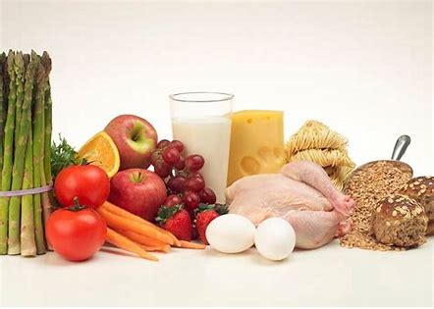
Menu Planning and Using Cycle Menus
Menu Planning Principle #1: Focus on Good Nutrition
Notes:
SAY:
Presenting a variety of nutritious foods helps introduce children to a wide range of tastes as well as nutrients. In addition to following the CACFP meal pattern a center or day care home can incorporate CACFP meal pattern best practices to provide a variety of nutritious foods. Some of the best practices are providing at least two whole grain rich grains per day, making one of the two components at snack a vegetable or fruit, serving a variety of fruits and vegetables, and serving only lean meats, nuts, and legumes

Slide 14
Menu Planning and Using Cycle Menus
Menu Planning Principle #2: Strive for Balance
Breakfast | Lunch | Snack
Scrambled eggs Baked sweet potato fries sprinkled with cinnamon 1% Milk | Baked lemon-pepper chicken Garden salad Sliced strawberries Whole grain roll 1% Milk | Grilled cheese on whole wheat Bread Carrot and celery sticks Water
Notes:
SAY:
As you plan nutritious, appealing, and tasty menus, strive to balance the foods in a number of ways.
Use herbs and spices to balance flavors- Herbs and spices are great for enhancing and adding flavors, as well as balancing the taste of strong and mild flavors. For example on the breakfast menu, cinnamon has a spicy and sweet flavor. Sprinkle it on baked foods, such as sweet potatoes, to enhance flavors.
Balance flavors in appealing ways- Too many mildly flavored or strongly flavored foods may make a meal unappealing to both children and adults. For example, a lunch menu with baked lemon-peppered chicken, spicy red potatoes, coleslaw, garlic toast, and milk may have too many spicy and strong flavors. A more balanced menu may include a garden salad, sliced strawberries, whole grain roll, baked lemon-peppered chicken, and milk. Another good practice is to use whole grain-rich foods to provide balance to strong flavors.
Balance high fat with low-fat foods- Look for ways to serve “heavier” dishes with lighter sides. For example, when the main dish is a grilled cheese sandwich, a food that is typically higher in fat, serve with carrots and celery sticks to balance the menu.

Slide 15
Menu Planning and Using Cycle Menus
Menu Planning Principle #3: Emphasize Variety
Breakfast | Lunch | Snack
Whole grain English muffin Fruit salad with pineapple and papaya 1% Milk | Sweet and sour chicken with red and yellow peppers Mandarin oranges Brown Rice 1% Milk | Carrot sticks Whole grain crackers Water
Notes:
SAY:
Serving a variety of foods is important because no one food or group of foods can provide all the nutrients for good nutrition. Variety also makes menus interesting and appealing.
Include a small amount of new or unfamiliar food periodically- One way to introduce a new food is to allow opportunities for children to sample the new food. Another way is to offer it with familiar foods. For example, in the breakfast menu, if papaya is new to your menu, but pineapple is a favorite, serve a fruit salad with fresh pineapple and papaya. It is important to offer only one new food at a time for better acceptability.
Vary the types of main dishes you serve- Vary the protein you use in your main dish by serving a variety of lean meats, poultry, fish, and legumes. Another way is to add whole grains and vegetables to a main dish. For example in the lunch menu, add yellow and red peppers to sweet and sour chicken and serve over brown rice,
Include different forms of food and prepare them in a variety of ways- Serve the same fruits and vegetables in both raw and cooked forms. You can also add different seasonings each time to increase the variety of flavors. For example, serve carrots raw, roasted with parsley and thyme, or sautéed with olive oil and cinnamon.

Slide 16
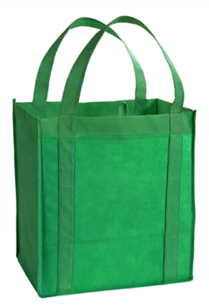
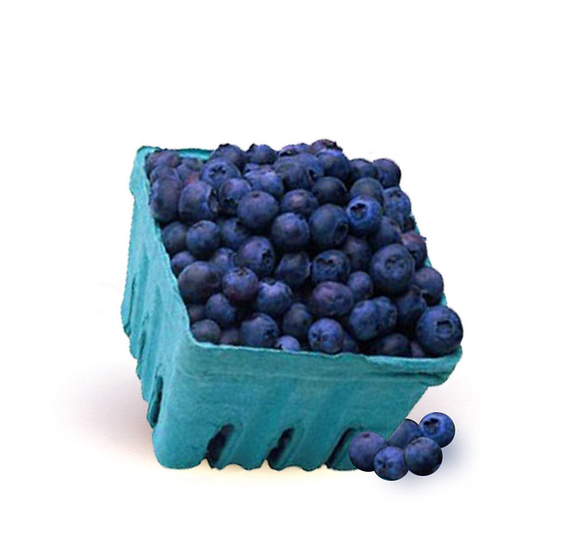
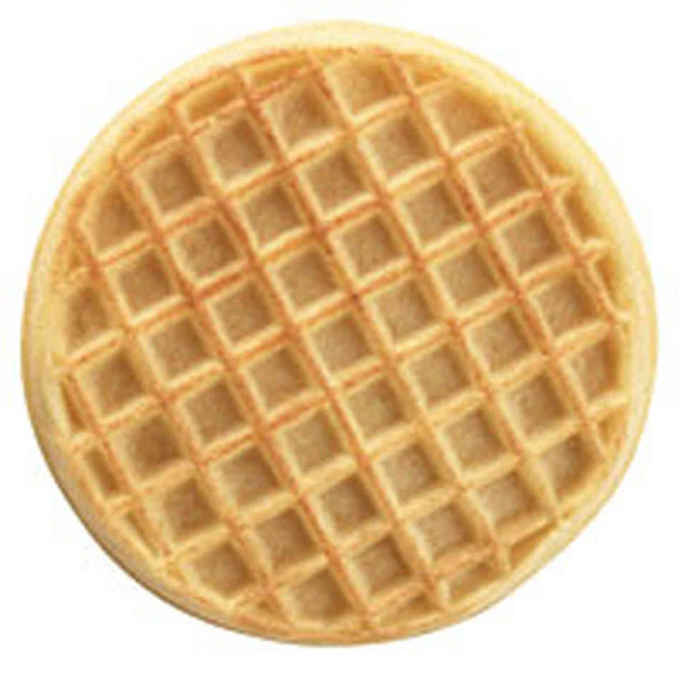

Menu Planning and Using Cycle Menus
Menu Planning Principles #4: Add Contrast
Breakfast
Notes:
SAY:
By adding blueberries to this breakfast menu adds contrast by creating a pleasing combination of sizes and shapes of food.
DO: Click a second time for the blueberries to appear.
SAY:
Within a menu, present foods in several different shapes, such as cubes, wedges, strips, rounds, and shredded bits. A meal with cubed meat, diced potatoes, mixed vegetables, and fruit cocktail needs more contrast because they are all similar in size and shape. However, replacing the diced potatoes with potato wedges or serving thinly sliced apples instead of fruit cocktail adds more contrast to the menu.

Slide 17
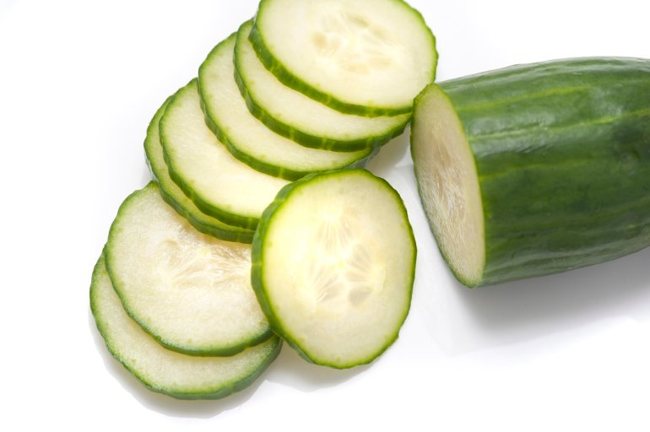
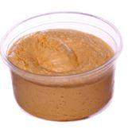
Menu Planning and Using Cycle Menus
Menu Planning Principles #4: Add Contrast
Snack
Notes:
SAY:
Use foods with different textures to enhance taste and appearance and add contrast to your menus. Include different textures in the same meal or snack, such as soft, crisp, smooth, fluffy, crunchy, and creamy. Cucumber slices and hummus provide a combination of crunchy, smooth, and creamy textures. Other examples might include a crunchy fruit or vegetable with a burrito or crisp steamed carrots and broccoli with meatloaf.

Slide 18

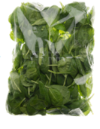


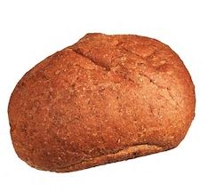
Menu Planning and Using Cycle Menus
Menu Planning Principles #4: Add Contrast
Lunch or Supper
Notes:
SAY:
Vary the types of food on the menu to add contrast. A menu with too many starches, sweet flavors, or heavy (filling) food lacks contrast as well as balance. If you are serving a hearty casserole, plan to serve colorful fresh raw or lightly cooked fruits or vegetables as side dishes. For example, a light fresh spinach salad with watermelon wedges would add contrast to a heavy main dish like lasagna.
DO: Click a second time to add the spinach and once more to add the watermelon to the screen.

Slide 19
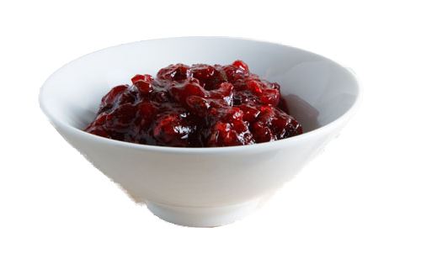
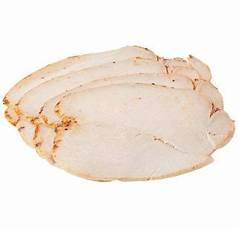

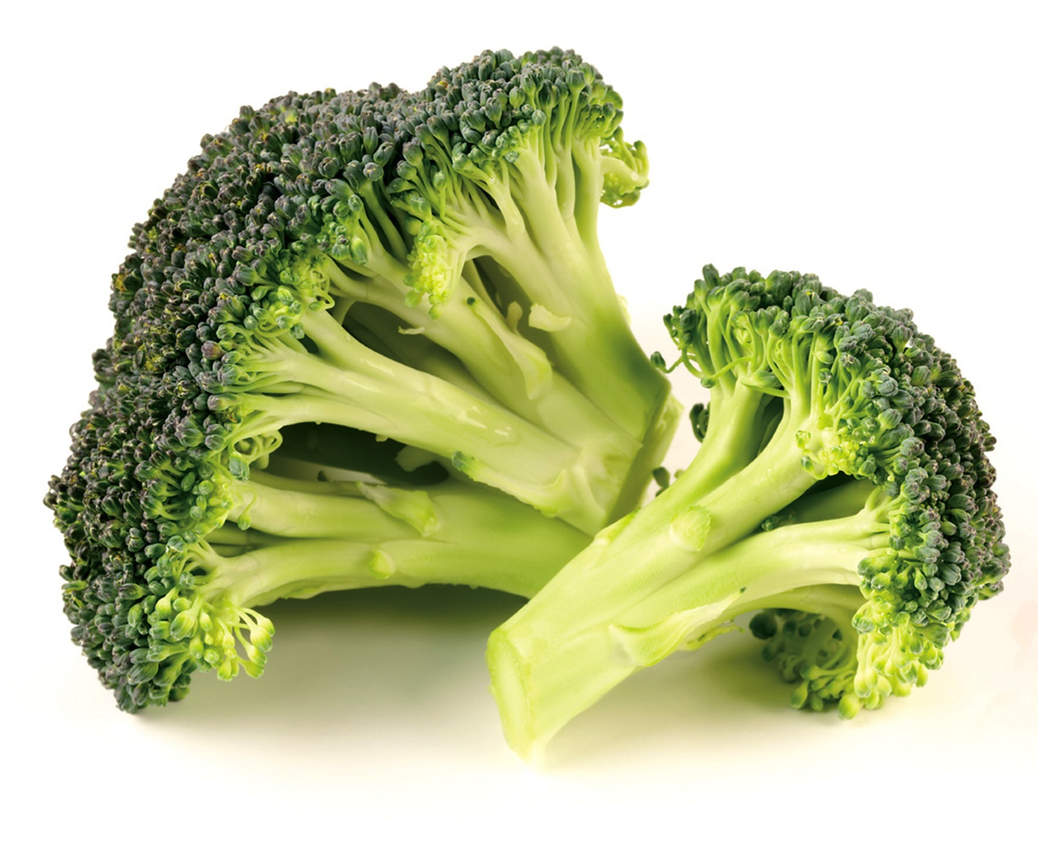
Menu Planning and Using Cycle Menus
Menu Planning Principle #5: Think About Color
Notes:
SAY:
Strive for contrast and maximize color in your menus. Use foods with a variety of colors in each meal. A good rule of thumb is to use at least three colorful foods in each meal for visual appeal. For example, turkey, rice, cauliflower, and pears are similar in color. A better combination would be turkey with cranberry sauce, steamed broccoli, whole wheat roll, orange wedges and milk. Another way to add color to a meal is to sprinkle herbs and spices on top of food.. Add a dash of cinnamon on oatmeal or canned fruit, or a little paprika on potatoes or eggs for color.
Think about the food items that have very little color, such as mashed potatoes and baked chicken. For example, serve broccoli spears with mashed potatoes. Another way is to add green or red peppers to corn or serve strawberries and romaine lettuce with a turkey burger, baked beans, and milk.
Finally use fruits and vegetables in a variety of colors like dark green, red, orange, purple, white, and blue. Add color to the plate and a broad range of nutrients. For example, try serving green kiwi at breakfast, and orange peaches and red bell peppers at lunch to increase the colors on the menu.

Slide 20
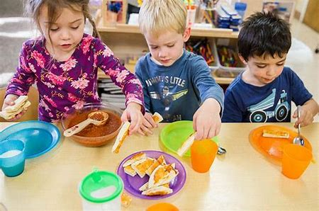
Menu Planning and Using Cycle Menus
Menu Planning Principle #6: Consider Eye Appeal
Notes:
SAY:
Consider the way food looks in the serving bowl. Children develop an opinion about the food the moment they see it. If you are serving meals family style, make sure that what you serve is visually appealing when placed on plates and in the bowls. If your budget allows, purchase colorful serving dishes to add more appeal to the meal.

Slide 21
Menu Planning and Using Cycle Menus
Steps to Planning Cycle Menus
Prepare for menu planning
Determine the length of the menu
Think about the changes you would like to make
Select the main dish for lunch
Select the remaining menu items for lunch
Plan menus for breakfast
Plan menus for snack
Evaluate what you have planned
Notes:
SAY:
Now that we have explored the menu planning principles, let’s review the following eight steps to planning cycle menus.
Prepare for menu planning
Determine the length of the menu
Think about the changes you would like to make
Select the main dish for lunch
Select the remaining menu items for lunch
Plan menus for breakfast
Plan menus for snack
Evaluate what you have planned
We will review some basic information for implementing each step. As we go through the process, think about how to apply this information when planning your menus.

Slide 22

Menu Planning and Using Cycle Menus
Variations from Menu Planning Steps
Meals and Snacks
Additional Steps
Regulatory Requirements
Notes:
SAY:
Before we begin exploring the first steps, it is important to note that this process only serves as a guide. Specifically, your steps may slightly differ from those noted in this training in three ways.
Meals and Snacks
Additional Steps
Regulatory Requirements
The menu planning process may call for changes. For example, you may need to focus on creating a budget for planning menus. Therefore, as we review the steps for planning cycle menus, make notes of any additional steps you will need to incorporate during the process.

Slide 23
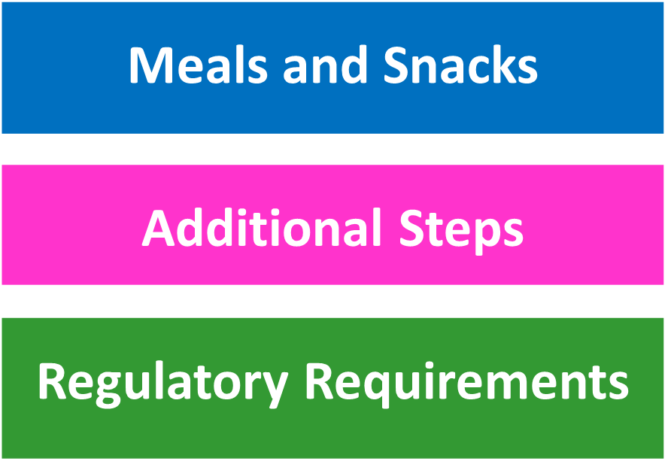
Menu Planning and Using Cycle Menus
Meals and snacks served may vary by center or day care home
Regulatory Requirements
Notes:
SAY:
The menu planning steps call for planning menus for breakfast, lunch (or supper), and snack meals. However, if your center or day care home does not serve one or more of theses meals, then you will need to skip this step when planning your menus.
You may also have a specific step you need to follow as outlined by your organization, sponsor or other regulatory agency. For example, a Head Start program may require additional nutritional requirements. Always consult with your regulatory agency when planning menus for compliance purposes.

Slide 24

Menu Planning and Using Cycle Menus
Step 1: Prepare for Menu Planning
Set a date and time
Establish a team (optional)
Collect menu planning resources
Notes:
SAY:
The first step in the menu planning process calls for preparation. Before planning menus, complete the following tasks.
Set a date and time. Plan menus at least a month in advance to ensure you know just what you need in a timely manner. Also, choose a time when you can focus with limited distractions. For example, nap time or after hours of operation are usually perfect for planning menus in child care settings.
Menu planning teams may offer unique perspectives for planning diverse, appealing, and nutritious meals and snacks. The team may consist of a parent, child, dietitian, and/or staff just to name a few.
Lastly, collect menu planning resources. Let’s review some resources.

Slide 25
Menu Planning and Using Cycle Menus
Menu Planning Resources
CACFP meal pattern charts
Current and past cycle menus
Previously used standardized recipes
New recipes for future use
CN labels, Product formulation statements, and product labels
Special dietary needs
Program celebrations
Budgetary information
Menu planning templates
Notes:
SAY:
Some common items may include, but are not limited, to the following items.
CACFP meal pattern charts
Current and past cycle menus
Previously used standardized recipes
New recipes for future use
CN labels, Product formulation statements, and product labels
Special dietary needs
Program celebrations
Budgetary information
Menu planning templates

Slide 26

Menu Planning and Using Cycle Menus
Menu Planning Resource Binder(s)
Notes:
SAY:
One of the most efficient ways for collecting menu planning resources is to store all necessary documents in a single location as they become available. Just think about the time it takes to locate each of those previously mentioned resources if they are not organized and easily accessible. Therefore, creating a Menu Planning Resource Binder(s), featuring those key menu planning resources, will greatly reduce the time it takes to plan your cycle menus.

Slide 27
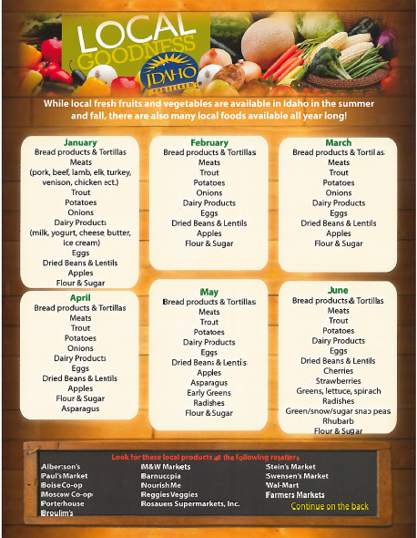
Menu Planning and Using Cycle Menus
Step 2: Determine the Length of the Menu
Seasonal-based menus
Regulatory agency
Participants
Notes:
SAY:
A cycle menu should have a minimum of two weeks but no more than eight weeks. This timeframe enables you to serve a variety of food combinations, but is also allows you to introduce a number of new foods.
When determining the length, you may want to consider the following points. Think about how you can align your menus with each season. Seasonal-based menus may reduce food cost and foods often taste better when purchased in season. Idaho preferred provides a calendar of when local products are available in our state. The calendar is in the Menu Planning binder at your table. Another great source for your binders.
A regulatory agency, such as the health department Head Start programs, may determine the length of the cycle. Therefore, always consult with your regulatory source when determining the length of the cycle menu.
Keep in mind that adults usually eat a wider variety of foods than children; therefore, you may need to use shorter cycles for children.

Slide 28
Menu Planning and Using Cycle Menus
Step 3: Think about the Changes
Were the menus age appropriate?
Did you stay within budget?
Were the menus nutritious and appealing?
Did you prepare the menus using current equipment?
Did the children like the menus?
What food items do you need to change?
Notes:
SAY:
The next step call for you to think about the changes you wish to make. Taking this approach allows you to easily update your previous cycle menus to reflect any necessary changes. On the other hand, if you desire to create a new menu, you can easily apply what you learned, incorporating a few child favorites, using the key information identified in this step.
Specifically, think about what went well during the previous cycle and what changes you would like to make for the new menu. For example, assessing your menus for the following information:
Were the menus age appropriate?
Did you stay within budget?
Were the menus nutritious and appealing?
Did you prepare the menus using current equipment?
Did the children like the menus?
What food items do you need to change?

Slide 29

Menu Planning and Using Cycle Menus
Children and New Foods
Some children may need a minimum of 15 offerings before they try or like a food item
Notes:
SAY:
It is important to note that when making changes and incorporating new foods, some children may need a minimum of 15 offerings before they try or like a food item. During the early years, everything is new to young children and trying new foods can be scary. Therefore, when first serving a new food item on the menu and the children do not try it or like it, continue to offer it in a variety of ways to provide them with opportunities to acquire a taste for the food.

Slide 30

Menu Planning and Using Cycle Menus
Step 4: Select the Main Dish for Lunch
The main dish is the central focus of the menu
Notes:
SAY:
The main dis is the central focus of the menu. It helps to shape the planning process when it comes to cost and time. Specifically, planning the main dish first helps to control cost because these items are often the most expensive.
Also, the main dish regularly contains more than one food component Therefore, if you identify these additional food items during this step, it will help you to reduce the total time for planning the remaining food items.
When planning the main dish, use a menu planning template, such as the Menu Planning Template in your participant packet.

Slide 31
Menu Planning and Using Cycle Menus
Key Points for Step 4: Selecting Main Dish for Lunch
Select child friendly main dishes
When repeating main dish, vary other food components
Add serving size to each food item
Verify processed foods have CN Label or PFS
Notes:
SAY:
Begin by selecting those main dishes from the previous menus that you would like to serve during this new cycle menu. Following, identify and list the new menu main dishes for the remaining days of the cycle. As you complete this step, keep the following points in mind.
Select child friendly main dishes to increase acceptance of the menu. Choosing those that are not child friendly can result in poor acceptance of the menu.
When repeating main dish during a two-week period, vary the other food components.
Add serving size to each food item as a way to increase accuracy when purchasing, preparing, and serving menus.
Verify processed foods have a current CN Label or product formulation statement.

Slide 32

Menu Planning and Using Cycle Menus
Step 5: Select the Remaining Menu Items for Lunch
Component-Based Planning
Menu-Based Planning
Notes:
SAY:
Next, select the remaining items to create a reimbursable meal. There are a number of ways to complete this step, such as through component-based or menu-based planning. Both ways are ideal, and you may need to try both to see which way works best for you.
Component-based planning means you plan the entire menu, one component at a time. For example, you begin with grains and identify a grain for each meal and or snack on the menu. Once you are finished with this component, you begin selecting food items for the next component. This way allows you to ensure you are incorporating a variety of options for the entire menu cycle.
Menu-based planning means you plan an entire menu one day at a time. For example, you plan Monday’s menus first, followed by Tuesday’s menu and so on.

Slide 33
Menu Planning and Using Cycle Menus
Considerations for Remaining Menu Items for Lunch
List serving sizes for each item
Include menu items that complement main dish
Work to make at least half your grains whole grains
Plan the menus around seasons
Incorporate “other foods”, such as condiments and water
Notes:
SAY:
Regardless of the way you choose, keep the following points in mind when selecting the remaining items for a reimbursable meal.
List the serving sizes for each food item. You may need to refer to the Child and Infant Meal Patterns included in your training packet and the menu planning binder.
Include food items that complement the main dish. For example, avoid adding noodles when the main dish contains rice.
Work to make at least half of your grains whole grains.
Plan the menus around seasons, so that you can incorporate seasonal fruits and vegetables.
Incorporate “other foods”, such as condiments or water, making sure that you have the necessary items for each meal.

Slide 34
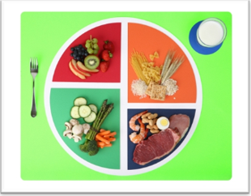
Menu Planning and Using Cycle Menus
Cross Check the Lunch Menu
Fluid Milk
Meat/Meat Alternates
Vegetables
Fruits
Grains
Notes:
SAY:
Before advancing to the next step, cross check your lunch menus to ensure you have reimbursable meals. Each day should feature a food item, along with the serving size, for the following five components:
Fluid Milk
Meat/Meat Alternates
Vegetables
Fruits
Grains

Slide 35

Menu Planning and Using Cycle Menus
Step 6: Plan Menus for Breakfast
Fluid Milk
Vegetables, Fruits or portions of both
Grains
Notes:
SAY:
Now that you have planned the lunch menus, begin planning the menus for the next meal. If you offer lunch and supper it is recommended to complete the supper menus first and then plan breakfast menus because they will feature the most expensive items when compared to snack.
Just like the lunch menu, plan menus that align with the CACFP meal pattern requirements. Select a food item from the following food components for the breakfast menus.
Fluid Milk,
Vegetables, fruits or portions of both,
Grains
Before advancing to the next step, cross check your breakfast menus to ensure you have reimbursable meals for each day. In addition, be sure to include the serving sizes for each food item.

Slide 36

Menu Planning and Using Cycle Menus
Step 7: Plan Menus for Snack
Select two of five components
Include a variety of fruits and vegetables
Notes:
SAY:
Next, if you serve snacks in your program, select food items from two of the five CACFP meal pattern components for each snack for your cycle menu.
Be sure to include a variety of fruits and vegetables. In addition, plan to include water when possible to increase hydration in the children.
Just like lunch and breakfast, always cross check your snack menus to ensure they are reimbursable for each day.

Slide 37
Menu Planning and Using Cycle Menus
Meal Substitutions
Do the menus reflect any special events, holidays, etc.?
Are the menus age-appropriate?
Are considerations made for children with special nutritional needs or preferences?
Notes:
SAY:
During your cycle period, if there is a special event you regularly have, such as a fall festival or spring picnic, think about the foods you would like to serve during the special event. Make any adjustments to your cycle menu to reflect these occasions.
In many CACFP programs, there are infants, preschoolers, and school age children. Other programs may include only school age children at an afterschool program. Think about the participants in your program; then, make sure that each menu is developmentally appropriate. For example, older infants may be able to eat the same food items as older children, but some may need a texture modification. A general guideline when cutting up food for younger children is ¼” bites for children under 2 years of age and ½” for children over age 2. Always check with the state agency or your sponsoring organization if you should have questions with modifying food items for each age group.
You may have some participants who may need a modified menu due to disabilities, special dietary needs, or religious beliefs. Always follow current USDA guidance to ensure your menus align with the CACFP and meet the needs of the participants. Special meal accommodations requirements will be reviewed later in this training.

Slide 38
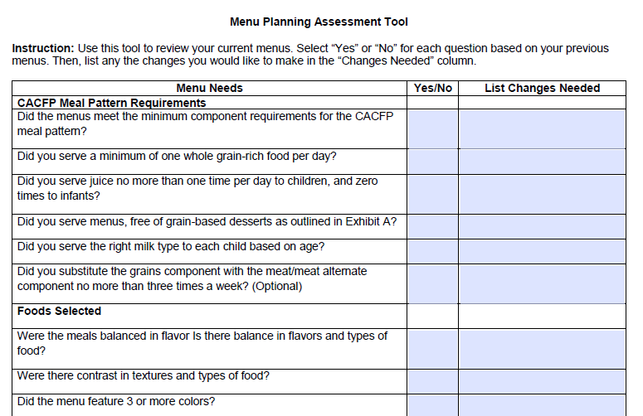
Menu Planning and Using Cycle Menus
Step 8: Evaluate What You Have Planned
Notes:
SAY:
The final step requires you to evaluate your planned menus for good nutrition, appeal, and compliance with the CACFP.
Use an assessment tool, such as the Menu Planning Assessment Tool in your participant packet and in the Menu Planning Binder at your table to evaluate your menus for the following:
Meal pattern requirements
Foods selected
Preparation
Cost
Menus and recipes
Special considerations

Slide 39
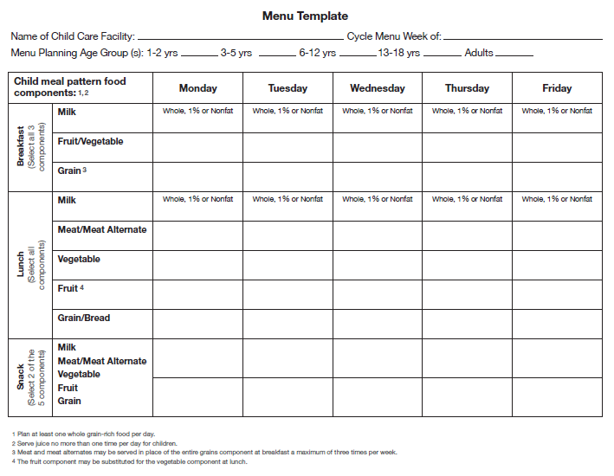
Menu Planning and Using Cycle Menus
Menu Planning Activity
Notes:
SAY:
Now that you have explored the advantages of cycle menus, six menu planning principles and the eight steps for planning cycle menus, it’s time to create your own cycle menu.
Each table will work as a team to complete this activity. At your tables there is a flip chart stand with a poster size Menu Template. In your tables activity packet is a set of laminated menu components. Use each component to create your one week cycle menu on the menu template. Once completed use your menu planning assessment tool in your tables Menu Planning Binder to quickly evaluate your planned menus for CACFP meal pattern requirements and foods selected. You will have 10 minutes to complete this activity.
DO: Allow 10 minutes for activity. Walk around room and answer any questions.
SAY: (after activity is complete) How did you like this activity? (allow responses) This method provides you with a good vision of each menu and is a good way to include your center or day care home children in the menu planning process.

Slide 40

Morning Break
10 Minute Morning Break
Notes:
SAY:
This is a good time for the morning break. Let’s take 10 minutes and meet back at (give the time to be back).

Slide 41
How to Standardize a Recipe
Standardized Recipe
A standardized recipe is one that “has been tried, adapted, and retried several times for use and has been found to produce the same good results and yield every time when the exact procedures are used with the same type of equipment and same quantity and quality of ingredients.”
Notes:
SAY:
Now that your cycle menu is completed, the next steps is to ensure you have all the menu records to prepare and document the menus. Let’s start with standardized recipes.
Can someone read USDA definition of a standardize recipe.
A standardized recipe is one that “has been tried, adapted, and retried several times for use and has been found to produce the same good results and yield every time when the exact procedures are used with the same type of equipment and same quantity and quality of ingredients.”

Slide 42

How to Standardize a Recipe
Benefits of Standardized Recipes
Consistent food quality
Predictable yield
Customer satisfaction
Consistent nutrient content
Food cost control
Efficient purchasing procedures
Notes:
SAY:
Using standardized recipes provides many benefits to child care operations. These benefits include:
Consistent food quality-The use of standardized recipes ensures that menu items will be consistent in quality each time they are prepared and served.
Predictable yield-The planned number of servings will be produced by using standardized recipes. This can help to reduce the amount of leftover food if there has been overproduction, and also will help to prevent shortages of servings.
Customer satisfaction-Well-developed recipes that appeal to children will help to increase consumption of nutritious foods and customer satisfaction.
Consistent nutrient content-Standardized recipes will ensure that nutritional values per serving are valid and consistent.
Food cost control-Standardized recipes provide consistent and accurate information for food cost control because the same ingredients and quantities of ingredients per serving are used each time the recipe is produced.
Efficient purchasing procedures-Purchasing is more efficient because the quantity of food needed is easily calculated from the information on each standardized recipe

Slide 43
How to Standardize a Recipe
Benefits of Standardized Recipes- continued
Inventory control
Labor cost control
Increased employee confidence
Reduced record keeping
Successful CACFP program reviews
Notes:
SAY:
Inventory control- The use of standardized recipes provides predictable information on the quantity of food inventory that will be used each time the recipe is produced.
Labor cost control- Written standardized procedures in the recipe make efficient use of labor time and allow for planned scheduling of foodservice personnel for the work day. Training costs are reduced because new employees are provided specific instructions for preparation in each recipe.
Increased employee confidence- Employees feel more satisfied and confident in their jobs because standardized recipes eliminate guesswork, decrease the chances of producing poor food products, and prevent shortages of servings during meal service.
Reduced record keeping- A collection of standardized recipes for menu items will reduce the amount of information required on a daily menu record.
Successful CACFP program reviews- Standardized recipes are a source of documentation for the CACFP reviews. A review cannot be completed if the recipes are missing information or provide inaccurate information on ingredients, yield, or serving size.

Slide 44
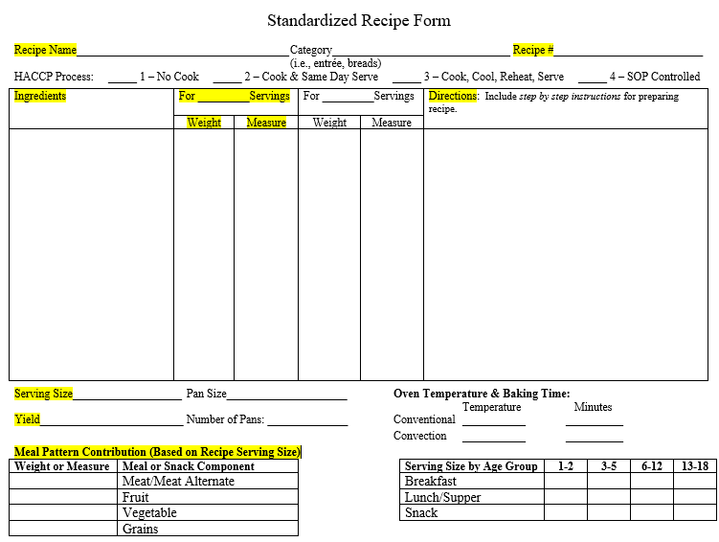
How to Standardize a Recipe
Standardized
Recipe
Components
Notes:
SAY:
We will now review the key parts of a standardized recipe. Here is a sample standardized recipe form. This form is in your training packet. Lets review.
Recipe name -that adequately describes the recipe and you can choose to categorize the recipe for example if it is an entrée, bread, vegetable …
Recipe number- this is optional but a good practice if you plan to use the Recipe Analysis Workbook in the Interactive Food Buying Guide.
Ingredients- All products in the recipe
Weight/Volume of each ingredient- The quantity of each ingredient listed in weight and/or volume
Instructions – detailed directions for preparing the recipe
Serving size- the amount of a single portion in volume and/or weight, for example ½ cup carrots or 1 ounce roll
Recipe yield – the amount (weight or volume and number of servings) of prepared product. Example: 20-- ½ cup servings or 20 1 ounce rolls
Meal pattern contribution- Since the product will be served in reimbursable meals or snacks, the recipe must include how the product credits to the CACFP meal pattern. Which components, how it credits and what is the serving size for each age group based on meal or snack service.

Slide 45
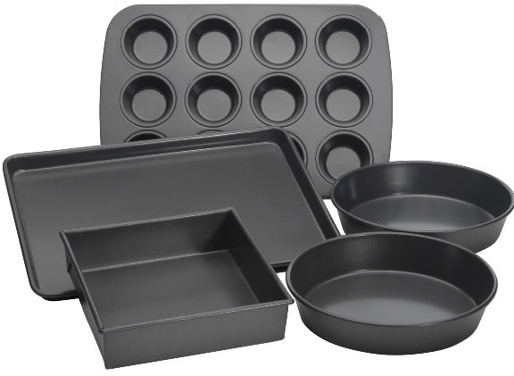
How to Standardize a Recipe
Recipe Instruction Standards
Oven temperature
Prepare pans
Mix ingredients
Notes:
SAY:
It is important the instructions for your recipe is detailed and includes all necessary information to prepare and serve the recipe. Here are standard recipe instructions. If the recipe is to be prepared in the oven the first step is usually preheating the oven to the oven temperature provided. Next the recipe includes which pan or pans to use when baking or cooking the recipe and how to prepare the pans. What is the pan type and size; sheet pan, muffin pan, 13x9 baking pan, large skillet etc.
Do the pans need to be sprayed, oiled or not and can parchment paper be used?
The next step is how to mix the ingredients. This may take more than one step to include all ingredients and how to prepare each one and how to combine.. Examples are chopping, draining, blending, mixing etc. The recipe may include more than one recipe, for example, a pizza recipe may include the recipe for the crust and the recipe for making the pizza. When standardizing a recipe ask other employees, friends or family if they have any questions as to how to prepare the recipe from your standardized recipe. It might need more detail in the instructions. Clear instructions will help to achieve desired results.

Slide 46

How to Standardize a Recipe
Recipe Instruction Standards- continued
Baking and cooking time and details
Serving dishes and serving ware
How to serve
Critical control points
Notes:
SAY:
Baking and cooking times and temperature of the finished product is next. In this section it is important to include details such as does the product need to covered when baking or cooking. Are any additional ingredients added while cooking? How do you know when it is done? This information is important in the recipe.
Serving dishes, serving ware necessary for serving and how the product is served is very helpful for getting the product ready for service. Examples; how to cut the lasagna in the baking pan to meet the serving size, what scoop to use to serve the soup,, and serving platters to use when preparing for family style meal service.
Critical control points are necessary for serving safe food. What is the serving temperature, how long or what temperature to hold the product before service, what to do with leftovers, can you freeze the product?

Slide 47

How to Standardize a Recipe
Phases of Recipe Standardization
Recipe verification phase
Product evaluation phase
Quantity adjustment phase
Notes:
SAY:
The recipe standardization process can be summarized in three phases: recipe verification, product evaluation, and quantity adjustment. Recipe verification consists of reviewing the recipe in detail, preparing it, verifying its yield, and recording changes. Product evaluation focuses on determining the acceptability of the product produced from the recipe. Changing the recipe yield and ingredient amounts occurs in the quantity adjustment phase. A recipe may go through these phases several times before becoming standardized at the necessary quantity for an operation. The standardization process may take up to 3-4 weeks with testing. Input from children and other customers is critical during the evaluation phase.
Decisions made during each phase determine the flow of a recipe through this recipe standardization process. Once a recipe has been standardized for an operation, the standardization process should not have to be repeated unless changes occur in availability of ingredients or equipment.

Slide 48
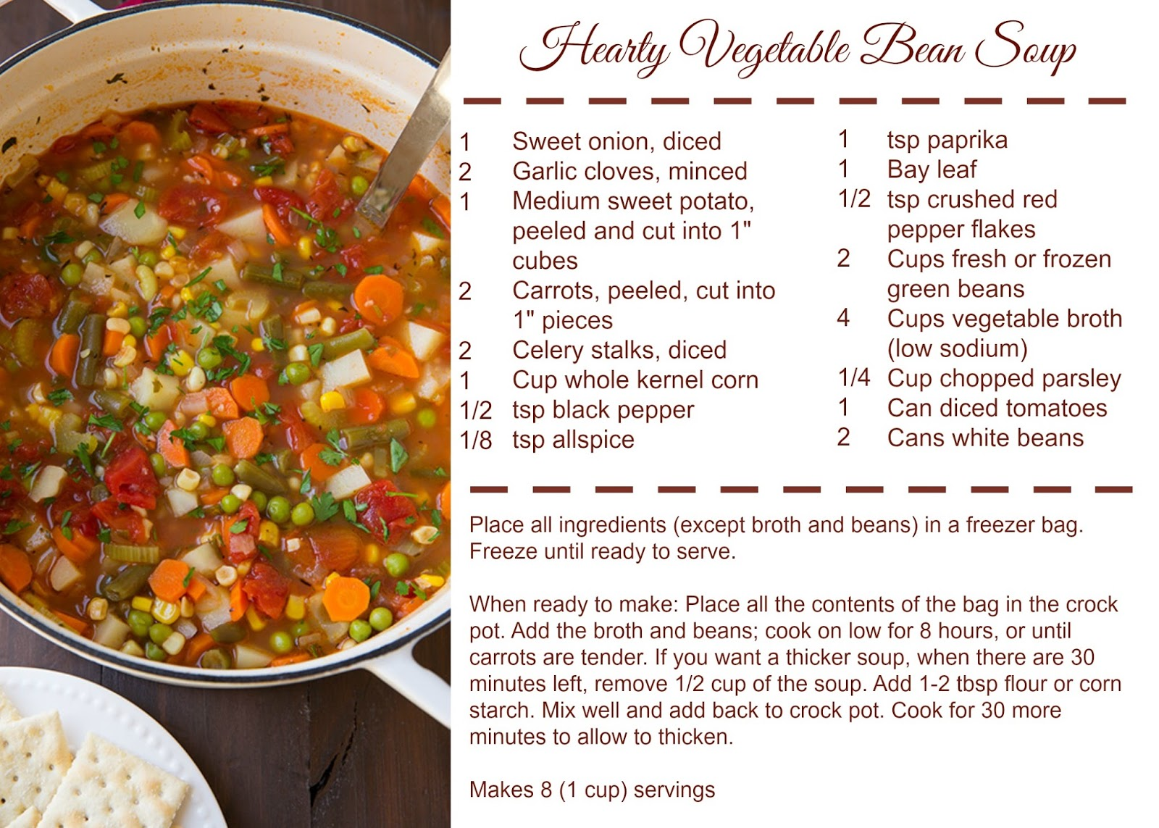
How to Standardize a Recipe
Recipe Verification Phase
Review the recipe
Prepare the recipe
Verify the recipe yield
Record changes to the recipe
Notes:
SAY:
The first phase of the recipe standardization process is the recipe verification phase. This phase includes four major processes: review the recipe, prepare the recipe, verify the recipe yield, and record changes to the recipe.
Review the recipe to verify it contains all the recipe components. If information is missing, make note of any information that must be determined during the recipe preparation process. Once the recipe has been reviewed, it can be prepared. Throughout the process of making the recipe, keep careful notes about any variations. Record this information directly on the recipe for future reference. Cooking time to reach the internal temperature and product quality may vary slightly depending on the type and age of equipment.
Verification of the recipe yield occurs once all of the ingredients have been combined and the recipe preparation completed. Recipe yield should be specified in both total quantity (weight and/or volume) and number of servings. Recipe yield can be determined by weighing the final product or measuring its volume. If the desired serving size is not achieved, changes in the recipe, portioning, or ingredient amounts may be needed. Changes or concerns should be recorded on the recipe in this phase.

Slide 49
How to Standardize a Recipe
Product Evaluation Phase
Informal Evaluation - prepare product to determine if acceptable
Formal Evaluation- seven step evaluation process
Select group of people to taste recipe Choose an evaluation form Prepare the recipe Set up sampling area | Participants taste and evaluate food Summarize the results Determine plans for recipe based on evaluations
Notes:
SAY:
Product evaluation follows the recipe verification phase and is an important part of the recipe standardization process. It will help determine acceptability of the recipe and will provide objective information that can be used to further improve the recipe. Recipe evaluation should include the manager, foodservice staff members, and customers (can include children, teachers, and parents). Two types of evaluation occur in the evaluation phase: informal and formal.
Informal evaluation involves only the child care center cook(s), employees or the day care home provider. During informal evaluation, the product is prepared for the first time in the operation and an assessment is made of whether the product is acceptable or not and if efforts to standardize the recipe should continue.
Formal evaluation occurs when the center staff or day care home provider believes a recipe has potential for service in their operation. Procedures for conducting a formal evaluation of the recipe include: Selecting a group of people to taste recipe, choose an evaluation form, prepare recipe, set up sampling area, participants taste and evaluate food, summarize results, and determine plans for recipe based on the results.

Slide 50
How to Standardize a Recipe
Grandma’s Famous Fluffy Biscuits
2 cups flour
1 Tbs. sugar
3 tsp. baking powder
1 tsp. salt
½ cup butter
¾ cup milk
Heat oven to 450 degrees. In bowl stir flour, sugar, baking powder and salt. Add butter and milk. Knead dough 10 times. Roll out dough to ½ inch thick. Cut out biscuits with 2 ½ inch round cutter. Place biscuits on cookie sheet and bake 10-12 minutes. Serve warm. Makes 12 biscuits.
Notes:
SAY:
It is important when planning menus you verify all the recipes in the menus are standardized. There are several standardized recipes available through Idaho Menu Toolkit and USDA Standardized Recipes. USDA recognizes that sometimes you would like to use a family recipe in your menus. Look at this recipe I received from my grandmother. It is her famous biscuit recipe. When I went to prepare the recipe I noticed the recipe was missing information and was not standardized.
Can you see what is missing? (missing information: need type of flour, more detain in instructions- size bowl, cut in butter with fork, use flour to roll out dough and describe how to knead, use flour so biscuits don’t stick to cutter, need to cut straight down, how far apart do you put the biscuits on the pan, is the pan greased or ungreased, need the weight of the biscuit to determine meal pattern contribution)
SAY: At this time review your tables one week cycle menu and recipes in the tables activity packet. Do you have a standardized recipe for all homemade combination foods? (wait 3 minutes and say) What did you find? (each table will have one recipe that is not standardized)
DO: Allow a 3 minutes for everyone to check menus and recipes.

Slide 51
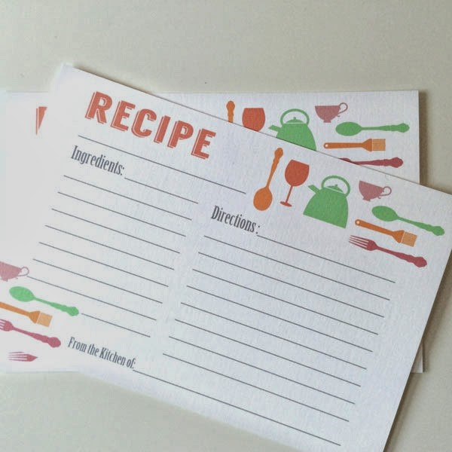
How to Standardize a Recipe
Standardizing recipe activity
Notes:
SAY:
Each table has one recipe in your table activity packet for your weekly menu that is not standardized. Using the Standardize Recipe Template as a team at your table review the recipe for the missing information. Use your flip chart to write and report the missing information and how you would obtain the missing information.
DO: If a table cannot find the recipe that is not standardized provide assistance. Give 3 minutes for this task and have each table report their findings to the class. Each team will need a spokes person. Since three tables share a recipe see if the other tables had any different findings.
Table 1, 3, 5: Banana bread squares (missing serving size and yield, when to put yogurt in batter, how to cut pan for serving yield, meal pattern contribution)
Table 2, 4, 6: Garden vegetable soup (missing serving size, meal pattern contribution, green beans in directions when to add, how to serve)

Slide 52
How to Standardize a Recipe
Quantity Adjustment Phase
Factor Method of Recipe Adjustment- three basic steps
Determine the “factor” to be used
Multiply each ingredient quantity by the “factor”
Change amounts into more common measurements
Notes:
SAY:
When a recipe has been evaluated positively in the evaluation phase but is not in the desired quantity, it is time to move to the quantity adjustment phase of recipe standardization. There are several methods that can be used to adjust a recipe to get to the desired number of servings (yield). Some methods are done manually; others involve use of the computer.
The factor method for adjusting recipes involves mathematical calculations and is the most commonly used method of manual adjustment. The factor method consists of three basic steps. They are:
Determine the “factor” to be used
Multiply each ingredient quantity by the “factor”
Change amounts into more common measurements

Slide 53


How to Standardize a Recipe
Determining the “Factor” to be Used
Desired yield ÷ Current yield = Adjusting Factor
Example: 36 desired biscuits ÷ 12 current yield = 3
Notes:
SAY:
The factor is a multiplier that will be used to increase or decrease the quantity of ingredients in a recipe. The factor is determined by dividing the desired yield (in number of servings) by the current recipe yield (in number of servings).
For example, with my family biscuit recipe, it yields 12 biscuits. To use this recipe in a child care center that needs 36 servings, the recipe will need to be adjusted. Dividing 36 by 12 equals an adjusting factor of 3.

Slide 54
How to Standardize a Recipe
Multiply Each Ingredient Quantity by the “Factor”
Ingredients | 12 Servings (Recipe Amount) | Converted Quantities | Factor | 36 Servings (Calculated Amount) | 36 Servings (Common Measure)
Flour | 2 cups | 2 cups | 3 | 2 x 3 = 6 cups
Sugar | 1 Tbs. | 1 Tbs. | 3 | 1 x 3 = 3 Tbs.
Butter | 1/2 cup | .5 cup | 3 | .5 x 3 = 1.5 cups
Milk | 3/4 cup | .75 cup | 3 | .75 x 3 = 2.25 cups
Notes:
SAY:
To adjust my families biscuit recipe, each ingredient quantity in the recipe is multiplied by the factor to determine the ingredient quantity needed to produce the new yield. Ingredient quantities given as fractions would need to be converted to decimals prior to doing this calculation. In addition, it may be easier to convert quantities that are in multiple units (i.e., quarts and cups) to one unit (cups) before doing calculations. Table 6 in your packet provides the common used fractions and decimal equivalents. This is a great resource to keep in your menu planning binder.
For example, to increase my families biscuit recipe to 36 servings we determined the adjusting factor would be 3. Let’s review the chart. (go over each column) Any questions?

Slide 55
How to Standardize a Recipe
Change Amounts into More Common Measurements
Ingredients | 12 Servings (Recipe Amount) | Converted Quantities | Factor | 36 Servings (Calculated Amount) | 36 Servings (Common Measure)
Flour | 2 cups | 2 cups | 3 | 2 x 3 = 6 cups | 1 quart 2 cups
Sugar | 1 Tbs. | 1 Tbs. | 3 | 1 x 3 = 3 Tbs. | 1/8 cup 1 Tbs.
Butter | 1/2 cup | .5 cup | 3 | .5 x 3 = 1.5 cups | 1 1/2 cups
Milk | 3/4 cup | .75 cup | 3 | .75 x 3 = 2.25 cups | 2 1/4 cups
Notes:
SAY:
Often, the result of the mathematical calculations is a quantity that is hard to measure or not commonly used. These quantities may need to be converted to a more common measurement. Rounding to the nearest common measure also may occur.
For example, since we know there are 4 cups in a quart, 6 cups minus 4 cups equals 1 quart and the remaining number of cups is 2. Therefore, a more common measure would be 1 quart and 2 cups. For sugar, 3 Tbs. can be converted to 1/8 cup since there are 2 Tbs. in an 1/8 cup. For the butter and milk you would change the decimals back to fractions to get the most common measure. Butter is 1 ½ cups and Milk is now 2 ¼ cups.

Slide 56
How to Standardize a Recipe
Additional Information for Adjusting Recipes
Ingredients | 12 Servings (Recipe Amount) | Converted Quantities | Factor | 36 Servings (Calculated Amount) | 36 Servings (Common Measure)
Flour | 2 cups | 2 cups | 3 | 2 x 3 = 6 cups | 1 quart 2 cups
Sugar | 1 Tbs. | 1 Tbs. | 3 | 1 x 3 = 3 Tbs. | 1/8 cup 1 Tbs.
Butter | 1/2 cup | .5 cup | 3 | .5 x 3 = 1.5 cups | 1 1/2 cups
Milk | 3/4 cup | .75 cup | 3 | .75 x 3 = 2.25 cups | 2 1/4 cups
Baking Powder | 3 tsp | 1 Tbs. | 3 | 1 x 3 = 3 Tbs. | 1/8 cup 1 Tbs.
Notes:
SAY:
Be aware that several categories of ingredients require special attention when adjusting recipes because the amount needed for these ingredients often does not increase proportionately to the increase in other ingredients. Ingredients that may not increase proportionately include herbs/ spices, leavening agents (baking soda, baking powder, yeast), thickening agents (flour, cornstarch, eggs), and liquid (water, juice). Factors such as exposed surface area, evaporation, and handling loss can change the total amount needed of an ingredient when the recipe quantity is changed.
This would apply to the salt and baking powder in the biscuit recipe. Only by preparing the recipe and evaluating the product can a determination of changes needed be made. For the recipe, I converted the baking powder using the factor method. There are 3 teaspoons in a tablespoons so I used 1 Tbs. for the conversion. The common measure for 36 servings was 1/8 cup and 1 Tbs.
You can prepare the recipe with the 1/8 cup 1 Tbs and evaluate the product to determine if the amount was adequate.

Slide 57
How to Standardize a Recipe
Practice Exercise for Factor Method of Recipe Adjustment
Ingredients | Servings (Recipe Amount) | Converted Quantities | Factor | Servings (Calculated Amount) | Servings (Common Measure)
Notes:
SAY:
Now that we know how to adjust a recipe lets practice by using the factor method to adjust the serving yield. Each tables recipe from the standardization exercise is now standardized and is located in your training packet on a Standardized Recipe Form. Work together at your table to adjust your recipe to the new serving yield listed on the recipe form. You can do this as a team at your table.
Table 1, 3, 5: Banana bread squares 12 servings to 36 servings
Table 2, 4, 6: Garden vegetable soup 4 servings to 20 servings
DO: Allow 10 minutes for the exercise and assist where needed.
SAY: How did everyone do? (allow for feedback)

Slide 58
How to Standardize a Recipe
Sources for Standardized Recipes
Idaho Menu Toolkit
USDA Standardized Recipes
https://www.fns.usda.gov/usda-standardized-recipe
Recipes for Healthy Kids Cookbooks http://teamnutrition.usda.gov
Notes:
SAY:
Here are a list of resources where you can find Standardized Recipes. It is important to note, that if you change ingredients, baking or cooking methods, it will be necessary to follow the standardized recipe phases to standardize the recipes again. For example,
For a recap, we discussed the benefits of standardized recipes, components of a standardized recipes, phases to standardize a recipe and wrapped it up with the steps to adjust the yield of a standardized recipe.

Slide 59
Determining Creditable Foods and Serving Sizes
Tools to Credit Foods and Determine Serving Sizes
Web-based interactive Food Buying Guide- Recipe Analysis Workbook
Notes:
SAY:
At this time we have planned and created a one week cycle menu, evaluated our menus with the assessment tool and standardized and adjusted recipes yields for use.
What else do you need to plan a creditable meal? The Web-based Interactive Food Buying Guide and tools are an excellent resource for planning creditable meals. The food buying guide is an authoritative source of food yield information for all Child Nutrition Programs. The guide provides information for purchasing the required quantities of foods and determining contribution toward the meal pattern requirements.
The food buying guide was first published in July 1947 and was revised a few times before USDA created the web-based interactive guide in 2017. And now there is a mobile app!

Slide 60
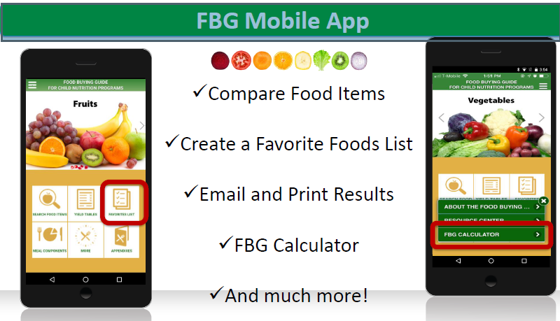
Determining Creditable Foods and Serving Sizes
Notes:
SAY:
In your participant packet there is a Mobile App card like the one showing on the screen. If you have not already downloaded the app now is a good time. In this section of the training we will learn how to use the app tools.
How many of you have already used the mobile app?

Slide 61
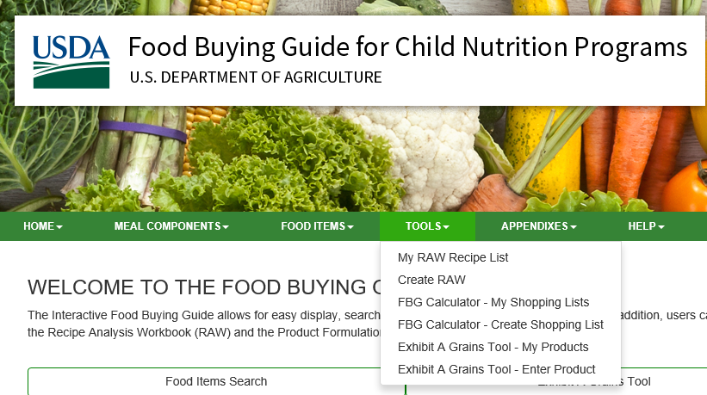
Determining Creditable Foods and Serving Sizes
Interactive Food Buying Guide Tools
Notes:
SAY:
Let’s review each of the tools in the Interactive Food Buying Guide. If you have a mobile device you can follow along as we go.
This is the home page of the FBG. To access the Tools go to the green task bar and use the arrow drop down box to select the tool you would like to use.
The tools are:
My RAW recipe list
Create RAW
FBG Calculator-My shopping lists
FBG Calculator-Create shopping list
Exhibit A Grains tool-My products
Exhibit A Grains tool- Enter product- This tool was just released in July!
Have you used any of these tools? After this training today if need any assistance when using any of the tools refer to the Appendixes and Help sections on this page. The appendix has written guidance and the Help area has video tutorials.

Slide 62
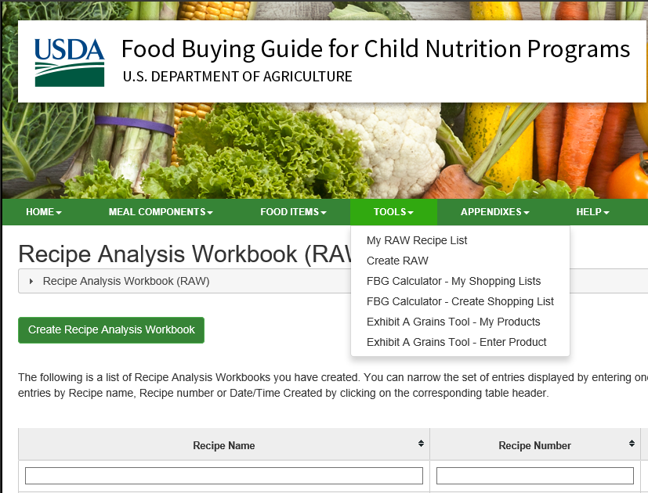
Determining Creditable Foods and Serving Sizes
USDA
Recipe
Analysis
Workbook (RAW)
Notes:
SAY:
Now that we have Standardized Recipes we can now determine how the recipe contributes to the meal pattern.
The Recipe Analysis Workbook is a tool used to determine the expected meal pattern contribution and crediting statement for a recipe. The Recipe Analysis Workbook consists of a worksheet for each meal component. The worksheets, in hard copy format can be found in the "Recipe Analysis Workbook templates“ in the Appendix section This workbook is a tool for calculating the meal pattern contribution of a recipe’s ingredients toward the vegetable (expressed in subgroups), fruit, meat/meat alternates, and grains components of the Federal meal pattern requirements. Determining meal pattern contributions for recipes is an important step in ensuring that meals served are nutritious and meet Federal meal pattern requirements
If you select either My RAW recipe list or Create RAW you will land on this page shown on the screen. On this page you can review and access any of the recipes you already added to the Recipe Analysis Workbook also referred to as RAW. In addition you can click on the green button “Create Recipe Analysis Workbook” to add a new standardized recipe. We are going to add Harvest Delight recipe that is in your packet.

Slide 63
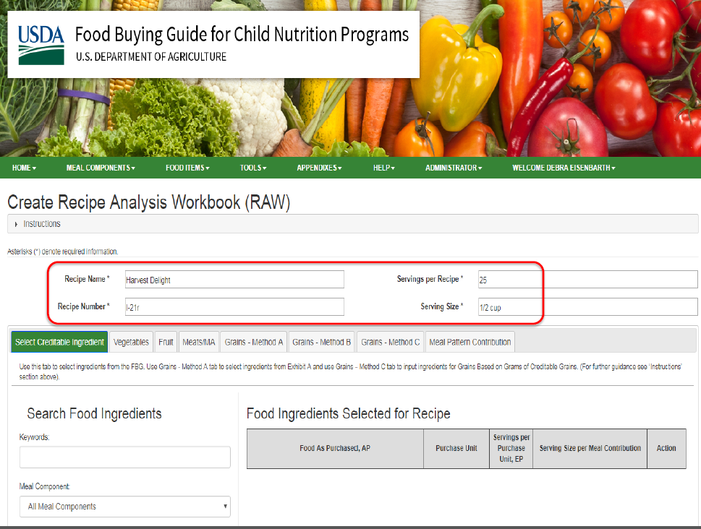
Determining Creditable Foods and Serving Sizes
To Create a Recipe
Select Tools
Select Create RAW
Type in Recipe Name, Recipe Number, Servings per Recipe and Serving Size
Notes:
SAY:
To create a recipe in RAW select Tools on the green task bar, in the drop down select Create RAW and you will get to the screen on this slide. Start by adding the recipe name, recipe number (you can create this number), servings per recipe (this is the yield) and serving size. In this example the recipe is Harvest Delight, serving is 25 and serving size is ½ cup.

Slide 64
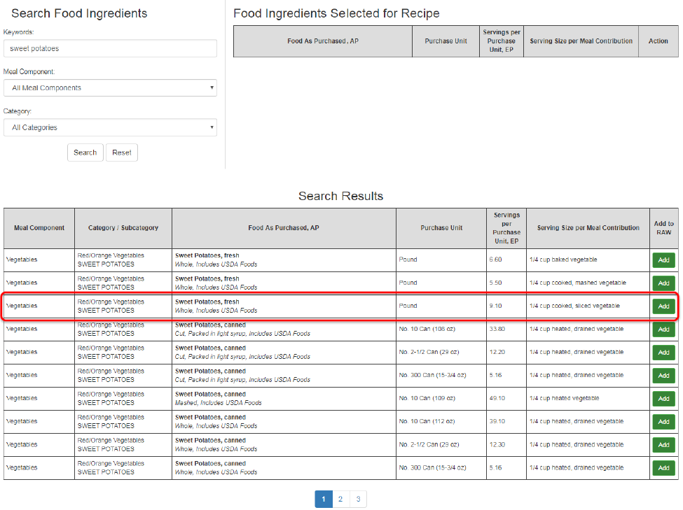
Determining Creditable Foods and Serving Sizes
Adding Ingredients to Recipe
Use Search Food Ingredients
Select the products to add to your recipe based on how you will purchase it
Select “Add”
Notes:
SAY:
To add ingredients to your recipe use the search food ingredients section in RAW. Type in the food you are searching for, select the food item based on how you will purchase it for the recipe and select “Add”. In this example the food item they were searching for was sweet potatoes. In the interactive food buying guide there are several options and they selected Sweet Potatoes Fresh.
Continue this process until you have added all food items you are crediting in your recipe. In the Harvest Delight recipe each vegetable and fruit in the recipe will be added to determine the vegetable and fruit contributions. The remaining ingredients are non-creditable food items i.e. the oil, seasonings, herbs, spices and syrup.

Slide 65
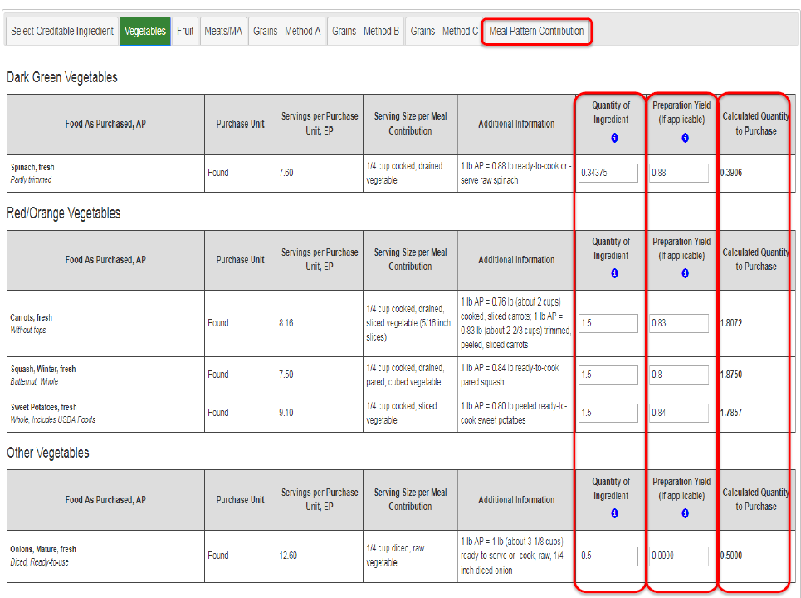
Determining Creditable Foods and Serving Sizes
Determining Quantity to Purchase
Select Component groups for all ingredients added
Add Quantity of Ingredient from recipe for each food item
Add Preparation Yield if applicable for each food item
Notes:
SAY:
Once all food items are added select the food components for all ingredients that were added. For example: Sweet potatoes was one food item added to this recipe. Sweet potatoes are a vegetable component so you would select Vegetable on the tool bar for RAW. Under Sweet Potatoes you will enter the quantity listed in your recipe for sweet potatoes in the Quantity of Ingredient column. In this example, the quantity needed is 1.5 lbs. so they entered 1.5. For the sweet potato selected 1 lb. as purchased is .80 lb. peeled and ready to cook so you would enter .80 under Preparation Yield. The system will then calculate the quantity of sweet potatoes you will need to purchase.
Continue this process for all food items you added for your recipe

Slide 66
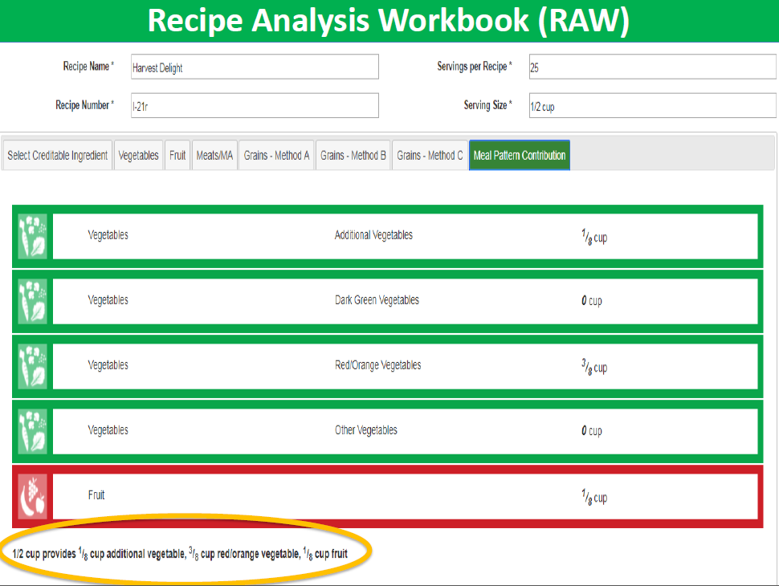
Determining Creditable Foods and Serving Sizes
Meal
Pattern
Contribution
Notes:
SAY:
Now that all food items are added to your recipe in RAW and you entered the quantities for each ingredient select Meal Pattern Contributions to see how your recipe will contribute to the meal pattern components. RAW does separate vegetables by sub groups. A ½ cup serving of this recipe will yield 3/8 cup vegetables and 1/8 cup fruit.
It is important to save your recipes in RAW for future use. To access your saved recipes and print them select Tools on the green task bar and in the drop down select My RAW Recipes List.

Slide 67
Determining Creditable Foods and Serving Sizes
Recipe Analysis Workbook (RAW) Activity
Garden Vegetable Soup
As team at your table enter vegetables from recipe in RAW and determine the recipe meal pattern contribution
Notes:
SAY:
In your packet is the standardized Garden Vegetable Soup recipe from the standardize recipe activity. As a team at your table enter the vegetables from the recipe in RAW and determine the recipe meal pattern contribution.
DO: Assist tables as needed. Give 10 minutes to complete and ask each table what the vegetable contribution was for the food items they entered.
Note: There may be variances based how they purchase the vegetables. A meal pattern contribution sheet is in the packet to compare to each tables results.

Slide 68
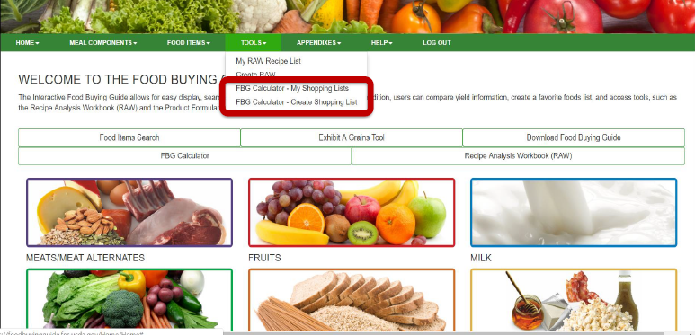
Determining Creditable Foods and Serving Sizes
Food Buying Guide Calculator
Notes:
SAY:
Next we will review how to use the Food Buying Guide (FBG) Calculator. This tool is used to create a shopping list of food items you need to purchase for your menus. The amount to purchase is based on the quantity you already have on hand, the serving size, and number of servings per food item.
To access the FBG Calculator select Tools on the green task bar. In the drop down box you will see FBG Calculator- My Shopping Lists and FBG Calculator- Create Shopping List.

Slide 69
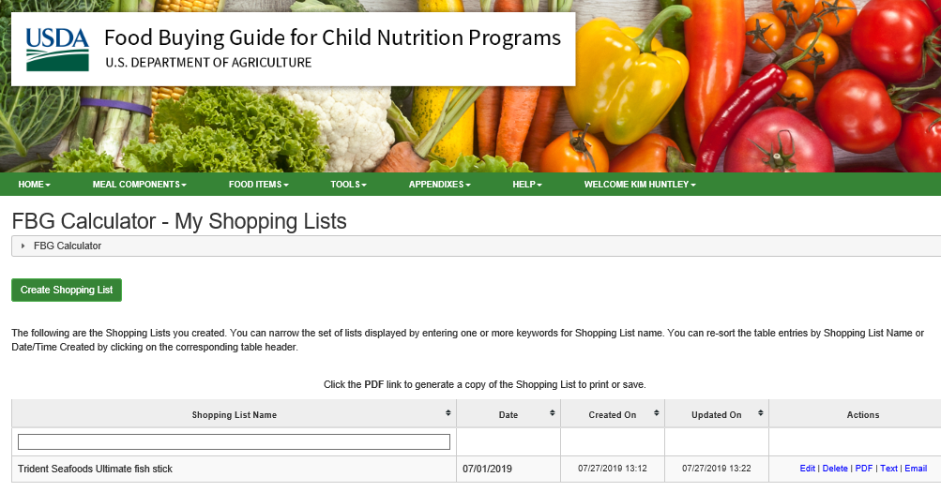
Determining Creditable Foods and Serving Sizes
Food Buying Guide Calculator- My Shopping Lists
Notes:
SAY:
When you select the FBG Calculator- My Shopping Lists this page will appear. Here you can see any shopping lists you already created. For the ones already created you can edit, delete, access as a PDF and save, text and email to yourself or others.
On this page you can also select the green button “Create Shopping List” to create a new list.

Slide 70
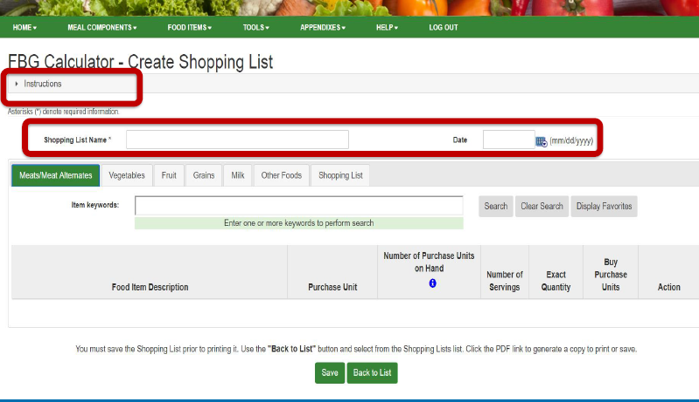
Determining Creditable Foods and Serving Sizes
Food Buying Guide Calculator-Create Shopping List
Notes:
SAY:
This is the page to create a shopping list. On this page you enter a Shopping list Name and Date (this may be your shopping date). Next you enter the food items by menu component. On this screen Meat/Meat Alternate is selected. There is a food item search box. Enter the food item you are searching for and enter. A list of food items that match your food item will appear under the Item Search box. Select “Add” next to the food item that best matches how you purchase the food. For example; pounds, pints, gallons etc.
After adding all food items for one menu component scroll down to the Food Item Description list and enter the Purchase Units on Hand for the first food item. Select “Add Serving Size” and then select the serving size for the food item and number of servings. Once this is completed for all food items select Save at the bottom of the page.
Repeat this step for each menu component until you completed your list. When you are done entering all food items select shopping list and you could view your list. Save the list. At this time you can access it under FBG Calculator-My Shopping List to print, text or email.

Slide 71
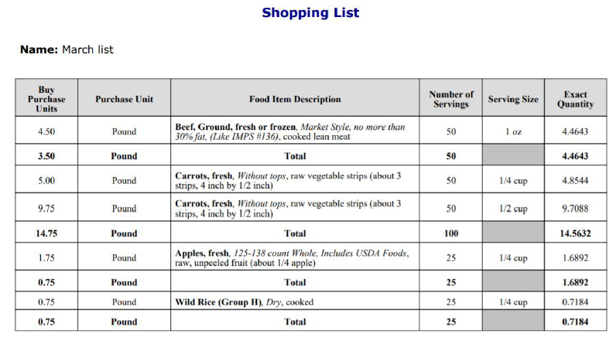
Determining Creditable Foods and Serving Sizes
Food Buying Guide Calculator-Shopping List
Notes:
SAY:
Here is a sample shopping list. The first column is the amount to purchase, the second column is the purchase unit, and the third column is a description of the food item.

Slide 72
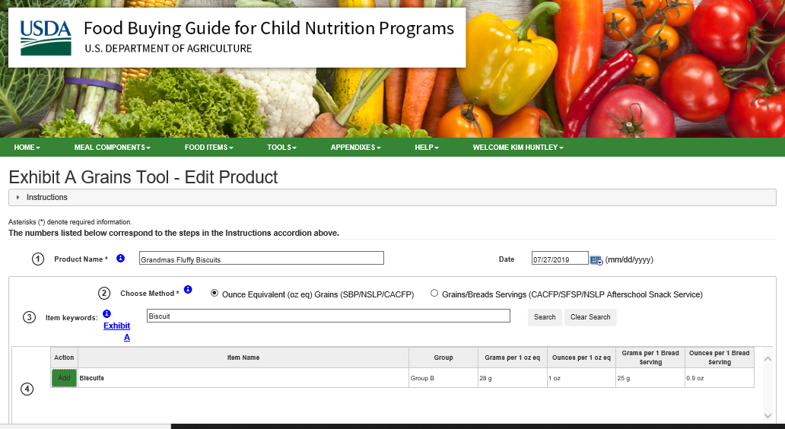
Determining Creditable Foods and Serving Sizes
Food Buying Guide Exhibit A Grains Tool- Enter Product
Notes:
SAY:
Now we will review how to use the FBG Exhibit A Grain Tool and how to enter a product. This is the product entry page. The first step is to add the Product Name and date. Here I entered my Grandma’s Fluffy Biscuits.
The second step is to select either Ounce Equivalent or Grain/Bread Servings. For this product I selected Ounce Equivalent.
The third step is to enter the grain name. Here I entered biscuit.
The fourth step is to select “Add” next to the Item Name.

Slide 73
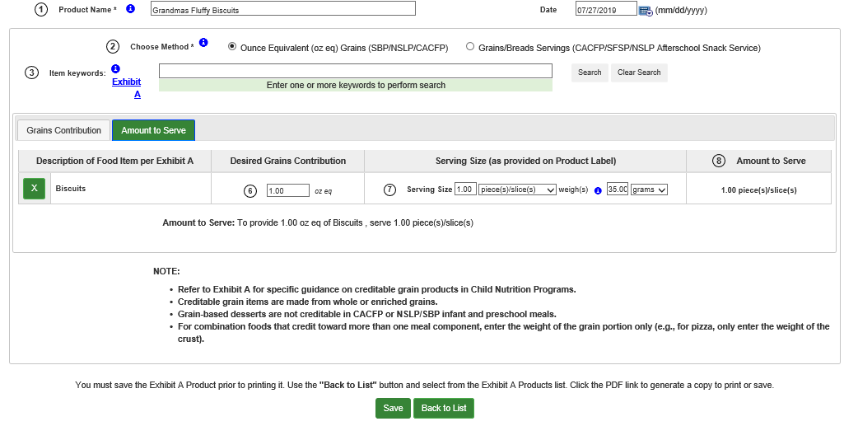
Determining Creditable Foods and Serving Sizes
Food Buying Guide Exhibit A Grains Tool- Enter Product
Notes:
SAY:
To receive the Grain Contribution, scroll down the page and enter the serving size of the product as on the product label or in the recipe in either grams or ounces and then enter measurement unit-either grams or ounces.
Note: For a grain recipe, you will need the products serving size weight. If the weight is not listed you will need to weigh the final product as part of the recipe standardization process.
To receive the amount to serve select the Amount to Serve tab. Enter the desired grains contribution. For example, for my biscuit I enter 1 for oz. equivalent. Finally enter the serving size and weight of a serving in either grams or ounces and select save. My biscuit is 35 grams. The serving size for a one ounce serving is one biscuit.

Slide 74
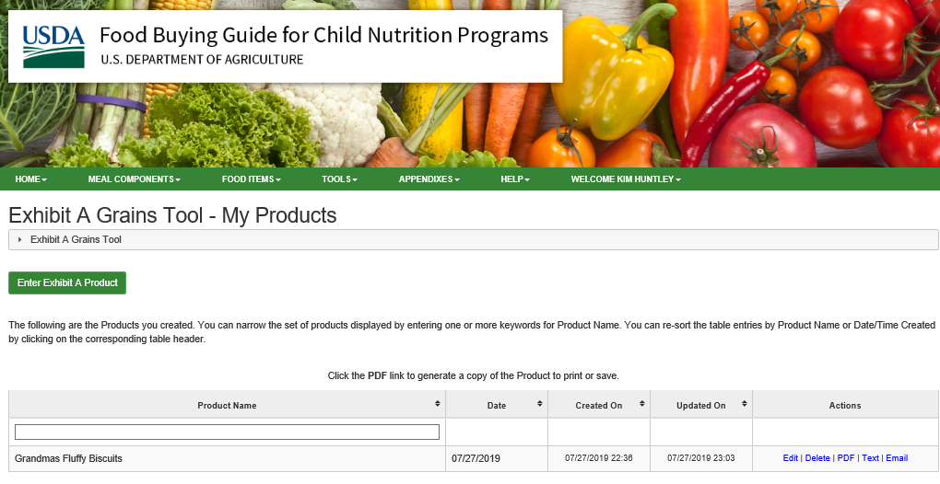
Determining Creditable Foods and Serving Sizes
Food Buying Guide Exhibit A Grains Tool – My Products
Notes:
SAY:
This is the My Products page for the Exhibit A Grain Tool. This is where your saved list of grains. For each grain listed you can edit, delete, save or print as PDF, text and email.
In my example, I used ounce equivalents. As part of the new CACFP meal pattern requirements grain ounce equivalents are to be implemented by centers and day care homes by October 1, 2019. In June 2019, USDA issued a proposed rule to delay ounce equivalents. USDA collected comments until July 31, 2019 and will review all comments before issuing a final rule.
Since there is not a maximum serving size for grains in the CACFP meal pattern centers and day care home may choose to implement ounce equivalents prior to October 1, 2019 or if delayed before the new implementation date. With the this new tool, determining grain serving sizes is much easier.

Slide 75
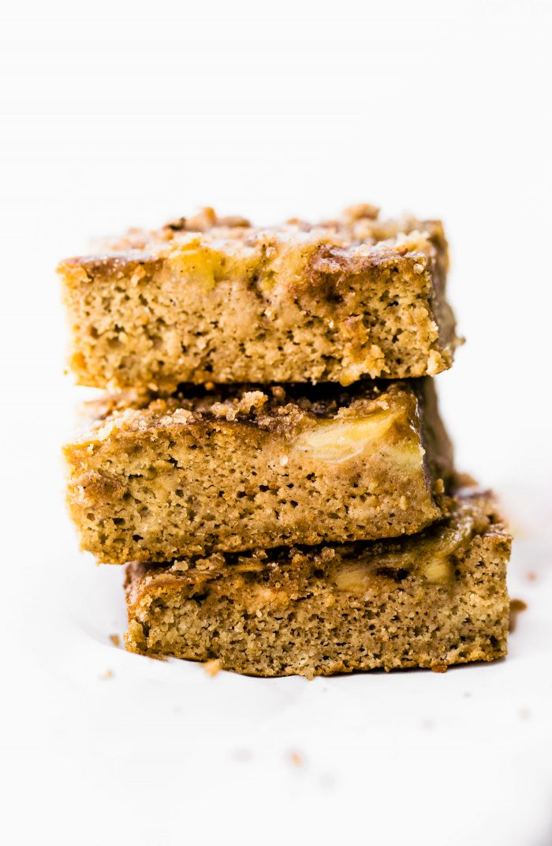
Determining Creditable Foods and Serving Sizes
Food Buying Guide Exhibit A Grains Activity
Practice by entering two grains in tool!
Enter Banana Bread Squares in Tool
Pick any other grain label at your table to enter
Notes:
SAY:
Now it is your turn to practice entering grains in the tool. Enter the Banana Bread Square recipe in your packet from the standardized recipe activity and then pick any other grain label at your table to enter.
DO: Allow 5 minutes to complete and ask for results from entering the Banana Bread Squares.
Note: For a quick bread they should select muffin as grain from the Exhibit A for determining the serving size since the ingredients and products are similar in weight.

Slide 76
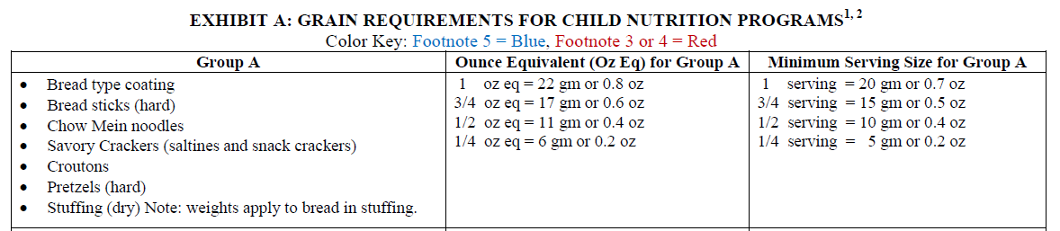
Determining Creditable Foods and Serving Sizes
Factor Method
Required serving size (grams or oz.) ÷ Product serving size (grams or oz.) = Serving Factor
Serving Factor x Product serving quantity = Minimum required product serving size
Notes:
SAY:
If you do not have access to the Interactive Food Buying Guide Exhibit A Tool you can use the factor method to determine the serving size of a creditable grains. Here is a cracker label. Before using a grain product you must first determine if the grain is creditable. A grain must be enriched, fortified or whole grain to be credited to the meal pattern. Under the ingredient list on this cracker label, the first ingredient is enriched flour. This product is enriched and is a creditable grain.
We will now review the factor method. You are welcome to follow along using the Cheez it nutrition label and the Exhibit A grain chart in your packet

Slide 77
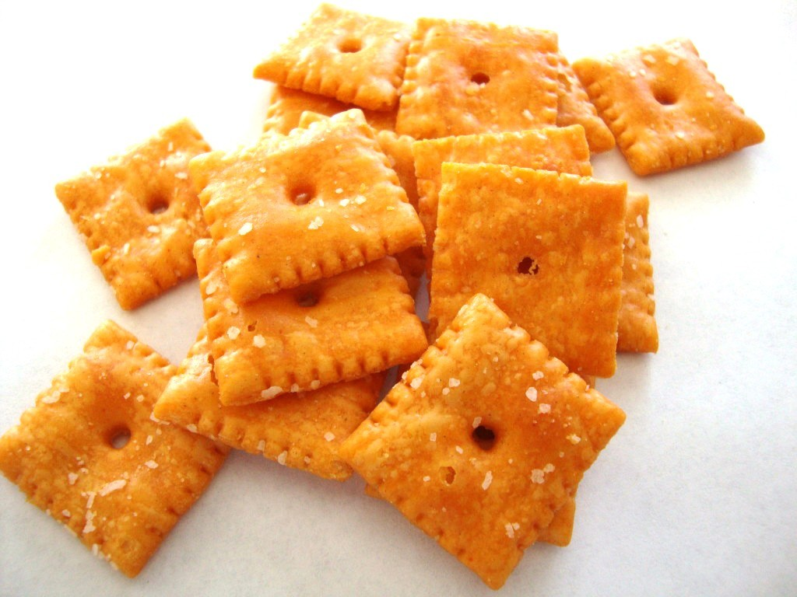
Determining Creditable Foods and Serving Sizes
Factor Method
Example: Cheez it crackers (Savory crackers)
1 serving (current) 20 grams ÷ 30 grams = .667 .667 x 26 crackers =17.342 Always round up = 18 crackers | Ounce Equivalent (October 1, 2019) 22 grams ÷ 30 grams = .733 .733 x 26 crackers = 19.058 Always round up = 20 crackers
Notes:
SAY:
Let’s try the factor method with this grain label. Based on the Nutrition Facts label for Cheez its, a savory cracker, 1 serving is 26 crackers or 30 grams. Using the Exhibit A chart in packet, savory crackers is listed under Group A. In Group A the minimum serving size for 1 serving (current requirement) is 20 grams or .7 oz. and for one ounce is 22 grams or .8 oz. (possible requirement October 1, 2019).
To determine the minimum serving size, divide the Exhibit A required minimum serving size in grams by the product (cracker) serving size in grams. First we will use the current requirement of one serving for children 6 -18, so 20 grams divided by 30 grams equals .667. Use this factor, and multiply it by product quantity which is the number of crackers in a serving from the nutrition facts label (.667 times 26 crackers equals 17.342). When determining serving size always round up, so for this savory cracker 18 crackers meets the minimum serving for children ages 6-12 and 13-18. For children ages 1 – 5 the minimum ½ serving is 9 crackers.
If we do the same method for Ounce Equivalents the new serving size is 20 crackers for children ages 6-12 and 13-18. For children ages 1-5 the minimum ½ ounce serving size is 10 crackers. The difference between serving and ounce equivalents is minimal and the process to determine the serving size remains the same.

Slide 78

Menu Records and Documentation
CACFP Menu Planning and Records| 78
Notes:
SAY:
We will now review the menu records requirements for CACFP This information is also located in the Idaho CACFP manual- Menu Planning and Menu Records Requirements section that is located on the Idaho CNP website.

Slide 79

Menu Records and Documentation
Menu Records –are required to document the CACFP meal pattern 7 CFR 226.20
How daily meals and snacks contribute to each menu component in the meal pattern
That enough food was planned/prepared for each menu component served to meet the minimum serving per age group
Notes:
SAY:
Menu records also referred to as meal pattern menu compliance records or food service records are required to document daily how meals and snacks served contributes to each menu component in the meal pattern. The record provides supporting documentation for each meal and snack claimed for reimbursement and confirms the center or day care home provider planned, prepared and served enough of each menu component to meet the minimum servings per age group.
Sponsoring Organizations and facilities (centers and day care homes) are required to maintain daily dated menus which list the menu items prepared and served to participants for each meal or snack service. Some centers and day care homes choose to serve several meals or snack services throughout the day to participants, but only request approval for a few of them in the site or provider’s application. The Sponsoring Organization and facilities only need to document the meals and snacks that are approved in the Sponsors site or provider application in MyIdahoCNP to meet CACFP menu record requirements.

Slide 80
Menu Records and Documentation
Daily dated Menus
Standardized recipes
Product nutrition fact labels including ingredient lists
CN labels and product formulation statements (PFS)
Food receipts/invoices (centers only)
Monthly food inventory records (centers only)
Notes:
SAY:
Meal pattern menu records must be maintained in written or electronic format and must be made available to SDE or USDA during program reviews with the Sponsoring Organization and during monitoring visits with the center or day care home. The following meal pattern menu compliance records are required:
Daily dated menus;
Standardized recipes;
Product nutrition fact labels including ingredient list;
CN Labels and manufacturer’s Product Formulation Statements (PFS);
Food receipts/invoices must be maintained by centers only and we already reviewed some of the findings with receipts in the budget section of this training.
Monthly food inventory is also for centers only. It is important to maintain a monthly food inventory to determine the cost of food used. This is a requirement per FNS 796-2 revision 4.
Next we will review each record

Slide 81
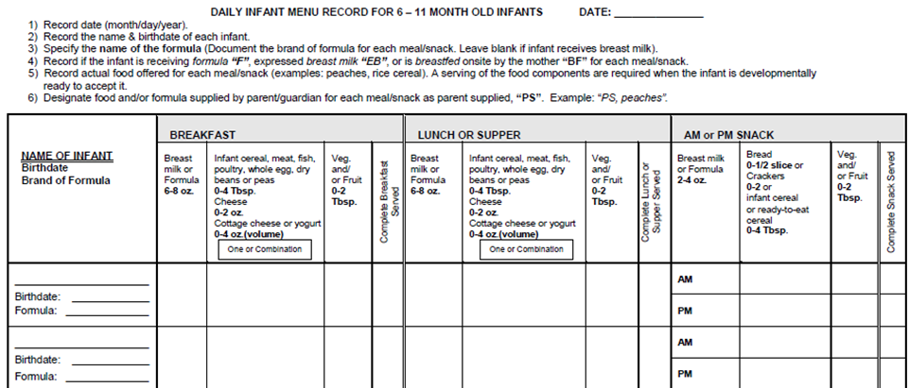
Menu Records and Documentation
Daily Dated Menus
Individual Infant Menu records-required for centers and day care homes
Notes:
SAY:
Let’s review the daily dated menu records for both centers and day care homes. The first is the Individual Infant menu record as seen on this screen. This is the sample state agency form facilities may use and is available in MyIdahoCNP in download forms. It is important infant menu records are maintained for each individual infant since infants eat on demand and consume different food items and formula or receive breast milk.
Infant menus must document the date in month, day and year, the infant’s name and date of birth, the type of meal (breakfast, lunch, supper or snack) offered, required meal components per meal type, minimum portion size per age group, all actual food items offered and served for each meal/snack, brand of formula or expressed breast milk or breast-fed mom, and if food or formula is supplied by the parent/guardian.
For the infant meal or snack to be eligible for reimbursement, the center or day care home must offer at least the minimum serving portion size for each required meal component. If the center or day care home provider offers at least the minimum serving of a required component, the provider is only require to document the actual item offered (i.e. expressed breast milk (EB), Formula, or the actual solid food).

Slide 82
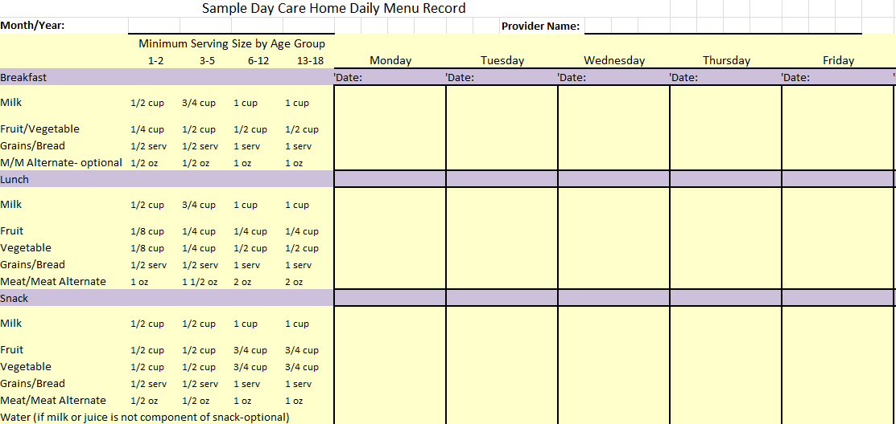
Menu Records and Documentation
Day Care Home Daily Menu Record
Notes:
SAY:
Here is the state agency sample Day Care Home Daily Menu Record and is in your packet and is available in MyIdahoCNP in download forms. The record includes and must document the date by month the day and year, provider’s name, the type of meal (breakfast, lunch, supper, or snack), minimum serving sizes per age group, actual food items served each day, type of milk served each day (whole, 1% or nonfat and if the milk is flavored – nonfat or 1%), if a food items is CP (Commercially Prepared) or HM (Home Made) and which grains are WG (Whole grain rich).
Each item on the menu must be the actual item served, i.e. apple, green beans, cheerios, etc. It is important to denote the meat/meat alternate in a main dish, i.e. beef burrito, chicken fettuccine, etc.

Slide 83
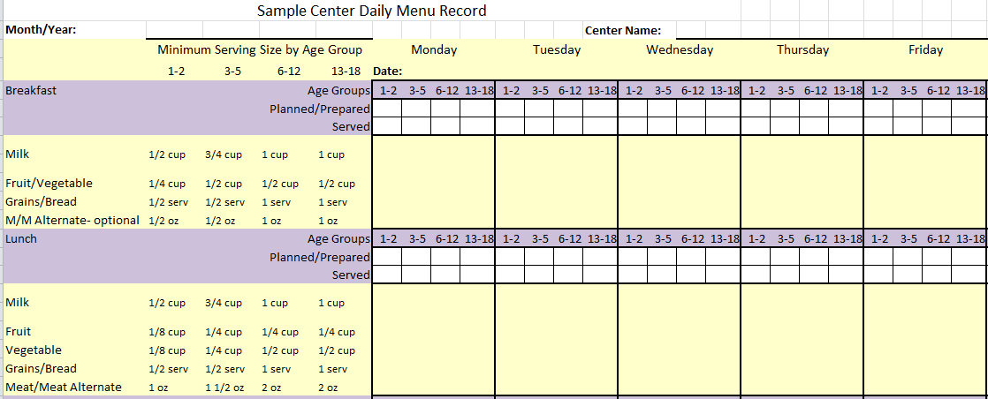
Menu Records and Documentation
Center Daily Detailed Menu Record
Notes:
SAY:
This is the center daily detailed menu record. Centers may also choose to use a daily menu production record in place of the daily detailed menu. A sample of the Center Daily Detailed Menu Record is located in your packet and is available in MyIdahoCNP in download forms. The detailed menu record was developed to streamline the menu record process for centers since the standardized recipes, CN labels, product formulations statements and food labels support how the food items credit to the meal pattern The detailed menu record supports all required meal components were offered by meal type and the center planned and prepared enough servings for the number of meals or snacks served.
The detailed menu records must document the date, month and year the meals were served, the center name, serving sizes by each age group for all required components, actual food items served each day, the type of milk served each day (whole, 1% or nonfat and if the milk is flavored – nonfat or 1%), substitutions made to the planned menu, which food items are CP (Commercially Prepared) or HM (Home Made), the grains that are WG (Whole grain rich), the planned and prepared number of portions per age group, and the served number of portions per age group.
As with the day care home daily dated menu the centers must also record the actual item served i.e. apple, green beans, cheerios, etc. It is important to denote the meat/meat alternate in a main dish, i.e. beef burrito, chicken fettuccine, etc.

Slide 84
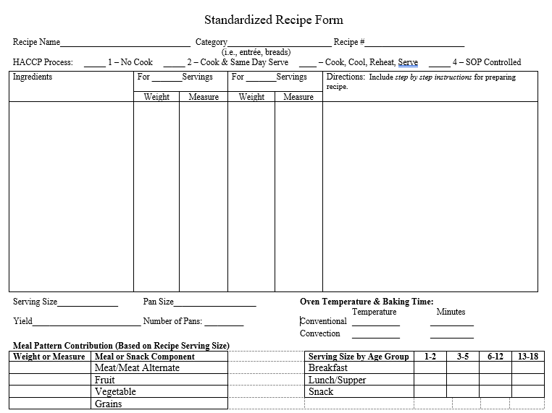
Menu Records and Documentation
Notes:
SAY:
Here is the updated Standardized Recipe form we reviewed earlier today. When serving combination homemade menu items the center or home must have a standardized recipe to credit the components of the recipe to the meal pattern. This form is available in MyIdahoCNP download forms.

Slide 85
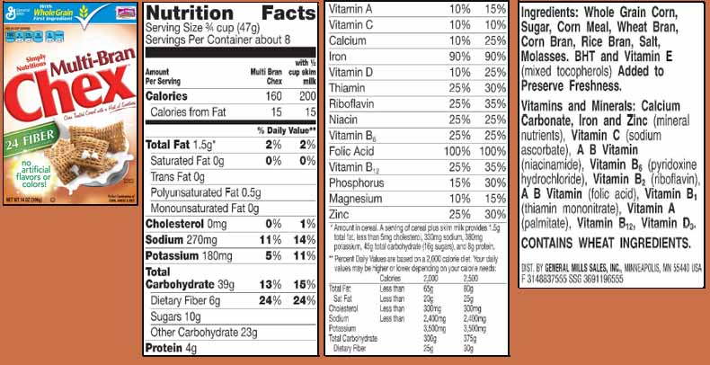
Menu Records and Documentation
Product Nutrition Facts Labels with Ingredient Lists
Labels are used to determine if product is creditable and serving size per age group.
CACFP Menu Planning and Records| 85
Notes:
SAY:
The next menu record is Product Nutrition Facts labels for grains including cereals, yogurt and non-dairy beverages. Product Nutrition Facts labels that include the ingredient lists and product name are necessary for day care homes and centers to determine if the product is a creditable food item and the correct serving size is provided per age group to meet the meal pattern requirements.
The labels support the meals and snacks claimed for reimbursement met the meal pattern requirements and are reviewed by the state agency during program reviews when verifying the claim.
Grain labels are used to determine if the grain is creditable, if it is whole grain-rich, and the serving size per age group; and for cereals, if the cereal meets the sugar limits. In the previous session we reviewed how to use the new Exhibit A Grain Tool in the Interactive Food Buying Guide and the factor method to determine a grains serving size by age group.
Yogurt nutrition facts labels support the yogurt meets the sugar limits and non-dairy beverage labels support the non-dairy beverage meets the nutritional requirements for milk substitutions.

Slide 86
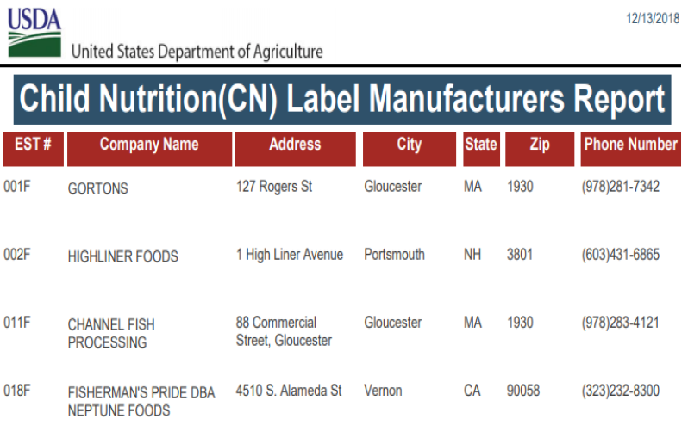
Menu Records and Documentation
CN Labels Verification Report
CACFP Menu Planning and Records| 86
Notes:
SAY:
CN Labels and Product Formulation Statements are the fourth menu record on the list. Either a CN Label or Product Formulation Statement is required for all commercially processed meat/meat alternate or combination food items that are served and counted toward meal pattern components.
This is a CN Label Verification Report that was developed to assist State agency reviewers, CN program operators, and food industry to verify the status of a CN Label and the validity of a CN Label copied with a watermark. It does not replace the requirement to maintain CN labels. Day care homes and centers may maintain the CN Label from the original container, a photo of the label on the container or a watermark copy with attached bill of lading (invoice).
This verification report can be found on the FNS website.

Slide 87
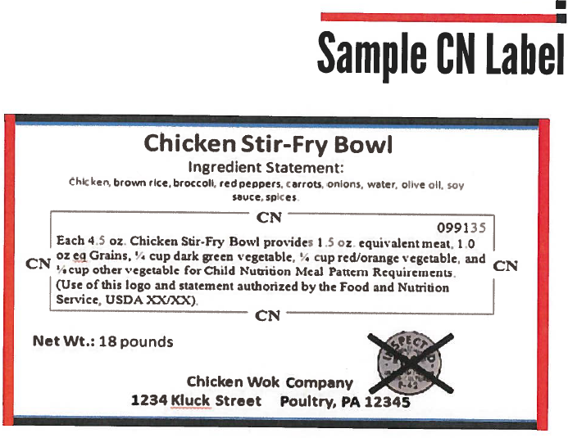
Menu Records and Documentation
Notes:
SAY:
Here is a sample CN label. This label is also in your packet. The Child Nutrition (CN) label product contains the following information:
The CN label which has a distinctive border
The meal pattern contribution statement
A unique 6 digit product identification number (assigned by FNS) appearing in the upper right hand corner of the CN logo.
The USDA/FNS authorization statement
The month and year of the final FNS approval appearing at the end of the authorization statement
And the remaining required label features; product name, inspection legend, ingredients, USDA statement, signature/address line, and net weight.

Slide 88
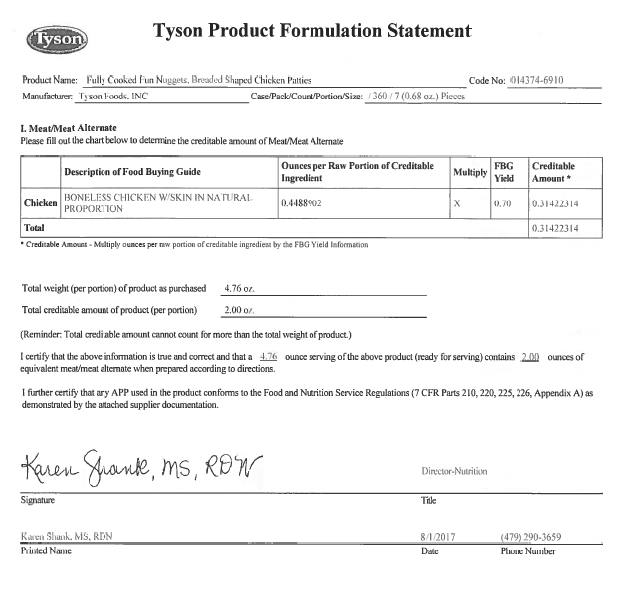
Menu Records and Documentation
Notes:
SAY:
Here is a sample Product Formulation Statement this is also located in your packet. If a commercially processed product was not CN labeled you must obtain a Product Formulation Statement to determine the product meal contribution and the minimum serving size of the product by age group.
Looking at this Product Formulation Statement in your packet let’s review the required components of a statement. As I review the requirements see if you can find each on the statement.

Slide 89
Menu Records and Documentation
Manufacturer Product Formulation Statements
Must be on the manufacturer’s letterhead and include:
  Product name and product code
  A description of all ingredients as listed in the FBG for CNP, i.e. grain products must be specified whole grain or enriched;
  The ingredient weight per serving of each ingredient to be credited;
  The weight of ingredients specified as raw or cooked weight;
  The weight or volume of the product serving size, or the number of pieces per serving;
  Manufacturer’s authorized individual name, signature and telephone number; and
  Detailed breakdown of how the product credits toward each component of the meal
Notes:
SAY:
The product formulation statement for a commercially prepared combination food product must be on the manufacturer’s letterhead and include:
Product name and product code
A description of all ingredients as listed in the Food Buying Guide for Child Nutrition Programs, i.e. grain products must be specified whole grain or enriched;
The ingredient weight per serving of each ingredient to be credited;
The weight of ingredients specified as raw or cooked weight; and
The weight or volume of the product serving size, or the number of pieces per serving.
Manufacturer’s authorized individual name, signature and telephone number
Detailed breakdown of how the product credits toward each component of the meal.
Additional resources for guidance on CN labels and Product Formulation Statements are the Tip Sheet for Accepting Processed Product Documents and the USDA CNP Tips for Evaluating a Manufacturer’s Product Formulation Statement. Both are located in you packet and available in MyIdahoCNP download forms.

Slide 90

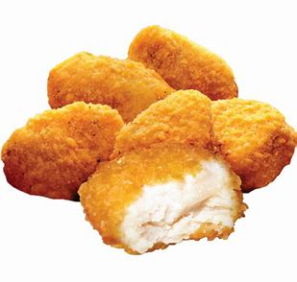
Menu Records and Documentation
CN Label and Product Formulation Statement Activity
Corn dog product sheet
Chicken nuggets product statement and product label
Notes:
SAY:
This activity we will do together. In my one week cycle menu I have a corn dog as a meat/meat alternate for lunch and the corn dog breading as the grain for that meal. In my center I have always purchased a CN labeled corn dog at my local grocery store and maintained a copy of the label for my Menu Planning Book.
When shopping for my new cycle menu I noticed the corn dog I normally purchased change at the store and no longer had a CN label. In fact no other corn dogs at the store had a CN label, so I checked the CN label verification report and noticed the CN label for my corn dog was expired and no longer effective. Since I also purchase food from a vendor when possible I contacted my vendor and he had a CN labeled corn dog! My vendor sent me the corn dog product sheet with the CN label information so I could see the corn dog did credit as 2 oz. meat/meat alternate and 2 ounce grain. Perfect! In addition, from the ingredient list I determined it was whole grain-rich!
Can I use the product sheet to support the meal pattern contribution? (Answer: no, the center needs to either cut the CN label from the box once purchased or take a picture of label on the box for their records.)
Next let’s look at the chicken nugget product formulation statement and product label. Does this documentation support the meal contribution? (Answer: yes)
What is the serving size for children ages 1-2, 3-5 and 6-12? ( Answer: 4, 6, 7 )

Slide 91

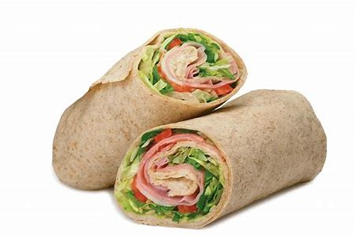
Menu Records and Documentation
CN Label and Product Formulation Statement Activity- Continued
Fish sticks product label
Turkey wrap recipe- Turkey CN label
Notes:
SAY:
Here are two more for this activity. Next is the fish sticks product label. How can I determine the meal contribution for this product? Hint: Check the food buying guide first.
(Answer: the description matches FBG so you can use the FBG to determine the meal pattern contribution)
What is the serving size for children ages 1-2, 3-5 and 6-12? (Answer: 2, 3, 4)
(package serving size is 3 pieces (85 g/3 oz) and package size is 4 lbs. or 64 oz.)
(FBG: 3- 1 oz sticks provides about 1 ½ oz. of cooked fish)
Finally let’s look at the Turkey wrap recipe in your packet. This recipe was standardized using the USDA Foods (commodity product) for the roast turkey. Since most CACFP sponsors do not receive USDA foods a center or home would need to re-standardized this recipe based on the creditable turkey they purchase. Refer to the sliced turkey breast CN label in your packet. What is the serving size of turkey for children ages 1-2, 3-5 and 6-12?
(Answer: (1.5 oz., 2.25 oz., 3 oz.) One turkey wrap would yield 2 oz. meat/meat alternate. Since the slices are .5 ounce each you will need 6 slices (3 oz) for one turkey wrap. With the product change, the minimum serving size by age groups changed. It is now ½ wrap -children ages 1-2, ¾ wrap- children ages 3-5, and 1 wrap- children ages 6-12. If you use the recipe with 4 ½ oz. turkey per wrap the serving sizes by age group could stay the same as the recipe but you need to consider the amount of turkey on each wrap and the cost difference. Note: (4.5 oz. would be 9 slices)

Slide 92

Menu Records and Documentation
Food Receipts and Invoices- Centers only
These are records of cost and quantity of food purchased with any cost reductions or invoice of amount of meals or food use or received
Notes:
SAY:
Sponsoring Organizations and centers must maintain records of the cost and quantity of food purchased, cost reductions, and amount of food used. Required food cost records include: Procurement documents, including bids and contracts, purchase orders, delivery receipts, invoices, canceled checks, itemized cash receipts, purchase records, cost records for transporting, storing, handling and processing that are not included in the purchase price, credits, returns, rebates and inventory records. Food sales receipts and invoices must include the following information:
Name of vendor or supplier
Date of Purchase
Description or name of item purchased- if information is not clear on receipt-center must record on receipt name of food item.
Purchase unit – gallons, case, can
Total number of units purchased
Gross price per unit
Any refund, rebate or discounts taken
Total cost of all items purchased
Sales tax if applicable and Total cost with sales tax if applicable

Slide 93
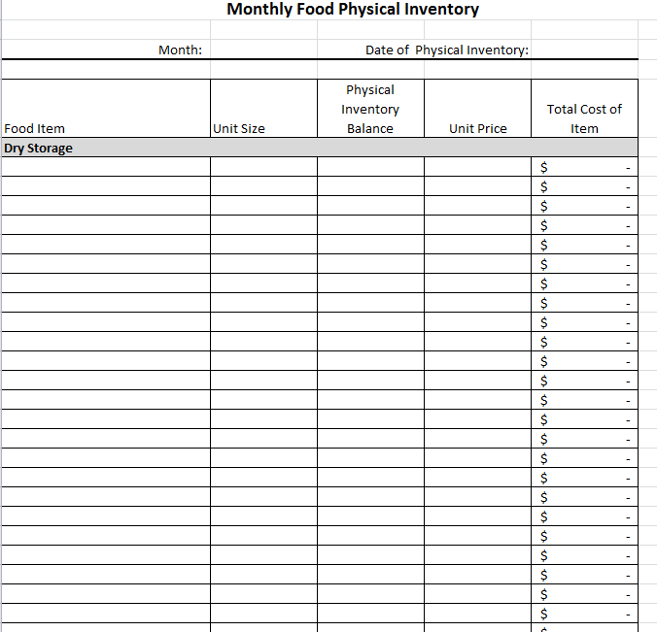
Menu Records and Documentation
Monthly Food Inventory Record
Notes:
SAY:
The monthly food inventory record is a list, with quantities noted, of all food and milk available in the center during the month to prepare the meals and snacks served in the center. The monthly inventory must be derived from either a perpetual or physical inventory system or both. If a center uses a perpetual monthly inventory system, the center must complete a physical inventory at least annually at the end of the program fiscal year (September 30).
A physical or perpetual inventory record must be maintained for each claiming month. Here is a sample monthly physical inventory record form. This record is available to all sponsors in MyIdahoCNP Download Forms.
The monthly inventory records, food receipts and invoices are necessary records for the sponsoring organizations of affiliated centers and Independent centers to determine the cost of food used each month.

Slide 94
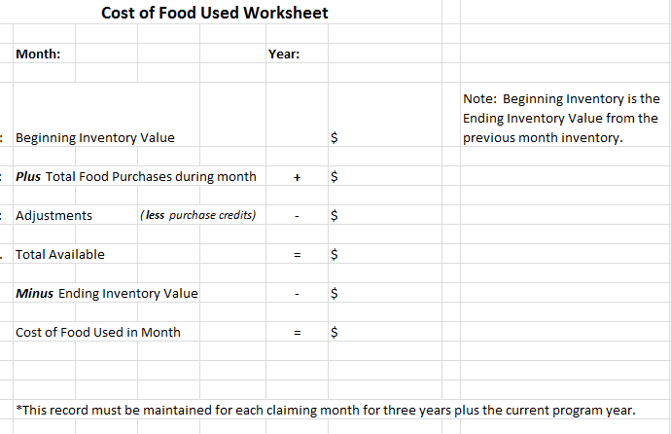
Menu Records and Documentation
Notes:
SAY:
All sponsoring organizations of affiliated centers and Independent centers must compute the cost of food used in the CACFP claim month. The monthly cost of foods record is a required procurement and financial record. For more information on the cost of food used in CACFP, please refer to FNS Instruction796-2, revision 4 and the Procurement Requirement section of the Idaho CACFP manual. Here is the sample Cost of Food Used Worksheet. This worksheet is available in MyIdahoCNP under Download Forms.

Slide 95

Lunch Break
Starting
back
at
1:00 pm
Notes:
SAY:
Lunch Break, let’s start back at 1:00 pm
(or in 1 hour depending on what time it is when presenter reaches this slide)
DO:
At lunch set up any remaining supplies for the afternoon topics except knife skills

Slide 96

Weights and Measures
Notes:
SAY:
Welcome back! Let’s get started with our next training topic “Weights and Measures.

Slide 97
Weights and Measures
Learning Objectives
Identify weights and measures (volume) units and tools
Differentiate between “ounces” and “fluid ounces”
Recognize when to use weight and when to use volume
Know how to do a simple yield study
Notes:
SAY:
Let’s review the learning objectives of todays weights and measures training.
Identify weights and measures (volume) units and tools
Differentiate between “ounces” and “fluid ounces”
Recognize when to use weight and when to use volume
Know how to do a simple yield study

Slide 98


Weights and Measures
Recipes indicate the amount of each ingredient in two ways…. Weight and volume
Notes:
SAY:
Standardized recipes can indicate the amount of each ingredient in two ways; either weight or volume and sometimes both may be provided for some ingredients. For example, a recipe might have the weight and volume listed for flour.

Slide 99



Weights and Measures
Weight
Pound, ounce, gram, kilogram
Volume
Cup, pint, quart, gallon,
fluid ounce, teaspoon, Tablespoon, milliliter, liter
Notes:
SAY:
Just to review, the recipe provides weight or volume by the units. Pounds, grams, ounces or kilograms is weight. This is measured using a scale. Cups, pints, quarts, gallons, fluid ounces or liters is volume. This is measured by filling a container. For example, measuring spoons, cups or pitchers.

Slide 100

Weights and Measures
Which are volume?
Which are weight?
Notes:
SAY:
Let’s look at a recipe– starting with the first ingredient– 8 oz oats– is this weight or volume? (continue through all ingredients)
DO: This slide has animation to identify weights in green and volumes in red. Animation will advance with each click. Ask your class before you click.
(Eggs were ignored because they are measured per item. )

Slide 101


Weights and Measures
Who named these units anyway?
WEIGHT:
Ounce
Oz.
16 oz of beef= 1 pound
VOLUME:
Fluid Ounce
Fl. Oz
8 fl. oz of milk = 1 cup
THIS IS A COMMON AREA OF CONFUSION
Notes:
NOTE TO PRESENTER– SPEND AS MUCH TIME AS YOU NEED ON THIS SLIDE UNTIL THIS POINT IS CLEARLY UNDERSTOOD.
SAY:
We have an unfortunate situation in measuring using the English system, and that the word OUNCES is used in both a volume and a weight measurement.
How do you tell the difference?? For weight it is “ounce” and 16 ounces is 1 pound.
If it says “FLUID ounces” or “fl. oz.” It’s volume, like 8 Fluid ounces of milk is one cup.
DO: Check for understanding, then SAY: What are some suggestions on how to make this clear in your facilities?
For clarity, you can use cups/pints/quarts instead of fluid ounces. For a quick training idea for staff use a light and a heavy substance of similar volume. For example, compare 8 fluid ounces of lettuce verses 8 fluid ounces of milk. Do they weigh exactly 8 weight ounces? Do they weigh the same?

Slide 102
Weights and Measures
Volume: Liquids
Use volume to measure liquid ingredients and other ingredients in amounts less than two ounces (4 tablespoons)
Volume Measures
milliliter
teaspoon
tablespoon
fluid ounce
cup
pint
quart
gallon
Notes:
SAY:
Use volume to measure liquid ingredient and other ingredients in amounts less than two ounces (4 tablespoons). Here are some volume measurements; milliliter, teaspoon, tablespoon, fluid ounce, cup, pint, quart and gallon.

Slide 103

Weights and Measures
Volume Tools
Measuring spoons measure small volumes
Notes:
SAY:
Measuring spoons are used for small volumes. In the US we use teaspoons & tablespoons…. In most of the rest of the world, they use milliliters. For easy conversion, a teaspoon is about 5 milliliters, (4.93, actually) so a Tablespoon is about 15 ml (14.79)

Slide 104

Weights and Measures
Volume Tools
Use flat-topped measuring cups to measure dry ingredients by volume
Notes:
SAY:
Nesting cups are perfect for measuring dry/solid ingredients. The reason they have flat tops is so you can even them out to get an exact measure.

Slide 105

Weights and Measures
Volume Tools
Graduated dry measures have a flat top, but also have visual measures along the sides.
Notes:
SAY:
Graduated dry measures also have flat tops for level even measurements, but they also have visual measures along the sides to accurately measure ingredients. Graduated dry measures come in cups, pints and quarts.
I will demonstrate how to measure dry ingredients. It is important to level off the top.
NOTE TO PRESENTER--EQUIPMENT NEEDED– DRY MEASURE AND SOMETHING TO MEASURE:
DO: Demonstrate proper technique for measuring dry ingredients this for the class. Use measuring cup, straight edge and sugar or flour. If you have time, bring a volunteer up to the front to demonstrate this instead. Spoon into container and level off the top.

Slide 106

Weights and Measures
Volume Tools
Graduated Liquid Measures have a pouring lip instead of a flat top. They can be clear, so you can read them from a flat surface, or ringed, so you look down into the measure to see the liquid level.
Notes:
SAY:
Graduated liquid measures have a pouring lip instead of a flat top. They can be clear, so you can read them from a flat surface, or ringed, so you look down into the measure to see the liquid level. Using color water I will demonstrate filling and how to read the measurement. When reading a clear container, go to eye level and read from the outside of the container. For opaque, visualize level inside the container.
DO: Demonstrate proper technique for liquid measuring by using water (or colored water for more visual clarity) by filling a liquid measure to the line and reading.
NOTE TO PRESENTER --EQUIPMENT --REQUIRES LIQUID MEASURE AND WATER: Demonstrate this with both a clear container and an opaque container. Bring a volunteer up to “eyeball” your volume measure.

Slide 107

Weights and Measures
Volume Tools (serving)
The size of a scoop
indicates the number
of portions per quart
Notes:
SAY:
Scoops are also called dishers. These measure volume, and should be thought of as a measuring cup used for serving. Just like any measuring tool, care needs to be taken to insure an accurate measure. A heaping scoop will be a different volume than a level amount. Using a heaping scoop can reduce the number of servings you can get out of a recipe. so you run out earlier than anticipated. For dishers that are standardized to US measurements, the disher number indicates how many of the scoops are needed to make a quart. The larger the number, the smaller the scoop size.
Scoops are more commonly used on serving lines for cafeteria meal style service or for pre-plate meal style service.
What scoop number of disher/scoop do I need for a ½ cup serving? (Answer: #8 scoop)

Slide 108
Weights and Measures
Volume Tools (serving)
The size of a ladle or spoodle is written as oz.,
but it measures
FLUID OUNCES
Notes:
SAY:
Ladles are also volume measures. They measure fluid ounces even though only “oz” is often marked.
This chart gives fluid ounce to cup size for ladles. Spoodles are a combination of a spoon and a ladle. They allow for more volume control, but with the convenience of a spoon-like utensil. The are usually marked by the volume they hold in fluid ounces.
If I want to give a half cup serving in my spoodle or ladle– which size would I use? (Answer: 4 fluid ounce)

Slide 109

Weights and Measures
Volume Tips
Always measure ingredients in the largest appropriate container.
What is the exception? Why?
Notes:
SAY:
A volume measuring tip is to always measure ingredients in the largest appropriate container. What is the exception to this rule?
DO: Allow the class to provide the answer. Animation: Flour image will come in on click.
SAY:
The exception to this rule is flour – don’t measure volumes larger than 1 quart because flour can easily pack.

Slide 110

Weights and Measures
Weight Tools
Digital Scale: Small sizes
2 oz. meat
Notes:
SAY:
Now let’s review weight tools. How many have a scale like this in their kitchen? Who uses it?
A digital scale is used for small size measures, for example when measuring serving portions like 2 ounces of meat.
DO: NOTE TO PRESENTER– EQUIPMENT NEEDED- SMALL SCALE: Show the digital scale

Slide 111

Weights and Measures
Weight Tools
Traditional Scale: Heavier weights 2 - 50 lbs.
Baking – 2# or more of Whole Wheat Flour
Notes:
SAY:
Traditional scales weighs heavier weights of ingredients that range from 2-50 pounds. For example, when preparing a baked grain that calls for more than a quart of flour you would weigh the flour in the recipe rather than use a volume measurement.
How many have a scale like this in their kitchen? Who uses it?
Please note, this scale actually measures in kilograms. Typically, in the US, you will have one that measures in pounds.

Slide 112
Weights and Measures
Weight: Proper Technique
Weighing product in a container
  Be sure the scale is on zero
  Place the empty container on scale, record weight
  Weigh ingredient in container, record weight
  Subtract weight of empty container from weight of container with ingredient
Notes:
SAY:
When weighing a product that is in a container it is important to remove the weight of the container to determine the weight of the product. Tare weight is the weight of an empty container. SAY and DO: To determine the tare weight of a container, first make sure the pointer or digital scale is on zero, then place the empty container on the platform of the scale. Record the weight of the empty container.
SAY and DO: Next, to determine the weight of an ingredient in a container, place the ingredient in the container and weigh the filled container. Record the weight of the container and ingredient. Finally, subtract the weight of the empty container from the weight of the container with ingredient to obtain the weight of the ingredient only.
Digital scales usually have feature where you can electronically remove the tare weight before weighting the container with ingredient so the weight you receive is without the weight of the container and only the weight of the ingredient. It is important when using this feature to clear the tare weight before using the scale for another product that does not include the same container.

Slide 113
Weights and Measures
Weight Verses Volume
Weighing is faster
Weighing is more accurate
Weighing requires a kitchen scale
Volume uses common tools
In U.S. home recipes, volume is more common
Notes:
SAY:
What is the difference between using weights or measures in cooking?
In recipe and meal preparation weighing is faster, more accurate and required a kitchen scale. Volume uses common kitchen measuring tools and in U.S. home recipes, volume is more common than weight.

Slide 114




Weights and Measures
MEASURE VOLUME
Fruits & Vegetables
including legumes used as M/MA
Nut butters (peanut butter)
Yogurt
Cooked pasta (H)*
Cooked oats/rice (H)*
Ready to eat cereal (I)*
Milk
Notes:
SAY:
When measuring for child care meals, the meal patterns requires weight for meats, cheese, nuts and seeds.
For Grains, we use exhibit A. For most grains it is weight (currently grams and after October 1, 2019 ounces), but for cooked pastas, cooked grains like rice or oats, and ready to eat cereal, we can use volume or weight.
When measuring fruits and vegetables for serving measure in volume. Note: For purchasing, often you will need to convert to weight. The interactive food buying guide is the best source to assist with this conversion. For peanut butter, yogurt, and milk you will also use volume.

Slide 115
Weights and Measures
Weights and Measures Activity
Activities at each station
Follow instruction sheet
Complete recording sheet
Review results
Notes:
SAY:
Let’s practice our weighing and measuring skills. In your packet there is a weights and measures instruction and results recording sheet. This activity involves stations throughout the room. Your worksheet has activities to be done at each station. Each table will be assigned a station and can work together to complete the activities. Everyone will have 4 minutes per station. If a group finishes early, have a different member of the group try it and see if their results are consistent. The six stations are:
Understanding ounces (marshmallow and legumes)
Sugar
Flour
Water
Gold fish crackers and Triscuits
Lettuce
DO: Allow 25 minutes will allow for each group to do each station, with one minute to get back to their spots. Review results ask each table to report on one station and see if any table had any different results or findings.

Slide 116

Weights and Measures
Fractions to Decimal
Notes:
SAY:
We’re going to go over a few charts that are available in your packet. These will be a good resource for your Menu Planning Binder. The first is decimal equivalents of commonly used fractions. This is also located in the Idaho Menu Toolkit with each recipe.
These conversions can quickly be done on a calculator, but if you want to save time, post a chart of common fraction to decimals. If it is something you use frequently, it won’t be long before you have them memorized, as we learned this chart is useful when you have to adjust recipes.

Slide 117

Weights and Measures
Abbreviations & Symbols
Use this chart as a resource to ease written communication and avoid production errors
Notes:
SAY:
One area that can get confused in handwritten recipes is teaspoon and tablespoon. If I was making a batch of oatmeal, and it called for a ½ of a teaspoon of salt, and I used ½ of a tablespoon--- I’m going to have a salty product.

Slide 118

Weights and Measures
Volume Equivalents for Liquids
Notes:
SAY:
This is a very useful chart. It gives volume equivalents for liquids. Notice the second line, that 1 Tablespoon is 3 teaspoons and both of these volume measures equal ½ fluid ounce. This chart is also located in the Idaho Menu Toolkit with each recipe.

Slide 119

Weights and Measures
Weight:
Ounces to Pounds
Notes:
SAY:
This chart deals with weight. If you do a lot of weighing with an old fashioned scale in your baking area, this might be useful to have around, although, most digital scales will convert between oz and pounds with a quick click of a button. A portion of this chart is in the Idaho Menu Toolkit.

Slide 120
Weights and Measures
Volume Summary
FLUID OUNCES are not the same as weight ounces
Units- Teaspoon, Tablespoon, cup, pint, quart, gallon, milliliter, liter
Tools- spoons, liquid & dry measures
Level dry ingredients, view liquid ingredients
Use volume for liquids, fruits, vegetables, small amounts
Notes:
SAY:
To summarize– Today we reviewed that Volume is different than weight, so fluid ounces (volume) are not the same as weight ounces.
The units that refer to volume are teaspoon, tablespoon, cup, pint quart, fluid ounce. In the metric system, you will see milliliters and liters as standard volume measures.
To measure volume, you are seeing how much can fit in a container– so we use standard sized spoons, and cups.
To measure dry ingredients, fill the container and level the top. To measure liquid, fill the container and check to see if it comes to the right line.
Use volume for liquids, fruits, vegetables, and small measures.

Slide 121
Weights and Measures
Weights Summary
Units- Pounds, ounces, grams, kilograms
Tools- Digital scale, Traditional scale
Techniques- Tare and weigh
Use weight for meats, cheeses, nuts, seeds, and most grains
More accurate and faster
Notes:
SAY:
For weights summary, today we reviewed that weights are measured in ounces (NOT FLUID OUNCES), and pound. The metric system uses grams and kilograms.
To measure ingredients in weight, you need a scale– either digital or traditional.
To use a scale, you need to tare it– or balance it– before you use it. If you are using some sort of container, tare the scale with the empty container on it.
Weights are more accurate and faster for most ingredients, but are not helpful in recipes and menus for fruits and vegetables that require volume measures.
Are there any questions before we move on to Special Dietary Accommodations?

Slide 122

Special Dietary Accommodations
Notes:
SAY:
In this session we will be discussing special dietary accommodations. Because the CACFP is a federally funded program, program operators must follow several civil rights requirements. One such requirement is to accommodate participants with special dietary needs because of a disability.

Slide 123
Special Dietary Accommodations
Learning Objectives
Define the term “disabled person”
Review CACFP requirements for providing food substitutions because of disability
Review the Medical Statement Form
Discuss documenting substitutions on menu records
Review requirements for milk substitutions
Discuss how to handle parent preferences
Notes:
SAY:
The learning objectives for this session include:
Defining the term “disabled person,” reviewing the CACFP requirements for providing food substitutions because of disability, reviewing the Medical Statement Form, discussing how to document substitutions on menu records, discussing how to handle parent preferences and reviewing the requirements for milk substitutions.

Slide 124
Special Dietary Accommodations
Definition for Disabled person:
“Any person who has a physical or mental impairment which substantially limits one or more “major life activities”, has a record of such impairment, or is regarded as having such impairment.”
Most physical and mental impairments constitute a disability
Notes:
SAY:
A disabled person is defined as “any person who has a physical or mental impairment which substantially limits one or more “major life activities”, has a record of such impairment, or is regarded as having such impairment.”
The definition of disability is very broad and almost any physical or mental impairment now constitutes a disability. This means that food allergies and food intolerances would now be considered a disability.

Slide 125
Special Dietary Accommodations
Requirements for accommodating special dietary needs because of a disability:
Obtain completed, signed medical statement form
Maintain form
Provide the required food substitution
Document food substitution on menu records
Notes:
SAY:
If a participant has a disability that requires their diet to be modified, program operators must accommodate the special dietary need.
Program operators must obtain a fully completed, signed medical statement form for the participant and keep it on file.
And, program operators must provide the required food substitution and must document the food substitution on menu records.

Slide 126
Special Dietary Accommodations
Medical Statement Form
CACFP operators must make substitutions to meals for participants with a disability that restricts their diet, on a case-by-case basis, and only when supported by a written statement from a state licensed healthcare professional (licensed physician, physician assistant, nurse practitioner, dentist)
Notes:
SAY:
As a program operator, if one of your participants has a disability that restricts their diet, you must make substitutions to meals. This is done on a case by case basis and only when the food substitution is supported by a written statement from a state licensed healthcare professional.
In Idaho, the licensed healthcare professionals are licensed physicians, physician assistants, nurse practitioners and dentists.

Slide 127
Special Dietary Accommodations
Medical Statement Form
Description of the participant’s physical or mental impairment and how it restricts the participant’s diet
Explanation of what must be done to accommodate the disability
If a food allergy, identify food(s) to be omitted and recommending alternatives
Signed by a licensed healthcare professional
Notes:
SAY:
So, what does a medical statement form look like? The medical statement form must include a description of the participant’s physical or mental impairment and state how it restricts the participants diet.
There must be an explanation of what must be done to accommodate the disability.
If the disability is a food allergy, the statement must identify the foods to be omitted and identify alternatives to substitute for the omitted foods.
The medical statement form must be signed by a licensed healthcare professional.

Slide 128
Special Dietary Accommodations
Medical Statement Form
If the medical statement is unclear or lacks enough detail, program operators must obtain clarification to ensure that a proper and safe meal can be provided
Work with the family to obtain the needed information from their healthcare professional
Notes:
SAY:
Each participant’s disability should be handled on a case by case basis so that a safe and proper meal can be provided.
If the medical statement is unclear or lacks enough detail, program operators must work with the participant’s family to obtain the needed information from their healthcare professional.

Slide 129

Special Dietary Accommodations
Idaho Child Nutrition Programs Medical Statement Form Template
Notes:
SAY:
The state agency provides a Medical Statement for program operators to use. Let’s look at the form and review what is included on the statement. The medical statement form starts with places to note the participant’s name and date of birth, the organization’s name, the name of the parent or guardian and the telephone number for the parent or guardian.
Number 7 provides the statement that the participant has a medical condition or is disabled and requires a special meal or accommodation. It provides the definition for “disabled person”, “physical or mental impairment” and “major life activities.”
Number 8 is where the licensed healthcare professional would provide a description of the impairment.
Number 9 is where the diet prescription and/or accommodation would be noted.
If texture modification of food is required, it would be noted in Number 10.
Number 11 is where any foods to be omitted must be listed
Number 12 is where the recommended alternatives for the omitted foods must be listed
Number 13 would be where any adaptive equipment needed would be listed
Number 14 is where the medical authority would sign the form
Number 15, 16 and 17 is for printing the medical authority’s name, their telephone number and the date they sign the form
Number 18, 19 20 and 21 is for the parent or guardian to sign the form, print their name, their telephone number and the date they sign the form.

Slide 130
Special Dietary Accommodations
Medical Statement Form
If program operators develop their own medical statement form template it must contain all of the required information and be approved by the state agency before being implemented
Notes:
SAY:
If you want to develop your own medical statement form, it must contain all of the required information we just covered and it must be approved by the state agency before being implemented.

Slide 131
Special Dietary Accommodations
Doctor’s Notes…may be accepted,
A doctor’s note must include all of the same information found on the medical statement form
If information is missing from the doctor’s note, work with the family to obtain the needed information from their healthcare professional
Notes:
SAY:
A family can provide a doctor’s note and it can be used as the written statement from the licensed healthcare professional – if it includes all of the necessary information. If information is missing from the doctor’s note, work with the family to obtain the needed information from their healthcare professional.
DO: Have participants find the sample doctor’s note in their participant materials and follow along as each section of the doctor’s note is reviewed.

Slide 132
Special Dietary Accommodations
Meals containing substitutions that do not meet the CACFP meal pattern requirements are not eligible for reimbursement unless supported by a medical statement.
Notes:
SAY:
If meals contain substitutions that do not meet the CACFP meal pattern requirements and are not supported by a medical statement, they cannot be claimed for reimbursement.
For example: If a child has an allergy to milk and the program operator provides almond milk, the meal will not be reimbursable unless there is a medical statement form on file for the child.

Slide 133
Special Dietary Accommodations
Operators may choose to accommodate requests related to a disability that are not supported by a medical statement
  IF the requested modifications can be accomplished within the CACFP meal pattern. Such meals are reimbursable.
Notes:
SAY:
If meal substitutions are made to accommodate a disability and the substitutions still meet the meal pattern, then a medical statement form is not required and the meals can be claimed for reimbursement.
For example: If a child has an allergy to strawberries, the program operator can provide a different fruit and the meal will still be reimbursable. The program operator would not need a medical statement form on file for this situation. However, the program operator should still work with the family to obtain written documentation of the special dietary accommodation.

Slide 134
Special Dietary Accommodations
Medical Statement Form/Doctor’s Note Activity
At your table, review the Medical Statement Form or Doctor’s Note and determine whether the form or note contains enough information for you to provide a food substitution.
  If not, what would you do?
Notes:
SAY:
I’ve handed each table either a completed medical statement form or a completed doctor’s note. At your table, read the information and decide whether the form provides enough information for you to confidently provide a food substitution. If not, what would you do?
DO: Hand out the medical statement forms and doctor’s notes. There will be two different medical statement forms and one doctor’s note. For 6 tables, two tables will receive the same document. Have the groups discuss at their table and then report out to the large group.

Slide 135

Special Dietary Accommodations
Case Study #1 - Emily
Notes:
SAY:
For the group(s) that had case study number one, would someone please read the case study.
Was there enough information for you to be able to provide a substitution?
If no, what would you do?

Slide 136

Special Dietary Accommodations
Case Study # 2 - Arthur
Notes:
SAY:
For the group(s) that had case study number two, would someone please read the case study.
Was there enough information for you to be able to provide a substitution?
If no, what would you do?

Slide 137

Special Dietary Accommodations
Case Study #3 - Franklin
Notes:
SAY:
For the group(s) that had case study number three, would someone please read the case study.
Was there enough information for you to be able to provide a substitution?
If no, what would you do?

Slide 138
Special Dietary Accommodations
Document Food Substitutions on Menu Records!
Add in food substitutions on daily detailed menu or daily menu production record; or
Create a separate daily sheet that lists menu substitutions for each child
Notes:
SAY:
In addition to obtaining and maintaining a medical statement for participants with disabilities, the menu substitutions provided must be documented on daily menu records.
The written documentation of the substitution can be written directly on the detailed daily menu or the daily menu production record. The state agency templates for these documents can be modified to add lines for menu substitutions like soy beverages or tree nut allergies.
Program providers can also create a separate daily menu substitution sheet that lists the menu substitutions provided to each child needing accommodation. This may work better for centers or homes who have several children needing special dietary accommodations.

Slide 139

Special Dietary Accommodations
Documenting Food Substitutions – Activity!
Susie has a medical statement form stating that she is to have soy milk. Susie attended your facility on Monday and ate breakfast and lunch and you served her soy milk. How will you document the food substitution?
Notes:
SAY:
This activity will provide you with practice documenting food substitutions on daily menu records. Will someone please read the scenario on the screen?
SAY:
Thank you. In your materials you will see a sample detailed menu for centers, a sample detailed menu for homes and a Daily Menu Substitution Form template. At your table work as a group to determine where on the detailed menu for centers and where on the detailed menu for homes you would record the food substitution.
For the Daily Menu Substitution form template, work as a group to design a template to use to be able to record the daily food substitutions for several children.
DO: Have participants complete the activity and ask for volunteers to share their results.
SAY: Hopefully this activity was helpful and provided you with practical ways to document food substitutions on your daily menu records.

Slide 140

Special Dietary Accommodations
Spotlight on Milk Substitutions
Notes:
SAY:
Now we are going to focus on milk substitutions, as this is a topic that comes up frequently.

Slide 141
Special Dietary Accommodations
Milk Substitutions
Disability – There must be a completed medical statement form, signed by a medical authority that states what the milk substitution should be. The milk substitution does not need to meet the nutritional standards for cow’s milk
Non-disability – There must be a written request and the non-dairy beverage substitution must meet the nutritional standards for cow’s milk
Notes:
SAY:
For children with a disability that requires medical statement form to provide a milk substitute, the milk substitute can be whatever beverage is listed on the medical statement form as the milk substitute. The milk substitution does not need to milk the nutritional standards for cow’s milk.
For example: A signed medical statement states the child is allergic to milk and the milk substitute listed is almond milk. Almond milk can be served to the child and a reimbursable meal can be claimed.
For any other non-disability request for a milk substitution, there must be a written request and the non-dairy beverage substitution must meet the nutritional standards for cow’s milk.
For example: A parent provides a written request that their child not be served cow’s milk, but instead be served soy milk. The soy milk that is served to the child must meet the nutritional standards for cow’s milk.

Slide 142

Special Dietary Accommodations
Nutritional Standards for Cow’s Milk
Notes:
SAY:
The chart on the screen shows what the nutritional standards for cow’s milk are. If the non-dairy beverage being used as a substitute for milk for a non-disability and does not meet these standards, the meal cannot be claimed for reimbursement.

Slide 143

Special Dietary Accommodations
Notes:
SAY:
Recently, the Food and Drug Administration changed the Nutrition Facts label and all of the nutrients are no longer listed on the label and the amounts of nutrients are listed in different ways (like microgram and milligram amounts for vitamins and minerals). Identifying non-dairy beverages that meet the nutritional requirements of milk have become more challenging.
Some non-dairy beverages that previously met the nutritional requirements of milk no longer do so, based on the information provided on the new Nutrition Facts label.
(Instructor’s note – The labels depicted on the slide are not for a non-dairy beverage. It is a fictional product used to show the changes in the Nutrition Facts label design.)

Slide 144

Special Dietary Accommodations
Non-dairy Beverages that still meet the nutritional standards for cow’s milk:
8th Continent Original Soymilk
West Soy Organic Plus Plain
Great Value Original Soymilk
Pearl Organic Smart Original
Notes:
SAY:
There are now four non-dairy beverages that still meet the nutritional standards for cow’s milk:
8th Continent Original Soymilk
West Soy Organic Plus Plain
Great Value Original Soymilk
Pearl Organic Smart Original
USDA is aware of this new challenge and plans to come out with additional guidance. Until then, these four non-dairy beverages still meet the requirements and can be served as a milk substitute.

Slide 145
Special Dietary Accommodations
Parent Requests for Food Preferences
Program operators may choose to accept parent requests for food preferences (religious, moral, general health reasons, etc.); or
Program operators may choose not to accept parent requests for food preferences
Notes:
SAY:
CACFP program operators may accommodate parent requests for food preferences for religious, moral or general health or lifestyle reasons.
Program operators may also choose not to accept parent requests for food preferences.

Slide 146
Special Dietary Accommodations
Parent Requests for Food Preferences
Program operators must have a policy and procedure in place to handle parent requests
All meals containing food substitutions must still meet the CACFP meal pattern in order for the meal to be claimed
Notes:
SAY:
Either way, program operators must have a policy and procedure in place to handle parent requests.
All meals providing food substitutions to handle parent requests must still meet the CACFP meal pattern in order for the meal to be claimed.

Slide 147
Special Dietary Accommodations
Parent Requests for Food Preferences
If food preferences are allowed, they must be allowed for all participants
  Example: If one parent requests that their child not be served pork for religious reasons and you honor that request; then if another parent requests that their child not be served beef for religious reasons, that request must be honored also
Notes:
SAY:
If a program operator chooses to allow parent requests, then requests must be honored for all participants.
For example: If one parent requests that their child not be served pork for religious reasons and you honor that request – then if another parent request that their child not be served beef for religious reasons, that request must be honored also.

Slide 148
Special Dietary Accommodations
Parent Requests for Non-dairy Beverages:
Parents must provide a written request for the non-dairy milk substitution that meets the nutritional standards for cow’s milk
The written request must identify the need that restricts the diet of the child
Non-dairy beverage substitutions are served at the option and the expense of the program operator
Notes:
SAY:
Parents sometimes request that their child be served a non-dairy beverage, like soy milk, instead of cow’s milk. If your facility allows parent preferences, then the parent must provide a written request for the non-dairy milk substitute. The written request must identify the need that restricts the diet of the child.
The non-dairy milk substitute must meet the nutritional standards for cow’s milk and non-dairy beverage substitutions are served at the expense of the program operator.
If a parent wants their child to be served a non-dairy substitute that does not meet the nutritional standards for cow’s milk (like rice or almond milk) and the program operator serves that beverage, the meal cannot be claimed for reimbursement.

Slide 149
Special Dietary Accommodations
Parent Preference Policy – Activity!
Answer the questions below and share with the people at your table:
  What is your facility’s policy for parent preferences?
  Is the policy in writing?
  How do you communicate the policy to your participants?
Notes:
SAY:
All institutions and facilities participating in CACFP need to have a policy on providing parent preferences for dietary substitutions. For this activity, take a minute or two to answer these questions and write them down on the Parent Preference Policy worksheet and then share your answers with the people at your table.
DO: Have participants complete the activity in their small table groups. When done, ask a few participants to share some of their answers.

Slide 150
Special Dietary Accommodations
Resources
FNS Policy Memo: CACFP 14-2017 Modifications to Accommodate Disabilities in the Child and Adult Care Food Program and Summer Food Service Program, June 22, 2017
FNS Policy Memo: CACFP 17-2016 Nutrition Requirements for Fluid Milk and Fluid Milk Substitutions in the Child and Adult Care Food Program, Questions and Answers, July 14, 2016
FNS website: https://www.fns.usda.gov/resources
Notes:
SAY:
There are several resources available concerning special dietary accommodations. The Special Dietary Accommodations Reference sheet lists these resources for your reference.
The two policy memos:
FNS Policy Memo: CACFP 14-2017 Modifications to Accommodate Disabilities in the Child and Adult Care Food Program and Summer Food Service Program, June 22, 2017, and
FNS Policy Memo: CACFP 17-2016 Nutrition Requirements for Fluid Milk and Fluid Milk Substitutions in the Child and Adult Care Food Program, Questions and Answers, July 14, 2016, can be found on the FNS website at: https://www.fns.usda.gov/resources.

Slide 151
Special Dietary Accommodations
Resources (continued)
Idaho Child and Adult Care Food Program (CACFP) Manual, Section 14 Meal Pattern Requirements: https://www.sde.idaho.gov/cnp/cacfp/
Medical Statement Form: https://www.sde.idaho.gov/cnp/resource-center.html
Milk Substitute Nutrition Standards:
MyIdahoCNP download forms (sponsored centers and homes, check with your sponsor)
Notes:
SAY:
There is also information on special dietary accommodations in the Idaho Child and Adult Care Food Program (CACFP) Manual, Section 14 Meal Pattern Requirements: https://www.sde.idaho.gov/cnp/cacfp/
The Medical Statement form can be found on the Child Nutrition Programs website at https://www.sde.idaho.gov/cnp/resource-center.html
and the Milk Substitute Nutrition Standards list of soy beverages that meet the nutritional standards for cow’s milk can be found in Download Forms in MyIdahoCNP. For sponsored homes and centers, you should check with your sponsor, they have access to Download Forms.

Slide 152
Special Dietary Accommodations
Session Wrap Up Activity - Roll the Dice!
Instructions:
  Everybody stand up at your table.
  Each table has a large cube that looks like a die.
  Each person at your table will roll the die and then answer the question that lands face up.
Notes:
SAY:
To wrap up this session, we are going to do a table group activity called “Roll the Dice!” I’m putting a large cube that looks like one of a pair of dice – or a die - on each table. On every side of the die there is a question. Every person at your table must take a turn rolling the die and answering the question that comes up. Answering the questions is a fun way to summarize what you have learned. You have 2-3 minutes to complete the activity.
DO: Provide one die to each table and have each participant roll the dice and answer the question as it pertains to special dietary accommodations.

Slide 153

Meal Service Styles
Notes:
SAY:
In this session you will learn about the meal service styles that can be used in the Child and Adult Care Food Program, with a focus on family style meal service.

Slide 154
Meal Service Styles
Several meal service styles are available for program operators to use in CACFP:
Pre-plate style
Cafeteria style
Family style
Combination style
Notes:
SAY:
Several meal service styles are available for program operators to use in CACFP. This provides program operators with the flexibility to serve foods in ways that work the best for them. The meal service styles are:
Pre-plate style
Cafeteria style
Family style, and
Combination style.
Let’s take a look at each meal service style.

Slide 155
Meal Service Styles
Pre-Plate Style
Adult puts full minimum serving of each food component on a plate and pours the full minimum serving of milk
The plate of food and glass of milk are served to the child at the same time
Notes:
SAY:
What is pre-plate style meal service? This meal service style is where the adult puts the full minimum serving of each food component on a child’s plate and pours the full minimum serving milk into a cup or glass. Then the plate of food and glass of milk are served to the child at the same time.

Slide 156

Meal Service Styles
Cafeteria Style
The food is set up in a serving line and the adult serves the full minimum portion of each meal component, including milk, to each child as they move through the serving line.
Notes:
SAY:
What is cafeteria style meal service? This is where the food is set up in a serving line and an adult serves the full minimum portion of each meal component, including milk, to each child as they move through the serving line.

Slide 157
Meal Service Styles
Family Style
All foods and beverages are placed on the table in child size serving dishes and pitchers
Food items are passed around the table and children serve themselves with the assistance from teacher or provider
Children and adults sit and eat together
Children may take second portions
Notes:
SAY:
What is family style meal service?
This meal service style is where all food are placed in serving bowls on the table. Milk is placed in child-sized pitchers and placed on the table.
The food items are passed around the table and children serve themselves with the assistance of their teacher or provider. Children and adults sit and eat together while enjoying meaningful conversations and if desired, children may take second portions.

Slide 158
Meal Service Styles
Combination Style
Some food components are served family style and some are pre-plated (or poured) by an adult
Combination style is often used as young children are first learning to serve themselves
Notes:
SAY:
What is combination style meal service? This meal service style is where some food components are served family style and some food components are pre-plated (or poured) by an adult. Combination style meal service is often used as young children are first learning to serve themselves.

Slide 159
Meal Service Styles
Activity – Match the Meal Service Style!
Instructions:
Work with the people at your table to complete the “Match the Meal Service Style” activity sheet.
For each meal service characteristic, mark the meal service style(s) where it applies
Notes:
SAY:
To review the meal service styles, work with your table group to complete the Match the Meal Service Style activity sheet. For each of the meal service characteristics listed, mark the meal service style (or styles) where it applies. Take about 2 to 3 minutes to complete the activity.
SAY: Let’s review the answers. DO: Have a volunteer from each table answer one of the characteristics except the tricky bonus.
SAY:
For the tricky bonus characteristic “Foods are available in a buffet line and children serve themselves” – what did you decide for this one?
(If no one responds or correctly provide answer) this does not apply to any of the meal service styles, as this is not a food service style used in the Child and Adult Care Food Program. The answer key to this activity is provided in your participant packet.

Slide 160
Meal Service Styles
Spotlight on:
Family Style Meal Service
Notes:
SAY:
Now we are going to put the focus on Family Style meal service and explore the advantages of using family style meal service and identify and list methods for implementation.

Slide 161
Meal Service Styles
Family Style Meal Service is highly encouraged and is considered best practice for feeding children in childcare settings
Notes:
SAY:
In CACFP, family style meal service is highly recommended and encouraged, as it is considered best practice when feeding young children in a child care setting.

Slide 162

Meal Service Styles
Family Style Meal Service reinforces social skills
Children learn to:
Share
Take turns, and
Say “please” and “thank you”
Notes:
SAY:
There are several advantages for using family style meal service in child care settings. Let’s review some of these advantages.
Family style meal service reinforces social skills in a variety of ways Children learn to:
Share,
Take turns, and
Say “please” and “thank you”

Slide 163
Meal Service Styles
Family Style Meal Service strengthens serving skills
Practice fine motor and gross motor skills
Learn how to serve themselves
Learn how to pour beverages and pass food
Notes:
SAY:
Family style meal service strengthens young children’s serving skills. When children serve themselves, they practice both fine and gross motor skills they also learn how to serve themselves without touching the food with their bare hands and eating off the serving dishes and utensils Additionally, they learn how to pour their own beverages and pass food in serving dishes to others.

Slide 164
Meal Service Styles
Family Style Meal Service gives children control
Take small servings first and additional servings later
Choose to pass on certain foods or not to take a food item
Feel confident that additional servings are available
Notes:
SAY:
Family style meal service gives children control of what they eat. It reassures them that they can take small servings of food first and then take additional servings throughout the meal, if desired. Children may choose to “pass” on certain foods or choose not to take a food item initially but change their minds later. Additionally children shall feel confident that additional servings are available throughout the meal.

Slide 165

Meal Service Styles
Family Style Meal Service
Allows children to try new foods
Model the behaviors of those around them
Pressure free environments are key
Notes:
SAY:
Family style meal service indirectly encourages children to try new foods. More specifically, when young children see others eating a new food, they often model those same behaviors by trying the new food. Additionally, when children do not feed pressured and feel in control of their eating, they are more likely to try new foods.

Slide 166
Meal Service Styles
Family Style Meal Service Benefits for Providers
Sit and enjoy meals and conversations with children
Model appropriate mealtime behaviors
Relaxed and enjoyable mealtime
Notes:
SAY:
Child care providers also benefit from serving meals family style. When all food is available at the start of the meal, you can sit and enjoy meals and conversations with the children. Providers and center teachers can model appropriate mealtime behaviors, and have a more relaxed and enjoyable mealtime. It is important to allow enough time for the meal service for children to eat. Meals should be at least 30-45 minutes and snacks 15-30 minutes.
When planning meal times there should be no more than 2-3 hours between meals and at least one hour to allow hunger to develop.

Slide 167

Meal Service Styles
Family Style Meal Service is Advantageous Activity
Notes:
SAY:
To review the advantages of family style meal service, find the “Family Style Meal Service is Advantageous” worksheet in your packet.
On this worksheet, list some of the advantages of serving meals family style. You have about 5 minutes to complete the activity.
DO: When time is up, ask volunteers to share their responses. Some common responses may be:
Children can choose how much of each food to eat.
Children practice fine motor skills and social skills during mealtimes
Children are more relaxed
Food and beverages are at the table at the start of the meal
Children practice good table manners and pleasant mealtime conversations.

Slide 168

Meal Service Styles
Implementing Family Style Meal Service-
Develop a Plan and Make a Commitment
In a perfect world what would
family style meal service look like?
Notes:
SAY:
Now that we have discussed the advantages of family style meal service, let’s discuss some strategies for implementation. Through the last activity, we learned that there are many advantages of implementing family style meal service in childcare settings. However, the most common mistake when serving meals family style is inconsistency. For example, serving meals family style today and pre-plating meals tomorrow. Therefore, the most beneficial step you can take to implementing the new service is to begin with a plan and make a commitment to serving meals family style in your child care setting.
Let’s take a moment to visualize meal service in a perfect world. In a perfect world, what would family style meal service look like? There are no right or wrong answers
DO: Large group discussion. Encourage participants to respond, as you write their responses on a flip chart. Then, review the responses with the group.
Note: some potential responses may include: All the food is ready at the start of the meal, Everyone sits at the table together, There are serving utensils for all the food, Food is passed from one person to another, Everyone is happy and talking

Slide 169
Meal Service Styles
Family Style Meal Service Plan
When you have a plan:
Everyone is knowledgeable and committed
Parents are supportive
Children understand what to do
Notes:
SAY:
Thorough planning is the most efficient way to implement the new meal service, as you envisioned it in a perfect work. When you have a plan in place and everyone is supportive, family style meal service is more likely to be a success for several reasons:
Everyone is knowledgeable and committed
Parents are supportive because they are aware of the benefits
Children understand what to do at mealtime
To gain more insight in the planning phase, let’s review some strategies for successfully implementing family style meal service.

Slide 170

Meal Service Styles
Family Style Meal Service Checklist
Complete an assessment to gain insight
What are you already doing?
What you may need to do?
Notes:
SAY:
Before any planning can occur, you need to know where to start. Therefore, complete an assessment of your mealtimes, such as the Family style Meal Service Checklist handout that is in your packet. This assessment will provide insight into what you are already doing and what you may need to do to implement the new meal service.
DO: Briefly review the Meal Service Checklist with the participants.

Slide 171
Meal Service Styles
Implementation Plan for Family Style Meal Service
Set a Start Date
Evaluate your current meal service
Inform parents and children
Inform and train all child care staff
Practice passing, pouring and serving with children
Notes:
SAY:
After assessing mealtimes, set a start date. When setting a date, allow a minimum of thirty days before officially transitioning to family style meal service. During this period, make it a festive time because the more involved and excited everyone is, the more likely they will buy in to the new meal service.
This time will allow you to evaluate your current meal service and inform parents and children. Also, if you have staff, this period allows time to inform and train all child care staff, while gradually implementing the new meal service. Additionally, when you work towards a date, it gives you time to introduce the meal service to the children. It also allows time to begin incorporating activities for children to practice passing, pouring, and serving themselves.

Slide 172
Meal Service Styles
Family Style Meal Service Supplies
Child-sized tableware and equipment
Standard kitchen utensils are typically not appropriate
Include other supplies that make mealtimes extra special
  tablecloths or placemats;
  flowers in small vases; and
  brightly colored plates and bowls
Notes:
SAY:
Next, ensure that you have child sized tableware and equipment, such as those listed on the Mealtime Tableware Supplies handout in your packet. Your standard kitchen utensils are typically not appropriate for young children. In addition, include other supplies that make mealtimes extra special, such as tablecloths or placements, flowers in small vases, and brightly colored plates and bowls. Ensuring that you have the right supplies will help children have great experiences during mealtimes.
DO: Show child size dishes as they are described and pass samples around for participants to see.
Serving bowls – 8 ½ inches diameter
Plates – 7 in diameter
Serving lades/scoops – shorter handle
Measuring cups with longer handles (use as serving utensil)
Small plastic tongs
Cups of various sizes – (5-7 oz. cup for 4 oz. serving; 8 oz. cup for 6 oz. serving; 10 oz. cup for 8 oz. serving)
Small pitchers -

Slide 173


Meal Service Styles
Child-sized Tableware and Equipment
Sources:
Online businesses
Dollar stores
Other program operators
Notes:
SAY:
Most regular sized serving dishes, utensils and pitchers are too large for children to handle easily. To find child sized serving equipment, try online stores – in your packet is a list of websites that carry child sized equipment.
You could also try the dollar store for inexpensive measuring cups with longer handles to use as serving scoops for children.
Finally, talk to your colleagues! They are excellent resources to tap into. In fact, let’s do that now.

Slide 174
Meal Service Styles
Activity - What Do Your Peers Know?
Discuss at your table where you have found child size:
  Plates, bowls, eating utensils, serving dishes (bowls, platters)
  serving utensils, and pitchers
Write sources on flipchart
Select a spokesperson to share out to the large group
Notes:
SAY:
Take a few minutes and talk at your table and share where you have found some of the equipment needed to implement family style meal service. Have one person take notes on the flip chart. You have three minutes for this activity. When done, each table will report their results.
DO: Have participants work at their tables and list out sources for child sized equipment on the flipchart. After 3 minutes, have each table report their results to the class.

Slide 175
Meal Service Styles
Introduce Family Style Meal Service to Parents
Host parent meeting to present new meal service
Provide parents with written information
Display a table with tableware
Notes:
SAY:
There are many ways to introduce the new meal service to parents. You could host a parent meeting to present the new meal service and explain the benefits of family style meal service. Provide parents with written materials that supports why you are choosing to incorporate family style meal service in your childcare setting, For example, the Sample Parent Letter in your packet. Another idea is to display a table with tableware to show parents what to expect during mealtimes.

Slide 176
Meal Service Styles
Activity --
Ways to Introduce Family Style Meal Service to Parents
Discuss at your table additional ways you can inform parents about Family Style Meal Service
List on flip chart
Select spokesperson to share out to large group
Notes:
SAY:
In your table group, discuss some additional ways you can inform parents about family style meal service and list them on the flip chart. You have 5 minutes to discuss and record. When finished each table will share their responses.
DO: Allow 5 minutes for the discussion and then ask each table group to share their responses.
Note: Some possible responses:
Information about family style meal service in the monthly newsletter
Creating a nutrition education display by showcasing pictures and basic information about family style meal service
Invite parents to participate in a meal where family style meal service is implemented

Slide 177
Meal Service Styles
Introduce Family Style Meal Service to the Children
Children need to know what to expect
Incorporate activities that promote skill development
Begin with snacks and then advance to meals
Notes:
SAY:
It is important to Introduce the new meal service to children. They will need to know what to expect during mealtimes, and they will need time to adjust to the change.
Begin early in the 30 day planning phase, incorporating activities that promote skill development, such as pouring water into cups or scooping dried beans during small group activities. Add play cups, bowls, and other eating utensils to play areas for children to enjoy during free play. This method will help them learn, through play how to handle tableware. Additionally, you may find it beneficial to begin allowing children to serve themselves at snack times and then advance to meals throughout the 30 day period.

Slide 178

Meal Service Styles
Expect Spills
Avoid reprimanding or criticizing children for spills
During an accident, determine if it poses any danger
Quickly clean up spills that are hazards
Notes:
SAY:
At this age, children are learning new skills, and it takes time for them to master each skill. Therefore, create a supportive mealtime environment, where children are not reprimanded or criticized for spills.
When accidents occur, aim to minimize distractions by determining if it poses any danger. Disregard any spills that do not pose a threat to you or the children in your care; however, if it is a hazard to anyone, quickly clean up the spill, wash hands, and return to the meal.

Slide 179

Meal Service Styles
Appropriate serving sizes
Use measured hard plastic serving spoons or ladles
Allow seconds...children will likely choose single serving
Notes:
SAY:
When first introduced to family style meal service, some children may find it difficult to determine how much food to take. However, using measured hard plastic serving spoons or ladles can help control the portion size a child takes. In addition, when children know that they are allowed to have seconds, they are more likely to choose the single serving size.
Now that we have review some strategies for implementing family style meal service, let’s review the skills children will need to master family style meal service

Slide 180
Meal Service Styles
Skills to Master Family Style Meal Service
Passing and handling
Serving utensils
Pouring
Notes:
SAY:
Young children need time to develop necessary skills for serving themselves. However, with practice and support, they can develop the necessary skills at a faster rate. First, children will need to learn the skill of passing, handling and balancing serving bowls and pitchers. Passing and handling tends to be the most challenging because children can spill food on themselves, their neighbor, or on the floor. To reduce spills and increase children’s ability to handle tableware, place small amounts in serving bowls and pitchers and add more as the children increase their skill levels. As children master this skill, add more food to the bowls. This method will help children gradually learn the skill of handling and passing.
Secondly, children will need to learn the skill of using serving utensils to serve themselves. To master this skill, children need to learn the difference between serving and eating utensils. One way to teach this is to ensure there is a definite and obvious difference in the size and feel of the utensils. Then explain to children the differences and model using the appropriate utensil for serving and eating.
Finally, children will need to learn the skill of pouring. Allow children to practice pouring using child sized pitchers with lids and pouring spouts. For example, a sandbox is a great place to practice pouring; another idea is to use child sized cups to pour water into cups. Being creative with teaching each new skill will help children make the transition to pouring, passing, serving and handling foods and beverages themselves, during mealtimes.

Slide 181
Meal Service Styles
Family Style Meal Service - Before mealtime
Know which food components are required
Make sure the full required serving is available
Follow the mealtime schedule and routine
Properly wash hands
Supervise children
Allow children to help set the table
Place all foods on the table
Notes:
SAY:
During this time, become familiar with the family style meal service process. Let’s explore some common tasks for mealtimes. Before mealtime begins providers and child care center staff will need to know which food components are required for each meal or snack served. They will also need to make sure there is a full serving of all meal components in the serving bowls and pitchers for all children and adults.
It is important the day care home and center follow the mealtime schedule and transition process into mealtimes. In the transition process from other child care activities to meal time, children and adults will need to properly wash their hands. With adult supervision, it is a best practice to allow children to set the table.
And finally, the provider or center staff must place all foods on the table before or as the children are ready to sit down and eat.

Slide 182
Meal Service Styles
Family Style Meal Service - During Mealtime
Ensure children are offered each food
Help children with serving (as needed)
Sit at the table and eat with the children
Do not force children to eat
Offer food a second time
Allow additional servings
Notes:
SAY:
During mealtimes providers or center staff must offer each menu item to each child and help children with serving themselves as need. The provider and center staff shall sit at the table and eat with the children and should never force children to eat any food or to eat more food than they want.
After each food item has been passed around the table offer the food a second time to children who either did not want any or took only a very small portion of the food(s). At the same time allow additional servings to children who request for more.
It is important to make mealtime a happy time by making positive comments and happy facial expressions, such as smiles
Talk about foods, practice good table manners, handle food safely and during the entire meal time properly supervise the children.

Slide 183

Meal Service Styles
Family Style Meal Service- After Mealtime
Help children to clear the table
Properly wash hands
Transition to next activity
Notes:
SAY:
At the end of mealtime the provider and center staff shall help children to clear the table and the providers shall properly wash hands and assist children in washing their hands before transitioning to the next activity. During this process the providers must properly supervise the children.
This information can be found on the Family Style Meal Service Process handout in your packet.

Slide 184
Meal Service Styles
Activity – Mastering Skills
In your table group, work together to complete the Mastering Skills worksheet
Share your responses with the large group
Notes:
SAY:
As we just discussed, there are several skills young children need to learn to serve themselves. On your Mastering Skills worksheet, identify some creative ways to teach children how to pass, pour, handle tableware, and serve themselves during mealtimes. Activities may be structured or unstructured and lead by adults or children. List the activities in the appropriate space. Note: There are no right or wrong answers; however responses should reflect positive and supportive activities that allow all children to participate, such as those listed below:
Passing and handling: During a small group activity, fill bowls with craft supplies. With a group of two to three children, pass each bowl around the group and encourage each child to take an item. Build on this activity, by incorporating items that resemble food and allow children to scoop items from the bowl.
Pouring: During outdoor play, have small cups and child sized pitchers for children to practice pouring their beverages.
During center play, place cups in the sandbox and encourage children to pour sand into the cups
Serving: During center play, have play plates, food, utensils, and serving bowls. Model for the children by playing “mealtime” during center play in the play area.

Slide 185
Meal Service Styles
Meals Service Styles -Recap
Meal service styles
Advantages of using family style meal service
Methods for implementing family style meal service
Notes:
SAY:
During this session, we reviewed the four meal service styles used in the Child and Adult Care Food Program. We also discussed the advantages of using family style meal service. Additionally, we talked about some methods and strategies form implementation. Lastly, we discussed the skills young children need to master family style meal service. Following these practices can help you successfully implement family style meal service in your child care setting.
Now please take out the “Excellence in Three” handout from your packet.
SAY: In the space provided, write three things you learned in this session. Then, write three ways you can apply the information in your child care setting.
Allow participants about 5 minutes to complete the activity and then ask volunteers to share one of their three things.

Slide 186
Afternoon Break
10 Minute Afternoon Break
Notes:
SAY:
Let’s take a 10 minute break before starting the last topic Knife Skills.
DO:
Set up cutting mats, knifes, fruits and vegetables at each table for knife skills activities.
Have cleaning supplies ready for during and end of class:
Trash cans and bags, tubs or buckets of water, dish rags or cleaning wipes, and cleaning agent.

Slide 187

Knife Skills
Notes:
SAY:
Our final topic for today is Knife Skills. Each of you shall have a knife skills handout, chef’s knife in a sleeve, cutting board and slip free mat or wet towel, melon, carrots, onions, celery, and spinach or basil.
Please note in this class we are using floppy cutting boards but they are not recommended in any kitchen. The knifes put deep grooves in them which could house bacterial growth.
The purpose for offering this topic is to decrease accidents in the kitchen, improve efficiency when preparing meals, and to increase the offering of fresh fruits and vegetables.

Slide 188
Knife Skills
Learning Objectives
Knife safety
Knife maintenance
Proper use of a knife
Basic cuts of fruits and vegetables
Why knife skills are important
Notes:
SAY:
At the end of the class each of you will have obtained knowledge in:
Knife safety
Knife maintenance
Proper use of a knife
Basic cuts of fruits and vegetables and
Why knife skills are important in the kitchen
It is important to understand that it takes time to develop good knife skills. Chefs who go to culinary school take one whole week of cutting and chopping to learn basic knife skills. Therefore, it is recommended that you diligently continue your knife skills practice after this class. It is recommend to practice until you feel comfortable holding your knife properly and with your cutting and chopping abilities. To obtain more practice using your knifes take the time after this course to cut up a five pound bag of onions and carrots, five cantaloupes or other melon, three bunches of celery and many different kinds of herbs.

Slide 189

Knife Skills
Safety First
Always use a sharp knife
Never leave your knife unattended
Never put your knife in a sink
Always use proper technique
Notes:
SAY:
When using knifes think safety first. It is important to always use a sharp knife. Dull knives are the number one cause of accidents in the kitchen. You can determine if your knife is sharp if it easily glides through a tomato.
It is important to know where your knife is at all times to avoid accidents.
Putting a knife in a sink with soapy or clear water is dangerous because someone could put their hand in the sink and not know that it is there. It is not a good idea to put it in a rinse or sanitizing sink because they often fill up with dishes and it can be hard to see the knife.
When using a knife you should stay focused on what you are doing, keeping you eyes and attention on your knife when it is in your hands and ensuring you are using the proper techniques.

Slide 190


Knife Skills
Proper technique when using a knife
No Yes
Notes:
SAY:
The above technique photos are on your knife skills handout. Let me demonstrate, when using your knife it is important you do not put your extra hand on top of the knife to push down into the food. Doing this could cause it to roll over and severely cut into your hands. To properly cut through tough foods like carrots and potatoes you should use the heel of your knife or use your strength to make the cuts. When cutting, hold the food securely on both sides making a bridge between your pointer finger and thumb. Slide your knife under the bridge to cut the food in half. Placing the flat surface of each half on the cutting board, hold the food down with your palm or fingers, pointing your fingers up to keep out of the way of the knife blade (as seen on the tomato photo). The blade of the knife should never be facing their fingers, hands, or arms. Begin slicing and dicing.
DO:
Using your potato and tomato, show how to properly use their knives. Show them that they do not want to put their extra hand (the one that is not gripping their knife) on top of the knife to push it down into foods, as seen in the “No” photo of their handout. Then, turn the “No” technique into a “Yes” by showing them the proper technique.

Slide 191

Knife Skills
Maintaining Your Knife
Washing- Use mild dish soap and wash by hand
Maintenance- Use a steel every time you use your knife
Notes:
SAY:
To maintain your knife it is important to use mild dish soap and wash by hand. Harsh dish detergents and heat can change the chemistry of the metal of your knife. Change of chemistry to your knife may cause rust and other deteriorating elements to occur. Be sure to wash between the metal and handle to keep food build up from occurring.
The steel is not a sharpener. It is used to maintain the sharpness of their knives by removing any burrs that occur on the knife and prevents dullness to occur. Each time you use your knife you should use your steel. The proper way to use a steel is to place the tip of the steel on the table. Hold your knife’s blade to the steel at a 20 degree angle, starting at the knifes heel, slide the blade along the steel through to the tip. Repeat 5-10 times. To avoid risk of injuries, you should not hold the steep with the end facing towards the ceiling and the knife facing their hands and wrists. Let’s practice, please stand up and push your chairs away from the table.
DO:
Show how to properly use a steel by placing your knife in one hand and the steel in the other. Pass around and have each one take a turn using the steel. Encourage them to listen to be sure they are doing it correctly.

Slide 192


Knife Skills
Sharpening- Manual sharpener or electric?
Notes:
SAY:
If you are not comfortable sharpening your knife, find a company who will do it for you. The best way to sharpen your knife is with a coarse, medium or fine sharpener. Electric sharpeners tend to wear down the metal on your knives and are not recommended. You can purchase a good knife for $8-$10. If you are not worried about replacing knives, using an electric sharpener may be good. If you have a tight budget using a steel and appropriate knife sharpener is recommended.

Slide 193
Knife Skills
Setting up your cutting mat or board
Notes:
SAY and DO:
To set up your cutting mat or board, place the slip resistant mat at the edge of your table. Next line the mat at the edge of your table on top of the mat and place your knife on the mat with the blade facing away from you. A slip resistant mat is required for good knife skills.

Slide 194


Knife Skills
How to hold your knife
Notes:
SAY:
We will know go through the steps on how to hold your knife. First grip the blade with your thumb and index finger. This is how you control movement of your knife.
Wrap your remaining fingers around the handle with your middle finger opposite of the bolster. As you can see from the picture this is where the blade starts going into the handle.
Use a gliding motion with the tip of your knife starting at the mat first. Guide away from your body. Usually start tough cuts with the heel of the knife. This is the last few inches of the knife near the bolster. Is the proper way of holding their knife is uncomfortable? Holding your knife this way can be very uncomfortable. Especially if you are not used to it, but it is the proper technique. It is important that everyone holds their knife properly and keep focused when cutting the foods today.
DO:
Demonstrate how to hold the knife and the gliding movement of cutting on the mat. Use a carrot and show how to cut a tough vegetable with the heel of the knife.

Slide 195

Knife Skills
Basic Cuts- Large Dice (¾” x ¾” x ¾”)
Notes:
SAY:
The first cut I will demonstrate with the cantaloupe is the large dice cut. (¾” x ¾” x ¾”)
SAY and DO:
Here are the steps to cutting a melon and doing the large dice cut.
Create your flat surface by cutting the bottom of the cantaloupe off.
Hold securely.
Peel by placing the flat surface down on the cutting board. Cut off the rind without getting too much waste of cantaloupe, the best that you can.
When cutting the knife’s blade never goes toward you.
Slice the melon in half, use a spoon to clean out the center and cut each half into wedges.
Turn wedges onto their flat surface. Don’t try to balance the rounded edges of the fruit, place the flat surface on the cutting board and then slice.
Cut the wedges into large dice.
DO: Leave melon cuts out for participants to look at.

Slide 196

Knife Skills
Basic Cuts- Medium Dice (½” x ½” x ½”)
Notes:
SAY:
The next cut is the medium dice (½” x ½” x ½”). I will demonstrate with a carrot. As mentioned earlier some carrots are tough so putting the tip of the knife to the cutting board will provide security to push down into tough foods. If you are going to cut coins out of the carrots, using the heel of their knife is best.
SAY and DO:
Cut carrots about 3” in length.
Create a flat surface in each carrot 3” piece by holding the carrot on both sides and sliding your knife between your thumb and pointer finger to cut it in half. Remember to not put your hand on the top of your knife.
Put the carrot halves on the cutting board with the flat sides down. With the tip of your knife to the cutting board and your other hand securely holding one of the other halves, glide your knife to cut 2-3 strips out of each carrot half.
Line carrot strips evenly and cut large dices out of the strips.
DO: Leave cut carrots out for participants to look at.

Slide 197

Knife Skills
Basic Cuts- Small Dice (¼” x ¼” x ¼“)
Notes:
SAY and DO:
With the onion we will practice the small dice. (¼” x ¼” x ¼“)
Cut off the stem part of the onion bulb, not the root. Cutting onion down the center, through the root side, helps to better peel the onion.
Peel, leaving the root attached to each onion half. Place onion halves flat side down.
Place palm or fingers down flat on top of the onion to hold it securely to the board, as shown on the tomato in the “Safety First” section.
Make horizontal slices through the onion, towards the root, but not all the way through.
Then, make slices on the top of the onion, back to front, and holding on the outer sides in the back of the onion. Do not cut all the way through to the root.
Slice vertically, making small dices with your fingers curled on the top of the onion and your thumb on the root end. Your curled fingers may guide your knife.
Dice up the end of the onion that is attached to the root.
DO: Leave cut onion out for participants to look at.

Slide 198

Knife Skills
Basic Cuts- Julienne: (1/8” x 1/8”x 1/8”)
Notes:
SAY:
The julienne cut is a good time to practice maneuvering and controlling your knife.
SAY and DO:
Use the tip of the knife to cut narrow and even strips. Make the strips as uniform as possible. The key is to go very slow.
You can also make very small dices from their julienned strips, if you wish.
DO:
Leave the cut celery out for participants to look at.

Slide 199

Knife Skills
Basic Cuts- Chiffonade (fine shreds)
Notes:
SAY:
When cutting leaves and herbs it is very important to use a gliding technique.
SAY and DO:
Stack 5 leaves on top of each other.
Roll them up.
Place the tip of your knife on the board and glide though to make strips of ribbons.
DO: Leave the leaves out for participants to look at.

Slide 200

Knife Skills
Practice your
knife skills
Notes:
SAY:
Now it is time for you to practice each cut. When practicing focus on the proper technique of holding and using your knife. Try not to focus on speed. Speed will come with practice, as your skills develop. Don’t worry if the cuts are not exactly the correct size or the cuts do not look perfect. Consistent cuts will come with practice as well.
To prevent slips and cuts, make sure your cutting board or mat stays dry and clean between cuts.
DO:
Walk around the classroom to assist with their knife skills. The important things to constantly do:
Watch if participants are holding their knives properly. Ask the whole class every 10 minutes.
Make sure they are not putting their extra hand on the knife to push it into the foods.
Watch to make sure they do not have their blades facing their body.
Make sure everyone is fully engaged at what they are doing.
Once everyone has finished practicing clean up the work areas and through away all cut foods.

Slide 201
Questions?
Kim Huntley | Child and Adult Food Care Program
Child Nutrition Programs, Idaho State Department of Education
650 W State Street, Boise, ID 83702
208 332 6935
khuntley@sde.Idaho.gov
www.sde.idaho.gov/cnp/cacfp
Notes:
SAY:
We have now come to the end of the Menu Planning and Records training. To recap we have reviewed menu planning principles, steps for creating and using cycle menus, components of a standardized recipe and steps to standardize a recipe.
We used the interactive food buying guide and tools to determining creditable foods and serving sizes. We reviewed menu records, how to document your meals and snacks served, used kitchen math to adjust a standardized recipes yield and reviewed weights and measures.
We reviewed the requirements for special dietary accommodations.
We reviewed the meal service styles, including family style meal service and wrapped up with practicing our knife skills.
Are there any questions?
DO: Pass out the evaluations, make sure everyone signed the attendance sheets and thank them for coming to the training. Collect the evaluations.

Slide 202
Nondiscrimination Statement
In accordance with Federal civil rights law and U.S. Department of Agriculture (USDA) civil rights regulations and policies, the USDA, its Agencies, offices, and employees, and institutions participating in or administering USDA programs are prohibited from discriminating based on race,
color, national origin, sex, disability, age, or reprisal or retaliation for prior civil rights activity in any program or activity conducted or funded by USDA.
Persons with disabilities who require alternative means of communication for program information (e.g. Braille, large print, audiotape, American Sign Language, etc.), should contact the Agency (State or local) where they applied for benefits. Individuals who are deaf, hard of hearing or have speech disabilities may contact USDA through the Federal Relay Service at (800) 877-8339. Additionally, program information may be made available in languages other than English.
To file a program complaint of discrimination, complete the USDA Program Discrimination Complaint Form, (AD-3027) found online at: http://www.ascr.usda.gov/complaint_filing_cust.html, and at any USDA office, or write a letter addressed to USDA and provide in the letter all of the information requested in the form. To request a copy of the complaint form, call (866) 632-9992. Submit your completed form or letter to USDA by:
(1) mail: U.S. Department of Agriculture
Office of the Assistant Secretary for Civil Rights
1400 Independence Avenue, SW
Washington, D.C. 20250-9410;
(2) fax: (202) 690-7442; or
(3) email: program.intake@usda.gov.
This institution is an equal opportunity provider

