Slide 1
Mealtimes with Toddlers
Child Nutrition & Wellness
To receive the slide handout for this class:
Email: Sarah Bruschi at sbruschi@ksde.org
Subject: Mealtimes with Toddlers
Notes:
Welcome to the Mealtimes with Toddlers training.

Slide 2
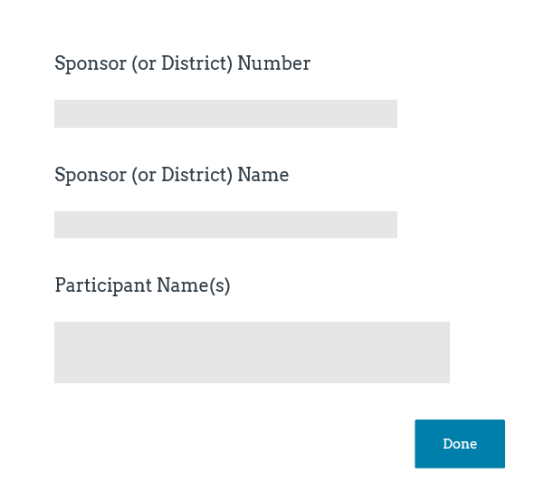
Class Logistics
Class ending time
Participant materials
Recorded class
Mute and unmute features
Q&A protocol
Attendance
Notes:
Inform participants this is a two hour class and will end by (insert time that is two hours from planned start time).
Explain that the Slide File is available upon request as an email attachment. Add contact information to chat box by copying and pasting from title slide.
Let participants know that the class will be recorded, if applicable. (record class to the Cloud).
Inform participants that they can mute and unmute their audio. When in “unmute” mode, their conversations and background noise can be heard.
Encourage participants to ask questions and provide comment as appropriate to the class content. Explain that participants may ask questions or provide input by unmuting their audio or typing in the chat box.
Attendance will be taken at the end of class via a Survey Monkey survey. It is important to complete the Attendance Survey in order to receive a Certificate of Completion for the class. The Attendance Survey will ask for three pieces of information, Sponsor Number, Sponsor Name, and Names of Attendees. For example, Sponsor Number for a public school is the USD designation. Sponsor Name for a public school is the name of the school district. As an added note regarding the Attendance Survey, multiple attendees from one Sponsor can be included in a single Attendance Survey.

Slide 3
Objectives
Identify and review toddler developmental milestones.
Discuss ways to prepare and serve toddler friendly meals.
Review strategies and tips on how to encourage toddlers to try new foods.
Review provider responsibilities prior to and during meal times.
Notes:
By the end of this training, participants will be able to identify ways to create a positive and supportive mealtime environment that will help toddlers develop skills that they will use for a lifetime. This training will: read slide…

Slide 4
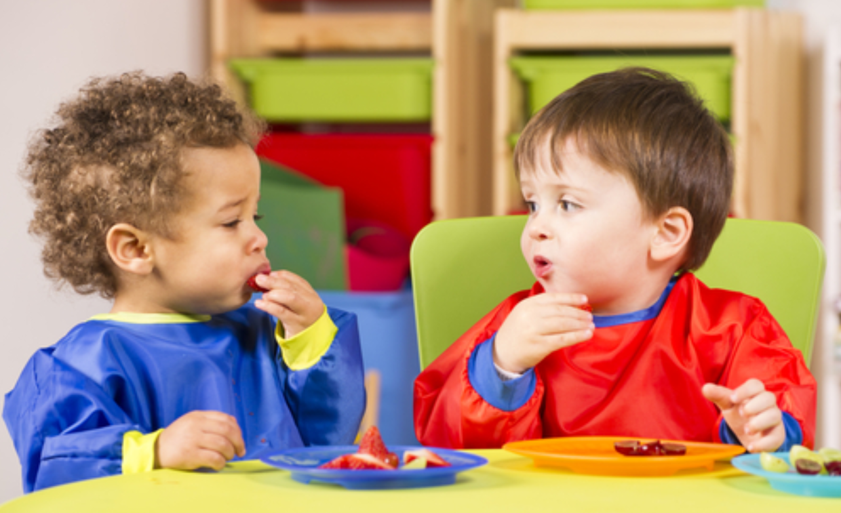
Toddler Times: Beyond Nourishment
Social skills
Self-expression
Confidence
Motor skills
Notes:
Toddlers are defined as children between 1-2 years of age. During the toddler stage it’s important to expose toddlers to a variety of nutritious foods so they learn to eat a balanced diet. It’s easy to focus only on the nutritional quality of meals. As providers you want to make sure that toddlers in your care are provided access to foods that will support growth and development. Providers must not overlook that meal time is an important time for a toddler to develop social skills, learn and be able to express themselves, develop confidence in self and develop motor skills. Mealtime is more than just getting a toddler to eat! Providers have a very powerful opportunity to help toddlers develop a healthy relationship with food that can positively impact future health.

Slide 5
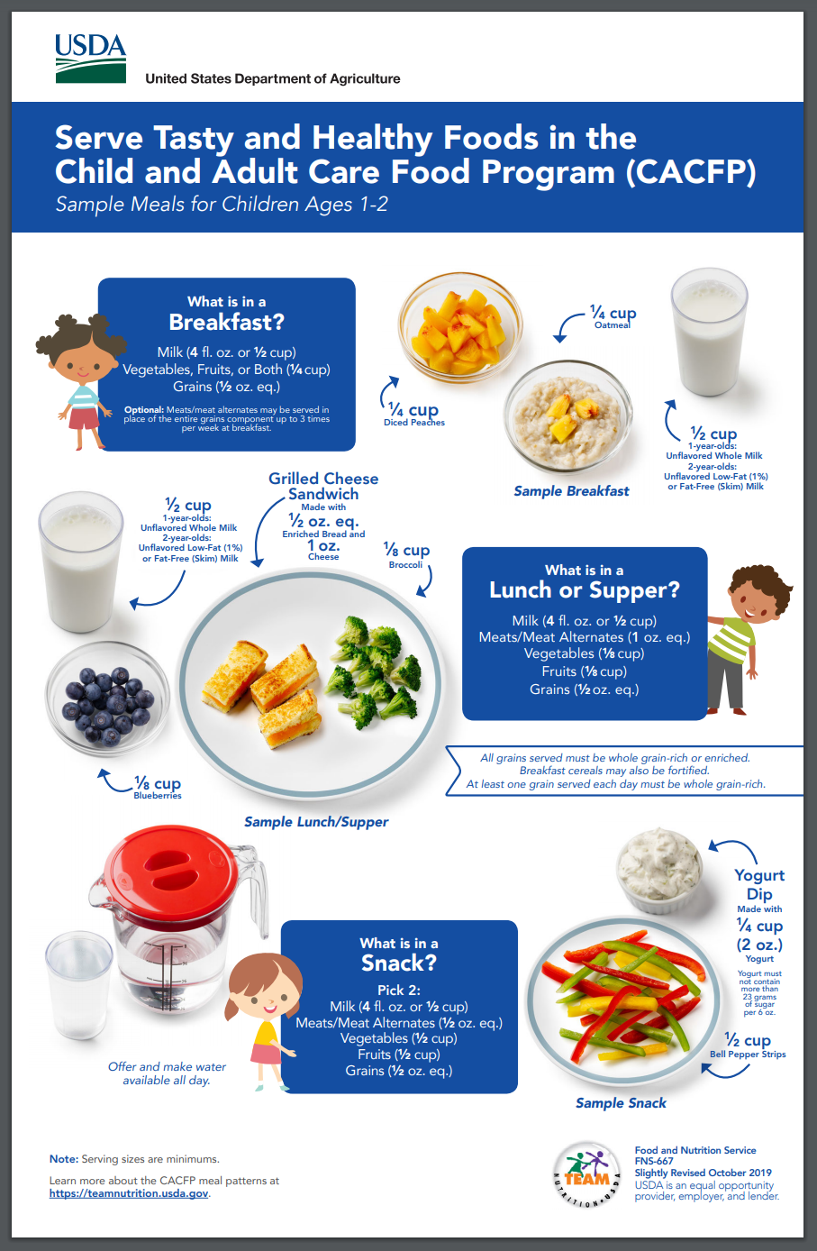
Food for the Toddler Years
Notes:
Toddlers are growing and developing quickly. They are learning about themselves and the world around them, even at mealtimes. Meals and snacks offered through the USDA’s Child and Adult Care Food Program help support toddler’s growth and development. Review toddler meal patterns shown on slide by reading component requirements in the three blue boxes.

Slide 6
Gotta Have Milk!
Notes:
Milk provides valuable nutrients to support toddler growth and development and is a required component of the CACFP meal pattern. For children ages 12 months through 23 months unflavored whole milk or breastmilk is required to be served, however, the CACFP meal pattern allows time for children to get used to milk with different amounts of fat. Let’s take a closer look at choosing the right type of milk to serve children in the CACFP.
Click on video icon to play video or go to https://www.fns.usda.gov/tn/choose-right-type-milk-serve-children-cacfp to play video directly from the USDA website. End video before it talks about the USDA resources (at 2:24 minutes).

Slide 7
The Typical Toddler
Notes:
Toddlers are learning to navigate their world, communicate, and control some parts of their lives. They don't actually have control over much, but eating is one of the first areas they will master. Providers and parents can help toddlers enjoy their limited power by giving them appropriate amounts of freedom when it comes to choosing foods and eating them.
That's not to say toddlers are deciding what to have for each meal. Providers and parents have the important job of providing the kinds of foods that an active toddler needs. The provider and parent’s role is to present healthy foods and let a child decide which ones to eat — or whether to eat at all. By anticipating challenges and offering choices, providers and parents teach toddlers which behaviors will yield positive results and which ones won’t.
Let’s review some characteristics of the typical toddler and approach the typical toddler behaviors from a developmental perspective. Although challenging, these behaviors are perfectly natural!

Slide 8
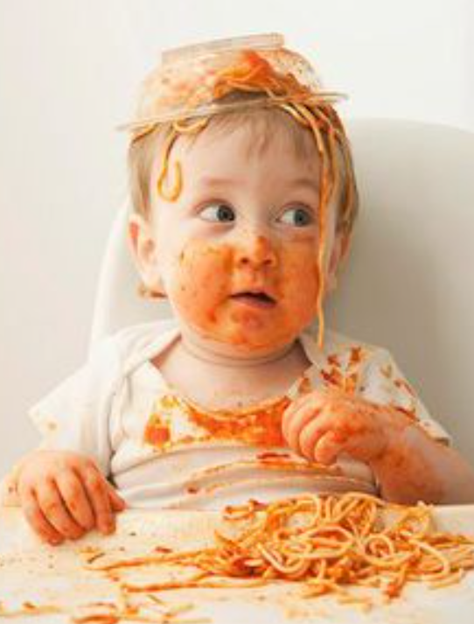
1 Year Old
Worried about a mess?
Put newspaper or a plastic mat on the floor under the child’s high chair or booster seat. This can help with cleanup.
Appetite varies from day to day
Drinks from a cup with assistance
Eats with fingers and utensils
Very messy!
Notes:
After the toddler’s first birthday, you'll probably notice a sharp drop in his or her appetite. Maybe the toddler is suddenly turning his or her head away after just a few bites and/or is resisting coming to the table at mealtimes. Despite this behavior and increased activity, there's a good reason for the change. The toddler’s growth rate has slowed; he or she really doesn't require as much food now. Read slide… When done reading slide, click on mouse to advance the quick tip drop-down on the right side of the screen.

Slide 9
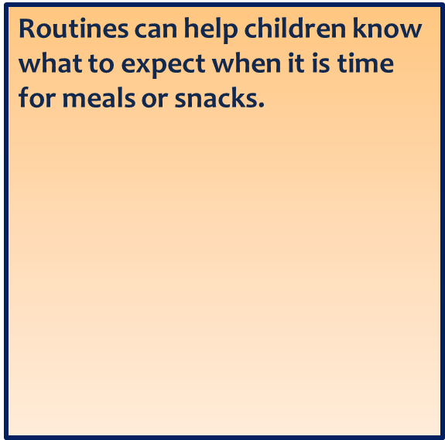
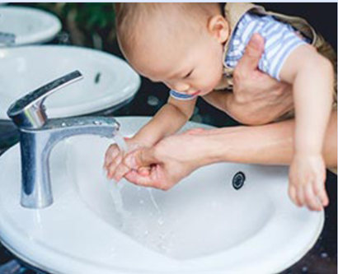
2 Year Old
Can use a spoon and drink from a cup
Can be easily distracted
Growth slows and appetite drops
Develop likes and dislikes
Can be very messy
May suddenly refuse certain foods
Notes:
Read slide... click on mouse to advance the quick tip drop-down on the right side of the screen.

Slide 10
Toddler Cues
Notes:
We have identified the developmental characteristics of toddlers, now lets review typical behaviors of the toddler that indicate hunger and fullness. You will notice that this video is geared towards parents but the same information is applicable to providers or any adult in a toddler’s life. Click on video icon to play video or go to https://www.youtube.com/watch?v=bKAwRTxKOmQ to play video. Show video and end promptly at 45 seconds.

Slide 11
Toddler Cues
Hungry
Not Hungry
Reaches for or points to food
Opens mouth when offered spoon or food
Gets excited when sees food
Uses hand motions or sounds to let you know is still hungry
Pushes food away
Plays with food
Closes mouth when food is offered
Turns head away from food
Uses hand motions or sounds to let you know is full
Notes:
What were some of the cues that you noticed from the video? Allow participants the opportunity to type responses in chat box. After a few seconds click the mouse to advance the hunger cues drop box and then the not hungry drop box.
Some typical toddler cues to hunger and fullness include: Read slide…

Slide 12
Picky Eater or Perfectly Natural?
A way to express independence.
Toddlers eventually tire of the food or pass out of the phase.
Sean will only eat grilled cheese sandwiches.
Emily won’t eat anything green.
Bananas used to be Hannah’s favorite food,
but now she won’t even touch them.
Notes:
Many toddlers express their budding independence through eating — or not eating, as the case may be. So nearly all toddlers could be described as picky eaters. Click mouse three (3) times to advance drop-in boxes.
When a toddler is stuck on one food, a provider or parent might feel forced to serve that food every day so the toddler eats something. It is important to remember that eventually the toddler may tire of that food. Providers choose the foods to put on the toddler's plate. When only serving a limited variety of food providers and parents miss an opportunity to introduce new foods and increase the number of those foods the toddler is willing to eat. Most of these "food jags" or “picky eating phases” won't last long if providers and parents don't give in to them.

Slide 13
Food Jags
Normal part of development.
If the desired food is generally nutritious and easy to prepare, consider offering it along with a variety of other foods at each meal.
Most toddlers will usually start eating other foods before too long.
Avoid focusing on the behavior.
Notes:
A food jag is when a child will only eat one food item, or a very small group of food items, meal after meal. Keep in mind that food jags are a normal developmental stage for toddlers and the toddler's eating habits are a way for them to feel independent. Know that, often, the toddler is in a resting stage of the growth process.
If the desired food is nutritious and easy to prepare, consider offering it along with a variety of other foods at each meal. Or you may want to say “sorry” these are the foods we are having today for lunch. We will have “green beans” again tomorrow. Try to minimize the situation.
Most toddlers will usually start eating other foods before long. If the toddler does not receive additional benefits (like extra attention) they are going to get tired of eating the same thing just like an adult would.
Click mouse for tip to appear on right side of slide and say: Avoid focusing on the behavior, which may cause the behavior to continue. If they feel like they are getting a lot of attention with the food jag, they may keep on it just for the extra attention.
Toddlers won't starve, but they will learn to be more flexible rather than go hungry. Present a variety of healthy foods including established favorites and some new foods. The toddler in your care may surprise you one day by eating all of them!

Slide 14
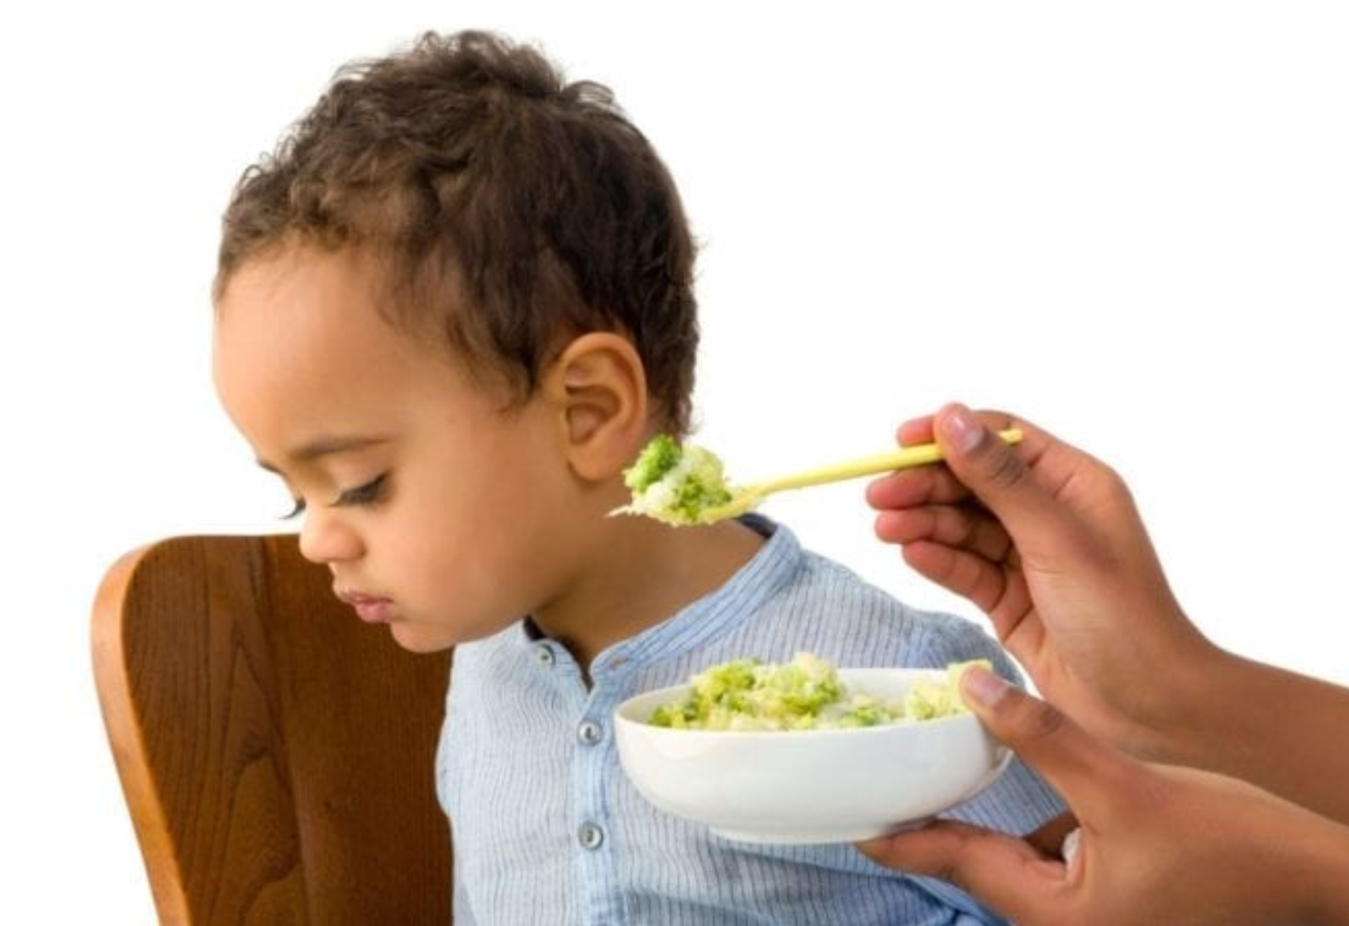
Food Phobia
Neophobia – the aversion to new foods.
Common between ages 2-5.
Evolutionary roots that served as a protective response because eating new or unfamiliar foods was potentially life-threatening.
Don’t give up - keep offering the new food! It may take more than 9 times before a child may decide to eat a new food.
Notes:
Neophobia or the aversion to new food is common and normal in the years between 2 and 5. Food neophobia appears to be a evolutionary response which results in young children initially rejecting a new food. In hunter gatherer societies this neophobia was a protective response as eating new and unfamiliar foods was potentially risky and could result in illness or even death. Neophobia changes with age and is minimal in infancy, may increase in early childhood and then usually declines to adulthood.
A toddler in your care doesn't like green beans the first time around? Don't stop serving them. Toddlers are naturally slow to accept new tastes and textures, so keep reintroducing the beans. Serve a small portion and encourage the toddler to try a bite without nagging or forcing.
Click mouse so that tip appears on the right side of slide and say: Don’t give up- keep offering the new food!
Be sure that as a provider you are setting a good example! Serve nutritious foods that you like or eat something new with the toddlers so all children see you enjoying what you're asking them to eat.

Slide 15
Encourage Children to Try New Foods
Notes:
USDA has created a second short video on how to introduce and encourage children to try new food. The video can be found on the USDA Team Nutrition Mealtimes With Toddler in the CACFP webpage. Let’s check the video out!
Double click on video icon to play the USDA Encourage Children to Try New Foods video. If clicking on the embedded video link does not work then go to the USDA website at https://www.fns.usda.gov/tn/encourage-children-try-new-foods to play the video titled Encourage Children to Try New Foods. End video after 1:59 minutes, do not play USDA resource reference portion- resources will be covered later in the training.
To help summarize the video, after done showing video ask participants to type in one tip that they thought was the most helpful. Allow participants a few moments to type their tips in and then pick various tips to read from the chat box.

Slide 16
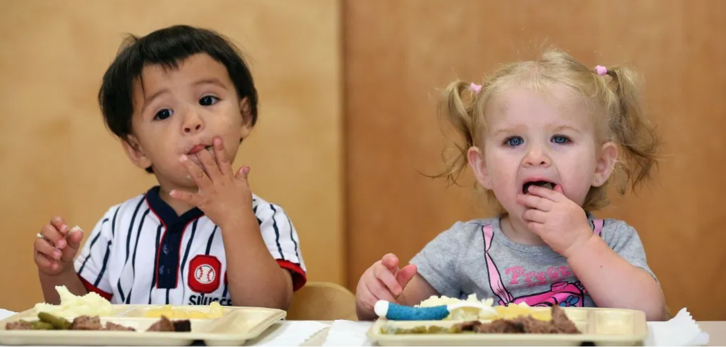
Toddlers At The Table
Notes:
Now that we have identified some typical toddler behaviors at mealtime let’s discuss how to create a positive mealtime environment and enjoyable experience for toddlers.

Slide 17
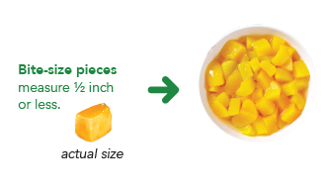
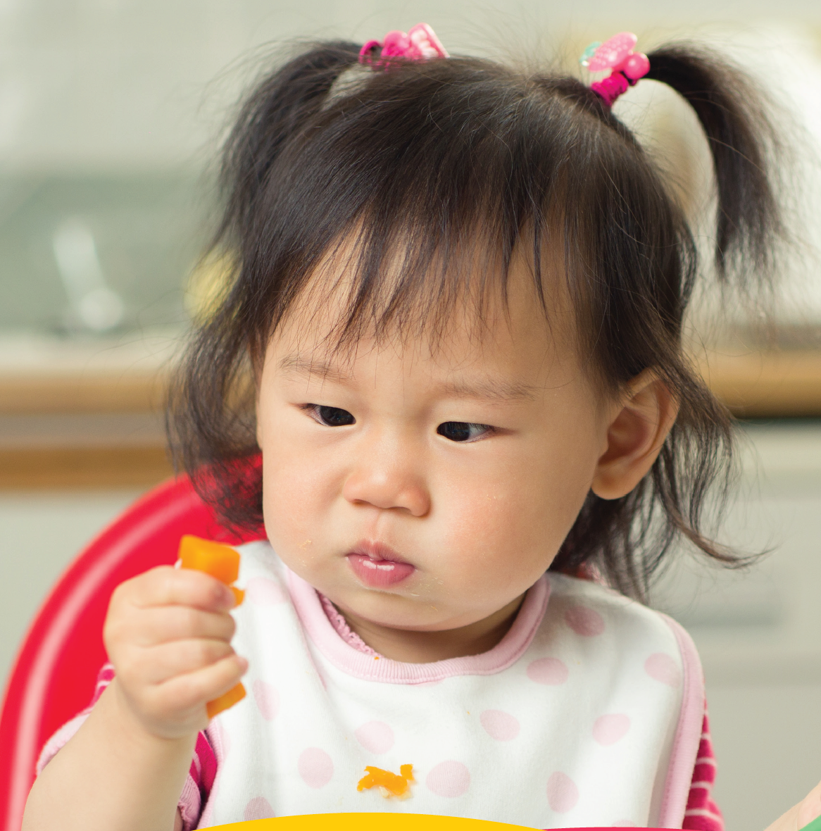
Toddler-Friendly Foods
Variety
Child-size portions
Offer foods in bite-size pieces that are easier to pick up with their fingers
Texture
Serve foods near room temperature
Notes:
First and foremost it is important to offer all children, not just toddlers, a variety of foods within the CACFP meal patterns. By offering a variety of foods at an early age children are exposed to new foods and this can help increase the likely-hood of future acceptance and ultimately promote a healthy eating pattern through life.
Be realistic about food amounts. Following the CACFP meal pattern ensures reasonable portion sizes and helps to reduce food waste.
Cut food into bite-size pieces that are easy to pick up with fingers. Bite-size pieces help with developing fine motor skills and can reduce the risk of choking. Click mouse to advance the Quick Tip drop-in on the right side of the slide. Read quick tip.
Offer a variety of food textures to help with the continued development of fine motor and chewing skills. Make some foods soft and moist for ease of swallowing.
Serve foods near room temperature. Test food temperature before feeding. Be careful with food or liquids warmed in a microwave, which might heat foods unevenly.

Slide 18
Assist Children in Learning How to Feed Themselves
Notes:
USDA has also created a third short video on how to assist children in learning how to feed themselves. The video can be found on the USDA Team Nutrition Mealtimes With Toddler in the CACFP webpage. Let’s check the video out!
Double click on video icon to play the USDA Assist Children in Learning How to Feed Themselves video. If clicking on the embedded video link does not work then go to the USDA website at https://www.fns.usda.gov/tn/assist-children-learning-how-feed-themselves to play the video titled Assist Children in Learning How to Feed Themselves. Stop video at 2:18 minutes before the video talks about the USDA resources- resources will be covered at the end of the training.

Slide 19
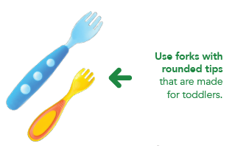
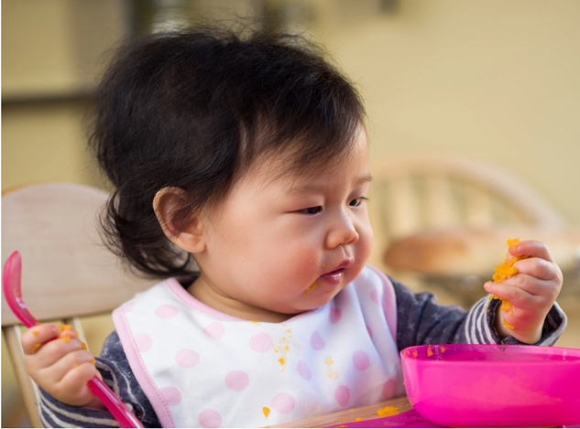
Practice Makes Perfect!
Allow toddlers to practice eating with spoons and forks at mealtimes.
Use tables, chairs, forks, spoons, bowls, and plates designed for children.
Always seat toddlers at a comfortable height in a secure chair.
Model how to use a spoon or fork at mealtimes.
Notes:
As you can see from the video we just viewed, toddlers are excited to learn new skills and providers can help toddlers become more independent while still providing supervision and gentle support at mealtimes. Providers help toddlers to develop important skills that can be used for life by: Read slide… On second bullet click mouse to advance Quick Tip drop-in on the right side of the slide and read Quick Tip.

Slide 20
Division of Responsibility in Feeding
For toddlers through adolescents:
The adult is responsible for what, when, where.
The child is responsible for how much and whether.
With support and an appropriate eating environment, children can naturally decide what they eat and self-regulate around food.
supports a child’s exploration and decision making when it comes to food
respects the specific roles and responsibilities between parents, or providers
Recognizing children’s natural capacities and abilities when it comes to feeding.
allows parents and providers to create the environment children need in order to become competent and confident eaters.
Ellen Satter Institute at ellynsatterinstitute.org.
Notes:
The Division of Responsibility provides a framework for providers and families to establish healthy feeding relationships and to be able to create a positive mealtime experience for toddlers in your care. The Division of Responsibility is a term coined by feeding expert Ellyn Satter of the Ellen Satter Institute. It acknowledges what both child and parent (or the adult(s) in the child’s life) are responsible for when it comes to feeding. Emphasized is that with support and an appropriate eating environment, children can naturally decide what they eat and self-regulate around food. An appropriate eating environment is one that supports a child’s exploration and decision making when it comes to food, and that respects the specific roles and responsibilities between parents, or providers for purposes of this training and child(ren) at each stage of development. Recognizing children’s natural capacities and abilities when it comes to feeding is what allows parents and providers to create the environment children need in order to become competent and confident eaters.
Simply put: The parent/provider job is trusting the child(ren) to decide how much and whether to eat. If the parent/provider does their jobs with feeding, children do their jobs with eating.
For more information on the Division of Feeding go to the Ellen Satter Institute at ellynsatterinstitute.org.

Slide 21
What are some examples of your “job” as the adult?
Choose and prepare the food.
Provide regular meals and snacks.
Make eating times pleasant.
Show children by example how to behave at family mealtime.
Be considerate of children’s lack of food experience without catering to likes and dislikes.
Not let children have food or beverages (except for water) between meal and snack times.
Let children grow into bodies that are right for them.
Notes:
Ask participants to type in the chat box what are some examples of your “job” as the adult? Allow participants a few seconds to type their answers in the chat box. When participants are done typing in the chat box click the mouse to advance the drop in comments below and read the examples of the jobs of the adult.
Fundamental to parents’ and providers jobs is trusting children to determine how much and whether to eat from what parents provide. When parents/providers do their jobs with feeding, children do their jobs with eating. Adults’ feeding jobs:
Choose and prepare the food.
Provide regular meals and snacks.
Make eating times pleasant.
Step-by-step, show children by example how to behave at family mealtime.
Be considerate of children’s lack of food experience without catering to likes and dislikes.
Not let children have food or beverages (except for water) between meal and snack times.
Let children grow into bodies that are right for them.

Slide 22
What would be some examples of the “job” of the child?
Eat (or not).
Eat the amount they need.
Learn how to eat the food provided.
Grow predictably.
Learn to behave well at mealtime.
Notes:
Ask participants to type in the chat box some examples of the “job” of the child. Allow participants a few seconds to type their answers in the chat box. When participants are done typing in the chat box click the mouse to advance the drop in comments below and read the jobs of the child.
Review comments from drop-in box for a child’s eating jobs, which may include:
Children will eat (or not).
Eat the amount they need.
Learn how to eat the food provided.
Grow predictably.
Learn to behave well at mealtime.

Slide 23
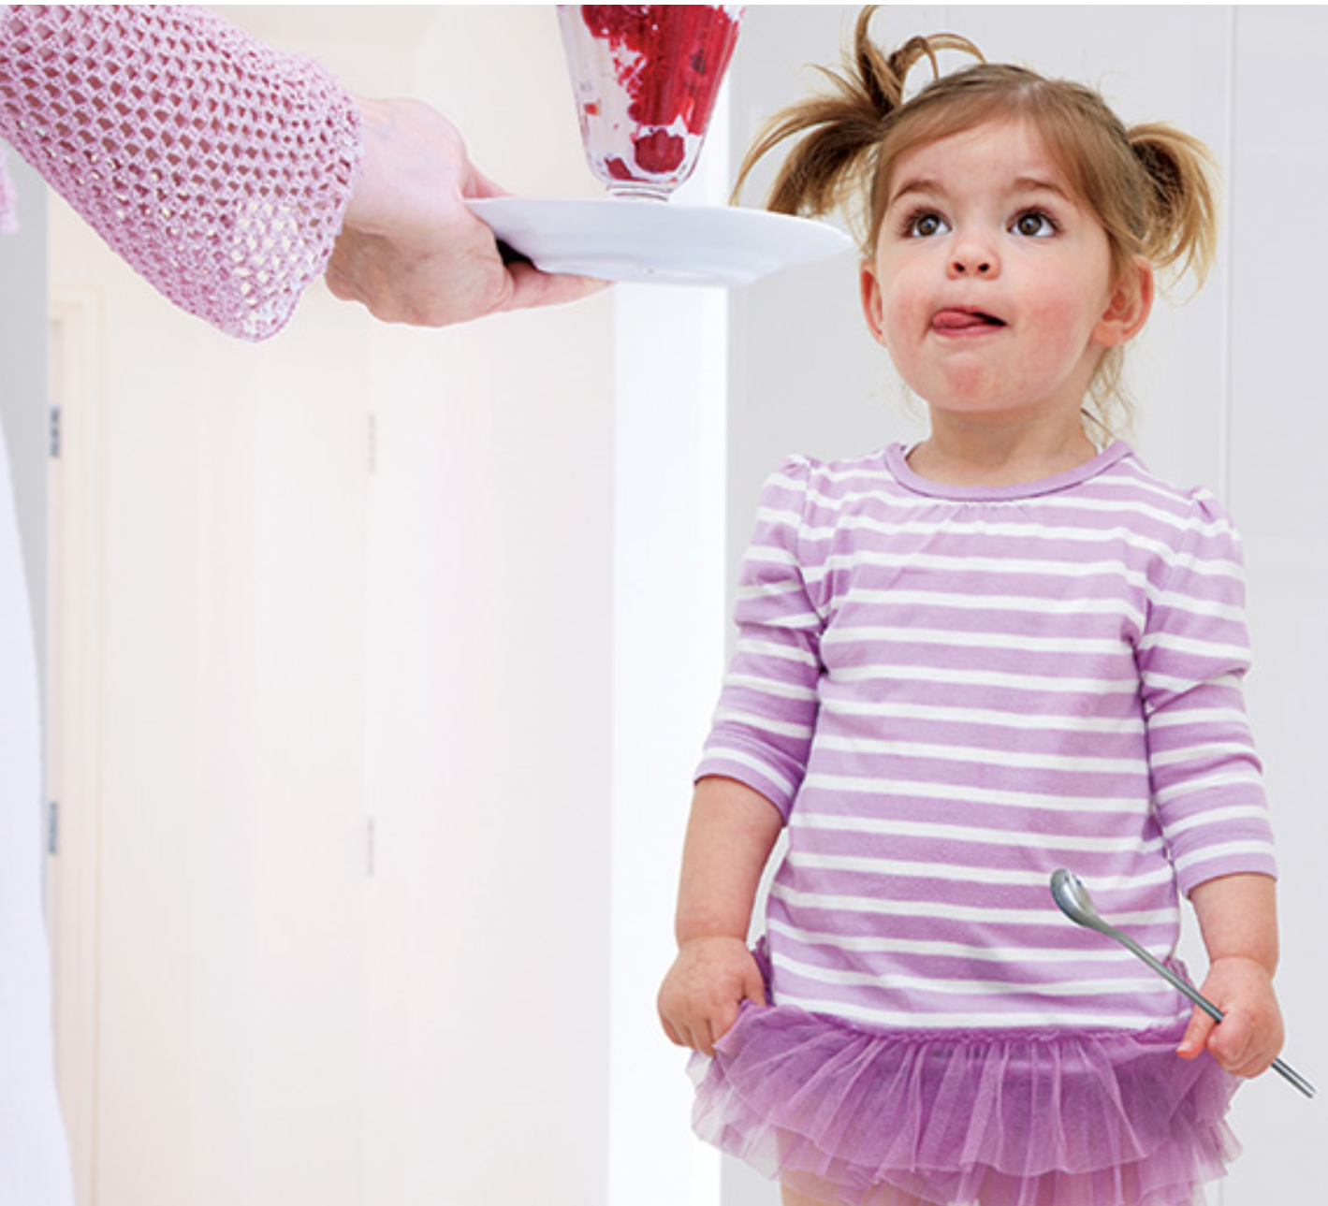
Don’t Bargain for Bites
Mealtime is not “negotiation” time.
Sends message that sweets, treats or rewards are more important than mealtime.
Notes:
As tempting as it may be to want to offer some type of reward for trying a new food or cleaning a plate, one of the most common mistakes adults make is to bargain for bites.
As an adult you know that spinach is very nutritious and you want children to eat the spinach you serve so it can be a bit dis-heartening when a child drops it on the floor. Your well-meaning impulse may be to start talking up nutritious foods, saying how big and strong spinach will make a child. Or you might start bargaining by using phrases such as “If you eat three more bites, you can get down from the table” or by being tempted to reward the child with a special treat" The problem is that these tactics don't work in the long run.
Who hasn't used the line about spinach making a child strong? But this approach may build dislike for the healthy food rather than acceptance. This doesn't mean providers shouldn't teach children about the benefits of healthy foods, but don't push too much by celebrating every bite of spinach a toddler eats or disapproving when he or she refuses.
For some children, mealtime becomes a negotiation session from the very start, and parents and providers can be tempted to use special treats or playtime as an incentive. As an adult you can probably remember this very experience as a young child or maybe even used with your own children. Bargaining or bribery doesn't encourage healthy eating. Instead it creates the impression that "treats“ (either in food form or reward) are more valuable than mealtime food. Foods like candy and cookies are not creditable in the CACFP nor are they essential to a child's diet. So although candy and cookies or grain-based desserts are not creditable in the CACFP, it can be tempting to reward a child with “sweet” food such as fruit. You may have found yourself saying, “no more fruit until you eat all your broccoli”. This is still bribery and should not be done.
Threatening a punishment, much like bribing a child with dessert or sweet food, ultimately isn't effective either because it creates a power struggle.
Providers (and parents) need to be mindful of the messages being sent to children!

Slide 24
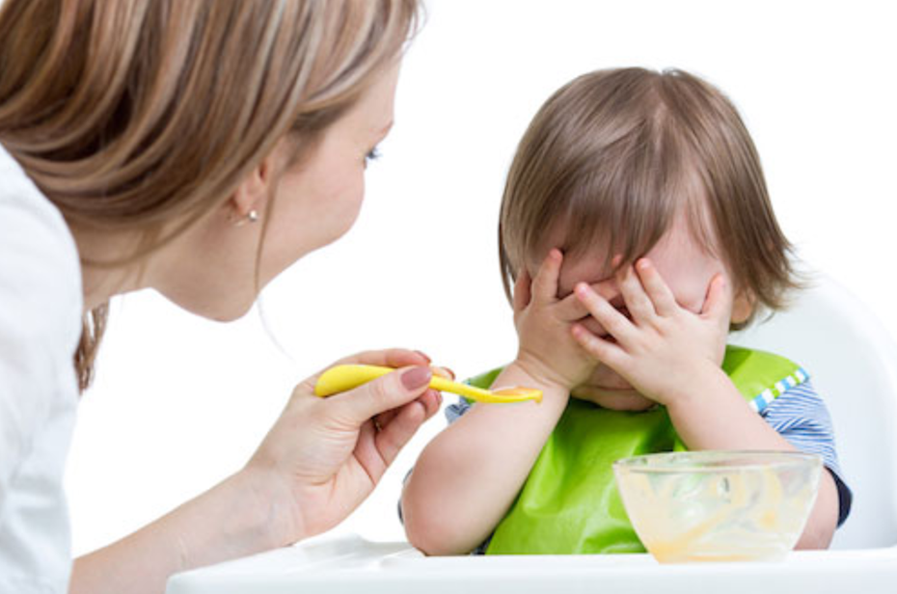
Help Them Know When They Have Had Enough
Let them learn by serving themselves.
Avoid praising a clean plate.
Reward toddlers with attention and kind words, not food.
Try not to restrict specific foods.
Notes:
Children really do know when they have had enough to eat but sometimes adults make it difficult for children to be able to listen to their internal cues of hunger and fullness.
Children who "listen" to their own fullness cues stop eating when they feel full and are less likely to become overweight. Give children a chance to stop eating when they feel full, even if you think they aren't. They'll feel more independent and more likely to keep a healthy weight.
Let children serve themselves if possible. Implementing Family Style Meal Service is an excellent way to teach toddlers! Teach toddlers to take small amounts at first. Toddlers can practice serving from small bowls that you hold for them. Tell them they can get more if they are still hungry.
Avoid praising a clean plate. A Toddler, or any child for that matter, should stop eating when he or she is full, rather than when the plate is clean.
Reward toddlers with attention and kind words, not food. Console with encouraging and positive words. Giving a toddler sweets when they feel sad or as a special treat can teach the toddler to eat when he or she is not hungry. This may cause the toddler to ignore body signals of fullness and overeat. Rewarding with sweets also teaches a toddler to think sweets or dessert foods are better than other foods. For example, telling a toddler "no dessert until you finish your vegetables" may make them like the vegetable less and the dessert more.
Try not to restrict specific foods. If a restricted food becomes available to a toddler, he or she might eat it despite feeling full. This can lead to a habit of overeating. And never restrict sweets or any food as punishment for bad behavior.

Slide 25
Toddler Talk
Instead of: Try this:
“Eat that for me.”
OR
“If you don’t eat one more bite, I will be sad.”
“This is a mango; it’s sweet like a strawberry.”
OR
“This celery is very crunchy!”
Notes:
It is important that providers model good behaviors during meal time by showing children they are eating the very foods that the child is offered. Providers should have a positive conversation about the taste, texture and type of food the child has been offered. Phrases such as “eat that for me” teach children to eat for adult approval and love. This can lead children to have unhealthy behaviors, attitudes, and beliefs about food and about themselves. If children are eating to please an adult as opposed to listening to their bodies, they may be eating more than they need.
Phrases such as “this is a mango; it’s sweet like a strawberry” help to point out the sensory qualities of food. They encourage children to try new foods. Adults don’t need to overdo it and talking about how the food tastes, smells and feels, can help children become more comfortable with new foods.

Slide 26
Toddler Talk
Instead of: Try this:
“You’re such a big boy;
you finished all your broccoli.”
OR
“Look at Maria. She ate all of her peaches.”
OR
“You have to take two more bites before you leave the table.”
“Is your stomach telling you that your are full?”
OR
“Has your tummy had enough?”
Notes:
Phrases like these teach children to ignore fullness. Read phrases in blue comment box. It is better for children to stop eating when full or satisfied than when all of the food has been eaten.
Phrases like these help children to recognize when he or she is full and can prevent overeating. Read phrases in red comment box.

Slide 27
Toddler Talk
Instead of: Try this:
“No more fruit until you eat your vegetables.”
OR
“Stop crying and I will give you a treat.”
“We can try these vegetables again another time.”
OR
“I am sorry you are sad. Come here and let me give you a hug.”
Notes:
Offering some foods, such as fruit or sweets, in reward for finishing others, like vegetables, makes some foods seem better than others. Getting a food treat when upset teaches children to eat to feel better which can lead to overeating.
Phrases such as “we can try these vegetables again another time.” Take away the pressure - children need to feel like there are no negative consequences for not liking a food. Our taste buds change over time so a child is likely to start liking a food that he/she used to not like or want. It is good to keep trying but again, make sure not to pressure or force.
Phrases such as “I am sorry you are sad. Come here and let me give you a hug.” Reward children with attention and kind words and not food. Comfort him or her with hugs, talking and extra attention.
Ask participants to type in the chat box other examples of phrases that they may have used that may not be the best phrases for modeling healthy eating behavior. Allow participants a few moments to type their responses in the chat box and then review some of the responses. Pick out one or two responses and ask participants to provide an alternate response that models healthy eating behaviors.

Slide 28
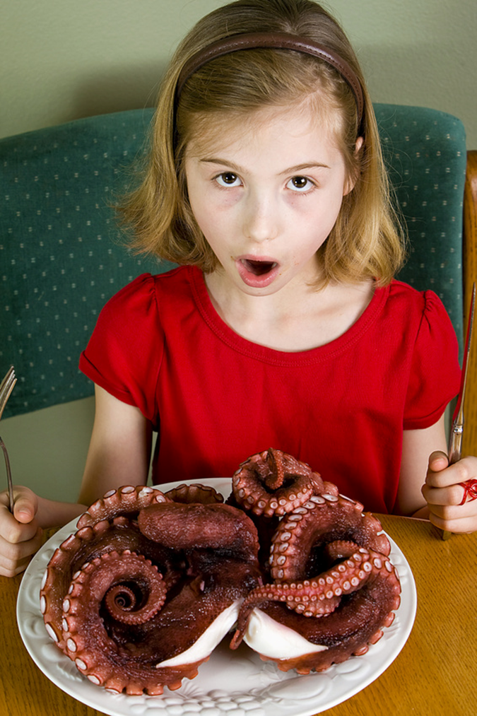
Too Early To Teach Good Manners?
It’s never too early!
Adults can model polite behavior.
Teach age-appropriate table manners.
napkin
not throwing food
sitting during the meal
Notes:
It’s never too early to start teaching good manners. Teach toddlers how to politely decline food by a simple “no thank you”. Younger toddlers obviously can’t say “no thank you” but older toddlers may be able too. Staff can model good mealtime manners by using the phrases “please”, “thank you”, “no thank you”. Age-appropriate manners also include behaviors such as not throwing food, sitting during mealtime and attempting to use a napkin. Providers can offer praise to the toddler who is trying to behave well during mealtime.

Slide 29
Food Without The Fuss!
Eating should be an enjoyable experience!
Understand that some toddlers do not want to try new foods because of their developmental stage. It’s ok, but keep offering new foods.
Try to offer just one new food at a time, and do not mix foods.
Know that serving one favorite food with one new food often helps the child try the new food.
When possible involve toddlers with meal preparation so that the toddler has the opportunity to become familiar with new foods.
Provide the opportunity for toddlers to become familiar with new food at a time other than mealtime.
Model desired behaviors.
Watch your words.
Trust the toddler!
Notes:
Eating food without any fuss can be challenging! First and foremost it is imperative that children learn that eating is an enjoyable experience so that they can develop a healthy relationship with food as they continue to grow and develop. Additional key points to remember include the following: Read the next seven bullets (don’t read last bullet). Last but not least, and probably one of the most difficult is to trust the toddler to eat when they are hungry and stop eating when they are full.

Slide 30
Share Successes With Families
Notes:
You’ve worked hard to create a positive and enjoyable mealtime experience for the toddlers in your care so make sure to share successes and resources with families. Keep families informed of milestones and any positive eating behaviors during mealtimes. By sharing resources you can help families reinforce the positive mealtime experiences and learning opportunities achieved during the time the toddler has spent in your care.

Slide 31
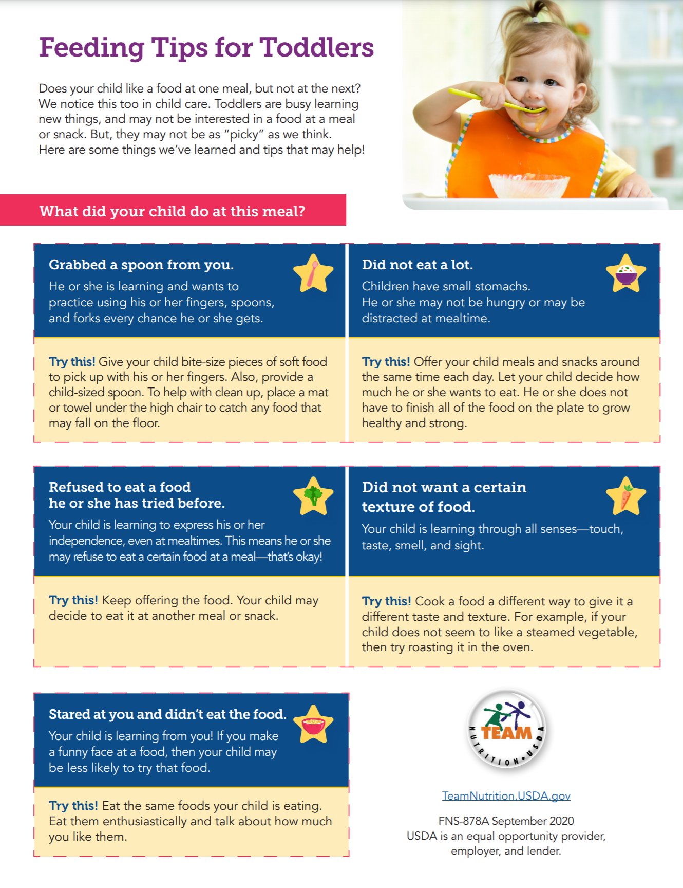
Share Successes with Families
Communication is important!
Helps to reinforce what is being learned and accomplished during meal times.
https://fns-prod.azureedge.net/sites/default/files/resourcefiles
Notes:
The hard work that providers do to create positive environments during meal times can be communicated to families to help ensure consistency from child care to the home setting. Communicating with families can provide valuable tips to reinforce what is being modeled by the provider. The USDA Meal Times With Toddlers Family handout is a helpful resource that providers can give to families. The handout identifies typical mealtime behaviors and tips for families during mealtime and can be found on the USDA Mealtimes With Toddlers in the CACFP webpage at the link listed on the slide. The handout is available in English and Spanish.

Slide 32
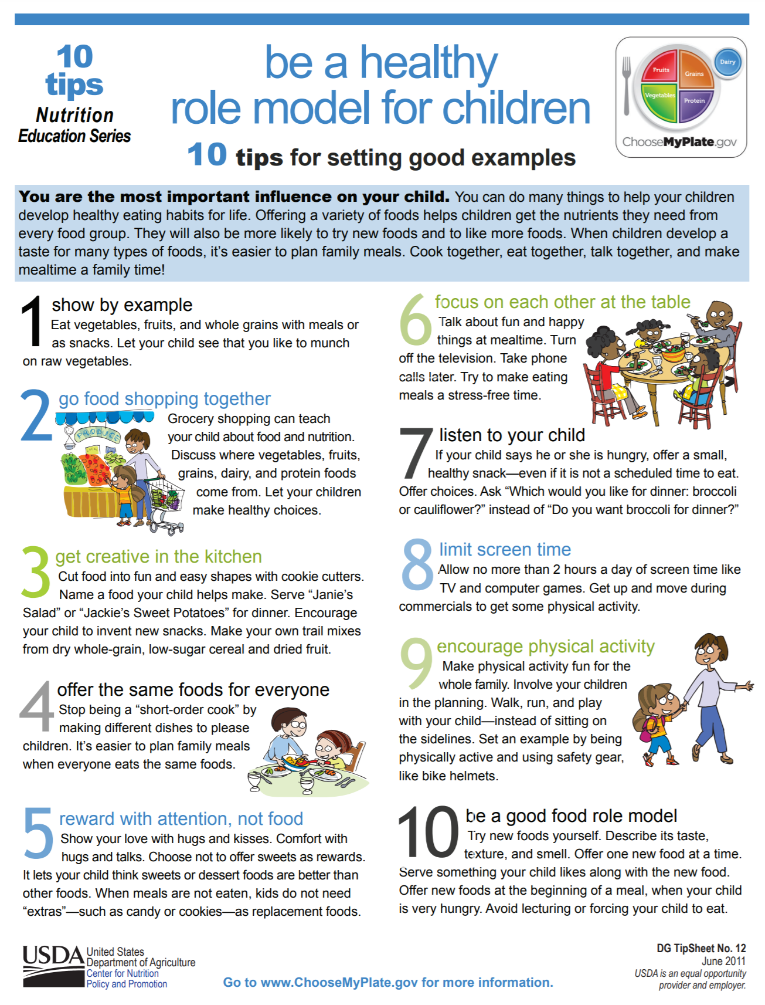
Be A Healthy Role Model
Show by example.
Offer the same foods for everyone.
Reward with attention, not food.
Listen.
https://www.choosemyplate.gov/ten-tips-be-a-healthy-role-model
Notes:
Adults can have a positive and powerful influence on the eating behaviors of a child which is why it is important to remember that providers and parents can be a healthy role model for children. Providers can be a healthy role model by the following actions which have been adapted from the USDA Be A Healthy Role Model for Children tip sheet:
Show by example. Eat vegetables, fruits, and whole grains with meals or as snacks. Let children see that you like to munch on raw vegetables.
Offer the same foods for everyone. Don’t be a “short-order cook” by making different dishes to please children. Of course if a child has a medical condition that requires a meal modification then meals and snacks must be modified as specified by the medical authority.
Reward with attention, not food. Comfort with hugs and talks. Choose not to offer sweets as rewards. It lets children think sweets or dessert foods are better than other foods. When meals are not eaten, children do not need “extras” as replacement foods.
Listen. If a child says he or she is hungry, make sure to offer a small, healthy snack at the regularly scheduled snack time. When possible, offer choices. Ask “Which would you like for lunch: broccoli or cauliflower?”
Providers are encouraged to share the tip sheet with families. The tip sheet can be found on the USDA website at the link listed on the slide.

Slide 33
Resources
Notes:
In this last section we will share helpful resources for both providers and parents!

Slide 34
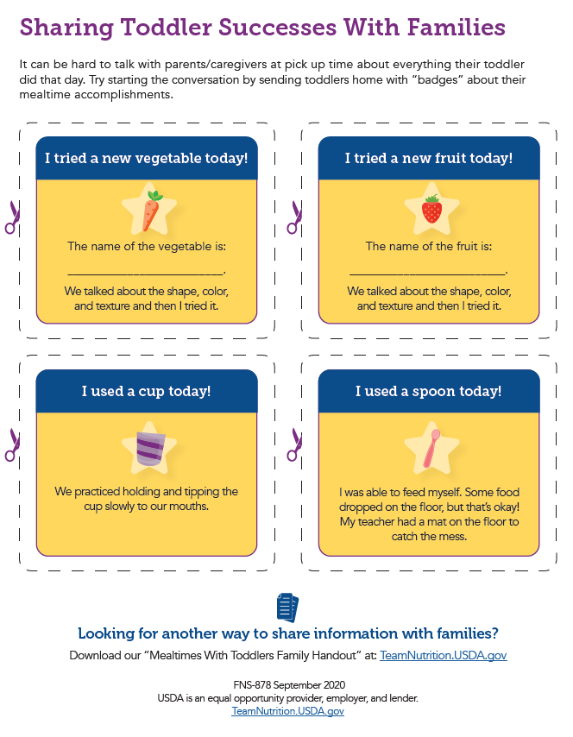
https://www.fns.usda.gov/tn/mealtimes-toddlers-cacfp
Notes:
The USDA Meal Times With Toddlers in the Child and Adult Care Food Program booklet is an excellent resource for providers. The resource provides an overview of the material discussed during this training and also provides a template for badges that providers can use to communicate with families. On the slide you can see that the badges can be cut-out and customized. The resource can be found on the Mealtimes With Toddlers in the CACFP webpage at the address on the bottom of the slide. In addition to this booklet there are also videos and webinars available for providers to view and are available in English and Spanish.

Slide 35
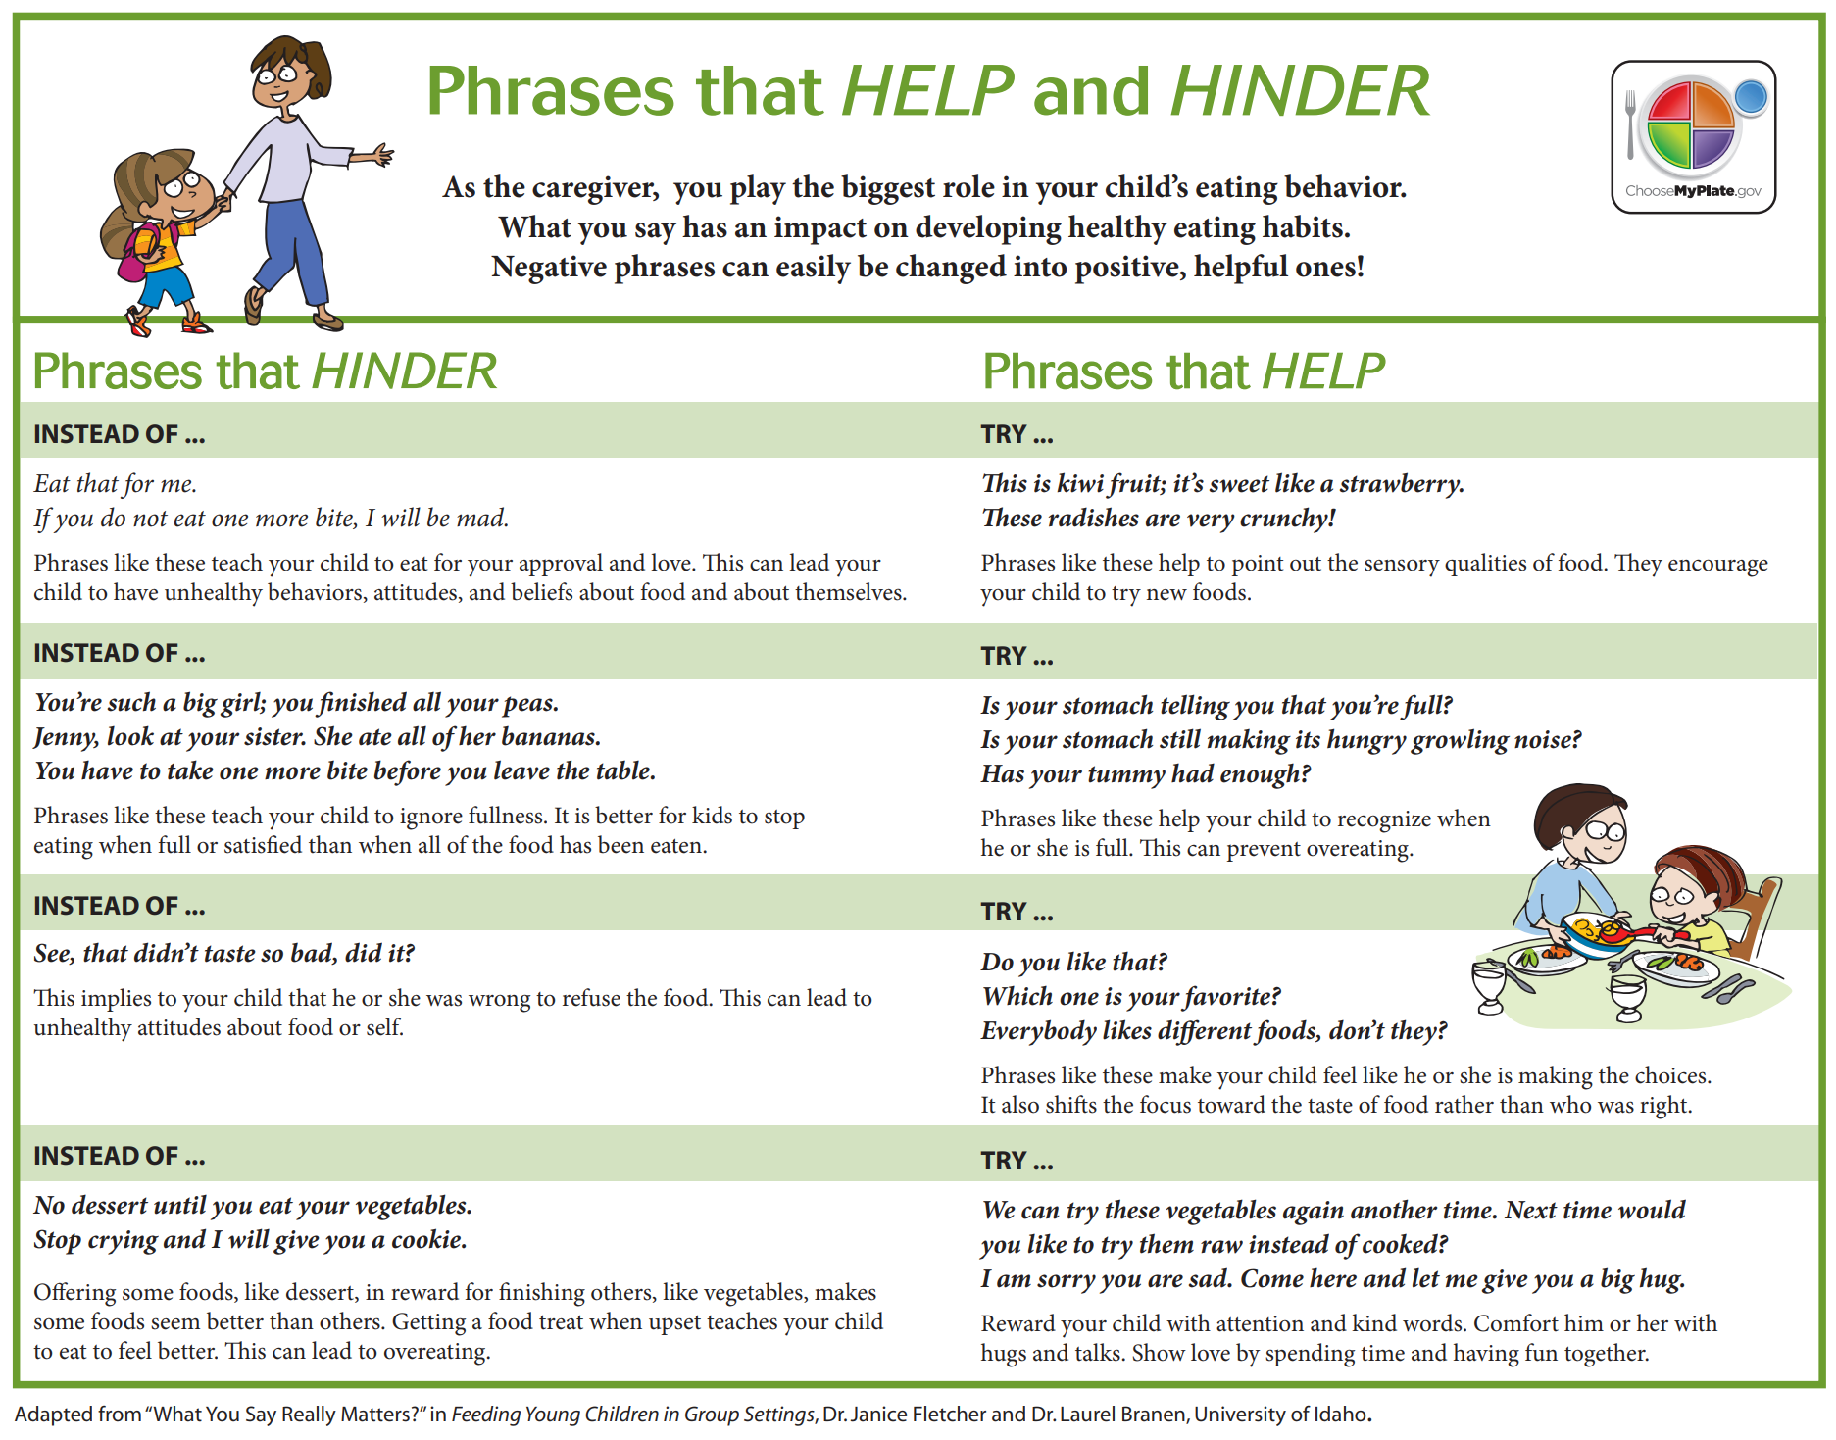
Notes:
Earlier during the Toddler Talk section we reviewed some helpful adult responses to encourage positive mealtime experiences. USDA also provides the Phrases that Help and Hinder handout for providers and families. This resources is another great resource to share with families.

Slide 36
Research and Recommendations
Ellyn Satter Institute
The Feeding Infants and Toddlers Study (2018)
Key Learnings from the Nestlé Feeding Infants and Toddlers Study
Scientific Report of the 2020 Dietary Guidelines Advisory Committee: Advisory Report to the Secretary of Agriculture and the Secretary of Health and Human Services. Dietary Guidelines Advisory Committee (2020).
Nestle Nutrition Institute Toddler Hub.
Is Your Toddler a Picky Eater Video
https://www.youtube.com/watch?v=We2DsUCbgf8
Notes:
In addition to the USDA resources we have mentioned during this training additional resources for parents and providers include: Read slide…

Slide 37
To Sum It Up!
Notes:
The Handling Picky Eating in Toddlers video from Nemours is not only a great resource for parents but it also provides a great summary of the information that has been provided in this training.
Click on the video icon to play the video.
When video is done, say: Thank you for attending the Mealtimes with Toddler training and thank you for all that you are doing to create an enjoyable mealtime experience for the toddlers in your care! The work that you are doing has a powerful impact on the growth, development and future health of children!

Slide 38
USDA Nondiscrimination Statement
In accordance with Federal civil rights law and U.S. Department of Agriculture (USDA) civil rights regulations and policies, the USDA, its Agencies, offices, and employees, and institutions participating in or administering USDA programs are prohibited from discriminating based on race, color, national origin, sex, disability, age, or reprisal or retaliation for prior civil rights activity in any program or activity conducted or funded by USDA.
Persons with disabilities who require alternative means of communication for program information (e.g. Braille, large print, audiotape, American Sign Language, etc.), should contact the Agency (State or local) where they applied for benefits. Individuals who are deaf, hard of hearing or have speech disabilities may contact USDA through the Federal Relay Service at (800) 877-8339. Additionally, program information may be made available in languages other than English.
To file a program complaint of discrimination, complete the USDA Program Discrimination Complaint Form, (AD-3027) found online at http://www.ascr.usda.gov/complaint_filing_cust.html, and at any USDA office, or write a letter addressed to USDA and provide in the letter all of the information requested in the form. To request a copy of the complaint form, call (866) 632-9992. Submit your completed form or letter to USDA by:
Mail: U.S. Department of Agriculture
Office of the Assistant Secretary for Civil Rights
1400 Independence Avenue, SW
Washington, D.C. 20250-9410;
Fax: (202) 690-7442; or
Email: program.intake@usda.gov.
This institution is an equal opportunity provider.
Notes:
KSDE is an equal opportunity provider.

Slide 39
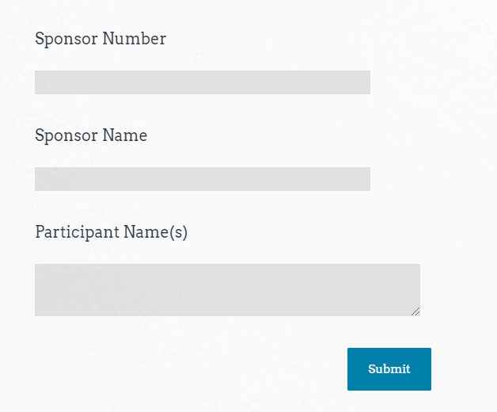
Attendance
Sample
https://www.surveymonkey.com/r/K72VQQM
Thank you for Attending!
Please contact us whenever you need assistance.
785-296-2276
Child Nutrition & Wellness
www.kn-eat.org
Mealtimes with
Toddlers
Notes:
Class attendance will be conducted electronically through Survey Monkey. Participants must complete the survey to receive a certificate of completion. Participants may use their phones, laptops, or nutrition program computer to access the survey electronically. Enter the link provided into the address bar of preferred web browser. If using a mobile device with a QR Code reader, scan the QR code that will be provided on the screen at the end of the session.
The attendance survey set up so that a lead person, such as the Director, can enter multiple names on the comment line of the attendance survey in Survey Monkey. This should make it easier to track group participation in the electronic delivery of these classes.

Slide 40
Thank You for Attending!
Please contact us whenever you need assistance.
Child Nutrition & Wellness, KSDE
785-296-2276
www.kn-eat.org
Notes:
Thank you for your participation in this training. Please contact your child nutrition consultant or the main Child Nutrition and Wellness office if you have any questions.

