Slide 1
Quick Train on Grains
A Short Tutorial on
Using the Grains Measuring Chart to Calculate Ounce Equivalents for Grains.
To received the slide handout for this presentation:
Email: Sarah Bruschi at sbruschi@ksde.org
Subject: Quick Train on Grains Handout
Notes:
Display this slide prior to class.
Welcome participants and perform periodic sound checks prior to the start of the class.
As participants enter the zoom class, explain that there is not a Participant Booklet for this class. To receive the slide handouts for this class via Email: Sarah Bruschi at sbruschi@ksde.org with the subject Quick Train on Grains Handout. Also, the handout can be uploaded to the chat box for download.
At the designated starting time, thank participants for coming, introduce yourself and welcome them to the class.
Welcome to Quick-Train on Grains!
Grains are an important part of meals in the CACFP. To make sure participants get enough grains in CACFP meals and snacks, required amounts for the grains component are listed in the meal pattern as ounce equivalents (oz. eq.) Ounce Equivalents tell you the amount of grain in a portion of food.
Today’s quick-train on grains will provide a short tutorial on using a Team Nutrition resource, the Grains Measuring Chart to Calculate Ounce Equivalents for Grains.

Slide 2
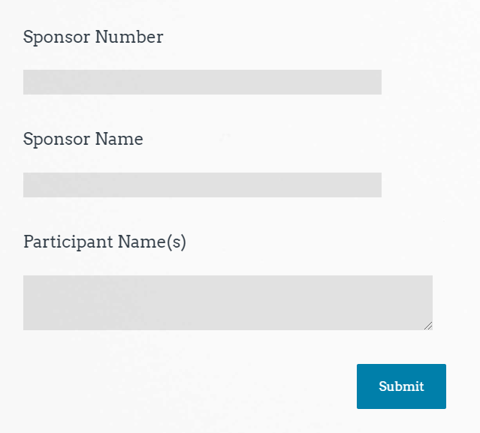
Class Logistics
Class ending time
Participant material
Q&A
Attendance
Sample
Notes:
Inform participants this is a 30-minute training and it will end by ________(insert end time).
Encourage participants to locate a calculator or be ready to access the calculator function on their cell phone.
Participants may ask questions by unmuting their audio or typing in the chat box.
Attendance will be taken at the end of class via a Survey Monkey survey. Please take the time to complete the attendance survey in order to receive a certificate of completion.

Slide 3
Objectives
Learn the definition of ounce equivalents
Review the Meal Pattern for grains in the CACFP
Confidently be able to use the Grains Measuring Chart to determine if grain products meet the minimum requirement for ounce equivalents for grains in the CACFP.
Notes:
By the end of today’s training, <click> participants will know the definition of ounce equivalents, <click> review the meal pattern for grains, <click> and confidently be able to use the Grains Measuring Chart to determine if grain products meet the minimum requirement for ounce equivalents for grains in the CACFP.

Slide 4
What is an Ounce Equivalent?
Definition: A method of measurement for the grains component in Child Nutrition Programs.
As of October 1, 2021, ounce equivalents must be used to calculate the grains component in the Child and Adult Care Food Programs (CACFP).
Notes:
<click>
An ounce equivalent is defined as a method of measurement for the grains component in Child Nutrition Programs.
<click>
As of October 1, 2021, ounce equivalents must be used to calculate the grains component in the Child and Adult Care Food Programs.

Slide 5
Review of CACFP Meal Pattern for Grains
1-5 Years Old
½ ounce equivalent
6-18 Years Old
1 ounce equivalent
Adults
2 ounce equivalents for breakfast/lunch
1 ounce equivalent for snack
Notes:
Let’s review the meal pattern for grains in the CACFP.
<click>
For 1-5-year-olds, they must be served ½ ounce equivalents at all meals and snacks when a grain is served.
<click>
For 6-18-year-olds, they must be served 1 ounce equivalent at all meals and snacks when a grain is served.
<click>
For adults, they must be served 2-ounce equivalents for breakfast and lunch and 1 ounce equivalent at snacks.

Slide 6
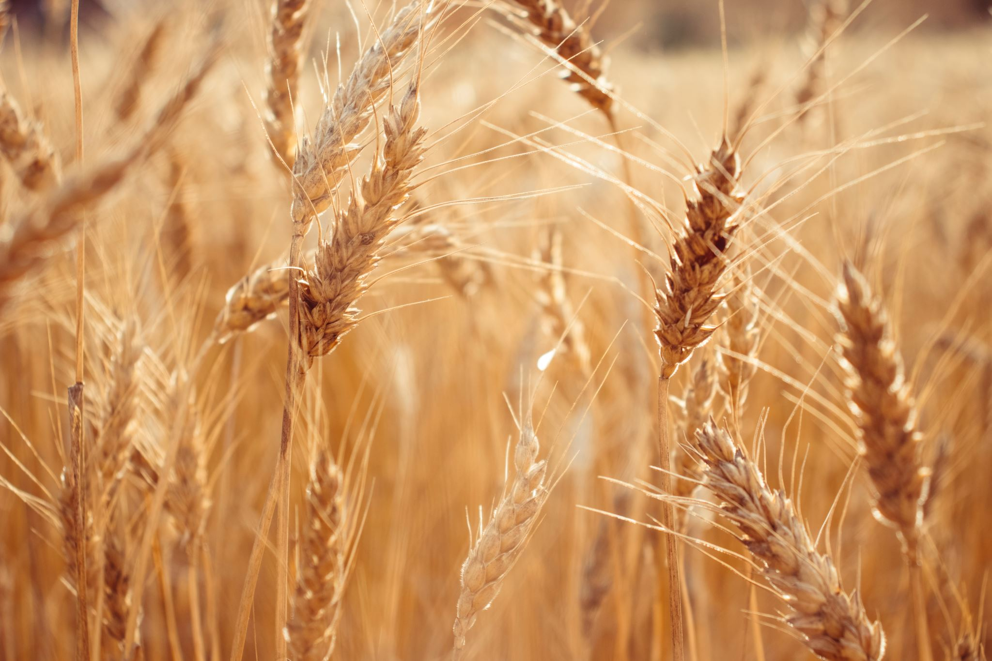
Using Ounce Equivalents for Grains in the Child and Adult Care Food Program (CACFP)

Slide 7
Using the Grains Measuring Chart
USDA Team Nutrition resource
Very easy
to use
No calculations required
Spanish and English versions available
https://www.fns.usda.gov/tn/using-ounce-equivalents-grains-cacfp
Notes:
Using Ounce Equivalents for Grains in the Child and Adult Care Food Program is a 6-page worksheet provided by USDA’s Team Nutrition Initiative. It includes a very easy to use Grains Measuring Chart that requires no calculations.
There are Spanish and English versions available online as well as in print.
Participants can find this resources on the USDA Team Nutrition webpage shown on the slide.
Let’s take a closer look at this resource.

Slide 8
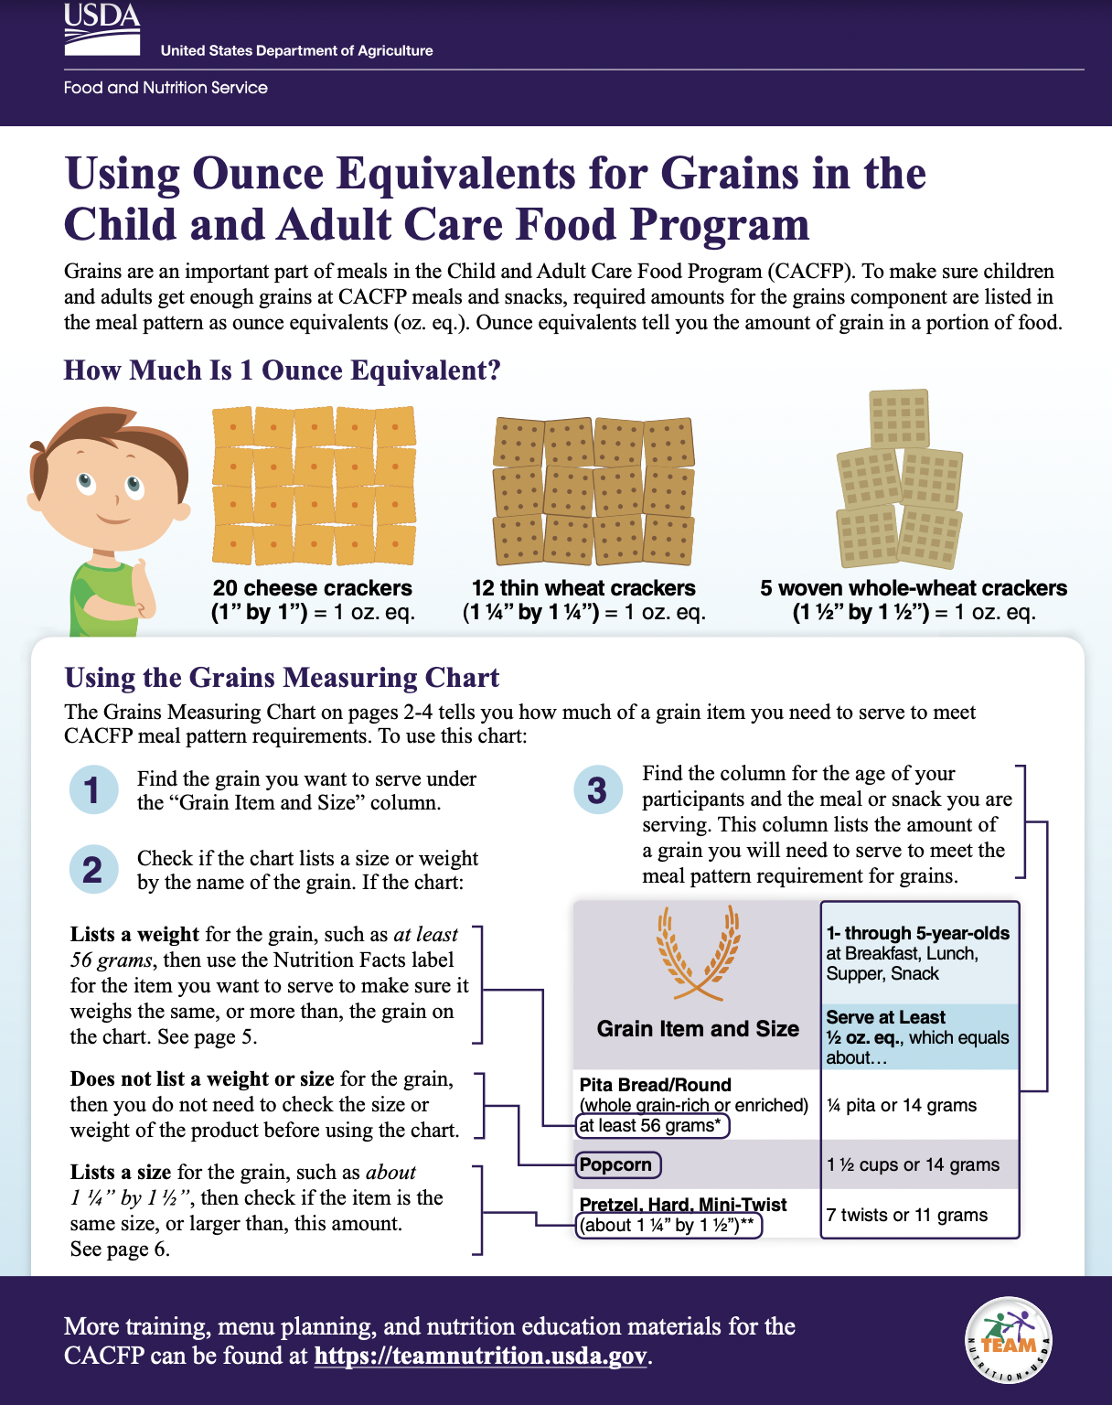
Using the Grains Measuring Chart
Notes:
Page 1 of the Using Ounce Equivalents for Grains in the CACFP resource gives three visuals of what one ounce equivalent looks like.
One ounce equivalent is the amount of food needed to make up 16 grams of grains.
As seen on the screen, there are three different types of crackers that all provide 1 ounce equivalent of grain.
It shows <click> twenty 1”x1” cheese crackers, <click> twelve 1 ¼” x 1 ¼” thin wheat crackers <click> , or five 1 ½” x 1 ½” woven whole-wheat crackers.
Also on this page are written instructions on how to use the Grains Measuring Chart <click> . In this training, we will go through these instructions step-by-step and provide the opportunity for participants to practice using the chart.

Slide 9
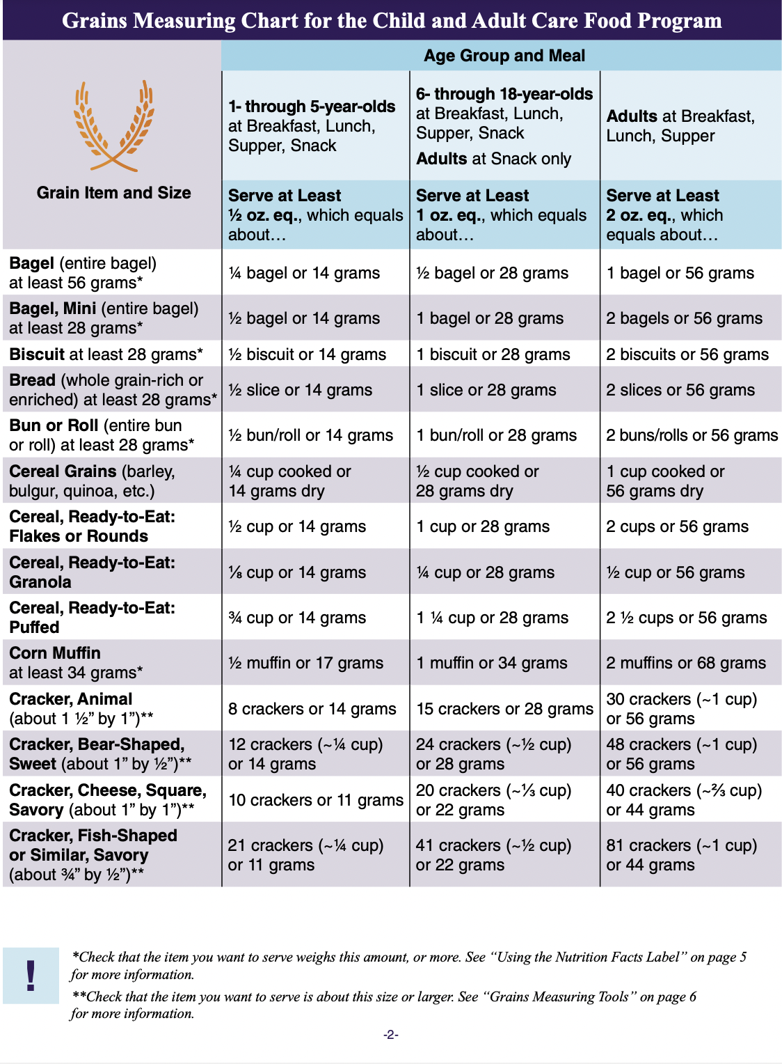
Using the Grains Measuring Chart
Notes:
Pages 2-4 of the Grains Measuring Chart include a list of over 40 of the most commonly used grain items in the CACFP in alphabetical order. While there are many items on this list, it is not all-inclusive.

Slide 10
Using the Grains Measuring Chart
Notes:
<click>
Column 1 in the Grains Measuring Chart shows the grain item and size.
<click>
Column 2 shows the amount of food needed to make a ½ ounce equivalent, which is the minimum required for 1-5-year-olds.
<click>
Column 3 shows the amount of food needed to make 1 ounce equivalent, which is the minimum required for 6-18-year-olds as well as adults at snack.
<click>
Column 4 shows the amount of food needed to make 2 ounce equivalents, which is the minimum required for adults at breakfast, lunch, and supper.

Slide 11
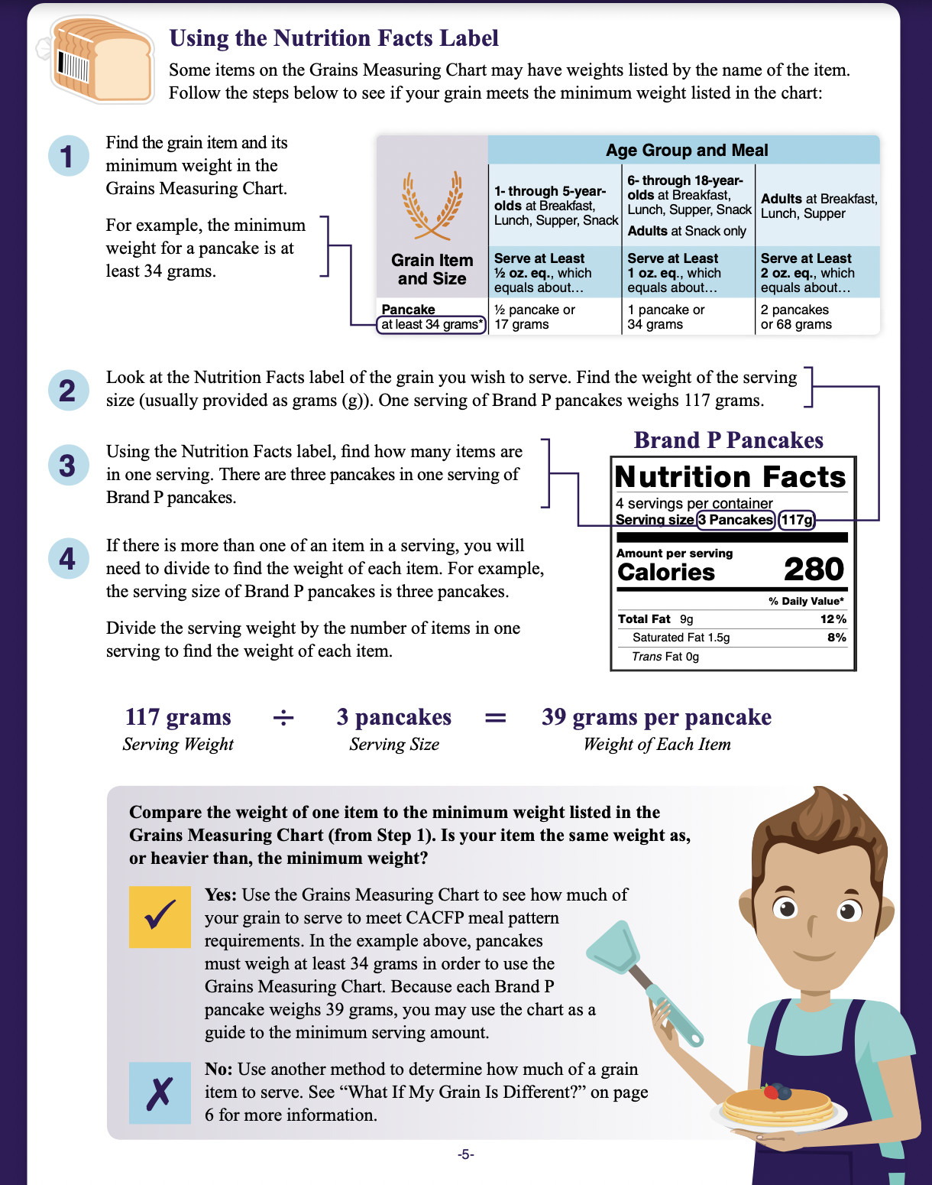
Using the Nutrition Facts Label
Notes:
Page 5 provides instructions on how to use the Nutrition Facts Label to determine if the grain that is being served meets the minimum weight that is listed next to items in the Grains Measuring Chart.
Don’t worry, this training will also cover these instructions and provide the opportunity to practice.

Slide 12
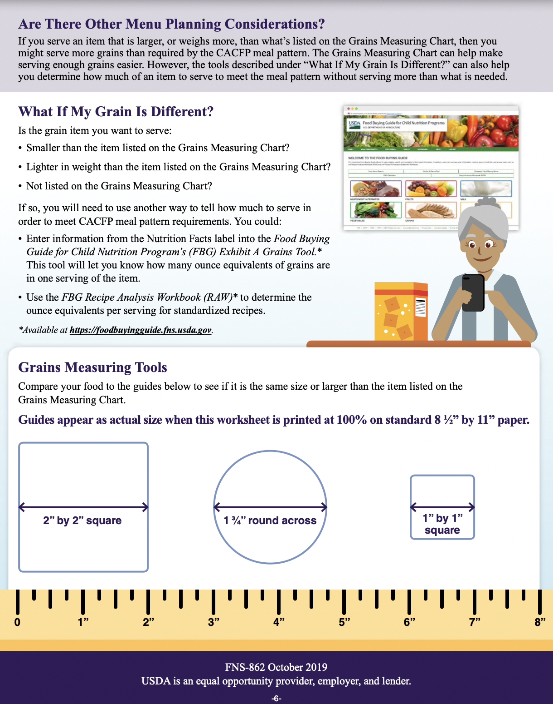
Using the Grains Measuring Tool
Notes:
<click>
Page 6 provides options on what to do if the grain being served is different from those on the chart. We will discuss later in this training what to do if you come across this situation.
It also includes the Grains Measuring Tool.
<click>
When this worksheet is printed at 100% on standard 8 ½” x 11” paper, the guide is actual size. This can be used to measure crackers and other grain items to see if it fits the minimum required size that is listed next to some items in the Grains Measuring Chart.

Slide 13
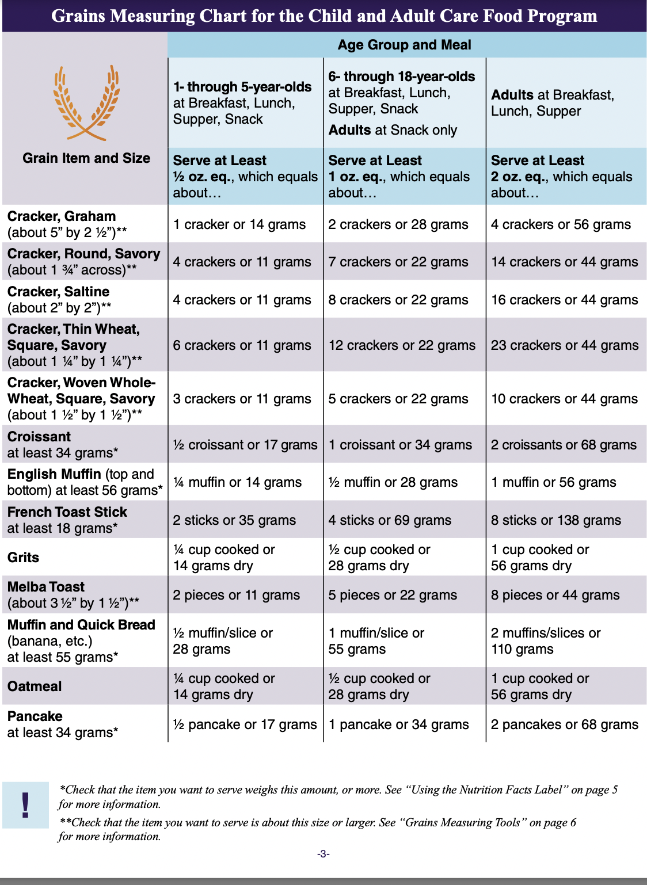
Example 1…
A sponsor is menu planning for a group of 5-year-olds for breakfast and wants to serve oatmeal. What is the minimum portion size per child that must be served?
Notes:
Now that we know what each page of the Using Ounce Equivalents for Grains in the CACFP worksheet contains, let’s try an example of how to use this tool together!
A sponsor is menu planning for a group of 5-year-olds for breakfast and wants to serve oatmeal. What is the minimum portion size per child that must be served?

Slide 14
Example 1…
A sponsor is menu planning for a group of 5-year-olds for breakfast and wants to serve oatmeal. What is the minimum portion size per child that must be served?
Step 1: Find the grain item in the Grain Item and Size column.
Notes:
Step 1 is to find the grain item under the Grain Item and Size column and check to see if it has a size or weight listed along with it.
<click>
In this example, oatmeal is the grain being served. Oatmeal does not have a size or weight listed next to it, so there is no need to check the size or weight of the item before using the chart.

Slide 15
Example 1…
A sponsor is menu planning for a group of 5-year-olds for breakfast and wants to serve oatmeal. What is the minimum portion size per child that must be served?
Step 2: Find the age group of the participants that are being served.
Notes:
After locating the grain item on the chart, step 2 is to find the age of the participants that are being served.
<click>
In this example the menu is being planned for 5-year-olds, so use the 1- through 5-year-olds column.

Slide 16
Example 1…
A sponsor is menu planning for a group of 5-year-olds for breakfast and wants to serve oatmeal. What is the minimum portion size per child that must be served?
Step 3: Find where the age group and the grain item intersect.
The minimum portion is 1/4 cup cooked or 14 grams dry oatmeal.
Notes:
After locating the item being served as well as the age group that is being served, step 3 is to find where the item and age group intersect on the Grains Measuring Chart.
<click>
The oatmeal row and the 1- through 5-year-olds column intersect at ¼ cup cooked or 14 grams dry.
<click>
This tells us that we need to serve, at a minimum, 1/4 cup cooked or 14 grams dry oatmeal per child to meet the minimum amount of grains required for 1- through 5-year-olds at breakfast in the CACFP.

Slide 17
Example 2…
A sponsor is menu planning for a group of 4-year-olds for lunch and wants to serve graham crackers. What is the minimum portion size per child that must be served?
Notes:
Let’s try one additional example.
A sponsor is menu planning for a group of 4-year-olds for lunch and wants to serve graham crackers. What is the minimum portion size per child that must be served?

Slide 18
Example 2…
A sponsor is menu planning for a group of 4-year-olds for lunch and wants to serve graham crackers. What is the minimum portion size per child that must be served?
Step 1: Find the grain item in the Grain Item and Size column.
Notes:
Step 1 is to find the grain item under the Grain Item and Size column and check to see if it has a size or weight listed along with it.
<click>
In this example, graham crackers are the grain item being served. Graham crackers do have a size listed by them, so you would need to measure them to see if they are 5” x 2.5” or larger.
Remember, when the Grains Measuring Chart is printed at full size, it provides an accurate ruler on the page to measure grain items with.

Slide 19
Example 2…
A sponsor is menu planning for a group of 4-year-olds for lunch and wants to serve graham crackers. What is the minimum portion size per child that must be served?
Step 2: Find the age group of the participants that are being served.
Notes:
After locating the grain item on the chart, step 2 is to find the age of the participants that are being served.
<click>
In this example the menu is being planned for 4-year-olds, so use the 1- through 5-year-olds column.

Slide 20
Example 2…
A sponsor is menu planning for a group of 4-year-olds for lunch and wants to serve graham crackers. What is the minimum portion size per child that must be served?
Step 3: Find where the age group and the grain item intersect.
The minimum portion is 1 cracker or 14 grams per child.
Notes:
After locating the item being served as well as the age group that is being served, step 3 is to find where the item and age group intersect on the Grains Measuring Chart.
<click>
The graham cracker row and the 1- through 5-year-olds column intersect at 1 cracker or 14 grams.
<click>
This tells us that we need to serve, at a minimum, 1 cracker or 14 grams per child to meet the required amount.

Slide 21
Poll #1
Based on the chart shown, what is the minimum number of animal crackers that must be served to a classroom of 3-year-olds at lunch per child?
2 crackers
5 crackers
8 crackers
10 crackers
Notes:
Now that we have gone through two examples together, it is your turn to try!
Based on the chart shown, what is the minimum number of animal crackers that must be served to a classroom of 3-year-olds at lunch?
Is it A. 2 crackers, B. 5 crackers, C. 8 crackers, or D. 10 crackers?
<Give participants time to respond>
<Click to reveal answer>
Based on the grains measuring chart, 8 crackers is the minimum amount that must be served to a classroom of 3-year-olds at lunch.
Good job everyone!

Slide 22
Poll #2
Based on the chart shown, what is the minimum slices of bread that must be served per child to a group of 3-year-olds at lunch?
½ slice
1 slice
2 slices
2 ½ slices
Notes:
Let’s do one more poll to get more comfortable using the Grains Measuring Chart.
Based on the chart shown, what is the minimum slices of bread that must be served per child to a group of 3-year-olds at lunch?
Is it A. ½ slice, B. 1 slice, C. 2 slices, or D. 2 ½ slices?
<Give participants time to respond>
<Click to reveal answer>
The answer is 1/2 slice or 14 grams.
Great job everyone! Wasn’t that easy!
<Pause and ask for questions>
Now that we have gone over the grains measuring tool, let’s take a look at how to use the Nutrition Facts Label.

Slide 23
Using the Nutrition Facts Label with the Grains Measuring Chart

Slide 24
Using the Nutrition Facts Label
Some of the grain items in the Grains Measuring Chart list a weight next to the item.
Pancake
at least 34 grams*
Notes:
Some of the grain items in the Grains Measuring Chart list a weight next to the item.
For example, pancakes list a minimum weight of 34 grams.
<click>
Let’s take a closer look on how to use the Grains Measuring Chart for items that have a weight listed next to them.

Slide 25
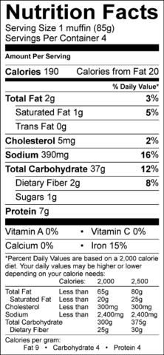
Example 3…
A sponsor is serving English muffins to a group of 3-year-olds at breakfast. Based on the nutrition facts label, will this brand of English muffins meet the minimum grain requirement?
Notes:
A sponsor is wanting to serve English muffins to 3-year-olds at breakfast. Based on the nutrition facts label, will this brand of English muffins meet the minimum grain requirement?

Slide 26
Example 3…
A sponsor is serving English muffins to a group of 3-year-olds at breakfast. Based on the nutrition facts label, will this brand of English muffins meet the minimum grain requirement?
Step 1: Find the grain item you want to serve as well as the minimum grams that must be served.
Notes:
Step 1 is to find the grain item that is being served under the Grain Item and Size column as well as the minimum weight that is listed.
<click>
In this example, an English muffin lists the minimum weight of 56 grams. Remember, this is important because there can be a wide variety of sizes of English muffins!

Slide 27
Example 3…
A sponsor is serving English muffins to a group of 3-year-olds at breakfast. Based on the nutrition facts label, will this brand of English muffins meet the minimum grain requirement?
Step 2: Locate the nutrition facts label for the grain item you want to serve.
Notes:
Once we know what the minimum required weight for the item is, step 2 is to locate the nutrition facts label for the grain item that is being served.
The nutrition facts label for this brand of English muffins can be seen on the screen.

Slide 28
Example 3…
A sponsor is serving English muffins to a group of 3-year-olds at breakfast. Based on the nutrition facts label, will this brand of English muffins meet the minimum grain requirement?
Step 3: Using the Nutrition Facts Label, find the weight of the serving size (typically in grams) of the item you are wanting to serve.
Notes:
Once the Nutrition Facts Label is located, the 3rd step is to find the weight of the serving size, which is typically listed in grams, of the item that is being served.
<click>
This label for English muffins tells us that one English muffin weighs 85 grams.

Slide 29
Example 3…
A sponsor is serving English muffins to a group of 3-year-olds at breakfast. Based on the nutrition facts label, will this brand of English muffins meet the minimum grain requirement?
Step 4: Look back at the Grains Measuring Chart to make sure that the weight of the grain item weighs more than the weight listed on the chart.
Notes:
Now that we know that each serving weighs 85 grams, look back at the Grains Measuring Chart to make sure that the weight of the grain item weighs the same as or more than the weight listed on the chart.
<click>
In this example, we are serving 3-year-olds, so the minimum required to serve is ¼ muffin or 14 grams, so this brand of English muffins meet this requirement.
Remember, the whole muffin can be served, but it would be acceptable to serve only half or a quarter as well, as long as it meets the 14 gram minimum.

Slide 30
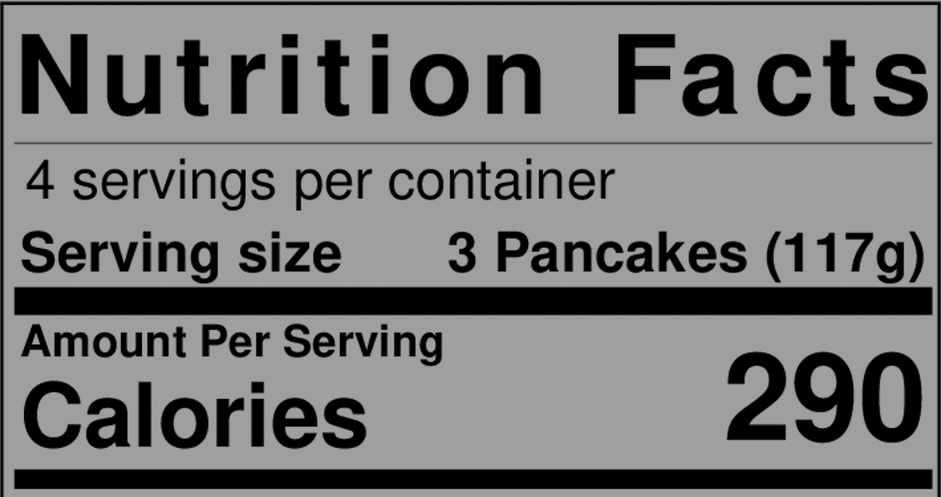
Example 4…
A sponsor is serving Brand P Pancakes to a group of 2-year-olds at breakfast. Based on the nutrition facts label, will Brand P Pancakes meet the minimum grain requirement?
Notes:
See, wasn’t that easy? Now let’s take it one step further!
What if there is more than one item per serving?
Let’s take a closer look!
A sponsor is wanting to serve Brand P pancakes to a classroom of 1-5-year-olds at breakfast. Based on the nutrition facts label, will Brand P Pancakes meet the minimum grain requirement?

Slide 31
Example 4…
A sponsor is serving Brand P Pancakes to a group of 2-year-olds at breakfast. Based on the nutrition facts label, will Brand P Pancakes meet the minimum grain requirement?
Step 1: Find the grain item you want to serve as well as the minimum grams that must be served.
Notes:
Step 1 is to find the grain item that is being served under the Grain Item and Size column as well as the minimum weight that is listed.
<click>
In this example, a pancake lists the weight of 34 grams. The reason this weight is important is that there can be a wide array of pancake sizes, anywhere from mini pancakes to pancakes that are the size of your head!

Slide 32
Example 4…
A sponsor is serving Brand P Pancakes to a group of 2-year-olds at breakfast. Based on the nutrition facts label, will Brand P Pancakes meet the minimum grain requirement?
Step 2: Locate the nutrition facts label for the grain item you want to serve.
Notes:
Once we know what the minimum required weight for the item is, step 2 is to locate the nutrition facts label for the grain item that is being served.
The nutrition facts label for Brand P Pancakes can be seen on the screen.

Slide 33
Example 4…
A sponsor is serving Brand P Pancakes to a group of 2-year-olds at breakfast. Based on the nutrition facts label, will Brand P Pancakes meet the minimum grain requirement?
Step 3: Using the Nutrition Facts Label, find the weight of the serving size (typically in grams) of the item you are wanting to serve.
Notes:
Once the Nutrition Facts Label is located, the 3rd step is to find the weight of the serving size, which is typically listed in grams, of the item that is being served.
<click>
This label for Brand P Pancakes tells us that one serving of pancakes weighs 117 grams.

Slide 34
Example 4…
A sponsor is serving Brand P Pancakes to a group of 2-year-olds at breakfast. Based on the nutrition facts label, will Brand P Pancakes meet the minimum grain requirement?
Step 4: Using the Nutrition Facts Label, find how many items are in one serving.
Notes:
Step 4 is to use the Nutrition Facts label to determine how many items are in one serving.
<click>
This label for Brand P pancakes reveals that there are 3 pancakes in 1 serving.

Slide 35
Example 4…
A sponsor is serving Brand P Pancakes to a group of 2-year-olds at breakfast. Based on the nutrition facts label, will Brand P Pancakes meet the minimum grain requirement?
Step 5: Take the weight of the serving size divided by the number of items in the serving to determine if it meets the minimum requirement or not.
117 grams ÷ 3 pancakes =
39 grams per pancake
Notes:
Now that we know that each serving weighs 117 grams and has 3 pancakes in one serving, a simple calculation will determine if the weight of each pancake is the same as, less than, or greater than the minimum weight requirement.
<click>
Take the weight of the serving, which is 117 grams, divided by the number of items in a serving, which is 3. This tells us that each pancake weighs 39 grams.

Slide 36
Example 4…
A sponsor is serving Brand P Pancakes to a group of 2-year-olds at breakfast. Based on the nutrition facts label, will Brand P Pancakes meet the minimum grain requirement?
Step 5: Take the weight of the serving size divided by the number of items in the serving to determine if it meets the minimum requirement or not.
117 grams ÷ 3 pancakes =
39 grams per pancake
Notes:
In the last slide it was determined that each pancake weighs 39 grams. This is more than the 34 grams that is listed in the chart so Brand P pancakes meet the size listed in the grain item and size column.
<click>
In this example, we are serving 2-year-olds so the minimum required to serve is ½ a pancake or 17 grams, so Brand P pancakes meet this requirement.
Just a reminder that even though one serving size for Brand P pancakes is 3 pancakes, that does not mean that 3 pancakes have to be served.
The item served just has to meet the minimum requirement for weight.

Slide 37
Example 5…
A sponsor is serving mini pancakes to a group of 2-year-olds at breakfast. Based on the nutrition facts label, how many mini pancakes will need to be served to meet the minimum requirement?
Step 1: Find the grain item you want to serve as well as the minimum grams that must be served.
Notes:
A common item served for breakfast in the CACFP is mini pancakes. Let’s do an example of what to do if this item is being served.
Step 1 remains the same, find the grain item you want to serve as well as the minimum grams that must be served.
<click>
In the last example we used Brand P Pancakes, and in this example we are using mini pancakes. Both are pancakes, but of different sizes! This is the reason there is a weight listed by the grain item.

Slide 38
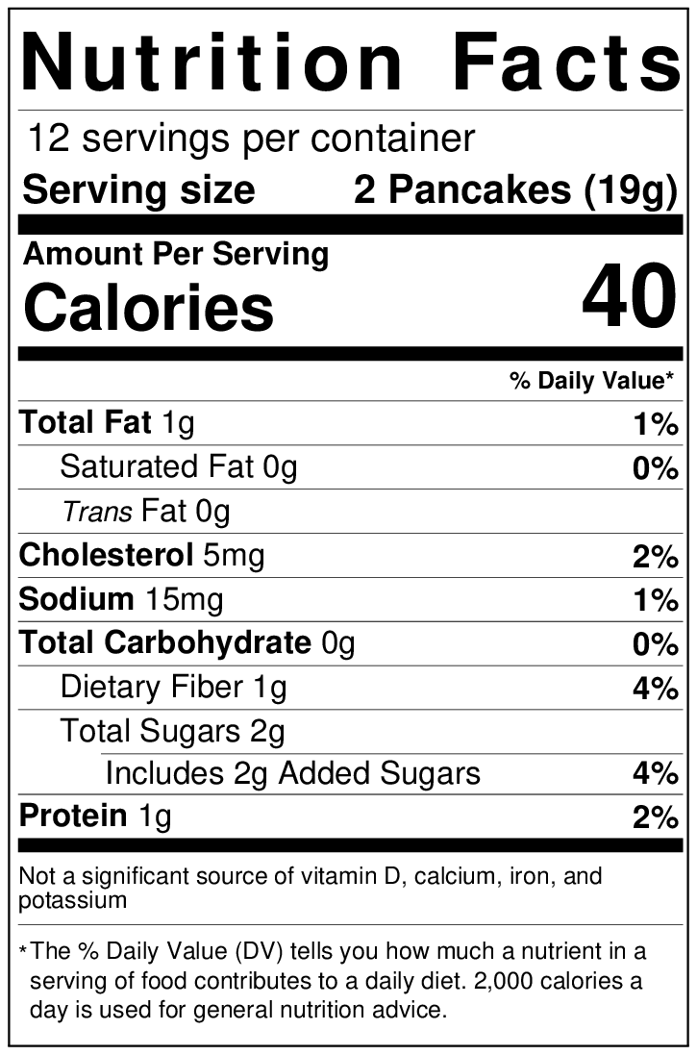
Example 5…
A sponsor is serving mini pancakes to a group of 2-year-olds at breakfast. Based on the nutrition facts label, how many mini pancakes will need to be served to meet the minimum requirement?
Step 2: Locate the nutrition facts label for the grain item you want to serve.
Notes:
Step 2 also remains the same, locate the nutrition facts label for the grain item that is being served.
The nutrition facts label for mini pancakes is shown on the screen.

Slide 39
Example 5…
A sponsor is serving mini pancakes to a group of 2-year-olds at breakfast. Based on the nutrition facts label, how many mini pancakes will need to be served to meet the minimum requirement?
Step 3: Using the Nutrition Facts Label, find the weight of the serving size (typically in grams) of the item you are wanting to serve.
Notes:
Once the Nutrition Facts Label is located, the next step is to find the weight of the serving size of the item that is being served.
<click>
This label for mini pancakes tells us that one serving of pancakes weighs 19 grams.

Slide 40
Example 5…
A sponsor is serving mini pancakes to a group of 2-year-olds at breakfast. Based on the nutrition facts label, how many mini pancakes will need to be served to meet the minimum requirement?
Step 4: Using the Nutrition Facts Label, find how many items are in one serving.
Notes:
Step 4 is to use the Nutrition Facts label to determine how many items are in one serving.
<click>
This label for mini pancakes reveals that there are 2 pancakes in 1 serving.

Slide 41
Example 5…
A sponsor is serving mini pancakes to a group of 2-year-olds at breakfast. Based on the nutrition facts label, how many mini pancakes will need to be served to meet the minimum requirement?
Step 5: Take the weight of the serving size divided by the number of items in the serving to determine if it meets the minimum requirement or not.
19 grams ÷ 2 pancakes =
9.5 grams per pancake
Notes:
Now that we know that each serving weighs 19 grams and has 2 mini pancakes in one serving, a simple calculation will determine if the weight of each pancake is the same as, less than, or greater than the minimum weight requirement.
<click>
Take the weight of the serving, which is 19 grams, divided by the number of items in a serving, which is 2. This tells us that each pancake weighs 9.5 grams.

Slide 42
Example 5…
A sponsor is serving mini pancakes to a group of 2-year-olds at breakfast. Based on the nutrition facts label, how many mini pancakes will need to be served to meet the minimum requirement?
Step 5: Take the weight of the serving size divided by the number of items in the serving to determine if it meets the minimum requirement or not.
17 grams ÷ 9.5 grams =
1.79 pancakes = 2 pancakes
Notes:
In the last slide it was determined that each pancake weighs 9.5 grams. This is less than the 34 grams that is listed in the chart so all this means is that multiple pancakes must be served to meet the minimum weight requirement.
In this example, <click> we are serving 2-year-olds so the minimum required to serve is ½ a pancake or 17 grams, so we need to do another quick math problem to determine how many mini pancakes need to be served.
<click>
Take the minimum weight needed for the age group, 17 grams divided by 9.5 grams, weight of one pancake, to get the minimum number of pancakes that are needed to be served. In this example, that equals 1.79 pancakes. It isn’t realistic or practical to serve 1.79 pancakes; therefore round up to the nearest whole number. In this example, 2 pancakes.

Slide 43
Example 6…
A sponsor is serving the same mini pancakes to a group of school age children at breakfast. Based on the nutrition facts label, how many mini pancakes will need to be served to meet the minimum requirement?
Step 5: Take the weight of the serving size divided by the number of items in the serving to determine if it meets the minimum requirement or not.
34 grams ÷ 9.5 grams =
3.5 pancakes = 4 pancakes
Notes:
Let’s assume that this same child care site is also serving school age children, how many mini pancakes would need to be served for this age group?
Most of the work has already been done for this product from the previous example.
Since children aged 6-18 would need to be served a minimum of 34 grams worth of mini pancakes. To figure out many mini pancakes this would be equal to, <click> take 34 grams divided by 9.5 grams, which is the weight of each pancake, to get the minimum number of pancakes that are needed to be served.
This equals 3.5 pancakes, which is the minimum number of pancakes that need to be served. However, its unlikely that a center would serve 3.5 pancakes so the site would need to round up to 4 pancakes. Please note that sites cannot round down to 3 pancakes as that would not meet the minimum meal pattern requirements.
<Pause and ask for questions>

Slide 44
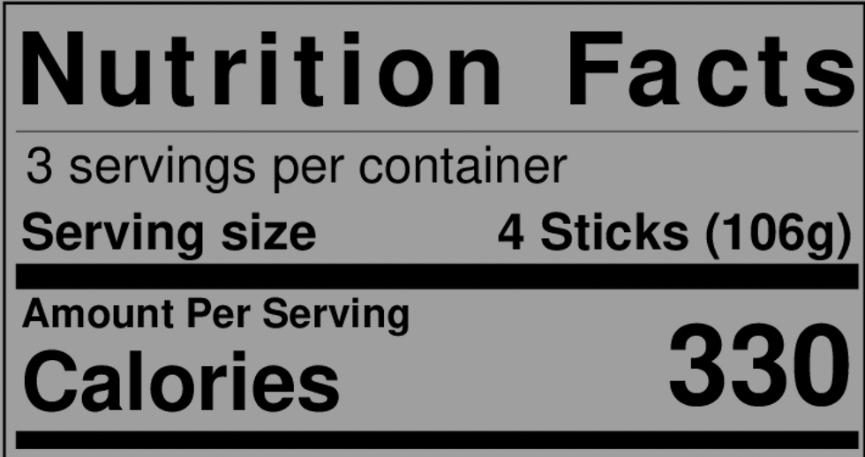
Poll #3
Based on the Nutrition Facts Label provided, will this brand of French Toast Sticks meet the minimum weight requirement for grains?
Yes
No
106 grams ÷ 4 sticks =
26.5 grams per stick
Notes:
Now that we have done two examples together, it is your turn to try!
Based on the Nutrition Facts Label on the screen, will this brand of French Toast sticks meet the minimum requirement for grains?
Is it A. Yes, or B. No?
<Give participants time to respond then click to reveal answer>
The answer is yes, it meets the minimum requirement.
<click>
Let’s review how this was determined.
First, locate the item under the Grain Item and Size column, as well as the minimum weight that is listed.
<click>
In this example, locate French Toast Sticks. The minimum weight listed is 18 grams per stick.
Then look at the Nutrition Facts Label and find the serving size and weight.
<click>
For this product, 4 sticks equals 106 grams.
A simple calculation will determine if this brand of French Toast Sticks meet the minimum weight requirement.
<click>
Take 106 grams divided by 4 sticks to equal 26.5 grams per stick.
This is more than the 18-gram minimum, so it meets the requirement!

Slide 45
Poll #4
What is the minimum number of French Toast Sticks that must be served to a group of 1-5-year-olds at breakfast?
1 stick
2 sticks
3 sticks
4 sticks
Notes:
Now let’s take it one step further..
Sticking with the same brand of French Toast Sticks from our last poll, what is the minimum number of French Toast Sticks that must be served to a group of 1-5-year-olds at breakfast?
Is it A.1 stick, B. 2 sticks, C. 3 sticks, or D. 4 sticks?
<Give participants time to respond>
<Click to reveal answer>
The answer is 2 sticks!
This is because 1 French Toast Stick weighed 26.5 grams which is less than the 35 grams required for breakfast for 1-5-year-olds, therefore 2 French toast sticks must be served to meet the minimum.
It is important to keep in mind that the 2 sticks or 35 grams is just the minimum, it is okay to serve more than the minimum, just not less.

Slide 46
Summary
An ounce equivalent is a method of measurement for the grains component in the Child and Adult Care Food Program
As of October 1, 2021, ounce equivalents must be used to calculate the grains component in the Child and Adult Care Food Programs (CACFP).
The Grains Measuring Chart can be used to determine how much of a food item to serve to meet the minimum requirement in the CACFP.
Notes:
Thank you so much for following along in today’s Quick-Train on Grains.
To summarize everything we learned, we went over the definition of ounce equivalents and when that will come into affect in the CACFP, we learned how to use the Grains Measuring Chart to calculate the grains component, and we learned how to use the Nutrition Facts Label to determine if a grain item meets the minimum requirement for grains in the CACFP.

Slide 47
USDA Nondiscrimination Statement
In accordance with Federal civil rights law and U.S. Department of Agriculture (USDA) civil rights regulations and policies, the USDA, its Agencies, offices, and employees, and institutions participating in or administering USDA programs are prohibited from discriminating based on race, color, national origin, sex, disability, age, or reprisal or retaliation for prior civil rights activity in any program or activity conducted or funded by USDA. Persons with disabilities who require alternative means of communication for program information (e.g. Braille, large print, audiotape, American Sign Language, etc.), should contact the Agency (State or local) where they applied for benefits. Individuals who are deaf, hard of hearing or have speech disabilities may contact USDA through the Federal Relay Service at (800) 877-8339. Additionally, program information may be made available in languages other than English. To file a program complaint of discrimination, complete the USDA Program Discrimination Complaint Form, (AD-3027) found online at: https://www.usda.gov/oascr/how-to-file-a-program-discrimination-complaint, and at any USDA office, or write a letter addressed to USDA and provide in the letter all of the information requested in the form. To request a copy of the complaint form, call (866) 632-9992. Submit your completed form or letter to USDA by:
(1) Mail: U.S. Department of Agriculture
Office of the Assistant Secretary for Civil Rights
1400 Independence Avenue, SW
Washington, D.C. 20250-9410;
(2) Fax: (202) 690-7442; or (3) Email: program.intake@usda.gov. This institution is an equal opportunity provider.

Slide 48
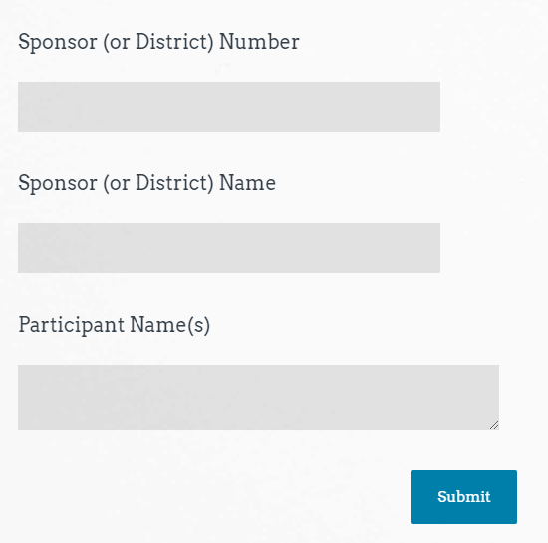
Class Attendance
Sample
https://www.surveymonkey.com/r/MKCRVXM
Thank you for Attending!
Please contact us whenever you need assistance.
785-296-2276
Child Nutrition & Wellness
www.kn-eat.org
Quick Train on Grains
Attendance
Notes:
Class attendance will be conducted electronically through Survey Monkey. Participants must complete the survey to receive a certificate of completion. Participants may use their phones, laptops, or nutrition program computer to access the survey electronically. Enter the link provided into the address bar of preferred web browser. If using a mobile device with a QR Code reader, scan the QR code that will be provided on the screen at the end of the session.
The attendance survey set up so that a lead person, such as the Director, can enter multiple names on the comment line of the attendance survey in Survey Monkey. This should make it easier to track group participation in the electronic delivery of these classes.

Slide 49
Thank you for Attending!
Please contact us whenever you need assistance.
Child Nutrition & Wellness
785-296-2276
www.kn-eat.org

