Slide 1
Reducing the Risk of Choking
Child Nutrition & Wellness
To receive the slide handout for this presentation:
Email: Sarah Bruschi at sbruschi@ksde.org
Subject: Reducing the Risk of Choking Slide Handout
Notes:
Show this slide as the participants arrive.
Turn on live transcription.
Start Recording – to cloud.
Post slides in chat box.
Welcome the participants as they enter the room and perform periodic sound checks prior to the start of the class. As participants enter the zoom class, explain that the slide handout can be downloaded from the chat box OR emailed to them by sending an email to the person listed on the slide. Encourage participants to practice the mute/unmute and chat features of Zoom while waiting for the class to begin.
At the designated starting time, thank participants for coming, introduce yourself and co-presenters and welcome them to the class.
Welcome to Reducing the Risk of Choking!
Children under the age of 4 are at a high risk of choking while eating. Young children are still learning how to chew food properly, and they often swallow food whole and their small airways can become easily blocked. This training will discuss actions child care providers can take to help reduce children’s risk of choking when eating.

Slide 2
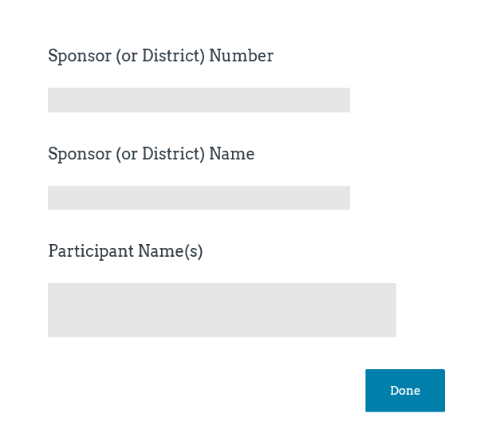
Class Logistics
Class ending time
Participant materials
Recorded class
Mute and unmute features
Q&A protocol
Attendance
Sample
Notes:
Inform participants this is a one hour class and will end by __________(insert time that is one hour from planned start time).
Explain that the Slide Handout is available upon request as an email attachment. Add contact information to chat box by copying and pasting from title slide.
Let participants know that the class will be recorded (reminder to be sure to record class to the Cloud).
Inform participants that they can mute and unmute their audio. When in “unmute” mode, their conversations and background noise can be heard.
Encourage participants to ask questions and provide comment as appropriate to the class content. Explain that participants may ask questions or provide input by unmuting their audio or typing in the chat box.
Attendance will be taken at the end of class via a Survey Monkey survey. It is important to complete the Attendance Survey in order to receive a Certificate of Completion for the class. The Attendance Survey will ask for three pieces of information, Sponsor Number, Sponsor Name, and Names of Attendees. For example, Sponsor Number for a public school is the USD designation. Sponsor Name for a public school is the name of the school district. Multiple attendees from one Sponsor can be included in a single Attendance Survey.

Slide 3
Objectives
Providers will learn actionable steps that can be taken to reduce a child’s risk of choking by:
Learning about developmental readiness for the introduction and advancement of solid foods when feeding infants.
Identifying choking hazards for infants, toddlers and young children.
Identifying food preparation methods to prepare foods that are easy to chew and swallow.
Identifying and discussing tips to teach good eating habits during meal time.
Notes:
The safety of children in any child care setting is of utmost importance and today providers will learn actionable steps that can be taken to reduce a child’s risk of choking by: Read bullets on slide.

Slide 4
Pre Assessment
All of the following finger foods are creditable in the CACFP infant meal pattern and can be prepared the right way to avoid choking, except:
Small strips of bread
Grapes cut into quarters
Peanut butter or other nut butters
Soft cooked, chopped vegetables
A parent brings in a container of whole grapes for her 11-month-old. To build a good partnership with the family, which of the responses may be better to say?
I will be happy to serve these to your child at the next meal, just as they are.
Fruits are always an excellent choice. To make these safer and reduce choking risk, I will cut these grapes in quarters before I serve them to your child.
Grapes are not creditable in the CACFP infant meal pattern.
None of the above
Which of the following are signs an infant is developmentally ready to start solid foods?
Able to sit in a high chair and hold his or her head up
Able to move his or her tongue to help swallow food
Opens mouth when foods come towards him or her
All of the above
Cut soft foods into small pieces no larger than how many inches to reduce the risk of choking?
1 inch
¾ inch
½ inch
¼ inch
True or False:
Gagging is a natural reflex that prevents choking.
Notes:
Before we begin let’s take a quick quiz. Don’t worry, you won’t be graded and we will discuss the answers at the end of the training! You can write your answers down on a piece of paper or if you have a mind that is like a steel trap then you can simply remember your answers! . (Click to reveal the question, click to clear the question, etc.)
1. True/False: Gagging is a natural reflex that prevents choking.
2. Which of the following are signs an infant is developmentally ready to start solid foods?
Able to sit in a high chair and hold his or her head up
Able to move his or her tongue to help swallow food
Opens mouth when foods come towards him or her
All of the above
3. Cut soft foods into small pieces no larger than how many inches to reduce the risk of choking?
1 inch
¾ inch
½ inch
¼ inch
4. All of the following finger foods are creditable in the CACFP infant meal pattern and can be prepared the right way to avoid choking, except:
Small strips of bread
Grapes cut into quarters
Peanut butter or other nut butters
Soft cooked, chopped vegetables
5. A parent brings in a container of whole grapes for her 11-month-old. To build a good partnership with the family, which of the responses may be better to say?
I will be happy to serve these to your child at the next meal, just as they are.
Fruits are always an excellent choice. To make these safer and reduce choking risk, I will cut these grapes in quarters before I serve them to your child.
Grapes are not creditable in the CACFP infant meal pattern.
None of the above

Slide 5
Ages & Stages
Notes:
Let’s review some developmental milestones and eating behaviors of young children and approach choking prevention from a developmental perspective.

Slide 6
Young Children
Developmental perspective
Learning about their environment
Learning how to chew and move food around in the mouth
Trachea (wind pipe) is about the diameter of a drinking straw
Notes:
Children under the age of five are at the greatest risk for choking injury and death. The thought of a child choking is very frightening and as providers and adults caring for small children we want to take all the necessary precautions to prevent choking.
From a developmental standpoint learning how to eat is an opportunity for young children to learn about their environment. The actual process of learning how to eat involves several skills: learning to move the food around in the mouth, chewing food, moving food to the back of the mouth, swallowing and breathing all in quick succession. This is quite a big task! Just like anything else, children grow, learn and develop at different rates.
In young children, the tracheas or windpipe is the diameter of a drinking straw (and not the kind that comes with a super-size drink or milk shake either!). When food becomes stuck in the trachea choking occurs. With such a small diameter it is easy to understand why young children are at a greater risk for choking.

Slide 7
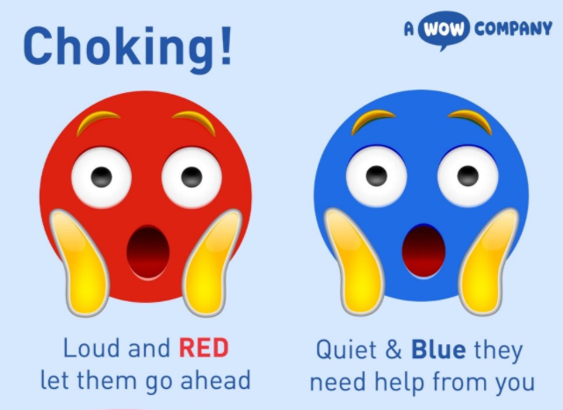
Gagging vs Choking
Gagging
Gagging is a safety mechanism that keeps the airway safe and is very sensitive
Gagging may be loud with coughing or sputtering
Tongue thrusts forward
Eyes may water a bit
Face may be red
Don’t intervene
Notes:
Often gagging is confused with choking. Regardless, gagging can be a bit scary but it is actually a safety mechanism against choking that helps children learn to manipulate food in their mouths.
When infants begin eating solids around 6 months, their gag reflex is actually farther forward in the mouth. The gag reflex moves farther back in the throat as they get older. Because of that, coughing and gagging and expelling food will be a common occurrence during those first few months of solids. Gagging helps to protect the airway and even prepares for a strong swallow!
If a child starts to cough or gag, give them time to work through it on their own. Don’t try and remove the food with your fingers initially- as you risk pushing it farther back and causing it to get lodged in the throat. In extreme cases, the child might actually vomit. Again, this is a perfectly normal and instinctual defense against choking.
Choking, on the other hand, means a piece of food has partially or completely blocked the windpipe. Whereas gagging involves a lot of coughing and gurgling, choking can cause high pitched sounds while breathing or may even be silent.
If you have determined that a child is choking then take appropriate action immediately as learned in the basic first aid or CPR training required by your facility.

Slide 8
Gagging vs Choking
Choking
Choking tends to be quiet or silent
Can’t talk or cry
May gasp or wheeze
Ineffective cough
Face will start to turn blue
Take action immediately!
Choking Posters available at https://www.keepabeat.com/chokinghazards
Notes:
Read slide.

Slide 9
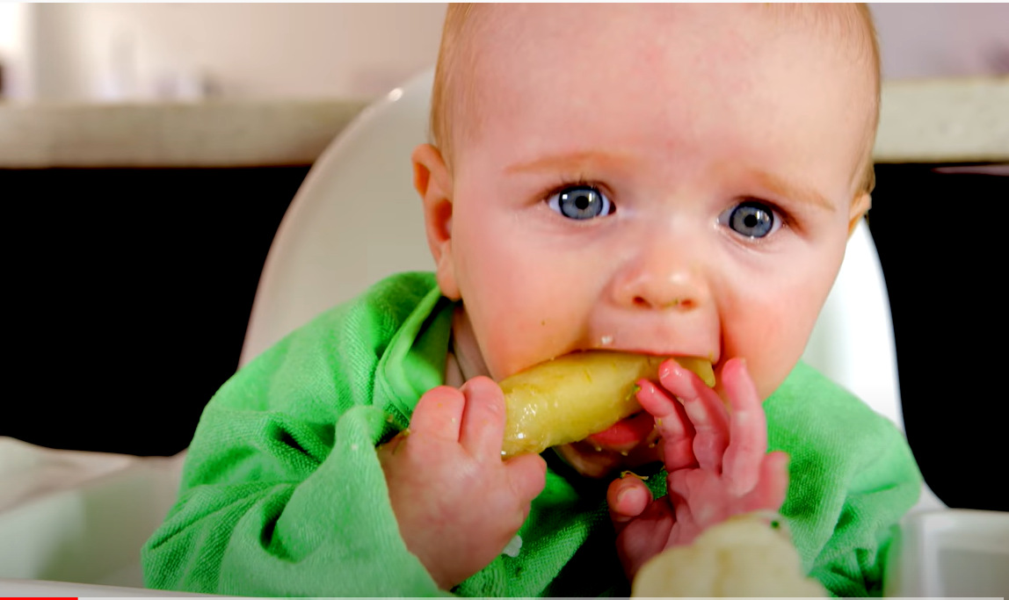
Gagging
Notes:
Show the short video clip from https://www.youtube.com/watch?v=uRrbZuP-pjk. Begin video clip at about 13 seconds end at 40 seconds.
When done watching the video clip ask participants which of the signs they notice from the previous slide.
That’s right, the child in the video showed the following:
Loud coughing and sputtering.
Tongue thrusted forward.
Watery eyes.
Face was slightly red
As you can see from the video the child ended up being fine but this certainly was a bit scary to watch- even as a video!

Slide 10
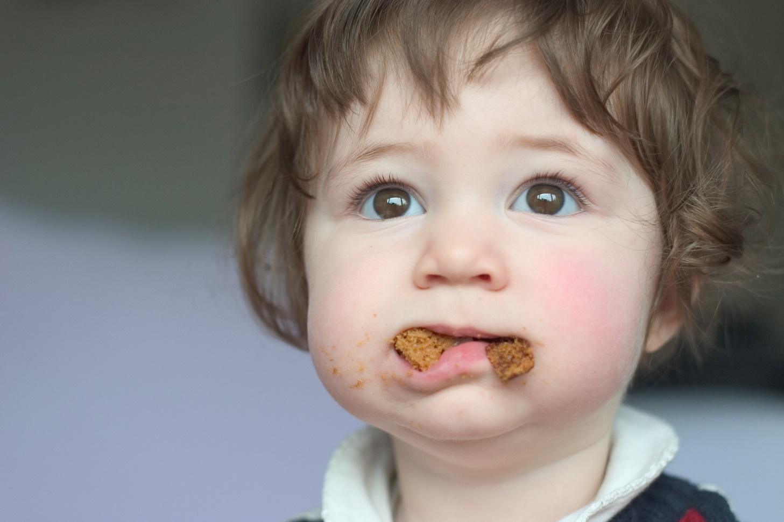
Other Developmental Behaviors
Overstuffing
Pocketing
Spitting food out
Notes:
Eating provides a very important opportunity for young children to learn about their environment through the taste and textures of food as well as to develop new skills.
Overstuffing and food pocketing can happen when children are eating too fast and haven't mastered chewing skills or he/she is excited about eating new flavors and textures and stuffs food in the mouth all at once! Sometimes young children stuff their mouths to learn about their mouths and the boundaries of their mouths or may simply be trying to figure out how much food is too much to put in the mouth.
Although typically not an acceptable adult behavior, spitting food out is a normal part of development.
In the case of overstuffing or pocketing, prevention is the best remedy because these can increase the risk of choking.

Slide 11
Overstuffing
Child is still learning how much food is too much.
Child enjoys playing and tasting the foods.
Child just doesn’t know how to take it slow…yet.
A phase that children go through as part of learning how to eat.
May be scary for adults to witness but it provides information to the child about their mouth and what’s on the inside of the mouth.
Notes:
Overstuffing is common in older infants and toddlers. Overstuffing occurs due to a variety of reasons:
Child is still learning how much food is too much.
Child enjoys playing and tasting the foods.
Child just doesn’t know how to take it slow…yet.
According to Kay Rappaport, pediatric occupational therapist and swallowing specialist with Solid Starts, food stuffing seems to be a phase most children go through and there’s good reason for it- they are learning where everything is inside their mouth. Since they can’t look at the inside of their mouth, they rely on touch sensation and feedback from the muscles in the tongue, jaw, and cheeks. This helps create what’s known as a “map” of the mouth. Imagine you are chewing a bite of omelet and suddenly crunch into a small bit of eggshell. A number of things happen at that moment.
You pause and immediately “picture” where that eggshell is located in your mouth.
You sift around the food in your mouth until you isolate the tiny eggshell.
You scoop it up and move it back to the front of your mouth with your tongue.
You spit it out.
You proceed to finish chewing and swallowing the bite of omelet in your mouth.
This level of sensory awareness within your mouth takes years to hone and is incredibly important to be able to safely chew and swallow a variety of food textures.
A child builds a road map of their mouth by biting down against a piece of food which touches multiple points in the child’s mouth at once (i.e., the tongue, gums, roof of the mouth and the lips) helps the child relate each of these areas to one another. In fact, the bigger, firmer, and more flavorful the piece of food, the more input it gives the child. When a child stuffs too much food in their mouth, they tend to get a really clear “picture” of what’s going on inside their mouth. It can be scary and risky, but it has a purpose!
Do not open video links in Internet Explorer.
Show 1 minute video clip of Julian stuffing kiwi in mouth at https://solidstarts.com/food-pocketing-why-baby-shoves-too-much-food-in-their-mouth/ .

Slide 12
Don’t Panic!
Do not panic or react quickly if a child overstuffs.
Can cause more harm!
Do not try to remove the food from the child’s mouth.
Provide verbal cues.
Notes:
One of the worst things that an adult can do when observing a child overstuffing is to react quickly or in a scared or panicked manner. This can scare the child and cause the child to gasp, take in a deep breath while the food is stuffed and can actually cause the child to choke. Remain calm, don’t try to remove the food from the child’s mouth because this can actually push the food back further into the mouth and cause the child to choke.
Modeling eating behaviors is a great way to teach children how to eat safely. When you observe a child overstuffing provide verbal cues such as “That looks like a lot of food in your mouth. Finish that bite first.” Or: “Slow down, you have too much in your mouth.” As adults we know that it is not good table etiquette to spit food out but in the case of overstuffing adults can coach the child to spit some of the food out.

Slide 13
Pocketing
Normal between 6-12 months.
Can occur when a child is eating too fast and hasn’t mastered chewing skills.
More serious choking risk than overstuffing.
Make sure that all food is cleared from the child’s mouth before leaving the meal table.
Notes:
We have all heard the term chipmunk cheeks and there is probably no cuter image than a small child with chipmunk cheeks! Although cute as it may be chipmunk cheeks or food pocketing can occur when a child is eating too fast and hasn’t mastered chewing skills.
Some children may accidentally pocket food, or the food moves to a place in the mouth where the child can’t quite get it back out. Other infants are purposeful in their pocketing — holding the food in the same spot every time because they don’t feel confident about safely swallowing.
Just like over-stuffing, food pocketing is often totally normal in 6-12-month-old infant as they map and learn the boundaries and spaces of their mouth. Pocketing should happen less as a infant builds the “map” of their mouth and develops the tongue coordination and jaw strength to successfully chew and swallow foods.
Over-stuffing the mouth may look more dangerous and scarier because you can see it. Pocketing can seem less dangerous possibly because it’s not as obvious and easy to miss. However, food pocketing may be more concerning than over-stuffing. The longer the food sits in a child’s mouth, the more likely the child will have moved on to something else, potentially unsupervised and forget all about the food, which is a serious choking risk. Pocketing also carries a significant risk for tooth decay and cavities as food sits for an extended period of time against the child’s teeth.

Slide 14
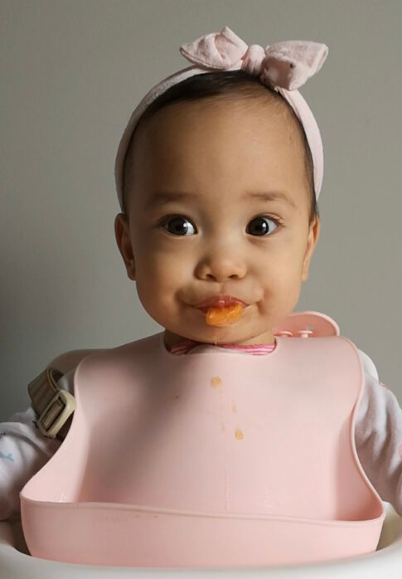
Spitting Food Out
Normal!
A necessary part of learning to eat
Doesn’t always mean the child doesn’t like the food- especially when it comes to babies
Notes:
Spitting food out is absolutely normal for an older infant. The ability to spit food out is actually a good thing- especially when it comes to overstuffing or pocketing food. Older infants will typically spit food out when they have put too much food in their mouth.

Slide 15
Starting Solids - Older Infants
Introduction of solid food around 6 months.
Offer when infant shows signs of developmental readiness:
Sits up
Good head control
Reaches for food or opens mouth when food is near
Accepts food and swallows instead of pushing food out of mouth
Feeding solid foods before an infant is developmentally ready may increase the risk of choking.
Notes:
Starting solid foods can be a time of great anxiety for parents and care givers due to choking risk worries that seem to loom over every bite a child takes. Rest assured that choking risks can be significantly reduced by waiting until an infant is developmentally ready to start solids.
Solid foods are foods that are easy and safe for a baby to eat once he or she is developmentally ready, usually around 6 months of age. Solid foods can be pureed, mashed, ground, or finely chopped to allow an older infant to swallow the food without choking.
Developmental readiness signs regarding food consistency and texture advancement include:
ability to sit up
good head control
reaches for food or opens mouth when food is near
accepts food and swallows food instead of pushing food out of mouth
Signs of developmental readiness are needed for the baby to eat solid foods safely. The CACFP infant meal pattern allows for solid foods starting around 6 months of age. The term “around” is used because not all babies are developmentally ready for solid foods at exactly 6 months of age. Some babies may be ready for solid foods at 5 months, others at 6½ months
It takes time for infants to master the ability to chew and swallow food, and infants might not be able to cough forcefully enough to dislodge an airway obstruction if they are not developmentally ready.

Slide 16
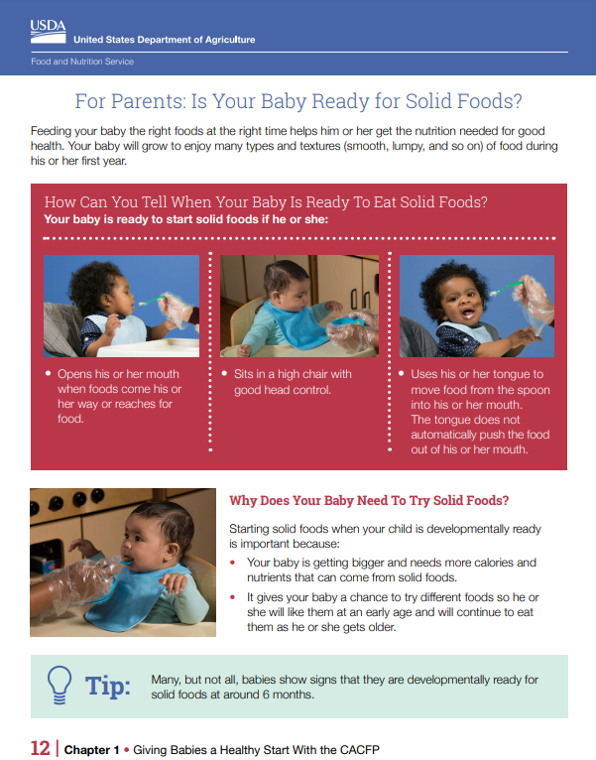
Ready for Solids
https://www.fns.usda.gov/tn/feeding-infants-child-and-adult-care-food-program
Notes:
If you've noticed signs that an infant in your care is ready for solid foods, you may also want to share the “For Parents: Is Your Baby Ready for Solid Foods?” handout to start the conversation with the infant’s parents or guardians. The handout can be found on the Feeding Infants in the Child and Adult Care Food Program webpage at the link shown on the slide. At this time, you may want to ask the baby’s parents to provide a written note or response about starting or delaying solid foods.

Slide 17
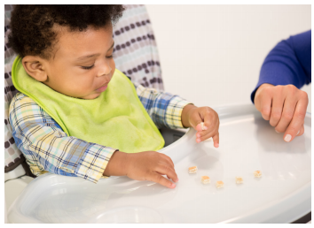
Toddlers & Young Children
Social skills
Self-expression
Confidence in self
Motor skills
Much more mobile!
Notes:
By 12 months old, toddlers are getting better at eating and are likely feeding themselves. Even though a toddler can eat most foods, some foods are still choking hazards. The way food is prepared may increase the risk for choking. Some foods that are served uncooked, whole or in certain shapes can still be a choking hazard for toddlers.
During the toddler stage it’s important to expose toddlers to a variety of nutritious foods so they learn to eat a balanced diet. Providers must not overlook that meal time is an important time for a toddler to develop social skills, learn and be able to express him/herself, but to also develop confidence in self and feeding abilities using their developing motor skills. Toddlers are much more mobile than older infants and can be more challenging to keep calm and seated during meal time. It is important that toddlers remain seated during meal time to decrease the risk of choking.

Slide 18
Let’s Talk About It!
Textures and consistencies play an important role in linguistical (language) development.
Waiting too long to feed solid foods can delay speech and motor development.
Notes:
Advancement of textures and consistencies helps with the development of muscles in the mouth and neck that also aid in lingual development. Simply put advancement of textures and consistencies helps infants and toddlers to learn how to talk! It can be scary when introducing new foods or even familiar foods that are served in a different shape or texture. But know that advancement of textures and consistencies are a necessary part of child development and when offered in a supervised and safe environment can allow for a positive eating experience for the child and can help the child develop confidence in his or her own feeding skills. Waiting too long to feed solid foods can delay speech and motor development.

Slide 19
More Likely to Choke
Cerebral palsy
Epilepsy
Intellectual disability
Asthma
Reflux disease
Cleft palate
Notes:
It is important to note that children are more likely to choke if they have a disability such as cerebral palsy, epilepsy, intellectual disability, asthma, reflux disease and cleft palate. Always make sure to discuss with parents and guardians special instructions for feeding during meal times and snacks.

Slide 20
Identification and Prevention of Choking Hazards
Notes:
Now that we have covered the developmental milestones of infants and toddlers let’s discuss in more detail the identification and prevention of choking hazards.

Slide 21
Prevention!
Developmental readiness is key!
Don’t wait until the child is starving.
Provide comfortable seating for the child.
High chair or booster chair that supports feet
Consider offering food in strips vs. small pieces
Notes:
First and foremost, prevention is the key when it comes to choking! Parents and providers can decrease the risk of choking by taking a preventative approach which includes:
Offering children developmentally appropriate foods.
Not waiting until a child is extremely hungry to offer a meal or snack. If a child becomes extremely hungry he/she may try to eat the food too fast and this increases choking risk.
Proper posture and seating is important too! Always seat children comfortably in a high chair or booster chair that supports the feet. If a child is uncomfortable he/she may be in a hurry to eat.
Consider offering older infants and toddlers food in strips instead of individual, small pieces. If the child bites off one larger piece of food then it will be easier for the child to pull the food out of their mouth if they put too much in. Where as if a child puts too many small pieces of food in their mouth it is harder to get the food out. One larger piece is easier for the child and the adult- if the adult does indeed need to remove the food from the child’s mouth.

Slide 22
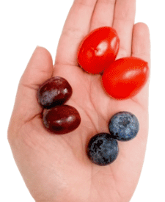
More Prevention Tips!
Reduce forms of food that increase choking hazards
Ensure child remains seated while eating
Reduce distractions while eating
Notes:
Additional prevention tips include: Read slide.
Let’s discuss these in more detail.

Slide 23
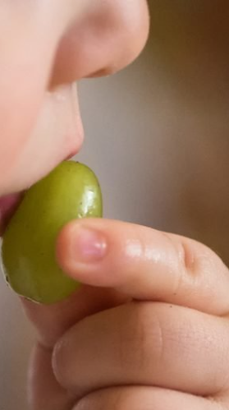
Food Choking Hazards
Small and round- marble-size
Sticky
Slippery
Hard
Difficult to chew and easy to swallow whole
Examples: Popcorn, nuts and seeds, hard candy, marshmallows, chunks of peanut butter or other nut butters, hot dogs, tough meat, grapes, cherries, mango, small hard blueberries
Notes:
It’s no surprise that food accounts for over 50% of choking episodes in young children. To lower the choking risk, prepare the food in a way that negates the characteristics on the slide: Read slide.
Blueberries (roundness) can be smashed or quartered, raw vegetables (firmness) can be steamed and sliced lengthwise, and mango (slipperiness) can be rolled in ground coconut flakes to add texture. Avoid serving sticky foods such as peanut butter, or hard foods that are difficult to chew but easy to swallow such as nuts.

Slide 24
Don’t Run With Scissors Food!
Do not allow children to walk, run or move around in an infant/toddler walker while eating.
If a child needs a snack during an activity, make sure to stop the activity and have the child either sit or stand still while eating.
Notes:
Just like the old adage goes-you shouldn’t run with scissors. From a safety standpoint, you also shouldn’t run with food in your mouth either! Do not allow children to walk, run or move around in an infant/toddler walker while eating.
So just say “no” to grab & go if it literally involves eating while a child is moving!

Slide 25
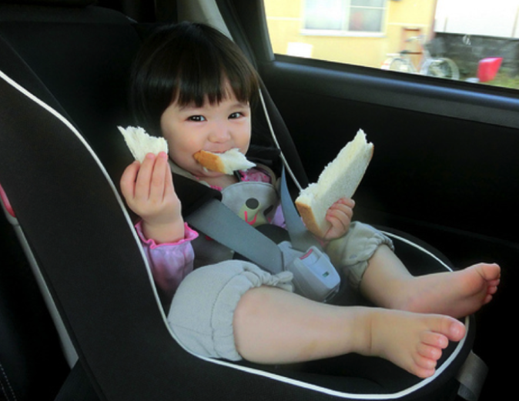
Unattended Children
Eating at the table
Eating in the car
Notes:
It’s not difficult to understand why leaving children unattended while eating is a choking risk. As providers this certainly seems obvious during meal times but it is also important to mention that eating in the car without adult supervision is also a choking risk. Meal time isn’t occurring in vehicles while the child is in your care but this is an important reminder for parents and also for providers who transport children to and from school. Although a food isn’t offered by a provider during transportation- such as picking up from school, children could still have a snack in their school bag that is just too tempting to resist when they are hungry.

Slide 26
Distraction
Notes:
Children should be able to focus on chewing and swallowing. Loud and distracting activities should be discouraged when eating. That goes for adults too!

Slide 27
Identify the Choking Risks
Karla is sitting at the table with 8 month old Jack and 3 year old Shayla while Jack and Shayla are enjoying a snack. The phone rings and Karla immediately jumps up and runs to answer the phone leaving the two children unattended. The TV is on in the background and the volume is a bit loud. Shayla is eating apple slices with peanut butter. Jack is eating thin slices of apple that have been peeled and placed on the tray of his high chair. Shayla just loves her little brother and likes to help her dad feed him. While Karla is gone Shayla decides to share her apples and peanut butter with Jack.
Notes:
Read the scenario to participants. Allow participants time to assess the situation and identify the choking risks. Ask participants to either type in the chat box or unmute their microphones and identify the choking risks in this scenario.
Choking risks:
Karla left the two children unattended while they were eating.
The TV is on so this is a distraction for both children and Karla.
The TV is on and if one of them starts to choke Karla likely would not be able to hear.
Shayla wants to offer her brother food that is not developmentally appropriate by sharing her snack with little brother: apple slices with the peel and peanut butter.
Shayla could very easily get up from the table and run around with food in her mouth.
Other concerns?

Slide 28
Food Preparation Tips & Techniques
To Reduce the Risk of Choking

Slide 29
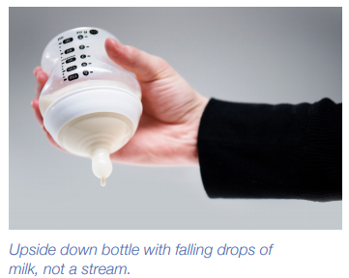
Bottle Feeding Infants
Make sure the hole in the nipple of the bottle is not too large.
If the bottle is held upside down, the falling drops should follow each other closely and not make a stream.
Have infants sit in an upright position when feeding from a bottle. Do not lie infants down with a bottle!
Notes:
We must not forget that bottle-fed infants also are at risk for choking too! To reduce the risk of choking for bottle-fed infants: Read slide.

Slide 30
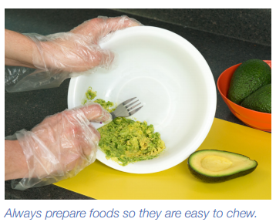
Prepare It Right
Developmentally appropriate.
Puree
Squished
Finger food
Offer “squishable” foods = soft and easy to chew
Cooked cereal
Squished berries
Ground beef
Soft, cooked vegetables
Notes:
When preparing foods for older infants and toddlers, make sure the food is in a form that is developmentally appropriate which includes pureed, squishable and finger foods.
Squishable foods are foods that are soft and easy to chew, examples include cooked cereal, whole blueberries that have been squished (or flattened), ground beef and soft, cooked vegetables.

Slide 31
Just Right
Size – ½ inch or less
Shape – cut food into thin strips instead of round pieces
Texture – offer “squishable” instead of sticky foods
Can place on spoon or directly onto high chair tray of older infants
Notes:
Prepare foods to the right shape, size, and texture to lower the risk of choking. Read slide.
We will discuss examples of the right shape, size and texture for meat/meat alternates, vegetables, fruits and grains.

Slide 32
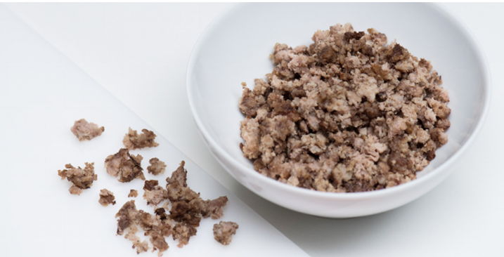
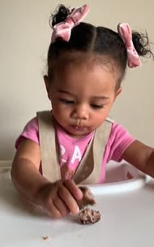
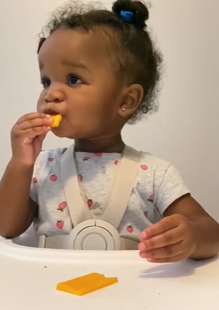
Meat & Meat Alternates
Beef and poultry can be offered as a first food
Ground beef, pork or poultry
Homemade shaped “sticks” or meat balls made from ground meat/poultry
Cheese
Cut into thin slices or short strips
Grate
Notes:
While it used to be thought that babies needed to try new foods in a certain order, we now know that is not the case. Iron-fortified infant cereals and pureed meats are good first foods because they provide iron and zinc that infants need around 6 months of age. It is a recommended practice to only introduce one new food at a time over the course of a few days. This allows time to watch the infant closely for any allergic reactions to the food.
Ground beef as shown on the slide can be offered to older infants in chunks of no more than ½ inch. As the infant developmentally progresses, ground beef can also be shaped into a “stick” form or meat ball shape that older infants and toddlers can grab and feed themselves.
Cut cheese into thin slices or short strips rather than round pieces or blocks. If offering cheese for the first time consider offering it in a grated form. It may be tempting to slice pre-packaged string cheese but this is a choking hazard.

Slide 33
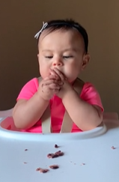
Meat & Meat Alternates
Beans
Cook well and smash with a fork
When ready, offer cooked, whole beans
Do not offer nut butters by themselves, spread thin layer on bread/toast and offer
Only offer to advanced eaters
Remove bones from poultry, meat and fish
Avoid dry, overcooked meat, poultry and fish offered as whole pieces.
Shred if tough or dry
Notes:
When offering beans for the first time, cook the beans and smash the beans with a fork (or puree and put on a teething rusk cracker) so that the beans are easier to chew without accidently swallowing whole. Show short video clip of Sebastian (8 months) being offered beans. https://solidstarts.com/foods/black-beans/. Click on the icon in the lower right hand of the video image to view the video in full screen mode.
When the child is ready whole beans can be offered. Show video clip of Julian feeding himself whole black beans. (same link as above) https://solidstarts.com/foods/black-beans/.
Peanut butter and other nut butters by themselves are very sticky and are a choking risk. Offer nut butters by spreading a thin layer on bread or toast and only offer to advanced eaters.
Always make sure to remove bones from poultry, meat and fish.
Meat, poultry and fish that is overcooked can be dry, tough and difficult to chew so avoid offering pieces of overcooked meat, poultry and fish. If the meat, chicken, poultry is dry or tough then make sure to shred. It is also important to be aware of hard, sharp pieces of meat, poultry, fish that has been overcooked with a sauce. Sauces can provide extra moisture to the food but if overcooked can create hard pieces that are also difficult to chew and swallow.

Slide 34
Vegetables
Remove tough skins.
Cook hard vegetables until they are soft.
Offer cooked carrot sticks instead of small pieces.
Cut raw vegetables like cucumbers in small, thin strips or slices.
Cut cherry and grape tomatoes into lengthwise quarters or halves (depending on the size).
Notes:
Vegetables provide important vitamins and minerals to the developing infant and toddler diet. Make sure to remove any tough skins and cook hard vegetables until they are soft.
Carrots are a popular first vegetable offered to infants but raw carrots can be a choking hazard if not prepared according to a child’s developmental readiness. To minimize the risk, cook carrots until soft before serving to an older infant (ideally soft enough to smash with their finger but not so soft that it falls apart when he/she tries to pick it up).
Avoid cutting raw or cooked carrots into coin-shape pieces- small, thin strips or slices of carrots or other raw vegetables such as cucumbers or zucchini are best for children who are ready to tackle the challenge of raw vegetables.
Cut cherry and grape tomatoes lengthwise into quarters or halves depending on their size. Show video clip of Amelia who is now eating quartered cherry tomatoes. https://solidstarts.com/foods/tomato/ . When video is done, say: It looks like Amelia is enjoying eating a variety of foods, you can see in the video that Amelia was able to pick up the quartered cherry tomatoes and feed herself. You can also smash the cherry tomatoes and then offer. For larger tomatoes- cut into thin strips and offer.

Slide 35
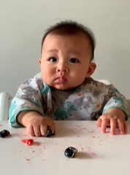
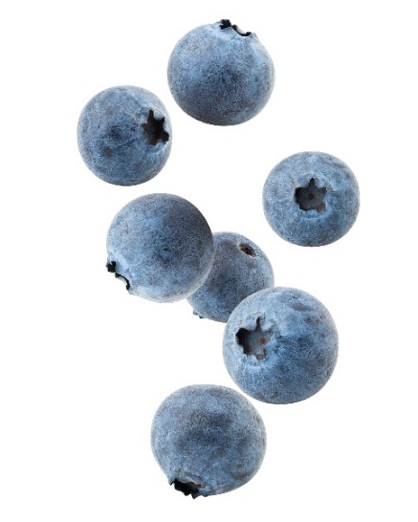
Fruit
Berries
Ripe berries are softer
Flatten slightly with a fork
Oranges
Remove membrane (“supreme”)
Serve canned mandarin oranges
Melons – cut into thin slices
Notes:
Ripe berries are softer than unripe and are less of a choking risk, this is especially true for strawberries. Berries can be smashed or flattened slightly with a fork when offering to an infant for the first time.
Show video of Ronan eating smashed blueberries. https://solidstarts.com/foods/blueberries/. When done watching the video make sure to point out that Ronan did gag a bit but when left alone he was able to move the berries back to the front of his mouth and prevented himself from choking.
Once a child becomes an advanced eater (chewing and swallowing well and not smashing fistfuls of food into their mouth) he or she may be offered whole blueberries in a safe eating environment.
Remove the membrane of oranges - it’s the membrane that poses a choking risk. Let’s watch a quick video on how to remove the membrane.
Show video on how to remove the membrane: https://solidstarts.com/what-you-must-know-before-giving-citrus-to-babies/. Obviously it takes more time to remove the orange membrane so serving canned mandarin oranges is fine too!
When serving melons such as watermelon, cantaloupe and honeydew cut into thin slices.

Slide 36
Fruit
Remove tough skins
Cut raw fruit such as apples in small, thin strips or slices
Remove large seeds and pits and cut into smaller pieces no larger than ½ inch.
Cut grapes lengthwise, then cut into smaller pieces no larger than ½ inch.
Notes:
Apples another popular favorite with children and adults are a high choking risk for children- their skins are tough and the flesh tends to be a bit firmer than other fruit which when served raw can easily become lodged in the windpipe. To prepare apples, cook until very soft or grate, mash, or slice into paper-thin slices.
Always remove any large seeds and pits and then if not cutting the fruit into thin slices make sure to cut into pieces no larger than ½ inch.
Gut grapes into lengthwise, then cut into smaller pieces no larger than ½ inch.

Slide 37
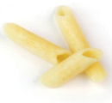
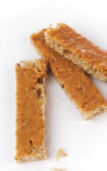
Grains
Pasta
Well-cooked, easily squished
Consider serving with a sauce if pasta is “sticky”
Bread
Cut into thin, pinky-finger width strips
Try offering lightly toasted bread to decrease the “stickiness”
Choose crackers without seeds, nuts or whole grain kernels
Notes:
When offering grains it is important to consider the following:
Serve well-cooked, easily squished pasta. If pasta is sticky then consider serving with a sauce to add extra moisture so the pasta is easier to move around in the mouth and doesn’t form a sticky mass on the roof of the mouth.
Bread can be an unsuspecting choking hazard, especially soft bread. Make sure to cut bread into thin, pinky-finger width strips that the child can bite off. Try offering lightly toasted bread to decrease the formation of the sticky mass that can get stuck on the roof of the mouth.
Choose crackers without seeds, nuts or whole grain kernels. Seeds, nuts and whole grain kernels are hard and can get lodged in the child’s throat.
Encourage frequent drinks while the child is eating grains. The extra moisture helps the food go down easier and decreases choking risk.

Slide 38
Try It Out!
How would you prepare each of these to reduce the risk of choking?
Carrots
Grapes
Peanut butter
Cheddar cheese
Notes:
On this slide we have four examples of foods that could pose a choking risk. How would you prepare each of these foods to reduce the risk of choking for a child in your care? Allow participants a few moments to come up with suggestions and then ask to type their answers in the chat box or unmute their microphones and share with the group.
Carrots - cook until soft or serve in thin strips if serving raw
Grapes - cut lengthwise and quarter if needed- keep to a size no larger than ½ inch
Peanut butter - serve as a thin layer on bread
Cheddar cheese - cut into thin slices

Slide 39
Mealtime Opportunities to Teach Good Eating Habits
That Can Reduce the Risk of Choking

Slide 40
Meal Time is “Together Time”
Family-style meal service
Eating together may help you quickly spot a child who might be choking.
Slow and relaxed – allow plenty of time for meals and snacks.
Only provide foods as part of meals and snacks served at a dining table or high chair with adult supervision.
Make sure children are sitting upright while eating.
Adult modeling of chewing and eating
Up and down motion
Rotary motion
Remind children to take small bites of food
Remind children to swallow their food before talking or taking another bite
Notes:
We are all familiar with the social and emotional benefits of family-style meal service but another important aspect of family-style meal service is that it can help reduce the risk of choking. When adults eat with children an adult can quickly spot a child who might be choking and can also remind children to take small bites of food and swallow between bites. Creating a meal time environment that is enjoyable for all children is very important. Meal time should be slow and relaxed with plenty of time for children to eat meals and snacks and not feel rushed.
Food should only be provided as part of a meal or snack and be served at a dining table or high chair with adult supervision. It is important that children are sitting upright while eating at the table or in the high chair. Slouching over can restrict the airway. An open airway (windpipe) is important so that food can easily be directed down the right tube- the esophagus and not the windpipe!
Adult modeling is also very important. Adults can demonstrate how to eat safely by showing children how to chew. Older infants don’t need teeth to eat safely, they can chew perfectly fine with just an up and down motion. As children develop more teeth then the grinding or rotary motion naturally develops and children can be offered more advanced textures. Adults can also provide important cues to children by reminding children to take small bites and swallow their food before talking or taking another bite.

Slide 41
Meal Time is “Together Time”
During meals:
Encourage older children to serve as role models for younger children as well.
All children should avoid playing games with food, as that may lead to an increased risk of choking.
Notes:
Additional tips during meal time include:
encourage older children to serve as role models for younger children as well.
all children should avoid playing games with food, as that may lead to an increased risk of choking. Never allow a child to throw food in the air and catch it in his or her mouth and although it may make children laugh, adults should also never do this either!

Slide 42
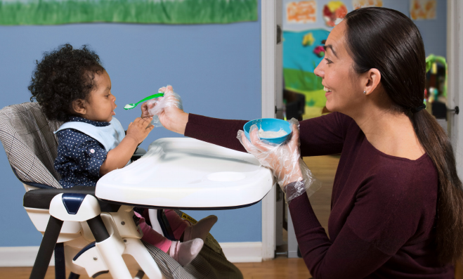
Food Without Fear!
Eating should be an enjoyable experience!
Notes:
First and foremost it is imperative that children learn that eating is an enjoyable experience so that they can develop a healthy relationship with food as they continue to grow and develop. Adults play a critical role in this process!

Slide 43
Helpful Resources
USDA Reducing the Risk of Choking in Young Children at Mealtimes Tip Sheet
https://wicworks.fns.usda.gov/sites/default/files/media/document/English_ReducingRiskofChokinginYoungChildren.pdf
USDA Team Nutrition Feeding Infants in the Child and Adult Care Food Program Guide, Chapter 9 Choking Prevention
https://www.fns.usda.gov/tn/feeding-infants-child-and-adult-care-food-program
USDA Team Nutrition Trainer’s Guide, Child and Adult Care Food Program Trainer’s Tools: Feeding Infants, Lesson 8- Infant Feeding Skills and Modifying Food Textures
https://www.fns.usda.gov/tn/feeding-infants-cacfp-trainers-tools
For Child Care Providers: Making Foods Safer for Baby Handout adapted from Feeding Infants in the Adult and Child Care Food Program.
https://www.fns.usda.gov/tn/feeding-infants-child-and-adult-care-food-program
Solid Starts website
https://solidstarts.com/
Notes:
In addition to the USDA resources we have mentioned during this training additional resources for parents and providers include: Read slide.

Slide 44
Post Assessment
Which of the following are signs an infant is developmentally ready to start solid foods?
Able to sit in a high chair and hold his or her head up
Able to move his or her tongue to help swallow food
Opens mouth when foods come towards him or her
All of the above
All of the following finger foods are creditable in the CACFP infant meal pattern and can be prepared the right way to avoid choking, except:
Small strips of bread
Grapes cut into quarters
Peanut butter or other nut butters
Soft cooked, chopped vegetables
Cut soft foods into small pieces no larger than how many inches to reduce the risk of choking?
1 inch
¾ inch
½ inch
¼ inch
A parent brings in a container of whole grapes for her 11-month-old. To build a good partnership with the family, which of the responses may be better to say?
I will be happy to serve these to your child at the next meal, just as they are.
Fruits are always an excellent choice. To make these safer and reduce choking risk, I will cut these grapes in quarters before I serve them to your child.
Grapes are not creditable in the CACFP infant meal pattern.
None of the above
True or False:
Gagging is a natural reflex that prevents choking.
Notes:
Remember that quiz that you took at the beginning of the training? Well, let’s see how well you did! Read each question and then ask participants to give you the correct answer. (Click to reveal the question, click to reveal the answer, click to clear the question, etc.) When done, ask participants how they did. Likely they missed a few the first time but the second time did better. Congratulate them on a job well done.
1. True/False: Gagging is a natural reflex that prevents choking.
2. Which of the following are signs an infant is developmentally ready to start solid foods?
Able to sit in a high chair and hold his or her head up
Able to move his or her tongue to help swallow food
Opens mouth when foods come towards him or her
All of the above
3. Cut soft foods into small pieces no larger than how many inches to reduce the risk of choking?
1 inch
¾ inch
½ inch
¼ inch
4. All of the following finger foods are creditable in the CACFP infant meal pattern and can be prepared the right way to avoid choking, except:
Small strips of bread
Grapes cut into quarters
Chunks of peanut butter or other nut butters
Soft cooked, chopped vegetables
5. A parent brings in a container of whole grapes for her 11-month-old. To build a good partnership with the family, which of the responses may be better to say?
I will be happy to serve these to your child at the next meal, just as they are.
Fruits are always an excellent choice. To make these safer and reduce choking risk, I will cut these grapes in quarters before I serve them to your child.
Grapes are not creditable in the CACFP infant meal pattern.
None of the above
Trainer Note: Parents or guardians may choose to provide one of the meal components in the updated CACFP infant meal patterns, as long as this is in compliance with local health codes. State agencies and sponsoring organizations must ensure that the parent or guardian is truly choosing to provide the preferred component and that the center or day care home has not requested or required the parent or guardian to provide the components in order to complete the meal and reduce costs.

Slide 45
Prevention is Key!
During meal time
Safe behaviors and meal time expectations
Food preparation
Notes:
We hope that you have enjoyed the training today and are leaving feeling more confident about your abilities to prevent choking. Remember that prevention is key when it comes to choking. Preventive measures should be taken when creating the meal time environment, modeling safe eating behaviors and preparation of food.

Slide 46
USDA Nondiscrimination Statement
In accordance with Federal civil rights law and U.S. Department of Agriculture (USDA) civil rights regulations and policies, the USDA, its Agencies, offices, and employees, and institutions participating in or administering USDA programs are prohibited from discriminating based on race, color, national origin, sex, disability, age, or reprisal or retaliation for prior civil rights activity in any program or activity conducted or funded by USDA.
Persons with disabilities who require alternative means of communication for program information (e.g. Braille, large print, audiotape, American Sign Language, etc.), should contact the Agency (State or local) where they applied for benefits. Individuals who are deaf, hard of hearing or have speech disabilities may contact USDA through the Federal Relay Service at (800) 877-8339. Additionally, program information may be made available in languages other than English.
To file a program complaint of discrimination, complete the USDA Program Discrimination Complaint Form, (AD-3027) found online at: https://www.usda.gov/oascr/how-to-file-a-program-discrimination-complaint, and at any USDA office, or write a letter addressed to USDA and provide in the letter all of the information requested in the form. To request a copy of the complaint form, call (866) 632-9992. Submit your completed form or letter to USDA by:
Mail: U.S. Department of Agriculture
Office of the Assistant Secretary for Civil Rights
1400 Independence Avenue, SW
Washington, D.C. 20250-9410;
Fax: (202) 690-7442; or
Email: program.intake@usda.gov.
This institution is an equal opportunity provider.
Notes:
KSDE is an equal opportunity provider.

Slide 47
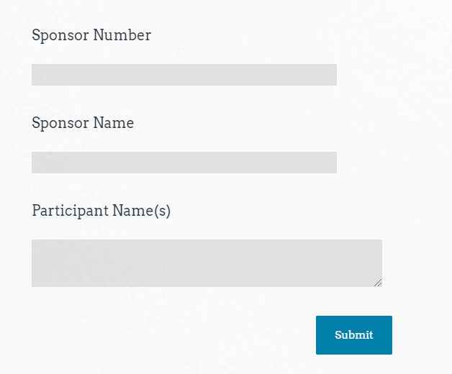
Class Attendance
Sample
https://www.surveymonkey.com/r/DFSRPQC
Thank you for Attending!
Please contact us whenever you need assistance.
785-296-2276
Child Nutrition & Wellness
www.kn-eat.org
Reducing the Risk of
Choking Attendance
Notes:
Class attendance will be conducted electronically through Survey Monkey. Participants must complete the survey to receive a certificate of completion. Participants may use their phones, laptops, or nutrition program computer to access the survey electronically. Enter the link provided into the address bar of preferred web browser. If using a mobile device with a QR Code reader, scan the QR code that will be provided on the screen at the end of the session.
The attendance survey set up so that a lead person, such as the Director, can enter multiple names on the comment line of the attendance survey in Survey Monkey. This should make it easier to track group participation in the electronic delivery of these classes.

Slide 48
Thank you for attending!
Please contact us whenever you need assistance.
Child Nutrition& Wellness, KSDE
785-296-2276
www.kn.eat.org

