Slide 1

Leadership
Employee Motivation, Engagement, and Recognition

Slide 2
USDA Funding and Non-Discrimination Statements:
“This project has been funded at least in part with Federal funds from the U.S. Department of Agriculture. The contents of this publication do not necessarily reflect the view or policies of the U.S. Department of Agriculture, nor does mention of trade names, commercial products, or organizations imply endorsement by the U.S. Government.”
In accordance with federal civil rights law and U.S. Department of Agriculture (USDA) civil rights regulations and policies, this institution is prohibited from discriminating on the basis of race, color, national origin, sex (including gender identity and sexual orientation), disability, age, or reprisal or retaliation for prior civil rights activity.
Program information may be made available in languages other than English. Persons with disabilities who require alternative means of communication to obtain program information (e.g., Braille, large print, audiotape, American Sign Language), should contact the responsible state or local agency that administers the program or USDA’s TARGET Center at (202) 720-2600 (voice and TTY) or contact USDA through the Federal Relay Service at (800) 877-8339.
To file a program discrimination complaint, a Complainant should complete a Form AD-3027, USDA Program Discrimination Complaint Form which can be obtained online at: https://www.usda.gov/sites/default/files/ documents/ad-3027.pdf, from any USDA office, by calling (866) 632-9992, or by writing a letter addressed to USDA. The letter must contain the complainant’s name, address, telephone number, and a written description of the alleged discriminatory action in sufficient detail to inform the Assistant Secretary for Civil Rights (ASCR) about the nature and date of an alleged civil rights violation. The completed AD-3027 form or letter must be submitted to USDA by:
1. mail:
U.S. Department of Agriculture
Office of the Assistant Secretary for Civil Rights
1400 Independence Avenue, SW
Washington, D.C. 20250-9410; or
2. fax:
(833) 256-1665 or (202) 690-7442; or
3. email:
Program.Intake@usda.gov
This institution is an equal opportunity provider.

Slide 3

What challenges have you faced in the last year?
How do you feel about those challenges?

Slide 4
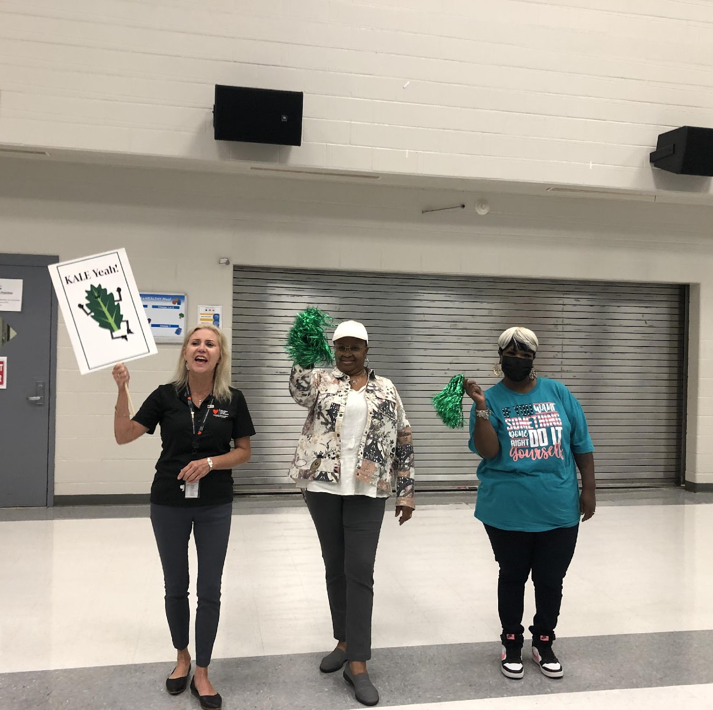
As an administrator, one of your jobs is to keep staff motivated
Have you thought about who or what motivates you?
Is it possible…
The same things that motivate you may motivate your team?

Slide 5
For you to thrive in the 21st Century, become more like Indiana Jones…
Think quickly, strategically, creatively
The shrinking ETBS – Expected Time Between Surprises
The demands of more, better, faster
You must become even better at anticipation and adaptation
Notes:
Recreate scene of Indiana Jones
How to keep employees motivated during times of drastic change

Slide 6
Bring every mind into the game…
Teamwork wins games, but teamwork and intelligence wins championships. -Michael Jordan
Notes:
When you have served on a highly functioning team, you know the beauty of teamwork.
Inviting people into the “game” keeps them motivated and inspires engagement.

Slide 7
The Good News and
The Bad News

Slide 8

The Bad News
You must stay motivated first in order to motivate others

Slide 9

The Good News
See the Bad News
You must stay motivated to motivate others!

Slide 10
Keep people engaged and motivated: the core of leadership
Stay focused: leaders are signal senders
  Budgets, calendars, metrics, questions, over communication, modeling
Create a “boundaryless” organization: break down the silos
  Listen, share info, collaborate, share best practices internally
Create passion and excitement: unleash the energy
  Freedom, incentives, the Team as HERO, and the Mission
Notes:
We sometimes hear about silos within a program, or between departments. Do you have silos within your program, or relationships that need to be mended to carry out the work of your program?

Slide 11
Keep people engaged and motivated
“There are two kinds of success: initial and ultimate.” -Winston Churchill
Notes:
You may sometimes feel you are making little progress. Daily wins are important, but changing direction over the long-term is much more important.

Slide 12
Leadership roles for keeping employees motivated, engaged, and recognized
Visionary and revolutionary
  Create a sense of urgency
  Challenge the status quo
Storyteller
  Tell the shared story
  Master the language of leadership
Politician
  Build trust
  Secure buy-in and support for change
Cheerleader
  Lift others up
  See the positive in situations

Slide 13
A Leadership Challenge
“Wisdom is knowing what to do next. Skill is knowing how to do it. Virtue is doing it.” -David Starr Jordan

Slide 14
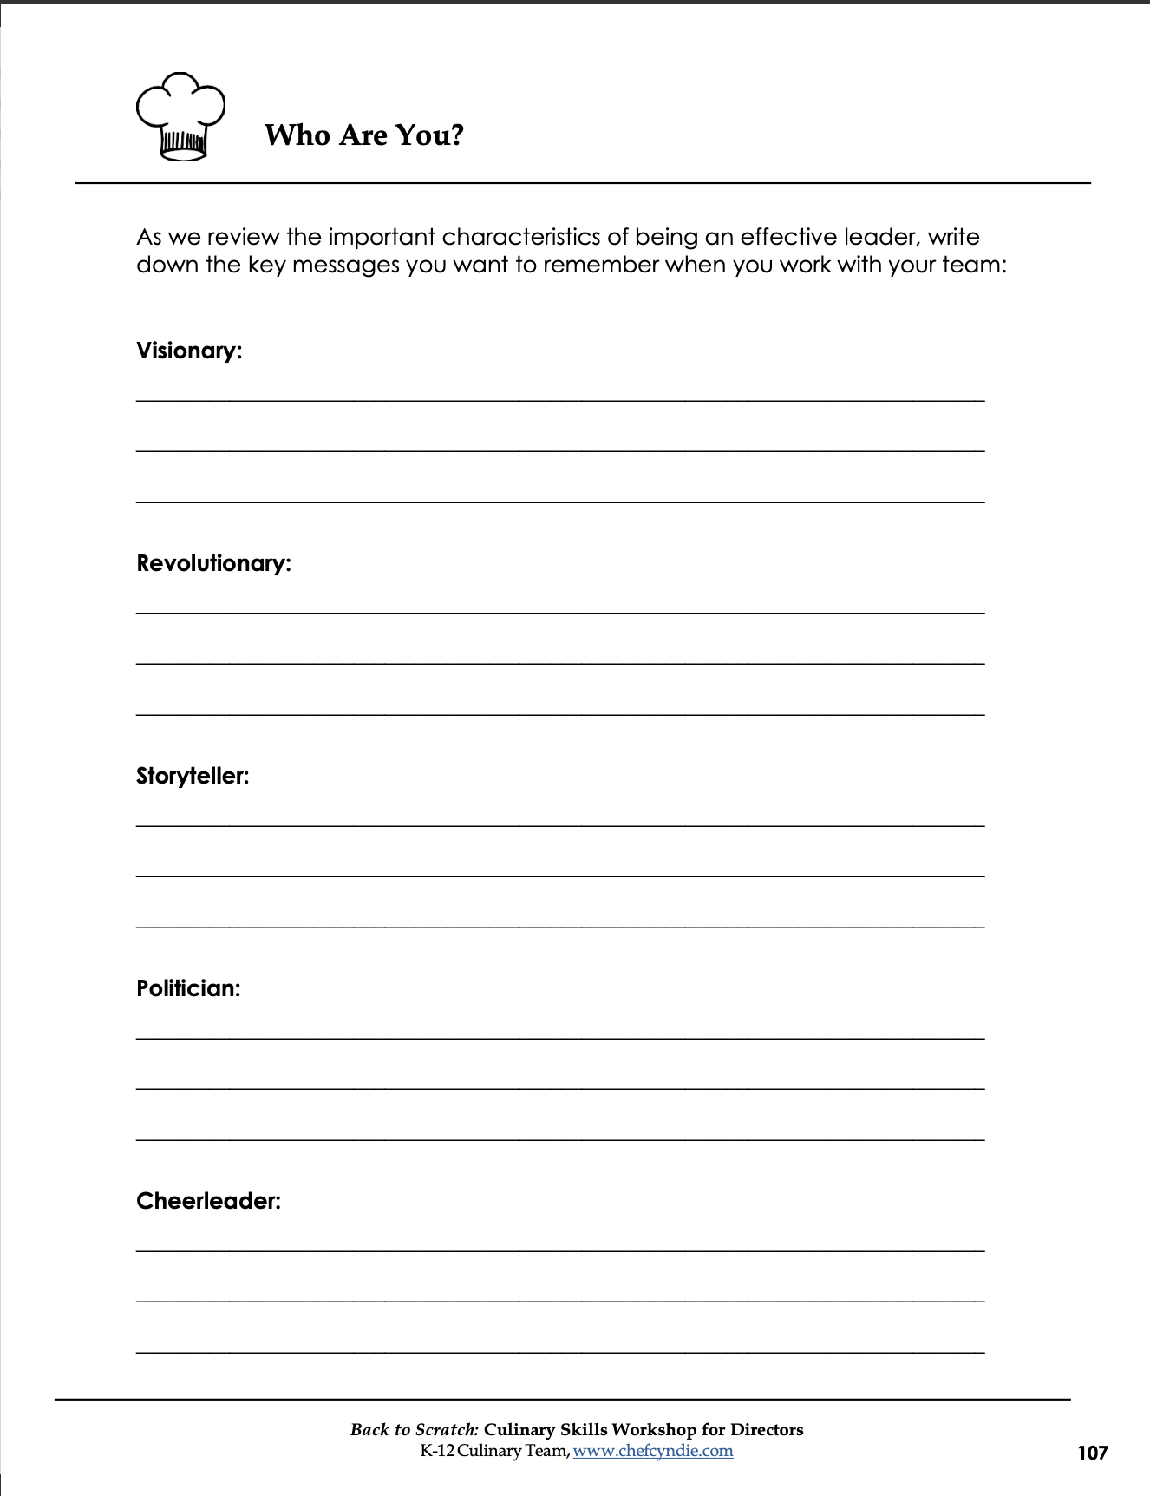
Handout - Who are you?
Who do you want to be as a leader?
What actions will you take to motivate others?
What will you do to keep yourself motivated?
Notes:
HANDOUT: Who are you? As a Visionary, Revolutionary, Storyteller, Politician, Cheerleader
As we review the important characteristics of being an effective leader, write down the key messages you want to remember when you work with your team

Slide 15
The Leader as
Visionary and Revolutionary

Slide 16
Be prepared for change
“Not everything that is faced can be changed, but nothing can be changed until it is faced.” -James Baldwin

Slide 17

The Leader as Visionary and Revolutionary
Challenge the status quo
What are two things you can change?
If you were hired as a consultant for your own program, what advice would you give?
Feedback, feedback, feedback
Notes:
Being a revolutionary doesn’t always mean leading a revolt. More often, it means leading change, and change cannot occur without vision. They go hand in hand. If you want to make a change, you need to be able to describe the process and end goal. Realize that the process may shift as you gain more information or experience, but the end goal needs to be the guiding light. It needs to stay the same.
Ask: What are two things you can change”
Ask: If you were hired as a consultant for your own program, what advice would you give?
Communicate! Talk with your people! They can and will be your source of inspiration and motivation…if you promote it and allow it.

Slide 18

The Leader as Visionary and Revolutionary
Share the numbers
Identify current or expected shifts in doing business
Vigilance as a strategic imperative – only the paranoid survive!
Notes:
Numbers equal data
Current or expected shifts – trends
What’s next? Plan ahead – don’t wait for the inevitable to happen. Anticipate. Help drive the process

Slide 19
Be adaptable
“Even if you are on the right track, you’ll get run over if you just sit there.” -Will Rogers
Notes:
Be ready to switch gears, to be flexible, to change direction if and when new information surfaces.
Don’t be a Debbie Downer.

Slide 20
The Leader as Storyteller
Notes:
Who is responsible for keeping the story alive in your program or school? Is it important to have a shared history? Why?

Slide 21

Story line and Style
Plausible, compelling story which answers three questions:
How will it affect me?
What is the road map for success?
Will there be a happy ending?
Notes:
Will there be a happy ending? People want a happy ending. If you, as the leader, are uncertain of your goals or intended outcomes, who will be the champion?

Slide 22
Story line and Style (Continued)
The story line
  Embark on a new journey
  Meet with setbacks and adversity
  Regroup, refocus, and conquer!
You need an engaging delivery style, but make it your own
Notes:
Regroup, refocus, and conquer! Give examples of the pandemic, a new POS system, etc.

Slide 23
YOUR Persona
How do you express your vision, your ideas?
Your use of communication techniques
How do you help others express their ideas?
Notes:
How would people describe you? How would employees describe you? Is this how you want to be perceived? Who are you? Beautiful soul, intelligent caring, thoughtful, helpful?

Slide 24
Your Persona (Continued)
Be positive and optimistic
Bring passion and enthusiasm
Have a bias for action
Notes:
How do you want to be known as a leader?
Decisive? Capable? Empathetic?
Avoid paralysis by analysis

Slide 25
Your vision, your ideas
Our vision, our ideas
Create a sense of urgency
Look to the future

Slide 26


Provide the Grand Vision
People must understand their:
  Role
  Contribution
  Their importance…and you need to be the one to tell them!
We feed the future
Notes:
People need to know, “Where do I fit it in?” You need to know, “Where do I fit in?”

Slide 27

Appeal to the sacred, core values of your organization
Create links to common values…
  A chance to change the way things are
  A chance to take part in something new
  A chance to do something good
  A chance to make a difference
Notes:
When challenges seem overwhelming, bring staff – and yourself – back to the basics. What is our mission? What values do we hold dear or have in common?

Slide 28
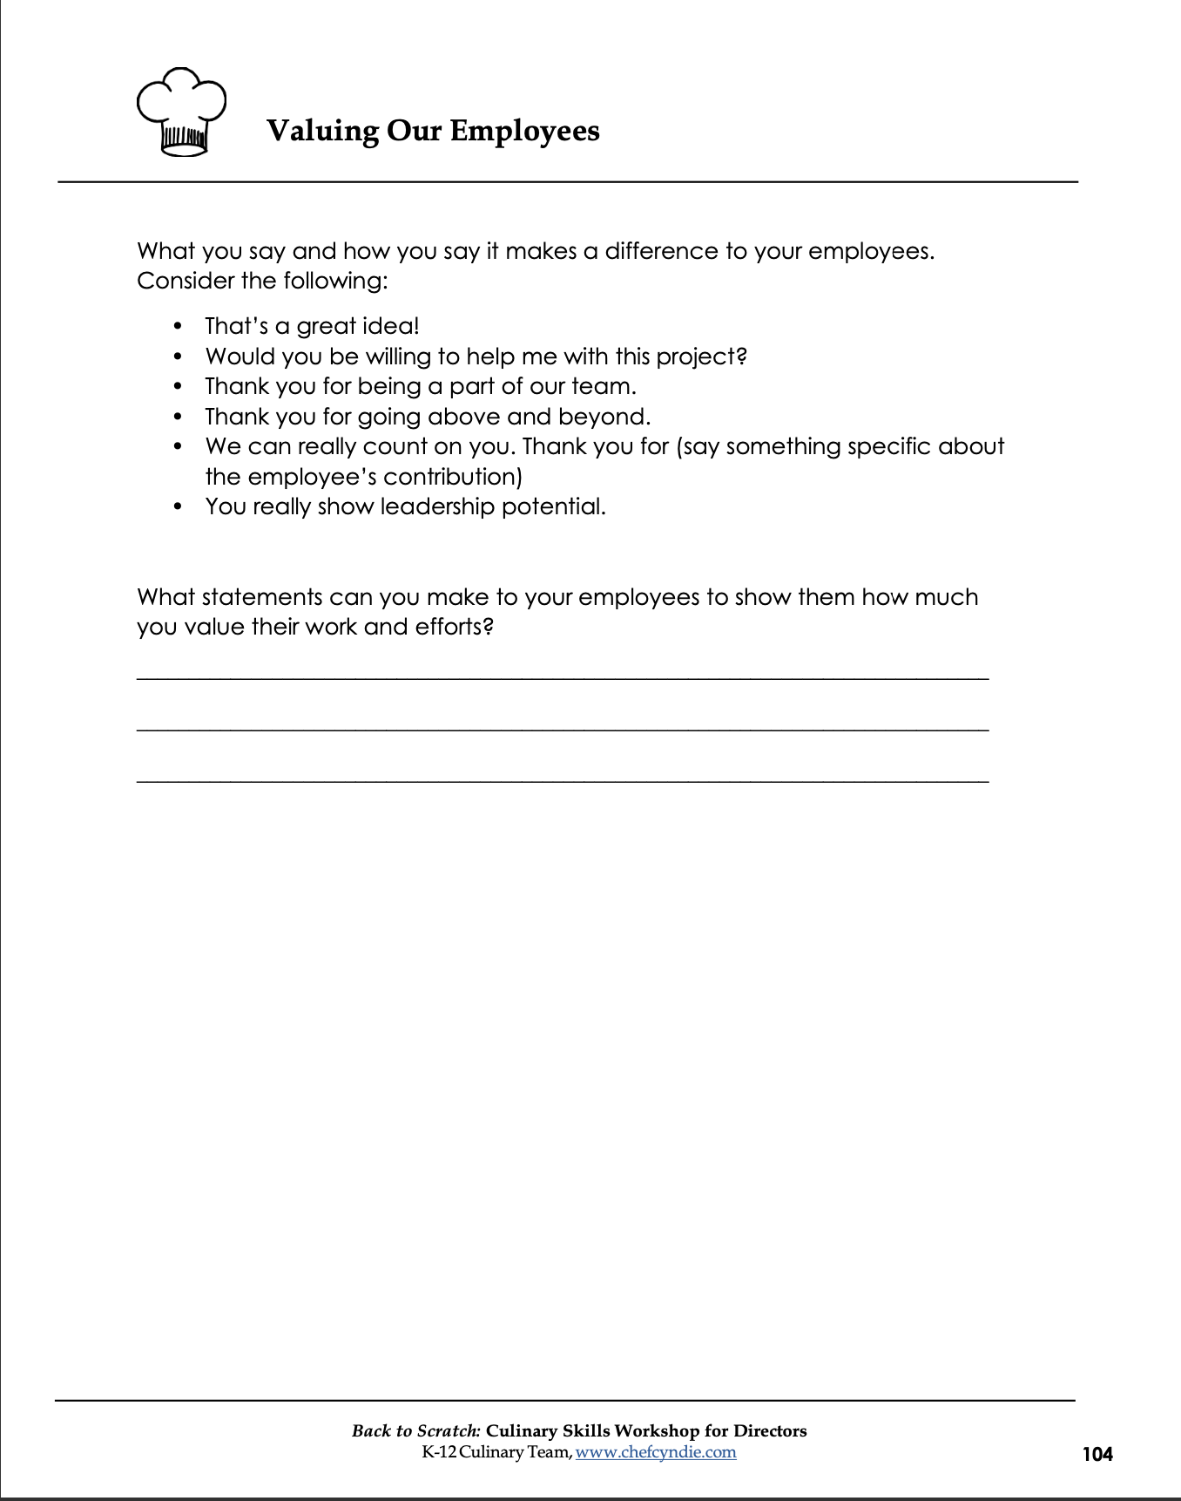
Handout
Valuing Our Employees
Notes:
HANDOUT: Valuing our employees – what you say and how you say it makes a difference to your employees.

Slide 29
Your vision, Your Ideas
Our vision, Our Ideas
Give life
Tell stories – personalize and humanize
Give hope
Be a “possibility” thinker, not a “probability” thinker
Don’t say “TRY”, Say “I WILL” and “WE ARE”
Use examples that people can relate to
Notes:
Remember the pandemic stories! Emergency feeding, supply chain disruptions
The importance of shared stories so employees don’t feel isolated. Keep them engaged.
Say “Imagine” and don’t kill the thrill with the word “BUT”

Slide 30
Your vision, Your Ideas
Our vision, Our Ideas
Give life
  Tell stories – personalize and humanize
  Use examples that people can relate to
Give hope
  Be a “possibility” thinker, not a “probability” thinker
  Don’t say “TRY”, Say “I WILL” and “WE ARE”
Notes:
Remember the pandemic stories! Emergency feeding, supply chain disruptions
The importance of shared stories so employees don’t feel isolated. Keep them engaged.
Say “Imagine” and don’t kill the thrill with the word “BUT”

Slide 31
Martin Luther King, Jr.
Master storyteller
What happens when you hear “I have a Dream”?

Slide 32

Use of Communication Techniques
Repeat key phrases
Change the pace
Over communicate by a factor of 10
Notes:
The person speaking has the most responsibility; make sure your language, your story, your intent, your meaning is clear
Repeat key phrases. What are your key phrases? Do you hear them repeated to you by others?
Change the pace. Think about the cadence of your delivery – I Have a Dream

Slide 33
When you get home or back to your office…
One minute speech
  Engage
  Energize
  Embrace change
  Achieve excellence
Question: what are you going to write about?
Notes:
When you get home…thinking about the language of leadership, write a one-minute inspirational speech to engage and energize people on your team to embrace change and achieve excellence in these challenging times.

Slide 34
Sharing the Vision
“Vision without action is a daydream. Action without vision is a nightmare.” -Japanese Proverb

Slide 35
The Leader as Politician
Building Three Kinds of Trust

Slide 36
The Leader as Politician
Strategic Trust
  Trust that the organization is doing the right things in terms of goals and strategies
Organizational Trust
  Trust in the way things are being done in terms of processes and decision making
Personal Trust
  Trust in you as the leader

Slide 37

Build Strategic Trust
Be ambitious, but realistic, when setting expectations
Communicate as much as possible the “why” of setting goals and how they can be met
Think through as many possible interpretations of what you say
Communicate often and in as many ways as possible
Get an “early victory”

Slide 38

Build Organizational Trust
Make sure you and your leadership team deliver a consistent message
Broaden the circle of employee involvement and input – let them be your “voice”
Apply rules, regulations, and standards consistently
Ensure transparency of decision making
Notes:
If you have a leadership team of yourself and other admin, be sure you are all delivering the same message – inconsistent messages breed doubt…and contempt
There is no time for “mysterious leadership” – in a time of turmoil, tell people what you safely know, and don’t be afraid to tell people what you don’t know)

Slide 39
Build Personal Trust
Listening is THE most important leadership skill
Put yourself in the listener’s shoes – they need calm, visible leadership
Put yourself in the listener’s shoes – they need calm, visible leadership
Don’t withdraw – be visible and engaged
Over deliver on promises

Slide 40
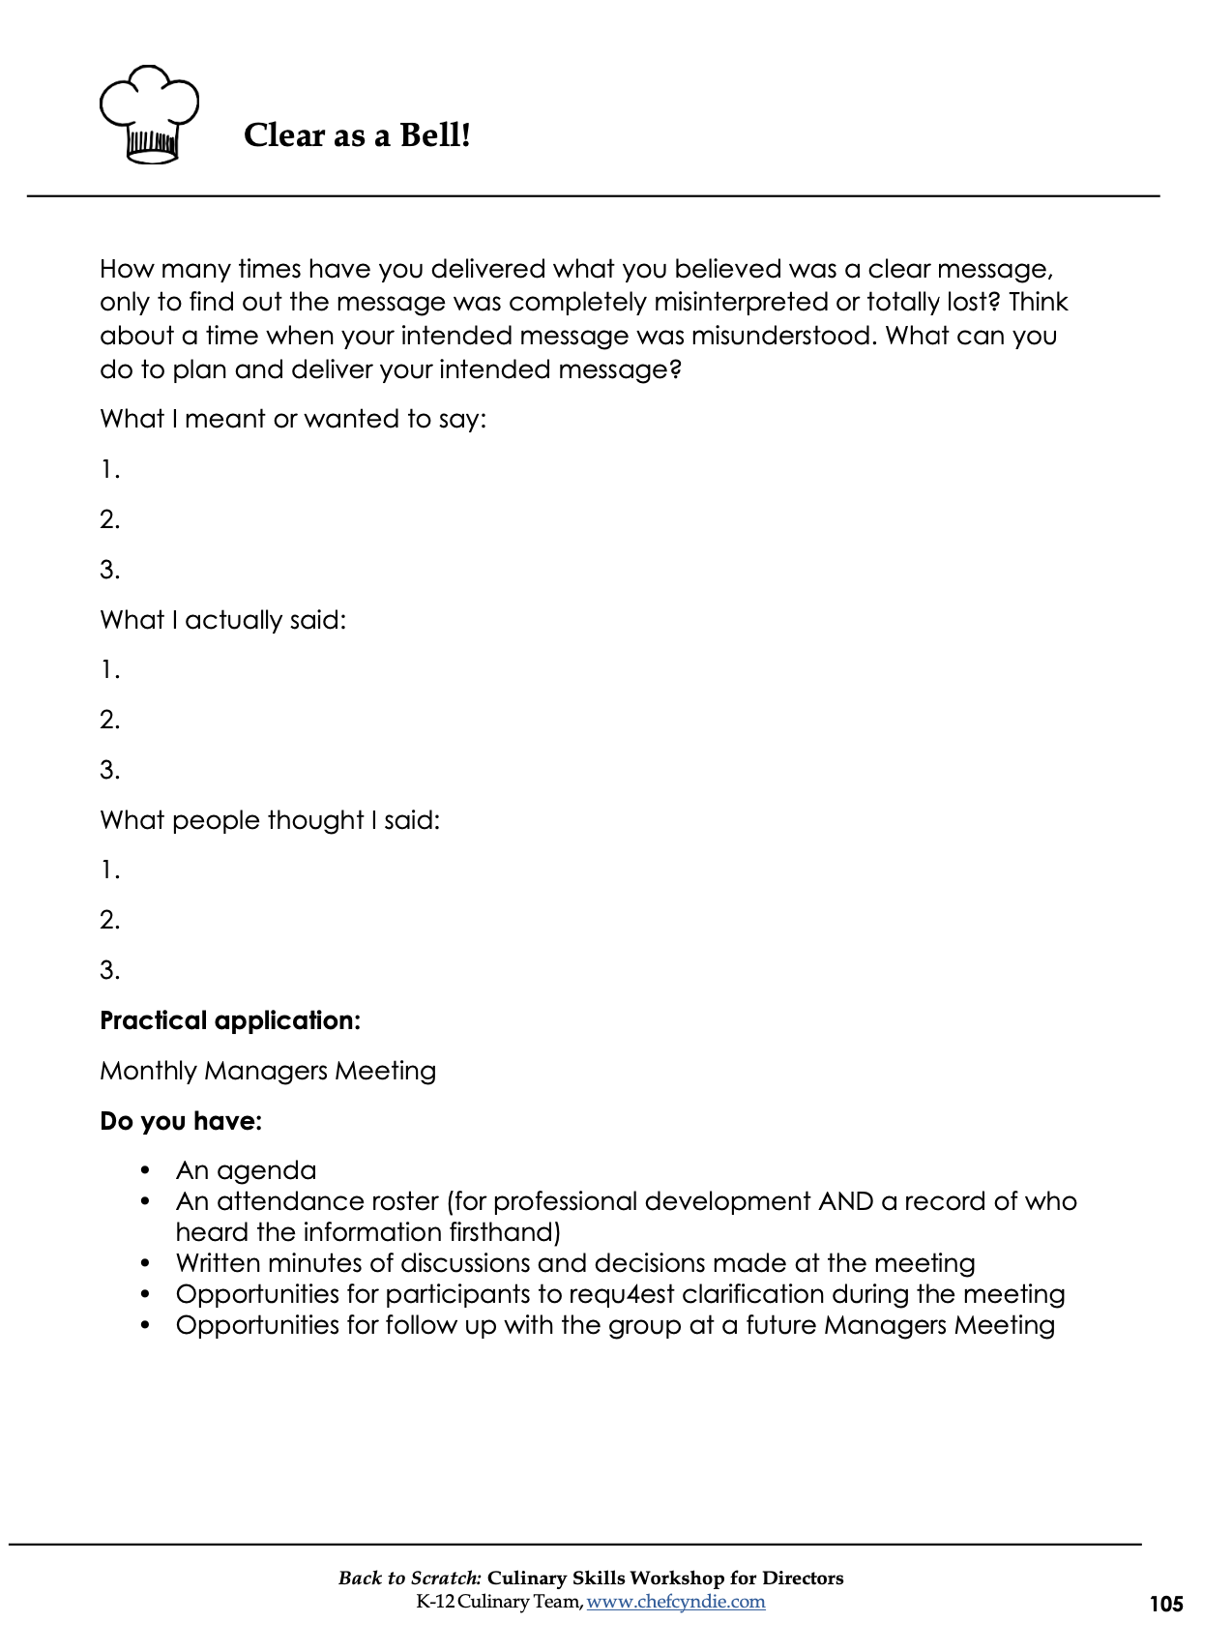
HANDOUT
Clear as a Bell!
Notes:
Clear as a Bell handout: What I wanted to say, what I actually said, what people thought I said.

Slide 41
Get Buy-in and Support for Change

Slide 42
Be Trustworthy – and show it
To be humble to superiors is a duty,
To equals a courtesy,
To inferiors, nobleness. -Thomas Moore
Notes:
You don’t have to humble yourselves to others, but you need to if you want their respect and trust.

Slide 43
Get Buy-in and Support for Change
Lay the groundwork
Cultivate, don’t alienate
Sustain the motivation
Celebrate victories
Notes:
When we think of buy-in and support, we usually think of our bosses first.
Without buy-in and support from your team, nothing will happen
Directors who have the trust and support of their team often earn the trust and support of their bosses

Slide 44

Buy-in and Support – Phase One
“Lay the groundwork”
The Political Principle:
  Due diligence with stakeholders (Employees, Supt., COO, Finance, SB members, Teachers, Parents)
  Stay close to people and the situation
The Alliance Principle:
  Build the team: the power of the passionate core
  Search for common ground and shared interests
  Search for a common challenge
  Stand up, but never stand alone

Slide 45
Build Your Team
“The loftier the building, the deeper must the foundation be laid.” -Thomas Kempis

Slide 46
Buy-in and Support – Phase 2
The Reciprocity Principle
  Build a “political capital” account
  Share information, resources, and support
The Empathy Principle
  Listen, understand, care
The Approval Principle
  Recognize, appreciate, make the team feel important and special
Notes:
Recognize the input and hard work of employees - expound

Slide 47
Buy-in and Support – Phase 2
The Foot in the Door Principle
  Ask for small favors or make small requests
The Proof Principle
  Benchmark data, polls, experts/consultants, and examples
The Sharing Principle
  Ask for ideas and use at least some of the ideas
The Self-interest Principle
  Appeal to individuals’ needs to be valued
  Satisfy their needs, solve their problems

Slide 48
Buy-in and Support
“Pull the string, and it will follow wherever you wish.
Push it, and it will go nowhere.” -Dwight D. Eisenhower
Notes:
Motivation, Engagement, Recognition

Slide 49
Buy-in and Support
Sustain the motivation
Look for the “small wins”
Develop achievable targets, get a quick victory, share or publicize successes
The “spin” principle
Do answer the “why” question
Focus on positives, look forward to improvements
Notes:
Marketing professionals know all about the “Spin” – the question is, how do you want your story to be told?
Will employees tell a shared story?
What are you doing to recognize your team members?

Slide 50

Support
No matter what accomplishments you make, somebody helped you.
Notes:
Engagement

Slide 51
Recognize the need for change, and respond with a request for support
“When the rate of external change exceeds the rate of internal change, the end of your business is in sight.” -Jack Welch
Notes:
Question: What ARE you doing? Are you making necessary changes, or are you hoping issues will magically take care of themselves?)

Slide 52
The Leader as Cheerleader
Lift others up!
See the positive in situations
Notes:
Recognize the contributions of others

Slide 53
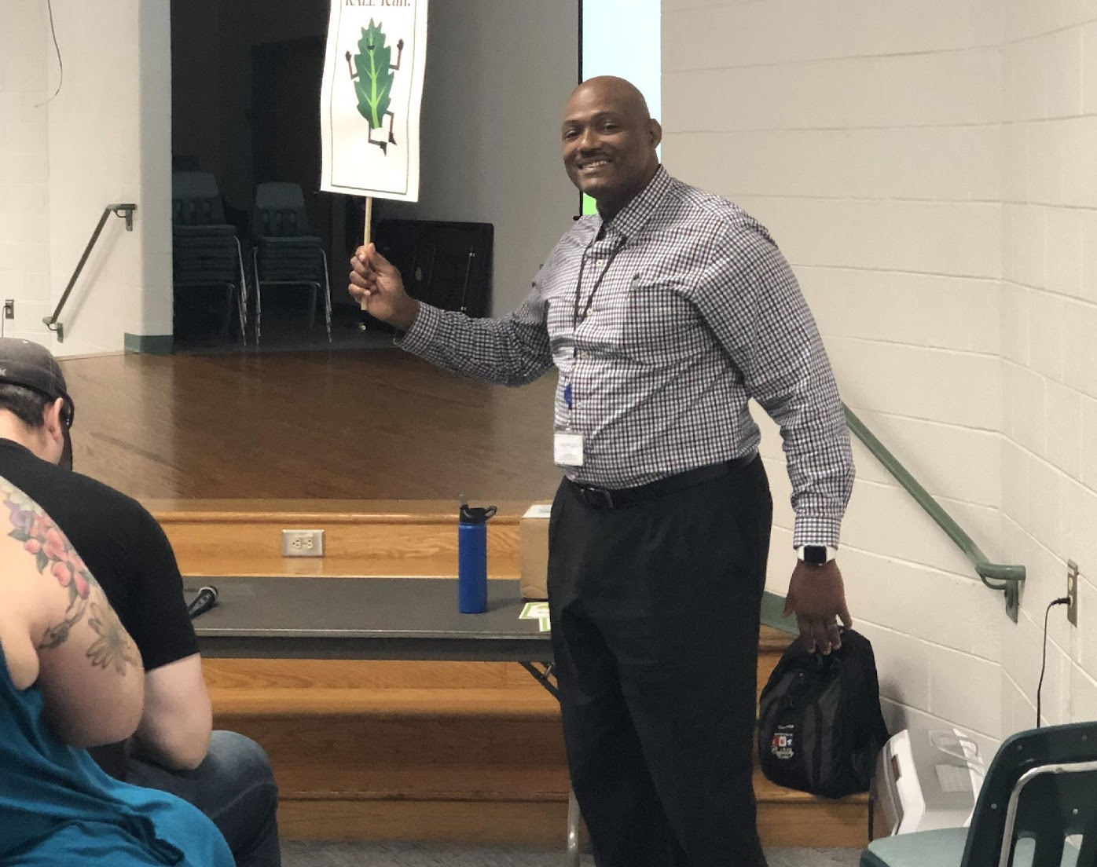
Lift Others Up!
Inspirational
Participative
Able to share thoughts while staying calm and upbeat
More important to give than to receive
Notes:
Be a motivator
Keep people engaged

Slide 54

See the Positive in Situations
Create a feeling of teamwork
Keep the eye on the prize
Provide guidance
Optimistic
Notes:
Individuals can receive recognition, but it’s important to recognize the entire team

Slide 55
It’s All About Leadership
“Leadership and learning are indispensable to each other.” - President John F. Kennedy
Notes:
John F. Kennedy said that leadership and learning are indispensable to each other. As you lead, you will continue to learn. You are likely going to make mistakes along the way. That’s okay! It means that you are taking chances, evolving, and trying new ideas.

Slide 56
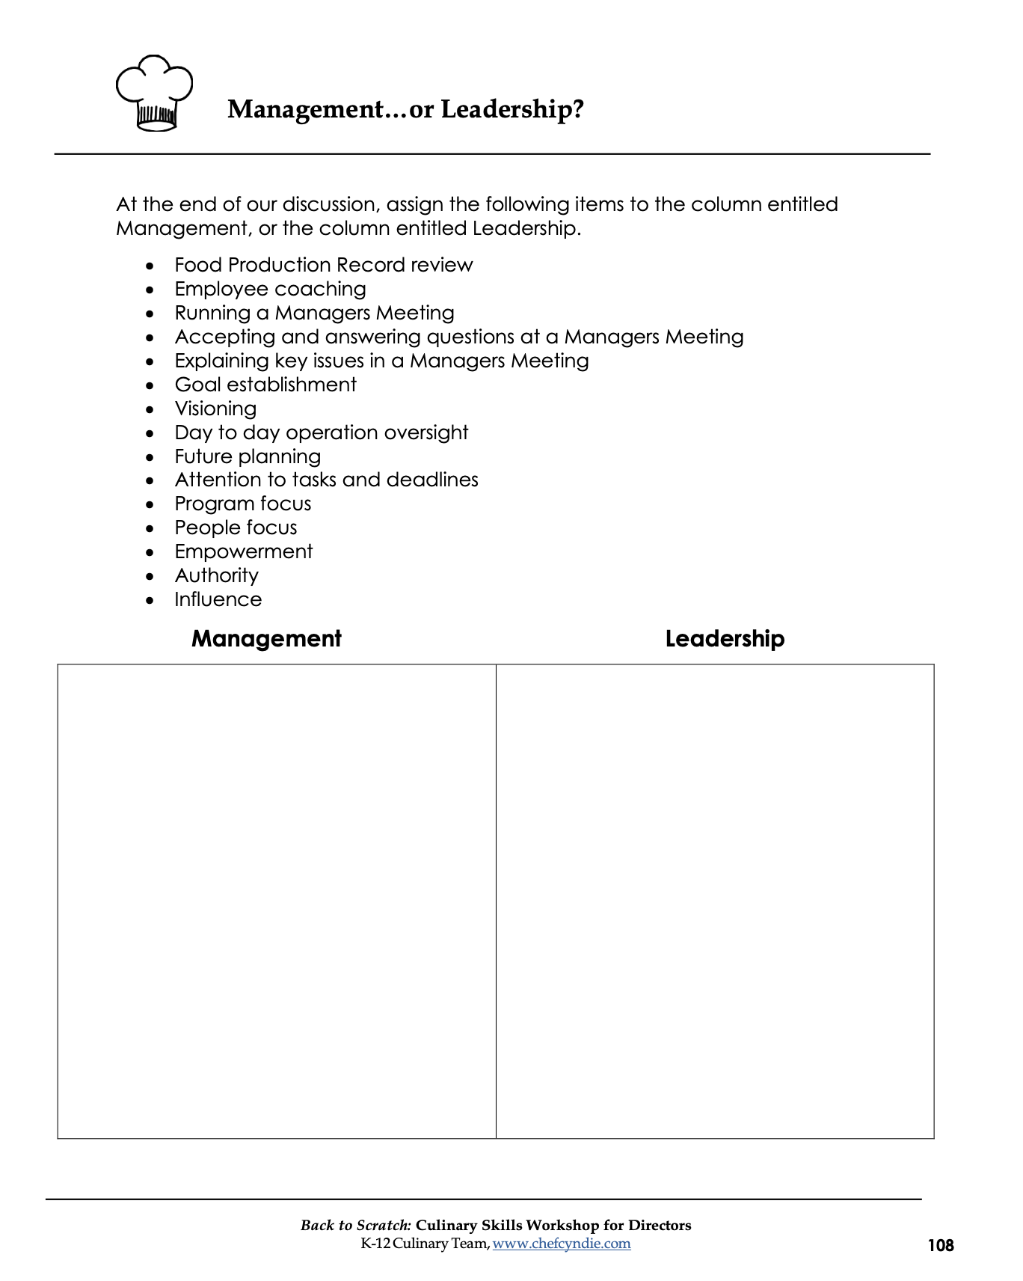
Handout
Management…or Leadership?
Notes:
HANDOUT
You may have noticed that we haven’t talked about our programs during this entire presentation today. We haven’t talked about Food Production Records, the menu, CEP or Free and Reduced – none of it. But those areas are crucial to our programs, right? Instead, we have talked about people, and the way we keep them motivated, engaged, and recognized.
One of the most important things you can do to help people perform well is to BE the leader they need you to be! I like to say that we manage programs, and we lead people. Take a moment and look at the “Management…or Leadership?” handout. You have a bulleted list of responsibilities, and at the bottom of the page, an opportunity to divide the list into managerial roles, or leadership roles. Take a couple of minutes and write down the statements that are more closely aligned to management, or leadership.

Slide 57
The Leader Sets the Pace
“We can’t become what we need to be by remaining who we are.” -Oprah Winfrey
Notes:
Finally, we are all on a journey. Whether you are a newer director, a seasoned director, whether you have people on your team who support you, or whose trust you need to win, we cannot become what we need to be by remaining who we are!
It has been our pleasure to be with you today, but before we end, let’s turn in your workbook again to the SMART Goals handout.

Slide 58
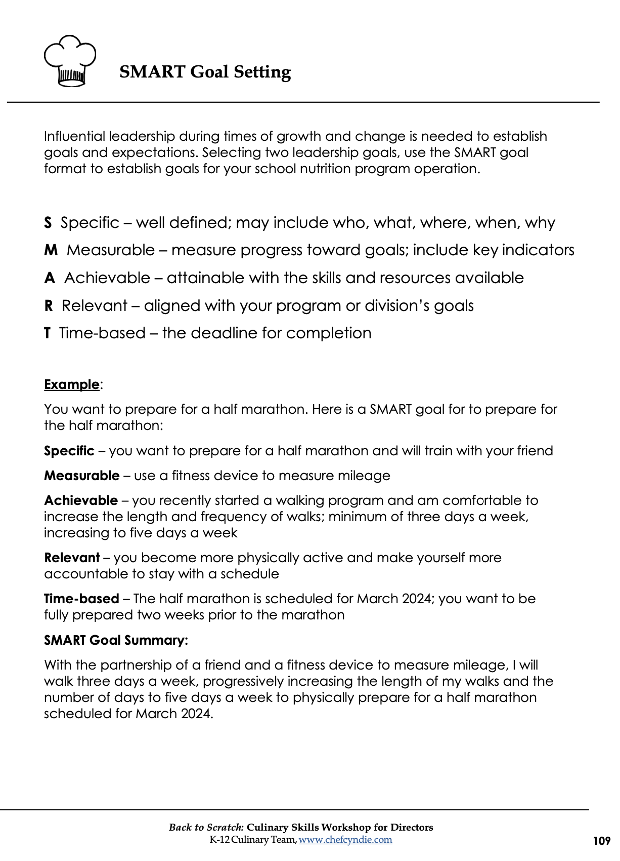

Handout
SMART Goal Setting

