Slide 1

Mentoring Others
TNTG Director Workshop
October 2023

Slide 2
USDA Funding and Non-Discrimination Statements:
“This project has been funded at least in part with Federal funds from the U.S. Department of Agriculture. The contents of this publication do not necessarily reflect the view or policies of the U.S. Department of Agriculture, nor does mention of trade names, commercial products, or organizations imply endorsement by the U.S. Government.”
In accordance with federal civil rights law and U.S. Department of Agriculture (USDA) civil rights regulations and policies, this institution is prohibited from discriminating on the basis of race, color, national origin, sex (including gender identity and sexual orientation), disability, age, or reprisal or retaliation for prior civil rights activity.
Program information may be made available in languages other than English. Persons with disabilities who require alternative means of communication to obtain program information (e.g., Braille, large print, audiotape, American Sign Language), should contact the responsible state or local agency that administers the program or USDA’s TARGET Center at (202) 720-2600 (voice and TTY) or contact USDA through the Federal Relay Service at (800) 877-8339.
To file a program discrimination complaint, a Complainant should complete a Form AD-3027, USDA Program Discrimination Complaint Form which can be obtained online at: https://www.usda.gov/sites/default/files/ documents/ad-3027.pdf, from any USDA office, by calling (866) 632-9992, or by writing a letter addressed to USDA. The letter must contain the complainant’s name, address, telephone number, and a written description of the alleged discriminatory action in sufficient detail to inform the Assistant Secretary for Civil Rights (ASCR) about the nature and date of an alleged civil rights violation. The completed AD-3027 form or letter must be submitted to USDA by:
1. mail:
U.S. Department of Agriculture
Office of the Assistant Secretary for Civil Rights
1400 Independence Avenue, SW
Washington, D.C. 20250-9410; or
2. fax:
(833) 256-1665 or (202) 690-7442; or
3. email:
Program.Intake@usda.gov
This institution is an equal opportunity provider.

Slide 3

Quote
“The growth and development of people is the highest calling of leadership.” - Harvey S. Firestone

Slide 4
The Time is Now!
What is the status of your team?
  Lots of new employees?
  Retirements?
  Resignations?
Challenge:
  Develop team members internally
  Attract team members externally

Slide 5
Virginia Director Mentoring Program Goals
Developing leadership,
Increasing core competency,
Increasing engagement among employees,
Developing an employee succession plan,
Promoting diversity and inclusion,
Attracting and retaining top talent,
Building future leaders and high potential employees, and
Reducing employee turnover.
Notes:
Virginia has recognized the need to mentor new SNP directors to develop a strong local SNP team, and has responded with the introduction of a Director Mentoring Program. The objectives of the mentoring program are to (review bullet points)

Slide 6
Virginia Director Mentoring Program –
What’s Included?
ICN’s Introduction to School Nutrition Leadership 30.5 hour course
Mentee paired with a current local SNP director mentor
Highly qualified mentors; most have 10+ years
VDOE consultant coordinator; central point of contact
Training involves hands-on experiences
Notes:
The VA Director Mentoring Program includes the ICN’s ISNL, which provides an overview of school nutrition programs, defines the role and responsibilities of a director, and reviews the relationship between local policies and state/federal regulations.
Review bullets
Total of 17 mentors, two from each of the 8 VDOE Superintendent’s region, and 1 from private schools paired with a mentee in the same region

Slide 7
Virginia Director Mentoring Program –
Dates
October 20, 2023
  Review Mentor applications and make selections
October 23-27, 2023
  ICN’s ISNL training
October 27, 2023
  Mentees complete self-assessment
October 27, 2023
  Mentor paired with Mentee
October 2023 – September 2024
  Monthly meetings with Mentor & Mentee
Notes:
A high level of commitment is expected…but think of the rewards!

Slide 8
Future Leaders and Followers
School division level
Planning for your future
Notes:
So, thinking about the VA Directors Mentoring Program, you can see that the VDOE believes in the importance of planning for the future, whether it’s tomorrow, next year, or 5 years from now!

Slide 9

USDA Professional Standards
All Directors
  At least 12 hours, in addition to food safety training required in first year of employment
All Managers
  At least 10 hours annually
All Work Staff (at least 20 hours or more/week)
  At least 6 hours annually
Part-Time Staff
  At least 4 hours annually, regardless of number of hours worked
*Some states and divisions have higher educational standards
Notes:
Importance of on-going training
How to engage employees through training
Training future leaders

Slide 10

Establish a Path; Define the Process

Slide 11
Reflection…
What mentoring did you receive to for your leadership position?
How could that mentoring be better or how could it have been done differently?
What opportunities exist in your department/job for mentoring?

Slide 12
Think about it…
What areas could use attention in your program?
Who has leadership potential on your staff?
Again, what opportunities exist in your department/job for mentoring?

Slide 13
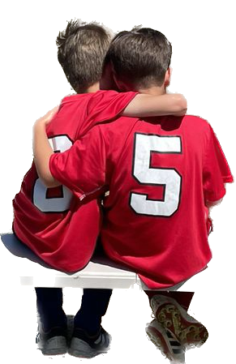
Remember…
You don’t have to do all of this alone!
Notes:
Think about the areas of your operation in which you could use some help, or you could “share” with members of your team.

Slide 14
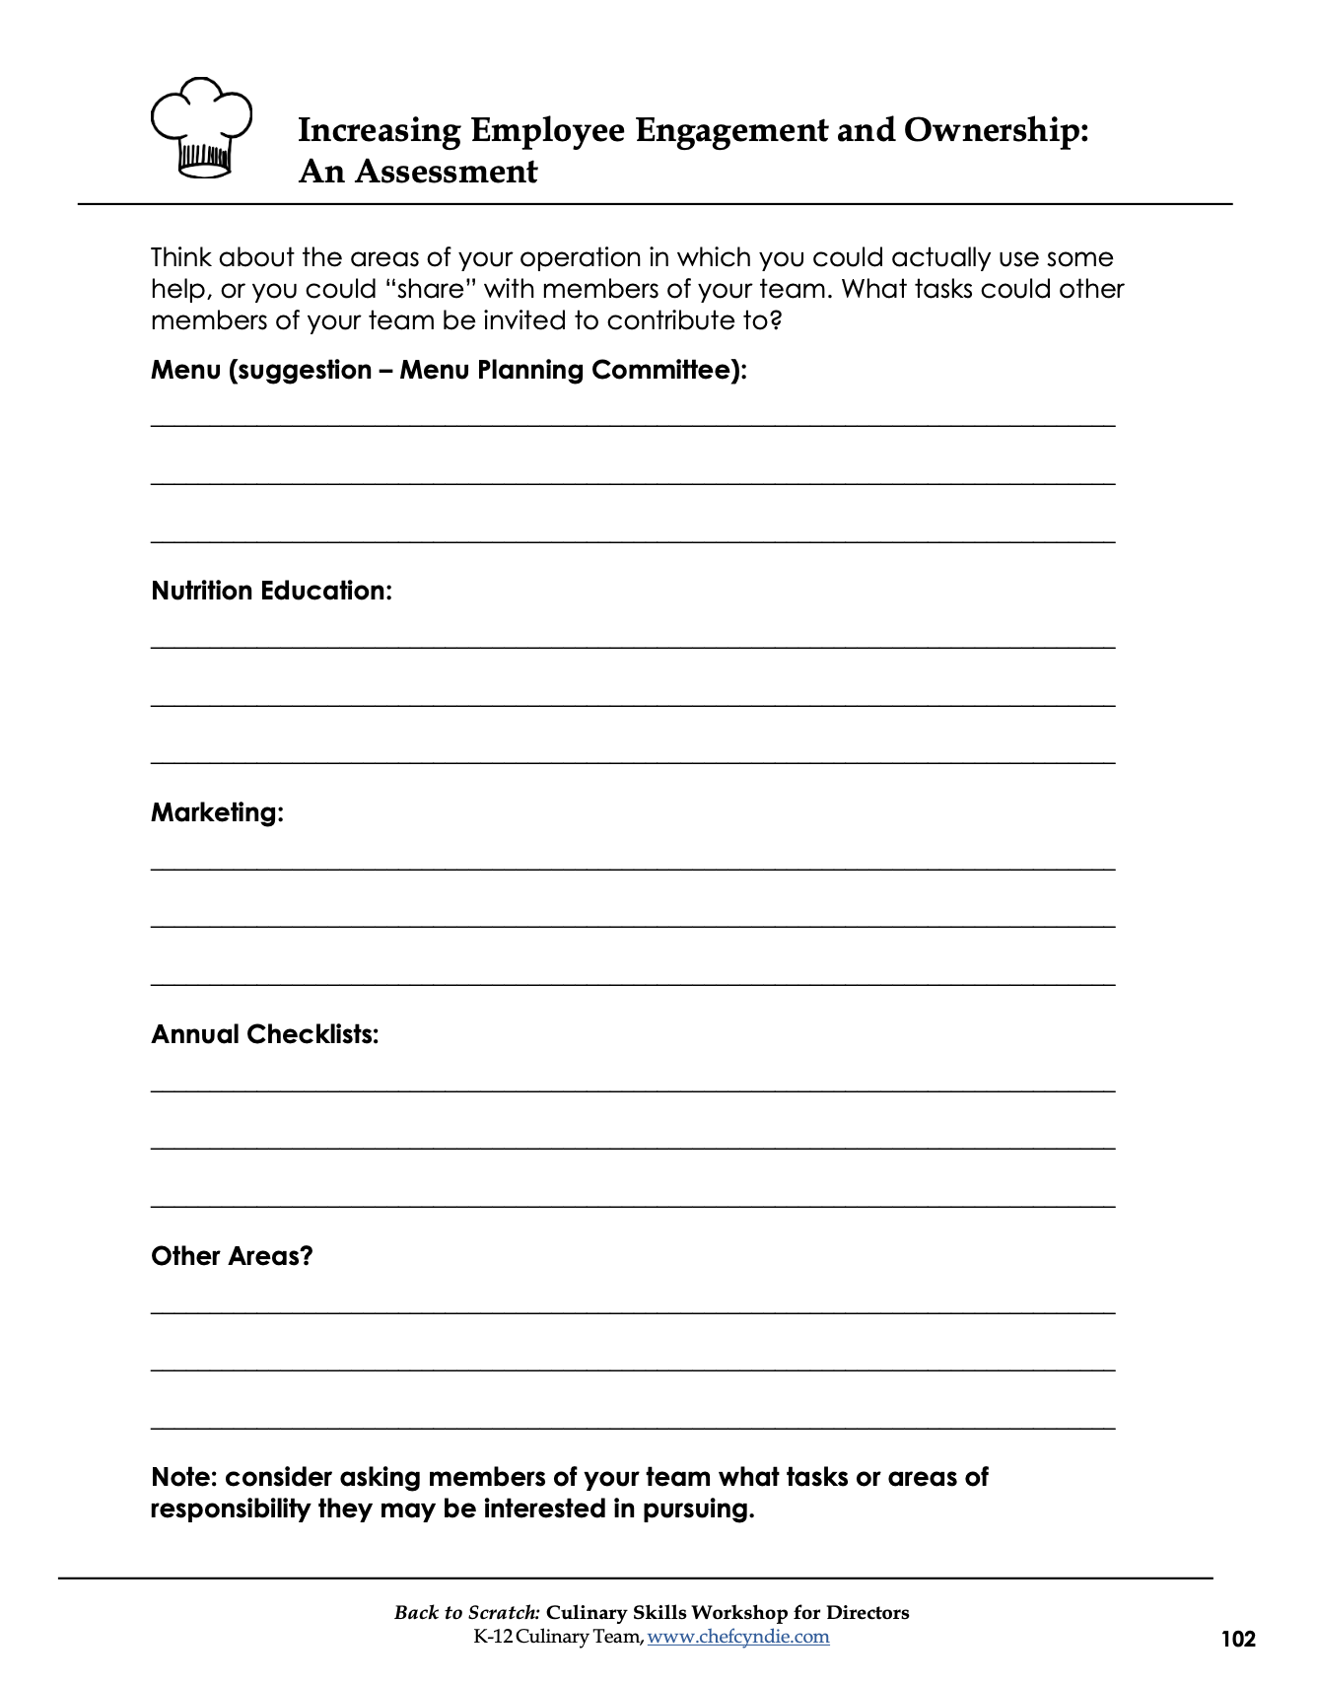
Handout
Increasing employee engagement and ownership an assessment

Slide 15
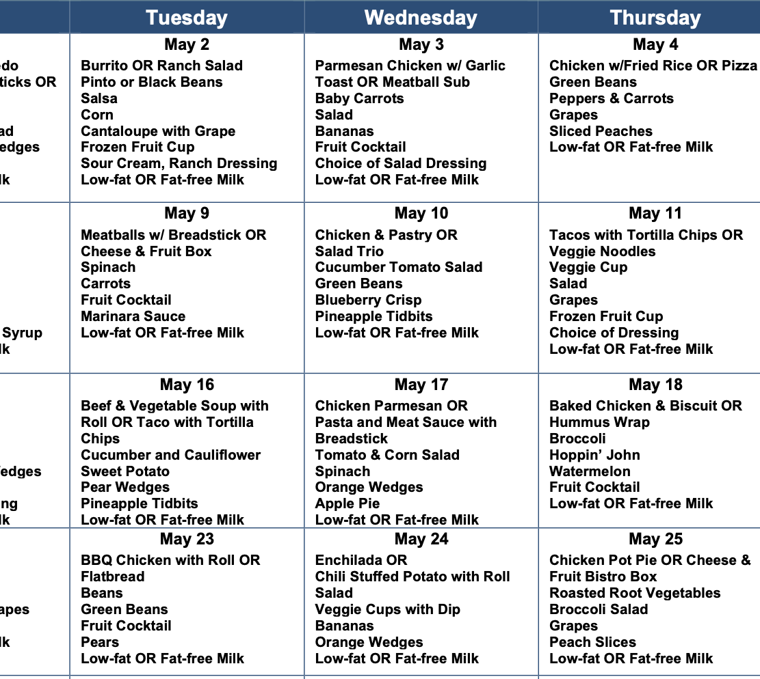

Start with the needs of the program
Menu
Nutrition Education

Slide 16
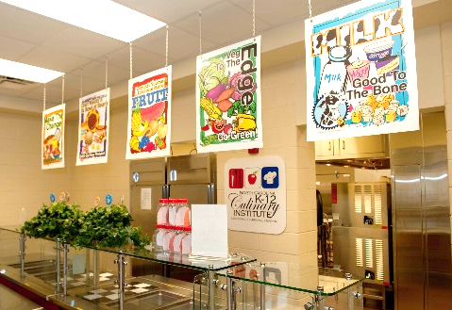


Start with the needs of the program
Marketing
Checklists

Slide 17
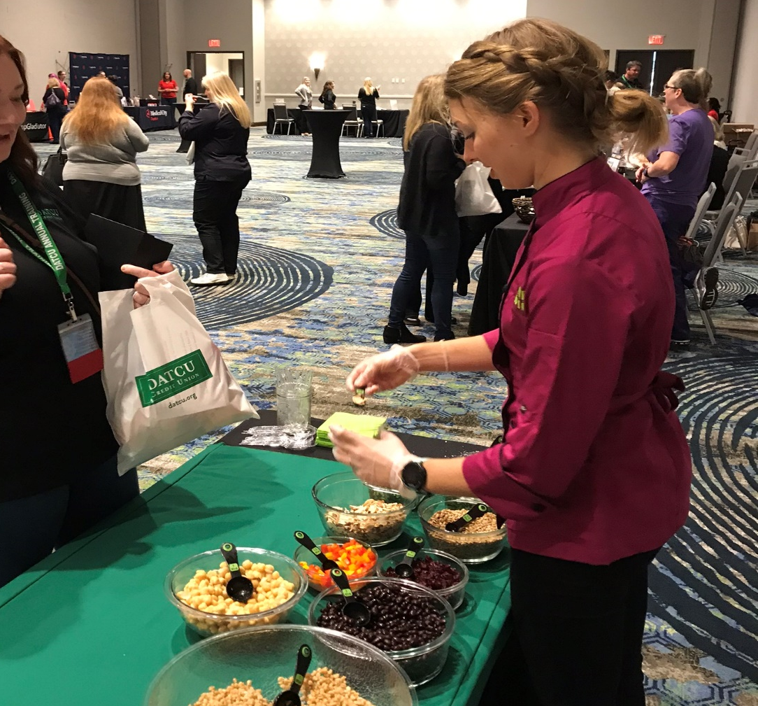
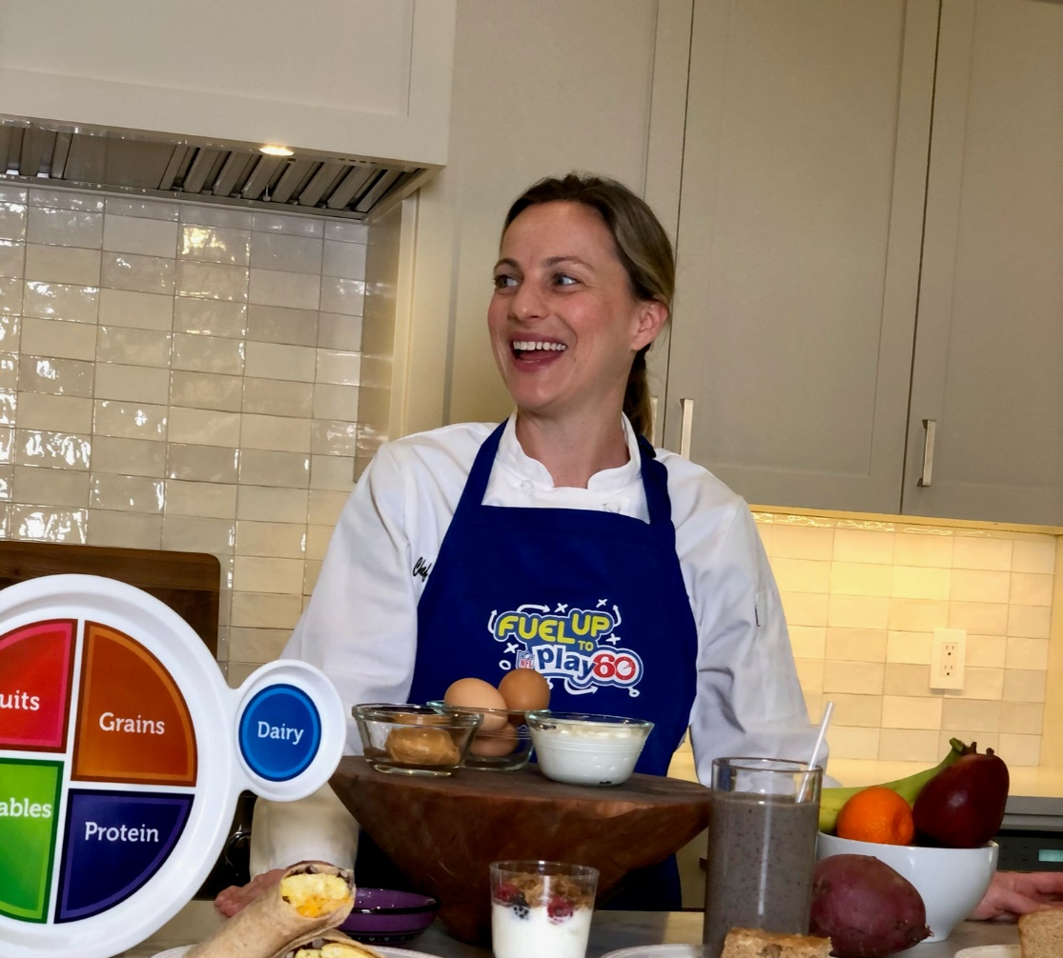
Other areas of need?
Notes:
Handout, continued
Identify all areas of need, which may include:
Community outreach
Employee recruitment
New products
Recipe testing

Slide 18
Food & Nutrition Career Ladder
Director
  Area Supervisor
    Manager
      Manager Intern
      Food Service Assistant II – Main Dish Cook
      Food Service Assistant I – Entry Level
  Nutrition Educator
Notes:
Explain why managers need to understand the entire career path in your program
Help define a possible path for growth, and explain the potential
Create excitement and a sense of what’s possible

Slide 19
Qualifications
Assistant I – Entry Level
  Minimum of an 8th grade education
  Clear background check
Assistant II – Main Dish Cook
  1 year experience FSA I
  Quantity Cooking
  Equipment Use & Care
  Foundations
  High School Diploma
Manager Intern
  1 year experience as FSA II
  Nutrition education
  Customer satisfaction
Notes:
Explaining the path for future leaders.
Job Goals:
Entry Level – to perform skilled work in the preparation & service of food that covers all phases of the FNS program
Main Dish (or similar title) – to prepare main entrees & other food items; monitor the preparation of other food items as assigned while assisting the manager/staff in building & maintaining a high level of productivity/efficiency in the kitchen
Manager Intern – to prepare for position of manager by completing requirements of the manager intern program while assisting the manager & FNS in the daily operation of the NSLP consistent with federal, state, & county regulations.

Slide 20
Qualifications
Area Supervisor
  3 years of administrative experience and Bachelor’s Degree
  Transition into Director’s position
Nutrition Educator
  Bachelor’s Degree in nutrition
  RD credential
  Transition into Area Supervisor’s position
Manager
  Complete a Bachelor’s Degree
  Transition into Area Supervisor’s or Nutrition Educator’s position
Notes:
Help define the potential. Create an environment of inclusivity – don’t be vague – be straightforward and encouraging!
Let people see what they can do, if they choose:
Manager – to manage all aspects of the school cafeteria in such a way as to provide a well-prepared nutritious meal for students & staff, and to provide this service within budgetary restraints.
Nutrition Educator – to promote and support nutrition education by consulting with teachers on projects & providing direct instruction to students
Area Supervisor – to provide FNS managers & school principals assistance and guidance to ensure program compliance and maximum operational efficiency

Slide 21
Employee Investment
Clear Direction
Setting Expectations
Providing the Polish

Slide 22
Return on Investment
Credibility
Commitment
Dedication
Knowledge
Performance
Notes:
What the program, and the director, will receive as an ROI

Slide 23
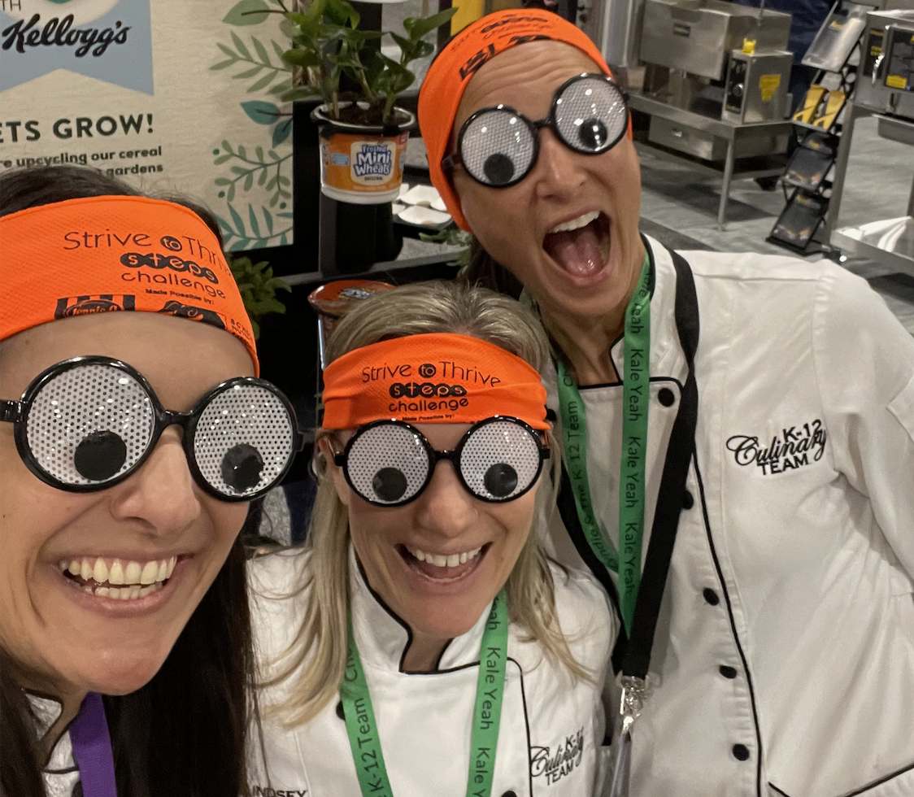
Values and Benefits of Mentoring
You really don’t have to do it alone!
Keeps you on the cutting edge with new knowledge
Hones your own skills
You may always be 25 years old!
District and department viewed as leaders
Make positive impact on trainees’ lives

Slide 24

Benefits (continued)
Cost – can be minimal or can be significant
Good return on investment dollars
Consistent with educational institution mission, vision, values
New future managers…and maybe supervisors, coordinators, and directors?
Greater credibility, competent peers
Good PR for your SN program

Slide 25

Characteristics of a Mentor
Loves their job
Excited about school nutrition and foodservice
Share knowledge with others
Natural “givers”, big hearted, loves to volunteer
Partnering, nurturing

Slide 26

Characteristics (continued)
Does their own job well; expertise
Good time management
Delegation skills
Trustworthy
Inclusive
Good delegator

Slide 27
Quote
“When you want to help people, you tell them the truth. When you want to help yourself, you tell them what they want to hear.” - Dr. Thomas Sowell
Notes:
Read slide, then ask:
When you need to “be real” with managers and future leaders, and you have decided to delegate, be more inclusive, and be more transparent, what comes next? Seasoned directors know how to give needed information to managers and staff, but at the same time, provide a “buffer.” Unloading too much information at once may have the unintended affect of alienating managers.

Slide 28

How transparent?
Notes:
Honestly, you may not be legally or ethically allowed to tell all of the details about a situation. It’s a fine line to share information without oversharing.
Discuss how to share information without oversharing details.
Examples:
HR issues
Conversations with superiors
New regulations that may not be popular

Slide 29
Tracy’s Path
Sub to FSA I to FSA II to manager to buyer to area supervisor to trainer

Slide 30
Where is Tracy now?
Director of Purchasing!
Notes:
Making it real – story

Slide 31
That’s not all!
Sara Dan, MBA, RD
  Director of Food and Nutrition Services
  Started as a Nutrition Educator in 1996
Don Hampton
  Director of Facilities Services
  Started as the FNS
  Equipment Repair Technician in 1997
Notes:
Making it real - story

Slide 32

Managers & Future Leaders
Notes:
Now, we are going to talk about the very people you may have on staff right now. Who are the managers you have currently have in position? Let’s talk about some of the different characteristics they may be bringing to their jobs.

Slide 33
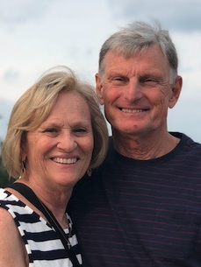
Baby Boomers
Born 1946-1964
Characteristics
  Loyal
  Optimistic with a desire for change
  Passionate
  Technology innovation
  Workaholics

Slide 34
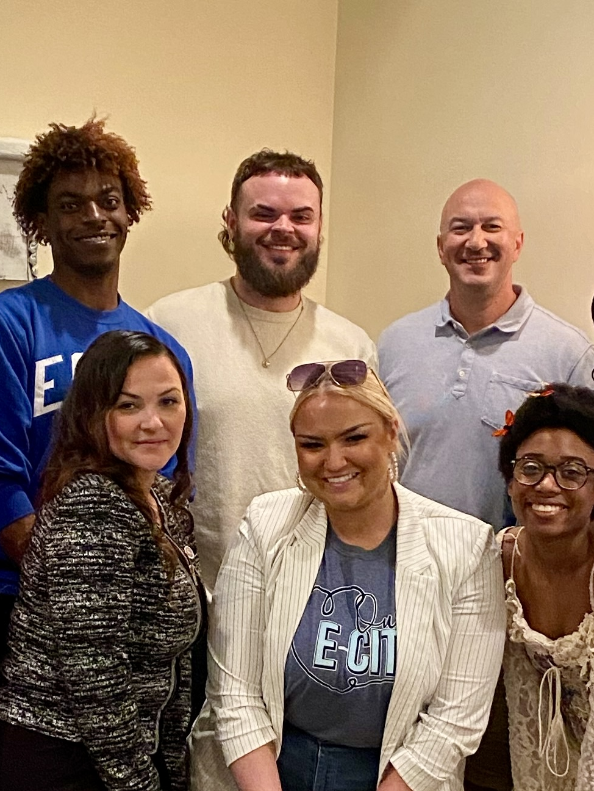
Gen-X
Born 1965-1980
Characteristics
  Independent
  Greater work-life balance
  Flexible
  Technologically proficient

Slide 35
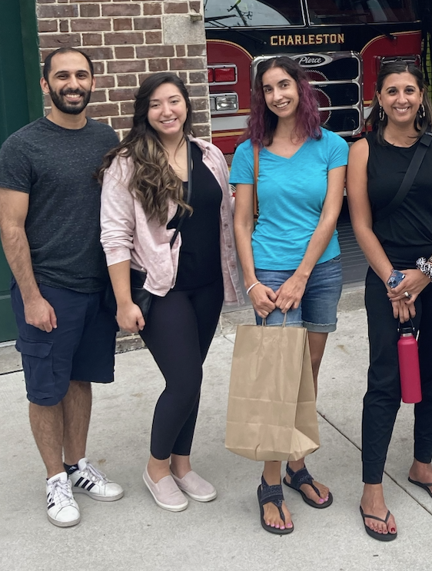
Millennials
Born 1981-1996
Characteristics
  Collaborative
  Civic-minded
  Flexible
  Sociable
  Digital Natives

Slide 36
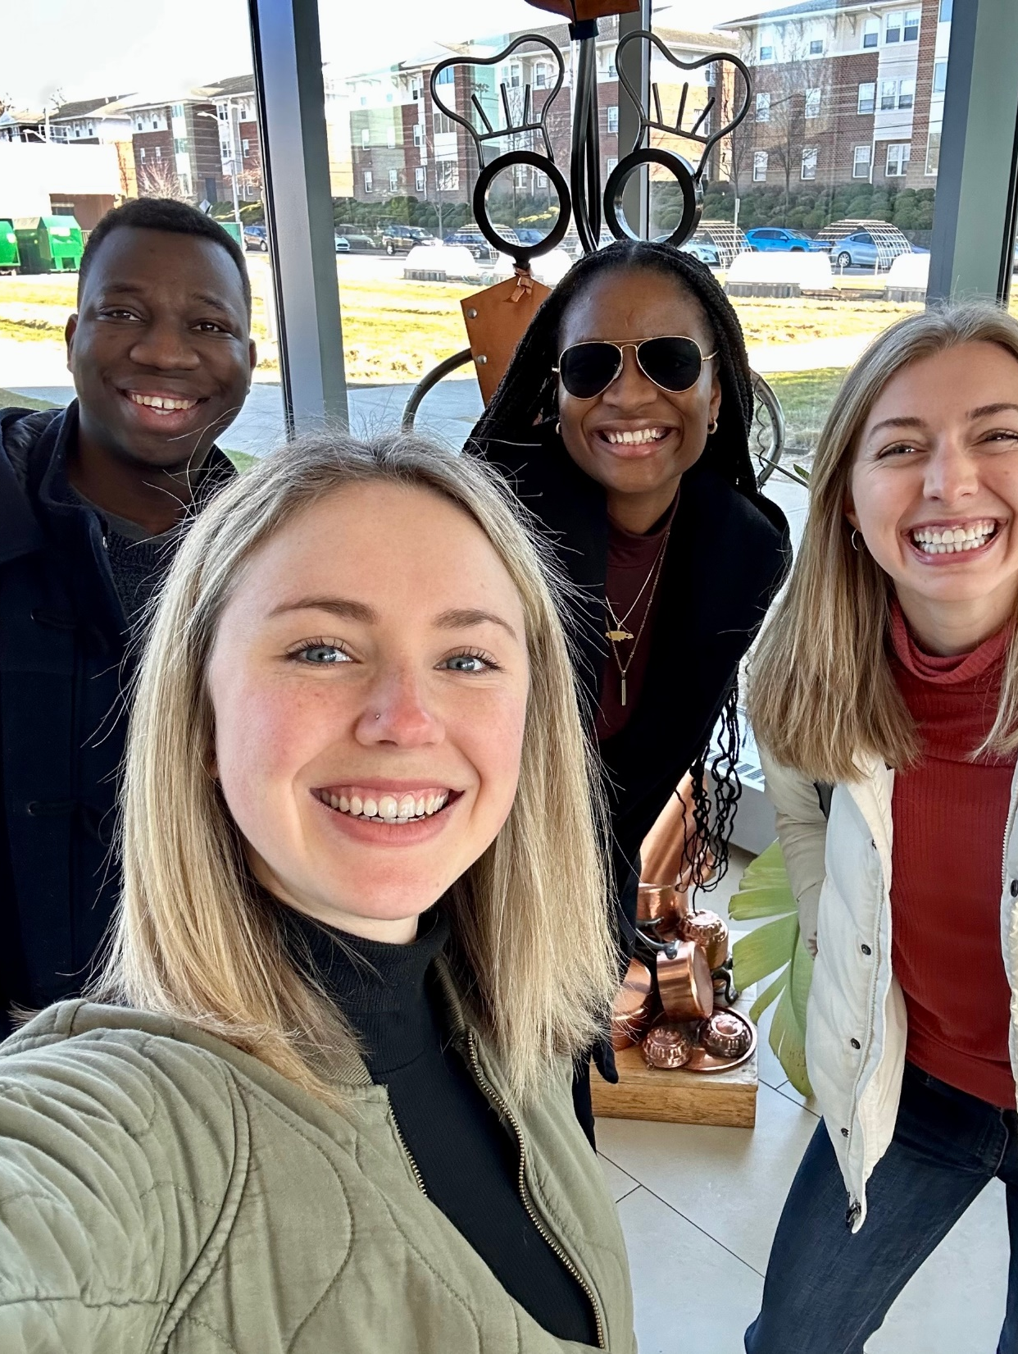
Gen Z
Born 1997-2012
Characteristics
  Digital natives
  Socially aware
  Politically aware
  Most ethnically diverse
T

Slide 37
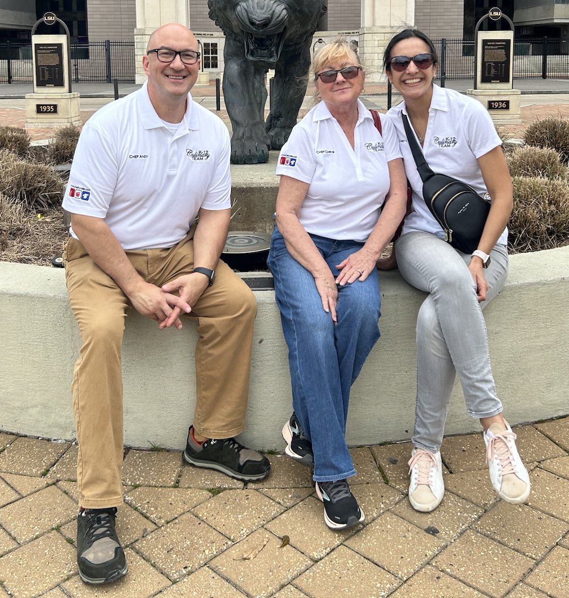
Generations Together
Baby Boomers: Appreciate involvement and being a change agent.
Gen X: Like to make their own hours; creative and adaptable.
Millennials: Want to connect work to personal and career goals.
Gen Z: Cares about others, inclusive and progressive.
Notes:
How can you tap into strengths to help the individual grow, as well as assist your program?

Slide 38
Generalizations of Generations
Generalizations do not apply to everyone.
Generalizations are not absolute predictors of success or failure.
We are ALL a product of our times.
We all need to feel valued.

Slide 39
Establish a Path; Define the Process

Slide 40
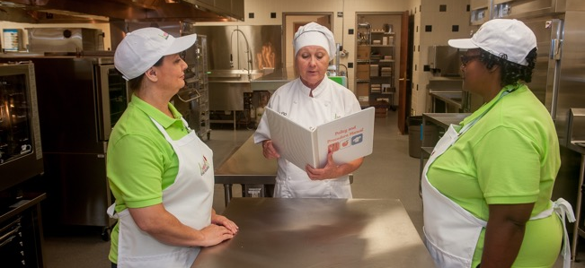
Develop with Cross-Training
Let them take the reigns!
Notes:
Provide cross training & experience
Let them take the reigns:
Where can managers take the lead?
Idea: Managers and Area Supervisor to have greater leadership role in summer programs
Logistics
Paperwork
Outreach to partners

Slide 41

Challenges to Mentoring
Lack of support of school district, bosses
Lack of resources
No TIME!
Like to keep job “mysterious”
Job security – see trainee as a threat

Slide 42
Provide Experience
Talent
Mystique
Content area experts

Slide 43
Return on Investment
Shared philosophy & vision
Dedication, commitment, loyalty
Programmatic responsibility
Excitement about the future
Notes:
Another ROI!

Slide 44
Challenge
Describe it for them!
Future leaders don’t always see their own potential…

Slide 45
Challenge
Give them wings to fly!
Future leaders may be scared to “leave the nest”…

Slide 46
Future Leaders
Employed elsewhere
Culinary Students
Stay at home parents
Notes:
In today’s job market, it’s always a good idea to keep an eye on the future. Where are potential future leaders coming from?

Slide 47
Previous Employment
Where are they coming from?
  Food & Beverage, Chefs
  QSR
  Somewhere else?
Notes:
Quick serve restaurants, as well as food & beverage and chefs, are a great addition to SNP’s
What are some of the less traditional avenues for attracting managers and future leaders to your program?

Slide 48
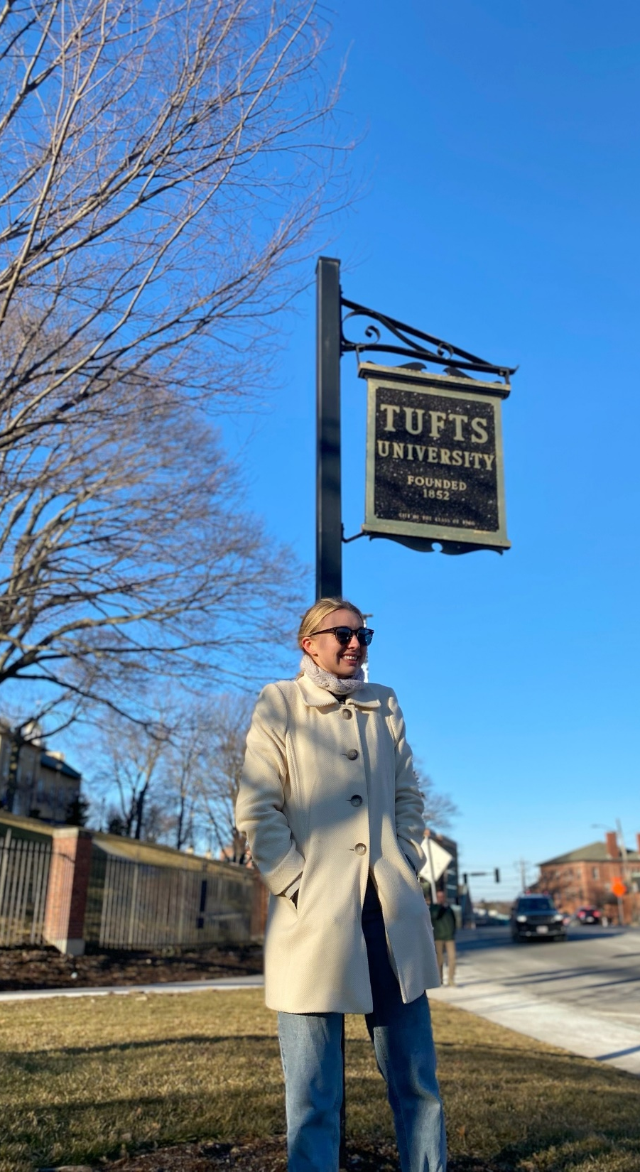
College Students
Bright & Talented
Blurred vision of the future
Hopeful, but no promise of employment
Tentative
Nervous
Scared
Notes:
College students who are unable to find jobs may be a great fit for SNP’s. Get the word out!

Slide 49
Professional Development
When we are young, we have a duty to learn.
At a certain point in our careers, we have a responsibility to teach.

Slide 50

Establish a Path; Define the Process

Slide 51
Training Tools & Resources
ICN
  Introduction to School Nutrition Leadership
  HR Training
  Financial Management
  Competencies
Colleges
  Local colleges
  Career & Tech centers
Training Opportunities
  Chef Cyndie and the K-12 Culinary Team

Slide 52
Your Task and Mine
Become a talent agent
Train everyone
Mentor as many as possible
Develop a few

Slide 53

Future Leaders
FSA I
FSA II
Managers
Area Supervisors
Notes:
Start looking now from your internal field for future managers and other leaders

Slide 54
What Can You and I Do?
Reach out
  Provide volunteer/shadowing opportunities. Who will your future leaders be?
Look inside
  Tap the strengths of internal candidates. Who do you need to mentor?
Wake up
  Potential SN leaders are all around you

Slide 55
Return on Investment
Capable, intelligent, and well-trained managers lead to a legacy, which leads to the future of SNPs

Slide 56
My Personal Goals
Develop SN leaders
Work for 34 years in school nutrition
  Author
  Serve as a resource
  Teach and mentor
60 total DI graduates
Notes:
During employment, develop as many SN leaders as possible
After retirement, become a magnet for SN:
Write articles
Serve as a resource
Instructor/Trainer
University/College

Slide 57
Your Personal Goals
What are they?

Slide 58

Who are the “angels on your shoulders”?
Notes:
Remember when we talked about those who mentored you? I like to think of my past mentors as “angels on my shoulders.” Who are the people who invested in you?
Make a list!
Send a thank you card!

Slide 59
Mine
Employer
Teachers/professors
Family
Parents
Mentors
Employees
Friends

Slide 60
Leave a Legacy
As a FNS Director:
  Area Supervisors: 8
  Dietetic Interns: 40
  Managers: 40
  FSA Employees: 126

Slide 61
Mentoring – Just do it!
Need is great for mentoring future generation of SN managers and professionals
Leave a legacy – touch the lives of many professionals
Your work can live on forever
It’s fun, it’s worthwhile, and you’ll be glad you did it
Grow your own! Go out and mentor!

Slide 62
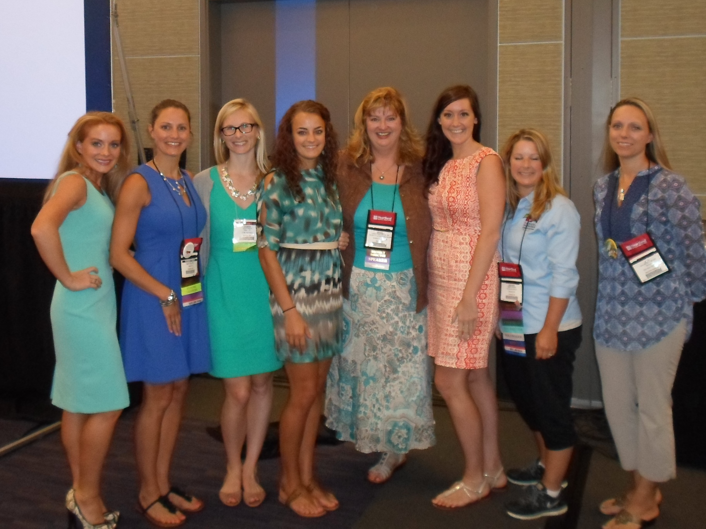
My Legacy
Notes:
The payoff of mentoring. Your legacy will last for years to come!

Slide 63

Questions?

