Slide 1

Standardizing Recipes

Slide 2
USDA Funding and Non-Discrimination Statements:
“This project has been funded at least in part with Federal funds from the U.S. Department of Agriculture. The contents of this publication do not necessarily reflect the view or policies of the U.S. Department of Agriculture, nor does mention of trade names, commercial products, or organizations imply endorsement by the U.S. Government.”
In accordance with federal civil rights law and U.S. Department of Agriculture (USDA) civil rights regulations and policies, this institution is prohibited from discriminating on the basis of race, color, national origin, sex (including gender identity and sexual orientation), disability, age, or reprisal or retaliation for prior civil rights activity.
Program information may be made available in languages other than English. Persons with disabilities who require alternative means of communication to obtain program information (e.g., Braille, large print, audiotape, American Sign Language), should contact the responsible state or local agency that administers the program or USDA’s TARGET Center at (202) 720-2600 (voice and TTY) or contact USDA through the Federal Relay Service at (800) 877-8339.
To file a program discrimination complaint, a Complainant should complete a Form AD-3027, USDA Program Discrimination Complaint Form which can be obtained online at: https://www.usda.gov/sites/default/files/ documents/ad-3027.pdf, from any USDA office, by calling (866) 632-9992, or by writing a letter addressed to USDA. The letter must contain the complainant’s name, address, telephone number, and a written description of the alleged discriminatory action in sufficient detail to inform the Assistant Secretary for Civil Rights (ASCR) about the nature and date of an alleged civil rights violation. The completed AD-3027 form or letter must be submitted to USDA by:
1. mail:
U.S. Department of Agriculture
Office of the Assistant Secretary for Civil Rights
1400 Independence Avenue, SW
Washington, D.C. 20250-9410; or
2. fax:
(833) 256-1665 or (202) 690-7442; or
3. email:
Program.Intake@usda.gov
This institution is an equal opportunity provider.

Slide 3
What is a Standardized Recipe?
The United States Department of Agriculture (USDA) defines a standardized recipe as one that has been tried, adapted, and retried at least three times and has been found to produce the same good results and yield every time when the exact procedures are used with the same type of equipment and the same quantity and quality of ingredients.

Slide 4
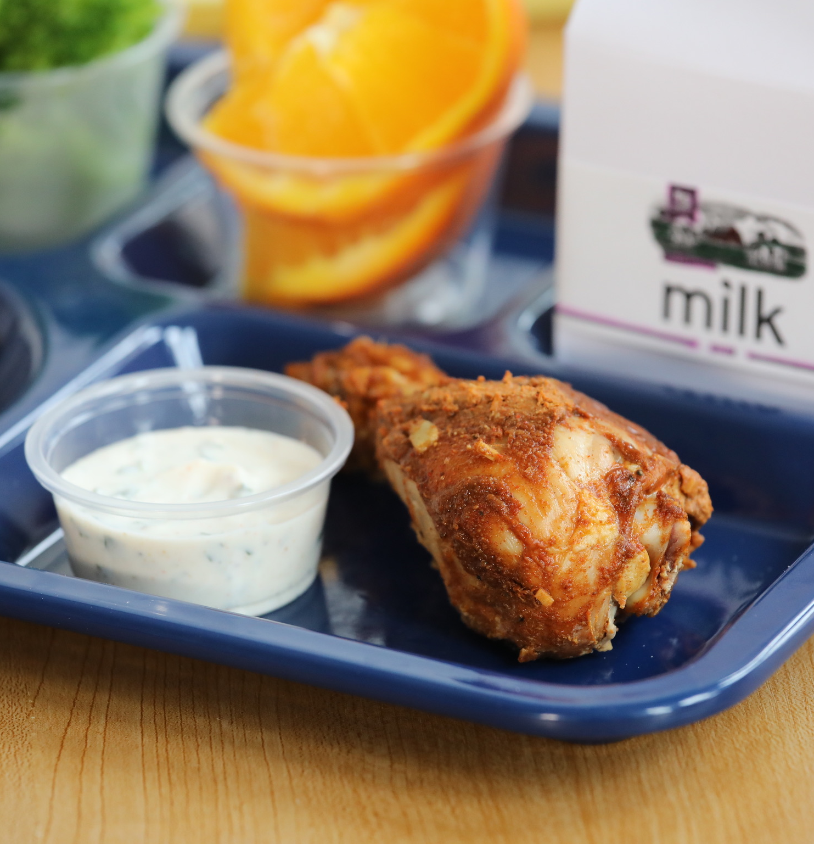
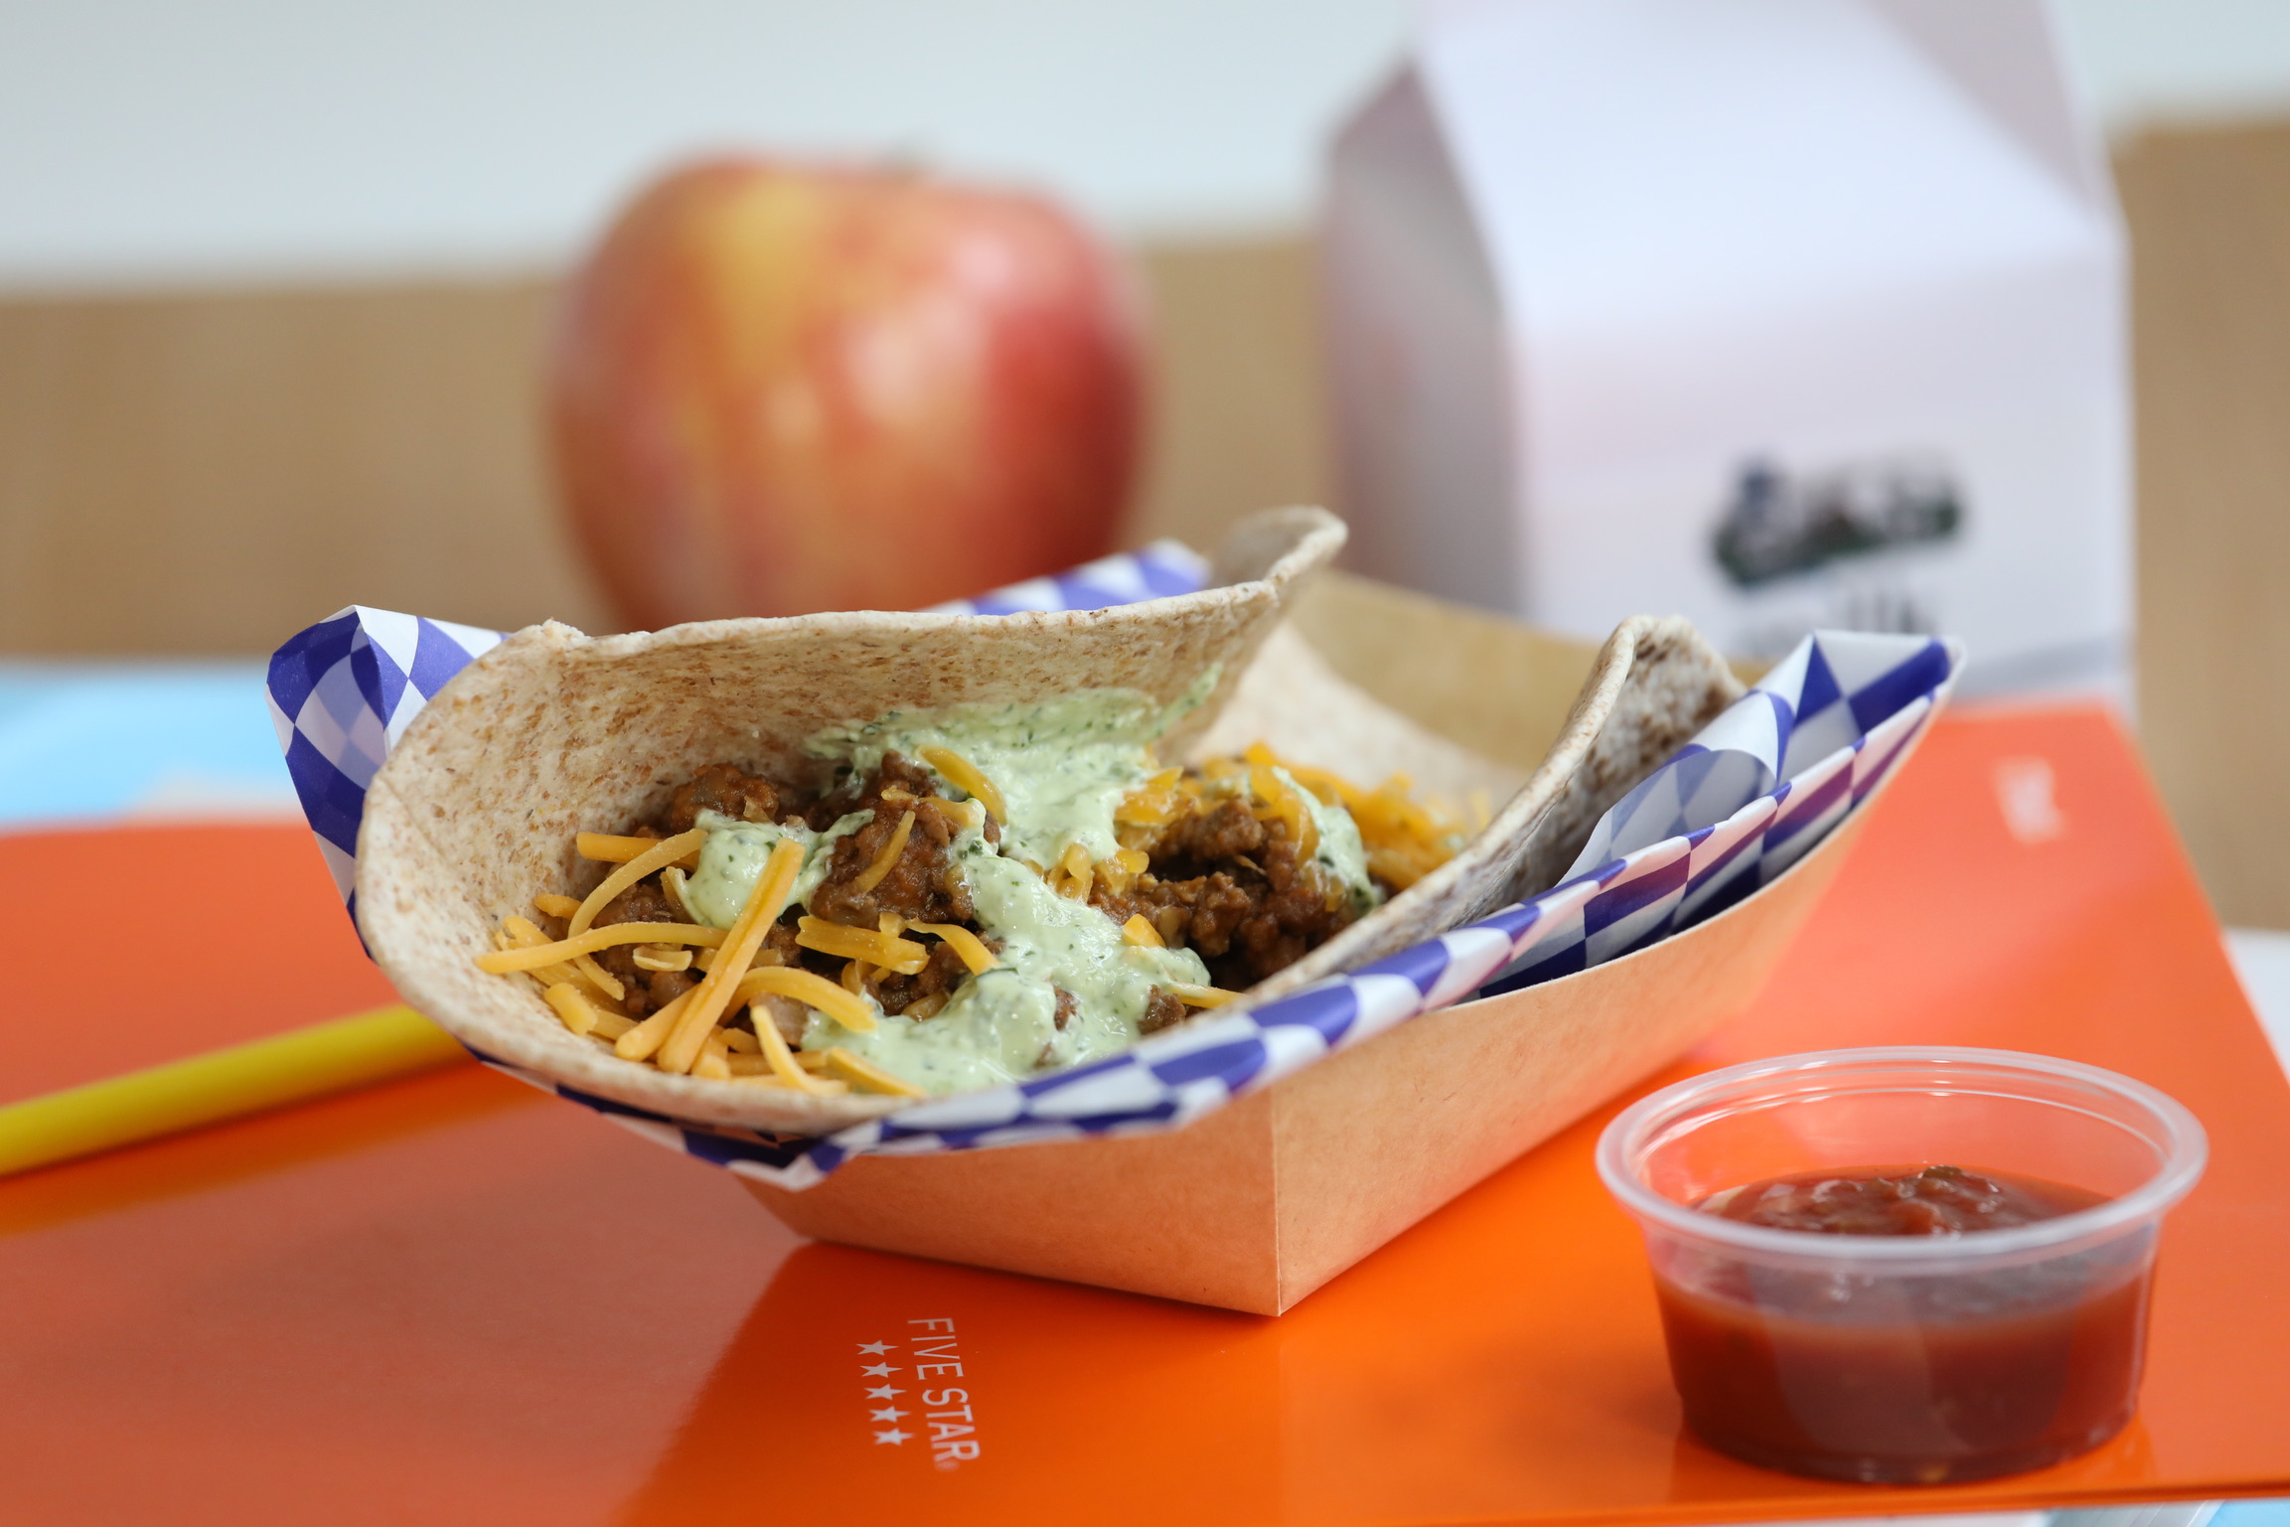
Benefits of Standardized Recipes
Consistent food quality, taste, and appearance
Predictable yield
Customer satisfaction (parents and students)
Adequate nutrition
Food and labor cost control
Employee confidence
Efficient purchasing and inventory
Control allergens
Successful Administrative Reviews

Slide 5
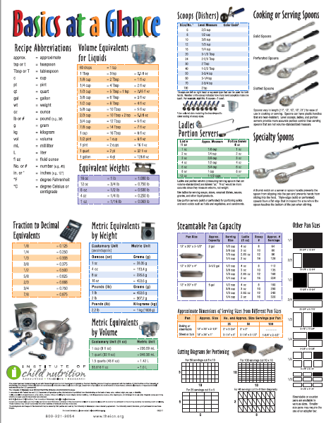
Create a Resource Guide
Breakfast and Lunch Meal Pattern
ICN’s Basics at Glance
Vegetable Subgroups
Exhibit A
Product Formulation Statement Guide
CN Label Guide
Offer vs Serve Resource

Slide 6
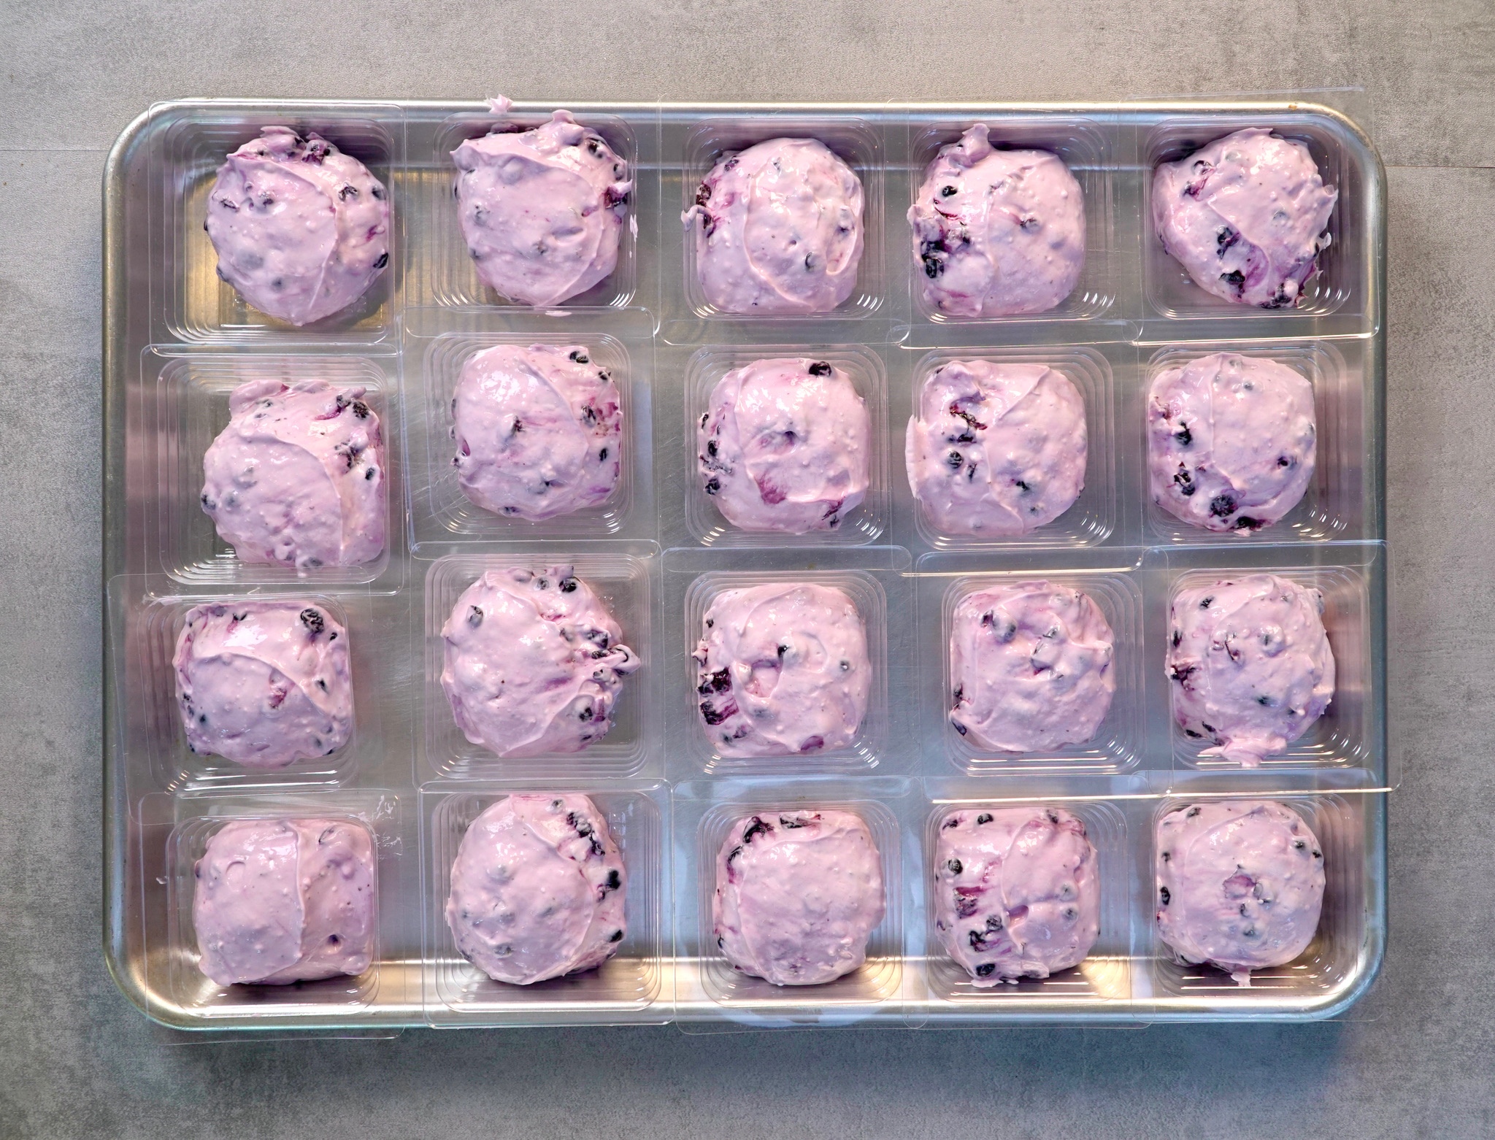
Four Steps to Recipe Standardization
Recipe Ideation Phase
Small Batch Recipe Verification Phase
Large Batch Evaluation Phase
Quantity Adjustment Phase
Notes:
Visit the Recipe Standardization Handout in your workbook.
Four Steps to Recipe Standardization
RECIPE IDEATION PHASE: The Recipe Ideation in child nutrition programs involves the creative process of generating new dishes or menu items while taking into consideration various factors and constraints. Identify key steps to implement in your division.
SMALL BATCH RECIPE VERFICATION PHASE: The Small Batch Recipe Verification Phase is a critical step in ensuring that a recipe is suitable for use in school kitchens and meets the specific needs of school nutrition operations. This phase focuses on assessing the quality, taste, and feasibility, while also considering the preference of children. Identify key steps to implement in your division.
LARGE BATCH EVALUATION PHASE: The Large Batch Evaluation Phase is a crucial step in the recipe standardization process. This phase involves thorough testing and feedback collection to ensure that the recipe meets quality standards, operational feasibility, and student preferences. Identify key steps to implement in your division.
QUANTITY ADJUSTMENT PHASE: The Quantity Adjustment Phase is the final step in the recipe standardization process, focusing on large-scale production while ensuring the recipe meets nutritional standards and can be successfully added to school menus. Identify key steps to implement in your division.

Slide 7
Process at a Glance
Develop flavor profile in small batch sizes
Create in large quantity servings to verify the recipe works in larger servings
Taste test with students
  Finalize the recipe with directions
  Limited equipment and space
  Staff cooking knowledge
Staff training
Add to menu and market with nutrition education

Slide 8
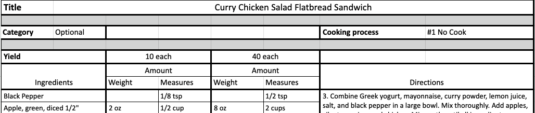

Standardized Recipe Sections
Recipe Title
Recipe Description (optional)
Recipe Category
Ingredients (weight & measure)
Preparation directions
Yield and serving size
Crediting and nutrient analysis
Notes:
Ingredients – weight, measure of as purchased and edible portion – sometimes this is referred to as a marketing guide
Preparation directions include preparation (including tasks such as thawing), cooking time, temperature, preparation time (this should go on your work schedule), serving instructions, what to do with leftovers, and FDA and local FDA food safety guidelines – HACCP
Crediting and nutrient analysis does not need to be done by a nutrition software program, it can be completed using the Certification worksheets provided by the USDA

Slide 9
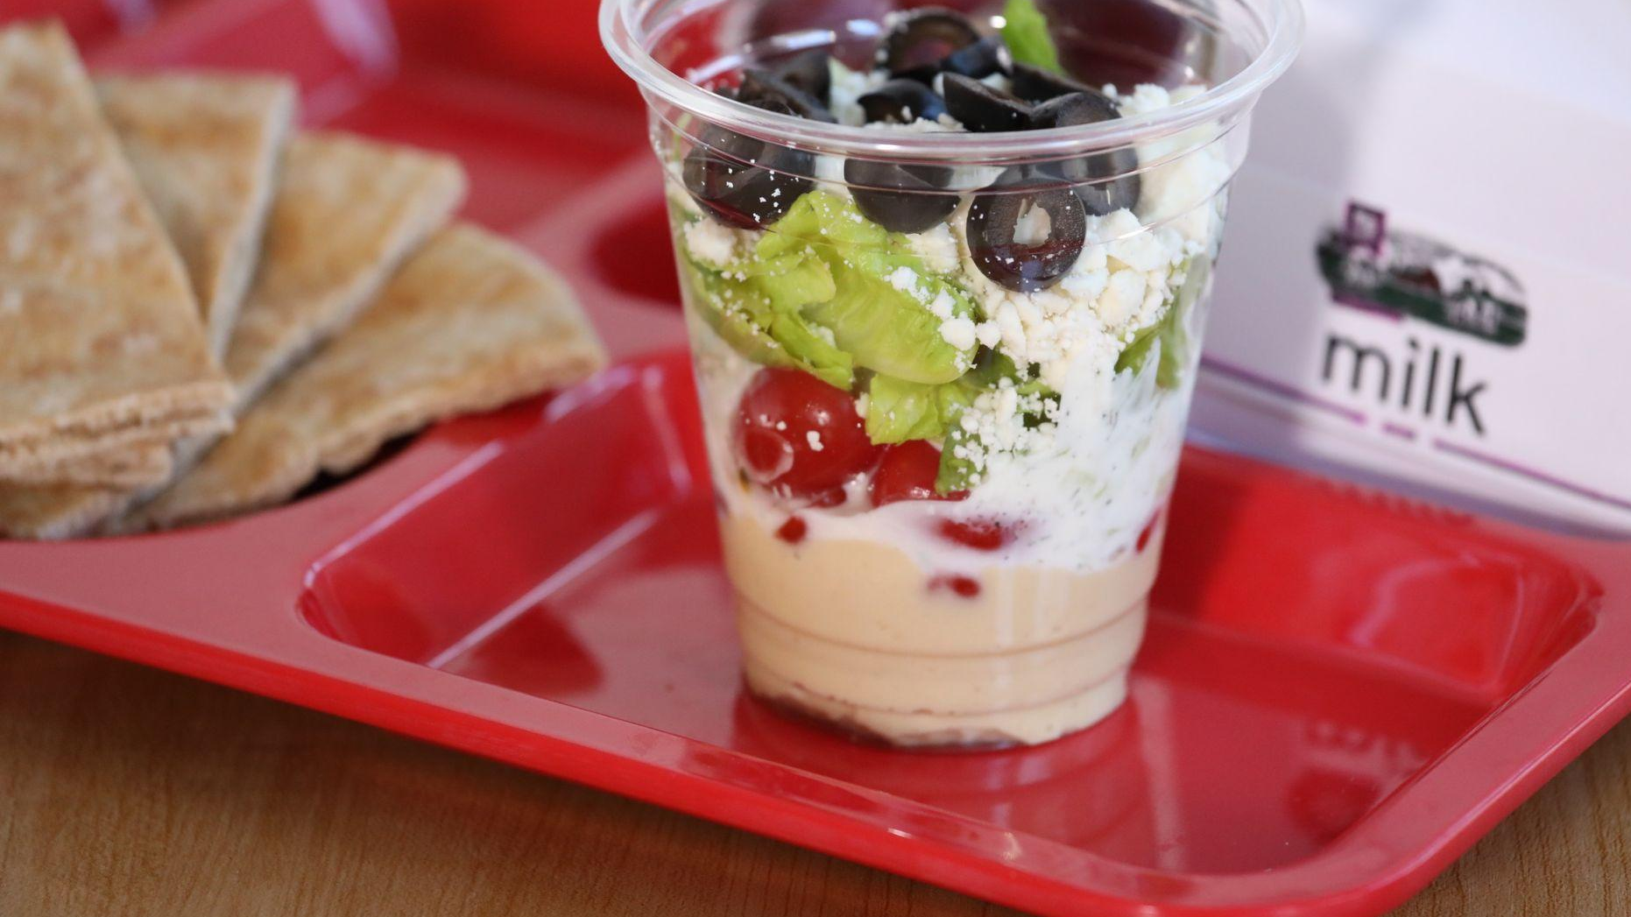
Recipe Ideation Phase

Slide 10

Who is on your team?
Director
Supervisor(s)
Menu Planner
Kitchen Manager(s)
Kitchen Cook(s)
Students
Other

Slide 11

The Business of Recipe Ideation
Menu needs
Available ingredients
Customer satisfaction
Allergens
Local competition
Kitchen(s)
Labor and food cost
Training
Inventory control
District nutrition claims
Special Considerations
Notes:
Menu Needs: Flavor Profiles, Variety, Balance
Available Ingredients: Local, USDA Foods, Further Processed, DOD Fresh, Purchased/Bid
Customer Satisfaction: Cultural Preference, Religious Preferences, Likes and Dislikes, Participation, Speed of Service
Allergens: 9 Big Allergens (milk, eggs, fish, shellfish, tree nuts, peanuts, wheat, soybeans, sesame), Others
Local Competition: Student Favorite Restaurants, Lunch Boxes
Kitchen: Equipment and Storage Availability
Labor Costs: Current Staffing, Additional Staff Needed, Meals per Labor Hour (MPLH)
Training: Kitchen Staff Skill Levels, Training Hours Needed
Food Cost: Mix & Match Inexpensive Items with More Expensive, Cost of Food
Inventory Control: Number of Current Food Items
District nutrition claims: restricted ingredients
Special Considerations: Transport Schools, Central Kitchens, No to Minimal Warehouse Space

Slide 12
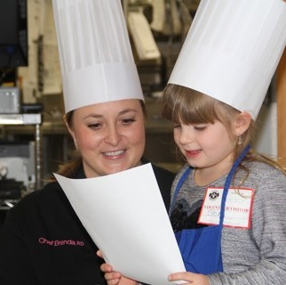
Food Item & Recipe Ideas
Seasonal local foods
Social media (other school districts)
School nutrition magazines
Student/parent recipe contests
Popular local restaurant dishes
Student culinary competitions
Student culinary focus groups

Slide 13
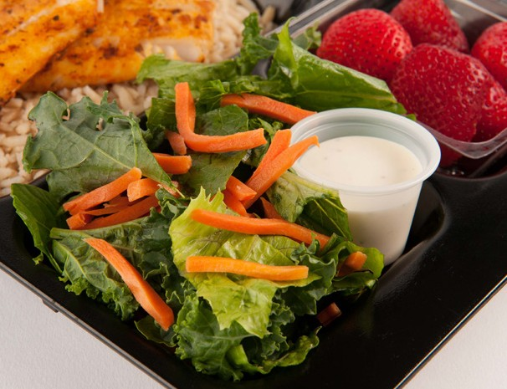

VA Local Foods
Virginia Seasonal Availability Calendar & Agriculture Map
Notes:
See the Virginia Seasonal Availability Calendar in the workbook.

Slide 14

Preliminary Recipe Writing
Grade appropriate recipe name(s)
Ingredient list
  Meal pattern considerations
  Nutrient standard considerations
  As purchased, edible portions
  Pack, can, and pan sizes
Preparation directions
  School equipment
  Kitchen staff skills
Notes:
Pack, can, and pan sizes – this determines the large batch sizes

Slide 15
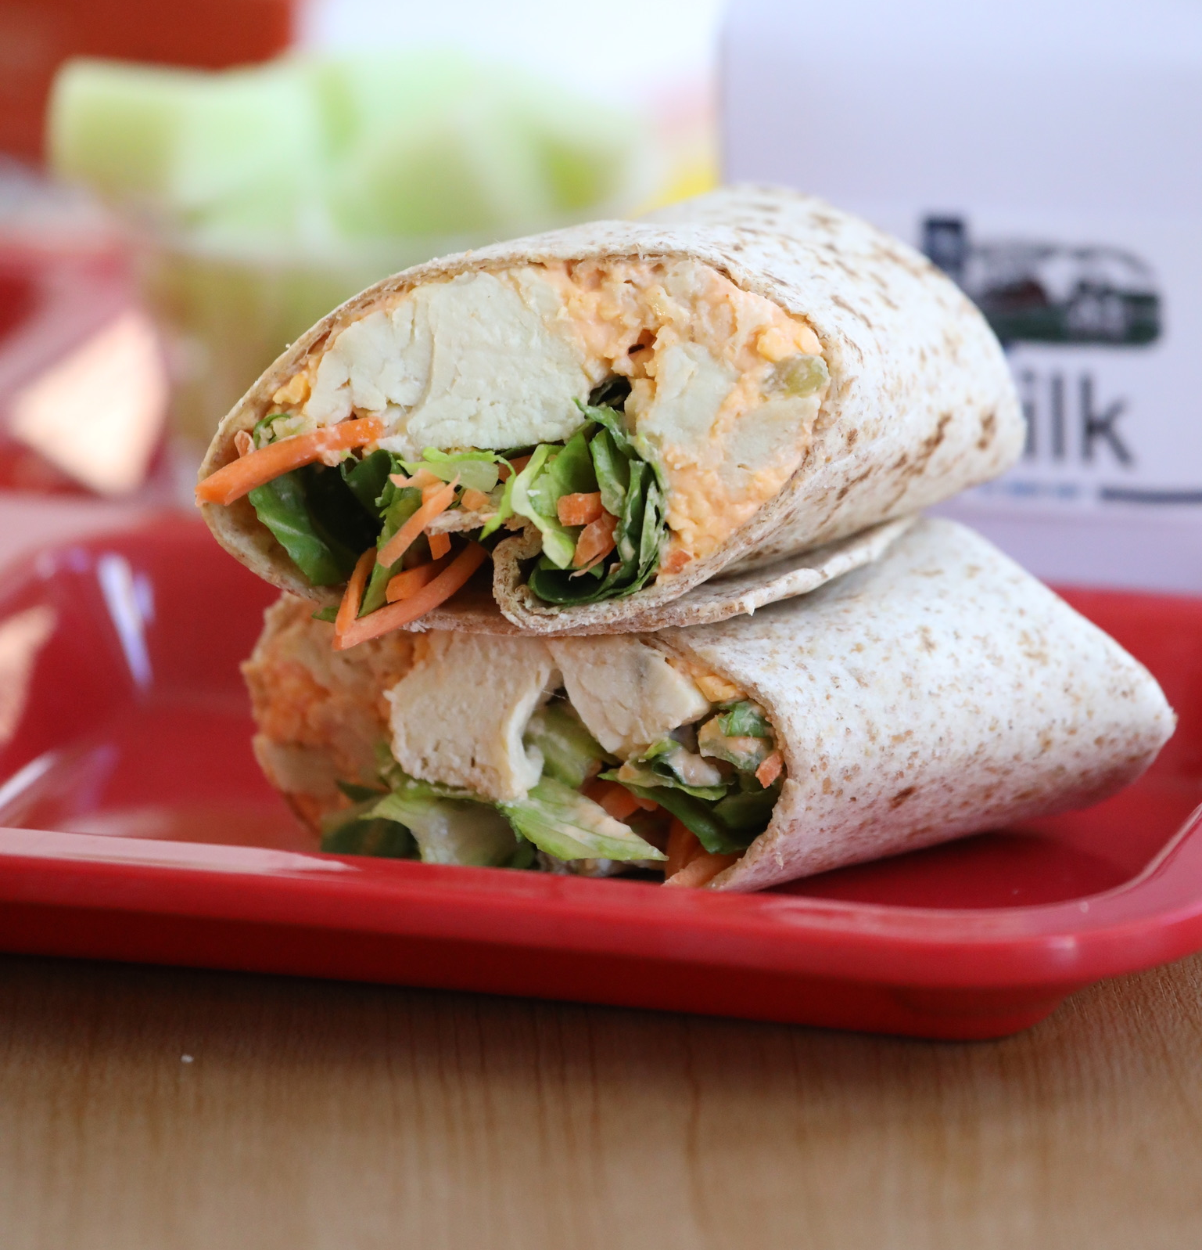
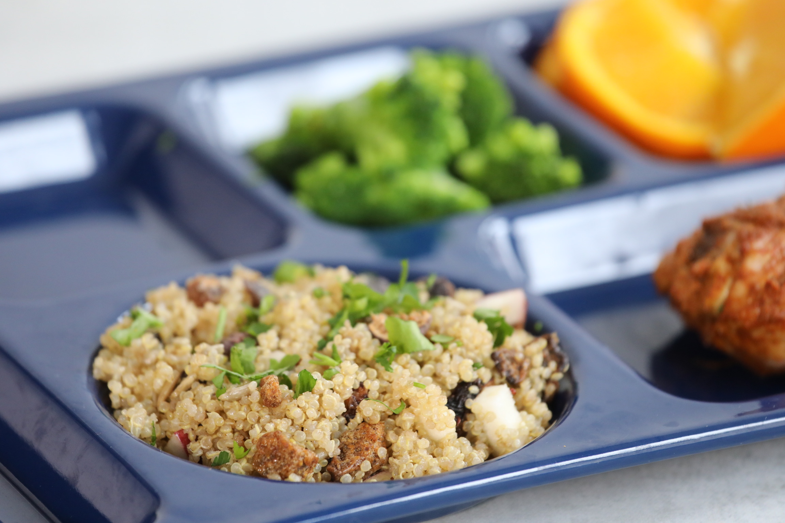
Flavoring Foods for Children
Tips to increase flavor
  Roast vegetables – Caramelization increases the sweet flavor
  Pan-sear, grill, or broil
Add Flavor to Food
  Lemon, lime, or orange zest
  Low sodium stocks
  Smoked paprika
  Sweet bell peppers
  Vinegar
  Worcestershire sauce
Notes:
Revisit the Flavoring Foods for Children handout in the workbook.
Children are born naturally enjoying sweet flavors!

Slide 16
Sodium Levels Processed vs Scratch
Purchased Ranch Dressing
  2 Tbsp = 260 mg sodium
Chef Cyndie’s Scratch Made Ranch Dressing
  2 Tbsp = 92 mg sodium
Notes:
168 mg less!

Slide 17
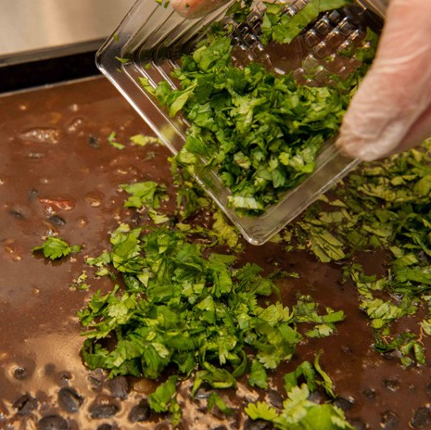
Quality
Locally sourced seasonal produce
Fresh herbs and garnishes
Food Cost
Skillful cooking techniques
Presentation
Feedback and Improvement
Notes:
Locally sourced seasonal produce can provide optimal flavor and freshness
Fresh herbs and garnishes enhance flavor and appearance
Food Cost The least expensive food item is not always the best choice – pairing lower cost items with more expensive items
Skillful cooking techniques influence flavor, texture, and overall appeal
Presentation can make food more enticing and enjoyable
Feedback and Improvement – soliciting feedback from customers and continuously working to improve recipes can lead to better-quality food over time.

Slide 18
Small Batch Recipe Verification Phase

Slide 19
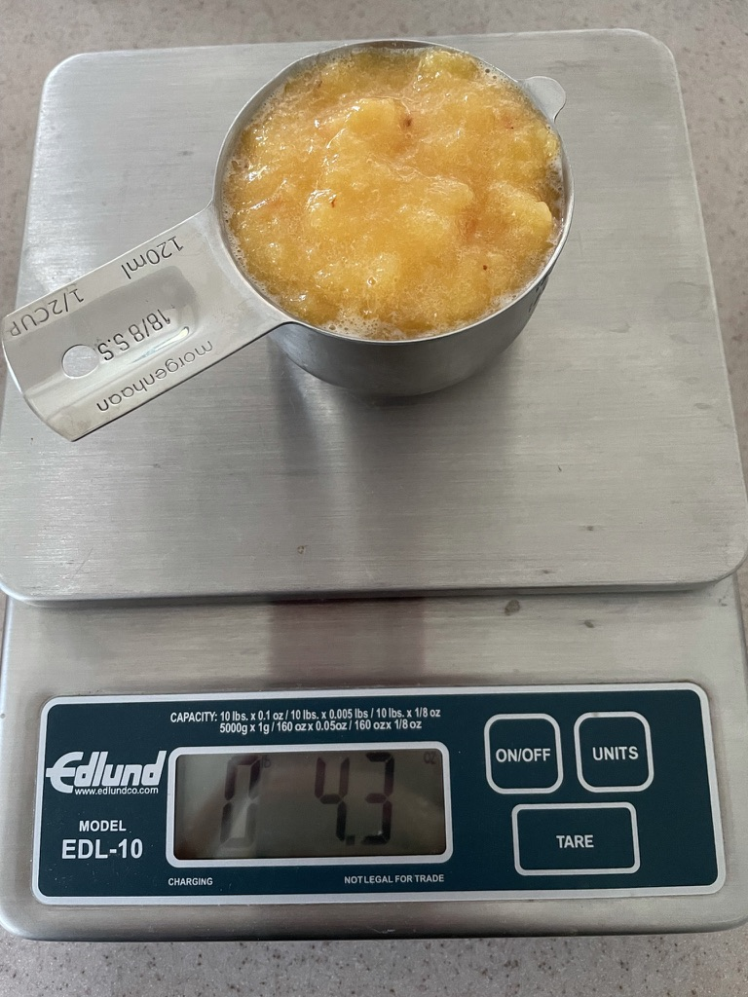
Steps for Small Batch Recipe Verification Phase
Ensure ingredient and food items meet meal pattern and nutrient compliance
Accurate weights and/or measure of ingredients
Gather required documentation
Re-evaluate food availability and cost
Finalize flavor profile
Feasibility from small batch to large batch foodservice yield and Method of Production (MOP)
Total Recipe Yield per Serving with preliminary serving sizes
Take notes on all steps
Notes:
Ensure ingredient and food items meet meal pattern and nutrient compliance
Accurate weights and/or measure of ingredients
Gather required documentation
Re-evaluate food availability and cost
Finalize flavor profile
Feasibility from small batch to large batch foodservice yield and Method of Production (MOP)
Total Recipe Yield per Serving with preliminary serving sizes

Slide 20
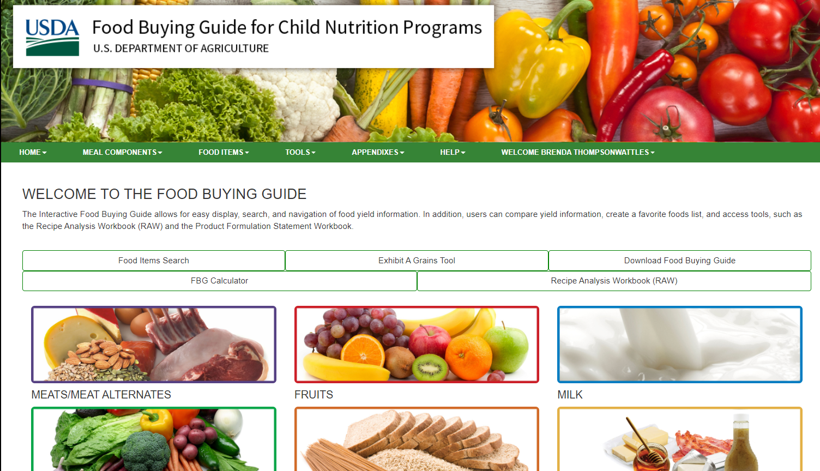
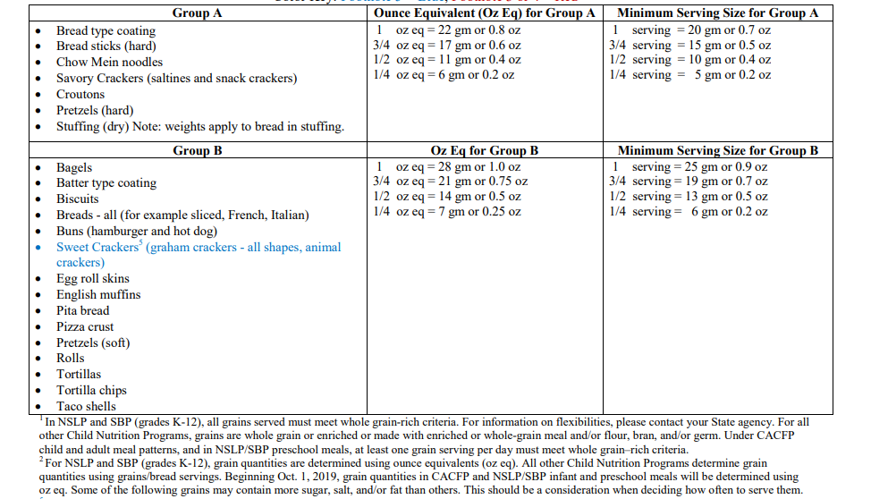
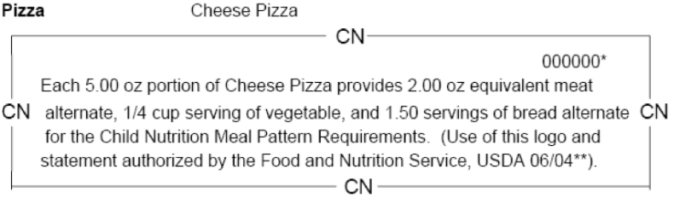
Component Documents/Resources
Nutrition Facts/Ingredients
NSLP Fact Sheet (USDA)
CN Label
PFS
FBG
Yield Study
Exhibit A

Slide 21
Large Batch Evaluation Phase

Slide 22
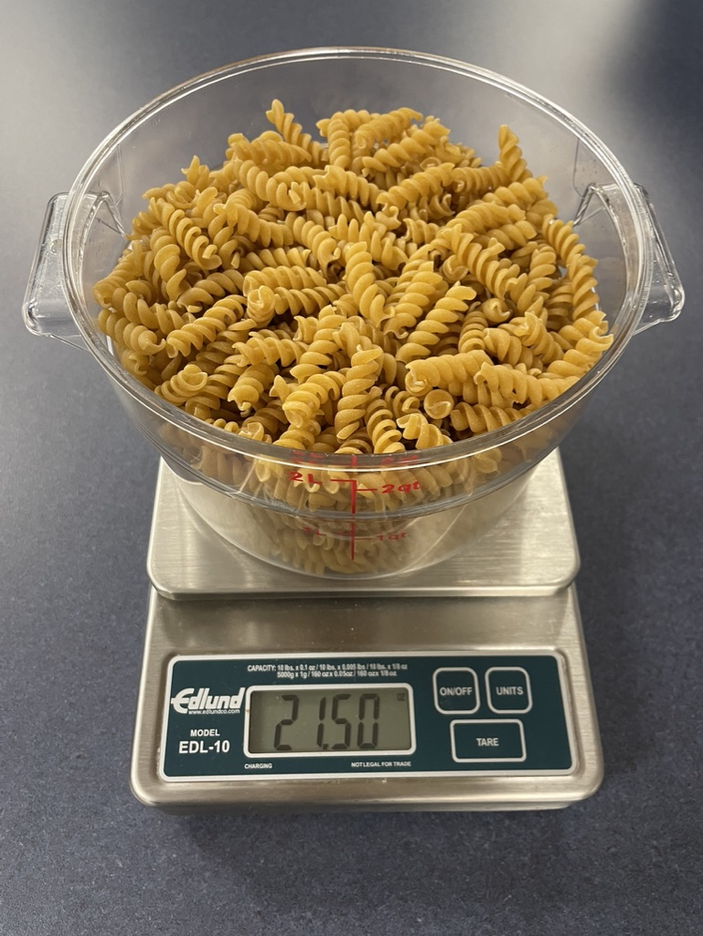

Steps for Large Batch Evaluation Phase
Verify ingredient pan, can, and pack size
Determine recipe quantity serving size
Test large batch recipe
Write quantity preparation, cooking, serving, and leftover instructions
Provide FDA and local Hazard Analysis Critical Control Point (HACCP) requirements
Collect kitchen manager and staff feedback
Identify kitchen staff training needs
Adjust recipe as needed
Conduct taste testing with students

Slide 23
Quantity Adjustment Phase

Slide 24
Steps for Quantity Adjustment Phase
Adjust according to large batch evaluation phase results
Conduct nutrient analysis
Refine all aspects of the recipe
Provide photos and videos with directions, if applicable
Predict and recommend possible substitutions
Develop and conduct kitchen training
Add recipe to menus
Market new recipes
Include nutrition education

Slide 25
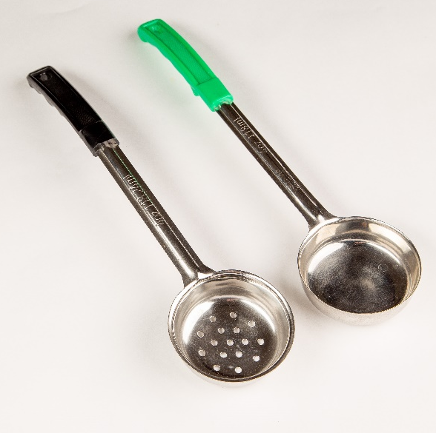
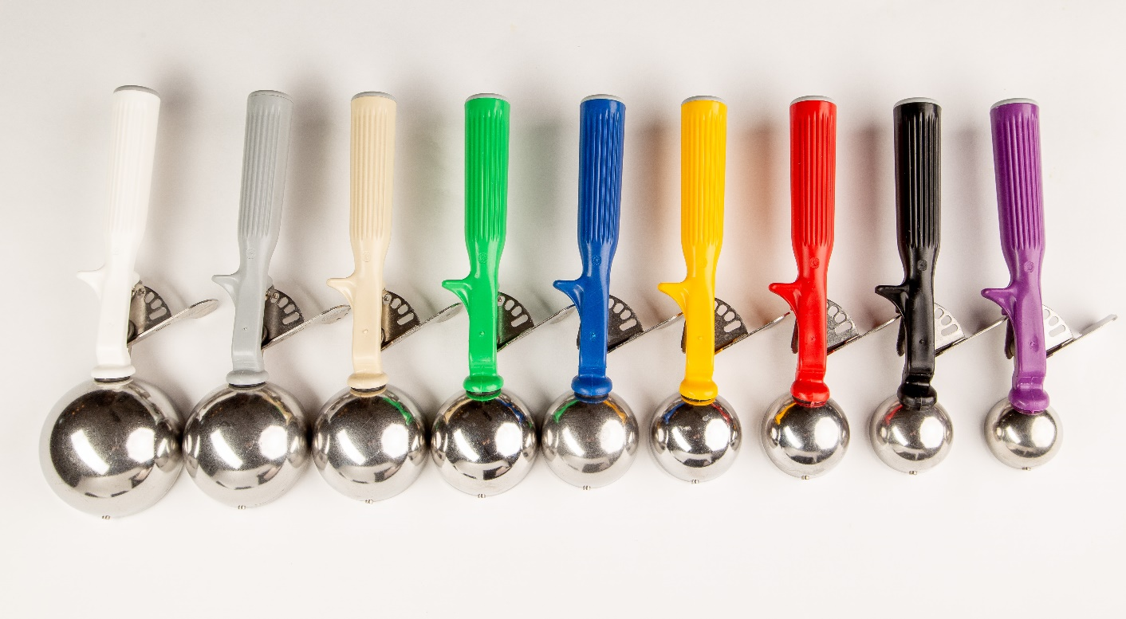
Standardization that Makes Sense
How many servings per pan, pack, can sizes
Calculating servings per pan
What’s The Scoop
Notes:
How many servings per pan, pack, can sizes
Calculating Servings in a Pan handout in workbook.
What’s The Scoop Activity in workbook – also provide approximate weight of scoop (Scant, level, heaping)

Slide 26
Variations of the Same Recipe
This may even be something simple like blender and immersion blenders
Browning ground beef in the oven or tilt skillet
Cooking pasta in steamer or kettle
Recipes for substitutions (canned corn vs frozen corn)

Slide 27
Marketing

Slide 28
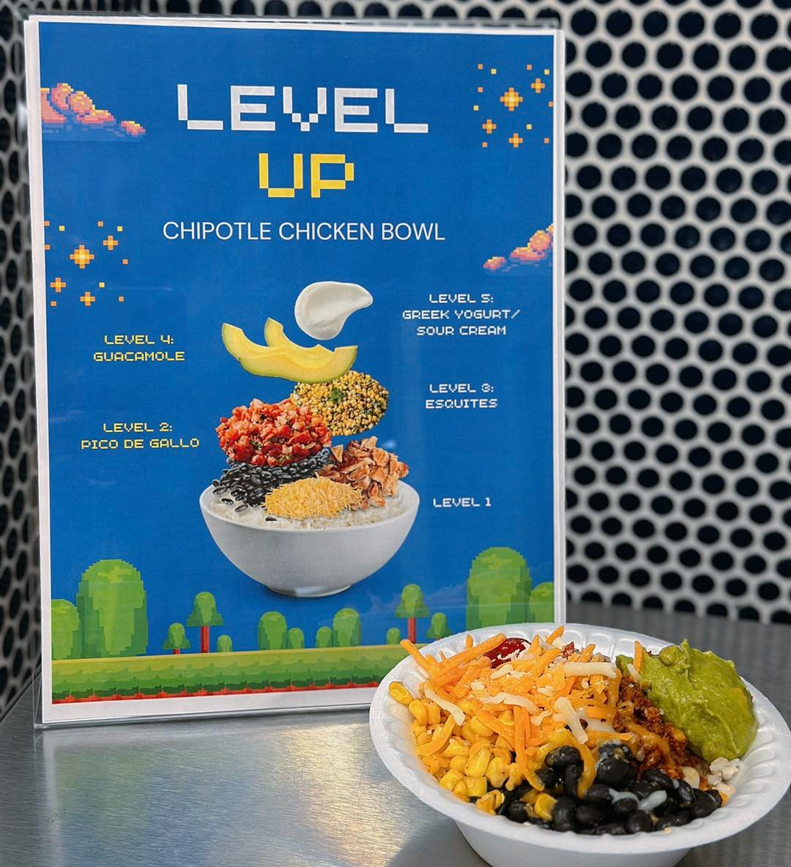
Create a Department Brand
Mission statement
Vision
Logo (if school division allows)
Colors and fonts
Staff uniforms/standard of dress
Department catch phrases or tag lines

Slide 29
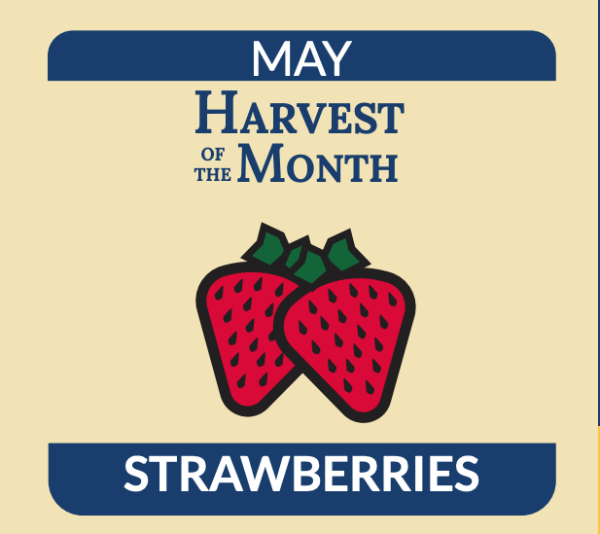
Nutrition Education
Seasonal highlights
Nutrient highlights
Channels in which recipes were sourced
Nutritional icons or symbols on menus
Kid fun facts about fruits and vegetables
Try it days

Slide 30
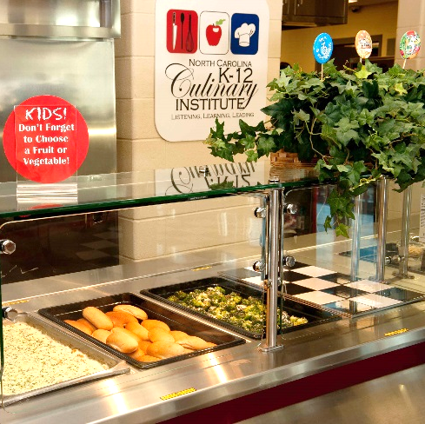
Perception
Promote Farm to School
Engage students and parents in Menu Planning
Provide photos on the menus
Theme Days
Incorporate student feedback
Naming recipes
Community engagement

Slide 31
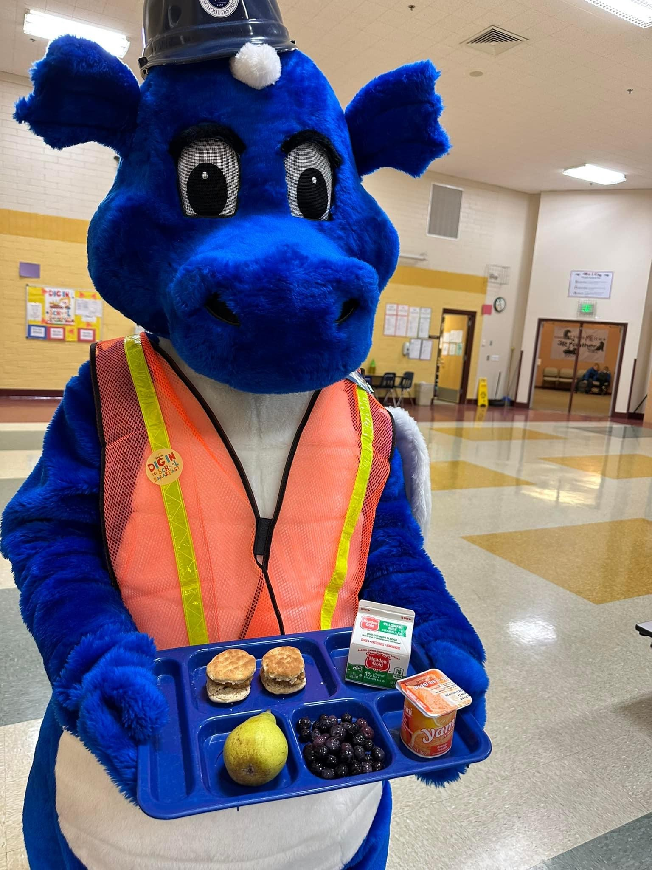
Market and Engage
Division opportunities to communicate
Student, parent, and community engagement
Staff training
Notes:
Upcoming opportunities to communicate the positive changes in their meal programs to the school board, division leadership, school administration and educators, parents, and the broader community (e.g., local festivals, job fairs, social media, school sporting events, conferences, board meetings, etc.),
Creative strategies to engage students (e.g. taste tests, kitchen tours, cooking classes, signage featuring new menu items, etc.), and
Developing customer service trainings for kitchen staff because, ultimately, our cafeteria staff are the best marketers of the programs!
This is a photo of a School Nutrition Mascot marketing a new breakfast menu item. He goes to schools with our director at least once a week to engage with students.

Slide 32
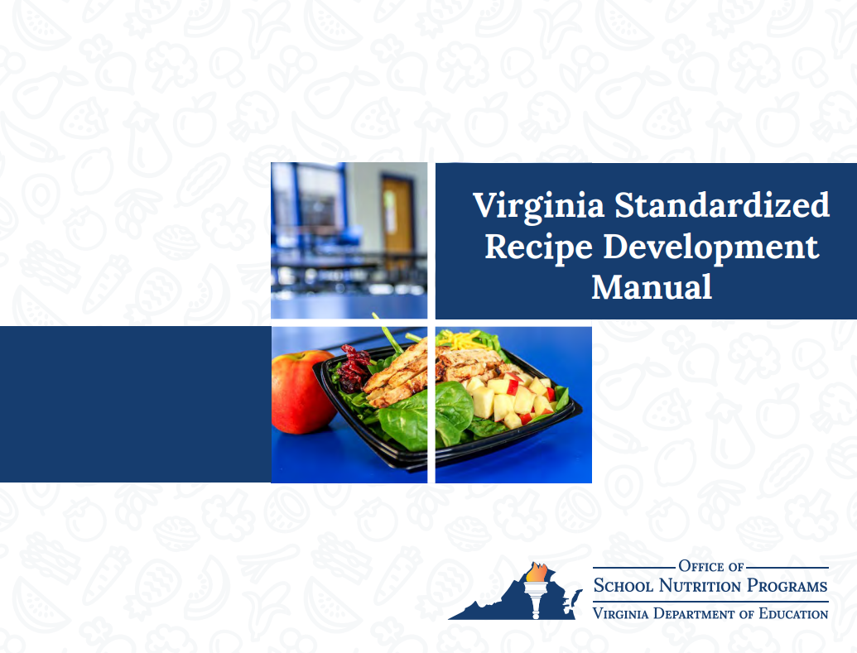
Virginia Standardized Recipe Development Manual

Slide 33

Questions

