Slide 1

Cycle Menus & Promotion
Chef Lindsey Schoenfeld, RDN
Chef Vahista Ussery, MS, MBA, RDN

Slide 2
USDA Funding and Non-Discrimination Statements:
“This project has been funded at least in part with Federal funds from the U.S. Department of Agriculture. The contents of this publication do not necessarily reflect the view or policies of the U.S. Department of Agriculture, nor does mention of trade names, commercial products, or organizations imply endorsement by the U.S. Government.”
In accordance with federal civil rights law and U.S. Department of Agriculture (USDA) civil rights regulations and policies, this institution is prohibited from discriminating on the basis of race, color, national origin, sex (including gender identity and sexual orientation), disability, age, or reprisal or retaliation for prior civil rights activity.
Program information may be made available in languages other than English. Persons with disabilities who require alternative means of communication to obtain program information (e.g., Braille, large print, audiotape, American Sign Language), should contact the responsible state or local agency that administers the program or USDA’s TARGET Center at (202) 720-2600 (voice and TTY) or contact USDA through the Federal Relay Service at (800) 877-8339.
To file a program discrimination complaint, a Complainant should complete a Form AD-3027, USDA Program Discrimination Complaint Form which can be obtained online at: https://www.usda.gov/sites/default/files/ documents/ad-3027.pdf, from any USDA office, by calling (866) 632-9992, or by writing a letter addressed to USDA. The letter must contain the complainant’s name, address, telephone number, and a written description of the alleged discriminatory action in sufficient detail to inform the Assistant Secretary for Civil Rights (ASCR) about the nature and date of an alleged civil rights violation. The completed AD-3027 form or letter must be submitted to USDA by:
1. mail:
U.S. Department of Agriculture
Office of the Assistant Secretary for Civil Rights
1400 Independence Avenue, SW
Washington, D.C. 20250-9410; or
2. fax:
(833) 256-1665 or (202) 690-7442; or
3. email:
Program.Intake@usda.gov
This institution is an equal opportunity provider.

Slide 3

Objectives
Identify the benefits from using cycle menus.
Utilize menu engineering to optimize profitability and student satisfaction by analyzing menu items, pricing, and popularity.
Strategize menu promotions to enhance customer engagement, drive sales, and elevate brand visibility
Implement SMART (Specific, Measurable, Achievable, Relevant, Time-bound) goals as a framework for goal-setting and drive individual and organizational cycle menu success.
Notes:
Review objectives

Slide 4
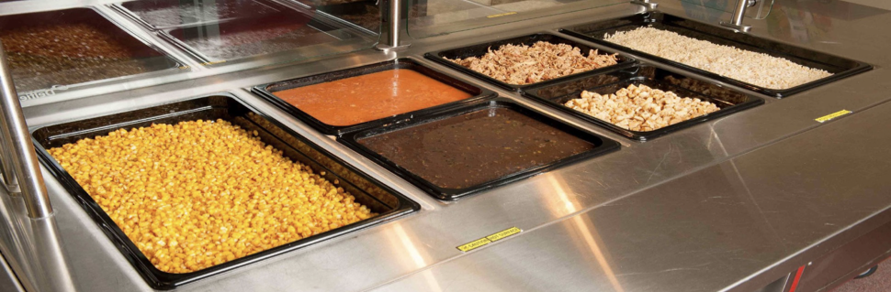
Cycle Menus
Notes:
Everything starts with your cycle menu!
The menu is the driving force for all aspects of the operation. It dictates the food purchased, food costs, the equipment used, and staffing needs. Of course, in school nutrition, the menu must meet USDA nutritional standards, too.

Slide 5
Benefits from Cycle Menus
Predictability
Efficiency
Financial benefits
Employee confidence
Reduced inventory
Easier training
Customer satisfaction
Notes:
Benefits from using cycle menus.

Slide 6
Predictability
Can use estimated time standards
Notes:
Cycle menus are predictable. You know what’s coming, you can be prepared, and you are not stressed, waiting for the latest menu to be released.
You and your team are able to become efficient and good at tasks.

Slide 7
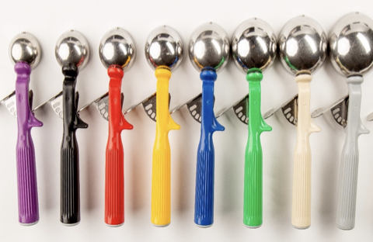
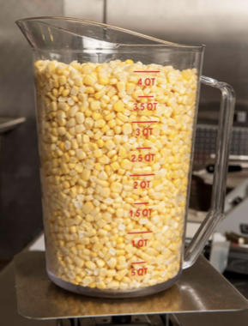

Efficiency
Notes:
If the menu is always changing, you lose predictability and certainly are unable to become efficient and more productive over time.
Incorporate seasonal items, but overall, the menu stays the same.
If the menu keeps changing, you cannot forecast, you cannot maximize production speed or create good work schedules, employees can’t improve their skills, and the list goes on and on.

Slide 8
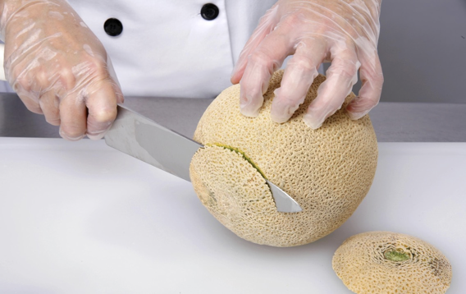
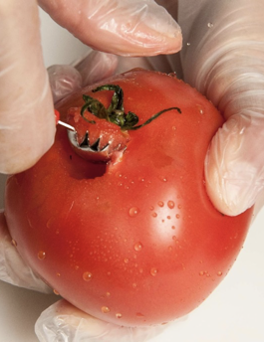
Financial Benefits
Notes:
Plan in advance, allowing for better inventory management and bulk purchasing
Familiarity: less waste when familiar with the product
Rotation of inventory

Slide 9
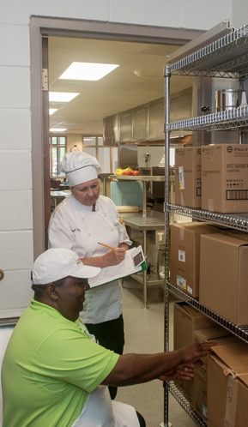
Reduced Inventory
Notes:
Allows for better inventory management and bulk purchasing
Minimize food waste by using ingredients across multiple dishes. This reduces the likelihood of unused perishable items going bad and needing to be discarded.

Slide 10
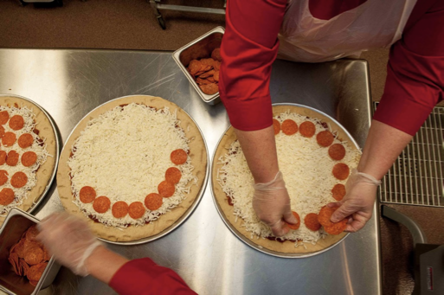
Easier Training
Notes:
Plan the work and work the plan
Identify kitchen hacks and easier ways of accomplishing tasks

Slide 11
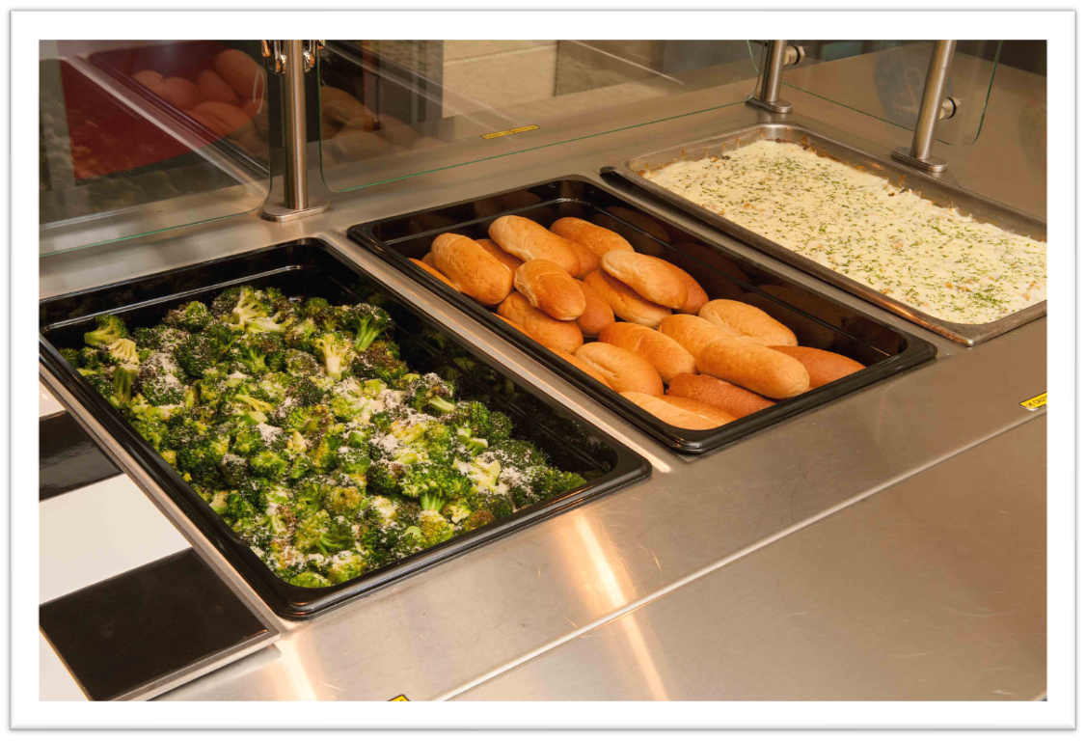
Customer Satisfaction
Notes:
Diverse range of dishes over a set period (cycle menus aren't boring when planned correctly), providing customers with variety and choice
Helps prevent menu fatigue and ensures that there's something for everyone, catering to different tastes and dietary preferences.
Customers enjoy consistency in the quality and preparation of dishes. Knowing that their favorite dishes will be available on a regular basis can build trust and loyalty among customers.
Seasonal and Fresh Ingredients: Cycle menus can be designed to incorporate seasonal and fresh ingredients, which not only enhance the flavor and nutritional value of dishes but also appeal to customers who prioritize freshness and sustainability.
Feedback Incorporation: Use feedback from students to refine and improve their cycle menus over time.

Slide 12
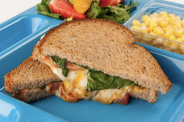
Length of Cycle Menu

Slide 13
Elementary
Longer cycles
3 to 4 weeks
Fewer entrée choices than secondary schools
Notes:
Longer cycles for elementary: 3-4 weeks
Less entree choices than secondary

Slide 14
Secondary Schools
Shorter cycles
1 to 2 weeks
Usually more entrée choices than elementary
Concept lines with individual cycle menus
Notes:
Shorter for secondary: 1-2 weeks
Usually more entree choices
Concept lines have individual cycles

Slide 15
Menu Engineering
Notes:
Menu engineering optimizes profitability and student satisfaction by analyzing the menu items, pricing, and popularity.
There are four types of menu items that are described here.
These were first identified back in the early 80’s, but still assisting in the menu building process.

Slide 16

Stars
Food items that are popular and profitable and many times come at a low cost.
Notes:
The first one is the Stars.
Food items that are popular and profitable and many times are low cost. We love Star menu items!
Some common star menu items in school nutrition might include chicken nuggets or pizza. It is going to vary depending on your division.

Slide 17

Plow-Horse
Popular but less profitable menu items
Notes:
Next menu item is the Plow-Horse.
Food items are relatively popular, but they are less profitable than other items on your menu, because they are a little more costly.
So how do we make an item more profitable?
Make it from scratch or speed scratch or pair it with less expensive side dishes.
Example of a Plowhorse that might be on your menu is purchased orange chicken which has become like other Asian flavors, super popular.
Students love it, but it’s typically more expensive than other entrees, so we need to be mindful when we are menuing them. Think about lowering your container cost if you are using disposables.

Slide 18

Puzzle Foods
These food items are not very popular, but very profitable.
Notes:
Puzzle foods – these are a puzzle!
Menu items are not very popular, but very profitable.
Goal would be to move Puzzle foods into the Star category by highlighting the Puzzle Food; marketing the puzzle food, make something special around it; get them excited about it, sampling, put it in the first slot on the steamtable line – a good psychology trick or put it first on the menu board.
Example of a puzzle food is spaghetti. How do we move spaghetti into the star category? Maybe change the noodle to a rotini or penne, or do a baked spaghetti with a sprinkle of cheese.

Slide 19

Dogs
These food items are not very popular, and not profitable.
Notes:
The Dogs!
Menu items are both low in popularity and low money makers.
You want to identify the Dogs and remove them from your menu….unless, a little caveat, the Dog is there for encouraging nutritious choices. It might take 10+ times for a student to accept it.
The kids might not like it, but we are teaching nutrition and maybe gradually increase student acceptability over time, right? Or, think about how can you make it more profitable. Can you lower the ingredient cost? Can you change the packaging to lower cost? Or put directly on the tray.
Don’t boost popularity, because it may only cost you more money.

Slide 20
Menu Engineering Summary
Star
  Popular
  Profitable
Plow horse
  Popular
  Not-so-much profitable
Puzzle
  Not popular
  Profitable
Dog
  Not popular
  Not profitable
Notes:
Summarize

Slide 21
Activity
Notes:
Writing a cycle menu or evaluating current cycle menu

Slide 22
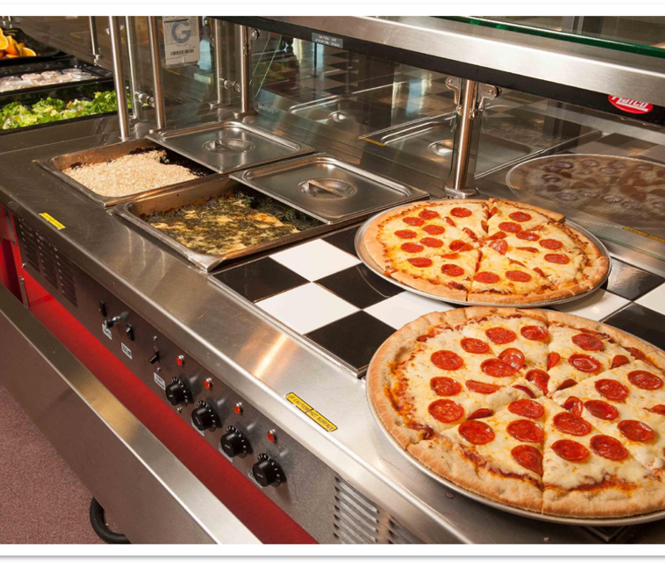
Promotions
Notes:
Tells them that you value them.
How do you present menu items?

Slide 23
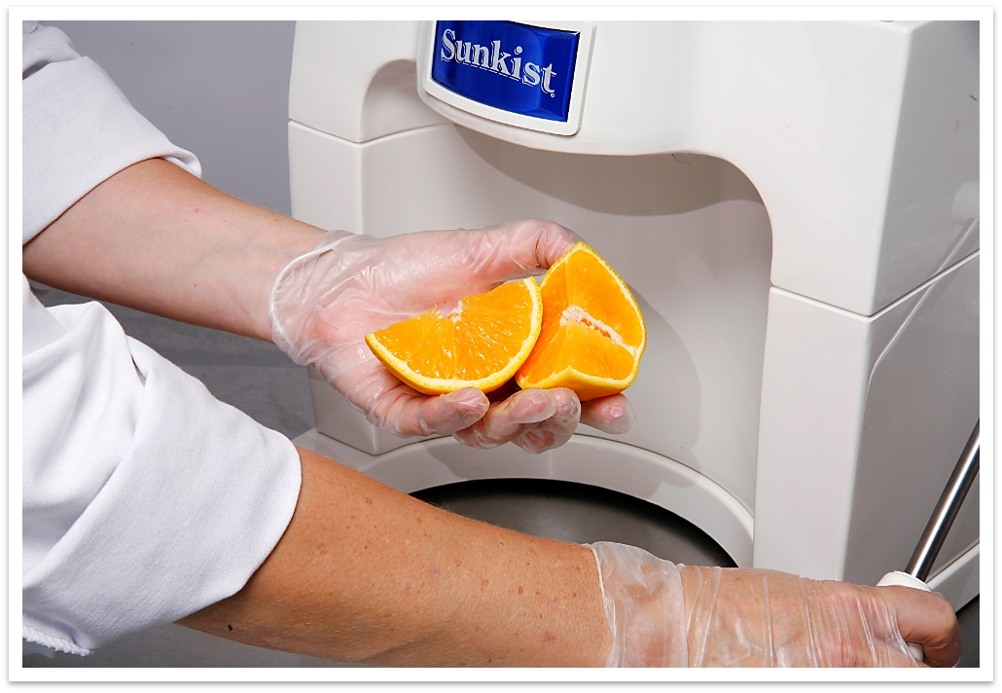
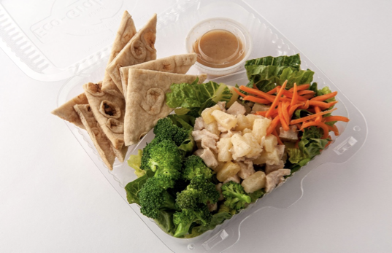
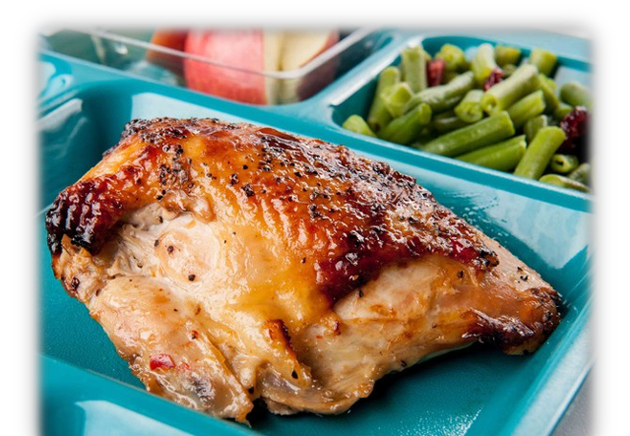
Presentation
Notes:
Color
Easy consumption
Proper culinary techniques
Containers
Grab and go options

Slide 24
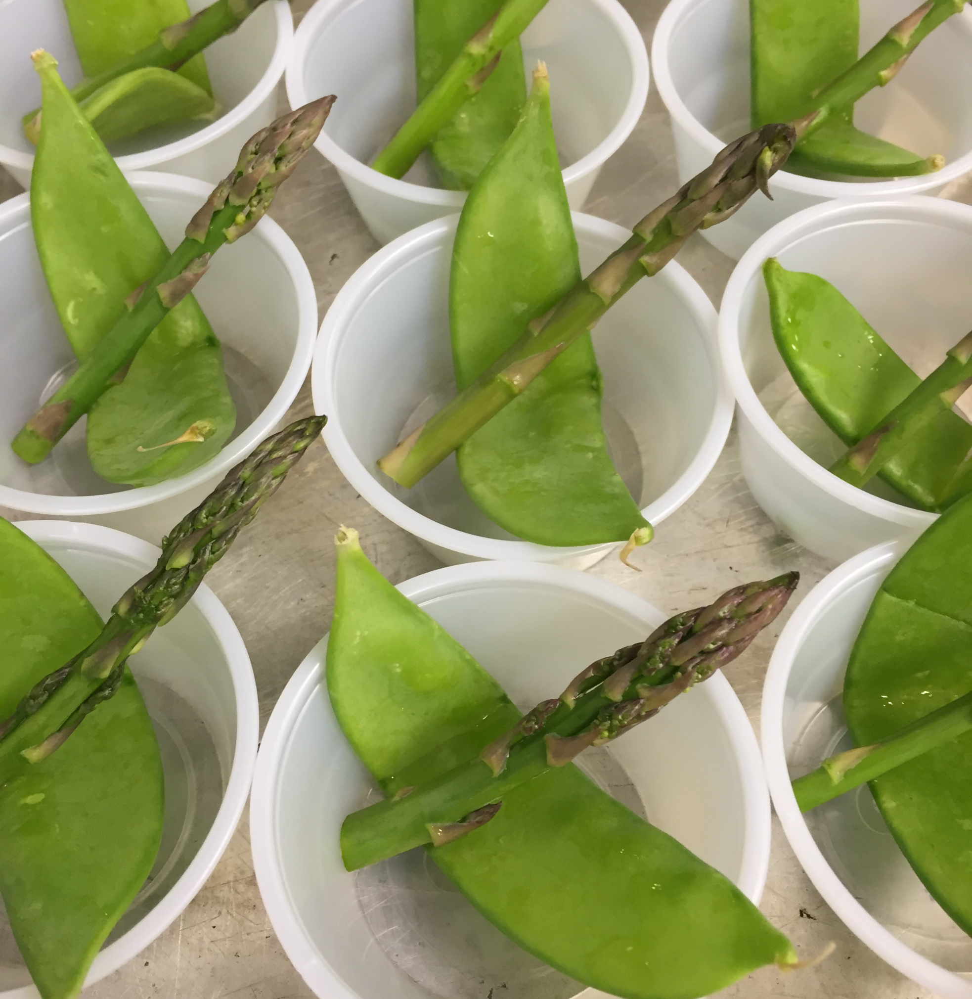
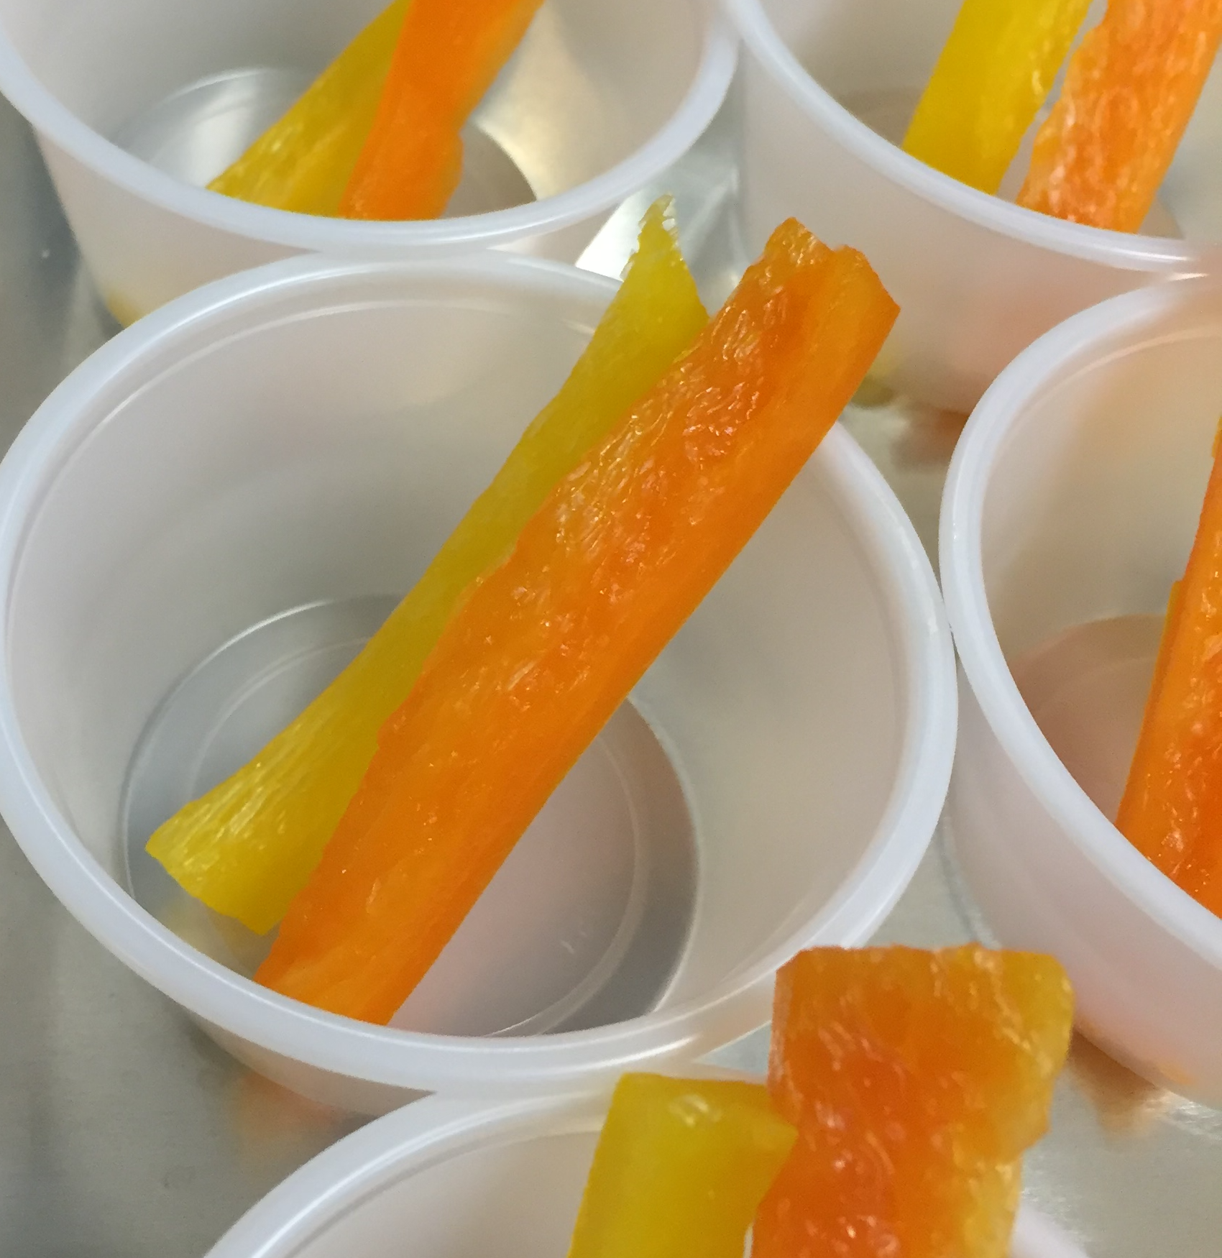
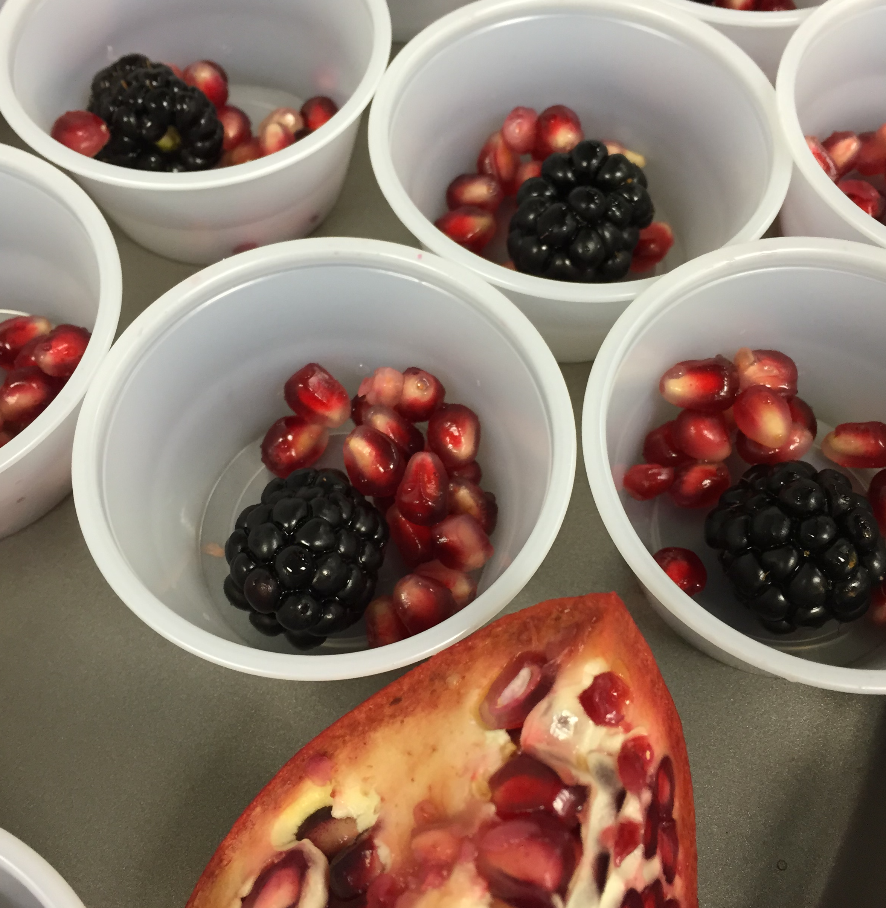
Taste Testing
Notes:
Reviewed in a directors webinar, but we are revisiting it because it can tell you if a menu item will make or break your participation.
Consistency is the key to the process of taste-testing. The same procedure must be followed for each recipe so that you confidently know that the ratings are based on the different recipes and not on differences in the process.
Make the information and process clear to students, consider setting up the taste-testing in stations that align with the defined phases. You want to avoid overwhelming the student with information, taste-testing, and then evaluation, all in one place

Slide 25

Student Focus Groups
Take time, but provide savings later
Select students who currently do not participate
Notes:
May take some time up front, but it will save you time, energy, and money in the long run.
Feedback on real and accurate ideas for promotions they want to experience.
Look for students not currently participating in the meal program.

Slide 26

Guest Chef
Uniform makes a difference
Notes:
Excited when they see the uniform
Raises the bar
Makes a connection to restaurants and culinary experience
Talk about the profession and excitement behind what we do

Slide 27
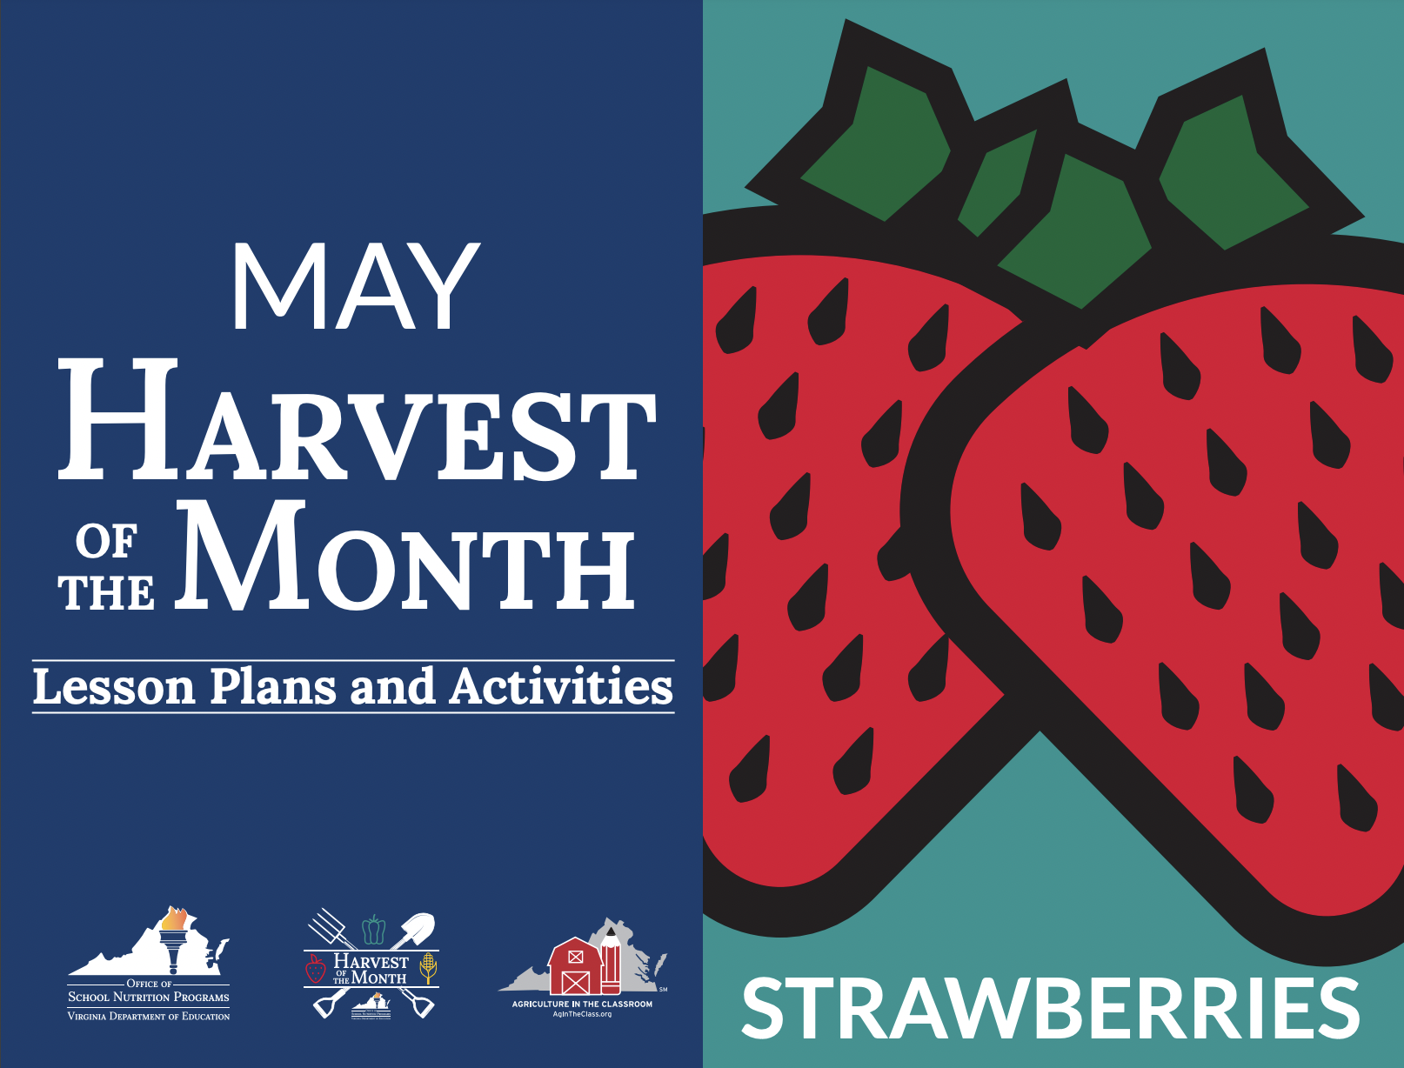
Special Promotions
Harvest of the Month
Notes:
What's new?
Getting a deal makes people feel special.

Slide 28

SMART Goals
Notes:
A SMART goal is an objective-setting technique that helps ensure goals are attainable within a specific time frame. SMART stands for:
Specific: Clearly define your objective
Measurable: Ensure it is measurable with criteria for success
Achievable: Make sure it is achievable within your resources
Relevant: Ensure it is relevant to your broader objectives
Time-bound: Set a time-bound deadline for completion

Slide 29

Questions

