Slide 1

Menu Planning
Chef Lindsey Schoenfeld, RDN
Chef Vahista Ussery, MS, MBA, RDN

Slide 2
USDA Funding and Non-Discrimination Statements:
“This project has been funded at least in part with Federal funds from the U.S. Department of Agriculture. The contents of this publication do not necessarily reflect the view or policies of the U.S. Department of Agriculture, nor does mention of trade names, commercial products, or organizations imply endorsement by the U.S. Government.”
In accordance with federal civil rights law and U.S. Department of Agriculture (USDA) civil rights regulations and policies, this institution is prohibited from discriminating on the basis of race, color, national origin, sex (including gender identity and sexual orientation), disability, age, or reprisal or retaliation for prior civil rights activity.
Program information may be made available in languages other than English. Persons with disabilities who require alternative means of communication to obtain program information (e.g., Braille, large print, audiotape, American Sign Language), should contact the responsible state or local agency that administers the program or USDA’s TARGET Center at (202) 720-2600 (voice and TTY) or contact USDA through the Federal Relay Service at (800) 877-8339.
To file a program discrimination complaint, a Complainant should complete a Form AD-3027, USDA Program Discrimination Complaint Form which can be obtained online at: https://www.usda.gov/sites/default/files/ documents/ad-3027.pdf, from any USDA office, by calling (866) 632-9992, or by writing a letter addressed to USDA. The letter must contain the complainant’s name, address, telephone number, and a written description of the alleged discriminatory action in sufficient detail to inform the Assistant Secretary for Civil Rights (ASCR) about the nature and date of an alleged civil rights violation. The completed AD-3027 form or letter must be submitted to USDA by:
1. mail:
U.S. Department of Agriculture
Office of the Assistant Secretary for Civil Rights
1400 Independence Avenue, SW
Washington, D.C. 20250-9410; or
2. fax:
(833) 256-1665 or (202) 690-7442; or
3. email:
Program.Intake@usda.gov
This institution is an equal opportunity provider.

Slide 3

Objectives
Utilize knowledge of the Dietary Guidelines for Americans (DGAs) to design menus that meet recommended nutrition standards for specific age groups.
Analyze the nutritional content of proposed menu items across various food groups such as meat/meat alternates, grains, fruits, and vegetables.
Design cycle menus incorporating factors beyond nutritional considerations, such as student-inspired meals, local foods, scratch cooking, and meal appeal.
Notes:
Review objectives

Slide 4
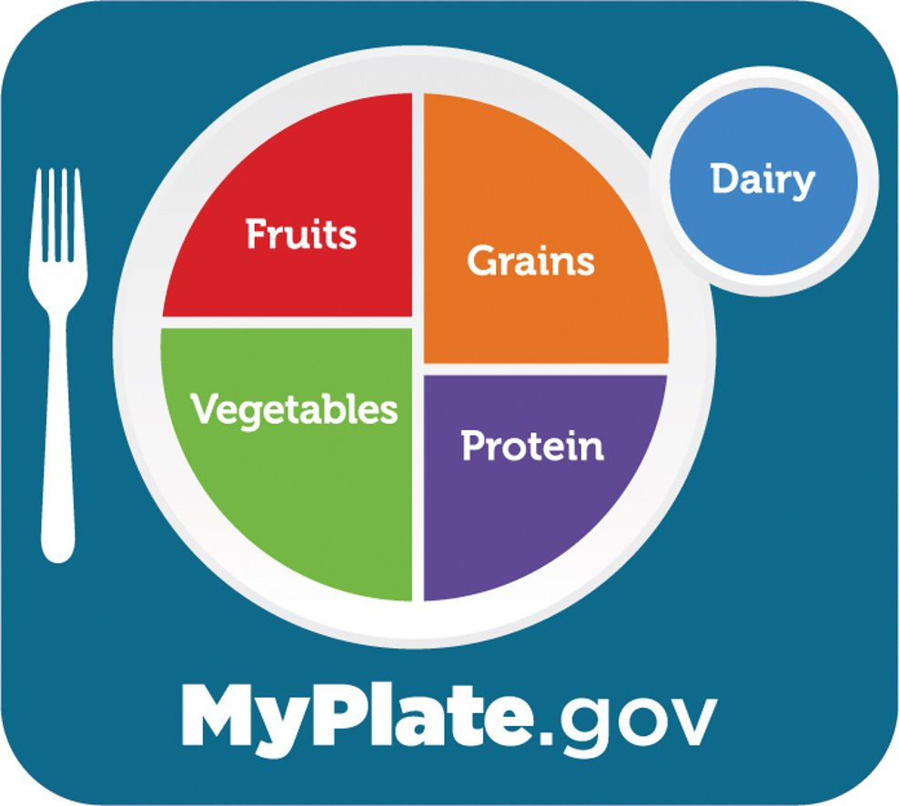
Menu Planning
Notes:
Provide meals to students every day, so remember that students consume the foods we prepare regularly
What you plan really makes a difference in how they feel now and their future health.
You and your team also eat these delicious meals. Let's prepare the foods that will help us all live healthier lives!

Slide 5
Meet the Guidelines
Healthier choices within each component
Plant-forward recipes
Whole foods
Notes:
Menu planning is not only about meeting the guidelines, but it's also about the BEST way to meet the guidelines.
We want to offer a variety of lean meat and meat alternatives, such as a bean and cheese burrito.
Plant-forward proteins are a healthful option! We want to choose more whole foods versus ultra-processed options. For example, roasted chicken with brown rice and fresh fruits & vegetables vs chicken nuggets with a roll and canned sides/juice.
Take a moment to think about a recipe you could serve regularly? What are some recipes you want to limit to once a week?

Slide 6
Nutrition Integrity
“a guaranteed level of performance that assures that all foods available in schools for children are consistent with recommended dietary allowances and dietary guidelines and, when consumed, contribute to the development of lifelong, health eating habits."
Notes:
The term “nutrition integrity” was coined at the American School Food Service Association 1990 Long Range Planning Seminar. Nutrition integrity is defined as “a guaranteed level of performance that assures that all foods available in schools for children are consistent with recommended dietary allowances and dietary guidelines and, when consumed, contribute to the development of lifelong, healthy eating habits."
Source:
White G Nutrition integrity defined. School Food Service J. 1994; 48: 21-22

Slide 7
Lunch
Notes:
Review how the Dietary Guidelines for Americans impact each meal component. Starting with lunch.

Slide 8
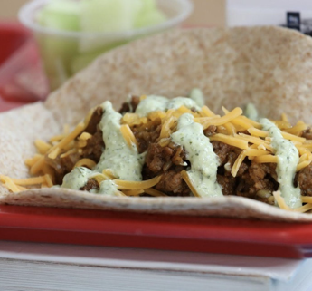
Meat/Meat Alternates/Entrees
Beef
Pork
Chicken
Seafood
Beans, Peas, Lentils
Nuts, Seeds
Soy
Dairy
Notes:
Top sources from earlier presentation:
Poultry
Meats
Cured meats
Plant based protein foods
Eggs
What are students missing? More seafood, nuts, soy.
Pair protein with carbohydrates to help control blood sugar

Slide 9
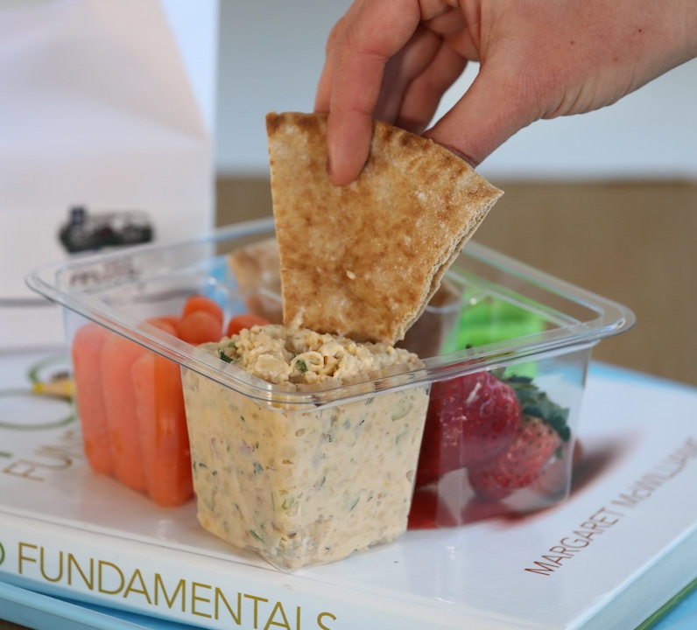
Lunch Grain Sides
Bread products
Intact grains
Notes:
Most meet recommendations for total grain intake
74% eat too many refined grains
2% meet recommendations for whole grains!
Bread products, such as sliced bread, bagels, and rolls, are convenient options for incorporating grains into meals. They require minimal preparation and can be easily stored and transported.
Intact grains, such as brown rice, quinoa, and barley, retain their natural bran, germ, and endosperm, preserving their nutrient content. They are rich in fiber, vitamins, minerals, and phytochemicals, providing more nutritional benefits compared to refined grains used in bread products.

Slide 10
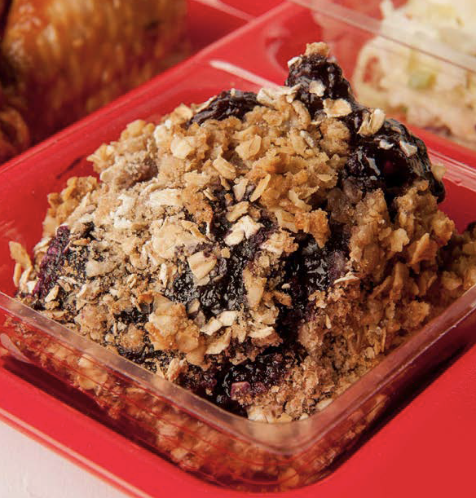

Lunch Fruits
Fresh
Frozen
Canned
Juice
Notes:
Consider fresh and local
Variety
Naturally sweeten recipes

Slide 11
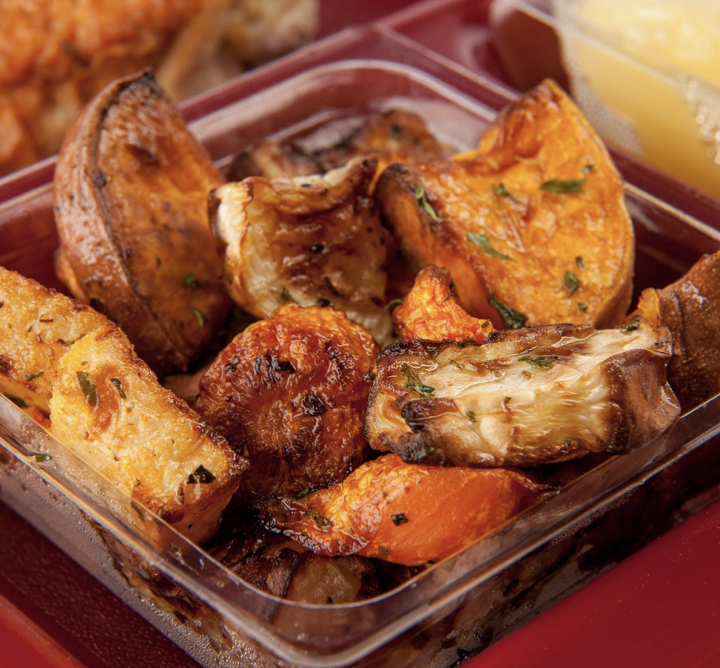
Lunch Vegetables
Red/orange
Dark green
Starchy
Beans/peas/lentils
Other
Additional
Notes:
Below recommendations
Consider different culinary techniques

Slide 12
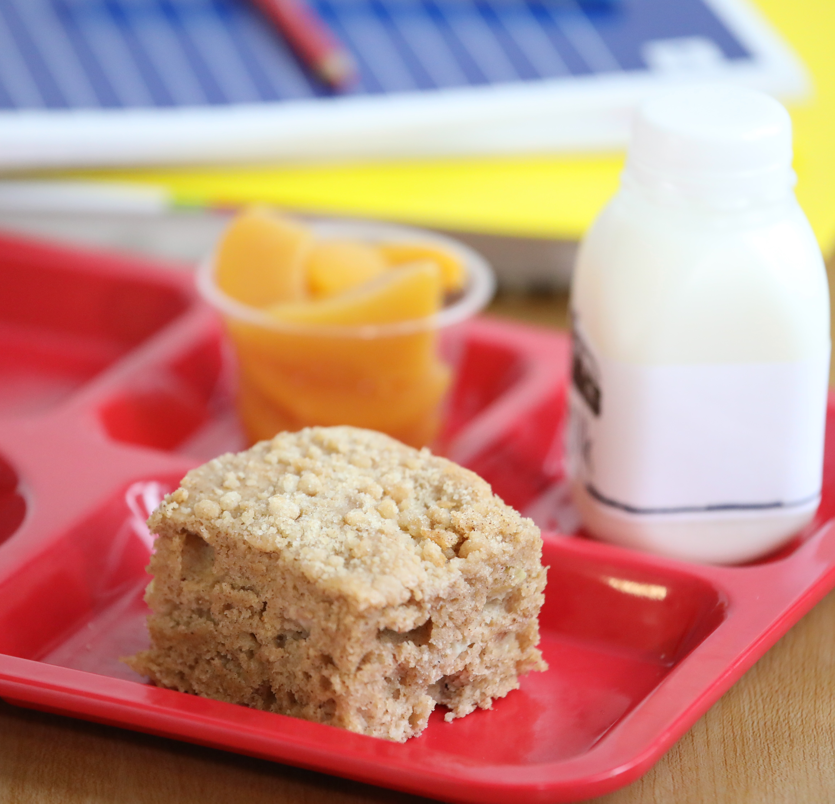
Breakfast
Grains
Meat/Meat Alternatives
Fruits
Notes:
Remember final rule – meat/meat alternates and/or grains can be served to meet requirement

Slide 13
Menu Considerations Beyond Nutrition
Overview
Notes:
Goal is not just to feed our students, but to nourish them with healthy, appetizing meals.
Meal appeal is extremely important. Meal appeal starts with the appearance of the food.
Students eat with their eyes! Consider color, shapes, and garnishing when menu planning and serving meals.

Slide 14
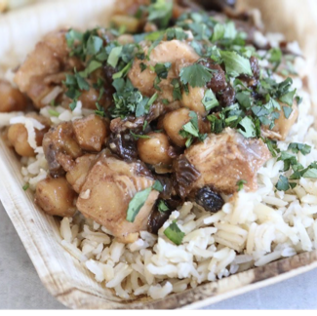
Flavorful
Notes:
Starting with flavor!
Quality ingredients
Spices and herbs
Acids
Aromatics
Culinary techniques

Slide 15
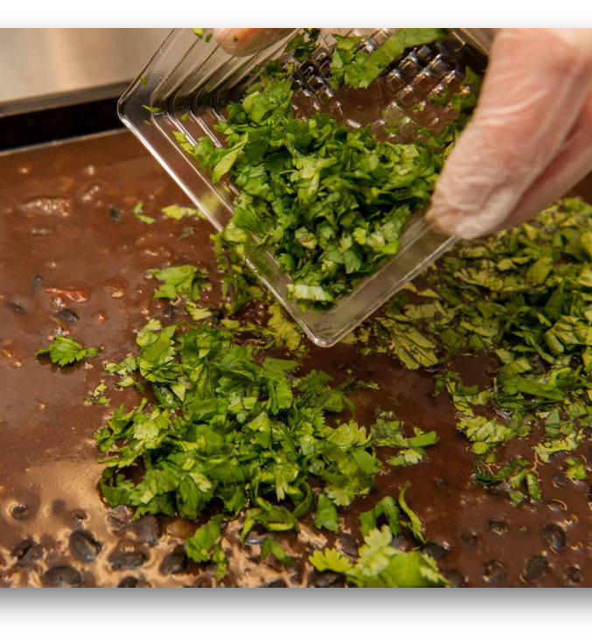
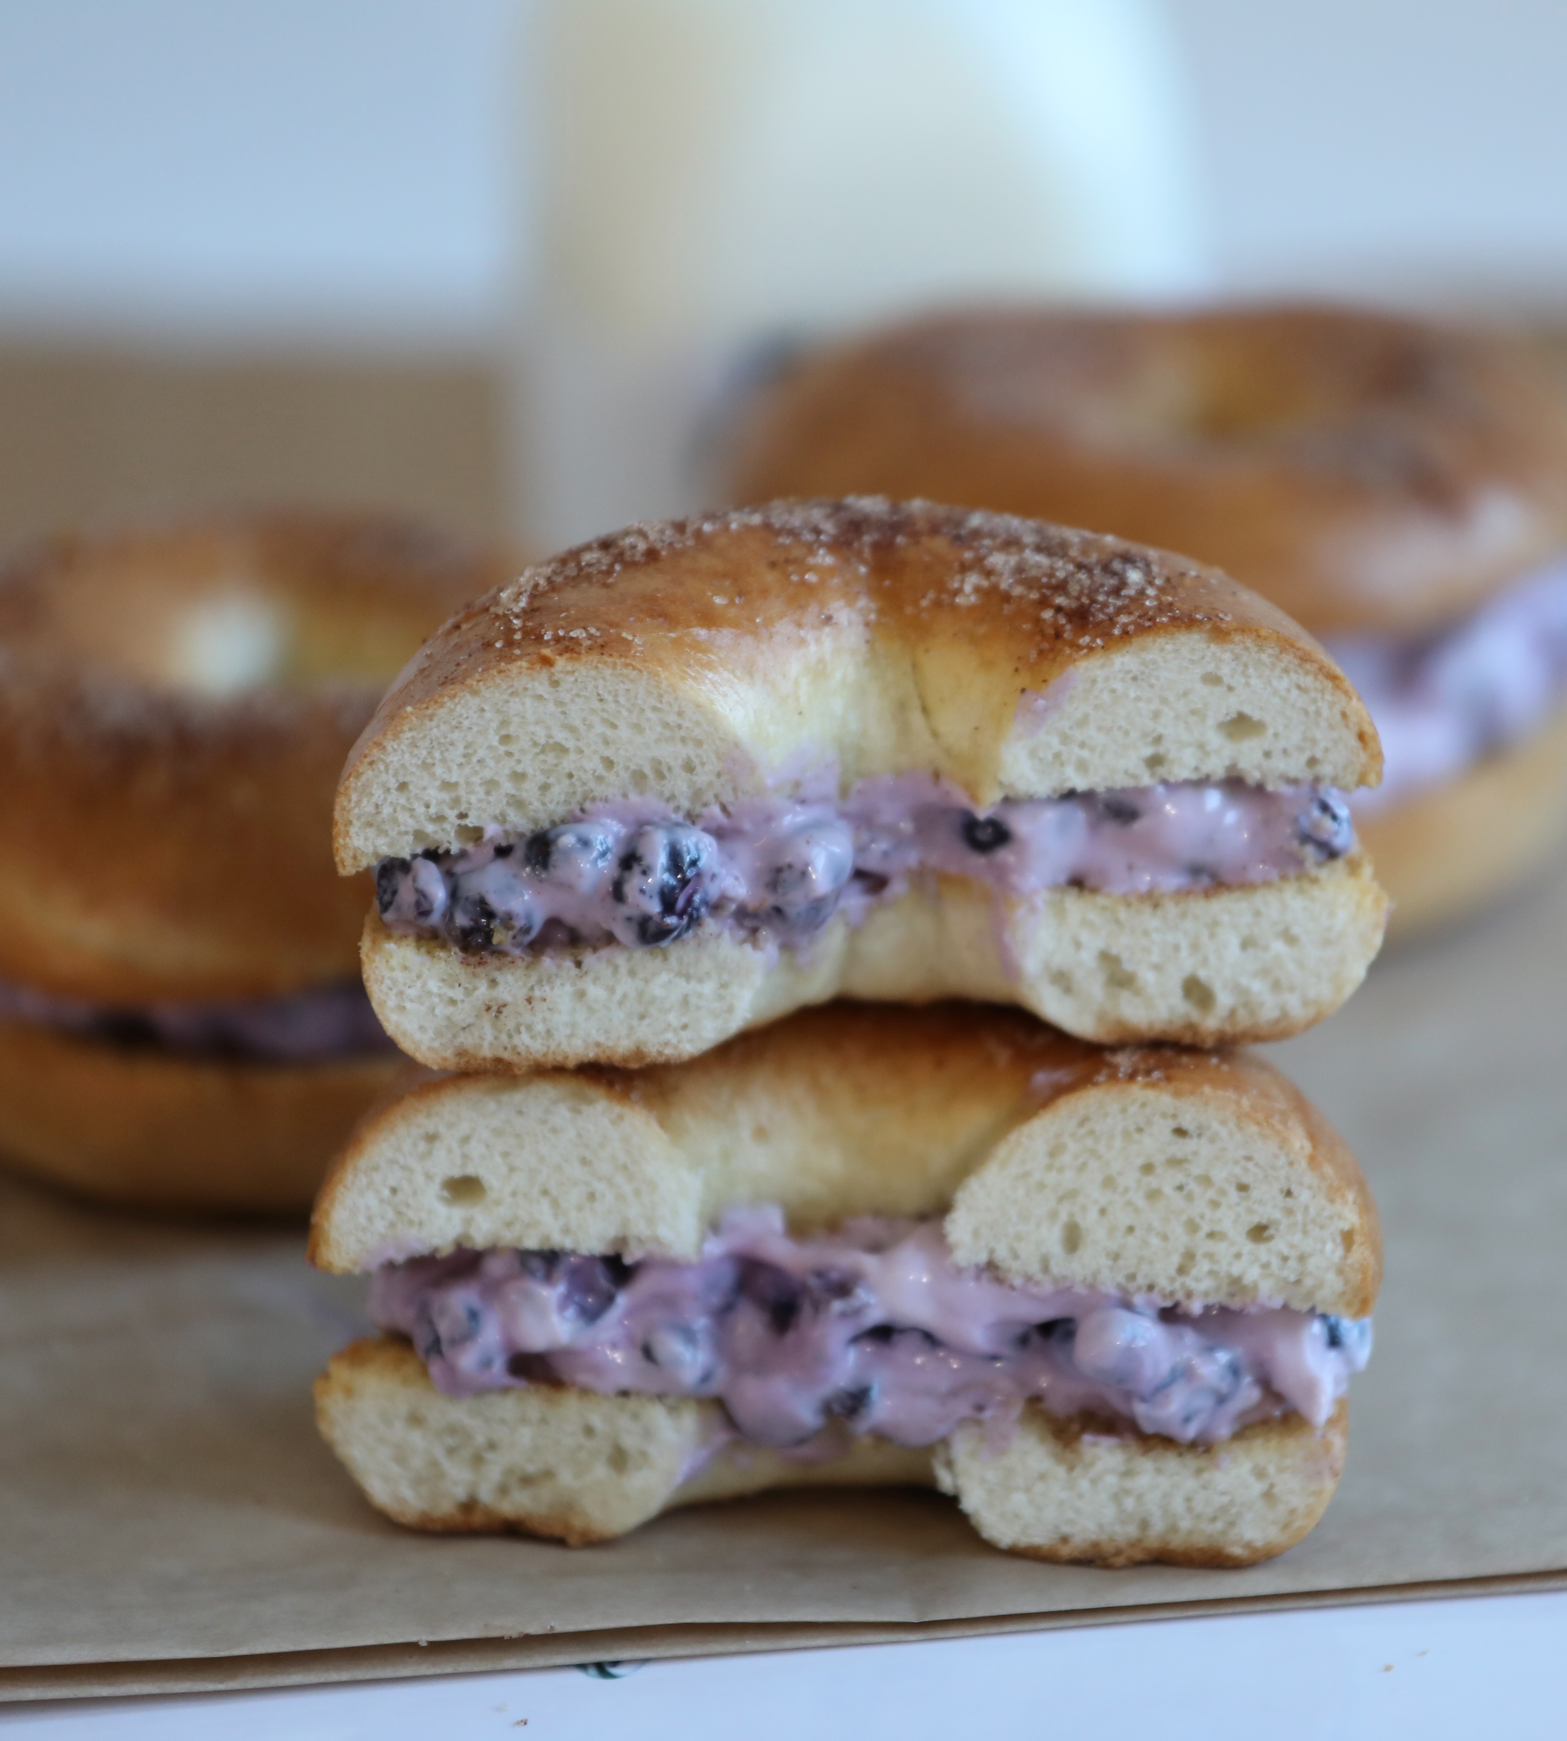
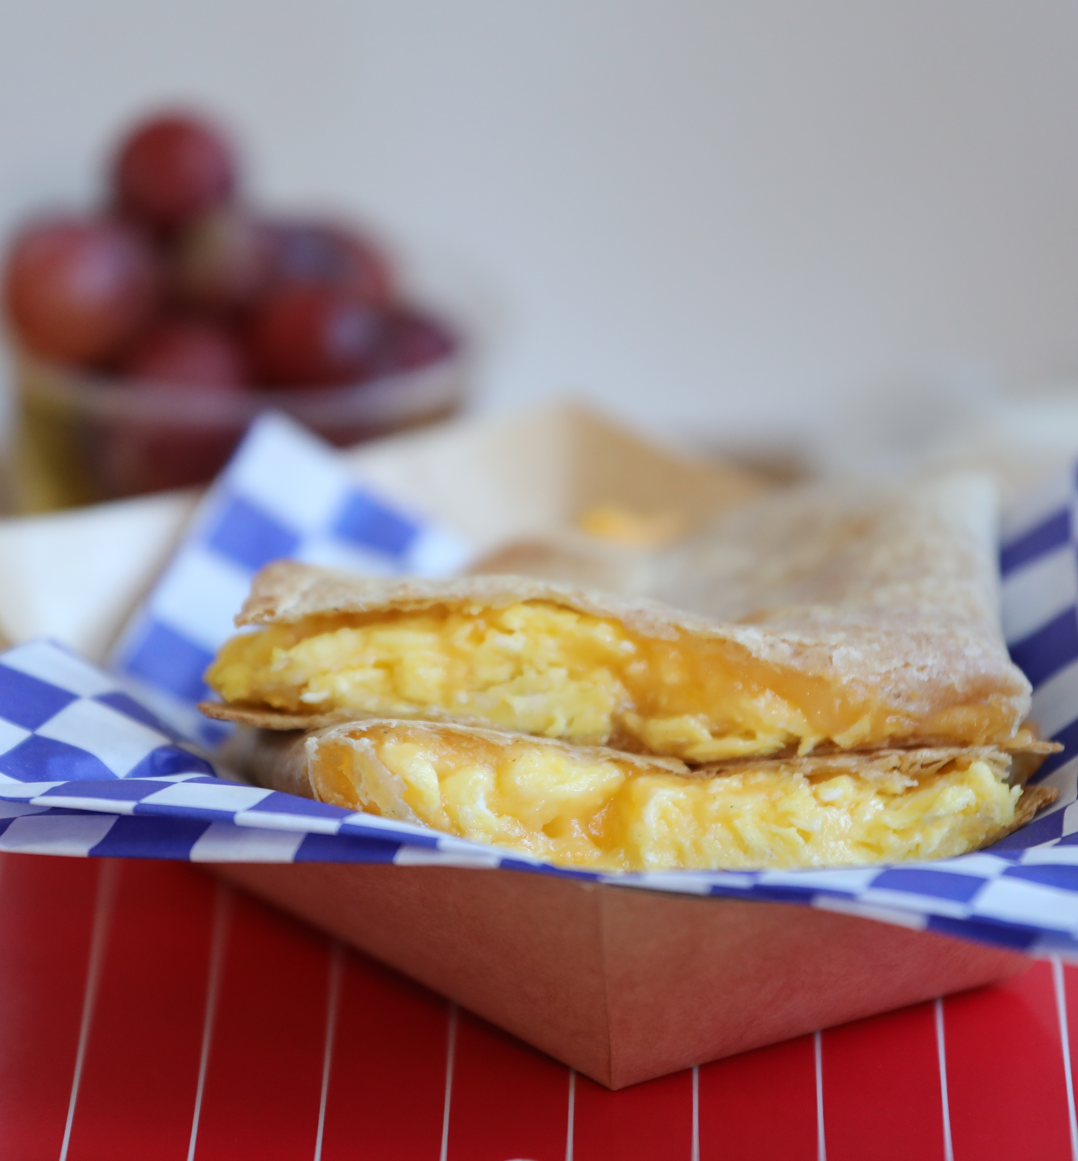
Colors
Notes:
Choose a variety of colors.
Think about colors when creating recipes and writing daily menus.
For example, when considering what fruits and vegetables to serve on a menu, peaches and baby carrots might not be the best choice. Peaches and cucumbers would be much more visually appealing! Garnishing a dull looking dish with fresh chopped parsley or other fresh herbs can help add a pop of color.

Slide 16
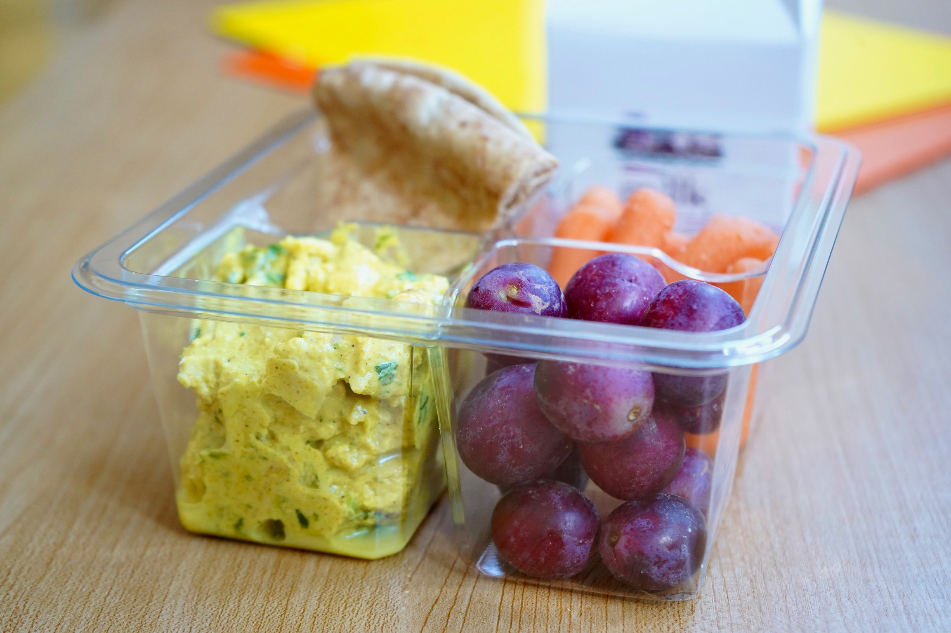
Textures
Notes:
The taste of the food is very important for meal appeal and to increase participation.
Always taste the food you make!
Think about texture when planning meals - balance crunchy with soft and chewy.
Don't want a tray of mushy menu items

Slide 17
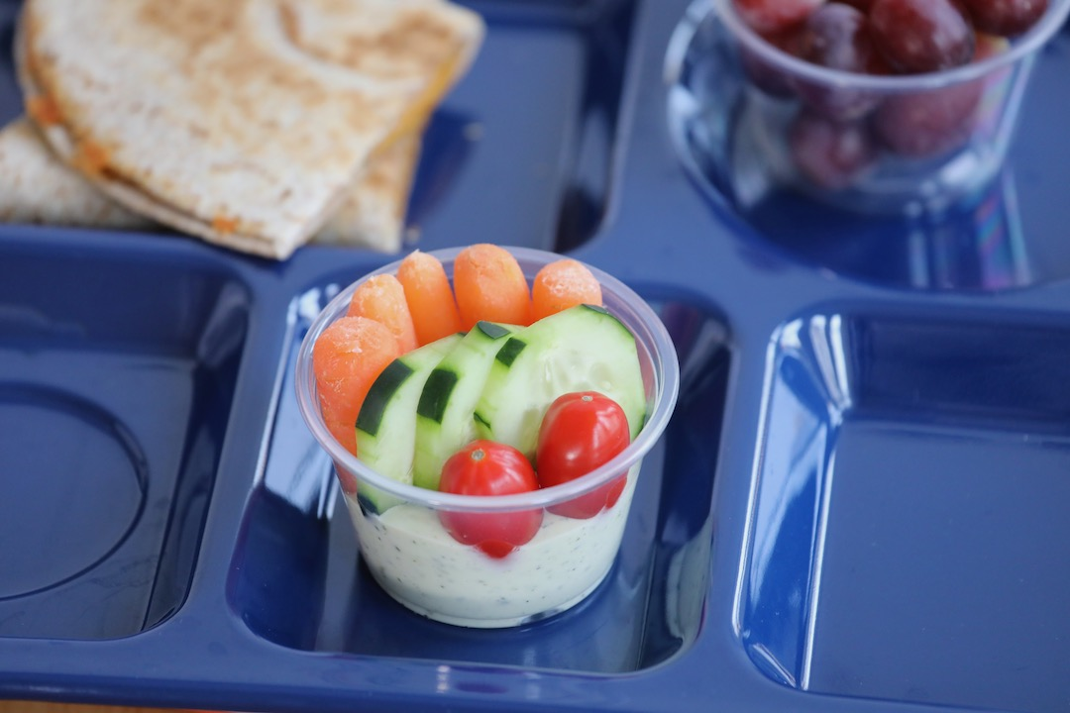
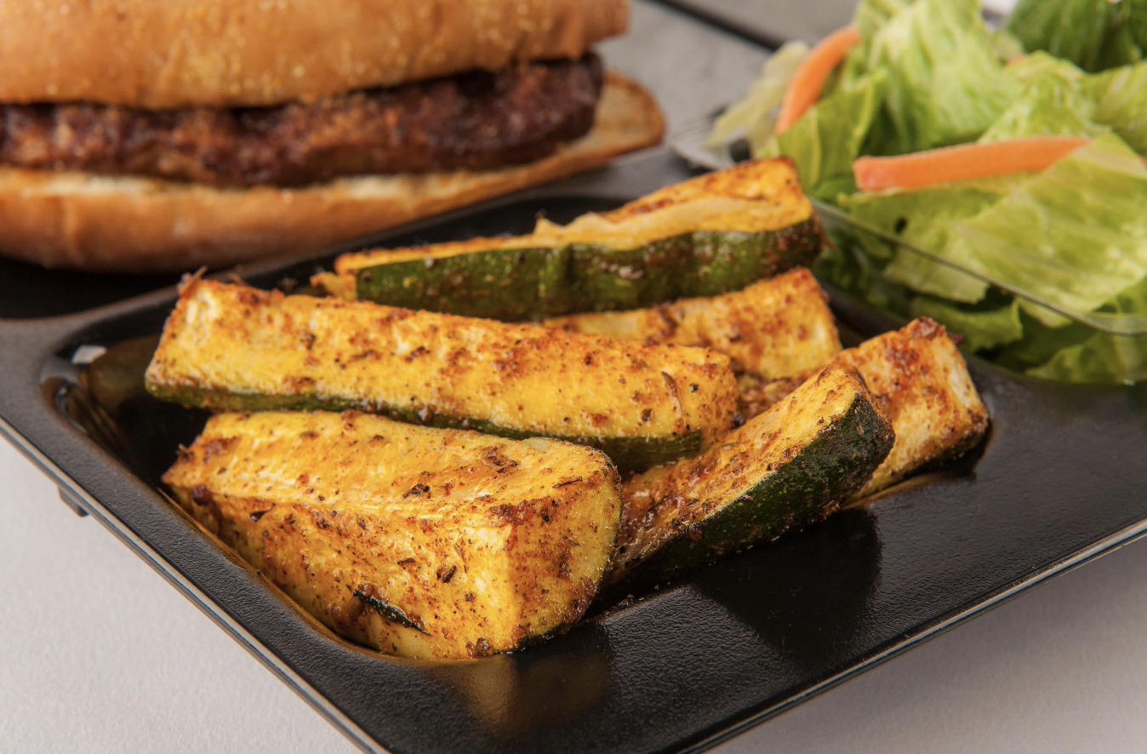
Shapes
Notes:
Vary shapes!
Imagine a meal of chicken tenders, a breadstick, carrot sticks, and a banana. Not very visually appealing
Varying shapes adds interest to a meal. Nature has provided a variety. Broccoli and cauliflower are shaped like trees, kiwis are ovals, baby carrots are sticks, and strawberries are like little cones.
Think about varying shapes for the menu day, but also within a dish. Garnishing diced melon with round blueberries adds shape and color contrast.

Slide 18
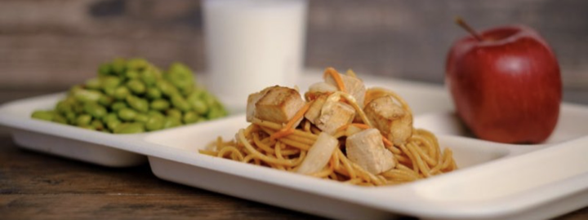
Protein Variety
Notes:
Think beyond beef and chicken
Recall the nutrition for your students presentation

Slide 19
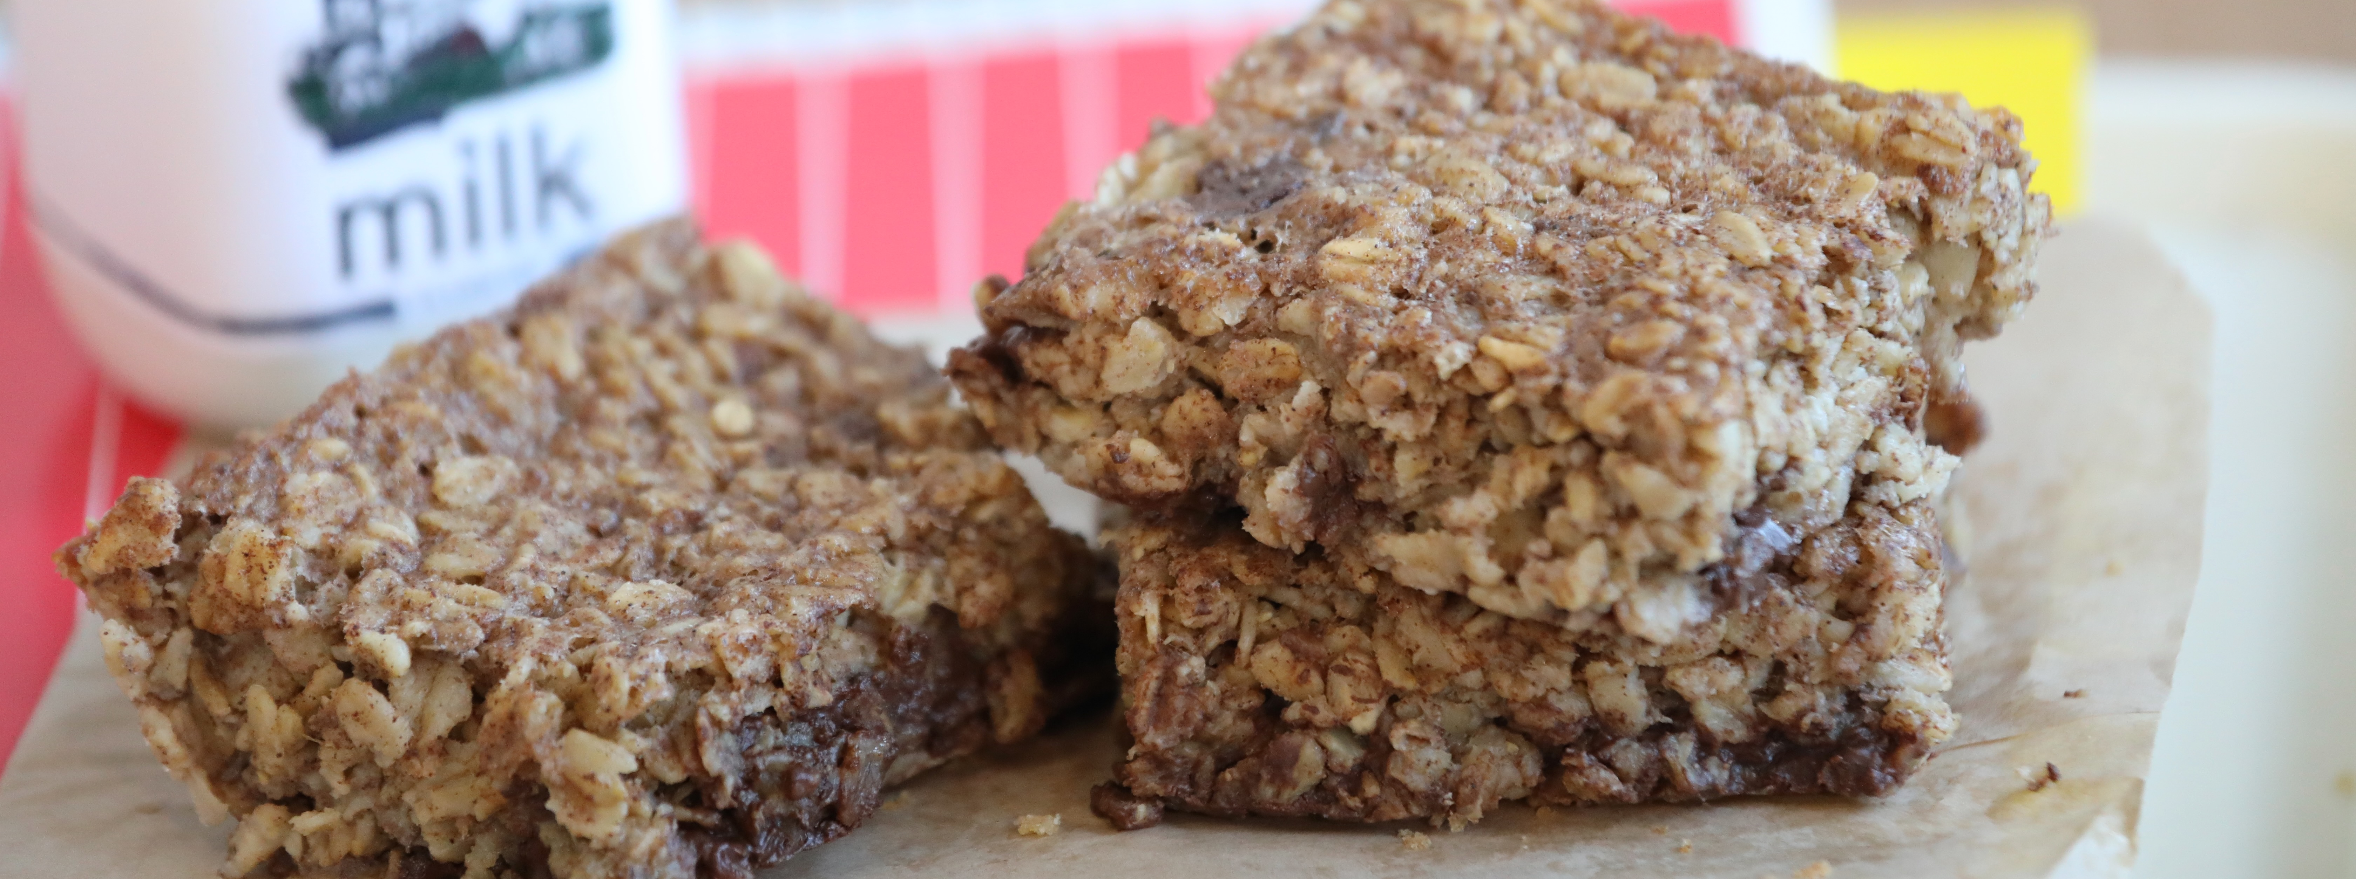
Ingredient Quality
Notes:
Flavor
Nutritional quality
Appearance – fresher food looks better

Slide 20
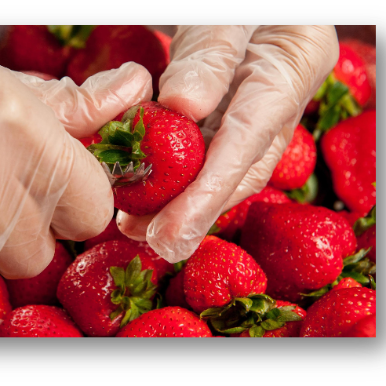
Seasonality
Local foods
Notes:
Farming practices and means of transporting foods have made more agricultural products available year-round.
Due to temperature, sunlight, and moisture, different foods thrive in different seasons.
When they thrive and are in season, they are at their peak in terms of flavor, quality, and nutritional content.

Slide 21
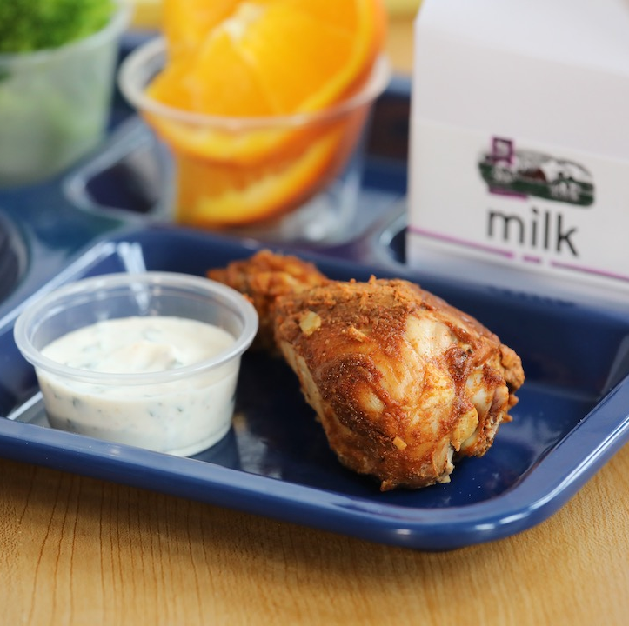
Scratch Cooking vs Convenience
Notes:
Scratch cooking provides more flexibility and healthier options for many menu items.
Incorporates ingredients as close to their original state as possible, including more than fruits and vegetables.
Economical choice
Use whole ingredients like canned beans, whole wheat flour, yogurt, and unseasoned meat and poultry. When you create recipes with basic ingredients, you control the amount of artificial and/or unnecessary ingredients you serve.

Slide 22
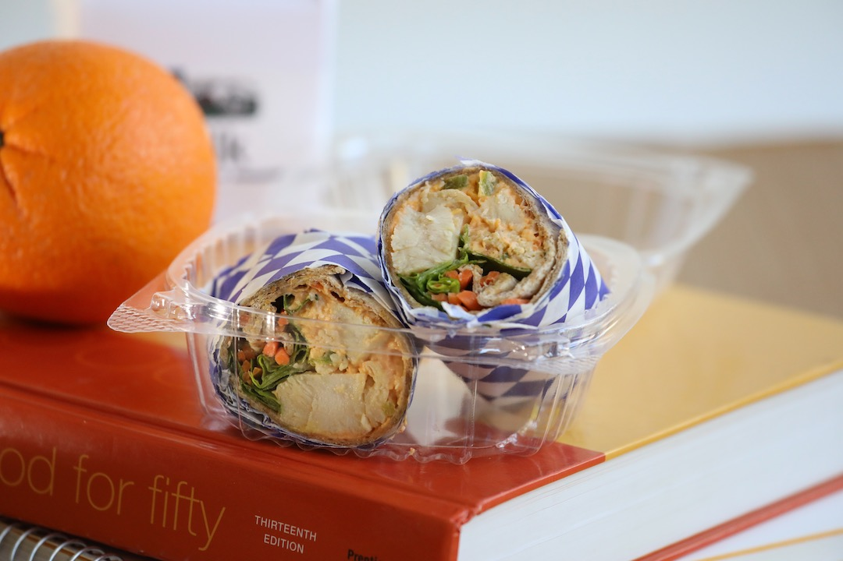
Ingredient Cross Utilization
Commodity foods
Notes:
List of commodity foods
How can we use them in multiple recipes
Curry chicken salad vs traditional buffalo chicken wrap = both commodity chicken, but adding more flavor, texture, shapes, color, etc.

Slide 23
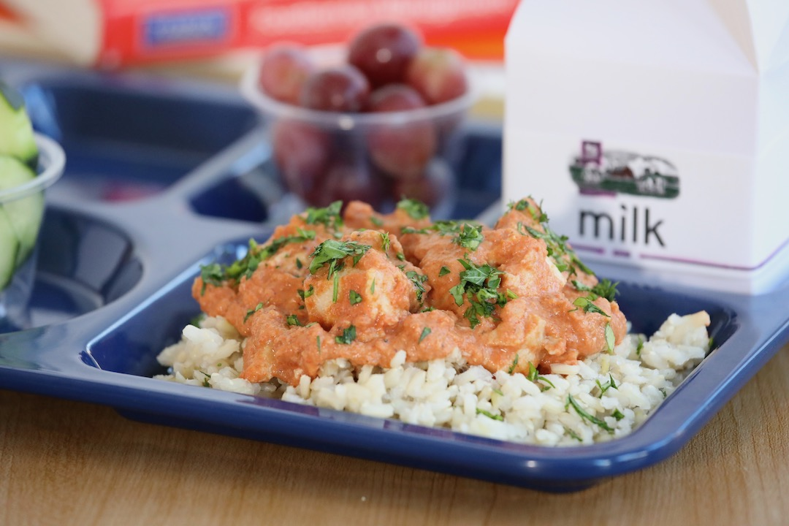
Cultural Inclusiveness
Notes:
Demonstrates interest in the diverse backgrounds and traditions of customers. It acknowledges that people come from different cultural backgrounds and have varying culinary preferences, dietary restrictions, and culinary traditions.
A diverse range of cuisines allows customers to explore and appreciate different culinary traditions from around the world.

Slide 24
Activity
List recipes under components around the room.
Notes:
List recipes under components and then identify best choices based on DGAs (include workshop recipes):
Lunch
Meat/Meat Alternates/Entrees
Beef
Pork
Chicken
Beans, Peas, Lentils
Soy
Dairy
Grain Sides
Bread products
Intact grains
Fruits
Fresh
Frozen
Canned
Juice
Vegetables
Red/orange
Dark green
Starchy
Beans/peas/lentils
Other
Additional
Breakfast
Grains
Meat/Meat Alternates
Fruits

Slide 25

Questions

