Slide 1

Nutrition for YOU!

Slide 2
USDA Funding and Non-Discrimination Statements:
“This project has been funded at least in part with Federal funds from the U.S. Department of Agriculture. The contents of this publication do not necessarily reflect the view or policies of the U.S. Department of Agriculture, nor does mention of trade names, commercial products, or organizations imply endorsement by the U.S. Government.”
In accordance with federal civil rights law and U.S. Department of Agriculture (USDA) civil rights regulations and policies, this institution is prohibited from discriminating on the basis of race, color, national origin, sex (including gender identity and sexual orientation), disability, age, or reprisal or retaliation for prior civil rights activity.
Program information may be made available in languages other than English. Persons with disabilities who require alternative means of communication to obtain program information (e.g., Braille, large print, audiotape, American Sign Language), should contact the responsible state or local agency that administers the program or USDA’s TARGET Center at (202) 720-2600 (voice and TTY) or contact USDA through the Federal Relay Service at (800) 877-8339.
To file a program discrimination complaint, a Complainant should complete a Form AD-3027, USDA Program Discrimination Complaint Form which can be obtained online at: https://www.usda.gov/sites/default/files/ documents/ad-3027.pdf, from any USDA office, by calling (866) 632-9992, or by writing a letter addressed to USDA. The letter must contain the complainant’s name, address, telephone number, and a written description of the alleged discriminatory action in sufficient detail to inform the Assistant Secretary for Civil Rights (ASCR) about the nature and date of an alleged civil rights violation. The completed AD-3027 form or letter must be submitted to USDA by:
1. mail:
U.S. Department of Agriculture
Office of the Assistant Secretary for Civil Rights
1400 Independence Avenue, SW
Washington, D.C. 20250-9410; or
2. fax:
(833) 256-1665 or (202) 690-7442; or
3. email:
Program.Intake@usda.gov
This institution is an equal opportunity provider.

Slide 3
Objectives
Summarize the Dietary Guidelines for Americans (DGA) recommendations for all food groups for adults.
Recall the current state of health of Americans and current food intake.
Describe other factors that influence health.
Notes:
Discussing nutrition teaches the why behind the regulations and also helps you!
Importance of role modeling

Slide 4
Current State of Health
74% of Americans are overweight or obese
45% of Americans have hypertension
11% of Americans have type 1 or type 2 diabetes
  35% of Americans have prediabetes
  1 in 3 Americans projected to have diabetes by 2050
Notes:
Stats are from the DGA
The Centers for Disease Control and Prevention (CDC) projects that if trends continue, 1 in 3 Americans will have diabetes by 2050
Diabetes type 1 and type 2 come from different causes: In type 1 diabetes, the pancreas does not make insulin, because the body's immune system attacks cells in the pancreas that make insulin. In type 2 diabetes, the pancreas makes less insulin than it used to, and your body becomes resistant to insulin. This is usually caused by weight gain. Type 2 diabetes is far more common than type 1.

Slide 5
Leading Causes of Death - 2021
Heart disease: 695,547
Cancer: 605,213
COVID-19: 416,893
Accidents (unintentional injuries): 224,935
Stroke (cerebrovascular diseases): 162,890
Chronic lower respiratory diseases: 142,342
Alzheimer’s disease: 119,399
Diabetes: 103,294
Chronic liver disease and cirrhosis : 56,585
Nephritis, nephrotic syndrome, and nephrosis: 54,358
Notes:
Heart disease and stroke, some types of cancer, and type 2 diabetes are diet related diseases. Colorectal cancer, which is diet related, is the third leading cause of cancer deaths.
Other factors impact these illnesses such as genetics and lifestyle factors, but a nutritious diet can help to prevent them. Genetic predisposition does not mean you cannot prevent an illness.

Slide 6
Preventing Chronic Diseases
Quit smoking
Eat healthy
Get regular physical activity
Avoid drinking too much alcohol
Get screened
Take care of your teeth
Get enough sleep
Know your family history
Make healthy choices in school and at work
Notes:
List from National Center for Chronic Disease Prevention and Health Promotion (NCCDPHP)

Slide 7
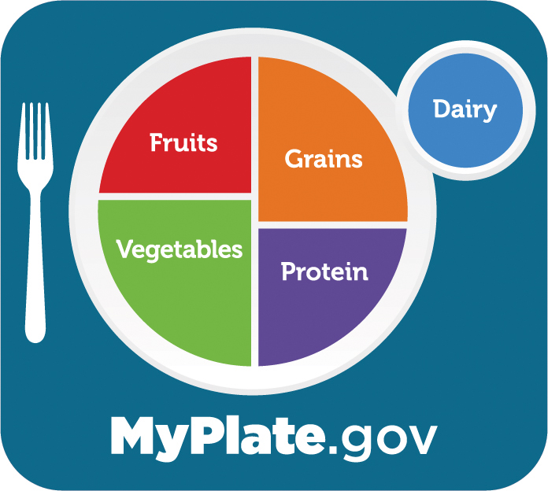
MyPlate
MyPlate Quiz:
https://www.myplate.gov/form/myplate-quiz#question_1
Notes:
MyPlate reflects recommendations found in the Dietary Guidelines for Americans.
Describe Dietary Guidelines.
As we go through food groups, recommendations should sound familiar
Take the quiz

Slide 8
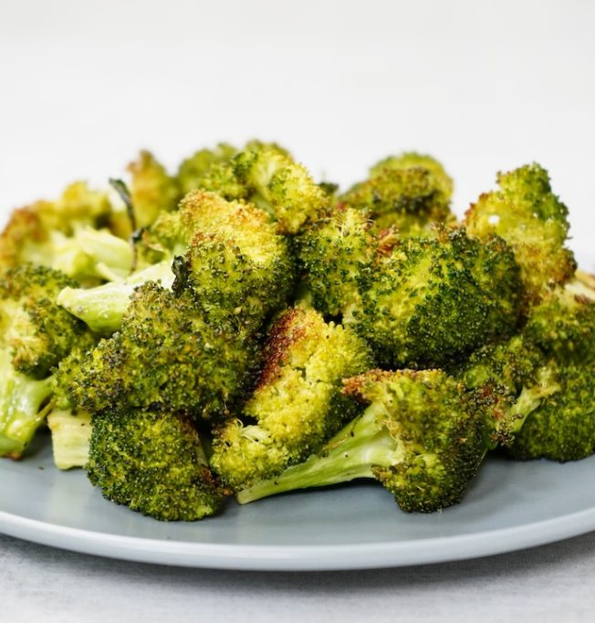
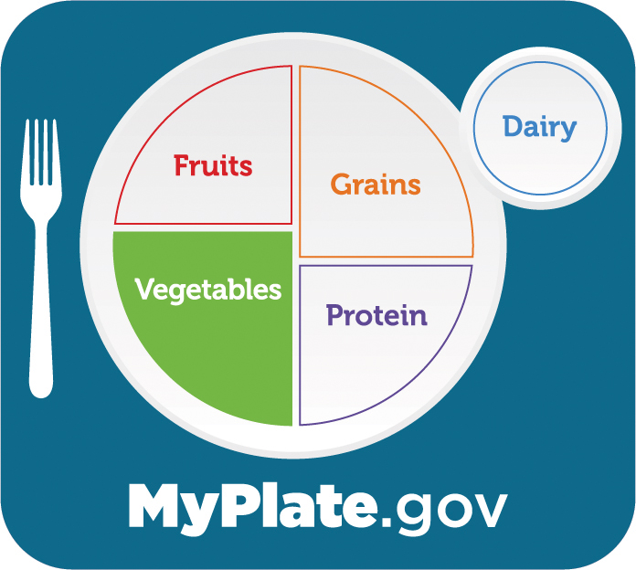
Vegetables
3 cups/day
90% of Americans do NOT meet recommendations!
Notes:
It is recommended that you should eat at least 3 cups/day. 2 cups leafy greens = 1 cup.
Currently, 90% of Americans do not meet guidelines (~3 cups/day).
The vegetable most commonly consumed is white potatoes.

Slide 9
Why consume vegetables?
Reduce inflammation
Prevent chronic diseases
  Weight management
Provide
  Fiber
  Vitamins
  Minerals
  Water
  Phytonutrients
Notes:
Each color = different phytonutrient
Phytonutrients: Important antioxidant compounds found in plants – that help your body fight these diseases

Slide 10
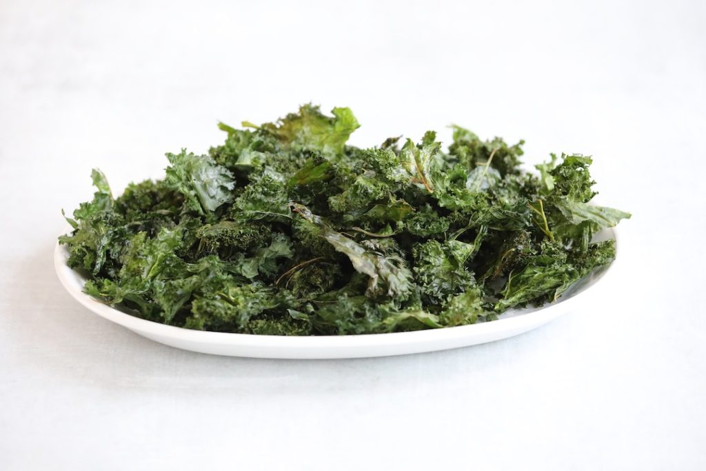
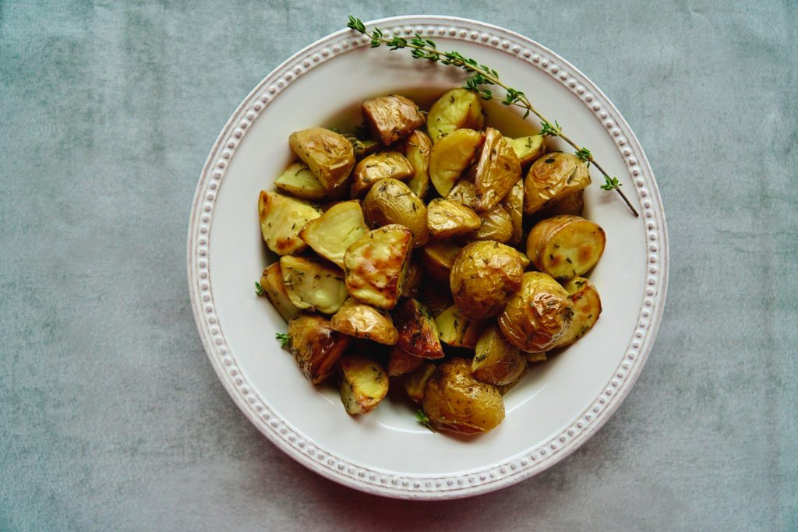
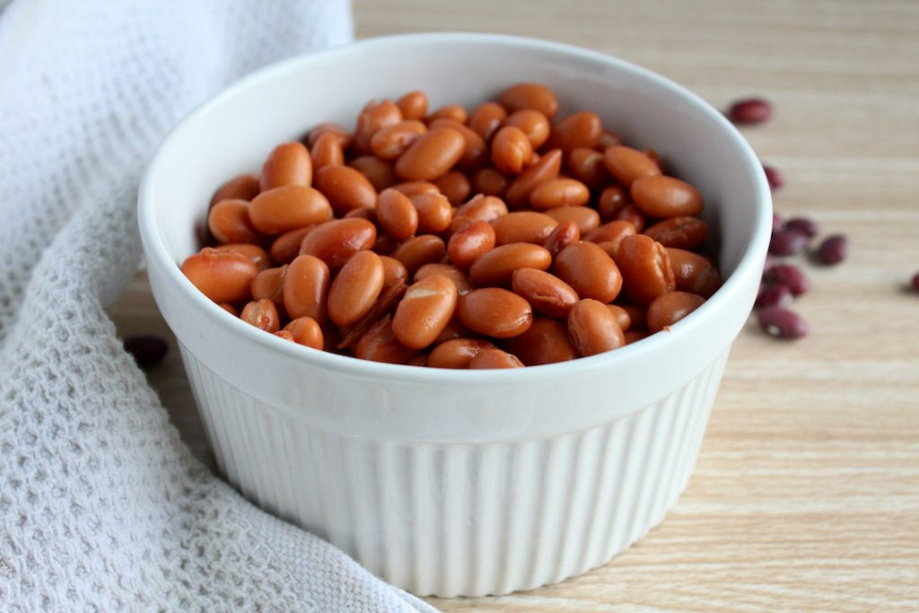

Vary your Veggies!
Subgroups
  Dark green
  Red/orange
  Beans, peas, lentils
  Starchy vegetables
  Other
Notes:
List example vegetables in the subgroups and benefits from each

Slide 11
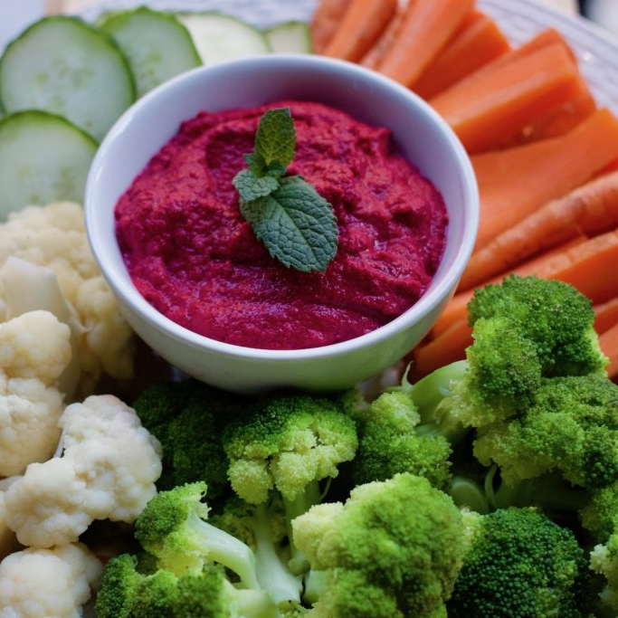
Which form of veggies is best?
Fresh
Frozen
Canned
Ultra processed
Notes:
Fresh is best for flavor
Frozen can be highest in nutrients
Canned most economical and shelf stable
Ultra-processed snack foods that say “made with real vegetables” do not count

Slide 12
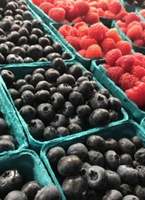
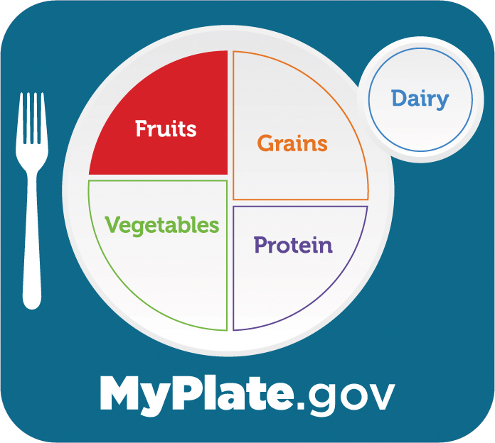
Fruits
2 cups/day
80% of Americans do NOT meet recommendations!
Notes:
It is recommended that you should eat at least 2 cups/day. ¼ cup dried = ½ cup.
80% of Americans do not eat the recommended amount
60% comes from fresh, canned, frozen, or dried fruit, and JUICE!
Remaining 40% comes from pastries, puddings, popsicles, fruit snacks, or ice creams

Slide 13
Why consume fruit?
Lower the risk of depression
Prevent chronic disease
Provide
  Fiber
  Vitamins
  Minerals
  Water
  Phytonutrients

Slide 14
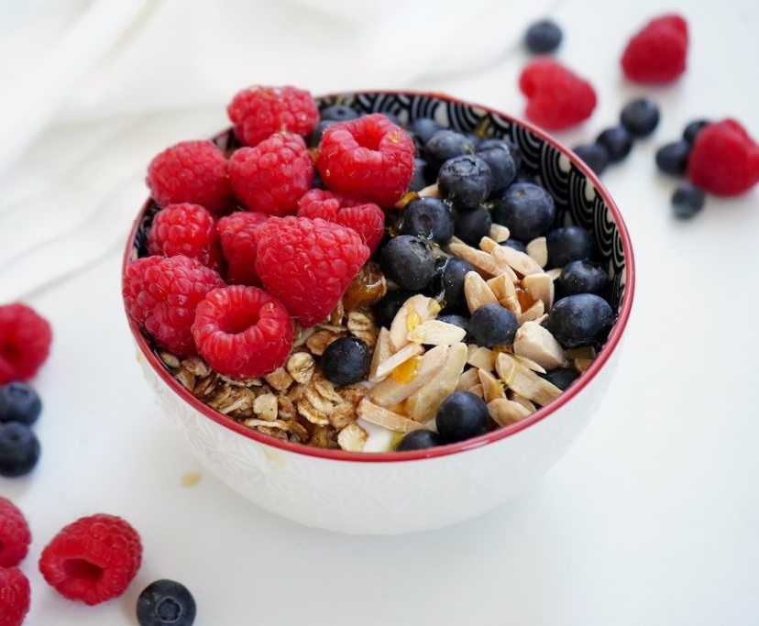

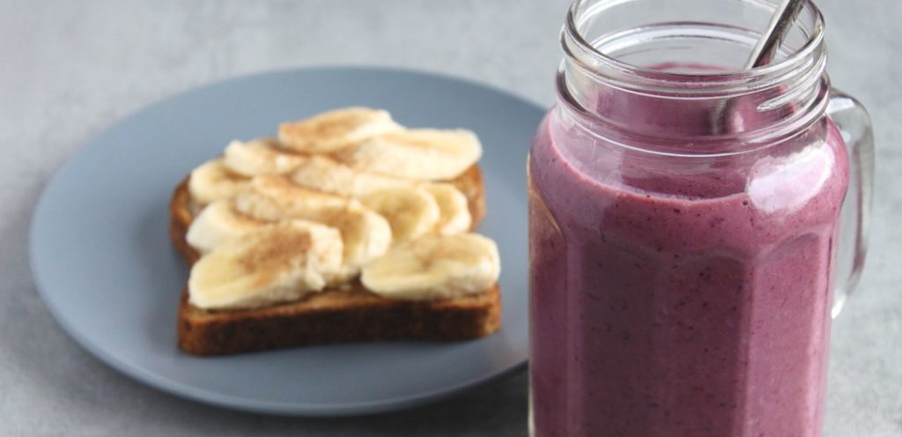
Eat a variety of fruits!
Whole Forms
  Fresh
  Frozen
  Canned
  Dried
Juice
  100%
Notes:
Watch for sugars in frozen, canned, and dried varieties. Look for canned in juice.
Limit juice to 1 cup or less per day (half of the recommended amount of total fruit). Juice is missing fiber and other vitamins and minerals.

Slide 15
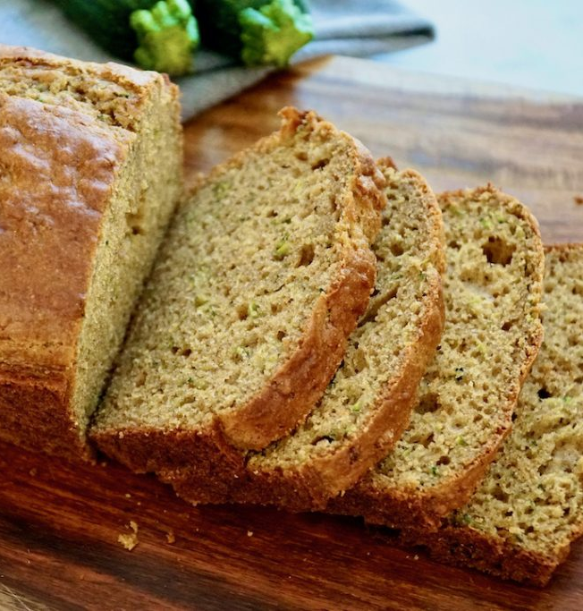
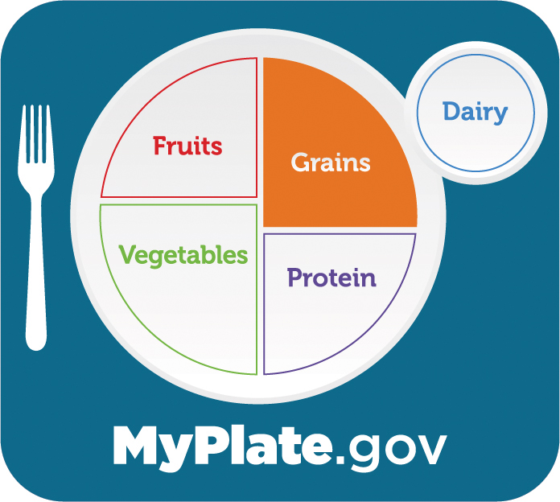
Grains
Most meet recommendations for total grain intake
74% eat too many refined grains
2% meet recommendations for whole grains!
Notes:
Make half of your grains whole grain!
How much?
½ cup grain is a serving or 1 slice of bread
Most meet recommendations for total grain intake
2% meet recommendations for whole grains
74% exceed limits for refined grains

Slide 16
Daily Recommendations of Grain Servings
Women:
  19-30 years:
    Total grains: 6 to 8 oz-equivalents
    Whole grains: 3 to 4 oz-equivalent
  31-59 years:
    Total grains: 5 to 7 oz-equivalents
    Whole grains: 3 to 3.5 oz-equivalents
  60+ years:
    Total grains: 5 to 7 oz-equivalents
    Whole grains: 3 to 3.5 oz-equivalents
Men:
  19-30 years:
    Total grains: 8 to 10 oz-equivalents
    Whole grains: 4 to 5 oz-equivalents
  31-59 years:
    Total grains: 7 to 10 oz-equivalents
    Whole grains: 3.5 to 5 oz-equivalents
  60+ years:
    Total grains: 6 to 9 oz-equivalents
    Whole grains: 3 to 4.5 oz-equivalents

Slide 17
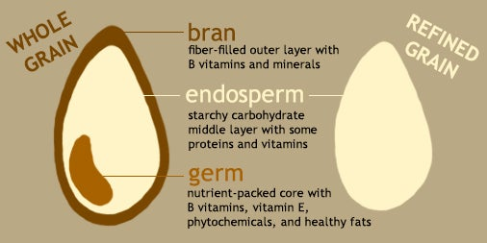
Whole Grains vs Refined Grains
Source: Harvard T.H. Chan School of Public Health: The Nutrition Source
Notes:
Bran and fiber slow the breakdown of starch into glucose—thus maintaining a steady blood sugar rather than causing sharp spikes.
Fiber helps lower cholesterol as well as move waste through the digestive tract.
Fiber may also help prevent the formation of small blood clots that can trigger heart attacks or strokes.
Phytonutrients and essential minerals such as magnesium, selenium and copper found in whole grains may protect against some cancers

Slide 18
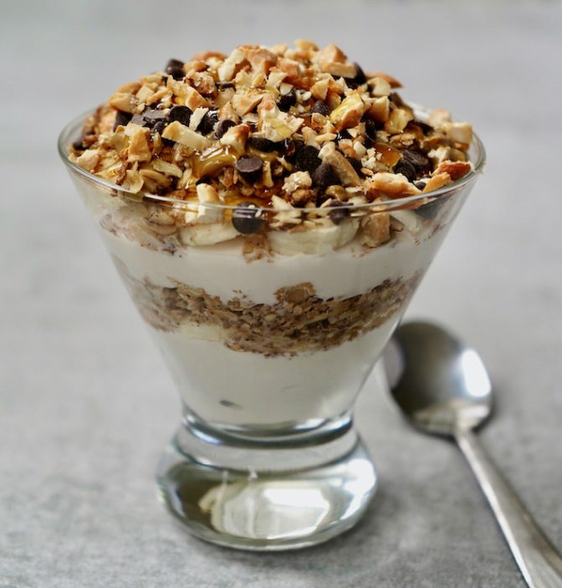
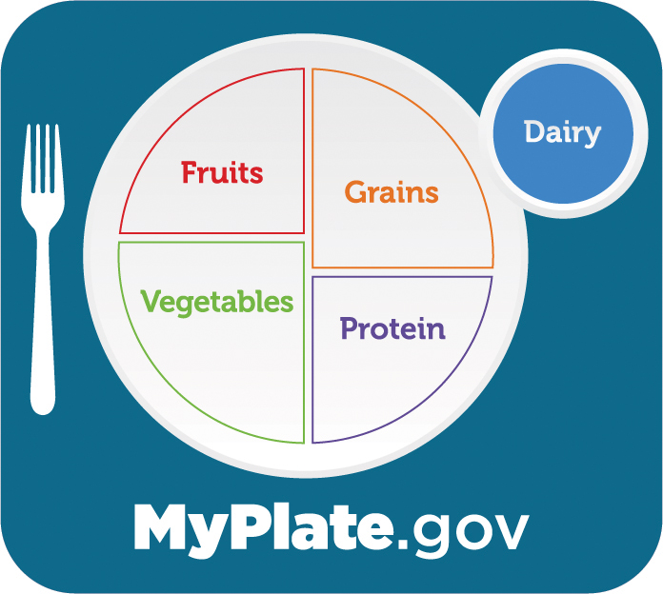
Dairy
3 cups/day
  More is not better!
90% of Americans do NOT meet recommendations!
Notes:
3 cups a day (but more is not better!)
Excess dairy for men is correlated with increased prostate cancer risk.

Slide 19
Why consume dairy?
Top contributor of calcium to the American diet
13 essential nutrients
  Protein
  Vitamin D
  Potassium and more
Bone health
Yogurt provides gut friendly probiotics
Notes:
13 essential nutrients: protein, calcium, phosphorus, vitamin A, vitamin D, riboflavin (B2), niacin (B3), pantothenic acid (B5), cobalamin (B12), iodine, potassium, selenium and zinc.

Slide 20

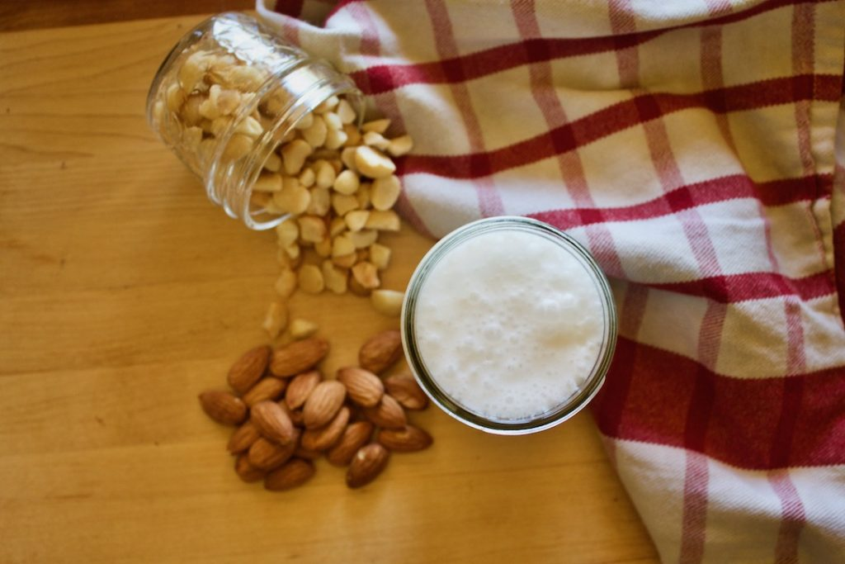
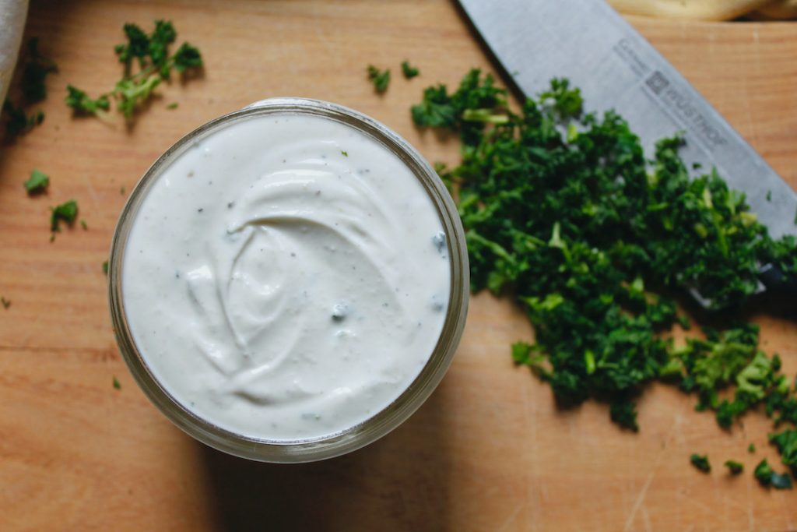
Dairy Recommendations
Low-fat or fat-free
Dairy substitutes
Notes:
Evaluate your own diet for saturated fat intake when selecting fat content
Dairy substitutes are not all created equal. Soy milk is nutritionally most similar to cow's milk. Many others are fortified with calcium and vitamin D.

Slide 21
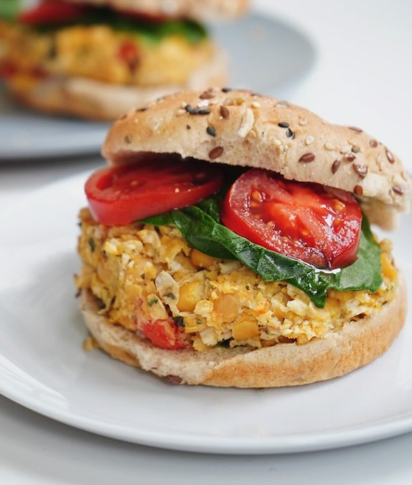
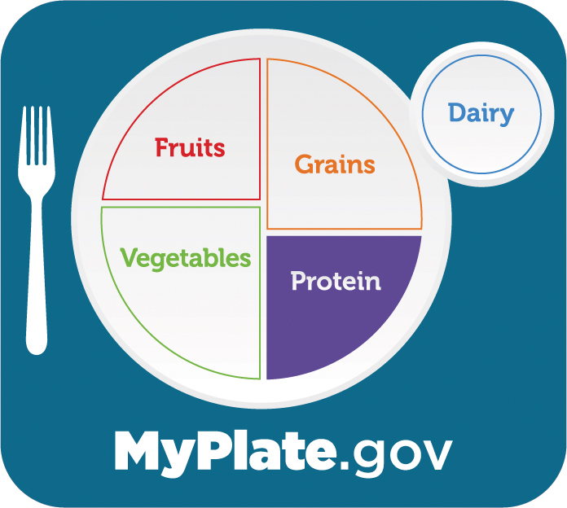
Protein Foods
90% do NOT meet recommendations for seafood
>50% do NOT meet recommendations for nuts, seeds, and soy products
Notes:
Intakes of total protein are close to target amounts, but most Americans do not meet recommendations for specific protein subgroups.
Majority of intake is from red meat, poultry, refined grains, dairy, and processed meats.

Slide 22
Daily Recommendations of Protein Foods
Women:
  19-30 years: 5 to 6.5 oz-equivalents
  31-59 years: 5 to 6 oz-equivalents
  60+ years: 5 to 6 oz-equivalents
Men:
  19-30 years: 6.5 to 7 oz-equivalents
  31-59 years: 6 to 7 oz-equivalents
  60+ years: 5.5 to 6.5 oz-equivalents
Notes:
Contrary to popular belief, you most likely do not need more protein. Manufacturers are fortifying many foods with protein and it is unnecessary! Protein water, for example

Slide 23
Why consume protein foods?
Hormone production
Nutrient transport
Immune support
Water balance
pH regulation
Enzyme creation
Muscle maintenance
Healthy hair, skin, and nails
Energy production
Notes:
Protein is made of amino acids. They are the building blocks of protein.

Slide 24
Protein at meals
Promotes satiety
Regulates appetite
Helps control blood sugar
Notes:
Pair protein with carbohydrates to helps control blood sugar

Slide 25
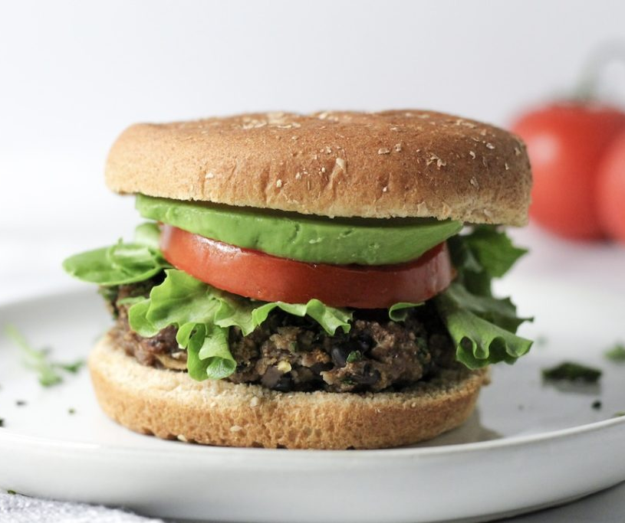

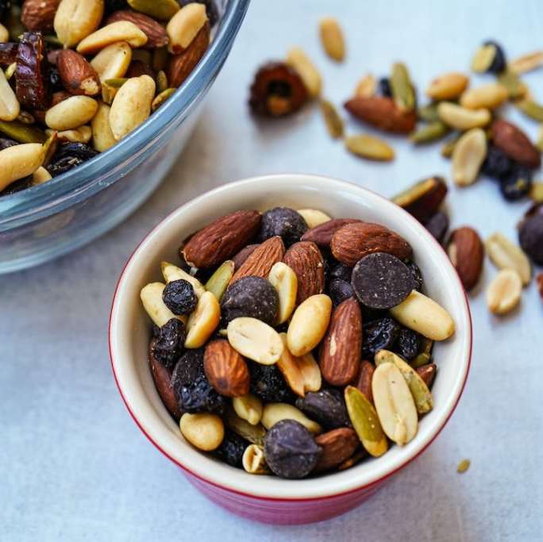
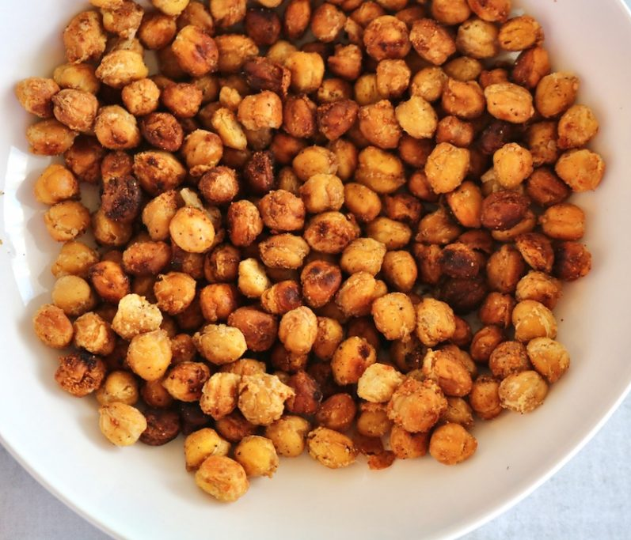

Eat a variety of protein foods!
Meats and poultry
  Lean forms
  Not processed!
Seafood
Beans, peas, lentils
Nuts and seeds
Soy products
Notes:
Meats and poultry from fresh, frozen, or canned, and in lean forms (e.g., chicken breast or ground turkey) versus processed meats (e.g., hot dogs, sausages, ham, luncheon meats).
Selecting from the seafood subgroup or the beans, peas, and lentils subgroup more often could help meet recommendations while still ensuring adequate protein consumption.
Changes will also reduce saturated fat and sodium intake, while increasing fiber intake

Slide 26
Other Considerations

Slide 27

Oils
Limit saturated fat to <10% of calories
Only 23% meet the recommendation!
Notes:
Saturated vs unsaturated fats – impact on cholesterol
Need to replace saturated fats with unsaturated fats. Commonly consumed oils include canola, corn, olive, peanut, safflower, soybean, and sunflower oils.

Slide 28
Why consume oils?
Flavor
Texture
Nutrition
  Heart health
Notes:
Monounsaturated and omega 3 fatty acids found in oils are heart health.

Slide 29
Oil Recommendations
Canola
Extra virgin olive oil
Notes:
Not all unsaturated plant oils are equal in nutrition
Canola – rich in monounsaturated fat; Monounsaturated fats are excellent for heart health, as they can help increase “good” HDL cholesterol and decrease “bad” LDL cholesterol. Also contain omega 3 fatty acids
Extra Virgin Olive Oil – full of flavor, rich in monounsaturated fats, good for heart health
Oils also are naturally present in nuts, seeds, seafood, olives, and avocados.
Tropical plants, such as coconut oil, palm kernel oil, and palm oil, are not included in the DGA oils category because they contain a higher percentage of saturated fat than do other oils

Slide 30
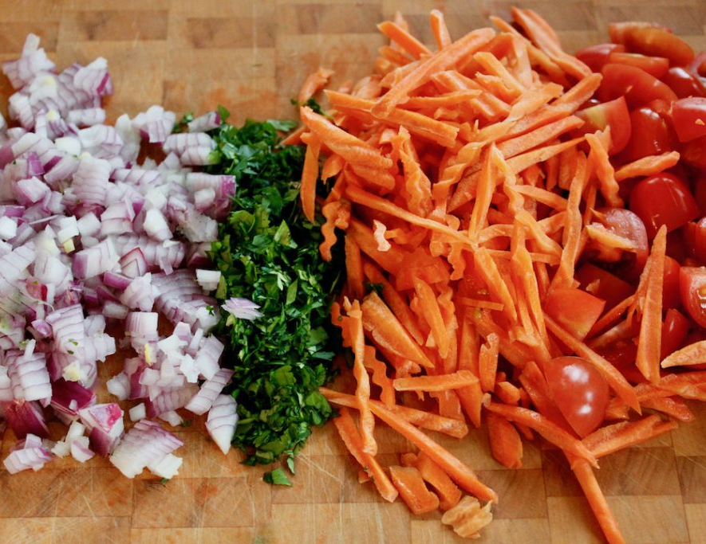
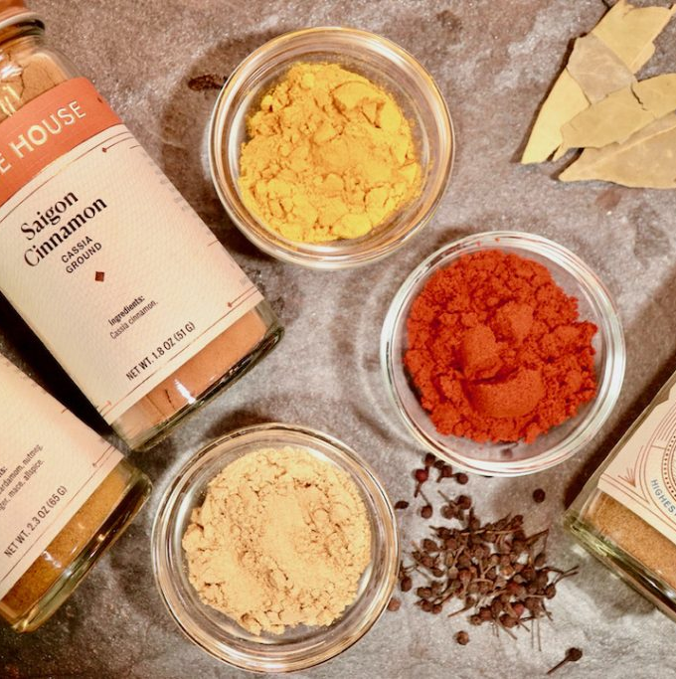
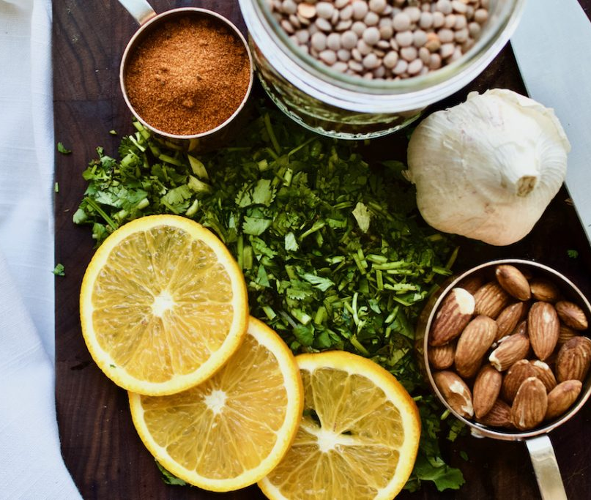
Flavor
Quality ingredients
Spices and herbs
Acids
Aromatics
Culinary techniques
Notes:
Eating healthy must be enjoyable
Boost flavor while reducing sodium and added sugars

Slide 31

Beverages
64 ounces/day
Water reigns supreme!
Watch added sugars
Notes:
General Recommendations: While specific fluid intake recommendations may vary, a general guideline is to drink about 8 cups (64 ounces) of water per day for adults. However, individual needs may be higher or lower based on lifestyle factors (exercise, pregnancy, etc.).
Water reigns supreme, as our bodies are 60–70% water.
Our cells, gut bacteria, organs, joints, bones, and ligaments depend on adequate hydration to function.
Watch out for added sugars. Limit your total added sugar intake from both foods and beverages to less than 24 grams (6 teaspoons) per day for women and children and less than 36 grams (9 teaspoons) per day for men.
According to the American Heart Association, American women consume 3x the recommended amount of added sugars; American men consume 2x the recommended amount. Sugar sweetened beverages are the #1 source of added sugars to the American diet.

Slide 32

Movement
150 minutes of moderate physical activity/week
  Two strength-training or resistance exercise sessions
Notes:
Both the World Health Organization and the Physical Activity Guidelines for Americans recommend engaging in at least 150 minutes of moderate physical activity (75 minutes vigorous activity) and up to 300 minutes of moderate activity (150 minutes vigorous activity) per week.
Including at least two strength-training or resistance exercise sessions per week in addition to aerobic activity provides further benefits.
Activity!: Walk or stretching session for class break

Slide 33

Mindfulness
The practice of enjoying food with understanding and compassion.
Notes:
Mindful eating is the practice of enjoying food with understanding and compassion. Simply put, it’s paying attention to what you are eating, rather than eating in the car, above the sink, or in front of the television.
By increasing your awareness and appreciation of the sensations you experience while eating, you can improve your relationship with food, discover the foods that make you feel your best, and promote your long-term health. Mindful eating can encourage healthy behaviors and may prevent weight gain.

Slide 34
Helpful Tips for Practicing Mindfulness
Ask the 4 questions of mindful eating
  What?
  Why?
  How much?
  How?
Apply your five senses while eating
Employ the three Es
  Express
  Engage
  Enjoy

Slide 35
Review
Cover half your plate with fruits and vegetables
Vary your veggies
Focus on whole fruits
Make half your grains whole grains
Vary your protein routine
Move to low-fat or fat-free dairy
Sip smart
Move more
Practice mindfulness

Slide 36
Resources
U.S. Department of Agriculture and U.S. Department of Health and Human Services. Dietary Guidelines for Americans, 2020-2025. 9th Edition. December 2020. Available at DietaryGuidelines.gov.
Xu JQ, Murphy SL, Kochanek KD, Arias E. Mortality in the United States, 2021. NCHS Data Brief, no 456. Hyattsville, MD: National Center for Health Statistics. 2022. DOI: https://dx.doi.org/10.15620/cdc:122516
Centers for Disease Control and Prevention. National Diabetes Statistics Report website. https://www.cdc.gov/diabetes/data/statistics-report/index.html. Accessed [date].
Wang X, Ouyang Y, Liu J, et al. Fruit and vegetable consumption and mortality from all causes, cardiovascular disease, and cancer: systematic review and dose-response meta-analysis of prospective cohort studies [published correction appears in BMJ. 2014;349:5472]. BMJ. 2014;349:g4490. Published 2014 Jul 29. doi:10.1136/bmj.g4490
Conrad Z, Raatz S, Jahns L. Greater vegetable variety and amount are associated with lower prevalence of coronary heart disease: National Health and Nutrition Examination Survey, 1999-2014. Nutr J. 2018;17(1):67. Published 2018 Jul 10. doi:10.1186/s12937-018-0376-4
Blumfield M, Mayr H, De Vlieger N, et al. Should We 'Eat a Rainbow'? An Umbrella Review of the Health Effects of Colorful Bioactive Pigments in Fruits and Vegetables. Molecules. 2022;27(13):4061. Published 2022 Jun 24. doi:10.3390/molecules27134061
Mujcic R, J Oswald A. Evolution of Well-Being and Happiness After Increases in Consumption of Fruit and Vegetables. Am J Public Health. 2016;106(8):1504-1510. doi:10.2105/AJPH.2016.303260
Zhang YJ, Gan RY, Li S, et al. Antioxidant Phytochemicals for the Prevention and Treatment of Chronic Diseases. Molecules. 2015;20(12):21138-21156. Published 2015 Nov 27. doi:10.3390/molecules201219753
Whole Grain Promo. Harvard T.H. Chan School of Public Health. The Nutrition Source. Accessed November 7, 2022. https://www.hsph.harvard.edu/nutritionsource/what-should-you-eat/whole-grains
Gaesser GA. Whole Grains, Refined Grains, and Cancer Risk: A Systematic Review of Meta-Analyses of Observational Studies. Nutrients. 2020;12(12):3756. Published 2020 Dec 7. doi:10.3390/nu12123756
Monteiro CA, Cannon G, Levy RB, et al. Ultra-processed foods: what they are and how to identify them. Public Health Nutrition. 2019;22(5):936-941. doi:10.1017/S1368980018003762
Berryman CE, Lieberman HR, Fulgoni VL III, Pasiakos SM. Protein intake trends and conformity with the Dietary Reference Intakes in the United States: analysis of the National Health and Nutrition Examination Survey, 2001–2014. Am J Clin Nutr. 2018;108(2):405-413. doi:10.1093/ajcn/nqy088

Slide 37
Resources Continued
Lopez MJ, Mohiuddin SS. Biochemistry, Essential Amino Acids. In: StatPearls. StatPearls Publishing; 2022. Accessed November 8, 2022. http://www.ncbi.nlm.nih.gov/books/NBK557845/
Zhong VW, Van Horn L, Greenland P, et al. Associations of Processed Meat, Unprocessed Red Meat, Poultry, or Fish Intake With Incident Cardiovascular Disease and All-Cause Mortality. JAMA Intern Med. 2020;180(4):503-512. doi:10.1001/jamainternmed.2019.6969
Fung TT, Long MW, Hung P, Cheung LWY. An Expanded Model for Mindful Eating for Health Promotion and Sustainability: Issues and Challenges for Dietetics Practice. J Acad Nutr Diet. 2016;116(7):1081-1086. doi:10.1016/j.jand.2016.03.013
Cherpak CE. Mindful Eating: A Review Of How The Stress-Digestion-Mindfulness Triad May Modulate And Improve Gastrointestinal And Digestive Function. Integr Med Clin J. 2019;18(4):48-53.
Clifton PM, Keogh JB. A systematic review of the effect of dietary saturated and polyunsaturated fat on heart disease. Nutr Metab Cardiovasc Dis. 2017;27(12):1060-1080. doi:10.1016/j.numecd.2017.10.010
Hooper L, Martin N, Jimoh OF, Kirk C, Foster E, Abdelhamid AS. Reduction in saturated fat intake for cardiovascular disease. Cochrane Database Syst Rev. 2020;5(5):CD011737. Published 2020 May 19. doi:10.1002/14651858.CD011737.pub2
Yubero-Serrano EM, Lopez-Moreno J, Gomez-Delgado F, Lopez-Miranda J. Extra virgin olive oil: More than a healthy fat. Eur J Clin Nutr. 2019;72(Suppl 1):8-17. doi:10.1038/s41430-018-0304-x
Sankararaman S, Sferra TJ. Are We Going Nuts on Coconut Oil?. Curr Nutr Rep. 2018;7(3):107-115. doi:10.1007/s13668-018-0230-5
Djuricic I, Calder PC. Beneficial Outcomes of Omega-6 and Omega-3 Polyunsaturated Fatty Acids on Human Health: An Update for 2021. Nutrients. 2021;13(7):2421. Published 2021 Jul 15. doi:10.3390/nu13072421
Get the Facts: Sugar-Sweetened Beverages and Consumption. Centers for Disease Control and Prevention. Published April 11, 2022. https://www.cdc.gov/nutrition/data-statistics/sugar-sweetened-beverages-intake.html
Olson RD, Piercy KL, Troiano RP, et al. Physical Activity Guidelines for Americans, 2nd Edition. US Department of Health and Human Services; 2018. https://health.gov/sites/default/files/2019-09/Physical_Activity_Guidelines_2nd_edition.pdf

Slide 38

Questions

