Slide 1

Introduction to the Team Nutrition Readiness and Retention Training Program
Notes:
Say: Welcome

Slide 2
USDA Funding and Non-Discrimination Statements:
“This project has been funded at least in part with Federal funds from the U.S. Department of Agriculture. The contents of this publication do not necessarily reflect the view or policies of the U.S. Department of Agriculture, nor does mention of trade names, commercial products, or organizations imply endorsement by the U.S. Government.”
In accordance with federal civil rights law and U.S. Department of Agriculture (USDA) civil rights regulations and policies, this institution is prohibited from discriminating on the basis of race, color, national origin, sex (including gender identity and sexual orientation), disability, age, or reprisal or retaliation for prior civil rights activity.
Program information may be made available in languages other than English. Persons with disabilities who require alternative means of communication to obtain program information (e.g., Braille, large print, audiotape, American Sign Language), should contact the responsible state or local agency that administers the program or USDA’s TARGET Center at (202) 720-2600 (voice and TTY) or contact USDA through the Federal Relay Service at (800) 877-8339.
To file a program discrimination complaint, a Complainant should complete a Form AD-3027, USDA Program Discrimination Complaint Form which can be obtained online at: https://www.usda.gov/sites/default/files/ documents/ad-3027.pdf, from any USDA office, by calling (866) 632-9992, or by writing a letter addressed to USDA. The letter must contain the complainant’s name, address, telephone number, and a written description of the alleged discriminatory action in sufficient detail to inform the Assistant Secretary for Civil Rights (ASCR) about the nature and date of an alleged civil rights violation. The completed AD-3027 form or letter must be submitted to USDA by:
1. mail:
U.S. Department of Agriculture
Office of the Assistant Secretary for Civil Rights
1400 Independence Avenue, SW
Washington, D.C. 20250-9410; or
2. fax:
(833) 256-1665 or (202) 690-7442; or
3. email:
Program.Intake@usda.gov
This institution is an equal opportunity provider.

Slide 3
Welcome!
Notes:
Say: As we go through today’s webinar, the chat box is open for business. Please feel free to make comments and ask questions in the chat at any time! We will be monitoring it throughout this hour together and would love to have some conversations going.

Slide 4

Objectives
Identify the school and community nutrition programs administered by the Virginia Department of Education, Office of School Nutrition Programs.
Describe the grants and initiatives managed by the Virginia Department of Education, Office of School Nutrition Programs, and their overarching goal.
Communicate the purpose and two main components of the Team Nutrition Readiness and Retention Training Program.
Explain two benefits of each of the following: scratch cooking, local procurement, and culturally-inclusive meals.
Describe the three components of the Transitional Nutrition Standards and the four components of the Proposed Final Rule.
Notes:
Review objectives.

Slide 5
Virginia School & Community Nutrition Programs
Notes:
Say: Through YOUR efforts - The GREAT state of Virginia participates in many USDA assisted meal programs. As you all are aware, these programs are essential to address food insecurity, improve nutrition education, and ultimately guarantee better health outcomes for our youth.

Slide 6

Program Overview
National School Lunch Program
School Breakfast Program
After School Snack Program
Special Milk Program
Summer Food Service Program
CACFP At-Risk Afterschool Meals Program
Fresh Fruit & Vegetable Program
This Photo by Unknown Author is licensed under CC BY-SA
Notes:
Say: This slide lists the federally assisted meal programs administered by the Virginia DOE, Office of School Nutrition Programs. Your division may participate in some or all of the programs! Whichever programs you participant in offering in your area, YOU are making a difference in the lives of our children for years to come.

Slide 7
VDOE Office of School Nutrition Program Grants & Initiatives
Notes:
Say: Next, we want to share with you some of the VDOE school nutrition program grants and initiatives. And as I said, applying for and receiving these funds is no small task. Your state agency has been awarded many federal grants, which allows our state and your programs to go above and beyond in its effort to feed children.

Slide 8
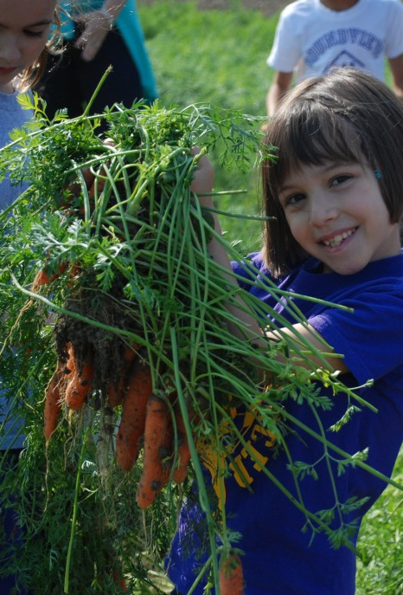
2020 Farm to School Grant
2 year grant
Building relationships
Notes:
Say: Virginia has three Farm to School Grants that we will highlight today, starting with the 2020 Farm to School Grant. This grant was a 2-year grant. The focus has been building relationships among schools, farmers, distributors, community groups, and others via a regionally-based collaboration model. Some of the products that have come from this grant include:
Farm to School Toolkit, which is being printed right now for distribution during the F2S Regional Network Meetings (another product of this grant - starting tomorrow) and the Spring Regional Meetings
The formation of a Farm to School Leadership Team
Bringing the Farm to School Producer Training, which is being paired with the Regional Network Meetings.
Farm to school video series (in the planning stages now)
Local food procurement data analysis

Slide 9
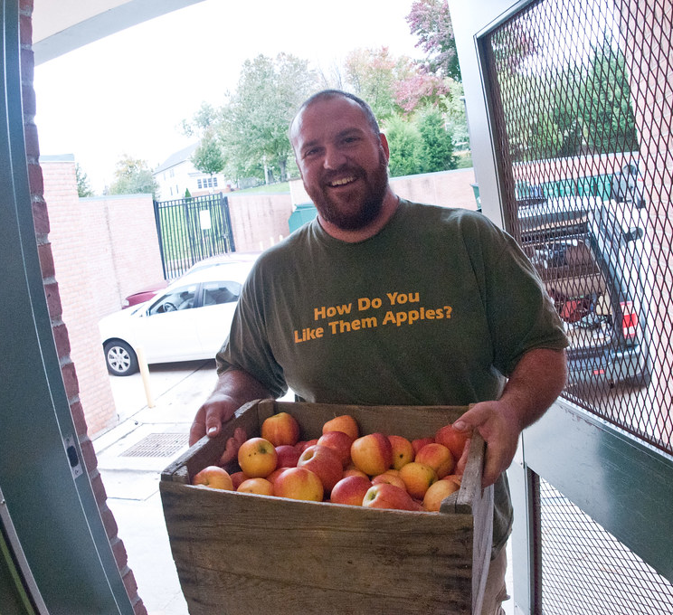
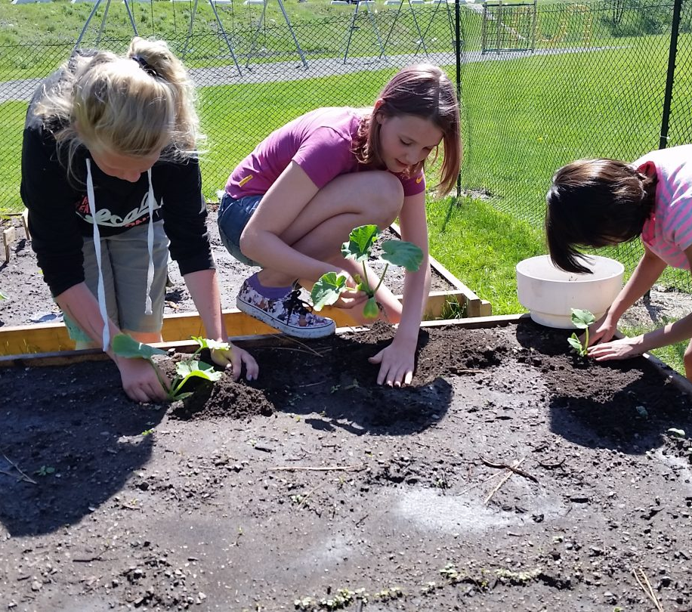
2022 Farm to School Grant
Expand VFVK
Notes:
Say: Virginia was also awarded a 2022 Farm to School Grant. With this grant, we will be expanding the Virginia Food for Virginia Kids (VFVK) initiative. Grant funds will be used to support Phase Two of VFVK.
Phase Two includes implementation, the official roll-out of VFVK, and the expansion into additional school divisions. In this phase, we contracted with the Chef Ann Foundation to develop and host virtual VFVK trainings and provide technical assistance to schools.
The Chef Ann Foundation is also assisting school divisions with building strategic plans based on individualized goals and assessment results. They will provide heavy technical assistance to schools as they implement their strategic plans and work towards their goals.
In 2024, we will host a 2024 Virginia F2S Conference to highlight this initiative, which I will talk a little bit more about in a moment.

Slide 10

Farm to School State Formula Grant
2022 – 2026
  A second VDOE-SNP Farm to School Specialist
  VFVK resource development
  Strategic planning and technical assistance for another VFVK cohort of eight divisions
  Local procurement data collection and analysis
  Farm to school promotional items
  VA Farm to School Conference
Notes:
Say: The third Farm to School Grant is the USDA Farm to School State Formula Grant, which runs from 2022-2026.
This grant will fund:
A second VDOE-SNP Farm to School Specialist
Stipends for VA Farm to School Regional Network Co-Lead
VFVK resource development and farm to school promotional materials
Strategic planning and technical assistance for another cohort of eight divisions that will implement VFVK
Local procurement data collection and analysis
VFVK financial management training
VA Farm to School Conference

Slide 11
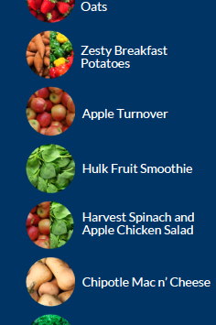
Team Nutrition Training Grant
2021
Expand Harvest of the Month
8 new appealing recipes with 7 VA-HOM products
Support scratch cooking and local procurement
Notes:
Say: In addition to Farm to School Grants, the VDOE-SNP has also been the recipient of several Team Nutrition Training Grants. We are currently operating two of these grants. The first is the FY 2021 TNTG. The purpose of this grant is to expand the Virginia Harvest of the Month program through recipe development, marketing, and nutrition education lessons targeting secondary students. Through this grant, a Recipe Development Team was formed and that team has been developing eight new HOM recipes featuring seven of the HOM items. Seven recipes passed testing, have been standardized, and are being implemented in our participating school divisions now. The eighth recipe is being tested with students now.
In addition to the recipes, we worked with VA Ag. in the Classroom to develop four nutrition education lessons targeting secondary students. We also developed a new set of HOM posters and POS signs that target secondary students. Finally, we plan to roll out training for you and your staff on this program in the fall. At that time we will launch eight recipe demonstration videos and a Virginia Standardized Recipe Development Manual.

Slide 12

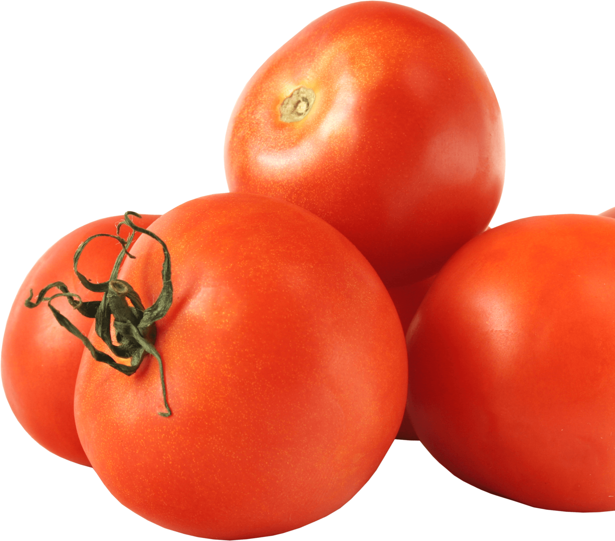
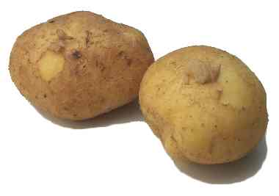
2022 Team Nutrition Readiness & Retention Training Program
Training to meet USDA Transitional Nutrition Standards
Freshly prepared, locally procured, culturally inclusive
Increase scratch cooking training and recipes
Recruiting and retaining strong team members
Notes:
Say: Let’s move on to the FY 2022 TNTG - the Team Nutrition Readiness and Retention Training Program. The purpose of this grant is to provide a comprehensive training program for you and your cafeteria managers that will help you meet the Transitional Nutrition Standards now and prepare to meet the updated standards when they are finalized. We are going to help you do this by supporting your ability to implement more scratch and speed-scratch recipes, procure more fresh, local foods, and offer a greater variety of culturally inclusive meals.
We will talk about the specific components of this program shortly.

Slide 13
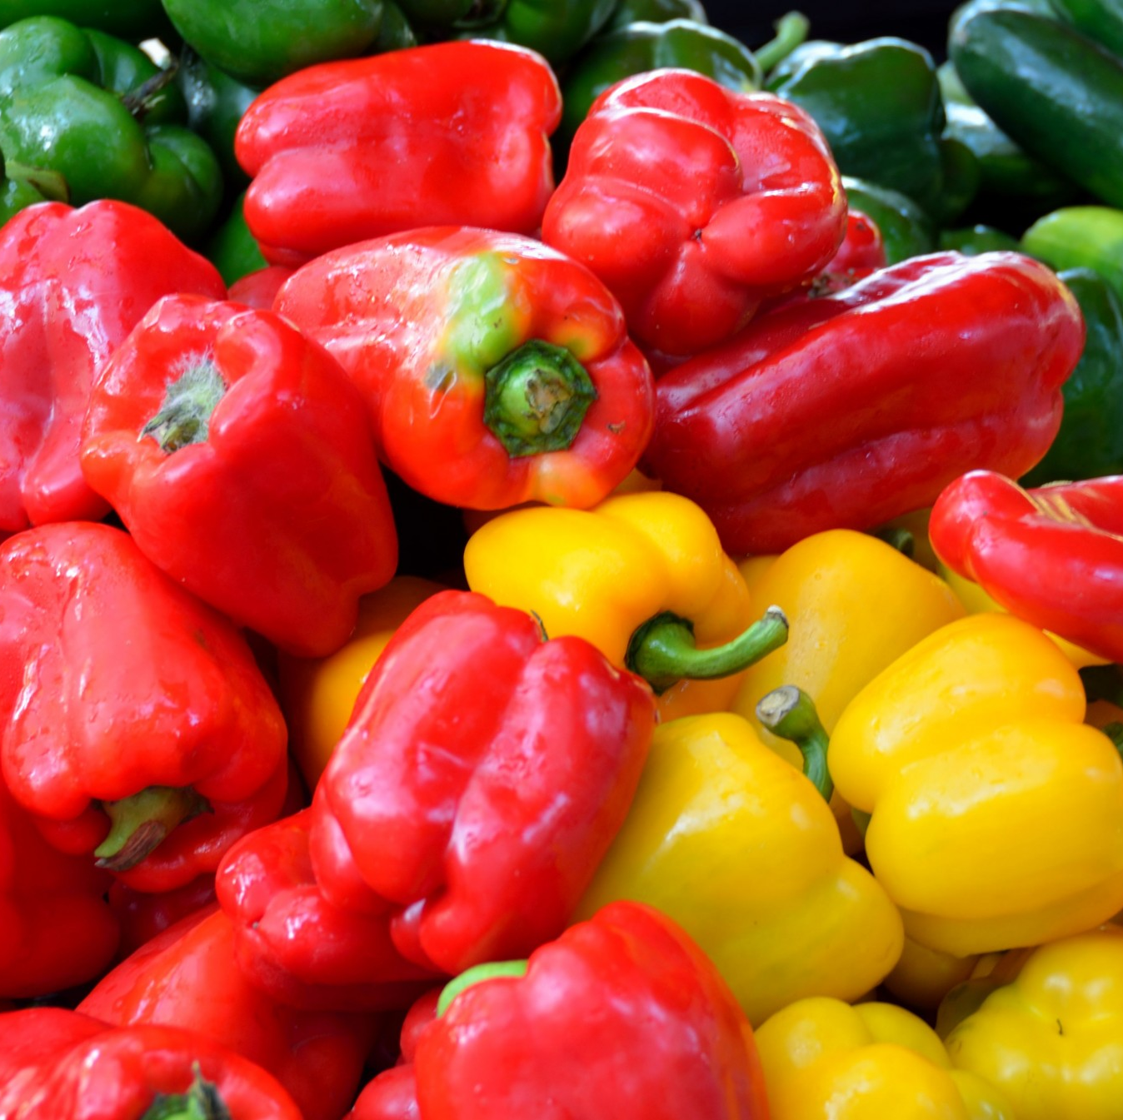
Harvest of the Month
Increased consumption of seasonal, VA grown fresh produce
Notes:
Say: But first, I want to share with you the some of our office’s other initiatives. We talked about this a little just a few moments ago, but the Virginia Harvest of the Month program is an initiative that promotes seasonal eating and increased fruit and vegetable consumption. It supports local economies as well as provides ready-to-use materials for classrooms, cafeterias, nonprofits, farmers’ markets, and early care centers to educate children about the joys of eating seasonal, local foods. The program's objective is to increase consumption of seasonal, Virginia Grown fresh fruits and vegetables, so children establish healthy eating habits to last a lifetime.

Slide 14
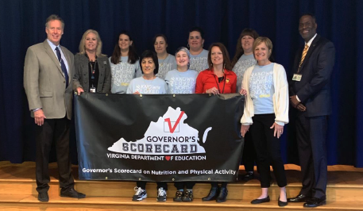
Governor’s Scorecard
Promote culture of health and wellness in VA schools
Three levels of superior performance: Gold, Silver, and Bronze
Notes:
Say: The Governor’s Scorecard on Nutrition and Physical Activity measures initiatives that go beyond just meeting the regulations to promote a culture of health and wellness in Virginia schools.
It is based on the CDC’s Whole School, Whole Community, and Whole Child model. The scorecard encourages schools to identify best practices and measure progress towards meeting the nutrition and physical activity needs of students.
The scorecard contains 40 scored questions, with each question worth up to four points for a total of 160 points. Three levels of superior performance are awarded: gold, silver, and bronze.

Slide 15
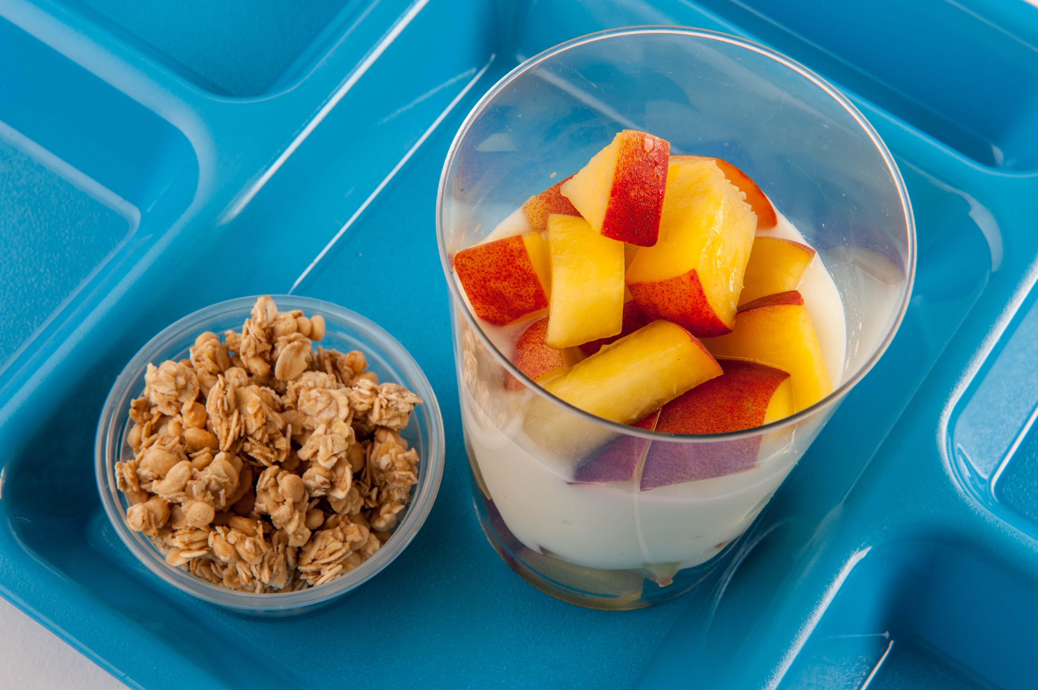
Breakfast Initiatives
Breakfast Club
Nutrition and equity
Improve nutritional quality and increase participation
Notes:
Say: The Virginia Breakfast Club is another initiative of ours. The Breakfast Club is a collaboration of nutrition and equity professionals from multiple Virginia sectors, including non-profit organizations, government agencies, and school nutrition directors from across the state.
The shared goal is to promote recommendations and best practices to improve the nutritional quality of school breakfast.
The Breakfast Club's best practices address: removing barriers to breakfast access, increasing consumption of high-quality protein foods, reducing consumption of sugar, and increasing participation by providing new, innovative menu items.

Slide 16

Virginia Food for Virginia Kids
Equitable access
Good, healthy, VA goods in school and community meals programs
Notes:
Say: All of these grants and initiatives that we have been talking about all support our flagship initiative, Virginia Food for Virginia Kids. The overarching goal of VFVK is to ensure that every Virginia child has equitable access to good, healthy, Virginia foods in school and community meals programs.

Slide 17
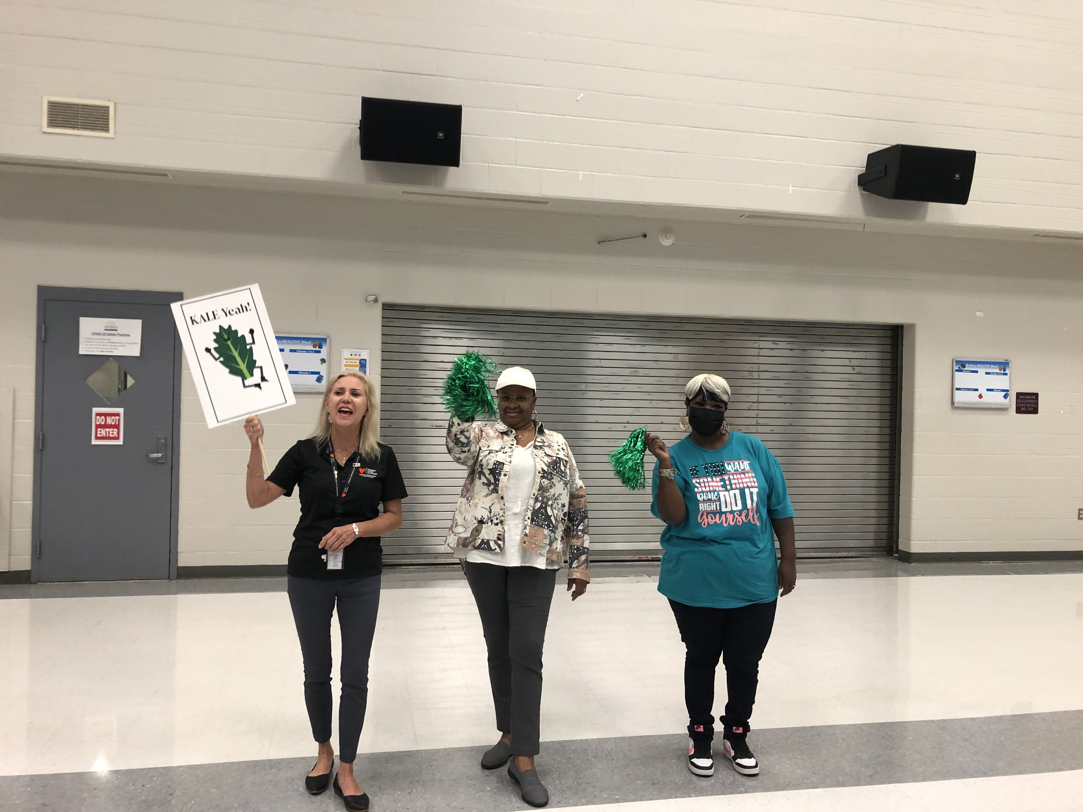
Virginia Food for Virginia Kids
Increase scratch cooking
More fresh, local, and culturally inclusive meals
Bolster the school nutrition workforce
Notes:
Say: There are four legs to the VFVK stool. The first three include increasing scratch cooking, increasing local procurement, and increasing culturally inclusive meal offerings. The fourth leg that supports the first three is workforce development. To support the development of VFVK, our office has partnered with local, state, and national partners like the Chef Ann Foundation, the Virginia Department of Aging and Rehabilitative Services, No Kid Hungry, and the University of Virginia.

Slide 18
Virginia Food for Virginia Kids
VDOE-SNP provides support
  Assessments
  Training
  Planning
  Technical assistance
Notes:
Say: SFAs participating in VFVK receive individualized wrap-around support to help them reach their goals towards increasing scratch cooking, local food procurement, and culturally inclusive meal offerings. Support is in the form of detailed assessments, training, strategic planning, and technical assistance.

Slide 19

Virginia Food for Virginia Kids
Workforce development initiatives with local, statewide, and national partners
This Photo by Unknown Author is licensed under CC BY-SA-NC
Notes:
Say: The VDOE-SNP recognizes that, in order to increase scratch cooking, local procurement, and culturally inclusive meals, SFAs need a skilled workforce. That is where the VFVK workforce development initiatives come in. We currently have several initiatives in the works:
We partnered with the Department of Aging and Rehabilitative Services to place specially abled clients in school division kitchens.
We are working with our CTE office to integrate school nutrition into the curriculum.
We are working to develop a couple of apprenticeship programs.
And now, I will turn it back over to Chef Cyndie’s team.

Slide 20
Additional Funding
Supply Chain Assistance Funds
  10% held back to purchase local food for school divisions via Centralized Local Procurement Pilot Program
P-EBT administration funds
Notes:
Say: Additional funding that has come into Virginia recently includes the Supply Chain Assistance Funds where 10% was held back to purchase local food for school divisions via Centralized Local Procurement Pilot Program and P-EBT administration funds.

Slide 21
2022 Team Nutrition Training Grant

Slide 22
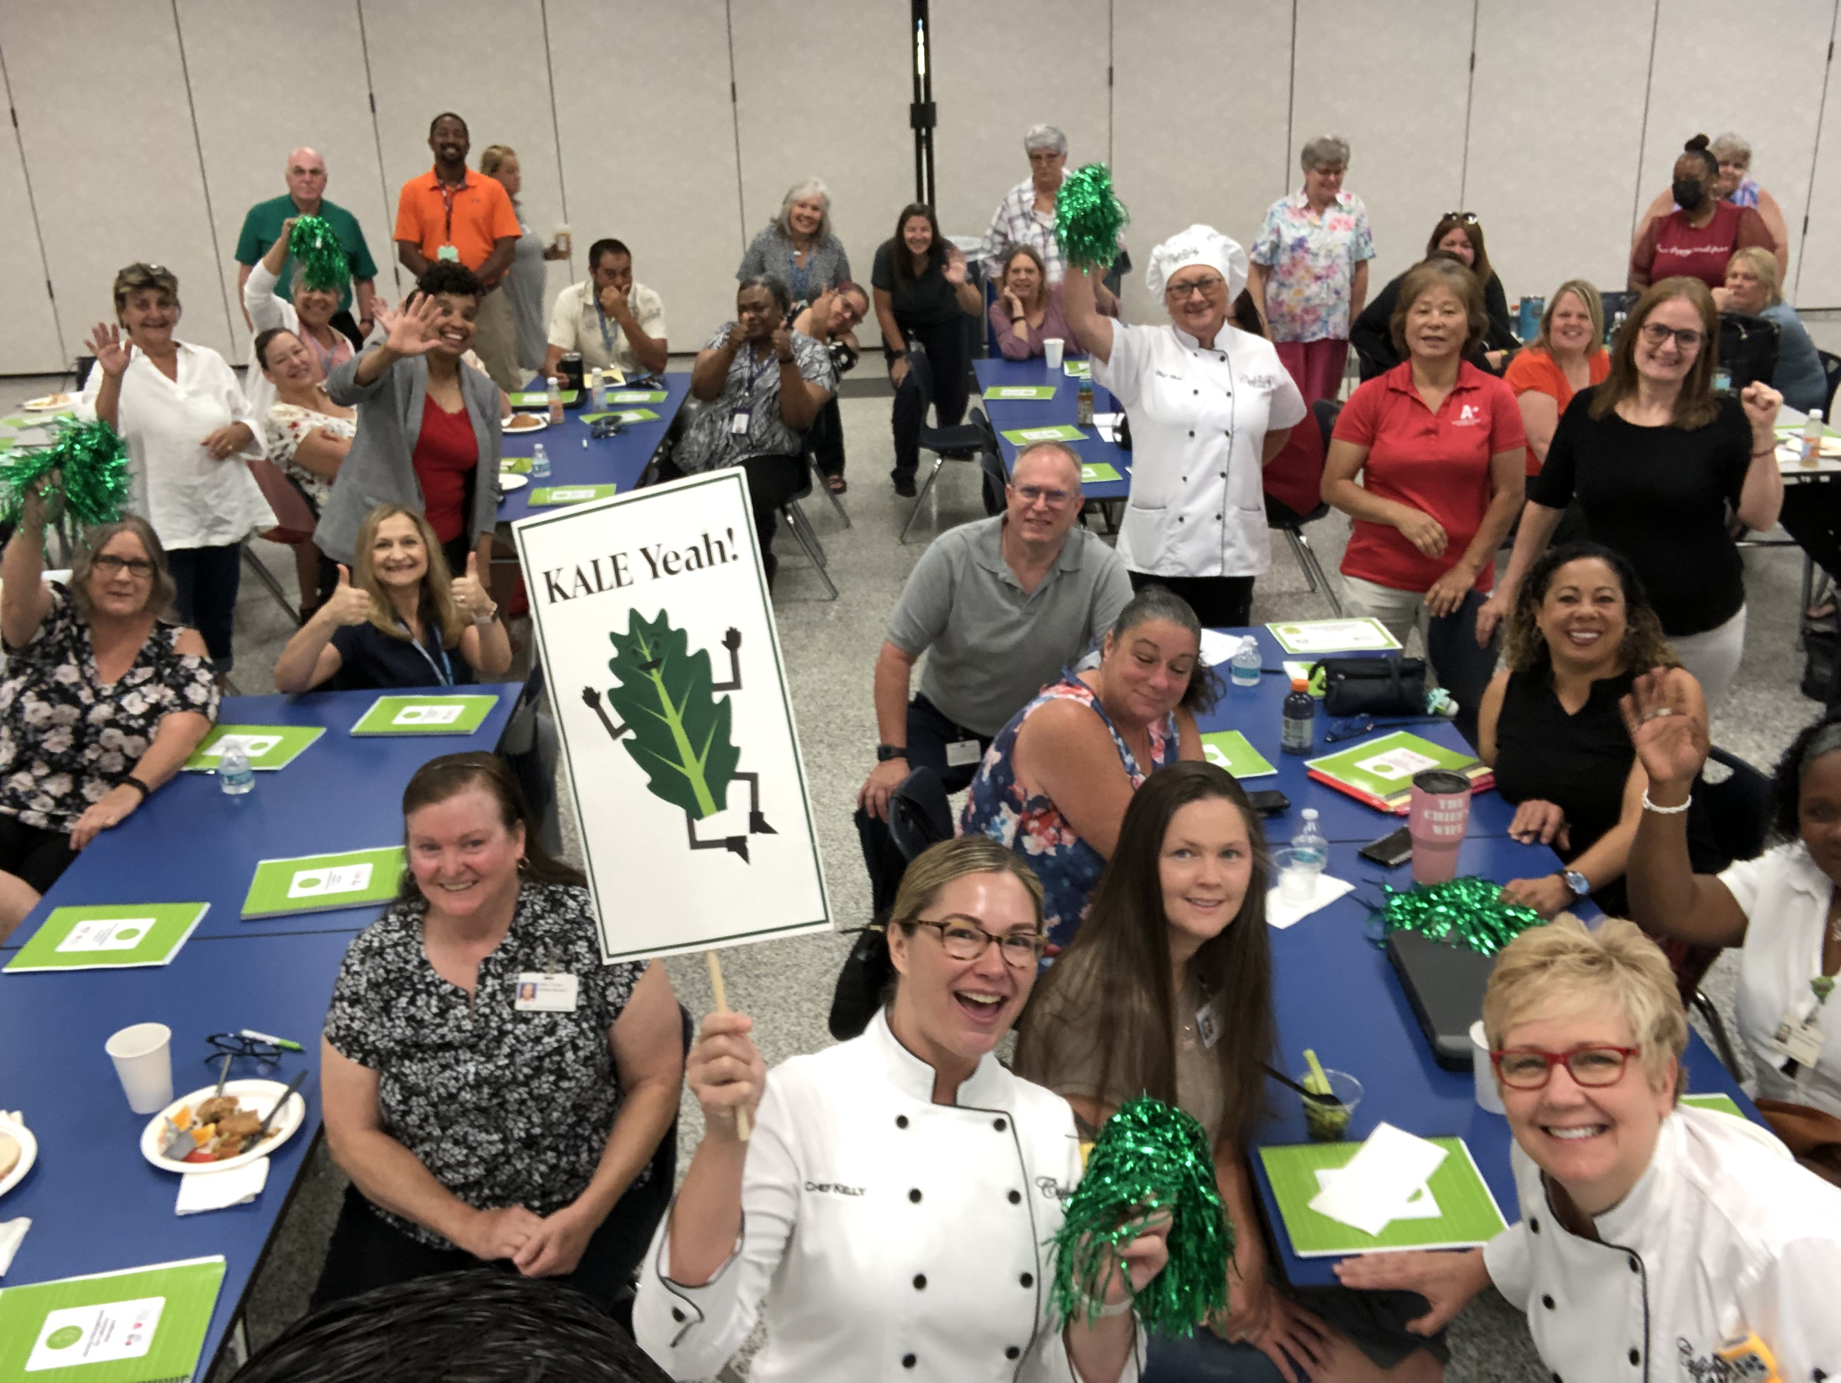
Director Training
18 virtual webinars
2 full days of in-person trainings in 2023 and 2024
Notes:
Say: Starting today through June 2024, there will be lots of time for quality training both in person and virtually for division leader grantees. The director training includes 18 hours of virtual training through these monthly webinars and drum roll please - 22 hours of in-person training. The in-person training right now is proposed for Oct, but we will nail down the exact dates soon and let you know. It will include two full days of culinary skills, we are bringing in our K-12 Team food photographer to provide lessons in taking pictures – because we know how hard you and your team work, let’s take some good pictures and tell everyone about it. We will also include leadership and mentoring – There is a lot of turnover and retirement. We have to teach the next generation of school nutrition professionals. Who can tell me what the number on a scoop means? Write it in the chat! So that everyone is on the same page, we will be reviewing requirements to make it easier to cook from scratch.

Slide 23
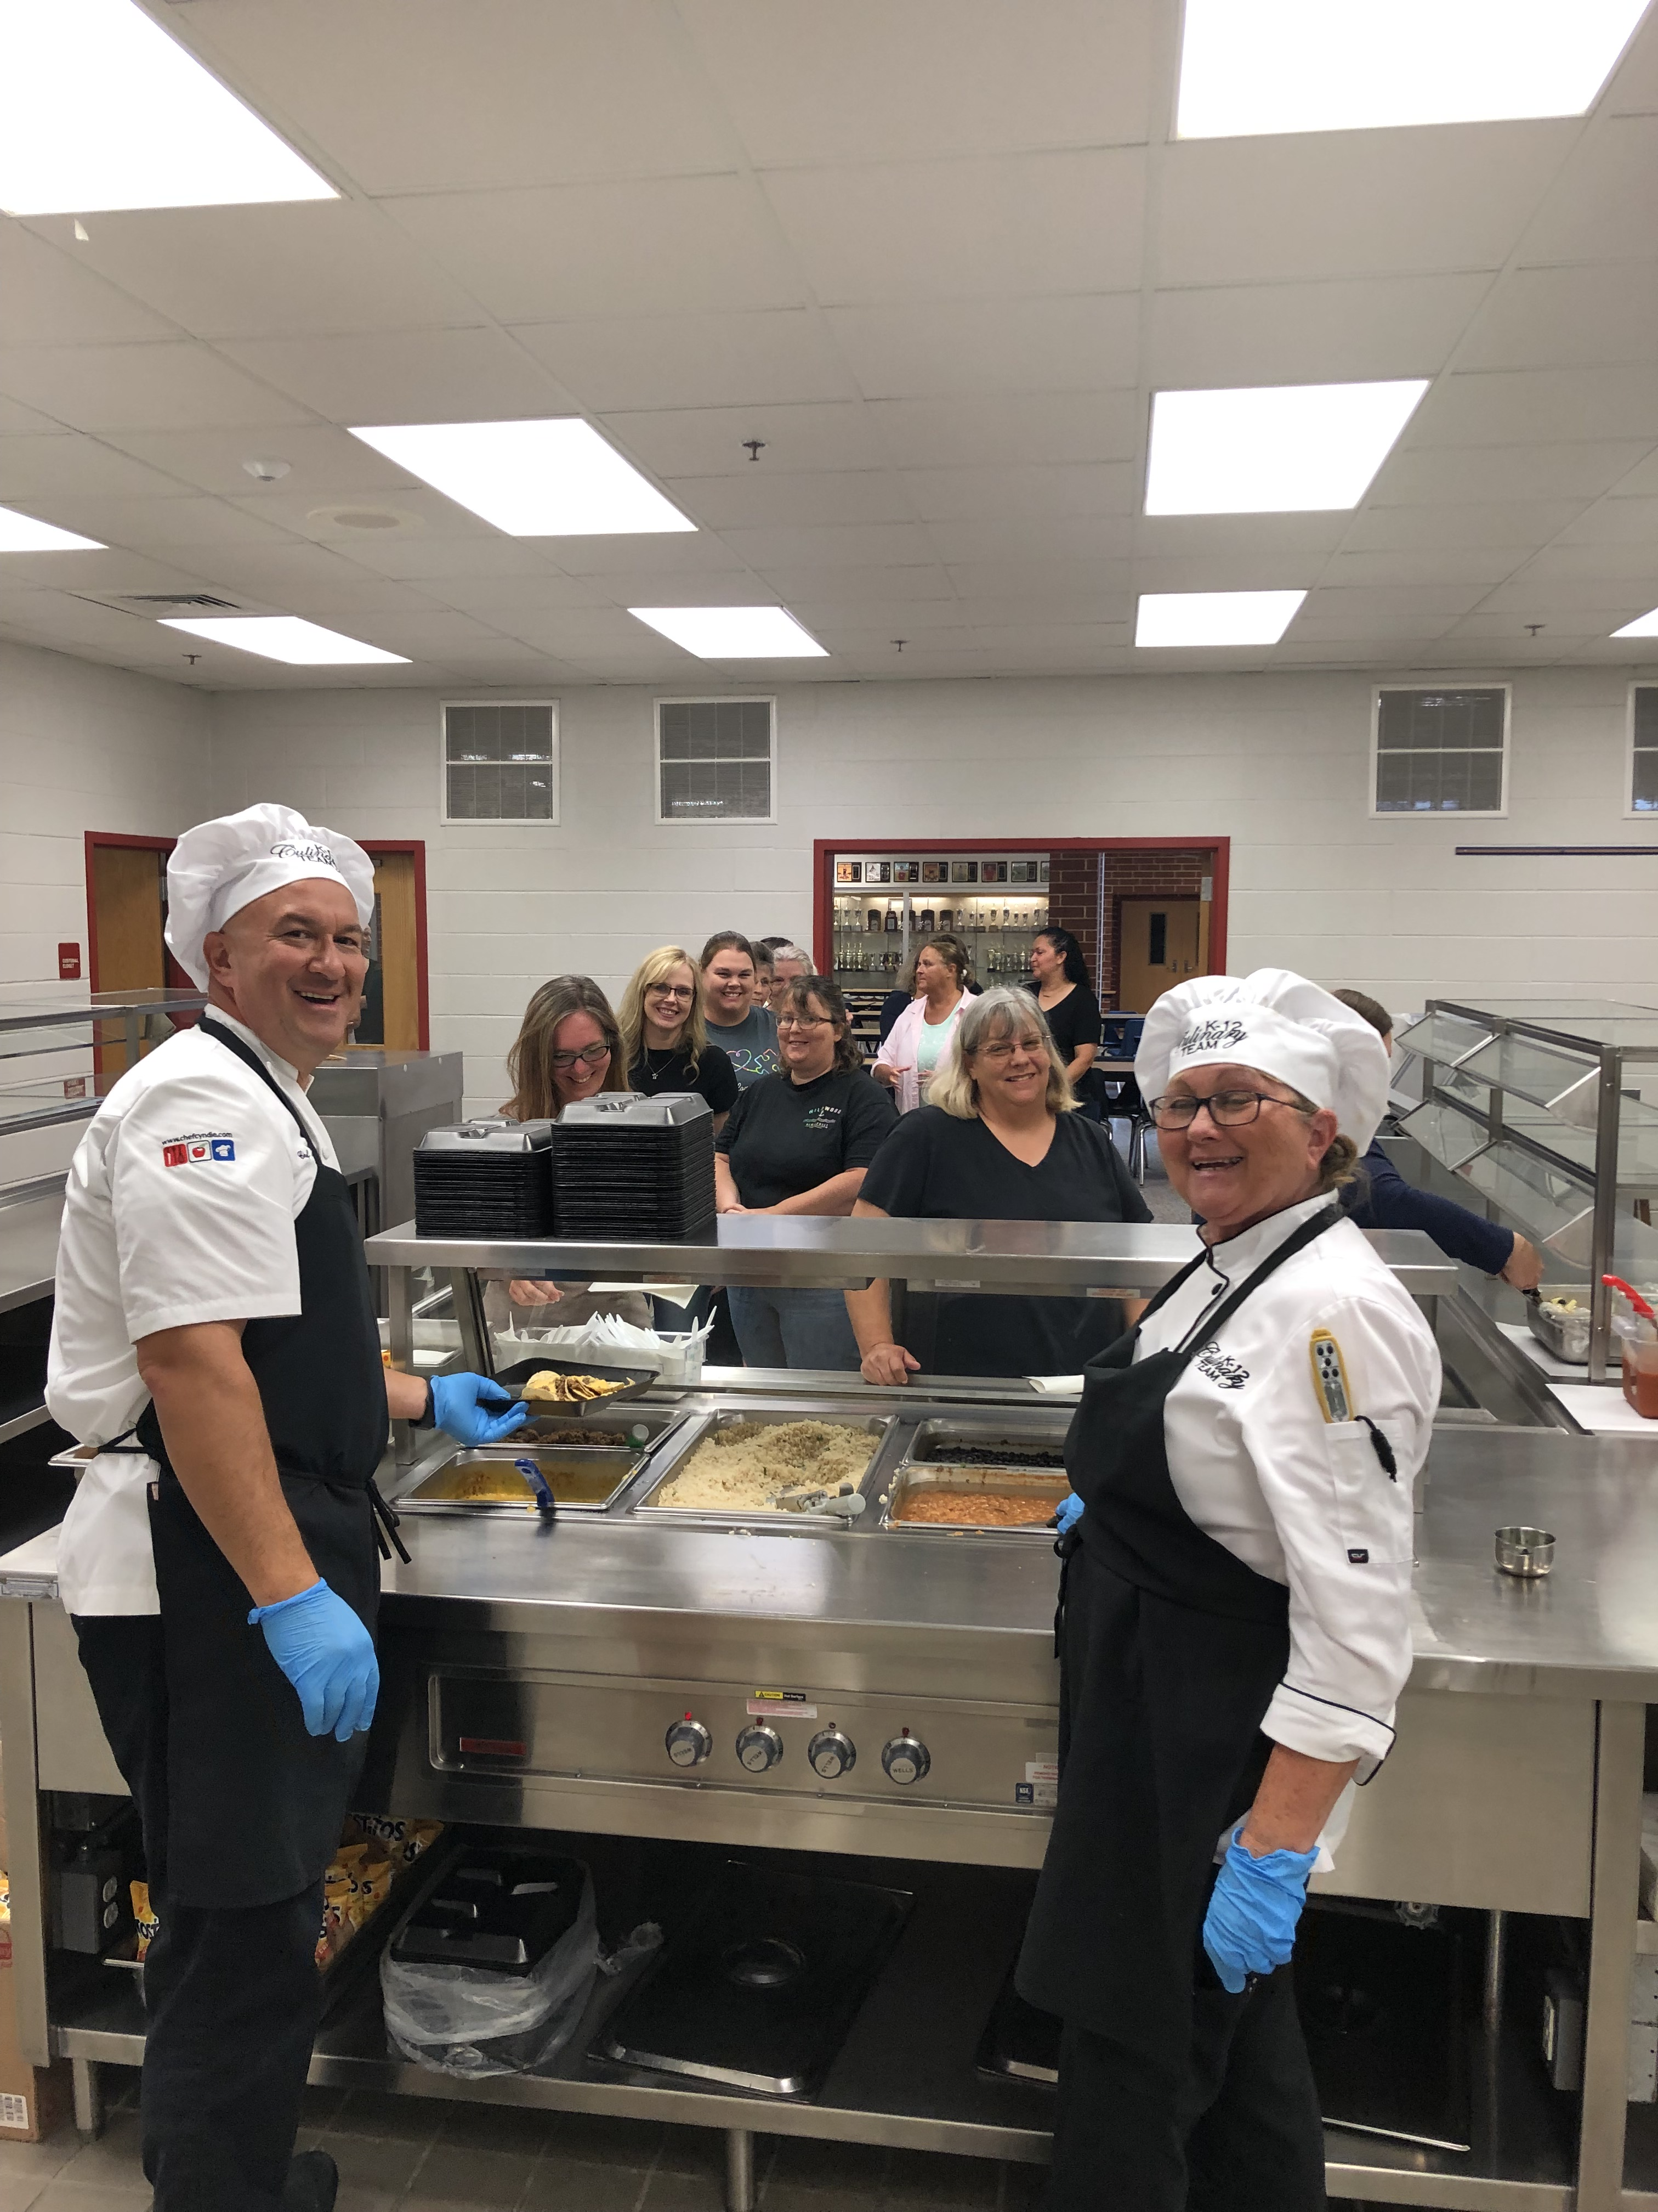
Cafeteria Manager Training
8 hours
2 hours virtually and 6 hours in person
$175 incentive
Notes:
Say: The other big piece to a strong meals program is your manager team. We know that our divisions must have strong managers, so it’s important to invest in their training. Managers will receive 8 hours of professional development with 2 hours virtually through a go at your own pace portal and 6 hours of in-person. The in-person training will include hands on culinary training including culinary equipment door prizes and all managers who complete both the online and in-person training will receive a $175 incentive! That’s right; this is so important that VDOE is providing some cash motivation. Teaching materials for café managers will also be translated in Spanish. All of these trainings will include information about flavoring recipes with spices and herbs and using different culinary techniques to help meet the meal guidelines. In addition, throughout these trainings, directors and managers will have the opportunity to share ideas and collaborate with another. We really do learn so much from each other!

Slide 24
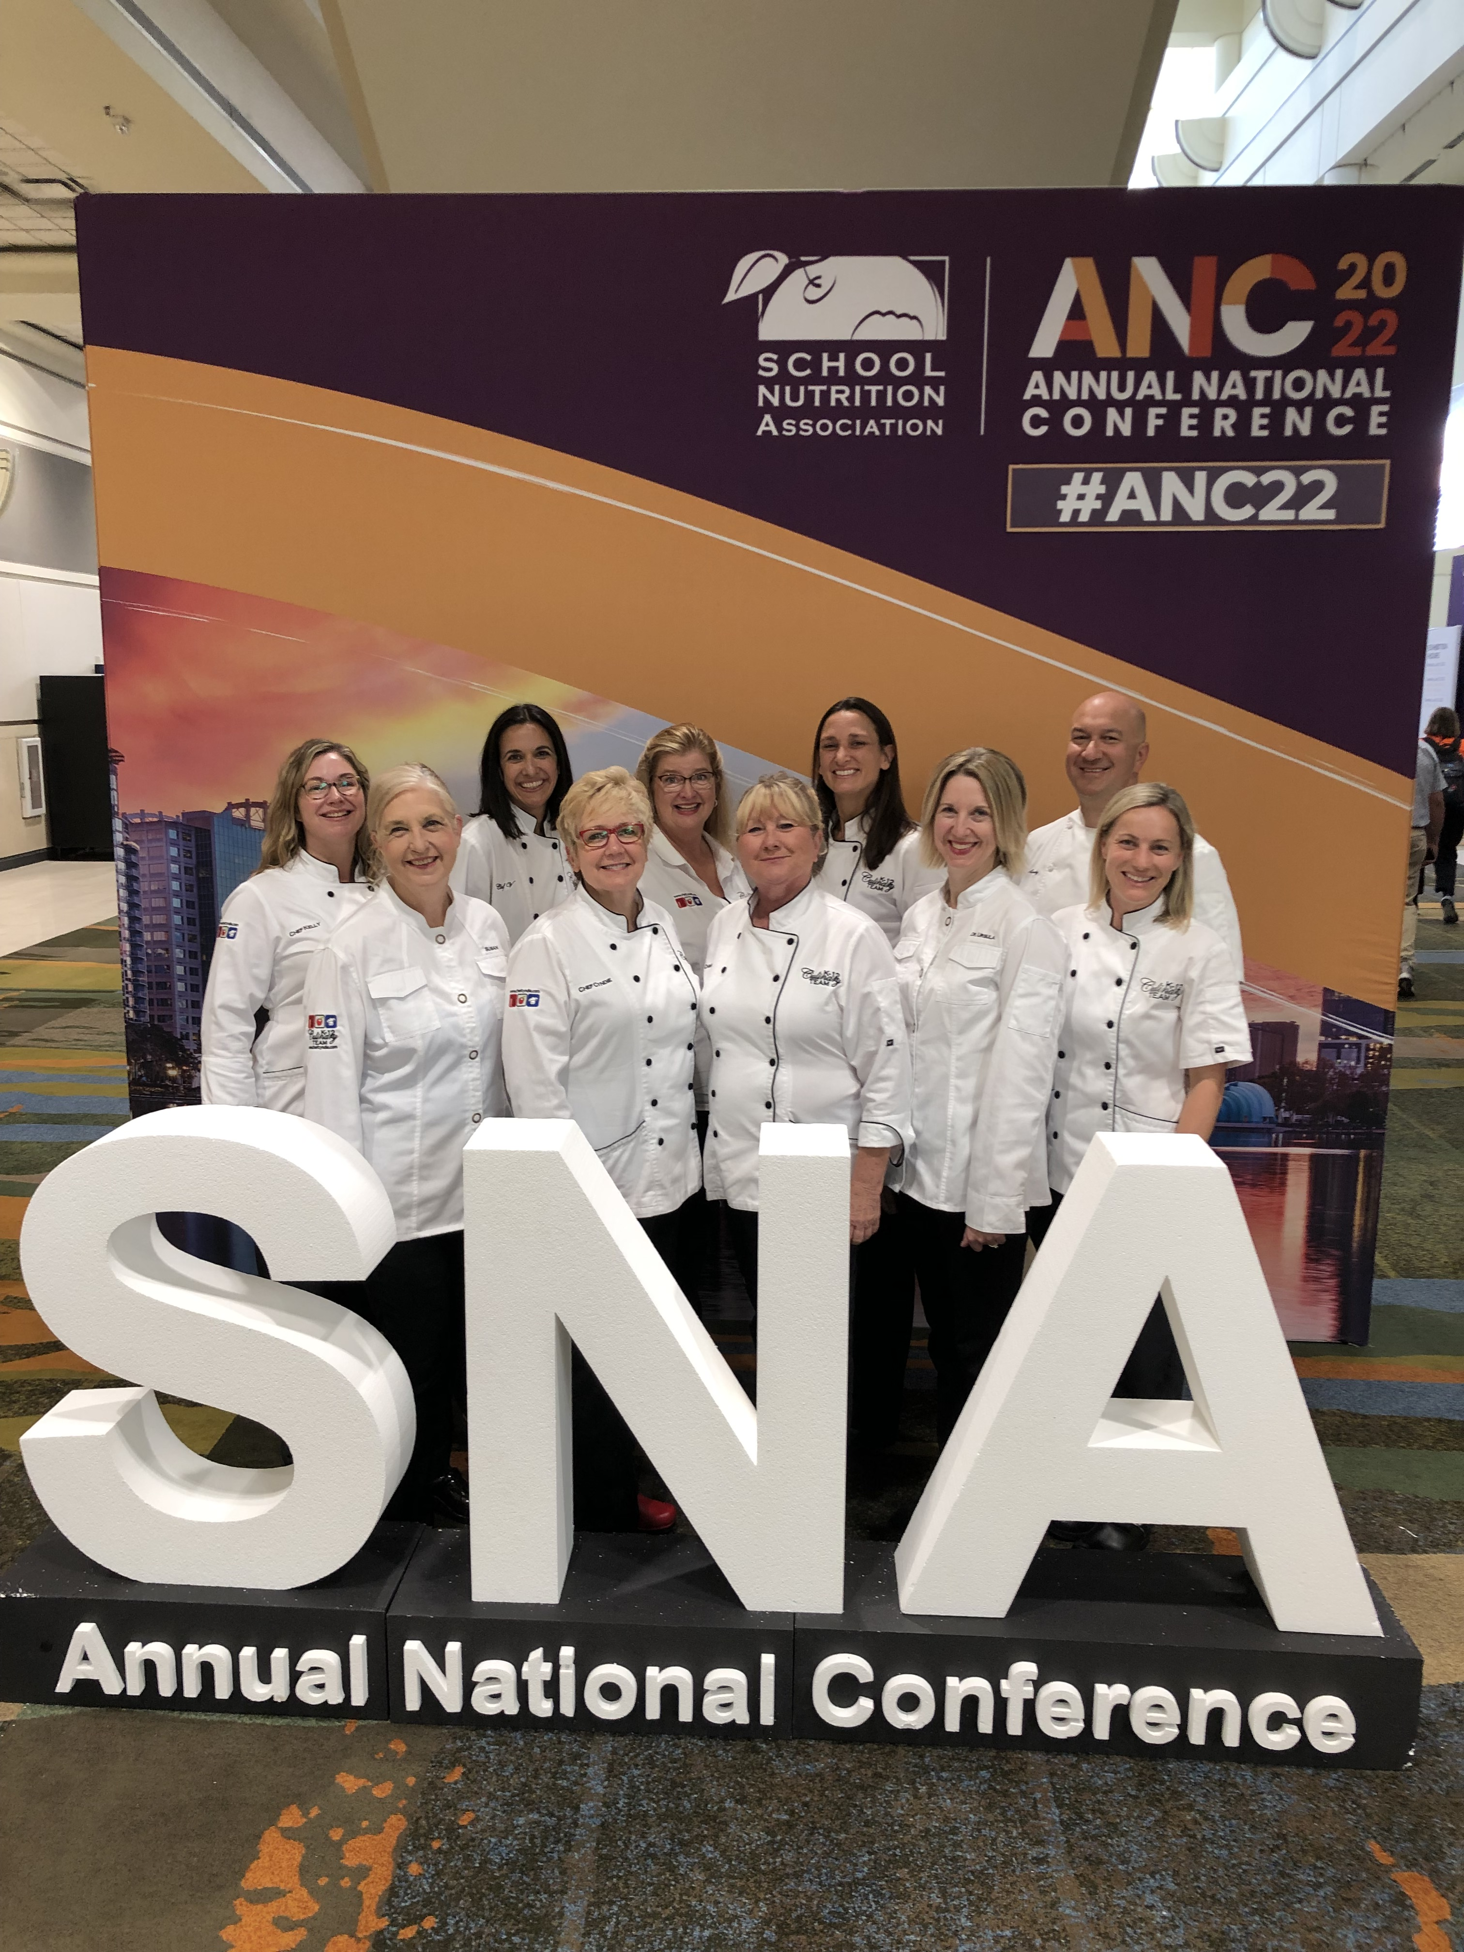
Your K-12 Teaching Team

Slide 25
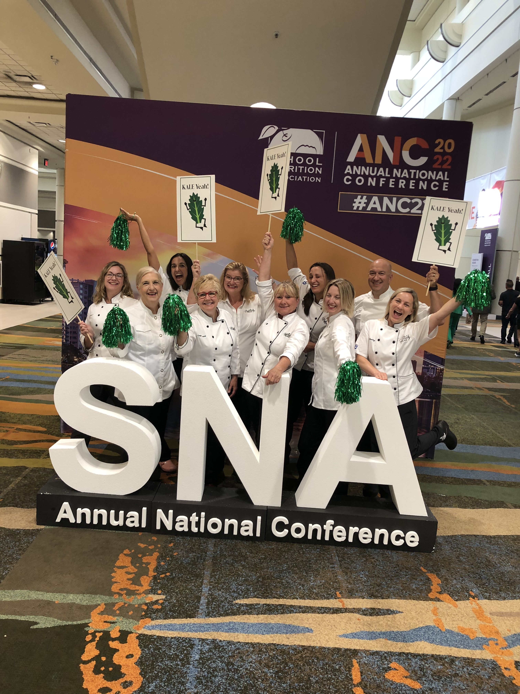
Kale Yeah!

Slide 26

TNTG + VFVK
Local procurement
Scratch and speed scratch cooking
Culturally inclusive
This Photo by Unknown Author is licensed under CC BY-SA-NC
Notes:
Say: The TNTG Grant fits within and aligns with the vision for Virginia Food for Virginia Kids. When we use locally grown products, we are using the freshest most flavorful ingredients. They are also more nutritious! Supply chain issues typically impact individual ingredients less often, but products such as convenience foods with multiple ingredients may not be as dependable. Both grants support local businesses to help build community partners you can count on. The trainings will support more scratch and speed scratch cooking. Our team has a wealth of experience working as dietitians and K-12 chefs. We promise to provide useful tips such as work scheduling, batch cooking, and hacks in the kitchen to make scratch cooking possible. With more culinary skills, scratch cooking of local produce and ingredients is achievable. Our team will teach you how to review recipes and find ways to lower sodium and added sugars by incorporating herbs, spices, and flavor building culinary techniques. And of course, we won’t forget teamwork and motivation tools, and especially marketing ideas to help sell new foods and recipes. And lastly, but not less important is training supporting culturally inclusive meals. We will discuss and taste many different herbs and spices, creating delicious global flavors that support meaningful, creative, and delicious meals. We want to ensure the foods served represent different cultures throughout VA, and also teach students about other flavors they may have never tried. Certainly, taste testing is a great way to promote these culturally inclusive foods. But more on that in future trainings

Slide 27
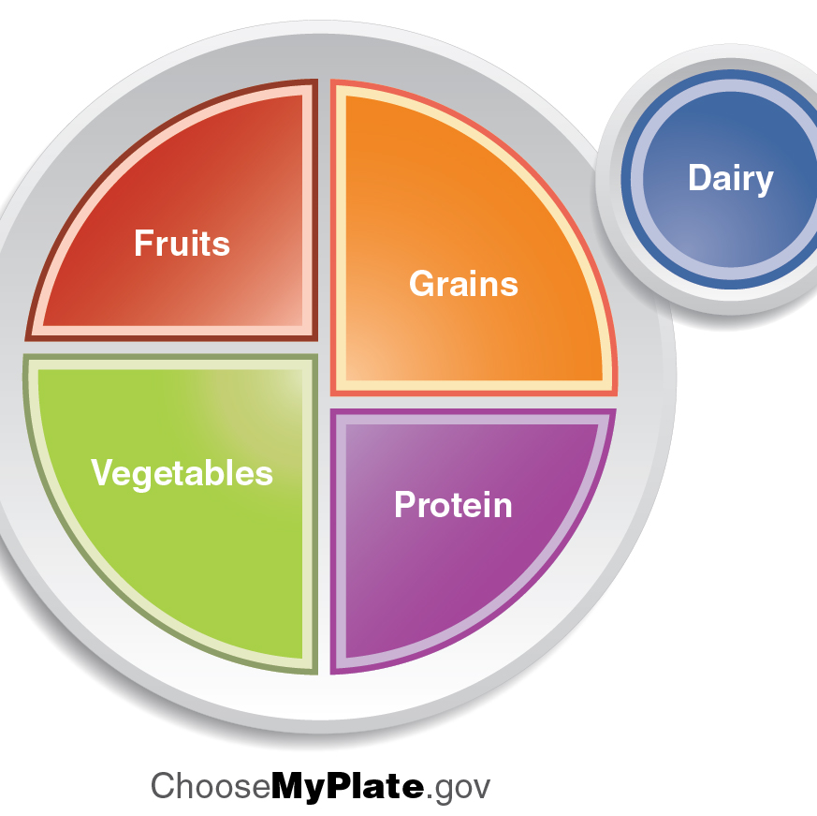
Meet Guidelines
Overcome challenges
  Transitional Nutrition Standards
  The Proposed Final Rule
Notes:
Say: We know there is a lot of excitement around the proposed new meal standards. New changes are not always easy, and they often bring new challenges.
All of these training and tools will make meeting the Transitional Nutrition Standards and even the Proposed Final Rule easier and more fun! WE PROMISE!

Slide 28
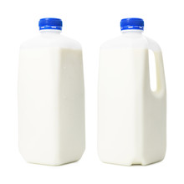
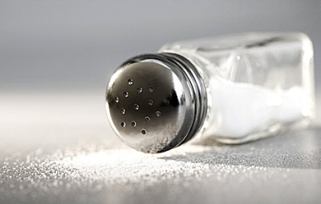
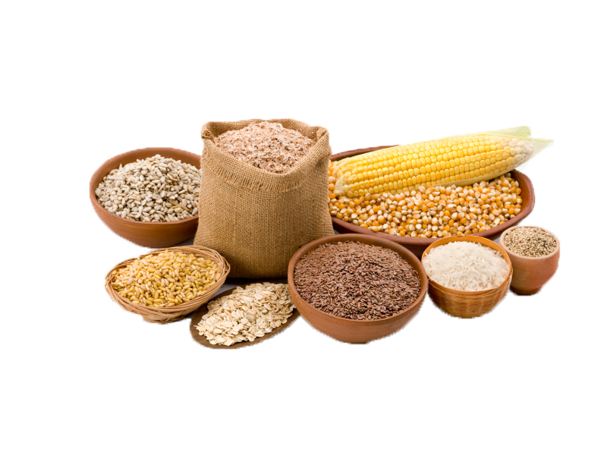
Transitional Nutrition Standards
Summary of Changes
  Milk
  Sodium
  Whole grains
Notes:
Say: Let’s briefly discuss the Transitional Nutrition Standards. This new rule establishes standards for milk, whole grains, and sodium for school years 2022-2023 and 2023-2024 to give schools time to transition in the short term. Meanwhile, USDA is working to develop long-term nutrition standards - based on the newest Dietary Guidelines for Americans and extensive input from a wide range of partners - that will work for schools, families, and industry alike.
There are three components of the transitional Nutrition Standards. They include milk, sodium, and whole grains.
First, Schools and childcare providers may offer flavored, low-fat milk (1%) in addition to unflavored, low-fat milk and flavored or unflavored nonfat milk.
Moving to sodium, the weekly sodium limit for school lunch and breakfast will remain at the current level, known as Target 1, for school year 2022- 2023. For school lunch only, the limit will decrease marginally (10%) in school year 2023-2024 to put schools on an achievable path toward long-term sodium reduction, which will be addressed in future rulemaking.
Finally, whole grains. At least 80% of the grains served in school lunch and breakfast per week must be whole grain rich (containing at least 50% whole grains).

Slide 29

The Proposed Rule
Overcome challenges
  Milk
  Sodium
  Whole grains
  Added sugar
Notes:
Say: The proposed rule – Child Nutrition Programs: Revisions to Meal Patterns Consistent with the 2020 Dietary Guidelines for Americans - is the next step in continuing the science-based improvement of school meals and advancing USDA’s commitment to nutrition security. The proposed changes, just like the Transitional Standards, are based on the latest Dietary Guidelines for Americans.
The proposed rule consists of 4 components: Added sugars, milk, sodium, and whole grains. This sounds very similar to the transitional standards, but it includes added sugars. Isn’t that sweet!
The Dietary Guidelines show that children are consuming too many added sugars. Additionally, USDA heard concerns from parents, teachers, health professionals, and other stakeholders about the amount of added sugars in school meals, particularly in breakfasts.
To limit added sugars in a practical way, USDA is proposing a phased approach.
First, the rule proposes limiting added sugars in certain products beginning in fall 2025, targeting the most common sources of added sugars in school meals: breakfast cereals, flavored milks, grain-based desserts, and yogurt.
Then, in fall 2027, the rule proposes limiting overall added sugars across the weekly menu to less than 10% of calories per meal, on average, to better align meals with the Dietary Guidelines.
USDA expects implementing product-based limits first would help schools be better prepared to meet the proposed weekly limit two years later.
Fat-free and low-fat milk contain essential nutrients that kids need to grow and thrive, while staying within the calorie and saturated fat limits recommended by the Dietary Guidelines. The proposed rule continues to encourage consumption of fat-free or low-fat milk, while allowing some flavored milk to be offered in school meals.
One option proposed would limit flavored milk to children in grades 9-12. A second option would allow flavored milk for children in all grades (K-12). Both options include a proposed added sugars limit for flavored milk.
The rule proposes a multi-year approach including two sodium reductions for breakfast (10% each in fall 2025 and fall 2027) and three for lunch (10% each in fall 2025, fall 2027, and fall 2029).
Be sure to submit comments for the proposed rule. You have from now until April 10, 2023, to submit comments.
Sources:
https://www.fns.usda.gov/cn/fr-020723
https://www.dietaryguidelines.gov/

Slide 30
Current Intake
Notes:
Say: Why is this all important?
Current intakes show that from an early age, dietary patterns are not aligned with the Dietary Guidelines. Unfortunately, by late adolescence, average fruit and vegetable consumption reduces to about half of the recommended range of intake. Further, children consume too many total grains, mostly refined and not nearly enough whole. Favorite foods and meals include high amounts of sodium, added sugars, and saturated fats.
1 in 3 children in the United States are overweight and 1 in 6 are obese. Children that are overweight or obese have substantially higher odds of remaining overweight or obese as adults, and increase their risk of developing heart disease, cancer, diabetes, depression, and disability.
When kids establish healthy eating habits at a young age, they carry these on into adulthood. School meals can and do make a difference!

Slide 31

Thank you!
Notes:
Say: You each play a very important role in these students' lives, and it is our goal alongside VDOE to help you continue to grow your program and meet these guidelines, through scratch cooking, local procurement, and culturally inclusive meals.

Slide 32

Questions
Notes:
Say: Well, we made it!
Ask: Does anyone have any questions?

