Slide 1

Why Whole Grains? + Live Demo
Notes:
Do: Record webinar!
Say: Welcome to today's webinar, Why Whole Grains? with a live culinary demo.

Slide 2
USDA Funding and Non-Discrimination Statements:
“This project has been funded at least in part with Federal funds from the U.S. Department of Agriculture. The contents of this publication do not necessarily reflect the view or policies of the U.S. Department of Agriculture, nor does mention of trade names, commercial products, or organizations imply endorsement by the U.S. Government.”
In accordance with federal civil rights law and U.S. Department of Agriculture (USDA) civil rights regulations and policies, this institution is prohibited from discriminating on the basis of race, color, national origin, sex (including gender identity and sexual orientation), disability, age, or reprisal or retaliation for prior civil rights activity.
Program information may be made available in languages other than English. Persons with disabilities who require alternative means of communication to obtain program information (e.g., Braille, large print, audiotape, American Sign Language), should contact the responsible state or local agency that administers the program or USDA’s TARGET Center at (202) 720-2600 (voice and TTY) or contact USDA through the Federal Relay Service at (800) 877-8339.
To file a program discrimination complaint, a Complainant should complete a Form AD-3027, USDA Program Discrimination Complaint Form which can be obtained online at: https://www.usda.gov/sites/default/files/ documents/ad-3027.pdf, from any USDA office, by calling (866) 632-9992, or by writing a letter addressed to USDA. The letter must contain the complainant’s name, address, telephone number, and a written description of the alleged discriminatory action in sufficient detail to inform the Assistant Secretary for Civil Rights (ASCR) about the nature and date of an alleged civil rights violation. The completed AD-3027 form or letter must be submitted to USDA by:
1. mail:
U.S. Department of Agriculture
Office of the Assistant Secretary for Civil Rights
1400 Independence Avenue, SW
Washington, D.C. 20250-9410; or
2. fax:
(833) 256-1665 or (202) 690-7442; or
3. email:
Program.Intake@usda.gov
This institution is an equal opportunity provider.

Slide 3
Welcome!
Notes:
Say: Remember that as we go through today’s webinar, the chat box is open for any questions and comments. We enjoy hearing from everyone and can learn a lot from each other. Please feel free to comment and ask questions in the chat anytime! We will monitor it together throughout this hour.

Slide 4

Objectives
Identify the key edible parts of a whole grain and explain why they are important.
Discuss the health benefits of consuming whole grains.
Explain how to select a whole grain.
Summarize whole grain options and how they can be incorporated into scratch recipes and culturally inclusive menus.
Notes:
Say: Let’s review today’s objectives.
Do: Review objectives.

Slide 5
Professional Standards – Learning Codes
Nutrition 1000
  Menu Planning (1100)
  General Nutrition (1300)
Notes:
Do: Review professional standards learning codes.

Slide 6
Why Whole Grains?
Notes:
Say: Ok, let's now really dive in! Why whole grains?

Slide 7

Current Intake
Notes:
Say: Let's begin with discussing how most Americans currently eat grains. The majority meet or exceed recommendations for total grain intake; however, only 2 percent meet recommendations for whole grains. What does this mean? It means that whole grains are under-consumed, and most of the grains consumed are refined grains. Refined grains include white bread, refined crackers, cakes, and cookies.
74 percent of our students exceed limits for refined grains, which do not naturally offer the fiber and other nutrients found in whole grains. We'll talk more about these nutrients later.
Source: https://www.dietaryguidelines.gov/sites/default/files/2020-12/Dietary_Guidelines_for_Americans_2020-2025.pdf

Slide 8

Ultra-Processed Foods
Notes:
Say: In many homes, convenience foods and ultra-processed foods made with refined grains take precedence over nutrition. Many of these foods are available in whole grain versions, but even though an item includes whole grains, it does not mean it is the most nutritious option. In our school kitchens, many packaged foods contain whole grains but also contain high amounts of added sugars, high sodium levels, and/or other unwanted ingredients. By moving to more scratch cooking, we can increase more natural forms of whole grains into our menus and have more control over the added sugars and sodium.
Ask: Can you think of a few whole grain foods marketed as being more nutritious than their counterparts, but are still high in added sugar, sodium, or other unwanted ingredients? Type a few in the chat box or share with us.
Do: Provide feedback on products that are listed.
Say: Thank you for sharing! Thinking about the overconsumption of refined grains and underconsumption of whole grains, what can we do as school nutrition professionals to help address this problem?

Slide 9

Educate
Notes:
Say: First of all, we can educate. It is important that you, as directors, understand why our students (and us) need whole grains, and that you educate your staff. We need staff buy-in to support the foods we serve, and to help educate and encourage our customers.
Working in school nutrition programs, we have the opportunity to educate children about nutrition. Teach your students about whole grains, why they are important for their health, and therefore, why we serve them. Yes, we are required to serve them, but that's not the message we should be spreading as to why. Hopefully, our students will take what they learn in the cafeteria home and educate their guardians as well! That is the goal!
We will discuss the nutritional benefits of whole grains shortly.

Slide 10
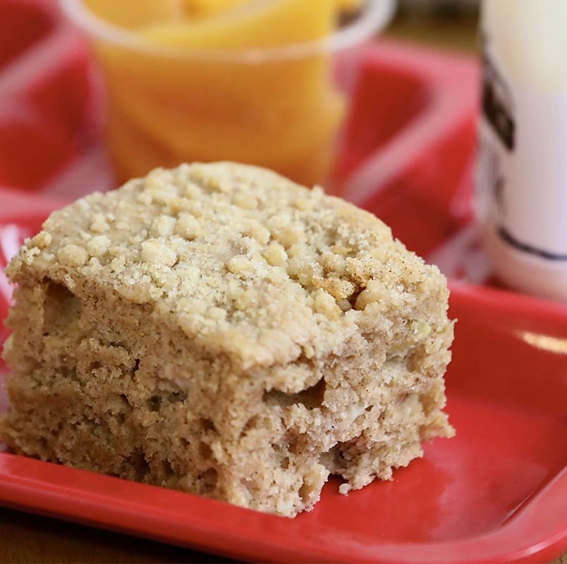
Add More!
Notes:
Say: Second, learn how to incorporate more whole grains into recipes and menus. You have lots of opportunities to use whole grains though scratch cooking, quality local ingredients, and combining them with flavorful herbs and spices!
Take a look at this apple cinnamon streusel yogurt muffin bar, which could easily be made with local VA apples. While it's whole grain, it still looks delicious, and we guarantee it tastes great! It is also lower in sugar and sodium than pre-made muffins.

Slide 11
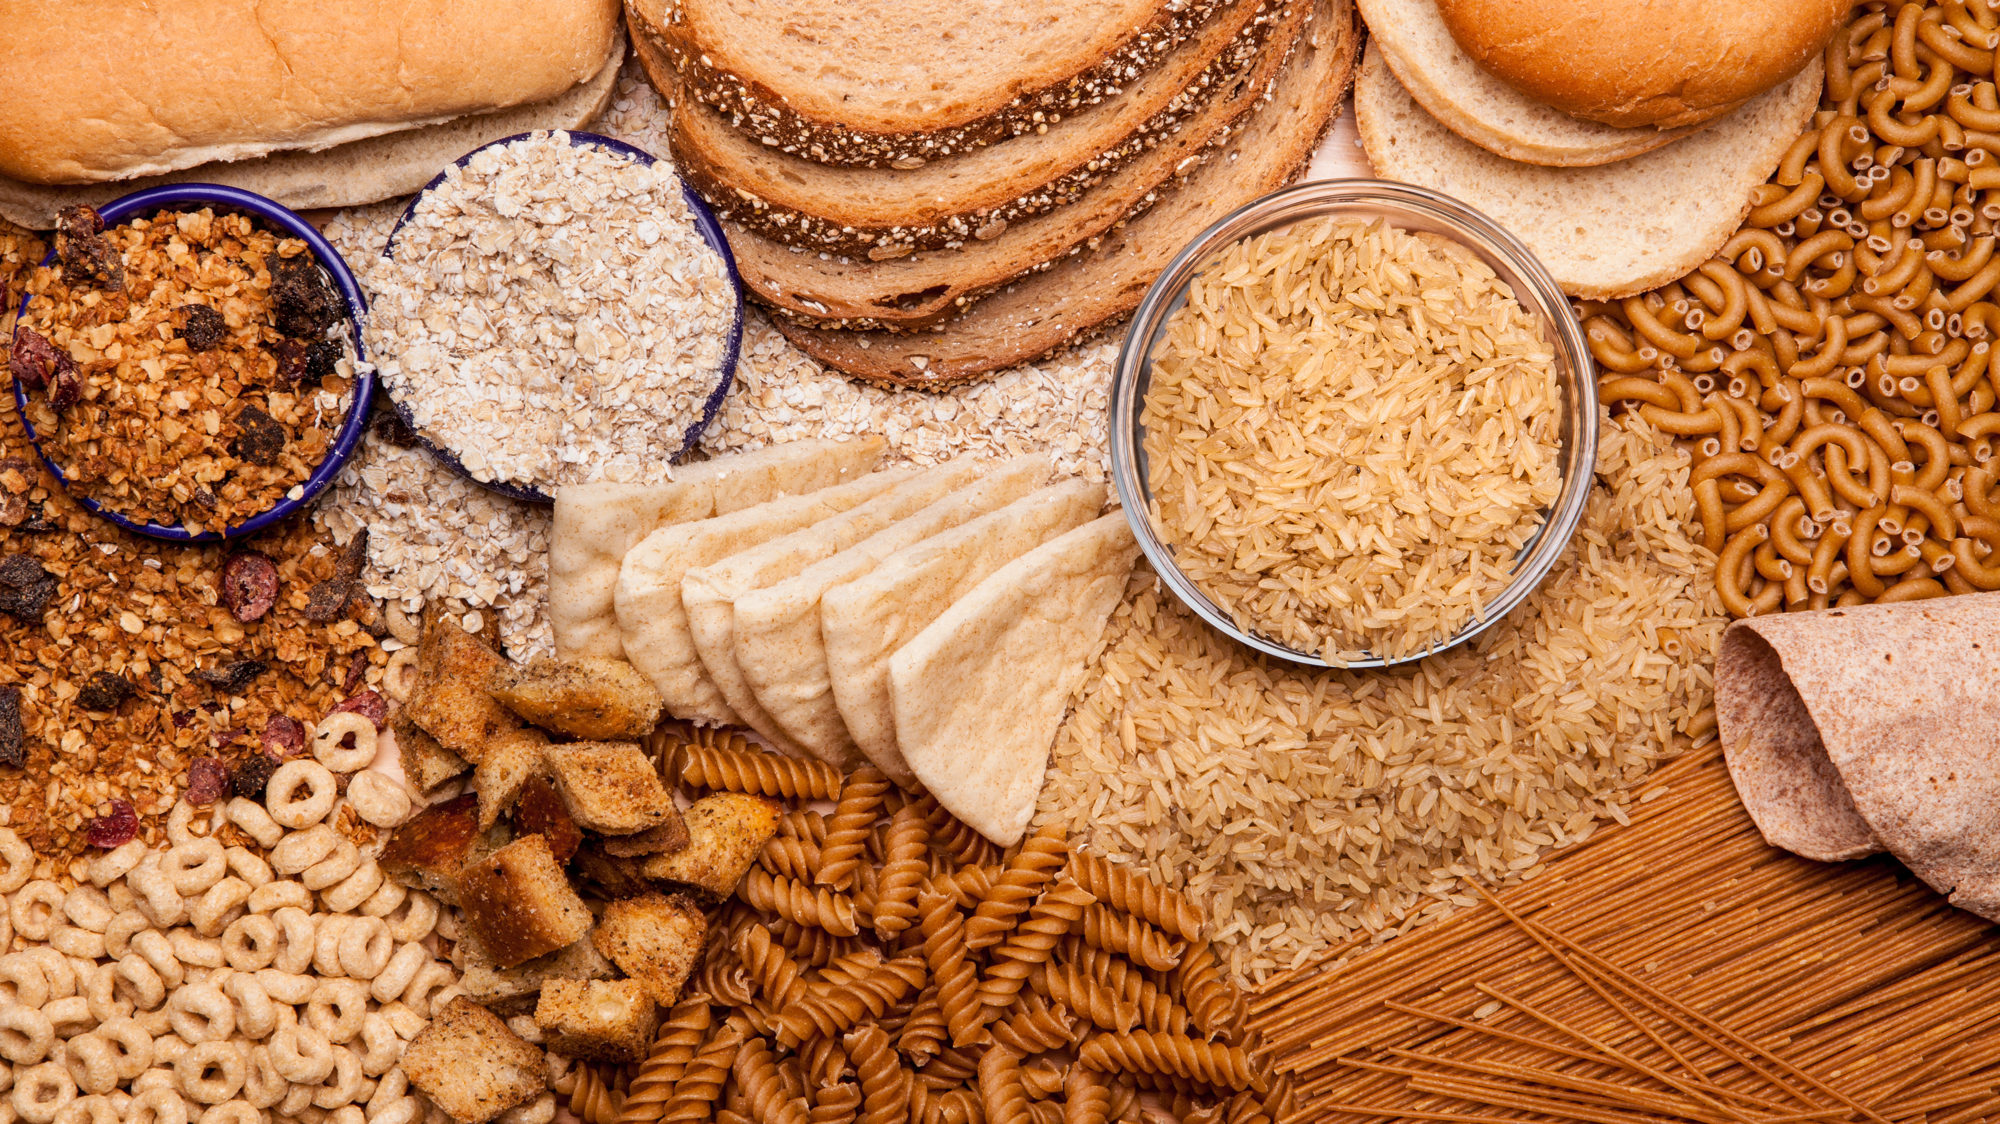
Examples of Whole Grains
Notes:
Say: Whole grains, unlike refined grains, are packed with essential nutrients and fiber, health benefits that can impact overall well-being. Let's take a look at a few examples of whole grains.
First, there are what we call intact grains, grains that we eat in their whole forms, such as rice, oats, and barley. Then, there are products that are made from processing these cereal crops into flours, such as whole grain breads and pastas.
Brown rice, oats, whole grain sandwich breads and rolls, and whole grain pasta are commonly served in schools across the country.
Ask: What whole grains are being prepared in your schools? Is anyone serving a local whole grain product? Take a minute to add them to the chat or share them by taking yourself off mute.

Slide 12
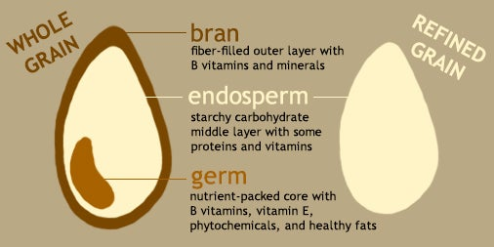
Nutrient Powerhouse
Notes:
Say: Let's take a look at why whole grains are so important. Check out this image from the Harvard T.H. Chan School of Public Health. It shows the difference between a whole grain and a refined grain.
Imagine a little powerhouse with three parts — the bran, germ, and endosperm. Each play a special role in keeping kids (and you) healthy!
Refined grains undergo a process that removes the bran and germ. Reﬁning a grain removes about a quarter of the protein, and half to two-thirds of nutrients (https://wholegrainscouncil.org/whole-grains-101/whats-whole-grain-refined-grain). All that's left is the starchy endosperm. Talk about a lot of nutrition lost! A refined grain is no longer a powerhouse. The DGA recommends that when selecting these refined grains, choose enriched grains, which means that some nutrients are added back in. Let's take a closer look.

Slide 13
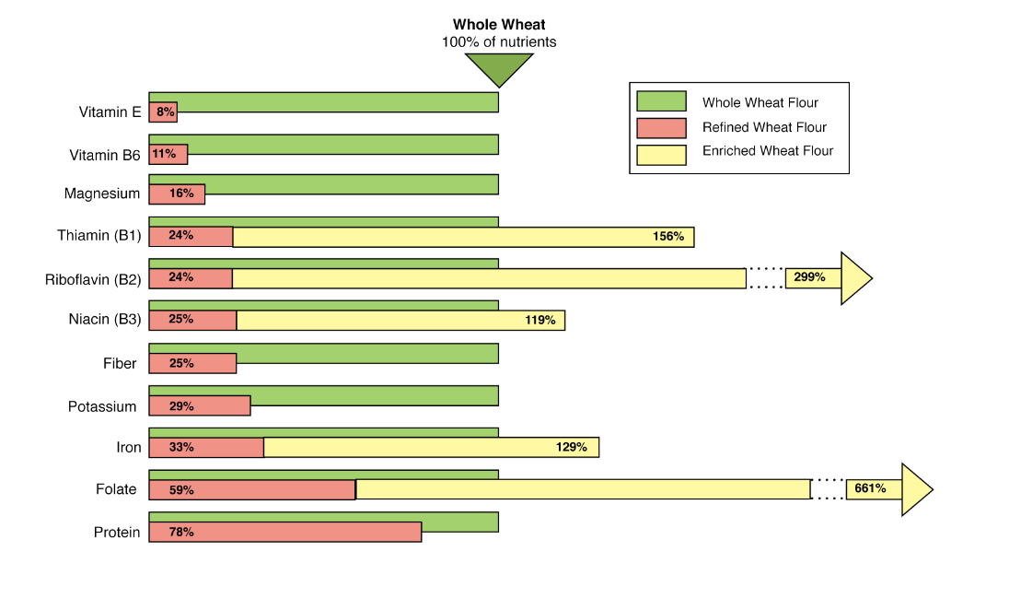
Nutrients in Whole Wheat Flour Compared to Refined and Enriched Flours
The chart shows the variety of nutrients that are found naturally in whole wheat flour (vitamin E, vitamin B6, magnesium, thiamin [B1], riboflavin [B2], niacin [B3], fiber, potassium, iron, folate, and protein). Refined wheat flour includes these nutrients in much lower quantities for most of the nutrients. Enriched wheat flour contains some but not all these nutrients (thiamin [B1], riboflavin [B2], niacin [B3], iron, and folate), and in much higher quantities.
Source: Whole Grains Council
Notes:
Say: This chart, also found in one of your handouts, displays the difference in nutrients between whole wheat flour (green), refined flour (orange), and enriched flour (yellow). As you can see, whole wheat flour contains a greater variety of nutrients. This is why the DGA recommends that we make at least half of our grains whole grain.

Slide 14
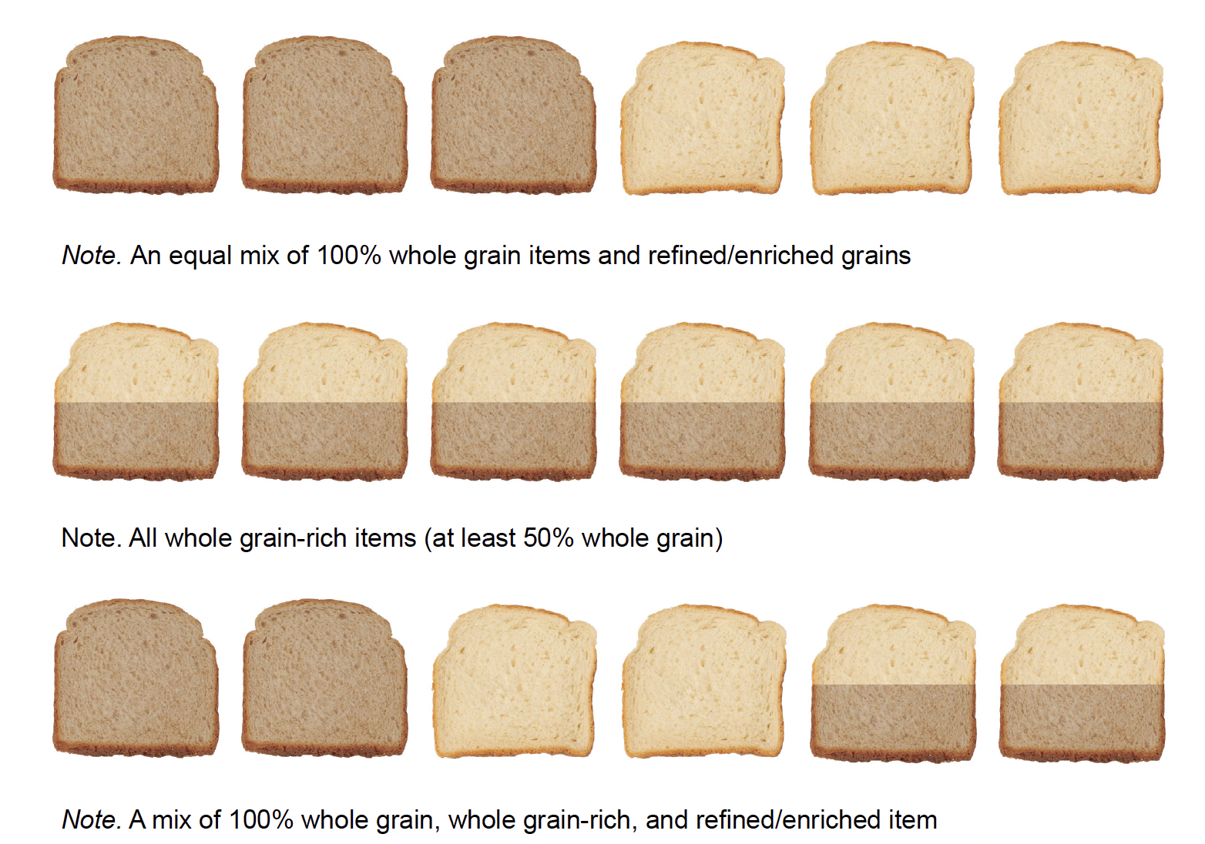
Make Half of Your Grains Whole Grain
The image shows an equal mix of 100% whole grain items and refined/enriched grains in the first row, all whole grain-rich items (at least 50% whole grain) in the second row, and a mix of 100% whole grain, refined/enriched, and whole grain-rich grains in the third row.
Notes:
Say: Here are a few ways to make half of your grains whole grain. The first row has an equal mix of 100% whole grain items and enriched grains.
In the second row, you'll see that half of the bread is shaded as whole grain. Each bread is at least 50% whole grain, like we serve in schools. We can clearly see that each piece of bread is at least 50% whole grain rich.
The last row is a little trickier. This last row has 2 100% whole grain products, 2 whole grain rich products, and 2 refined/enriched products. The 100% whole grain and refined products average out to 50% whole grains. You could look at it as together, they make 4 whole grain rich products, so we still made half of our grains whole grain.

Slide 15
Health Benefits of Whole Grains
Improve digestive health
Reduce the risk of chronic diseases
Promote weight management
Reduce inflammation
Notes:
Say: Eating whole grains can provide several health benefits and contribute to overall well-being. Whole grains help to improve digestive health, reduce the risk of chronic diseases, help with weight management, and provide anti-inflammatory properties.
The insoluble fiber in whole grains helps regulate bowel movements, prevents constipation, and promotes a healthy digestive system.
The fiber, healthy fats, vitamins, minerals, antioxidants, and phytonutrients work together to reduce the risk of chronic diseases. Whole grains can lower the risk of obesity, cholesterol, heart disease, stroke, type II diabetes, and cancer.
Ask: You don't need to raise your hand, but how many of you know someone affected by one or more of these?
Say: I'm guessing all of us!
Say: The fiber, protein, and healthy fats promote satiety and can help with weight management.
And finally, the antioxidants and phytonutrients help reduce inflammation in your body, which reduces chronic inflammation-related diseases.
After reviewing all of these health benefits, it's hard to argue against more whole grains in schools. They are so important to our health! Remember, share this information with your staff so that they understand why we are serving whole grains instead of refined.
Source: Whole Grains Council (https://wholegrainscouncil.org/whole-grains-101/health-studies)

Slide 16

Demo – Banana Split Muffin Bar
Notes:
Say: While we know whole grains provide good nutrition, as chefs, it's important that our whole grains taste good! If we take our original recipes and products and make them whole grain without any modifications, our products could fall flat (Ha!). The students would be unhappy!
Our first demo is an example of incorporating whole-grain flour with all-purpose flour. All purpose flour is a refined grain. Watch how the combination provides the nutrients we want while also keeping a delicious and fluffy final product! This recipes is also lower in sugar and sodium than a pre-made packaged muffin.
Ok, Chef, over to you!

Slide 17
Transitional Standards
80% of the grains must be whole grain rich
Notes:
Say: Thank you so much for that delicious demo!
Let's move on to the Transitional Standards. The Transitional Standards for whole grains require 80% of the grains served in school lunch and breakfast per week must be whole grain rich (containing at least 50% whole grains). Whole grain rich is a term that was actually coined for school nutrition programs.
When the Dietary Guidelines for Americans suggests making half of your grains whole grain, they mean half of your grains should be 100% whole grain or like the other ways shown in the chart we reviewed before the demo, so the transitional standards are still lower than the DGA recommendations. By serving 80% whole grain rich items, we are not making half of the grains whole grain; we fall short! Remember that when you hear complaints about too many whole grains being served!

Slide 18
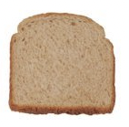
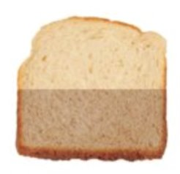

Example to Meet 80% Whole Grains
Whole Grain and Whole Grain-Rich
  Monday: 2 oz equivalent
  Tuesday: 2 oz equivalent
  Wednesday: 0 oz equivalent
  Thursday: 1 oz equivalent
  Friday: 2 oz equivalent
Enriched Grain
  Wednesday: 2 oz equivalent
  Thursday: 1 oz equivalent
Notes:
Say: Here's an example of how to make 80% of the grains whole grain rich over the course of a week. If you total the number of whole grain rich products (50% whole grain or more), you count 7. Then, we count the total number of grains. Our total number is 10.​ To see what percentage of grains we are serving for the week, we take 7/10. This would equal 70%. That's not enough.

Slide 19
Example to Meet 80% Whole Grains
Whole Grain and Whole Grain-Rich
  Monday: 2 oz equivalent
  Tuesday: 2 oz equivalent
  Wednesday: 0 oz equivalent
  Thursday: 2 oz equivalent
  Friday: 2 oz equivalent
Enriched Grain
  Wednesday: 2 oz equivalent
  Thursday: 0 oz equivalent
Notes:
Say: If the 2 oz equivalent on Wednesday is a biscuit, that we really want to keep, then we could change our Thursday 1 oz enriched to whole grain rich. Now we have 8 whole grain or whole grain rich products out of 10 grains total. 8 divided by 10 equals 80%! This will work!

Slide 20
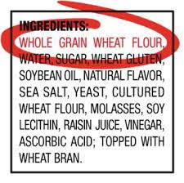
Identifying Whole Grains
First ingredient: "whole"
Notes:
Say: As you work to add more whole grain rich items to your menus, it is important to make sure you know how to identify a whole grain. To determine if a product is whole grain, you must check the ingredient list. Make sure “whole” is the first grain in the ingredient list. If it's not the first, it should be the second after the ingredient water.
But don’t stop there! Look at added sugars, total sodium, and any unfamiliar ingredients. As we discussed earlier, just because it says whole grain, doesn't mean it's healthy!

Slide 21
Culinary Canvas
Notes:
Say: Let's now talk about the culinary canvas whole grains provide!

Slide 22
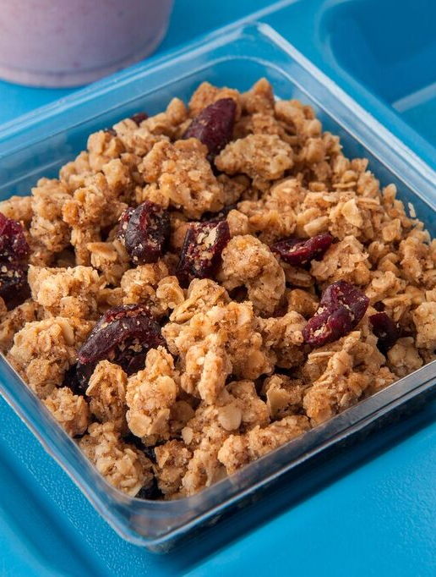

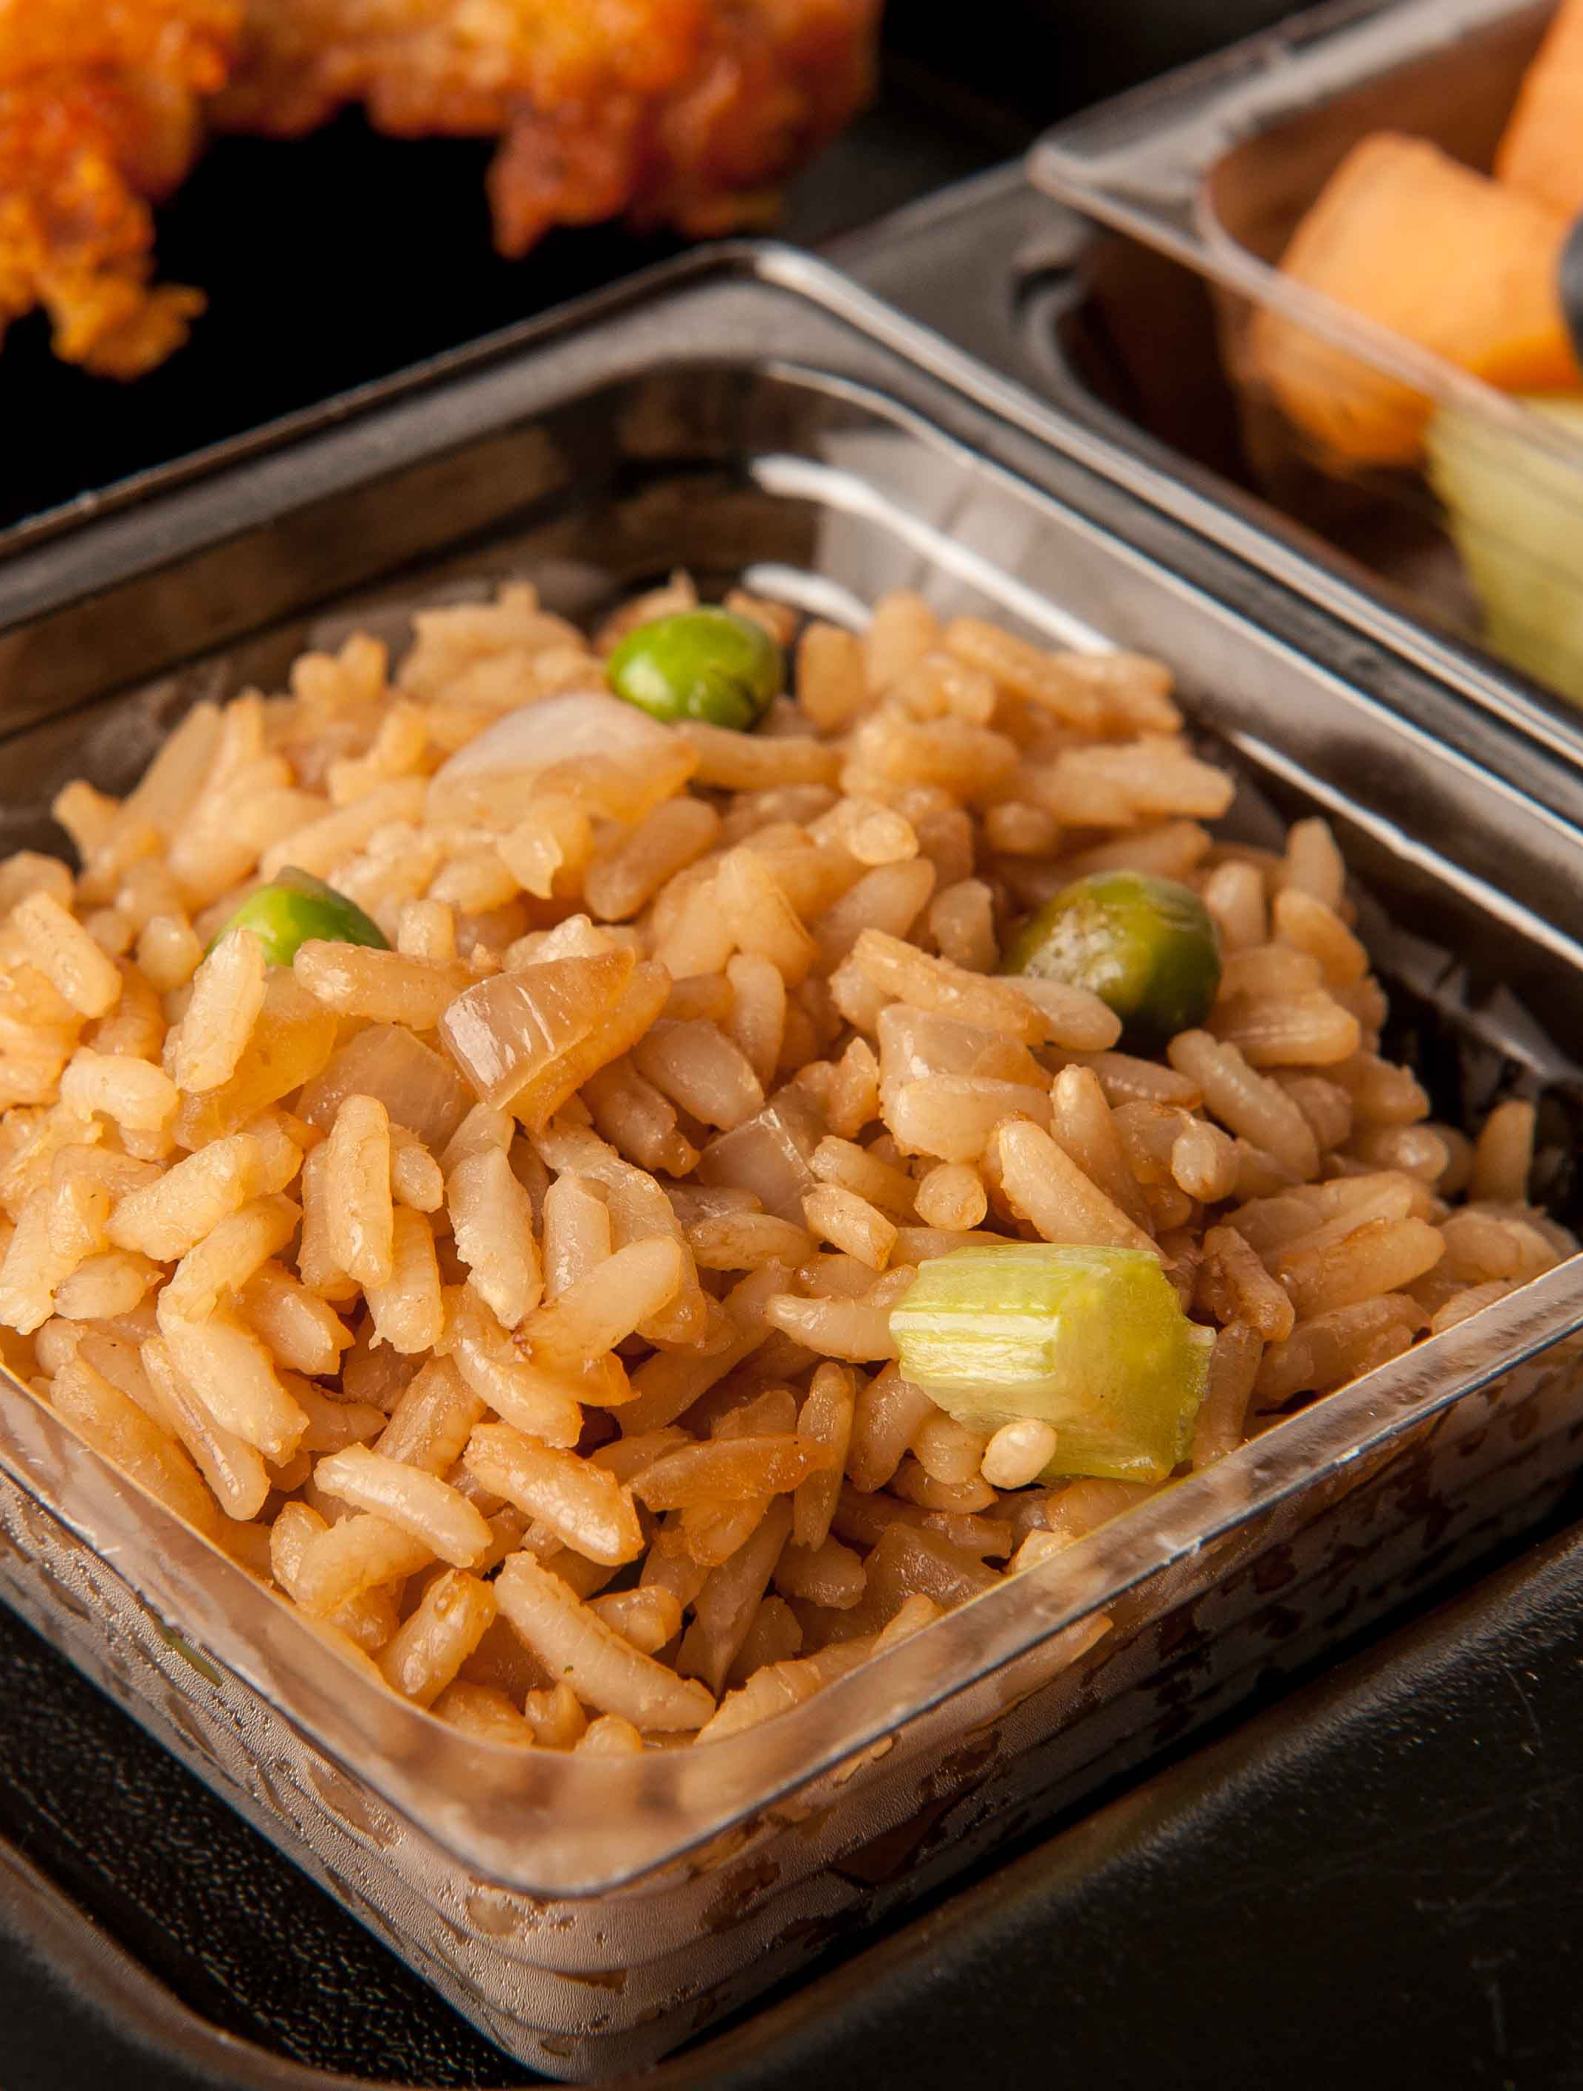
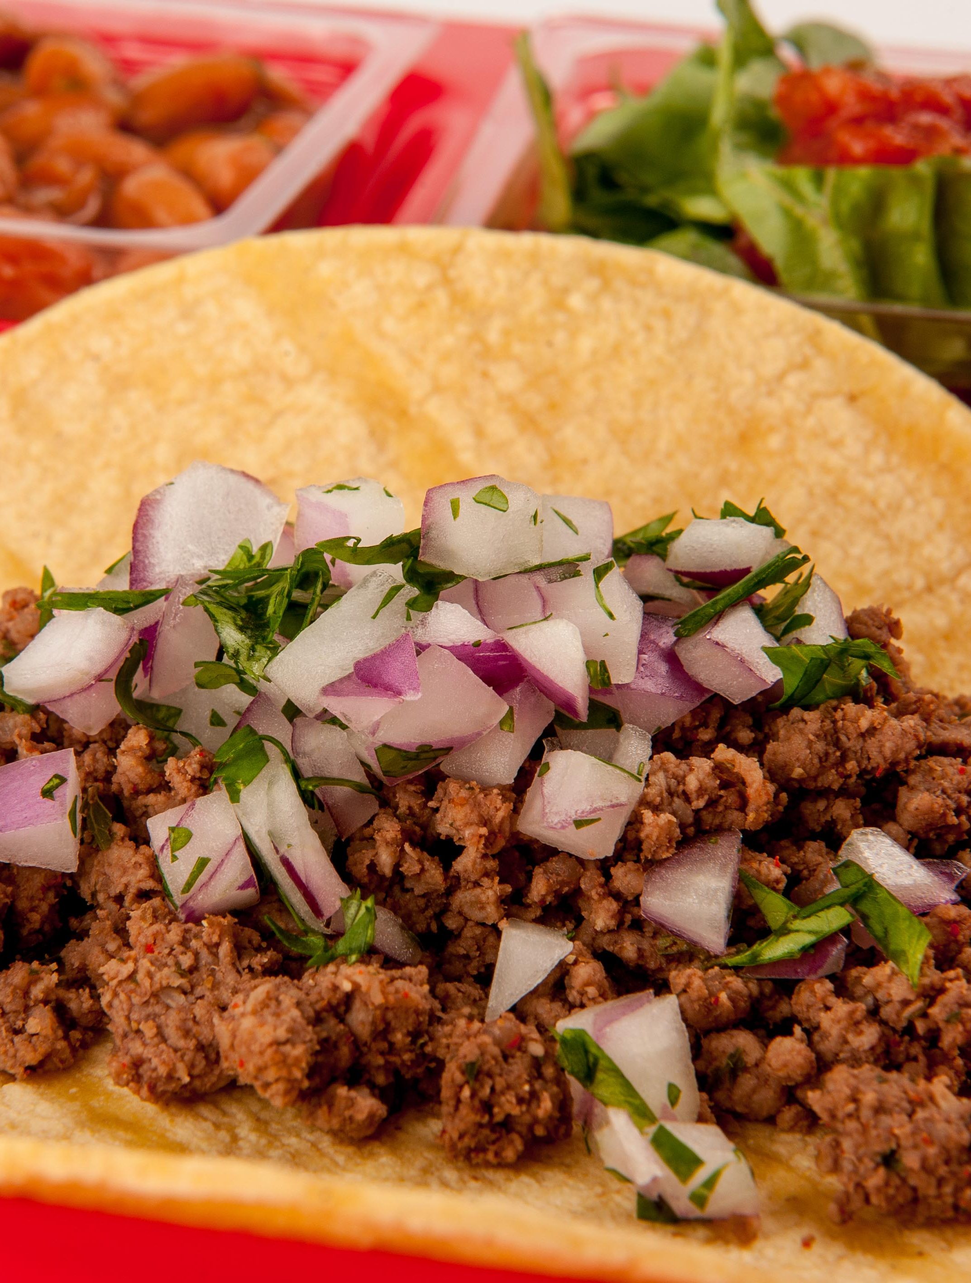
Cultural Inclusivity
Notes:
Say: Whole grains have been around for over 10,000 years and are used in many different cultures. Introducing more scratch whole grain recipes is a great way to promote cultural inclusivity. In African cuisine, sorghum, which is also gluten-free, makes porridge, bread, and couscous-like dishes. In Asian cuisine, you'll find stir-fried or steamed brown rice. European Cuisine uses oats for porridge, granola, and muesli (overnight oats in the US), and in Latin America, there's whole grain corn in “masa harina”, tortillas, and tamales.

Slide 23



Versatility
Notes:
Say: While each whole grain has its own flavor and texture, they provide a blank canvas and are perfect for scratch and speed scratch cooking. They can stand alone or be sprinkled into a dish!
Consider adding hot whole grain recipes like stir-fries, flatbreads, toast, and oatmeal to your menus. And don't forget about all of the variety of cold dishes that you can add your menus, such as pasta salad, granola, sandwiches, wraps, overnight oats, and cereals.

Slide 24
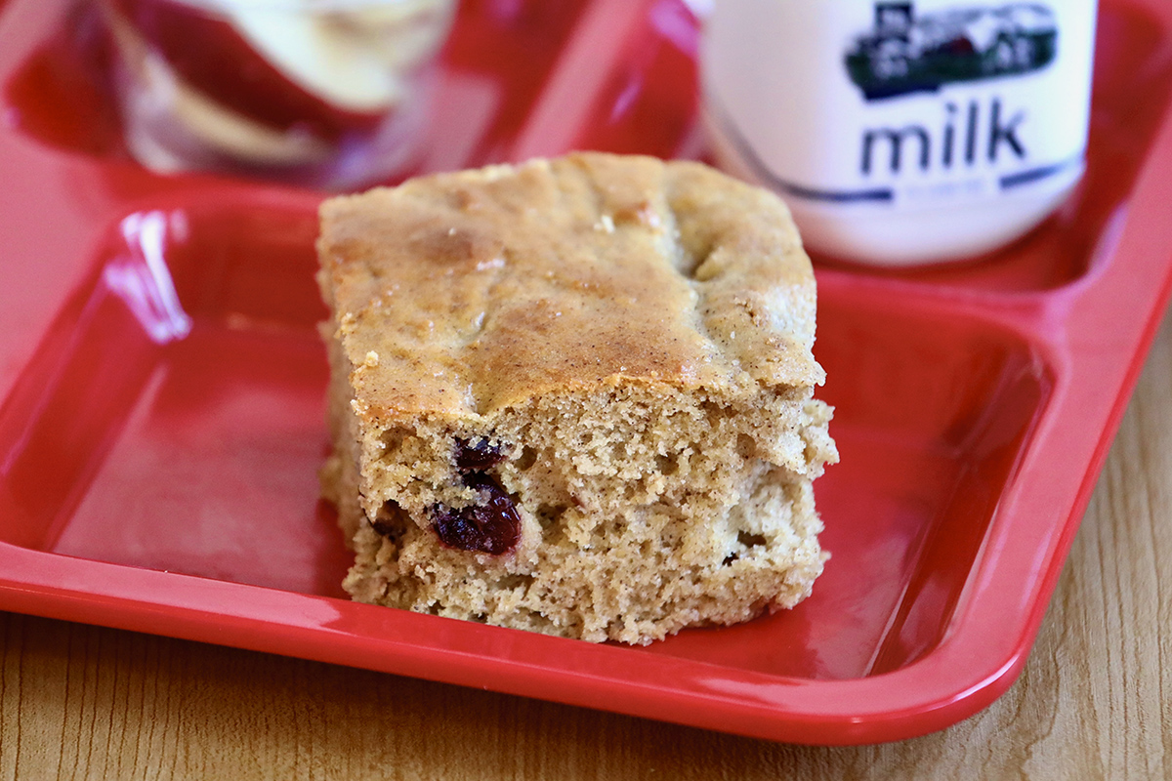
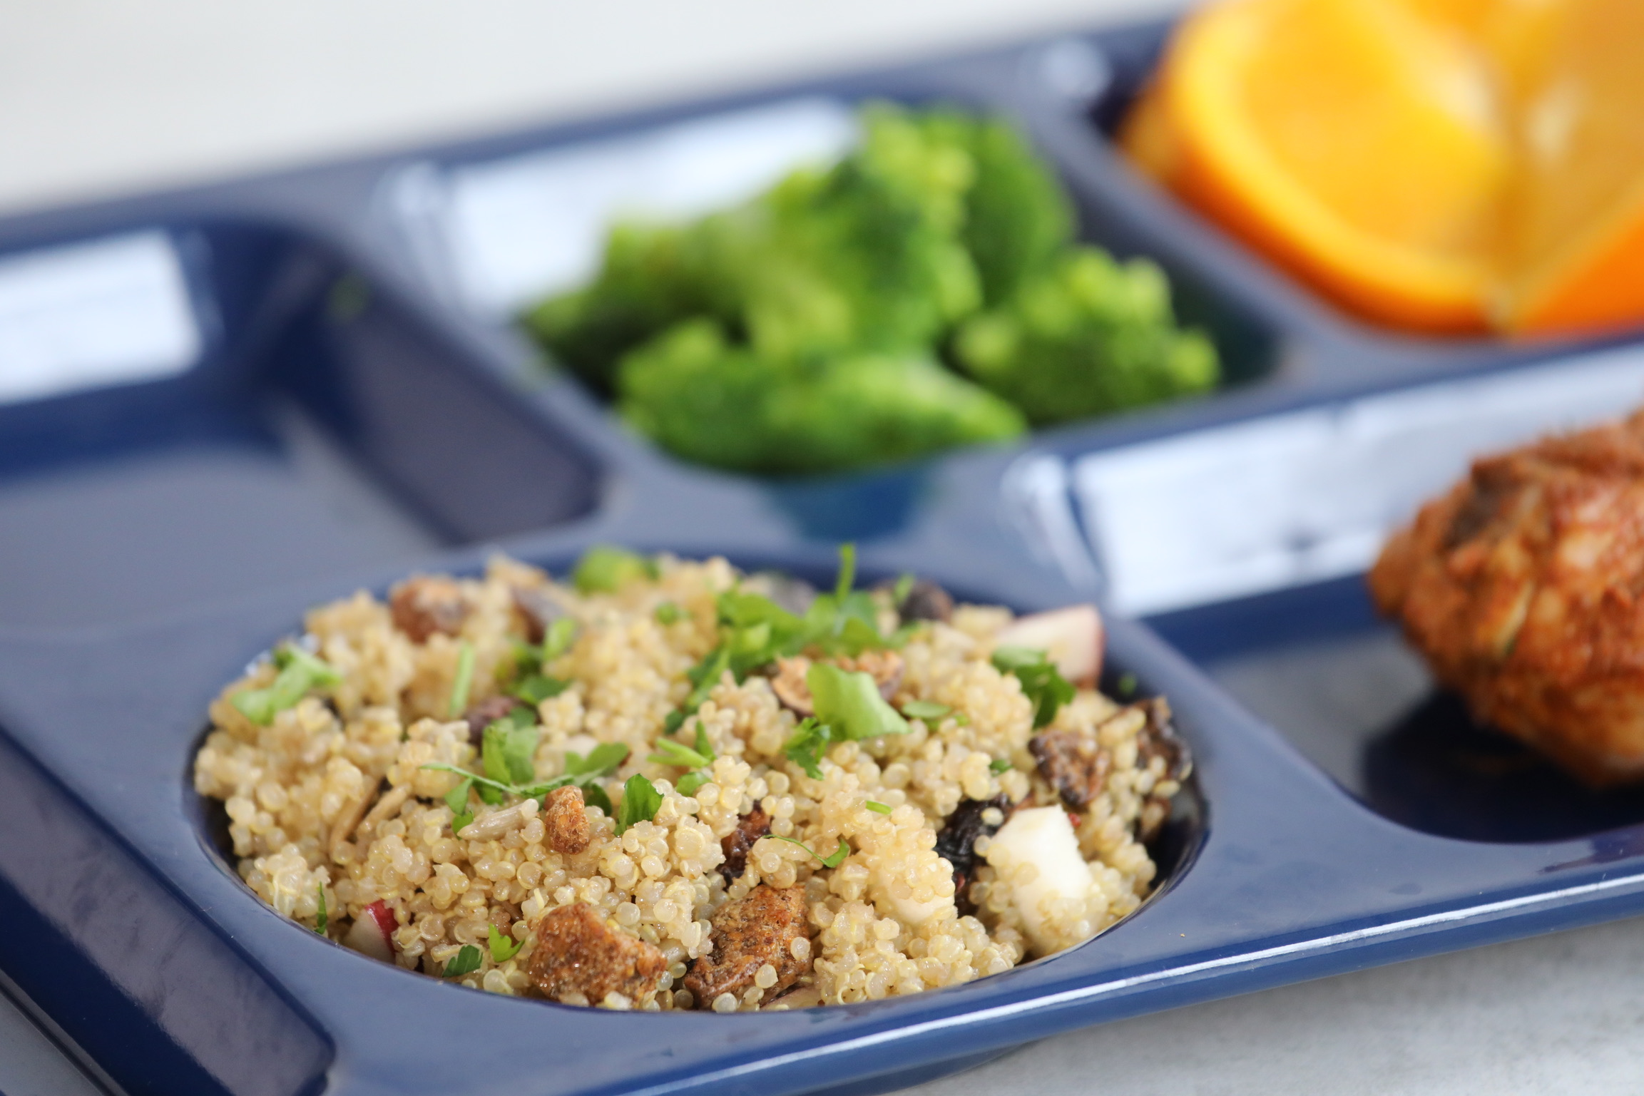
Adaptability
Notes:
Say: Whole grains can be enhanced or transformed using herbs and spices. They are also adaptable by blending flours for baking like the muffin bars as Chef V demonstrated earlier.

Slide 25

Familiarity
Notes:
Say: Most importantly to our students, grains are familiar to so many! Whole grains come in many shapes, sizes, and forms and can be used to connect less familiar foods with familiar foods. An example is with stir fry. The familiar rice or noodles can be combined with any new vegetable or meat/meat alternatives.

Slide 26

Demo – Nutty Asian Noodles
Notes:
Say: Speaking of a familiar whole grain. Chef V is going to create a Nutty Asian Noodle dish with a familiar whole grain pasta.

Slide 27
Let's chat!
What action item can you take to add more whole grains to your menus?
Notes:
Say: We are coming to the end of this webinar, but before we end, we want to ask you to think of one action item you can take to add whole grains to your menu or recipes. Once you have one in mind, please add it to the chat or unmute yourself and share with us!

Slide 28

Questions?
Notes:
Say: Thank you so much for committing to adding whole grains to your menus and recipes.
Ask: Does anyone have any questions?

