Slide 1

Local Food Procurement
Notes:
SAY: Good afternoon, everyone! It’s so great to see you today. Welcome back and Happy New Year! I’m Beverly Girard, and I am happy to present today with my friend, Chef Cyndie Story. Our goal today is to foster ideas, share resources, and encourage you to increase local food procurement in your divisions that support scratch cooking and culturally inclusive meals. We will present practical and useful information for you to begin, or expand, your school division’s local food purchases.

Slide 2
USDA Funding and Non-Discrimination Statements:
“This project has been funded at least in part with Federal funds from the U.S. Department of Agriculture. The contents of this publication do not necessarily reflect the view or policies of the U.S. Department of Agriculture, nor does mention of trade names, commercial products, or organizations imply endorsement by the U.S. Government.”
In accordance with federal civil rights law and U.S. Department of Agriculture (USDA) civil rights regulations and policies, this institution is prohibited from discriminating on the basis of race, color, national origin, sex (including gender identity and sexual orientation), disability, age, or reprisal or retaliation for prior civil rights activity.
Program information may be made available in languages other than English. Persons with disabilities who require alternative means of communication to obtain program information (e.g., Braille, large print, audiotape, American Sign Language), should contact the responsible state or local agency that administers the program or USDA’s TARGET Center at (202) 720-2600 (voice and TTY) or contact USDA through the Federal Relay Service at (800) 877-8339.
To file a program discrimination complaint, a Complainant should complete a Form AD-3027, USDA Program Discrimination Complaint Form which can be obtained online at: https://www.usda.gov/sites/default/files/ documents/ad-3027.pdf, from any USDA office, by calling (866) 632-9992, or by writing a letter addressed to USDA. The letter must contain the complainant’s name, address, telephone number, and a written description of the alleged discriminatory action in sufficient detail to inform the Assistant Secretary for Civil Rights (ASCR) about the nature and date of an alleged civil rights violation. The completed AD-3027 form or letter must be submitted to USDA by:
1. mail:
U.S. Department of Agriculture
Office of the Assistant Secretary for Civil Rights
1400 Independence Avenue, SW
Washington, D.C. 20250-9410; or
2. fax:
(833) 256-1665 or (202) 690-7442; or
3. email:
Program.Intake@usda.gov
This institution is an equal opportunity provider.

Slide 3
Welcome!
Notes:
SAY: As we go through today’s webinar, the chat box is open for any questions and comments. We learn a lot from each other during these times together. Please feel free to comment and ask questions in the chat anytime! We will monitor the chat box together throughout this hour and would love your input and feedback. Remember, having your camera on builds personal connections, and to be honest, we just love to see your faces!

Slide 4

Objectives
Define local food procurement
Explain how to get started and how to enhance local food procurement
Identify opportunities to partner with farmers and other divisions to promote the use of local foods in school nutrition programs
Review and document food safety practices
Identify local food procurement resources
Notes:
SAY: Let’s review today’s objectives:
Define local food procurement.
Explain how to get started and how to enhance local food procurement.
Identify opportunities to partner with farmers and other school divisions to promote the use of local foods in school nutrition programs.
Review and document food safety practices.
Identify local food procurement resources.

Slide 5
Farm to School Procurement: Types of Local Food
Apples
Aquaculture
Broilers
Cattle and calves
Corn
Cotton
Cucumbers
Dairy
Grapes
Green beans
Hay
Hogs
Peaches
Potatoes
Pumpkins
Sheep and lamps
Soybeans
Tomatoes
Turkeys
Watermelon
Notes:
SAY: When people think of local food procurement, the first thing that comes to mind for many is the purchase of local fruits and vegetables. However, there are all kinds of foods that can be purchased locally. We have included the link to this interactive map of Virginia Grown. If you purchase your milk from a local dairy that processes and sources milk from within your local radius, you are already buying local. So, how exactly do you define local?
Interactive Map: https://www.virginia.agclassroom.org/teachers/map/

Slide 6

Farm to School Procurement: Definition of Local Food
Farm
You decide!
Notes:
SAY: As you know, school nutrition has lots of important rules and regulations, but when it comes to local food procurement, you, as the director of your school division’s program, get to decide how you define local. You may decide to define local as food purchased within your own county, or from surrounding counties. Some school divisions define “local” as foods purchased within a 50 mile radius, while others consider foods from anywhere in the state local. If you border another state, such as Maryland, Kentucky, North Carolina, West Virginia, or Tennessee, your local foods may actually come from another state!

Slide 7
Let’s hear from you!
What types of local food do you currently purchase?
  Fruit
  Vegetables
  Grains
  Dried peas, beans, legumes
  Meat (beef, pork, poultry)
  Fish
  Fluid milk or other dairy items
  Eggs
  Nothing yet, but tell me more!
Notes:
Do: Run poll on Zoom.
SAY: The types of foods procured locally can be from every component of a school meal. What are the types of local food purchases you currently make for your school division? Let’s take a moment and respond to this polling question. (pause for responses to register)
Read question: While the poll is up, please answer this question….what types of local food do you currently purchase? You can click on more than one type of food. Please take your time to answer. Are you buying fruits and vegetables? Is anyone out there buying grains? We know you are buying milk, so maybe this truly is your first step to local procurement! Chef Cyndie, I can think of a wonderful local food in Virginia - I wonder if anyone is buying local fish?
SAY: As the responses come in, let’s take another look at this extensive list. As you can see, there are many opportunities for local purchases. We really are interested to see how much local purchasing occurs in your divisions!
Do: Review numbers/percentages from each category, and comment accordingly. (note: if someone mentions fish, please make a big deal out of it!)

Slide 8
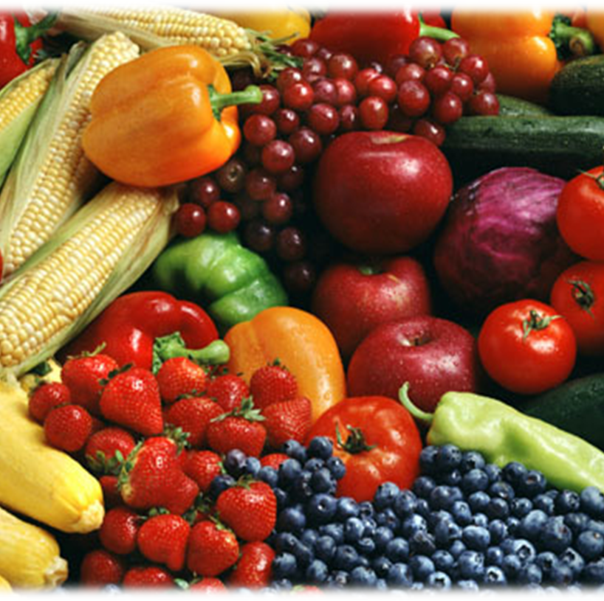
Purchasing Local Food for the Whole Tray
Locally grown fruits and vegetables
Pulaski County sources beef from local ranchers
Prince William County sources local tortilla chips
Notes:
SAY: As we mentioned, many school divisions start their adventure into local food purchases with locally grown fruits and vegetables, but local procurement is definitely not limited to produce.
Some divisions have incorporated local proteins, including beef, chicken, and cheese, as well as locally produced whole grain items. For example, Pulaski County, and other divisions in Virginia, have been sourcing local beef from area ranchers.
Other divisions purchase pre-made foods from local manufacturers, such as Prince William County, who purchases delicious local tortilla chips.

Slide 9
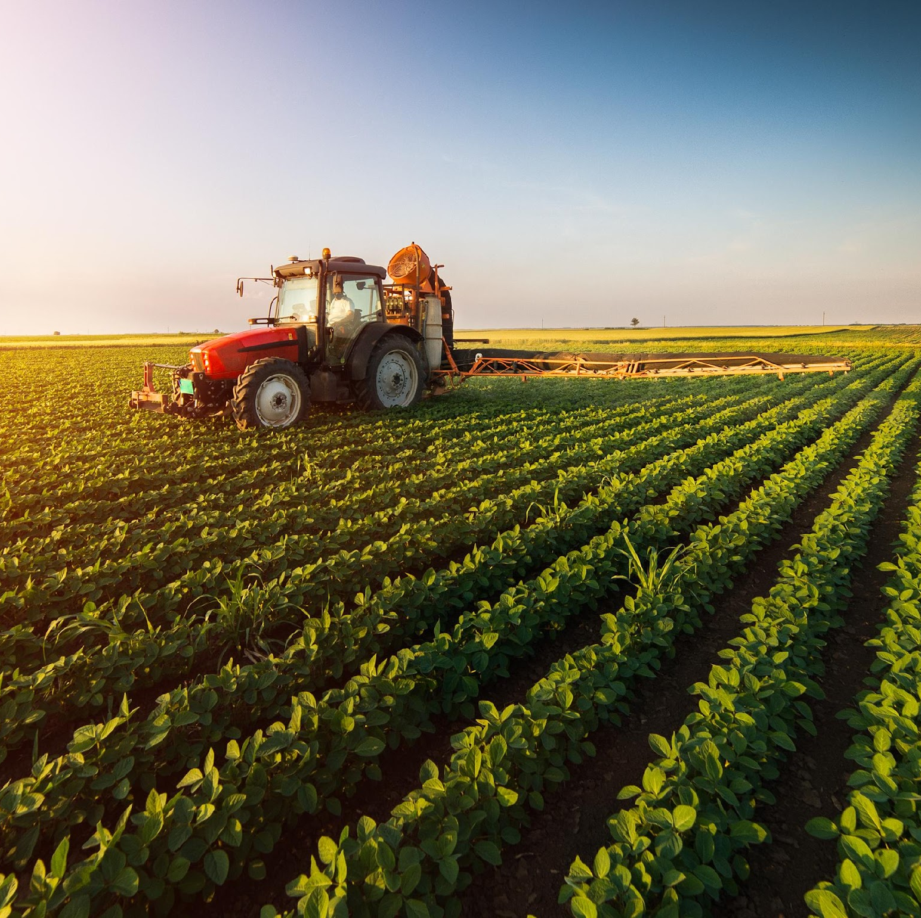
Time to chat!
Where does your local food come from?
Notes:
SAY: Let’s take a moment once again to hear from you. The poll question was an overview of the types of foods purchased locally. Now, let’s weed out (pun intended!) the specifics. We just provided a few examples of local food purchasing practices, but would like to know more about who and where you purchase your local food from.
Please go to the Chat Box and share your local food purchase information. Write in your division name, the foods purchased, and where you procure the foods, so that you can share with neighboring divisions. Let’s really take this opportunity to learn from each other!
DO: Make a big deal about the local purchases.
SAY: We will share the chat box responses as a pdf after the webinar.

Slide 10
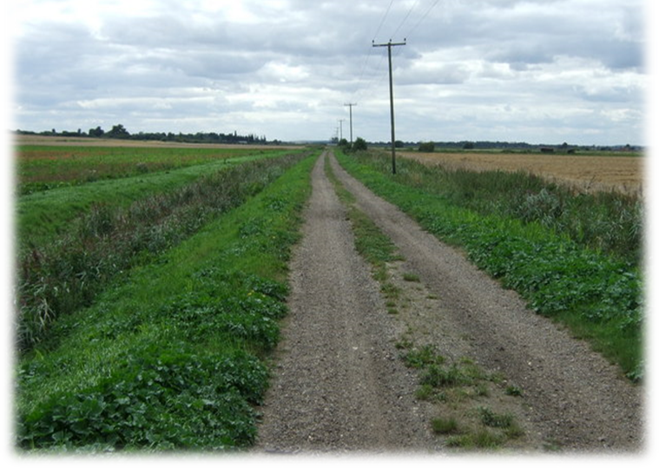
Expanding Local
Building a division’s Farm to School Program and local food procurement
Notes:
SAY: Next, let’s dig in to how to get started or how to expand. Dig in, get it? Over the last few years, the benefits of local food purchasing has been widely discussed, such as supporting the local economy, nutritional benefits, and our customers desire to know where their food comes from. Some of you may be asking, “This all sounds great, but how do I get started?” or, “I procure some items locally, but I am very interested in expanding local sources.” As you know, the local food movement is big in Virginia and is supported by the Virginia Food for Virginia Kids initiative. Just think about the local restaurants and well-known chefs who use, and praise, local foods. We can do the same!
States with year-round growing seasons like Arizona, California, and Florida with growing and harvesting seasons that closely mirror school calendars, are hotbeds, if you will, of Farm to School produce and the opportunity to purchase local foods. However, Virginia does not have the same harvesting and growing seasons, but much further up the map of the United States, Vermont has one of the most successful and sustainable Farm to School programs in the country! How do they do it? They plan, communicate, and utilize greenhouses and hoop houses to grow foods they wouldn’t otherwise have access to. In other words, there is no “one size fits all” approach, rather, “find what works for you, and make it happen!”

Slide 11
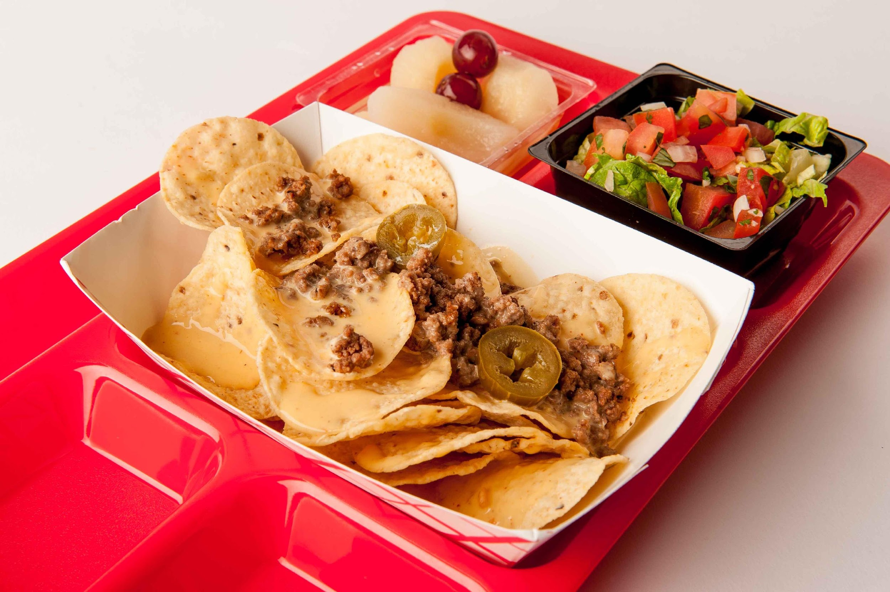
Incorporate Local Foods into the School Nutrition Program
Start with the menu!
Utilize larger amounts of local in main dishes and sides
Use existing recipes to maximize locally procured foods
Modify recipes to include local, based on availability and/or seasonality
Expand menu offerings
Incorporate locally grown items into the Fresh Fruit and Vegetable Program
Notes:
SAY: The very best place to determine how to use local foods in your school nutrition program starts with a review of your current menu. What are you already serving that could be purchased locally?
As divisions start to purchase locally and see the benefits, they tend to expand the procurement of local items to include foods for center of the plate main dishes, and sides. Existing recipes can be used to maximize locally procured foods. Recipes can be modified based on availability or seasonality of foods, such as using fresh Virginia apples instead of canned apples for Apple Crisp, as the slide suggests, or increasing culturally inclusive foods, such as a delicious Pico de Gallo. The FFVP is a fantastic way to introduce students to locally grown produce. Again, all food categories can be procured locally, depending on the availability of foods in your area!
You might also start to see some very interesting patterns, such as the impact of seasonal availability on food prices. Does it make sense to menu watermelon in December, or strawberries in October? No, it really doesn’t – not from a price perspective, or a seasonal availability standpoint. Buying local increases your awareness of what food is available, and when it’s available at the best quality and price.
Pictured: Spicy beef nachos (local beef) and fresh pico de gallo (Hanover tomatoes)

Slide 12
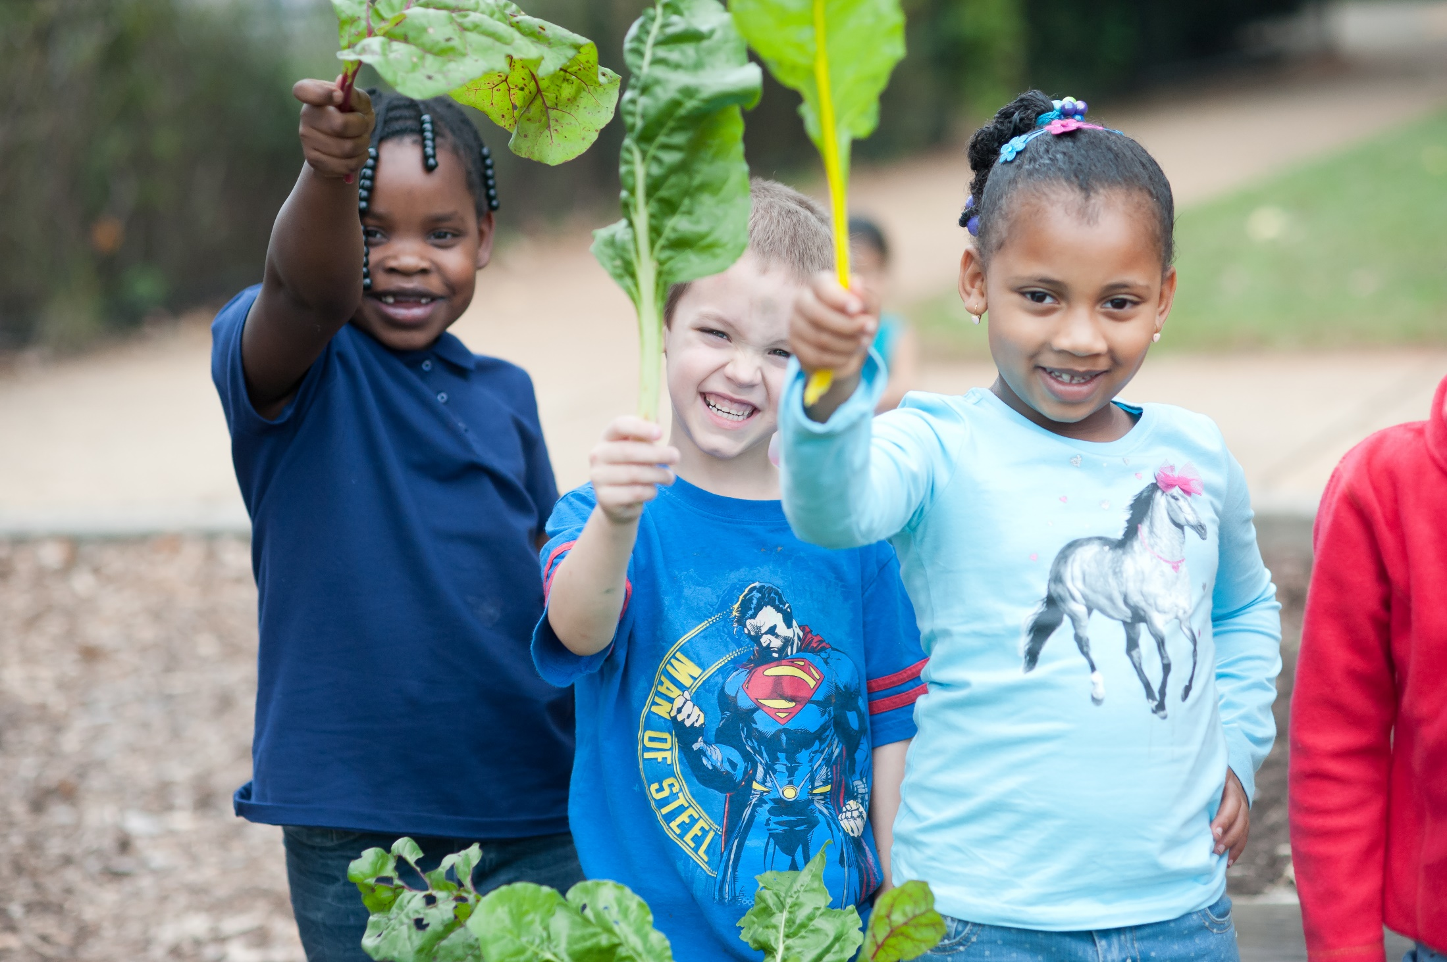
Incorporating Local Foods into the School Nutrition Program
Nutrition education opportunities:
  Harvest of the Month
  Taste tests
  Smoothie bikes
  School gardens
  Farm visits
  Farmer in the classroom and/or cafeteria (Farm to School Day)
  Virginia Farm to School Week
Notes:
SAY: Numerous educational opportunities exist for local foods. Harvest of the Month is a great way to learn about local foods, where they are grown, and the excellent nutrition local foods provide. Taste Tests encourage students to try new foods they may be unfamiliar with. Activities, such as a Smoothie Bike, where a bike powers a blender, can be lots of fun for kids! School gardens help students REALLY learn where food comes from when kids plant and harvest their food. Extra fun activities, such as farm visits, a farmer in the classroom, or farmer guest server can easily be integrated into nutrition education. How about a Farm to School Day, where students and staff dress as farmers, with nutrition education lessons about locally grown foods? The ideas are endless! Last, but certainly not least, is Virginia Farm to School Week, which is always the first full week of October each year. So many opportunities to explore!

Slide 13
Let’s Chat!
Based on your current menu and existing recipes, what specific produce items could you procure in January?
  Apples
  Beets
  Cabbage
  Carrots
  Carrots (rainbow)
  Celery Root
  Collard Greens
  Fennel
  Garlic
  Kohlrabi
  Leeks
Potatoes
Radishes (Red, Watermelon, Purple Daikon)
Rutabaga
Salad Mix (Hydroponic)
Spinach
Sunchokes
Sweet Potatoes
Swiss Chard
Tomatoes (Hydroponic)
Turnips
Winter Squash
Notes:
SAY: Based on your current menu and existing recipes, what specific foods could you incorporate to expand your local food purchases? For example, the Virginia Harvest of the Month program offers a recipe for Zesty Breakfast Potatoes that could utilize locally grown potatoes. On the screen is list of items included in the Virginia Seasonality Availability Calendar that is available on the Virginia Farm to School website. What else could you buy locally to incorporate on your Virginia January menu? Please go to the chat box and indicate your Division name and foods you could buy this month and include on your menu. Check out the Zesty Breakfast Potatoes recipe on the Virginia Harvest of the Month website.
Link to Virginia Farm to School website: https://www.doe.virginia.gov/programs-services/school-operations-support-services/school-nutrition/programs-promotions-and-initiatives/virginia-farm-to-school
Link to Virginia Harvest of the Month: https://www.doe.virginia.gov/programs-services/school-operations-support-services/school-nutrition/harvest-of-the-month-program

Slide 14
The 4 P’s for Local Procurement
Plan
Purchase
Prepare
Promote
Notes:
SAY: Wasn’t that easy to incorporate local on your menu? Now, how do we make the purchase? First, you plan. The planning stage is where a lot of your initial conversations will take place. These conversations could include meetings with your staff to review the menus and recipes, forecasting and establishing volume needs, and reviewing specific policies and procedures that might need to be developed or modified. Ask yourselves some questions: What is your kitchen capacity, such as available storeroom, cooler space, and do you have the kitchen equipment needed to process or cook the food? Will whole produce be accepted, or must it be minimally processed for your operation? Will you accept raw meat, or will only pre-cooked meat be allowed in your operation? Lastly, what type of staff training will be needed, if any? Planning also involves discussions with local producers and partners to determine availability. The Virginia Farm to School Toolkit includes helpful resources to get you started on building a farm to school team, addressing food safety with producers, and building the foundation for a strong farm to school program. Plans take time, but the effort pays off.
Then comes the purchase stage. This stage is where specifications are written, bids or proposals are advertised and received from qualified suppliers, and business practices such as how invoices are issued and payment schedules are communicated to potential partners. (note, we cover more in the next few slides)

Slide 15

Incorporating Local Food Purchases into the Procurement Profile
Calculate statistical budget information
Describe demographics and operational details
Identify key purchasing initiatives
Define sales calls policy
Notes:
SAY: The Procurement Profile is an introduction to the school division’s purchasing requirements, including any restrictions or preferences held for products and services. The procurement profile can be in the introductory paragraph of a solicitation or can be designed as a cover sheet or as part of an RFI to increase the likelihood of receiving products that meet the minimum product requirements.
The VDOE has a Procurement Profile template for divisions to use. As business leaders of your operation, you must be able to describe aspects of your operating budget, purchased food budget, and the food cost per meal by category, such as entree, fruit, vegetables, grains and milk. It is very important to know this level of detail before asking other potential partners to do business with you. School information is also included on the profile, as well as participation data. Importantly, there is a section for you to describe your program goals, called key purchasing initiatives, which gives you the opportunity to communicate issues that are very important to you, such as giving preference to Virginia grown foods and products grown using sustainable practices. The form will also help you define delivery requirements, such as delivery sites and frequency. Communication with your potential local partners will be greatly enhanced when you get all of your program’s information together before you enter into exploratory conversations.
Interested in learning more about Procurement Profiles? Check out eModule 17.2 on the VDOE Training Hub.
Link to VDOE-SNP Training Hub: https://vdoelearning.catalog.instructure.com/courses/vdoe-snp-training-hub

Slide 16
Let’s hear from you!
Do you have a procurement profile that incorporates details such as school information, participation data, and specific local foods desired for your farm to school program?
Yes
No
In Progress
Notes:
Do: Run poll on Zoom.
SAY: Take a moment to answer this question regarding the Procurement Profile. Do you have a procurement profile that incorporates details such as school information, participation data, and specific local foods desired for your farm to school program? Simply answer yes, no, or in progress if you are in the process of completing it. The poll results will be shared by category, not individually.

Slide 17

Hot Potatoes - Planning!
Complete Procurement Profile
Review cycle menu and identify local items to buy
Forecast quantity
Identify storage procedures/space/additional equipment for production
Notes:
SAY: Let’s go back to the buying local potatoes example and walk through the 4 Ps of local procurement: planning, purchasing, preparing, and promoting stages.
Let’s start with planning. Take a look at the important information to consider during the planning stage.
SAY: (from slide)
Let’s start with the Procurement Profile to get all of your important information in one place.
Review your cycle menu and identify the local items you want to purchase. We realize that not only can we buy local potatoes for breakfast, we can use them for roasting and roasted red potato salad!
Next, you need to forecast quantities of foods you are interested in purchasing. You have to know how much you are going to need, right? And let me add, if you forecast and notify vendors of the quantity you are going to buy, then you MUST buy that amount. We have a terrible reputation for committing to quantities and leaving the vendor holding the bag, which costs vendors big money and decreases trust and the likelihood that you will pay a higher price in the long term.
Identify storage procedures, space, and any additional equipment you may need for processing and production. Be sure to keep a couple of things in mind. Always store potatoes above 55 degrees. Cold temps turn the starch to sugar and cause it to be mealy. Regarding storage procedures, space, and equipment needed - how do you plan to prepare the potatoes? If you are dicing in quantity, you need a food processor; to make wedges, you can use a Sunkist sectionizer. Also, will they be cooked in an oven, a tilt skillet, a steamer? Russet potatoes don’t steam well, but red potatoes steam like a dream.

Slide 18

Hot Potatoes - Planning! (Continued)
Identify local source(s) that meet your needs
  Virginia Food Market Maker
    See resource handout
  Cooperative Extension
    See resource handout
  Identify other divisions or organizations (colleges/universities, hospitals, and restaurants) buying local in your area
Identify distribution/transportation channels
  Producer, distributor, Food Hub or Cooperative
Notes:
SAY: (from slide)
Identify local sources - there are a number of resources available to help you identify local sources and we have put together a handout for you. The Virginia Food Market Maker can help you connect directly with local growers, buyers, processors, Farmers Markets and more. The Cooperative Extension is an amazing resource to help you find farmers in your area. And finally, there may be other organizations in your area, such as colleges or universities, hospitals, or local restaurants that have agreements with local suppliers, and may be looking for partnerships to increase their volume and buying power.
Identify distribution/transportation channels - will you be dealing directly with the producer to deliver products, or will the volume warrant the use of a distributor? Do other like-minded groups exist that you can partner with, such as a Food Hub or Cooperative of other divisions?
TASK: In your experience, and we value your input here, what information would you include in the planning stage? We specifically want to hear success stories or challenges around identifying local sources and transportation channels. Feel free to write in the chat or if it’s easier, please unmute and share so we can all learn.
Link to Virginia Market Maker: https://va.foodmarketmaker.com

Slide 19
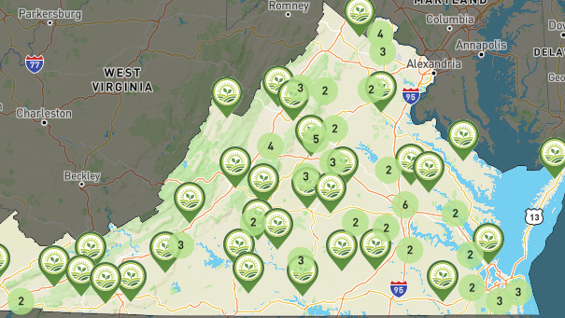
Hot Potatoes - Planning!
Notes:
SAY: Using the Virginia Market Maker, look at how many local farms in the Commonwealth of Virginia grow potatoes!

Slide 20
The 4 P’s for Local Procurement
Plan
Purchase
Prepare
Promote
Notes:
SAY: The next step of procurement is purchasing process.

Slide 21
Hot Potatoes - Purchasing!
Write or work with your purchasing department to develop the solicitation/boilerplate
Remember to include information such as:
  Number of schools or delivery sites
  Delivery windows
  Payment terms
  Food safety requirements
  Liability insurance
  What else?
Notes:
SAY: Take a look at the important information to consider during the purchasing stage. Using information from your purchasing profile, you can start to write the solicitation, including the boilerplate, which describes the expectations and requirements you have of your local producer. Examples may include information such as the number of schools, delivery windows, payment terms, food safety requirements, liability coverage insurance…essentially everything your partners need to know to agree to a contract and do business with you. Can you think of anything else you need to remember to include? ? (Write in the chat box or unmute)

Slide 22

Spec Your Tubers!
Write specification; consider:
  Size
  Type/variety
  Quality, condition (may use U.S. Grade Standards)
  Cleaned and/or trimmed requirements
  Type of packing
  Size of container, weight of container, type of container
Notes:
SAY: Next, write your specification to include detailed information such as size, type/variety - Virginia grows golds, reds, Russets and whites. Reds, golds and whites have a higher moisture content and thin skins so they tend to breakdown or rot quickly. Russets are lower moisture and thicker skinned which is why you see more of them in the Winter months – they are good for storing. Also, reds are going to hold up a bit better during roasting than golds or whites. You also need to include what quality, condition you will accept – as an option, you may use U.S. Grade Standards which are available on the USDA Agricultural Marketing Service – AMS website. Other requirements include cleaned and/or trimmed expectations, type of packing, size of container, weight of container, i.e., 25 versus 50 lb cardboard box), and food safety practices. Chef Cyndie will cover on-farm food safety shortly. Write in the chat box if you know the difference between Quality defects and Condition defects. Answer: quality defects are those that happen on the farm; condition defects are those that occur during shipping and storage. For example, a growth scar is a quality defect; decay is a condition defect. You as the buyer have to decide what you will and will not accept. The USDA’s Procuring Local Food for Child Nutrition Handbook dives into building strong product specifications to get the items you need for your program.

Slide 23
Hot Potatoes – Purchasing! (Continued)
Determine Procurement Method
  Micro-purchases up to $10,000
  Simplified Acquisition Threshold up to $200,000
  Sealed Bids (IFB’s) and Requests for Proposals when costs exceed $200,000
Notes:
SAY: A few words about procurement methods. Most importantly, your procurement methods must comply with federal, state, and local thresholds, whichever is the most restrictive. Micro-purchases allow a division to purchase in amounts of up to $10,000 or the threshold established by the locality if the amount is lower. For a small division, this might provide an opportunity to purchase multiple times from the same supplier but may only allow one or two purchases for a large division. Once the micro-purchase maximum of $10,000 is reached, purchases of up to $200,000 can be made under the Simplified Acquisition Threshold. Once the $200,000 limit is reached, a sealed bid or Request for Proposal must be issued.

Slide 24
Geographic Preference
Divisions may apply geographic preference
More information included in the Virginia Farm to School Toolkit
Notes:
SAY: Divisions may also apply geographic preference. For more information on how to use geographic preference and step-by-step local purchasing guidance, please refer to the Virginia Farm to School Toolkit. The Virginia Department of Education, Office of School Nutrition Programs team is available to answer any questions you have related to procurement methods. Also, the Virginia Farm to School Toolkit has a chapter on Local Procurement. It is legal to factor in a geographic preference, which allows a point system for award determination for local food items that might be more expensive under a Request for Proposal.

Slide 25

Hot Potatoes – Purchasing! (Continued)
Describe the business processes to potential partners
Publicize solicitation
Receive and evaluate submittals
Award and execute contract
Manage and monitor the procurement - service, quality, price, and contract compliance
Notes:
SAY: The communication of how your division does business may be new to some of your suppliers. Things we take for granted may be unknown to your potential local partners, such as the school calendar with early release and holidays indicated, a copy of the cycle menu, and school-specific delivery requirements, such as the surrounding parking lots are at times used as recess space.
Solicitations must be advertised, received and evaluated before awarding the contract. Once the contract is awarded, the critical step of managing and monitoring procurement must occur. A big reminder is that this entire process is circular. Something you may have addressed in the planning stage may need to be addressed or modified in the purchasing stage. Be sure to ask your supplier if they have any questions about the contract before making an award to avoid misunderstandings.
TASK: Is there anything else you can think of that we need to include in the purchasing stage? (Write in the chat box or unmute)

Slide 26
The 4 P’s for Local Procurement
Plan
Purchase
Prepare
Promote
Notes:
SAY: The next step is preparing. During the preparation stage, you’ll want to prepare your staff and operations for the new products. There might be additional equipment that is needed, or specific delivery needs. All of these conversations should build on the discussions you had during the planning stage as determinations must be made before you can proceed. In addition to preparing your staff and facilities, you’ll need to prepare the actual local food! Lastly, you’ll want to promote your program to your students and the broader school community. This includes getting the word out about local food items, such as highlighting them on the menu, on social media, or through press releases. To get students excited, consider promoting your program through taste tests or special events. Promotion can help increase student participation and perception, and it can also let other partners in the area know you are open to purchasing local food. The VDOE-SNP encourages divisions to include #Vafarmtoschool on social media posts to help with cross promotion. Divisions are also welcome to use the Virginia Farm to School logo in their promotions.

Slide 27

Hot Potatoes - Preparing!
Review and or modify recipe(s)
Confirm recipe and portion yield and recommended portion tool
Test quality holding temperature and time
Conduct staff training (retest recipe)
Photograph recipe or make a video of production
Identify serving container
Notes:
SAY: In preparing to use the local product, your recipes may need to be created or modified such as stressing the importance of removing soil with a veggie brush. Be sure to confirm the recipe and portion yield and portion tool, and test for quality holding times and temps. Your staff may need additional training. Pictures of the finished product and/or a video of preparation techniques are great tools to share with staff. Any considerations that arose during the planning stage should be reviewed one last time before introducing the food item.
TASK: Is there anything else you can think of that we need to include in the preparing stage? (Write in the chat box or unmute)

Slide 28
The 4 P’s for Local Procurement
Plan
Purchase
Prepare
Promote
Notes:
SAY: The last step in the process is to promote local procurement.

Slide 29
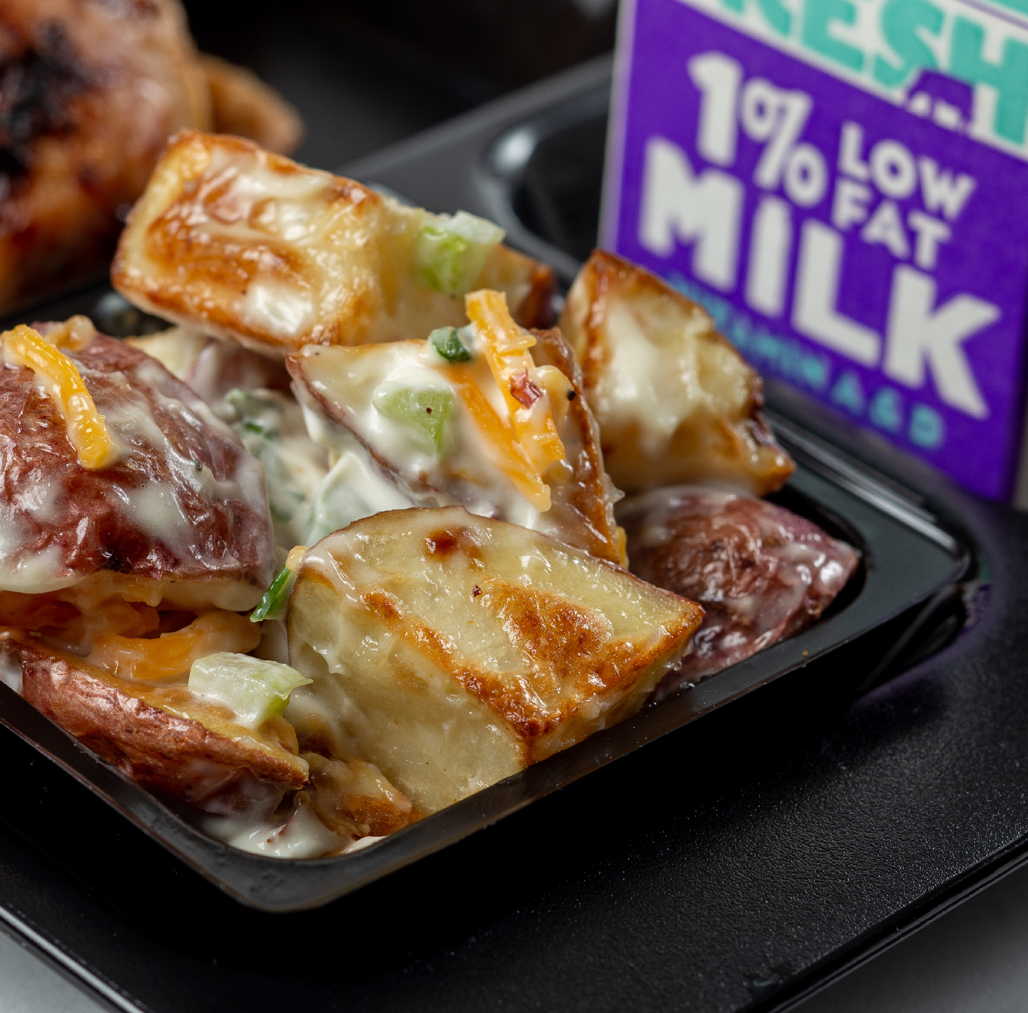
Hot Potatoes - Promoting!
Notes:
SAY: Promotion of your locally sourced product is the last, and very important step in this process. Product promotion that fails to advertise all of the work you accomplished from planning to preparing makes your efforts futile. You need to get the word out about local food purchases with strategies such as highlighting them on the menu, on social media, or through press releases. To get students excited, consider promoting your program through taste tests or special events. Promotion can help increase student participation and perception, and it can also let other partners in the area know you are open to purchasing local food. The VDOE-SNP encourages divisions to include #Vafarmtoschool on social media posts to help with cross promotion. Divisions are also welcome to use the Virginia Farm to School logo in their promotions.
TASK: Is there anything else you can think of that we need to include in the promotion stage? (Write in the chat box or unmute)

Slide 30
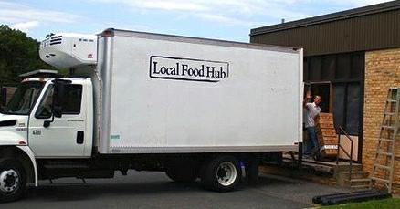
Procurement Summary
Notes:
SAY: An overall theme is that the food items procured must align with the needs of your program, as you have outlined on the Procurement Profile. Making sure that details of your program are well described and specifications are clearly written will help streamline your local food procurement, allowing you to buy the right products, at the right price.
We have discussed a number of important issues that affect local food purchasing. Chef Cyndie will now take over the webinar and talk about food safety considerations when buying local.

Slide 31
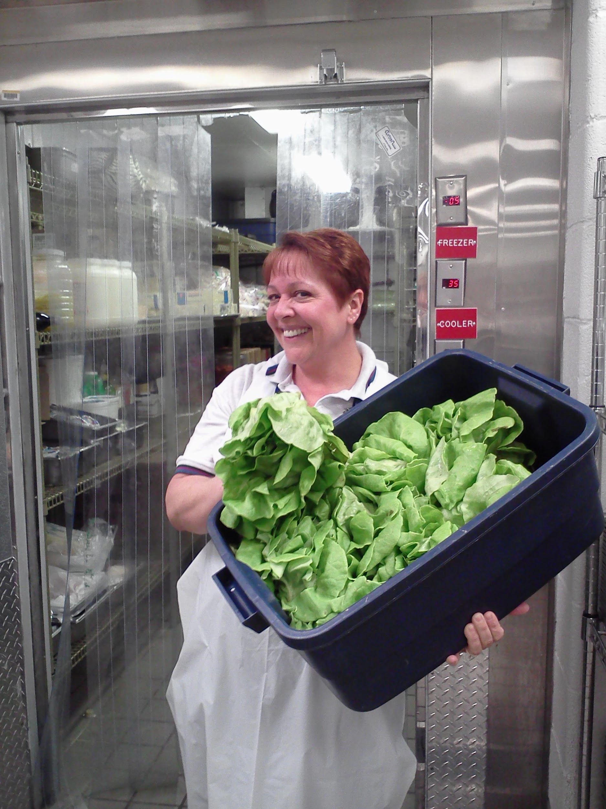
Food Safety: From Farm to School
Food Safety Modernization Act (FSMA)
Good Agricultural Practices (GAPs)
Good Handling Practices (GHPs)
Traceability
On site Farm Visits
Notes:
SAY: Thank you, Beverly! Next up, Food Safety From the Farm to your back door! Ensuring the foods we serve in school are grown, processed, transported, received, prepared, cooked, held and served safely is not only the right thing to do to protect our children and customers from harm, it’s part of the due diligence of a smart buyer and operator to protect yourself and the organization. No matter the source, it’s the responsibility of the buyer to ensure and document food safety practices in the case of a foodborne illness outbreak or recall. That said, you should not be afraid to purchase food direct from the farm. These are the same sources our country is relying on to provide food for our family tables. Growers and processors today are much more food safety savvy than you may realize. We have all learned so much from the past. Take the 2006 spinach outbreak of E.coli. The most tragic is three people lost their lives. For the growers - Not only did the farms that produced the spinach lose, but the entire industry was destroyed – no one ate spinach in any form. Frankly, that ONE incident is the reason we have the leafy greens food safety rules today. So let’s take a look at how our industry has changed for the better to alleviate any hesitation you may have when buying directly from the farm.
Pictured: Prince William County locally grown hydroponic greens

Slide 32
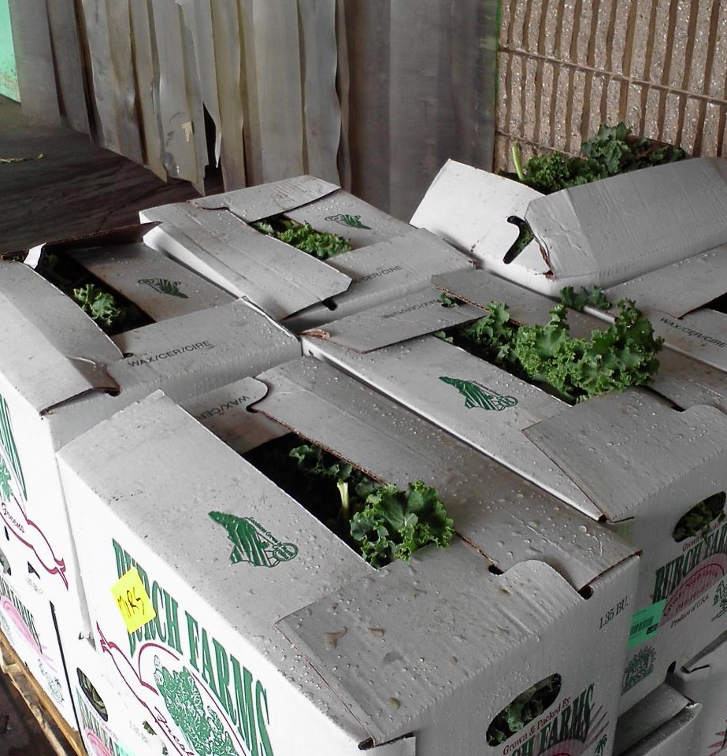
Food Safety Modernization Act of 2011 (FSMA)
Established regulatory standards
Developed the Produce Safety Rule - Growing, harvesting, packing and holding standards (some produce items exempt)
Notes:
SAY: Since 2011, FSMA and the Produce Safety Rule has strengthened food safety standards for growers, processors, distributors and shippers through Good Agricultural Practices and Good Handling Practices. There are exceptions for very small farms who sell less than about $25K a year. The final rule was published Nov. of 2022. Please note that some produce items are exempt from the regulations due to either not a common cause of foodborne illness or typically eaten cooked such as potatoes and sweet potatoes! The regulations are mandatory for some organizations especially those who process fruits and vegetables into ready to eat products like baby carrots.

Slide 33
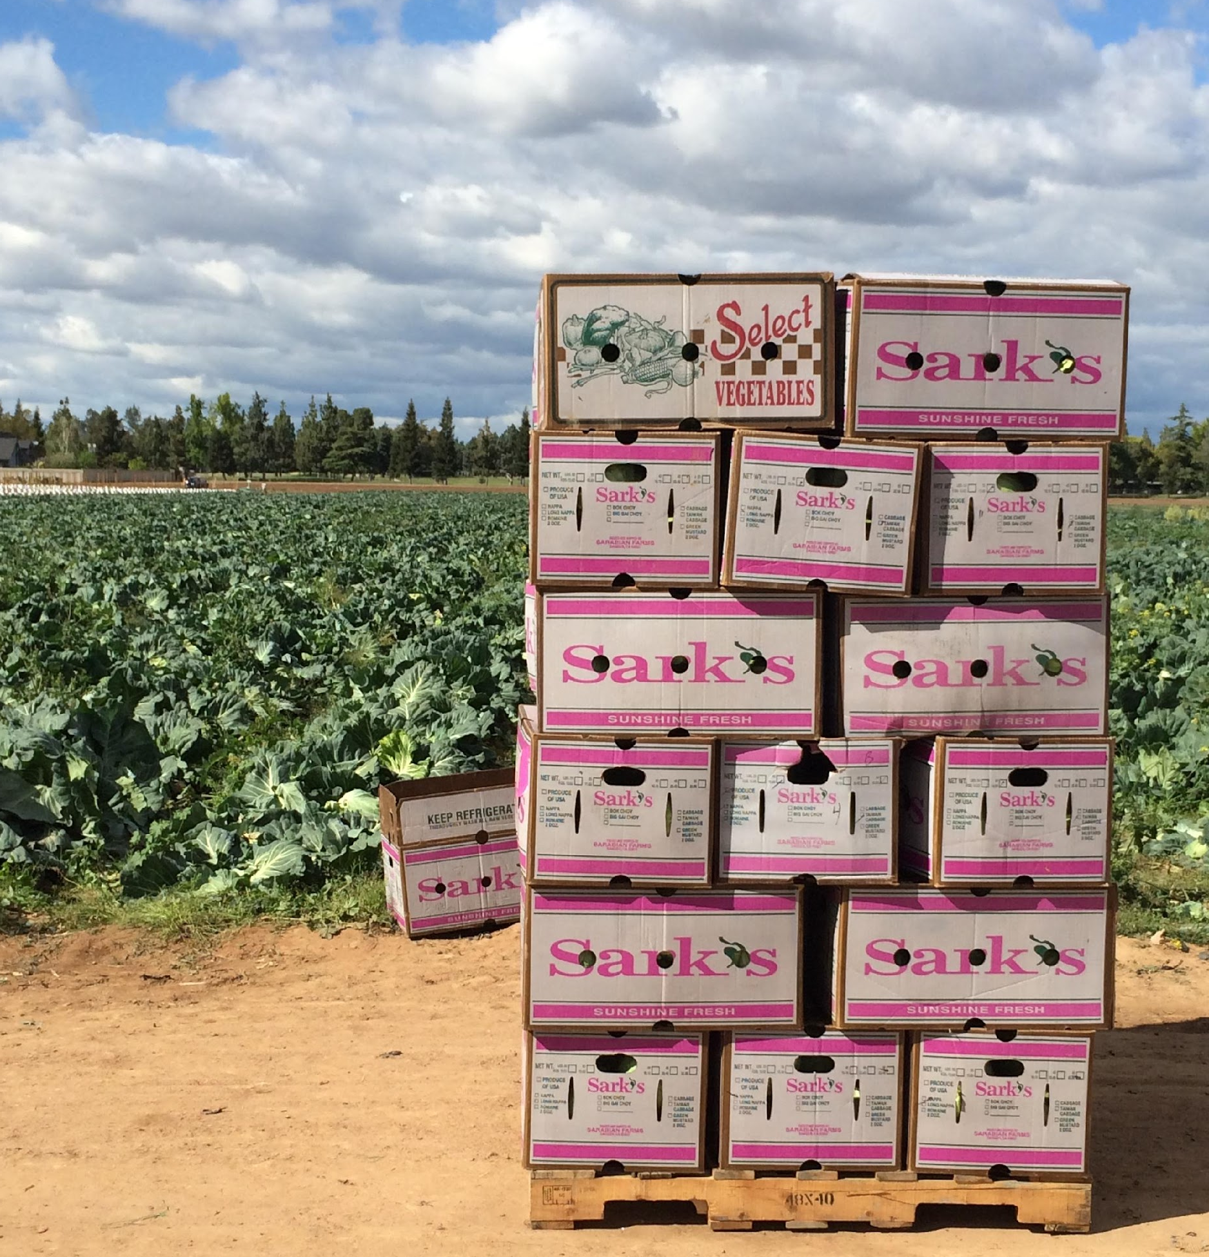
Good Agricultural Practices (GAPs) & Good Handling Practices (GHPs)
Proactive steps to reduce or mitigate risks of foodborne illness
Identifies critical contact points or points of contamination
  Water
  Soil
  Humans
  Animals
  Tools/equipment
Notes:
SAY: Good Agricultural Practices and Good Handling Practices are the proactive steps taken to reduce or mitigate foodborne illness risks. Sound familiar? It should…Remember your HACCP training? We do a hazard analysis or risk assessment to identify where something can go wrong in our kitchens. GAPS and GHPs apply this same principle to food safety areas for growers, shippers, and vendors. Today, we will focus on GAPs and GHPs on the farm in five specific areas: water, soil, humans, animals, and tools and equipment.

Slide 34

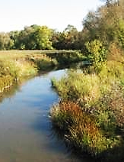
Good Agricultural Practices (GAPs) - Water
Notes:
SAY: Let’s start with water because it has been the cause of more biological outbreaks than any other source. Today, a microbial water quality test is required for GAP certification. There are two sets of criteria looking for the presence of generic E.coli which can indicate fecal contamination. If water does not meet these criteria, corrective action must be taken as soon as practicable. Water used during growing activities may have a limited amount of E.coli, while post-harvest water used for cleaning must have NO detectable generic E.coli. Aren’t we glad about that?! Well water must be tested annually, and surface water must be used quarterly if used year-round or during the growing season. On the slide are two photos of surface water; one is a stream, and the other is a pond. Why would we be more concerned with surface water than well or municipal water? Write in the chat? (wait for answers) Yes, surface water is subject to contamination and varying levels of concentration. Yep, that’s my dog….I still miss her! She loved a pond.

Slide 35
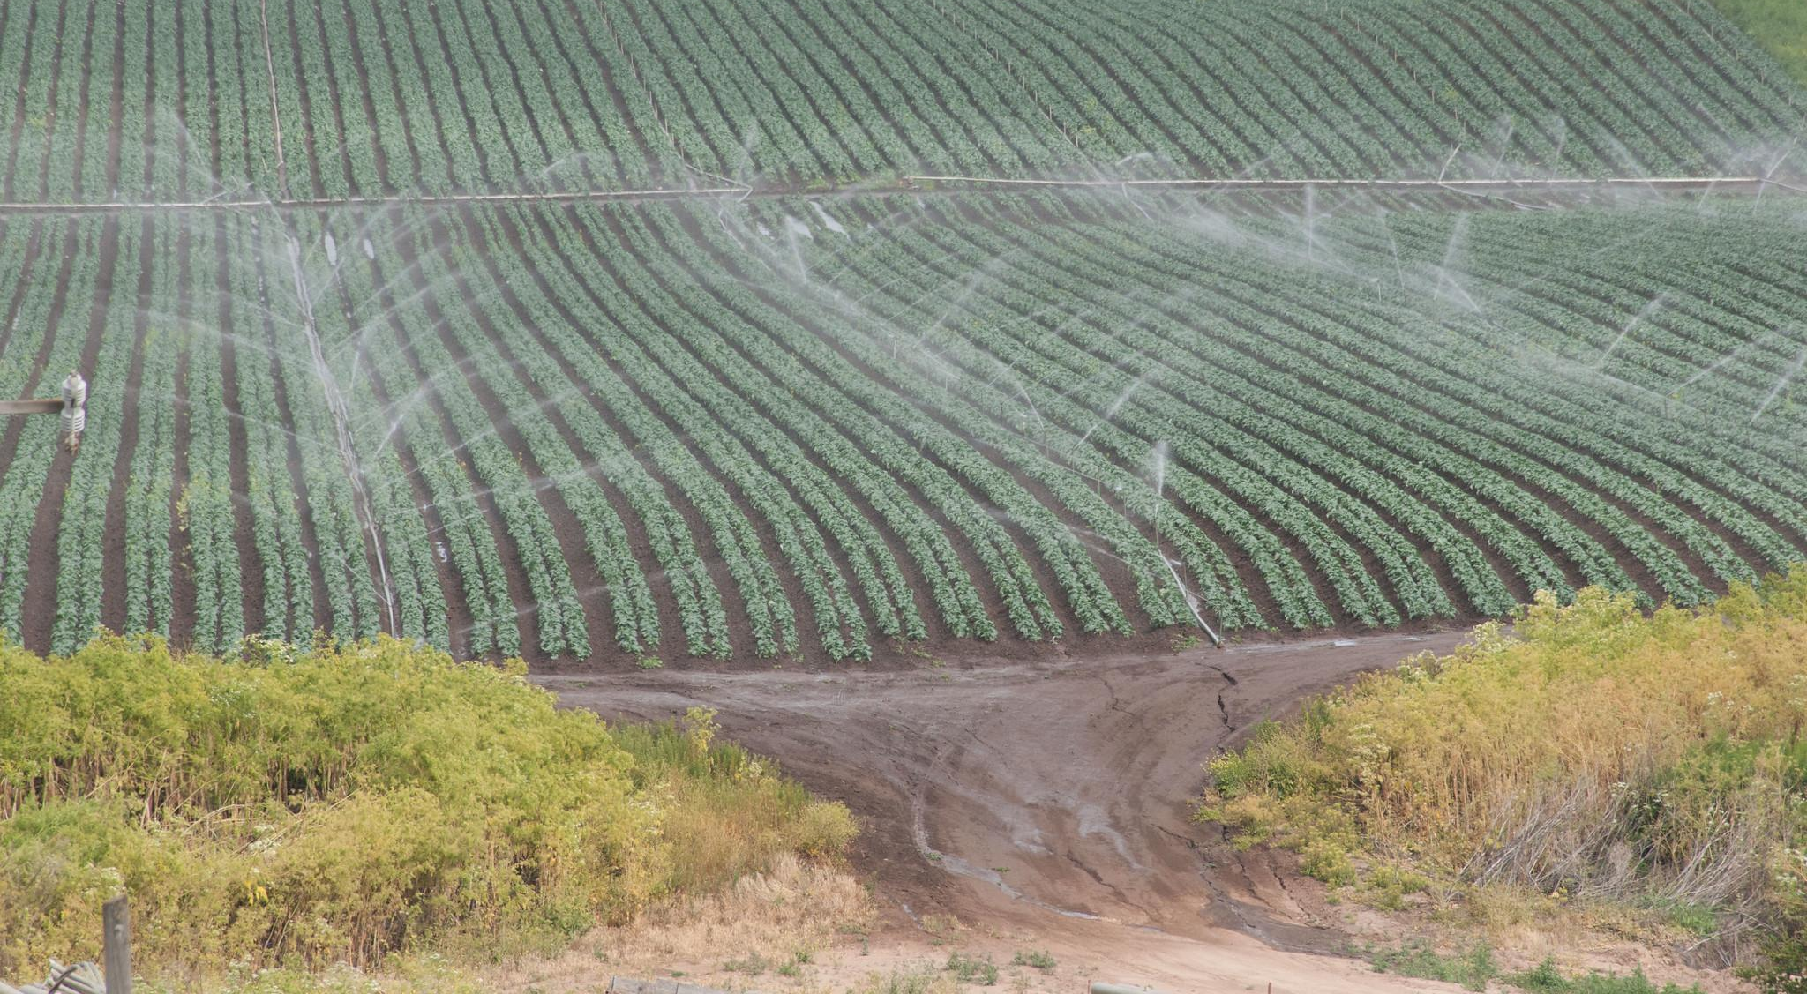
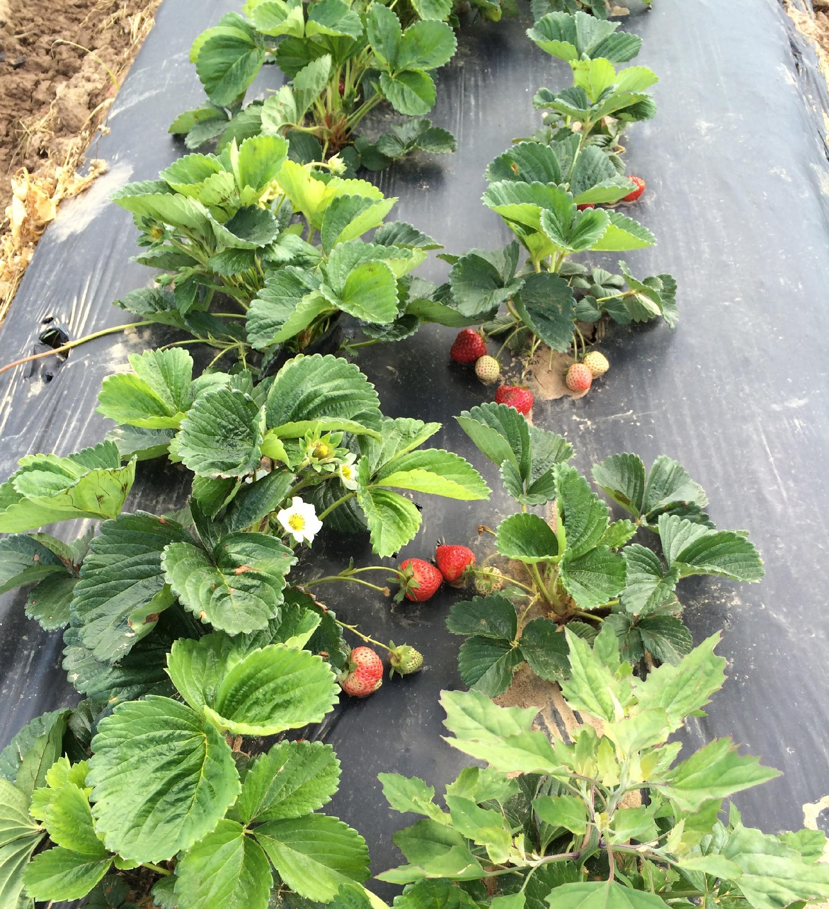
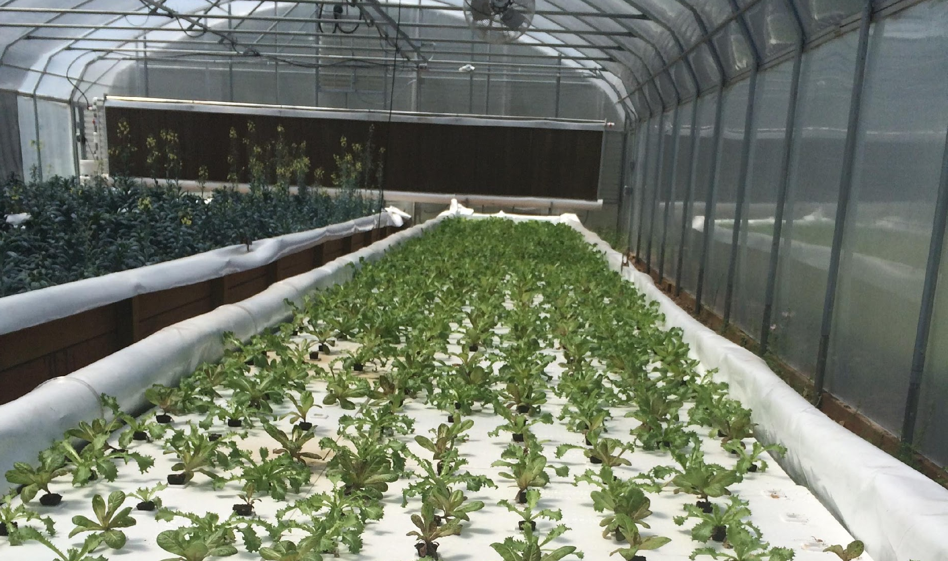
Good Agricultural Practices (GAPs) - Water
Notes:
SAY: Take a look at the photos. In the chat, write yes or no if you would be concerned about E.coli contamination in the water used for overhead irrigation? (wait for answers) Yes, we would be more concerned and would want to know the source and testing results of the water. Is it a well, a surface pond or municipal water source? What about the strawberries using underground irrigation? How concerned are we about the water for irrigation? (wait for answers) We may be less concerned because research shows that E.coli does not uptake through the root system. We would still want to know the source of the water and see water test results. What about the last photo showing hydroponic growing? (wait for answers) Correct, no matter where we get our water, WE ASK QUESTIONS such as what are your actual water sources for pre and post harvest and how often are the sources tested. Don’t hesitate to dig a little - Just like you would ask questions about any other product or service you are procuring.

Slide 36
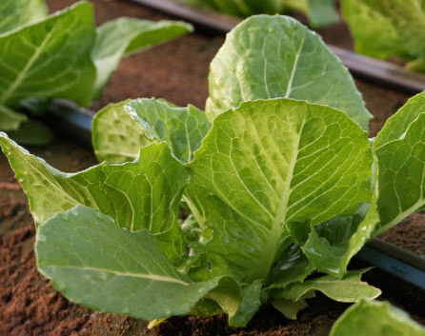
Good Agricultural Practices (GAPs) - Soil
Compost
  EPA sets guidelines
Raw manure
  2 weeks before planting and 120+ days before harvest
Always keep records
Notes:
SAY: Soil amendments could include anything that is added to the soil for growing, including fertilizers, moss, vegetable waste, compost, and manure. The Environmental Protection Agency sets guidelines for composting regarding the times and temperatures and the amount of times it must be turned for safety. For school gardens, we advise no animal proteins to avoid any food safety concerns. Farmers using raw manure must apply it as least 2 weeks prior to planting and up to 120 days prior to harvest depending on the crop. No matter the soil addition, recordkeeping is going to be really important.

Slide 37
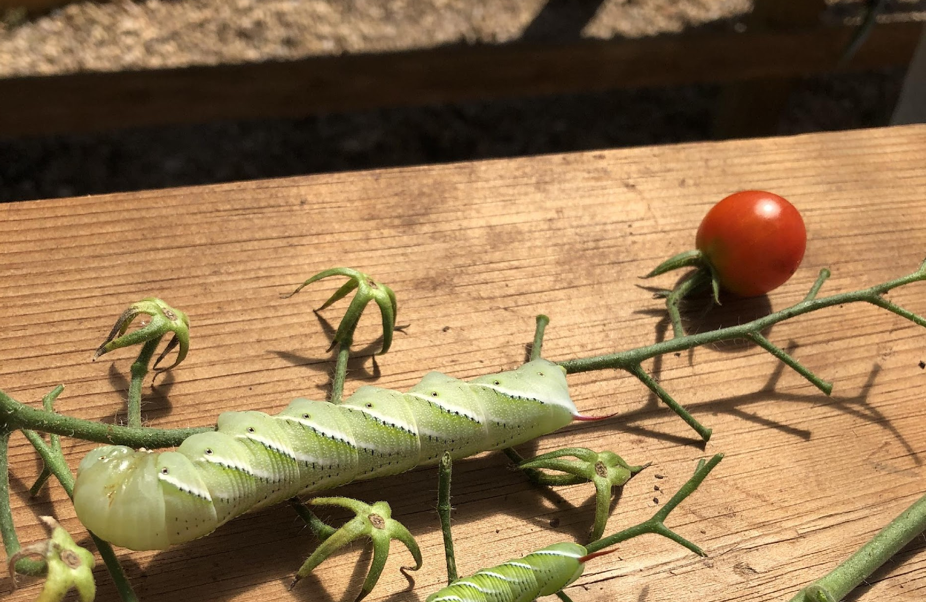
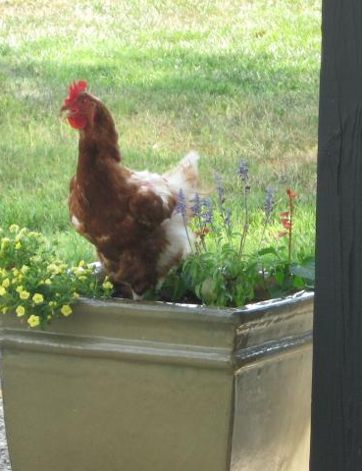
Good Agricultural Practices (GAPs) – Animals/Pests
Notes:
SAY: Oh boy, this is a hard one….Mother Nature is hard to keep out of anything you try to grow! I named these worms Godzilla tomato worms. They literally grow from that tiny worm in the circle to giants overnight. However, we are really concerned with animals such as livestock that contaminate water, soil, and food with fecal pathogens. While on your farm safety tour, determine if there is a fence or barrier between produce fields and livestock.

Slide 38
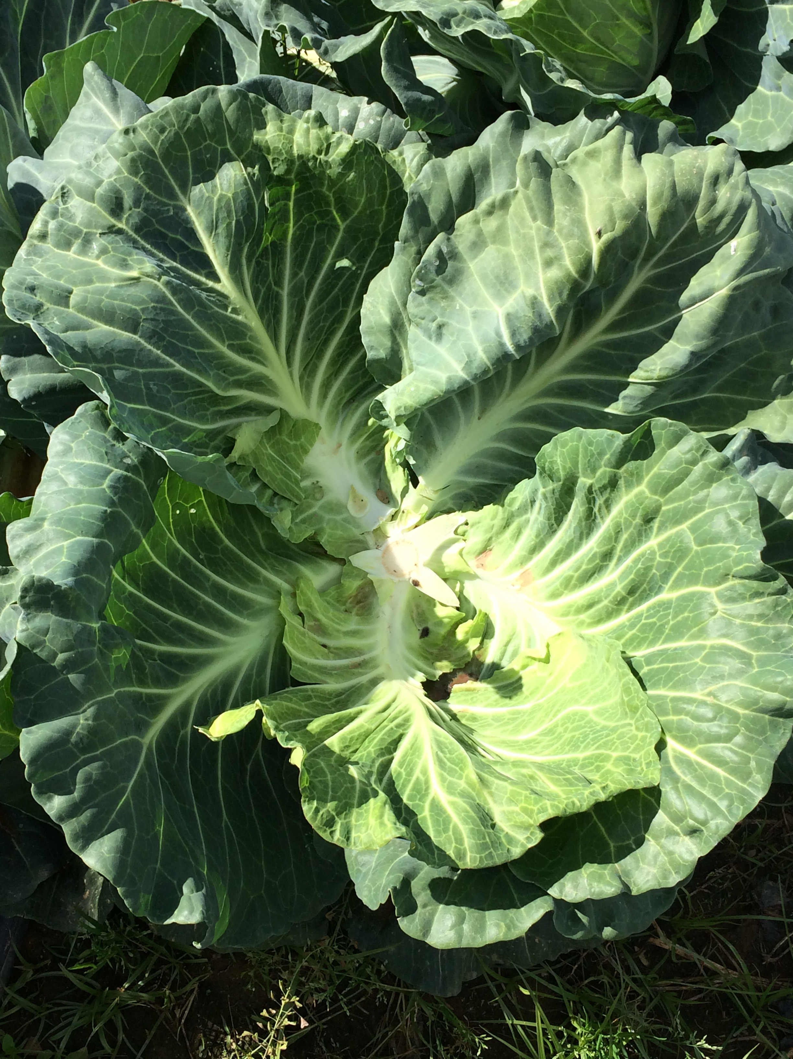
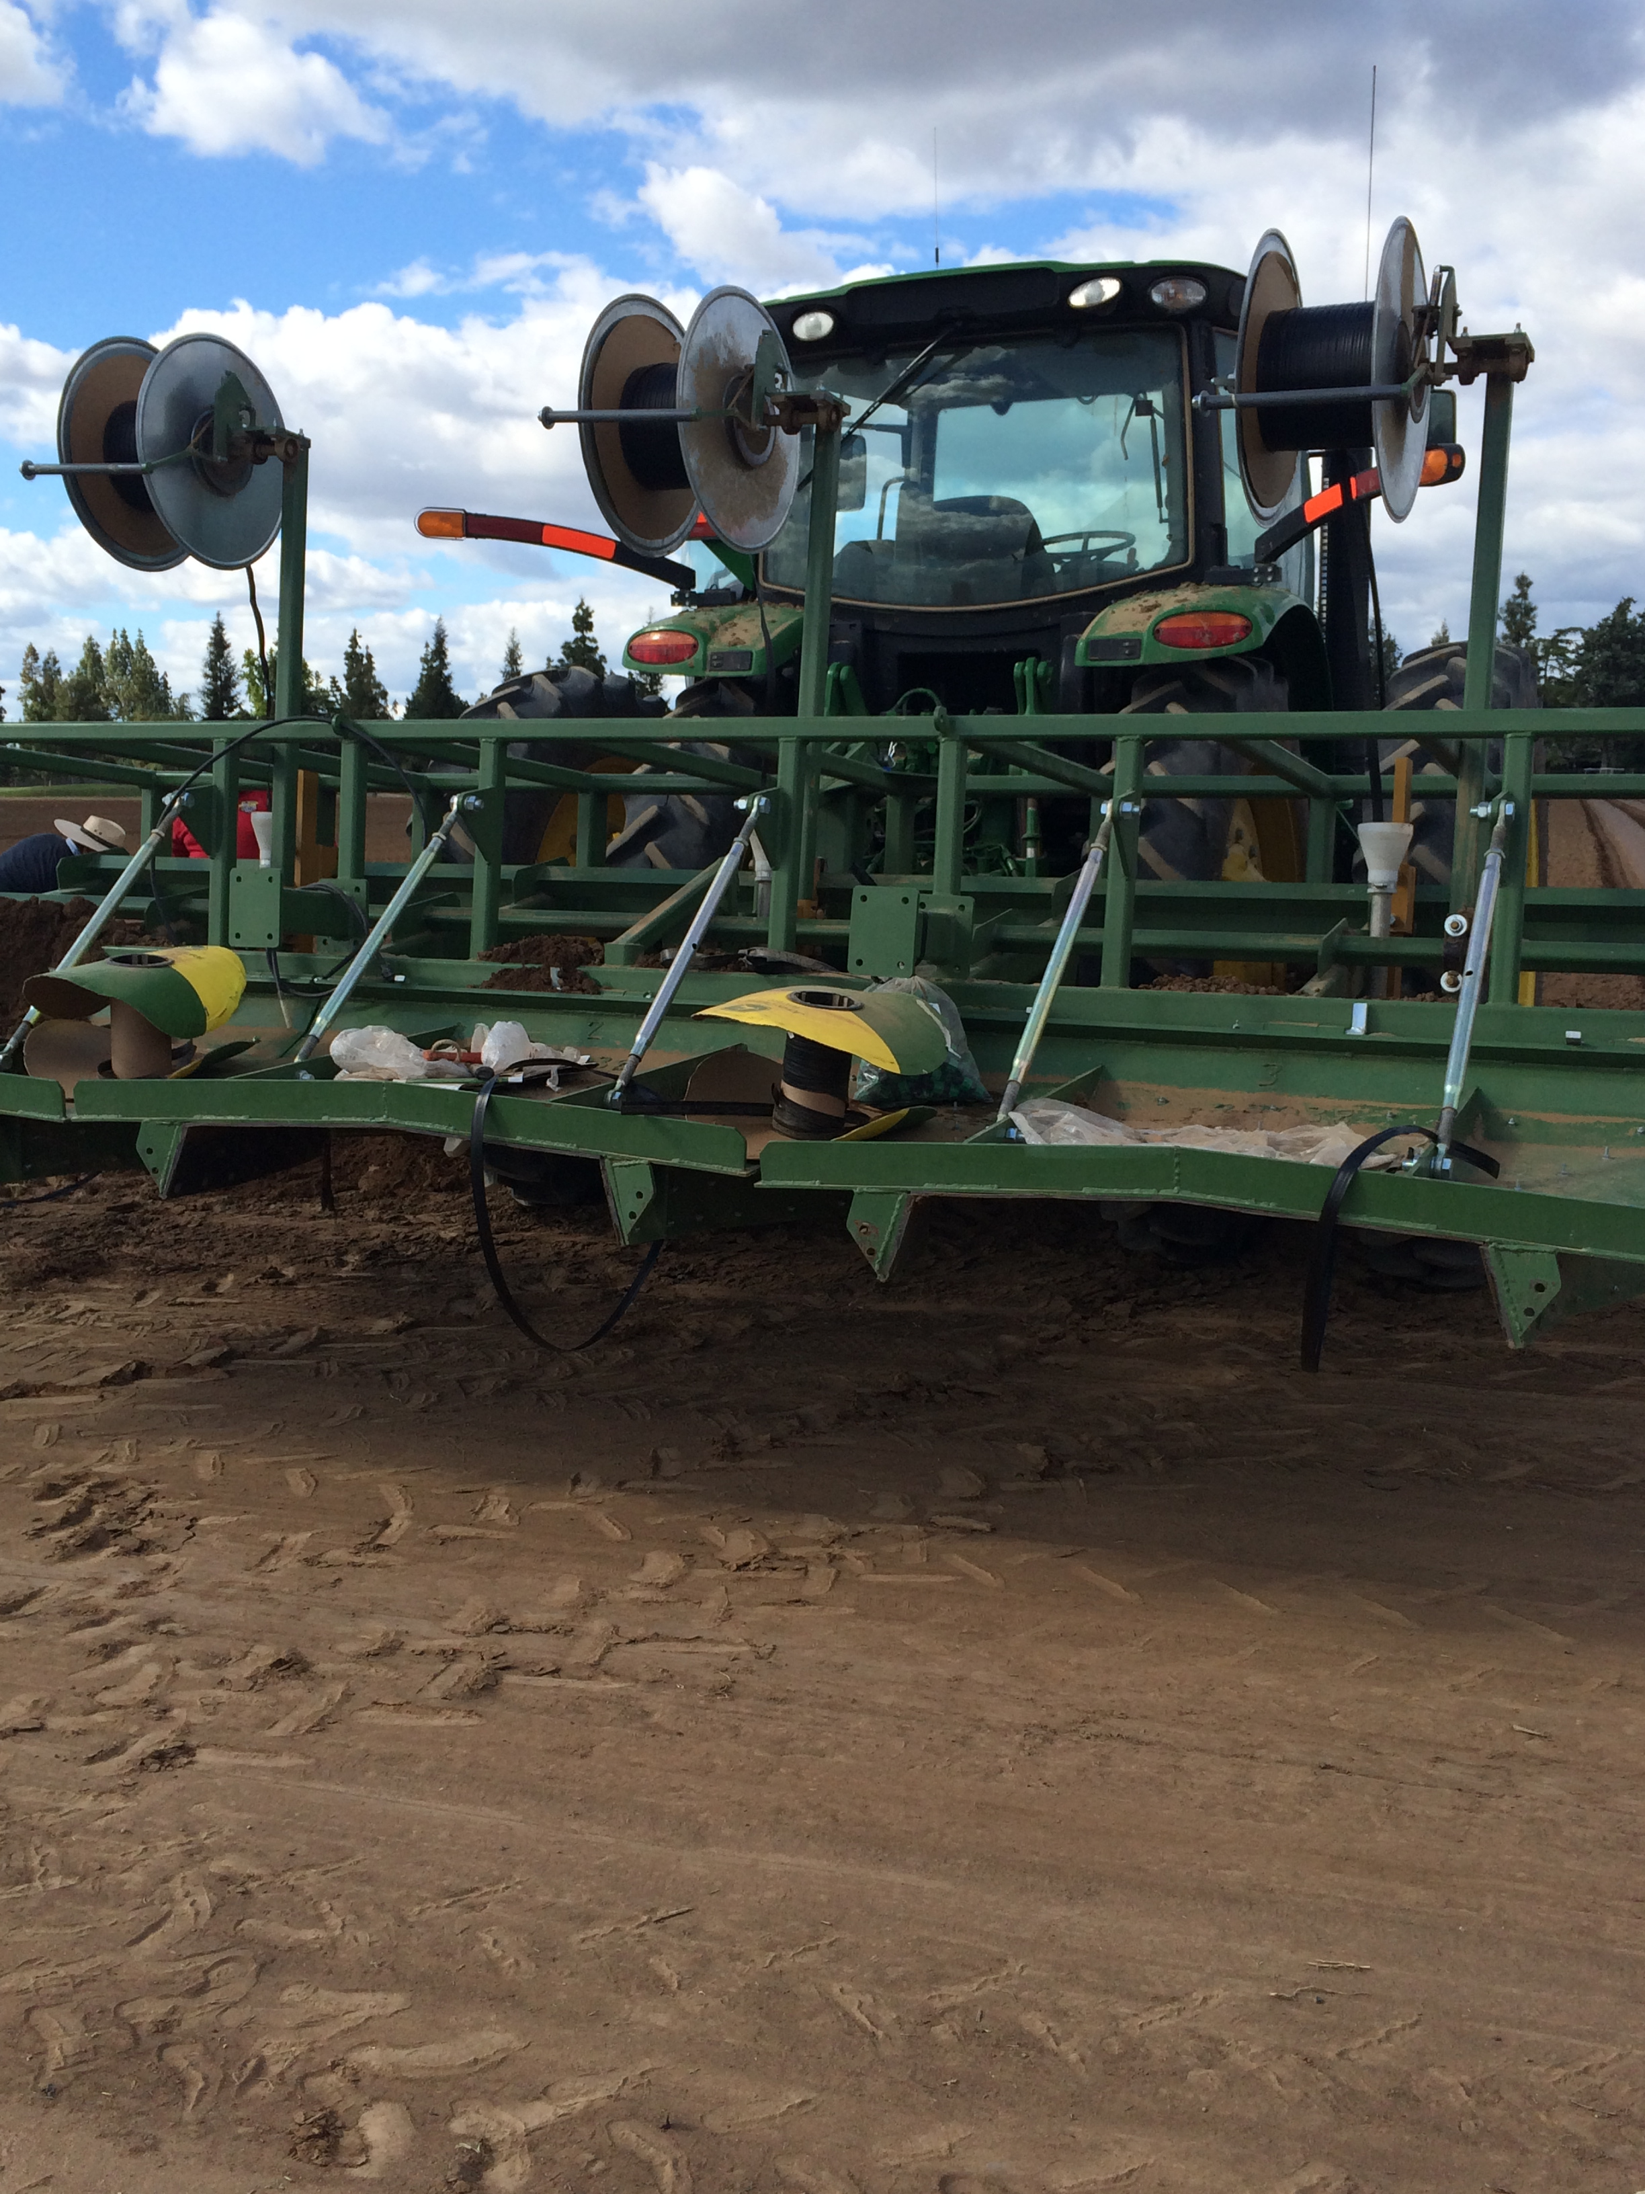
Good Agricultural Practices (GAPs) – Tools/Equipment/Harvest Bins
Notes:
SAY: The tools and equipment are also a point of potential contamination. Tires on tractors could drive through raw manure piles and then drive into packing houses. Harvesting tools and bins should be regularly cleaned and sanitized. Again, it is all about communication. Could the farm use specific harvest bins for your program that meet your needs? How can you work together?

Slide 39
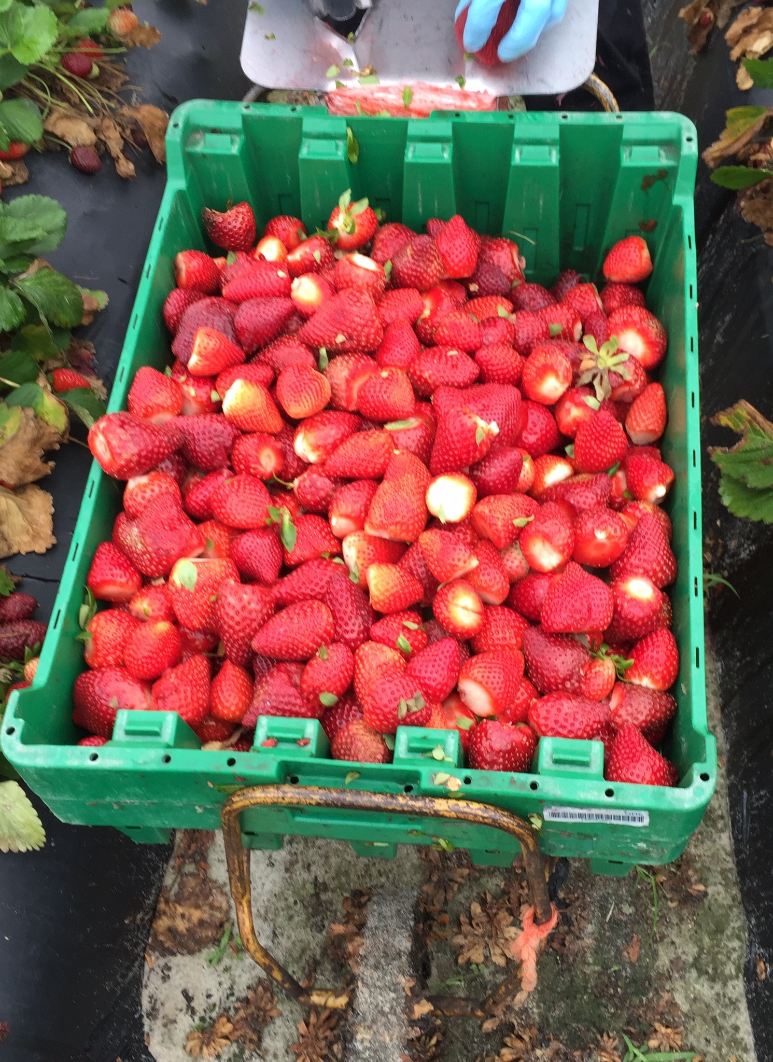
Good Agricultural Practices (GAPs) & Good Handling Practices (GHPs) – Worker Health and Hygiene
Handwashing facilities
Toilet
Glove use
Notes:
SAY: GAPs & GHPs include health and hygiene practices expected on the farm, especially during harvest. If a farmer’s food safety plan says the worker will wear gloves, then they should wear gloves, but gloves are not required. You should expect to see portable handwashing and toilet facilities in the field or the packing house should be within reasonable walking distance if it’s a small farm.

Slide 40
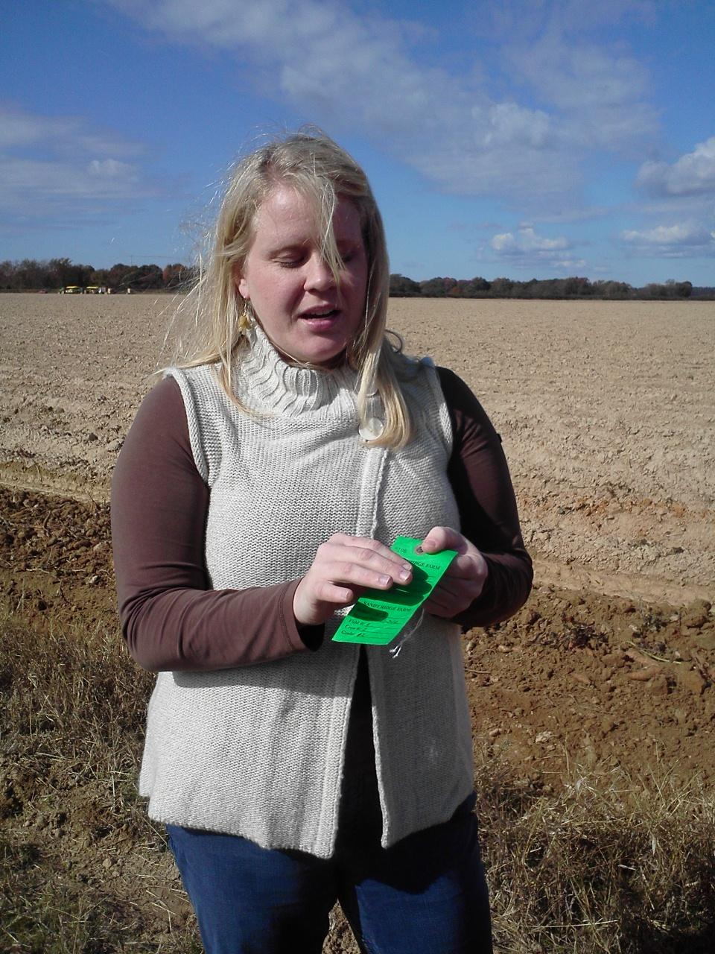
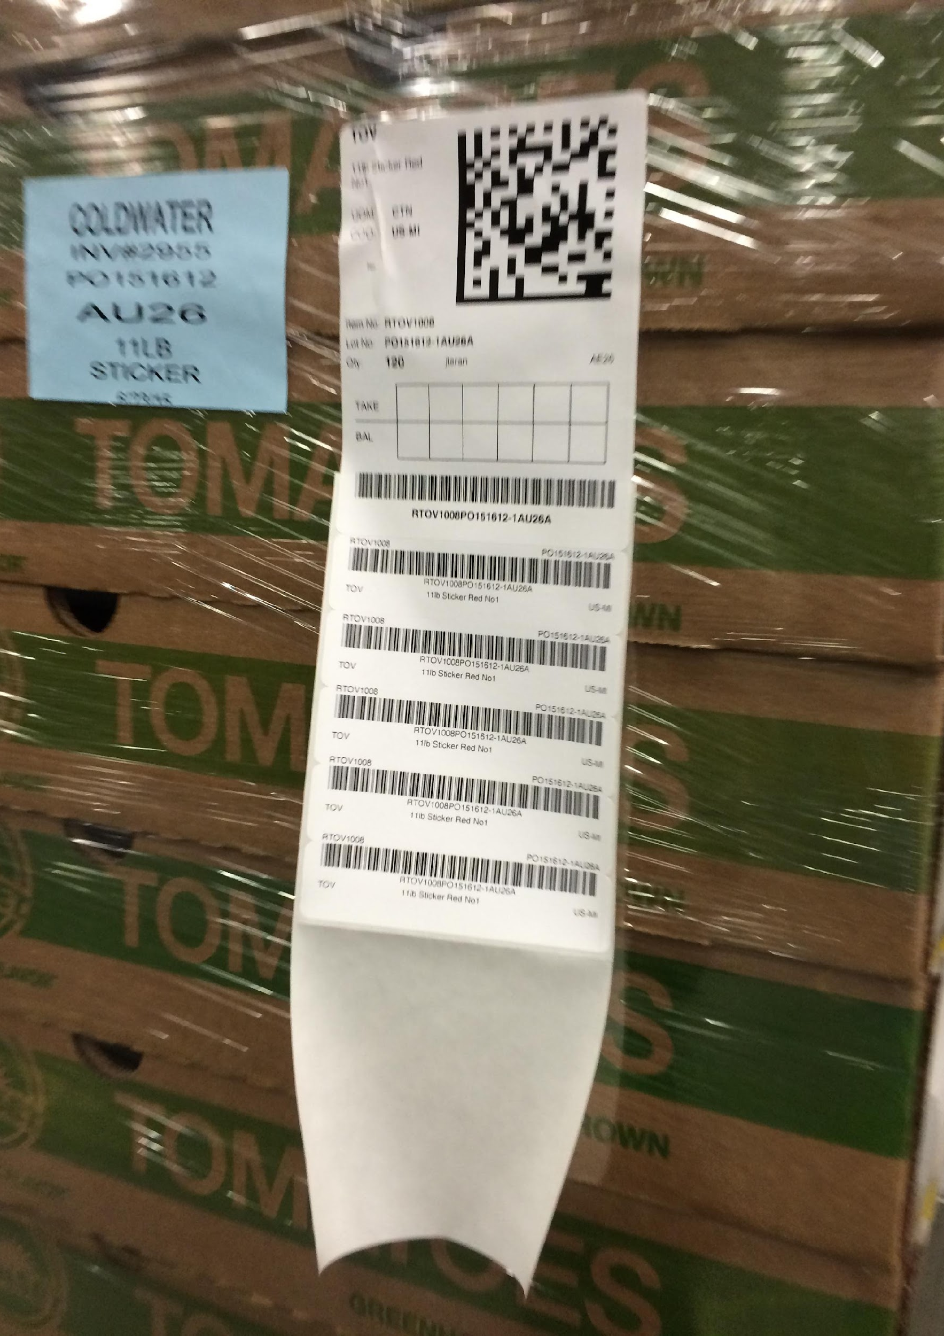
Traceability – One Step Forward; One Step Back
Notes:
SAY: Food safety also includes the ability to trace food to the source. Who’s danced the cha cha where you have to step forward and step back? Well, that’s traceability You must be able to trace the product back to where you purchased it from and trace it forward to where it went. When buying locally, it doesn’t need to be a complicated system. On the screen, you see a distributor’s electronic system on the left, but on the right, this is a sweet potato farmer who maintains the date of harvest, field of harvest, and harvest workers with a manual system. Traceability IS a requirement under FSMA unless you are a very very small producer – under $25000 in total sales per year. The farmer should have a system to document safe handling practices from the field and the packing and storage areas to the transport vehicle and the final point of sale.
*The VCE resource Considerations for School Nutrition Directors Seeking to Increase Farm to School Purchases includes helpful questions to ask producers.

Slide 41
Traceability Documentation
Schools can purchase from the farm, co-ops, distributor, produce distributor, or obtain food items from the school garden
Notes:
SAY: Farm to School produce items can arrive to the division differently. Today, we are focusing on how to safely purchase directly from the farm, but we want participants to be aware of alternate avenues. Remember that items must not be purchased directly from the farm to be considered “local.” Delivery of food products and their distribution within a school division can be a major challenge for producers and school systems. Farmers must consider which option makes the most sense for them, whether directly to the school division or through an intermediary such as a distributor. Selling to an intermediary means meeting certain food safety, liability, and quality standards. In many cases, the requirements may be more stringent than selling directly to a school division, so knowing what the intermediary requires is important. Typically, the larger the distributor, the more likely there will be requirements for specific food safety audits, liability insurance, and volume minimums. Everyone you purchase from must be able to provide documentation, such as batch and lot numbers, to trace the product back to the source. Sellers must maintain customer contact records in the event of a recall.

Slide 42
GAP Certification
GAP Audit to Obtain Certification ($)
GAP Certification
Harmonized GAP
Group GAP
Not Mandatory for School Nutrition Programs
Notes:
SAY: It is important to distinguish between Good Agricultural Practices, which all producers we intend to purchase from should be practicing, and GAP Certification. USDA does not require school nutrition programs to purchase from GAP Certified farms. However, food safety requirements should be clearly outlined in the bid proposal. It is up to the buyer to determine and document that purchases are coming from a safe source.
Only fresh produce farms (vegetables, fruits, herbs, nuts) can be audited. Farmers have the ability to obtain certification that their GAP and GHP practices meet FSMA standards through GAP Audits. There is NO federal requirement that school nutrition programs buy from a GAP-certified grower. You can conduct an informal audit to make sure you are comfortable as a buyer with the farmer’s food safety plan and practices. On the slide, please notice the farmer pays for the audit to obtain certification. This audit is per crop. USDA Agricultural Marketing Service or AMS or another third-party organization charges an hourly fee for certification. A harmonized GAP is a more detailed audit, and group GAP is available for farmers to band together, but their food safety plan must be the same. GAP Audits can be cost prohibitive for smaller producers. The Virginia Cooperative Extension (VCE) team developed a helpful checklist to discuss food safety with farms that are not GAP Certified. We'll touch on a few of those discussion topics on the next slide.
SFAs should always purchase food from reliable, reputable sources that follow GAPs and good handling practices (GHPs).

Slide 43
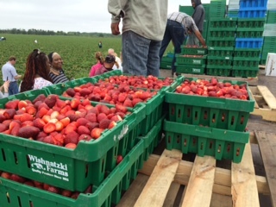
Food Safety Criteria and Expectations
Has the producer identified on-farm food safety risks for their farm?
Does the producer have a written food safety plan and/or procedures in place to mitigate identified risks, such as providing worker health and hygiene training?
How are food safety policies, procedures, and practices verified?
How much liability insurance does the producer carry?
Notes:
SAY: When building a relationship with a potential producer, clear communication regarding safe food handling expectations for all facets of the flow of food are essential. Important conversations must be held with producers to develop those relationships. We have listed some questions from the VCE resource, Considerations for School Nutrition Directors Seeking to Increase Farm to School Purchases” to determine whether a producer may meet the division’s criteria. The farmer should have a system to document safe handling practices from the field and the packing and storage areas to the transport vehicle and the final point of sale. The resource link is provided on the Resources handout. We have included the link in the PPT notes to the National Farm to School Network Communicating Food Safety Practices with Schools video (about 12 minutes) where NY State farmers from Common Ground Farms are interviewed regarding how they worked with a local school to provide leafy greens, farm tours and how they met school district’s food safety requirements including creating a GAPs checklist and liability insurance.
Case study link: https://www.youtube.com/watch?v=E3KsxIRK31c

Slide 44
Liability Insurance
Types of Insurance
  Food product liability
  General farm liability
  Commercial business liability
  Auto
Bodily injury does not include transmission of bacteria, viruses, parasites, or other foodborne hazards
Notes:
SAY: It’s important to understand the differences between types of liability insurance. Food Product Liability Insurance protects against claims of injury from contaminated fresh produce that causes foodborne illness. This policy covers only claims, not the cost of the recall. General Farm Liability insurance typically protects against claims for bodily injury and property damage that occur on the farm premises or as a result of farm operations. These policies cover accidents that affect farmers, employees, guests, and customers. Commercial business liability insurance may be necessary if the grower also undertakes activities that are not considered “agricultural” or “farming”. It works essentially the same way as general farm liability insurance. The insurance is appropriate for growers who have fresh produce processing facilities.

Slide 45
Farm Visits to Verify Food Safety Practices
Have all workers, including family members, been trained in proper health, hygiene, and produce handling practices and policies for any of the stages they are involved in?
Are visitors instructed in expectations, especially if they are allowed in any production and packing areas?
Is appropriate signage posted to remind workers and visitors of food safety practices and policies?
Are port-a-johns or indoor restrooms and wash stations readily available?
Do all workers and visitors wash hands after using the restroom and at other specified times as stated in training/policy?
Notes:
SAY: School and child nutrition program administrators may schedule a farm tour with new potential vendors to review food safety practices.
If the child nutrition program cannot conduct a farm visit, program administrators may request a signed copy of the checklist from potential producers during the bid process. While the assessment is not a substitute for a passed food safety audit or a food safety plan (which typically includes policies, standard operating procedures, and records), the assessment still demonstrates that owners/operators have identified and understood potential risks. The assessment can be used to verify risks have been addressed before school sales. All documentation should be signed and dated, and the farm contact information should be provided.
On this slide, we have included a sample of questions to ask during a farm visit. This is a VERY brief snapshot! For a complete and detailed checklist, which may be used either on-site during a visit or provided to the farmer to complete, please refer to the VCE Food Safety Checklist listed on the Resources handout.

Slide 46
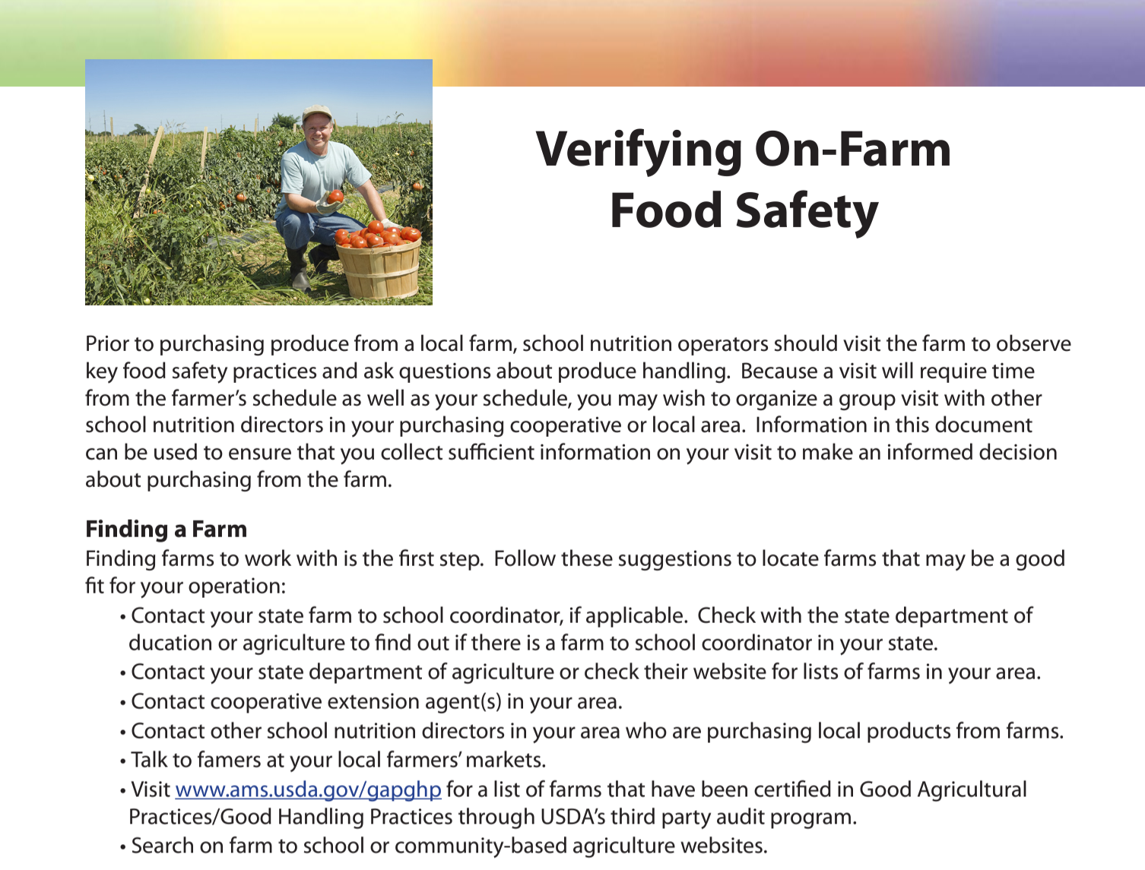
USDA Resource: Verifying On-Farm Food Safety
Notes:
SAY: USDA has produced a resource to help guide divisions in what to ask during an on-site farm visit: Verifying On-Farm Food Safety. If anyone in the audience has attended PSU, Produce Safety University, this resource may look familiar. The link to this resource is provided in the Resource Handout.

Slide 47
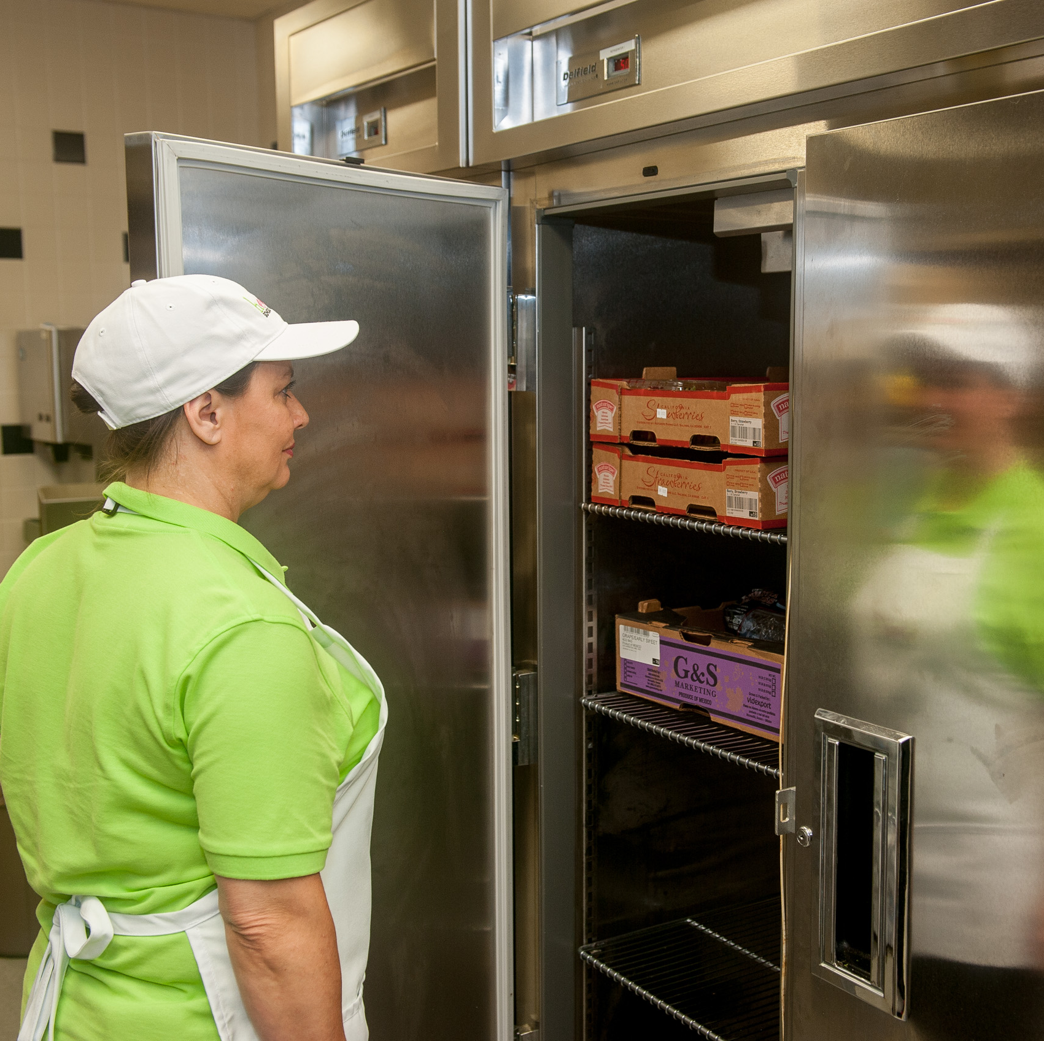
Incorporating Farm to School within the Food Safety Plan
Receiving
Storing
Preparing
Cooking
Holding
Serving
Cooling
Reheating
Notes:
SAY: No matter where you source your food, whether from a distributor or local farmer, you still must follow your SFA’s food safety plan. All staff should follow established SOPs from receiving to serving/cooling and reheating. However, you may need to review your food safety plan in some key areas to ensure it incorporates items that come directly from the farm.
With receiving, is your staff prepared to receive and inspect items? For instance: packaging. We've talked about how you should communicate with the producer to ensure the food comes in clean packaging that is to your food safety standards, but is your staff knowledgeable about what packaging to expect? If it is reusable packaging like food-safe containers from the student farm, are your staff aware of what do to with it when they are finished with the product?
With preparing, make sure your staff is ready for new items that might look different than what they're used to, and how to prepare them safely. If you source local greens that have not been thoroughly cleaned and your staff is accustomed to cleaned greens, they may be required to take more time in washing and cleaning the produce to remove soil. Or, maybe your staff is used to preparing fresh, raw ground beef and you want to bring in local ground beef that will be frozen. Are your staff prepared to properly thaw the ground beef and aware of the steps they need to take?
Additionally, we have already pointed out no matter the source, make sure your traceability plan is in place. We HIGHLY recommend keeping foods in their original containers until day of use and service in the event of a recall.

Slide 48
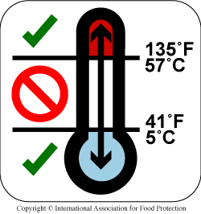
School Food Safety Plan
Site specific plan
HACCP-based SOPs
Notes:
SAY: Do you have a site-specific food safety and HACCP (Hazard Analysis Critical Control Point) plan? Each school should have a site-specific plan. And remember: Standard Operating Procedures (SOPs) must be in place before starting any new method of cooking or preparing. Have you spoken to your local regulatory authority/health department about your changes? They can help guide you on being compliant. Also, don’t forget to check in with your VDOE Specialist if you have questions.

Slide 49
Resources
Notes:
SAY: We have delivered a lot of information in this one-hour webinar today. To tie it all back together, please refer to the Resources Handout for websites which will help to support your Farm to School program at any stage.

Slide 50
VDOE-SNP as a Resource
Regional SNP Specialist
Regional CNP Specialist
Procurement and FSMC Contracts Specialist
Lead Farm to School Specialist
Notes:
SAY: As you know, the Virginia Department of Education, Office of School Nutrition Programs considers local food procurement a high priority and the various specialists are a wealth of information. Resources and contacts include the Regional SNP and CNP Specialists, a Procurement and FSMC Contracts Specialist, and the Lead Farm to School Specialist. All of these individuals would welcome questions and provide assistance as you grow your division’s program.

Slide 51
Contact Information
Bee Thorp, Lead Farm to School Specialist, Brittany.Thorp@doe.virginia.gov
Tom Patrick, Procurement and FSMC Contracts Specialist, Thomas.Patrick@doe.virginia.gov
Notes:
SAY: We want you to know the names and contacts for local procurement if you have any specific questions or need guidance. Bee Thorp is your Lead Virginia Farm to School Specialist and Tom Patrick is your Procurement and FSMC Contracts Specialist.

Slide 52
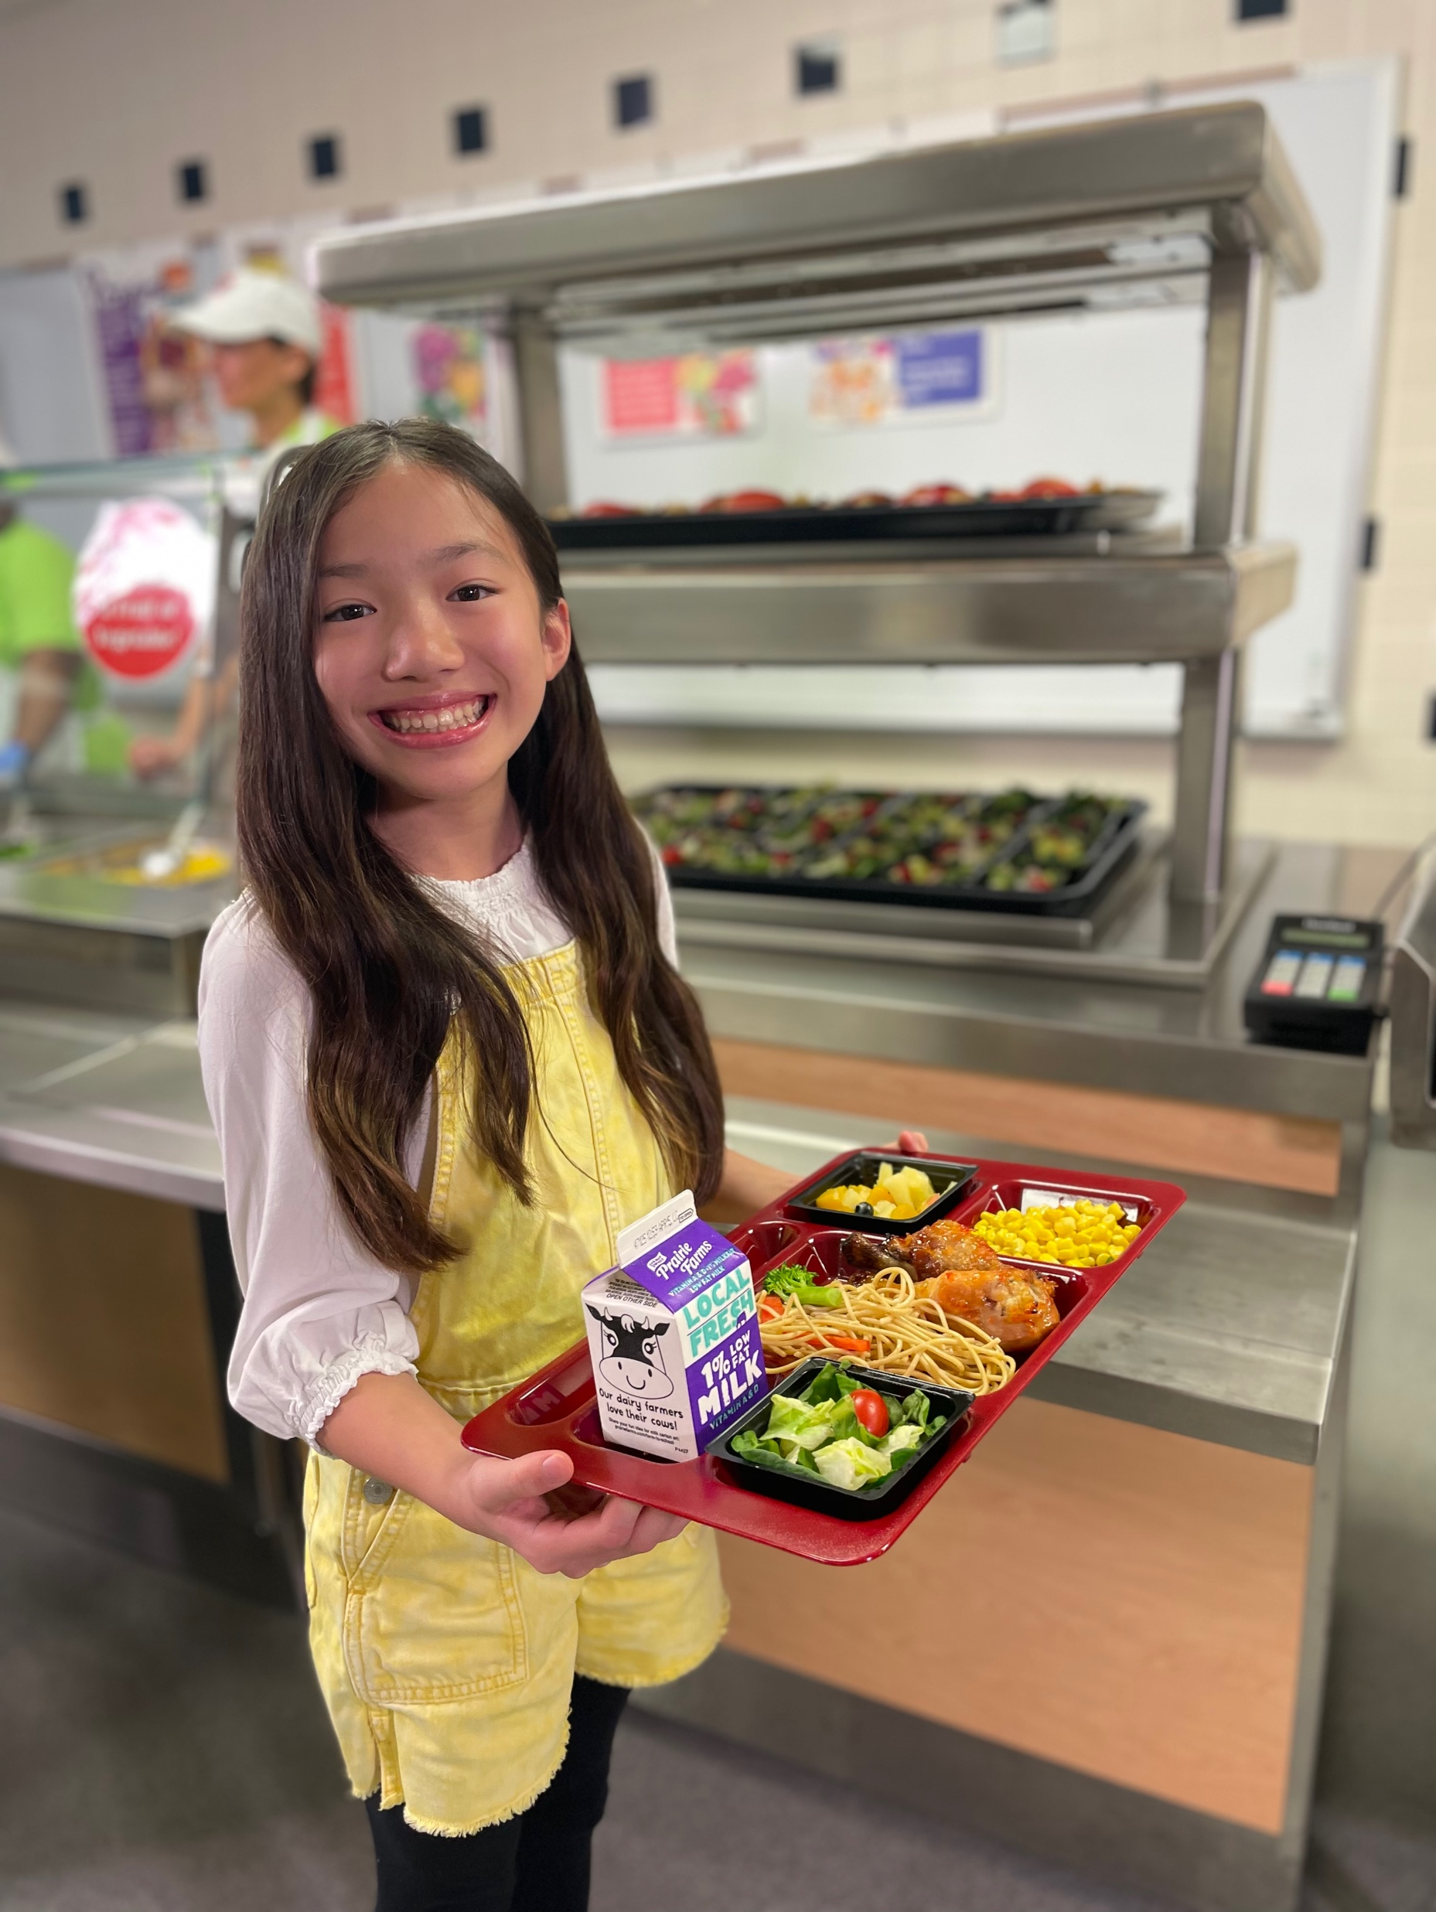
USDA Buying Local Food Resources
USDA Patrick Leahy Farm to School Website:
Procuring Local Foods in Child Nutrition Handbook
Farm to School Fact Sheets
Finding, Buying, and Serving Local Foods Webinar Series
Farm to School Policy Memos and Regulations
Notes:
SAY: 2021-2022 local procurement data showed that roughly 46% of respondents defined local as food “grown or raised in Virginia”. Another common definition among respondents was food “grown or raised in Virginia OR within a certain radius of the school board building.” USDA also provides a wealth of resources on the Patrick Leahy Farm to School website, including information on procurement, fact sheets, serving local foods, and F2S regulation and policy memos.
ASK: Bonus question! Can anyone tell us where Patrick Leahy is from? If so, please indicate your answer in the Chat Box.
SAY: That’s right! He was a Senator from Vermont, who closely aligned himself with school nutrition programs and agriculture! And remember, we said that Vermont has an outstanding local food procurement system…even though they are in the cold north!

Slide 53
VDOE Farm to School Website
Virginia Farm to School Toolkit
Procurement Templates
Resources related to:
  Farm to School Procurement
  Nutrition Education
  School Gardens
  Seasonal Availability Calendar
Link to Resources
Notes:
SAY: Resources from Virginia are available from the Virginia Department of Education and Virginia Cooperative Extension.
The Virginia Department of Education, Office of School Nutrition Programs’ Farm to School website includes:
a. Virginia Farm to School Toolkit
b. Procurement templates
c. Resources related to farm to school procurement, nutrition education, and school gardens
d. Seasonal Availability Calendar
e. Virginia Farm to School Week
f. Virginia Farm to School Network Link
Signing up for the Virginia Farm to School Network is a great opportunity to learn about upcoming events and connect with regional partners.

Slide 54
Virginia Partners
VDACS Virginia MarketMaker Website
Virginia Cooperative Extension Farm to School Program Team
Notes:
SAY: The Virginia Department of Agriculture and Consumer Services Farm to School website includes the Virginia MarketMaker website we referred to earlier to assist in identifying local produce. Additionally, the Virginia Cooperative Extension has a Farm to School team to support divisions at the local level with farm identification. The best way to get in touch is to contact your local Extension office. You can find that information on the Virginia Cooperative Extension website. These links are provided on the Resources Handout.

Slide 55

Thank you!
Notes:
SAY: As we wrap up, remember that local procurement looks different for everyone! Implement what works best for you, and be sure to network with your peers that are here today for ideas! (Depending on time available, encourage participants to unmute and share success stories, challenges, etc.)

Slide 56

Questions
Notes:
SAY: Thank you so much for being here today and participating in our webinar. We are excited to see and hear about your new endeavors in local food procurement!
ASK: Does anyone have any questions?
SAY: Time for the door prize wheel!

