Slide 1

Taste Testing and Promotional Activities
Notes:
Do: Record webinar!
Say: Welcome to today's webinar, Taste Testing and Promotional Activities. My name is Dr. Ursula Saqui and presenting with me today is Dr. Beverly Girard.

Slide 2
USDA Funding and Non-Discrimination Statements:
“This project has been funded at least in part with Federal funds from the U.S. Department of Agriculture. The contents of this publication do not necessarily reflect the view or policies of the U.S. Department of Agriculture, nor does mention of trade names, commercial products, or organizations imply endorsement by the U.S. Government.”
In accordance with federal civil rights law and U.S. Department of Agriculture (USDA) civil rights regulations and policies, this institution is prohibited from discriminating on the basis of race, color, national origin, sex (including gender identity and sexual orientation), disability, age, or reprisal or retaliation for prior civil rights activity.
Program information may be made available in languages other than English. Persons with disabilities who require alternative means of communication to obtain program information (e.g., Braille, large print, audiotape, American Sign Language), should contact the responsible state or local agency that administers the program or USDA’s TARGET Center at (202) 720-2600 (voice and TTY) or contact USDA through the Federal Relay Service at (800) 877-8339.
To file a program discrimination complaint, a Complainant should complete a Form AD-3027, USDA Program Discrimination Complaint Form which can be obtained online at: https://www.usda.gov/sites/default/files/ documents/ad-3027.pdf, from any USDA office, by calling (866) 632-9992, or by writing a letter addressed to USDA. The letter must contain the complainant’s name, address, telephone number, and a written description of the alleged discriminatory action in sufficient detail to inform the Assistant Secretary for Civil Rights (ASCR) about the nature and date of an alleged civil rights violation. The completed AD-3027 form or letter must be submitted to USDA by:
1. mail:
U.S. Department of Agriculture
Office of the Assistant Secretary for Civil Rights
1400 Independence Avenue, SW
Washington, D.C. 20250-9410; or
2. fax:
(833) 256-1665 or (202) 690-7442; or
3. email:
Program.Intake@usda.gov
This institution is an equal opportunity provider.

Slide 3
Welcome!
Notes:
Say: Remember that as we go through today’s webinar, the chat box is open for any questions and comments. We enjoy hearing from everyone and can learn a lot from each other. Please feel free to comment and ask questions in the chat anytime! We will monitor it together throughout this hour.

Slide 4
Objectives
Understand the appropriate taste-testing method for your objective
Describe the processes for testing a recipe with staff and students
Understand how to determine whether a recipe is acceptable at each stage and how to calculate an approval rating
Explain how promotional activities are essential to the success of school nutrition programs
Describe how promotional activities contribute to a healthy school nutrition environment
Identify opportunities to launch or expand promotional activities
Identify resources for promotional activities
Notes:
Say: Let’s review today’s objectives.
Do: Review objectives.

Slide 5
Professional Standard Learning Codes
Communications and Marketing – 4000
Nutrition – 1000
  Nutrition Education (1200)
Notes:
Do: Review professional standards learning codes.

Slide 6

What is Taste-Tasting?
Notes:
Say: Taste testing is a broad term describing several activities school nutrition programs conduct with menu items and foods. Today, we will walk through the process used by the Virigina Department of Education, Office of School and Community Nutrition Programs, which includes deciding on your objectives, choosing the appropriate testing method, conducting the taste testing process, and using the data you’ve collected.

Slide 7
Poll
Have you ever conducted any type of taste-testing with your students?
Notes:
Do: Run poll via Zoom. Review responses.

Slide 8

Decide on Your Taste-Testing Objective
I want students to try new menu items or foods.
I want students to become more aware and educated about new menu items and foods.
I want students to try a recipe and gather their feedback to revise the recipe.
Notes:
Say: I’ve seen school nutrition programs use three different types of taste-testing. One, they use samples to get students to interact with new food and perhaps increase the consumption of that food. Two, they use samples to increase awareness and educate students about new items. Or three, they have students sample a new recipe and gather their feedback to revise the recipe.
What’s the difference between the three? While all three activities involve students tasting food, the first two are promotional, while the last is a formal process that guides recipe development. Formal taste testing encompasses all three objectives as students naturally interact with and become more familiar with new menu items and foods through the testing process.

Slide 9
Choose the Appropriate Method
Promotional Taste-Testing
  Use USDA online resources
  Generally, less structured in the process, and who participates
Formal Taste-Testing
  Structured process
  Planning is essential
  Requires a certain number of students
  Data is collected and analyzed
  Recipe revisions are common
Notes:
Say: Now, you choose how to set up your taste testing based on your objective.
For promotional taste testing, USDA and other states have online resources to help you plan these events, which are focused more on student interaction with and education about the menu item. Student feedback during these events is usually informal. For example, students have a ticket and place it in a “liked it” or “didn’t like it” jar. They may get a sticker acknowledging them as an “official taste tester,” or there may be other fun giveaways. While these taste tests give you data on how many students chose the menu item, these events do not give you specific feedback to revise recipes.
There are certain things to do for formal taste testing to ensure the student feedback helps you revise the recipe. From this point on, we will discuss taste testing used to revise a recipe. It is a structured process that requires planning and a certain number of student testers. You will collect data to be analyzed and used to revise the recipe.

Slide 10
Taste-Testing & Grant-Funded Recipe Development Projects
Understand the parameters for taste testing
Set an approval rating aligned with project requirements
Ensure the stated number of students participate in the process
Notes:
Say:
For the VDOE-SCNP recipe development projects, you'll want to:
Understand the parameters for taste testing
Set an approval rating aligned with project requirements
Ensure the stated number of students participate in the process.
There may also be grant requirements about the number of students participating or approval rating. Even if you are not under a grant, you’ll want to use a benchmark for designating a recipe as successful with students. The Office of School and Community Nutrition Programs uses an approval rating of 70% for formal taste testing.
For our example today, we will use a 70% approval rating.

Slide 11
Taste Testing Phases
Nutrition Staff Taste-Testing
Student Taste-Testing
Recipe Acceptance
Notes:
Say: These are the general phases of the taste-testing procedure: test the recipe with the nutrition staff, test the recipe with the students, and then accept the recipe.
However, at each point, you may need to come back to a previous phase for adjustments and re-testing. Let’s go through each phase.

Slide 12
Taste-Testing: Nutrition Staff
When: Before testing with the students
Who: Recipe development team
Why: To pre-test the recipe and make adjustments
What: Small batch ~25 servings
How: Staff evaluation checklist
Notes:
Say: Nutrition staff taste-testing
Prior to taste testing, you'll identify the recipe, source and confirm ingredients, write and review the recipe in detail, and prepare it in a small-batch quantity (less than 25 servings) to verify its yield.
This is a qualitative testing method, meaning the focus is not on collecting ratings as you will do with formal taste testing with the students.
Instead, you are looking for data on the quality and characteristics of the recipes as expressed in words, which gives you more information to make any needed adjustments.
This phase is done first with the recipe development team before going out to the students with the recipe since you want to ensure the recipe is at its best before trying to obtain that 70% approval rating. We also know from experience that if the nutrition staff does not like the recipe, students may pick up on this.
The recipe should be served as it will be served to the students.
The testers can answer the questions on the staff recipe evaluation checklist.

Slide 13

Nutrition Staff Recipe Evaluation Checklist
Is the recipe visually appealing? What makes it appealing or unappealing?
Does the recipe taste good? What flavors do you notice?
Is the texture appealing? What makes it appealing or unappealing?
Is the smell appealing? How would you describe the smell?
Will the students like the recipe?*
Notes:
Say: You’ll want the nutrition staff to comment on the visual appeal, taste, texture, and smell. These questions are included as a handout that is optional to use.
Not only do these questions help you evaluate the recipe for any needed adjustments, but they also give you the language you can use when you go to market this recipe to your taste-testing student group. For example, if the team agrees that the recipe has a mellow, fruity flavor, then these are the words and phrases you can use to describe the recipe to the students.
*The last question regarding whether the students will like the recipe you want to interpret with caution. While it’s essential to consider if the students will enjoy the recipe, our case studies show that the nutrition staff has assumed that students would not like a recipe (for example, it was too spicy), but then the students liked it very much.
When most or all of the team agrees that the recipe is satisfactory in appearance, taste, texture, and aroma, you can move on to student taste-testing.
The recipe should be revised and re-evaluated if there are disagreements or concerns.
New recipe standardization is not a linear process! Going back and forth between standardization, testing, revision, and then back to testing is normal and part of the process. The key is to get the recipe in the best shape possible before it goes out to the students.

Slide 14
Informal Taste-Testing: Students and/or Staff
When: After staff taste-testing and approval
Who: Students and/or staff
Why: To check and adjust the recipe
What: Less than 50 servings
How: No formal ballots required
Notes:
Say: The VDOE-SCNP's process is to conduct informal testing with students and/or staff and tweak the recipe according to initial results and staff and student feedback. Informal testing is done with less than 50 servings per test and no formal ballots are required. Informal taste testing is also used to solidify the recipe concept, confirm the ingredients and preparation methods, and reconfirm yield.
Do a trial run with staff to ensure everyone knows their roles and responsibilities and the process is clear.

Slide 15
Formal Taste-Testing: Students
When: After informal taste testing and approval
Who: Up to three tests of 50+ students
Why: To achieve the 70% approval rating
What: Recipe as typically served
How: Formal ballots
Notes:
Say: Formal testing with students is done only after the recipe development team has evaluated and given it passing marks and the informal testing phase has been completed.
Conduct up to 3 tests with at least 50+ students per test, presenting the recipe as it will be typically served.
Teachers and other staff should not complete ballots for formal student taste testing to avoid bias.
Formal ballots are used.
Tweak recipe as needed based on student and staff feedback until a minimum of 70 percent of students tested indicate they want the recipe on the school menu
If by the third formal test the minimum acceptance rate is not reached, return to the recipe concept development phase to rework the recipe or develop a new recipe concept
Once desired student acceptance rate is achieved, produce the recipe at least two more times to ensure consistent yield and results for standardization
Testing with students requires pre-planning and gathering the necessary support. You will need enough support to recruit students and facilitate the taste testing (e.g., queue up the students, do the taste testing, and refill the samples).
To increase the likelihood of achieving the 70% approval rating, the recipe needs to be quality, and the taste-testing procedure must also be consistent, clear, and informative.
Do a trial run with staff to ensure everyone knows their roles and responsibilities and the process is clear.

Slide 16
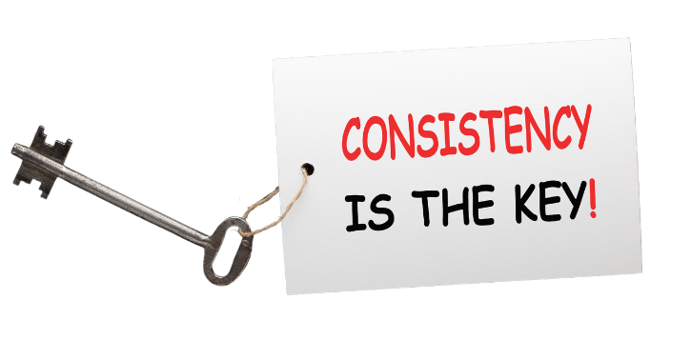
Consistency is the Key!
For the best taste testing results, be consistent in your procedure!
Notes:
Say: Consistency is the key to the process of taste-testing. The same procedure must be followed for each recipe so that you confidently know that the ratings are based on the different recipes and not on differences in the process. You follow this concept every time you make a recipe. You make it the same way each time to be standardized and yield the exact servings. And you avoid things that could potentially contaminate the recipe.
Here’s an example of how inconsistency in the procedure may affect the evaluation ratings. For recipe 1, you have a station where students learn about the recipe’s different ingredients and from where those ingredients are sourced. The students rate this recipe very highly. For recipe 2, you are short on support and cannot provide a station that gives the students any information on the recipe. Instead, they go straight to taste testing and then evaluation. This recipe is rated significantly lower than the first. Because the procedure was changed, you don’t know if the students really didn’t like recipe 2 as much or if the testing environment altered their perception and, therefore, the ratings of recipe 2.

Slide 17
Student Taste-Testing Components
Informing & educating
Taste Testing
Evaluation
Notes:
Say: To maintain consistency and make the information and process clear to students, consider setting up the taste-testing in stations that align with the defined phases. You want to avoid overwhelming the student with information, tasting, and then evaluation, all in one place. Also, peer influence can impact ratings!
Let’s look at each phase in more detail.

Slide 18
Informal and Educating Ideas
Tell them why a new recipe was developed
Identify the different ingredients that make up the recipe
Describe how it was prepared
Tell the students what nutrients the ingredients provide and how they help the body
Show where the local ingredients are grown on a state or county map
Notes:
Say: Here are some ideas to inform and educate the students on the recipe.
Tell them why a new recipe was developed
Identify the different ingredients that make up the recipe
Describe how it was prepared
Tell the students what nutrients the ingredients provide and how they help the body
Show where the local ingredients are grown on a state or county map
Keep this phase based on factual information and avoid biasing the student. For example, avoid saying, “You’re really going to love this new entree we created,” instead, say something such as, “This new entrée is made from tomatoes grown by a local farmer.”
Write a script for your support team so everyone says the same thing each time.
Color graphics and presentation material will grab the attention of the students.
Now, the student moves on to taste-testing.

Slide 19
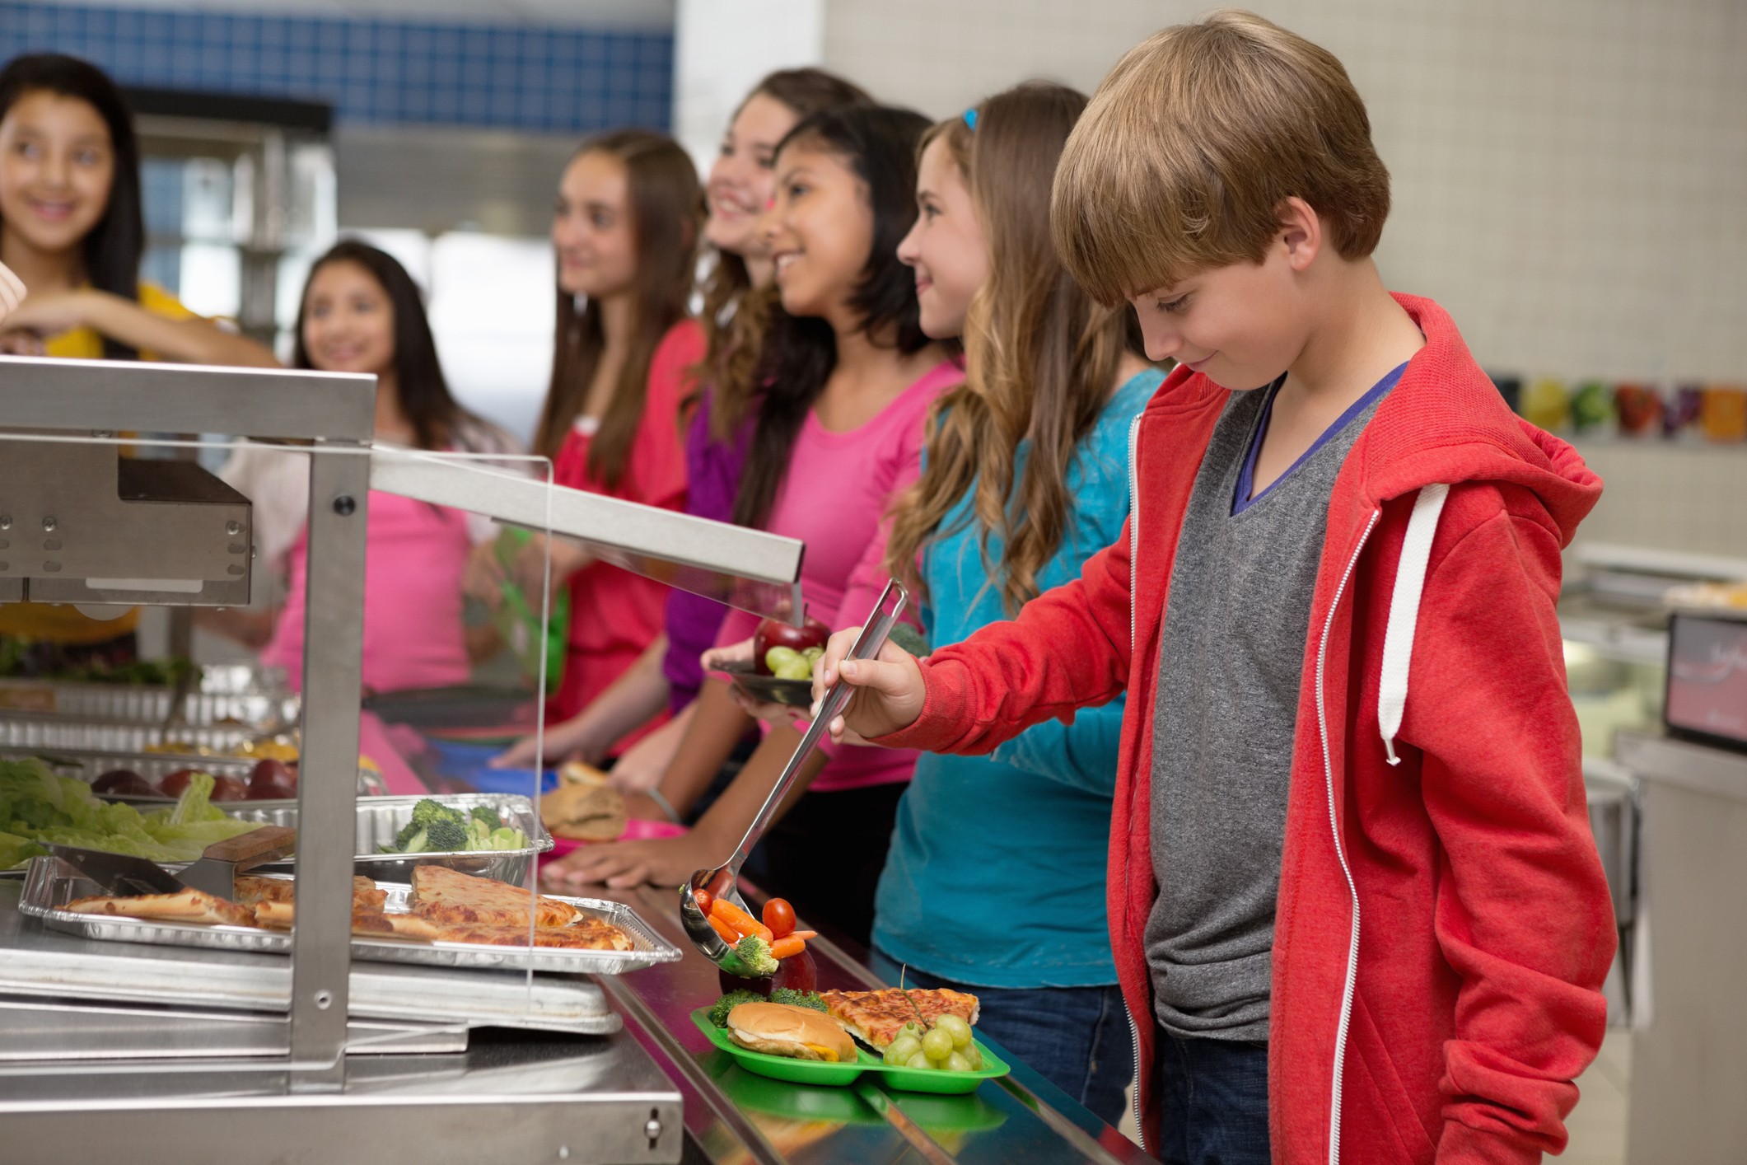
Formal Taste Testing Guidelines
Test the recipe at the time of day it will be served
Serve the recipe the way it would typically be served
Keep the introduction simple
Avoid biasing the student with any comments
Give the student ample time to taste the sample
Notes:
Say:
Formal taste testing should mimic how the recipe would be served if offered as a menu item, including the time of day and how it would be served.
The person providing the sample should give the student the sample and tell them what they are tasting. However, they should avoid biasing the student. For example, they should avoid saying things such as, “Isn’t that sweet flavor great?”
Keep the introduction simple: Hi, we are making new recipes for [mealtime], and we want to know how they taste to you.
Give them the sample: This is [recipe name]. Here is a sample for you to taste.
The student should have ample time to taste the sample before being asked to provide an evaluation.

Slide 20
Evaluation Guidelines
Provide the students with a taste testing ballot. The VDOE-SCNP has developed taste testing ballots for elementary school and secondary students.
Read off the instructions and options for younger students or students who look hesitant or confused.
If there is time, ask the student for open-ended feedback at the bottom of each form.
Minimize student interaction, if possible, as peer influence is a factor.
Notes:
Do: Review the below.
Provide the students with a taste testing ballot. The VDOE-SCNP has developed taste testing ballots for elementary school and secondary students.
Read off the instructions and options for younger students or students who look hesitant or confused.
If there is time, ask the student for open-ended feedback at the bottom of each form.
Minimize student interaction, if possible, as peer influence is a factor.

Slide 21
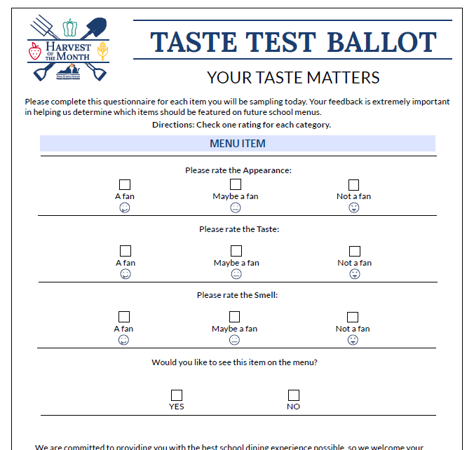
Evaluation Form
Notes:
Say: Here is an example of the taste testing ballot for secondary students developed by the Office of School and Community Nutrition Programs. There is also a ballot for elementary students, and both ballots have been provided as handouts. After collecting all the ballots, you will tally the counts for each question.

Slide 22
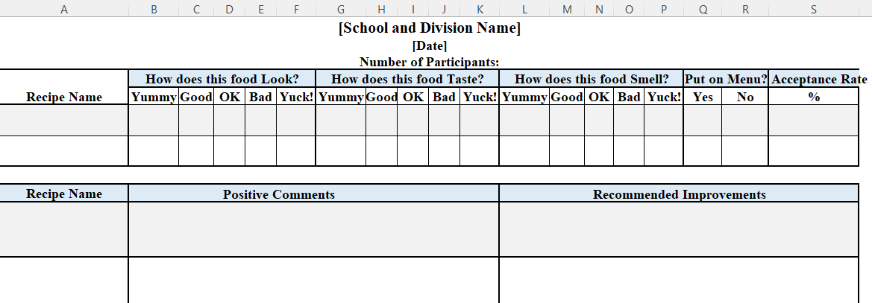
Data Entry
Use the taste testing summary sheet
Notes:
Say: Once you collect the data, you can use the taste testing summary sheet developed by the VDOE-SCNP to enter the total counts. This is a screenshot of this spreadsheet, and the spreadsheet is included as one of your handouts.

Slide 23
Additional Insight
Calculate a percentage for each response category for taste, look, and smell questions.
Example: 50 students tested the recipe. For the appearance, 15 said they were a fan, 30 were maybe a fan, and 5 were not a fan.
The calculations for each response category:
  15 divided by 50 multiplied by 100 equals 30%
  30 divided by 50 multiplied by 100 equals 60%
  5 divided by 50 multiplied by 100 equals 10%
Notes:
Say: After calculating the approval rating, you can gain additional insight by calculating a percentage for each response category for the taste, look, and smell questions.
For example, 50 secondary students tested the recipe. For the appearance question, 15 said they were a fan, 30 were maybe a fan, and 5 were not a fan. The corresponding percentages for these responses would be 30%, 60%, and 10%.

Slide 24
Calculating the Approval Rating
To calculate the approval rating, use the question asking if the students would like to see it on the menu.
Example: 50 students tested the recipe. 10 students said they would like it on the menu.
  The approval rating is: 10 divided by 50 multiplied by 100 equals 20%
Notes:
Say:
To calculate the approval rating, use the question asking if the students would like to see it on the menu.
In the example given, if 50 students tested the recipe and 10 students said they would like it on the menu, then the approval rating would be 20%.
If the percentage does not meet 70%, as it didn’t in this example, then the recipe needs to go back to the recipe development team for revision and re-evaluation. Any student re-testing should be done with a different group than those initially tested in the first round.

Slide 25
Analysis of
Open-Ended Comments
Open-ended comments are used for additional insight.
They can be categorized according to comments about taste, texture, smell, appearance, etc.
Once categorized, the number of comments in each category can be counted.
Comments are extremely helpful if the recipe needs to be revised and re-evaluated.
Notes:
Say: Don’t forget the open-ended comments. These comments are useful for getting a deeper understanding of what students thought about the taste, texture, smell, appearance, and anything else they commented on. You can categorize them into these attributes and then see how many comments are in each and what the nature of the comments are.

Slide 26
Summary
Taste testing is an activity that can be used to:
  Encourage the consumption of new menu items and foods
  Increase awareness and education about different foods
  Test and revise a new recipe
Identify your objective
Choose the appropriate method
Conduct the taste testing
Use the results to inform your original objective
Notes:
Do: review summary.
Taste testing is an activity that can be used to:
Encourage the consumption of new menu items and foods
Increase awareness and education about different foods
Test and revise a new recipe
Identify your objective
Choose the appropriate method
Conduct the taste testing
Use the results to inform your original objective
And now, I’m going to hand the presentation over to Dr. Beverly, who is going to talk about promotional activities.

Slide 27
Promotional Activities
Objectives:
  Explain how promotional activities are essential to the success of school nutrition programs.
  Describe how promotional activities contribute to a healthy school nutrition environment.
  Identify opportunities to launch or expand promotional activities.
  Identify resources for promotional activities.
Notes:
Say: Thank you, Ursula! At the beginning of today’s presentation, Ursula reviewed the webinar objectives, and the slide provides a review of the objectives for this section of the webinar. We will now talk about promotional activities, and how to make them work for you. Our first objective is to explain how promotional activities can contribute to the success of your school nutrition program. Next, we will describe how promotional activities contribute to a healthy school nutrition environment. Then, we will identify opportunities to launch or expand promotional activities. And finally, we will wrap up the webinar with some suggested resources for promotional activities.

Slide 28

Identify the Goal of the Promotion
SMART goals are:
  Specific
  Measurable
  Achievable
  Realistic
  Timely
Notes:
Say: In order for a promotion to be successful, you need to have a well defined goal. It needs to be specific, measurable, achievable or attainable, relevant, and time-bound. Does that sounds familiar? If you have used SMART goal development in the past, this is a great time to put those skills to work. Let’s think about what it is you want to accomplish with your promotion. Is your goal to increase breakfast participation at the elementary school level, or at a single elementary school? Are you trying to convince more students to drink milk at breakfast? Or is your goal to promote a certain vegetable, let’s say broccoli, during Harvest of the Month? Whatever your ultimate goal, using the SMART goal criteria will get you well on your way to achieving your goal. Let’s look at an example.

Slide 29
Increase Milk Selection at Breakfast
Specific: Increase milk selection at three elementary schools where breakfast milk selection is currently low, at less than 50% of meals served including milk.
Measurable: Increase milk selection to 70% of all breakfast meals served to include fluid milk.
Achievable/Attainable: Yes, with the appropriate promotion and monitoring.
Relevant: Very much so! Milk is an important source of calcium and protein for school-aged children.
Time-Bound: Establish a date, such as April 15, 2024.
Notes:
Say: Establishing a SMART goal, at the very onset of a promotion, essentially gives you a road map of what you are trying to accomplish. You want to make sure the goal is realistic and worth pursuing before you put a lot of time and effort behind a promotion. Let’s see how we might use this information to develop an attainable goal.
We need the goal to be:
Specific: Increase milk selection at three elementary schools where breakfast milk selection is currently low, at less than 50% of meals served including milk.
Measurable: Increase milk selection to 70% of all breakfast meals served to include fluid milk.
Achievable/Attainable: Yes, with the appropriate promotion and monitoring.
Relevant: Very much so! Milk is an important source of calcium and protein for school-aged children.
Time-Bound: Establish a date, such as April 15, 2024.

Slide 30
SMART Goal
The goal of the promotion is to increase student selection of milk at three elementary schools from the current 50% of meals served, to 70% of meals served, by April 15, 2024.
Notes:
Say: So here, you have your SMART goal statement: The goal of the promotion is to increase student selection of milk at three elementary schools from the current 50% of meals served, to 70% of meals served, by April 15, 2024.
This detail will help guide you through the promotion and will constantly remind you and anyone else involved in the promotion of exactly what the intended goal will be. As you can see, this promotion focuses on only three elementary schools. You may have only three elementary schools, or you might have twenty elementary schools. Regardless, the current situation is that at each of these three elementary schools, only 50% of students are selecting milk with their breakfast, and you have established 70% as the goal you want to reach by April 15th of this year.

Slide 31

Focus!
Notes:
Say: An important part of goal development is not to generalize the intent and results of the promotion. In this particular milk promotion, we indicated that the goal was to increase milk selection. This does not mean we will necessarily increase milk consumption. It’s important to stay focused on what can be accomplished, and what can be measured. If the intent of the promotion was to increase milk consumption, additional measures, such as a plate waste survey, or measuring the amount of milk actually left over from each breakfast tray, would need to be included. So again, it’s important to stay focused on the goal and the objectives set in place.

Slide 32
Essential to Your Success
You have an opportunity to “sell” the tangible and intangible benefits of your school nutrition program
It’s a great way to connect with your customers
You may educate or clarify details about your services to an expanded customer base
Promotional activities work!
Notes:
Say: Have you heard the old saying, “you’re just singing to the choir”? If you aren’t getting the word out to the people who need to hear your story, you are just talking with the people who are already on your team, or those who are already familiar with your services. This sometimes happens in school nutrition. We do GREAT work within our programs, but forget to tell people our story! We labor away behind the scenes, but fail to get the exposure we need to promote products and services to our customers. That’s why promotional activities are essential and vital to your success. Let’s consider WHY promotional activities are vital to your program’s success.
#1 – In school nutrition, we truly are selling tangible and intangible benefits. Every child who eats a meal with your program has received a tangible benefit, but the hidden benefits of a healthy diet, readily accessible nutrition services, providing balanced nutrition 180 days of the school year – these are intangible benefits that add value to the student’s school life experience, but it’s not an actual school meal.
#2 – Promotional activities are a fantastic way to connect with your customers! We will talk more about that in a few minutes.
#3 – One of the benefits of promotions in school nutrition is that you may be able to educate or clarify details about your services to an expanded customer base. Parents who view your menus online but never visit a school cafeteria make decisions on a daily basis about whether their student eats with you or not. So, it’s very important that your outreach via promotions are targeted to specifically what you want to accomplish. Do you want to extol the benefits of Virginia apples? A promotion is a great way to create excitement and make it happen.
#4 – The most important reason to invest your time and effort into promotions is that they work. They increase exposure, and can introduce a fun factor, or education, or any number of things, but overall, promotions help you get the word out about the benefits of school meals.

Slide 33

Opportunities for Promotions
Notes:
Say: So, what are some opportunities for promotions? Because our audience and clientele is predominantly students, the sky really is the limit. We will talk about specific activities in a few minutes, but take time to think about what you have done in the past, or develop ideas for what you would like to do in the future, as we discuss the importance of price, placement, signage, and the customization needed for an effective promotion.

Slide 34
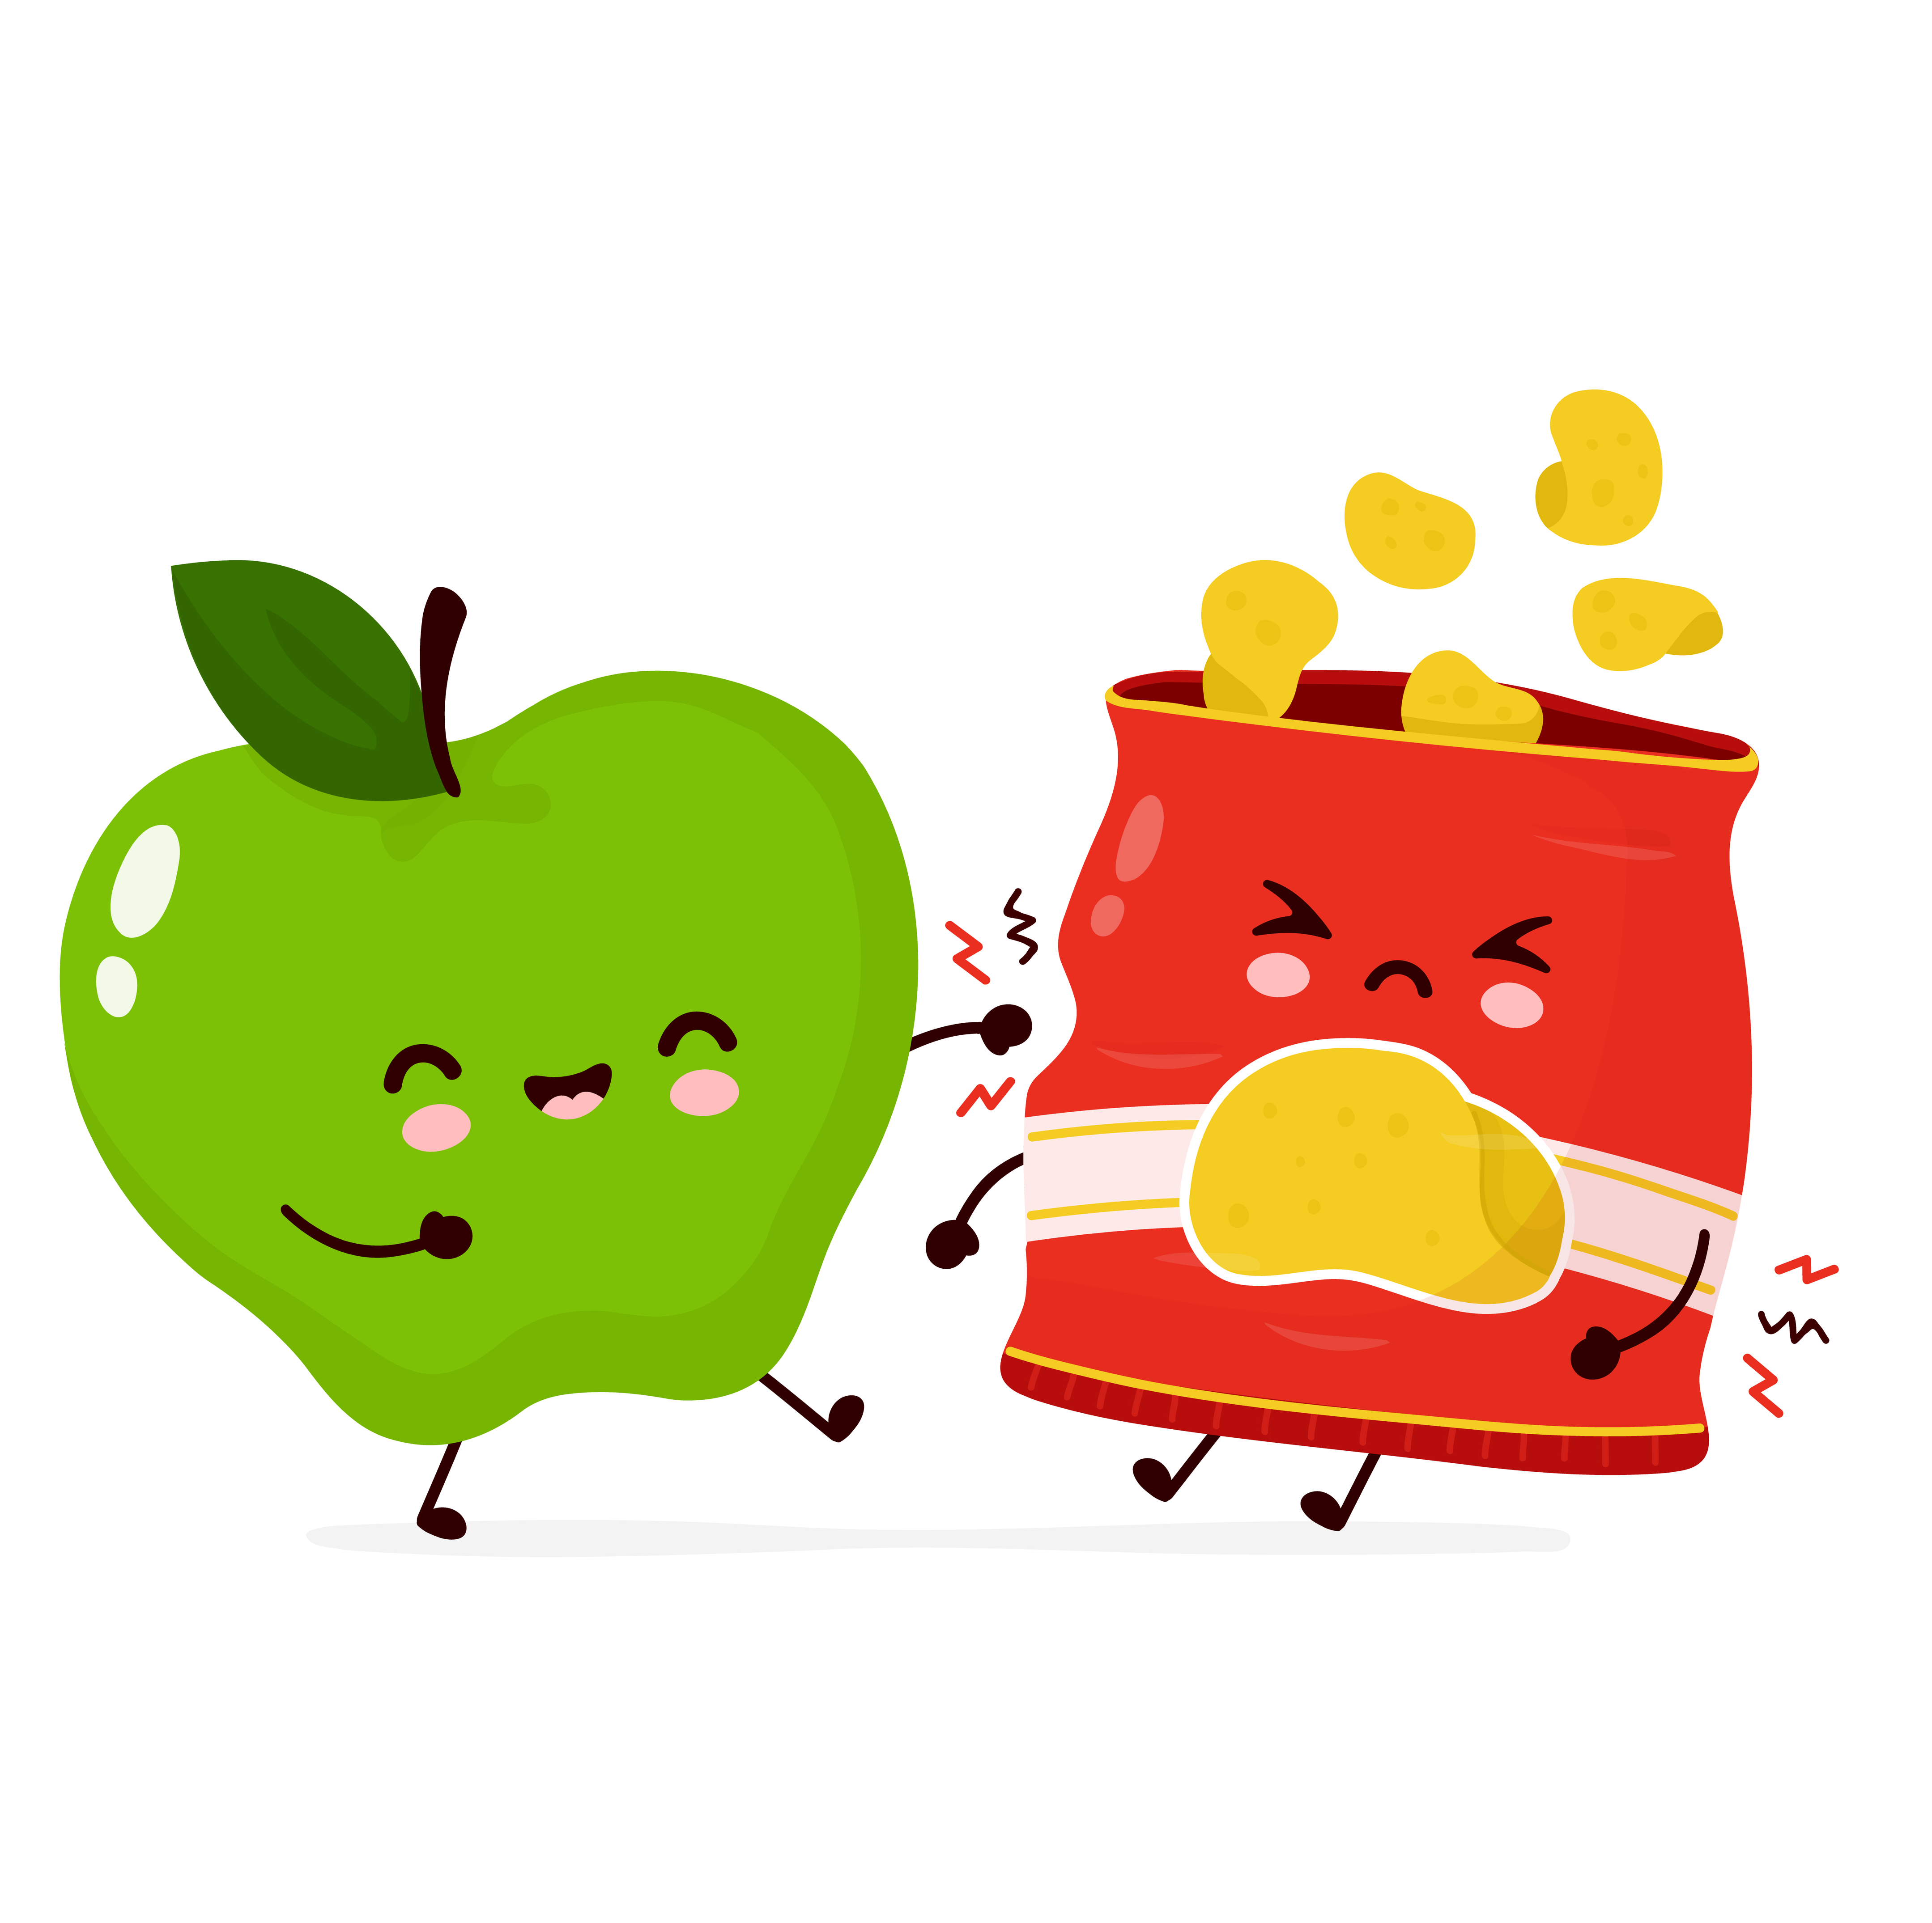
Price
Notes:
Say: One of the most important decisions you can make as a school nutrition director is to establish pricing for a la carte items to promote healthy food selection. How do you do that? Let’s look at an example of a fresh apple versus a bagged snack item. Let’s say that both items cost $.35 for you to purchase from your distributor. If you are operating at a 42% food cost, the price of these items should be about $.83. However, if your desire is to increase the likelihood of a student purchasing the apple instead of the snack, you would want to decrease the calculated purchase price of the apple, let’s say to $.50 or $.75, and increase the price of the bagged snack item to $1.00 or $1.25. Remember, both items cost your program the same amount to purchase, but strategic pricing helps you promote the healthier item over the less healthy item.

Slide 35
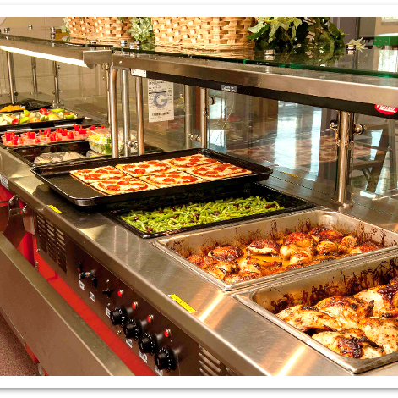
Placement
Notes:
Say: Placement on the serving line is another way to promote the selection of healthy foods. Beautiful presentation on a serving line, within easy reach of students, is one of the best ways to make foods not only accessible, but appealing to customers. You have heard of impulse buys at a grocery store? We could use these same techniques to place the foods we most want students to select in the best location on the serving line.

Slide 36
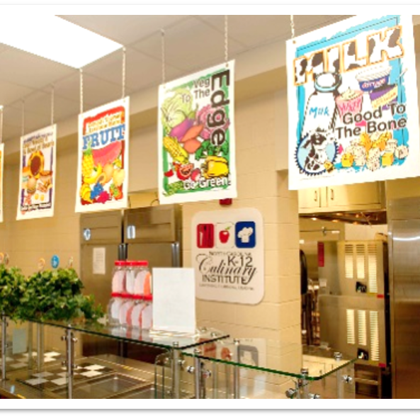
Signage
Notes:
Say: A sometimes overlooked area in school kitchens is signage. Students should be able to read what’s on the menu before they approach the serving line. Menu boards and electronic menu signs can help “sell” the meal. Appetizing descriptions can help pique a student’s interest. Signage directly on the serving line, identifying a food item, can help curtail the “What is that?” question that can be asked dozens of times a day!

Slide 37
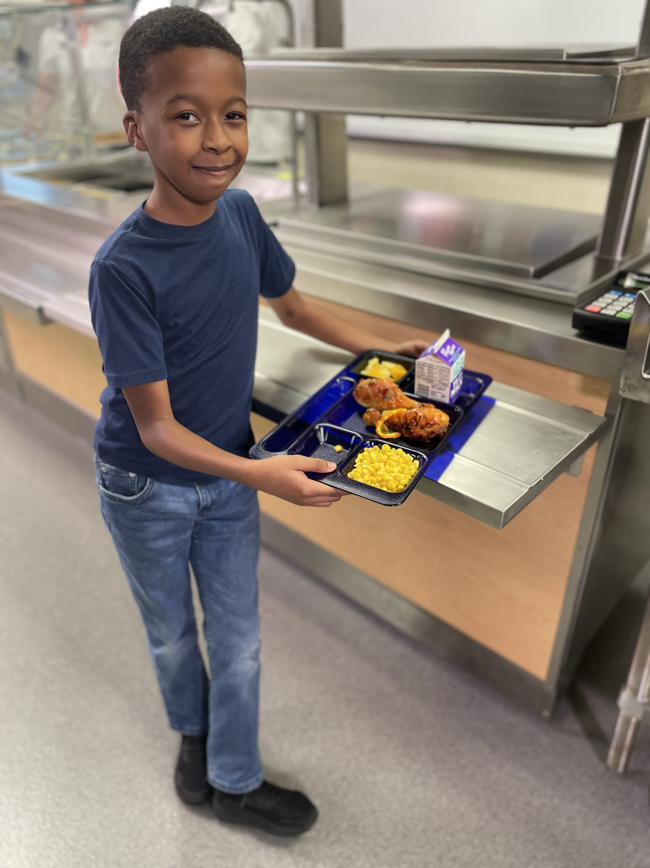
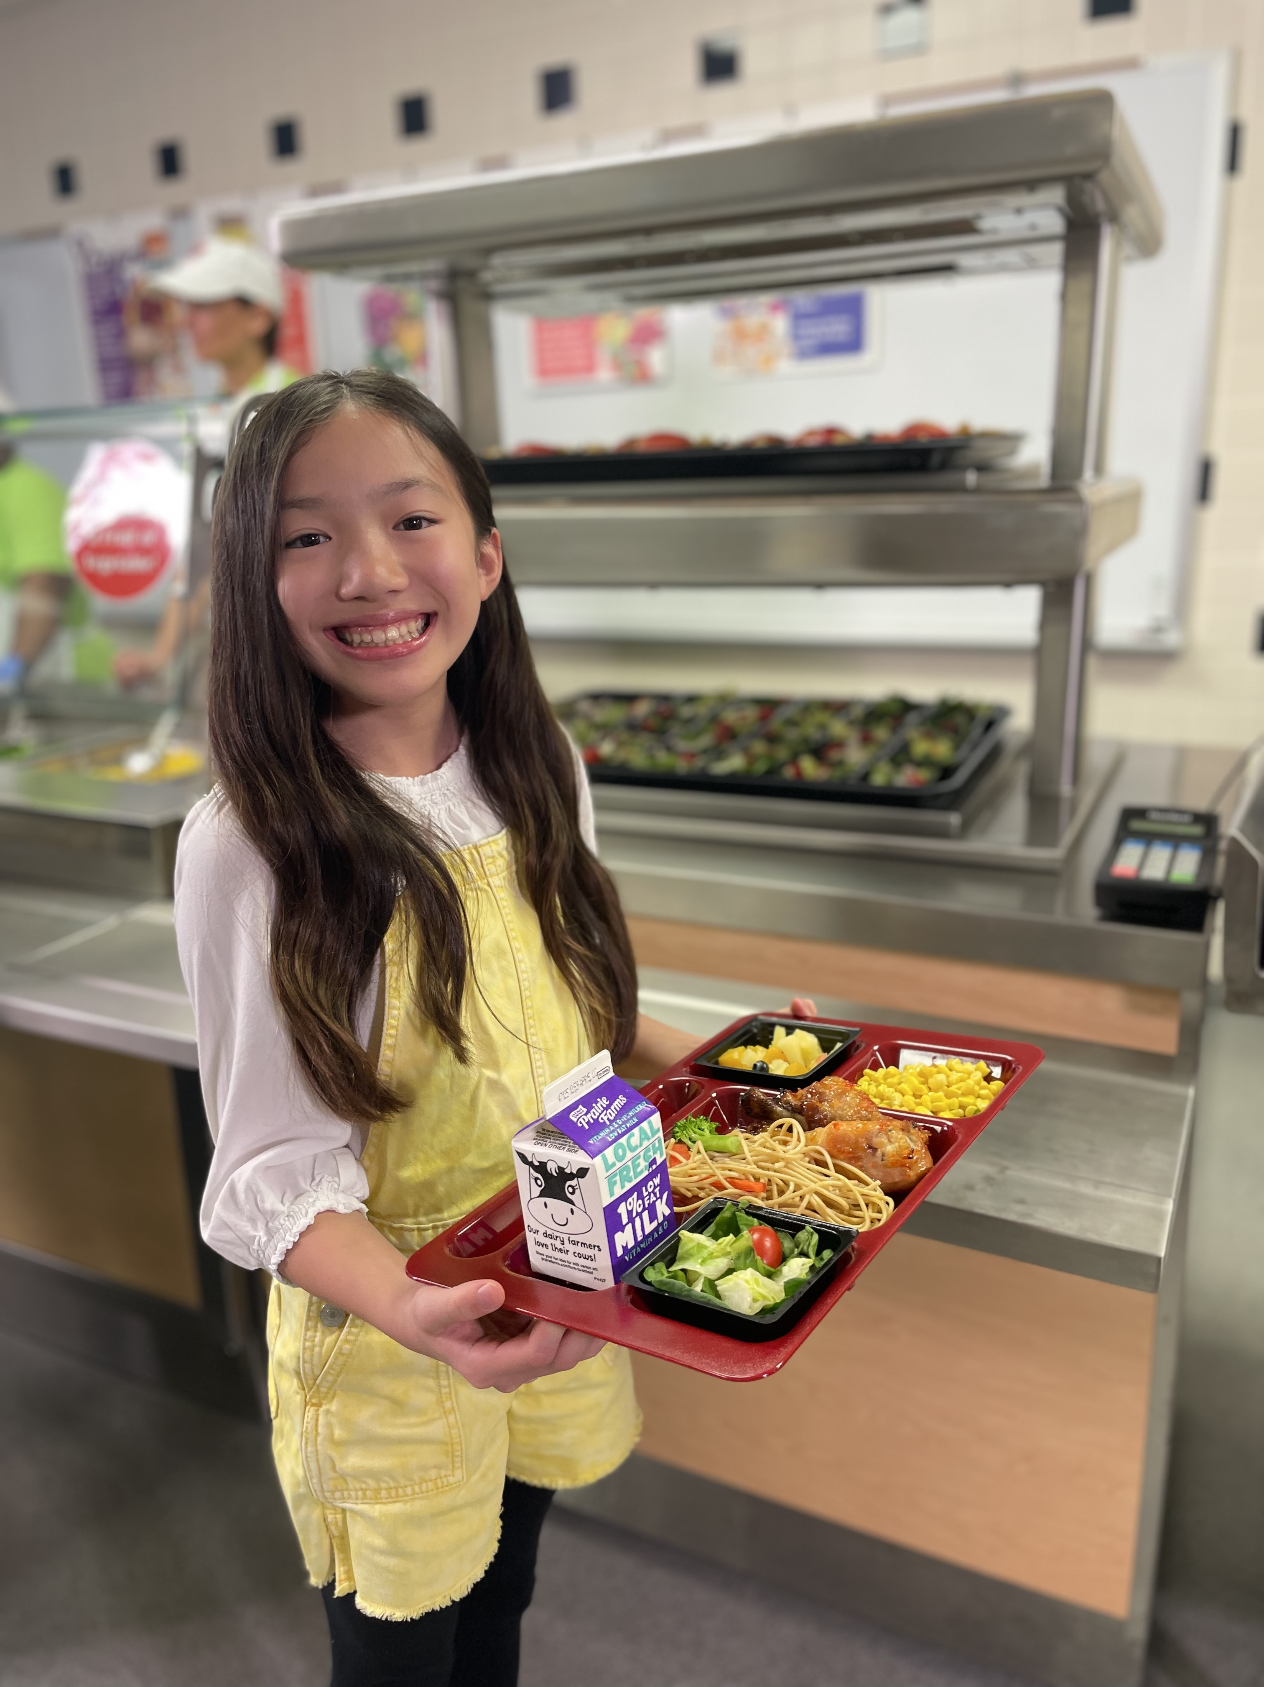
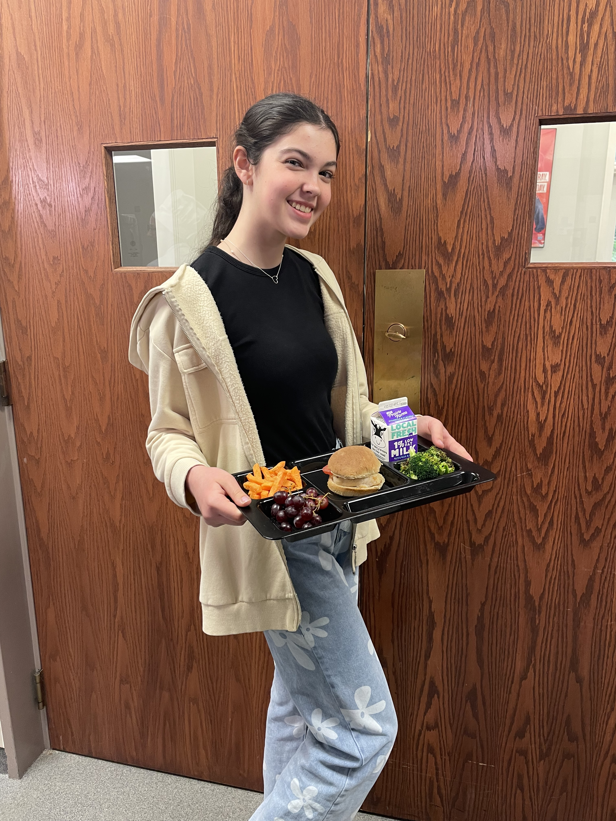
One Size Does Not Fit All!
Notes:
Say: Another thing to keep in mind as we set the stage for promotions is that one size truly does not fit all. Remember when we talked about the 3 elementary schools where the goal was to increase milk selection at breakfast from 50% of meals served to 75% of meals served? The actual promotion and related activities would look very different at the middle school or high school level. Approaches that work well at a high school may be too sophisticated for younger students. Again – think about the audience and what appeals to them.

Slide 38

Breakout Activity!
Share a promotion you have sponsored in the past with your assigned Breakout Room participants.
  What were your objectives?
  How did you structure the promotion?
  What went well?
  What challenges did you face, and what might you do differently next time?
  Were there measurable effects of the promotion?
Notes:
Say: Keeping all of this in mind, we are now going to a Breakout activity. During this activity, you will be assigned to breakout rooms. Please share a promotion you have sponsored in the past with your fellow breakout room participants, and please answer the following questions:
What were your objectives?
How did you structure the promotion? In other words, what key issues did you keep in mind as you developed the promotion?
What went well with the promotion?
What challenges did you face, and what might you do differently next time?
And finally, were there measurable effects of the promotion, such as an increase in breakfast participation?
You will have 5 minutes in your Breakout Room, and then we will come back together to provide an overview.
Do: Pause recording!

Slide 39
Breakout Activity Responses
What were your objectives?
How did you structure the promotion?
What went well?
What challenges did you face, and what might you do differently next time?
Were there measurable effects of the promotion?
Notes:
Do: Resume recording!
Say: Now, please go to the Chat Box and share what you said, or what you heard, answering the following questions:
What were your objectives?
How did you structure the promotion?
What went well?
What challenges did you face, and what might you do differently next time?
Were there measurable effects of the promotion?

Slide 40
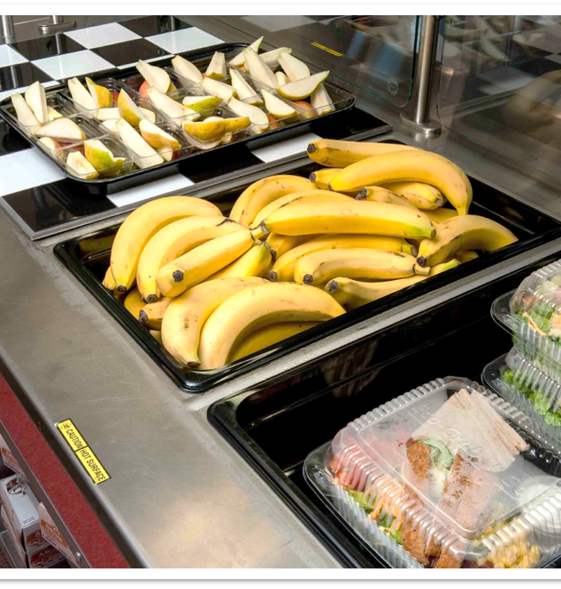
Healthy School Nutrition Environments
Notes:
Say: One of the most important things we can do in school nutrition programs is to promote healthy, balanced meals. However, the school nutrition environment reaches further than only the cafeteria and the school nutrition program. The Centers for Disease Control describes a healthy school nutrition environment as “An environment that provides students with nutritious and appealing foods and beverages, consistent and accurate messages about good nutrition, and ways to learn about and practice healthy eating throughout the time children spend on school grounds – including before and after school.” As you develop promotions and promotional activities, keeping the reimbursable meal at the forefront of your promotion is vital to your program. You want to emphasize the foods you want students to select. As you develop promotions, it’s also important to think about the broader school environment. Is the school nutrition program the primary advocate of healthy eating, or do you have others at the school who help to promote your goals? Conversely, is the school nutrition program the only proponent of healthy eating? Your promotions will be much more successful when different players within the school are aligned with your goals.

Slide 41


Value of Promotions
Increased participation
Improved familiarity and understanding of the school meals program
Notes:
Say: The value of promotions will be determined by their outcomes. Take a look at the two goals listed on the slide. The first is increased participation, which is a worthwhile goal. But what it does not indicate is whether the participation is at breakfast, lunch, the Fresh Fruit and Vegetable Program, supper? We don’t really know. The second goal of improved familiarity and understanding of the school meal program also sounds great, in theory. Again, without the details, we don’t really know what to expect, or what the ultimate value of the promotion will be.

Slide 42



Comprehensive Approach
Classroom
Cafeteria
Home
Notes:
Say: One of the best ways to bring value to a promotion is to tie the classroom, the cafeteria, and home together in one comprehensive approach. Think about a promotion where you tie all three components of a student’s experience together to reinforce a promotional activity. I’ll give you an example. Let’s say you want to launch a promotion for Virginia apples. Here’s how you could approach the promotion:
Classroom: Elem - coloring sheets, stickers, a story about apples. Johnny Appleseed, anyone?
Middle School – a map of VA with apple growers; maybe a history lesson tied to apples
High School – the nutritional benefits of apples; overall health benefits; a local farmer classroom guest who talks about his/her experiences in local agriculture
Cafeteria – posters, different types or colors of VA grown apples; pricing to promote apple purchases; placement on the serving line
Home – parent newsletter informing them of VA apple promotion; asking for parent volunteers for a field trip to a local apple grower
Say: Now, think about how you could tie all of the important groups together to help reinforce a promotion. If you can get teachers to partner with you on a promotion, you have accomplished the mission of involving the classroom. It’s always a good idea to communicate an upcoming promotion to administration to ask for their buy-in and simply to let them know there may be more celebration and fun in the cafeteria than on a normal school day!

Slide 43
Tried and True
National School Lunch Week: October 14-18, 2024
National School Breakfast Week: March 4-8, 2024
Virginia Farm to School Week: October 7-11, 2024
Crunch Heard ‘Round the Commonwealth: October 7-11, 2024 (one day)
Notes:
Say: Some of you already have promotions you sponsor each year. Maybe you have an extensive promotion, or maybe, just maybe, the promotion is a little stale? Maybe it’s time to infuse a little life into the promotions?

Slide 44

Let's chat!
New year, new ideas!
Notes:
Say: What additional promotions, other than those we just discussed, or that you mentioned during the Breakout Rooms, would you like to pursue in the future? We are only in the month of February, so there is still plenty of time left in the 2023-24 school year, and you might want to start planning for the 2024-25 school year! Remember – it’s perfectly fine to borrow an idea from your neighbor! Whatever you decide to implement will be new to your division! So, let’s go to the Chat Box and hear some of your ideas.

Slide 45

Contributing to a Healthy School Environment
Keep focus on healthy foods
Focus on nutrition as a key area of concern in schools
Notes:
Say: We reviewed the importance of a healthy school nutrition environment. Now, let’s be specific about promotions and promotional activities that contribute to an overall healthy school nutrition environment. (READ SLIDE)

Slide 46
Promotions Calendar
January
February
March
April
May
June
July
August
September
October
November
December
Notes:
Say: When thinking about the current year, or the upcoming school year, it’s a good idea to develop a promotions calendar. We are going to “fill in the blanks” in just a few minutes, but based on the ideas we just heard, please give some thought to the months ahead as we continue our discussion.

Slide 47
Get the Word Out!
Friends!
Division-wide and community advocates
Participation in wellness fairs
Community events
Notes:
Say: We talked about the different areas to emphasize during promotions, such as the classroom, cafeteria, and home. So now, we want to be more specific about how to get the word out and offer promotions. First, it really does help to have friends! Whether it’s industry partners who have promotional materials, give aways, or advocates within your division or community, it helps to have support as you plan promotions. If your school division or individual schools participate in a 5K, it would be a good idea to show up, as a participant, or as a helper. Any time you can be seen as a team player, interested in the school division beyond only your areas of responsibility, you are representing and promoting school nutrition! When you and your team participate in Wellness Fairs or community events, you increase your exposure to a broader community, and may have the help you need to launch your promotion.

Slide 48
Launching or Expanding Promotions
Fuel up to Play 60
Commodity Groups
  The Pear Board
  The Watermelon Board
  The Peanut Board
Notes:
Say: We indicated on the last slide that it really does help to have friends to make promotions work. Industry partners, such as manufacturers and brokers may have promotional materials for you. Without mentioning specific manufacturers, think about those who have helped you in the past, or who may be able to help you sponsor a promotional activity in the future. This is a good starting place. Commodity groups, such as the Pear Board, who represents farmers, have materials you can use. The National Dairy Council, partnering with the National Football League, and USDA, sponsor Fuel Up to Play 60, which provides a tremendous opportunity to emphasize physical activity and school nutrition at the same time! But the promotions can be much simpler. Holidays, theme days, school spirit days – school nutrition promotions can be tied to any of these events!

Slide 49
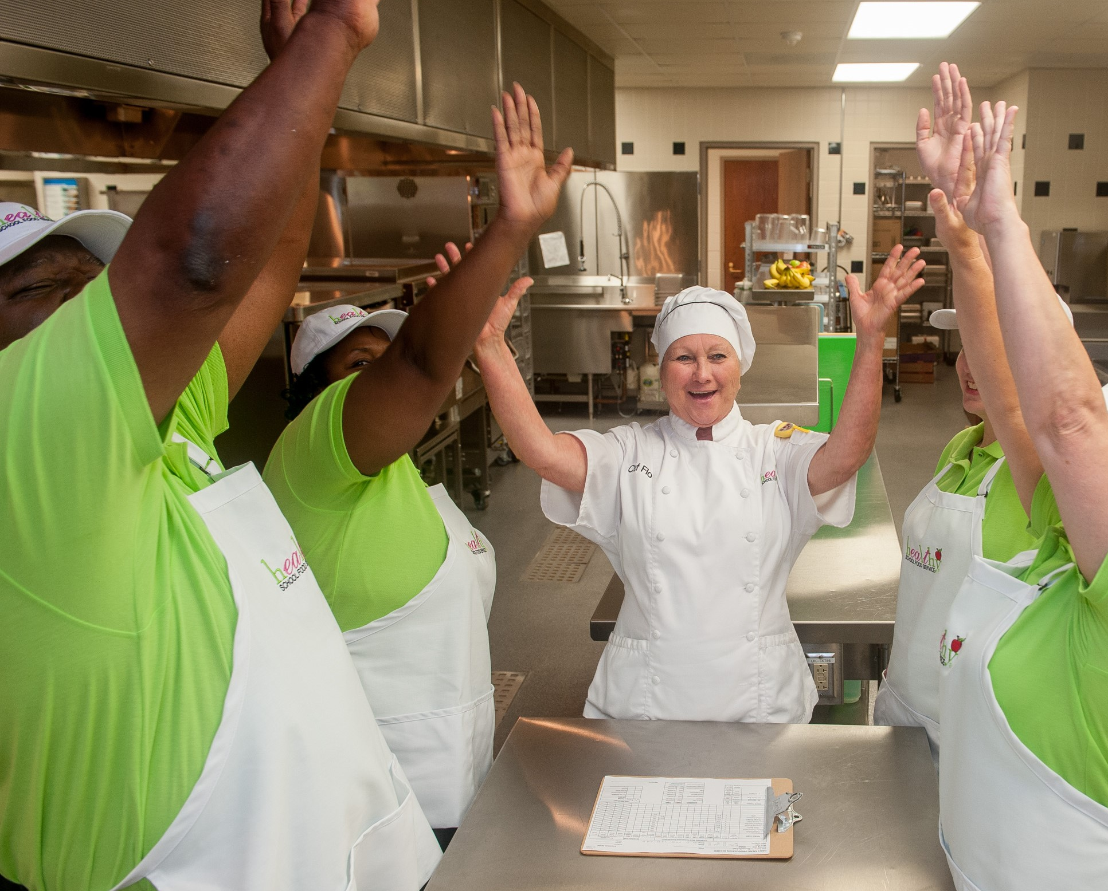
Engaging SNP Staff
Notes:
Say: It’s very important to engage School Nutrition Program staff in promotions and promotional activities. No matter where you are in the Commonwealth of Virginia, the real work of school nutrition, feeding children, occurs in schools. Providing a detailed description of the promotional activity, gaining staff buy-in, creating excitement, and explaining the desired outcome, is necessary to have a successful promotion. And don’t forget to ask your staff for promotional ideas – they tend to be very in touch with what students really like and want to see!

Slide 50

Student Advisory Groups
Notes:
Say: The involvement of student advisory groups may have lessened somewhat during the pandemic, but now is a good time to connect with students and find out what they want, and how they perceive the school nutrition program. Students can provide real and accurate ideas for promotions they want to experience. Remember, the more buy-in you can get from students and your own team, the greater the likelihood of success! The question of how to increase participation, of particular concern to CEP schools in which all students qualify for free meals, may be answered by Student Advisory Groups. Is it the menu? Is there not enough time for students to stand in line and eat? Is transportation during the morning hours keeping students away from the breakfast program? There is a tendency to ask students who already participate in the school meal program to serve on an advisory committee, when who you really may need to hear from are the students who currently do not participate. Is there a specific type of promotion that might reach current non-participants? You won’t know until you ask!

Slide 51
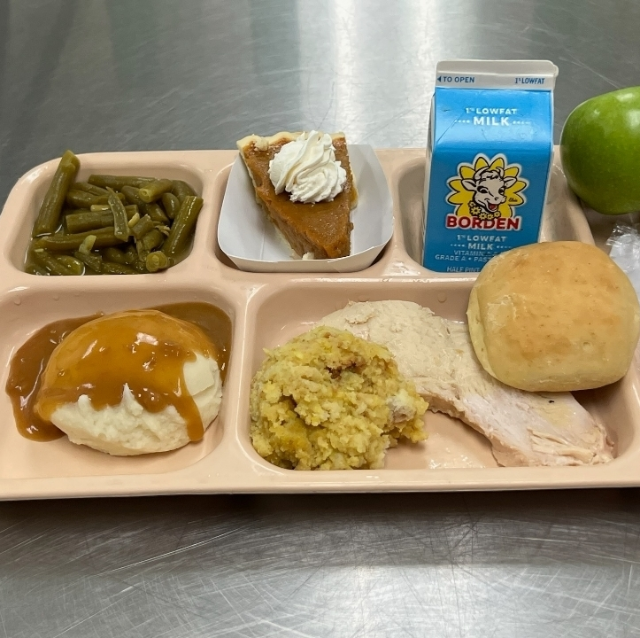
Theme Days and Holidays
Picture from Russell County Public Schools!
Notes:
Say: As we think about promotions, every month of the year has a holiday or theme you can borrow to have fun at lunch. With the use of a SMART goal, why not tie these promotions to specific goals of your program? The annual Thanksgiving Dinner might provide an opportunity to invite parents to eat lunch, with the goal of expanding overall outreach to parents, and even inviting parents to become part of the School Nutrition team! Pirate Day with peg-leg chicken drumsticks could be tied into a visit with a local poultry farmer, and a goal of increasing student requests for chicken on the menu from two days a week to three or four days a week. You get the idea – whatever the promotion, be thoughtful about how you might get more bang for the buck, and accomplish a few of your objectives while having fun!

Slide 52

Promotions Calendar: January - March
January
  Happy New Year!
  MLK Jr Day
  100th Day of School
  Super Bowl Celebration
February
  Black History Month
  Valentine's Day
  President's Day
March
  National Nutrition Month
  National School Breakfast Week
  St. Patrick's Day
  Spring Break!
  Welcome to Spring
Notes:
Say: Let’s take a look at this promotions calendar again. Here are just some ideas to share with you, but this is just meant to be a thought starter for you. Make the promotions work for you, your students, your staff, and your division. Take a look at the ideas on the slide, and go to your Chat Box to give us more ideas for our promotions calendar!
Do: Review slide.

Slide 53


Promotions: April - June
April
  Earth Day
  Spring Picnic
  Strawberry Extravaganza
May
  School Lunch Hero Day
  May 13th – Virginia Settlement Day in 1607
  Memorial Day
  Blueberries for All
June
  School's Out
  Last Week of School BBQ
  Welcome to Summer
  Cherries Jubilee
  National Go Fishing Day
Notes:
Say: Here are some ideas for April through June. Once again, please go to your chat box and give us some additional ideas! You will notice we just made up some of these promotions to coordinate with Virginia harvests…you can do the same!

Slide 54


Promotions: July - September
July
  4th of July
  International Joke Day
  Red Tomato Day
  A Summers Dream
  Watermelon Festival
August
  It's Just Peachy Day
  Friendship Day
  National Book Lovers Day
September
  Back to School Celebration
  Labor Day
  Hispanic Heritage Month
  ABC Produce Month
ABC
Notes:
Say: July and August may not be typically considered big months for school nutrition promotions, but they can be! If you have students in summer school, eating school meals, you still have a wonderful audience for a promotion! The idea is just to interject some fun into your calendar, but again, to bring attention to the school meals program. Remember, these don’t need to be actual holidays or theme days – they are promotions that you and your team can have fun with. Did you notice ABC Produce Month in September? I made that up. Why? Because there are produce harvests representing many letters of the alphabet in the month of September in Virginia, from apples to pears to squash to zucchini. Remember – have fun with this, but tie in the educational component of your promotion wherever possible. Please go to the Chat Box if you have other ideas you would like to share with your peers for the months of July through September.

Slide 55



Promotions: October - December
October
  American Cheese Month
  World Farm Animals Day
  Child Health Day
  Halloween
November
  Native American Heritage Day
  Veterans Day
  Thanksgiving Dinner
December
  International Mountain Day
  National Sock Day
  Winter Wonderland
  Christmas (or Holiday) Dinner
Notes:
Say: Some of the ideas are serious, some of the ideas are simply fun, like National Sock Day in December. But every time you appeal to the fun factor with students, you increase the likelihood that students will associate the school meal program with celebrations and enjoyment. And again, the idea is for you to develop a promotions calendar, before the beginning of the school year, that can be included on the menu, include planned celebrations, and provide a vehicle to connect with your customers. Back to the Chat Box if you have more ideas to share.

Slide 56
Allowable Costs and Potential Funding Sources
Prizes and rewards cannot be purchased with school nutrition funds.
National Dairy Council or other similar entities
Commodity groups, such as pears, potatoes, etc.
Manufacturers currently doing business with the SNP
Outside organizations may donate items
A PTO of school fund may assist with promotional items or rewards, especially when the promotion is geared toward school-based initiatives, such as decreasing chronic absenteeism, or increasing breakfast participation
Notes:
Say: One of the issues that often comes up regarding school nutrition promotions is this – who pays for it, and how do I legally fund promotions? It’s important to remember that any prizes or rewards cannot be purchased with school nutrition funds. Checking in with Crystal Crutchfield, the VA School Nutrition Programs Lead Compliance Specialist, there are a number of things to keep in mind if you plan to make giveaways part of your promotion.
Do: Read list.

Slide 57
Promotional Activities Resources
Action for Healthy Kids. Food and Beverage Marketing.
  https://www.actionforhealthykids.org/food-and-beverage-marketing
Action for Healthy Kids. Nutrition Education and Promotion.
  https://www.actionforhealthykids.org/nutrition-education-and-promotion
Alliance for a Healthier Generation. Promote Your Program.
  https://www.healthiergeneration.org/take-action/schools/promote-your-program
Notes:
Say: Finally, here are a few resources for you to consider as you plan promotions and activities for your school meals program.

Slide 58

Questions?
Notes:
Say: Thank you so much for committing to today's webinar.
Ask: Does anyone have any questions?

