Slide 1

Knife Skills, Equipment, and More!
Notes:
Record the webinar.
Say: Welcome!
Do: Introduce self briefly (no need for bio; name, credentials, and member of K-12 Culinary Team) and co-presenter.
Say: Remember that as we go through today’s webinar, the chat box is open for any questions and comments. We enjoy hearing from everyone and can learn a lot from each other. Please feel free to comment and ask questions in the chat anytime! We will monitor it together throughout this hour.

Slide 2
USDA Funding and Non-Discrimination Statements:
“This project has been funded at least in part with Federal funds from the U.S. Department of Agriculture. The contents of this publication do not necessarily reflect the view or policies of the U.S. Department of Agriculture, nor does mention of trade names, commercial products, or organizations imply endorsement by the U.S. Government.”
In accordance with federal civil rights law and U.S. Department of Agriculture (USDA) civil rights regulations and policies, this institution is prohibited from discriminating on the basis of race, color, national origin, sex (including gender identity and sexual orientation), disability, age, or reprisal or retaliation for prior civil rights activity.
Program information may be made available in languages other than English. Persons with disabilities who require alternative means of communication to obtain program information (e.g., Braille, large print, audiotape, American Sign Language), should contact the responsible state or local agency that administers the program or USDA’s TARGET Center at (202) 720-2600 (voice and TTY) or contact USDA through the Federal Relay Service at (800) 877-8339.
To file a program discrimination complaint, a Complainant should complete a Form AD-3027, USDA Program Discrimination Complaint Form which can be obtained online at: https://www.usda.gov/sites/default/files/ documents/ad-3027.pdf, from any USDA office, by calling (866) 632-9992, or by writing a letter addressed to USDA. The letter must contain the complainant’s name, address, telephone number, and a written description of the alleged discriminatory action in sufficient detail to inform the Assistant Secretary for Civil Rights (ASCR) about the nature and date of an alleged civil rights violation. The completed AD-3027 form or letter must be submitted to USDA by:
1. mail:
U.S. Department of Agriculture
Office of the Assistant Secretary for Civil Rights
1400 Independence Avenue, SW
Washington, D.C. 20250-9410; or
2. fax:
(833) 256-1665 or (202) 690-7442; or
3. email:
Program.Intake@usda.gov
This institution is an equal opportunity provider.

Slide 3

Objectives
Identify the best cutting boards and knives for school kitchens.
Explain different ways to protect and maintain a knife's cutting edge.
Summarize cutting techniques for preparing summer seasonal VA local produce.
Recall large equipment options for school kitchens.
List essential small equipment needed for scratch cooking success.
Notes:
Say: Let’s review today’s objectives.
Do: Review objectives.

Slide 4
Professional Standards – Learning Codes
Operations (2000)
  Food Production (2100)
Administration (3000)
  Facilities and Equipment Planning (3500)
Notes:
Do: Review professional standards learning codes.

Slide 5
Knife Skills
Notes:
Say: Let's begin with knife skills, starting with a discussion about necessary equipment for cutting success!

Slide 6
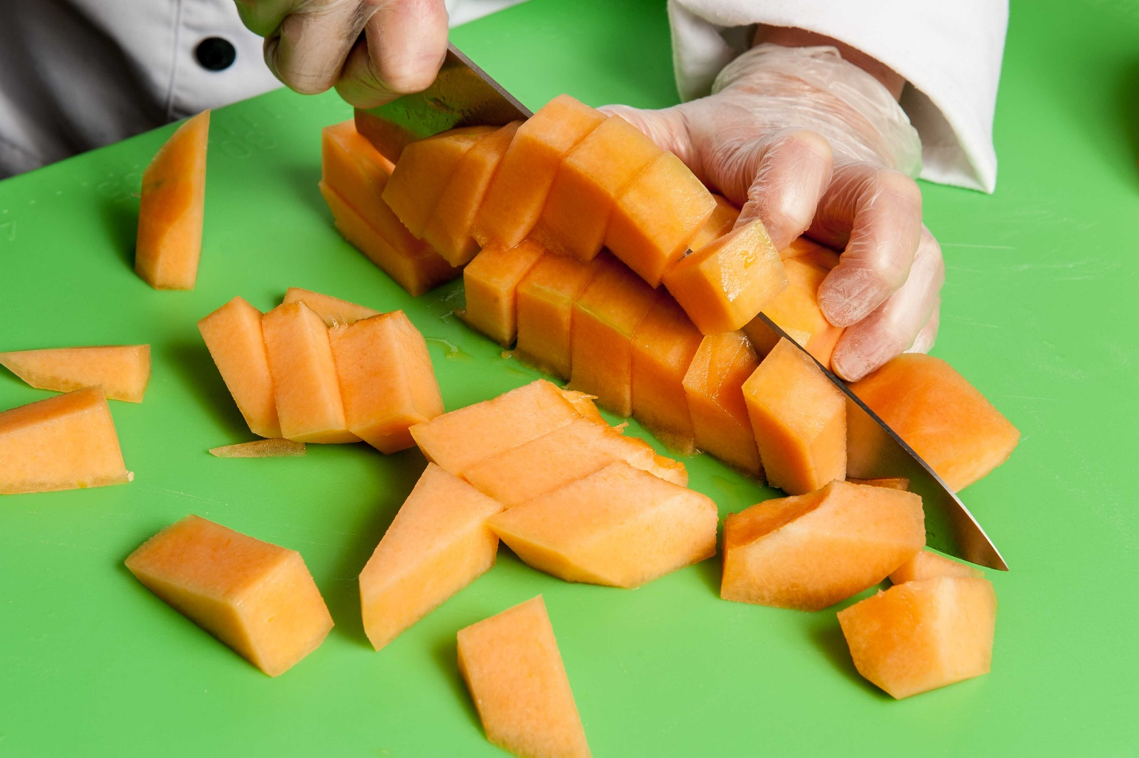
Cutting Boards – Material
Wood
Bamboo
Composite
Plastic
Rubber
Silicone
Notes:
Say: Cutting boards are widely used in school kitchens to protect the knife's edge, improve worker safety, and prevent cross contamination. It is essential that school chefs have access to enough cutting boards and know to always use them. We don't want to see slicing and dicing on other surfaces, like flat plastic trays (yes, we have seen this!).
Cutting boards are made from several different materials including bamboo, composite, plastic, rubber or silicone, and wood. We do not recommend wood cutting boards for school kitchens as they are more difficult to clean, sanitize, and upkeep.
Bamboo cutting boards are durable and eco-friendly, but not dishmachine safe.
Composite cutting boards are made from combined food-safe resin and wood fibers. They are dishmachine safe, durable, but more expensive than plastic.
Plastic cutting boards are made from polyethylene and have anitmicrobial additives. They are dishmachine safe, but note that boards with a thinner thicknesses may warp in high heat machines. Plastic cutting boards are the least expensive and lightweight. They are unfortunately susceptible to knife cuts and staining. It's always noticeable after chopping fresh green herbs!
Rubber or silicon cutting boards are non-absorbent and non-slip, but can be warped in high heat dishmachines. A positive is that knife cuts may be sanded away.
Ask: Which is the best for school kitchens? Let's see what you think!
Do: Run poll and then review answers.

Slide 7
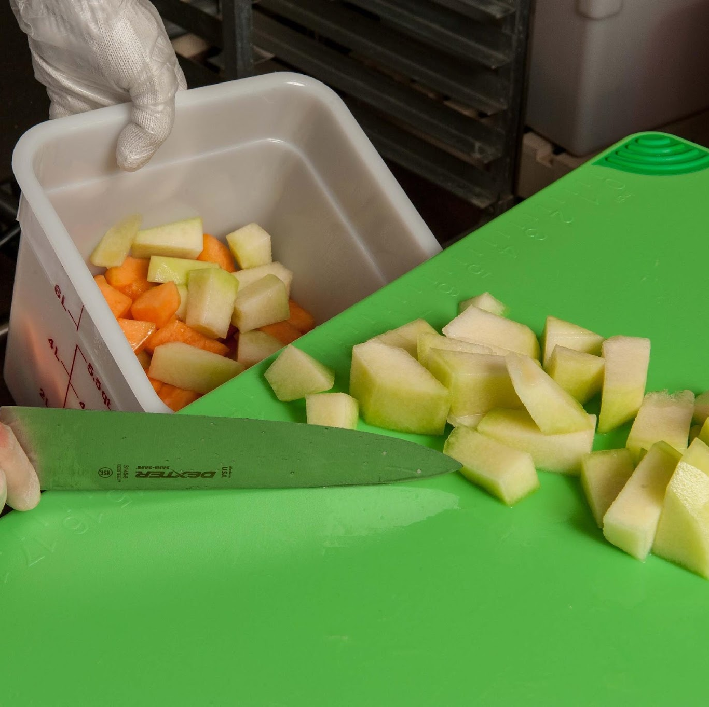

Cutting Boards – Thickness and Grip
Don't slip and slide!
Notes:
Say: Avoid the thin slippery cutting boards. There is no way to anchor them in place, and they barely protect the knife's cutting edge.
There are cutting boards available with silicon grippers, but you don't have to purchase this style. A shelf liner or damp kitchen towel, sanitizing towel, or even a paper towel will do the trick!

Slide 8
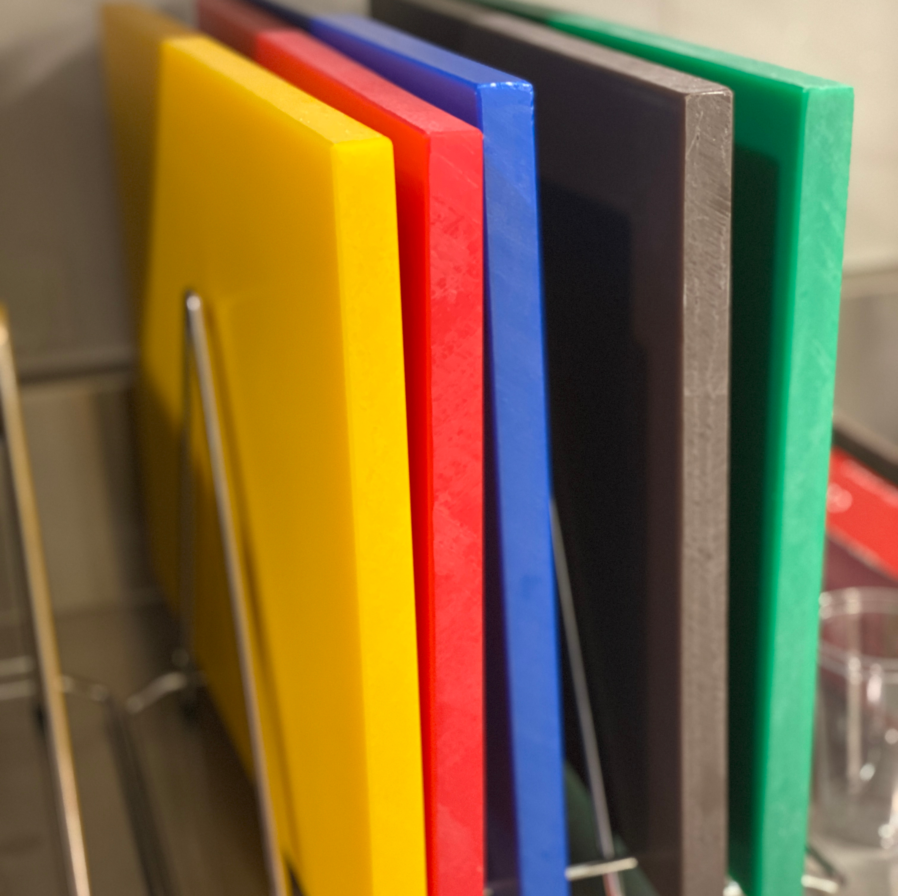
Cutting Boards – Color Coded
Notes:
Say: Color coded cutting boards can be helpful to prevent cross-contact with allergens and cross contamination. Typically green and/or brown boards are used for produce, blue for fish, red for raw meat, and yellow for raw poultry.
Now that we have reviewed board options, let's move on to knives.

Slide 9
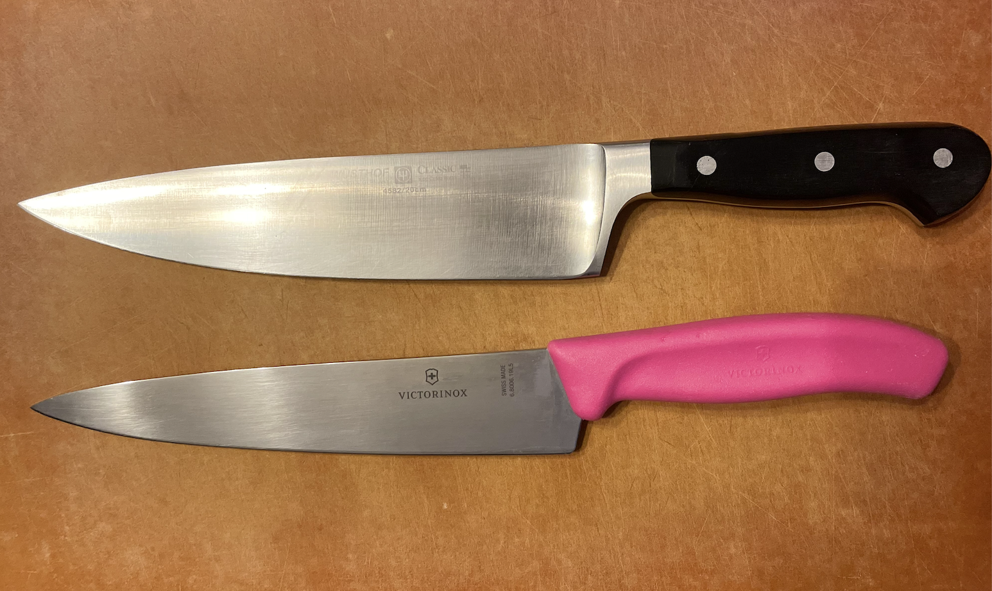
Chef's Knives - Types
Forged
Stamped
Notes:
Say: There are two ways chef's knives are made; they are either stamped or forged. To make forged knives, as pictured on top, the forged knife is made from a single piece of steel and extends through the handle, secured by rivets.
To make stamped knives, the blade is stamped from a piece of steel and then attached to the handle.
Forged knives are considered higher quality, but are more expensive.

Slide 10
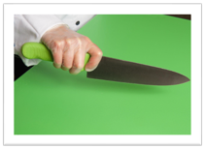
Chef's Knives - Material
Stainless steel
Carbon steel
High-carbon stainless steel
Notes:
Say: Chef's knives can be made from stainless steel, carbon steel, or high-carbon steel.
Do: Review information below.
Stainless steel
Rust resistant
Holds a sharp edge longer
Blade edge is harder to sharpen
Carbon steel
Loses the sharp edge quickly
Darkens when in contact with acidic foods
Pits and rusts more quickly than other types
Easier to sharpen
High-carbon stainless steel (recommended for school nutrition programs)
Takes advantage of the best qualities of both metals
Keeps the sharp edges longer
Rust resistant
Say: There are two available food safe materials for the handles: polyoxymethylene (POM – looks similar to wood grain) and polypropylene. When looking to purchase knives, don't go for the cheapest or most expensive.
School kitchens need good quality knives that can last a long time. Expect to pay $20 - $30 for one.

Slide 11
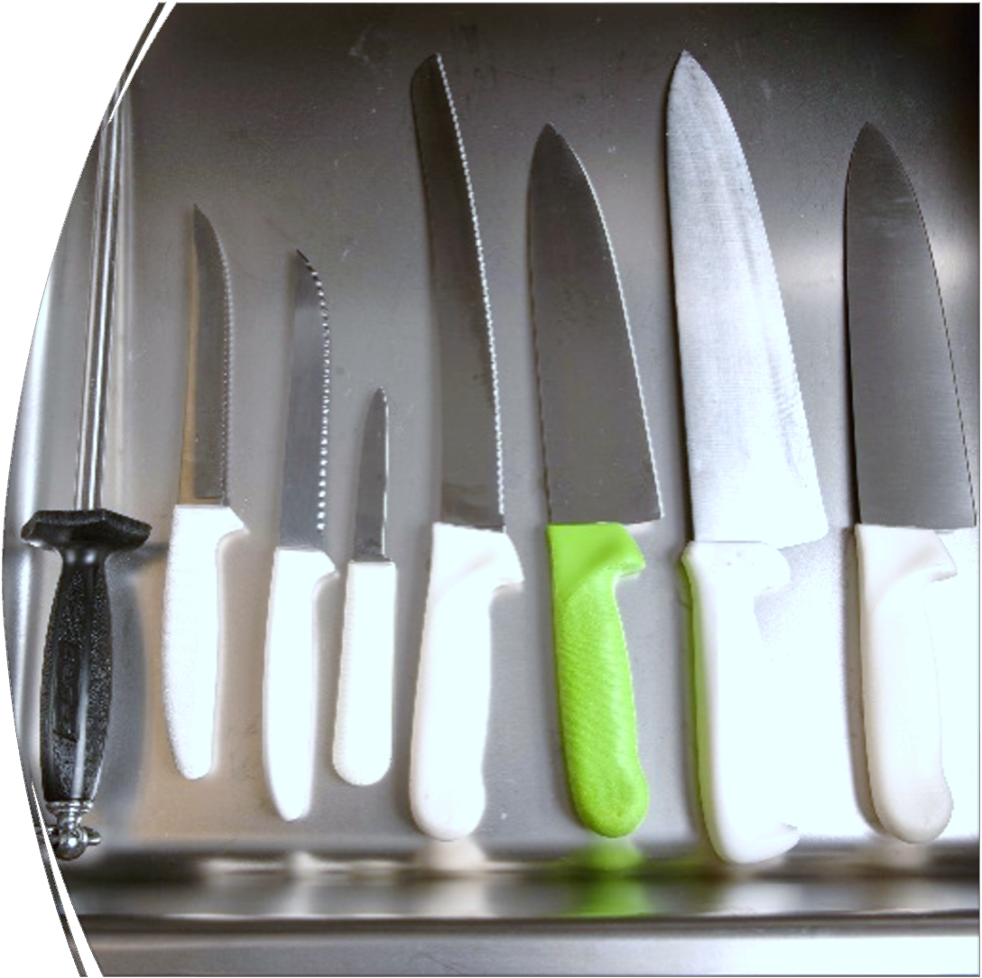

Other Knives
Notes:
Say: A Santoku knife is similar to a chef's knife. It's 5-7 inches long, has a slightly straighter edge, and the tip may be pointed or more rounded than a chef's knife.
In addition to a chef's knife or santoku knife, school kitchens should have paring and bread/serrated knives.
Do: Review the below information.
Paring knife: small, 3-4 inches with a sharp tip, used for paring and trimming fruits and vegetables (not quantity food production!)
Bread knife: varies in length (7-10 inches long), scalloped/serrated edge cuts through bread without crushing the soft center. Offset handles are available to keep hands/knuckles out from the food and away from the cutting board.

Slide 12
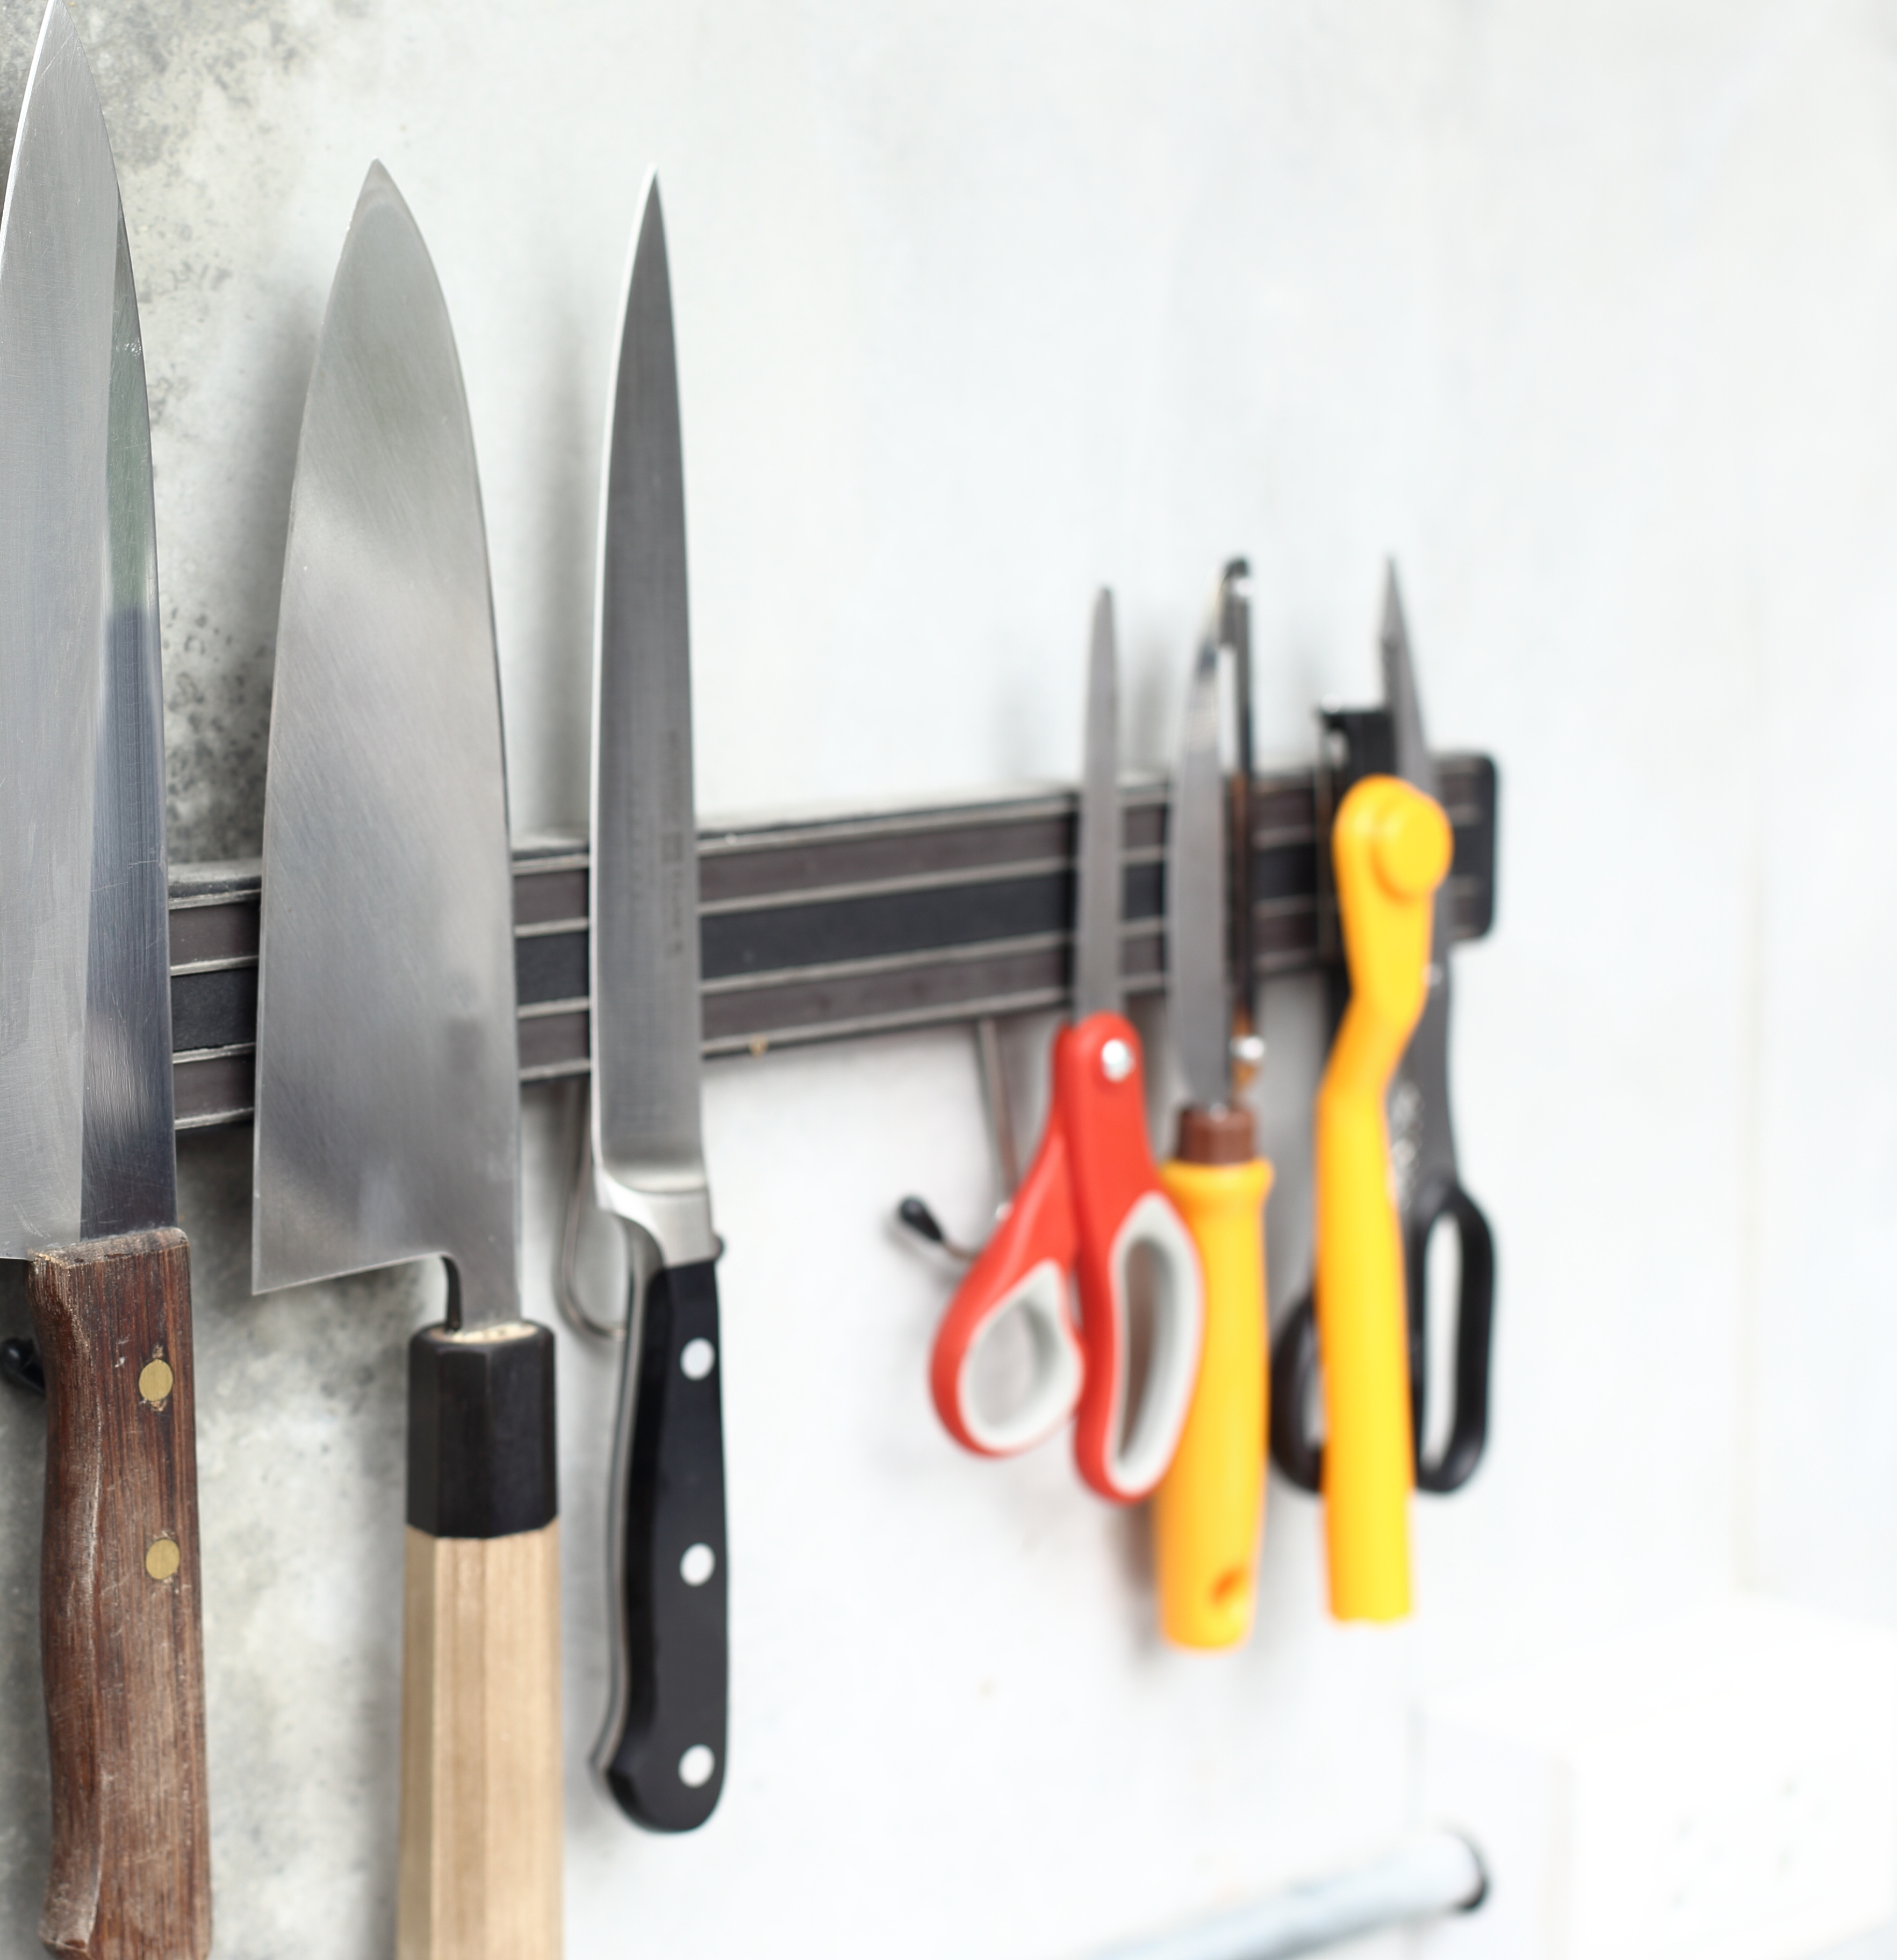
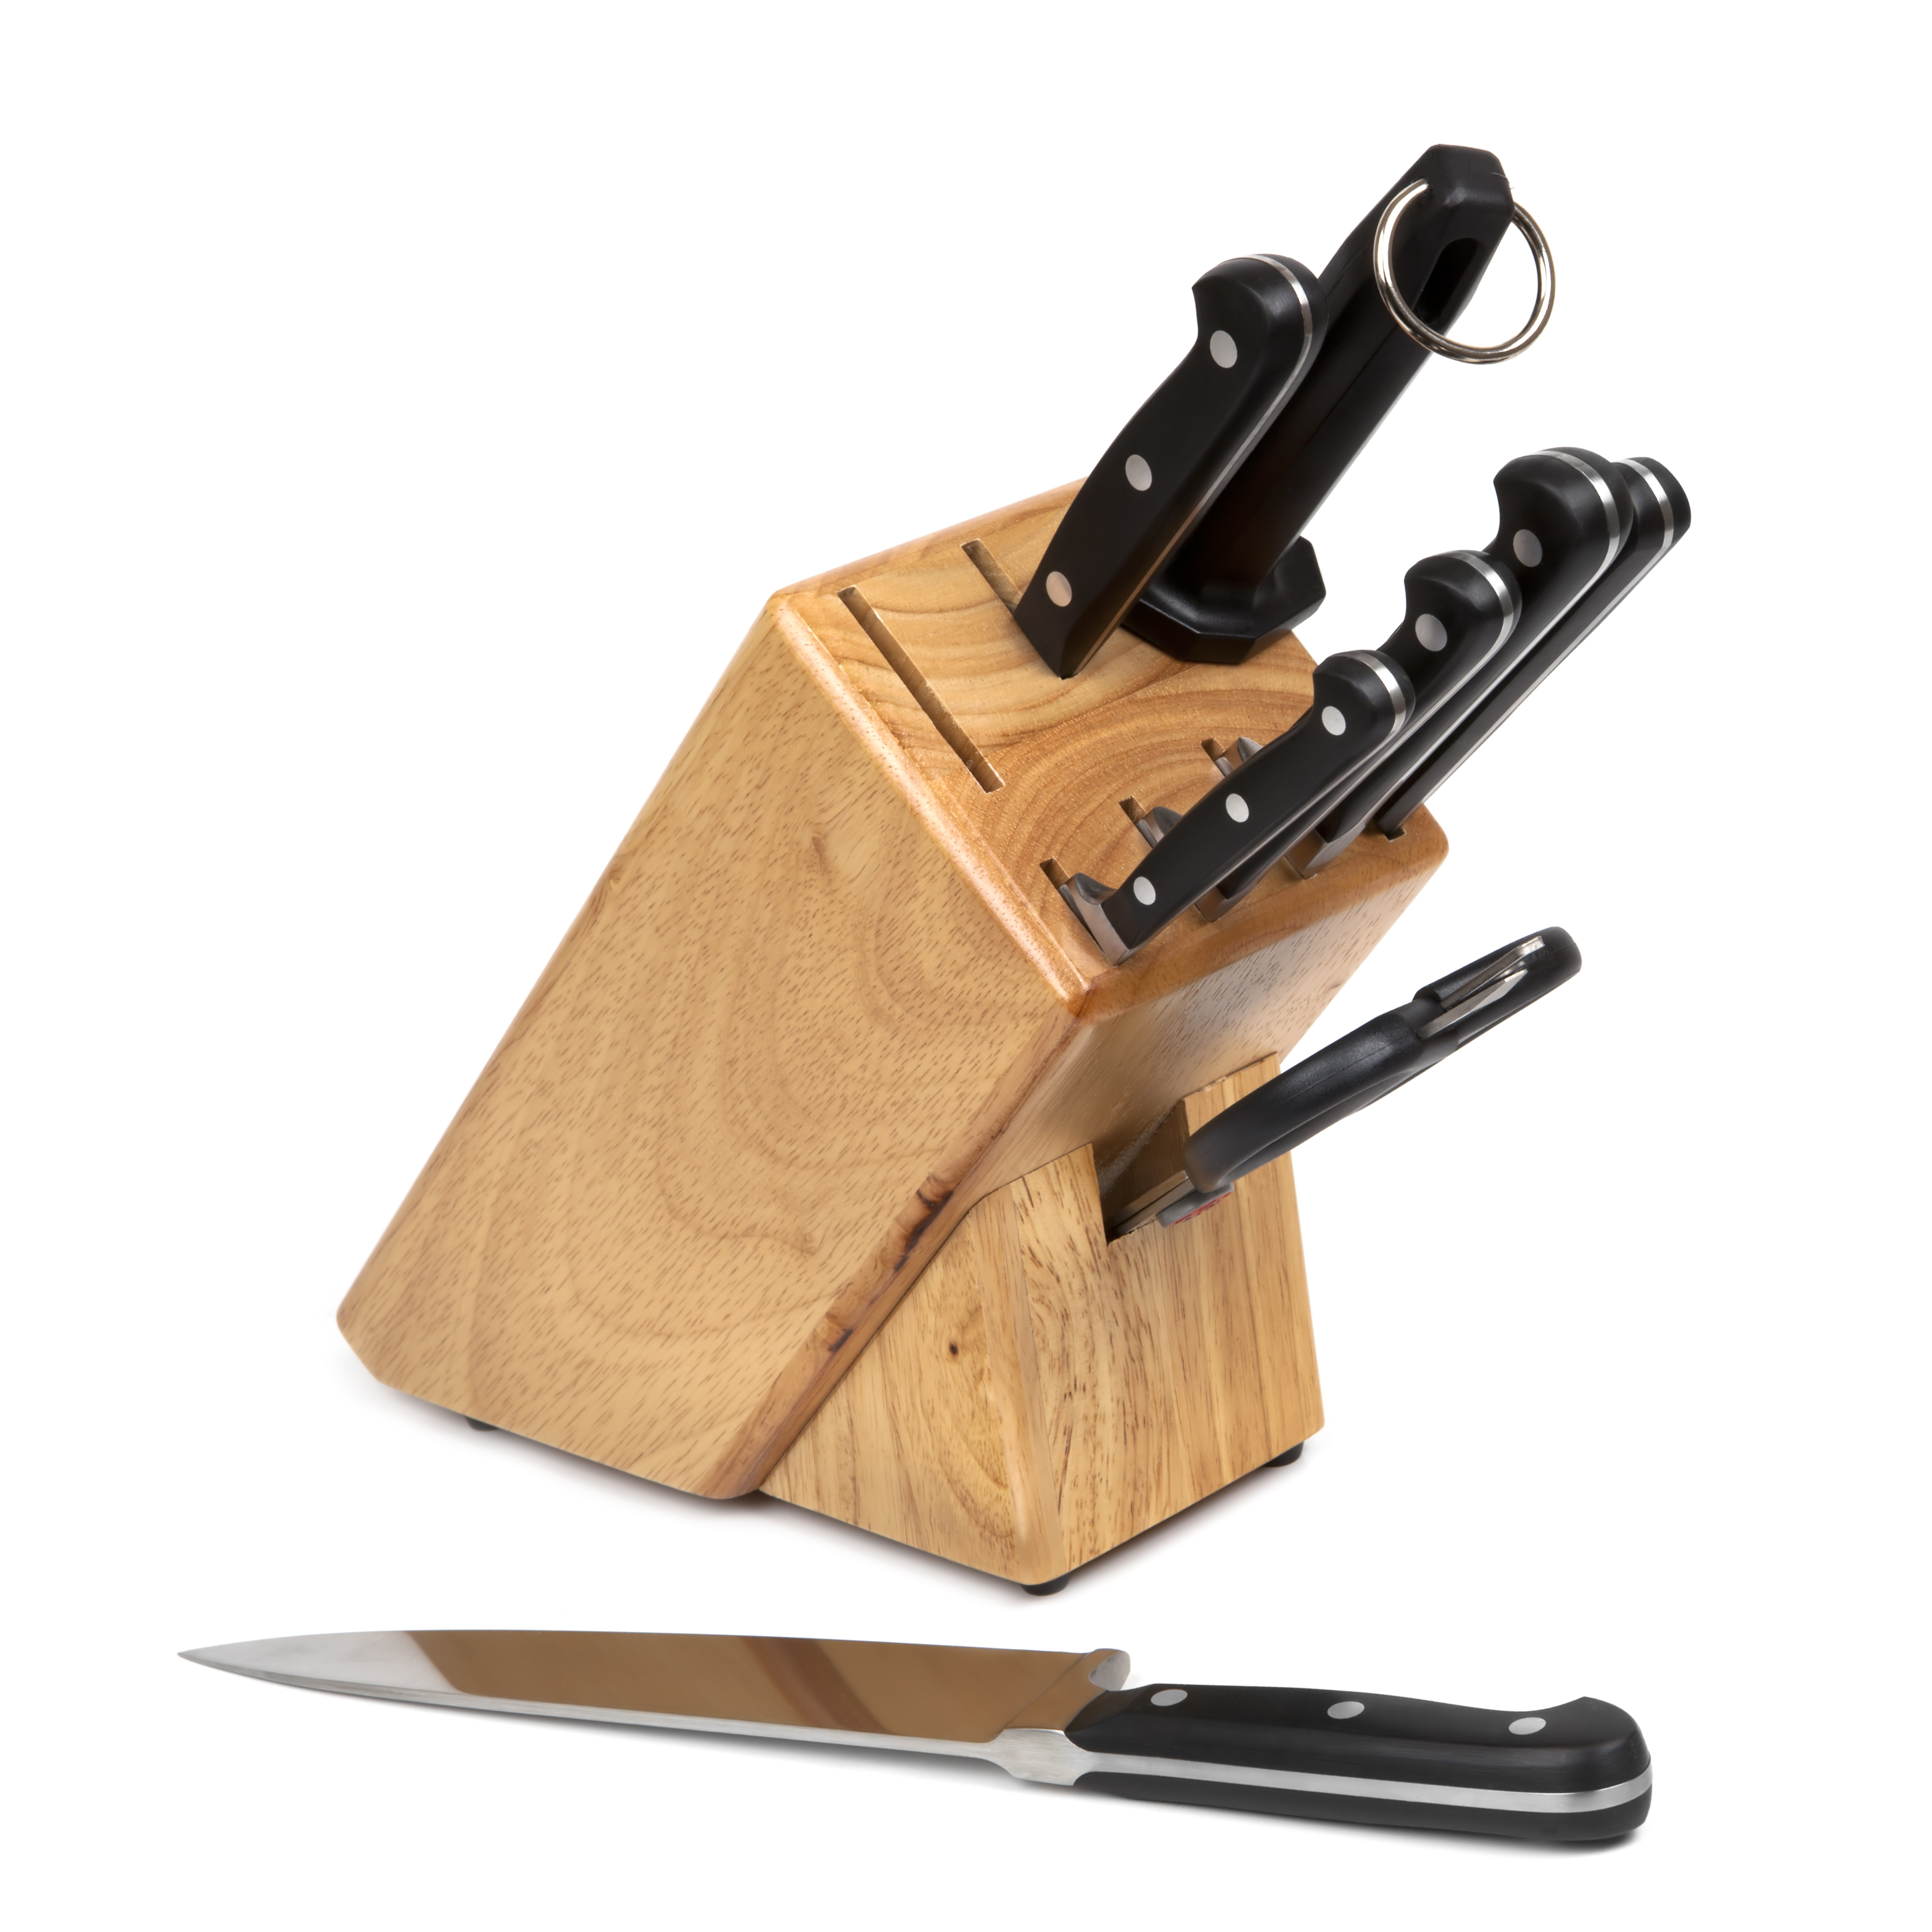
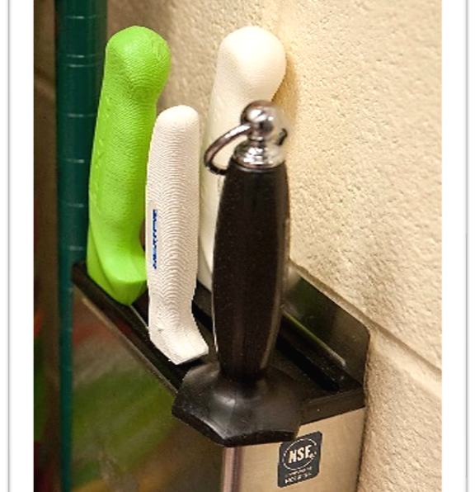
Storage Options
Notes:
Say: Storing knives safely to protect their blades is key to a long life and to help you save money! We see too many "danger drawers" where knives are just thrown in together with no protection at all. This is a great way to ruin them! Invest in storage tools such as blocks, magnetic strips, or racks, or you will be spending money on purchasing new knives. Another option is blade covers/guards if storage is not an option.
Do: Hold up example knife with scabbard covering.

Slide 13
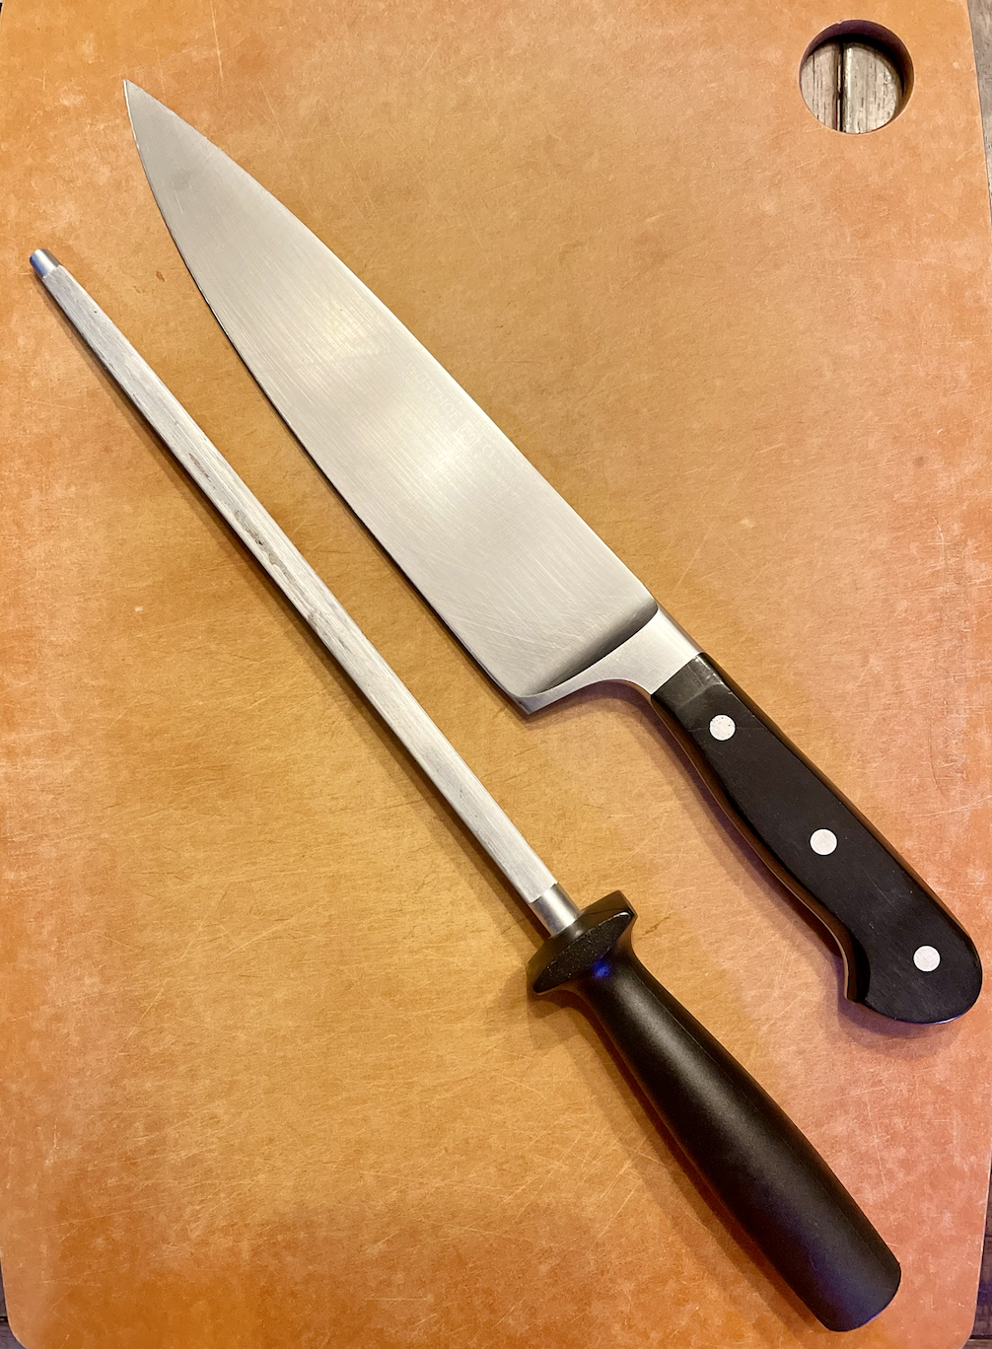

Honing
Notes:
Say: To keep the cutting edge of knives sharp, they need to be honed and sharpened. Many people think that honing rods or steel sharpen knives, but they actually do not. Instead, they realign the blade, correcting the cutting edge, making them seem like they were sharpened. There are steel, diamond, or ceramic honing rods. Make sure your school kitchens have this tool! They can be used daily.

Slide 14
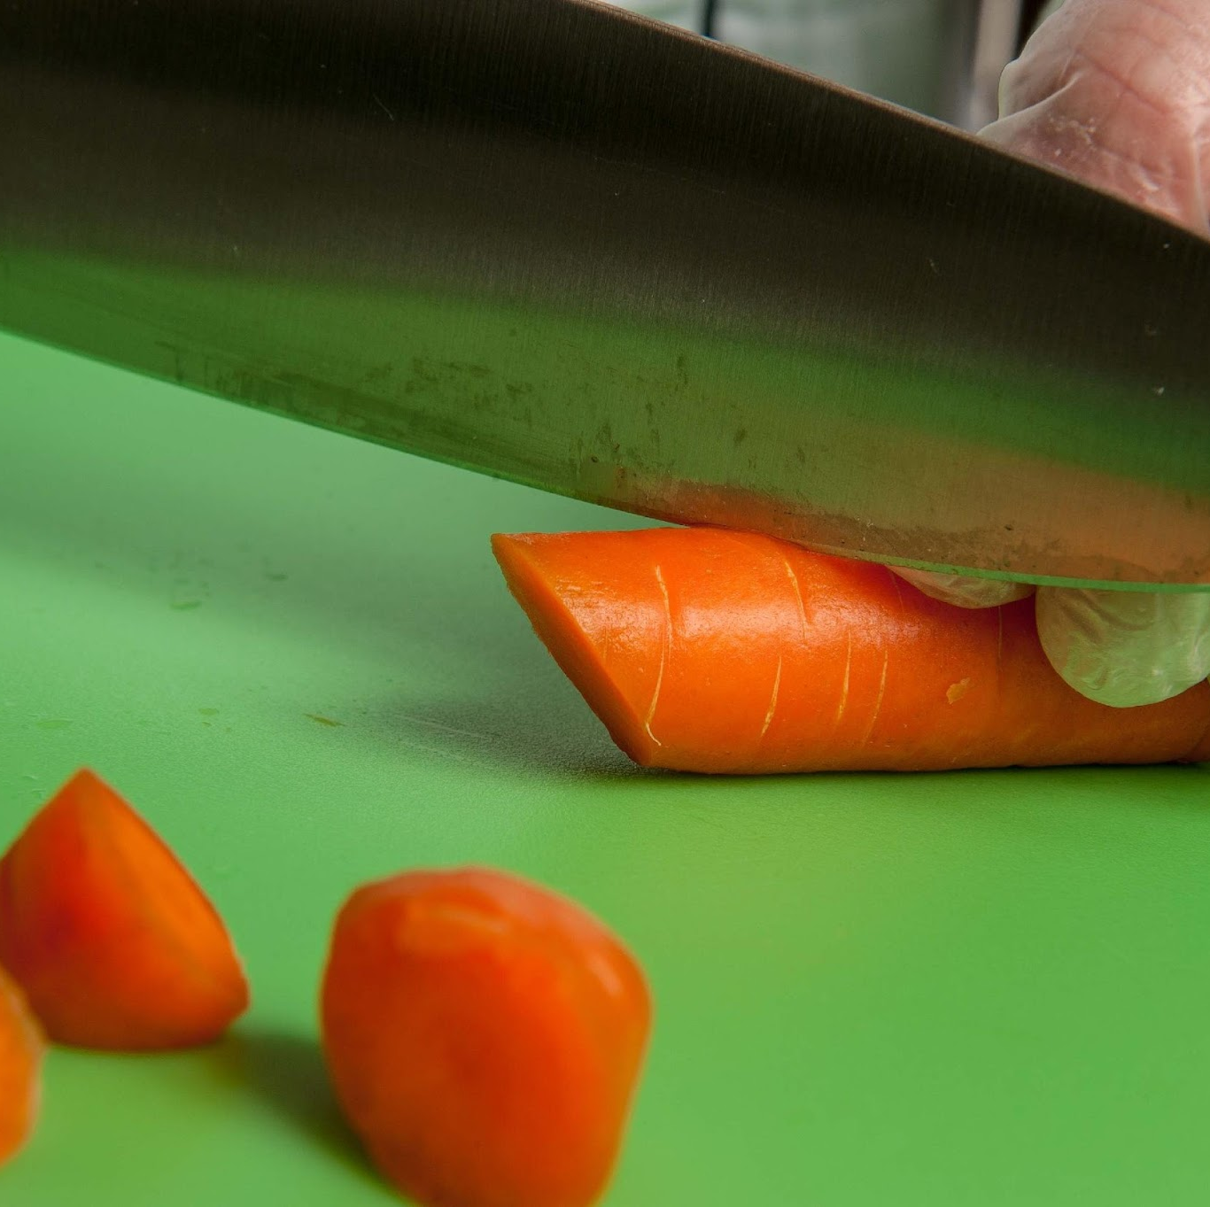
Sharpening
Manual
Mechanical
Notes:
Say: For maximum efficiency and safety, knives should be sharpened when dull. School nutrition staff are more at risk of injury from dull knives than sharpened knives because less pressure needs to be applied, reducing the risk of slipping.
Sharpening takes honing one step further and actually grinds and realigns the cutting edge of knives.

Slide 15
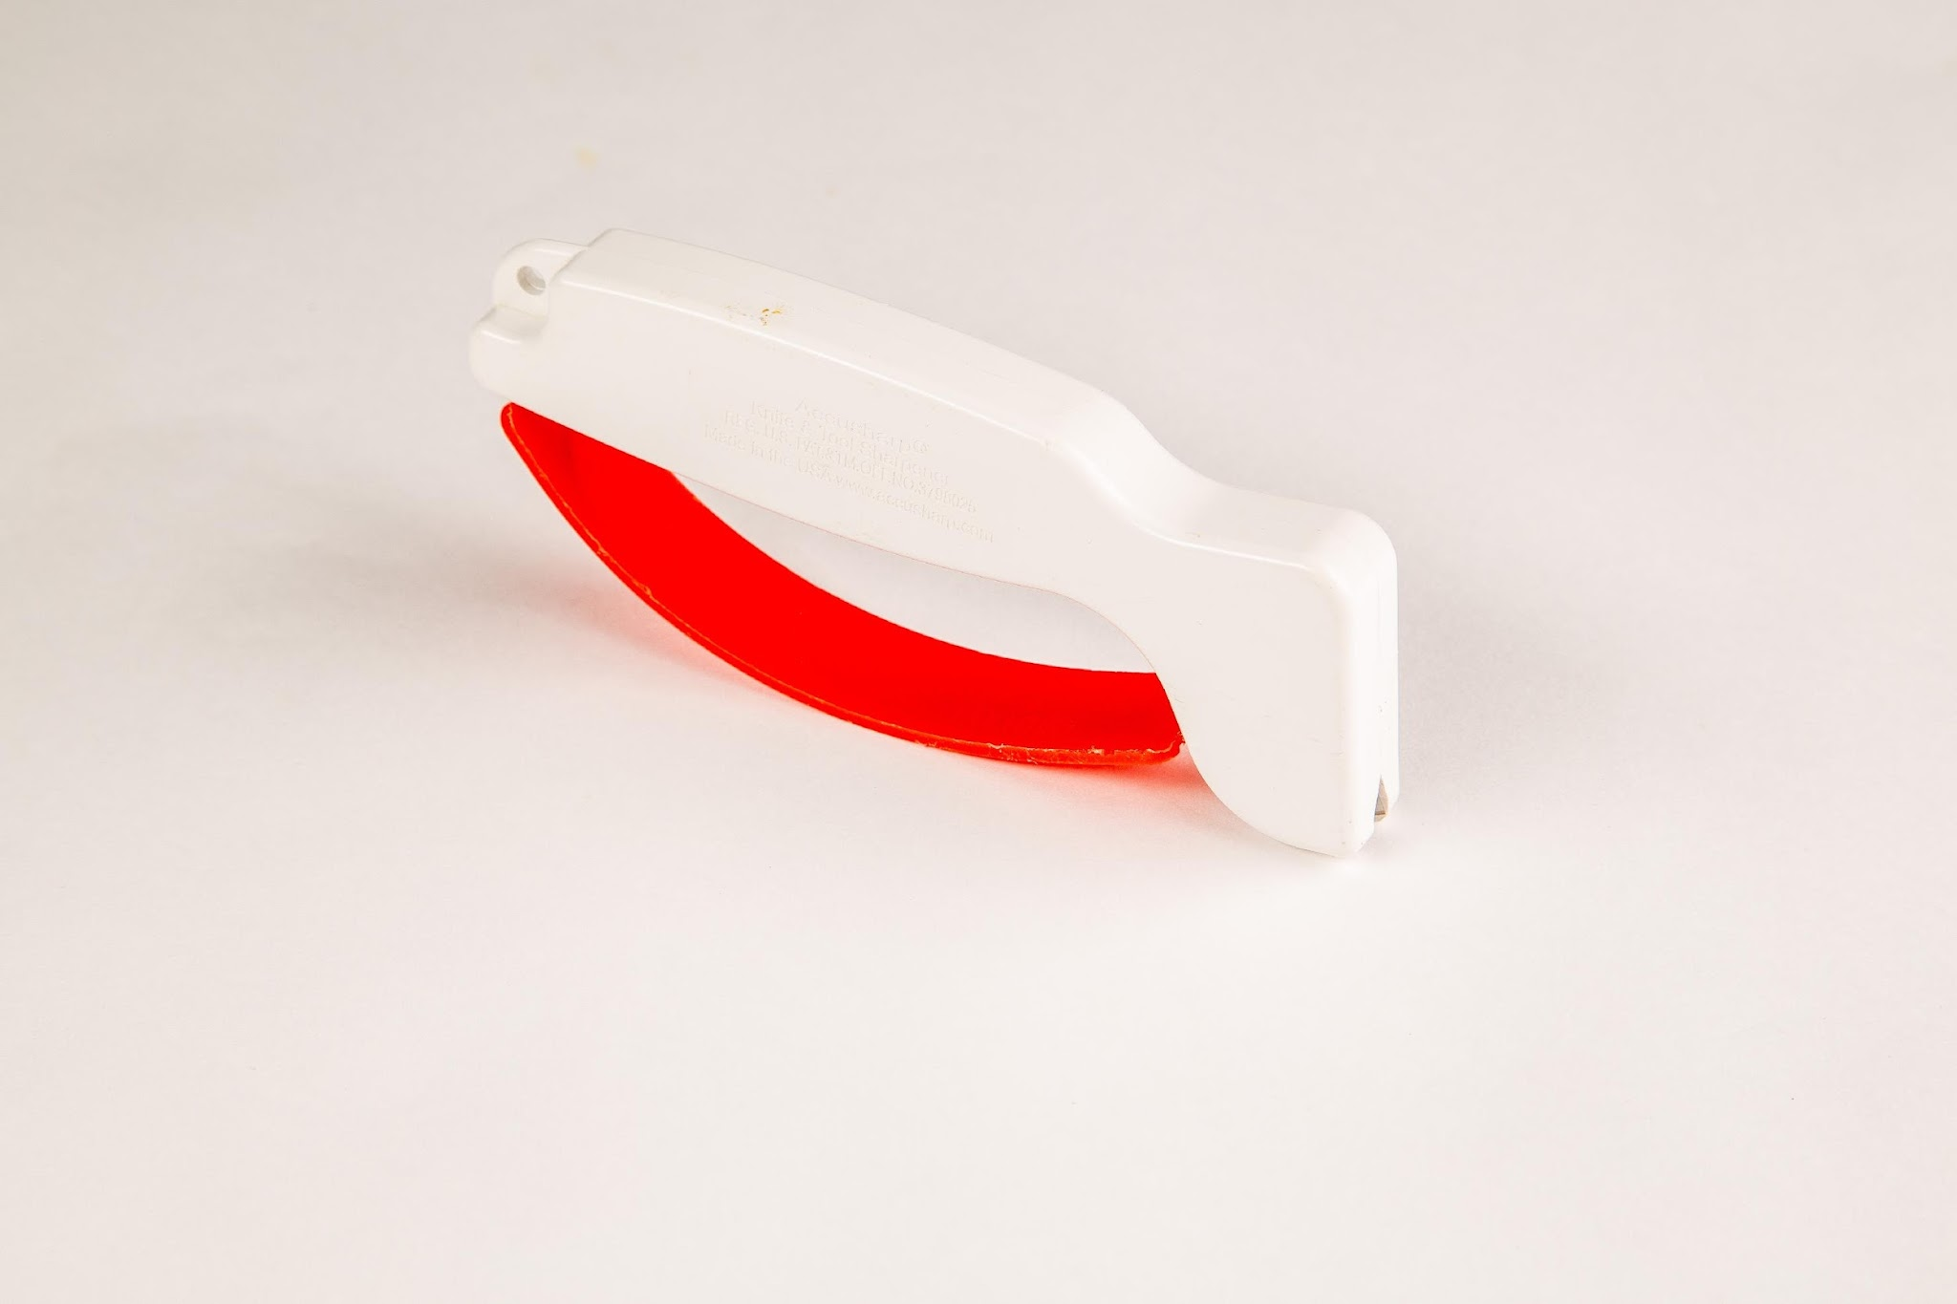
Sharpening - Manual
Notes:
Do: Review the characteristics of a manual sharpener.
Handheld with a non-skid base or handheld with safety guard for sharpening by moving the sharpener down the blade (cutting side up)
Steel blades
Blade replacement (some are reversible for extended use)
Ergonomic polycarbonate handle
Serrated knife sharpeners available

Slide 16
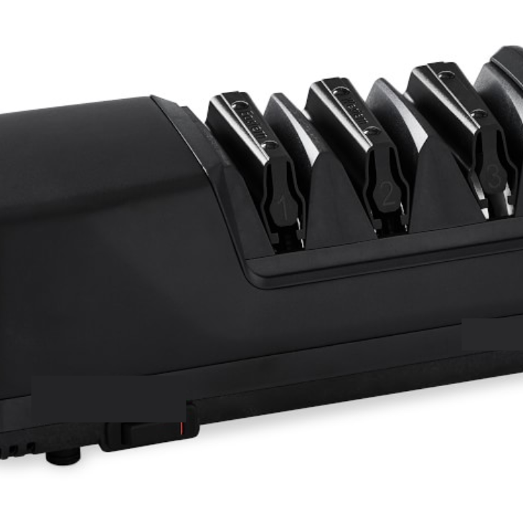
Sharpening - Mechanical
Notes:
Do: Review the characteristics of a mechanical sharpener.
120 to 230 volts
Single, two and three-stage sharpening options
Stropping wheel option (operates in reverse direction for blade polishing)
Grinding wheel (may be replaceable)
Serrated knife sharpeners are available
Magnetized drawer to capture metal shavings available
Grinding wheel material is typically aluminum oxide

Slide 17
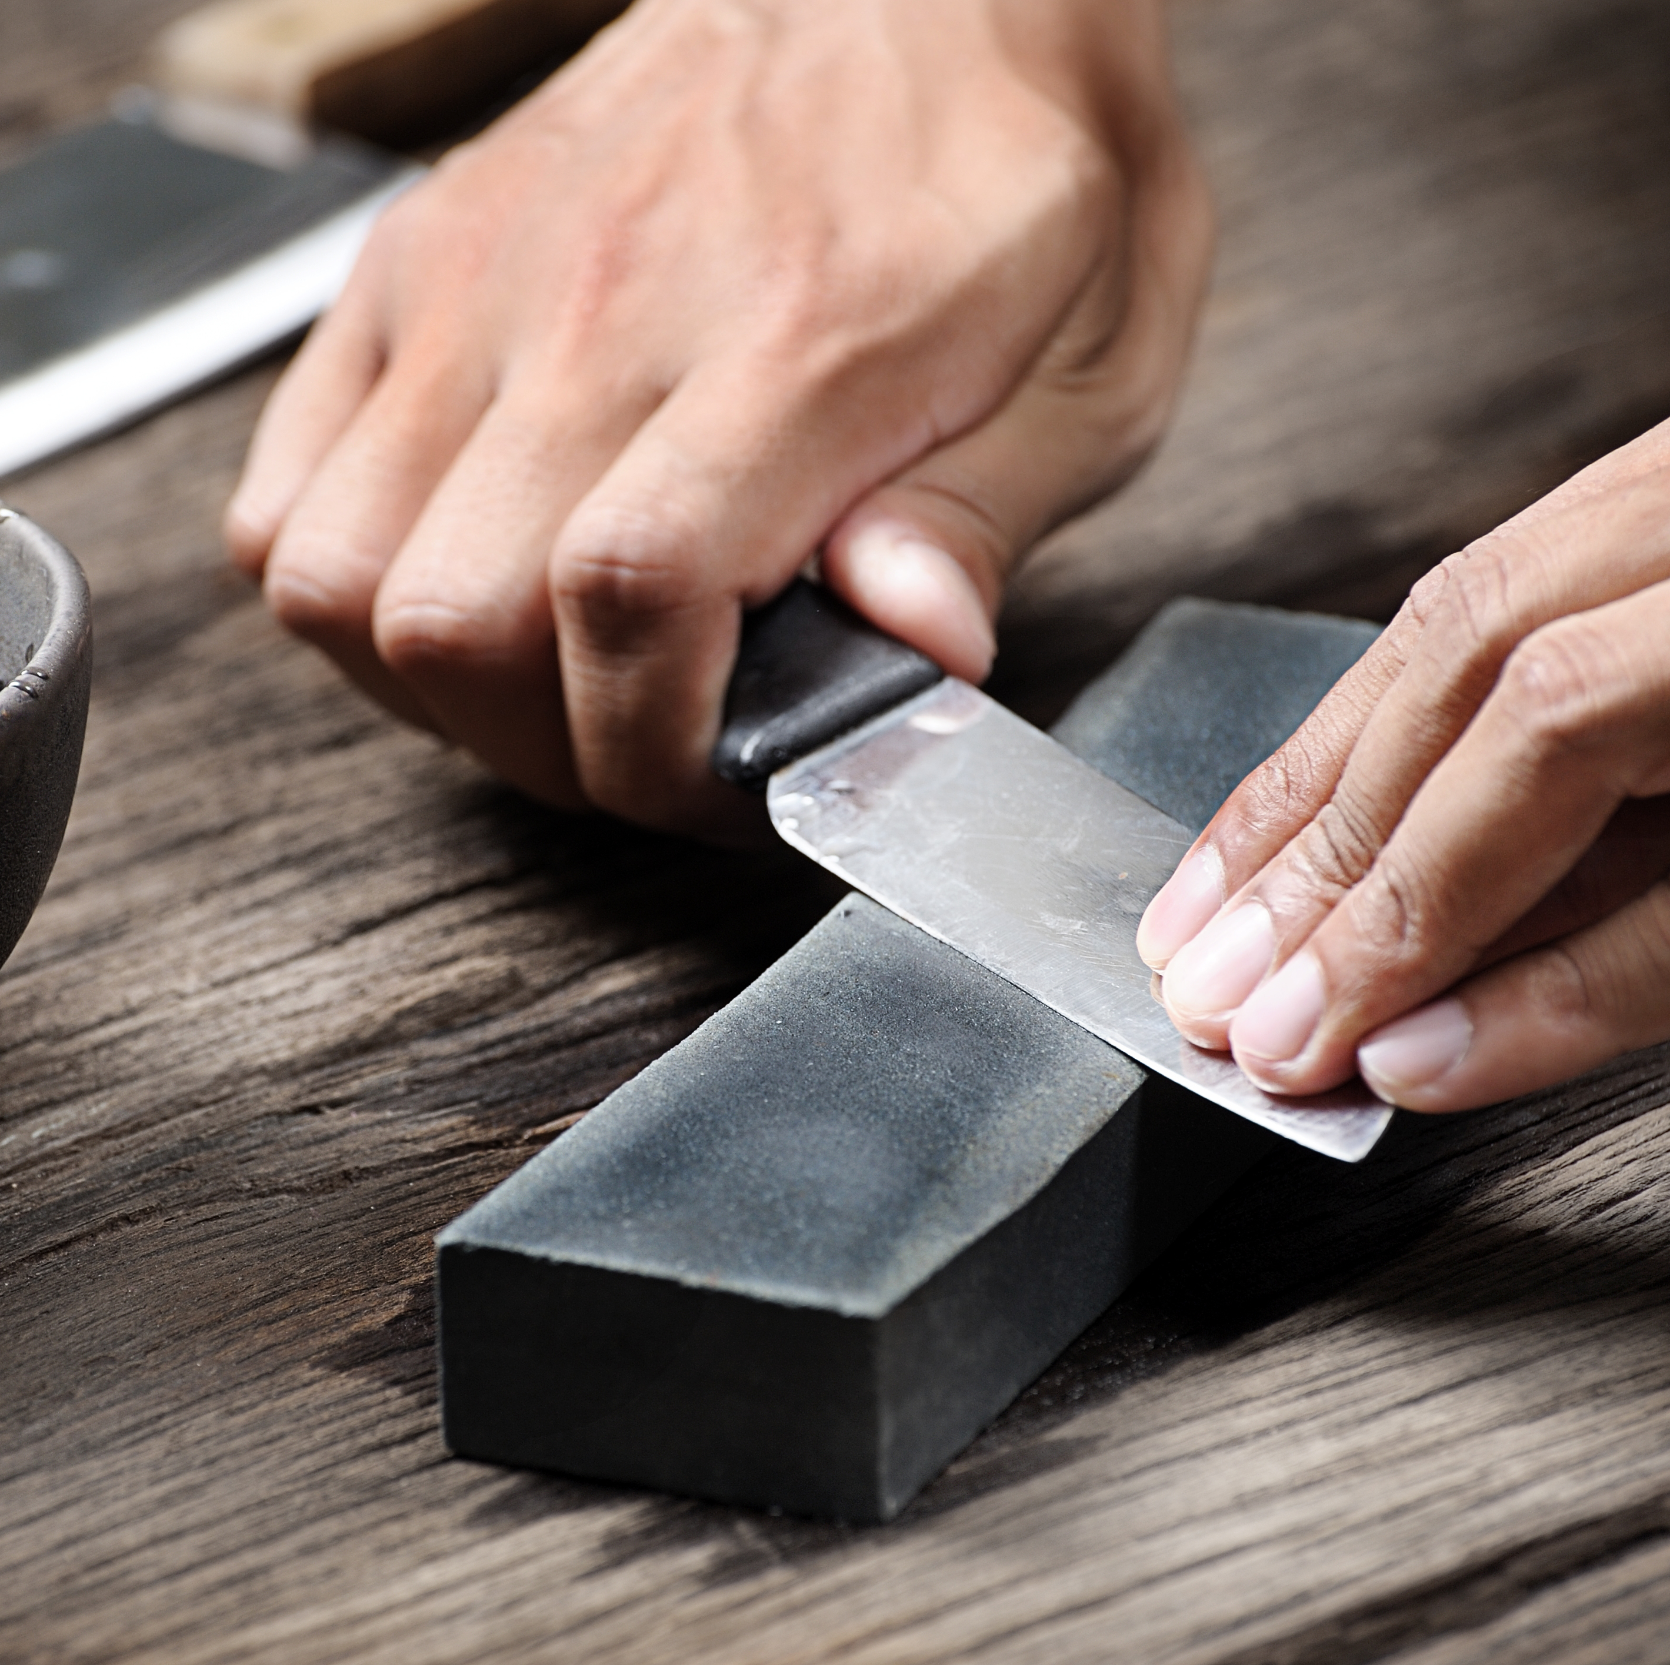
Sharpening - Whetstone
Notes:
Say: School nutrition professionals trained in the use of a sharpening stone may consider using a whetstone for manual sharpening. BUT if someone is not trained on the use of a whetstone, he or she can ruin or damage the knife! Before we move on to our demo, one more note on keeping knives sharp. Never ever put them through the dishmachine. This will dull and possibly damage knives!
Alright, over to you Chef Andy!

Slide 18
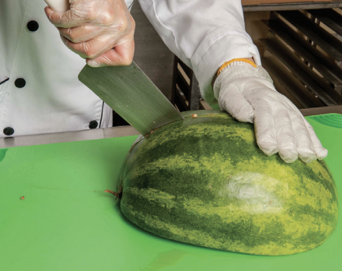
Summer Produce Processing
Demo time!
Notes:
Do: Demo the correct way to hold a knife and how to use a honing rod.
Do: Demo the produce listed below with specified cuts. Mention which produce is featured for Harvest of the Month.
Watermelon
Dices
Slices
Kale: March Harvest of the Month
Remove stem
Dice and shred
Peach
Freestone vs cling (discuss)
Slices
Dices
Strawberries: May Harvest of the Month
Remove stem
Dices
Slices
Summer squashes: Zucchini July Harvest of the Month
Half moon
Sticks
Onion (done in fall and spring workshops)
Dices

Slide 19
Equipment
Notes:
Say: Thank you Chef Andy for that wonderful demo! Let's now move our discussion on to equipment.

Slide 20
Large Equipment
Notes:
Say: Let's start by discussing large equipment. The cycle menu and type of food products to be prepared and served are two of the most significant determining factors of what equipment your kitchens need. As you move to more scratch cooking, you will need to evaluate your equipment. Convenience operations may utilize primarily convection ovens to heat and serve foods prepared by manufacturers. In contrast, a scratch cooking environment may need additional large equipment such as tilt skillets, steam jacketed kettles, mixers, and immersion blenders to prepare foods using various ingredients.

Slide 21
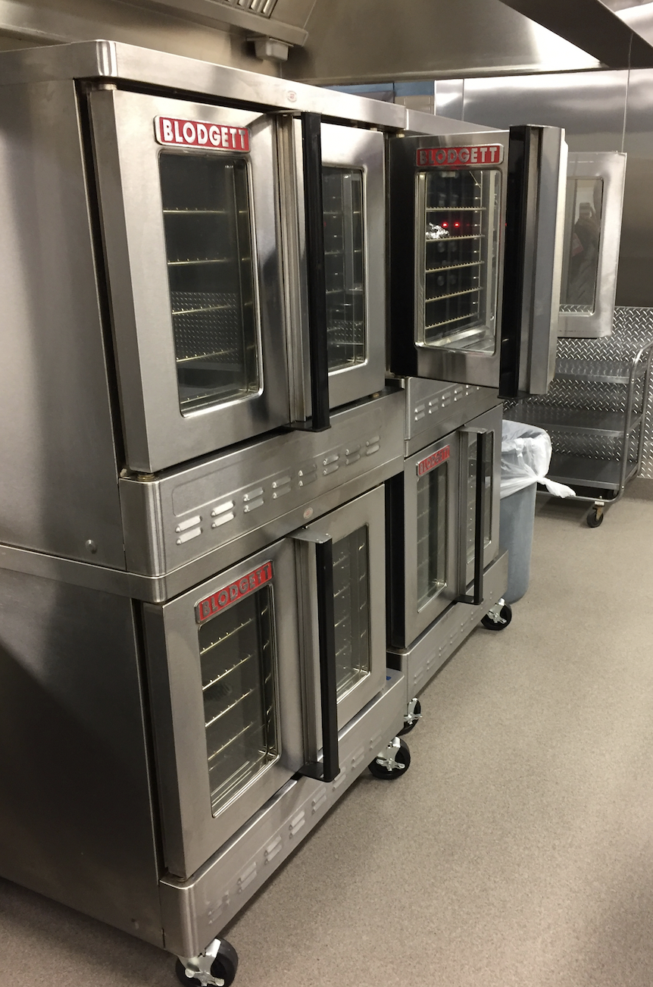
Ovens
Combi
Convection
Notes:
Say: Many types of ovens are available, with convection and combination ovens (often referred to as combi-ovens) being the most commonly used in schools. Always look at production schedules before making final cooking equipment selections, making sure all menu items can be prepared as needed. The menu may require several types of ovens or multiple ovens of the same type.
Combination ovens can be used as a steamer, a convection oven, or a combination of the two. There are a variety of control options: digital, manual, and programmable cook cycles. Combi ovens can help take the guesswork out of cook times and temperatures and help ensure quality by pre-programming recipe requirements. Some combi ovens also have a self-cleaning option (may require proprietary chemicals for cleaning to preserve warranty).
Convection ovens use fans inside of the unit to circulate the hot air. These ovens cook faster and more evenly than conventional ovens. Some convection ovens have the feature of being able to introduce moisture to the cooking cabinet for special cooking processes (such as baking and refreshing foods).

Slide 22
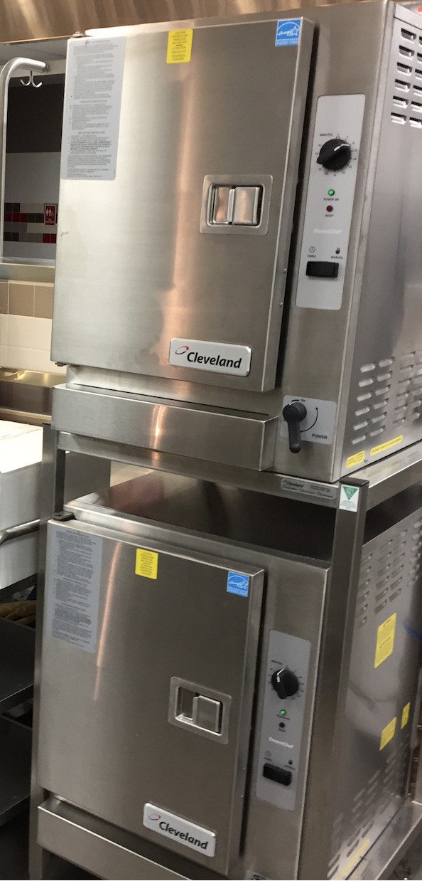
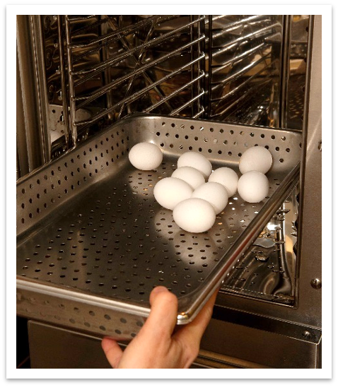
Steamers
Notes:
Say: Steamers use a closed cavity with moist steam heat at pressures from five to 15 psi to blanch vegetables, cook, and reheat food.
Steam via convection comes in direct contact with the food if using pressureless and connectionless units. Cooking times will vary significantly among types of equipment. Steam cooking uses less energy than convection ovens and allows for ideal quality batch cooking of vegetables (when thawed). Foods should be cooked in perforated pans unless solid pans are required (e.g., eggs), so please equip your schools with 2" versions of these pans for vegetables. Pasta can also be cooked in the steamer. Placing a 4" perforated pan inside a 4" solid pan allows for instant draining.
There are three main types of steamers: pressure, pressureless, and connectionless.
Do: Review the three main types of steamers.
Pressure
Five to 15 pounds psi; cooking temperature 228 °F to 250 °F (includes a pressure safety valve and door locks while compartment is pressurized)
Fastest cook time
May use 30 to 50 gallons of water per hour
Doors do not open during cooking
Ventilation required
A filtration system is recommended with regularly scheduled deliming
Pressureless
Zero psi; cooking temperature 212 °F
Uses one to three gallons of water per hour
Doors may open during cooking
Ventilation required
Connectionless
Zero psi; cooking temperature 212 °F
Ideal for facilities without water utilities or drains
Slowest cook time
Uses one to three gallons of water per hour
No scheduled deliming required
Hood may or may not be required (check local requirements)

Slide 23
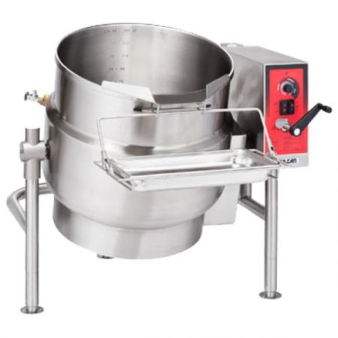
Steam Jacketed Kettle
Notes:
Say: Steam-jacketed kettles are considered vital to large production institutional kitchens. Steam jacketed kettles are available in various sizes and reduce preparation time due to the ability to cook from the bottom and sides instead of cooking in stock pots on ranges. They are ideal for the preparation of soups, stews, and sauces, as well as a variety of items such as beans and pasta. The capacity of 5-12 gallons is often found in school nutrition programs.

Slide 24
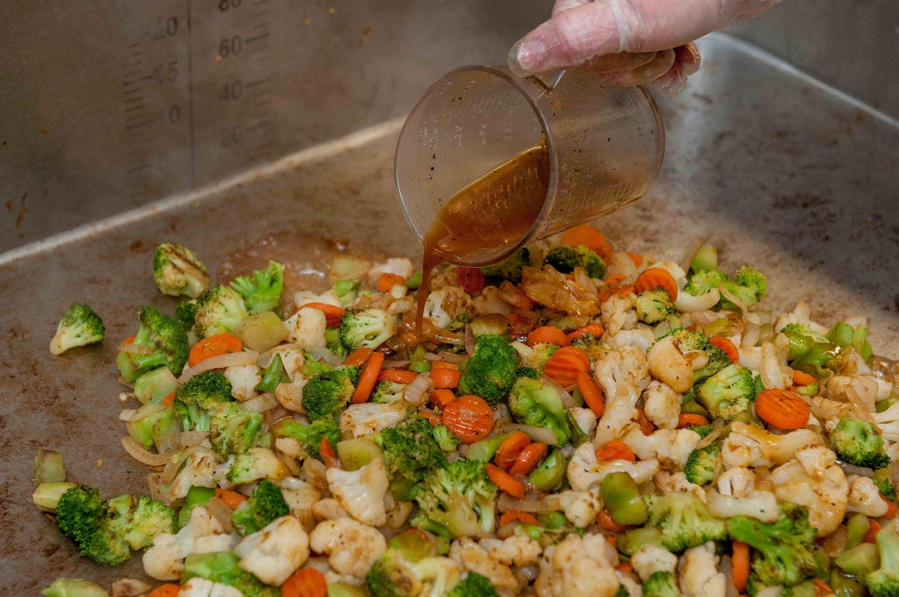
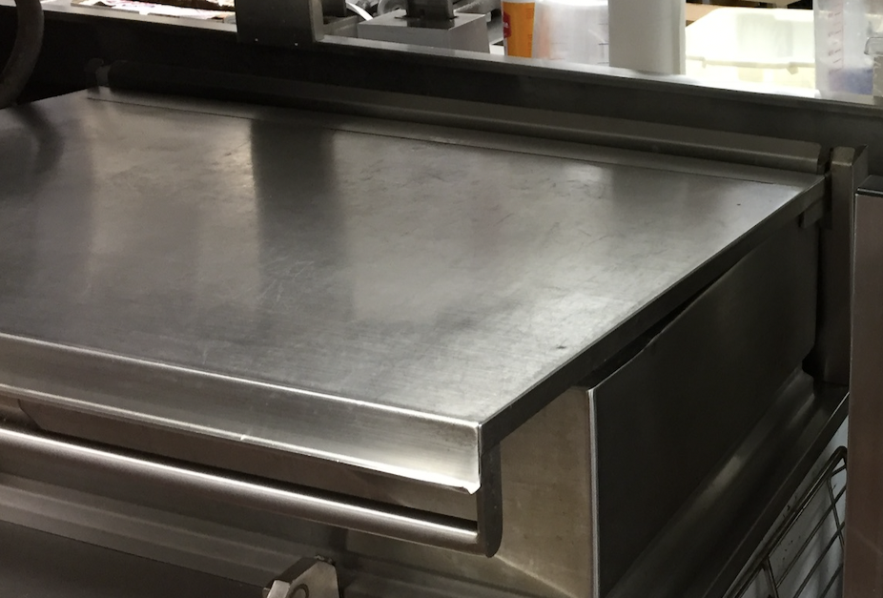
Tilt Skillet
Notes:
Say: Tilt skillets operate similarly to cooking on a stovetop or in a steam-jacketed kettle, and often are installed in school kitchens rather than steam-jacketed kettles. Units are made with a rectangular griddle bottom, varying volume depths, and a hinged lid with a steam release vent. Skillets may be tilted to drain at a 90-degree angle. Tilt skillets are versatile and work well for various menu items (e.g., grilled sandwiches, ground beef or hamburger patties, pasta, sauteed vegetables, soups, stews, and stir fry). In addition, when combined with boiling water and perforated steam table pans, the unit may be used as a steamer.
There are electric tilt and manual tilt options. If installing a tilt skillet, please carefully plan the drain. It's amazing how many times we have seen a drain out of alignment with the skillet or one that is way too small.
Tilt skillets might very well be one of the most under-utilized pieces of equipment in school kitchens. We often see them used for storage vs. cooking! Staff tend to avoid the tilt skillet because they don't want to clean it. Make sure to train them on proper cleaning techniques and emphasize the value of this piece of equipment. If not using the tilt skillet, they would be cleaning the equivalent in pans anyway! It might possibly be even more work.

Slide 25
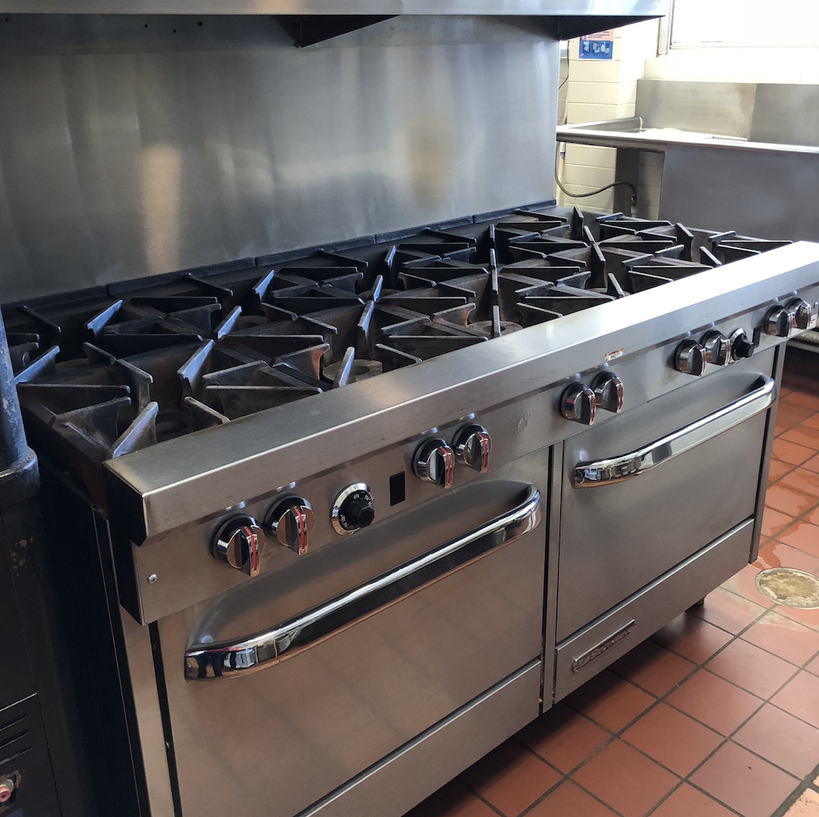

Ranges
Notes:
Say: While many operators have removed ranges from school nutrition programs, depending on the type of cooking, some smaller operations may find range cooking necessary for sautéing or heating stock pots and saucepans.
Do: Solicit questions on large equipment.
Say: Let's move on to small equipment.

Slide 26
Small Equipment
Notes:
Say: Small equipment is typically not a long-term and costly investment, but it is important that you equip your school chefs with the tools they need! While purchasing the most expensive options is not necessary or recommended, purchasing the cheapest option is usually not the best choice. Consider ergonomics and food safety when purchasing small equipment. We don't want to see measuring spoons from the Dollar Store!

Slide 27
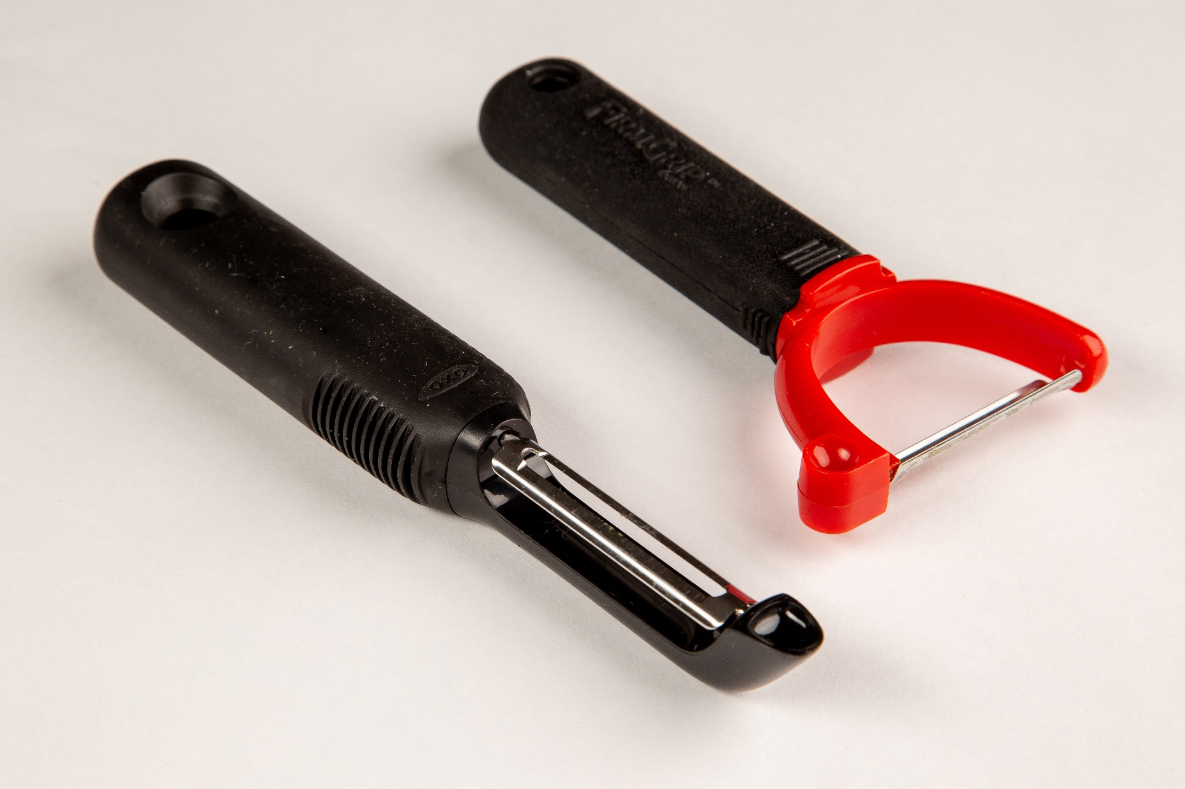
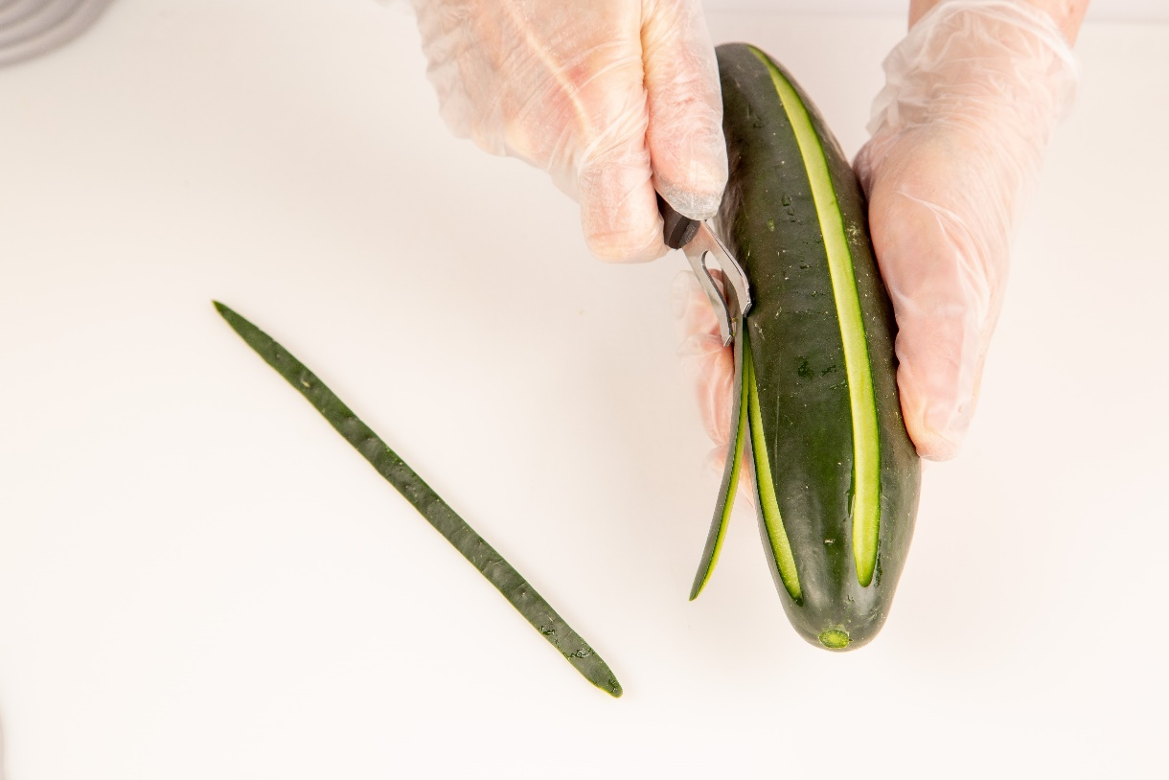
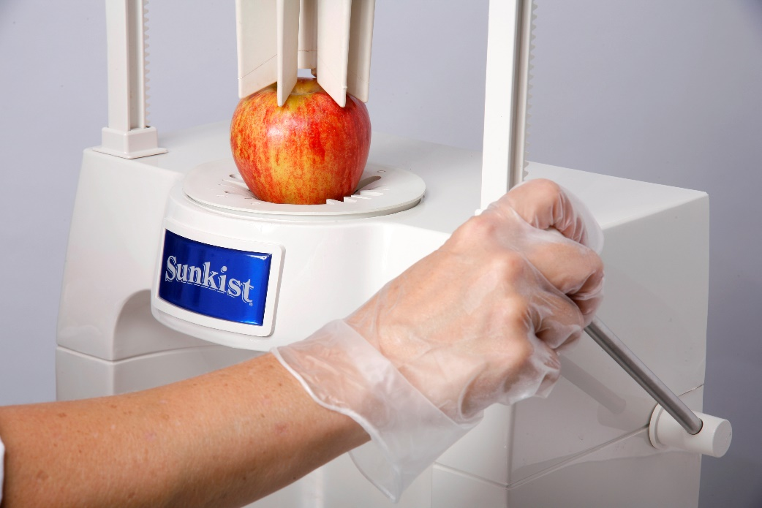
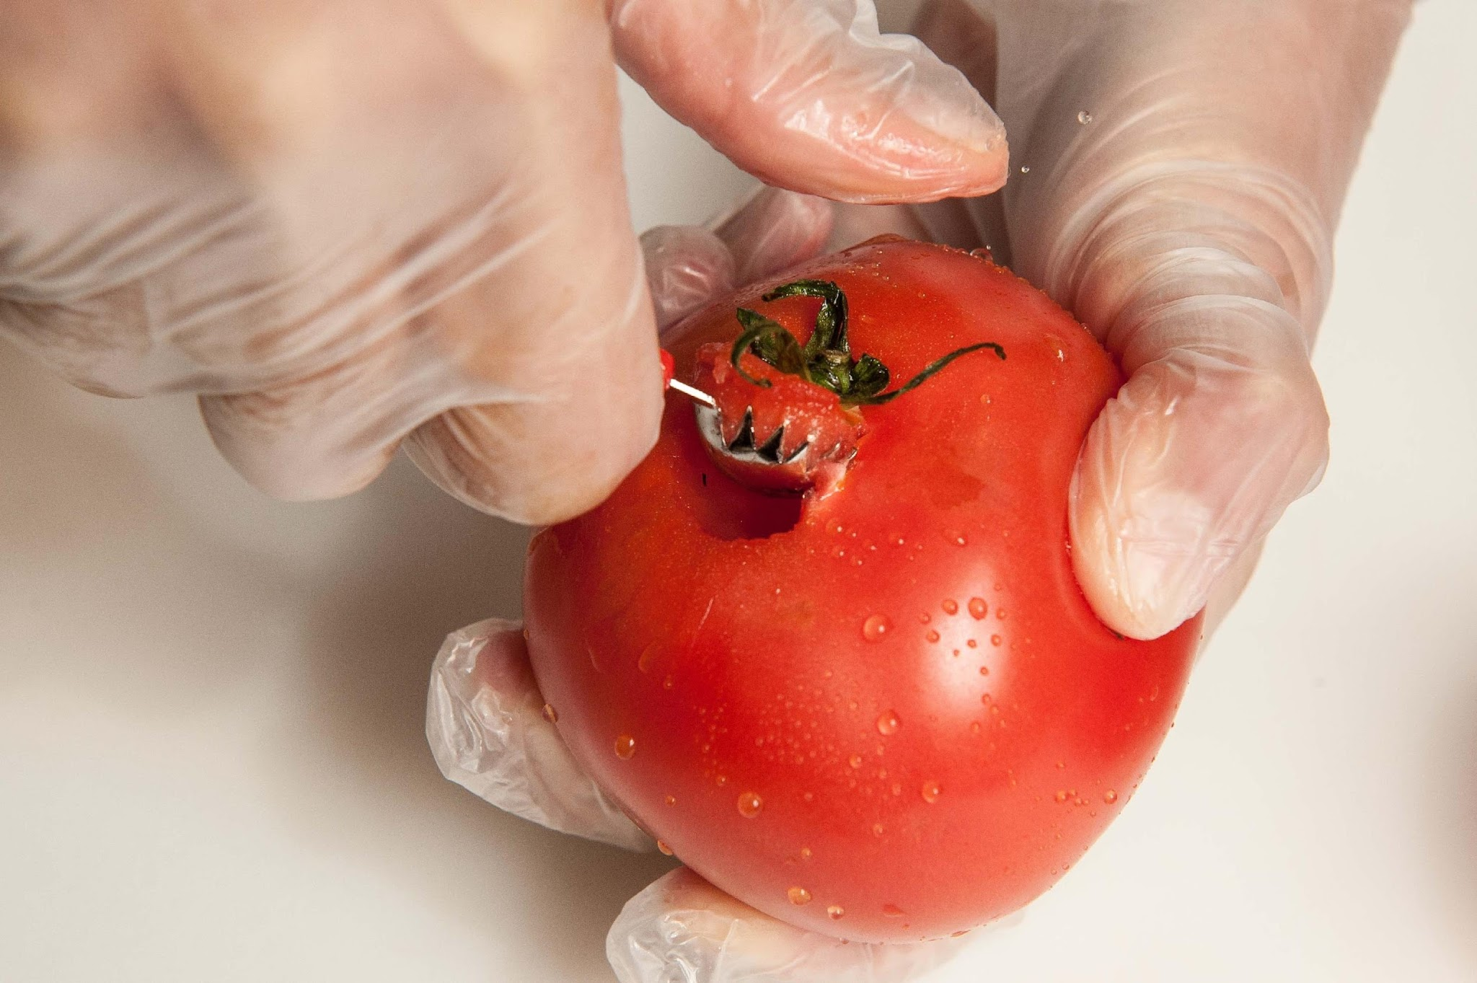
Cutting Tools
Peeler
Channel knife
Tomato scoop
Sheers
Bench scraper
Pizza wheel
Sectionizer
Notes:
Say: Let's start with cutting tools beyond knives. Equip your kitchens with the following:
Do: Describe the below tools.
Peeler: used to remove the peel or skin from produce
Please don't purchase the cheap metal handled kind that don't work well and are hard on hands!
Channel knife: used to cut long, thin strips of peel from citrus fruit or vegetables such as cucumber
Tomato scoop: used to remove the core and stem from tomatoes and strawberries
Sectionizer: used to process a variety of fruits and vegetables using different blades
Essential for bulk processing of sliced apples, oranges, etc. Chef Andy will demo this tool shortly!

Slide 28
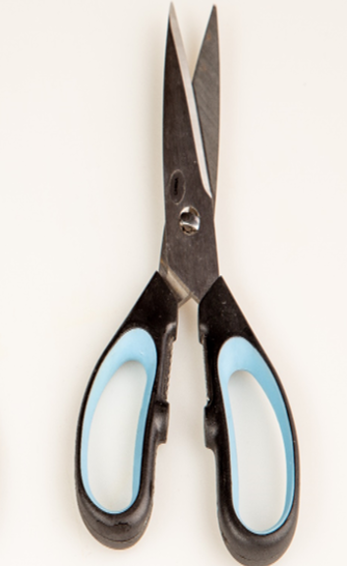
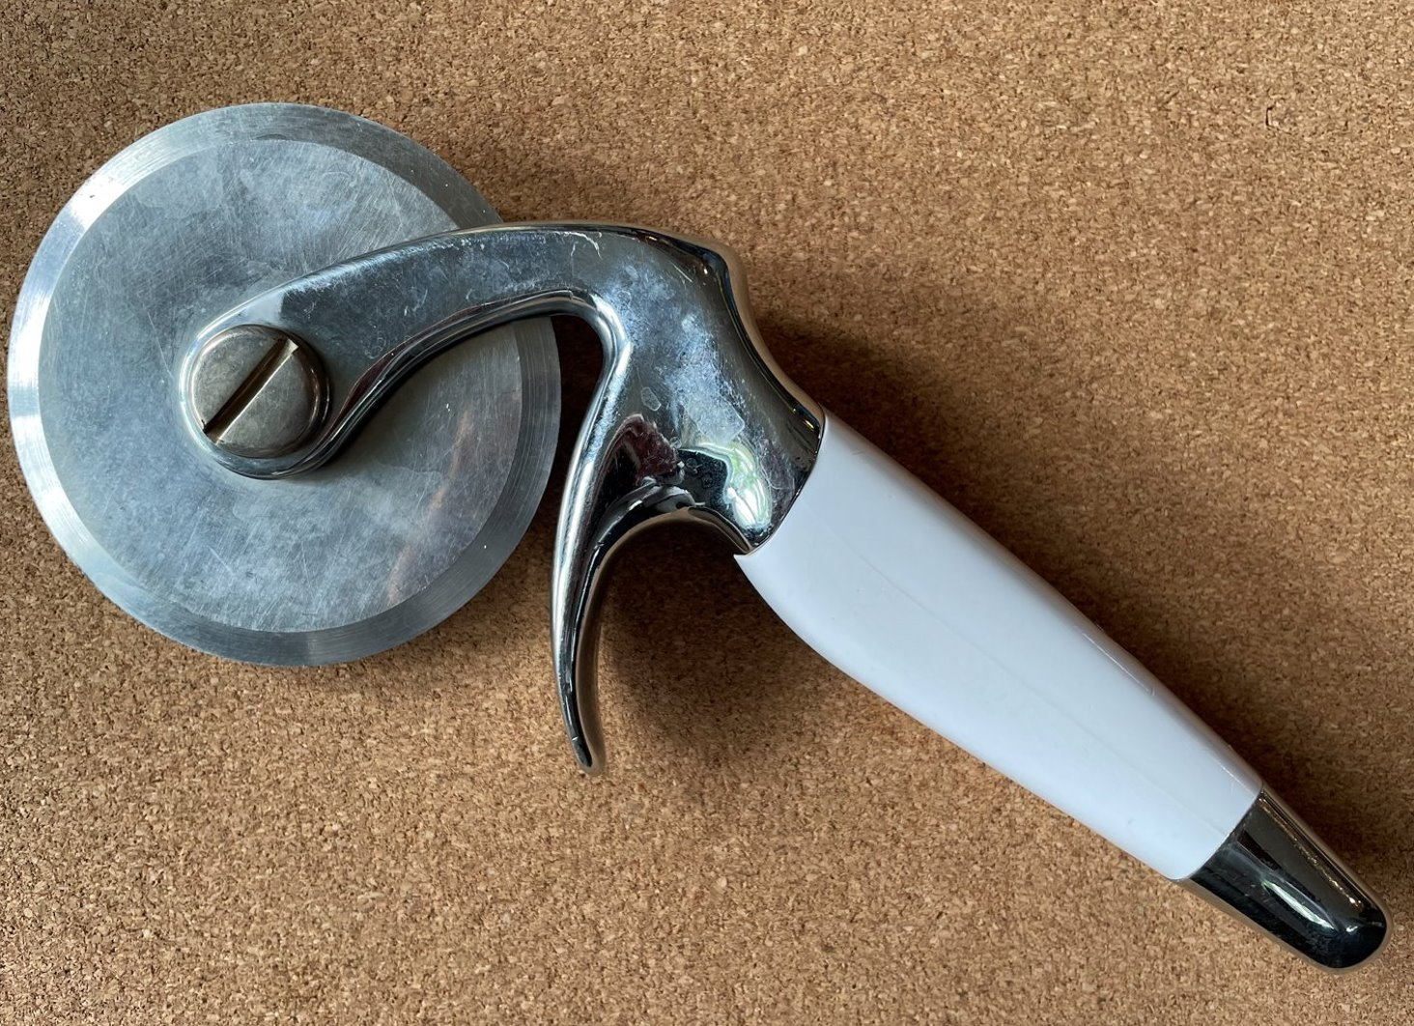
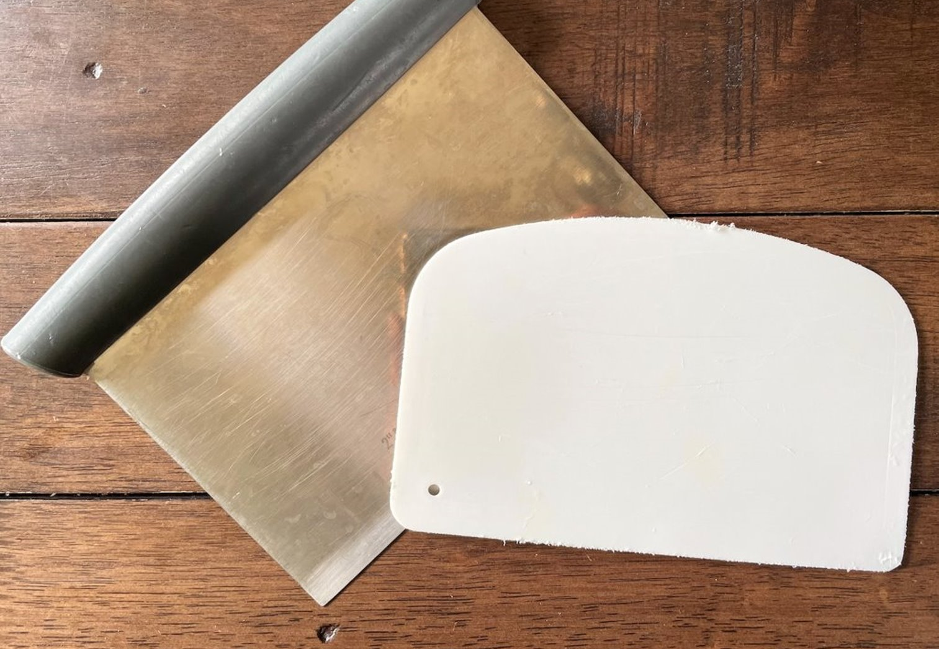
More Cutting Tools
Notes:
Do: Continue describing the tools below.
Sheers: used for snipping/chopping herbs, breaking down meat, especially poultry, and cutting open food packaging
Bench scraper: used to move product from the cutting board to a tray, bowl, or other container. Styles include plastic, stainless with polycarbonate handle, stainless with seamless rolled edge handle
Pizza wheel: used to slice through pizzas, quesadillas, and other similar products

Slide 29
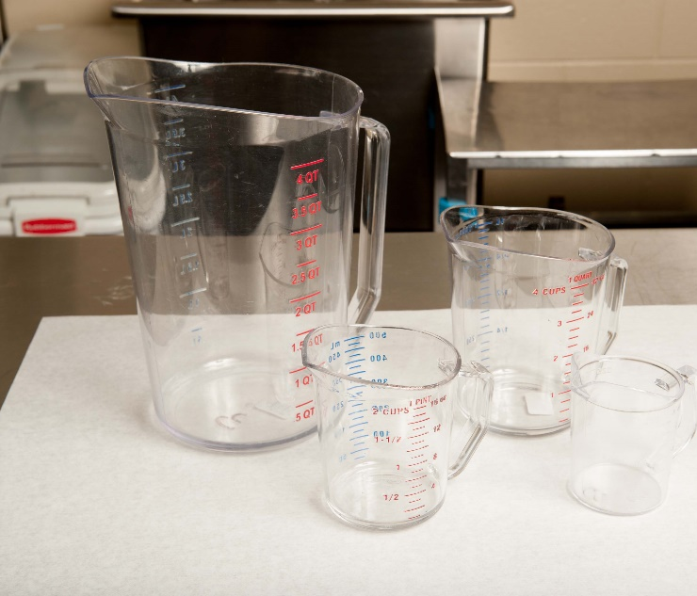
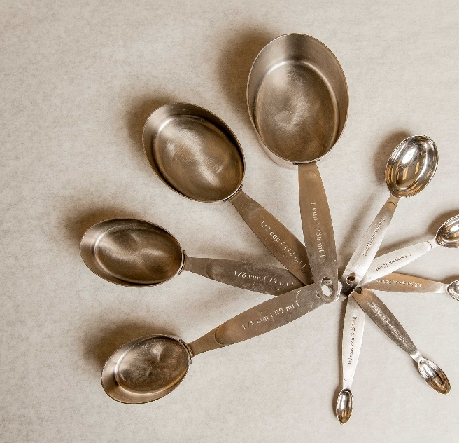
Measuring Tools
Solid measuring cups
Liquid measuring cups
Measuring spoons
Notes:
Say: Volume measuring tools are necessary for measuring success. Kitchens need to be equipped with solid measuring cups, liquid measuring cups, and measuring spoons. Purchase the same brand throughout your division if you want recipes to come out the same! It might sound crazy, but different brands vary in their measure.
Liquid measuring cups vary in material, and all have pros and cons. Just be aware that aluminum reacts with acidic ingredients, so if your kitchens have aluminum measuring tools, they need to be made aware! We do recommend measuring cups that have the measures written out on the tool rather than ones with only lines.
For measuring spoons, if you have the extremely flat ones, please replace them! Good measuring spoons should have a small bowl shape so that they can be properly filled and leveled off.

Slide 30
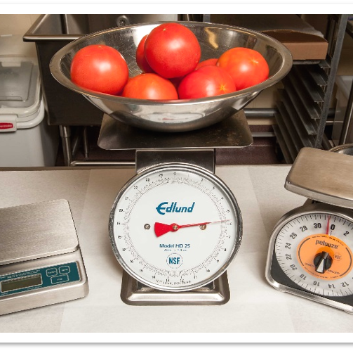
Weighing Tools
Portion scale
Receiving scale
Notes:
Say: Scales are considered more accurate than volume-measuring equipment. There are spring loaded scales and digital scales. While spring loaded scales are good tools, they are impacted by gravity's pull depending on where you are in the world, and the spring is impacted by changes in temperature. They can also be knocked out of calibration and damaged if not held correctly, by the base vs holding the spring loaded top. Digital scales are known to be more accurate and consistent. We highly recommend equipping your kitchens with digital ones.
School chefs need to be taught how to tare the scale, meaning to remove the weight of the container. If they do not tare their measuring containers while preparing a recipe, it could be a disaster!
Portion scales weigh up to 10 lb, whereas receiving scales weight up to 60 lb. Select the capacity needed based on the heaviest food item to be weighed during receiving, preparing, or serving. For example, a digital portion scale with a maximum weight of 10 pounds cannot be used to weigh a 25-pound case of fresh tomatoes.

Slide 31
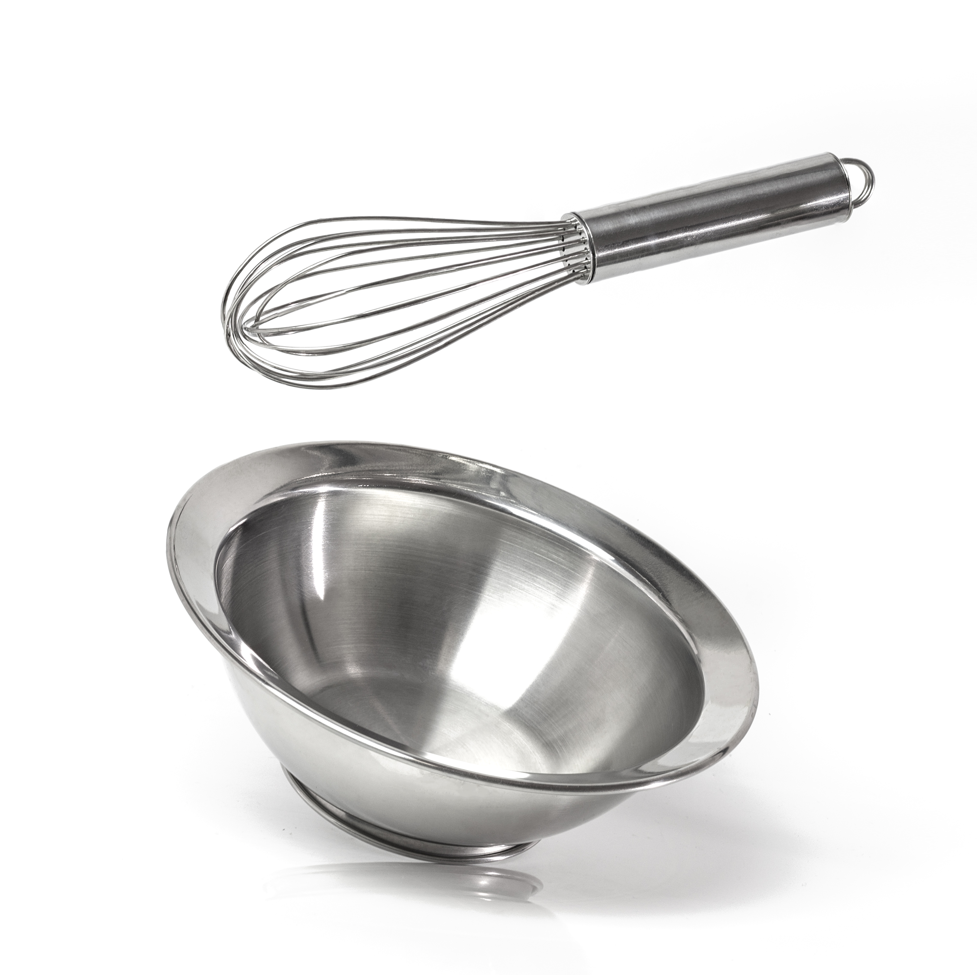
Mixing Tools
Spoons
Spatulas
Whisks
Mashers
Bowls
Notes:
Say: On to mixing tools! Mixing tools are used during the recipe preparation process, and every kitchen should be equipped with the ones listed on the slide. Spoons are available in different lengths, so consider equipment on site. For example, a deep steam jacketed kettle needs a long spoon! Spoons can be solid or slotted, and both are needed for different tasks.
Spatulas and whisks are available in various shapes and are selected based on the task. Spatula blades may be perforated, slotted, or solid. Spatulas and some whisks are made of rubber polyethylene or polypropylene that melts when exposed to high heat. Heat-resistant silicone (synthetic rubber) options are available.
Rubber spatulas can melt at about 350 °F, whereas silicone spatulas can withstand heat to about 570 °F! That's a big difference. Avoid spatulas with wooden handles as they cannot be sanitized properly.
Mashers aren't just used for potatoes. They can be used to mash anything to a chunky consistency, including beans, bananas, and more.
Commercial, stainless steel mixing bowls are available in various sizes, from small, less than 1 quart, to up to 80-quart bowls designed to accompany mobile mixing bowl stands. Kitchens should be equipped with a variety of sizes. Bowls of descending volume may be nested/stacked for compact storage. Some have silicone bottoms, which is nice to prevent slipping.

Slide 32
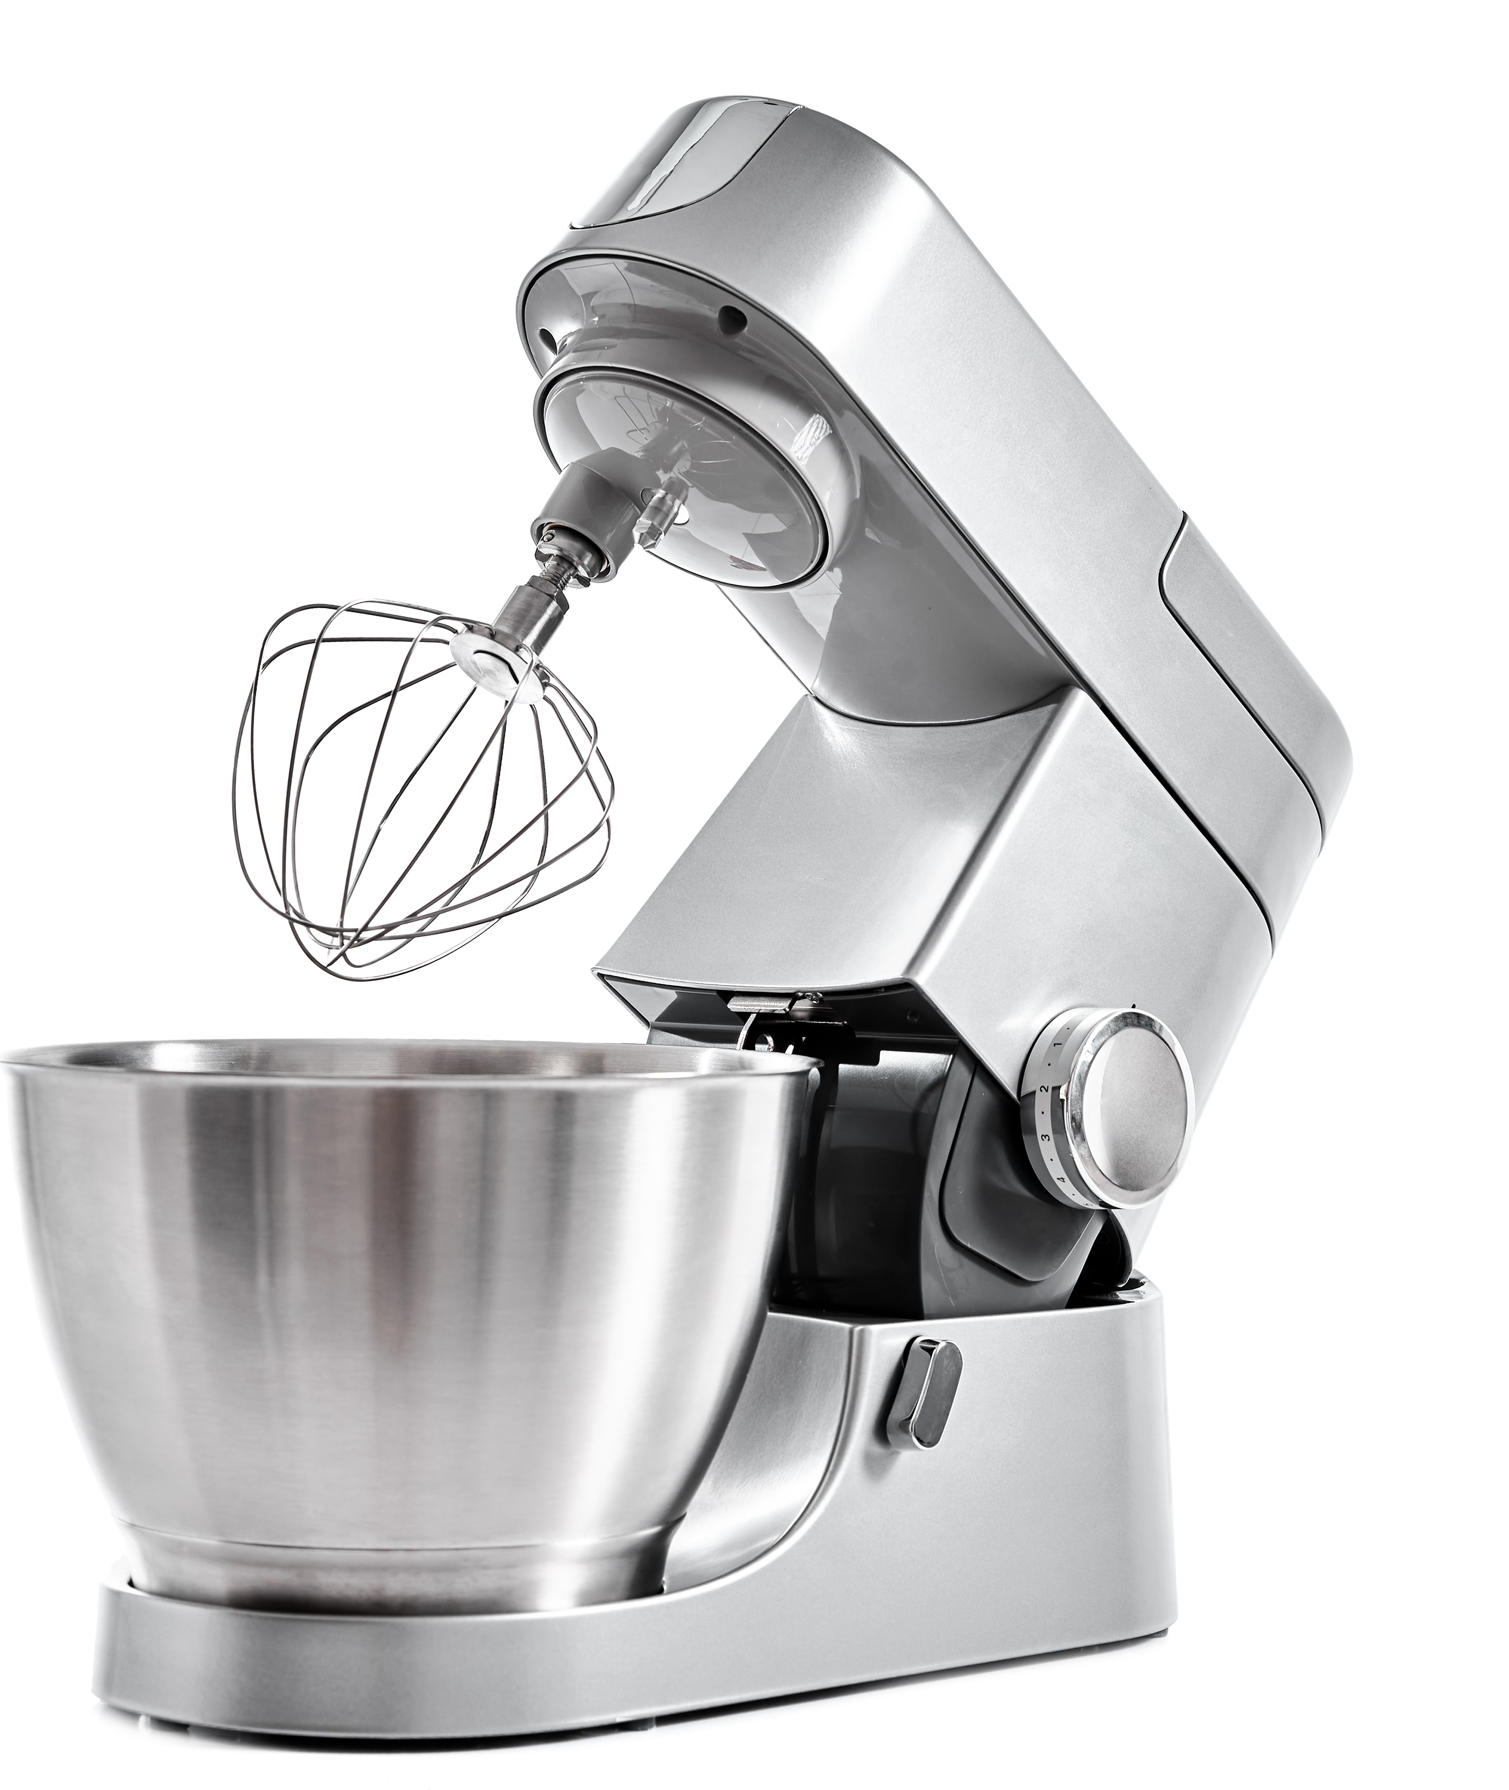
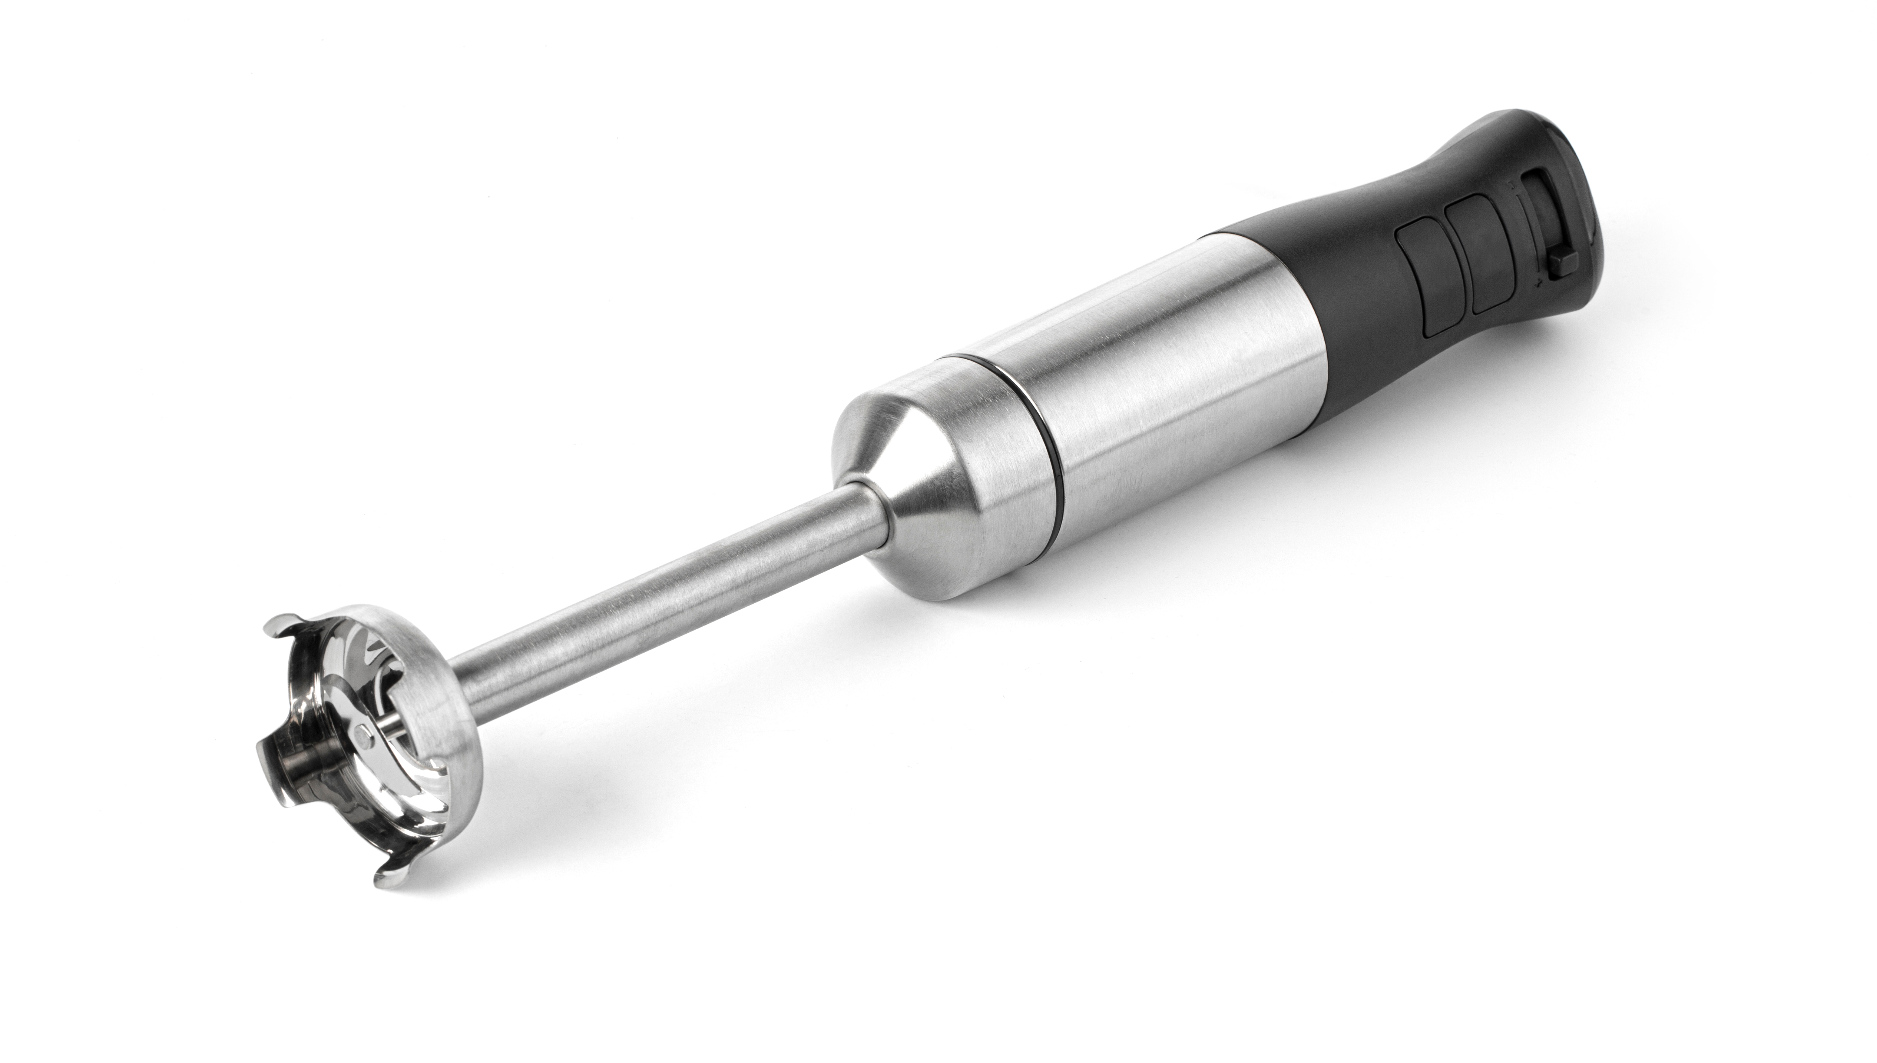

Large Mixing Tools
Stand mixers
Immersion blenders
Notes:
Say: For scratch cooking, stand mixers and immersion blenders are often necessary and ease preparation. Stand mixers can be used for mixing doughs, mashing potatoes, and more.
Immersion blenders can be used to prepare smoothies, dressings, sauces, and more. These are essential for volume production. A stand blender can only hold so much volume.

Slide 33
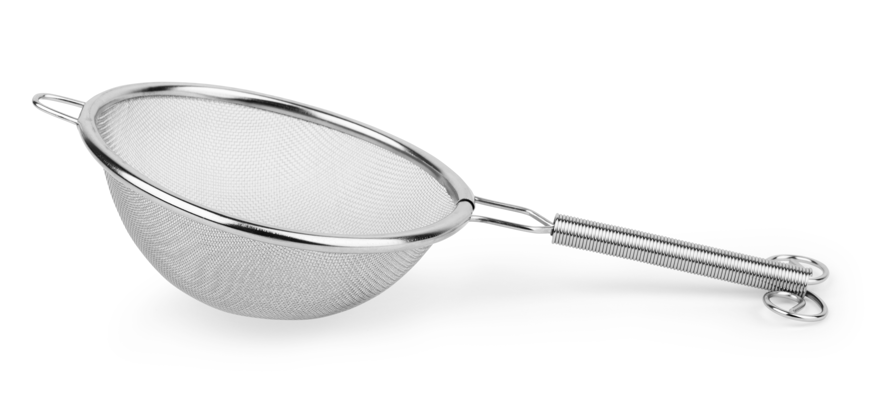
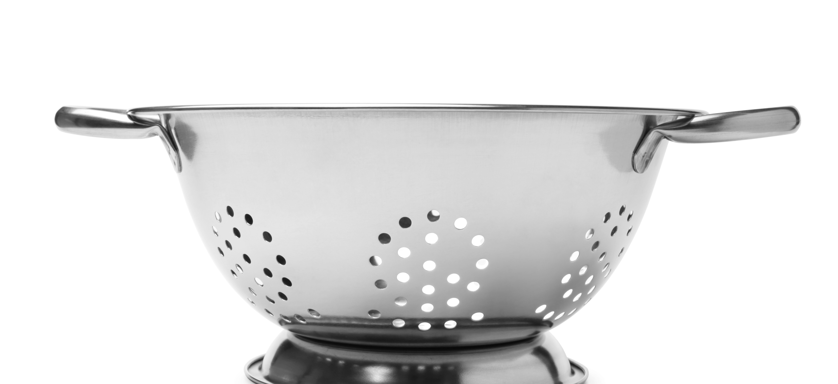
Straining Tools
Colanders
Strainers
Salad spinner
  Manual
  Mechanical
Notes:
Say: Let's now discuss straining tools. Colanders and strainers have multiple uses in food production. They are used to rinse foods, drain liquid from food, catch and remove smaller pieces of food, and sift foods into smaller pieces or blend dry ingredients. Colanders typically have large holes, whereas strainers/sieves have smaller holes or mesh.
Colanders can have a feet or ring base which allows them to sit in a sink vs holding for draining. This feature is essential for preparing large quantities of food! We sometimes find colanders that don't fit well in school kitchen sinks, so be sure to consider the dimensions of sinks when purchasing this piece of equipment.
Ask: Have you ever been served a salad with lettuce that is too wet? It's not appetizing is it?
Say: To get lettuce dry and crisp, you need a salad spinner. It will remove excess water from the leaves quickly. There are manual versions where you pull, push, or crank a lever or mechanical ones that do the labor for you. Manual salad spinners are more affordable for school kitchens, but if you have a central kitchen, you may consider the latter.

Slide 34
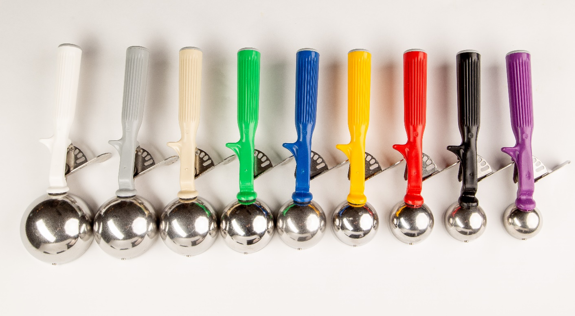
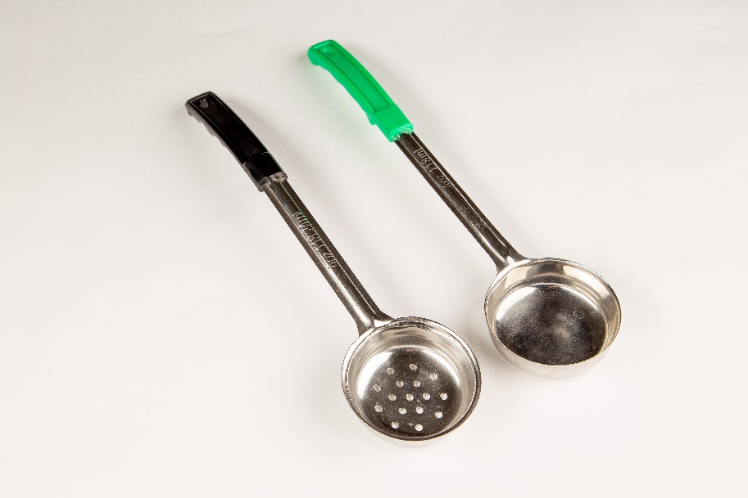
Serving Tools
Scoops
Spoodles
Ladles
Tongs
Notes:
Say: There are a variety of serving tools used in school nutrition programs, including scoops, spoodles, ladles, and tongs. These tools are essential for portion control! Make sure your schools are equipped with a variety of sizes. Staff need to not only be trained on the volume sizes, but also on which tool is appropriate for serving or preparing the recipe at hand.
While we often think of scoops for service, we use scoops often in scratch cooking to portion meatballs on a pan, yogurt for parfaits, toppings on a flatbread, and more. With that said, you might need more scoop sizes than your standard #16, #8, and #30 as you introduce more scratch cooking. It's much easier to portion with scoops than traditional measuring cups and spoons.
Did you know there is 1 cup scoop? We just discovered that tool last year! We had never seen them before.

Slide 35
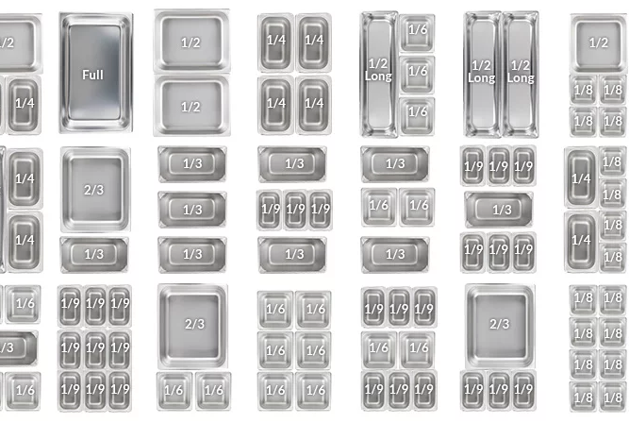
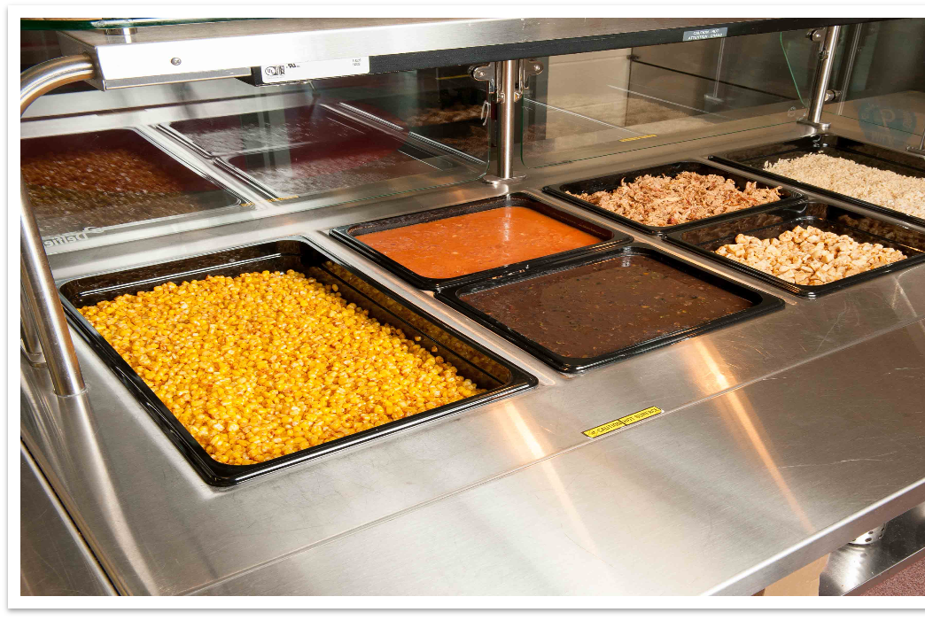
Pots and Pans
Notes:
Say: Pots and pans will wrap up our discussion on small equipment. The type and gauge of material will affect the durability, weight, look and cost of pots and pans. Aluminum and stainless steel are school kitchens' most common pot and pan materials. Stainless steel is more durable and does not react with acidic foods, but is not as good of a heat conductor as aluminum. Steam table pans are also available in regular and heat-resistant polycarbonate. There are black options that can help make the serving line look more appealing and less institutional. They are also easier to lift and move as they do not get as hot as stainless steel.
Cooking pans, such as saucepans, saute pans, stockpots are only needed for schools utilizing ranges, but of course all schools need sheet pans for oven cooking and steamtable pans for steaming and service. Half and full size sheet pans are a must. Consider equipping schools with a variety of steamtable pan sizes for cooking, but also for layout on the serving line. Shotgun style pans are visually more appealing, and quarter pans or smaller can be useful for build your own serving concepts.

Slide 36

Work Smarter, Not Harder!
Demo time!
Notes:
Say: We just went over a lot of information on equipment needed to best equip your schools for more scratch cooking. We wanted to drive the point home with one last demo. As you watch, think about if your schools have all of the equipment they need for success! Think about the wear and tear on your employees' bodies, as well as efficiency for production.
Let's watch Chef Andy try to prepare zucchini fire sticks in two different scenarios, one where he has limited equipment, and one where his director provided him with the tools needed to get the job done safely, efficiently, and ergonomically!
Demo preparing a recipe without proper equipment or inferior equipment, then demo with the right equipment
Zucchini fire sticks prep
Method 1
Dull knife
Flat measuring spoons
Anything else that can slow down the process
Method 2
Sunkist Sectionizer

Slide 37


Action Items
Evaluate your kitchens' tools
Develop a plan to purchase
Notes:
Say: As one of your handouts, we provided an equipment checklist. Use this list to evaluate your schools, and see what they need to be more efficient in the kitchen.
Ask: After hearing this presentation, are there any tools you already plan on buying? Please add to the chat!
Say: Develop a plan to purchase equipment needs. Decide which items are most important, and start there!

Slide 38
Questions?

