Slide 1

Global Flavors
Notes:
Record the webinar.
Say: Welcome!
Do: Introduce self briefly (no need for bio; name, credentials, and member of K-12 Culinary Team) and co-presenter.
Say: Remember that as we go through today’s webinar, the chat box is open for any questions and comments. We enjoy hearing from everyone and can learn a lot from each other. Please feel free to comment and ask questions in the chat anytime! We will monitor it together throughout this hour.

Slide 2
USDA Funding and Non-Discrimination Statements:
“This project has been funded at least in part with Federal funds from the U.S. Department of Agriculture. The contents of this publication do not necessarily reflect the view or policies of the U.S. Department of Agriculture, nor does mention of trade names, commercial products, or organizations imply endorsement by the U.S. Government.”
In accordance with federal civil rights law and U.S. Department of Agriculture (USDA) civil rights regulations and policies, this institution is prohibited from discriminating on the basis of race, color, national origin, sex (including gender identity and sexual orientation), disability, age, or reprisal or retaliation for prior civil rights activity.
Program information may be made available in languages other than English. Persons with disabilities who require alternative means of communication to obtain program information (e.g., Braille, large print, audiotape, American Sign Language), should contact the responsible state or local agency that administers the program or USDA’s TARGET Center at (202) 720-2600 (voice and TTY) or contact USDA through the Federal Relay Service at (800) 877-8339.
To file a program discrimination complaint, a Complainant should complete a Form AD-3027, USDA Program Discrimination Complaint Form which can be obtained online at: https://www.usda.gov/sites/default/files/ documents/ad-3027.pdf, from any USDA office, by calling (866) 632-9992, or by writing a letter addressed to USDA. The letter must contain the complainant’s name, address, telephone number, and a written description of the alleged discriminatory action in sufficient detail to inform the Assistant Secretary for Civil Rights (ASCR) about the nature and date of an alleged civil rights violation. The completed AD-3027 form or letter must be submitted to USDA by:
1. mail:
U.S. Department of Agriculture
Office of the Assistant Secretary for Civil Rights
1400 Independence Avenue, SW
Washington, D.C. 20250-9410; or
2. fax:
(833) 256-1665 or (202) 690-7442; or
3. email:
Program.Intake@usda.gov
This institution is an equal opportunity provider.

Slide 3
Objectives
List top culinary trends for main dishes according to National Restaurant Association.
Identify common ingredients and foods from different countries.
Describe how to offer student inspired scratch menu items in school nutrition programs featuring local foods.
Notes:
Say: Let’s review today’s objectives.
Do: Review objectives.

Slide 4
Poll Question!
Which cuisine is the most popular around the world?
Notes:
Say: Let's start with a poll! Who knows which cuisine is the most popular around the world?
Do: Reveal answer – Italian!

Slide 5




Why serve global flavors?
Nutrition
Nutrition Education
Local ingredients and scratch cooking
Meet customer demand
Notes:
Say: Why serve global flavors? There are a variety of reasons including nutrition, nutrition education, opportunities to use local ingredients and scratch made recipes, and to meet customer demand. Let's discuss these reasons a little more in depth, starting with nutrition.

Slide 6
Nutrition
Spices
Herbs
Less common fruits, vegetables, whole grains
Notes:
Say: Countries around the world use different spices, herbs, and possibly different fruits, vegetables, and whole grains than found here in the United States. Spices and herbs not only add flavor, but also powerful antioxidants and phytonutrients that work to prevent and fight chronic diseases.
If you attended our in-person director workshop this spring, you might remember we discussed the importance of eating a variety of fruits and vegetables. They all contain different nutrients, so the more, the better! The same can be said about different whole grains. Introducing your students to new fruits, vegetables, and whole grains may also be introducing them to different nutrients, and of course flavors!

Slide 7
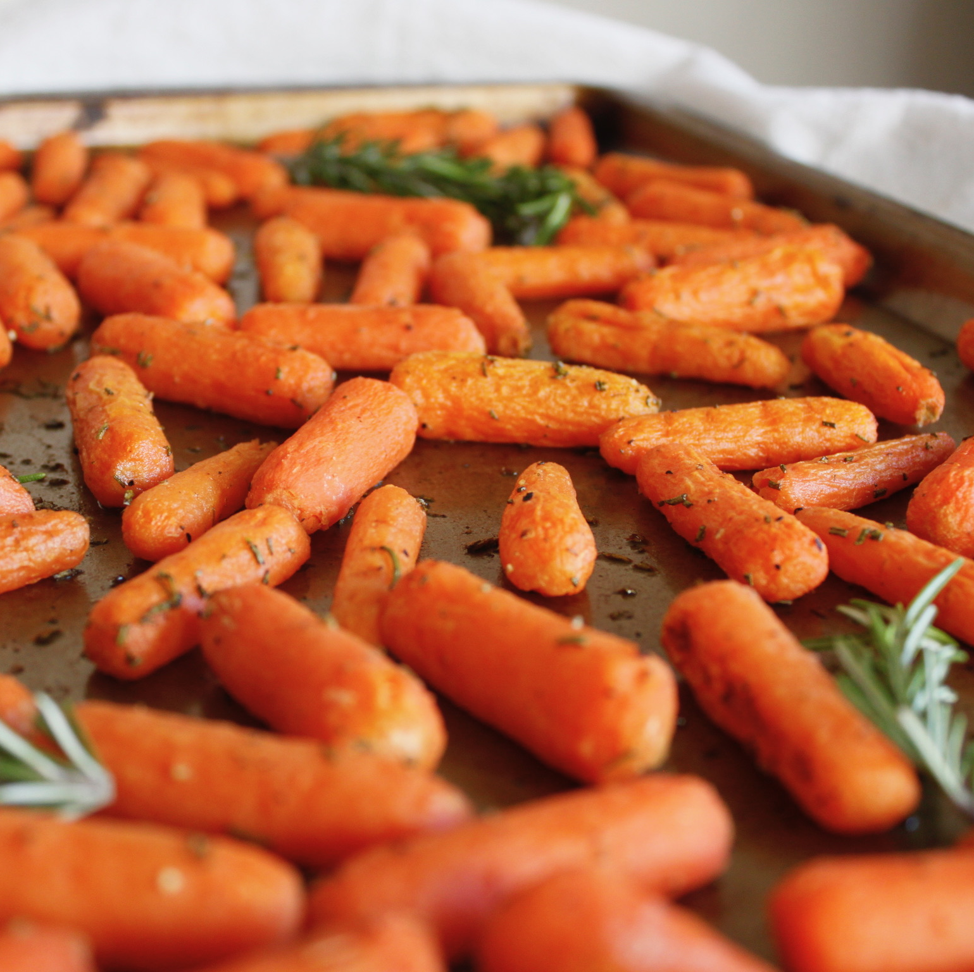
Nutrition Education
The cafeteria is an extension of the classroom
Notes:
Say: As you all know, the cafeteria is an extension of the classroom. When we serve global flavors, we have an opportunity to also educate students on the origin of the food served and provide any interesting facts. You could teach students about where the country is located, what ingredients are included in the food, and information on when it is served, such as for special holidays.

Slide 8
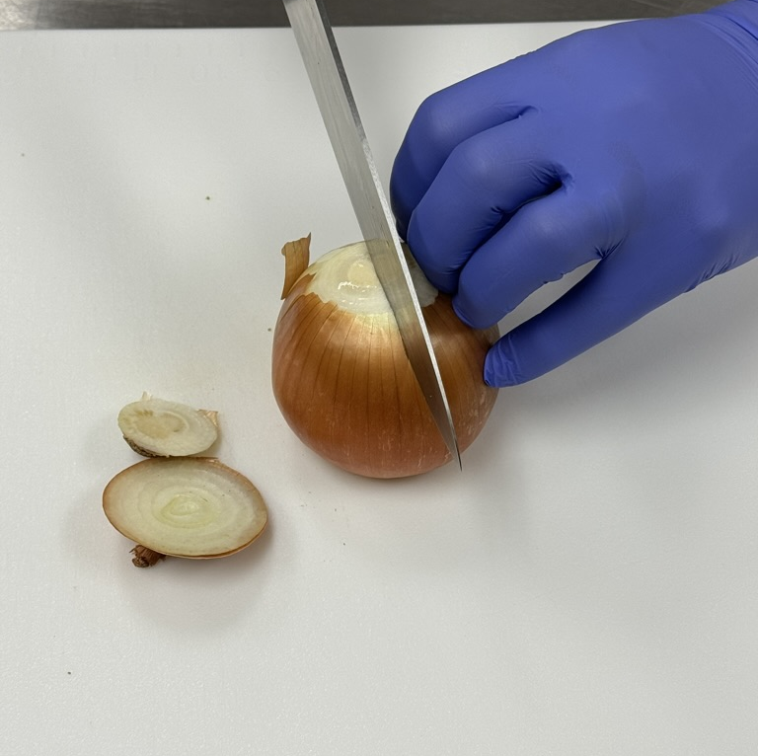
Scratch Cooking and Local Ingredients
Notes:
Say: Incorporating global flavors also allows more opportunities for scratch cooking and incorporating local ingredients. While you might be able to find global convenience foods, there are more opportunities through scratch cooking. And of course with more scratch cooking, comes more opportunities to include more local foods.

Slide 9
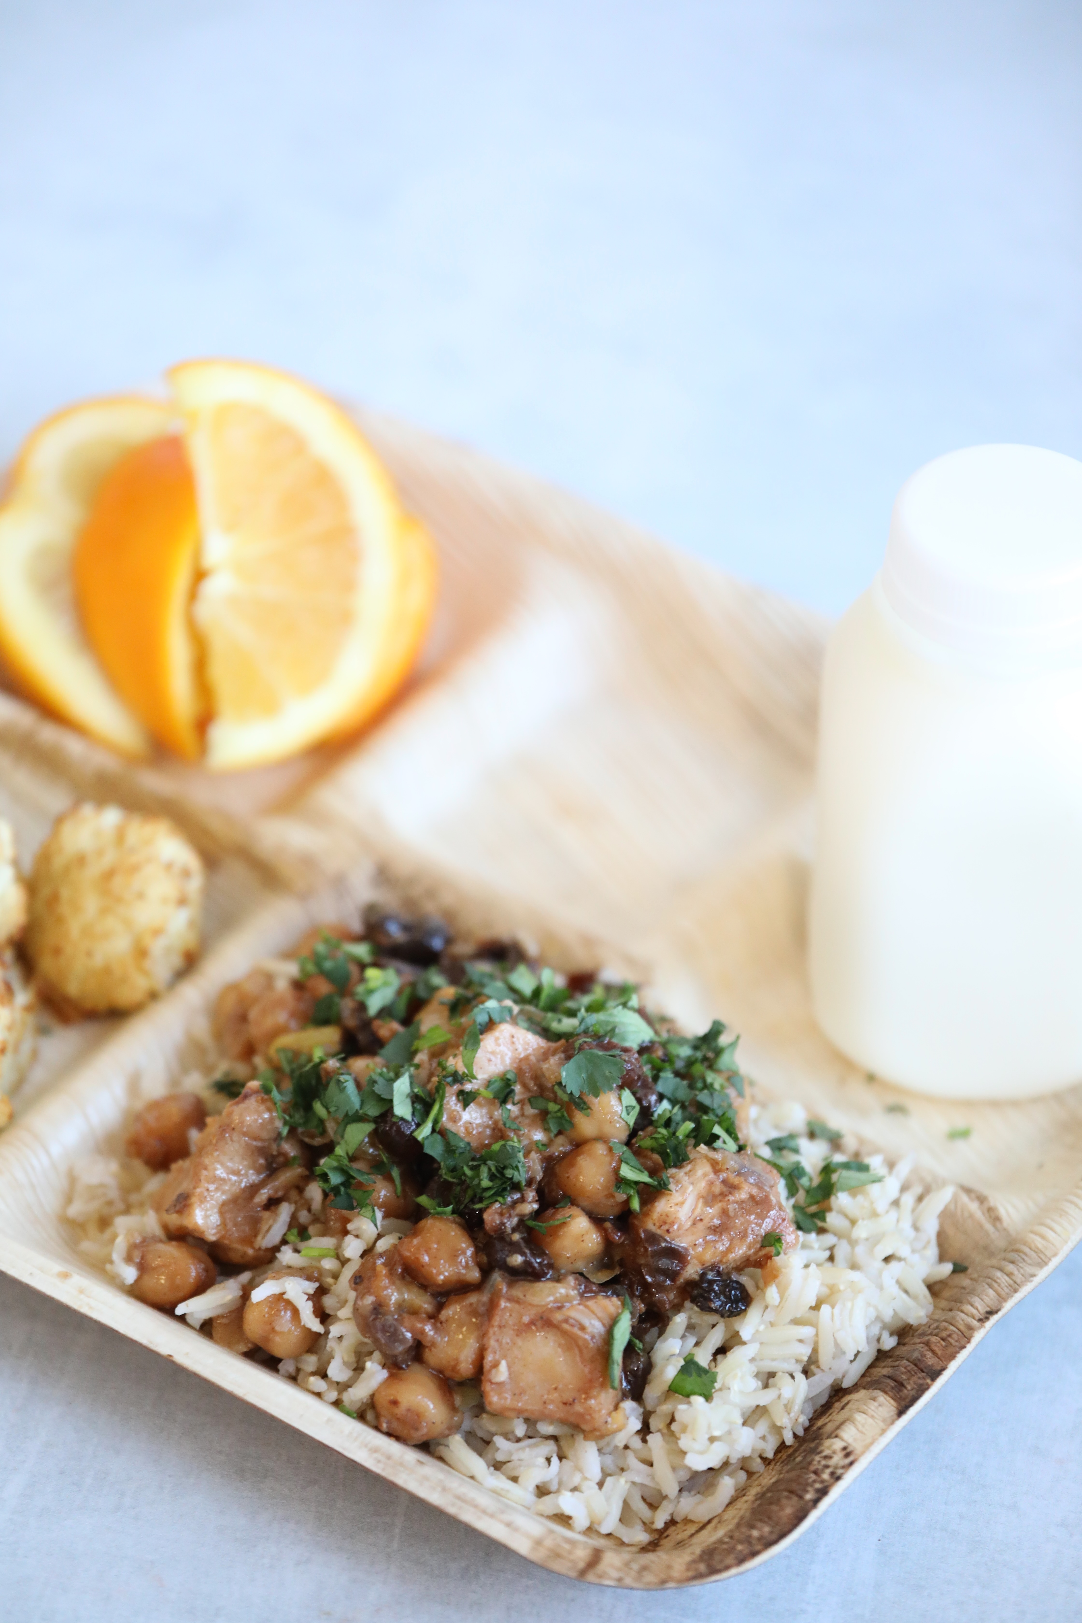
Student Inspired
Gen Z
Gen Alpha
Notes:
Say: No matter where they live or where they are from, students are globally connected through the internet and social media. Further, Gen Z and Gen Alpha are the most diverse generations in the history of the United States. With that said, they are most likely exposed to global flavors at home!
Look for opportunities to visit with your students and administration. Find ways to involve the students to learn more about their cultures, customs, cuisines, and what they're interested in. You can identify the student inspired preferences and incorporate those into your menu.
Ask: Is anyone currently seeing a trend in their student-inspired meal preferences? Or can you share an opportunity you had to visit with students about their cultures, customs, or different cuisines?

Slide 10
What’s Hot 2024 Culinary Forecast
What’s Hot 2024 Culinary Forecast
Global chicken wings
International BBQ
Grilled/cooked cheeses
Stuffed vegetables
Notes:
Say: Now let's take a look at the National Restaurant Association's What's Hot Culinary Forecast. The NRA forecast report draws on the expertise of more than 1500 culinary professionals. The report ranks 120 items into 7 categories: Dishes, Ingredients, Flavors, Condiments, Beverages, Alcohol Beverages, and Macro Trends. The list on this slide are the top 5 dishes. Notice the global theme!
World stage soups and stews include Mexican birria, Thai tom kha, Malaysian laksa, and Japanese ramen. Grilled/cooked cheeses include Mexican queso fundido, Swiss raclette, and Turkish halloumi. Stuffed vegetables include Mexican chiles en nogada, and multi-cultural stuffed peppers and cabbage rolls.

Slide 11
A Taste of Global Flavors
Common ingredients and dishes from around the world
Notes:
Say: Now, let's look at some common ingredients and dishes from around the world. This list is definitely not inclusive, but rather a taste, pun intended.

Slide 12
Mediterranean
Notes:
Say: Let's start in the Mediterranean part of the world.

Slide 13
Common Italian Ingredients
Olive oil
Tomatoes
Cheese
Basil
Oregano
Garlic
Balsamic vinegar
Pasta – dried and fresh
Notes:
Say: We will start with the world's most popular cuisine, Italian. Many of these ingredients we have in schools. Olive oil, balsamic vinegar, and fresh pasta are less common, but definitely not off limits. Extra virgin olive oil may be more pricey, but mixing it with canola oil is a way to cut cost and still bring this flavorful and healthy oil into schools.
Olive oil: This is a type of oil made from pressed olives. It's commonly used in cooking and salads. Olive oil is known for its rich flavor and health benefits.
Tomatoes: They come in various sizes and types, such as cherry tomatoes or Roma tomatoes. Tomatoes are versatile and can be eaten raw in salads, cooked in sauces, or roasted.
Cheese: a dairy product made from milk. There are many types of cheese, such as cheddar, mozzarella, or Parmesan. Cheese adds flavor and texture to dishes and can be melted, shredded, or sliced.
Basil: a fragrant herb commonly used in Italian cuisine. It has bright green leaves and a slightly sweet flavor with hints of pepper and mint. Basil is often used fresh as a garnish or added to sauces, salads, and pesto.
Oregano: another herb frequently used in cooking, especially in Italian, Mediterranean, and Mexican dishes. It has a strong, aromatic flavor and pairs well with tomatoes, cheese, and meats. Oregano can be used fresh or dried.
Garlic: a bulbous plant closely related to onions, leeks, and shallots. It has a pungent flavor and is used to add depth and richness to dishes. Garlic can be minced, sliced, or crushed and added to sauces, stir-fries, and marinades.
Balsamic vinegar: a dark, syrupy vinegar made from grapes. It has a sweet and tangy flavor with hints of fruitiness. Balsamic vinegar is often used in salad dressings, marinades, and drizzled over vegetables or fruits.
Pasta (dried and fresh): a staple food made from wheat flour, water, and sometimes eggs. It comes in various shapes and sizes, such as spaghetti, penne, or fettuccine. Dried pasta is shelf-stable and needs to be cooked in boiling water before eating. Fresh pasta is made with eggs and has a shorter cooking time. It's often found in the refrigerated section of grocery stores or made from scratch at home.

Slide 14
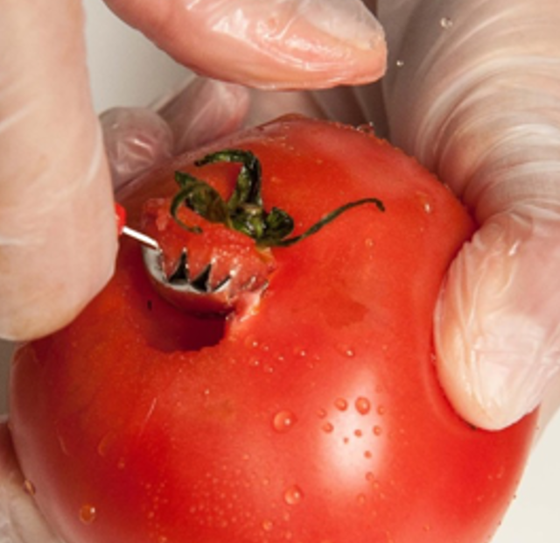
Popular Italian Dishes
Pizza
Lasagna
Bolognese
Risotto
Spaghetti carbonara
Notes:
Say: Starting with a favorite, Italian dishes! We are familiar with pizza and lasagna, but what about a few of these listed?
Bolognese: A rich Italian sauce made with ground meat (often beef or pork), tomatoes, onions, carrots, celery, and seasonings, usually served with pasta.
Risotto: An Italian rice dish cooked slowly with broth until creamy, often flavored with ingredients like cheese, vegetables, or seafood.
Spaghetti carbonara: An Italian pasta dish made with spaghetti noodles, eggs, cheese (usually Parmesan), pancetta (Italian bacon), and black pepper, resulting in a creamy sauce coating the pasta.

Slide 15
Common Greek Ingredients
Olives
Olive oil
Feta cheese
Lemon
Cucumber
Dill
Mint
Oregano
Honey
Yogurt
Tomatoes
Notes:
Say: The list for Greek ingredients is long. I want to take a moment to see how these ingredients are used in Greek recipes.
Do: Highlight a few favorites, but participants can have the list for later.
Olives: A staple in Greek cuisine and are often used in salads, as toppings for pizza and flatbreads, or as a garnish for various dishes. They can also be pressed to make olive oil, which is used in cooking and as a dressing for salads and vegetables.
Olive oil: A fundamental ingredient in Greek cooking, used for sautéing, frying, roasting, and dressing salads. It's also drizzled over dishes such as grilled meats, vegetables, and seafood for flavor enhancement.
Feta cheese: One of the most iconic Greek ingredients. It's crumbled over salads, used as a filling in pastries like spanakopita, or served with olives and tomatoes as part of a traditional Greek meze (appetizer) platter.
Lemon: Used to add a bright, citrusy flavor to many Greek dishes. It's squeezed over grilled meats, seafood, and vegetables, used in dressings for salads, and incorporated into marinades and sauces.
Cucumber: Sliced and served in Greek salads, along with tomatoes, onions, olives, and feta cheese. They're also used in tzatziki, a popular Greek yogurt sauce flavored with garlic, dill, and lemon.
Dill: A common herb used in Greek cuisine to flavor dishes such as fish, seafood, and yogurt-based sauces like tzatziki. It's also used to garnish dishes and add a fresh, herbal aroma.
Mint: Used in both sweet and savory Greek dishes. It's added to salads, used to flavor meats and sauces, and often brewed into tea. Mint also adds a refreshing element to desserts like baklava and yogurt with honey.
Oregano: A key herb in Greek cooking, used to season meats, vegetables, and tomato-based dishes like moussaka and pastitsio. It's also sprinkled over feta cheese and olive oil to create a simple yet flavorful appetizer.
Honey: Used to sweeten desserts like baklava, yogurt with fruit and nuts, and pastries such as melomakarona (honey cookies). It's also drizzled over cheese and served with nuts as part of a cheese platter.
Yogurt: A versatile ingredient in Greek cuisine, used to make sauces like tzatziki, served as a side dish or dessert with honey and fruit, or used as a marinade for meats. It's also used in baking to make cakes and breads moist and tender.
Tomatoes: Used in many Greek dishes, from salads and sauces to soups and stews. They're a key ingredient in dishes like moussaka, stuffed vegetables (gemista), and Greek-style meatballs (keftedes). Tomatoes are also used fresh in salads and cooked into savory pies like spanakopita.

Slide 16
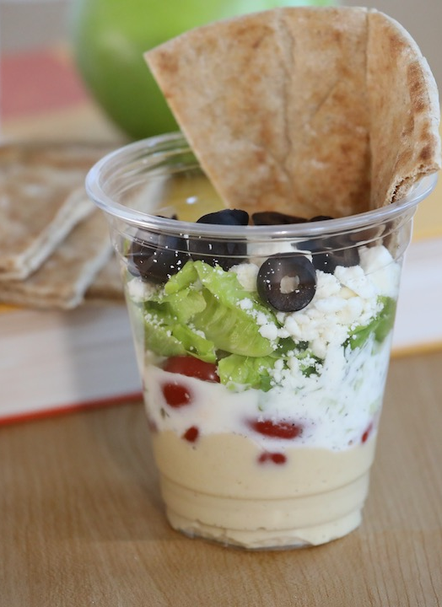
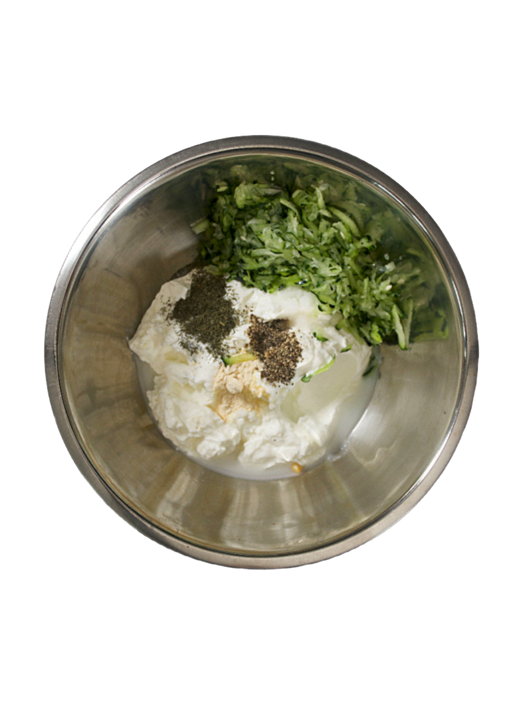
Popular Greek Dishes
Gyros
Moussaka
Dolmades
Souvlaki
Spanakopita
Hummus
Tzatziki
Notes:
Say: After seeing a list of common ingredients, let's see how we can put them to work! Here are a few popular Greek dishes. Starting with the one you see on the screen.
Tzatziki: Yogurt sauce with cucumber, garlic, and herbs, served cold. Look at all those delicious herbs and spices that go into this recipe. We have grated cucumber, garlic, lemon juice, and dill.
Gyros: Sliced seasoned meat wrapped in pita with veggies and tzatziki sauce.
Moussaka: Layers of eggplant, meat, and creamy sauce baked as a casserole.
Dolmades: Grape leaves stuffed with rice, herbs, and sometimes meat.
Souvlaki: Grilled skewers of meat or veggies served with pita and tzatziki.
Spanakopita: Spinach and feta cheese wrapped in crispy phyllo dough.
Hummus: Creamy dip made from chickpeas, tahini, and spices.

Slide 17
Chef Demo!
Ramen
Notes:
Say: We are going to do two different recipe demos today! We will start with tzatziki which we just saw in the beautiful Greek cup. Remember that it is a yogurt sauce with cucumber, garlic, and herbs, served cold. We will start by grating the cucumbers and squeezing all the water out. If you don't do this step, your yogurt sauce will be watered down and not as creamy or flavorful. Then, you'll combine the cucumber with yogurt, garlic, lemon juice, and dill. It's best made the day before serving, and it can be stored for up to 3 days. It can be served as a dip, layered with a salad, or a pita.​
You might have seen instant ramen in stores. It's like a quick version of the real thing that you can make in a few minutes by adding hot water. It's a favorite for quick snacks or meals. Ramen originally came from China and became popular in Japan. It's a type of noodle soup that's now famous worldwide. Ramen can have lots of different toppings. You can mix and match to make your perfect bowl. The soup in ramen or the broth comes in different flavors like pork, soy sauce, and miso (a kind of bean paste). Each one has its own taste.
Ramen noodles can be thick or thin, curly or straight. They're usually chewy and very yummy! So many students enjoy noodles, making this a more familiar dish from the start! In Japan, ramen is a big deal! It's like comfort food that people eat anytime, anywhere. Now, ramen is popular all over the world. It's easy to make at home, and you can find it in lots of restaurants and stores.
Now I believe we will travel to Asia, Chef, back to you!

Slide 18
Asia
Notes:
Say: Now we'll move on to Asia.

Slide 19
Common Japanese Ingredients
Soy sauce
Rice vinegar
Mirin
Miso
Nori
Wasabi
Rice
Seafood
Notes:
Say: Something unique to Japanese cuisine is the presentation of food is considered as important as its taste! Our presentation is important because our students eat with their eyes! They often look at what we are serving on the line before they make eye contact with us.
Soy sauce: A salty, brown sauce made from fermented soybeans and wheat. It's often used as a flavoring in Asian cooking, especially with dishes like stir-fries and sushi. While this does have a high sodium content, we use low sodium, and it still fits into our recipes!
Rice vinegar: A mild and slightly sweet vinegar made from fermented rice. It's commonly used in Asian cuisines to add acidity and flavor to dishes like sushi rice, salad dressings, and marinades. Adding a vinegar helps reduce the need for adding as much salt.
Mirin: A sweet rice wine used in Japanese cooking to add sweetness and depth of flavor to dishes like teriyaki sauce and marinades. It has a low alcohol content and is often used in combination with soy sauce and other seasonings.
Miso: A thick paste made from fermented soybeans, salt, and sometimes grains like rice or barley. It's used as a seasoning in Japanese cooking to add savory umami flavor to soups, marinades, and sauces.
Nori: Thin, dried seaweed sheets commonly used in Japanese cuisine, especially for making sushi rolls (maki) and wrapping rice balls (onigiri). Nori has a salty flavor and crisp texture.
Wasabi: A pungent green paste made from the grated root of the wasabi plant. It has a strong, spicy flavor and is often served with sushi and sashimi as a condiment.
Rice: A staple food grain that's a major part of many Asian cuisines, including Japanese cuisine. It's cooked by boiling or steaming and serves as the base for many dishes like sushi, stir-fries, and rice bowls.
Seafood: Any type of edible marine life, including fish, shellfish, and crustaceans. Seafood is a significant part of Japanese cuisine, with dishes like sushi, sashimi, grilled fish, and seafood soups being popular choices.

Slide 20
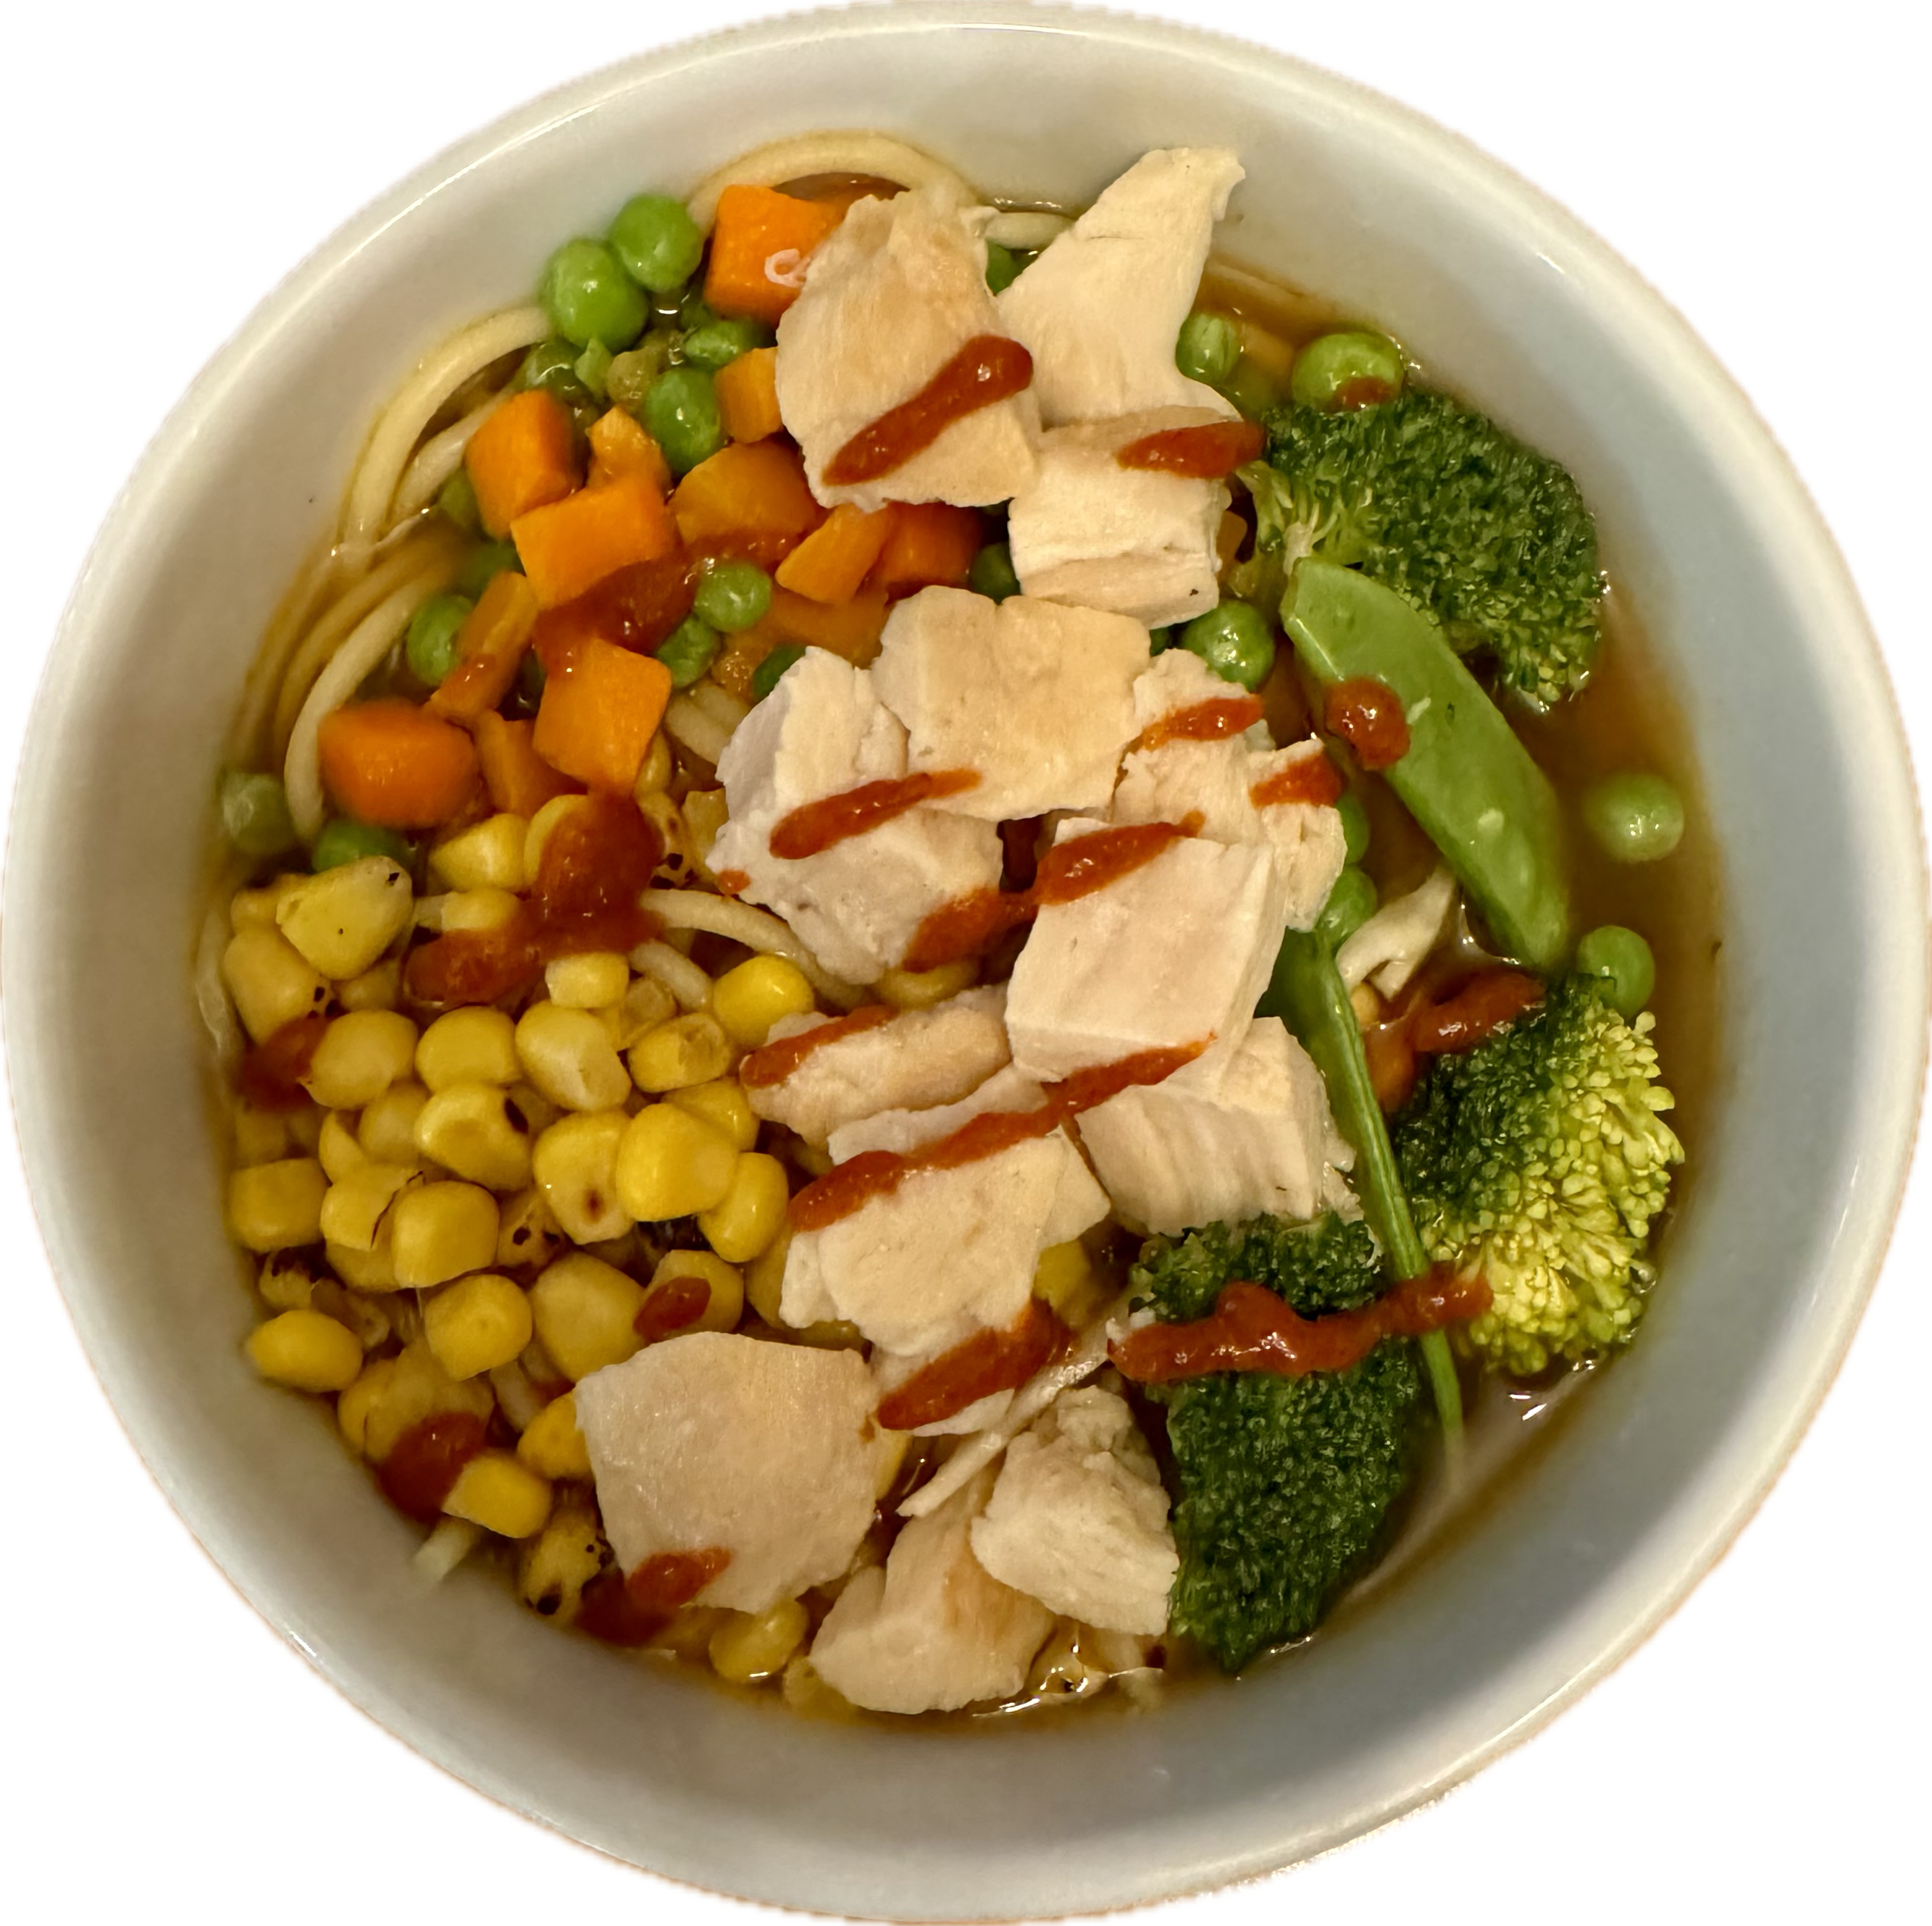
Popular Japanese Dishes
Sushi
Sashimi
Ramen
Tempura
Katsu
Notes:
Say: Many of these dishes are also a work of art. How many of you have had sushi? When you see the presentation, it's memorable! We have our K-12 ramen on the screen.
Ramen: A Japanese noodle soup dish consisting of wheat noodles served in a flavorful broth, typically flavored with soy sauce, miso, or pork bone broth. It's often topped with ingredients like sliced pork, boiled eggs, green onions, and seaweed. Ours is schoolified here with chicken, corn, peas and carrots, and broccoli. This is a great opportunity for students to build their own and choose what toppings they want to add!
Sushi: Bite-sized portions of seasoned rice topped or rolled with various ingredients, such as fish, seafood, vegetables, or egg. It's often served with soy sauce, wasabi, and pickled ginger.
Sashimi: Sliced raw fish or seafood served without rice. It's a popular Japanese dish known for its freshness and delicate flavor, often accompanied by soy sauce and wasabi.
Tempura: A Japanese dish made by deep-frying seafood, vegetables, or other ingredients coated in a light and crispy batter made from flour, egg, and cold water. It's served hot and often accompanied by a dipping sauce.
Katsu: A Japanese dish consisting of breaded and deep-fried cutlets of meat (usually pork or chicken). It's served with a sweet and savory sauce called tonkatsu sauce and often accompanied by shredded cabbage.

Slide 21
Common Chinese Ingredients
Soy sauce
Sesame oil
Ginger
Garlic
Scallions
Rice
Notes:
Say: Chinese cooking uses a wide range of cooking techniques, including stir-frying, steaming, braising, deep-frying, and roasting. It is often associated with rituals and symbolism, particularly during festivals and special occasions.
Soy sauce: A salty, savory sauce made from fermented soybeans, used to flavor many Asian dishes. As we mentioned earlier, we often use low sodium, because it can be high.
Sesame oil: A fragrant oil made from sesame seeds, adding nutty flavor to stir-fries and salads. A little bit goes a LONG way!
Ginger: A spicy root used to add flavor and warmth to dishes, often grated or sliced. This can be fresh or dried.
Garlic: A pungent bulb used for its distinct flavor in many cuisines worldwide.
Scallions: Also known as green onions, they add a fresh, mild onion flavor to dishes.
Rice: A staple grain used as a base for many dishes, providing sustenance and texture. This is easy to make a whole grain by using brown rice.

Slide 22
Common Filipino Ingredients
Soy sauce
Cane and coconut vinegar
Fish sauce
Ube (purple sweet potato)
Banana ketchup
Chili peppers
Notes:
Say: Rice is a staple food in the Philippines and is often served with every meal. It's typically steamed and eaten alongside meat, seafood, or vegetable dishes. We were discussing this with Chef Andy, whose family is Filipino. He said it is very strange to eat a meal without rice.
Soy sauce: A dark, salty sauce made from fermented soybeans and wheat. It's often used in cooking to add flavor to dishes like stir-fries and marinades.
Cane and coconut vinegar: Vinegar made from sugarcane or coconut sap. It's tangy and used in Filipino cuisine to add acidity and flavor to dishes like adobo and kinilaw (ceviche).
Fish sauce: A pungent, salty liquid made from fermented fish. It's commonly used as a seasoning in Southeast Asian cuisine to add a savory flavor to dishes like stir-fries, soups, and dipping sauces.
Ube (purple sweet potato): A type of sweet potato with a purple-colored flesh. Ube is used in Filipino desserts and baked goods to add color and a naturally sweet flavor. It's often made into treats like ube halaya (jam) or ube cake.
Banana ketchup: A sweet and tangy ketchup made from mashed bananas, vinegar, sugar, and spices. It's a popular condiment in the Philippines and is used as a dipping sauce or topping for dishes like fried chicken and hot dogs.
Chili peppers: Spicy peppers used to add heat and flavor to dishes. They come in different varieties and are used in cuisines around the world, including Filipino cooking, where they're used to make spicy sauces, marinades, and condiments.

Slide 23
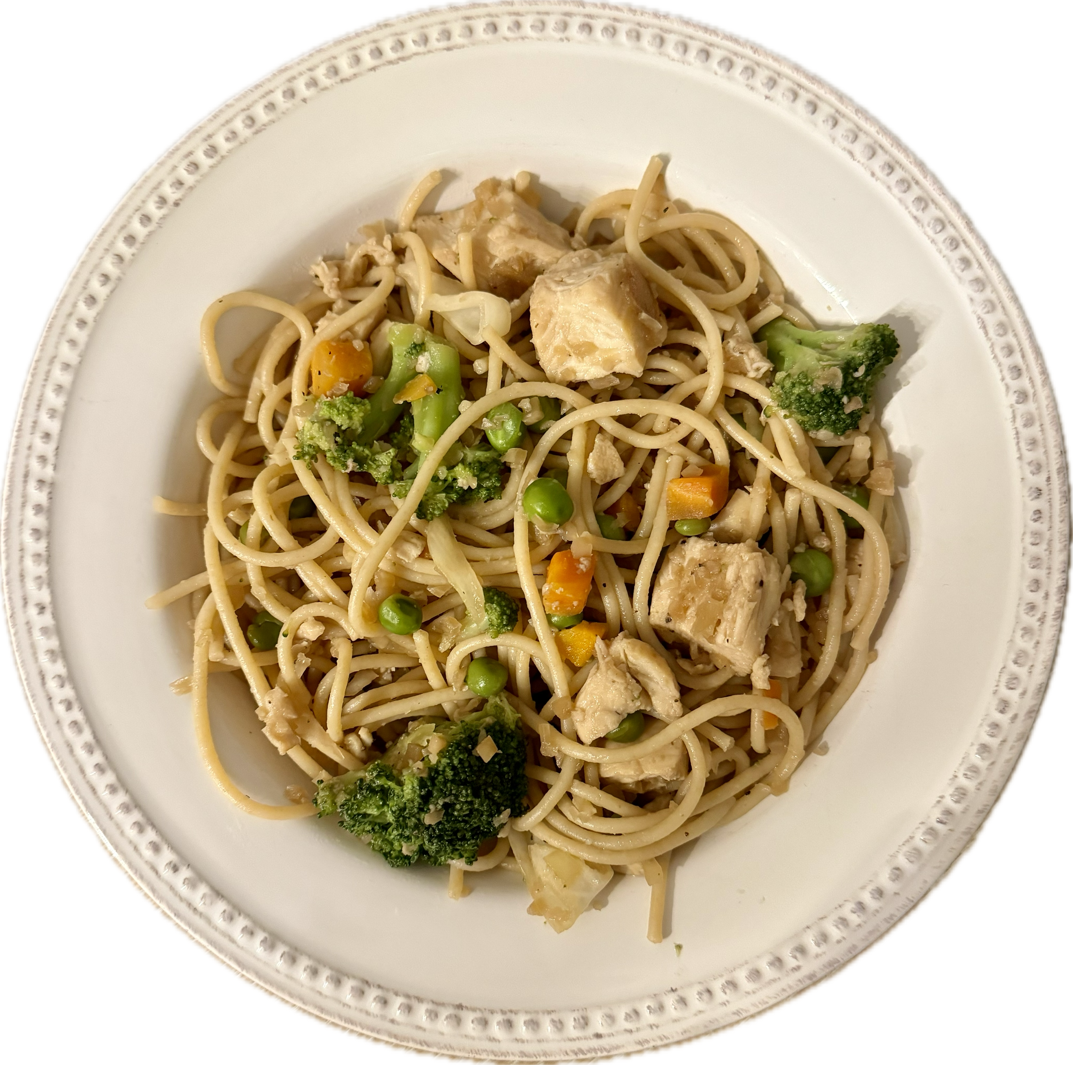
Popular Filipino Dishes
Adobo
Lumpia spring rolls
Pancit noodles
Roast pig
Notes:
Say: Because the Philippines is made up of over 7,000 islands, its cuisine has been shaped by various influences, including Chinese, Spanish, American, and indigenous Filipino cultures. This makes Filipino food a delicious mix of flavors, ingredients, and cooking styles that reflect the country's diverse history and heritage. So, when you enjoy Filipino dishes like adobo or pancit, you're also tasting a bit of history and culture from around the world! Pictured here is pancit noodles.
Pancit noodles: Long, thin noodles commonly used in Filipino cooking. They're stir-fried with veggies, meat, and sometimes seafood, making a yummy and filling dish often served at celebrations.
Adobo: A tasty Filipino dish made by cooking meat (like chicken or pork) in a tangy sauce made of vinegar, soy sauce, garlic, and spices. It's savory and often served with rice.
Lumpia spring rolls: Delicious Filipino snacks made by wrapping thin pastry sheets around a mix of veggies, meat, or seafood, then frying them until they're crispy. They're like Filipino egg rolls!
Roast pig: Also known as lechon, it's a special Filipino dish made by roasting a whole pig until the skin is crispy and the meat inside is juicy and flavorful. It's a big deal at parties and celebrations!

Slide 24
Common Indian Ingredients
Garam masala
Turmeric
Garlic
Ginger
Chilies
Tomato
Coconut
Lentils
Garbanzo beans
Basmati rice
Notes:
Say: Indian food has lots of different flavors and dishes depending on where you are in the country. From spicy curries to yummy vegetarian meals, Indian cuisine has something for everyone. They have lots of vegetarian options because their food culture has lots of tasty veggie options that are seasoned well! This is Chef Lindsey's favorite cuisine! Speaking of seasonings, let's take a look!
Garam masala: A blend of spices commonly used in Indian cooking, such as cumin, coriander, cardamom, cinnamon, and cloves. It adds warmth and depth of flavor to dishes.
Turmeric: A bright yellow spice that comes from a root. It's often used in Indian cooking to add color and flavor to dishes, and it's known for its health benefits.
Garlic: A pungent bulb used to add flavor to dishes. It's often chopped or crushed and added to curries, sauces, and marinades.
Ginger: A spicy root used in both sweet and savory dishes. It adds a zesty flavor and aroma to Indian cuisine, especially in curries and teas.
Chilies: Spicy peppers used to add heat to dishes. They come in various sizes and levels of spiciness and are a key ingredient in many Indian recipes.
Tomato: A juicy fruit used in cooking to add acidity and sweetness to dishes. It's often used as a base for sauces, curries, and soups in Indian cuisine.
Coconut: A tropical fruit known for its sweet flavor and creamy texture. Coconut is used in various forms in Indian cooking, including coconut milk, grated coconut, and coconut oil. This is challenging for us to use, because of the saturated fat.
Lentils: Small legumes that come in different colors like red, green, and brown. They're a staple ingredient in Indian cuisine and are often used to make dishes like dal (lentil curry) and soups. A great meat/meat alternate option!
Garbanzo beans: Also known as chickpeas, these are round legumes with a nutty flavor and firm texture. They're commonly used in Indian cooking to make dishes like chana masala (spicy chickpea curry).
Basmati rice: A fragrant, long-grain rice variety that's popular in Indian cuisine. It has a delicate flavor and fluffy texture when cooked, making it perfect for pilafs, biryanis, and other rice dishes. Has anyone looked for brown basmati rice? It does exist, but we can also use brown rice.

Slide 25
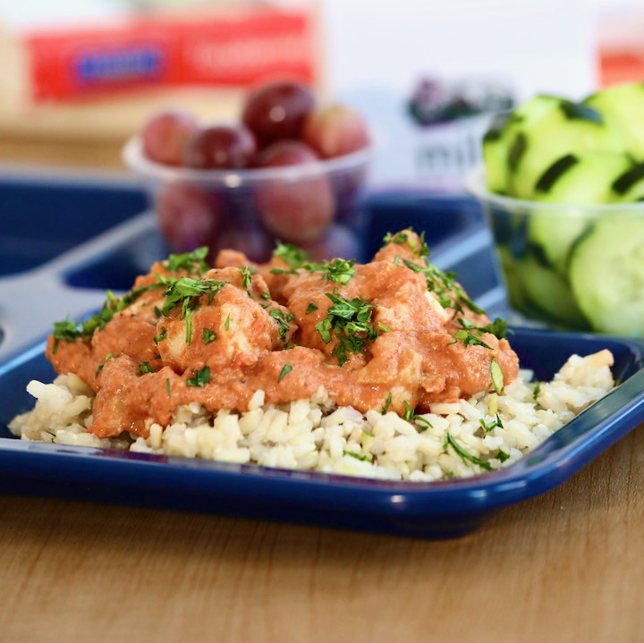
Popular Indian Dishes
Chicken tikka masala
Chana masala
Dahl (lentils)
Rice pulao and biryani
Samosas
Notes:
Say: Take a look at these Indian dishes, and you will notice that there are a few vegetarian options with lots of flavor including chana masala and dahl (read the definitions). We have also made a K-12 chicken tikka masala as pictured in this photo on your screen.
Chicken tikka masala: Tender pieces of chicken cooked in a creamy, tomato-based sauce with spices. It's a popular Indian dish known for its rich flavor and mild spice level. Traditionally finished with heavy cream, but we used yogurt for our school recipe.
Chana masala: A flavorful and hearty dish made from chickpeas cooked in a spiced tomato gravy. It's vegetarian-friendly and often enjoyed with rice or flatbread.
Dahl (lentils): A comforting and nutritious dish made from simmering lentils with spices and aromatics until they're soft and creamy. It's a staple in Indian cuisine and can be served as a soup or alongside rice or bread.
Rice pulao and biryani: Both are aromatic rice dishes cooked with spices, herbs, and with meat and/or vegetables. Pulao is simpler, while biryani is more elaborate and layered with flavors.
Samosas: Crispy, triangular pastries filled with spiced potatoes, peas, or meat. They're a popular Indian snack or appetizer, often served with chutney for dipping.

Slide 26
Latin America
Notes:
Say: And we will end in Latin American.

Slide 27
Common Mexican Ingredients
Beans
Rice
Avocado
Cilantro
Corn
Lime
Tomatoes
Salsa
Chili powder
Cumin
Garlic
Notes:
Say: There are many popular Mexican dishes that date back thousands of years to indigenous civilizations such as the Aztecs, Mayans, and Incas. Some of our favorite ingredients as chefs, including chocolate, tomatoes, avocados, and various types of chili peppers, were all first consumed by indigenous peoples in Mexico. This was long before the arrival of Europeans.
Common Mexican ingredients include:
Beans: A great plant-based protein that can be used as a meat/meat alternative. Often cooked and mashed into refried beans, which are used as a filling for tacos, burritos, and enchiladas, or served as a side dish.
Rice: Typically served as a side dish or as a base for dishes like burrito bowls or as an ingredient in stuffed peppers or tamales.
Avocado: Sliced or mashed and used as a topping for tacos, salads, or to make guacamole, a popular dip served with tortilla chips.
Cilantro: Chopped and used as a garnish or mixed into dishes like salsas, guacamole, and tacos for its fresh, citrusy flavor.
Corn: Used in various forms, including as whole kernels in salads or soups, as a filling for tamales or enchiladas, or ground into masa to make tortillas and tamales.
Lime: Squeezed over dishes like tacos, ceviche, or grilled meats for a burst of citrus flavor, or used to make lime-infused drinks like margaritas.
Tomatoes: Chopped and used as a base for salsas, sauces, and soups, or sliced and used as a topping for tacos, nachos, or salads.
Salsa: Made from chopped tomatoes, onions, chili peppers, cilantro, and lime juice, used as a dip for tortilla chips or as a topping for tacos, burritos, and quesadillas.
Chili powder: Used to add heat and flavor to dishes like chili con carne, soups, stews, or sprinkled over snacks like popcorn or roasted nuts.
Cumin: Ground and used as a key spice in Mexican dishes like chili, tacos, and enchiladas, adding a warm, earthy flavor.
Garlic: Minced or crushed and used as a seasoning in marinades, sauces, and salsas, or sautéed with onions as a base for many Mexican dishes.

Slide 28
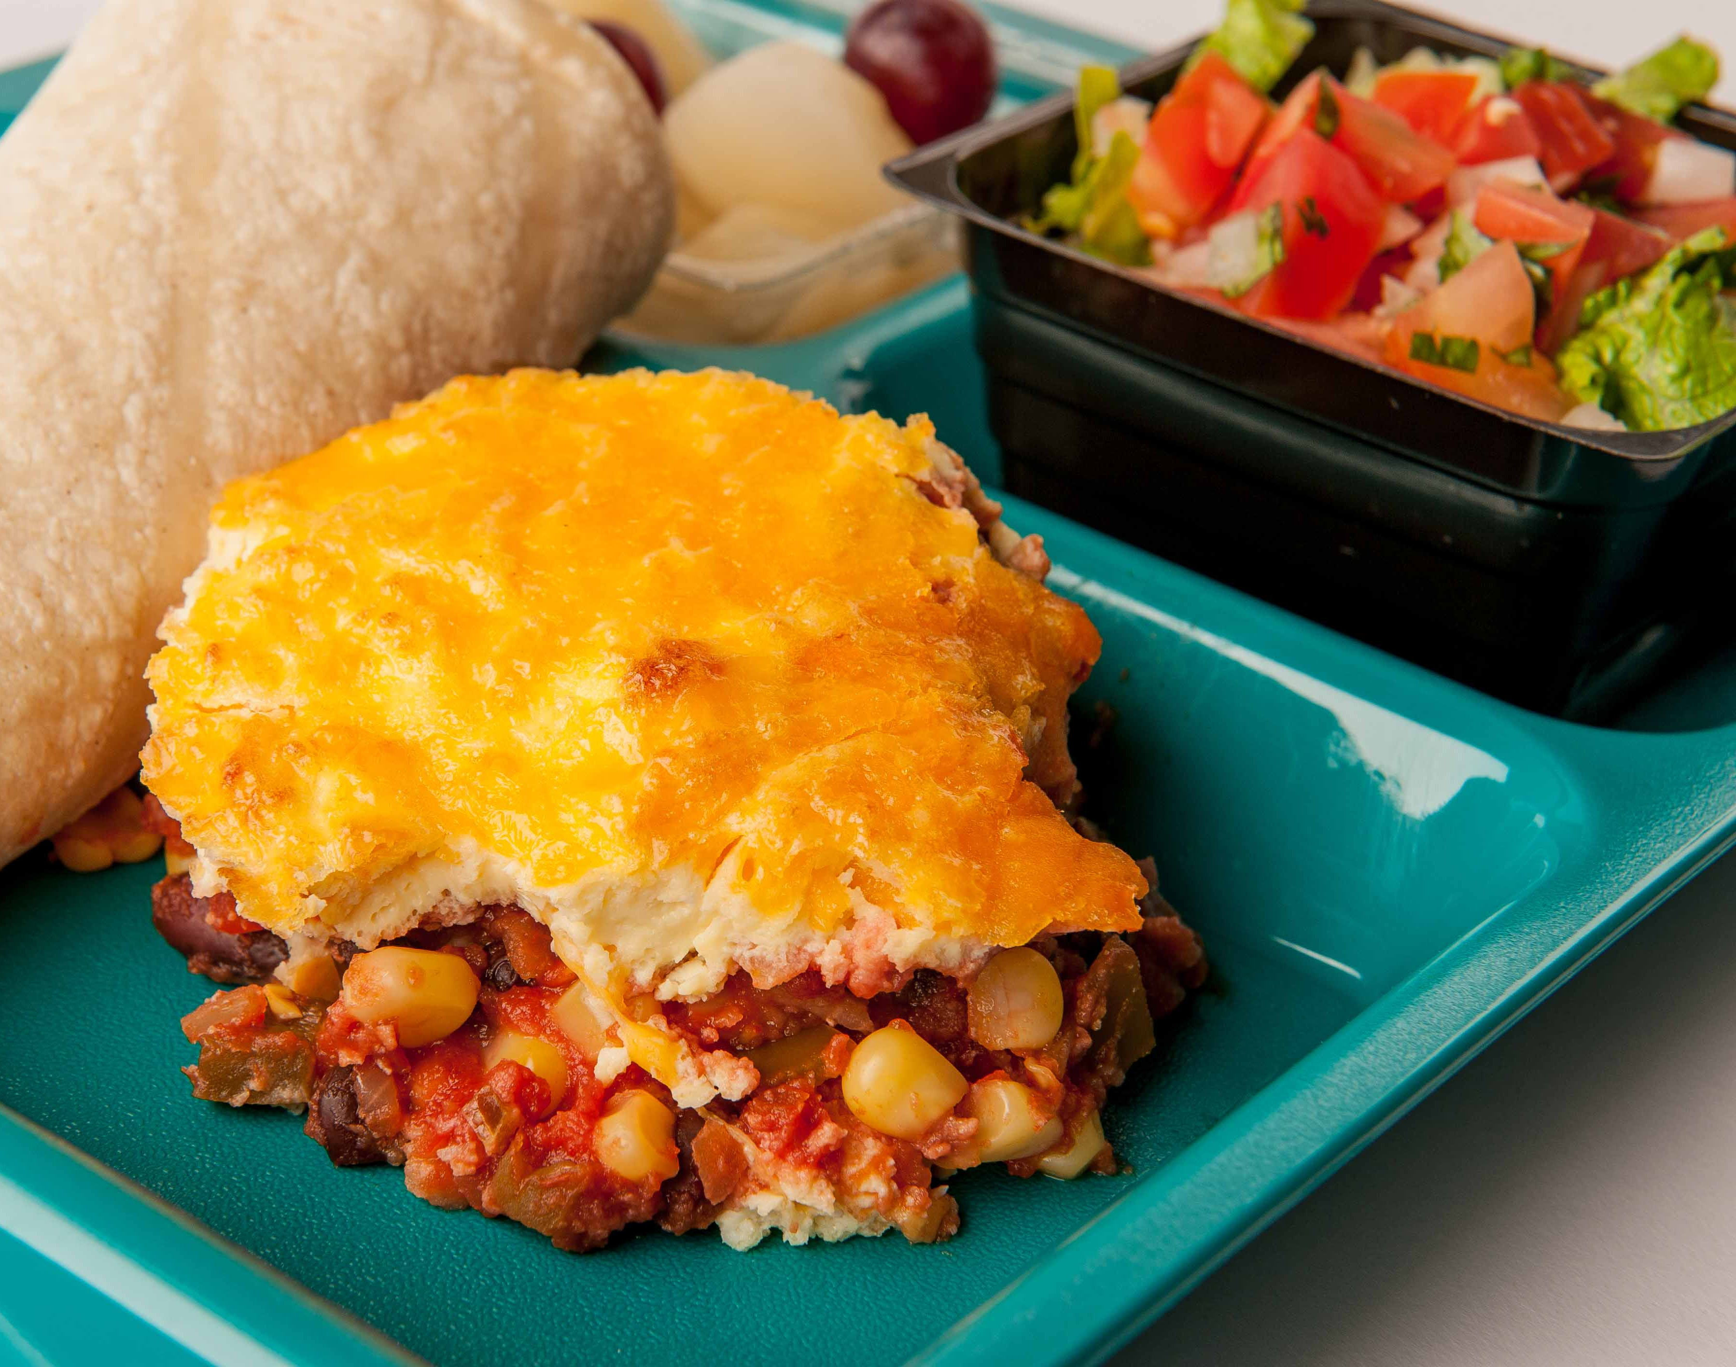
Popular Mexican Dishes
Enchiladas
Tacos
Chilaquiles
Menudo
Pozole
Tamales
Elote
Notes:
Say: Here are a few popular Mexican dishes. Enchiladas, tacos and tamales might be more familiar to our students, but let's take a look at a few of the others that might be less familiar. Highlight chilaquiles, pazole, and elote. Pictured on the screen is chilaquiles.
Chilaquiles: a tasty breakfast or brunch dish made with crispy pieces of tortillas topped with yummy stuff like eggs, salsa, cheese, and sometimes chicken or beans. We have a schoolified recipe where we layer the ingredients in a steamtable pan and bake it!
Enchiladas: rolled-up tortillas filled with yummy stuff like meat, cheese, or beans. They're covered in sauce and cheese, then baked until they're warm and gooey.
Tacos: delicious folded tortillas filled with all sorts of tasty ingredients like seasoned meat, veggies, cheese, and salsa. You can make them with lots of different toppings and flavors!
Menudo: a hearty soup made with beef tripe (which is the lining of a cow's stomach), hominy (which is like puffy corn kernels), and a yummy broth flavored with spices. It's often enjoyed as a special treat on weekends or for celebrations.
Pozole: another yummy soup made with hominy and meat, usually pork or chicken. It's cooked in a flavorful broth and served with toppings like lettuce, radishes, onions, and lime. It's warm and comforting!
Tamales: little packages of goodness! They're made by spreading masa (a dough made from corn) on a corn husk, filling it with yummy stuff like meat, cheese, or beans, then wrapping it up and steaming it until it's cooked. They're a special treat often enjoyed during holidays and celebrations.
Elote: a tasty snack made with grilled corn on the cob covered in yummy stuff like mayonnaise, cheese, chili powder, and lime juice. It's a popular street food in Mexico and super tasty! We like to serve this off the cob in schools!

Slide 29
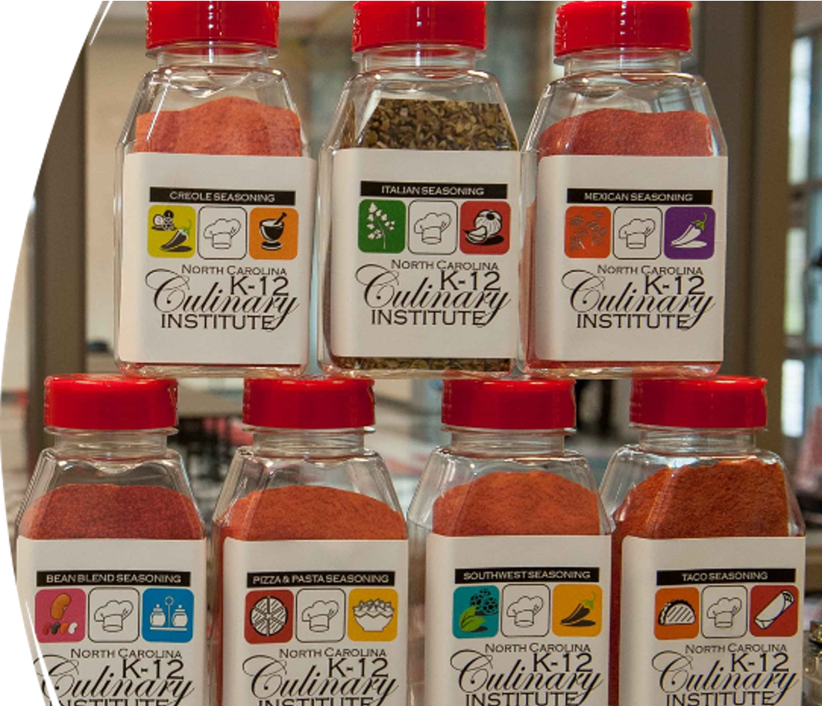
Cross Cultural Cuisine
Mixing two or more cultures' flavors, techniques, and ingredients
Notes:
Say: Cross cultural cuisine also known as fusion cuisine is mixing two or more cultures and ingredients together. This is very common and also trendy at this time. Currently, in Austin, TX, there's a Korean BBQ truck that is popular.
Ask: Can you think of any cross cultural cuisine in your area or your school? If not, can you think of two cultures' flavors, techniques, or ingredients together that would be fun?
Say: Please unmute yourself or feel free to type in the chat.

Slide 30
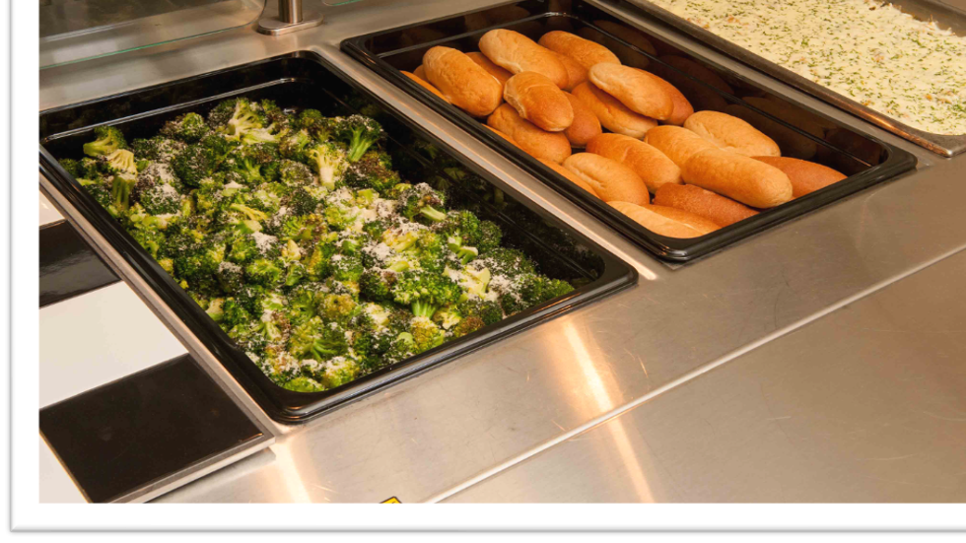
Menu Evaluation
What global flavors could you add?
Notes:
Say: Thinking about everything we just reviewed, what global flavors could you add to your menu?

Slide 31

Questions?

