Slide 1

Plant-Based Proteins + Demo
Notes:
Do: Record webinar!
Say: Welcome to today's webinar, Plant-Based Proteins, with a live culinary demo.
Do: Introduce ourselves.
Say: Plant-based proteins and meals are important to various populations around the world including religious beliefs, cultural practices, and personal preferences.

Slide 2
USDA Funding and Non-Discrimination Statements:
“This project has been funded at least in part with Federal funds from the U.S. Department of Agriculture. The contents of this publication do not necessarily reflect the view or policies of the U.S. Department of Agriculture, nor does mention of trade names, commercial products, or organizations imply endorsement by the U.S. Government.”
In accordance with federal civil rights law and U.S. Department of Agriculture (USDA) civil rights regulations and policies, this institution is prohibited from discriminating on the basis of race, color, national origin, sex (including gender identity and sexual orientation), disability, age, or reprisal or retaliation for prior civil rights activity.
Program information may be made available in languages other than English. Persons with disabilities who require alternative means of communication to obtain program information (e.g., Braille, large print, audiotape, American Sign Language), should contact the responsible state or local agency that administers the program or USDA’s TARGET Center at (202) 720-2600 (voice and TTY) or contact USDA through the Federal Relay Service at (800) 877-8339.
To file a program discrimination complaint, a Complainant should complete a Form AD-3027, USDA Program Discrimination Complaint Form which can be obtained online at: https://www.usda.gov/sites/default/files/ documents/ad-3027.pdf, from any USDA office, by calling (866) 632-9992, or by writing a letter addressed to USDA. The letter must contain the complainant’s name, address, telephone number, and a written description of the alleged discriminatory action in sufficient detail to inform the Assistant Secretary for Civil Rights (ASCR) about the nature and date of an alleged civil rights violation. The completed AD-3027 form or letter must be submitted to USDA by:
1. mail:
U.S. Department of Agriculture
Office of the Assistant Secretary for Civil Rights
1400 Independence Avenue, SW
Washington, D.C. 20250-9410; or
2. fax:
(833) 256-1665 or (202) 690-7442; or
3. email:
Program.Intake@usda.gov
This institution is an equal opportunity provider.

Slide 3
Welcome!
Notes:
Say: Remember that as we go through today’s webinar, the chat box is open for any questions and comments. We enjoy hearing from everyone and can learn a lot from each other. Please feel free to comment and ask questions in the chat anytime! We will monitor it together throughout this hour.

Slide 4
Objectives
Explain the health benefits associated with plant-based proteins.
List different plant-based menu items that can be served in schools.
Recall student inspired plant-based menu items.
Summarize culinary techniques for preparing plant-based proteins.
Notes:
Say: Let’s review today’s objectives.
Do: Review objectives.

Slide 5
Professional Standards – Learning Codes
Nutrition 1000
  Menu Planning (1100)
  General Nutrition (1300)
Notes:
Do: Review professional standards learning codes.

Slide 6
Poll
Are you actively working to add more plant-based proteins to your menus?
Notes:
Say: It's time for a poll! Let us know if you are actively working to add more plant-based proteins to your menus, and then we will share the results.

Slide 7
Protein
Notes:
Say: Let's begin today's webinar by discussing protein: what exactly it is, why we need it, and sources.

Slide 8
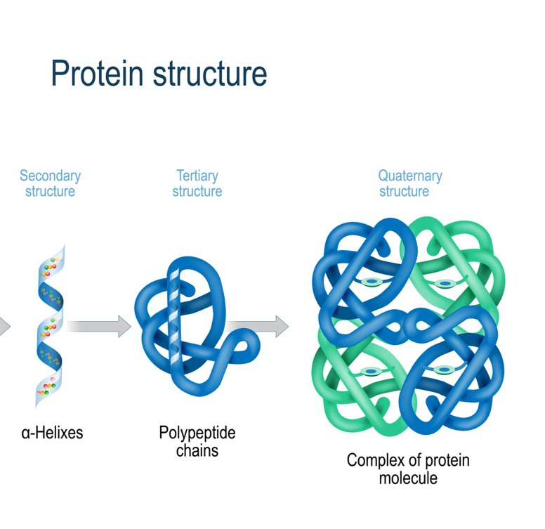
What is protein?
Combination of amino acids
  9 essential
  11 nonessential
Notes:
Say: Protein is actually a combination of building blocks called amino acids. Of the twenty amino acids, nine are essential, meaning that we have to get them from our diet. The other eleven amino acids are considered nonessential, which means that our bodies can actually make them. Although called nonessential, they are no less important. As you can see on the slide, the amino acids bind together to create protein molecules.

Slide 9
Protein Functions
Hormone production
Nutrient transport
Immune support
Water balance
pH regulation
Enzyme creation
Muscle maintenance
Healthy hair, skin, and nails
Energy production
Notes:
Say: Protein is important for more than just building muscles!
Do: Review the list on the screen.
Say: Eating protein with meals and snacks also helps promote satiety and can be one piece in helping to manage blood sugar.
Sources:
https://www.pubmed.ncbi.nlm.nih.gov/18469287/
https://www.ncbi.nlm.nih.gov/pmc/articles/PMC7956086/
https://www.myplate.gov/eat-healthy/protein-foods#:~:text=Health%20Benefits
https://www.ncbi.nlm.nih.gov/books/NBK555990/#:~:text=Proteins%20serve%20as%20structural%20support,secondary%2C%20tertiary%2C%20and%20quaternary.

Slide 10


Types of Protein
Animal
Plant-based
Notes:
Say: There are two types of protein foods: animal sources and plant-based sources. Animal sources include meat, poultry and eggs, fish and shellfish, and dairy. Plant-based sources include beans, dried peas, lentils, soy, nuts, and seeds. While in lesser amounts, even whole grains and vegetables provide protein. In fact, most foods do contain some amount of protein, including fruit!
Sources:
https://www.ncbi.nlm.nih.gov/pmc/articles/PMC8804093/

Slide 11
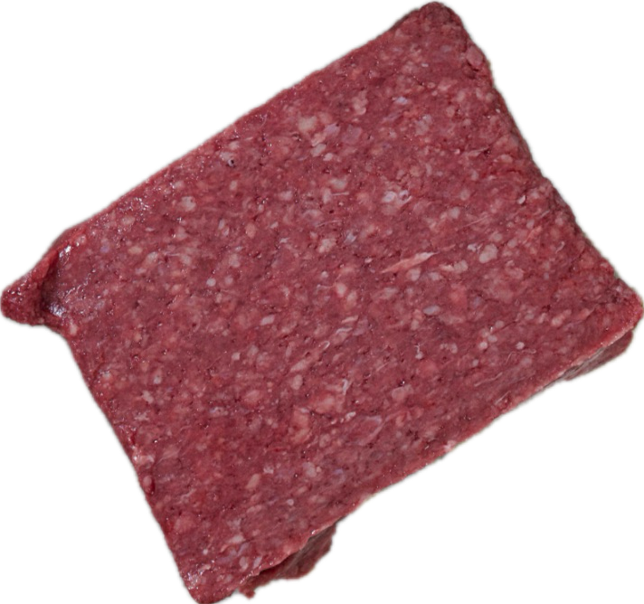
Animal Sources of Protein
Complete proteins
Rich in:
  Iron
  Zinc
  B vitamins
Approximately 1 oz = 7 grams protein
Can be high in saturated fat and sodium
Notes:
Say: Animal sources of protein are considered complete, meaning they contain all of the essential amino acids. Most animal proteins are rich in iron, zinc, and b vitamins. Iron is important for red blood cell production and oxygen transport; zinc for immune health and wound healing, and b vitamins for metabolism regulation and red blood cell formation.
Meat, poultry, and fish provide around 7 grams of protein per ounce, so they are very protein dense!
Some animal sources of protein like processed meats and red meats high in saturated fat are linked with an increased risk of certain cancers, heart disease, and type 2 diabetes, so it is best to limit their consumption. In fact, the World Health Organization classified processed meats as a group one carcinogen, meaning there is no doubt of the association. Red meat has been classified as a group 2 carcinogen, meaning it is probably carcinogenic.
No one lives in a bubble, so risks of CVD and mortality are determined by a range of different factors, including but not limited to genetic predisposition, demographic factors, socioeconomic status, weight, smoking, sleep, physical activity, and diet.
Sources:
https://www.doi.org/10.1016/S1470-2045(15)00444-1
https://www.pubmed.ncbi.nlm.nih.gov/15956652/
https://www.pubmed.ncbi.nlm.nih.gov/20215514/
https://www.pubmed.ncbi.nlm.nih.gov/33838606/
https://www.pubmed.ncbi.nlm.nih.gov/34455534/
https://www.pubmed.ncbi.nlm.nih.gov/36545687/
https://www.pubmed.ncbi.nlm.nih.gov/32011623/
https://www.pubmed.ncbi.nlm.nih.gov/32011623/
https://www.progressreport.cancer.gov/prevention/red_meat#:~:text=Red%20meat%20is%20associated%20with,beef%2C%20pork%2C%20and%20lamb.
https://www.bmj.com/content/365/bmj.l2110#:~:text=An%20increase%20in%20total%20red,confidence%20interval%201.04%20to%201.17).
https://www.hsph.harvard.edu/news/press-releases/red-meat-consumption-associated-with-increased-type-2-diabetes-risk/
https://www.doi.org/10.1002/ijc.29218
Say: Processed meats, like sausage and bacon, can also be high in sodium.

Slide 12
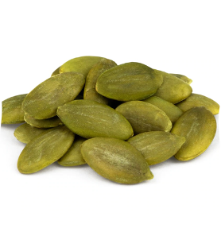

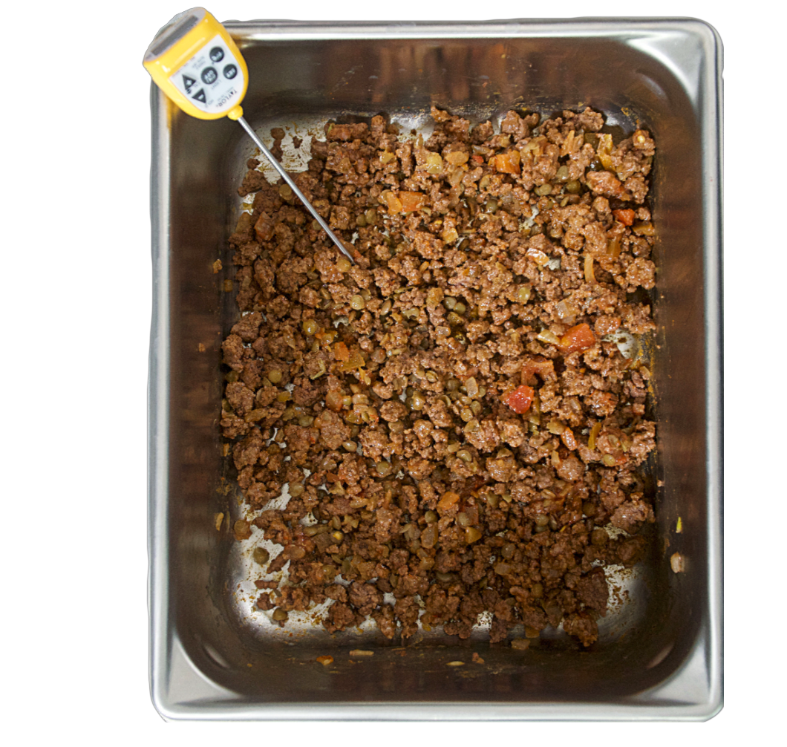
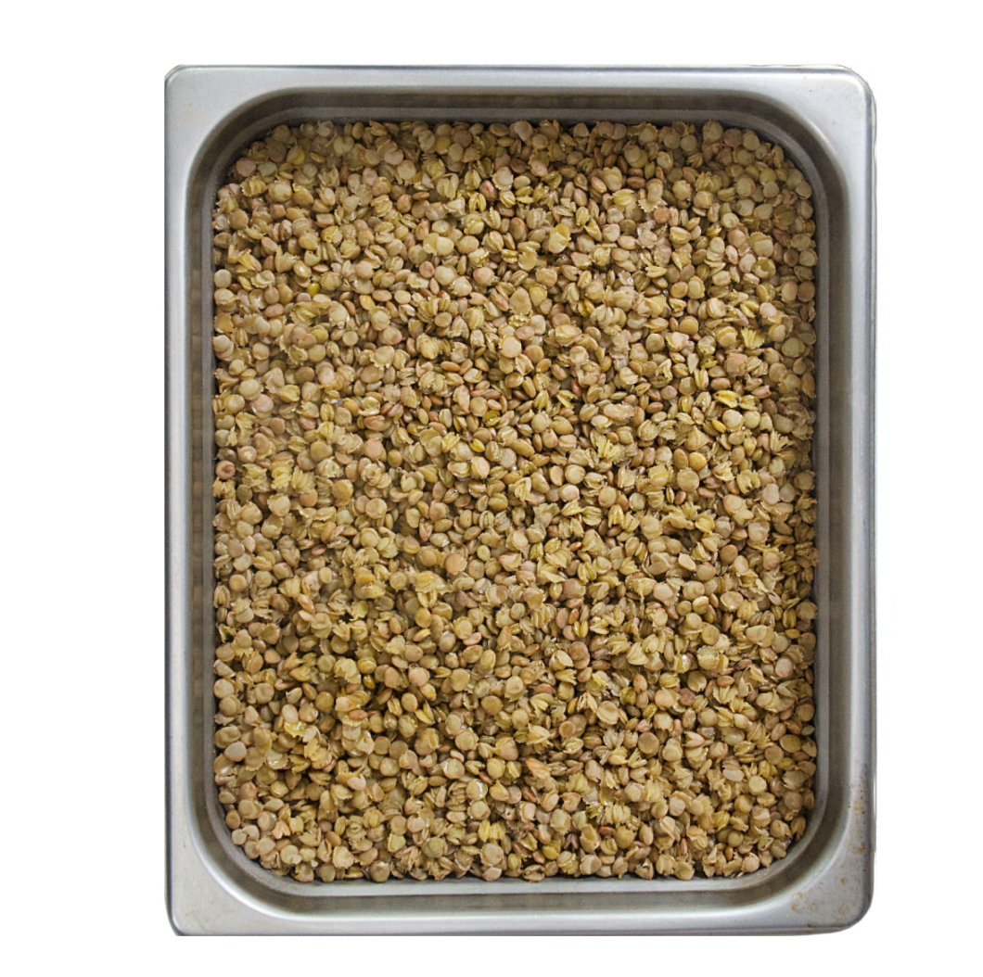
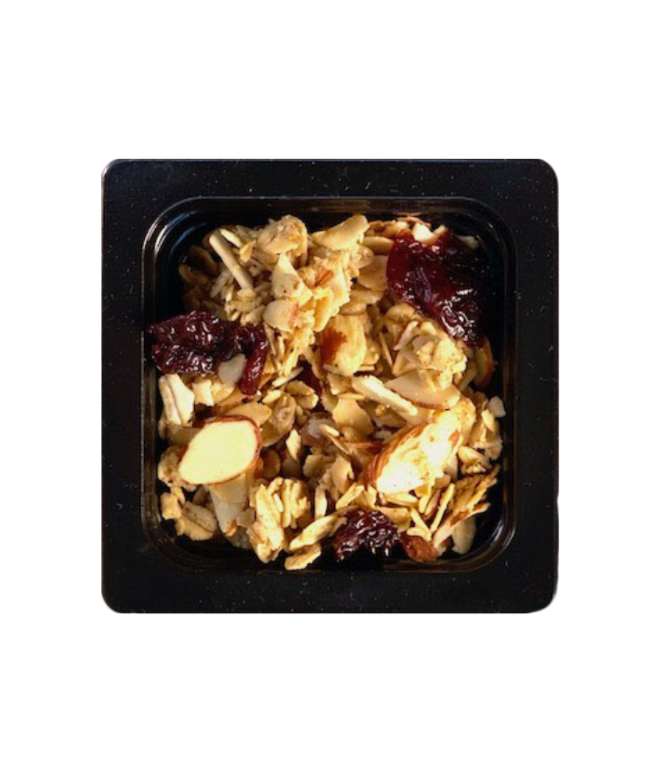

Current Eating Patterns
Meet or Exceed
90% DO NOT Meet
Notes:
Say: According to the DGA, "intakes of protein foods are close to the target amounts, but many Americans do not meet recommendations for specific protein subgroups. About three-quarters of Americans meet or exceed the recommendation for meats, poultry, and eggs. However, almost 90 percent do not meet the recommendation for seafood and more than half do not meet the recommendation for nuts, seeds, and soy products.
Protein foods are generally consumed in forms with higher amounts of saturated fat or sodium and often part of mixed dishes (e.g., sandwiches, casseroles, pasta dishes) that include other ingredients that are not in nutrient-dense forms." To summarize, we typically consume plenty of protein from various animal sources, not enough seafood and plant-based sources, and the ways we often consume protein foods are not in nutrient-dense forms.

Slide 13
Plant-Based Protein Sources
Incomplete protein
Excellent source of:
  Fiber
  B vitamins
  Magnesium
  Phytonutrients
Approximately ½ cup beans = 7 grams of protein
Can promote longevity
Notes:
Say: Most plant-based protein sources are considered incomplete because they do not contain all of the essential amino acids. In the past, it was recommended that you pair incomplete proteins together, like beans + rice, but now we know that they do not have to be eaten at the same meal to achieve a complete protein. Your body can mix and match amino acids throughout your meals to get what it needs to function. Of course, why not pair beans and rice together right? It's delicious! :)
Plant protein foods are excellent sources of fiber (which the majority of Americans lack), B vitamins, magnesium, and phytonutrients. Phytonutrients help fight inflammation in your body, which in turn helps to fight and prevent disease.
To compare to animal based sources, ½ cup of beans provides about 7 grams of protein. So in terms of volume, you need to eat a bit more to get the equivalent protein amount that you get from animal sources.
With that said, research shows that replacing some of your current animal protein intake with plant protein foods can decrease the risk of disease and promote longevity.
Sources:
https://www.pubmed.ncbi.nlm.nih.gov/27479196/
https://www.pubmed.ncbi.nlm.nih.gov/32658243/
https://www.pubmed.ncbi.nlm.nih.gov/35914402/
https://www.pubmed.ncbi.nlm.nih.gov/23836264/
https://www.ahajournals.org/doi/10.1161/CIRCULATIONAHA.118.035225
https://www.jamanetwork.com/journals/jamainternalmedicine/fullarticle/2540540

Slide 14
Plant-Based Protein in Schools
Notes:
Say: Let's now transition to discussing plant-based protein in schools.

Slide 15
Why serve (and eat) more?
Health/Nutritional benefits
  Fiber
  Phytonutrients
Notes:
Say: First of all, why should we serve more options? There are so many reasons! We already covered the health and nutritional benefits. Fiber and phytonutrients are two of the most important benefits that we want to emphasize when consuming plant proteins.

Slide 16

Environmental Benefits
Plants require less water and resources
Locally grown are better for environment
Notes:
Say: Another benefit is the impact on the environment. Many conventional animal feeding operations (aka CAFOs) wreak havoc on natural ecosystems and contribute large quantities of pollutants to the local and global environment. Consuming smaller amounts of sustainably raised or even conventionally raised beef, chicken, and pork can still support and promote economic and environmental health.
Plants require significantly less water and resources to grow, produce, and distribute. And, a lot of what we currently grow is used to feed animals (40%) and consists of a lot of government commodities - corn and soy (~56%). If we ate less meat, we could encourage more diversity, which improves soil health and air quality.
Locally-grown products are even better for the environment, as they do not use large amounts of fossil fuels to be transported across the country or world.
If local options are available and within your budget, choose those foods when possible.
Sources:
https://www.doi.org/10.1016/j.envint.2017.07.003.
https://www.medium.com/@RuralPolicyDiary/data-on-cafos-and-climate-change-e92acd4dd302
https://www.canr.msu.edu/uploads/236/29130/Sustainable_Animal_Agriculture.pdf
https://www.doi.org/10.1038/sj.ejcn.1602522
https://www.doi.org/10.1073/pnas.171188911
https://www.doi.org/10.1093/nutrit/nuw043
https://www.doi.org/10.3945/ajcn.113.071522

Slide 17
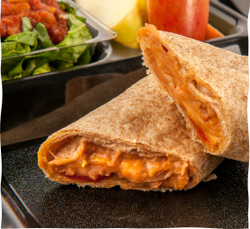
Student Inspired Meals
Notes:
Say: Plant-based proteins can be used to create student inspired meals. Grains, beans/legumes, nuts, and seeds are protein-rich ingredients that support and sustain societies across the globe. So menuing more plant-based proteins brings us all together and is relatable to everyone despite their background.
Plant-based dishes can also offer additional options for vegetarians, vegans, and some religious groups. For example, halal diets are not plant-based, but require meats and poultry to be slaughtered according to Islamic dietary law. The meat and poultry dishes served in school nutrition programs do not usually adhere to Islamic law (it would be advertised by the manufacturer). Offering more plant-based options to these students could help increase variety and participation.
Think about different restaurants you have eaten at featuring different cultures or maybe at friends’ homes, there is a version of beans and rice with so many different groups!
There are a lot of examples, but here are a few of my favorites:
Do: Read a few, not all!
Latin American Rice and Beans:
Dish: Gallo Pinto (Costa Rica, Nicaragua)
Beans: Black beans or red beans
Rice Preparation: Cooked with onions, bell peppers, and spices
Cuban Rice and Beans:
Dish: Moros y Cristianos
Beans: Black beans
Rice Preparation: Cooked with spices, garlic, and sometimes bacon or ham
Mexican Rice and Beans:
Dish: Mexican Rice and Beans
Beans: Pinto beans or black beans
Rice Preparation: Often flavored with tomatoes, onions, and spices
Caribbean Rice and Peas:
Dish: Rice and Peas (Jamaica)
Beans: Kidney beans or pigeon peas
Rice Preparation: Cooked with coconut milk, thyme, and scallions
Indian Dal and Rice:
Dish: Dal Chawal (India)
Beans: Various lentils (masoor dal, moong dal, toor dal)
Rice Preparation: Served with plain or spiced rice
Brazilian Rice and Beans:
Dish: Feijoada
Beans: Black beans
Rice Preparation: Accompanied by rice and various meats
Middle Eastern Rice and Lentils:
Dish: Mujadara
Beans: Green or brown lentils
Rice Preparation: Cooked with caramelized onions and spices
Filipino Rice and Munggo:
Dish: Ginisang Munggo
Beans: Mung beans
Rice Preparation: Served with plain rice and often flavored with garlic
African Jollof Rice:
Dish: Jollof Rice
Beans: Sometimes includes black-eyed peas
Rice Preparation: Cooked with tomatoes, peppers, and various spices
Iranian Rice and Kidney Beans:
Dish: Lubia Polo
Beans: Kidney beans
Rice Preparation: Cooked with tomatoes, tomato paste, and various spices

Slide 18

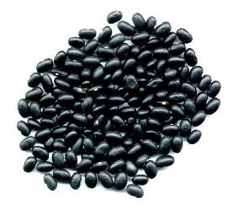
Financial Benefits
Most plant-based proteins cost less
Notes:
Say: And finally, the financial benefits! Which costs more: beans or meat? Most plant-based proteins cost less, and that means more money in your bank!

Slide 19
Plant-Based Proteins in Schools
Beans and lentils
Soy
  Tofu and Edamame
Nuts and seeds
  Nut and seed butters
  Nuts and seeds
Notes:
Say: Let's now look at specific plant-based proteins that we can easily offer in schools. All of these foods on the slide credit as meat/meat alternate in our programs. We have beans and lentils, soy products such as tofu and edamame, and nuts, seeds, and their corresponding butters.

Slide 20
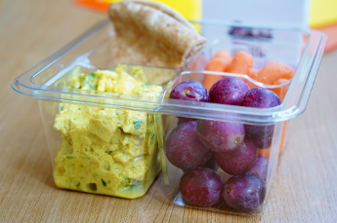
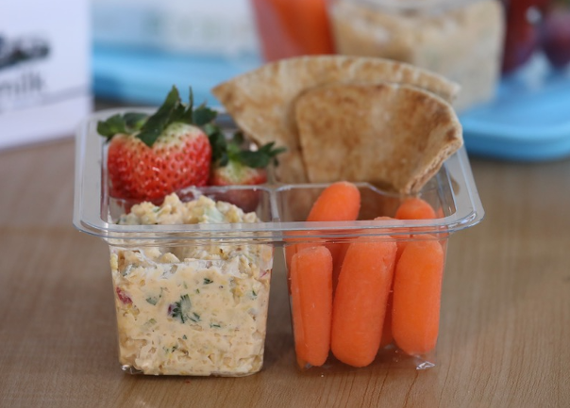
How to Serve
As the only meat/meat alternate
Mixed with an animal source of meat/meat alternate
Notes:
Say: There are multiple ways to incorporate more plant-based proteins into your menus. First, you can create recipes that solely feature a plant-based protein, like a bean burrito bowl or you can combine an animal-based protein with a plant-based protein, possibly a 1 m/ma equivalent of both, like beef and lentil tacos.

Slide 21
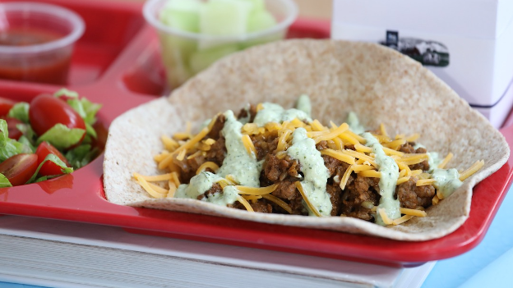
Mixed M/MA Demo!
Notes:
Say: With that said, it's time for a demo! Chef Lindsey is going to demonstrate how to cut half of the meat with lentils in a delicious taco recipe!
Script outline:
There are many ways to incorporate plant-based proteins into our current recipes! We'd like to start with a Beef and Lentil Taco recipe. Remember that you can find all the recipes in the recipe bank. Chef V can share the link in the chat.
Starting with the lentils. There are many different types of lentils. We chose a green lentil, but this recipe could be made with any lentil. When blending it with different products, you'll want to consider size and color. Lentils are versatile, holding their shape well during cooking, making them suitable for a variety of dishes such as soups, stews, salads, and side dishes. They cook quickly, too! Red lentils are popular in Indian and Middle Eastern dishes, but they probably would blend well here!
Important speaking points:
Combining plant proteins with animal proteins in a recipe can offer several benefits:
Nutrient Diversity: Combining plant and animal proteins can provide a more diverse range of nutrients. Plant proteins often contain different amino acids, vitamins, and minerals than animal proteins, contributing to a more well-rounded nutritional profile. They are also rich in disease fighting phytonutrients.
Healthier Fat Profile: Plant proteins, such as those from nuts, seeds, and legumes, can contribute healthier fats like omega-3 fatty acids or as in this recipe, can displace less healthy fats, like the saturated fat found in beef. Combining plant-based proteins with lean animal proteins can help improve the quality of fat in the diet.
Fiber Content: Plant proteins are often rich in dietary fiber, which can contribute to digestive health and help regulate blood sugar levels. Including plant proteins alongside animal proteins can increase the fiber content of a meal.
Environmental Sustainability: Plant proteins generally have a lower environmental footprint compared to animal proteins. Combining both sources allows for a more sustainable and environmentally friendly approach to protein consumption. Lentils in particular are sustainability superstars! They are considered carbon negative.
Texture and Flavor Variety: Incorporating plant proteins can add different textures and flavors to a dish, enhancing its overall taste and appeal. This can make the meal more interesting and enjoyable.
Dietary Flexibility: Combining plant and animal proteins allows for greater flexibility in catering to various dietary preferences and restrictions. It can accommodate those following vegetarian or for this recipe, flexitarian diets while still providing essential nutrients from animal sources.
Cost-Effectiveness: Lentils are more affordable than beef. Combining the two helps create a budget-friendly meal without compromising nutritional value.
Sources:
https://www.lentils.org/wp-content/uploads/2022/06/SPG-Sustainability-Flat-Sheet-KK-LRES.pdf

Slide 22
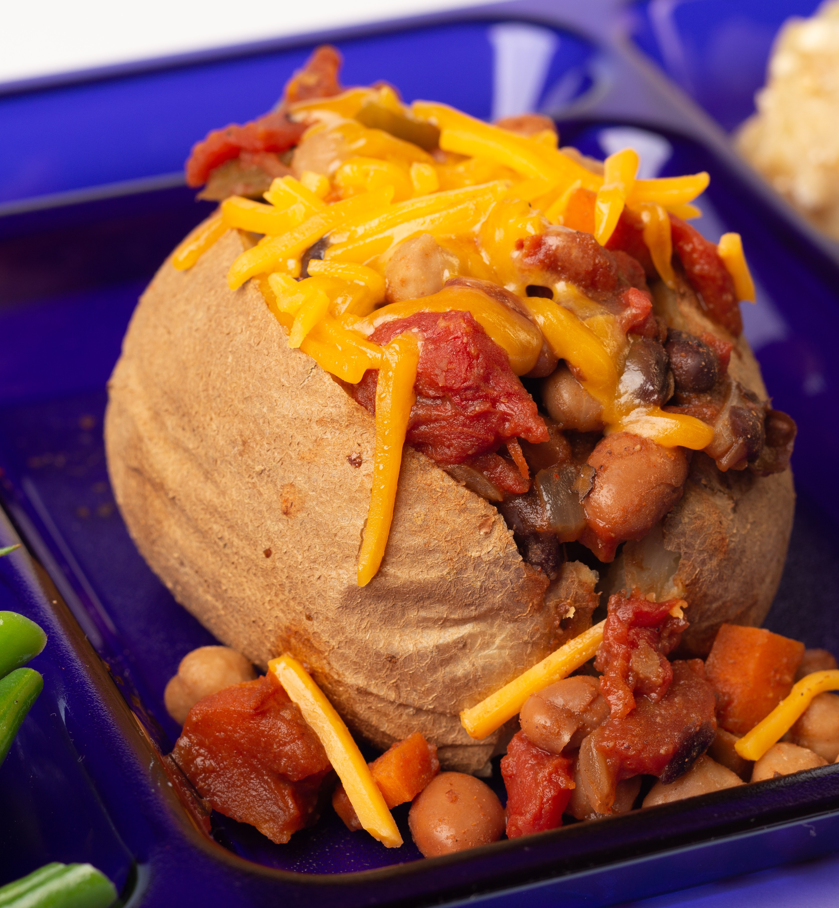
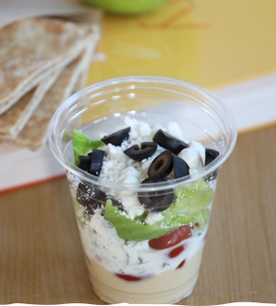
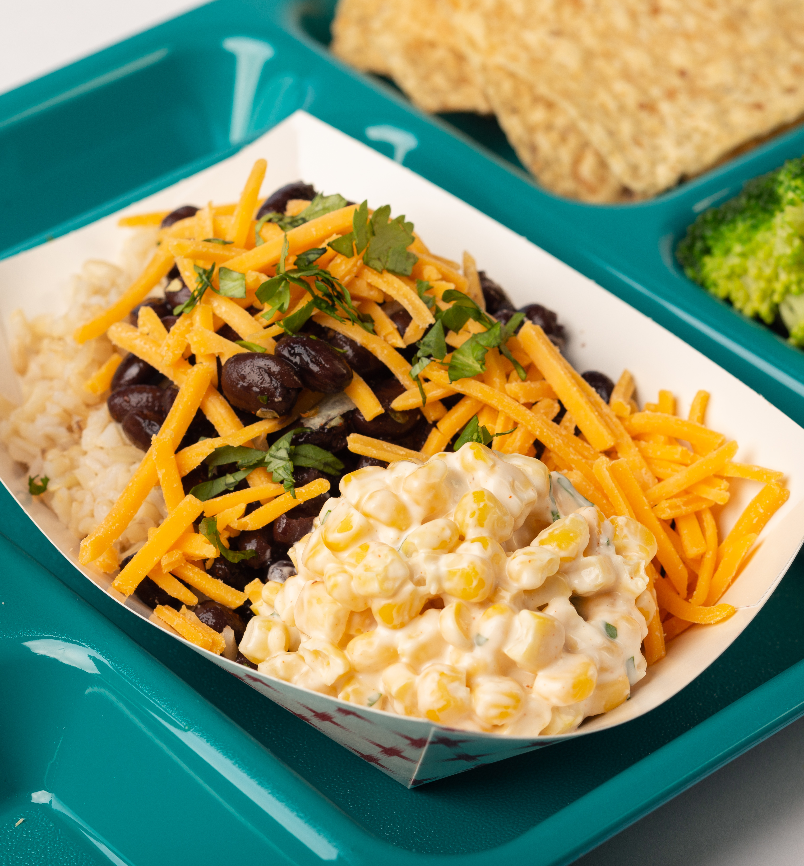
Lunch Menu Examples
Nut/seed butter sandwiches
Burrito bowls
Hummus wraps
Stir-fries
Veggie or black bean burgers
Notes:
Say: Take a look at the list of ideas for lunch menu items that feature plant-based menu items. Add to the chat if you serve any of these foods now or if you serve other plant-based options at lunch. We'll take a moment to let you add your responses to the chat, and we'll share them shortly with everyone!

Slide 23

Breakfast Menu Examples
Breakfast burritos with beans
Nut/seed butter on toast
Nut/seed butter with yogurt
Notes:
Say: Breakfast time can be a little more tricky to incorporate plant-based proteins, but we love the idea of adding beans to breakfast burritos or serving nut butter with toast. Nut and seed butters also combine deliciously with yogurt for dips or parfaits. In this photo, we have a nutty yogurt dip with a whole grain strawberry sheet pan pancake. With this combination, you have a balanced plant forward breakfast!
You can find some recipe ideas in the shared folder!

Slide 24
Beans
Notes:
Say: Let's look a little more closely at each of the school friendly plant-based meat alternates mentioned earlier, starting with beans.

Slide 25
Bean Varieties
Black
Pinto
Garbanzo
White
Notes:
Say: Beans are a great source of plant based protein, fiber, and phytonutrients. They are also affordable and available both canned and dried. Black, pinto, garbanzo, and white beans are all common varieties.

Slide 26
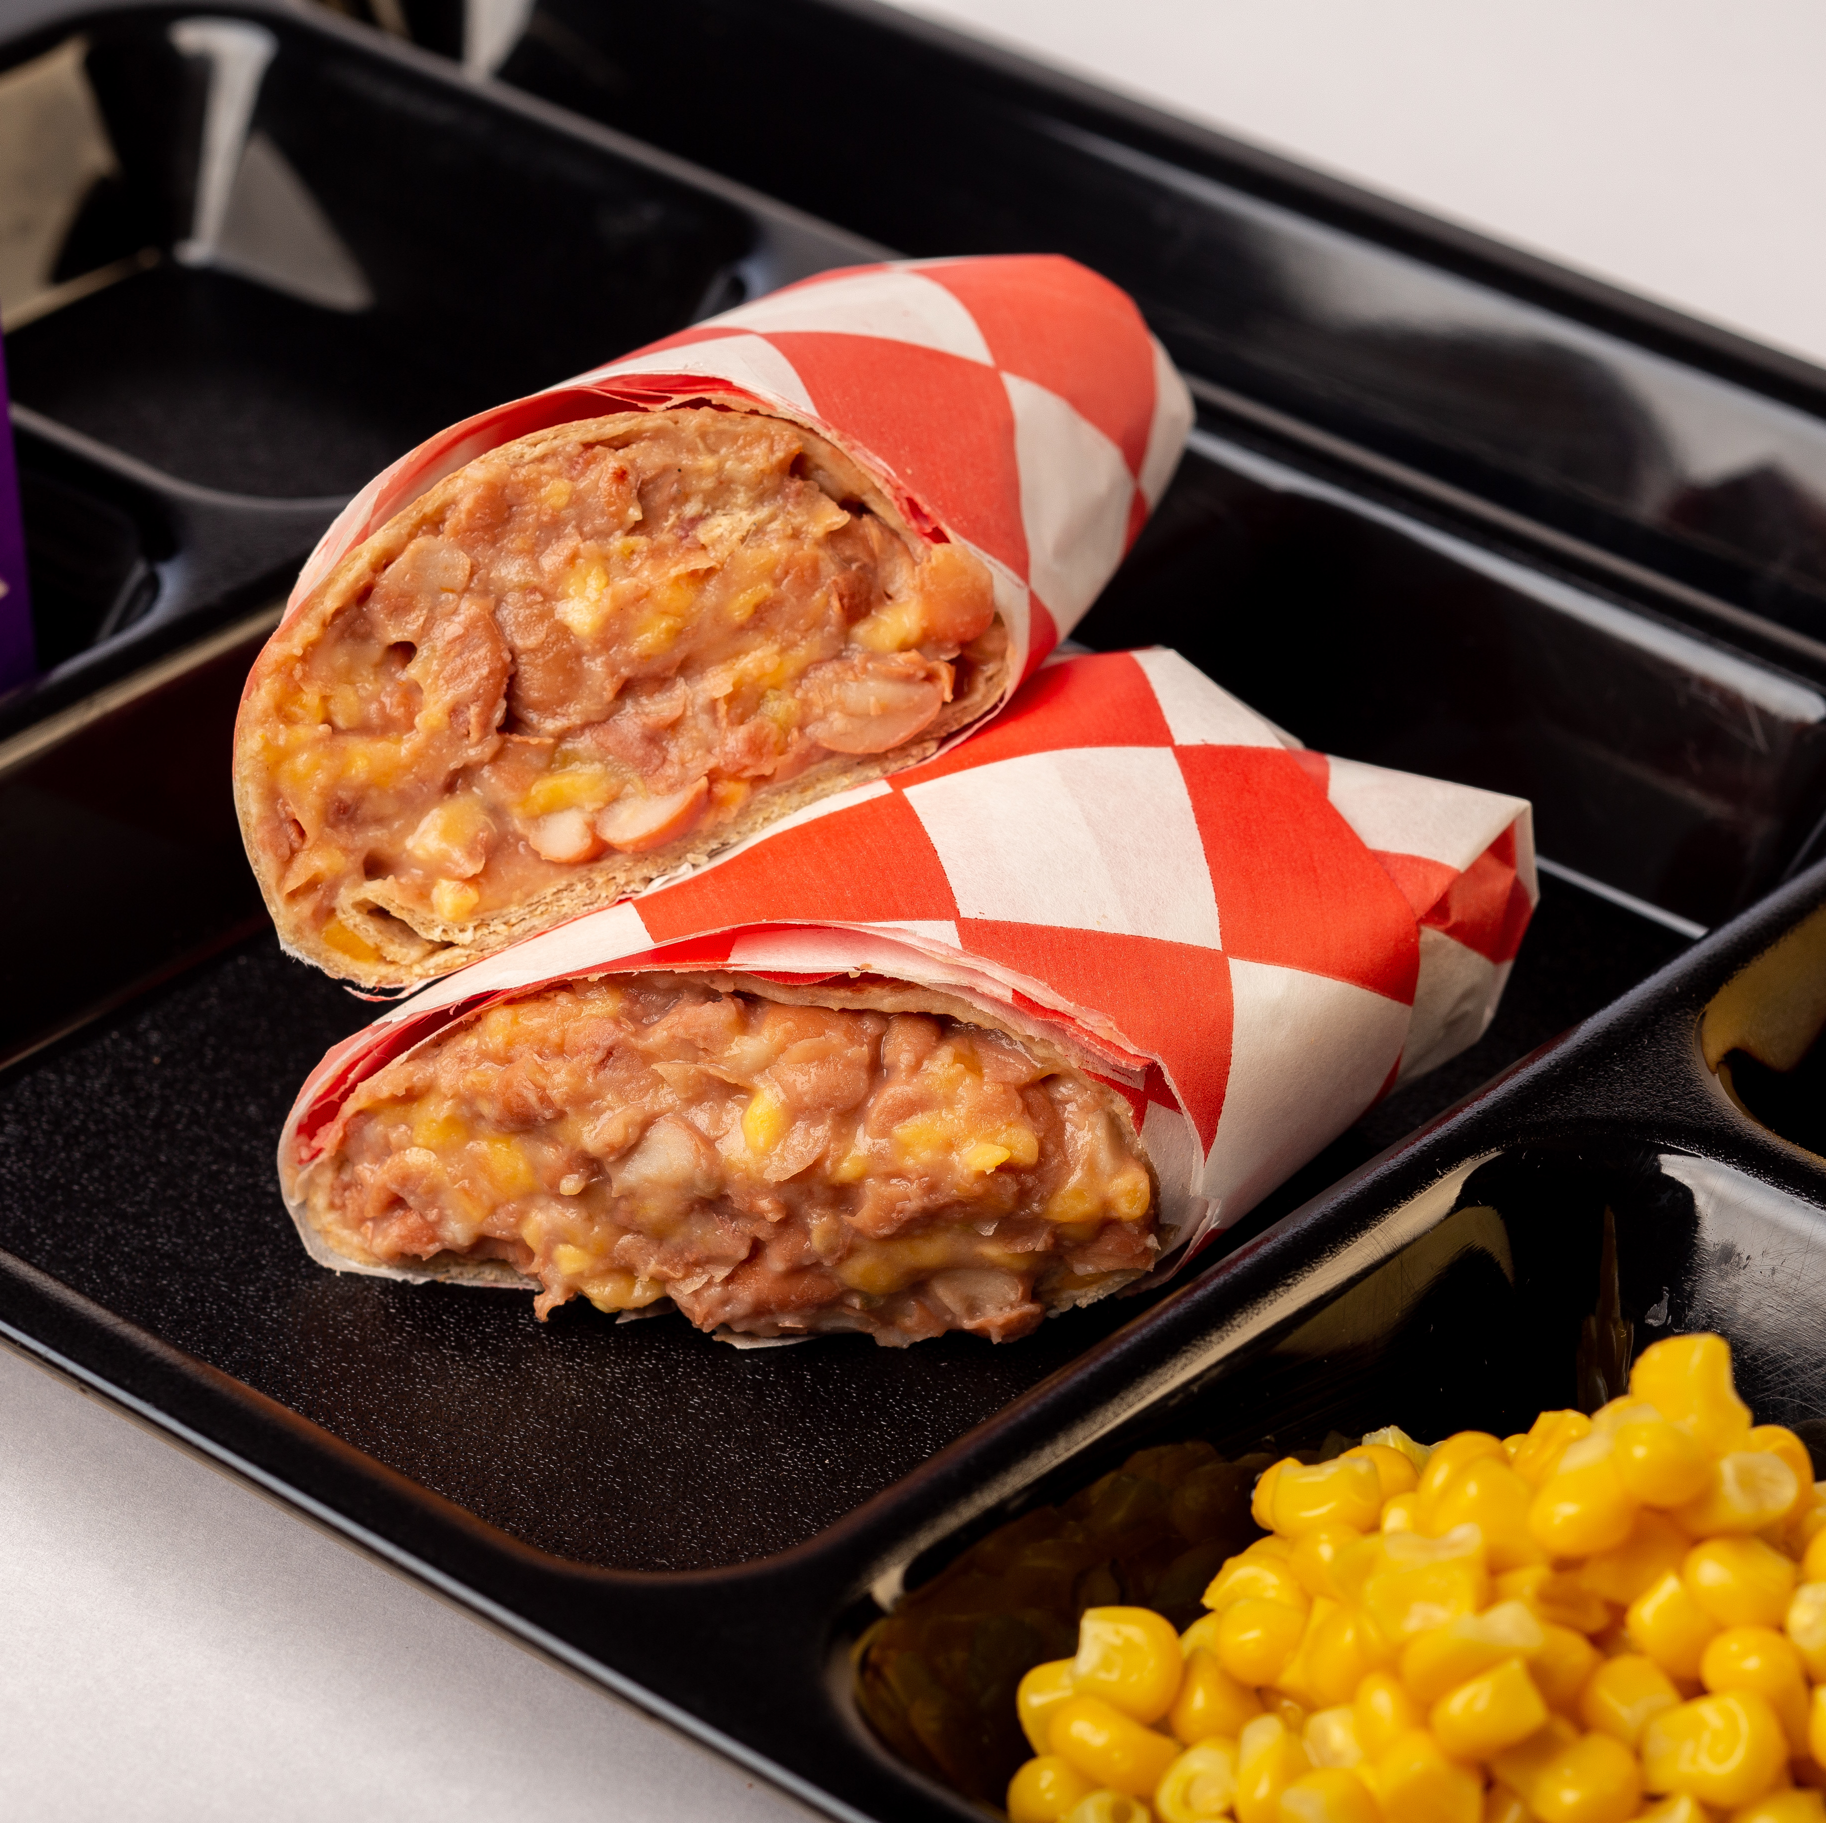
Student Inspired for Beans
Indian
  Chana
  Dahl
Mediterranean
  Hummus
Latin American
  Bean burritos, tacos, tostadas
Notes:
Say: Beans and lentils are common across cultures from India to the Mediterranean to throughout Latin America.
First, there's chana. Chana is a term commonly used in South Asian countries, particularly in India, to refer to chickpeas or garbanzo beans. Chana Masala is a popular Indian dish made with chickpeas cooked in a flavorful tomato-based sauce with various spices.
Dahl refers to a type of dried legume, and it is a common term used in South Asian cuisine. It is a staple food in many South Asian countries. The preparation of dahl can vary across regions and households, is sometimes blended, and usually served with rice or Indian bread (roti, chapati, or naan).
Hummus is served in many schools all over the nation. It is a popular Middle Eastern dip or spread made from cooked and mashed or blended chickpeas, blended with tahini (sesame seed paste), lemon juice, garlic, and olive oil.

Slide 27

Culinary Tips for Beans
Don't cook beans in the steamer
Concentrate the liquid
Consider dried beans
Notes:
Say: Let's review some culinary tips for beans. We don't recommend cooking beans in the steamer. This method will not concentrate the liquid, also known as the aquafaba. If you plan to serve the beans hot on the line, you need the liquid. As you simmer beans, the liquid reduces and concentrates flavors. Don't forget to add spices and herbs!
Ask: Do any of you cook dried beans in your divisions?
Say: Dried beans take longer to prepare, but are even more affordable than canned. Soak them overnight before cooking to help soften their fibers and possibly aid in digestibility. While cooking dried beans on the stovetop or in a tilt skillet is traditional, you can also cook them in the oven! Take a look at the Bean and Cheese Burrito recipe in the Google folder for oven instructions.
Sources:
https://www.ncbi.nlm.nih.gov/pmc/articles/PMC3602558/
https://pubmed.ncbi.nlm.nih.gov/12489819/
https://pubmed.ncbi.nlm.nih.gov/8882373/
https://www.ncbi.nlm.nih.gov/pmc/articles/PMC9474322/

Slide 28
Soy
Notes:
Say: Let's move on to soy, a less common, but readily available meat alternate for schools. Unlike other plant-based proteins, soy is considered a complete protein like animal sources.

Slide 29
Soy Varieties
Extra Firm Tofu
Edamame
Notes:
Say: Soy is sold in different forms, tofu and edamame being two of the most common. Extra firm tofu that doesn't require draining is a great option for schools. You can find edamame with or without the pod and simply steam it to cook. Kids love popping the beans out of the pod!

Slide 30
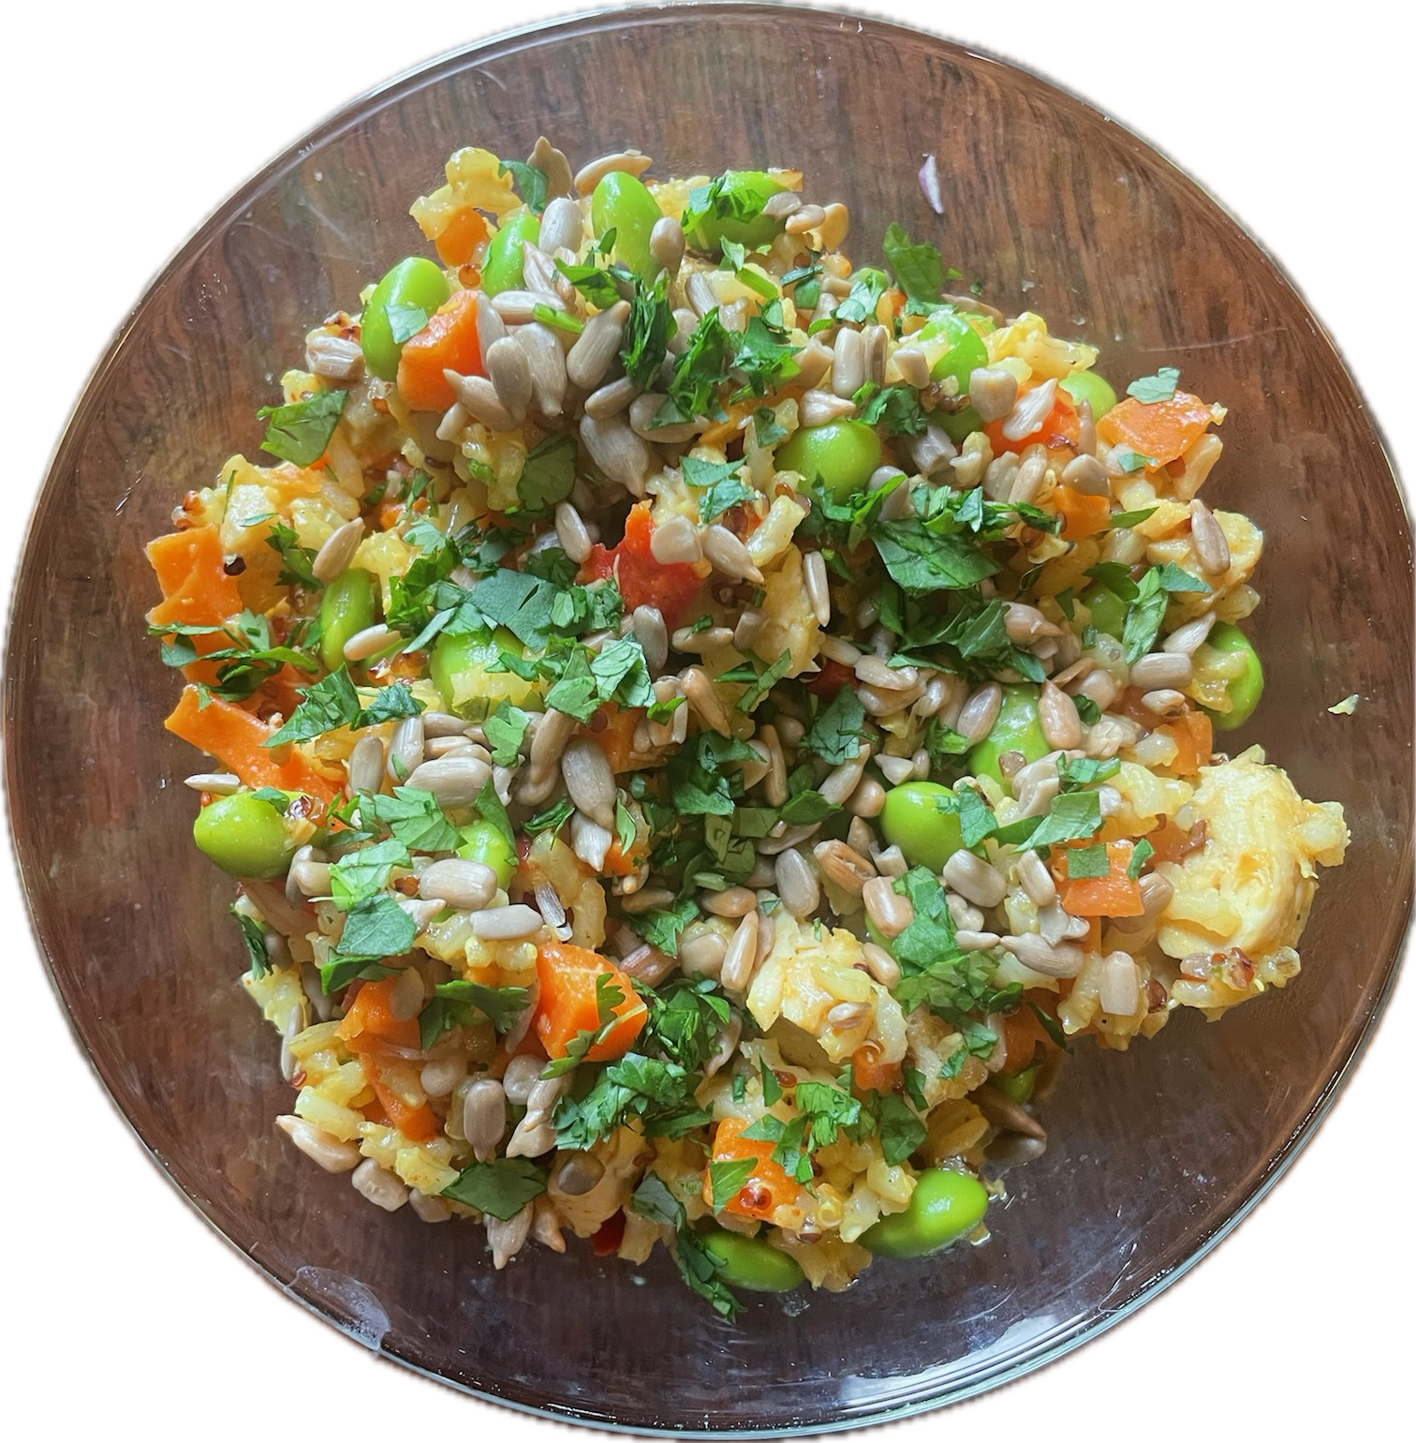
Student Inspired for Soy
Asian Cuisine
Notes:
Say: The soybean is possibly the most versatile ingredient in all of Asian cuisine and is made into everything from soy sauce to miso to soymilk to tofu. Tofu is used in stir-fries, curries, soups, and more.

Slide 31
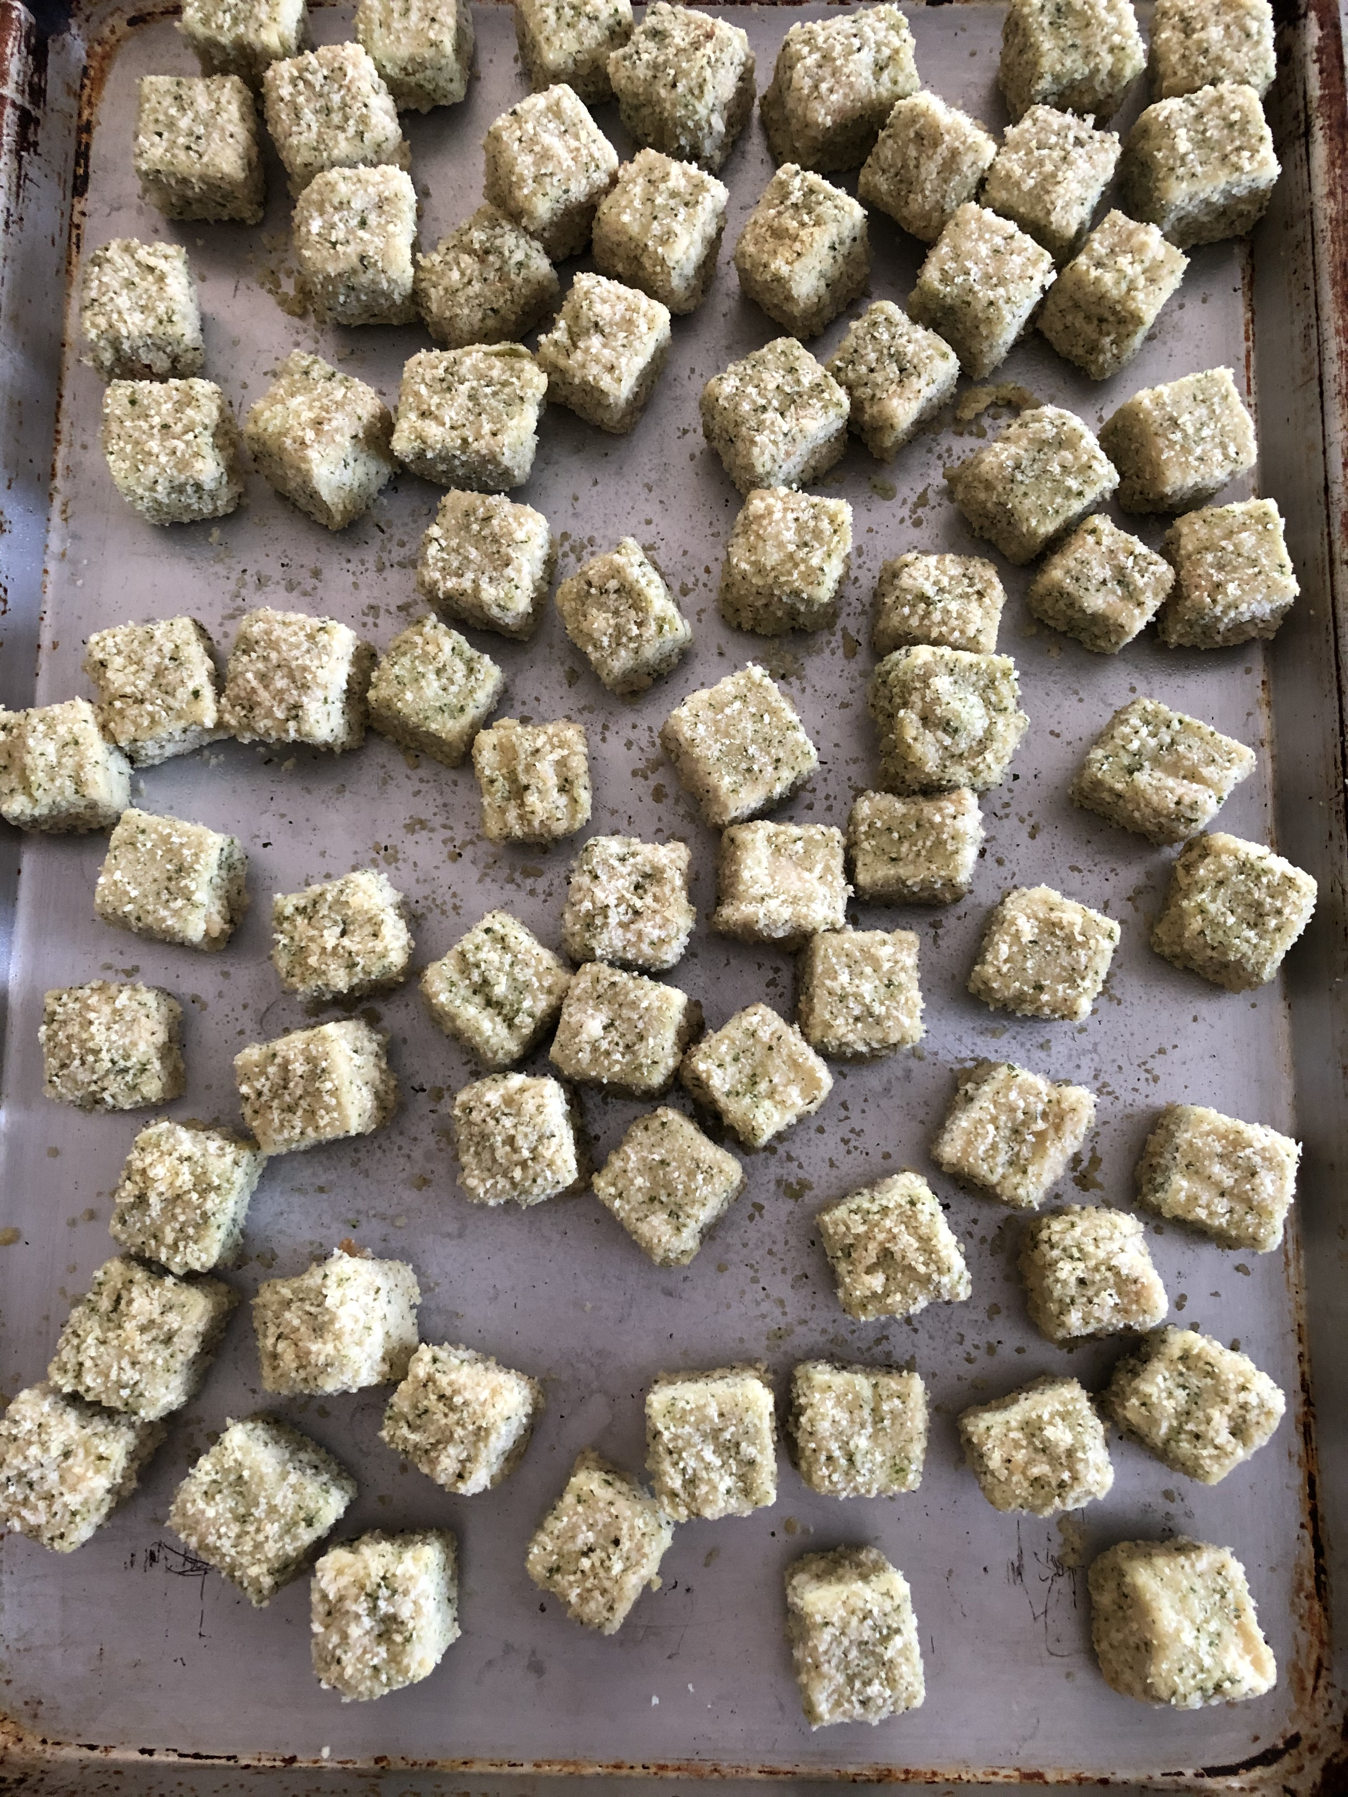
Culinary Tips for Tofu
Marinate or glaze
Bake
Toss in cornstarch
Notes:
Say: Let's talk about some culinary tips for tofu. Tofu alone does not have much flavor, so you can transform it into any flavor profile that interests your students. To do this, you will want to marinate it before cooking or glaze it after cooking. There are mixed thoughts on which is better. Baking tofu is an easy way to prepare tofu in schools, but it can also be stir-fried in a tilt-skillet. If stir-frying, toss it in cornstarch first to help the tofu not stick and form a crispy outercoat.

Slide 32
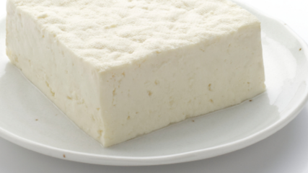
Tofu Demo!
Notes:
Say: Since many are not familiar with cooking with tofu, we thought we would do a demo on how to prepare it! Chef, over tofu!
Speaking notes:
Tofu is a versatile and protein-rich ingredient that can be prepared in various ways.
Choose the Right Tofu:
Firm or extra-firm tofu is best for most cooking methods, as it holds its shape well. Silken tofu is softer and better suited for recipes like smoothies, desserts, or dips.
Drain the Tofu:
Some companies produce a tofu that does NOT need to be drained. It's ready to go! Check with your distributor and look for that first. If you are unable to find the already drained, that's no problem! I'll show you how simple it is to do yourself. First, remove the tofu from its packaging and drain the excess liquid. Wrap the block of tofu in a clean towel, placing a weight on top (like a heavy pan) to press out additional liquid. Pressing helps the tofu absorb flavors and improves its texture.
Cut the Tofu:
Cut the tofu into the desired shape. Common shapes include cubes, slices, or triangles, depending on your recipe.
Marinate the Tofu:
Marinating tofu adds flavor. You can use store-bought marinades or create your own using less sodium soy sauce, teriyaki sauce, and always plenty of garlic, ginger, or other desired seasonings. Let the tofu marinate for at least 15-30 minutes, or longer for more flavor absorption.
Cooking Methods:
Tilt skillet:
Add marinated tofu to a stir-fry during the last few minutes of cooking, allowing it to absorb flavors while staying tender. You can toss it in cornstarch for a crispier exterior if desired.
Baking:
Preheat the oven to 375°F (190°C).
Place marinated tofu on a baking sheet lined with parchment paper.
Bake for 25-30 minutes, flipping halfway through, until the tofu is golden and slightly crispy.
Remember that tofu has a mild flavor, so it takes on the taste of the marinade or seasoning you use. Experiment with different flavors to find what you enjoy the most. Additionally, tofu is a great source of plant-based protein and can be a versatile addition to a variety of dishes.

Slide 33
Nuts and Seeds
Notes:
Say: Thanks, chef! Let's close with discussing nuts and seeds. Nuts and seeds are rich in protein, healthy fats, and phytonutrients.

Slide 34
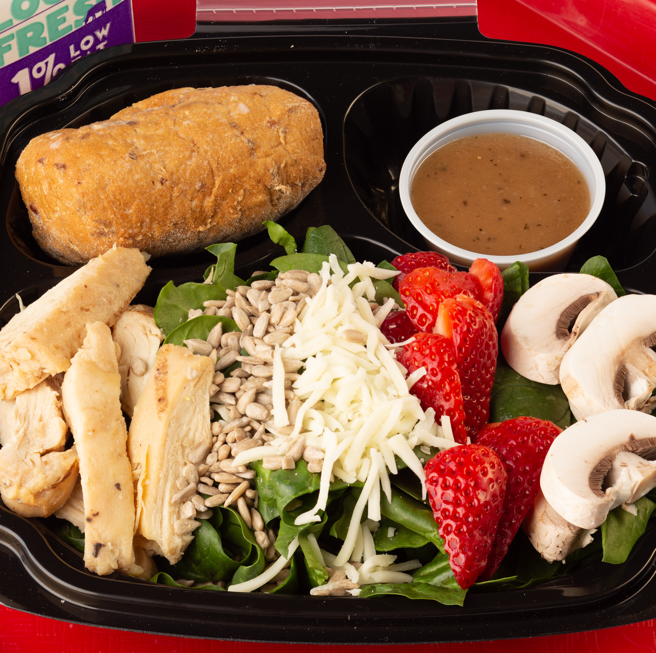
Nut and Seed Varieties
Peanut Butter
Sunbutter
Soybutter
Sunflower seeds
Pumpkin seeds
Peanuts and treenuts if allowed!
Notes:
Say: There are an abundance of nuts and seeds that we can serve in schools. We realize that some schools are peanut or nut free, but even if so, there are still plenty of options.

Slide 35
Student Inspired for Nuts and Seeds
African
  Stews
Asia
  Sauces and dips
  Toppings
Oaxaca and Puebla Mexico
  Mole sauces
Notes:
Say: While nut or seed butter is commonly used in sandwiches in the United States, and whole nuts and seeds are used as salad toppings, other countries use these ingredients in different ways, you might even say more creative or unique ways. In Africa, you can find peanut stew. There's a delicious recipe from the Peanut Board, and you can find the recipe link in our notes on this slide, and I will also add it to the chat now. In Asia, you can find sauces and dips made of nuts or peanuts; in Oaxaca and Puebla, Mexico, you can find mole sauces that include nuts and seeds.
Recipe for African Stew:
https://www.nationalpeanutboard.org/recipes/african-peanut-stew-schools/

Slide 36
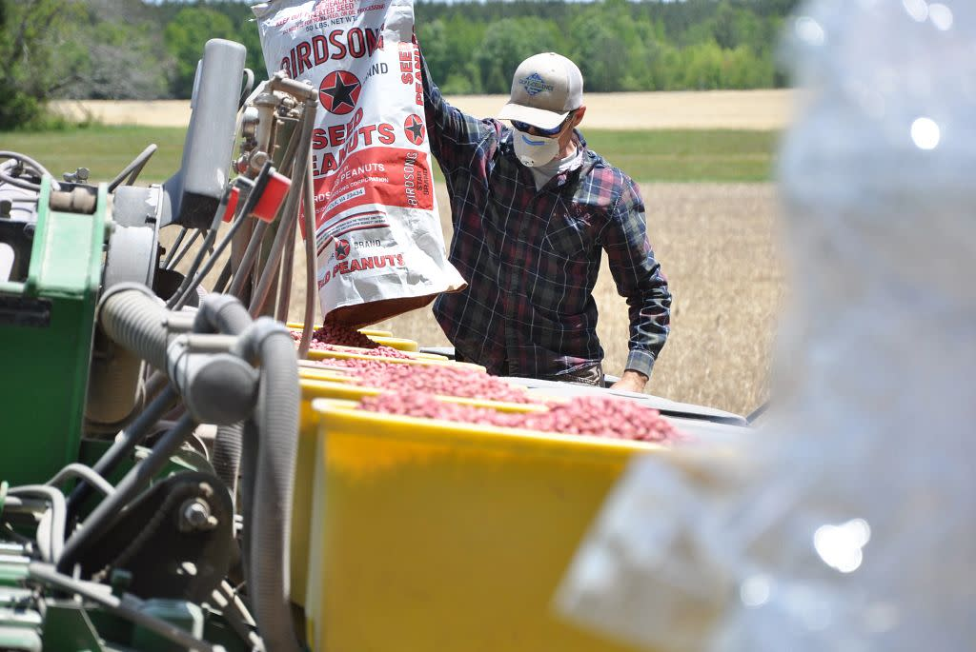
Local Sources of Nuts
Virginia farmers harvest enough peanuts annually to make 600 million peanut butter sandwiches
Notes:
Say: Did you know that Virginia peanuts are the largest variety of peanut? They are known for their distinctive crunch. They are grown in Virginia as well as North Carolina, South Carolina, and Texas.
Ask: Do any of you utilize Virginia peanuts or peanut butter in your programs?
Sources: https://www.virginia.org/blog/post/virginia-peanuts-history/
https://www.cdn.agclassroom.org/va/teachers/harvest/map1.jpg

Slide 37
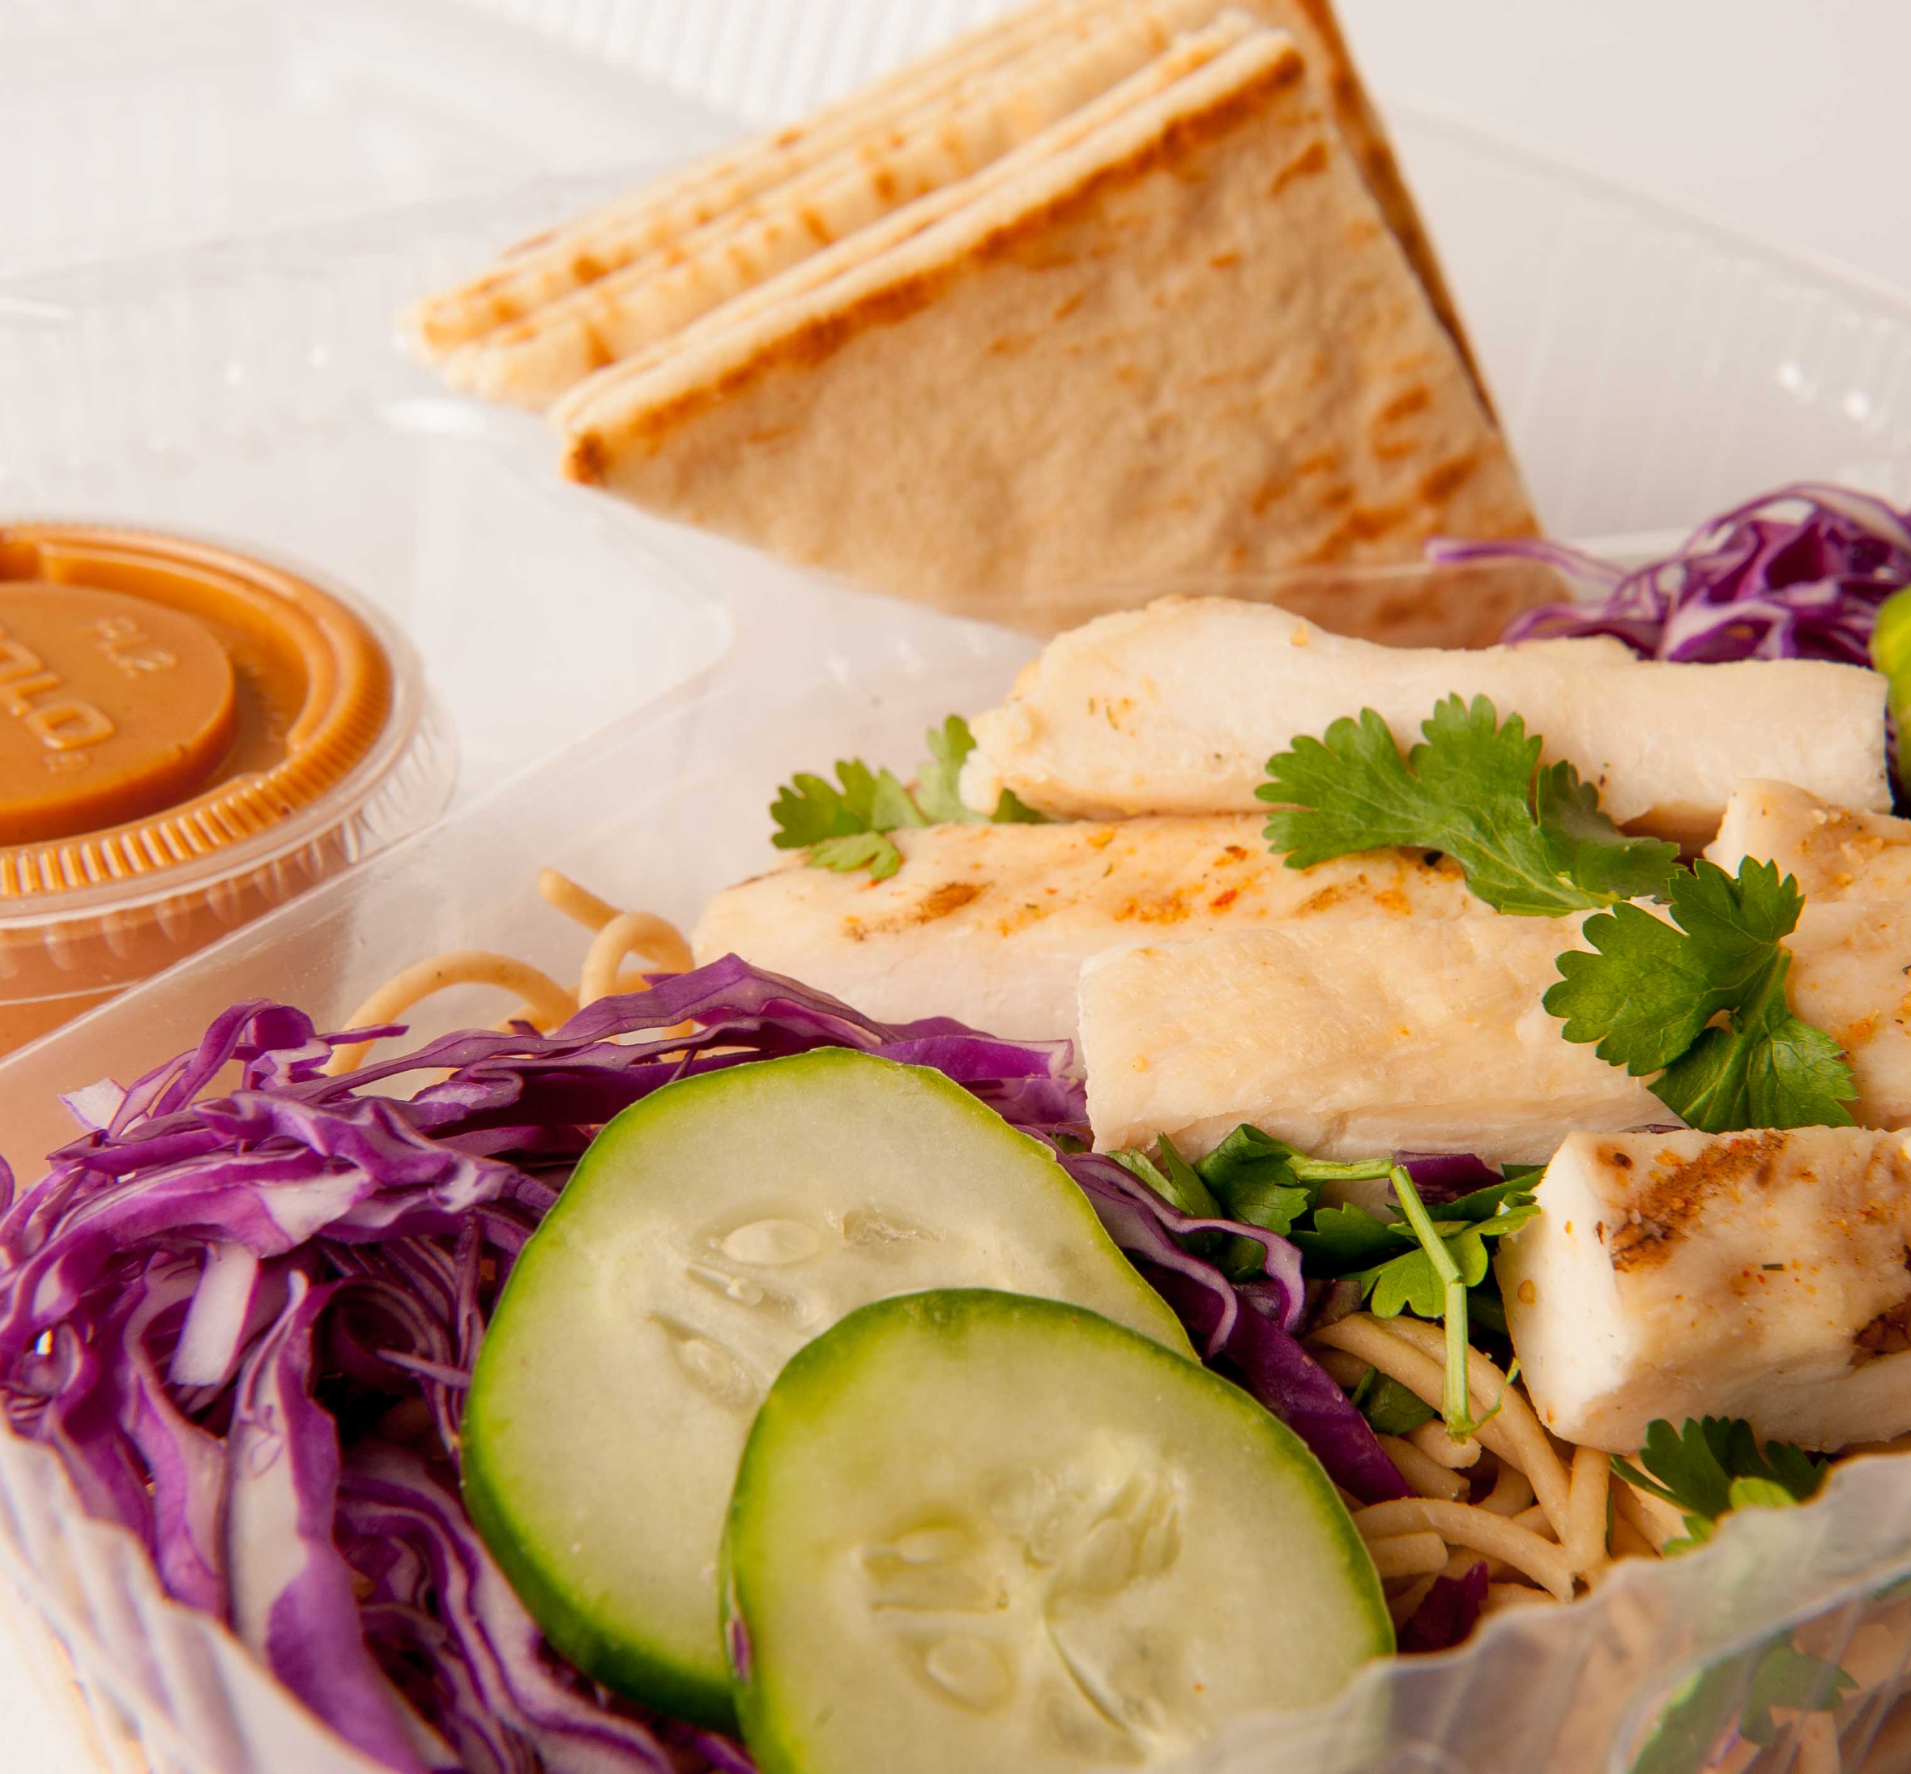
Culinary Tips for Nuts and Seeds
Think beyond the sandwich
Savory dishes
Notes:
Say: When working with nut and seed butters, we encourage you to think beyond the sandwich, and look beyond jelly as a pairing! Also, remember, nuts and seeds and their butters are great additions to savory dishes. If you attended the webinar in December, you might remember the Asian peanut noodle recipe we demoed, a good example of a savory dish with cultural inspiration.

Slide 38
Let's Chat!
What plant-based items or recipes would you like to include in your menus?
  Share any recipes you are currently using!
  Add to the shared folder in the chat
Notes:
Say: We wanted to end with one last question: what plant-based items or recipes would you like to include in your menus? Add your answers to the chat! If you have any recipes you would like to share, please add them to the shared folder we shared earlier. You can add your recipe to the plant-forward Virginia sub folder.

Slide 39

Questions?
Notes:
Say: Thank you so much for considering adding plant-based protein options to your menus.
Ask: Does anyone have any questions?

