Slide 1


Accommodating Dietary Practices with School Meals
Notes:
Record the webinar.
Say: Welcome!
Do: Introduce self briefly (no need for bio; name, credentials, and member of K-12 Culinary Team) and co-presenter.

Slide 2
USDA Funding and Non-Discrimination Statements:
“This project has been funded at least in part with Federal funds from the U.S. Department of Agriculture. The contents of this publication do not necessarily reflect the view or policies of the U.S. Department of Agriculture, nor does mention of trade names, commercial products, or organizations imply endorsement by the U.S. Government.”
In accordance with federal civil rights law and U.S. Department of Agriculture (USDA) civil rights regulations and policies, this institution is prohibited from discriminating on the basis of race, color, national origin, sex (including gender identity and sexual orientation), disability, age, or reprisal or retaliation for prior civil rights activity.
Program information may be made available in languages other than English. Persons with disabilities who require alternative means of communication to obtain program information (e.g., Braille, large print, audiotape, American Sign Language), should contact the responsible state or local agency that administers the program or USDA’s TARGET Center at (202) 720-2600 (voice and TTY) or contact USDA through the Federal Relay Service at (800) 877-8339.
To file a program discrimination complaint, a Complainant should complete a Form AD-3027, USDA Program Discrimination Complaint Form which can be obtained online at: https://www.usda.gov/sites/default/files/ documents/ad-3027.pdf, from any USDA office, by calling (866) 632-9992, or by writing a letter addressed to USDA. The letter must contain the complainant’s name, address, telephone number, and a written description of the alleged discriminatory action in sufficient detail to inform the Assistant Secretary for Civil Rights (ASCR) about the nature and date of an alleged civil rights violation. The completed AD-3027 form or letter must be submitted to USDA by:
1. mail:
U.S. Department of Agriculture
Office of the Assistant Secretary for Civil Rights
1400 Independence Avenue, SW
Washington, D.C. 20250-9410; or
2. fax:
(833) 256-1665 or (202) 690-7442; or
3. email:
Program.Intake@usda.gov
This institution is an equal opportunity provider.

Slide 3
Objectives
Describe reasons to accommodate students with dietary practices in school nutrition programs.
Describe common dietary practices among students.
Recall recipe concepts and ideas to make dietary accommodations in school nutrition programs.
List steps toward accommodating a variety of dietary practices in school nutrition programs.
Notes:
Say: Let’s review today’s objectives.
Do: Review objectives.

Slide 4
Professional Standards – Learning Codes
Nutrition 1000
  Menu Planning (1100)
  General Nutrition (1300)
Notes:
Do: Review professional standards learning codes.

Slide 5
Religions in Virginia
Christianity
  Catholic
  Mormon
Judaism
Islam
Buddhism
Hinduism
Notes:
Say: At the division level, there may be a variety of religious dietary practices followed by students. A few religions in VA include:
Do: Read list.
Say: Of course, there are more, but these are some of the most common.
Source: Pew Research Center, https://www.pewresearch.org/religious-landscape-study/database/state/virginia/

Slide 6
School Requirements
Student’s disability restricts his/her diet AND
The disability is supported by a medical statement signed by a medical authority that is licensed by the State to write medical prescriptions or meal accommodation requirement in a student’s individualized education program (IEP) as authorized by the Individuals with Disabilities Education Act or the Rehabilitation Act of 1973, Section 504.
Notes:
Say: As far as school requirements go, you may recall that we are only required to make dietary accommodations when a student has a disability supported by a medical statement or if there is a meal accommodation requirement in a student's individualized education program.
Currently, there are no U.S. federal or state laws mandating accommodations based on dietary preferences/practices. Does that mean we should not make an effort to accommodate these dietary practices? Absolutely not.

Slide 7
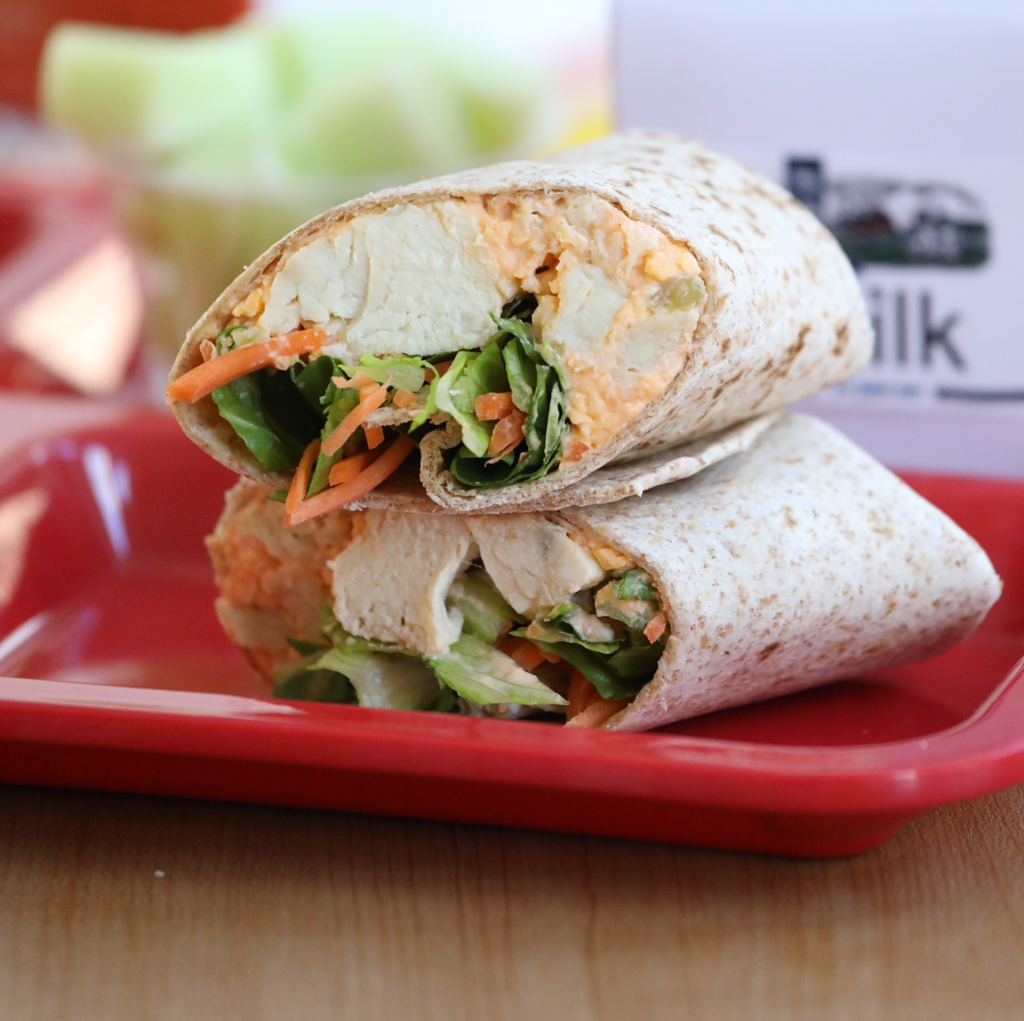
Extra Burden?
Fit into existing federal meal pattern requirements
Many foods meet these diets
No need for special crediting for Halal or Kosher foods
Notes:
Say: There is a misconception that accommodating dietary practices/preferences with school meals is an extra burden and requires significantly more work, but let's take a closer look. First of all, foods used for accommodations already fit into existing federal meal pattern requirements. Second, many foods already meet these diets. In fact, you may already be serving menu items that work! And third, there is no need for special crediting for Halal or Kosher foods. They credit the same as any other food; the food itself just requires a certification. You might be surprised to learn that many large manufacturers already have Halal and Kosher certifications for their products.

Slide 8
Why Accommodate?
Minimal effort
Welcome and include all students
Show respect and value
Increase participation
Education
Opportunity for scratch cooking and local foods
Notes:
Say: Why should we accommodate these dietary practices? We already discussed it does not take much additional effort, but beyond that we want to make sure we are welcoming and including all students in our school nutrition programs. By acknowledging and recognizing their dietary practices, we show respect and send the message that we value these students. You want your environment to be one where students feel welcome, safe, respected, and happy. Most importantly, it should be a place where they have access to the nutrition they need.
If you have a population of students that follows certain dietary practices, but they are not currently eating with your program, you are losing out on sales! Making dietary accommodations can help increase your participation and put more money in the bank! Michigan Dearborn Public Schools switched to halal meat that cost 15% more, but the increase in participation offset the costs!
Another consideration is education. Our school nutrition programs are fully intwined with the education system, and our cafeterias serve as an extension to the classroom. By accommodating dietary practices, we are educating all of the students on cultures that are different than their own, providing a more worldly view.
And finally, accommodating dietary practices provides yet another opportunity for increasing scratch cooking efforts and incorporating local foods.

Slide 9
Dietary Preferences/Practices
Notes:
Say: Let's now take a closer look at some of the most common dietary preferences and practices, including Kosher, Halal, and vegetarian/vegan diets.

Slide 10
Kosher (Judaism)
Restricts pork products and shellfish
Cannot simultaneously consume meat and dairy products
Foods with multiple ingredients must be certified Kosher
Fast during Yom Kippur and Tisha B’Av and more
Notes:
Say: Foods that are Kosher meet the requirements of the Jewish faith and law. Individuals that adhere to these rules must avoid pork products and shellfish. Kosher meat must be killed through ritual slaughter knows as shechita, which is done by a slaughterer called a shochet.
Individuals following a Kosher diet also cannot simultaneously consume meat and dairy products. These foods cannot be on the same plates, be prepared in the same cookware or touched by the same utensils, and sinks used to wash the dishes cannot also crossover. Think about popular school foods that might need to be reconsidered. Add to the chat menu items that include both dairy and meat. Are there ways we can separate the meat and dairy? Provide a choice?
Do: Allow some time for participants to add to the chat, reading and commenting on answers.
Say: In addition to these restrictions, foods made with multiple ingredients must be certified Kosher. There are several certification boards and symbols to demonstrate certification that we will review on the next slide.
Finally, it is important to be aware that individuals observing Jewish holidays fast twice a year for 24 hours during Yom Kippur and Tisha B'Av. They also fast at other times during the year, but not for a full 24 hours. It might be from sun up to sun down. If you have a large Jewish population, it would be helpful to learn what fasts they practice, so you know when to expect a drop in participation!

Slide 11


Kosher Certifications
Notes:
Say: Take a look at the different Kosher certifications, and this is not all of them! There are different boards that oversee these certifications, including two boards in Virginia, found in Norfolk and Richmond. Different countries and states have different boards and symbols. It can be hard to keep track, so be sure to make sure labels you see on products are legitimate.
https://www.kashrut.com/agencies/

Slide 12
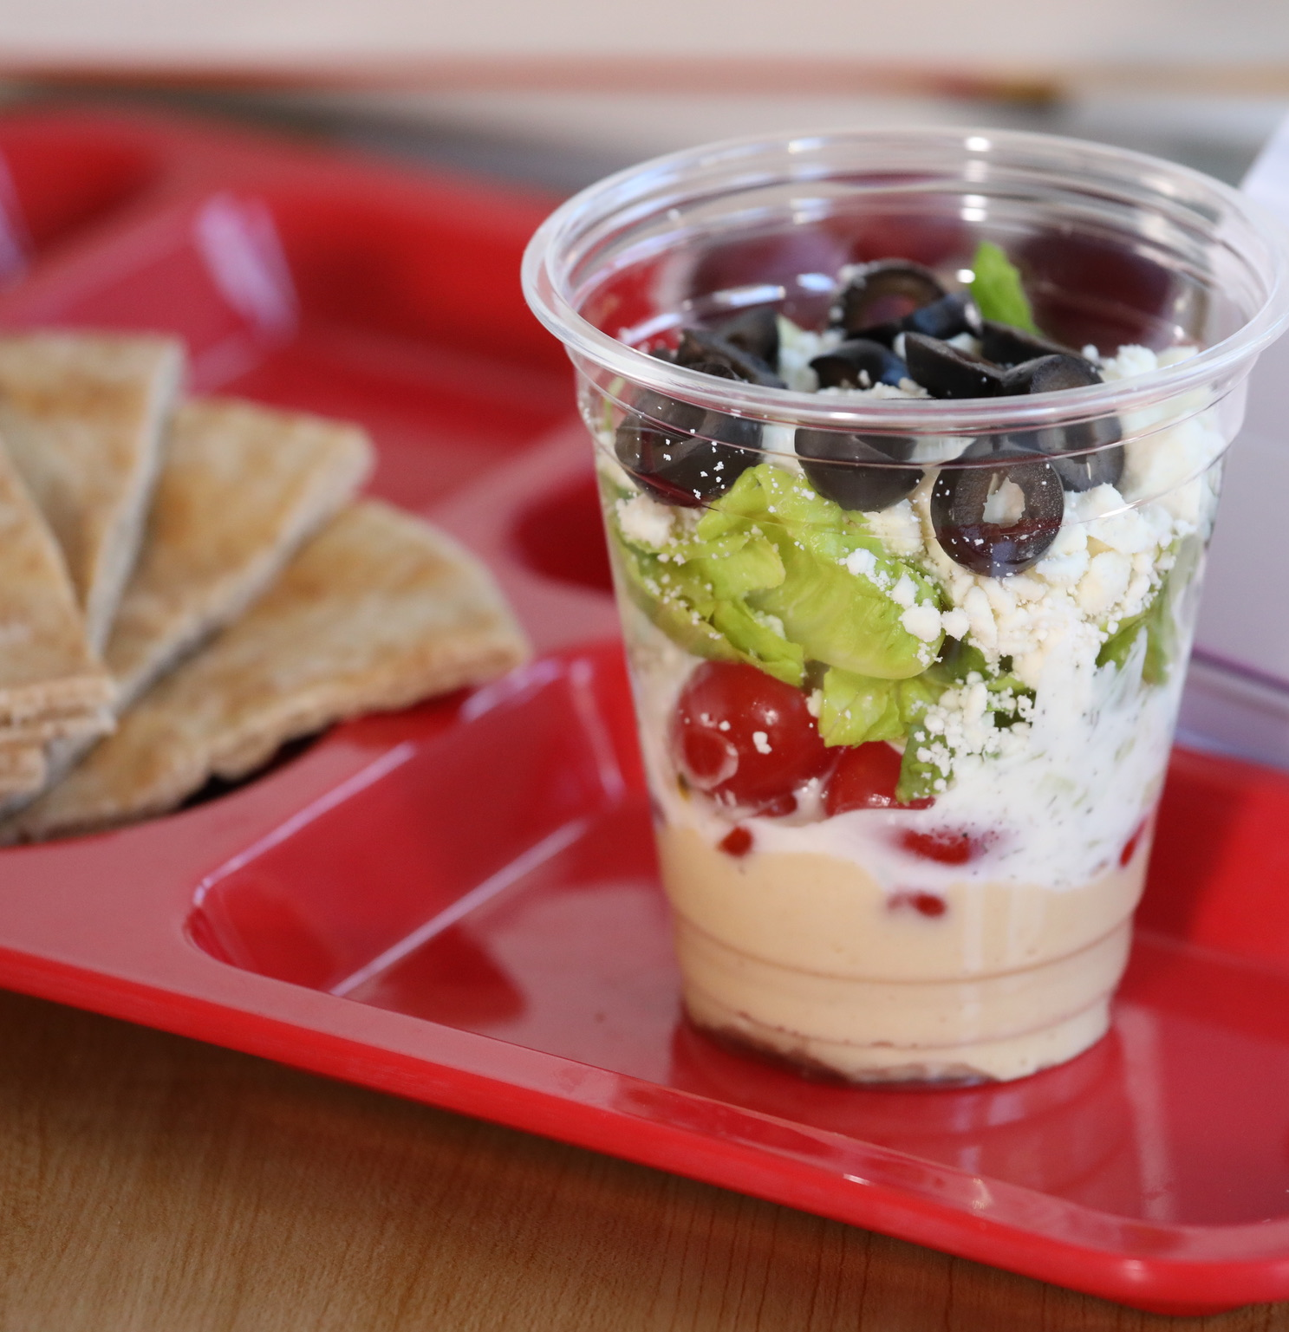


School Recipe Ideas for Kosher Diets
Notes:
Say: We have some school recipe ideas pictured on this slide for Kosher diets. Hummus Dipping Cups (with hummus being a traditional food consumed in Israel), a Buffalo Tofu Salad from the Mirowitz Jewish Community School posted on the Healthy School Recipes website, and a Cinnamon Sugar Bagel with a Greek yogurt/cream cheese berry schmear. Cream cheese and Greek yogurt are commonly certified as Kosher!

Slide 13


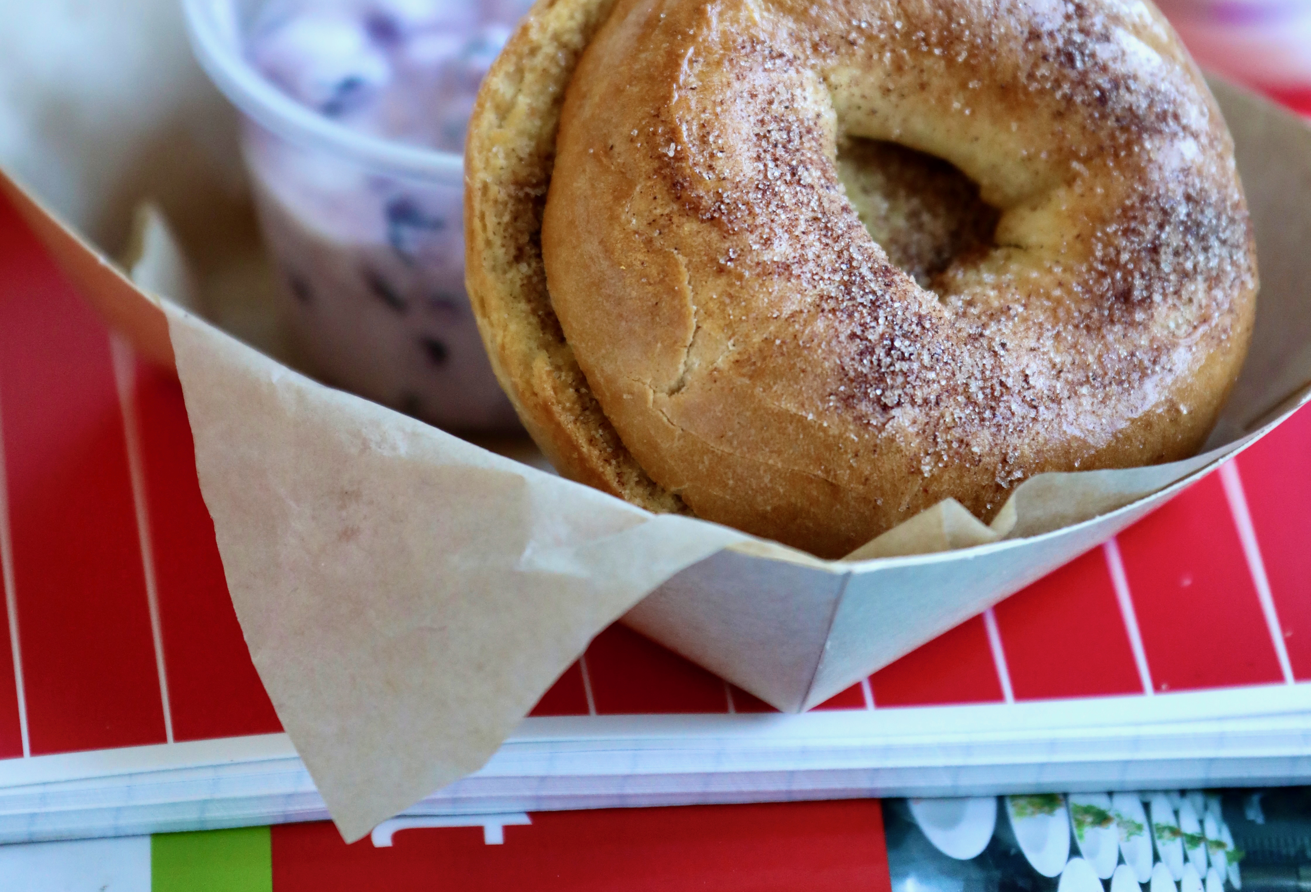
Demo!
Notes:
Say: I'm sure you all agree that the bagel on the previous slide looked delicious! Aren't you glad there is a demo?! Chef, take it away!
Demo Talking Points:
We realized that we have not demoed many breakfast recipes, so thought this one would be fun!
Bagels are a common food in Jewish culture. The concept of boiling the bread was a way Polish Jews got around laws forbidding them to bake bread.
Choose whole grain bagels for fiber, protein, phytonutrients, healthy fats, vitamins, minerals. They provide significantly more satiety and nutrition than a refined white bagel.
The cream cheese/yogurt schmear adds more protein, gut friendly probiotics, and phytonutrient rich berries. The new breakfast regulation allows us to credit meat/meat alternate easier (don't need to provide a grain first), which is fantastic because all of us (not just kids) should make sure we include whole grains + protein at breakfast for lasting power. Cream cheese does not credit as a meat/meat alternate, but yogurt does. The yogurt in this recipe provides .25 m/ma. Providing our students with protein at breakfast helps them last until lunch!
From scratch recipes better allow us to control the amount of sugar added. The kids see the sugar in this recipe, meeting their innate desire for more, while actually not providing that much! The vanilla yogurt is mixed with cream cheese, reducing the sugar vs. 100% yogurt.
Do: Demo how to toast the bagels with the cinnamon and sugar.
Demo how to make the Greek yogurt/berry schmear.
Demo how to serve as a sandwich or with the schmear on the side.
Source:
Boiling the bread: https://www.nycbageltours.com/bagel-history#:~:text=Bagels%20are%20created%20in%2017th,the%20dough%20before%20baking%20it.

Slide 14
Halal (Islam)
Forbids pork and all its byproducts
No predatory animals
Animals must be slaughtered by a Muslim
Foods with multiple ingredients must be certified Halal
Fast during Ramadan
Notes:
Say: Let's now move on to Halal dietary practices. Halal is an Arabic word meaning permissible or allowable. Islam forbids all pork and its by-products as well as predatory animals. To be considered Halal, animals must be slaughtered by a Muslim. The animals must also be raised under specific guidelines for humane treatment.
Similar to Kosher, foods with multiple ingredients must be certified Halal by certification boards.
Another consideration with Islamic students is that older ones (reached puberty) are required to fast during the month of Ramadan from sunrise to sunset. Ramadan occurs during the ninth month of the Islamic calendar, which does not align with traditional calendars, and therefore dates vary every year. Muslims might also fast during voluntary times throughout the year.

Slide 15


Halal Certifications
Notes:
Say: Three major certification bodies dominate the US halal certification market; Islamic Food and Nutrition Council of America (IFANCA); Islamic Society of North America (ISNA) and the Islamic Services of America (ISA). If you see the labels on this slide on products, you know that they can be trusted, but just like with Kosher certifications there are many more, varying by country and state.
Sources:
IFANCA: https://www.ifanca.org/certification-process/
ISNA: https://www.isna.net
ISA: https://www.isahalal.com

Slide 16
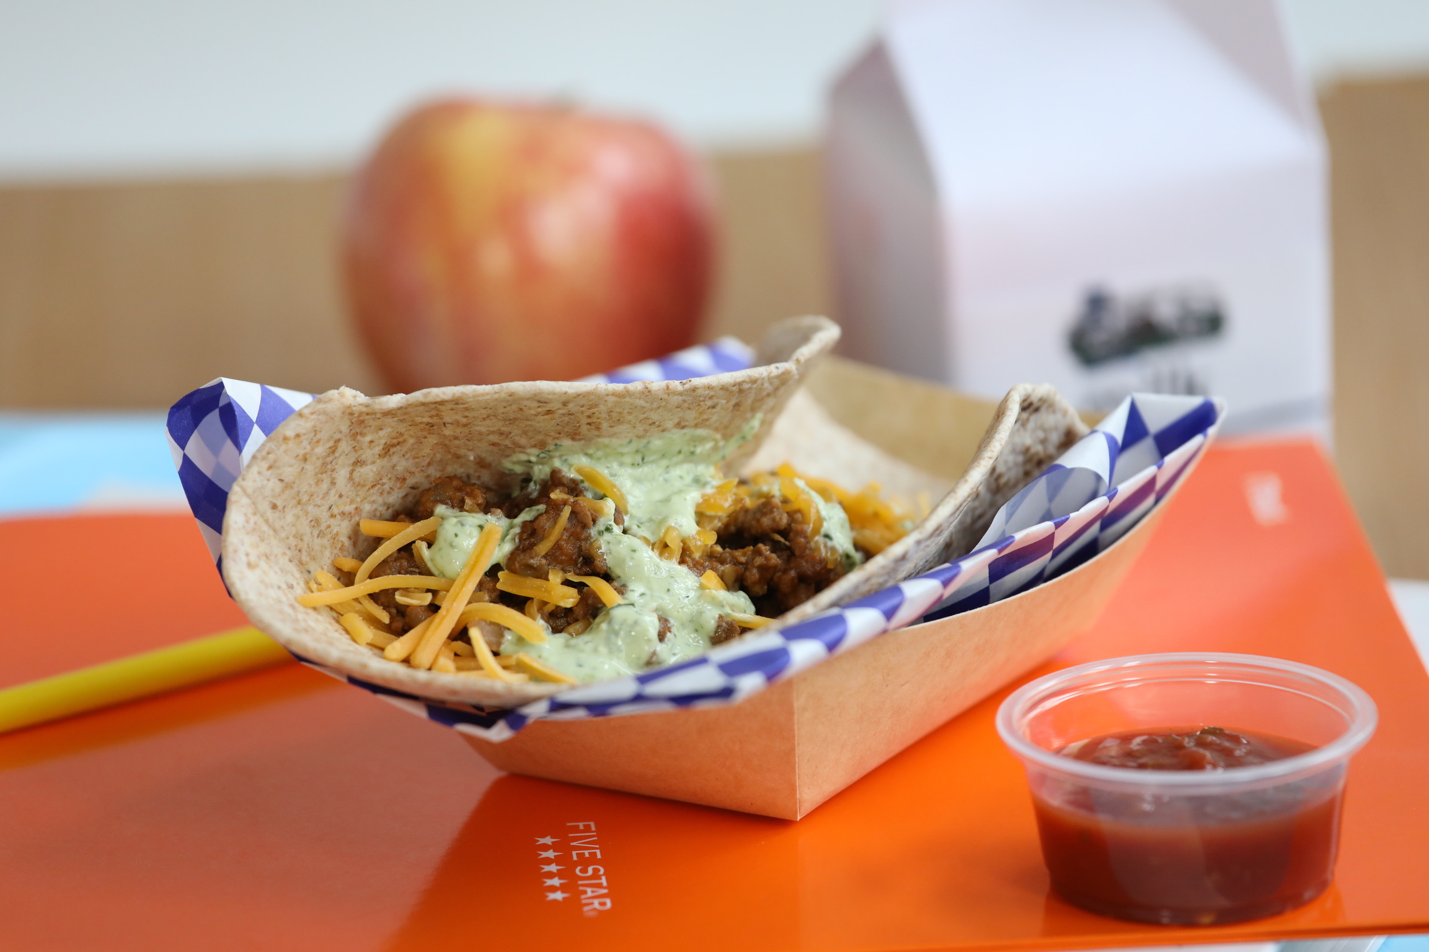
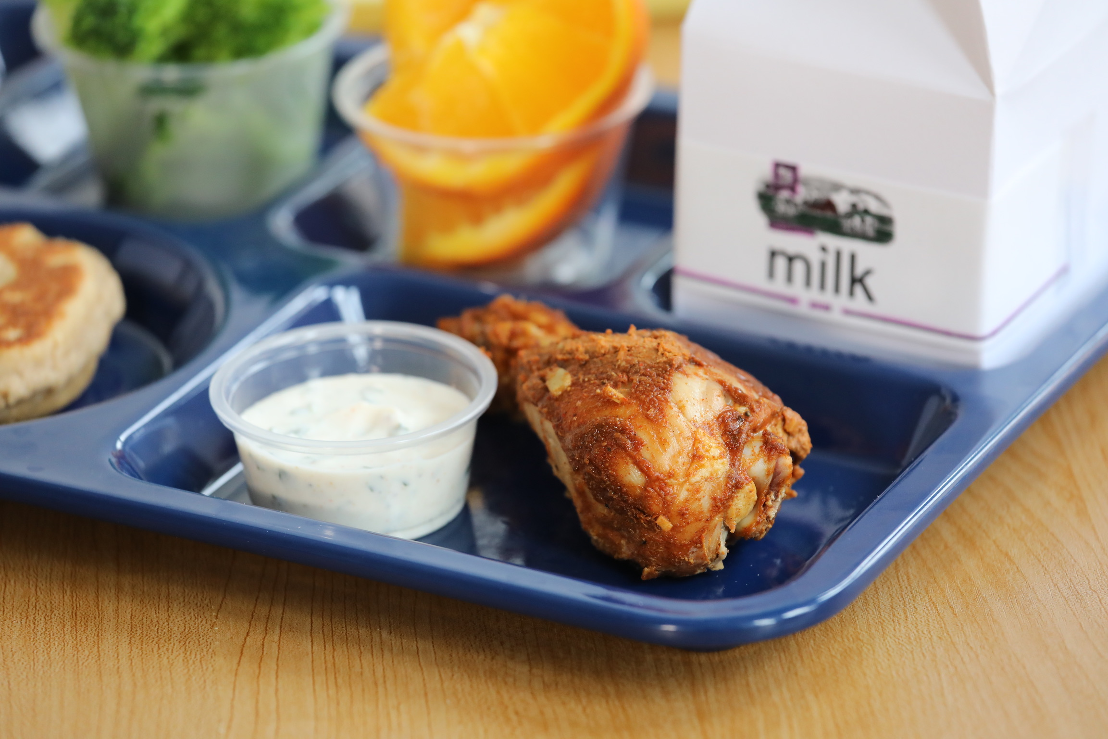
School Recipes for Halal Diets
Notes:
Say: We have some recipes pictured on this slide that could be Halal. We have tandoori chicken legs with a Raita dip, Curried Turkey and Squash, and Beef and Lentil Tacos. All of these meats would need to be Halal, but since they are meats found in natural forms vs. ultra processed, they would be easier to procure. Ground meats and chicken legs also require minimally more labor than pre-cooked forms.
Ask: Do any of you already limit pork on your menus? If so, let us know in the chat!

Slide 17
Vegetarian/Vegan
Option for many dietary practices
  Hinduism
  Jainism
  Buddhism
  Catholicism for Fridays during lent
    Fish also an option
Notes:
Say: Offering vegetarian or vegan items may provide an option for those who practice Hindu, Buddhism, Jainism, and even Catholics during lent. Catholics are allowed to eat fish as well during lent, but vegetarian or vegan dishes also work! Vegetarian options are also great choices for those in need of Kosher or Halal items, as long as certifications are in place.

Slide 18
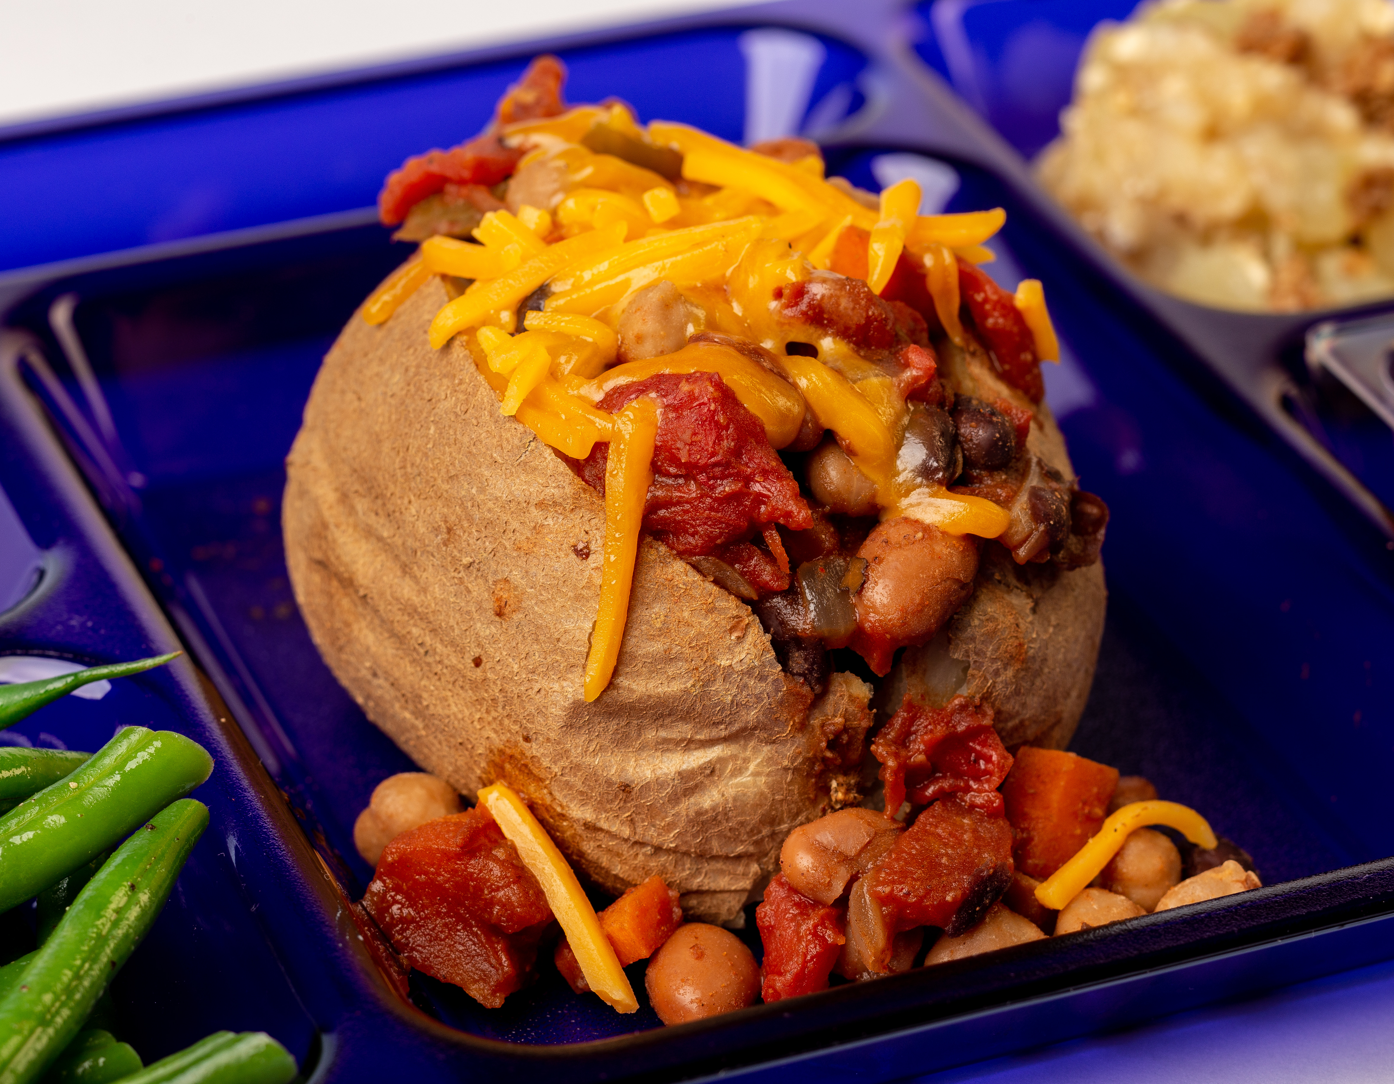
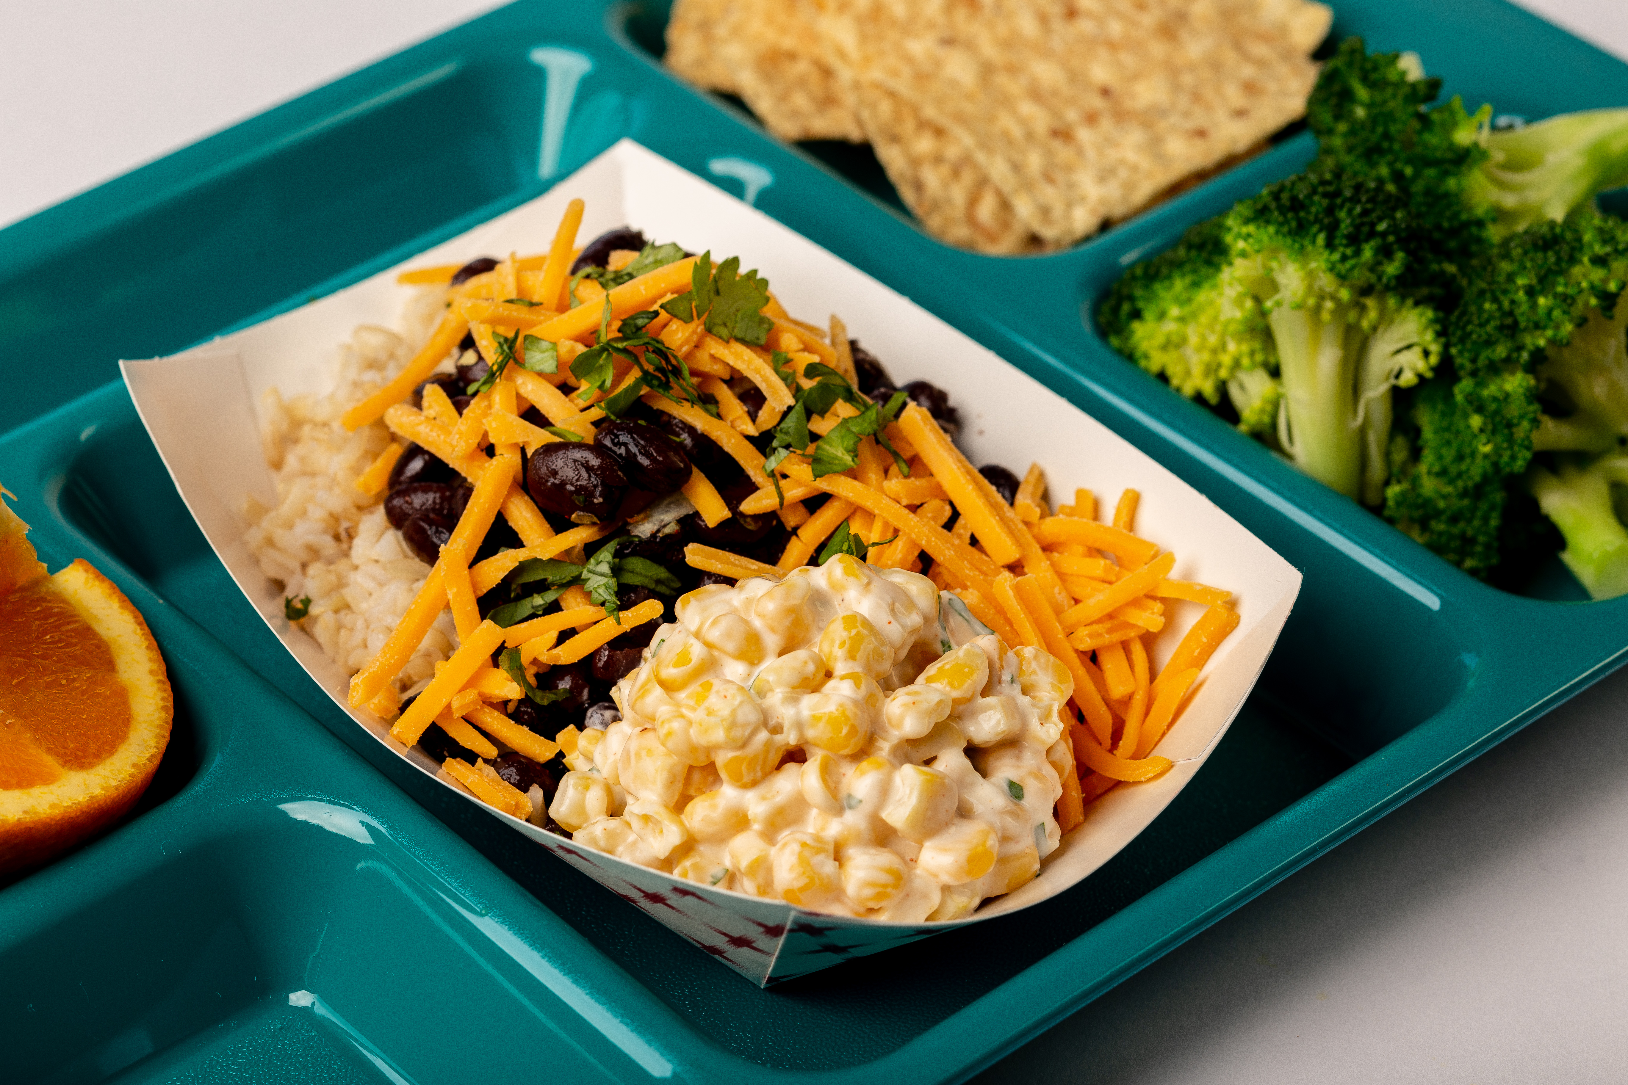
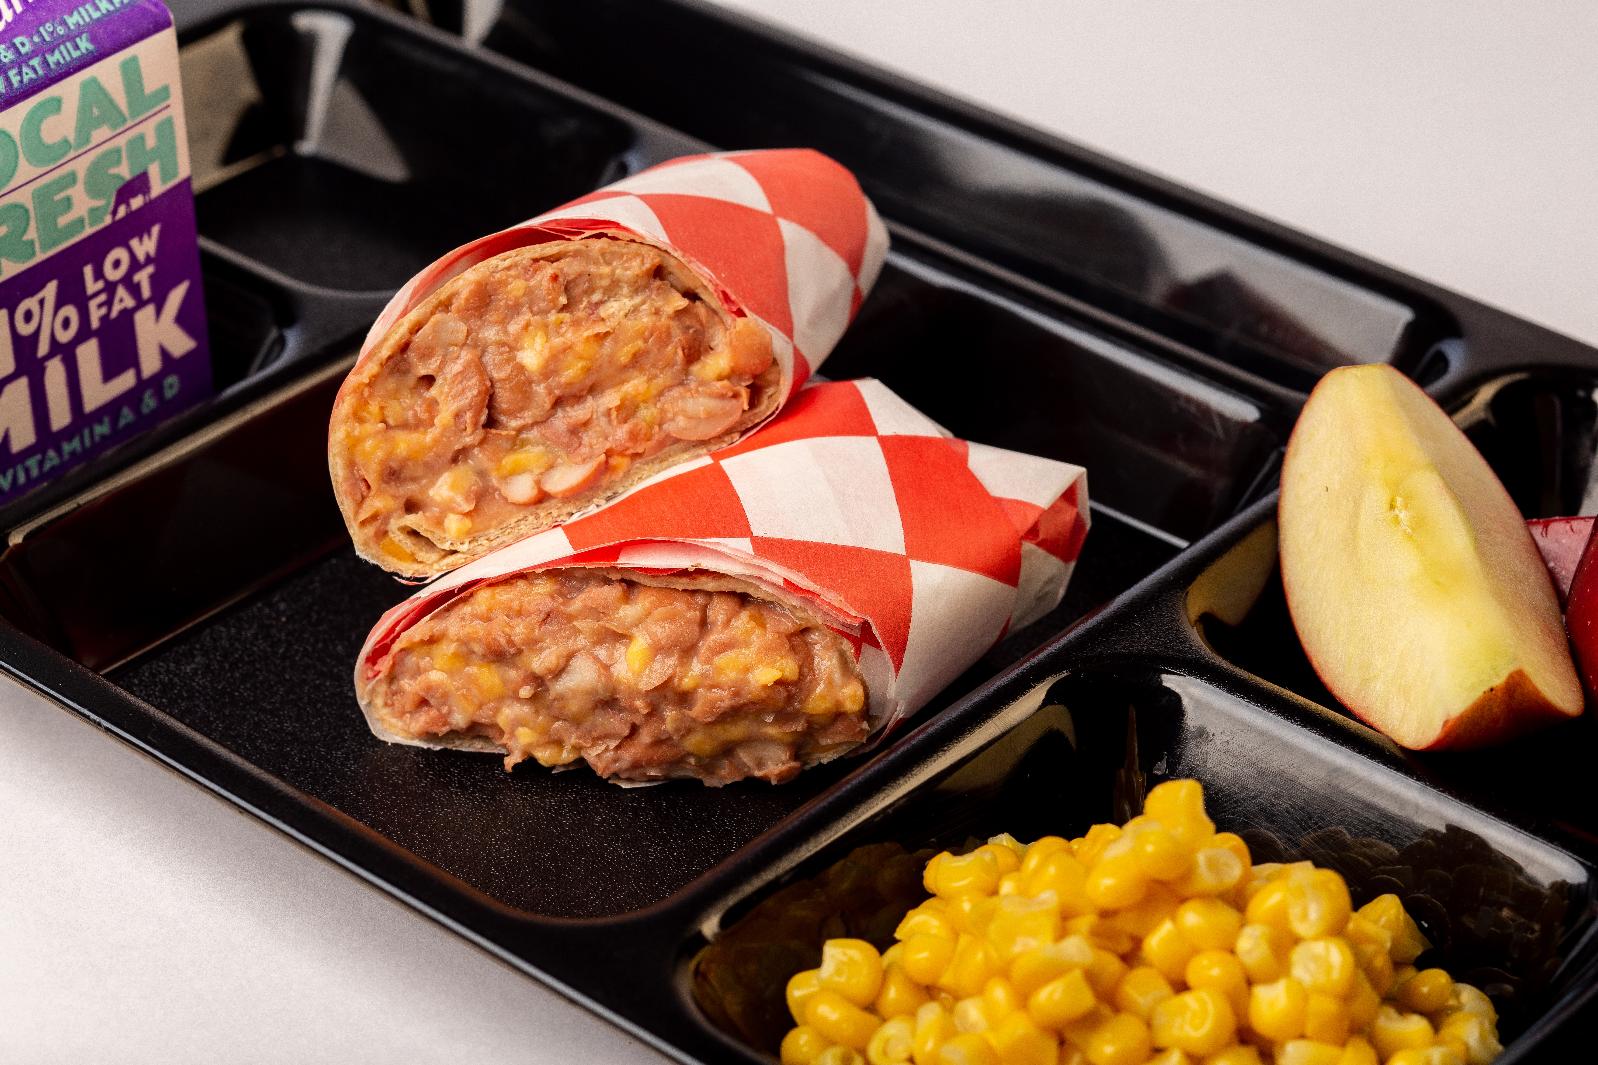
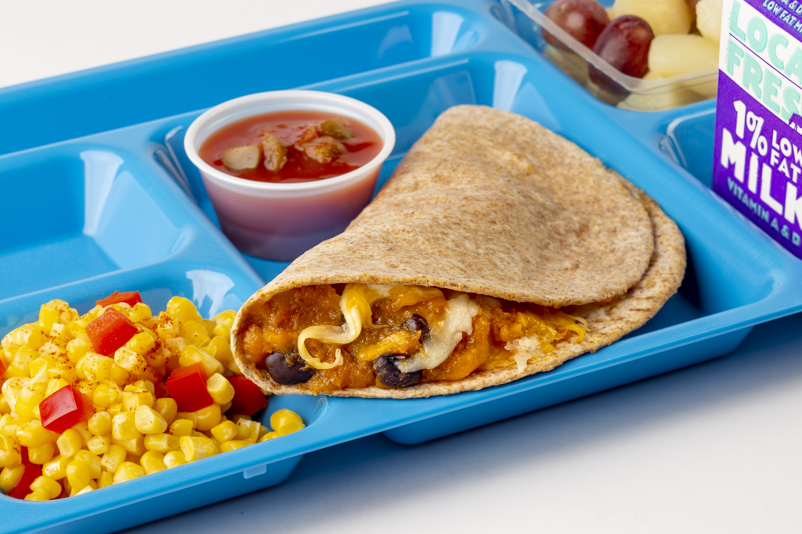
School Recipes for Vegetarian/Vegan Diets
Notes:
Say: We have a variety of recipes pictured on this slide, some vegetarian, and some vegan: vegetarian bean chili baked potato, sweet potato and black bean quesadilla, vegetarian Mexican burrito bowl, hummus wrap, and a bean and cheese burrito.
Ask: What are some of your favorite vegetarian or vegan menu items? Add them to the chat!

Slide 19
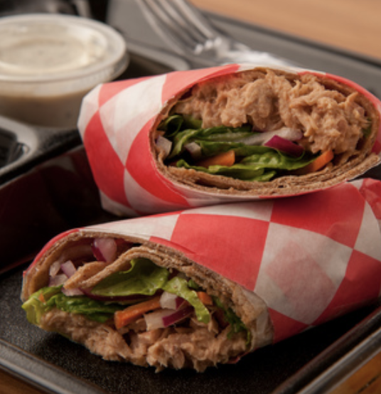
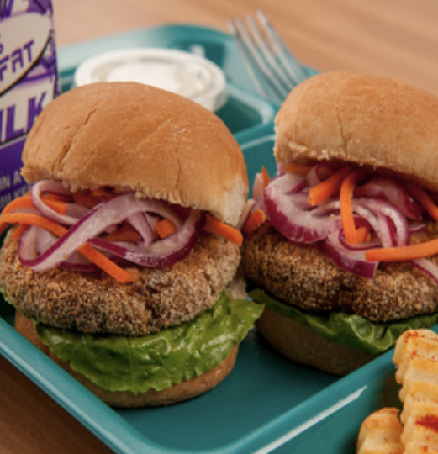
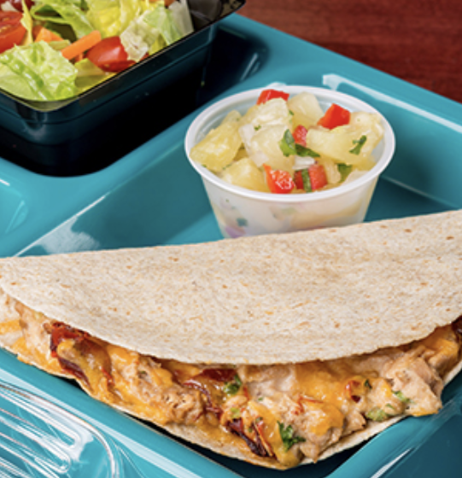
School Recipes with Fish
Notes:
Say: Looking for some fish options for the lent season or throughout the year? Try some more creative tuna recipes, like quesadillas, sliders, or wraps, or fish tacos for a change from fish sticks and sandwiches. Fish doesn't always need to be breaded and fried. In fact, it’s a healthier option when not.
Ask: Do you serve any unique and/or popular fish items? If so, add them to the chat!

Slide 20
Making Accommodations
Steps to take
Notes:
Say: What steps can you take to make more accommodations in your school nutrition programs? Let's take a look!

Slide 21

Meet with Community Members
Notes:
Say: Meeting with community members is a great start! Discuss specific dietary practices with community members. It's common for people to practice variations or allow leniencies. Don't assume; talk directly with the source.
If you have a menu advisory council, this might already be a great group to talk to, otherwise reach out to Parent Teacher Organizations, or school administration.

Slide 22




Designate a Kitchen Space
Special equipment and tools
Assigned area for preparation
Train staff!
Notes:
Say: Prepare certain foods on special surfaces with designated equipment and tools reserved exclusively for kosher or halal foods. This is very similar to cooking for food allergies, so your staff may already be familiar. Consider color coding tools for easier separation.
With that said, staff training is essential! Make sure SOPs are developed and everyone is on the same page. It would be a tragedy to advertise items as Kosher and Halal, and not practice the food preparation correctly.

Slide 23
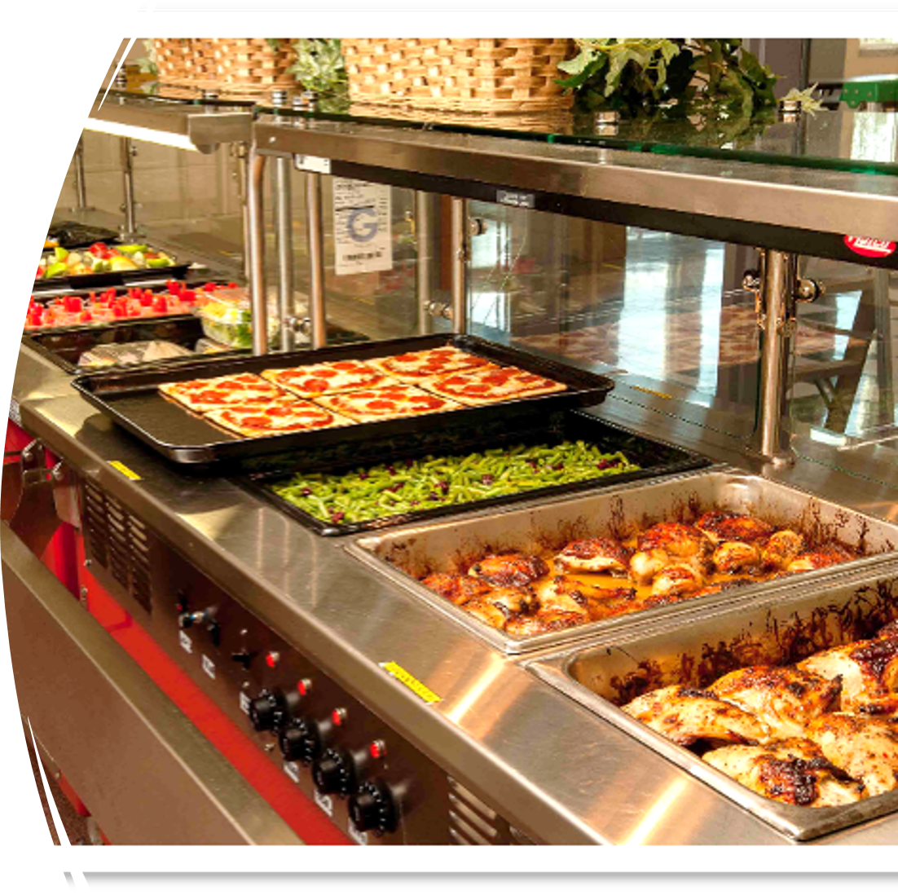
Scratch Cook
Notes:
Say: Scratch cooking almost always makes meeting dietary restrictions and practices easier. When you cook from scratch, you are fully in control of the ingredients that go into recipes. Scratch cooking also allows you to better create student inspired meals, geared towards their tastes and preferences. Let's not forget using whole food ingredients is also healthier than cooking ultra processed foods.

Slide 24
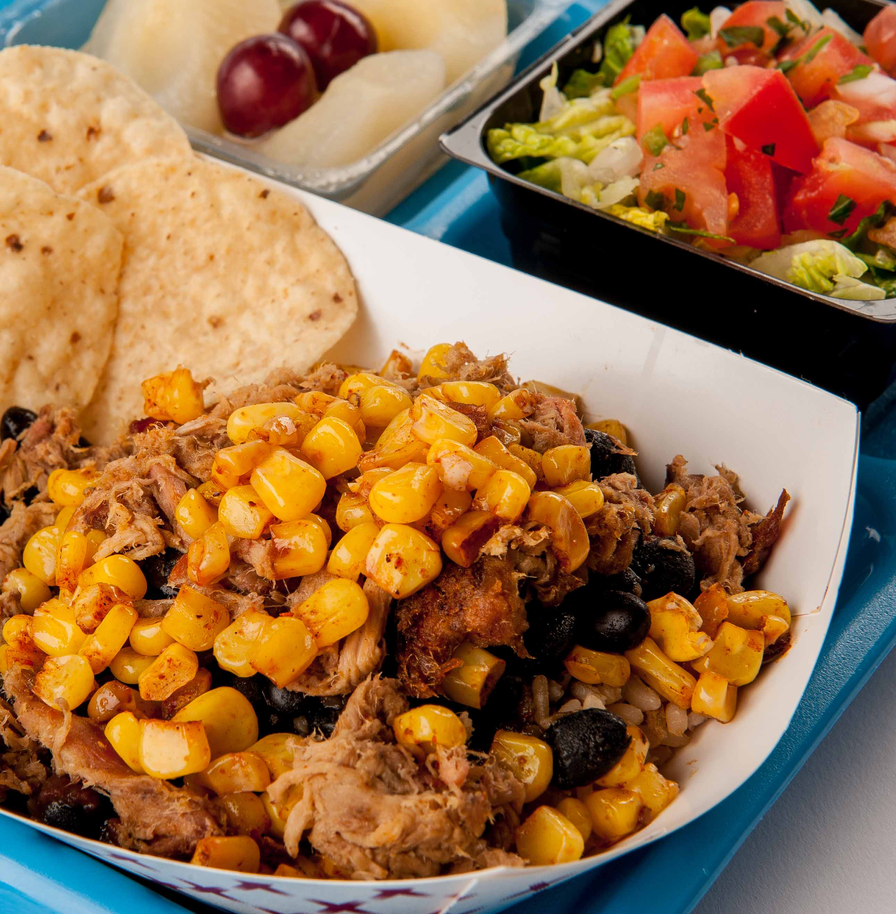
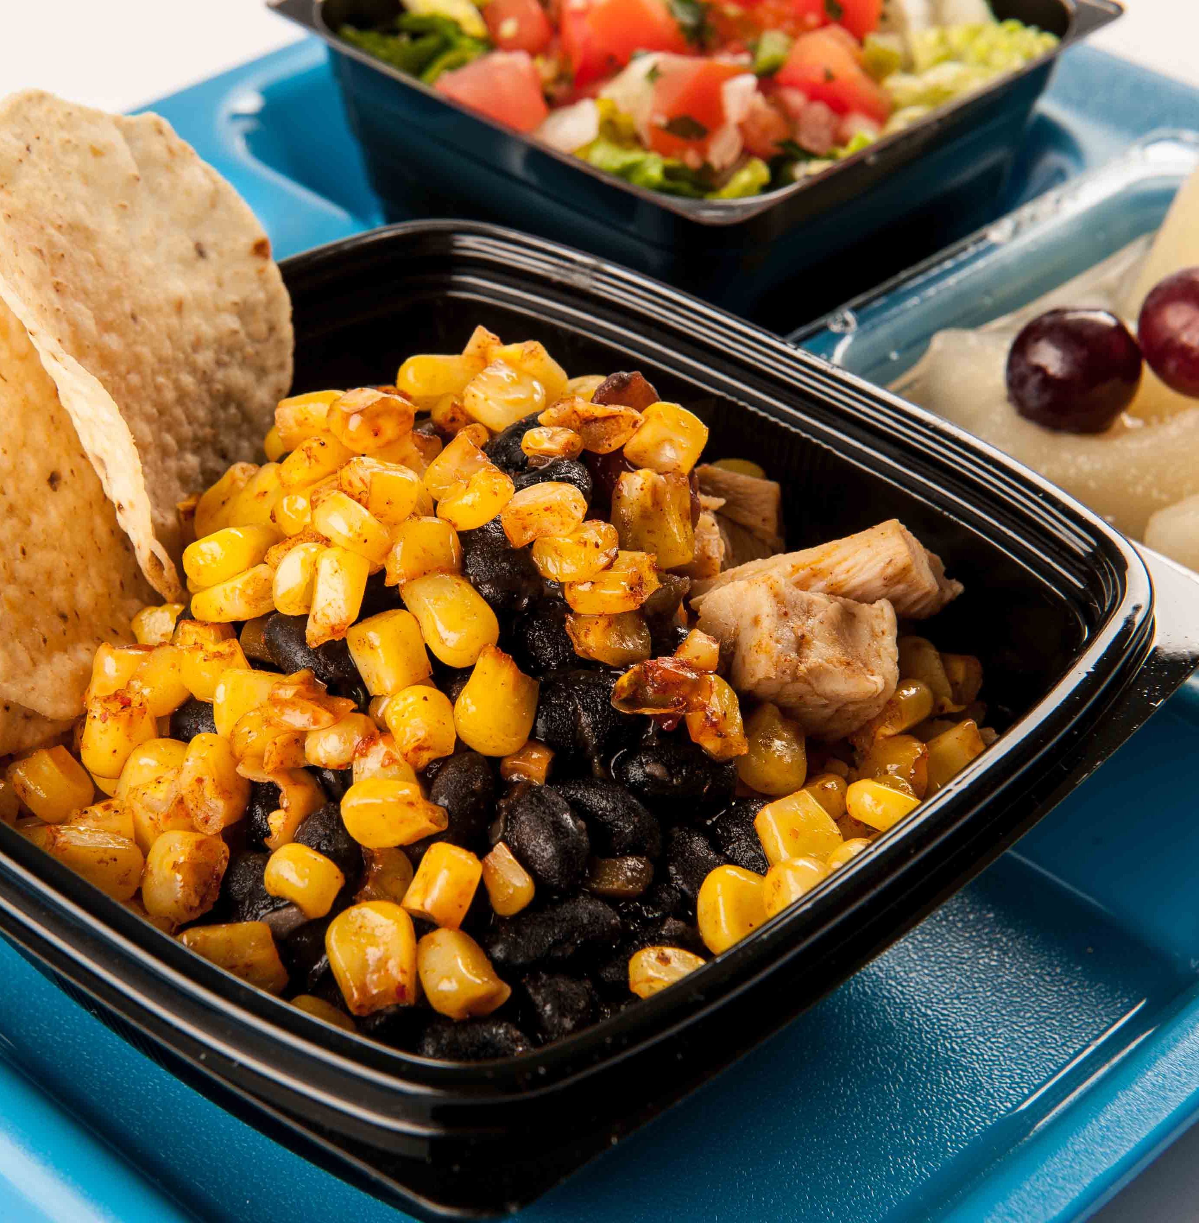
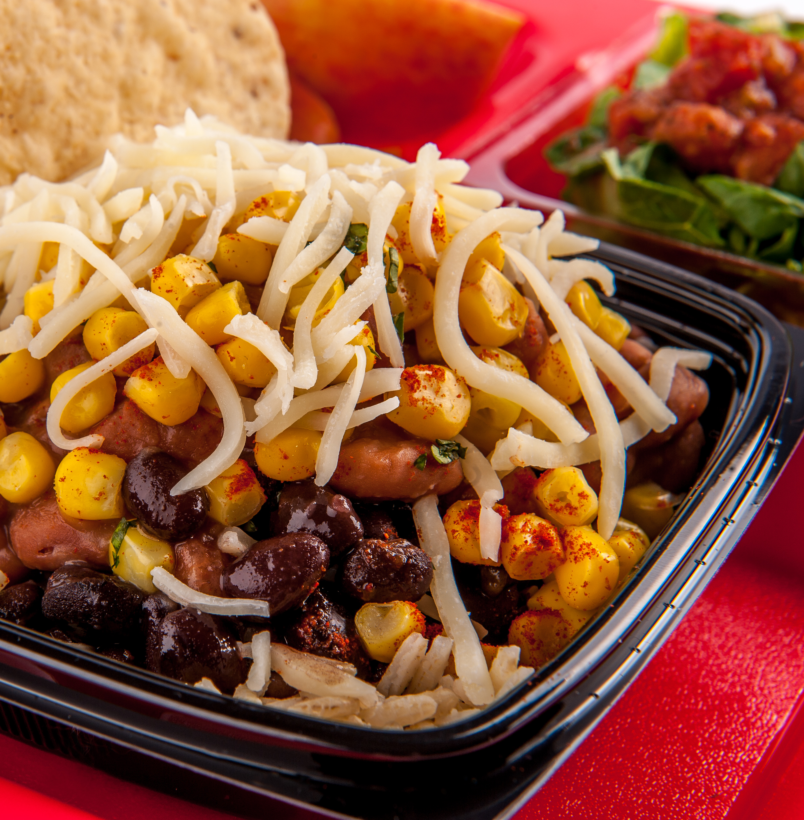

Menu Customizable Dishes
BYO options
Multiple meat/meat alternate options
  Include plant based
Notes:
Say: It's helpful to menu customizable dishes, so that students have some control of the ingredients. Remember with Kosher practice, meat and cheese cannot be combined, so consider offering cheese on the side rather than putting it on top of dishes when possible.
Instead of offering a set menu item, see if you can make it Build Your Own (BYO). Can students decide the meat/meat alternate and/or choose vegetarian options? Maybe it is a burrito bowl, as pictured on this slide, with an option of pork, chicken, or beans as the meat/meat alternate with cheese on the side. Regardless of dietary practices, most kids love to have control of what they eat!

Slide 25
Menu Plant-Based/Plant-Forward Dishes
Notes:
Say: Follow Fairfax County's lead and offer more plant-based options overall. Fairfax County has been taking steps to offer a more inclusive menu by offering a vegan or vegetarian option each day instead of making specific items that may align with some dietary patterns and not others. They focus on vegan menu options, which meets vegetarian, which meets Kosher, which meets Halal (look for certifications!).

Slide 26

Express Interest with Food Brokers
Notes:
Say: Be sure your food brokers and reps know that you are on the lookout for foods that meet Kosher, Halal, and vegetarian or vegan dietary practices. You might be surprised to learn of currently available options. I know our team was pleasantly surprised to see how many foods are already certified Kosher and Halal while researching for this webinar. Weigh the cost benefit. Remember, a slight increase in cost might be offset by an increase in participation.

Slide 27


Consider the Calendar
Periods of restriction
Don't introduce fun new foods or events
Notes:
Say: Finally, be sure to consider the calendar. During periods of restriction, it's a good idea not to introduce fun new foods or hold a special food focused event. You don’t want kids to feel left out. It all comes back to community and communication.
It's also a good idea to consider different dietary practices and faiths when decorating the cafeteria. For example, while schools often love decorating for Christmas, are there other holidays celebrated by students in your schools during that time of year that should be recognized? Just some more food for thought.

Slide 28

Questions?
Notes:
Say: Hopefully today provided you with ideas on how to accommodate dietary practices within your school nutrition program and provided some inspiration for menu items. We encourage you to continue to network with one another and share ideas.
Do: Thank everyone for attending and participating in this webinar series.
Ask: Does anyone have any last questions?
Source for presentation:
https://schoolnutrition.org/sn-magazine/ensuring-dietary-inclusivity-meet-religious-needs-with-school-meals/

