Slide 1

Incorporating USDA Foods + Live Culinary Demo
Notes:
Say: Good afternoon, everyone! It’s so great to see you today. Welcome back! The last webinar discussed The Transitional Nutrition Standards, Proposed New Rule, and the Reason Why. If you remember, our goal is to provide you with the tools to meet these guidelines through scratch cooking, local procurement, and culturally inclusive meals. Today we will incorporate a live culinary demo with our fabulous K-12 Chef, Chef Andy Montero. Please pay close attention because we don’t want you to miss the deliciousness!

Slide 2
USDA Funding and Non-Discrimination Statements:
“This project has been funded at least in part with Federal funds from the U.S. Department of Agriculture. The contents of this publication do not necessarily reflect the view or policies of the U.S. Department of Agriculture, nor does mention of trade names, commercial products, or organizations imply endorsement by the U.S. Government.”
In accordance with federal civil rights law and U.S. Department of Agriculture (USDA) civil rights regulations and policies, this institution is prohibited from discriminating on the basis of race, color, national origin, sex (including gender identity and sexual orientation), disability, age, or reprisal or retaliation for prior civil rights activity.
Program information may be made available in languages other than English. Persons with disabilities who require alternative means of communication to obtain program information (e.g., Braille, large print, audiotape, American Sign Language), should contact the responsible state or local agency that administers the program or USDA’s TARGET Center at (202) 720-2600 (voice and TTY) or contact USDA through the Federal Relay Service at (800) 877-8339.
To file a program discrimination complaint, a Complainant should complete a Form AD-3027, USDA Program Discrimination Complaint Form which can be obtained online at: https://www.usda.gov/sites/default/files/ documents/ad-3027.pdf, from any USDA office, by calling (866) 632-9992, or by writing a letter addressed to USDA. The letter must contain the complainant’s name, address, telephone number, and a written description of the alleged discriminatory action in sufficient detail to inform the Assistant Secretary for Civil Rights (ASCR) about the nature and date of an alleged civil rights violation. The completed AD-3027 form or letter must be submitted to USDA by:
1. mail:
U.S. Department of Agriculture
Office of the Assistant Secretary for Civil Rights
1400 Independence Avenue, SW
Washington, D.C. 20250-9410; or
2. fax:
(833) 256-1665 or (202) 690-7442; or
3. email:
Program.Intake@usda.gov
This institution is an equal opportunity provider.

Slide 3
Welcome!
Notes:
Say: Remember that as we go through today’s webinar, the chat box is open for any questions and comments. We can learn a lot from each other during these times together. Please feel free to comment and ask questions in the chat anytime! We will monitor it together throughout this hour and would love some conversations.

Slide 4

Objectives
Summarize the history of USDA Foods in schools.
Identify the USDA Foods categories available for 2023-2024.
Recall the different uses of USDA foods in schools.
Explain how USDA food can support scratch cooking.
Identify the best ways to pair USDA Foods with local foods.
Apply culinary techniques and global flavors to create culturally inclusive meals with USDA Foods and local produce.
Notes:
Next, let’s review today’s objectives: We will
Summarize the history of USDA Foods in schools – a founding reason for the 1946 school lunch legislation!
Identify the USDA Foods categories available for SY 2023-2024.
Recall the different uses of USDA foods in schools.
Explain how USDA food can support scratch cooking - in school kitchens.
Identify the best ways to pair USDA Foods with local foods – one of our favorite objectives.
Apply culinary techniques and global flavors to create culturally inclusive meals with USDA Foods and local produce.

Slide 5

Professional Standards – Learning Codes
Menu Planning (1100)
Food Production (2100)
Notes:
Say: Today’s USDA Professional Standards include two key areas: Nutrition and Operations, specifically menu planning and food production.

Slide 6
USDA Foods History
Notes:
Say: For any history buffs out there, we want to start with a few facts about USDA Foods. It’s not time to slouch in your chair, this history class is full of flavor!

Slide 7
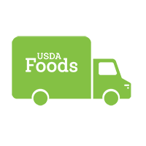
USDA Foods History
American grown
Nutritious & cost effective
Started in 1930s
Part of NSLP in 1946
Notes:
Say: This might be a review for some, but knowing the history of our program is important. USDA Foods provide American-grown foods that help schools create appealing, nutritious, and cost-effective menu options. As I mentioned in the objectives, USDA Foods started in the 1930s to help stabilize the farm economy but became part of the NSLP in 1946.
Each district is assigned an annual entitlement amount based on the total number of lunches served the previous year. Did you notice how I said cost-effective earlier and not free menu options? We cannot think of USDA Foods as free food. They are not free. If USDA Foods are incorporated into your menu with thought and strategy, they will help reduce the overall cost of your meals.

Slide 8


USDA Foods History
Farmers + kids
Notes:
Say: USDA Foods provide a dual purpose. They meet the economic needs of farmers and the nutritional needs of our children.

Slide 9
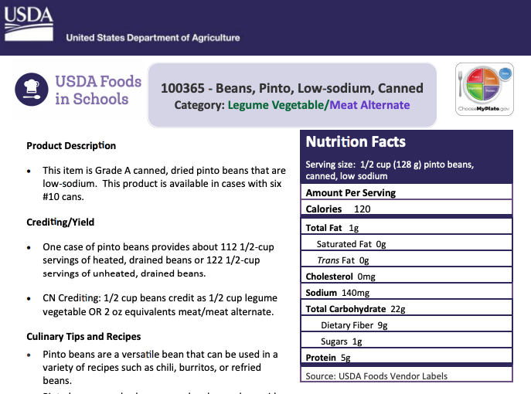
USDA Foods Available List
Fruits
Vegetables
Legumes
Nuts and seeds
Yogurt
Grain
Cheese
Oil
Egg, beef, poultry, pork, fish products
Notes:
Say: USDA Foods are categorized by food type. This includes fruits, vegetables, legumes, nuts and seeds, yogurt, grains, cheese, oil, egg, beef, poultry, pork, and fish products. On this slide, you’ll see an example of a product information sheet. Each food has a product information sheet providing more detail about the foods expected, including crediting/yield, culinary tips, recipe ideas, and even allergen information.
USDA foods can be further processed into convenience foods such as beef patties, chicken fajita strips, breaded options, or turkey taco filling.

Slide 10
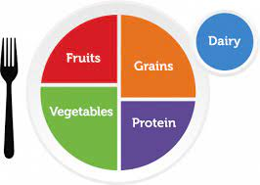

USDA Foods
Notes:
Say: USDA Foods keep up with Dietary Guidelines for Americans. If you recall from the list of foods available, they are staple ingredients and full of good nutrients. They consist of whole grains, extra-lean ground beef, low-fat dairy, low-sodium poultry, and fruit packed in light syrup, water, or juice.

Slide 11
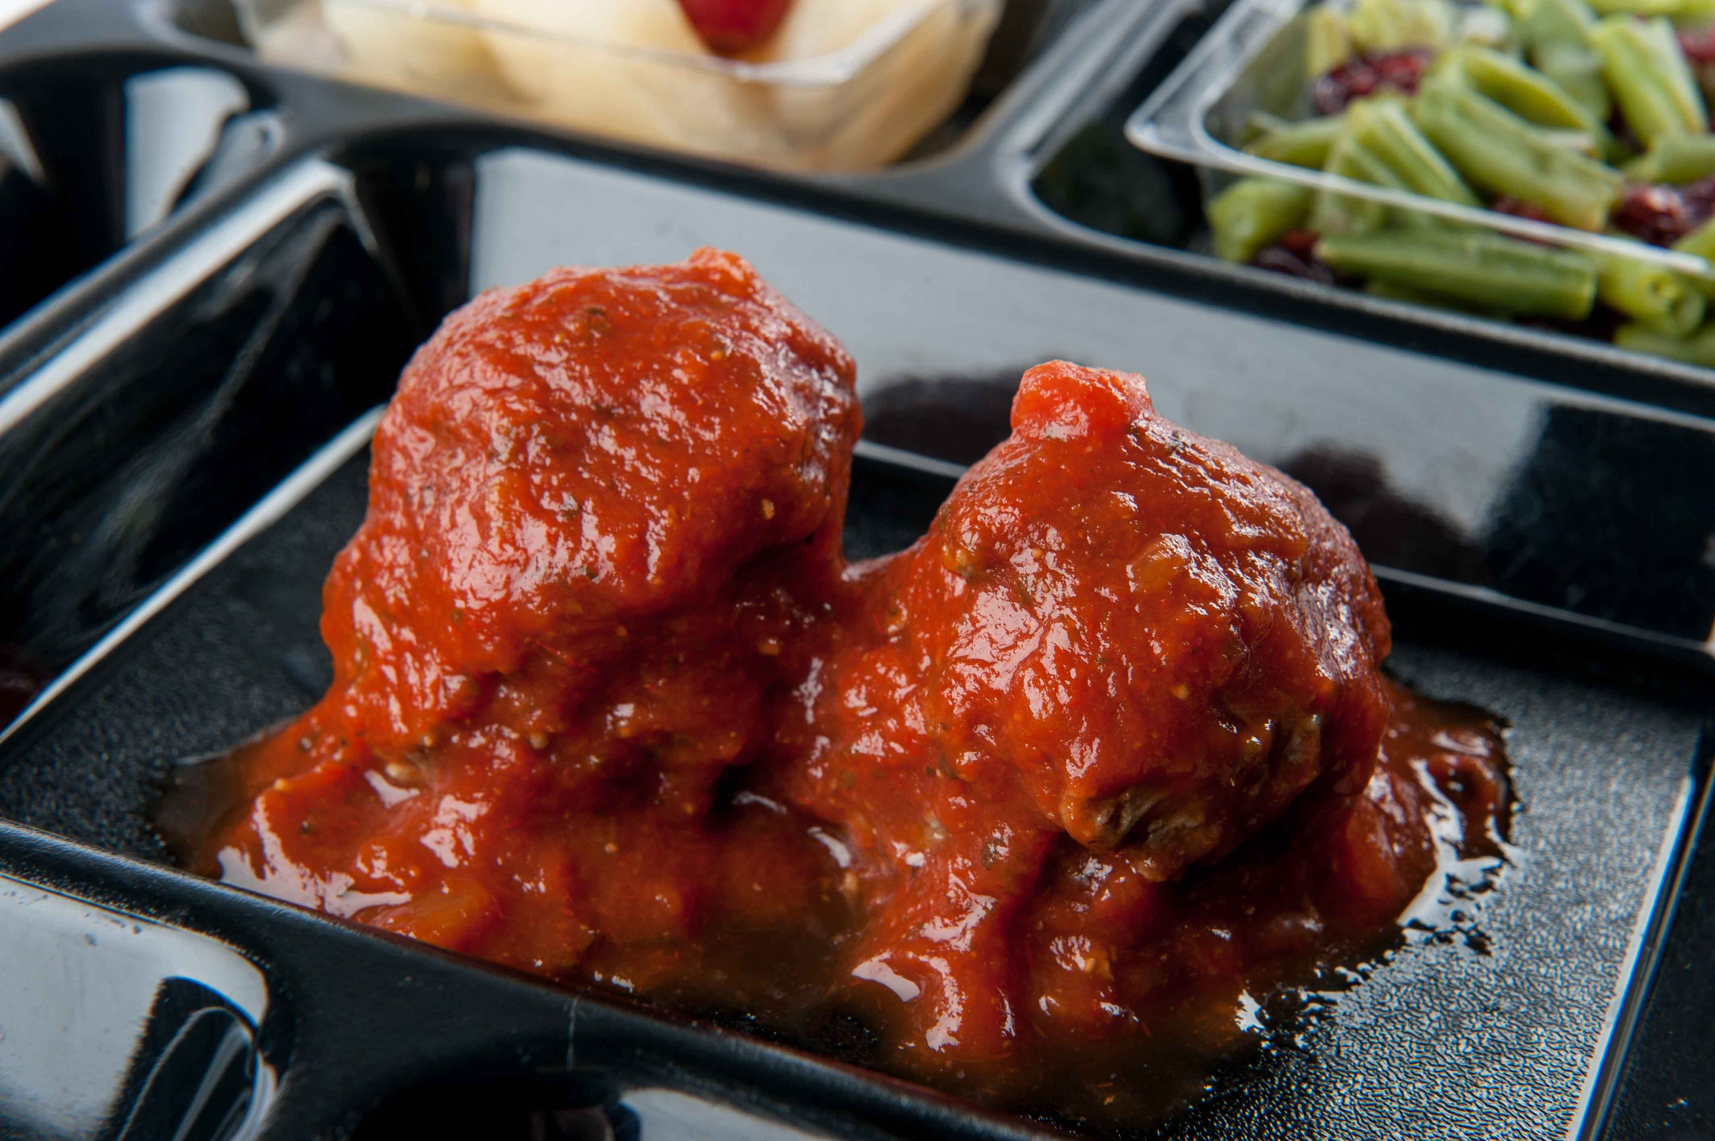
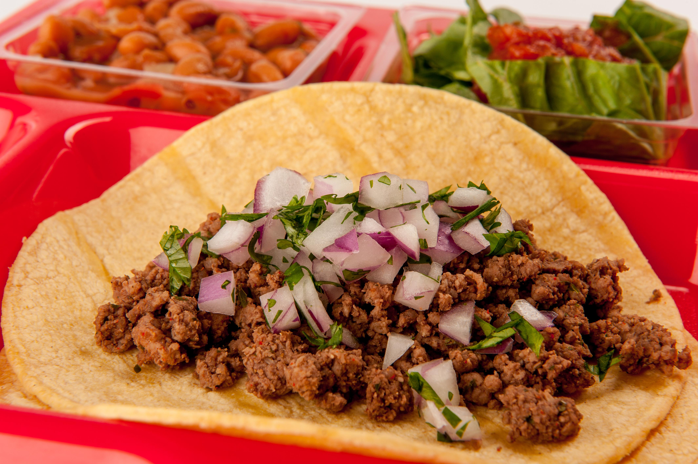
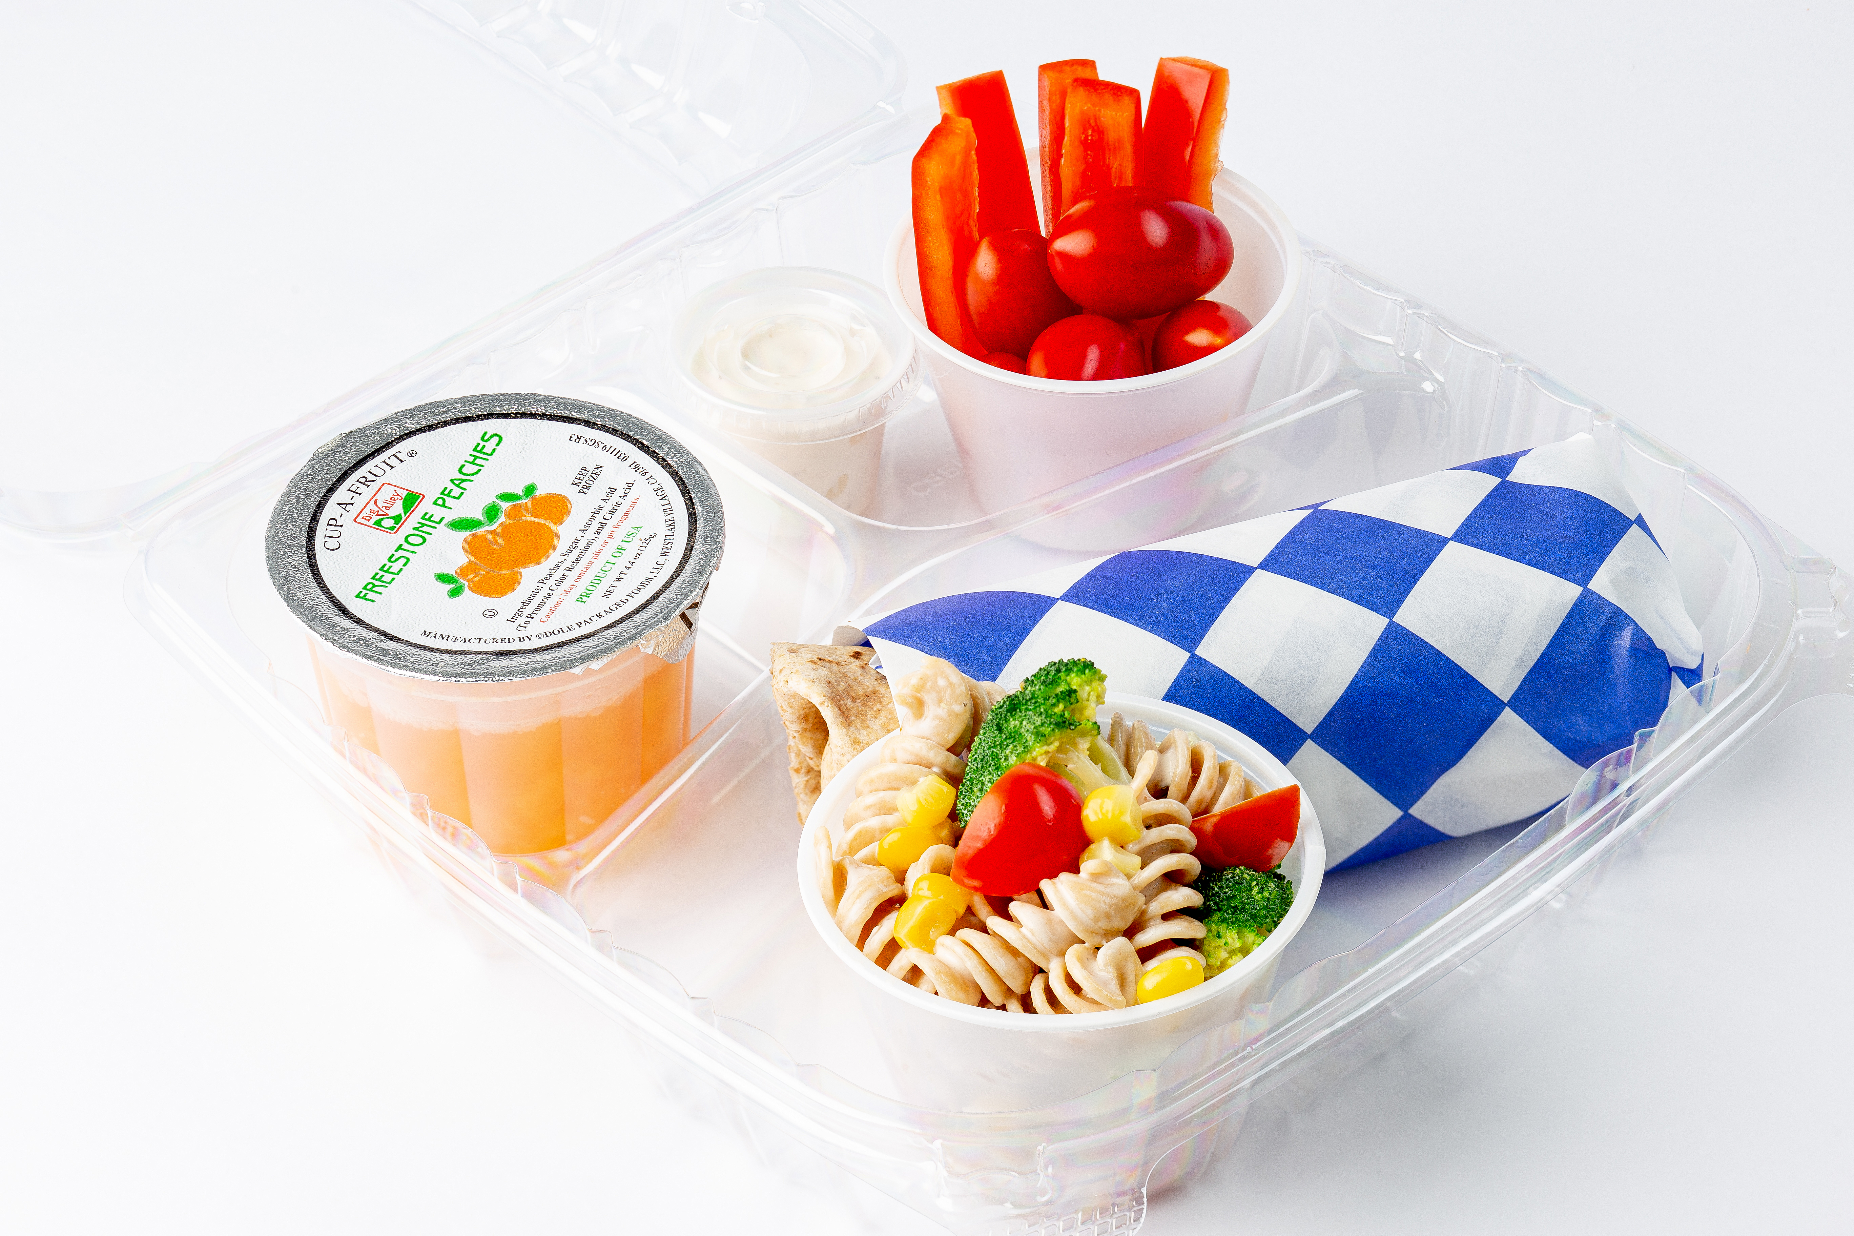
Choosing USDA Foods with Versatility
Use in many different dishes
Notes:
Say: There are many options when selecting USDA Foods. The right selections are the most versatile ingredients for your menu! When you think about versatility, you want to consider how many different ways you can use a food. Some foods were created for convenience, such as a beef patty, whereas others act as an ingredient, like ground beef. Let’s compare the ground beef and the beef patty. Ground beef is more versatile. It can be made into traditional Italian meatballs or Mexican tacos. If we take it one step further, we could make a plant-forward burrito recipe by combining ground beef with beans and cheese.

Slide 12
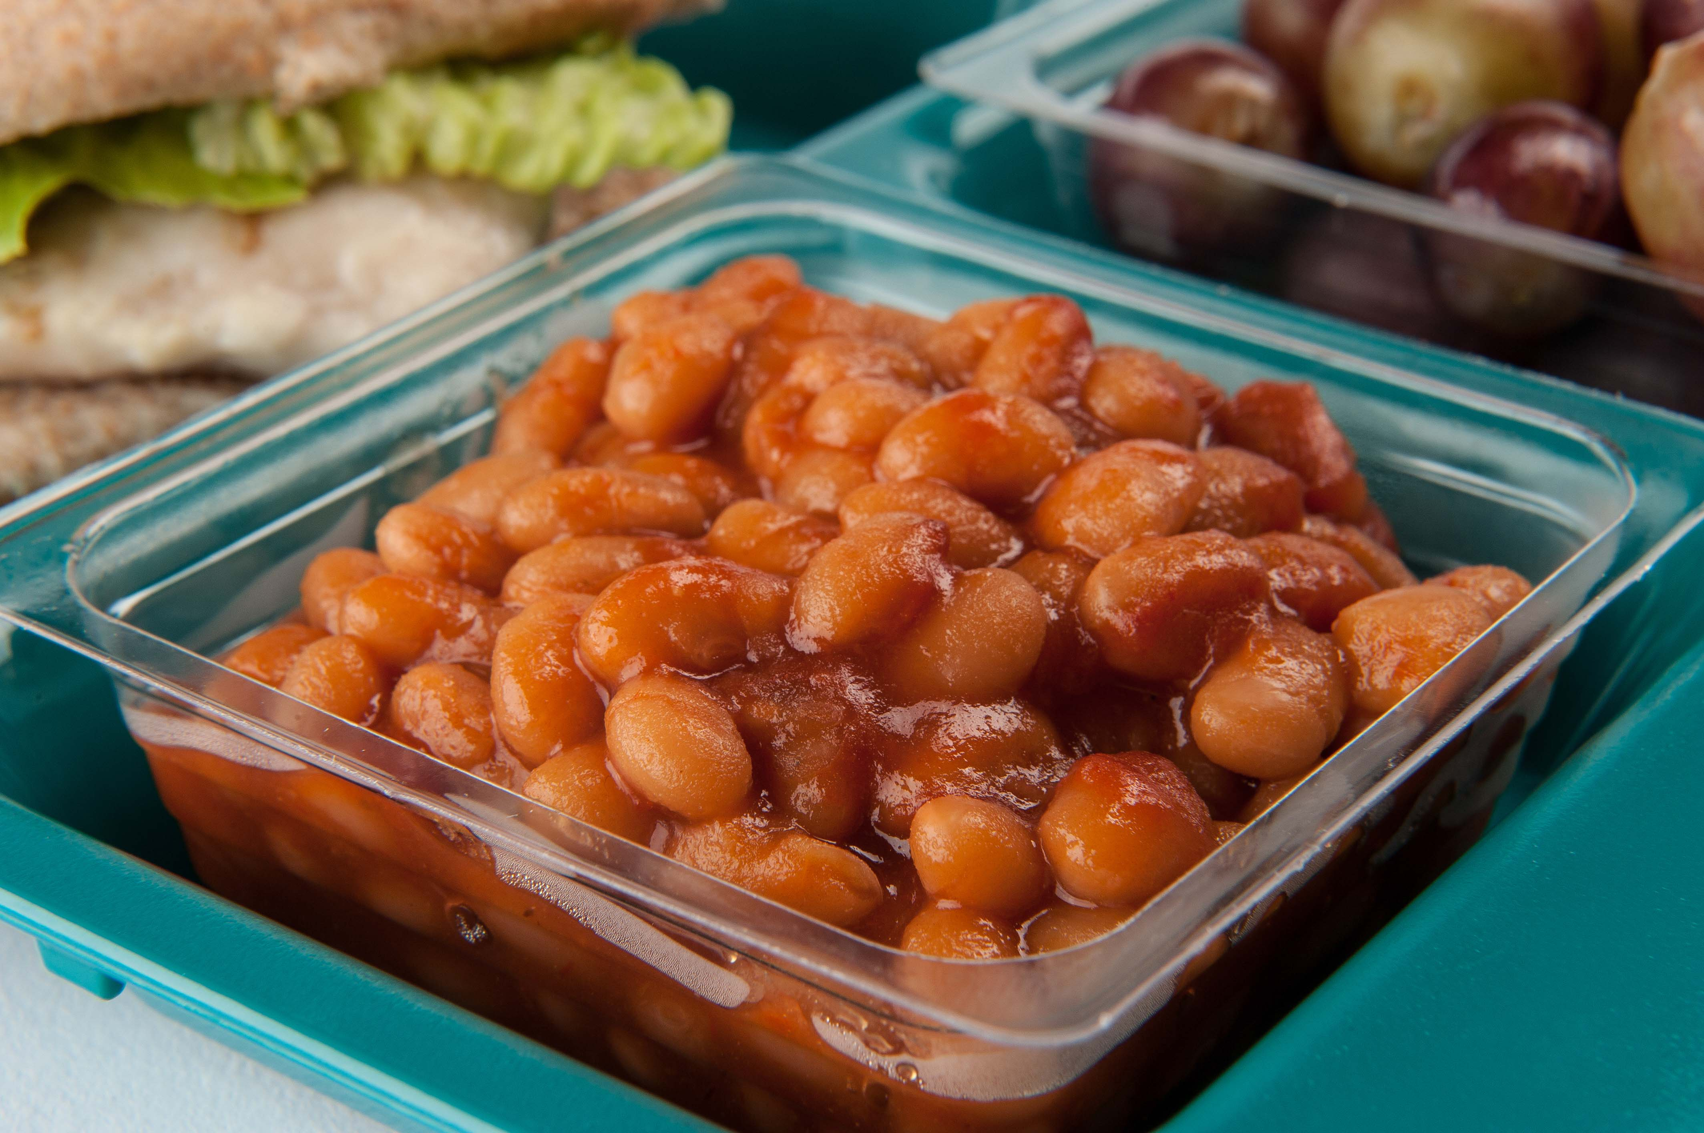
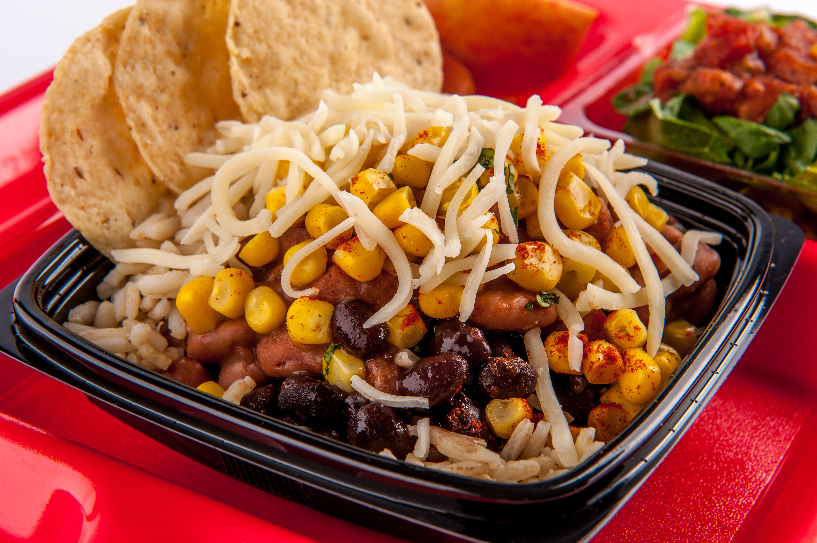
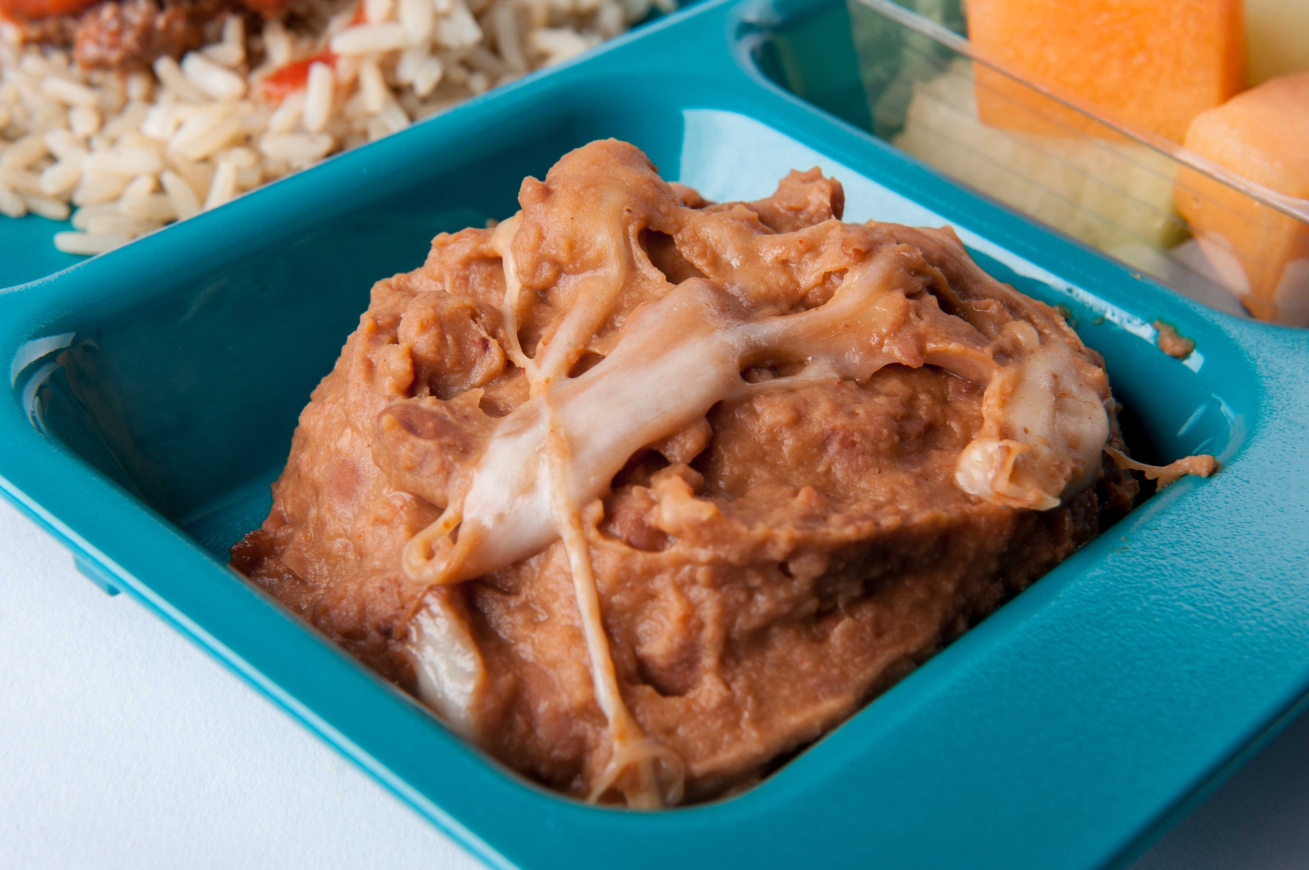
Choosing USDA Foods with Versatility
Use in many different dishes
Notes:
Say: One more idea! whole beans versus refried beans. whole beans can be used as a side of beans, tossed in a burrito bowl, salad, a wrap, or even made into refried beans with a little salsa and seasoning. Have you ever tried to put refried beans on a salad if you’re out of whole beans? It just wouldn’t work!
Now, we understand that there are uses for convenience products, and we are not asking you to make a 1000 hamburger patties, but when selecting USDA Foods think about choosing ingredients that allow you to pivot when foods are not available or when a recipe is unsuccessful.

Slide 13

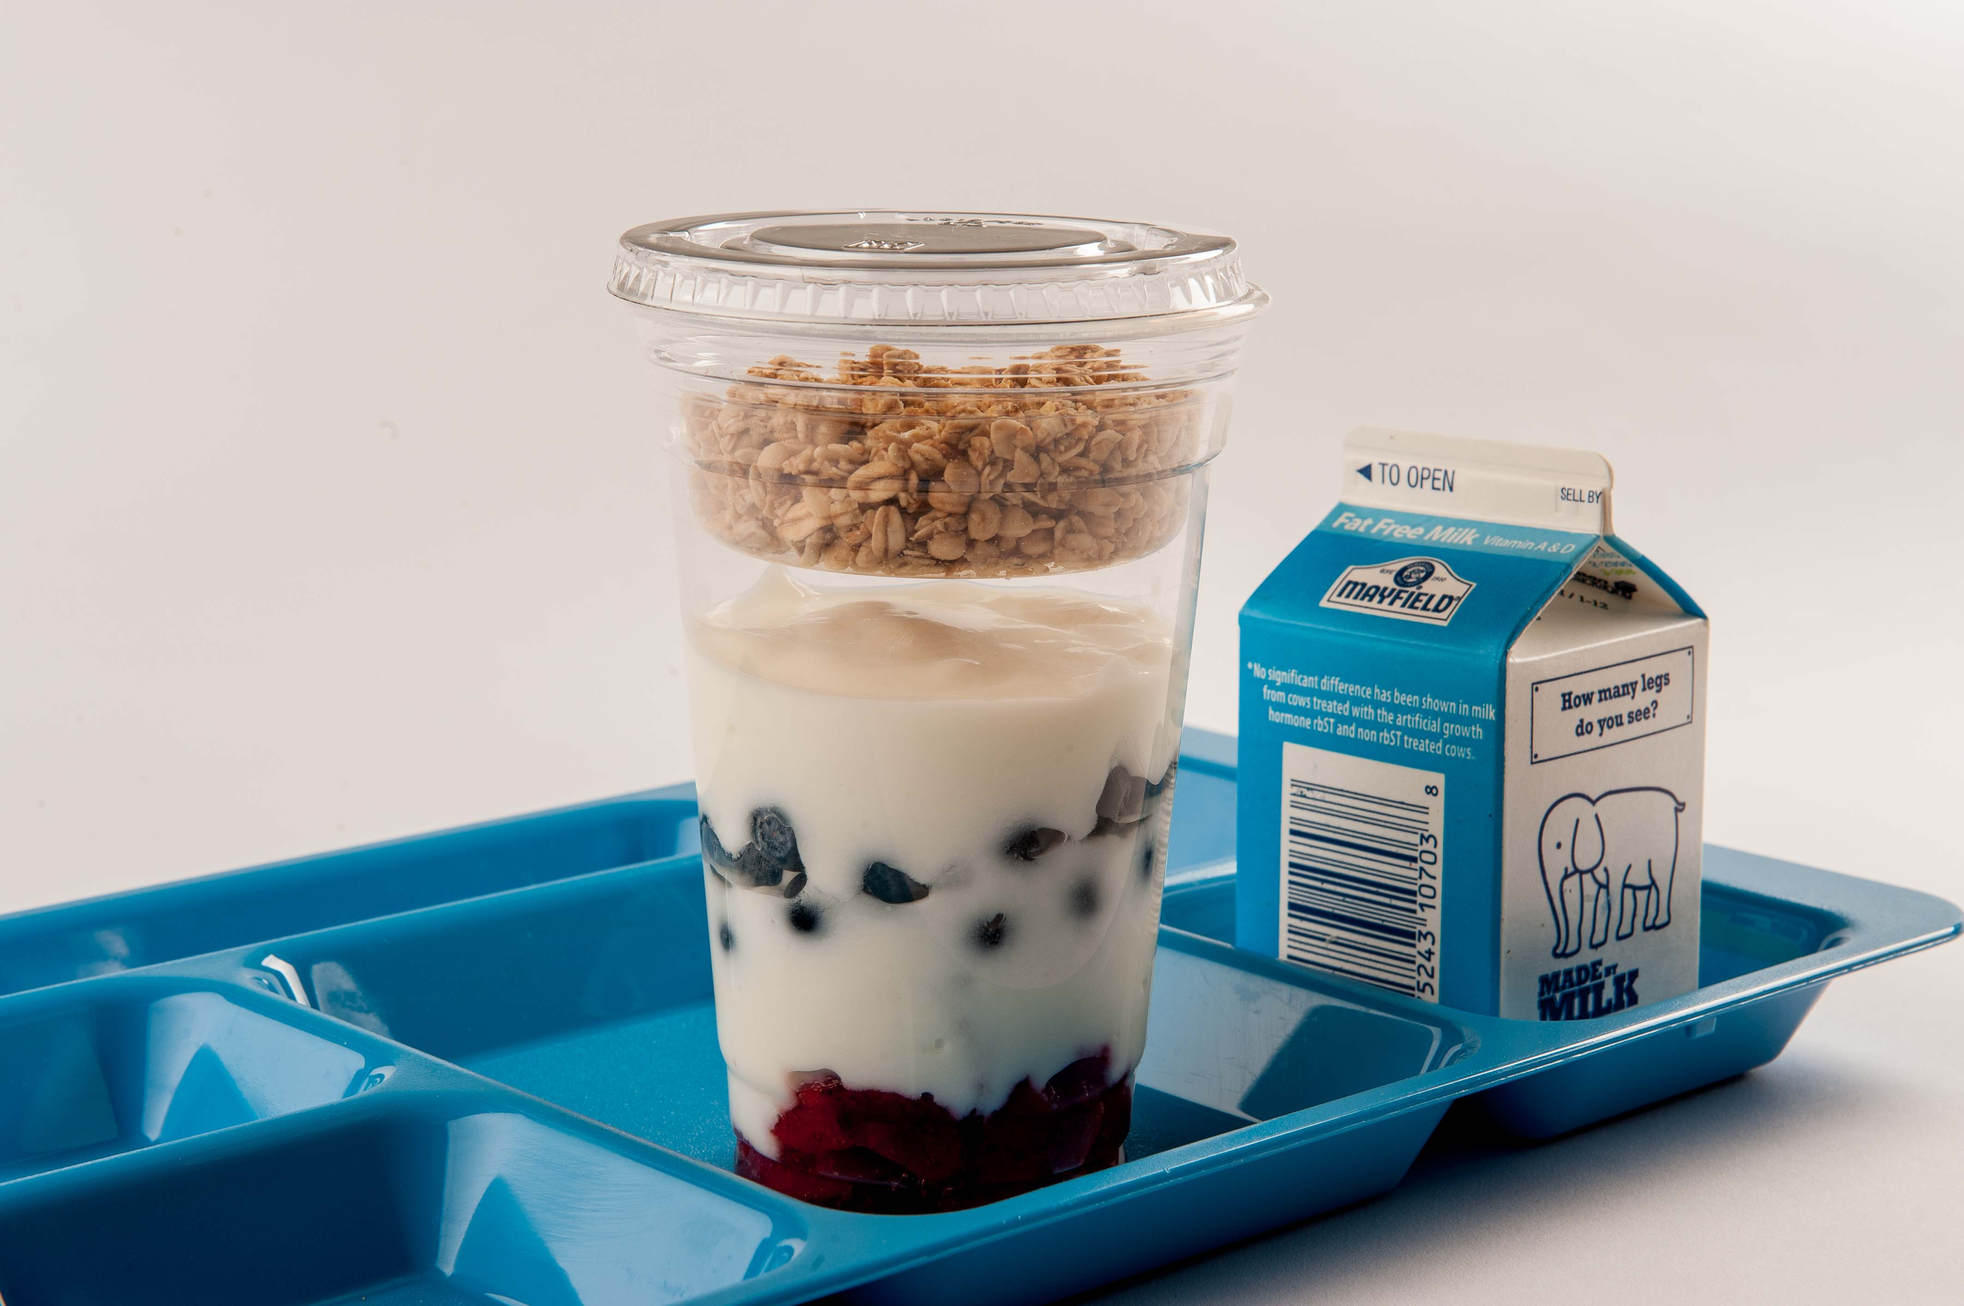
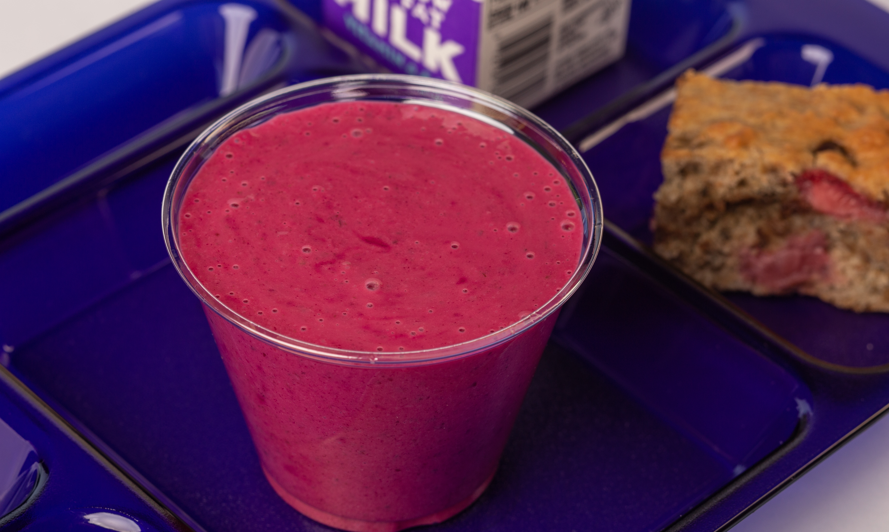
Choosing USDA Foods with Versatility
Select foods that can be used in multiple recipes – Menu Ingredient Approach (MIA)
Ability to change or modify recipes without a new product or waste
Notes:
Say: Use the Menu Ingredient Approach that allows you to diversify your menu, incorporate USDA Foods and Local foods with versatility. Its and easy way to change a recipe or menu item and decrease the chance of menu fatigue and student boredom. While some menu items children can eat every day without being bored, so they say that’s not the case with every menu item. In fact, it’s our responsibility to expose our students to various foods! We don’t want them eating the same food for 180 days per year.
Using a menu item like yogurt allows options for breakfast parfaits, grab-and-go bento boxes, smoothies, and even an ingredient for quick bread, such as muffins and pancakes.
If a menu item is not well received by students, the ingredient is not wasted. It can be transformed to meet the needs of the students and your kitchen.

Slide 14

Versatile Ingredients Meet Cultural Inclusivity
Italian – Chicken alfredo
Mexican – Street tacos
American – Chicken salad
Indian – Chicken tikka masala
Asian – Teriyaki chicken
Middle Eastern – Chicken & hummus wrap
Notes:
Say: Let’s take a minute to look at another example. Chicken fajita strips, fully cooked, with fajita compared to chicken, diced, cooked. Again, neither option is right nor wrong, but let’s look at the versatility. Have you ever painted a room? If you have a white wall, it’s easy to paint whatever color over the white wall. If you have a navy blue or bold color on the wall, it will take extra work and paint to turn that wall into something different.
It’s the same idea with the chicken. The fajita chicken is painted. It’s seasoned and ready to use in Mexican burritos, wraps, or salads, but adding it to an Italian dish would be challenging, right? Whereas the diced chicken without seasoning is ready to be painted. It can be seasoned differently for any cuisine.
On this slide, we’ve transformed diced chicken into many culturally inclusive and shall we say TASTY menu items using different seasoning blends, spices, and herbs. There’s a lot of flexibility with a blank canvas!
We can make…
Italian - chicken alfredo
Mexican - street tacos
American - chicken salad
Indian - chicken tikka masala
Asian - Teriyaki chicken
Middle Eastern – Chicken & hummus wrap

Slide 15
Versatile Ingredients Meet Cultural Inclusivity
Vietnamese Bánh mí
Notes:
Say: In our last webinar, we discussed the need to know how ingredients and recipes meet the expectations of authentic global cuisines. With ingredients and scratch recipes, recipe developers can taste test, sample with students, and make changes to create more authentic flavors. On the screen is a schoolified version of a Vietnamese Banh Mi with turkey, turkey ham and pickled vegetables. Banh mi literally means bread, and is a common sandwich with MANY versions on the streets of Vietnam. I know, because I spent a week in January eating different versions. Take time to work with and learn from your students – let them know you are interested in their cultural cuisines!

Slide 16
Live Culinary Demo
Thai Chicken Bowl with Zucchini
Notes:
Say: Now it’s time to put all of this information into action. Chef Andy is providing our live culinary demo today using diced chicken. He will be making a delicious Thai Chicken recipe and highlighting Asian cuisine. This recipe is available for you.
During this demo watch how Chef Andy also incorporates local products. We know using local products is not always the cheapest option, but they are packed with delicious flavor and nutrients. So, how do we balance the cost? USDA Foods! We will talk more about this a little later.
OK Chef Andy, what’s cooking?!

Slide 17
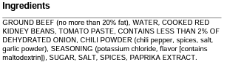
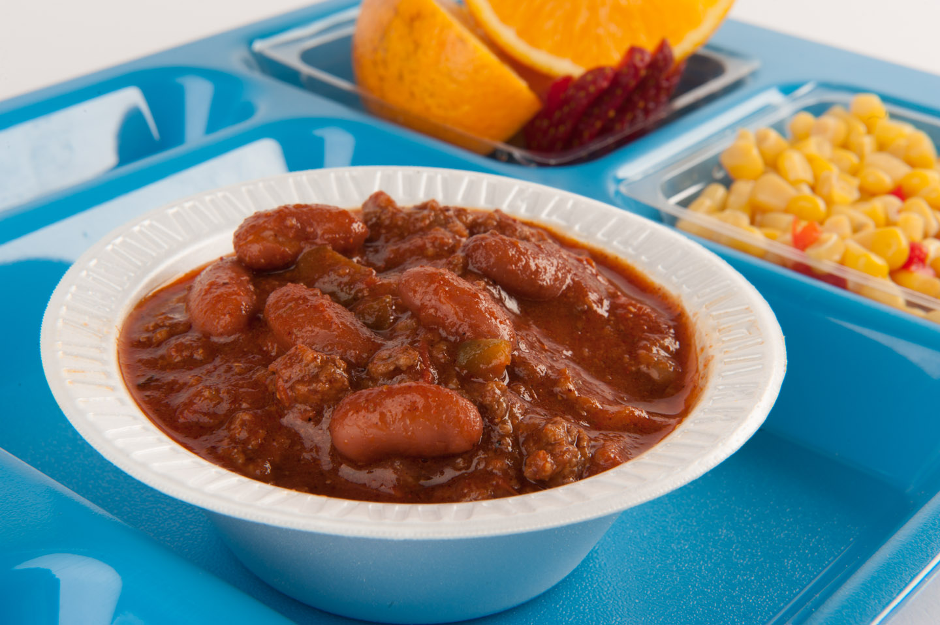
USDA Foods are Reliable
Take control of your menu/products
READ the ingredients
Chili from Scratch
Notes:
Say: Over the past few years, there have been many product shortages. It’s challenging when the shortages are not in your control. Commercially packaged menu items are not always reliable. There is a high expense to create commercial products to meet the Transitional Nutrition Standards and the Proposed Rule, which means that companies may not continue to make a product, OR the product might not be of the same quality. I challenge you to read the ingredient labels, not just the nutrition facts labels. What INGREDIENTS are replacing salt and added sugars in commercially packaged foods? In our example label, you see potassium chloride which is salt substitute. We hope herbs, spices, and vegetables for flavoring in savory menu items and fresh fruits for sweetness!
While manufacturers are trying to keep up, YOU can make the changes right now, in YOUR kitchens, with USDA Foods, local ingredients, and scratch cooking.

Slide 18
USDA Foods are Reliable
USDA Foods to commercial products
Complaints to manufacturer
Notes:
Say: USDA Foods may be processed into commercial products. At this stage, they are no longer considered a USDA Food, and complaints must be directed to the manufacturer. For example, if you had your USDA Foods ground beef processed into sloppy joes and you were not happy with the product, it is no longer a USDA Food. All quality or safety concerns must be addressed by the manufacturer.

Slide 19
Complement USDA Foods with Local Foods
More flavor, nutrition and community support
Reduce cost of recipe
Notes:
Say: As mentioned earlier, local foods provide more flavor, nutrition, reliability, and community support, but they are not always the cheapest option. You may say, we just can’t afford them! Combining USDA Foods with local foods reduces the total cost of a recipe while improving the quality. For example, how about some local VA red peppers to enhance the look of this chicken teriyaki and noodle dish?
USDA Foods and commercial products typically have a longer shelf life so that they can be stored longer or transported further. They are an ingredient looking to be seasoned with local herbs, fresh produce, and other flavorful ingredients.
Local produce complements USDA Foods perfectly. They naturally taste better! These flavorful foods don’t need as much salt or added sugar and help us meet the Transitional Nutrition Standards and Proposed Rule.

Slide 20
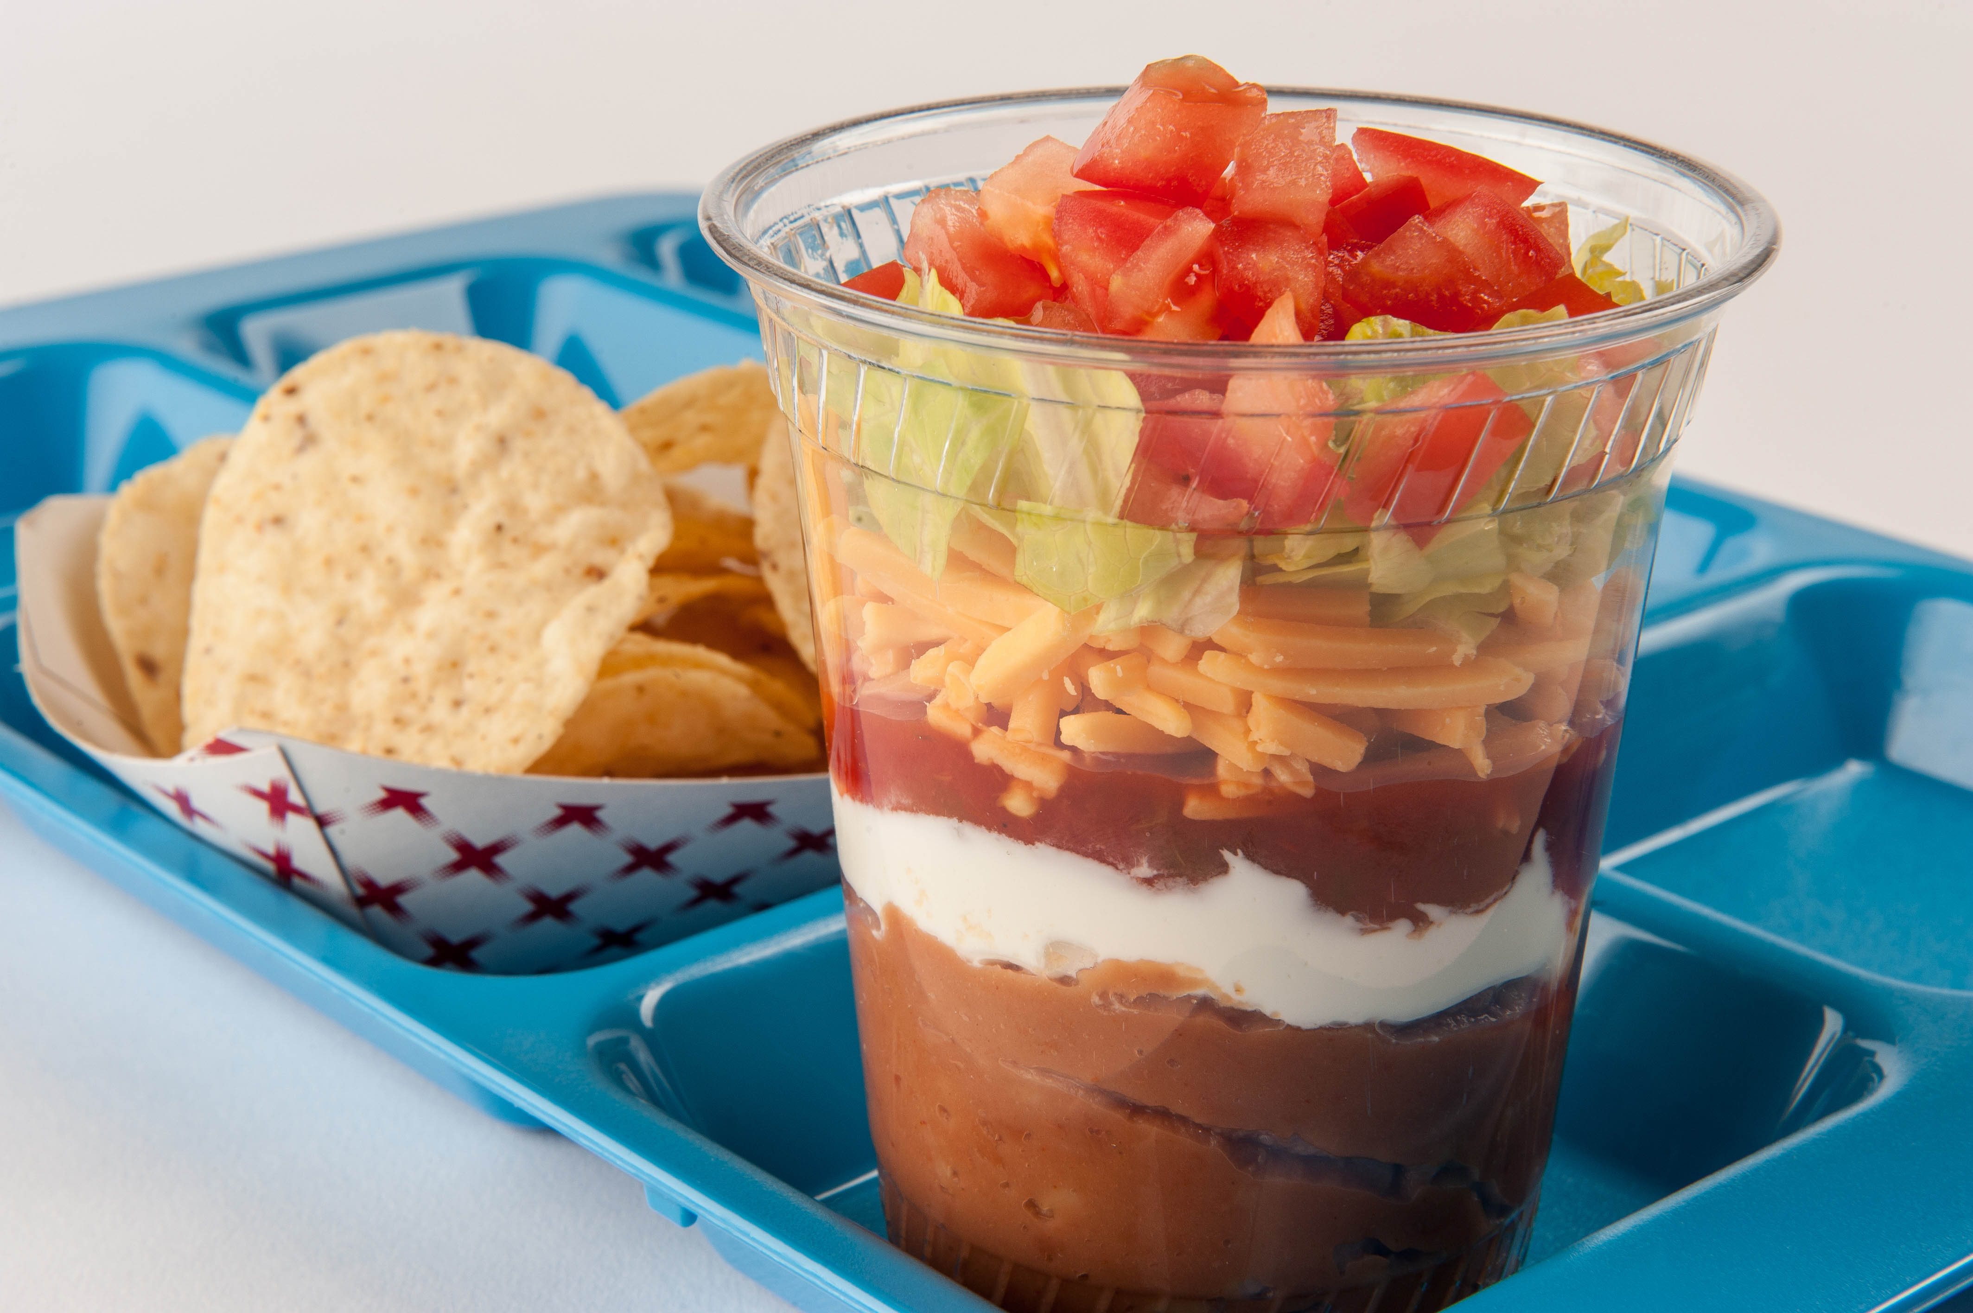
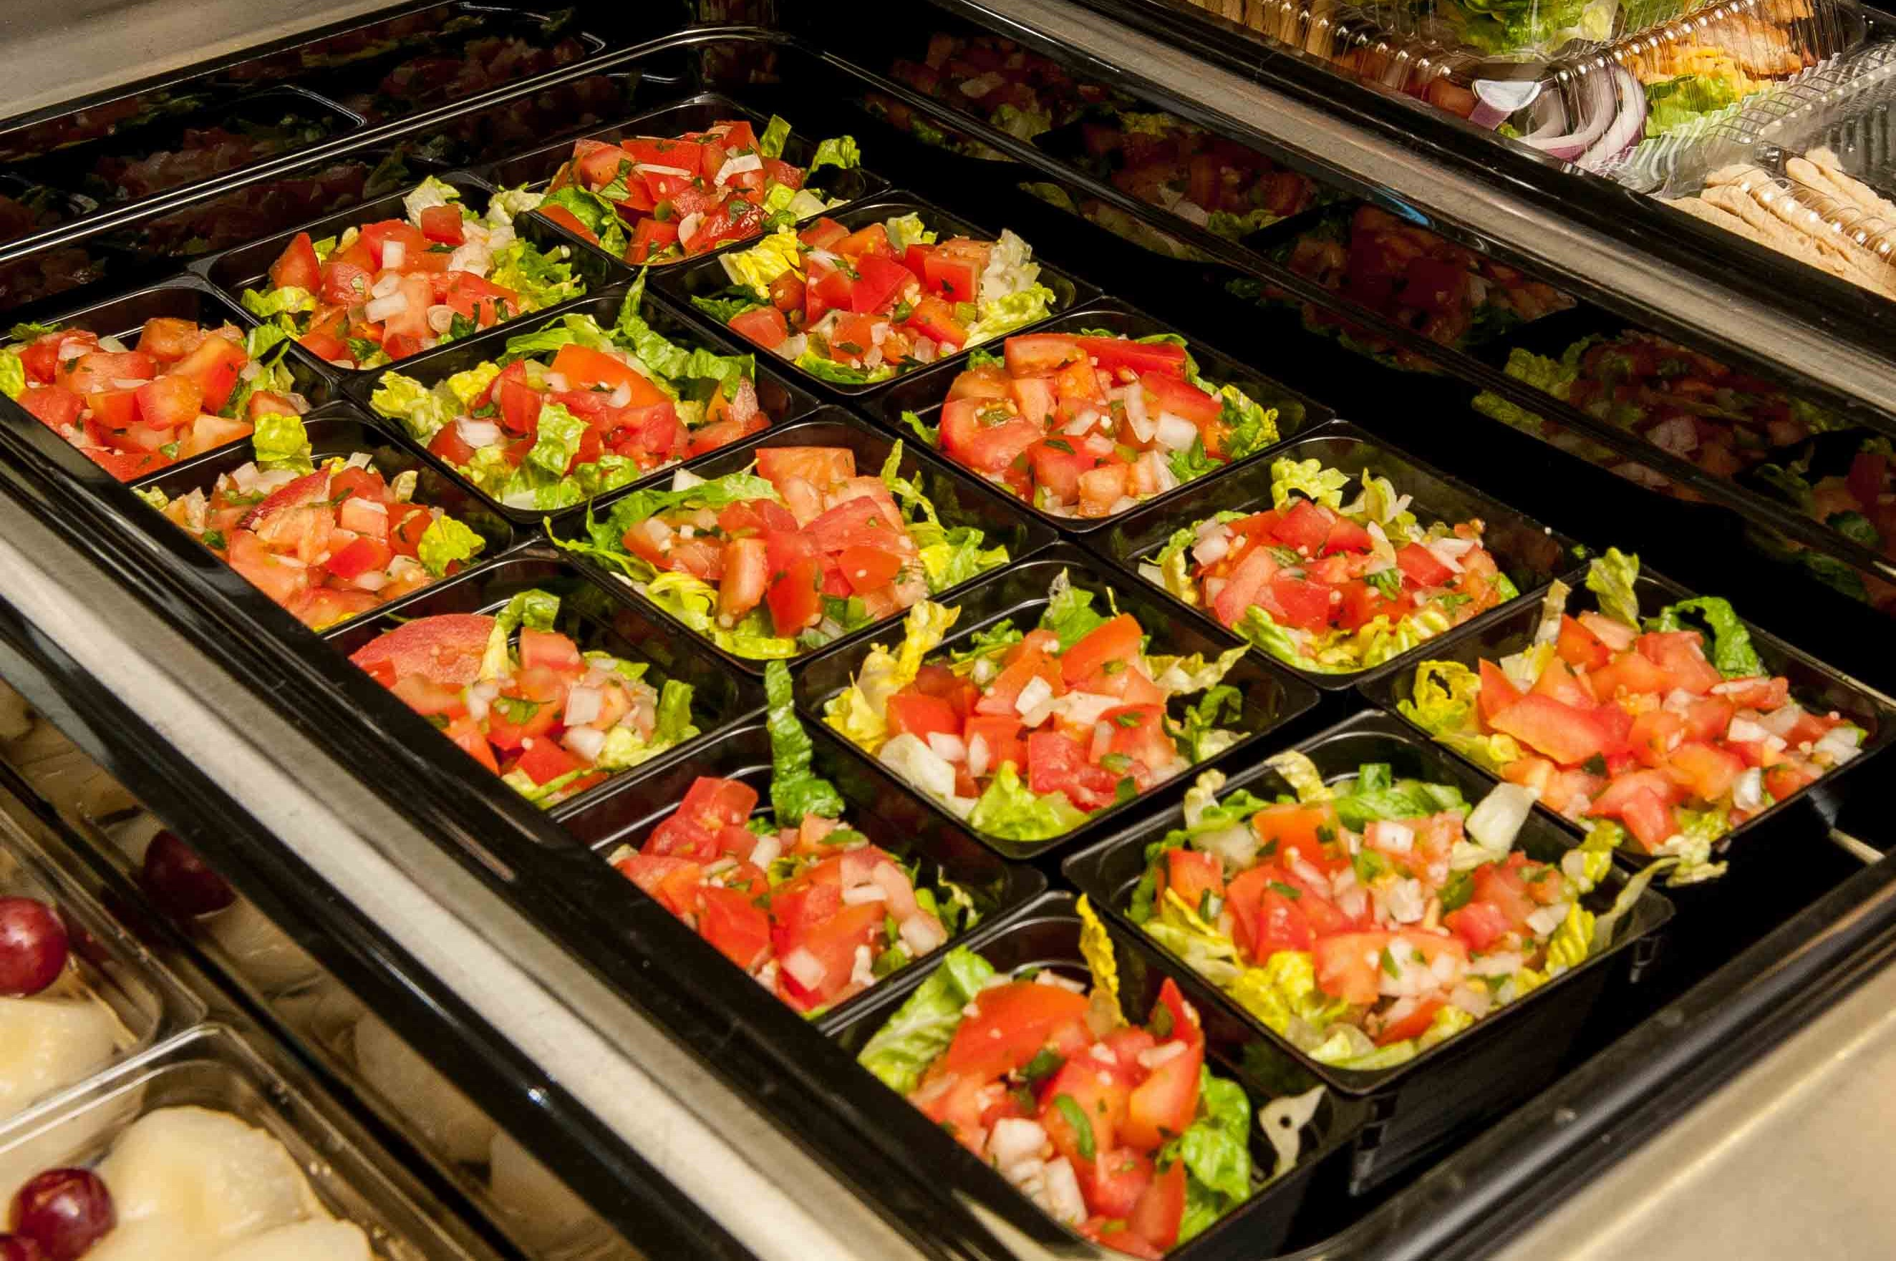
Culinary Demo
Notes:
Say: Now, we will check back in with Chef Andy for our second culinary demo. He will take the same diced chicken and make two recipes highlighting Mexican cuisine. He will also spotlight local tomatoes, which are in season this month. One more tip! Watch Chef Andy’s knife skills when making fresh pico de gallo. These knife skills will be included in this summer’s hands-on culinary workshops, because proper use of a chef’s knife will make it easier to prep fresh fruits and vegetables!

Slide 21

Thank you!
Notes:
Say: As we wrap up, remember that USDA Foods are more reliable and affordable. They provide control and flexibility when planning and changing your menu and recipes. They are also perfect for scratch cooking, local foods, and culturally inclusive recipes! Before considering commodity processing, identify the cost and versatility of the product. I want to leave you with the question: Can you pivot when a menu item isn’t successful? Are you in control of your recipes, and can they meet the transitional standards without sacrificing dependability, flavor, or quality?

Slide 22
Resources
https://www.fns.usda.gov/USDAFoods
https://www.commodityfoods.org
Notes:
Say: On the side are two resources for additional information regarding USDA Foods – the first is the link directly to FNS USDA Foods and the second is the link to the American Commodity Distribution Association website, also known as ACDA which brings together those in agriculture, government, and customers like you.

Slide 23

Questions
Notes:
Say: Chef Andy, are you sending everyone their samples? Great! Thank you so much for being here today and participating in our webinar plus the live culinary demo. We are excited to see and hear your new ideas for USDA Foods in your kitchen!
Ask: Does anyone have any questions? We look forward to cooking together later in the year. Please put the week of October 16th on your calendars!

