Slide 1

Developing Cycle Menus and Accommodating Students with Special Dietary Needs
Notes:
Say: Good afternoon, everyone! It’s so great to see you today. Welcome back! The last webinar discussed USDA Foods and how to prepare them alongside local foods, keeping cultural inclusiveness in mind. With every webinar, our goal is to help provide you with tools to meet the USDA transitional standards. Today we will discuss cycle menus and accommodating students with special dietary needs.
Do: Introduce selves.

Slide 2
USDA Funding and Non-Discrimination Statements:
“This project has been funded at least in part with Federal funds from the U.S. Department of Agriculture. The contents of this publication do not necessarily reflect the view or policies of the U.S. Department of Agriculture, nor does mention of trade names, commercial products, or organizations imply endorsement by the U.S. Government.”
In accordance with federal civil rights law and U.S. Department of Agriculture (USDA) civil rights regulations and policies, this institution is prohibited from discriminating on the basis of race, color, national origin, sex (including gender identity and sexual orientation), disability, age, or reprisal or retaliation for prior civil rights activity.
Program information may be made available in languages other than English. Persons with disabilities who require alternative means of communication to obtain program information (e.g., Braille, large print, audiotape, American Sign Language), should contact the responsible state or local agency that administers the program or USDA’s TARGET Center at (202) 720-2600 (voice and TTY) or contact USDA through the Federal Relay Service at (800) 877-8339.
To file a program discrimination complaint, a Complainant should complete a Form AD-3027, USDA Program Discrimination Complaint Form which can be obtained online at: https://www.usda.gov/sites/default/files/ documents/ad-3027.pdf, from any USDA office, by calling (866) 632-9992, or by writing a letter addressed to USDA. The letter must contain the complainant’s name, address, telephone number, and a written description of the alleged discriminatory action in sufficient detail to inform the Assistant Secretary for Civil Rights (ASCR) about the nature and date of an alleged civil rights violation. The completed AD-3027 form or letter must be submitted to USDA by:
1. mail:
U.S. Department of Agriculture
Office of the Assistant Secretary for Civil Rights
1400 Independence Avenue, SW
Washington, D.C. 20250-9410; or
2. fax:
(833) 256-1665 or (202) 690-7442; or
3. email:
Program.Intake@usda.gov
This institution is an equal opportunity provider.

Slide 3
Welcome!
Notes:
Say: Remember that as we go through today’s webinar, the chat box is open for any questions and comments. We can learn a lot from each other during these times together. Please feel free to comment and ask questions in the chat anytime! We will monitor it together throughout this hour and would love some conversations.

Slide 4

Objectives
Explain the benefits of cycle menus.
Summarize the steps to create cycle menus.
Develop a recipe data bank to assist in cycle menu development.
Describe best practices for modifying menus for students with special dietary needs.
Notes:
Say: Let’s review today’s objectives:
Explain the benefits of cycle menus.
Summarize the steps to create cycle menus.
Develop a recipe data bank to assist in cycle menu development.
Describe best practices for modifying menus for students with special dietary needs.

Slide 5
Professional Standards – Learning Codes
Menu Planning (1100)
Nutrition Education (1200)

Slide 6
Cycle Menus
Notes:
Say: Let’s begin!

Slide 7
Cycle Menus
A set of menus that repeat
  Each menu day is different
The image shows one week of a cycle menu with each day having a different menu
Notes:
Ask: How many of you currently utilize cycle menus? If yes, use the thumbs up reaction to let us know!
Say: Fantastic! As many of you know then, cycle menus are a series of menus that are repeated over a specified amount of time, such as 2 or 4 weeks. Usually, the daily menu is different each day during the cycle. Once you reach the end of the cycle, it is repeated.
It is common practice to include seasonality in a cycle menu; this can be done quarterly, so minor changes here and there to reflect the seasons and what is growing locally!
Let us know how long your cycle menus are in the chat, and we can compare! If you have different cycles for different age groups, add that too! For example, a 4 week cycle for K-5, 3 week for 6-8, and 2 week for 9-12.
Do: Look through chat answers and call out some noticeable trends.

Slide 8
Why Cycle Menus?
Meet nutrition standards
Save time
Control food and labor costs
Reduce storage cost
Reduce food waste
Build employee confidence
Notes:
Say: There are many reasons to utilize cycle menus.
Do: Read the reasons.
Say: Let’s start with meet nutrition standards.

Slide 9
Meet Nutrition Standards
Notes:
Say: Cycle menus are the key to meeting meal patterns for both breakfast and lunch, and to help us meet the transitional nutrition standards. As you know, you must complete weekly meal certification worksheets. With a cycle menu, you can complete the worksheets before school begins, and then simply tweak with any small changes made throughout the year, like if you make any seasonal adjustments.
In addition, creating a cycle menu allows you to know where you stand in meeting the dietary specifications for calories and saturated fat, as well as the transitional standards for sodium and whole grains. You can calculate all of the required nutrients and whole grain percentage at the beginning of the school year. If you need to swap a grain item, you already know where you are at and if it needs to be whole grain or can be refined.

Slide 10

Saves Time
Notes:
Say: Cycle menus save time in a multitude of ways. From procurement and purchasing to menu planning to forecasting to training staff, you only have one set of menus to work with. It helps to streamline processes and increase efficiency.

Slide 11
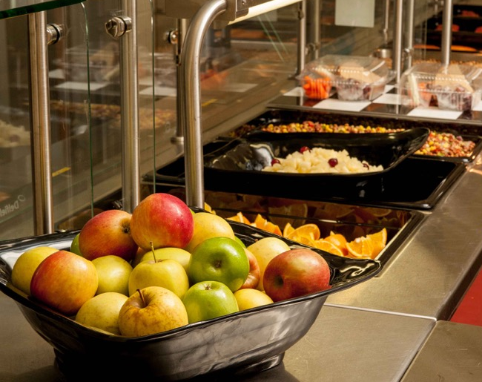
Control Food and Labor Costs
Notes:
Say: With a constantly repeating menu, you always know which products you need and how much. This makes procurement and purchasing easier and helps your supplier and food manufacturers as well.
And as you know, we must balance food and labor costs, so, with more control over food costs, you can better determine what you have left to spend on labor!

Slide 12
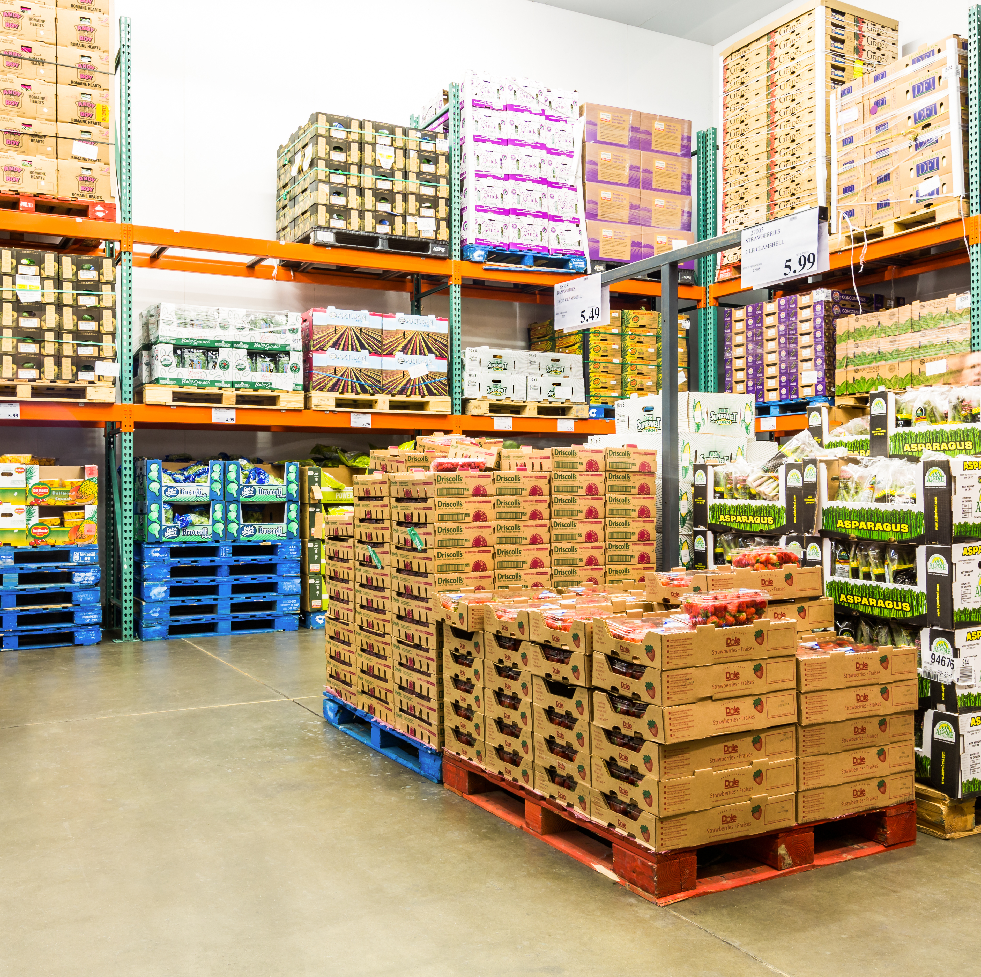
Reduce Storage Cost
Notes:
Say: Cycle menus help to minimize products, especially if menus are planned using multipurpose ingredients, like USDA Foods diced chicken, as demonstrated in the last webinar. Cycle menus also help prevent orphan items, items that are just sitting in storage taking up space because they only made it on the menu a few times.

Slide 13
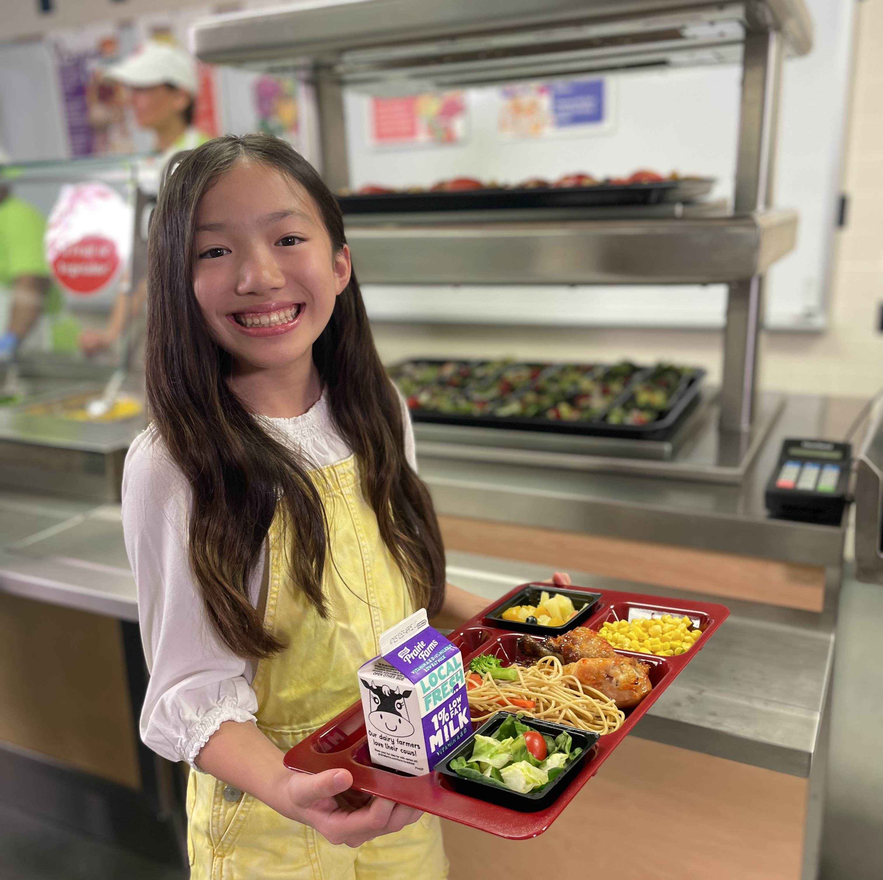
Reduce Food Waste
Notes:
Say: With cycle menus, not only do your staff become familiar with the menu, but so do your students. It becomes easier for your managers to forecast how much food to prepare each time.

Slide 14

Build Employee Confidence
Notes:
Say: And finally, cycle menus help build employee confidence. When your staff prepare the same meals over and over, they become experts. The process to prepare the menu items becomes quicker each time they prepare the food items.
If you think of any other advantages to using a cycle menu, please add them to the chat!

Slide 15
Steps to Develop Cycle Menus
Notes:
Say: Now that we have established that cycle menus are definitely the way to go, let’s review the steps to develop a cycle menu. By following these steps, the process should become easier and, in our opinion, more fun!

Slide 16
Steps to Develop Cycle Menus
Gather necessary information
Create new recipes
Create a recipe bank
Determine cycle length
Write menus
Notes:
Do: Review the steps on the slide.
Say: Let’s elaborate a little more on each of these steps, starting with gathering necessary information.

Slide 17
Step 1: Gather necessary information
Meal pattern charts
Ingredient labels
Existing recipes
Notes:
Say: Before you get started, it’s helpful to gather the following: meal pattern charts, ingredient labels, and existing recipes. Also, don’t forget about the transitional standards. All of these tools are necessary to help develop menus. Even if you basically have the meal pattern chart memorized like we do, it doesn’t hurt to keep it handy.

Slide 18
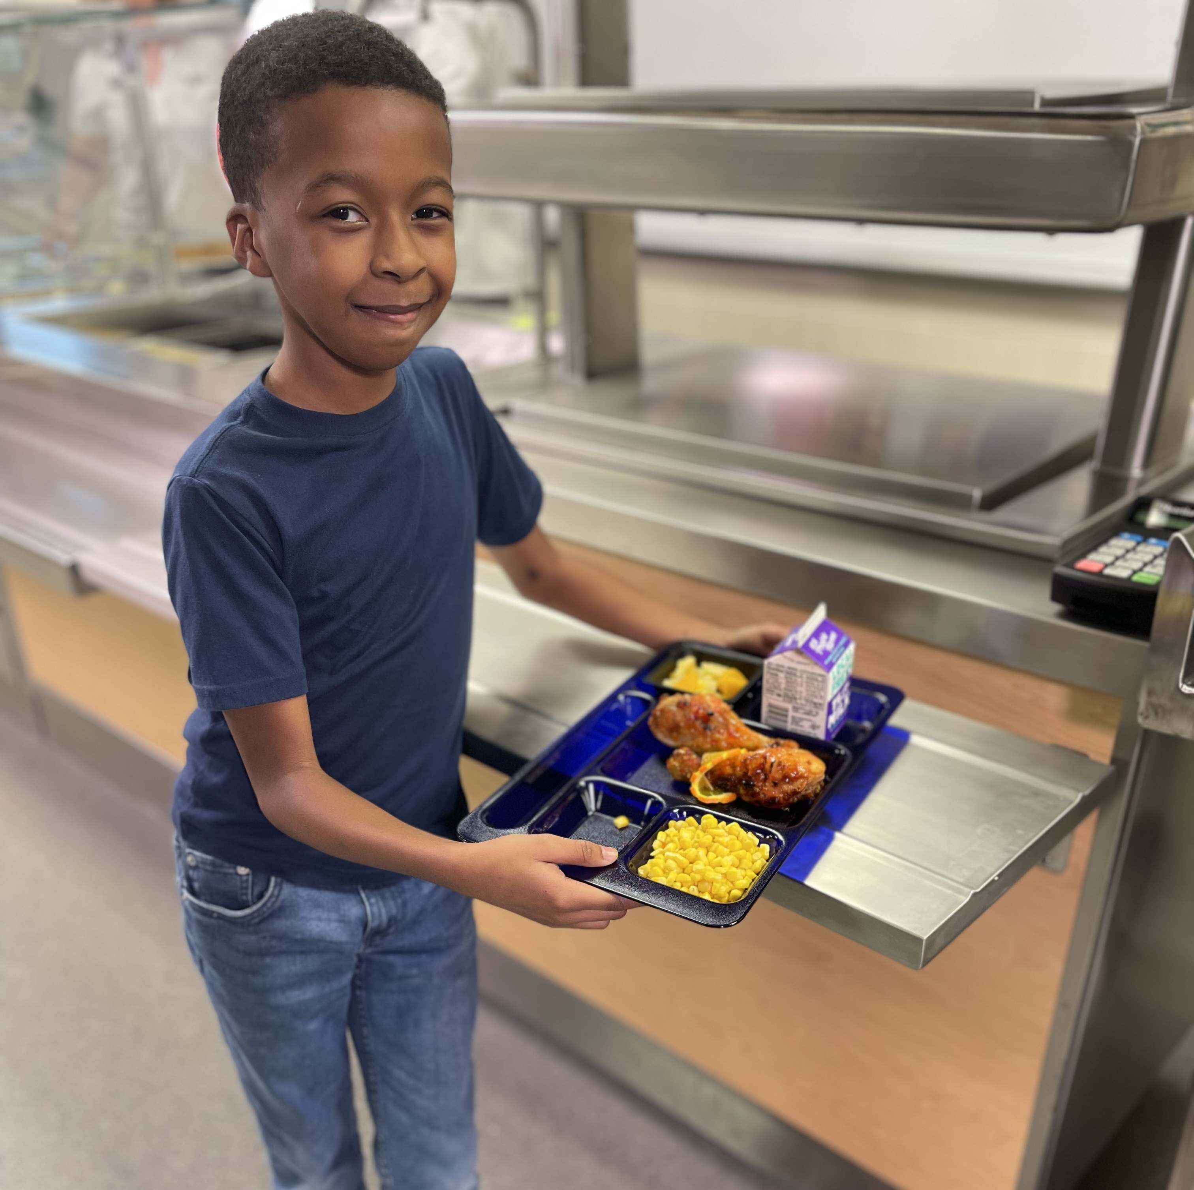
Step 2: Identify new recipe needs
Cultural Inclusiveness
Scratch
Local foods
Notes:
Say: On to step 2! Identify new recipe needs. While we know some foods will most likely always remain a staple in school meals, like pizza, we do want to stay relevant with the times and be in tune with what today’s students are craving! We are now serving Gen Z and Gen Alpha, the two most diverse generations in the history of the United States. They are also the most connected, having grown up in a world constantly connected through the internet. They know about foods from around the world! With that said it’s also important to identify what ethnicities and/or religious groups are predominant at your schools and see if you can add menu items that are more familiar to their tastes and/or beliefs. We want to be culturally inclusive when it comes to our menus.
While we understand labor shortages and a lack of skills, the more scratch-made dishes you can add to the menu, the more in control of nutrients and flavor, not to mention taste! Consider what scratch dishes you can add to help control sodium, add freshness, and meet the Transitional Standards. Think about balancing scratch dishes with heat and serve items to help with labor and production.
Another consideration: what local foods can you incorporate? Whether it’s fresh produce for sides or a local meat or grain.

Slide 19
Step 3: Create a recipe bank
The image shows a recipe bank that includes a column of hot entrees, cold entrees, fresh vegetable sides, cooked vegetables, fruit sides, and grain sides.
Notes:
Say: Step 3: Create what we like to call a recipe bank. This is so helpful when building menus! Basically, you create a list of all the recipes you would like to menu. We have an activity coming up where we will practice this step as a group!
Do: Go over the different column headers.

Slide 20
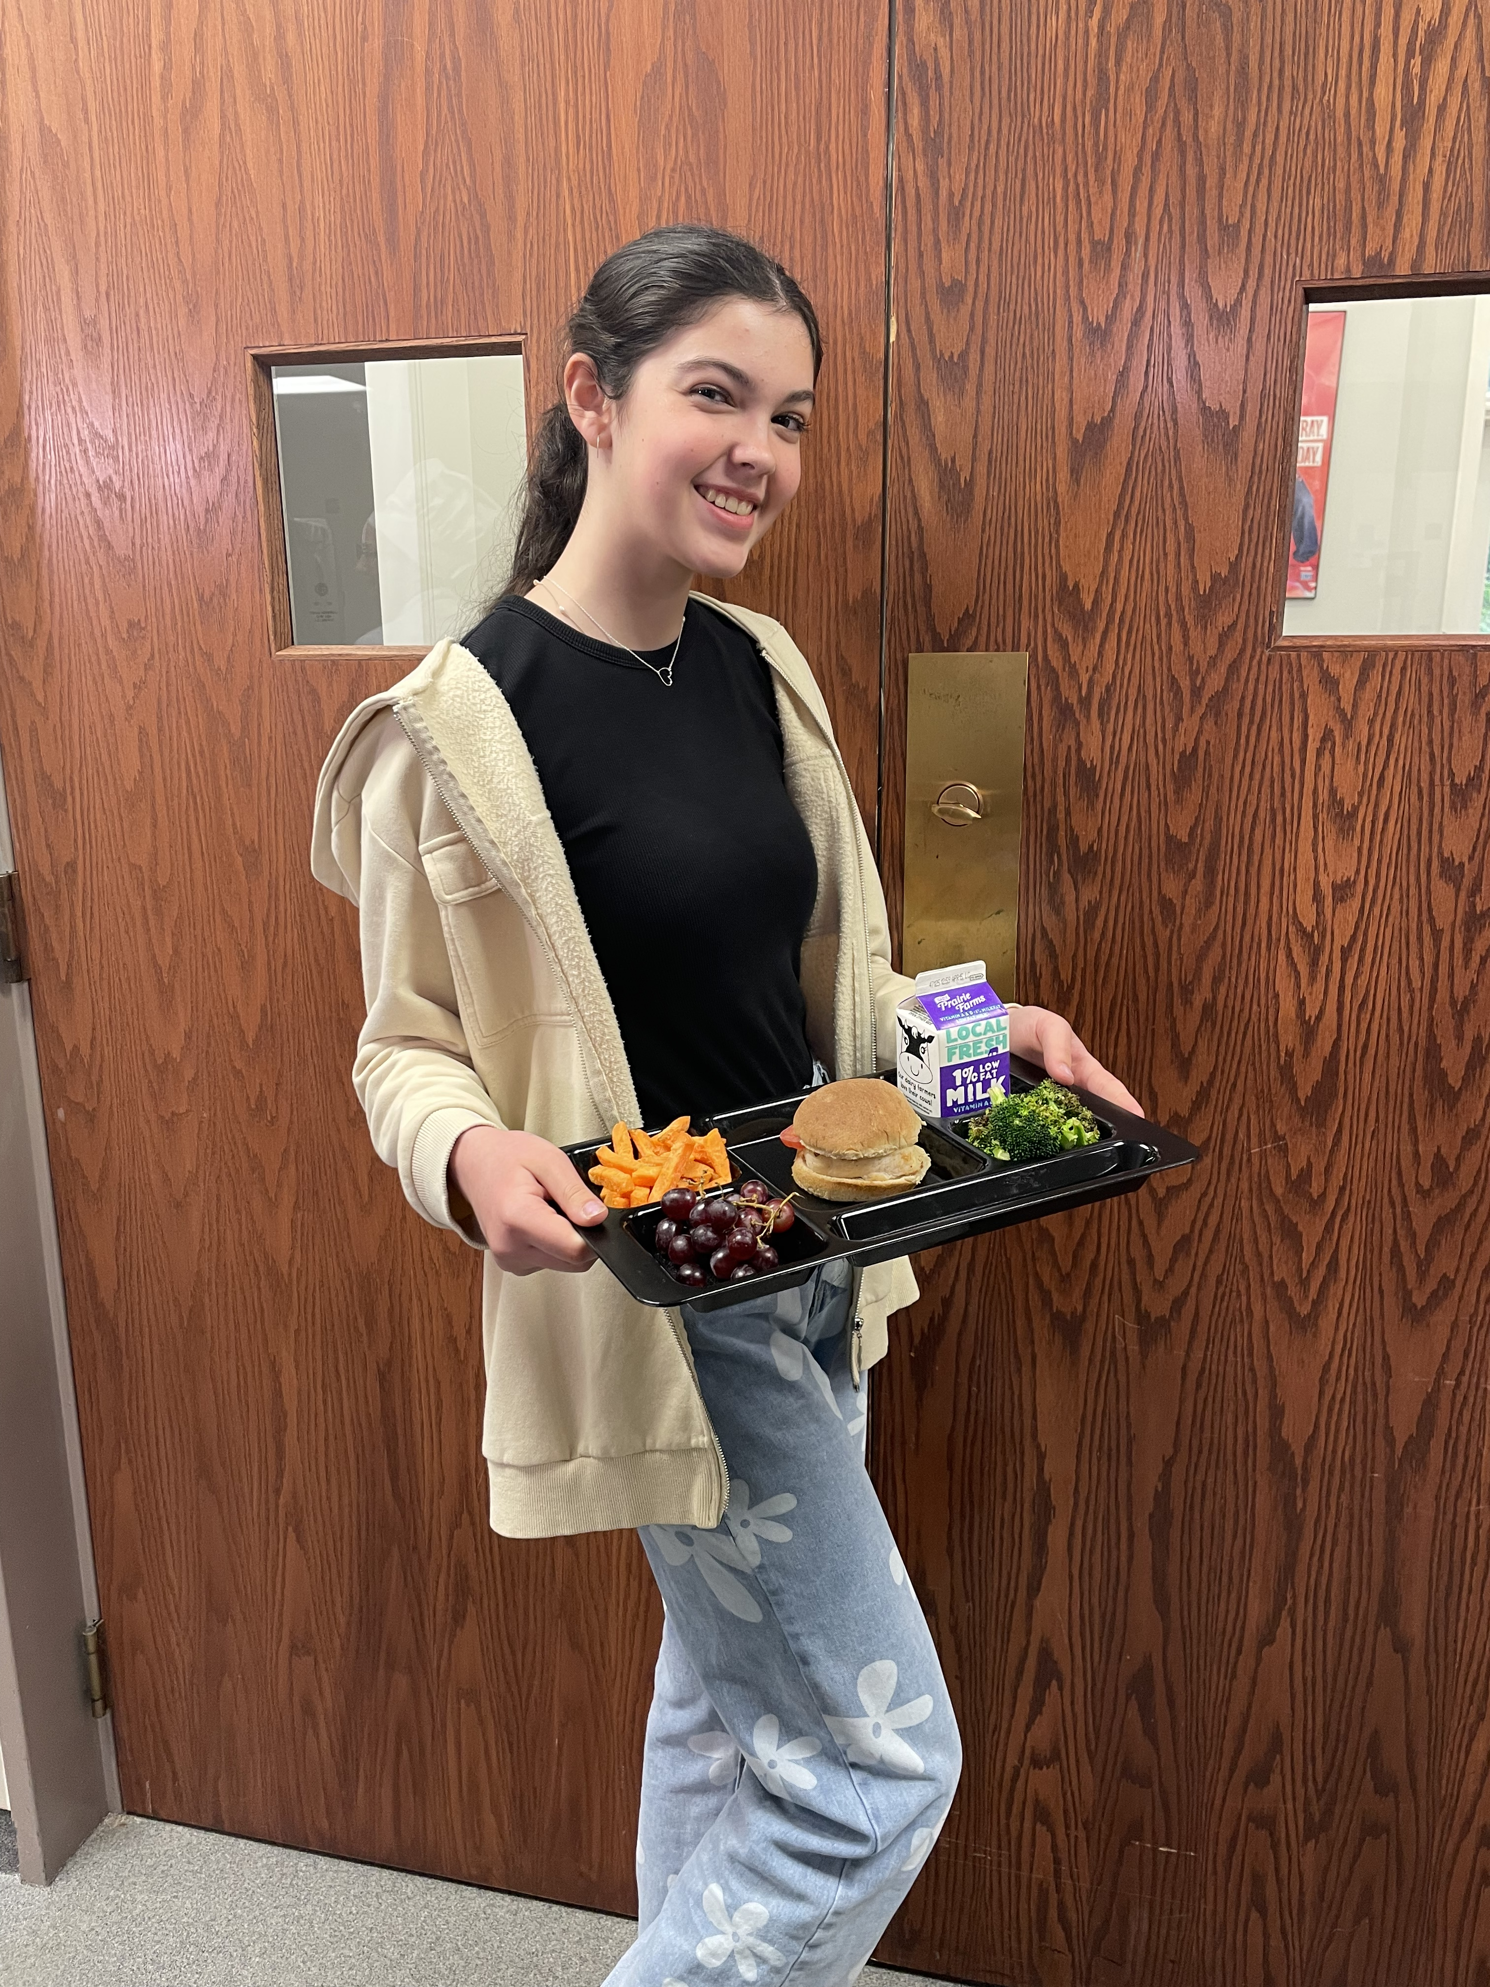

Step 4: Determine cycle menu length
Consider
  Age group
  Number of daily entrees
  Any theme lines
Notes:
Say: Step 4: Determine cycle length. For this step, consider the age group, the number of daily entrees you want to offer, and if there are any theme lines. It is common for K-5 menus to have a longer cycle with fewer entrée choices and 6-12 menus to have shorter cycles with more entrée choices. There isn’t a right or wrong, but make sure you provide enough variety so students don’t get bored.

Slide 21
Step 5: Write menus
Start with entrees
Add sides
Other considerations
Notes:
Say: Step 5: Now it’s time to write the menus! Reference your recipe bank, and start with the entrees. As you add entrees, be sure to vary the protein, be mindful of available equipment, and also consider nutrition recommendations. The Dietary Guidelines for Americans recommend adding more plant-based proteins, including lean meats, low fat dairy and seafood, and limiting red meat. Be sure to check that each week has the correct balance for the weekly minimums for grains and meat/meat alternates.
Once entrees are added, start adding sides, remembering to ensure you meet the requirements for each of the vegetable subgroups. And also, keep in mind although you are creating a cycle menu, you can still vary fruits and vegetables according to the season and what you can procure locally. Making quarterly changes is common. The last step is to add milk.
While writing the menu, other things to consider include: color variety, different shapes, textures, spiciness levels, and cold vs. hot foods.
Think about balancing familiar foods with new, high cost food items with low cost items, and as discussed earlier, high labor items (scratch) with less labor items.

Slide 22
Activity Time!
Notes:
Say: Alright, now it’s time for the activity we alluded to earlier!

Slide 23
Recipe Bank Activity
Add your division’s best recipes
Add menu items
Notes:
Say: We are going to create a recipe bank together! We thought this would be a great opportunity to not only share ideas but also set you up for planning next school year’s menus. We have created a Google link that has columns for each food category. We will drop it into the chat in just a minute. As you think of ideas, new or old, add them to the sheet. There will be a lot of us in there at once, so you might have to make sure you aren’t typing over someone else’s entry.
Also, before this webinar, we asked that you share a favorite recipe and add it to the Google folder we created. Remember, recipes are only standardized once you test them in your kitchen with your equipment and ingredients, so be sure to test them before implementing them in your division. Be sure to add the recipe name to our recipe bank!
Ok, we are adding the link for the recipe bank to the chat now. Let’s get started!
Do: Add link to chat: https://docs.google.com/spreadsheets/d/1YLl7qMZZ3a2OVweO2jL4CHifeYTnb1fjNivTXT57Vpg/edit?usp=sharing
Instructor Note: The recipe folder can be found at this link: https://drive.google.com/drive/folders/1nJWWAXzqQ-G_eBs2vXC1NGZpHzbhA47A?usp=sharing.
Do: Review the group's work and discuss recipes.

Slide 24
Accommodating Special Dietary Needs
Notes:
Say: Great work everyone! We are going to end this webinar with one last topic – accommodating special dietary needs.

Slide 25
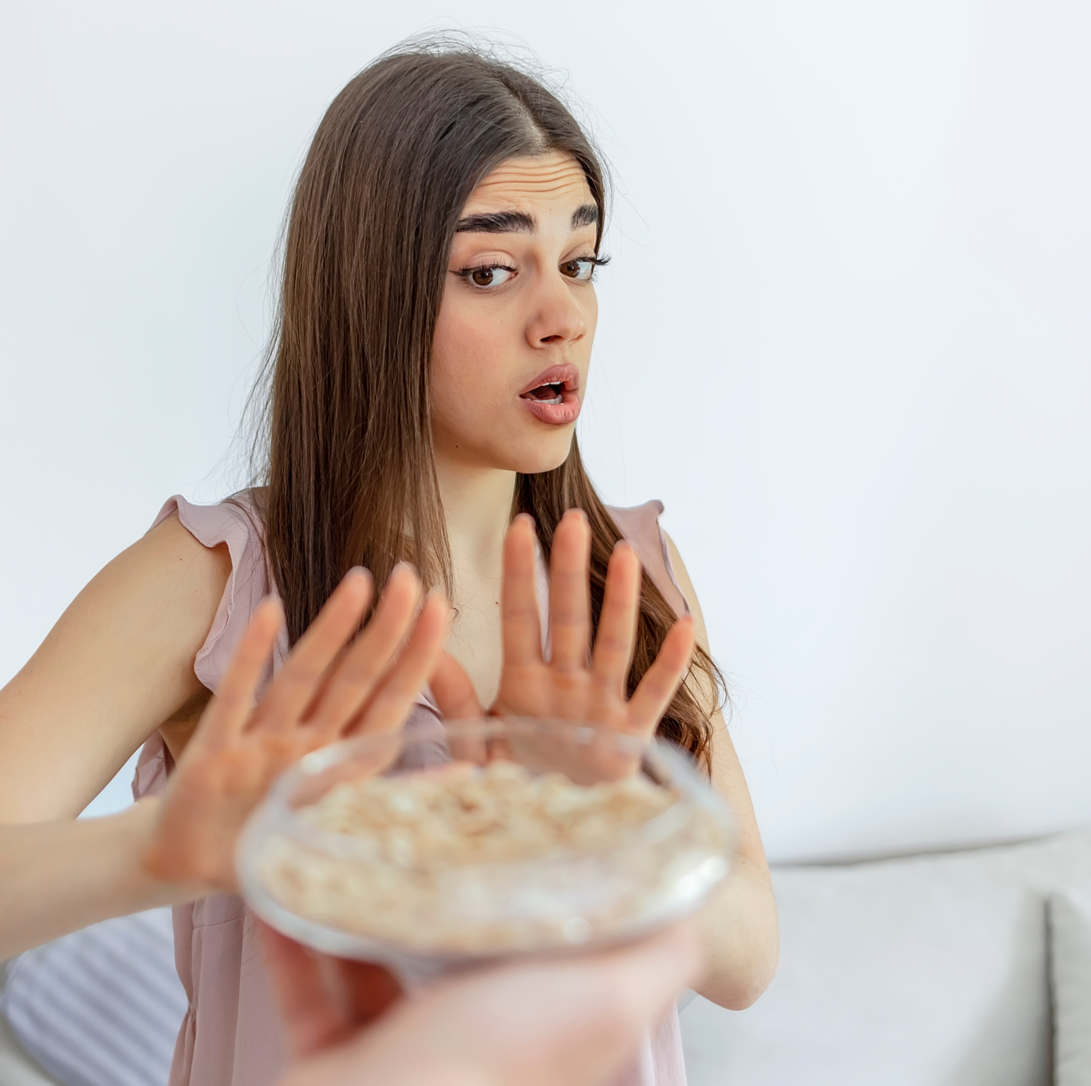
Requirements
Must accommodate if disability
Medical statement
Notes:
Say: As a reminder, we are required by law to accommodate students with disabilities. This includes students with severe food allergies, and those with diabetes, kidney disease, and more.
Students are required to have a medical statement on file signed by a licensed physician. Technically, we do not have to make accommodations for students with minor food allergies, meaning they do not result in anaphylactic shock. It is up to your division if accommodations will be made.
Ask: What are the most common food allergies you are seeing within your divisions? Add it to the chat!

Slide 26
Best Practices
Mimic regular menu
Reference ingredient list
Work closely with school nurse
Notes:
Say: When making accommodations, it’s best practice to mimic the regular menu as closely as possible so that the student doesn’t feel left out or even embarrassed by the different meal. For example, if the menu includes pasta, try substituting a wheat free pasta for a student with a wheat allergy.
Be sure to reference all of the ingredient lists, and buy specialty ingredients if necessary. Those can be pricey, so you have to do the best you can within your budget.
Lastly, work closely with the school nurse as needed to make sure everyone is on the same page, and looking out for the child.

Slide 27
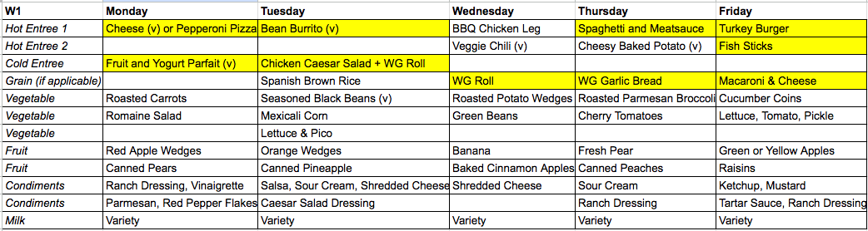
Example – Student with Wheat Allergy
An image of a menu with the following items highlighted that contain wheat: Cheese or Pepperoni Pizza (Monday), Fruit and Yogurt Parfait (Monday), Bean Burrito (Tuesday), Chicken Caesar Salad with Whole Grain Roll (Tuesday), Whole Grain Roll (Wednesday), Spaghetti and Meat Sauce (Thursday), Whole Grain Garlic Bread (Thursday), Turkey Burger (Friday), Fish Sticks (Friday), and Macaroni and Cheese (Friday).
Notes:
Say: Let’s take a look of what this might look like. We are going to continue with the example of a child with a severe wheat allergy. We are going to modify this menu together. We have highlighted the menu items that need to be adjusted.
Do: Walk through modifying the menu. Use the chat to generate ideas. Use link below to access:
https://docs.google.com/spreadsheets/d/1zdyI4_yBqujVVIhcqCeW9Bq9GSVNnjtgh4FwFZMRp6M/edit?usp=sharing
Ask: What are the most common challenges you all have encountered with accommodating students with disabilities? How have you overcome those challenges?

Slide 28

Thank you!
Notes:
Say: Great work today! As we wrap up, remember using cycle menus is a great way to help your divisions meet the transitional standards, as well as add local and culturally inclusive items to your menus. Cycle menus also make accommodating students with special dietary needs easier because you don’t constantly have to evaluate new menus.
Once cycle menus are written, your program will run more efficiently, leaving you more time to handle all the other tasks associated with your extremely busy jobs!

Slide 29

Questions
Notes:
Say: Thank you so much for being here today and participating in our webinar. We are excited to see and hear your new ideas as we travel through these webinars together!
Ask: Does anyone have any questions?

