Slide 1

Using Local Produce in Recipes
Notes:
Say: Good afternoon, everyone! It’s so great to see you today. Welcome back! The last webinar discussed writing standardized recipes. Today, we will be presenting useful information about preparing seasonal local produce in a variety of ways. We will start with a short PPT, and then there will be a live culinary demo presented by Chef Lindsey!

Slide 2
USDA Funding and Non-Discrimination Statements:
“This project has been funded at least in part with Federal funds from the U.S. Department of Agriculture. The contents of this publication do not necessarily reflect the view or policies of the U.S. Department of Agriculture, nor does mention of trade names, commercial products, or organizations imply endorsement by the U.S. Government.”
In accordance with federal civil rights law and U.S. Department of Agriculture (USDA) civil rights regulations and policies, this institution is prohibited from discriminating on the basis of race, color, national origin, sex (including gender identity and sexual orientation), disability, age, or reprisal or retaliation for prior civil rights activity.
Program information may be made available in languages other than English. Persons with disabilities who require alternative means of communication to obtain program information (e.g., Braille, large print, audiotape, American Sign Language), should contact the responsible state or local agency that administers the program or USDA’s TARGET Center at (202) 720-2600 (voice and TTY) or contact USDA through the Federal Relay Service at (800) 877-8339.
To file a program discrimination complaint, a Complainant should complete a Form AD-3027, USDA Program Discrimination Complaint Form which can be obtained online at: https://www.usda.gov/sites/default/files/ documents/ad-3027.pdf, from any USDA office, by calling (866) 632-9992, or by writing a letter addressed to USDA. The letter must contain the complainant’s name, address, telephone number, and a written description of the alleged discriminatory action in sufficient detail to inform the Assistant Secretary for Civil Rights (ASCR) about the nature and date of an alleged civil rights violation. The completed AD-3027 form or letter must be submitted to USDA by:
1. mail:
U.S. Department of Agriculture
Office of the Assistant Secretary for Civil Rights
1400 Independence Avenue, SW
Washington, D.C. 20250-9410; or
2. fax:
(833) 256-1665 or (202) 690-7442; or
3. email:
Program.Intake@usda.gov
This institution is an equal opportunity provider.

Slide 3
Welcome!
Notes:
Say: Remember that as we go through today’s webinar, the chat box is open for any questions and comments. We can learn a lot from each other during these times together. Please feel free to comment and ask questions in the chat anytime! We will monitor it together throughout this hour and would love some conversations.

Slide 4

Objectives
Define seasonality.
Describe the benefits of seasonal local produce.
Explain how to properly clean and prepare local produce.
Identify the best ways to store local fruits and vegetables.
Apply knowledge to prepare recipes using VA local seasonal produce.
Notes:
Say: Let’s review today’s objectives:
Define seasonality.
Describe the benefits of seasonal local produce.
Explain how to properly clean and prepare local produce.
Identify the best ways to store local fruits, vegetables, raw meats, poultry and seafood.
Apply knowledge to prepare recipes using VA local seasonal produce.

Slide 5
What is local produce?
You decide!
Notes:
Say: As you know, school nutrition has lots of important rules and regulations, but when it comes to local foods, you, as the director of your school division’s program, get to decide how you define local.
You may decide to define local as food purchased within your own county, or from surrounding counties. Some school divisions define “local” as foods purchased within a 50-mile radius, while others consider foods from anywhere in the state local. In today’s presentation, we will define local as produce from Virginia.

Slide 6
What is seasonal?
Naturally harvested and available during specific times of the year.
At peak in terms of flavor, quality, and nutritional content
Notes:
Say: When we purchase produce locally, we are limited by the seasons. What exactly does seasonal mean? Seasonal local foods naturally grow and are harvested during specific times of the year.
Now, I realize our farming practices and means of transporting foods have made more agricultural products available year-round. However, different foods thrive in different seasons due to temperature, sunlight, and moisture. When they thrive and are in season, they are at their peak in terms of flavor, quality, and nutritional content.
Ask: What are the benefits of including a rotation of seasonal local produce? Add your answers to the chat!

Slide 7
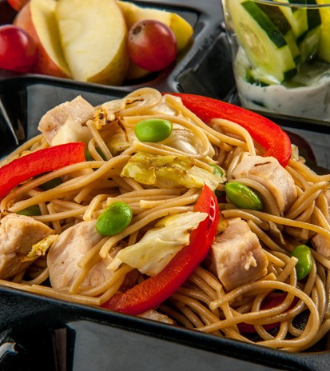
Benefits of Seasonal Local Produce
Increased nutrients
Better flavor
More affordable
Help the environment
Culturally relevant
Marketing and social media
Nutrition education
Notes:
Do: Acknowledge any of the benefits added to the chat!
Say: Here are a few benefits of purchasing and menuing seasonal local produce.
Seasonal produce is harvested at peak ripeness. At this time, it has the highest amount of nutrients because fruits and vegetables have had time to develop their vitamins, minerals, and antioxidants, including phytonutrients. The antioxidant content of some produce declines during storage. Getting antioxidants from foods is important to fight reactive molecules called free radicals that contribute to disease (1, 2). Vitamin C, an important water-soluble nutrient, begins to degrade in fresh fruits and veggies shortly after harvesting (3).
Peak ripeness also means better flavor. Local fruits and vegetables are harvested closer to peak ripeness, which means they’re allowed to ripen naturally on the plant, retaining more nutrients and flavor than conventionally grown produce.
Fruits and vegetables are more abundant when they are in season and require less transportation and storage to make it to your backdoor; this makes them more affordable. Less transportation also means less fossil fuel production, which helps our environment. Another note on the environment, seasonal produce thrives during a specific time of year due to the VA climate and soil. This in theory can lead to less of a need for chemicals and pesticides.
When you review your menu, you may want to write recipes or adjust recipes to promote locally procured seasonal produce. Local food purchases may increase the availability of foods that are culturally relevant to your student population.
Let’s move on to the next few slides to discuss marketing, social media, and nutrition education.
Additional articles on local farming practices that increase nutrients (4, 5, 6).
Sources:
1: https://pubmed.ncbi.nlm.nih.gov/30430937/
2: https://pubmed.ncbi.nlm.nih.gov/29952268/
3: https://pubmed.ncbi.nlm.nih.gov/25526594/
4: https://peerj.com/articles/12848/
5: https://www.tandfonline.com/doi/abs/10.1080/10408398.2015.1028023?journalCode=bfsn20
6: https://www.nature.com/articles/s41477-022-01191-1

Slide 8
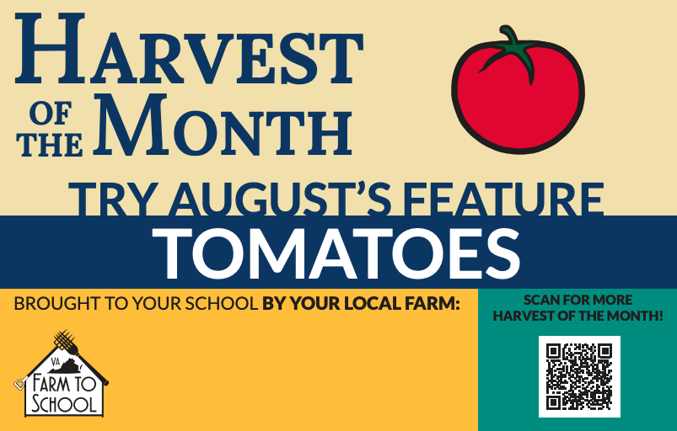
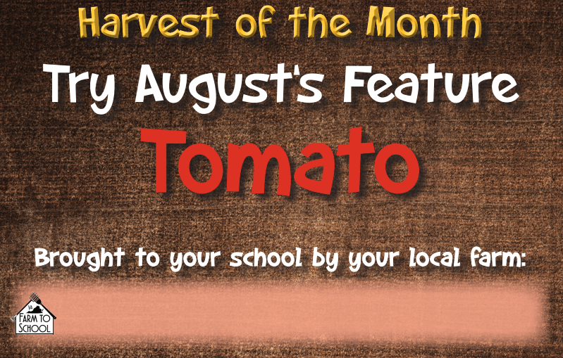
Benefits of Seasonal Produce
Marketing and social media
Notes:
Say: As you serve seasonal local produce, be sure to market your efforts! It’s a great benefit to help promote your program. VDOE has many marketing materials created just for you and your schools. You don’t necessarily need to create anything unless you want to customize materials for your division.
Let’s start with Virginia's Harvest of the Month featured produce items. A fruit or vegetable is featured each month with colorful marketing material like the ones shown here. We chose to spotlight tomatoes because we are in the month of August. Chef Lindsey will also be using tomatoes in her recipe shortly!
While you can use these marketing tools in your schools or cafeterias, you can also use them as part of your social media. Parents and customers love to learn about connections to their community, local farming, or even the benefits of eating certain foods!
Please note that there are two different sets of HOM marketing materials, one for elementary students and one for secondary students. The materials target these populations differently. You'll see one set with student artwork. This is for elementary schools, and the set that aligns with the agency's brand is for secondary students.

Slide 9
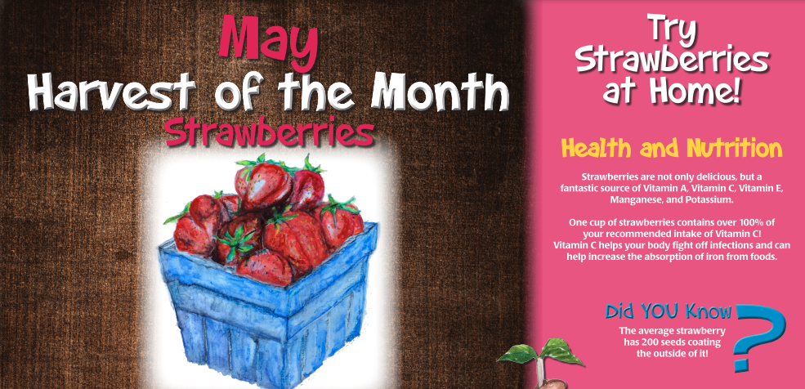
Benefits of Seasonal Produce
Nutrition Education
Notes:
Say: This brings us to nutrition education. Another benefit of seasonal local produce is that it provides an opportunity to educate our students about different types of produce. By offering local produce items, we allow our students to learn about and sample different fruits and vegetables.
Remember that many of our students do not receive fresh produce or a variety of fresh produce at home. When you menu fresh fruits and vegetables to your students, you help them establish healthy eating habits that last a lifetime (7).
You might be thinking, I do not have the time to educate my students or create materials, but remember that VDOE has many resources to assist you. In fact, there’s a promotional poster for each Harvest of the Month featured produce item. While your poster would be larger in print, we’ve provided a sample of the May Harvest of the Month: Strawberries on this slide. There's a fun fact and health and nutrition information.
Sources:
7: https://www.sare.org/wp-content/uploads/Building-Local-and-Regional-Food-Systems.pdf

Slide 10
Let’s hear from you!
What foods taste better when they are purchased seasonally?
Notes:
Say: Think about foods you eat year-round. Using the chat feature, type in a few foods you eat year around that might taste better during one season versus another season. Please feel free to take yourself off mute if that’s easier, and let us know!
Do: Wait for them to list a few. If they do not, continue with the examples below.
Say: I know that when I purchase tomatoes now, they are deliciously juicy and sweet. While they are available thought the year, and I am grateful, they are not as tasty as the ones I can eat when they are in season.
How about another example: Berries. They are much sweeter when the weather starts to warm, than during the winter months. They are in season during the month of May on your Virginia Seasonal Availability Calendar and the featured harvest of the month item during May.
Thank you all for including a few different foods in the chat (review any available).

Slide 11
Virginia Seasonal Availability Calendar
Notes:
Say: Speaking of the Virginia Seasonal Availability Calendar; this is a great tool to reference when creating your menu. Not only is it a good educational tool for our staff and students, but it is also helpful when we are planning our menus to ensure we are menuing seasonal local Virginia items. There is a list for each month of the year.
The seasonality calendar is on the Virginia Farm to School Website.
The VDOE will also be printing and distributing them at the October workshops!
Farm to School Website: https://www.doe.virginia.gov/programs-services/school-operations-support-services/school-nutrition/programs-promotions-and-initiatives/virginia-farm-to-school

Slide 12
Virginia Farm to School Map
Notes:
Say: This is yet another resource we love, the Virginia Farm to School Map. It highlights foods from different areas of the state. It would make a fun poster to hang in your cafeteria!
The Virginia Department of Agriculture and Consumer Services Farm to School website includes the Virginia MarketMaker to assist in identifying local produce.
Additionally, the Virginia Cooperative Extension has a Farm to School team to support divisions at the local level with farm identification. The best way to get in touch is to contact your local Extension office. You can find that information on the Virginia Cooperative Extension website.
MarketMaker Website: https://va.foodmarketmaker.com
Virginia Cooperative Extension Website: https://ext.vt.edu/agriculture/market-maker.html

Slide 13
Washing Produce
Notes:
Say: Let’s now move on and discuss how to clean our local produce.

Slide 14
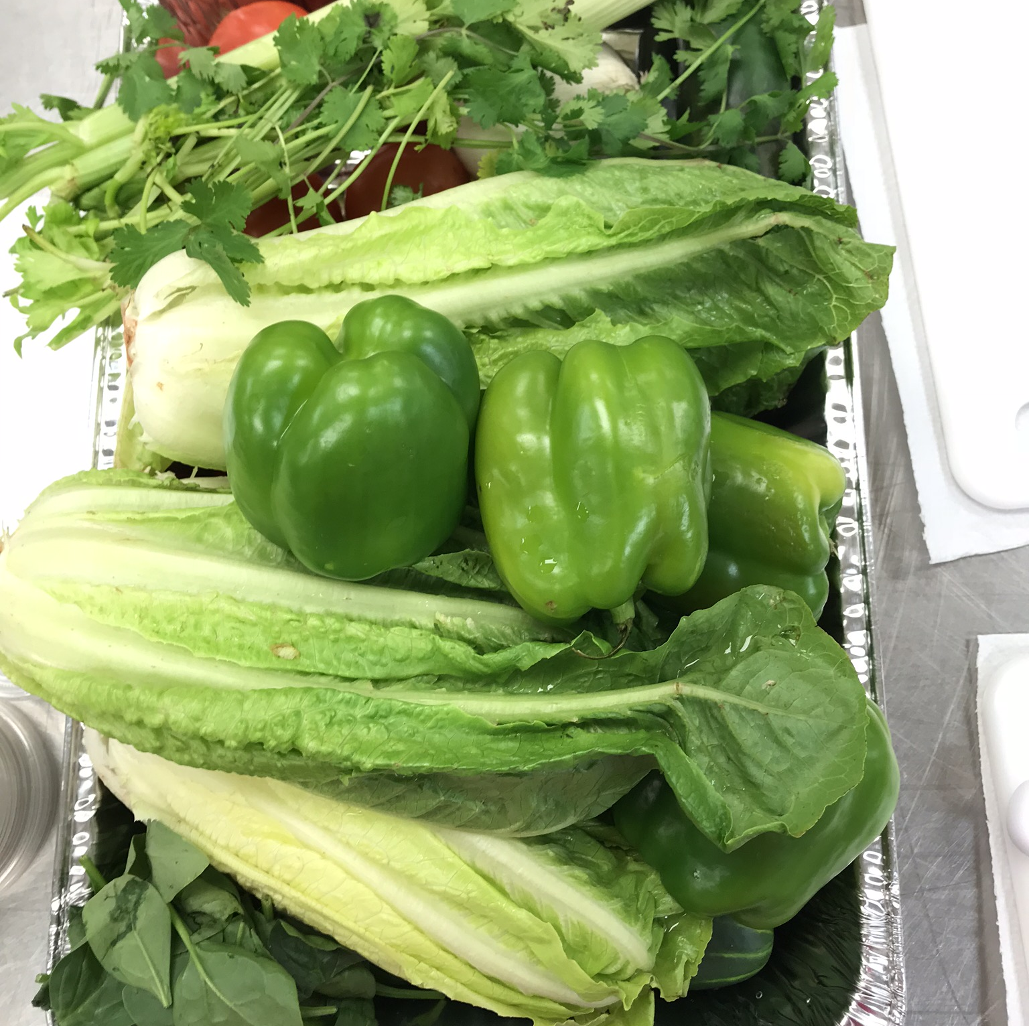
How to Wash Produce
Use running water
Use a scrub brush
Wait to wash
Remove the stickers
Notes:
Say: Use running water rather than filling sinks with water and soaking.
Use a scrub brush for produce with a tough rind or peel (such as carrots, potatoes, cucumbers and squash) that will not be bruised or scratched by the brush bristles. You can also use a scrub brush to remove wax coatings found on produce such as apples.
There are quite a few commercial produce washes marketed to home and commercial kitchens. FDA advises against commercial produce washes because the safety of their residues has not been evaluated, and effectiveness has not been tested or standardized. Never use bleach or soaps - it can absorb into the product and change the taste. Baking soda and vinegar might sound like better natural options, but they can impact flavor. Save your money and stick to running water and the strength of a good scrub brush.
Don’t wash your produce until you need it. Waiting to wash it right before using it in a recipe will keep it fresh longer and hinder mold growth.
And my goodness, don’t forget to remove the stickers from your produce. It sends a message to the students that you don’t care when fruits are sliced with the sticker still on or when they take a big bite of a sticker during their meal.
Let’s review a few produce items that require a bit more care, starting with leafy greens.

Slide 15
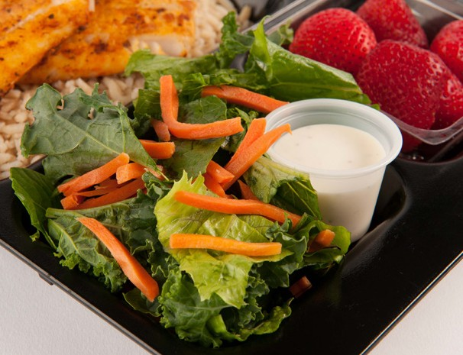
Leafy Greens
Notes:
Say: Leafy greens are deliciously crunchy and refreshing when stored and prepared correctly. To clean leafy greens, cut the heads of lettuce in half first to really clean between the leaves. Lots of dirt and bugs can be hiding in the leaves, and you don’t want them to end up on your cutting board or, even worse, in a customer’s salad. Additional insects do not count as a meat/meat alternate.
It’s essential to remove excess moisture after cleaning your leaves. A commercial salad spinner is the quickest way to dry your greens.

Slide 16
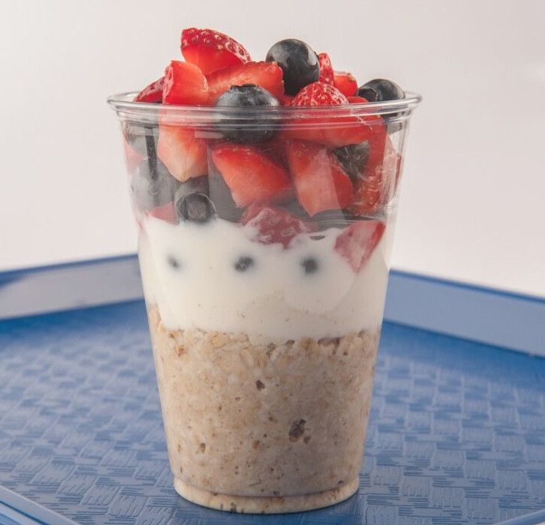
Berries
Notes:
Say: Store all berries unwashed until ready to use or serve. Before storing your berries, separate any moldy fruit from non-spoiled fruit. Spoiled fruit can cause fresh fruit to become overripe or spoiled more quickly.
Taking a minute to look at your fruit, preserves freshness and extends shelf life. Removing spoiled fruit promotes food safety, reduces waste, and saves your schools money.

Slide 17
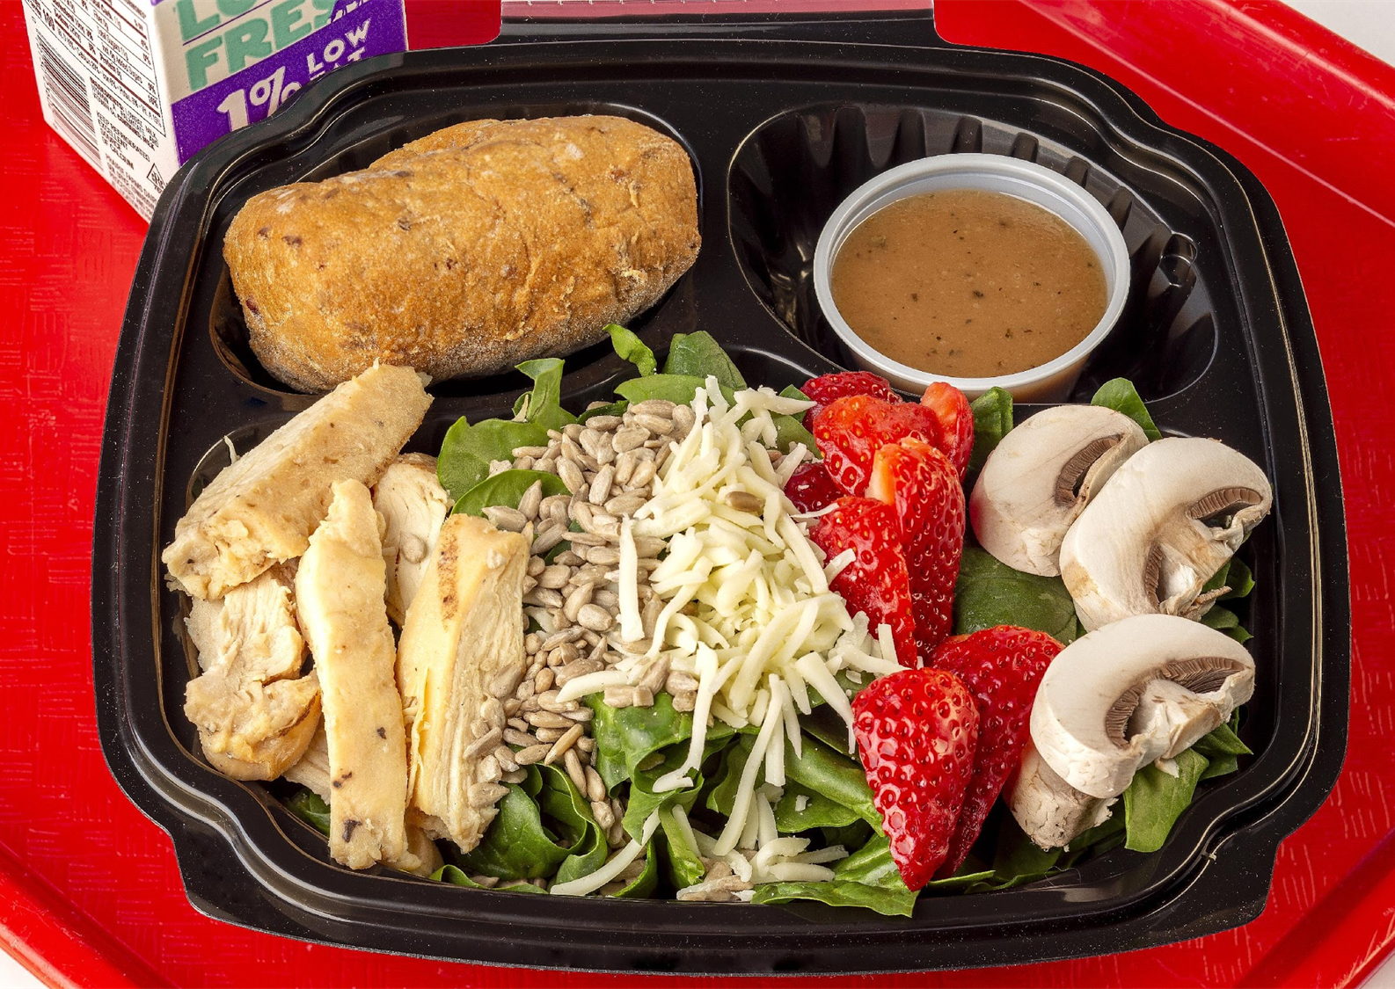
Mushrooms
Notes:
Say: Brush off any debris with your fingers or a damp paper towel, or rinse briefly under running water and pat dry with a paper towel. Avoid fully immersing or soaking your mushrooms so they don't get waterlogged.
Source: Mushroom Council

Slide 18
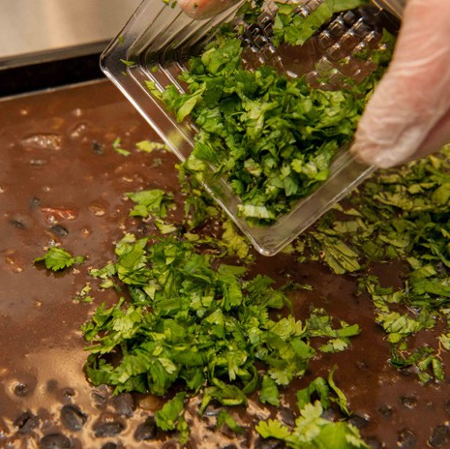
Herbs
Notes:
Say: Fresh herbs add so much color and flavor to our recipes! Just like leafy greens, they often have dirt or debris inside the leaves. Always rinse by putting under running water and then dipping and swishing in a bowl of cool water. Pat dry with a paper towel.

Slide 19
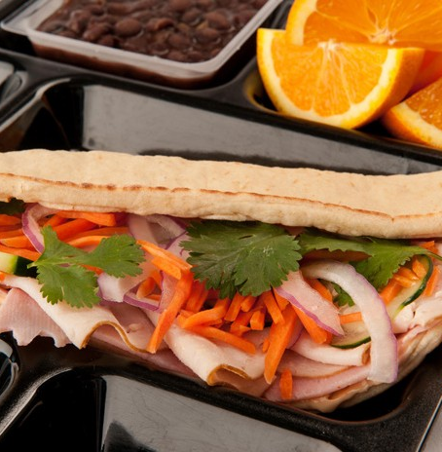
Onions
Notes:
Say: Don’t wash onions before storing! Onions need to stay completely dry or they will rot.
Onions release ethylene gas, so keep them separate from other produce items. If not, they will accelerate the ripening and spoilage of other produce items. We will discuss this more on the next slide. Whole uncut onions should not be stored in the refrigerator.
When you are ready to slice or dice your onion, rinse under running water to remove any dirt.

Slide 20
How to Store Produce
Notes:
Say: Proper storage is essential for food safety and to maintain optimal freshness!
Ask: Should all produce be stored in the refrigerator?
Say: The answer is no. Some produce items should NOT be refrigerated. Bananas, sweet potatoes, potatoes and onions should be stored ideally between 60 and 70 degrees F. Additionally, some fruits need to be ripened at room temperature first; typically ones that have soft interiors, like kiwis, peaches, pears, and plums. Don’t put them in refrigeration until ripe!
When storing under refrigeration, we need to consider food safety and ethylene gas.

Slide 21
How to Store
Ready-to-eat foods (produce)
Seafood
Whole cuts of beef and pork
Ground meat and ground fish
Whole and ground poultry
Notes:
Say: When it comes to food safety, always store fresh produce and ready-to-eat foods above eggs, raw meats, poultry, and seafood. Now, let’s take a look at how to store produce based on ethylene gas production.

Slide 22
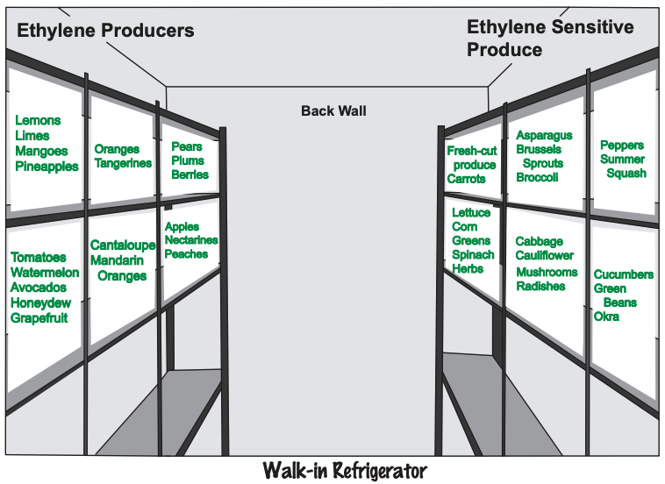
Ethylene Gas
Notes:
Say: You may recognize this chart from our Money Management for Managers course. Ethylene gas serves as a ripening hormone. Ethylene-producing foods, such as apples, should be stored away from ethylene-sensitive foods, such as broccoli. Ethylene gas can cause broccoli to flower more quickly, make carrots taste bitter, and cause brown spots on lettuce.
Sometimes however, you can use ethylene gas to your benefit to speed up ripening. Try storing some apples with unripe bananas in a closed box to help them turn yellow faster.

Slide 23
Culinary Demo
Notes:
Say: Now it’s time to take what we’ve learned to the kitchen! Chef Lindsey is here with a few ways to spice up your fresh local and seasonal produce. She will demo a school made ranch dressing, a delicious Lemon Spiced Roasted Cauliflower, and a stir-fry with a flavorful K-12 Teriyaki Sauce.
Chef Lindsey, Take it away!

Slide 24

Questions
Notes:
Say: Thank you so much for being here today and participating in our webinar. We are excited to see and hear about the successful inclusion of local and seasonal produce on your menus!
Ask: Does anyone have any questions?

