Slide 1

Kitchen Organization and Efficiency
Notes:
Do: Record webinar!
Say: Welcome to today's webinar, Kitchen Organization and Efficiency. As we all work to meet the USDA transitional standards and incorporate local, seasonal, and culturally inclusive foods, kitchen organization and efficiency are a must! The more organized your kitchens can be before implementing changes and returning to more scratch cooking, the better.

Slide 2
USDA Funding and Non-Discrimination Statements:
“This project has been funded at least in part with Federal funds from the U.S. Department of Agriculture. The contents of this publication do not necessarily reflect the view or policies of the U.S. Department of Agriculture, nor does mention of trade names, commercial products, or organizations imply endorsement by the U.S. Government.”
In accordance with federal civil rights law and U.S. Department of Agriculture (USDA) civil rights regulations and policies, this institution is prohibited from discriminating on the basis of race, color, national origin, sex (including gender identity and sexual orientation), disability, age, or reprisal or retaliation for prior civil rights activity.
Program information may be made available in languages other than English. Persons with disabilities who require alternative means of communication to obtain program information (e.g., Braille, large print, audiotape, American Sign Language), should contact the responsible state or local agency that administers the program or USDA’s TARGET Center at (202) 720-2600 (voice and TTY) or contact USDA through the Federal Relay Service at (800) 877-8339.
To file a program discrimination complaint, a Complainant should complete a Form AD-3027, USDA Program Discrimination Complaint Form which can be obtained online at: https://www.usda.gov/sites/default/files/ documents/ad-3027.pdf, from any USDA office, by calling (866) 632-9992, or by writing a letter addressed to USDA. The letter must contain the complainant’s name, address, telephone number, and a written description of the alleged discriminatory action in sufficient detail to inform the Assistant Secretary for Civil Rights (ASCR) about the nature and date of an alleged civil rights violation. The completed AD-3027 form or letter must be submitted to USDA by:
1. mail:
U.S. Department of Agriculture
Office of the Assistant Secretary for Civil Rights
1400 Independence Avenue, SW
Washington, D.C. 20250-9410; or
2. fax:
(833) 256-1665 or (202) 690-7442; or
3. email:
Program.Intake@usda.gov
This institution is an equal opportunity provider.

Slide 3

Welcome!
Notes:
Say: Remember that as we go through today’s webinar, the chat box is open for any questions and comments. We can learn a lot from each other during these times together. Please feel free to comment and ask questions in the chat anytime! We will monitor it together throughout this hour and would love some conversations.

Slide 4

Objectives
Identify best practices for food storage areas and identify areas to improve in the participants’ school divisions.
List small equipment that aids in kitchen efficiency.
Describe how to create an effective work schedule, including 15 minute increments, preparing for the next day, and staggering employee lunch breaks.
Discover new kitchen hacks to speed kitchen efficiency.
Notes:
Say: Let’s review today’s objectives.
Do: Review objectives.

Slide 5

Professional Standards – Learning Codes
Food Production (2100)
Receiving and Storage (2500)
Facilities and Equipment Planning (3500)
Notes:
Do: Review professional standards learning codes.
Say: As we go through today's webinar, we really want you to think about the train the trainer concept. A lot of what we cover today, you will know or have heard before, but it needs to be passed on to staff in the kitchens. That's not to say there won't be new material or discussion!

Slide 6
Dry Storage Organization
Notes:
Say: Let's begin with discussing dry storage organization.

Slide 7
Storage Equipment
Types of equipment
  Shelving
  Can storage racks
  Ingredient bins and storage containers
Formula for calculation
  Multiply the Volume per meal (0.1 cubic feet) by the Number of meals between deliveries
  Then, multiply the Depth of the shelves in feet by the Clearance between shelves in feet by 80% Capacity of shelf height
  Then, divide Step 1 by Step 2
Notes:
Say: An organized kitchen makes for an efficient kitchen. No one can work quickly and efficiently in a cluttered mess! We have seen some well organized dry storage areas, but we have also seen some disorganized! Oftentimes, we focus on teaching the food safety aspects of dry storage, but forget to mention the importance of organization or tips on how to organize.
Set up your kitchens for success with proper shelving, can storage racks, and enough ingredient bin and storage containers.
If you are designing a new kitchen or redoing storage spaces, consider how much shelving you need in feet. There is a formula to help determine this! For practical reasons, the highest shelf should be 7 feet and for food safety, the lowest shelf needs to be 6" off the floor. It is recommended that you keep 15" between shelves. To calculate the total shelving needed, you can use the formula on this slide.
Source: http://www.foodprotect.org/media/guide/2016-plan-review-manual.pdf
Say: Storage racks can help maximize limited space in your storage areas when there is not enough shelving.
How does your staff currently place items on shelves? Do they leave products in boxes? Move it to bins? Let's talk more about that, moving on to the next slide.

Slide 8

Let's talk boxes!
Notes:
Say: To box or not to box? That is the question. We know many kitchens lack storage bins, and we often see boxes used to hold small ingredients like bags of gravy, breakfast bars, or condiments, but we recommend getting rid of as many boxes as possible.
Boxes are dirty. Think about how they travel. They are also susceptible to coming into contact with bacteria, bugs, and vermin. This is not something often discussed in food safety, but it is something that we should be aware of, so we wanted to discuss it today!
Consider this when procuring small equipment in your kitchens. When you order storage containers, make sure you discuss what they should be used for. Don't let a manager's creativity run wild. In fact, many managers may not ask for storage containers; it's probably something they are not thinking about!

Slide 9
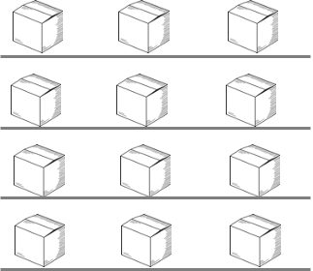
Layout
Keep like items near each other
Labels on shelves
FIFO
Heavy items low, light items high
Notes:
Say: A dry storage area can look neat and clean, but is it laid out in a way that makes sense? Speak with your managers about how to consider the flow of the storage area. Are like items grouped together? Are items used in higher frequency closer to the front?
Encourage the use of labels. Labels create accountability and they help when different employees are putting up inventory. You might even consider printing a set of labels and laminating them for all of your kitchens.
Of course, with layout, we also always need to consider FIFO, or first in, first out, and remember to educate our staff on this concept.
For ergonomic reasons and to save backs, heavy items should be stored down low, specifically as close to waist height as possible, and light items should be placed up high. Many people do not think about this when putting items away!

Slide 10
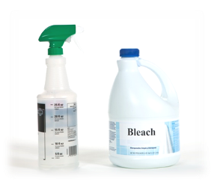
Food Safety
Food away from chemicals
Notes:
Say: We know you all know this, but again, in this training we also want to cover topics and concepts that should be taught consistently to staff. Food needs to be stored away from chemicals to prevent cross contamination.

Slide 11
Walk-In and Freezer Organization
Notes:
Say: Everything we just covered mostly pertains to the walk-in and freezer as well. There are just a few more considerations that we would like to review, including ethylene gas and temperature preferences.

Slide 12
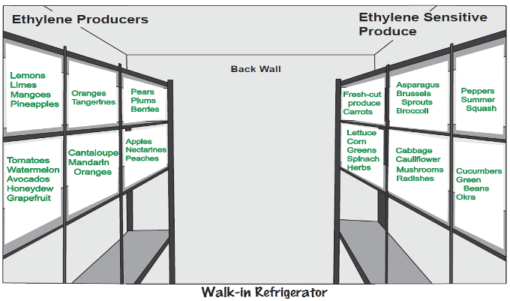
Considerations
Ethylene gas
Temperature considerations
Notes:
Say: Certain fruits release high levels of ethylene gas, which acts as a ripening hormone. Vegetables, on the other hand, are ethylene sensitive and can spoil more quickly if exposed to ethylene. It's important that every team member knows why we keep these items separated in the walk-in. Educate and follow up, to ensure good produce doesn't spoil quickly. You don't want your locally procured produce to go bad before you use it!
The ICN has a great chart you can download for free and print. If your managers attended Money Management for Managers last summer, they learned about this and might have already printed a copy of the chart! It would be nice to provide copies for all of them.
Source: https://theicn.org/wpfd_file/produce-storage-chart/
Say: Another consideration is the different temperatures within a walk-in and freezer. No matter how diligent staff are keeping the doors shut (another concept to train about often!), It's always warmer in the front and colder in the back. Some produce items, like basil, prefer warmer temperatures or don't need to be refrigerated for food safety, like unopened canned fruit. Keep those types of items near the front. The produce storage chart also takes temperatures into account!

Slide 13
Let's chat!
What areas with organization can your schools improve upon?
Notes:
Say: Now that we have reviewed dry and cold storage organization, we wanted to take a moment to reflect.
Ask: Which areas of organization can your schools improve upon?

Slide 14
Small Equipment Organization
Notes:
Say: Let's move on to small equipment organization. We will talk about specific items you should buy for efficiency shortly!

Slide 15
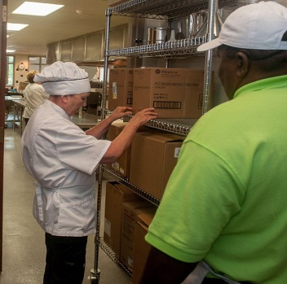
Storage
Drawers
Shelves
Hanging
Speed racks
Notes:
Say: There are lots of ways to organize small equipment. Consider what your kitchens are currently equipped with and what layout would make sense. Drawers, shelves, hanging racks, and speed racks are all great tools to help keep equipment sorted and easy to find.

Slide 16
Small Equipment Layout
Logics
Labels
Notes:
Say: We have been in many kitchens with disorganized small equipment storage. When an employee says, "We don't have enough time to scratch cook," it might be because they spend lots of extra time searching for small equipment. Small equipment hide-and-seek is a real game but it's also very annoying. Kitchen drawers are sometimes filled with a random assortment of equipment or small equipment is located in an area that is not logical and could disrupt or slow workflow. Consider the use of small equipment and how staff can maximize efficiency by minimizing the number of steps. Small equipment should be close to the areas that use those tools the most. That isn't to say there can't also be duplicate storage with the same equipment mix at different stations. For example, every work station might need a spoon, whisk, and spatula.
Labels, again would be very helpful!
Don't forget about trash cans. We once saw a kitchen with one trash can, just one! It's helpful to have a trash can positioned at each workstation or between work stations for maximum efficiency.

Slide 17
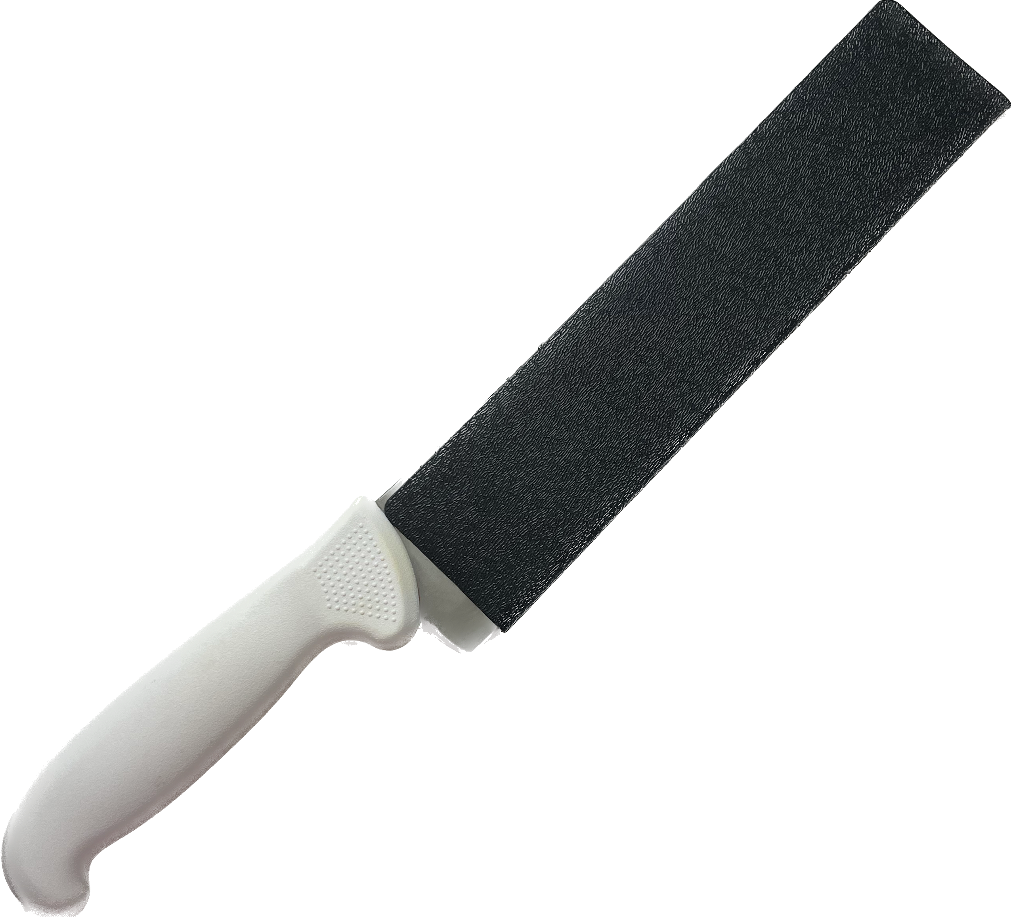
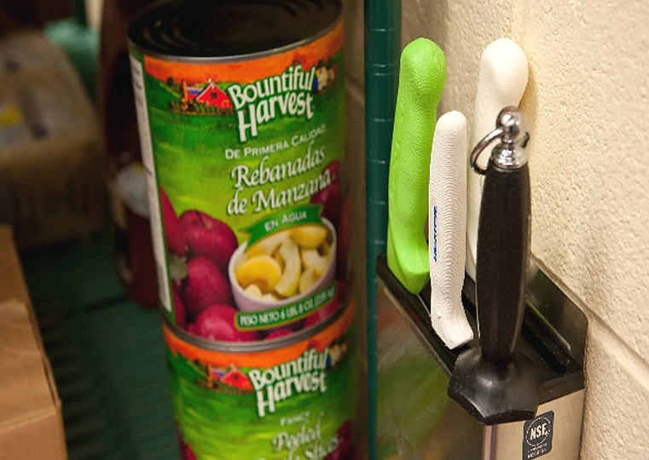
Knife Storage
Scabbards
Wall hangs
Magnetic strips
Notes:
Say: We wanted to take a moment to specifically talk about knife storage. This is a big problem in most school kitchens, and when knives are not cared for, efficiency goes way down. A dull, chipped knife is not going to help prepare scratch recipes. Most often, we see knives all stored in a drawer with no protection. Not only is this dangerous, but the blade is not protected. Using scabbards, wall hangs, and magnetic strips are all better options. We need to keep the blade protected!
As the director, you can provide this equipment to your staff. We hope some managers have now asked for this equipment after attending Money Management for Managers and the TNTG Back to Scratch culinary workshops, but we know some are reluctant to ask for things! Remember to check in with your kitchens.

Slide 18
Efficiency
Notes:
Say: Organized storage naturally leads to efficiency, but there are other things we can do within a kitchen to speed things up!

Slide 19
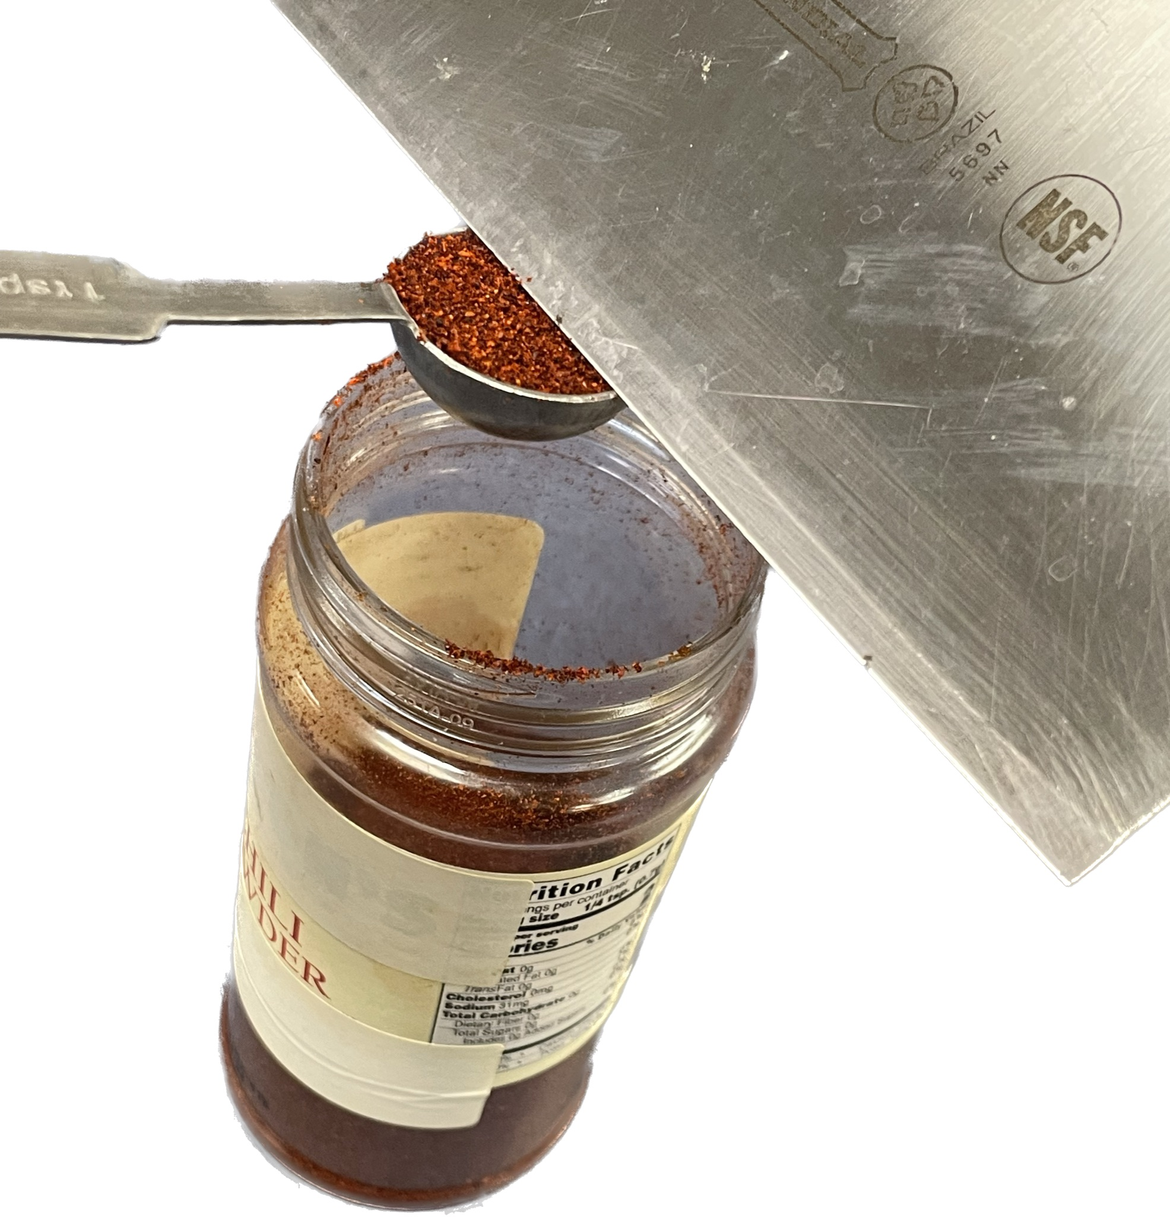
Mise en Place
"To put in place"
Read the recipe
Notes:
Say: Let's begin with discussing mise en place. We teach This concept at all of our culinary trainings because it is incredibly important for efficiency! Mise en place is a French term that literally translates to "to put in place." In a nutshell, it means measuring all of the ingredients, prepping any ingredients that have a preparation instruction in the ingredient list, and pulling all small equipment needed. All before starting the recipe! Of course to do this, the absolute first step is to read the recipe in its entirety before beginning.
As simple as this concept sounds, so many people do not read recipes first, but rather just dive in and get started. This concept needs to be taught to every single employee upon hiring! It is especially essential when cooking from scratch as more ingredients and a few more steps are listed in recipes.

Slide 20
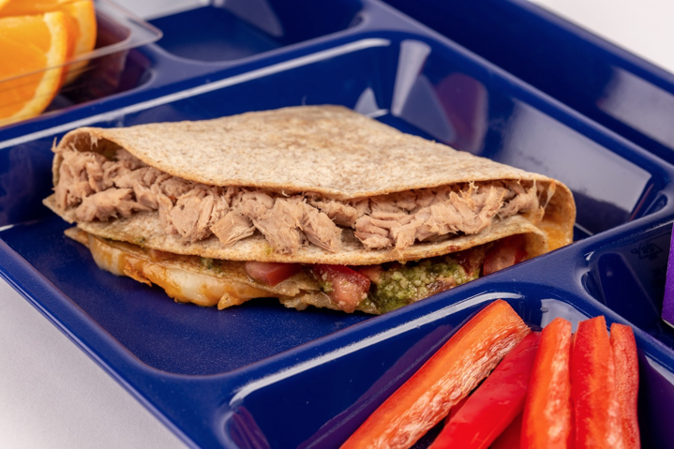
Organizing your Work Space
Live demo!
Notes:
Say: Once everything has been mise en placed, it's important to organize your work space in a way that is efficient and ergonomic. We are going to demonstrate this concept with the tik tok tuna wrap. You might remember this recipe from our webinar on writing standardized recipes.
Do: Show work space, and point out mise en place, small wares needed, efficiency in layout, and work flow. Explain how this would be a good demo for a manager's meeting with a division recipe.

Slide 21
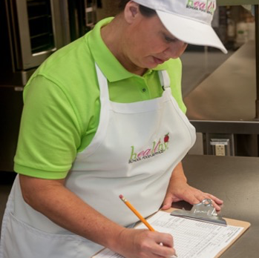
Work Schedules
Meals per labor hour
Time standards
15-minute increments
Next day preparation
Cross training
Notes:
Say: Thanks chef! Back to the PowerPoint and on to work schedules.
Ask: How many of you require your managers to use a daily work schedule?
Do: Run poll.
Say: If you said yes, great! If no, here is a big opportunity to increase efficiency! When done properly, work schedules ensure maximum time utilization. No unused minutes!
First, meals per labor hour should be determined for each kitchen, and a goal should be decided upon for your division's schools. We will review meals per labor hour (MPLH) more at the in-person workshop because we know this is a hot discussion topic! The main point is that you need to know how many hours you are working with in each kitchen.
Next, time standards should be determined. Time standards are how long it should take an employee to do a specific task. Not how long it currently takes, but how long it should take! If you give someone 30 minutes to do something, it's going to take them that long! People fill the time. Time standards may vary from kitchen to kitchen based on equipment and layout, but as director, you or the menu planner can determine goal time standards based on the menu.
We recommend 15-minute increments when creating time standards. This recommendation often shocks managers at first, but it makes sense, because there are a lot of tasks that only take that long! Take a look at this example on the screen.
Do: Share example work schedule.
Say: You will notice the 15-minute increments, batch cooking, and preparation for the next day. All very important as we work on meeting the transitional nutrition standards.
Another thing we want to note before moving on is cross training. Cross training is essential to guarantee efficiency. You can't rely on one person to do a job. If that person is out, it will lead to chaos in the kitchen.
VDOE has a couple of production schedule templates in their Productivity and Efficiency section on the Training and Resources webpage: https://www.doe.virginia.gov/programs-services/school-operations-support-services/school-nutrition/training-resources

Slide 22
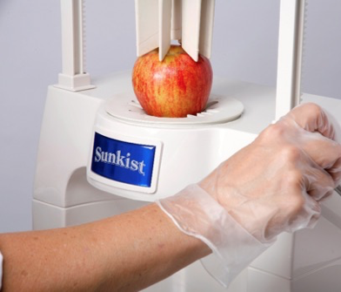

Small Equipment
Invest in quality equipment!
  NSF certified
Consider
  Peelers
  Measuring cups and spoons
  Knives and sharpeners
  Scales
  Sectionizers
  Salad spinners
Notes:
Say: We talked about small equipment storage earlier, but what about the small equipment itself? Please, invest in quality equipment and make sure it is NSF certified. Quality equipment may cost more up front, but it will last longer, work better, and improve efficiency.
We highly recommend evaluating the listed equipment items on the slide, and making sure your kitchens have enough quality items.
Let's start with peelers. Don't buy the cheap metal kind. They don't work well and they are tiresome for the cook using them! Not ergonomic at all. Look for peelers with a good comfortable grip made of plastic or rubber.
For measuring cups and spoons, purchase the same brand across your division to help ensure recipes come out consistently. Different brands measure differently! To keep track of them within the kitchen, keep them on the rings!
For knives, even with proper storage, they will dull. Make sure your kitchens are equipped with honing rods and sharpeners. Again, a dull knife is the opposite of efficient!
If you don't have digital scales yet, it is time to invest. They are more accurate and easier to use. Scales are essential for scratch cooking.
The last two items listed help with processing produce more efficiently. If you have your staff slicing and wedging apples, oranges, pears, cucumbers, and more, a sectionizer is a must have. The time savings is huge! If you are serving a lot of salads or have a salad bar, we highly recommend a salad spinner. It removes excess water from lettuce, improving quality and keeping product more crisp in storage.

Slide 23
Let's chat again!
What small equipment are you going to invest in for your schools?
Notes:
Ask: After discussing all of the small equipment, are there any items you have decided you will invest in for your schools? Please let us know in the chat!

Slide 24
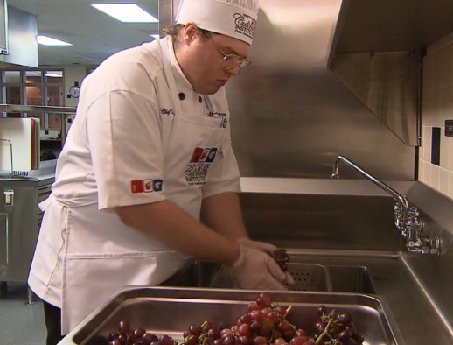
Kitchen Hacks
Work smarter, not harder!
Demo time!
Notes:
Say: Thank you for sharing! Your staff will be happy.
Another way to save time in the kitchen is to utilize kitchen hacks. They are sort of short cuts, if you will, that save time, but don't negatively impact quality! We are going to demo a few today.
Do: Demo hacks. Include lid to cut cherry tomatoes and gridded cooling rack to "dice" soft foods like hard boiled eggs.

Slide 25
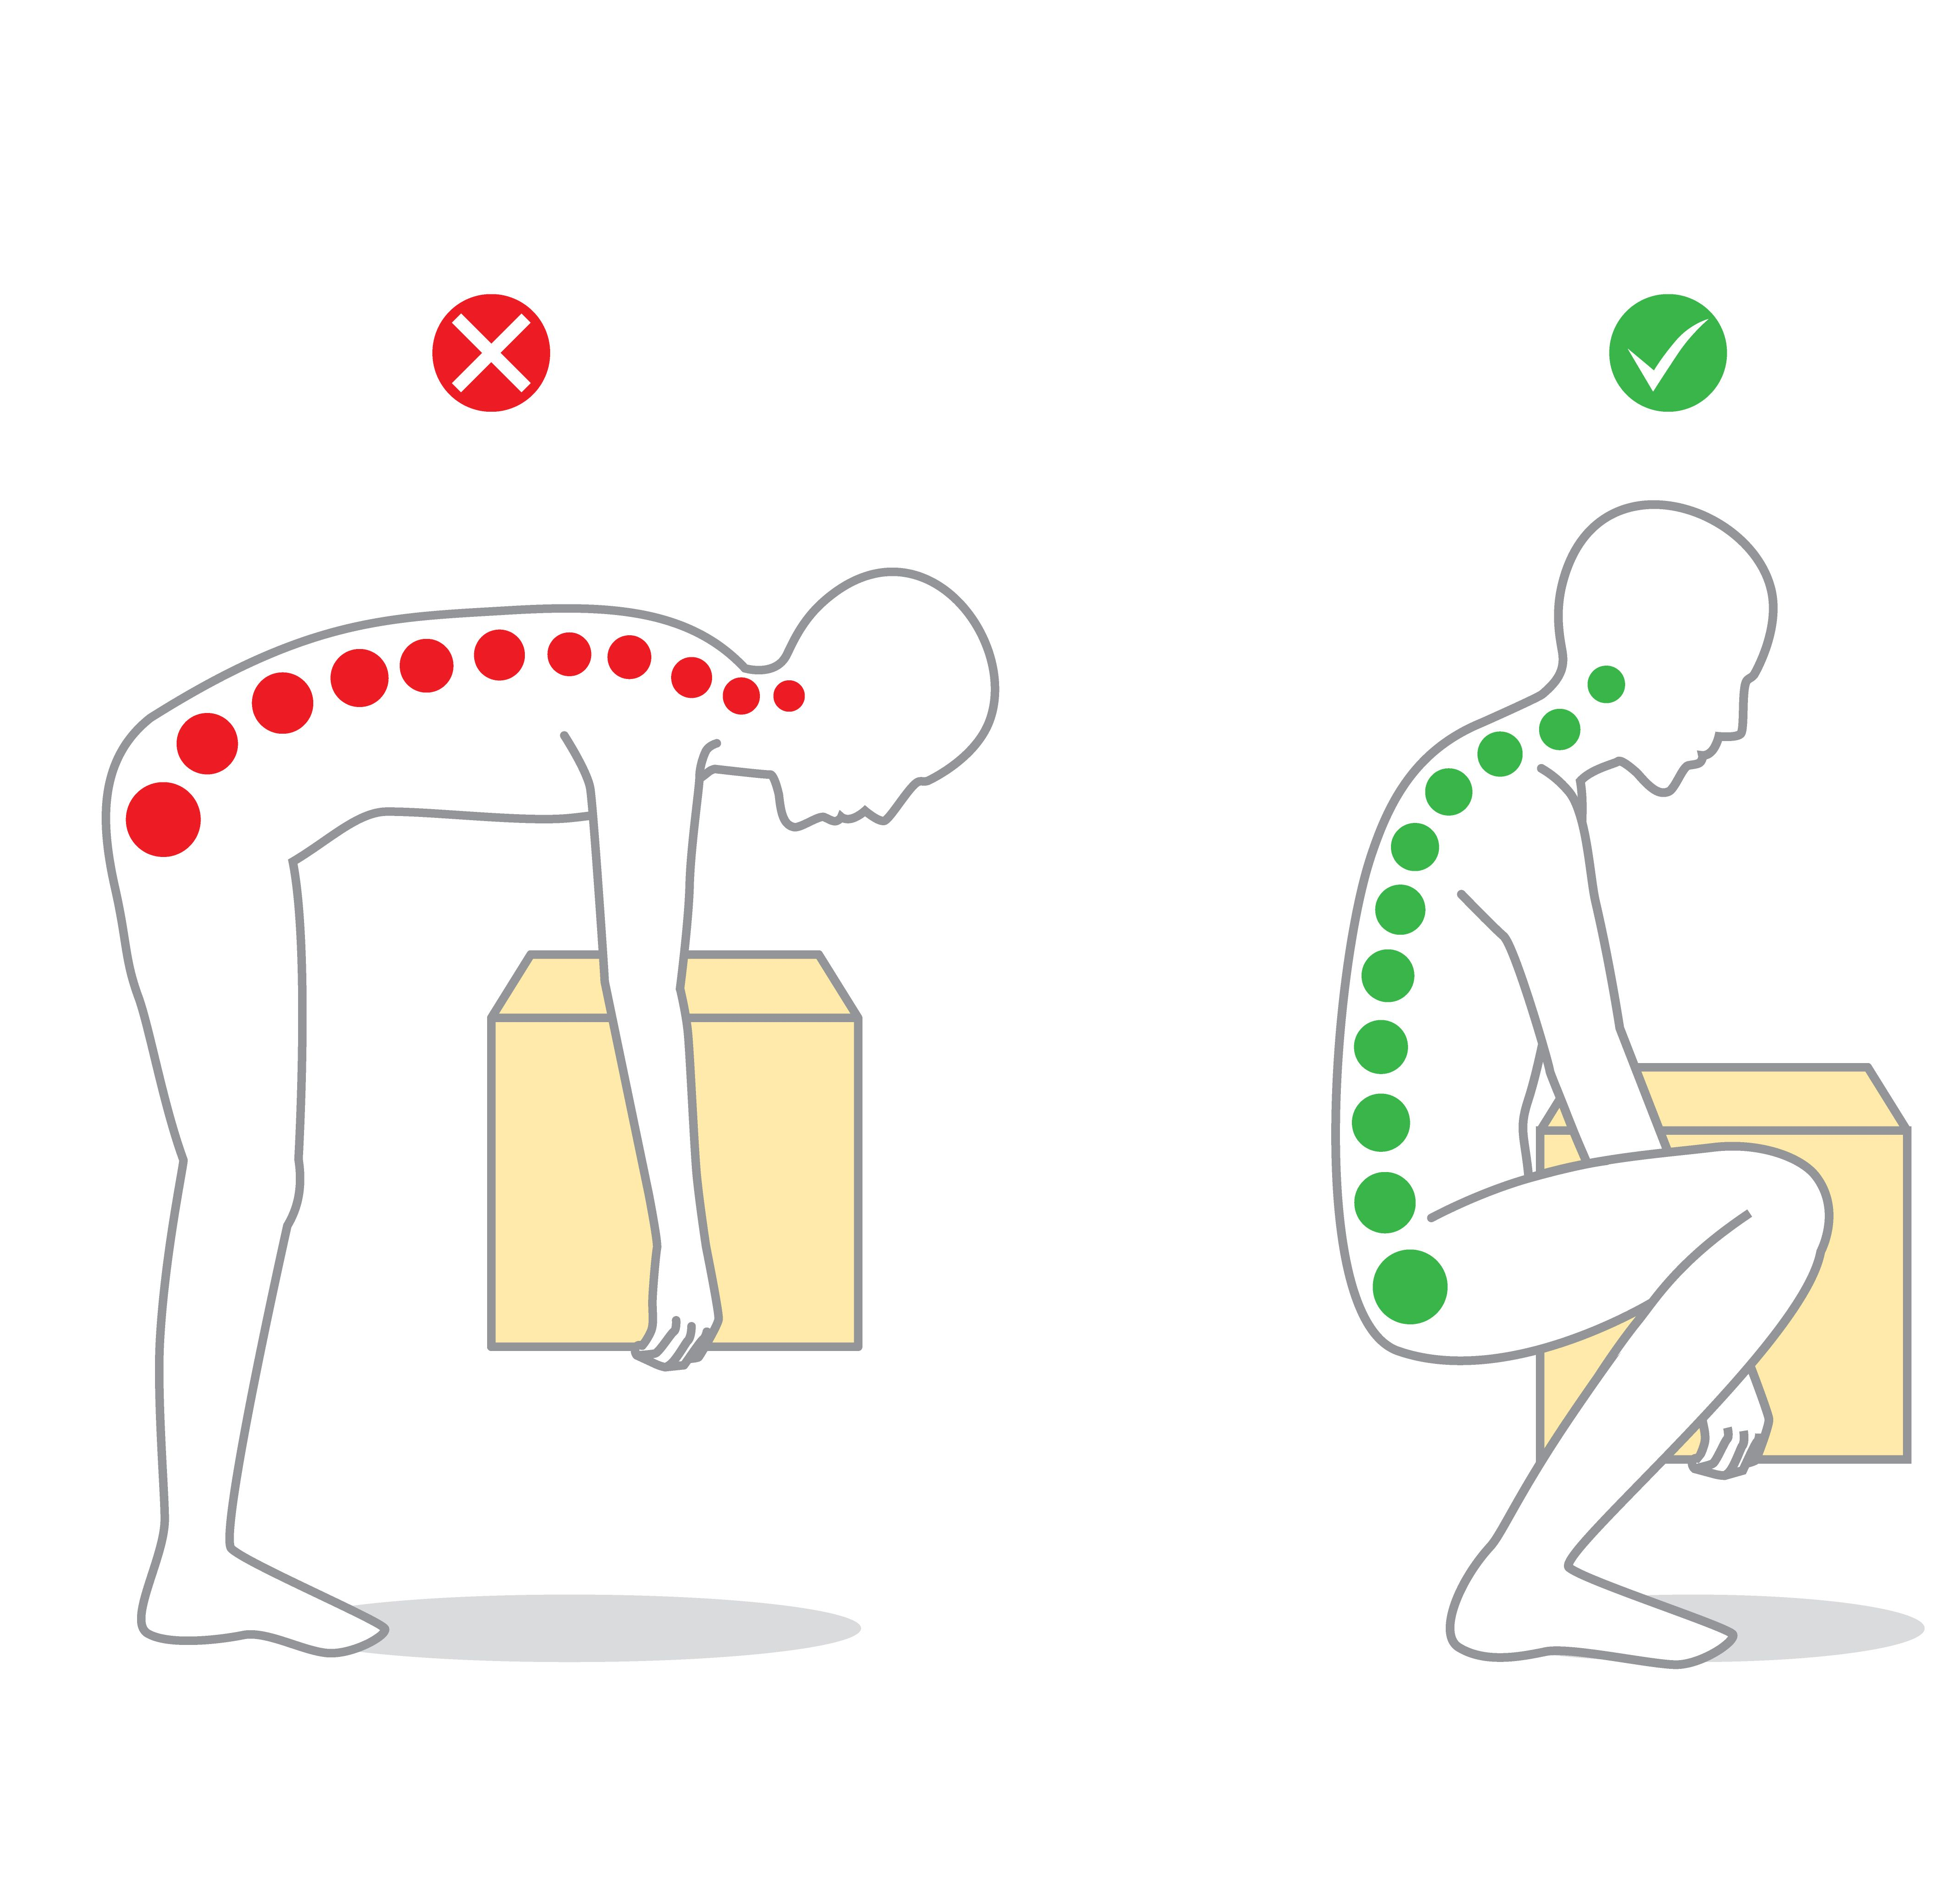
Ergonomics
Use both hands
Carts
Proper lifting
Cushioned floor mats
Notes:
Say: Thank you, chef! We have mentioned ergonomics a few times throughout this webinar, but we wanted to reiterate the importance. Working in a kitchen daily is hard work, and it is hard on bodies. We need to do everything we can to minimize employee injury and pain. A hurting employee will work slower and have a poor attitude, both things we want to avoid! Teaching concepts like using both hands, utilizing carts as much as possible, and proper lifting skills is a must. Add cushioned floor mats to lessen strain on backs and legs.
Back injuries account for one in five workplace injuries (1), and 75% of workplace-related back injuries occur during a lifting task (2).
For lifting items, consider teaching OSHA guidance.
Safe lifting involves (2):
Standing as close to the load as possible
Planting your feet shoulder-width apart with one foot slightly ahead of the other
Bending at the hips and knees only until you're deep in a squatting position
Keeping your head up and straight with your shoulders back to keep your back straight
Holding the load close to your body at waist height
Engaging your core muscles as you push against the ground and straighten your legs
Sources:
1: https://essr.umd.edu/about/occupational-safety-health/ergonomics/back-injuries-fact-sheet#:~:text=one%20of%20every%20five%20workplace%20injuries%20or%20illnesses
2: https://www.osha.com/blog/proper-lifting-techniques#:~:text=It%20means%20you%20should%20never,to%20the%20load%20as%20possible

Slide 26
Training
Notes:
Say: To wrap up today's webinar, we want to return to that train-the-trainer concept. Many of the concepts we covered today should be taught to managers and staff. While they can hear it from VDOE, they also need to hear it from you!

Slide 27
Train the Trainer
Monthly Meetings
JAM Sessions
Notes:
Say: Consider covering topics we discussed today at monthly manager meetings, and then encourage your managers to teach it forward at their own team meetings. We promote the idea of jam sessions, quick little meetings that can be held at the start of the day, before service, or at the end of the day, to bring the whole kitchen team together. Trained staff are happier, feel more empowered, and will work more efficiently!

Slide 28

Thank you!
Notes:
Say: Great work today! As we wrap up, remember that kitchen organization and efficiency will help your divisions meet the transitional standards, as well as add local and culturally inclusive scratch items to your menus. An efficient kitchen is a happy kitchen and more equipped to implement changes.

Slide 29

Questions
Notes:
Say: Thank you so much for being here today and participating in our webinar. We are excited to see and hear your new ideas as we travel through these webinars together!
Ask: Does anyone have any questions?

