Slide 1

The Road to Scratch Cooking
Notes:
Do: Record webinar!
Say: Welcome to today's webinar, The Road to Scratch Cooking. As we all work to meet the USDA transitional standards and incorporate local, seasonal, and culturally inclusive foods, scratch cooking is a must! If the thought of scratch cooking sounds daunting, don't worry, today we will discuss how to take baby steps to get there. If your operation is already scratch cooking, we hope to provide you with more tips and tools to help further your success.

Slide 2
USDA Funding and Non-Discrimination Statements:
“This project has been funded at least in part with Federal funds from the U.S. Department of Agriculture. The contents of this publication do not necessarily reflect the view or policies of the U.S. Department of Agriculture, nor does mention of trade names, commercial products, or organizations imply endorsement by the U.S. Government.”
In accordance with federal civil rights law and U.S. Department of Agriculture (USDA) civil rights regulations and policies, this institution is prohibited from discriminating on the basis of race, color, national origin, sex (including gender identity and sexual orientation), disability, age, or reprisal or retaliation for prior civil rights activity.
Program information may be made available in languages other than English. Persons with disabilities who require alternative means of communication to obtain program information (e.g., Braille, large print, audiotape, American Sign Language), should contact the responsible state or local agency that administers the program or USDA’s TARGET Center at (202) 720-2600 (voice and TTY) or contact USDA through the Federal Relay Service at (800) 877-8339.
To file a program discrimination complaint, a Complainant should complete a Form AD-3027, USDA Program Discrimination Complaint Form which can be obtained online at: https://www.usda.gov/sites/default/files/ documents/ad-3027.pdf, from any USDA office, by calling (866) 632-9992, or by writing a letter addressed to USDA. The letter must contain the complainant’s name, address, telephone number, and a written description of the alleged discriminatory action in sufficient detail to inform the Assistant Secretary for Civil Rights (ASCR) about the nature and date of an alleged civil rights violation. The completed AD-3027 form or letter must be submitted to USDA by:
1. mail:
U.S. Department of Agriculture
Office of the Assistant Secretary for Civil Rights
1400 Independence Avenue, SW
Washington, D.C. 20250-9410; or
2. fax:
(833) 256-1665 or (202) 690-7442; or
3. email:
Program.Intake@usda.gov
This institution is an equal opportunity provider.

Slide 3
Welcome!
Notes:
Say: Remember that as we go through today’s webinar, the chat box is open for any questions and comments. We can learn a lot from each other during these times together. Please feel free to comment and ask questions in the chat anytime! We will monitor it together throughout this hour and would love some conversations.

Slide 4

Objectives
Define scratch cooking, speed scratch cooking, and convenience foods.
Recall the benefits of scratch cooking.
Identify equipment and ingredients needed for successful scratch cooking in school nutrition.
Describe steps in taking a convenience food menu item to a scratch cooked recipe.
Notes:
Say: Let’s review today’s objectives.
Do: Review objectives.

Slide 5
Professional Standards – Learning Codes
Standardized Recipes (1140 & 2100)
Equipment Purchasing and Maintenance (3520)
Notes:
Do: Review professional standards learning codes.

Slide 6
Definitions
Notes:
Say: We have many different definitions in school nutrition, so we wanted to start by defining a few terms together. This way, we stay on the same page for the webinar, and you should make it a point to discuss these with your team as well.

Slide 7
ICN Definitions
Convenience foods
Speed-scratch food preparation
Scratch-based food preparation
Notes:
Say: These definitions were provided by the Institute of Child Nutrition. As you may have seen, these words mean different things to different people. Convenience foods, speed-scratch food preparation, and scratch-based food preparation all build on one another. Think of them as building blocks.
Let's start with the basic block, convenience foods. These foods are prepared and packaged by manufacturers and producers as ready-to-serve or ready-to-heat and serve item.
Then there's speed-scratch food preparation that incorporates value-added food products with additional ingredients, utilizing minimal production steps, to produce student-approved menu items.
Lastly, scratch-based food preparation is what we want to cover today. Scratch-based utilizes multiple culinary techniques within a recipe while prioritizing incorporating ingredients as close to their original state as possible to produce student-approved menu items.
Do: Run poll. What type of food production does your division mainly do?

Slide 8
Benefits of Scratch Cooking: Let's hear it from you!
Notes:
Say: While we’ve reviewed the benefits of scratch cooking in previous webinars, lets highlight a few of the benefits again today before we dive in. I’m going to post an activity poll QR code in the chat box. Please take a moment to answer this question: why is scratch cooking important? This is anonymous, so don't worry about putting your name. Don't rush either. You'll have a little time to complete it. Simply open your cameras on your smart phone, hold the screen over the code and it will take you to the App. Type in your first name and it will take you to the space where you can enter a response. Again, the question is why is scratch cooking important?
Do: Kelly to post QR code in Chat for Poll Everywhere word cloud activity: Why is scratch cooking important?
Do: Pause for 1 minute.
Say: Let's take a look at what everyone said.
Do: Kelly will share her screen; Review the words you see. Allow anyone to unmute and elaborate before continuing.
Say: Scratch cooking is rewarding for your students, the community, and for you and your team!

Slide 9
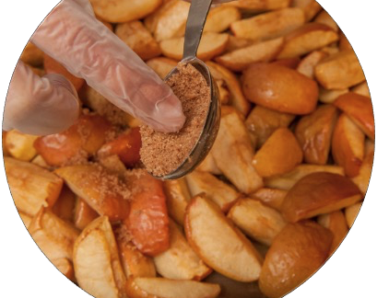
Healthier
Notes:
Say: Thank you all for your participation – we like to keep you active. Let's go through a few reasons that some of you have already highlighted. Scratch cooking is usually healthier. If you recall, scratch cooking incorporates ingredients as close to their original state as possible. This includes more than fruits and vegetables. It also includes basic ingredients like canned beans, whole wheat flour, yogurt, and unseasoned meat and poultry. When you create recipes with basic ingredients, you control the amount of artificial and/or unnecessary ingredients you serve. You can also control the amount of salt and added sugars which helps meet the transitional standards and proposed rule. This does not mean you are sacrificing flavor, which we will discuss shortly.

Slide 10
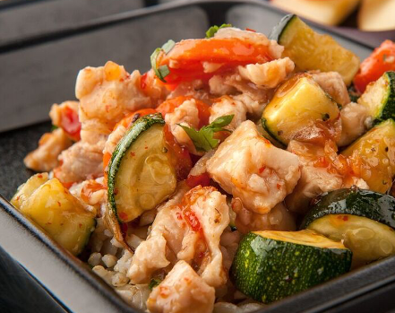
Flavorful
Notes:
Say: Have you ever received a packaged product and said, "This is salty, or this is too sweet," or how about, "I wish this didn't have [insert flavor]"? Or worse, do we have to serve this product to our students? When you cook from scratch, you control the flavors and staff are more likely to take pride in the work. As chefs, we know that flavor is produced in many ways. One way is by seasoning with spices, herbs, acids, and other flavoring agents. Using ingredients in their original state allows you to season according to your student's preferences. Take a moment to think about a pre-seasoned product you have. Do you like everything about it? Some products you probably do, but others, not so much!

Slide 11
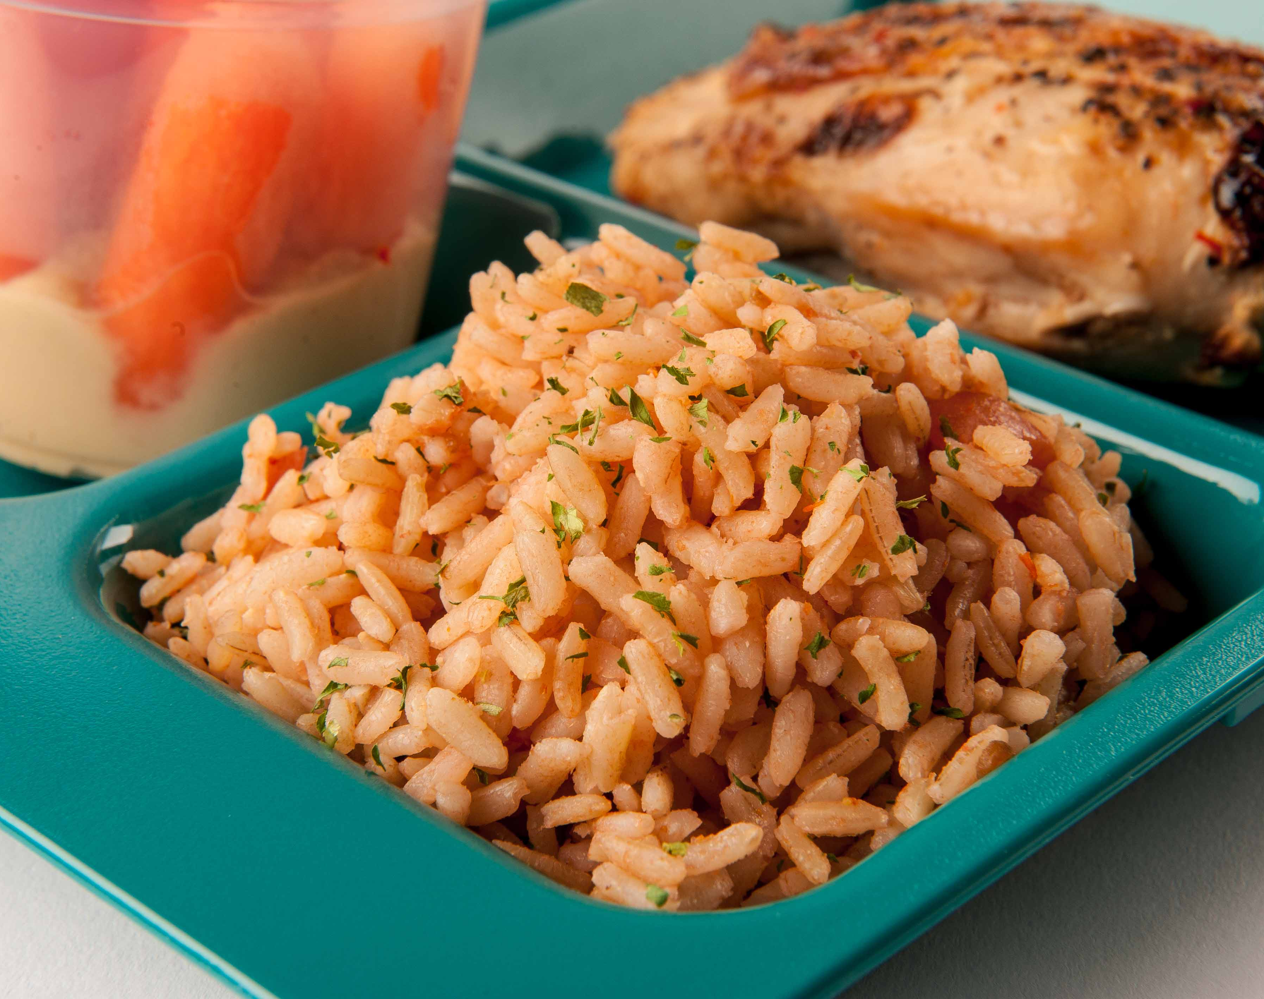
Flavorful & Healthy
Notes:
Say: Let's take a look at rice as an example: pre-seasoned rice versus plain rice. It's hard to modify the flavor profile of a pre-seasoned food, but a staple ingredient like plain rice can take on any flavor. It's a blank canvas, and you are in control. Not only are you in control of the flavor, you are in control of the nutrition. Many pre-seasoned rice brands are not available in whole grain options. Our K-12 Team has found that students are more accepting of brown rice and seasoned brown rice than some other whole grain options such as the whole grain southern biscuit! So let's get those whole grains on the menu wherever possible.

Slide 12
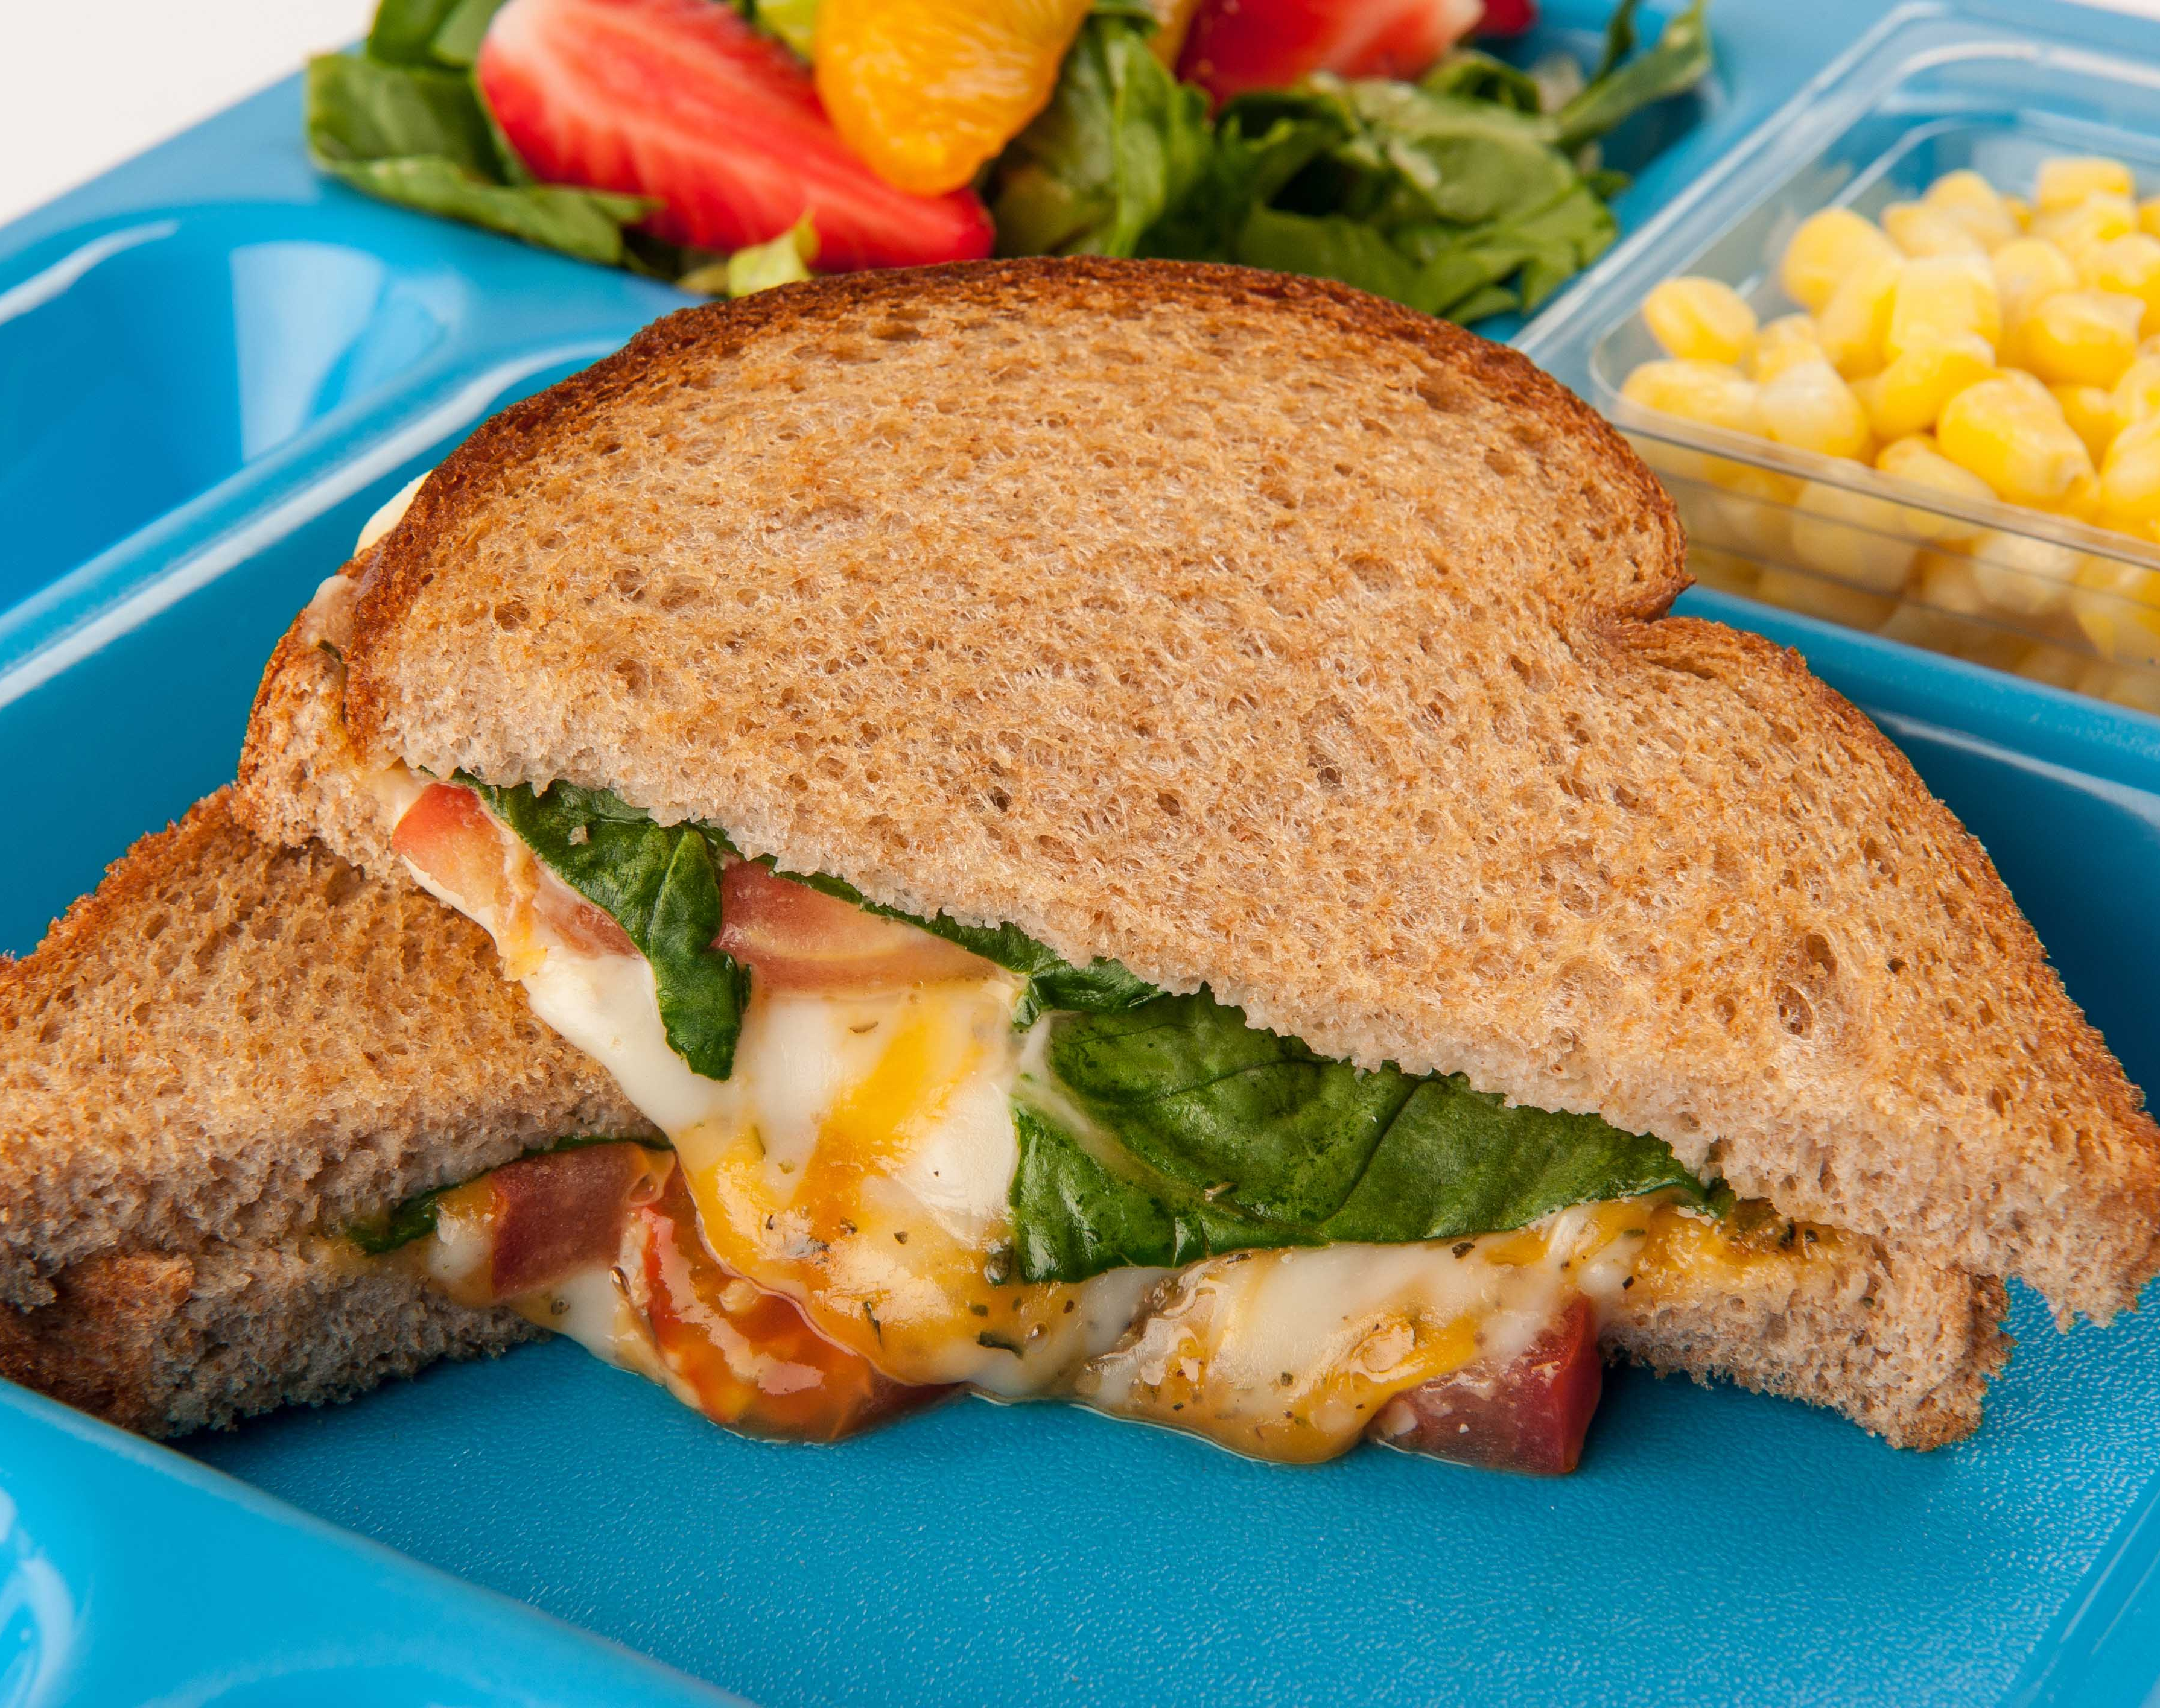
Flavorful & Creative
Notes:
Say: Culinary techniques also bring out flavor. We roast, saute, bake, steam, stir-fry. If you have a packaged product, it limits the amount of flavor you can introduce through these techniques. Think about a grilled cheese in a package, it's impossible to create that deliciously golden brown texture and flavor of toasted bread when it's sealed in a bag! Plus if you make your own grilled cheese, you can get really creative. This gourmet grilled cheese uses a blend of shredded mozzarella and cheddar, Italian seasoning blend and an option for a hint of spinach.

Slide 13
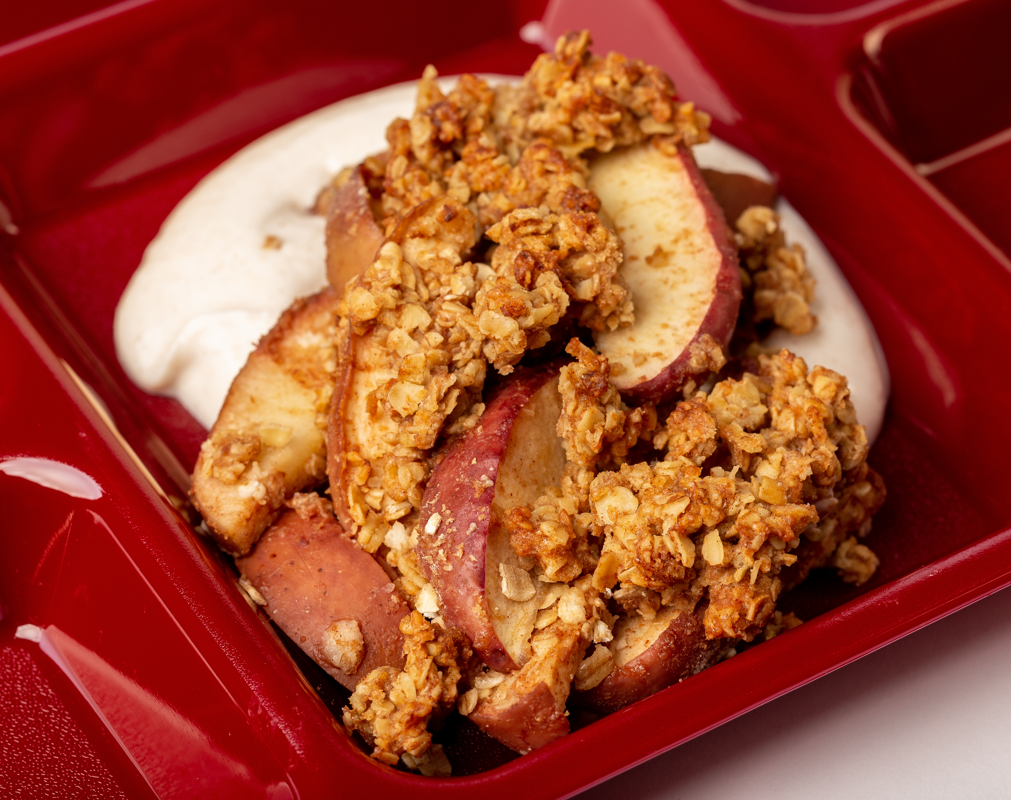
Flavorful & Local
Notes:
Say: And one more place we find flavor is in the foods we select! Purchasing whole produce keeps food fresh longer and can be used at peak ripeness. We also discussed in a previous webinar that local Ingredients spend less time traveling. This makes local foods a fresh and flavorful choice! You may not need as much seasoning when the original state of the ingredient provides great flavor. Next week, we will be cooking up this fresh, Virginia apple crisp with cinnamon yogurt.

Slide 14
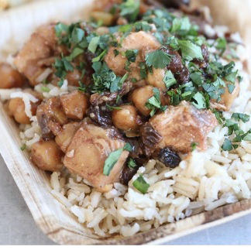
Greater Ingredient Control
Fewer supply chain issues
Confident in what you serve
Easier to make modifications
Incorporate cultural inclusivity
Notes:
Say: We absolutely want you to have control over flavor, creativity, buying local, and especially your health. Scratch cooking provides these controls in your school meals operation. When you select basic ingredients, there are fewer supply chain issues. You can be confident in what you're serving and be prepared to make modifications for special dietary needs.
And finally, our last favorite benefits is the creativity it provides for incorporating cultural inclusivity.. There are endless opportunities for cultural inclusivity, like the chicken tagine you see on the screen, and also for seasonal produce. We can completely transform recipes when we have different ingredients to work with from scratch.

Slide 15
Perceived Barriers
Cost
Labor
Culinary Skills
Notes:
Say: Before we discuss where to begin, we want to acknowledge common concerns we hear from directors all the time when discussing scratch cooking. There are fears that it will cost more money and be too labor intensive and advanced for staff.
Remember with costs, we have to balance food and labor costs. Convenience foods usually cost more than their scratch counterparts, but scratch cooking does require more labor. The good news is that many of you have the labor already; they just need to be trained on how to be more efficient in the kitchen.
We will continue to address all of these barriers as we move through the presentation.

Slide 16
Culinary Skills Workshop for Managers 2023 Survey Results
Perceived importance of increasing the amount of scratch cooking in managers’ schools
Measured the mean rating on a scale of 1 (very unimportant) to 5 (very important), which showed neutral to somewhat important ratings
  Pre-survey: 3.44
  Post-survey: 3.66
Change was statistically significant
Notes:
Say: In the Team Nutrition Culinary Workshops for Managers this summer, they were asked to rate perceived importance of increasing scratch cooking in their school from 1. Very unimportant to 5 very important. 474 managers completed the pre survey and 476 completed the post survey. On average, they had been in their current position for over eight years and had about 14 years experience in school nutrition. While a neutral to somewhat important rating was the overall rating in both pre to post surveys the change from pre to post was statistically significant showing that just one day of focusing on the importance of scratch cooking and teaching culinary skills, resulted in greater interest and hopefully buy in.

Slide 17
Culinary Skills Workshop for Managers 2023 Survey Results
Measured the mean rating on a scale of 1 (very unimportant) to 5 (very important)
Perceived importance of increasing the amount of locally procured foods offered in managers’ schools on the post-survey
  Mean rating: 3.60
  Neutral to somewhat important
Perceived importance of increasing offerings of culturally inclusive meals in manages’ schools on the post-survey
  Mean rating: 3.56
  Neutral to somewhat important
Notes:
Say: We also asked these two perceived importance questions. Increase the amount of locally procured foods and increase cultural inclusive meal offerings. Both were rated on average between neutral and somewhat important and there was not a significant change after the workshop. This could be due to lack of purchasing control and menu planning.

Slide 18
Where Do You Begin?
Notes:
Say: Where do you begin? Start small. Change can be hard for anyone, and educating your team and having some buy-in is important. We can't always make everyone happy, but by starting with a few simple changes and delicious recipes, more and more team members will enjoy cooking from scratch!

Slide 19

Inventory
Equipment
Ingredients
Labor
Staff morale
Community support
Notes:
Say: Start by taking inventory. What are your team's needs and your kitchen's needs? We'll examine equipment, ingredients, labor, staff morale, and community support.

Slide 20
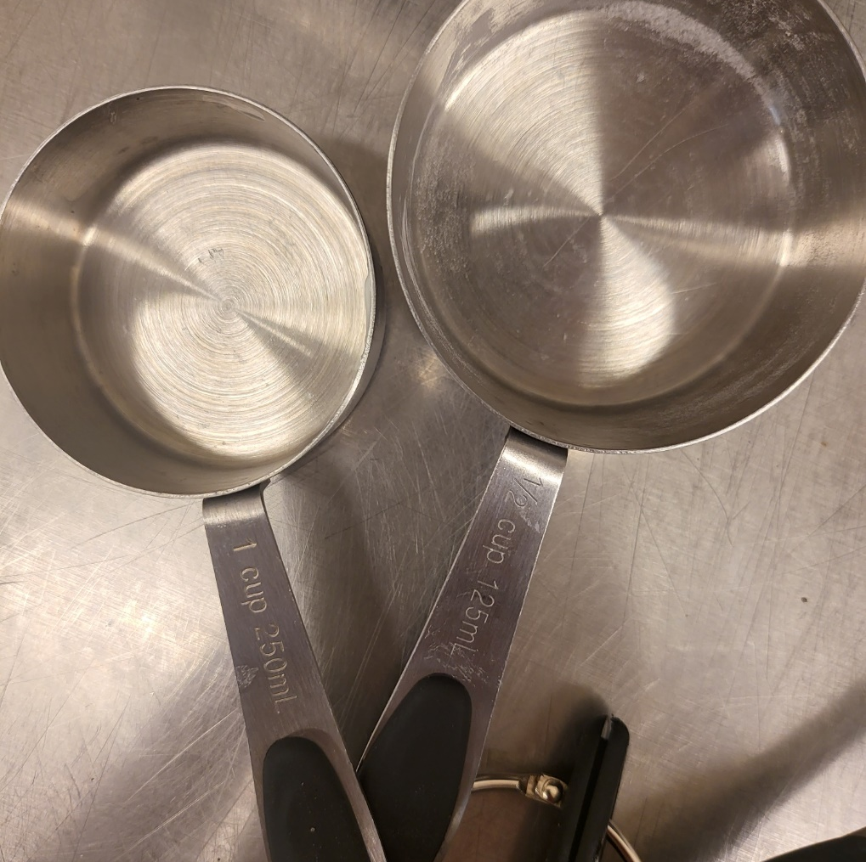
Equipment
Knives and cutting boards
Measuring cups and spoons
Mixing bowls
Whisks
Spatulas
Bench scrapers
Mixing spoons
Notes:
Say: Let's begin with equipment. Some people complain that they lack time to scratch cook. They might be spending lots of extra time roaming the kitchen looking for equipment or using the wrong piece of equipment for the job! Outfitting your kitchens with these tools will save time and boost morale. When taking inventory, inspect the quantity and quality of these items. Every kitchen should have good chef's knives, serrated knives, paring knives, and cutting boards. To keep knives sharp, it's important to have a honing rod and a knife sharpener. A dull knife can make a top chef look like a novice. And don't forget to teach your staff to keep the knives out of the dishwasher! The cutting boards need to be large enough to handle whole fruits and vegetables.
Measuring cups and spoons for both dry and liquid measuring are necessary at each cooking station. See if you can spot what’s wrong with these measuring cups in the photo and write it in the chat. Measuring tools provide consistency between schools and recipes. Take a moment to think about your personal restaurant experiences. You return to restaurants because you enjoyed the food and the recipes. You expect to receive the same flavors and experience each time you visit. Our students expect the same when they dine with us. Measuring cups and spoons vary in size. Try to purchase the same brand and quality throughout your division. Make sure they are NSF certified.
Have you ever tried to mix a large amount of food in a tiny bowl? It's a mess! Various sized mixing bowls, whisks, spatulas, bench scrapers, and spoons are important to work efficiently in the kitchen. With the proper equipment, the amount of time it takes to do a task can be cut significantly!

Slide 21

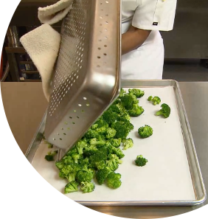
More Equipment
Commercial grade blenders & food processors
Storage containers
Sheet pans
Notes:
Say: Let's continue through the best equipment to have on hand when scratch cooking.
Commercial grade blenders and food processors are essential if you plan to make dressings, smoothies, refried beans, sauces, and/or salsas. Food processors speed up the time it takes to process fruits and vegetables. We cook in large quantities, so expecting someone to chop and dice several hundred servings of something by hand is not always realistic. This summer, we gave away a sectionizer at each culinary workshop…next week there will be more door prizes.
Storage containers are important for preparation. Some scratch-made recipes can be made earlier in the week for future use or to use in multiple recipes and need to be stored. Storing and labeling these foods is essential for organization and food safety.
While everyone has sheet pans, do you have enough? Are they a high gauge of metal? The higher the gauge, the thinner the metal and more likely they warp. When scratch cooking, sheet pans are used for muffin bars, roasted vegetables, flatbreads, properly cooling blanched vegetables (as you see in the broccoli image above), and preparation for the next day. If schools need more sheet pans, they may improvise and either pile too much food on one tray or use the incorrect pan. These decisions cost you money because the food quality will suffer, and as a result, you will lose customers.

Slide 22
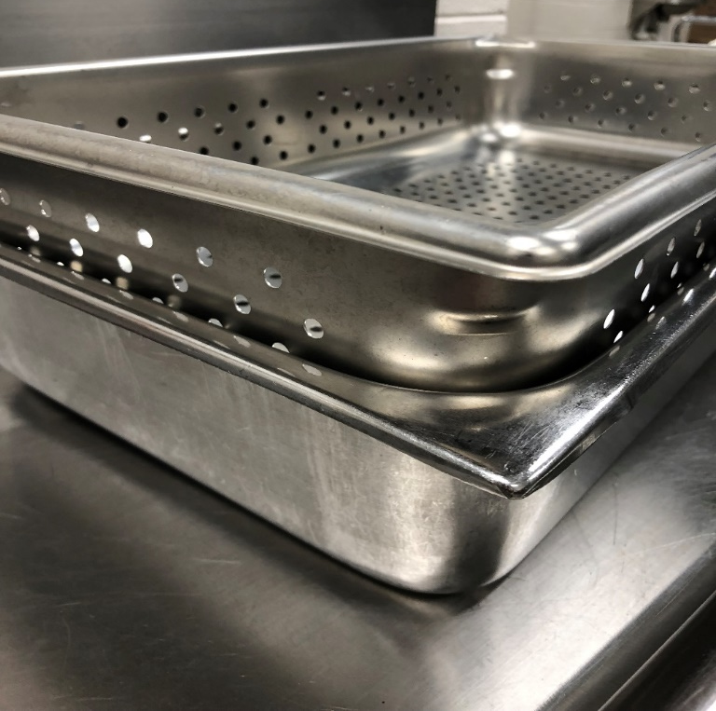
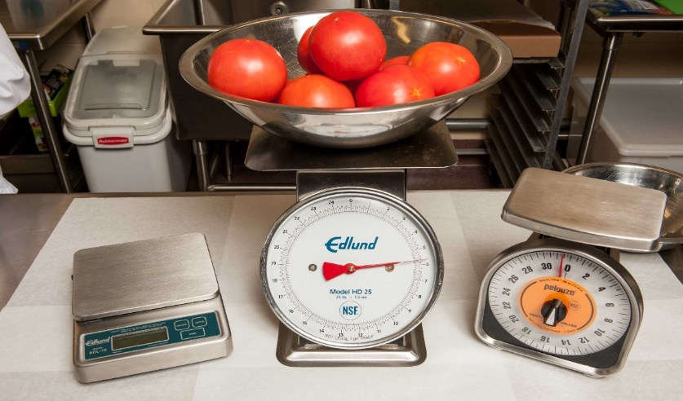
Small Equipment
Steamtable pans
Perforated Pans
Scales
Notes:
Say:
We visit a lot of schools that do not have any or nearly enough perforated pans. To increase speed and quality, vegetables need to be steamed in a perforated pan. The holes allow the steam to reach the food faster and more evenly as seen in the photo. Perforated pans can also be used to cook pasta quickly in batches in the steamer. And remember, sometimes you need a solid steamtable pan and they should be married, not divorced like you see in the photo.
Finally, don't forget about GOOD commercial grade kitchen scales. Not all scales are created equally OR treated equally. Consider investing in digital scales rather than spring loaded. Proper training on weight versus volume and how to tare a scale must be taught to every team member. Team members should also be trained on how to properly read a scale, whether digital or spring. Using scales correctly ensures not only a delicious recipe, but also the proper amount of nutrition for your students and compliance.

Slide 23
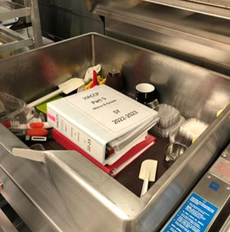
Large Equipment
Multiple ovens
Tilt skillet
Steamers
Combi ovens
Notes:
Say: Having multiple ovens ensures items can be cooked efficiently at the proper temps for quality. How? For one thing, there's less opening and closing of one oven. When an oven is constantly opened and closed, the heat is lost and compromises the quality of the recipe. It also takes longer to cook and can dry out the items. Beautifully roasted potatoes should be cooked at about 400 degrees Fahrenheit, whereas a muffin bar or baked pasta should be closer to 350 degrees Fahrenheit. If these menu items had to share an oven, you would have to compromise and choose a temperature in between and hope your cooks know how to adjust the cook time of the recipe. Product quality could suffer.
Tilt skillets are not used for storing spices, production records, holiday décor, or purses! We know some of you know what we are talking about! We love tilt skillets because they are efficient and versatile. They can be used to cook a wide variety of foods in large batches, which can save time and labor. They essentially serve as a giant skillet or saucepan. They are good for simmering soups, stews, and sauces. They can also sauté vegetables, meats, and poultry, or even be used to make fried rice or grilled cheese sandwiches. The large cooking surface allows for a lot of food to be cooked at once without overcrowding. This helps to ensure that each piece of food has enough contact with the hot surface to brown properly. This browning cannot be achieved in a steamer. Speaking of steamers, you can even turn a tilt skillet into a steamer by utilizing perforated steamtable pans.
And finally my favorite, the combi oven. It's a pricey piece of equipment, but combi ovens have several advantages over traditional ovens. They work by circulating hot air and steam around the food. This allows the food to cook quickly and evenly, while also preventing it from drying out.

Slide 24
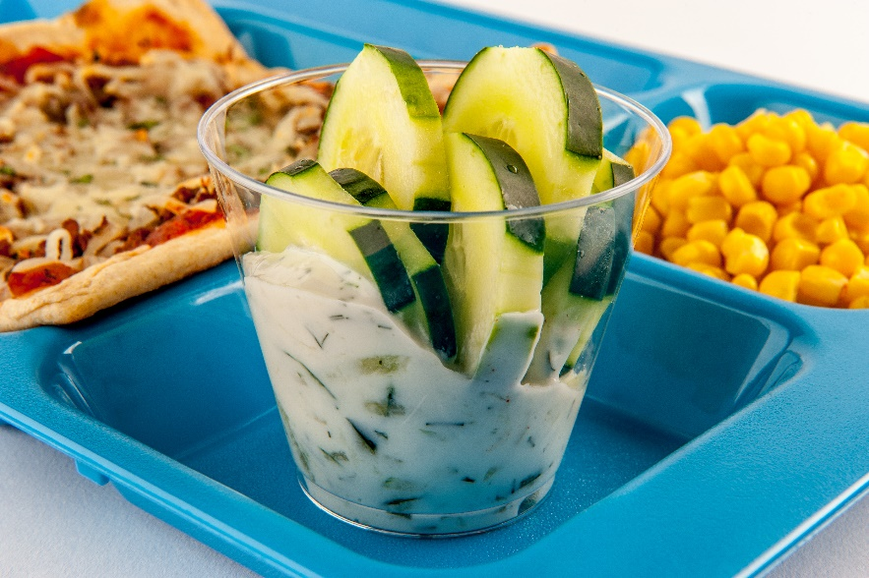
Cooler/Freezer Ingredients
Dairy products – cheeses, plain yogurt
Eggs
Unseasoned lean meats and meat alternates
Flatbreads
Fresh and frozen fruit
Fresh and frozen vegetables
Notes:
Say: We have a list of a few cooler and freezer staples, too. These items are all versatile, almost all available through USDA Foods, and can be used in multiple recipes. Dairy products shine in many scratch made recipes. Having a variety of shredded and sliced cheeses provide options when developing recipes. Vanilla yogurt is a perfect ingredient for many sweet recipes such as parfaits, smoothies, and quick breads, but plain yogurt is more versatile in sweet or savory scratch recipes. It's a blank canvas! Plain yogurt can be sweetened with honey and fresh or frozen fruit. It also provides a creamy texture for chicken or tuna salad, parfaits, smoothies, dressings, and quick breads. Plain yogurt is found in many culturally inclusive recipes. Raita is a condiment or side dish made from yogurt, spices, and vegetables. It is often served with curries and other Indian dishes. Also, tzatziki is a Greek sauce or dip made from yogurt, cucumbers, garlic, and dill. It is served with grilled meats, flatbreads, and vegetables.
What about eggs? I don't know about you, but I think cooking scratch recipes without eggs would be challenging! Tacos, frittatas, fried rice, and baked goods! Depending on the size of your operation, you might want liquid eggs and regular eggs, perhaps from a local farmer!
Unseasoned lean meats and meat alternates allow room to create recipes that your students enjoy, meet the guidelines, and keep YOU in control. Want a spicier taco meat or less sodium in your meatballs? There's no way to call a manufacturer and ask for them to quickly spice it up for next month, but you and your menu planner can! Don't wait for a manufacturer to make the "right" seasoning or formulation.
Whole grain flatbreads have become a favorite among our chef team. You can make flatbread pizzas, sandwiches, and more.
And finally, include various high-quality frozen fruits and vegetables, ideal for cooking up in a variety of ways.

Slide 25
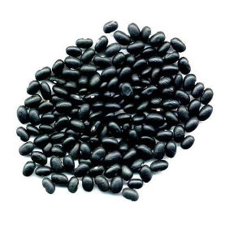
Dry Ingredients
Spices & herbs
Mayonnaise
Oil - canola and/or olive
Vinegar
Canned tomato products
Canned or dry beans
Nut/seed butters
Baking supplies (white whole wheat flour, baking powder, baking soda, oats)
Onion and garlic
Notes:
Say: Next, you want to take inventory of your ingredients. Are the dry storage areas in your kitchens packed with all convenience foods or do they contain simple ingredients that promote scratch cooking? Believe it or not, scratch cooking can actually help you reduce inventory, which could result in cost savings. You probably have some spices and herbs, but do you have enough variety for all the recipes you want to prepare? Mayonnaise, oil, and vinegar can be used to create a variety of dressings. Oils are also used to brown foods, whether in the tilt skillet or oven. Since the idea is to cook more from scratch, consider purchasing oil that is good for your student's health, either canola or olive. Vinegars can be used to brighten flavors and help reduce sodium.
Canned tomato products, canned or dry beans, and nut/seed butters are all available through USDA and can be used in so many dishes. Canned tomato products can be used in sauces, soups, stews, pasta dishes, rice recipes, and many more. Beans can also go in soups, stews, and rice dishes, and also wraps, burritos, and salads. Nut and seed butters are often used in classic sandwiches, but they can also be used in smoothies, sauces, and baking. One of our favorites is in our PBJ Parfait!
We'll look at a muffin bar here shortly, and you will see that a few staple baking supplies creates delicious scratch quick bread recipes.

Slide 26
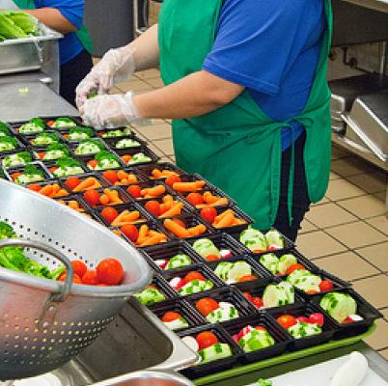
Labor
Current culinary skill level
Training
MPLH
Organization
Notes:
Say: Think about each of your schools and their current culinary skill level.
Do your employees have basic culinary skills mastered? Do you provide culinary training?
Do any of your schools currently use scratch recipes?
If yes, do scratch recipes look and taste the same at each school?
Do you have enough employees to transition to scratch cooking at your schools? Do you know the MPLH at each school, and is it shared with staff?
Are your kitchens well run and organized?
If you answered "no" to some or all of these questions, starting with a few speed scratch recipes is a good place to start. It's always important to educate your teams on why the changes are being made to a particular recipe, including but not limited to flavor profile, nutritional content, ingredients, budget, and customer satisfaction. Our students are part of a different generation. They enjoy global flavors, and we know that we must reduce added sugars and sodium to keep them healthy. And always taste test and ask for team input regarding new recipes with your team along the way! We need that buy in!

Slide 27
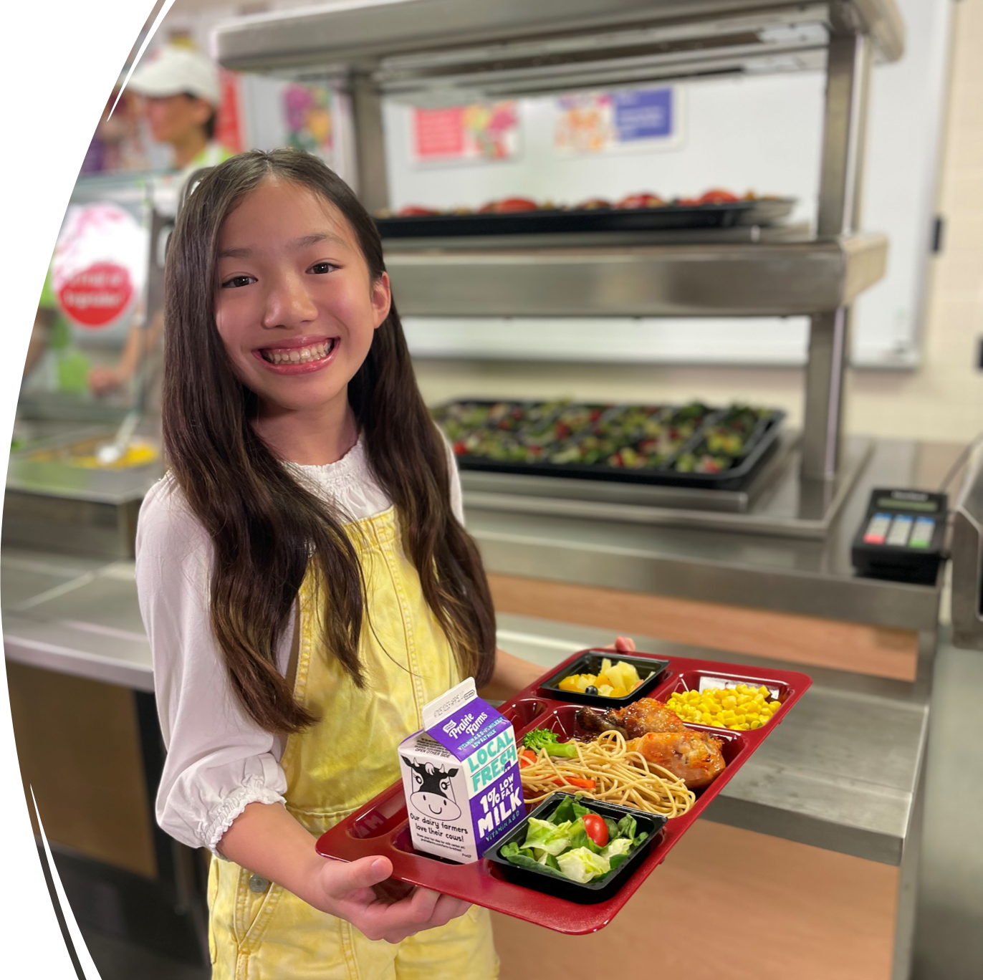
Community Support
Getting community groups and stakeholders involved in your school
Notes:
Say: And finally, take inventory of your community's support. Do your parents and students want more scratch cooking? What about administration? Please take a moment and share in the chat about your experience with your community. This summer managers rated this close to neutral on a scale from 1 to 5.

Slide 28
Recipe Development
Scratch & Speed-scratch
Notes:
Say: We discussed how to evaluate your programs' readiness for scratch cooking. Now, it's time to look at recipe development.

Slide 29

Where to Start
USDA Recipes
VDOE Recipes
Healthy School Meals
Current Recipes
VA Standardized Recipe Development Manual
Notes:
Say: Incorporating speed scratch recipes and scratch recipes into your menu doesn’t mean writing every recipe from scratch. There are lots of great resources available. Here's where you can R&D, rip off, and duplicate! USDA has a great selection of recipes, along with VDOE! Healthy School Meals is another online resource with school nutrition contributors from around the US. You can also use Virginia Harvest of the Month recipes and the Virginia Standardized Recipe Development The Manual is located on our Harvest of the Month webpage forget to use your current recipes! Transforming convenience foods to speed scratch recipes and then into scratch recipes is a great way to make changes slowly.
Harvest of the Month webpage: https://www.doe.virginia.gov/programs-services/school-operations-support-services/school-nutrition/harvest-of-the-month-program

Slide 30
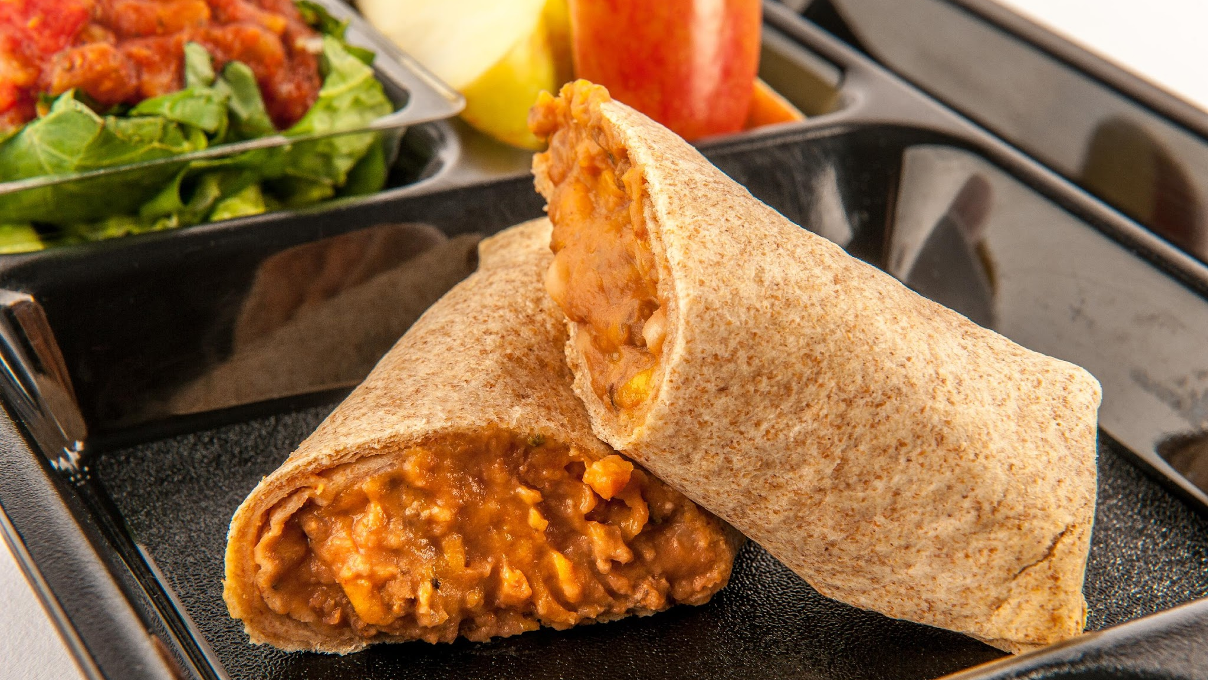
From Convenience to Scratch
Notes:
Say: Let's walk through an example of taking a convenience menu item to a scratch recipe at Storyville County Schools.

Slide 31
Convenience Burrito
Benefits
Challenges
Minimal labor
Product consistency
Limited flavors
Sodium concerns
Undesirable textures of meat and/or tortilla
Dependent on processor/distributer
Environmental concerns
No creativity
Notes:
Say: There's comfort in knowing that there's minimal labor involved with a convenience (heat and serve) burrito, but the challenges definitely exceed the benefits. The challenges are not easy to overcome. In fact, some of them you cannot change if you stick to a packaged burrito. The meat and tortilla's flavor, sodium, and texture are all unchangeable. You are dependent on the processor and distributor. The packaging is going into the landfill and there's no creativity.

Slide 32
Convenience to Speed Scratch
Speed scratch
  Value-added food products with additional ingredients
  Minimal production steps
  Produce a student-approved menu item
Notes:
Say: A packaged beef and cheese burrito consists of a tortilla filled with ground taco meat and cheese. Remember that the definition of speed scratch is that it incorporates value-added food products with additional ingredients, utilizing minimal production steps, to produce student-approved menu items.

Slide 33

Speed Scratch Burrito
Value-added food products with additional ingredients
  Added canned pinto beans
Minimal production steps
  No change to taco meat
  Shredded cheese
Produce a student-approved menu item
  New tortilla
    Local bakery
    Softer texture
    Easier to roll
    Student approved!
Notes:
Say: Let's review what our dietitian chef team came up with for our Division. We chose to add canned pinto beans to the taco meat. This increases the fiber and still qualifies as a m/ma. Adding plants whenever possible boosts nutrition. We decided to use a pre-seasoned taco meat because our team isn't quite ready to cook raw ground beef and season it ourselves, and shredded cheese. We did however start purchasing a delicious tortilla from a local bakery that the students are familiar with. In fact, the owner's grandchildren attend one of our schools!
Do you see how these changes brought life to this recipe? It also brought nutrition and flavor. We want our recipes to tell stories, so our customers take pride in dining with us. They remember and care about these stories!

Slide 34
Speed-Scratch Benefits & Challenges
Benefits
Challenges
Added more plants
Selected tortilla
Incorporated local foods
Limited flavors & use of meat
Sodium
Undesirable textures
Dependent on processor/distributer
Notes:
Say: Looking back at our benefits and challenges. Speed-scratch helped even them out. We added plants, selected a better tortilla, and incorporated local foods. There's more control over the ingredients and quality of the final product. Students are happier and you can add or change ingredients as you please! BUT, the taco meat comes fully cooked and seasoned, and if the students don't enjoy the texture or the flavor, there's not much we can do. We cannot remove any sodium. We are also still dependent on the processor and distributer for this taco meat. Let's try to take one more step!

Slide 35
Speed-Scratch to Scratch-Based
Scratch-based
  Multiple culinary techniques
  Incorporating ingredients as close to their original state
  Produce a student-approved menu item
Notes:
Say: Now we're going from speed-scratch to scratch-based. To review, scratch-based food preparation utilizes multiple culinary techniques within a recipe while prioritizing incorporating ingredients as close to their original state as possible to produce student-approved menu items.

Slide 36
Scratch-Based Burrito
Multiple culinary techniques
  Cook meat in tilt skillet or steamer
  School made spicy salsa with VA local tomatoes
Incorporating ingredients as close to their original state
  Raw meat
  School-made taco seasoning
  Canned pinto beans
  Shredded cheese
Produce a student-approved menu item
  Fresh and flavorful!
Notes:
Say: Let's look at what we decided to do! We decided to purchase raw meat. We can cook it in the steamer and season it with school-made taco seasoning. We spice it up for the middle and high school students with our secret spicy salsa using Virginia's local tomatoes. They love it! We kept the canned pinto beans and shredded cheese from our speed scratch version. We can modify the sodium at any time!

Slide 37
Scratch-Based Benefits & Challenges
Benefits
Challenges
All the speed scratch benefits plus:
  Local ingredients
  Flavor variation
  Control sodium and added sugars
  Ingredient versatility
  Not depended on processor/distributor
Culinary skill
Labor
Equipment
Notes:
Say: The benefits list keeps growing! The meat, spices, herbs, and beans are always available, and we have a good relationship with our local bakery. The food is fresh, flavorful, nutritious, and we are in control. We recognize the challenges still exist, so we are only transitioning a few recipes to scratch-based at this time. We will continue to grow our culinary skills, balance labor, and improve our inventory.

Slide 38
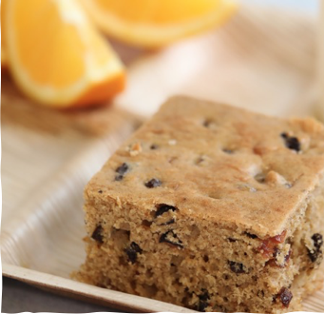

Packaged Muffin to Scratch Muffin
Ingredient control
Marketing
Taste Testing
Notes:
Say: Let's quickly look at one more example, taking a packaged muffin to a scratch-based muffin. We encourage you to carefully read your ingredient labels. While the nutrition fact panels of many whole grain muffins align with our regulations, the ingredients can be less desirable for our students. If making a scratch made muffin or muffin bar, you can use real fruit and flavors from spices and extracts. Another bonus is that the smell of the kitchen travels down the hallway and brings students to the cafeteria. We guarantee that students will tell their parents that they want to eat breakfast the next time that muffin bar is served. Remember to taste test with your team and also with your customers!
Do: Read off a few, and ask for volunteers to provide elaboration or share a success story regarding the convenience to scratch cooking journey.

Slide 39
Menus
Notes:
Say: Now that we reviewed how to transition recipes to scratch-based, let's discuss how to evaluate your menu for opportunities to make changes.

Slide 40
Menu Activity
Monday:
  Cheeseburger or hamburger
  French fries (from frozen)
  Burger salad
  Watermelon
Tuesday:
  Soft beef tacos (with frozen taco meat) or chicken quesadilla (convenience food)
  Spanish rice
  Refried beans (from can)
  Lettuce and salsa
  Grapes
Wednesday:
  Chicken nuggets or Sunbutter and jelly sandwich (individually wrapped)
  Whole grain roll
  Mashed potatoes (from dry)
  Canned green beans
  Mandarin oranges
Thursday:
  Orange chicken (pre-made kit) with brown rice or cobb salad
  Steamed broccoli
  Baby carrots
  Pears
Friday:
  Pepperoni pizza or cheese pizza
  Canned corn
  Side salad
  Apple slices
Notes:
Say: Take a look at the menu on the screen and think about what you could change to speed scratch or scratch recipes. Please add ideas to the chat! As you make comments, ask your self what local products you could use, and think about equipment that you are already using or may be missing.
Do: Provide feedback as comments come in, and share own ideas.
Say: These are all great suggestions! Some other changes you may consider are substituting scratch made seasoned potato wedges in place of French Fries from time to time. Could a burger be even more enticing if we offered a scratch made condiment alongside like a spicy honey mustard, or maybe topped with some sauteed mushrooms and onions? We could certainly make our own taco seasoning blend in bulk in advance then use in a recipe for scratch-made beef taco filling. Chicken quesadillas could be made in bulk, frozen, and cooked when needed. Maybe your existing refried beans from a can would benefit from some additional (added sodium-free) bean blend seasoning or some school made salsa. Spicy BBQ Roasted chicken could be a great sub for Chicken Nuggets. Certainly making sunbutter and jelly sandwiches in house would minimize plastic packaging and the perception that, “everything comes from a box”. Orange chicken could be a big winner with scratch made orange sauce where you control the sodium and the flavor profile. Using USDA Foods diced chicken simplifies the process. Pizza—we won’t mess with the pizza here! If you have a good quality pizza that the students enjoy, great! Could you personalize it a bit? Maybe offer spicy pepperoni pizza with fresh jalapenos on the cylce menu once per month? Or how about substituting some school-made flatbread style pizza once or twice on the cycle menu?

Slide 41
Start small, think big!
Notes:
Say: Start small, but think big! Even the biggest and most successful journeys start with one small step. It is important to be patient and persistent as you work towards your goals, but it is also important to celebrate your small successes along the way.

Slide 42
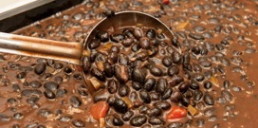


Market Your Program
Notes:
Say: We wanted to end with a note about marketing. You and your team work hard! Unfortunately, negative news travels faster than positive stories. As a director, it is up to you to market your program and teach your staff how to do the same. Don't give people time to guess or make an assumption. Attend meetings, advertise local foods, educate on the meaning of cultural inclusivity, provide taste testing, serve the school board YOUR SCHOOL SCRATCH-MADE recipes, and use social media to share the great things you are doing and maybe even where you would like to take the program in the future! Let them know that your program provides the best nutrition for the students!

Slide 43

Thank you!
Notes:
Say: Great work today! As we wrap up, remember that scratch-based cooking and even speed-scratch cooking allows you to be creative with the freshest and most flavorful ingredients. It will also help meet or exceed the transitional standards while adding local and culturally inclusive scratch items to your menus.

Slide 44

Questions
Notes:
Say: Thank you so much for being here today and participating in our webinar. We are excited to see and hear your new ideas as we travel through these webinars together!
Ask: Does anyone have any questions?

