Slide 1

Limiting Added Sugars and Reducing Sodium
Notes:
Do: Record webinar!
Say: Welcome to today's webinar, limiting added sugars and reducing sodium. The Healthy Hunger Free Kids Act and transitional standards have already begun to address sodium, but added sugars is new, and something we expect to come down the pipeline once the new rule is released.
The great news is that scratch cooking, and incorporating local, seasonal, and culturally inclusive foods, all can help reduce sodium and added sugars in school meals.

Slide 2
USDA Funding and Non-Discrimination Statements:
“This project has been funded at least in part with Federal funds from the U.S. Department of Agriculture. The contents of this publication do not necessarily reflect the view or policies of the U.S. Department of Agriculture, nor does mention of trade names, commercial products, or organizations imply endorsement by the U.S. Government.”
In accordance with federal civil rights law and U.S. Department of Agriculture (USDA) civil rights regulations and policies, this institution is prohibited from discriminating on the basis of race, color, national origin, sex (including gender identity and sexual orientation), disability, age, or reprisal or retaliation for prior civil rights activity.
Program information may be made available in languages other than English. Persons with disabilities who require alternative means of communication to obtain program information (e.g., Braille, large print, audiotape, American Sign Language), should contact the responsible state or local agency that administers the program or USDA’s TARGET Center at (202) 720-2600 (voice and TTY) or contact USDA through the Federal Relay Service at (800) 877-8339.
To file a program discrimination complaint, a Complainant should complete a Form AD-3027, USDA Program Discrimination Complaint Form which can be obtained online at: https://www.usda.gov/sites/default/files/ documents/ad-3027.pdf, from any USDA office, by calling (866) 632-9992, or by writing a letter addressed to USDA. The letter must contain the complainant’s name, address, telephone number, and a written description of the alleged discriminatory action in sufficient detail to inform the Assistant Secretary for Civil Rights (ASCR) about the nature and date of an alleged civil rights violation. The completed AD-3027 form or letter must be submitted to USDA by:
1. mail:
U.S. Department of Agriculture
Office of the Assistant Secretary for Civil Rights
1400 Independence Avenue, SW
Washington, D.C. 20250-9410; or
2. fax:
(833) 256-1665 or (202) 690-7442; or
3. email:
Program.Intake@usda.gov
This institution is an equal opportunity provider.

Slide 3
Welcome!
Notes:
Say: Remember that as we go through today’s webinar, the chat box is open for any questions and comments. We can learn a lot from each other during these times together. Please feel free to comment and ask questions in the chat anytime! We will monitor it together throughout this hour and would love some conversations.

Slide 4

Objectives
Explain why USDA's proposed rule focuses on reducing added sugars and sodium.
Identify top sources of added sugars and sodium in school meals.
Describe ways to reduce added sugars and sodium in school meals.
Determine one way to reduce added sugars or sodium in your division.
Notes:
Say: Let’s review today’s objectives.
Do: Review objectives.

Slide 5
Professional Standards – Learning Codes
Nutrition 1000
  Menu Planning (1100)
  General Nutrition (1300)
Notes:
Do: Review professional standards learning codes.

Slide 6
Added Sugars
Notes:
Say: Let's begin by discussing added sugars.

Slide 7


Sugar Definitions
Natural Sugars
Added Sugars
Notes:
Say: But first, let's make sure that we are clear on the definition of added sugars. They are often confused with natural sugars, and they are NOT one in the same. Natural sugars are found naturally in fruits, vegetables, and milk. Mother nature does have a bit of a sweet tooth.
Added sugars include granulated sugar, brown sugar, honey, agave, maple syrup, etc. and are added to foods to increase sweetness levels. We want to focus on limiting added sugars, not natural (unless diabetic).

Slide 8

Sugar Recommendations
Dietary Guidelines for Americans
  less than 10% of total daily calories
American Heart Association
  limit to 6 teaspoons/day (24 grams)
    4 grams = 1 teaspoon
Notes:
Say: We shared this statistic in a previous webinar, but as a reminder, the typical American child eats about triple the recommended amount of added sugars, half from food and half from drinks.
The Dietary Guidelines for Americans recommends that we keep added sugars to less than 10% of total daily calories. For more visual learners, we like the American Heart Association's recommendations. The AHA recommends limiting added sugars to 6 teaspoons/day for women and children (9 teaspoons for men) or 24 grams a day.
4 grams = 1 teaspoon of added sugar. This is helpful to remember when comparing nutrition fact labels among products.

Slide 9

4 Pillars of the Dietary Guidelines for Americans
Follow a healthy dietary pattern at every life stage
Customize and enjoy nutrient-dense food and beverage choices to reflect personal preferences, cultural traditions, and budgetary considerations
Focus on meeting food group needs with nutrient-dense foods and beverages and stay within calorie limits
Limit foods and beverages higher in added sugars, saturated fat, and sodium
Notes:
Say: You might recognize this slide from another webinar, but we wanted to emphasize the current missing element in school nutrition regulations, and that's added sugars. The DGA clearly states that we need to limit foods and beverages in added sugars. Our regulations currently address saturated fat and sodium, but not added sugars.

Slide 10
Added Sugar Health Implications
Cardiovascular disease
Alzheimer's and dementia
Colon cancer
Diabetes
High blood pressure
Cholesterol and triglyceride levels
Kidney disease
Liver disease
Obesity
Pancreatic cancer
Retina, muscle, and nerve damage
Notes:
Say: We live in a country that overloads children with added sugars. If you are a parent or grandparent, you know it is nearly impossible to go a day without your child being exposed to some sort of sweet treat, and when birthday parties hit on the weekends, forget about it. Cakes, candy, sugar sweetened beverages, and more. It's too much!
Oftentimes, people don't worry as much about what kids eat, thinking it's fine, they are young and active, they can afford to eat what they want. It's not about what they look like on the outside, but what's going on in the inside! And don't forget, 40% of children in this country are overweight or obese.
Consuming too much added sugars increases risk for the following...
Do: Review ailments on slide.

Slide 11
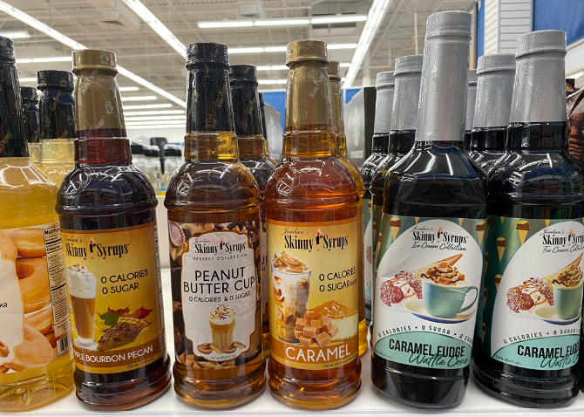
Added Sugar Taste Implications
Notes:
Say: Something else to think about - consumption of both sugar (and artificial sweeteners) may change palates or taste preferences over time, increasing desire for sweet foods, and making naturally sweet foods taste less sweet. We don't want kids that can't enjoy the natural sweetness found in fruit!
Sources:
Bartolotto C. Does Consuming Sugar and Artificial Sweeteners Change Taste Preferences? Perm J. 2015 Summer;19(3):81-4. doi: 10.7812/TPP/14-229. PMID: 26176574; PMCID: PMC4500487.
Vaziri A, Khabiri M, Genaw BT, May CE, Freddolino PL, Dus M. Persistent epigenetic reprogramming of sweet taste by diet. Sci Adv. 2020 Nov 11;6(46):eabc8492. doi: 10.1126/sciadv.abc8492. PMID: 33177090; PMCID: PMC7673743.
Wise PM, Nattress L, Flammer LJ, Beauchamp GK. Reduced dietary intake of simple sugars alters perceived sweet taste intensity but not perceived pleasantness. Am J Clin Nutr. 2016 Jan;103(1):50-60. doi: 10.3945/ajcn.115.112300. Epub 2015 Nov 25. PMID: 26607941.

Slide 12
Added Sugars in Schools
School breakfast: 17% of calories
School lunches: 11% of calories
Notes:
Say: The DGA recommend limiting added sugars to less than 10 percent of calories daily, yet school breakfasts currently provide about 17 percent of calories from added sugar and school lunches currently provide 11 percent. That means if a child eats both breakfast and lunch at school, 28% of the calories are coming from added sugars!

Slide 13
Added Sugars in the Proposed Rule
Breakfast cereals: no more than 6 grams per added ounce
Grain based desserts: limit to no more than a 2-ounce equivalent per week in school breakfast, including cereal bars, doughnuts, sweet rolls, toaster pastries, coffee cakes, and fruit turnovers.
Yogurt: no more than 12 grams of added sugars per 6 ounces
Flavored milk: limited to no more than 10 grams of added sugars per 8 fluid ounces, or for flavored milk sold as a competitive food for middle and high school students, 15 grams of added sugars per 12 fluid ounces
Notes:
Say: The proposed rule includes product-based limits beginning in SY 2025-2026. We thought you would like to see these spelled out again, so they are listed on the slide.
CACFP already has limits on added sugar, but the proposed rule plans to match CACFP to NSLP and SBP for consistency.
Do: Read Slide - Breakfast cereals: no more than 6 grams per added ounce. Grain based desserts: limit to no more than a 2-ounce equivalent per week in school breakfast, including cereal bars, doughnuts, sweet rolls, toaster pastries, coffee cakes, and fruit turnovers. Yogurt: no more than 12 grams of added sugars per 6 ounces. Flavored milk: limited to no more than 10 grams of added sugars per 8 fluid ounces, or for flavored milk sold as a competitive food for middle and high school students, 15 grams of added sugars per 12 fluid ounces

Slide 14
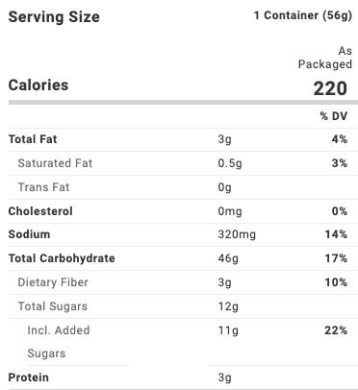
Example Cereal Label
Notes:
Say: Let's take a look at an example school cereal bowl, brand undisclosed! Look at added sugars. That's 11 grams. If I divide by 4, I can calculate the number of teaspoons. That's 2.75 teaspoons (picture that!) in just one bowl of cereal. That's before flavored milk is added to the meal, and we are only at breakfast. Remember, kids should limit added sugars to 6 teaspoons for the TOTAL day.

Slide 15
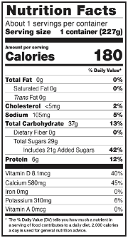
Example Yogurt Label
Notes:
Say: Now, let's take a look at a school 8 ounce (2 m/ma) yogurt product. This one is mind blowing – 21 grams of added sugars! That's almost a whole day's worth of added sugar: 5.25 teaspoons. Do we really want our kids eating that much sugar in just one meal?!

Slide 16

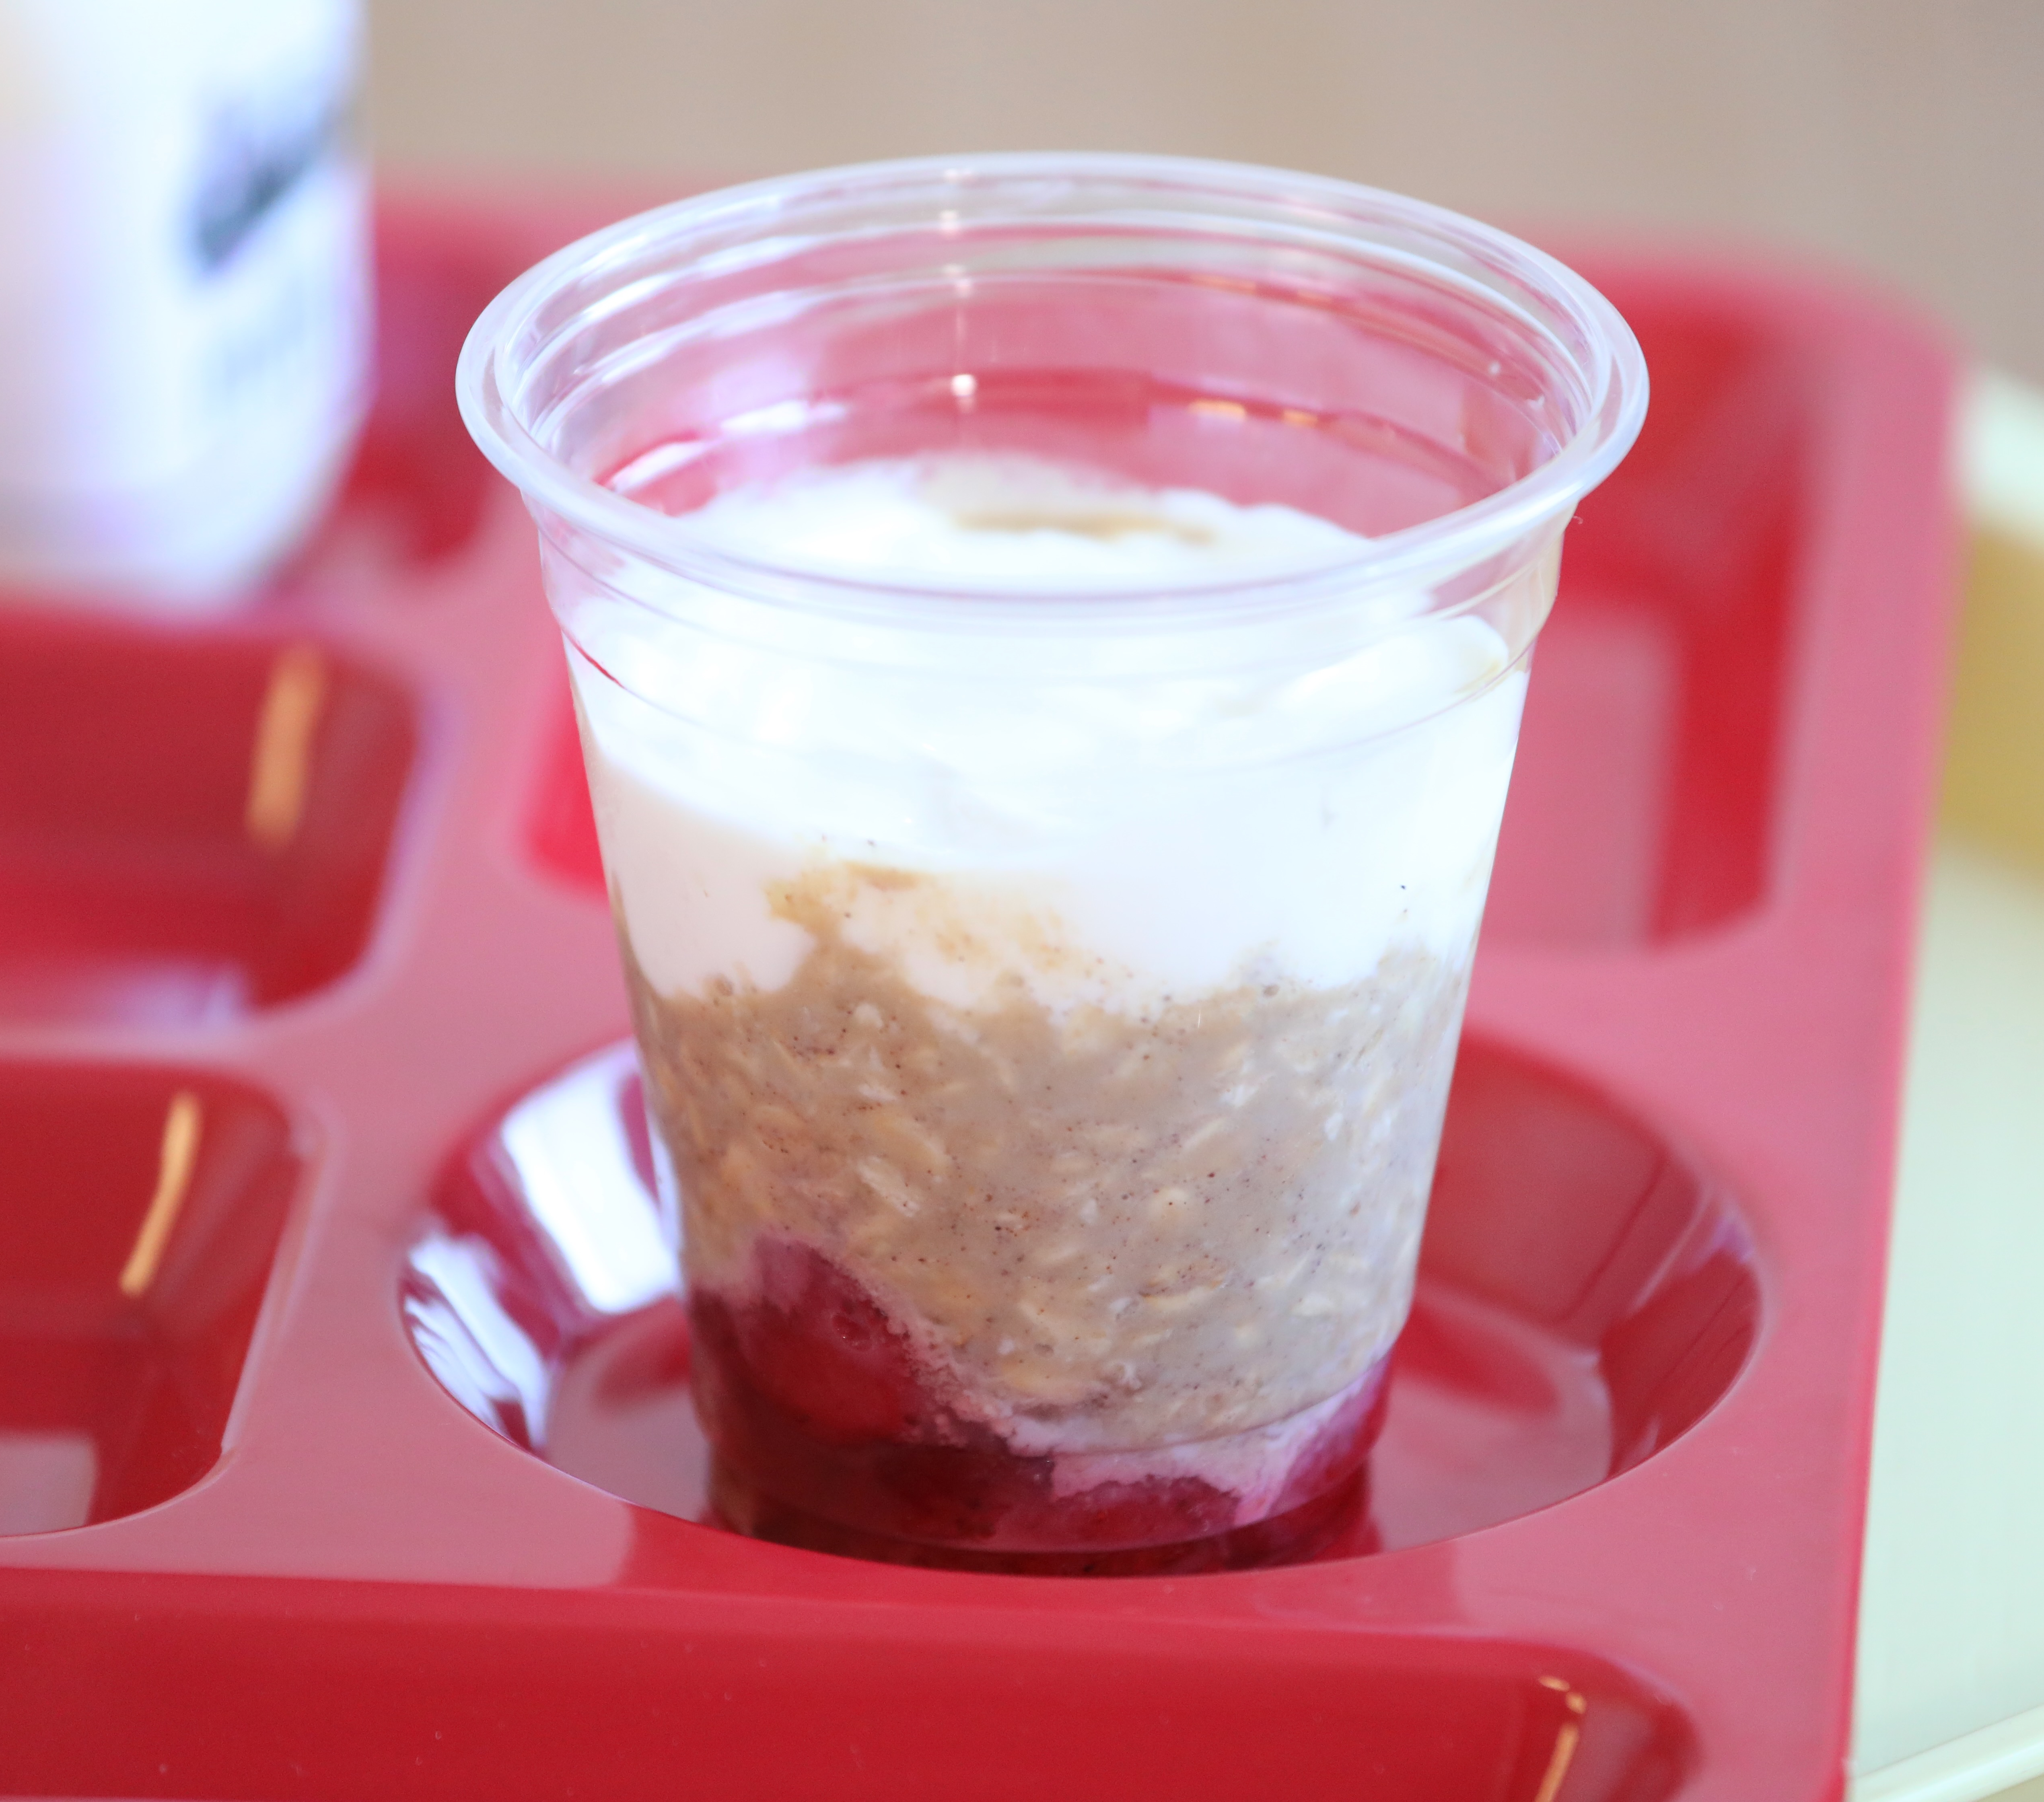
Ideas to Reduce Added Sugar
Cooking from scratch
Explore culturally inclusive items at breakfast
Consider plain yogurt
Work with local vendors
Notes:
Say: Obviously, there is work to be done by our manufacturers, but we can take steps to start reducing sugar before they get there.
First, cook from scratch. Then YOU can control the sugar.
Second, explore savory breakfast items. We tend to favor the sweet items when menu planning. This is a great time to consider culturally inclusive items, like beans with eggs, common in Hispanic cultures, at breakfast time.
Third, think about using plain yogurt when making smoothies or yogurt parfaits. You can sweeten it yourself with honey, powdered sugar, or jelly, and control the level of sweetness added.
Finally, work with local vendors to make changes to their products. It can be easier for smaller companies to make change faster than large corporations. Tell them what you want! It's a partnership.

Slide 17
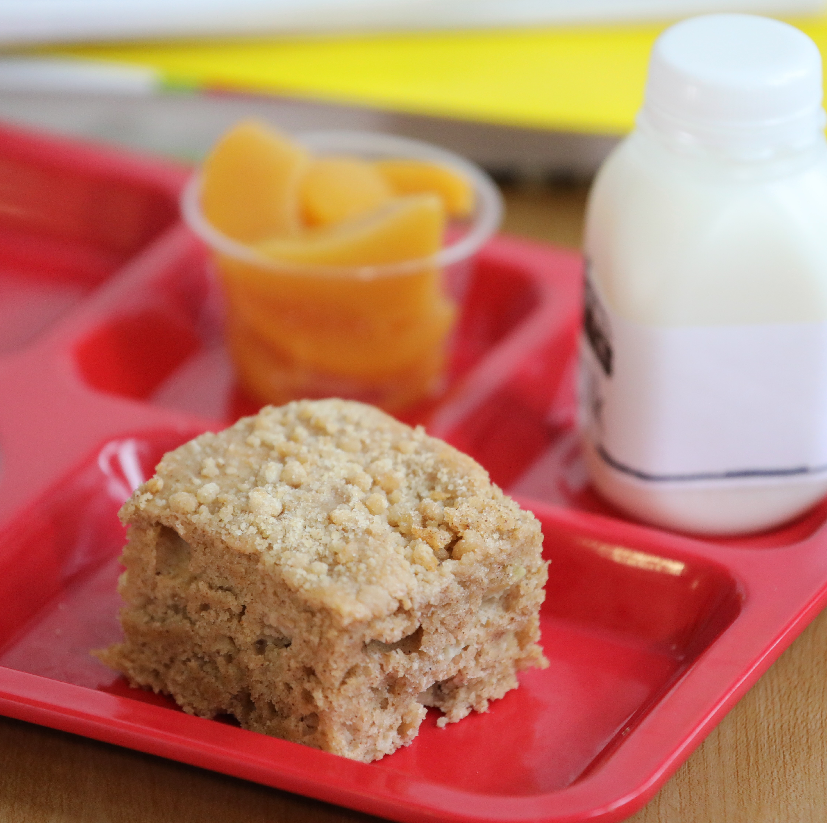
Items to Cook from Scratch
Granola
Oatmeal
Granola Bars
Muffin Bars
Notes:
Say: These are all great items to cook from scratch, and the smell from your ovens will have the whole school drooling with excitement. Remember, in addition to added sugar, you can sweeten foods using the natural sugars from fruits. We like to add mashed bananas to muffin bars to help cut back on the sugar needed.

Slide 18
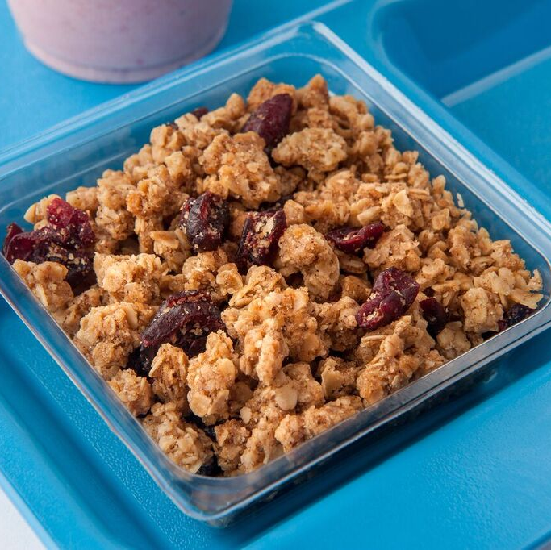
Demo – Reduced Sugar Granola
Notes:
Say: It's demo time! We first developed this recipe about 8 years ago! We went back to it though to see if we could lower the sugar, and guess what, we did! Remember, according to the proposed rule, breakfast cereals should contain no more than 6 grams of added sugars per dry ounce. This granola contains 5 grams! The cranberries add a little more, but are exempt from added sugar regulations. We could always change the dried fruit out with one that doesn't have added sugars, like raisins.
Take it away Chef Lindsey!

Slide 19
Sodium
Notes:
Say: Thank you, Chef Lindsey! That granola is fabulous on yogurt parfaits, and I cannot emphasize the delightful smell it leaves in your kitchen. Let's move on to sodium!

Slide 20
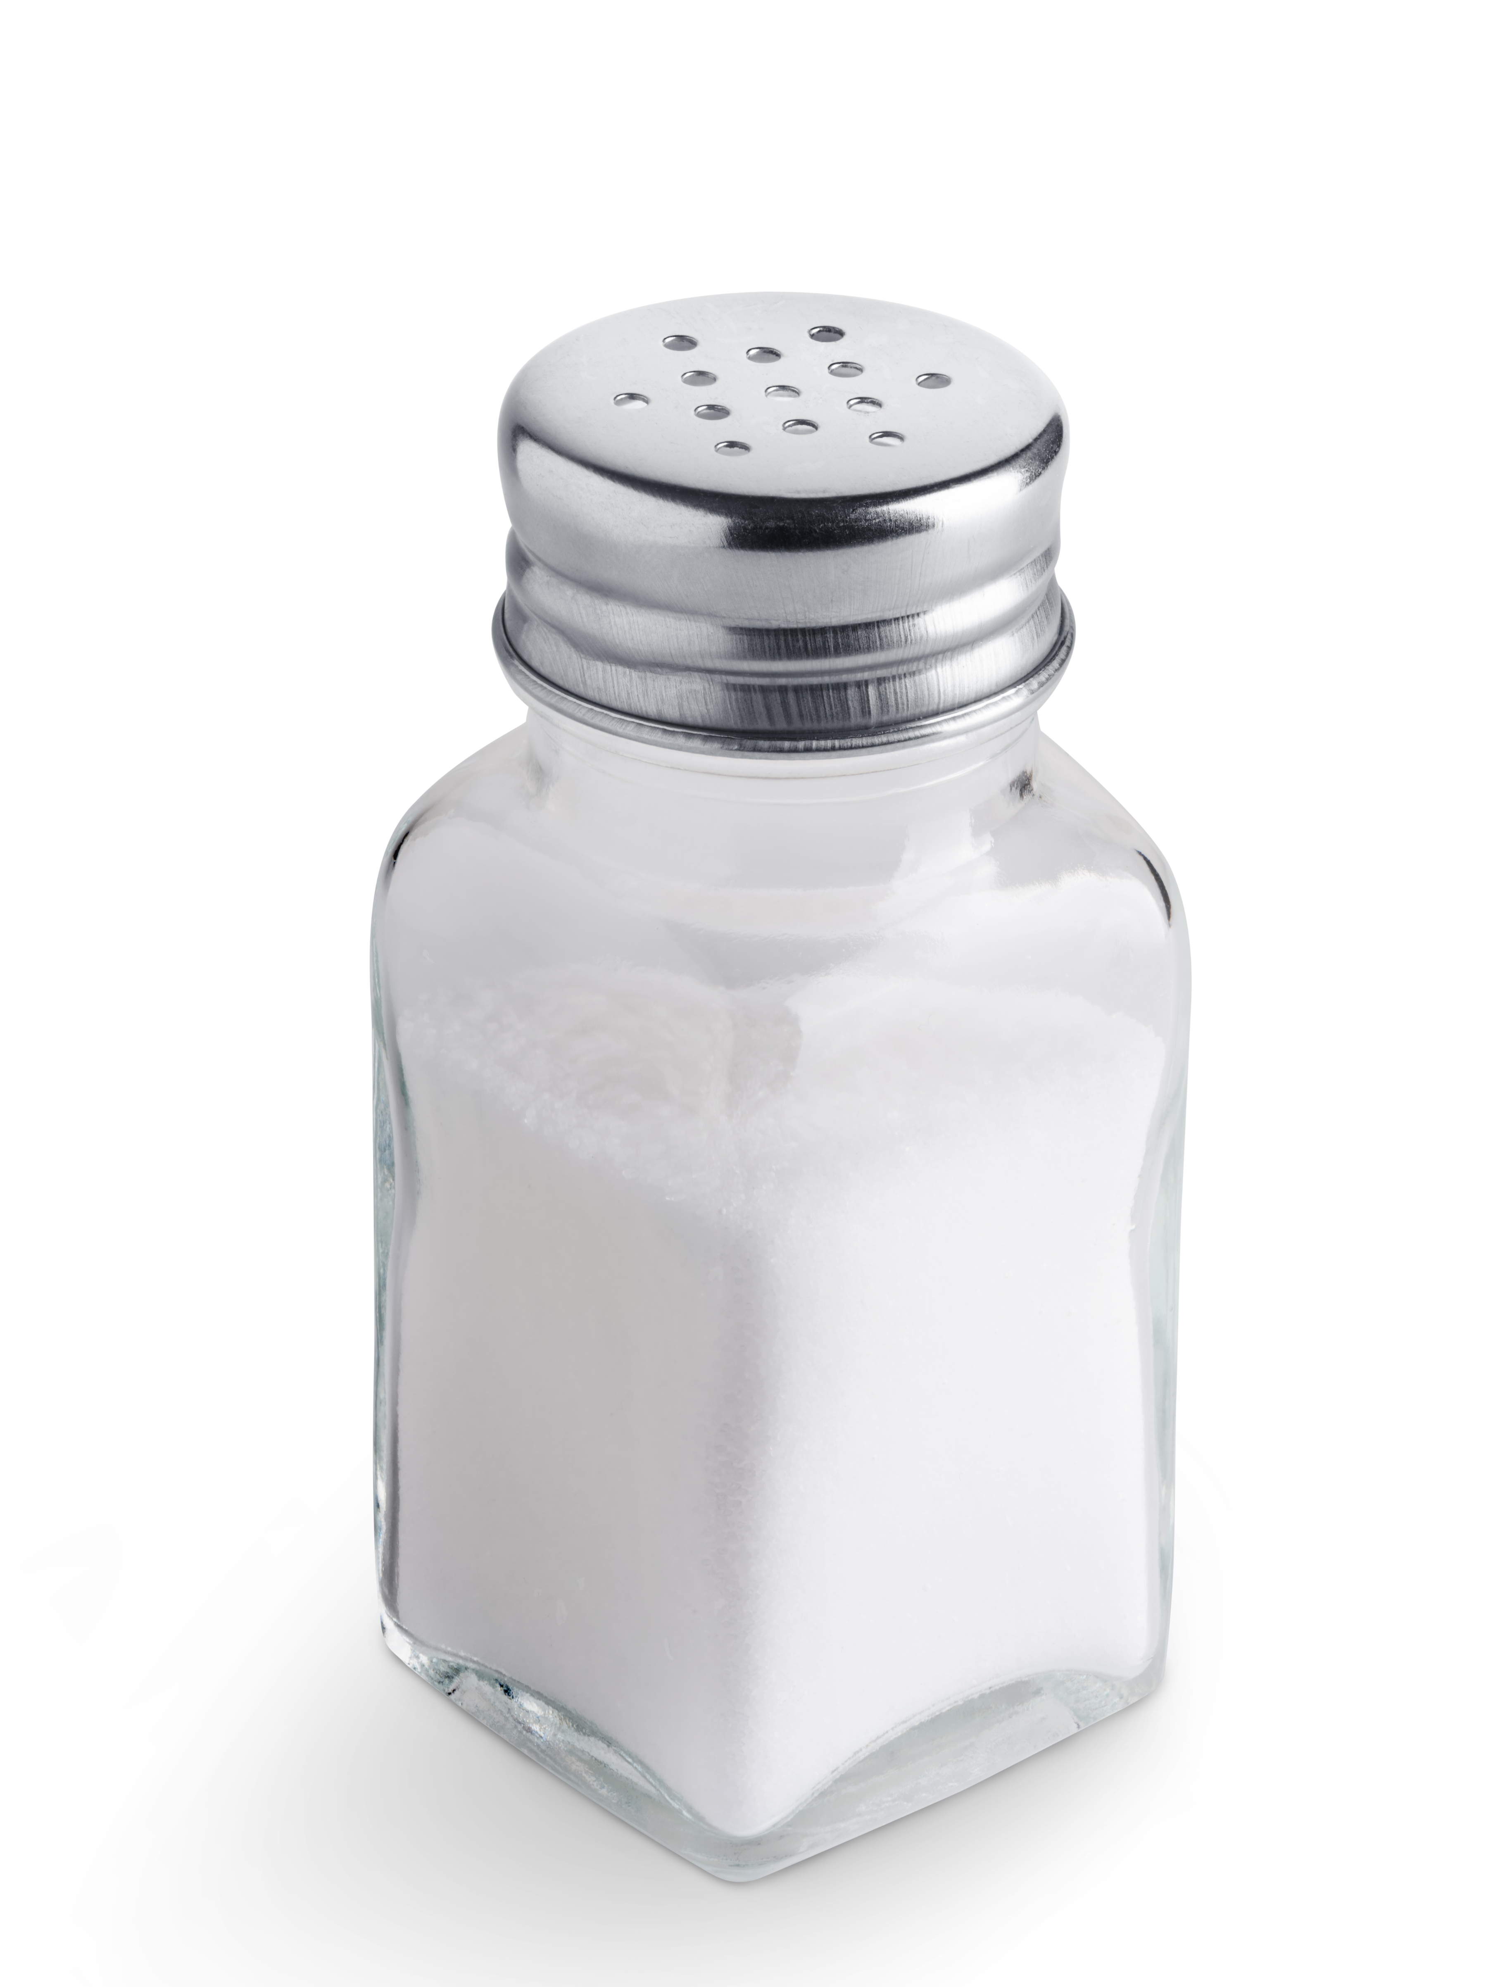
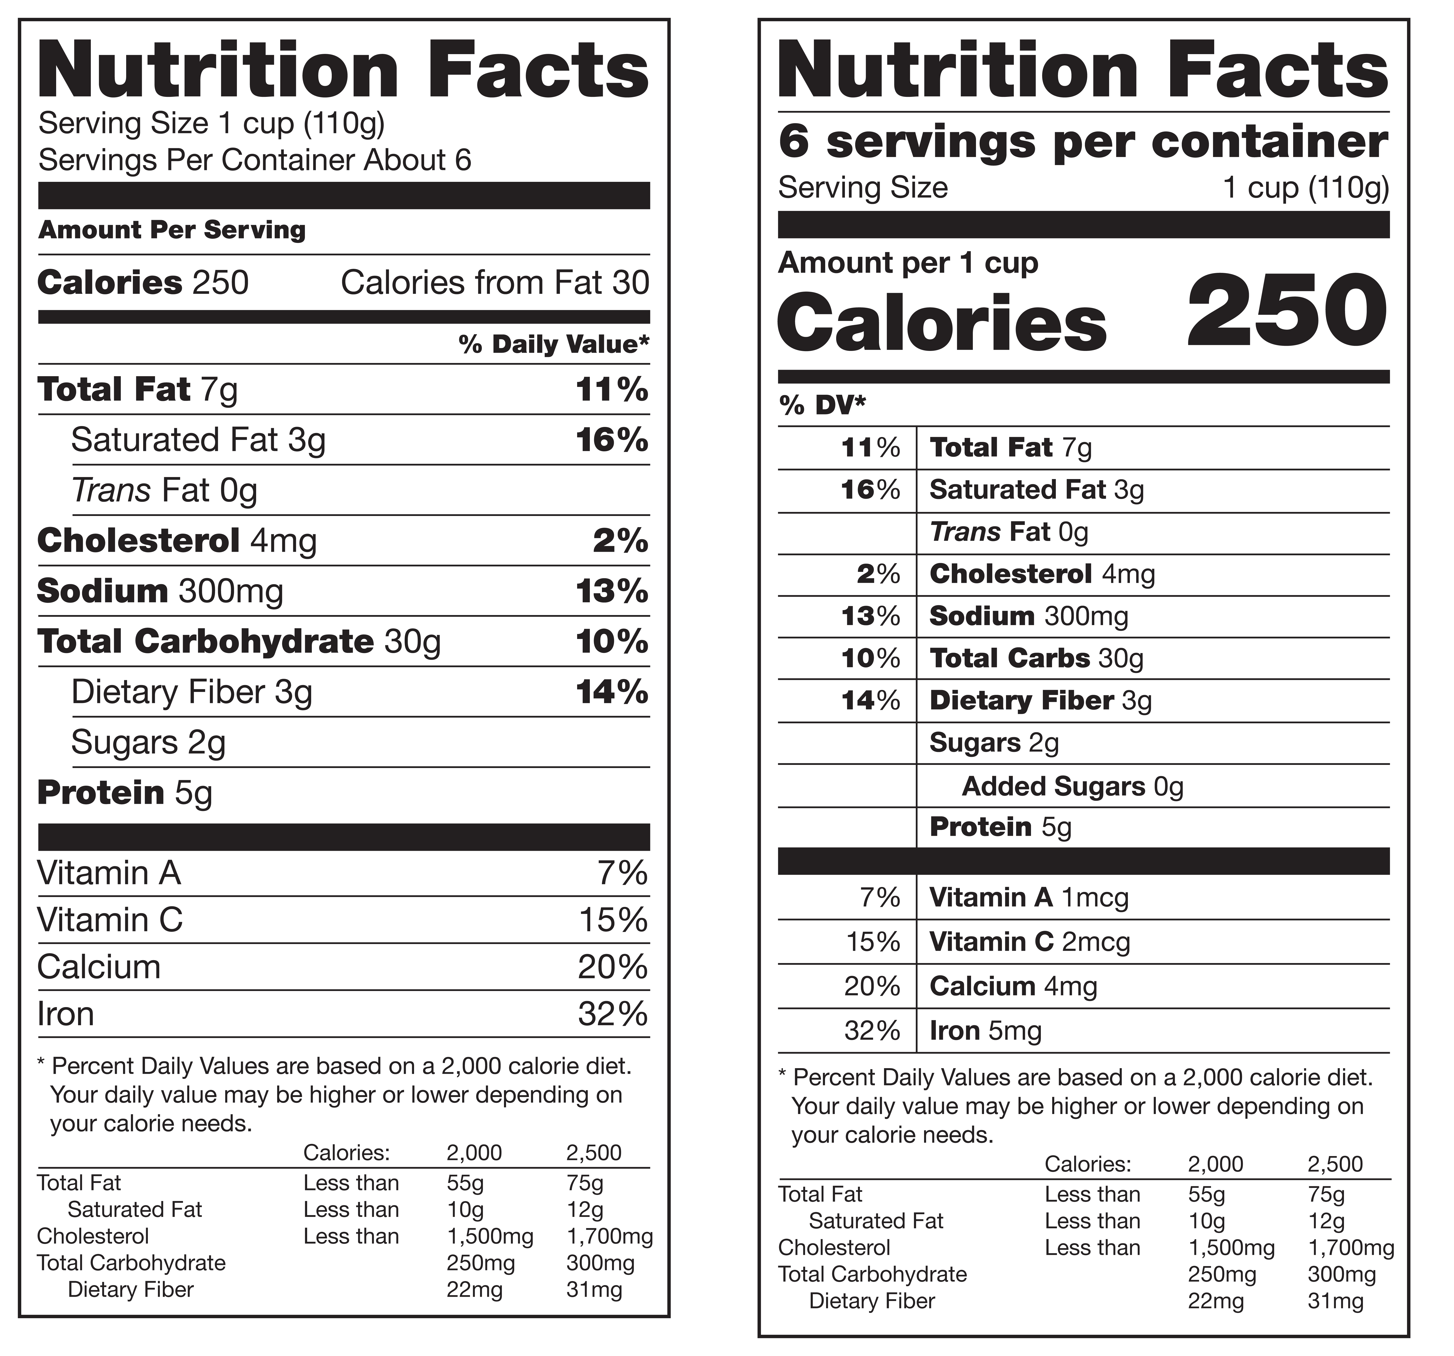
Sodium Definitions
Sodium
Salt
Notes:
Say: Oftentimes, the terms sodium and salt are used interchangeably, but they are not the same. Sodium is a mineral, and one of the elements found in salt, but also in other ingredients like sodium bicarbonate (baking soda) or sodium nitrite (a preservative).
Salt is actually a chemical compound made of sodium and chloride, which is added to food

Slide 21
Sodium Recommendations
Ages 4-8: 1500 mg/day
Ages 9-13: 1800 mg/day
Notes:
Say: For adults, the Dietary Guidelines for Americans recommends limiting sodium to less than 2300 mg/day and to less than 1500 mg/day for people with high blood pressure. For children and adolescents, the DGA references the Chronic Disease Risk Reduction levels defined by the National Academies.
Do: Review recommendations for children and adolescents on the slide.

Slide 22

Sodium Taste Implications
Notes:
Say: We train our taste buds to expect a certain level of salt, so most of our students are accustomed to high levels of sodium in foods. The good news is that we can retrain our taste buds and our students' taste buds over time by gradually lowering the amount.
We do recommend if there is a recipe with too much salt, cut back slowly, rather than take it all out. A little salt can be ok, especially when cooking from scratch. Cutting back slowly will give your students’ tastes time to adjust until you reach an acceptable lower level. It takes a good menu planner to arrange sodium where it’s needed. It’s easy to put all the sodium in the entrée and reduce to drastic levels in other foods such as beans. BUT, if you reduce sodium in black beans to really low levels, no one is going to eat them!

Slide 23
Sodium Health Implications
High blood pressure
Stroke
Heart Failure
Enlarged heart muscle
Headaches
Kidney disease
Osteoporosis
Kidney stones
Stomach cancer
Notes:
Say: Why reduce sodium? Current consumption levels far exceed recommended levels. According to the American Heart Association, excess sodium intake is associated with higher blood pressure in children, and children with high-sodium diets are almost 40 percent more likely to have elevated blood pressure compared to children with lower-sodium diets.
About one in six children ages 8-17 years has raised blood pressure. That is a lot!
High blood pressure in childhood is linked to early development of heart disease.
In addition to high blood pressure and heart disease, take a look at all of the other health implications associated with high sodium intake.

Slide 24

Sodium in Schools
Notes:
Say: Sodium levels in school meals have been on the decline, but unfortunately they are still too high for our student's health!

Slide 25
Transitional Standards
Breakfast – Target 1
  Grade K-5: 540 mg
  Grade 6-8: 600 mg
  Grade 9-12: 640 mg
Lunch – Target 1A
  Grade K-5: 1110 mg
  Grade 6-8: 1225 mg
  Grade 9-12: 1280 mg
Notes:
Say: Based on the original HHFKA, we would already be at Target 3 sodium levels, but reducing sodium has proved to be way more challenging than anticipated, so the requirements have been rolled back.
Breakfast is currently at Target 1 and lunch is at Target 1A.

Slide 26
Sodium in the Proposed Rule - Lunch
Sodium limit: effective July 1, 2025
  Grades K-5: < 1000 mg
  Grades 6-8: < 1105 mg
  Grades 9-12: < 1150 mg
Sodium limit: effective July 1, 2027
  Grades K-5: < 900 mg
  Grades 6-8: < 990 mg
  Grades 9-12: < 1035 mg
Sodium limit: effective July 1, 2029
  Grades K-5: < 810 mg
  Grades 6-8: < 895 mg
  Grades 9-12: < 935 mg
Notes:
Say: Remember, USDA has proposed a gradual series of sodium reductions, but may adjust the frequency of the reductions and proposed levels. This slide shows the proposed limits for lunch. They do get low, but remember with more scratch and speed scratch cooking, we can control the sodium levels. And we have until 2029 for that final target!

Slide 27
Sodium in the Proposed Rule - Breakfast
Sodium limit: effective July 1, 2025
  Grades K-5: < 485 mg
  Grades 6-8: < 540 mg
  Grades 9-12: < 575 mg
Sodium limit: effective July 1, 2027
  Grades K-5: < 435 mg
  Grades 6-8: < 485 mg
  Grades 9-12: < 520 mg
Notes:
Say: Here are the proposed sodium limits for breakfast.

Slide 28
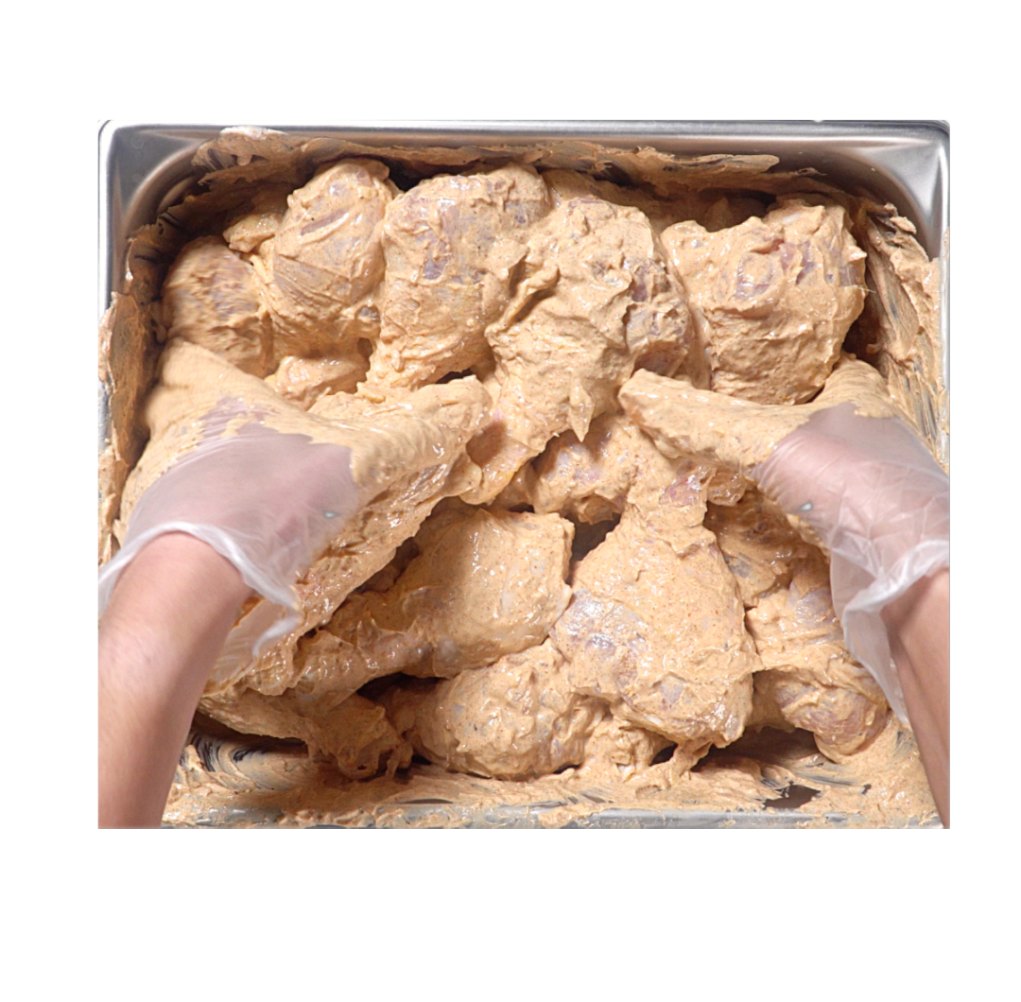


Ideas to Reduce Sodium
Cook from scratch
Build flavor through
  Local products
  Ingredients
  Culinary techniques
Notes:
Say: So how can we reduce sodium in school meals? You guessed it! Cook from scratch. Again, when you cook from scratch, you are in control of the ingredients, seasonings, and salt added to the food!
There are lots of ways to build flavor, starting with the quality of the ingredient themselves. Work with local vendors to see if you can procure local produce, that may be more flavorful than produce that has traveled across the country to get to your back door.
When cooking, use aromatics – celery, onions, and carrots, known as mirepoix. Add garlic for more pizazz.
Explore new spices and herbs. Bloom the spices in warm oil when cooking; this helps to draw out the flavor even more.
Add acids, like vinegars and lemon juice. Oftentimes, when a recipe tastes flat, people reach for the salt shaker, but what it really needs is acid to brighten its flavor.
Utilize different culinary techniques – marinating, brining, pickling, and browning through searing and roasting. Use spice and herb rubs on commodity meats, and rely on reduction, the simple method of simmering the volume down in liquids to intensify flavors.

Slide 29

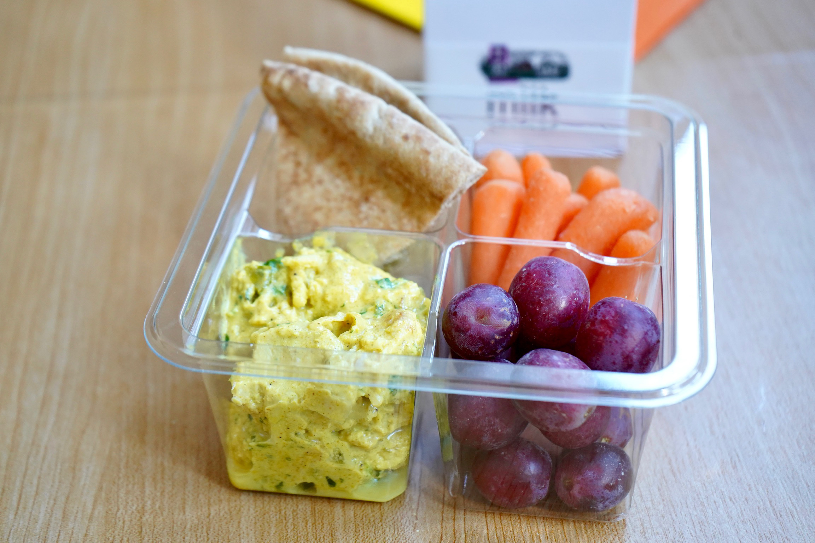
Ideas to Reduce Sodium Continued
Culturally inclusive meals
Incorporate more produce
Notes:
Say: Look to incorporate culturally inclusive meals that include new flavors. Many recipes from other countries rely heavily on spices and seasoning foods for flavor.
And finally, work to incorporate more produce on the menu. Fruits and vegetables are rich in potassium which counters the effects of sodium within the body.

Slide 30
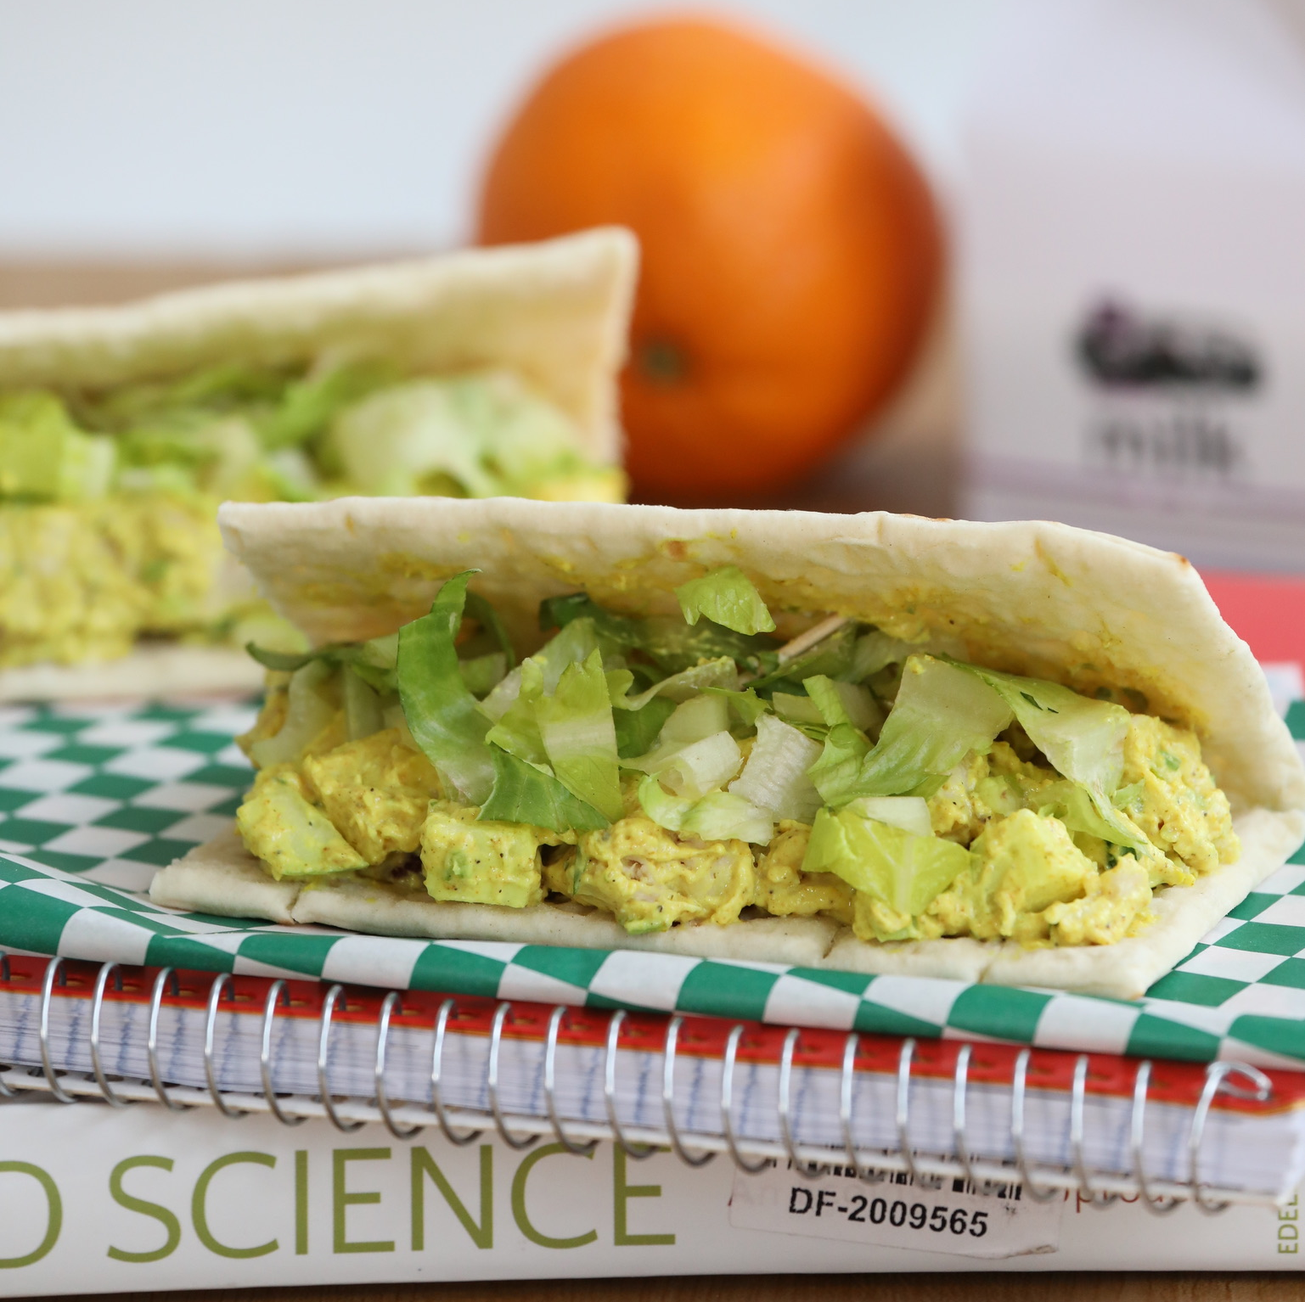
Demo – Reduced Sodium Curry Chicken Salad
Notes:
Say: With all that said, I think it is time for another quick demo! This recipe was a HUGE hit this summer. Chef Lindsey is going to demonstrate how to transform a basic chicken salad that might rely too much on salt for flavor with a culturally inclusive inspired curry chicken salad recipe. Take it away chef!

Slide 31
Let's chat!
What action item can you take to either reduce added sugars or sodium in your division?
Notes:
Say: We are coming to the end of this webinar, but before we end, we want to ask you to think of one action item you can take to either reduce added sugars or sodium in your division, and add it to the chat!

Slide 32

Questions?
Notes:
Say: Thank you so much for committing to lower sodium and added sugars in your divisions.
Ask: Does anyone have any questions?

