Slide 1
Farm to School
Notes:
Hello everyone. Today we are going to talk about how farm to school is fueling Georgia’s future.

Slide 2
School Nutrition Vinn Diagram
Notes:
School nutrition is a valuable partner in education pledging to provide coordinated support for outstanding student achievement through our commitment to excellent service in each of these core areas: quality meals, student and community engagement, and professional development.

Slide 3

Overview
Farm to School
Georgia Grown and Local Foods
Harvest of the Month
Notes:
In today’s presentation we will learn more about the definition of farm to school, discuss Georgia grown versus locally grown foods, and talk about Georgia’s Harvest of the Month initiative.

Slide 4
Farm to School
Farm to School Connects
Local Food
with
School Meals
Classroom Lessons
Notes:
Farm to school connects all parts of the food system with all aspects of the school day. It provides quality foods that are safe and nutritious for all of Georgia’s students, supports Georgia agriculture by strengthening local markets, raises awareness of the origin of food in the school cafeteria, and adds opportunities for food-based learning and classroom lessons.

Slide 5

Farm to Table Book
Notes:
Although this book is geared towards younger students, the concepts emphasize the connections that occur in farm to school and the people who are a part of the process. Everyone from farmers, to producers, to distributors, and menu planners and chefs all work together to allow us to enjoy safe and healthy food.

Slide 6
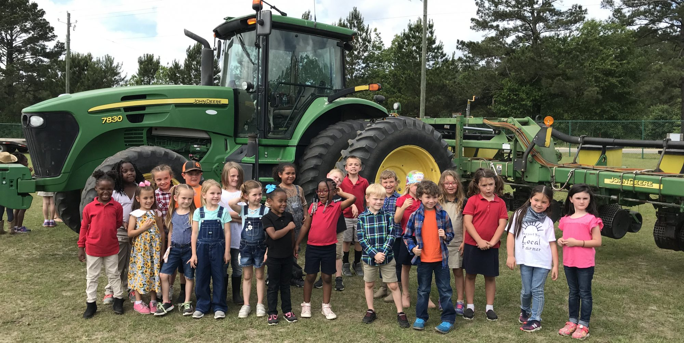
Farm to School
Does your school need a farm to participate in Farm to School?
Notes:
As you can see in the picture here, we have students represented from Effingham County, Georgia standing in front of a tractor at their elementary school. This is a fantastic example of a farm to school lesson, but a district does not have to have a tractor or even if its own farm like Effingham County to participate in farm to school.

Slide 7
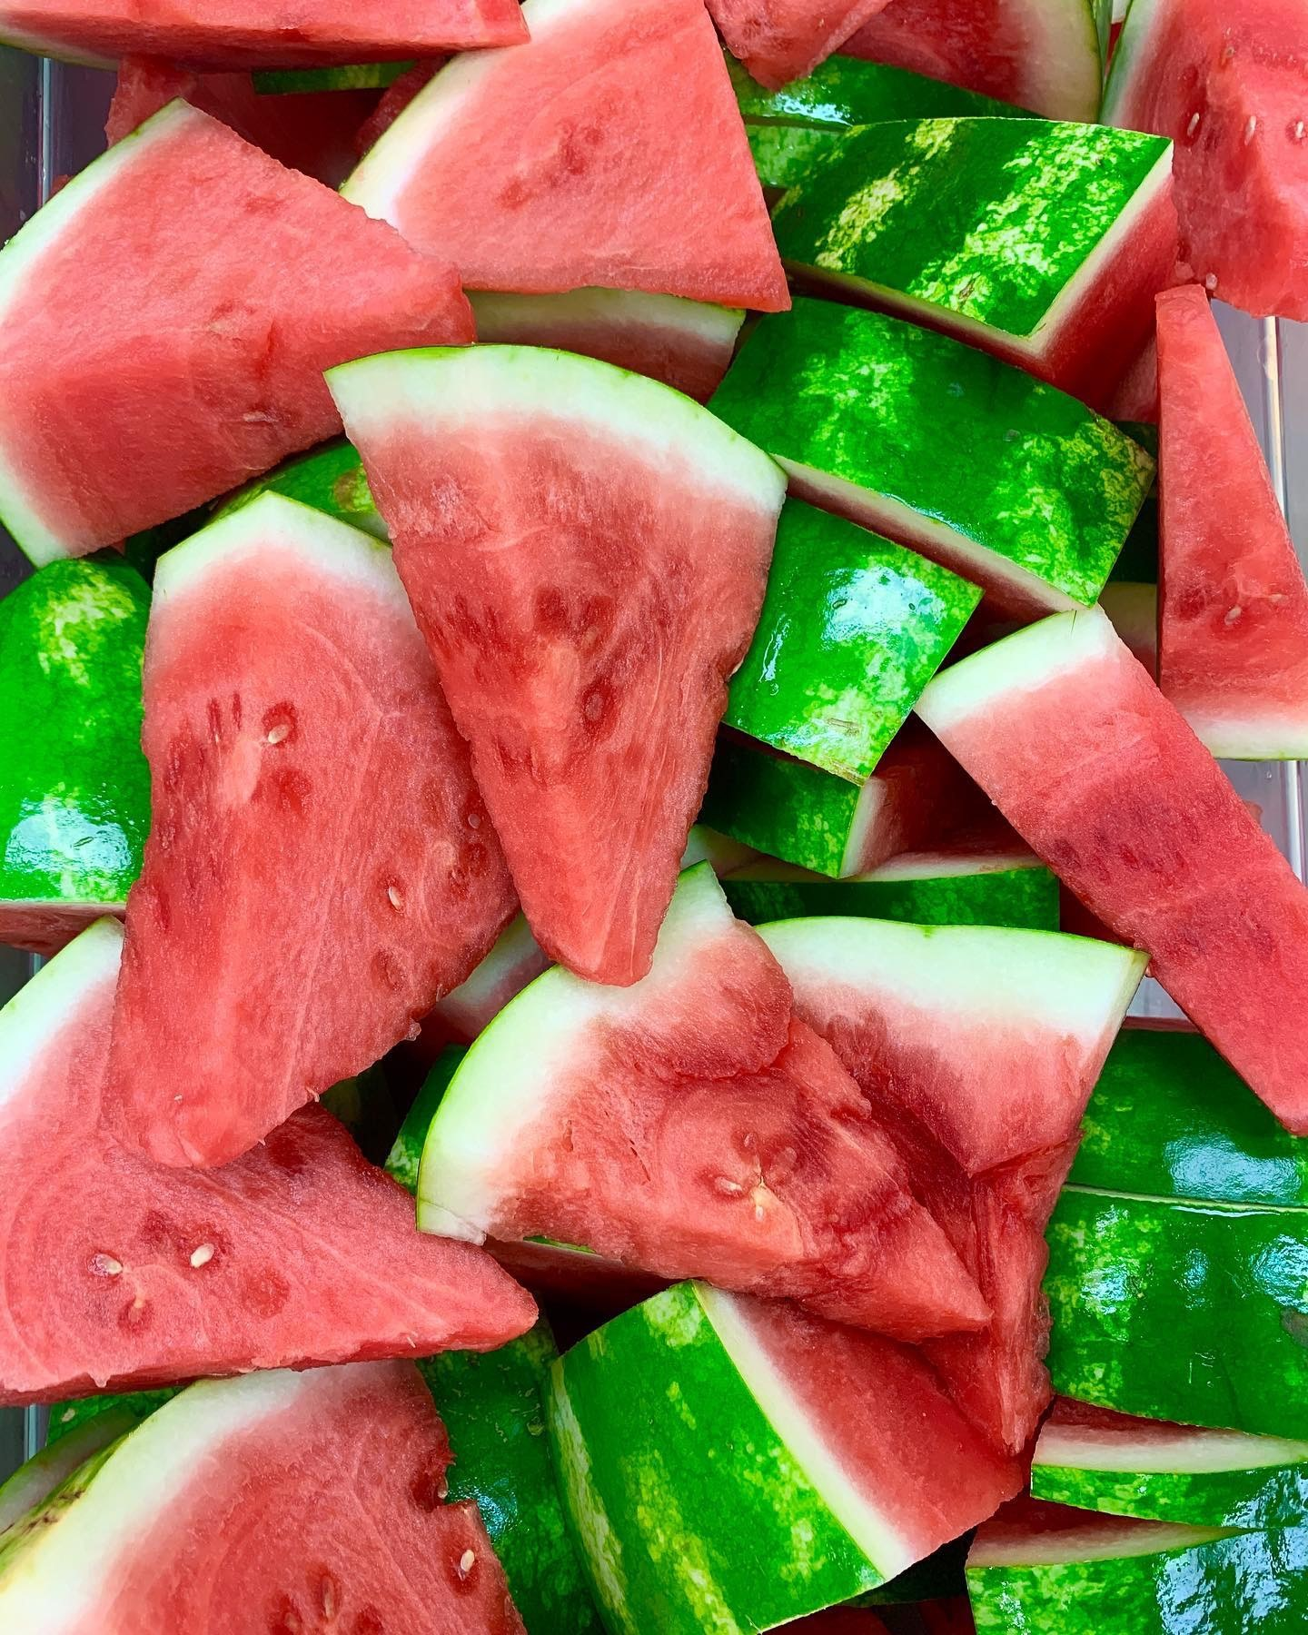
Farm to School
Gardens
Curriculum
Taste tests
Locally grown on the menu
Field trips
Farmer visits
Culinary Program
Notes:
There are no minimum requirements for what it means to have a farm to school program. No activity is considered too small. Whether a school is serving local watermelon in the cafeteria, teaching students to grow a plant in a science class, or having a farmer visit the school to talk about their operation, these are all wonderful examples of farm to school in action.

Slide 8
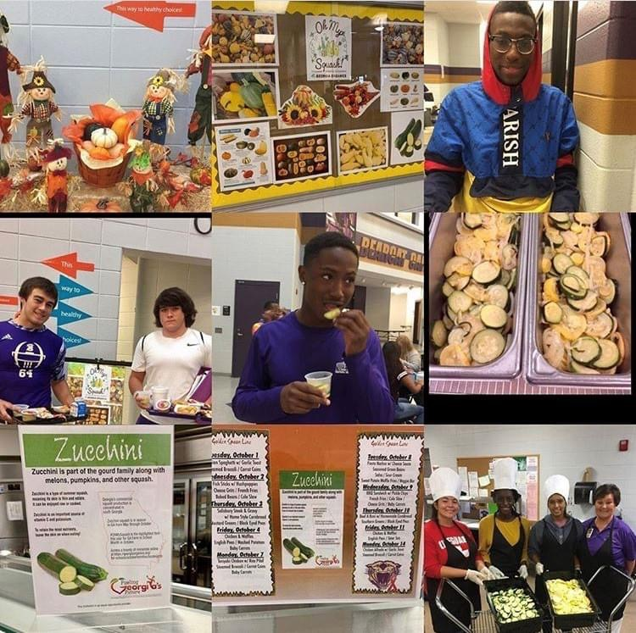

USDA Farm to School Census
Notes:
Some additional history about farm to school can be found in the farm to school census. The Healthy Hunger Free Kids Act of 2010 formally established the farm to school program within the United States Department of Agriculture. The idea was simple- to improve access to local foods in schools. In order to establish realistic goals around increasing the availability of local foods in schools, the United States Department of Agriculture conducts the Farm to School Census. The Farm to School Census captures information about the level to which farm to school efforts are underway and increasing across the nation.

Slide 9


Partner in Education
Fruit component of school lunch
Agriculture lesson
Math lesson
Notes:
So why does the Georgia Department of Education feel so strongly about farm to school connections? Because we firmly believe that school nutrition is a partner in education. Learning does not stop when you enter our school cafeterias. School breakfast and school lunch meals are absolutely part of the school day. For example, let’s look at our Harvest of the Month initiative. These items can be served and highlighted as a Harvest of the Month in the cafeteria. They can also be discussed as part of an agriculture lesson in the classroom and incorporated as part of even a math lesson. Our website provides many resources that highlight these connections between cafeterias and classrooms and can be utilized for inspiration in all Georgia school districts.

Slide 10
Selling to Schools
What is local?
Georgia Grown?
Does one size fit all?
Notes:
Let’s talk about selling items to schools. There is not one standard definition of the word local. Each school nutrition program determines their own definition. Some define local within a certain mile radius. Others within the state of Georgia and even others within the southeastern region. Georgia grown means grown within the state of Georgia. Farm to school achieves similar goals across programs, but it does look different in each program.

Slide 11
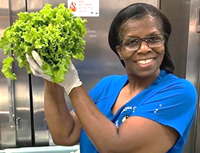
Harvest of the Month
Notes:
We’ve mentioned the Georgia Harvest of the Month initiative a few times now, so what do we mean? What is this initiative? The Harvest of the Month initiative highlights an item each month that can be sourced locally for service in school meals and offers the opportunity to share information about both nutrition and agriculture. The initiative encourages collaboration between school nutrition programs, teachers, farmers, and our communities. We also include five additional celebration items that are important to our state and these items have resources developed for use both in school cafeterias and classroom settings as well.

Slide 12
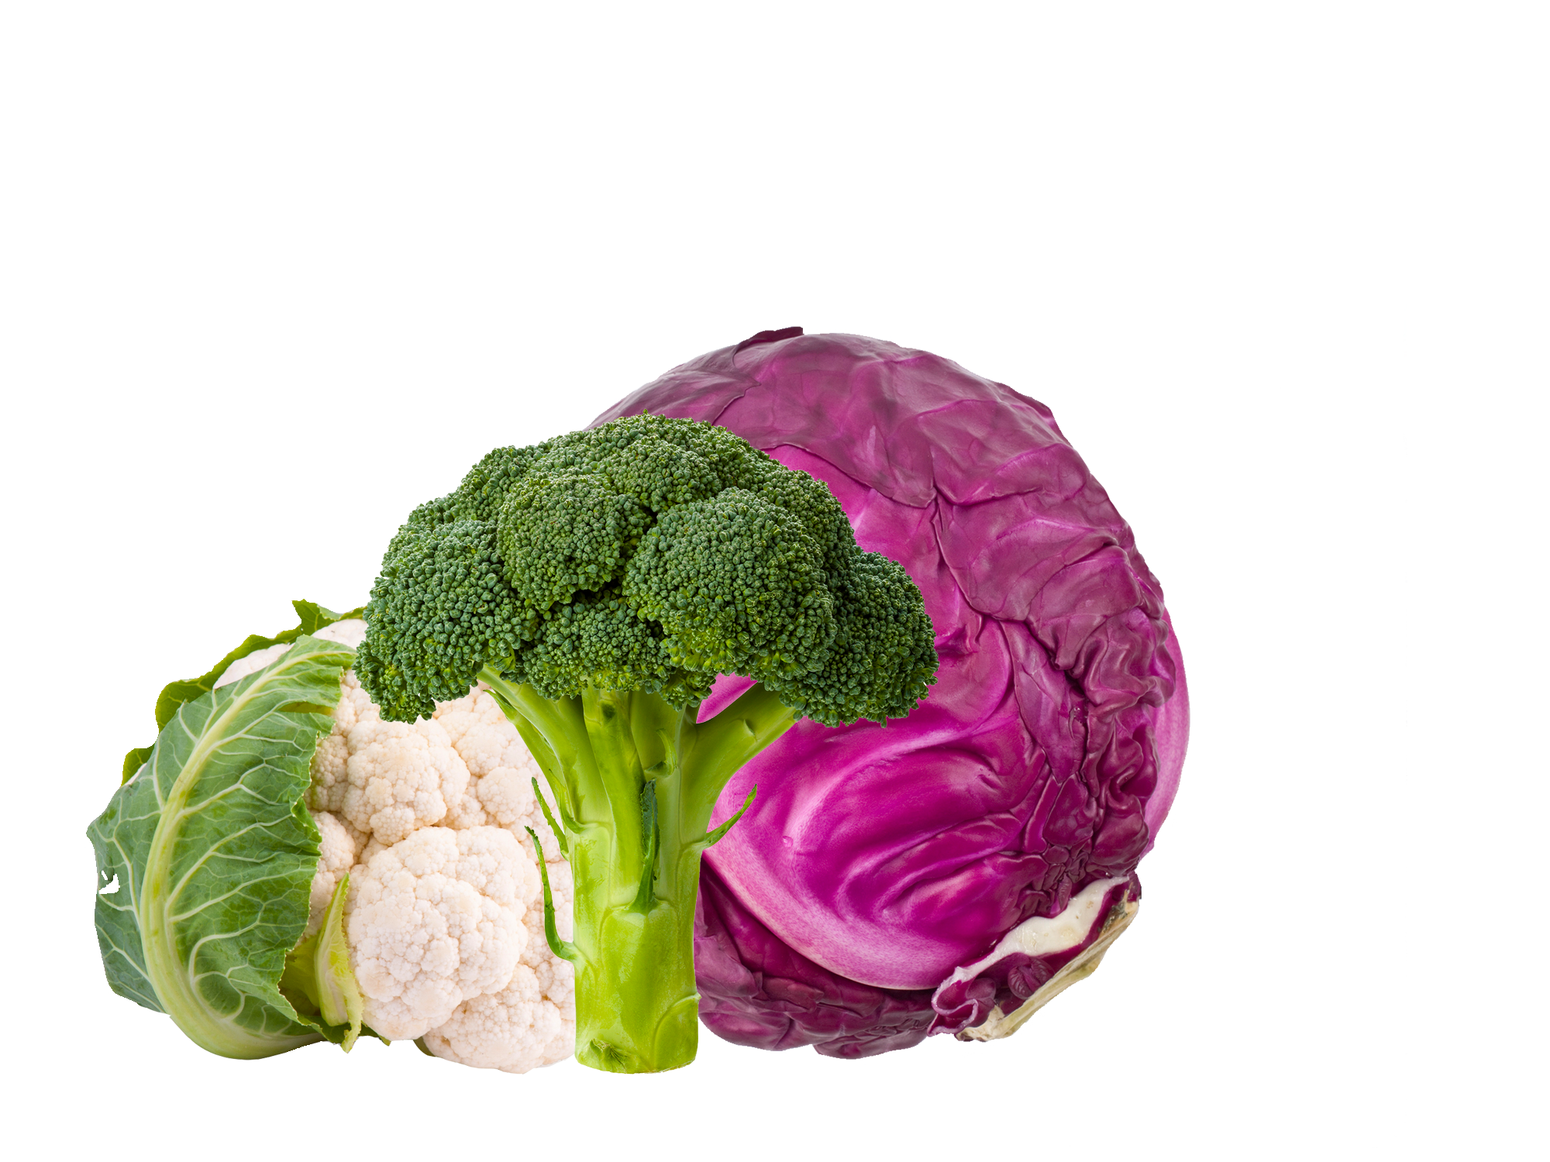
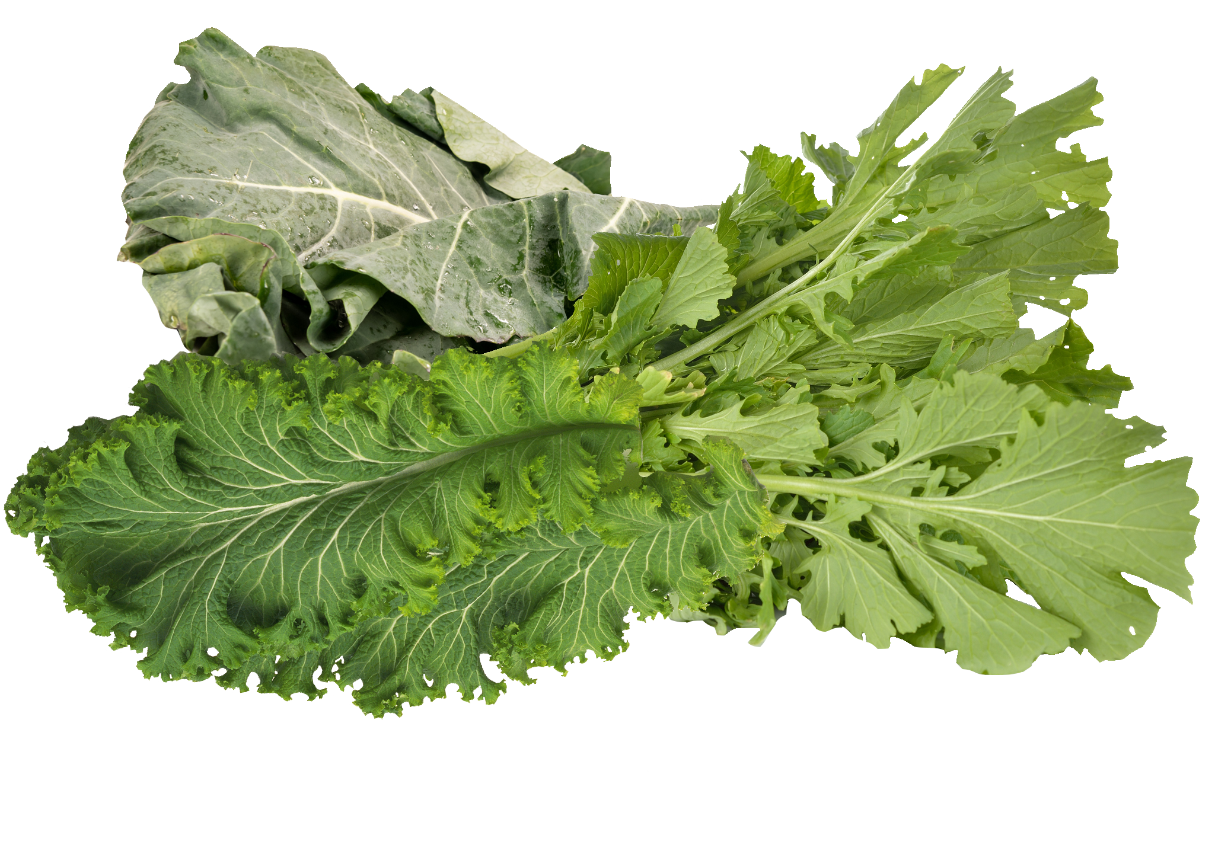
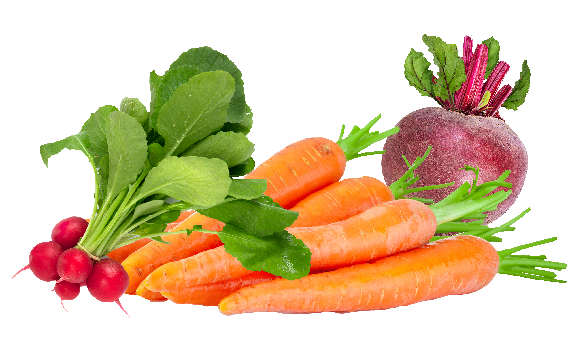
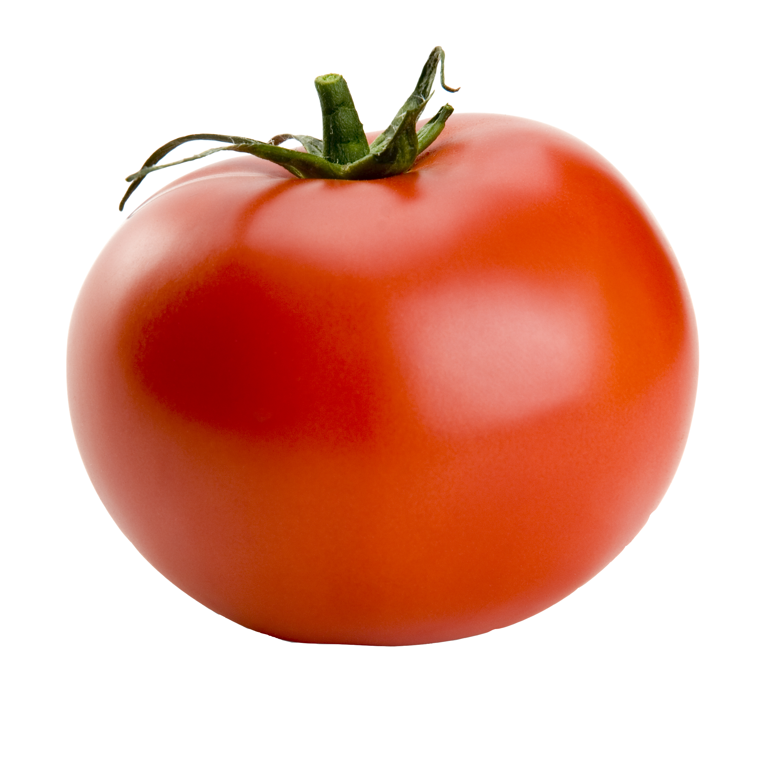




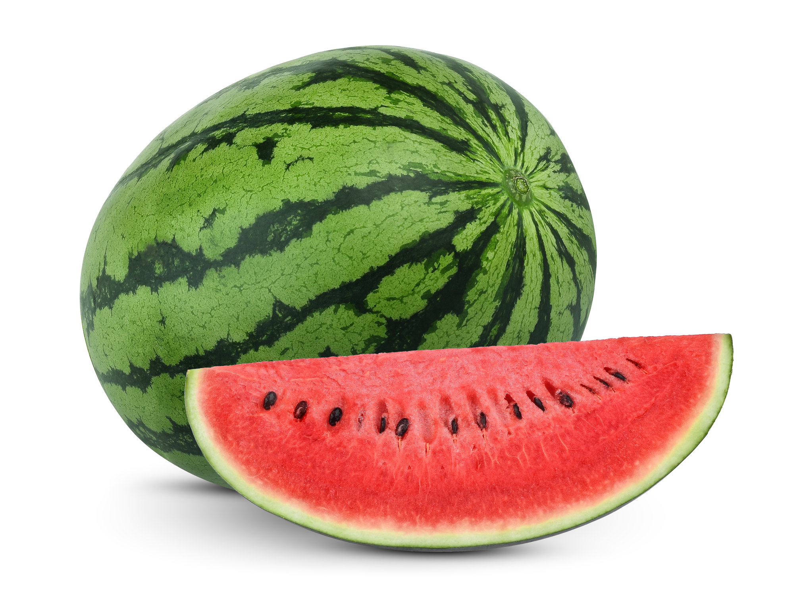
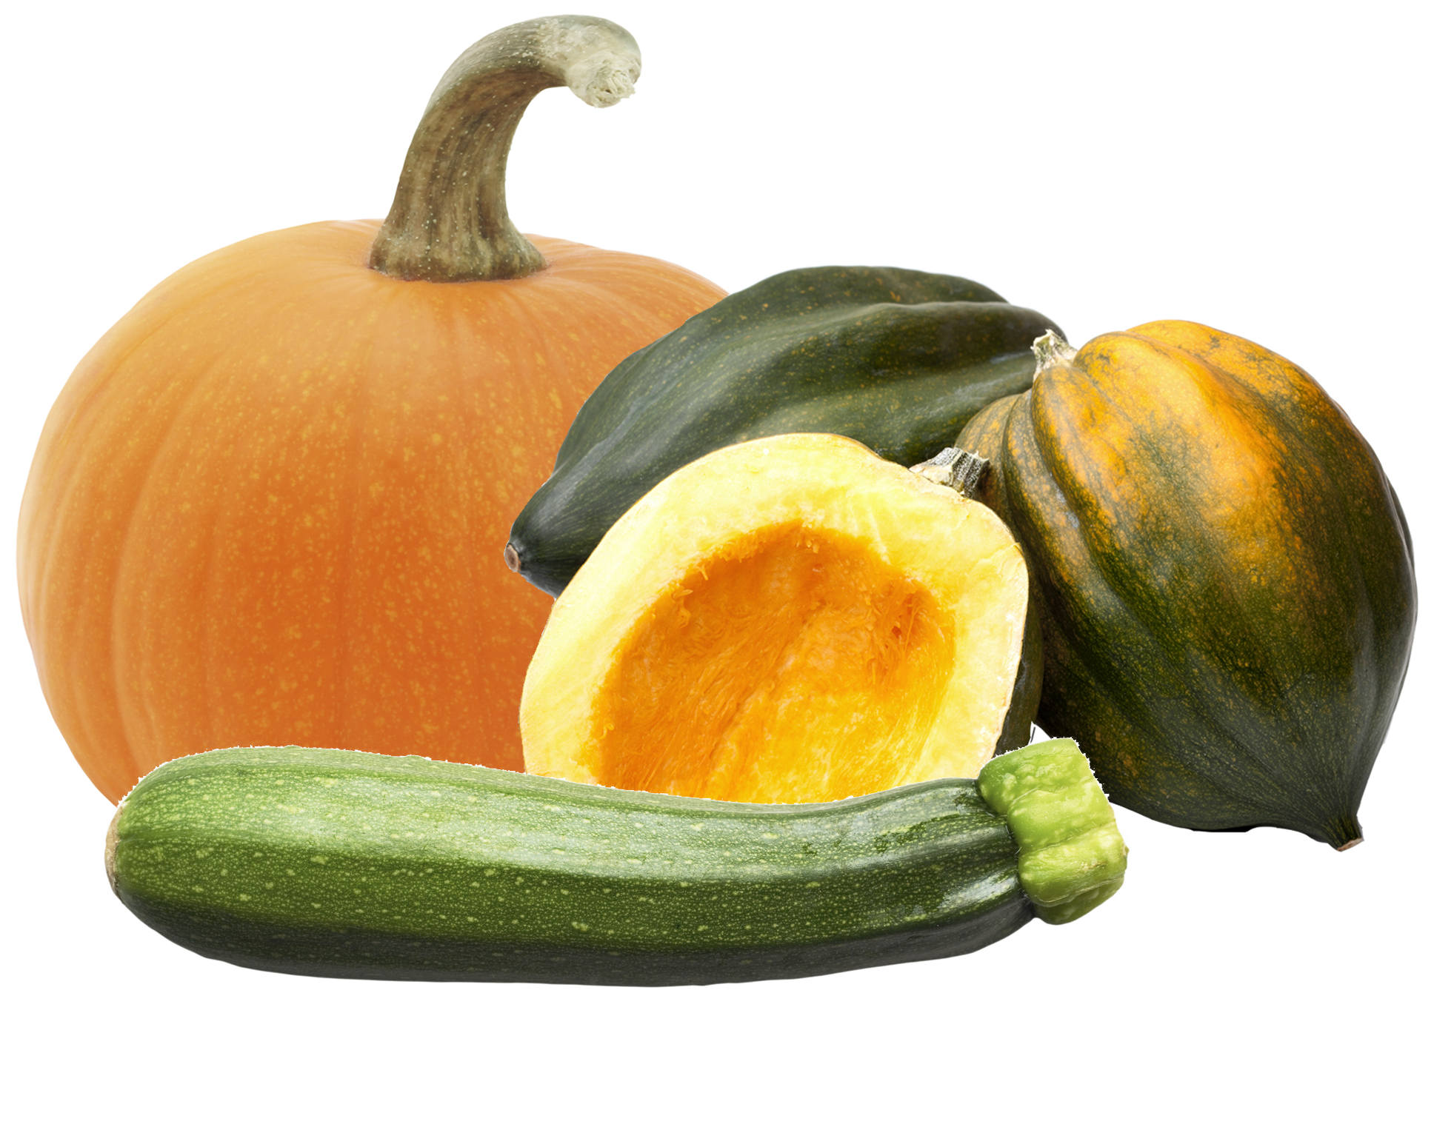
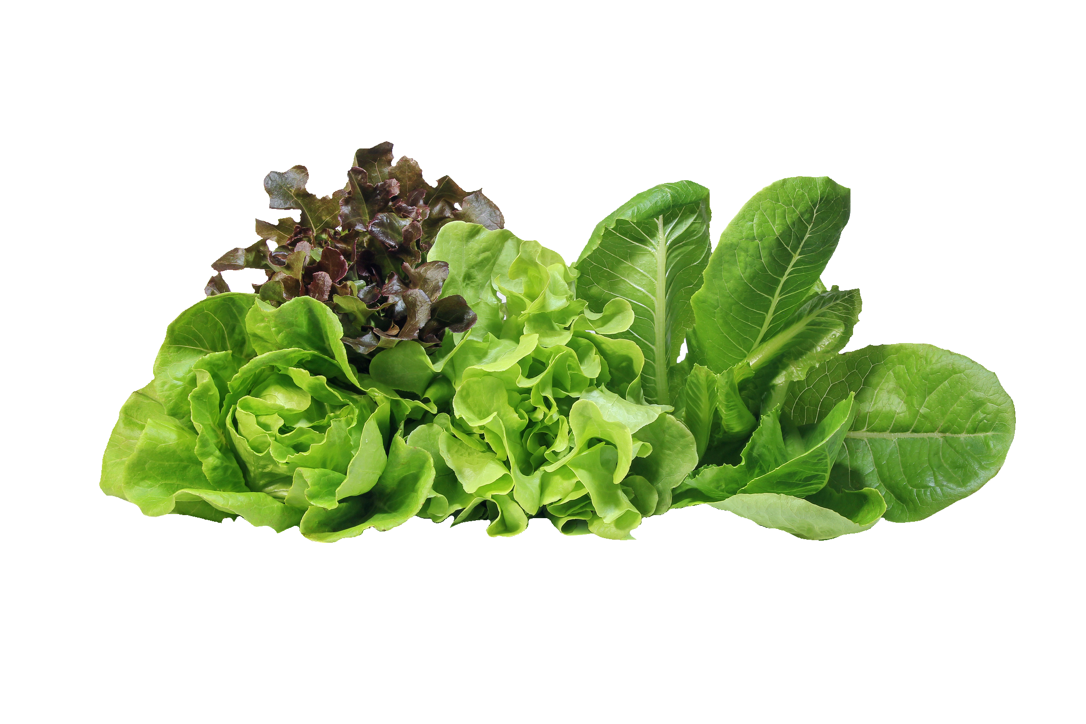
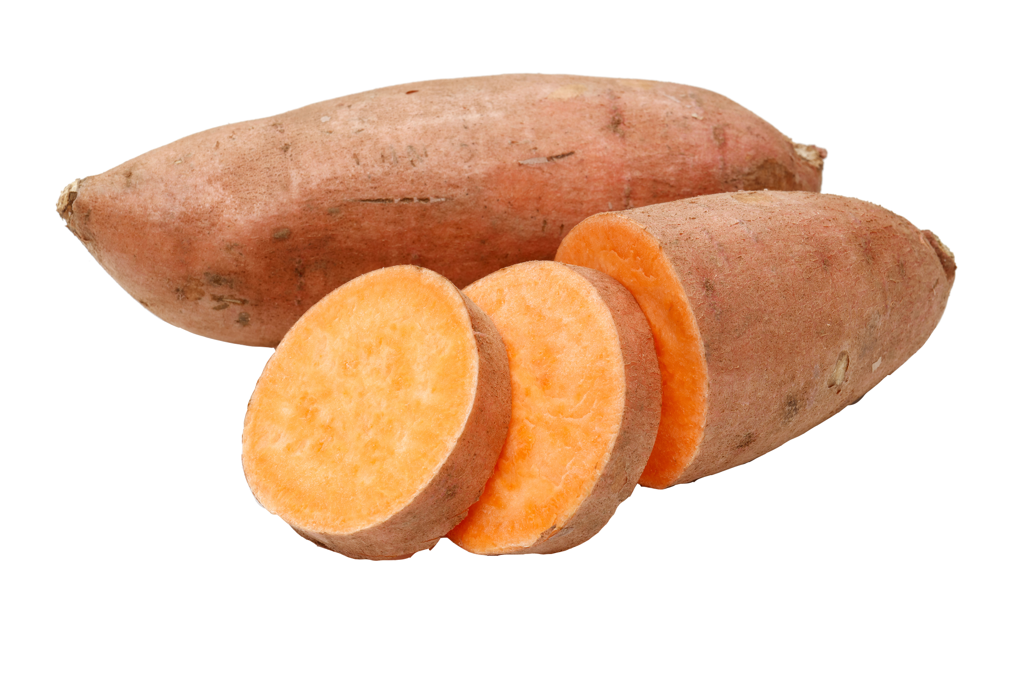
Recipe Ingredient: Georgia Grown
Notes:
Georgia’s Student Chef Competition requires that recipes include at least one Georgia grown ingredient for middle school and at least two Georgia grown ingredients for high school. Georgia grown ingredients must be noted on the recipe. Please reference the Harvest of the Month Calendar for inspiration.

Slide 13
Georgia School Nutrition Social Media
Notes:
You can find additional farm to school resources on our Georgia School Nutrition website. We also encourage you to like, follow, and engage with us on our school nutrition social media platforms. Here, you’ll be able to stay up to date with the latest and greatest of Georgia’s school meals.

Slide 14
USDA Nondiscrimination Statement

