Slide 1
Student Chef Competition
National School Lunch Program,
Meal Components and Culinary Tips
Notes:
Welcome to the Student Chef Competition. Today we are going to talk about the NSLP, meal components and culinary tips. This overview will assist you as you develop your recipes.

Slide 2
Georgia Department of Education School Nutrition Division Venn Diagram
Notes:
School Nutrition is a valuable partner in education pledging to provide coordinated support for outstanding student achievement through our commitment to excellent service in each of these core areas: Quality Meals, Student & Community Engagement, and Professional Development.

Slide 3
Presentation Objectives
Discuss the role and function of the National School Lunch Program (NSLP)
Identify required school lunch meal components
Describe how meal components are credited to meet the NSLP meal pattern
Practice utilizing United States Department of Agriculture (USDA) resources used for meal component crediting
Review culinary tips and trends to create flavorful and innovative recipes

Slide 4
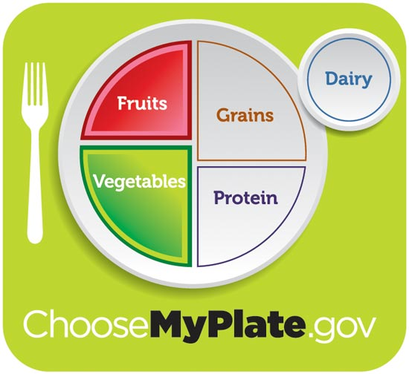
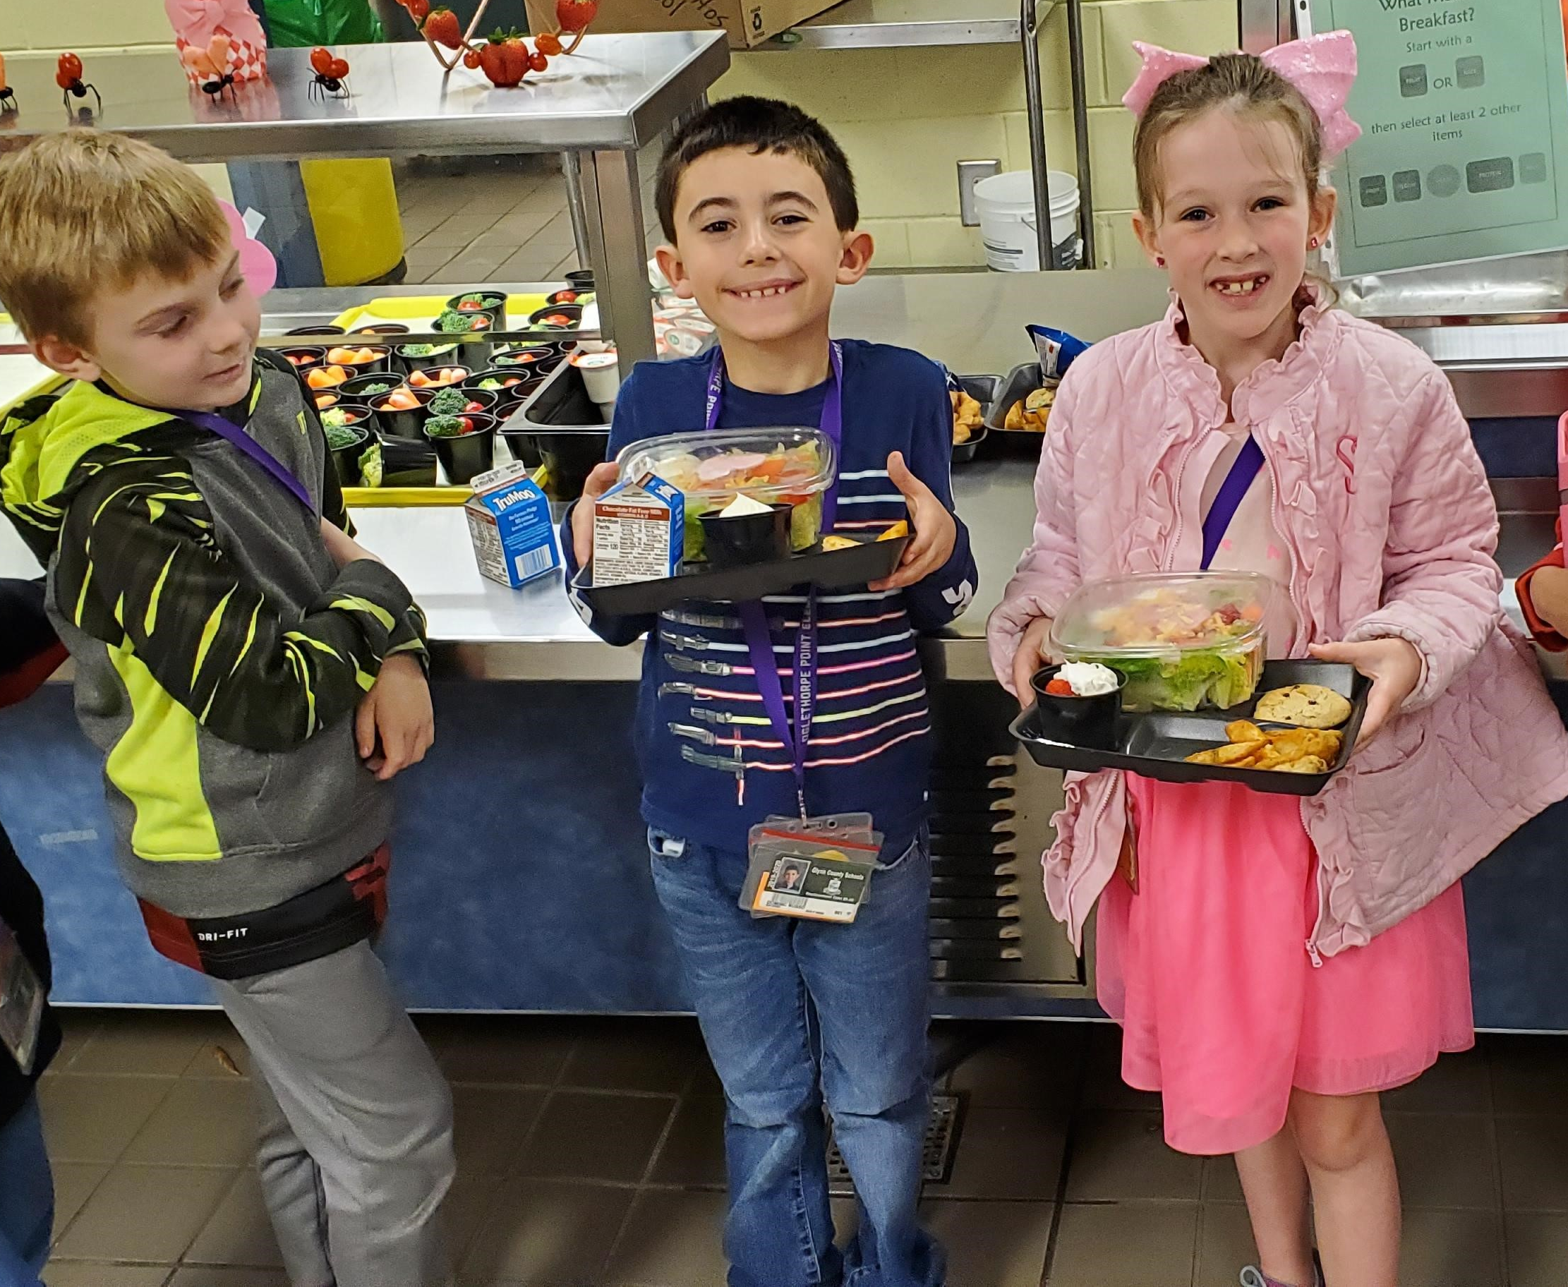

National School Lunch Program (NSLP)
Notes:
The National School Lunch Program (NSLP) is a federally assisted meal program operating in schools throughout the nation. The program provides reimbursement to schools that meet the federal requirements for school meals.
The NSLP meal pattern and nutritional standards are based on the latest Dietary Guidelines for Americans.
The meal pattern increases the availability of fruits, vegetables, and whole grains in the school menu. It reduces the levels of sodium, saturated fat, and trans fat in meals, and meets the nutrition needs of school children within their calorie requirements.
We will use this overview as a foundation to help you understand the criteria.

Slide 5

MyPlate
Notes:
As a reminder, MyPlate:
Focus on whole fruits. Whole fruits include fresh, frozen, dried, and canned options. Choose whole fruits more often than 100% fruit juice.
Vary your veggies. Vegetables are divided into five subgroups and include dark-green vegetables, red and orange vegetables, legumes (beans and peas), starchy vegetables, and other vegetables. Choose vegetables from all subgroups.
Make half your grains whole grains. Grains include whole grains and refined, enriched grains. Choose whole grains more often.
Vary your protein routine. Protein foods include both animal (seafood, meat, poultry, and eggs) and plant sources (nuts, beans and peas*, seeds, and soy products). Choose a variety of lean protein foods from both plant and animal sources.
Move to low-fat or fat-free milk or yogurt. Dairy includes milk, yogurt, cheese, and calcium-fortified soy beverages (soymilk). Choose fat-free (skim) and low fat (1%) dairy foods.

Slide 6
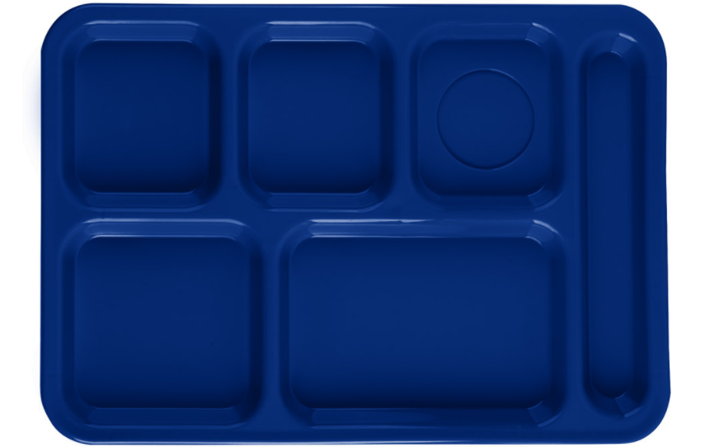
Meal Pattern Components
Grains
Fruits
Milk
Vegetables
Meat/Meat Alternates
Notes:
Similar to MyPlate, there are 5 meal components that must be offered to students at lunch --- they include grains, meat/meat alternates, vegetables, fruits and milk.
The amounts that must be offered to children in each component varies based on the ages served. There are daily and weekly requirements for each grade group.
We will discuss how each food credits (or counts) toward the meal pattern. Sometimes the amount of an item served is the amount it credits toward the meal pattern and other times it is different.
Let’s discuss each component in more detail.

Slide 7
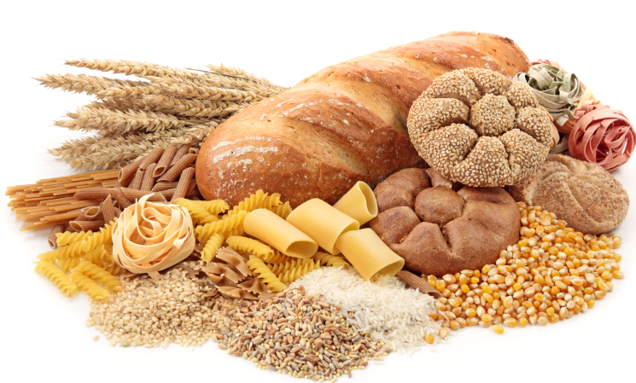
Grains
Grains must be whole grain rich
Grain products must contain 50% or more in the product
Credited in ounce equivalents
Notes:
Let’s discuss the grain component.
Grains are credited in ounce (oz.) equivalents
All grains must be whole grain rich. This means that ≥50% of the grains in the product must be a whole grain.
Let’s look at some examples of whole grains.

Slide 8
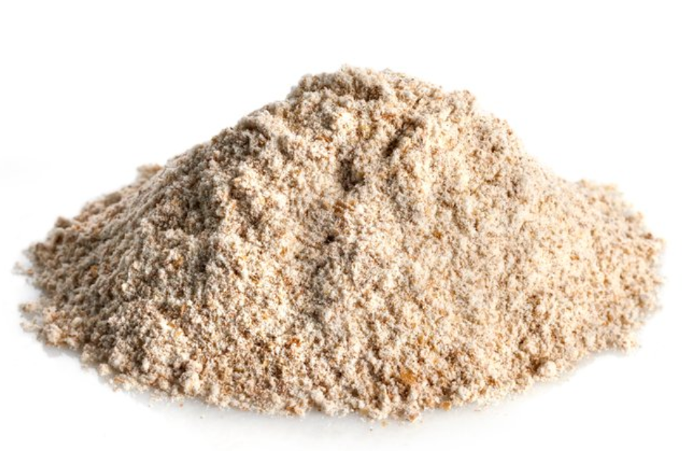

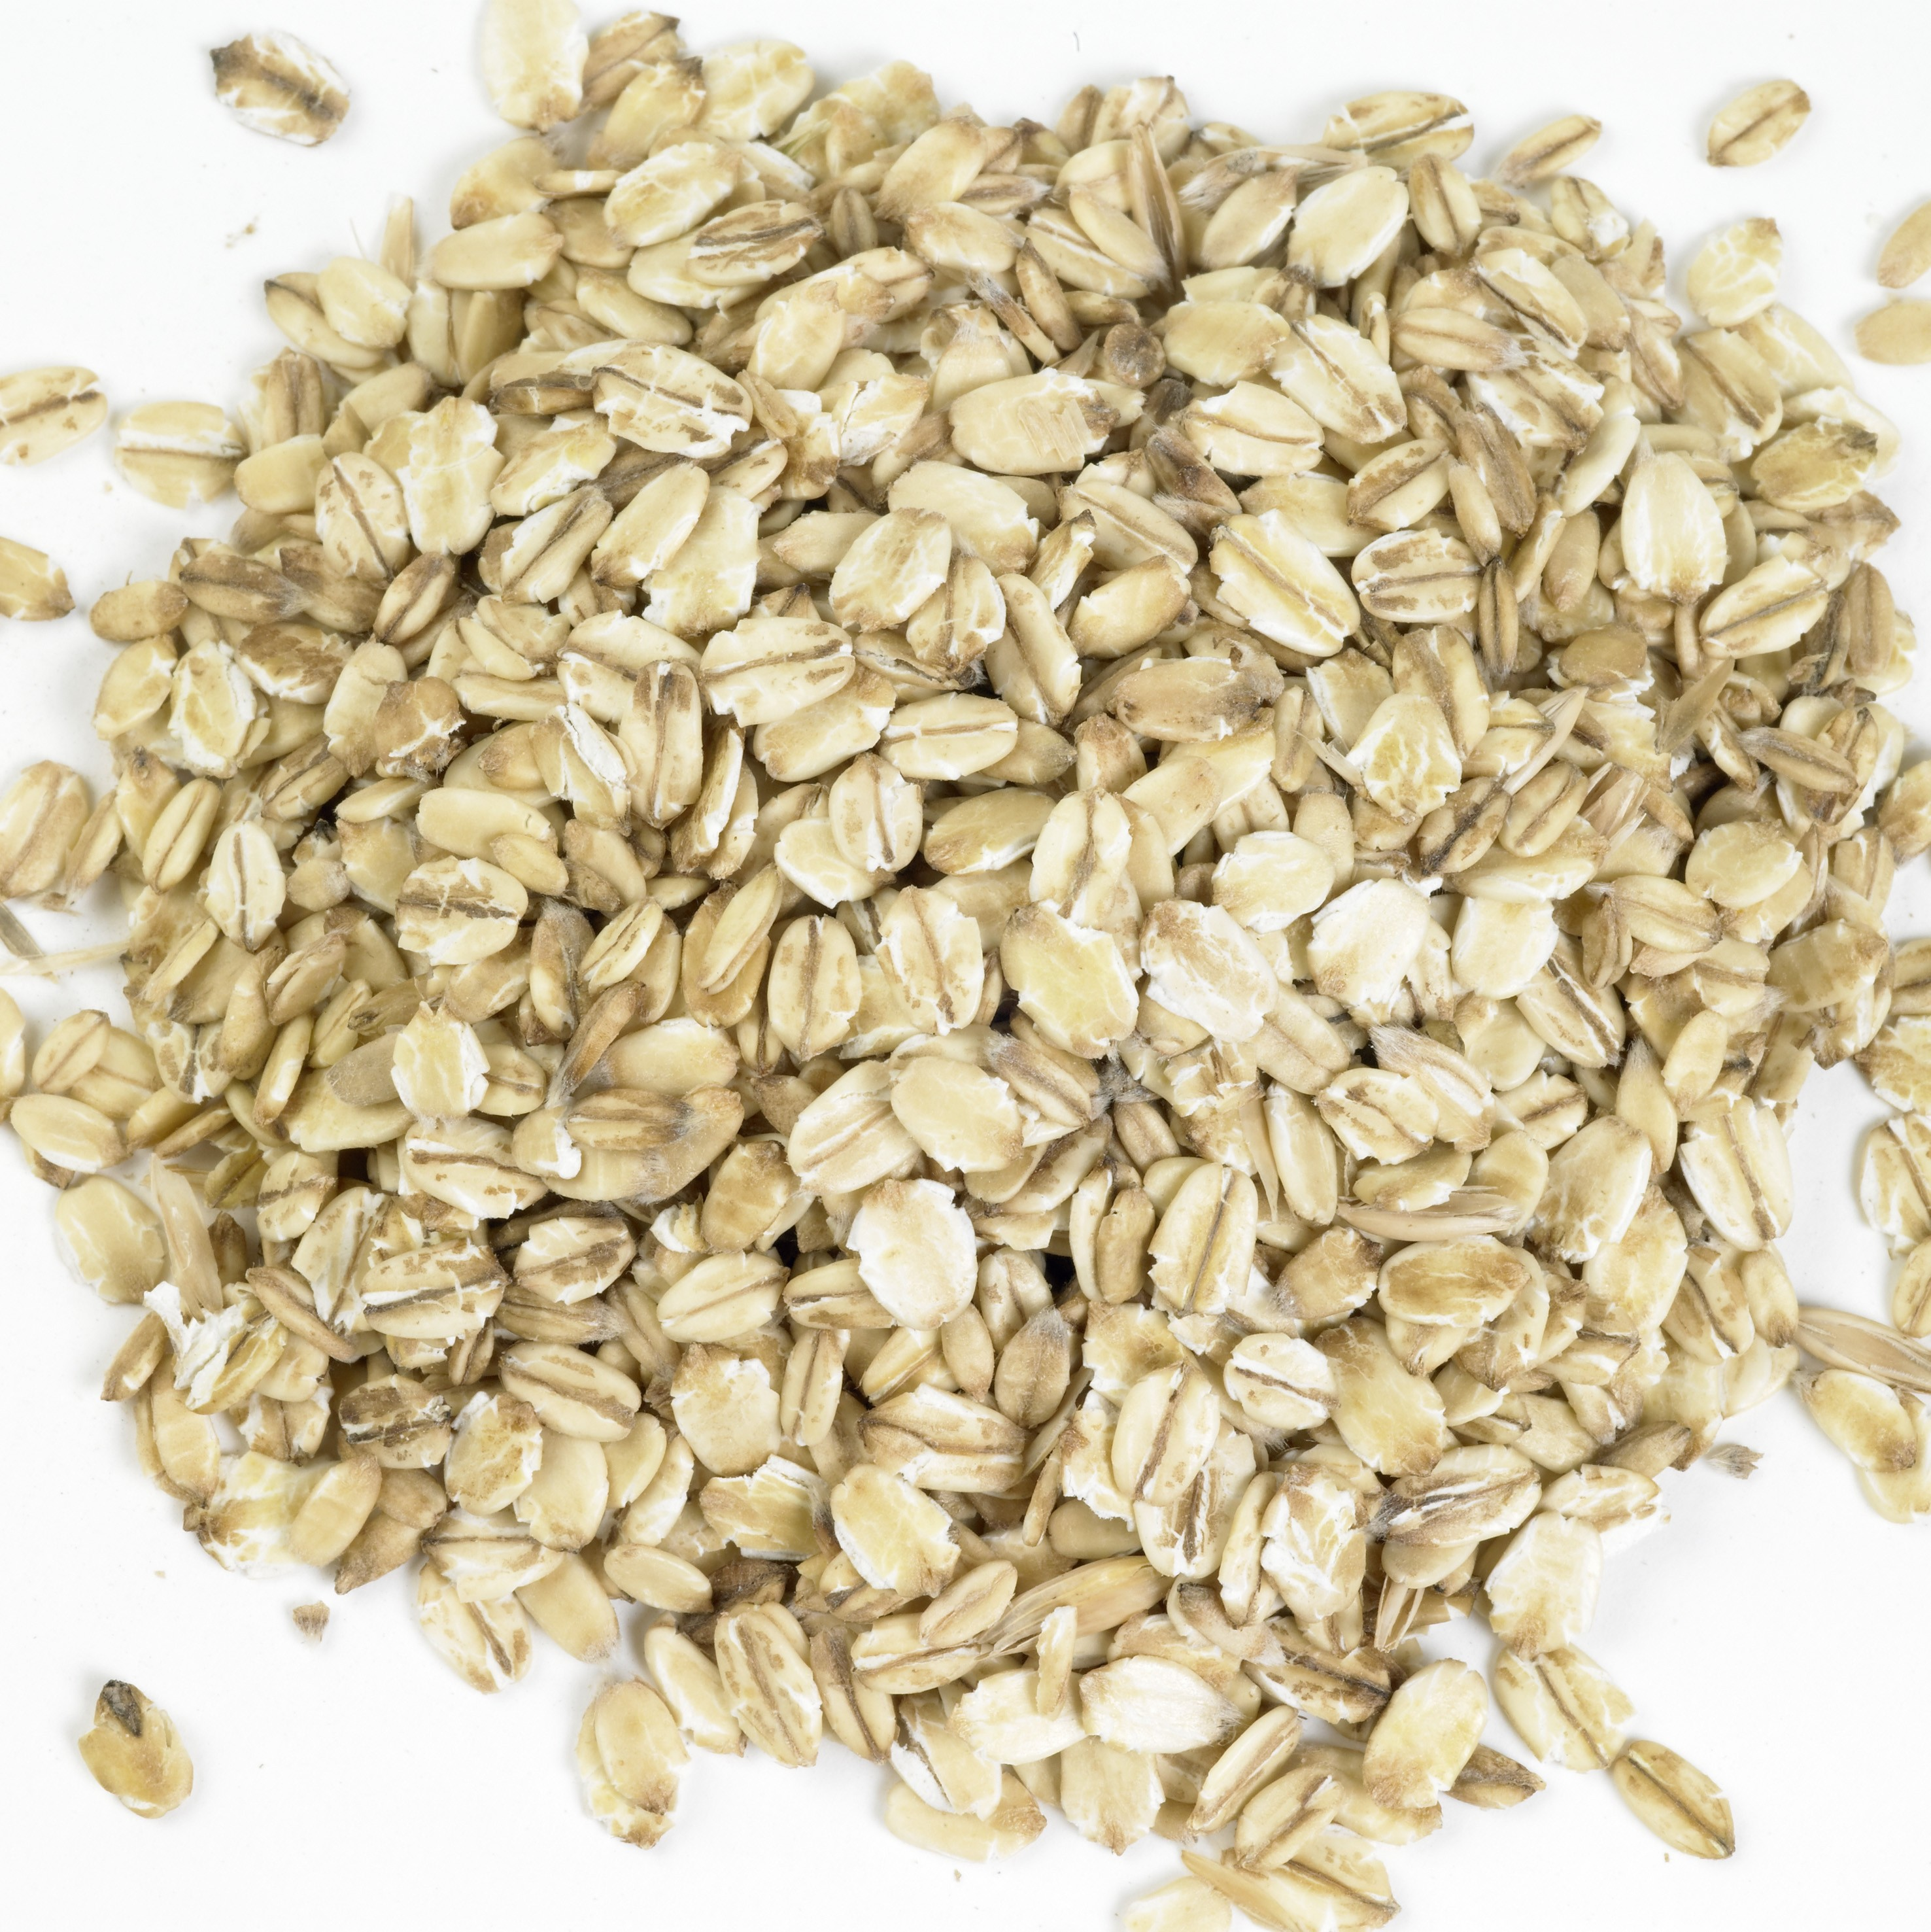
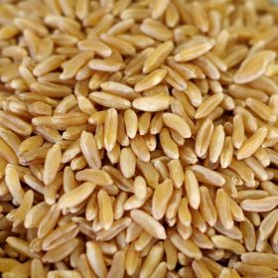
Examples of Whole Grains
Whole Wheat Flour
Whole Kernel Corn
Oats
Brown Rice
Notes:
Some examples of whole grains include whole wheat flour, whole-kernel corn, oats, and brown rice.

Slide 9

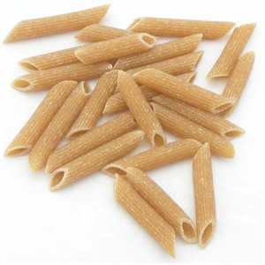
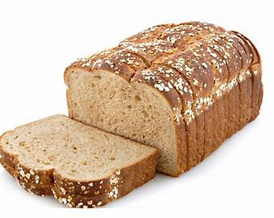
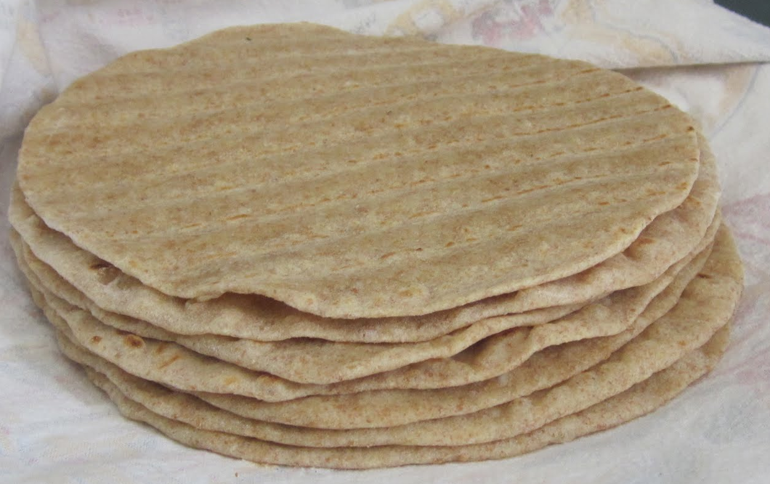
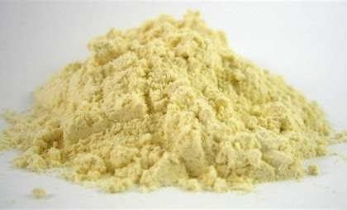
Purchased & Other Grains
Bagels
Pasta
Breads
Tortillas
Corn Masa/Masa Harina
Notes:
Grain options can include purchased grains. These are items such as bagels, pastas, bread, tortillas and other flours including corn masa and masa harina.
You may find that some products have enriched grains sources, and these are also acceptable to use.
USDA has provided a chart that provides equivalents for the different types of grain items served. We will discuss this chart later in the presentation. If you want to use flour and other cereal grains in your recipe the USDA has provided factors to use when calculating crediting.
Entrees generally have 2-ounce equivalents of whole grain. A grain side item generally has 1-ounce equivalent.

Slide 10
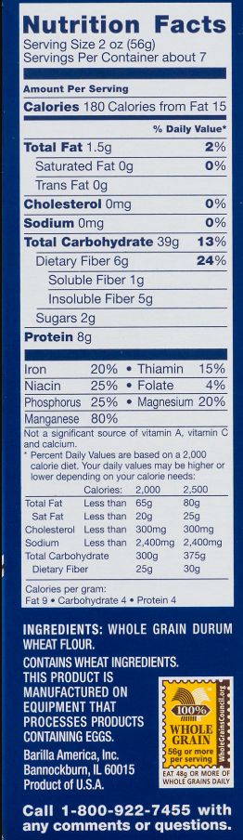
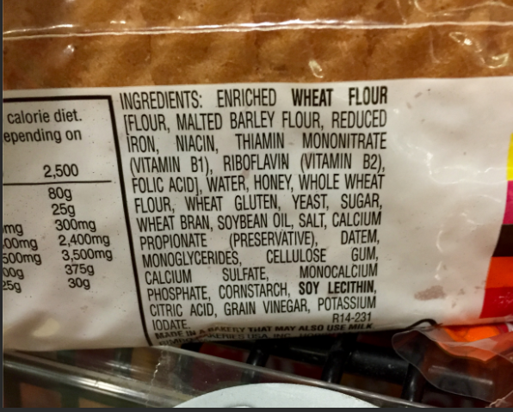
Which is whole grain?
Notes:
How do you know if a product is whole grain? The best way to tell if a product is whole grain is to look at the ingredient list on the nutrition facts label.
Let’s check these items to see.
The item on the left is an example of a whole grain pasta label. It listed as the first ingredient or is the only ingredient in the product label. This tells you that a majority (most) of the product contains whole grain.
The item on the right is an example of a bread nutrition facts label. Whole wheat is listed at beginning of the ingredient list. This means that most of the product is whole grain.
Both items meet the whole-grain rich requirement.
The USDA has resources and tools to make sure (ensure) grain items are credited correctly.
Let’s discuss how to one of those resources next.

Slide 11
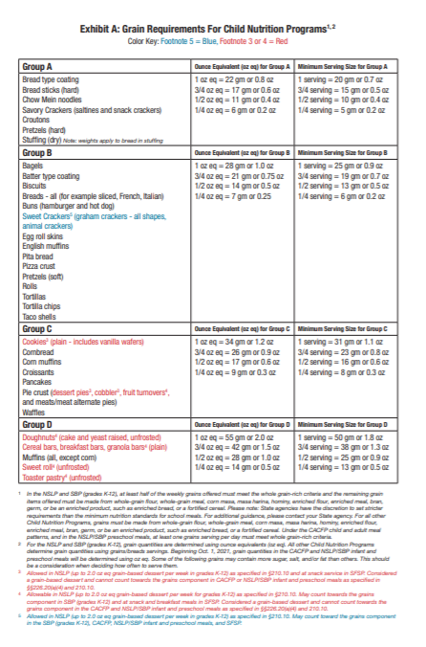
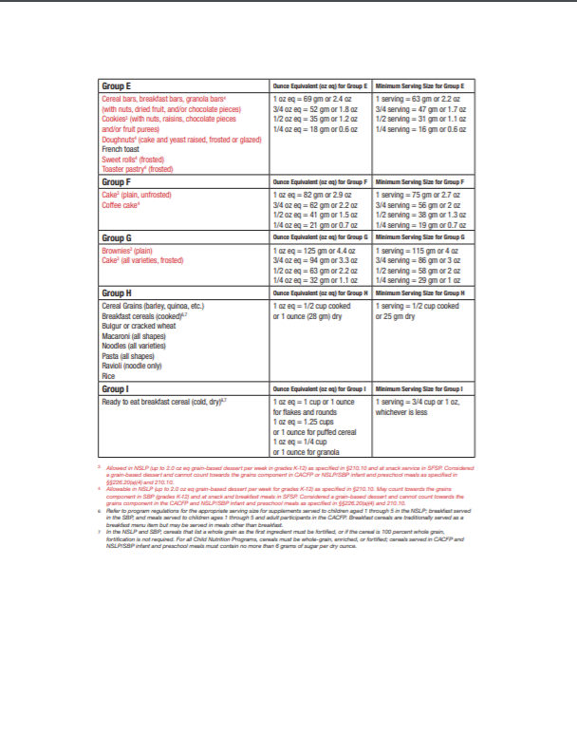
Grain Crediting Resource: Exhibit A
Notes:
The USDA Grain Crediting Resource Exhibit A. This is a table that explains how to credit grains based on the type. It is defined by a group and has specific grain items within that group. It also tells you the ounce equivalents for the group as well as the minimum serving for items listed.
This tool is in the resources section at the end of this presentation.
As a reminder, you are not permitted to create a dessert recipe.

Slide 12
A Grain of Truth!
Notes:
Let’s see if we can find a grain of truth…

Slide 13
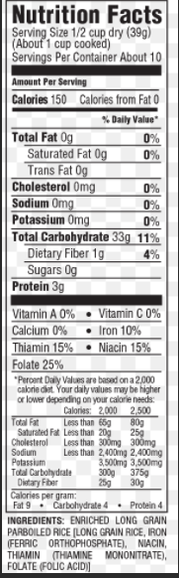
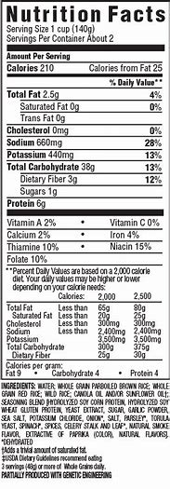
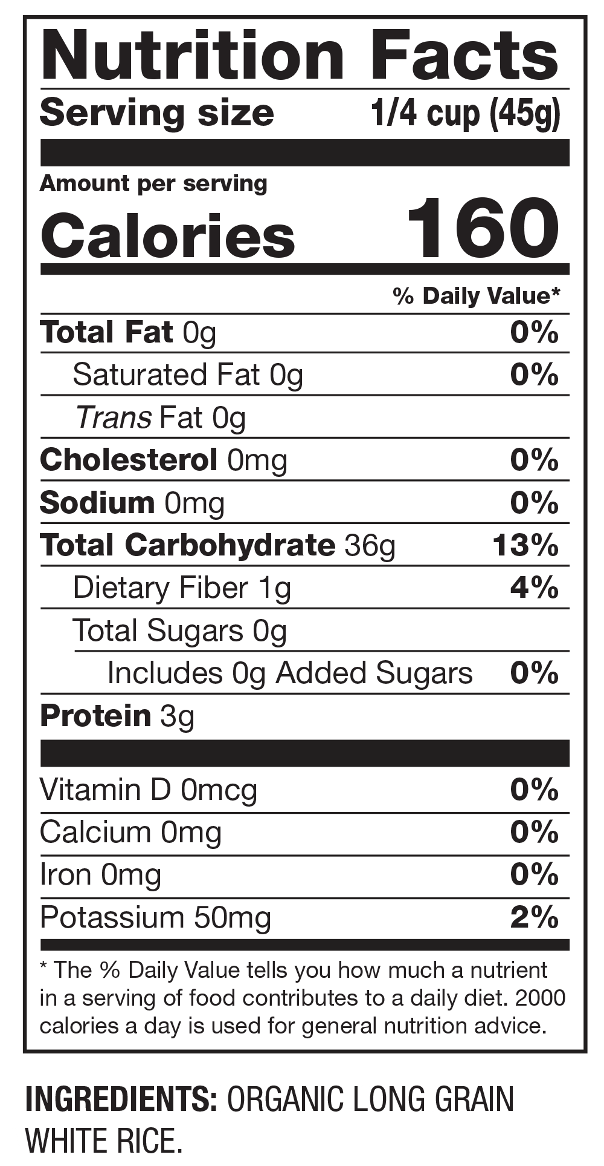
C
B
A
Notes:
Student Chef Kelsey would like to make an Asian inspired fried rice for her recipe. Which of the following rice options is the best to meet the whole-grain rich requirement?

Slide 14

A
B
C
Notes:
If you said option B that is correct! Whole grain parboiled brown rice is listed as the second ingredient after water.

Slide 15
Chef Kelsey’s teammate Roberto wants to figure out how many cups of cooked brown rice he needs for a 2-ounce serving.
½ cup
¾ cup
1cup
Notes:
Let’s try another one!
Chef Kelsey’s teammate Roberto wants to figure out how many cups of cooked brown rice he needs for a 2-ounce serving.
His options are a. ½ cup, b. ¾ cup or c. 1 cup.
Review the example on the next slide to help you find the best answer.

Slide 16
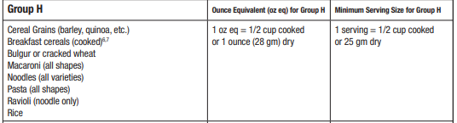
Grain Crediting Resource: Exhibit A
Example
Notes:
Rice is categorized in Group H. Ounce equivalents and minimum serving sizes are also included.

Slide 17
Chef Kelsey’s teammate Roberto wants to figure out how many cups of cooked brown rice he needs for a 2-ounce serving.
½ cup
¾ cup
1cup
1 ounce = ½ cup
2 ounces = 1 cup
Notes:
Let’s check!
If you answered letter C that is correct! The GCREA table indicates 1 ounce is equivalent to ½ cup of cooked rice. Therefore, Roberto will need 1 cup of brown rice to for a 2 oz serving.

Slide 18
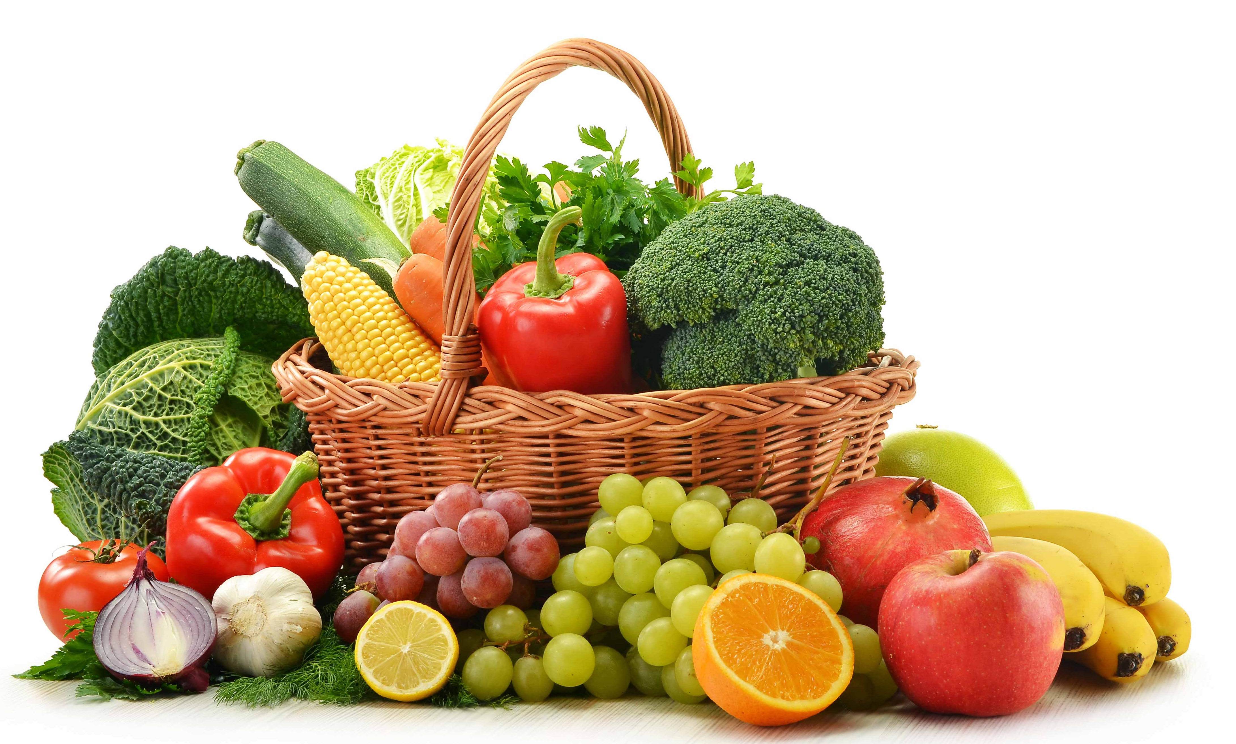
Fruit and Vegetables
Separate components with different daily and weekly requirements
Both are credited in cups
All forms count including:
  Fresh
  Frozen
  Canned
  Dried
  Juice
Notes:
Now let’s discuss fruits and vegetables.
Fruits and Vegetables are separate components and have different daily and weekly requirements.
They are both credited in cups and all forms count, this includes fresh, frozen, canned, dried, and juice.
A fruit or vegetable side item would have at least ½ cup of fruit or vegetable
Generally, a cup of fruit or vegetable counts as a cup toward the meal pattern, however, there are two exceptions:

Slide 19
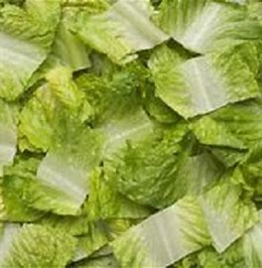
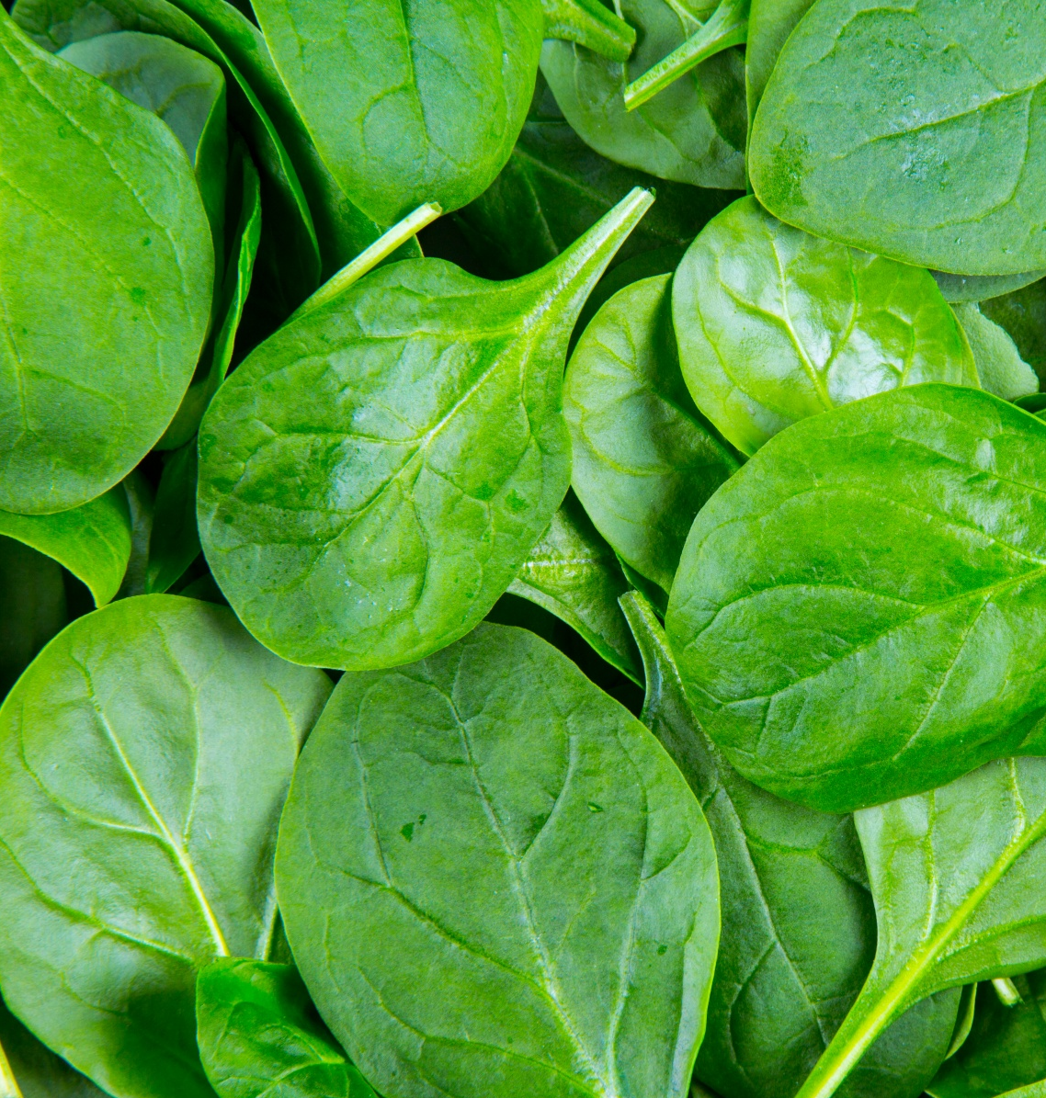


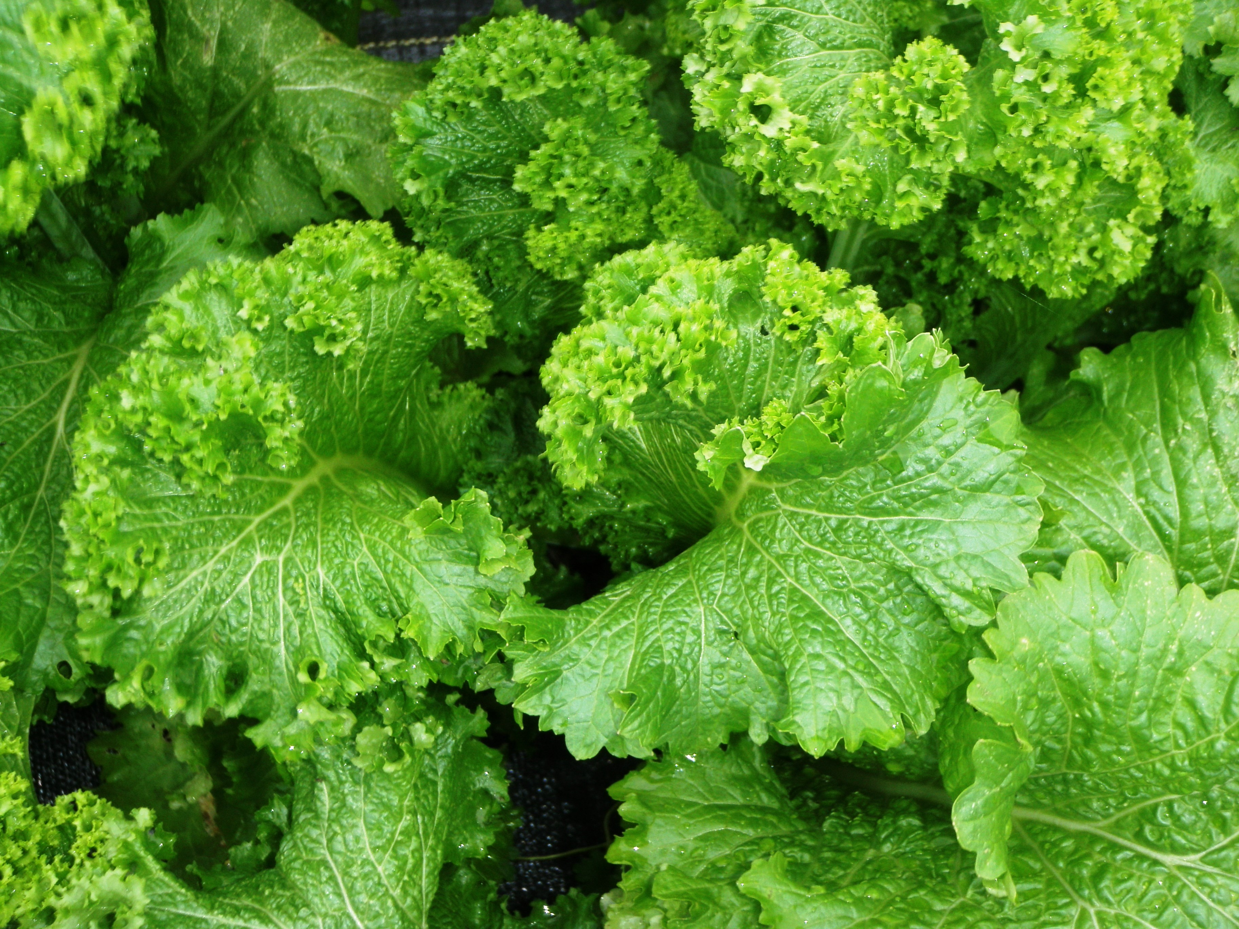
Exceptions: Leafy Greens
Credits for
HALF the volume
Notes:
Raw leafy greens include items such as romaine lettuce, fresh spinach or kale, collards or mustard greens.
Leafy greens credit as half the volume. This means 1 cup counts as ½ cup

Slide 20
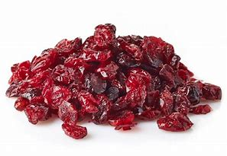
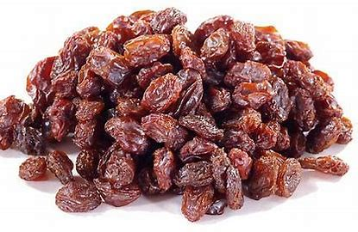


Exceptions: Dried Fruit
Dried fruits credits as DOUBLE the volume served.
Notes:
Dried fruit is the opposite. It credits as double the volume served. This means 1 cup counts as 2 cups.

Slide 21
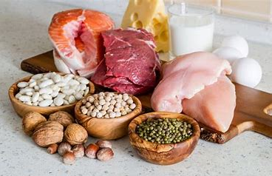
Meat/Meat Alternate
Beef
Poultry
Fish
Eggs
Nuts and seeds
(and their butters)
Beans, peas, and lentils
Also includes foods such as yogurts
and cheese
Credited in ounce equivalents
** In a meal, beans can count as either a
meat alternate or a vegetable.
Notes:
The next component we will discuss is meat and meat alternates.
This component includes foods like, beef, poultry, fish, and eggs. Nuts and seeds and their butters. And beans, peas and lentils. It also includes foods such as yogurt and cheese. This is bit different as cheese and yogurt are included in the dairy category of MyPlate.
Like grains it is credited in ounce equivalents.

Slide 22
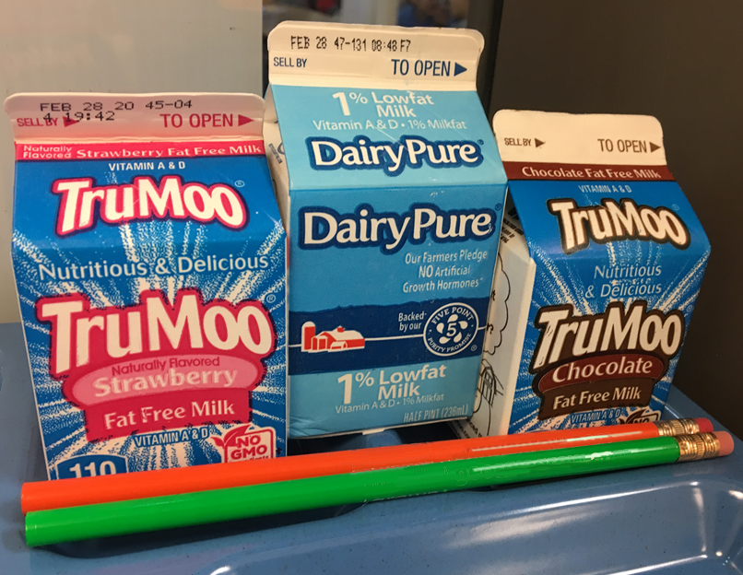

Fluid Milk
1 cup Offered Daily
Notes:
The last component is fluid milk.
One cup of fluid milk must be offered in at least 2 types with every meal.
Only fat free flavored and unflavored and low-fat unflavored milk be offered to students.
Only milk or allowable milk substitutes may be offered to meet this component. Lactose free or lactose reduced milk are acceptable if they follow the milk types listed on this slide.
For this competition milk used in recipes cannot count toward this component.

Slide 23
Nutrient Requirements
Calorie range
Percent of calories from saturated fat
is limited
Sodium is limited
ALL are averaged over the week
Ingredients must be trans fat-free
Notes:
In addition to meeting the component requirements, schools must also meet nutrient requirements.
The nutrients of concern are calories, sodium, saturated fat, and trans fat.
The standards for calories, sodium, and saturated fat are to be met on average over the school week.
This means that the levels of any of these in any ONE MEAL COULD EXCEED THE STANDARD AS LONG AS THE AVERAGE NUMBER FOR THE WEEK MEETS THE STANDARD.
Trans fat is looked at with each food products and ingredients used. A serving must contain zero grams of trans fat per serving, unless the trans fat is naturally occurring.
For instance, some foods like beef may contain naturally occurring trans fat.

Slide 24
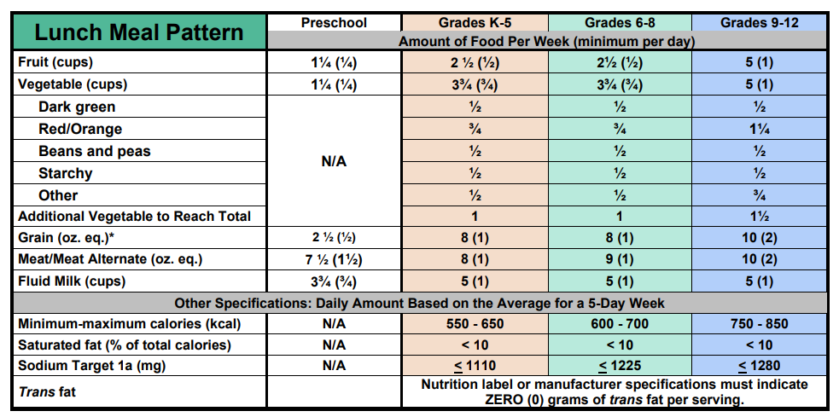
NSLP Lunch Meal Pattern
2
Notes:
Let’s look at the NSLP Meal Pattern. This is a tool that meal planners use in school nutrition to ensure that meals meet the daily and weekly requirements.
The chart is organized by grade level, weekly and daily amounts, meal components, and nutrient requirements.
Daily amounts for each category are in parentheses but weekly amounts are not.
Grades 9-12 require 1 cup of fruit and vegetables per day or 5 cups for the week. For grains and meat/meat alternates the requirement is 2 oz equivalents per day or 10 oz equivalents for the week.
Let’s discuss how this information relates to your recipe for the Student Chef competition.

Slide 25
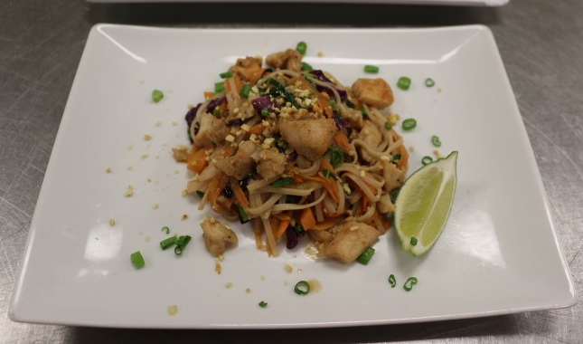
Nutrient Requirements for High School
An entrée* is defined as the main course of a meal that has a combination of:
Meat/meat alternate + whole grain rich food
Meat/meat alternate + vegetable
Meat/meat alternate + fruit
High school recipes must be an entrée for school lunch
Per serving* | Amount
Calories | < 850
Saturated Fat | < 9 g
Sodium | < 667 mg
*For nutrient analysis, the recipe must fall below these maximums.
Notes:
High School recipes must be an entrée for school lunch.
An entrée is the main course of a meal and has combination of:
Meat/meat alternate + whole grain rich food
Meat/meat alternate + vegetable
Meat/meat alternate + fruit
Nutrient requirements for an entrée per serving should be less than the maximums listed in this chart for calories, saturated fat and sodium content.
As mentioned in the meal pattern slide meats/meat alternates and grains must be a 2 oz equivalent each per serving.

Slide 26

Student Chef Competition
Culinary Tips and Trends
Notes:
Let’s discuss a few culinary tips and trends to help you create innovative and flavorful recipes!

Slide 27
Culinary Tips to Reduce Sodium
Choose fresh or frozen fruits and vegetables
Select whole grain products over processed grain products
Add spices
Include herbs – fresh or dried
Use seasoning blends – combinations of spices and herbs
Notes:
As mentioned on the nutrient requirements slide sodium is limited in school meals. However, there are several ways to reduce sodium without losing flavor. Let’s face it, everyone wants flavorful food. Of course, there is a lot of data out there to tell you why flavor is important. As student chefs we want to encourage to think about what you want in your recipe. What do students like eat in school meals? What flavors do you or your friends enjoy? No one wants to eat bland, boring food!
Sodium or salt has a purpose in cooking and should not be discarded or eliminated completely. But sodium and salt are not what creates great dishes and amazing flavor. It can easily make foods too salty. Also, it can cause foods to be tough, dry and rubbery. Instead, consider these strategies to ensure delicious-flavorful dishes.
Choose fresh or frozen fruits and vegetables. Select whole grain products that you can customize with flavor over processed grains products. Add spices or include fresh or dried herbs. Or use a seasoning blend that combines spices and herbs.

Slide 28
Culinary Tips to Reduce Sodium
Utilize cooking techniques-roasting, sauteing or caramelization
Add citrus juices and zests
Use liquids like peach, mandarin orange, or pineapple juices
Incorporate seasonal and local ingredients
Create a glaze for complex flavor
Notes:
Consider trying a different cooking technique such as roasting, sauteing or caramelization to bring out the natural flavor in fruits and vegetables. Add citrus juice and zests to brighten or use liquids that school kitchens typically discard like peach, mandarin orange or pineapple juice.
Incorporate seasonal and local ingredients. They are at the peak of the season and at their freshest which tastes better and provides more flavor. Create a glaze using a reduction technique that has a more intense complex flavor.

Slide 29




Food Trends
Foods
Flavors
Ingredients
Dishes
Notes:
Let’s discuss food trends. Food trends change the way people eat. If you have a favorite food or item that you like to buy it may have started with a trend. Information from trends can provide insight on why consumers chose what they eat. Food trends can be a food, flavor, ingredient or a dish. We can use also use trends in school nutrition to give us insight to students’ food behaviors and preferences. Let’s check out a few popular food trends in the next few slides.

Slide 30
Menu Winners
Birria
Global
Plant Forward
Familiar Remix
Notes:
Here are some menu winners that are growing in popularity:
Birria: Birria is a Latin meat dish or stew composed of dried chilis, vinegar, garlic and other herbs and spices. It is known for its deep, rich flavor and texture.
Global: These are dishes inspired by global cuisines like Mexican, Indian, Caribbean, Cuban, Greek and Korean. Global dishes may be authentic or inspired. Global cuisine does not have to be 100% authentic. Influences may come from authentic dish ingredients, flavors, techniques and serve as inspiration for creating dishes that are new and exciting!
Plant forward: Plant forward recipes are popular with students. Think of smaller amounts of animal protein mixed with plant-based proteins like a burrito bowl with black beans, pinto beans and a small amount of shredded chicken and cheese.
Familiar remixes: These are familiar flavors with a gentle twist on timeless comfort foods. This is also called “NEW-stalgia.“
Picture Links:
Birria: https://i.pinimg.com/originals/10/1e/94/101e94ea9c6fdfbb3334a6e761ca5e43.jpg
Global: Vermicelli Noodle Salad: Vermicelli Noodle Salad (vegan | gluten-free | healthy) | Aline Made (aline-made.com)
Plant-Forward: Burrito Bowl: Plant-Based Burrito Bowl Recipe (skinnyms.com)
Newstalgia: Meatloaf: Meatloaf Is the Way to My Heart As Long As It Has Kick and Potatoes Are Around Recipe | Sunny Anderson | Food Network

Slide 31
Popular Flavors
Sweet, Sour & Spicy
Sweet & Savory
Citrus Blends
Barbeque Influences
Mushrooms
Sour
Notes:
There are several popular flavors being featured on menus!
Sweet, Sour, and Spicy – think of a chili lime spice with pineapple.
Sweet and Savory flavors may have fun combinations like apples and cheddar, melons and Spy Sauce or Strawberry and Ghost pepper.
Citrus blends combine lemon, lime and orange that can brighten dishes.
Barbeque influences can provide smoky flavors while sour flavors can incorporate pickled or fermented vegetables and fruits.
Mushrooms add “umami” or savory flavor to dishes as well.

Slide 32

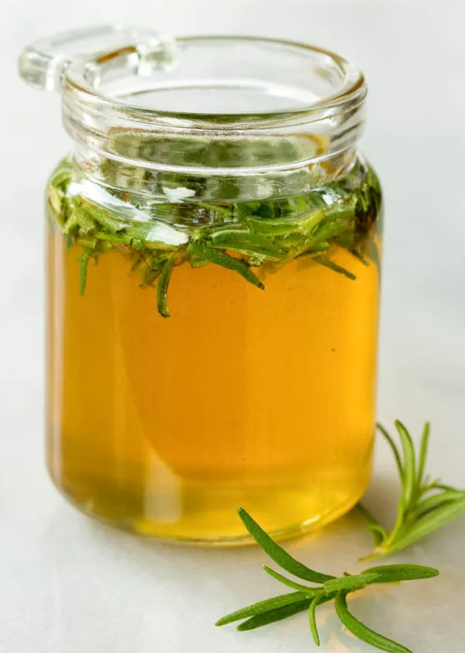
Additional Trend Considerations
Natural Color – Visually bright, attention-grabbing dishes
  Ube-purple sweet potato
Condiment Mash Ups
  Sambal and mustard, herb infused honey, BBQ Sauce
Presentation is Key
  Bright colors, fun patterns, new textures, and personalization
Notes:
There are few other food trends to consider.
Look for the natural color in foods. It grabs attention like Ube-a purple sweet potato. Condiment mash ups add twists with interesting combinations like Sambal Olek and mustard, an herb infused honey with rosemary or thyme or BBQ sauce combinations using fruit, spices or chilis for heat.
Lastly, presentation is key. Think about bright colors, fun patterns, new textures and personalization for your customers-the students. We also eat with our eyes!
We hope that you find these culinary tips and trends helpful as you create your dishes!

Slide 33
NSLP Resources
Grain Crediting Resource-Exhibit A:
https://foodbuyingguide.fns.usda.gov/Content/TablesFBG/ExhibitA.pdf
NSLP Meal Pattern:
LunchMealPatternCHARTSY24.pdf (gadoe.org)
USDA Foods Available List:
https://www.fns.usda.gov/usda-fis/usda-foods-available
Notes:
The district school nutrition program is a great resource. They can help develop recipes that meet the meal pattern and dietary specifications, recipes that work in the school meal program, available ingredients and equipment, and labor efficiency.
Remember that recipes do need to be approved by your school nutrition director, thus it is helpful to start the process early.
The Georgia Department of Education Student Chef website also contains resources that will assist you.
The Georgia Harvest of the Month website contains resources for each produce item, including fact sheets, menu and recipe ideas, food-based education opportunities, and general resources.

Slide 34
Culinary Resources
GaDOE Flavor Chart:
FlavorChart2021Letter.pdf (gadoe.org)
Culinary Institute of Child Nutrition:
Flavor Enhancement – Culinary Institute of Child Nutrition (theicn.org)
Notes:
Additional culinary resources are available on the Georgia Department of Education School Nutrition website and on the Culinary Institute of Child Nutrition website.

Slide 35
Social Media
Notes:
You can find more information about school meals on our website. Also, we encourage you to like, follow, and engage with us on social media.

Slide 36
U
Notes:
Update Nondiscrimination Statement?

