Slide 1
Overview of
Federal child nutrition programs
Institute of Child Nutrition
The University of Mississippi
theicn.org
2017

Slide 2

This resource is provided by the
The University of Mississippi
School of Applied Sciences
icn.org
800-321-3054

Slide 3
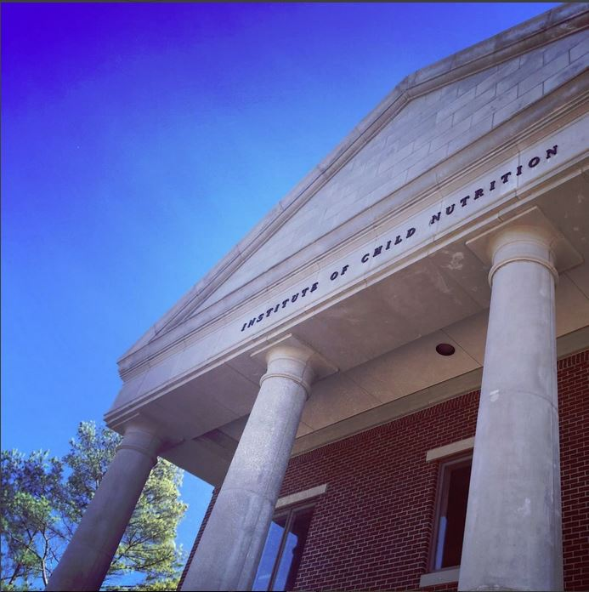
Institute of Child Nutrition
The University of Mississippi
Mission: To provide information and services that promote the continuous improvement of child nutrition programs
Vision: To be the leader in providing education, research, and resources to promote excellence in child nutrition programs

Slide 4
Objectives
Identify the six major federal child nutrition programs.
Identify the administrative flow of the federal child nutrition programs from the federal level to the child care center and school levels.
Describe the main requirements associated with each program.

Slide 5
Administrative Flow
United States Department of Agriculture (USDA)
Headquarters – Washington, DC
Food and Nutrition Services (FNS)
Headquarters – Arlington, VA
USDA Regional Offices
Western
Mountain Plains
Southwest
Midwest
Southeast
Mid-Atlantic
Northeast
State Agencies
Local School Food Authorities (SFA)
Child Care Centers
Family Child Care Homes
Schools
Notes:
The federal child nutrition programs (CNPs) are administered at the federal level by the Food and Nutrition Services (FNS), headquartered in Arlington, Virginia. The FNS is under the United States Department of Agriculture (USDA), with headquarters in Washington, DC.
There are seven USDA FNS regional offices who oversee the programs at the federal level. These seven regional offices are the Western, Mountain Plains, Southwest, Midwest, Southeast, Mid-Atlantic, and Northeast.
Passing next to the state level, the CNPs are administered through the governing State agency, which in Texas, New Jersey, Florida, and Nevada is the State Department of Agriculture. In all other states, the State Department of Education administers the program. There are 56 State agencies including Washington, DC; American Samoa; Guam; Northern Mariana Islands; Puerto Rico; and Virgin Islands.
For child care, the programs are then managed by each child care center or family child care home, where the children receive the benefits of the programs.
For school nutrition, the programs are managed by a local school food authority (SFA). An SFA is the local unit that administers the operation of a school feeding program. The SFAs receive the federal meal reimbursements for meal programs and ensure meal counts and eligibility criteria are met.
Finally, the children receive the benefits of the programs at individual schools.

Slide 6
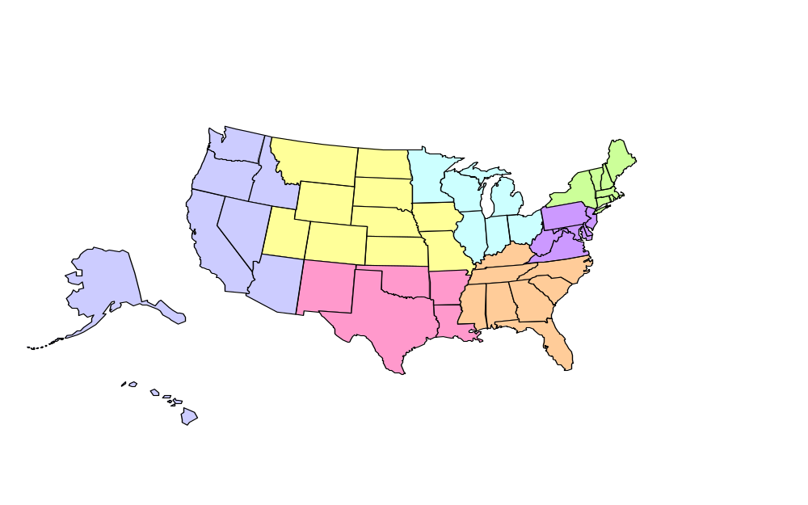
FNS Regional Offices
USDA Food and Nutrition Service Regional Offices
Mountain Plains Region
Northeast
Region
Midwest
Region
Western
Region
Mid Atlantic
Region
Southeast
Region
Southwest
Region
Notes:
There are seven USDA Food and Nutrition Service Regional Offices are located across the united States and oversee the CNPs at the federal level.
The Western Regional Office (WRO) is located in San Francisco, California and serves eight states and three US territories: Alaska, American Samoa, Arizona, California, Guam, Hawaii, Idaho, Nevada, Northern Mariana Islands, Oregon, and Washington.
The Mountain Plains Regional Office (MPRO) is located in Denver Colorado and serves ten states in the Mountain Plains region; Colorado, Iowa, Kansas, Missouri, Montana, Nebraska, North Dakota, South Dakota, Utah, and Wyoming.
The Southwest Regional Office (SWRO) is located in Dallas, Texas and serves five states: Arkansas, Louisiana, New Mexico, Oklahoma, and Texas.
The Midwest Regional Office (MWRO) is located in Chicago, Illinois and serves seven states: Illinois, Indiana, Michigan, Minnesota, Ohio, and Wisconsin.
The Southeast Regional Office (SERO) is located in Atlanta, Georgia and serves eight states: Alabama, Florida, Georgia, Kentucky, Mississippi, North Carolina, South Carolina, and Tennessee.
The Mid-Atlantic Regional Office (MARO) is located in Robbinsville, New Jersey and serves six states, two US territories, and the District of Columbia: Delaware, Maryland, New Jersey, Pennsylvania, Puerto Rico, Virgin Islands, Virginia, and West Virginia.
The Northeast Regional Office (NERO) is located in Boston, Massachusetts and serves seven states: Connecticut, Maine, Massachusetts, New Hampshire, New York, Rhode Island, and Vermont.

Slide 7
Child Nutrition Programs
National School Lunch Program (NSLP)
School Breakfast Program (SBP)
Child and Adult Care Food Program (CACFP)
Fresh Fruit and Vegetable Program (FFVP)
Special Milk Program for Children (SMP)
Summer Food Service Program (SFSP)
Afterschool Snack Service
Seamless Summer Option
At-Risk Afterschool Meals
Notes:
The USDA FNS administers a variety of programs that provide healthy food to children.
There are six major programs:
National School Lunch Program (NSLP), which includes Afterschool Snack Service and the Seamless Summer Option
School Breakfast Program (SBP)
Special Milk Program (SMP)
Child and Adult Care Food Program (CACFP), which includes At-Risk Afterschool Meals
Summer Food Service Program (SFSP)
Fresh Fruit and Vegetable Program (FFVP)
These programs help improve the well-being of children by reimbursing organizations (i.e., schools, child care centers, and afterschool programs) for providing healthy meals to children.

Slide 8

National School Lunch Program (NSLP)
Richard B. Russell National School Lunch Act (1946)
Established “…as a measure of national security, to safeguard the health and well-being of the Nation’s children and to encourage the domestic consumption of nutritious commodities…”
Photo credit: ICN - Archives
Notes:
Signed by President Harry Truman in 1946, the Richard B. Russell National School Lunch Act supported schools in providing meals to children.
It was established “as a measure of national security, to safeguard the health and well-being of the Nation’s children and to encourage the domestic consumption of nutritious commodities.”

Slide 9
National School Lunch Program (NSLP)
Nutritionally balanced, low-cost or free lunches
Public and nonprofit private schools and residential child care institutions
Includes reimbursement for snacks served in afterschool educational and enrichment programs
  Children through age 18
Notes:
The National School Lunch Program (NSLP) is a federally assisted meal program that operates in public and private nonprofit schools and residential child care institutions.
It provides assistance to offer nutritionally balanced, low-cost or free lunches to children each school day.
NSLP also provides reimbursements for afterschool snacks if they are served in an educational or enrichment program for children through age 18.

Slide 10
NSLP Requirements
Serve during specific time period
Meet nutritional requirements
Display reimbursable meal signage
No overt identification
No discrimination based on free/reduced price (F/RP) eligibility
Notes:
Lunch must be served during the specified time period between the hours of 10:00 a.m. – 2:00 p.m. It is important to note; however, there are no requirements for the length of the meal time.
Lunches must meet specific meal pattern and nutrition standards. These specifications set specific calorie limits based on age/grade levels (K-5, 6-8, and 9-12), as well as the accepted amount of sodium in a meal.
Schools may not make it obvious which students receive free or reduced price meals (F/RP), known as overt identification.
In no way can schools differentiate between students based on their level of eligibility for F/RP meals, including: serving different meals, color-coded tickets, separate lines, etc.

Slide 11
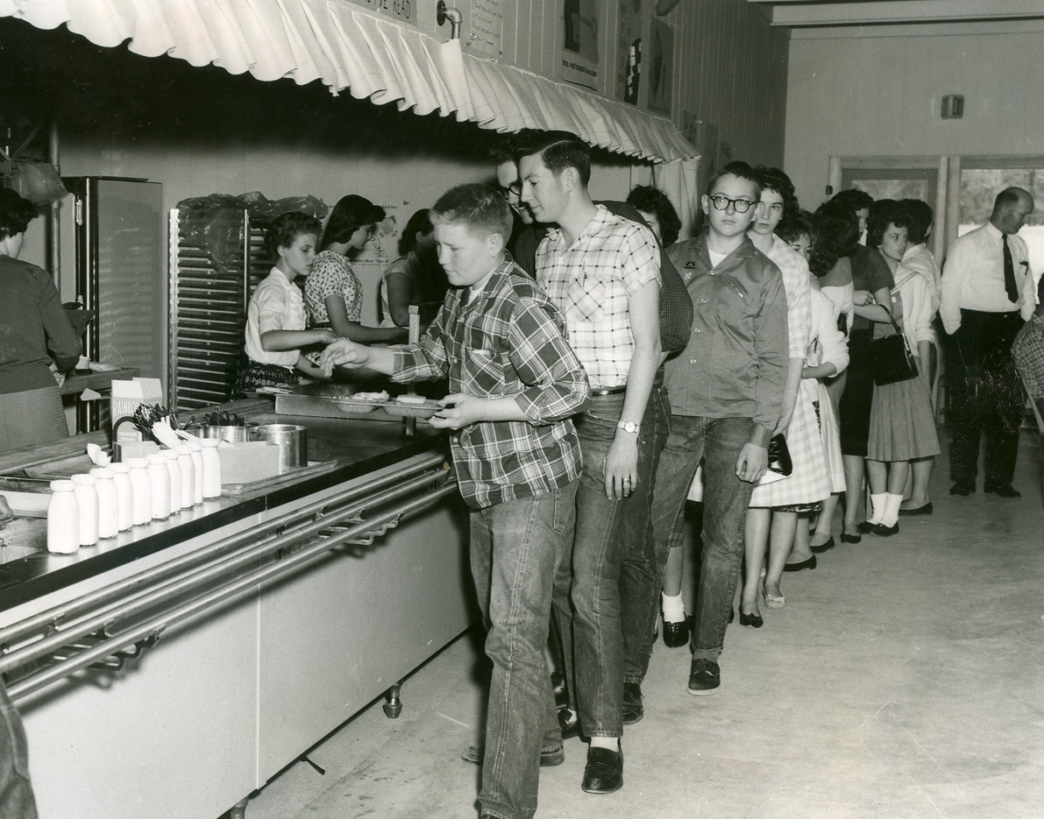
School Breakfast Program (SBP)
Child Nutrition Act (1966)
Expanded the Richard B. Russell National School Lunch Act
Serve complete breakfasts at the beginning of the school day
Count and claim by category
Inform families of availability
Same eligibility criteria as NSLP
Photo credit: Earnestine Camp Collection
Notes:
In 1966, Congress passed the Child Nutrition Act. Among other things, it expanded the Richard B. Russell National School Lunch Act to include breakfast.
To participate in the program, SFAs must serve complete breakfasts at the beginning of the school day. They must also count and claim these meals based on the same categories as lunch (free, reduced price, and paid).
In addition, SFAs must notify families about the availability of breakfast at the beginning of or just before each new school year, as well as send reminders throughout the year.
The eligibility criteria for the SBP is the same as for the NSLP.

Slide 12

Special Milk Program (SMP)
Provides milk
Reimburses schools
Half-day pre-kindergarten and kindergarten programs
Nonprofit
Reimbursement funds – cost of milk
Buy milk or receive it free
Photo credit: School Milk Program Collection
Notes:
The Special Milk Program (SMP) provides milk to children in schools, child care institutions, and eligible camps that do not participate in other federal child nutrition meal service programs.
The SMP reimburses schools and institutions for each half-pint of milk they serve.
Schools in the National School Lunch or School Breakfast Programs may also participate in the SMP to provide milk to children in half-day pre-kindergarten and kindergarten programs where the children do not have access to the school meal programs.
Schools must operate the milk program on a nonprofit basis and must use the federal reimbursement funds to reduce the price of milk to all children.
Based on the school’s choice of program options, the children may either buy milk or receive it free.

Slide 13

Child and Adult Care Food Program (CACFP)
Child and adult care institutions and family or group day care homes
Wellness, healthy growth, and development
Young children, older adults, and chronically impaired disabled persons
Healthy, balanced meals and snacks
Photo credit: ICN – CACFP
Notes:
The Child and Adult Care Food Program (CACFP) provides aid to child and adult care institutions and family or group day care homes. These funds are for the provision of nutritious foods that contribute to the wellness, healthy growth, and development of young children, and the health and wellness of older adults and chronically impaired disabled persons.
The CACFP ensures children and adults have access to healthy, balanced meals and snacks throughout the day.

Slide 14
Child and Adult Care Food Program (CACFP)
Reimburses meals and snacks
Recently updated nutrition standards
  Increased variety of vegetables and fruit
  More whole grains
  Less added sugar and fat
Notes:
The CACFP reimburses meals and snacks served in child care centers, afterschool care centers, at-risk afterschool care centers, adult day care centers, and adult day care homes.
Nutrition standards and meal patterns for CACFP recipients have recently been updated and must be implemented by October 1, 2017. These updates require using: 1) increased variety of vegetables and fruit, 2) more whole grains, and 3) less added sugar and fat.

Slide 15

Summer Food Service Program (SFSP)
Federally funded and state administered
Children and teens in low income areas – free meals
  age 18 and younger
When school is not in session
Three main players
  State agencies
  Sponsors
  Sites
Photo credit: Donna Matsufuru – Hawaii Collection
Notes:
The Summer Food Service Program (SFSP) is a federally-funded, state-administered program. It ensures that children and teens (age 18 and younger) in low-income areas receive free, nutritious meals when school is not in session.
State agencies administer the program and communicate with USDA.
Sponsors enter agreements with the State agencies to run the program. Sponsors may include schools, camps, and faith-based and other non-profit community-based organizations.
The sites work directly with the sponsors and are the places in the community where children receive the meals in a safe and supervised environment. Examples of sites include parks, churches, hospitals, and apartment complexes.

Slide 16

Fresh Fruit and Vegetable Program (FFVP)
Free, fresh fruits and vegetables
Overall diet
Healthier eating habits
Elementary schools with highest free and reduced price enrollment
Photo credit: Extension Service Records
Notes:
The Fresh Fruit and Vegetable Program (FFVP) provides free, fresh fruits and vegetables to students in participating elementary schools during the day.
The goals of the FFVP are to “improve children’s overall diet and create healthier eating habits to impact their present and future health.”
FFVP is targeted to elementary schools with the highest free and reduced price enrollment.

Slide 17
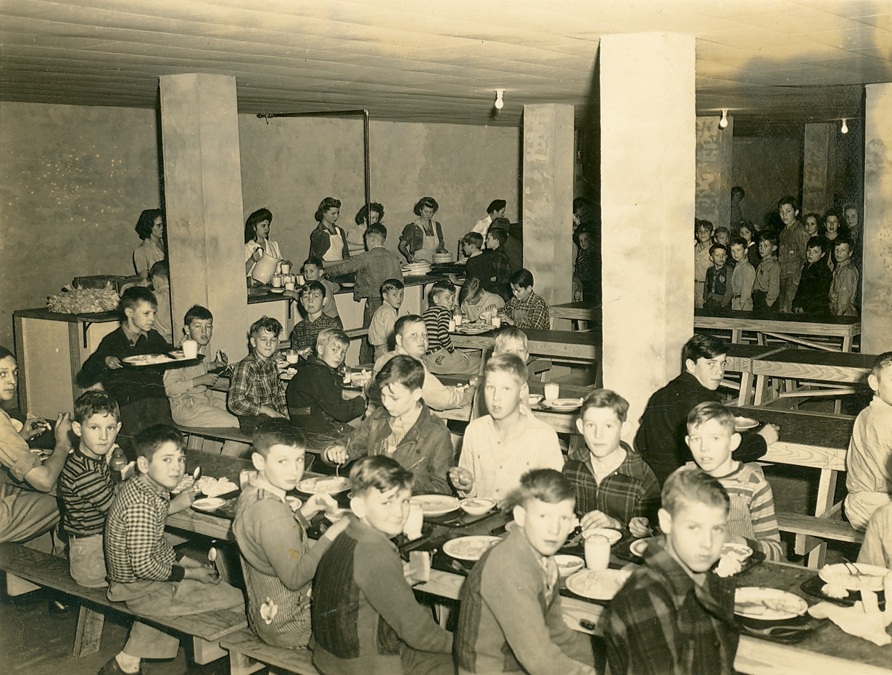
Conclusion
Health, nutrition, and access
Healthy meals to children
Photo credit: Earnestine Camp Collection
Notes:
As you can see, there are a variety of federally-assisted child nutrition programs available from the USDA.
The six programs discussed aim to improve the health and nutrition of children, as well as their access to a variety of foods.
Individually and together, these federal child nutrition programs are making a positive difference in the well-being of children throughout the United States and its territories by reimbursing organizations for providing healthy meals to children.

Slide 18
References
https://www.fns.usda.gov/school-meals/child-nutrition-programs
https://www.fns.usda.gov/sites/default/files/NSLPFactSheet.pdf
https://www.fns.usda.gov/sites/default/files/sbp/SBPfactsheet.pdf
https://www.fns.usda.gov/sites/default/files/SMPFactSheet.pdf
https://www.fns.usda.gov/cacfp/managing-cacfp
https://www.fns.usda.gov/sfsp/summer-food-service-program
https://www.fns.usda.gov/sites/default/files/FFVPFactSheet.pdf

