Slide 1
Customer Service, Merchandising, and Food Presentation
ORIENTATION TO SCHOOL NUTRITION MANAGEMENT

Slide 2
Six Top Statements Made by Staff to Children in The Serving Line
Starting in reverse order:
6. “Next…”
5. “What do you want?”
4. “Come on and get moving!”
3. “Stop talking!”
2. “Enter your PIN, TRY AGAIN. Just tell
me your name and I will do it!”
1. The most common thing said to our
customers: Nothing!!

Slide 3
Statements Customers Hear When They Enter a Restaurant
“Hi, may I help you?”
“Great to see you today; hope you enjoy
your meal.”
“Great choice of food selections today.”
“Don’t you look nice today?”

Slide 4
Objective 1
      Identify your customer.

Slide 5
The Customer for School Nutrition
Who are the primary customers?
Who are the secondary customers?
What influences the needs and wants of the school nutrition customers?
What factors or groups influence customers' eating habits?

Slide 6
Objective 2
      State how the principles of customer service, merchandising, and food presentation relate to attracting and keeping customers.

Slide 7
5 Key Elements of Presentation
COLOR
Shape
Texture
Height
Simplicity

Slide 8
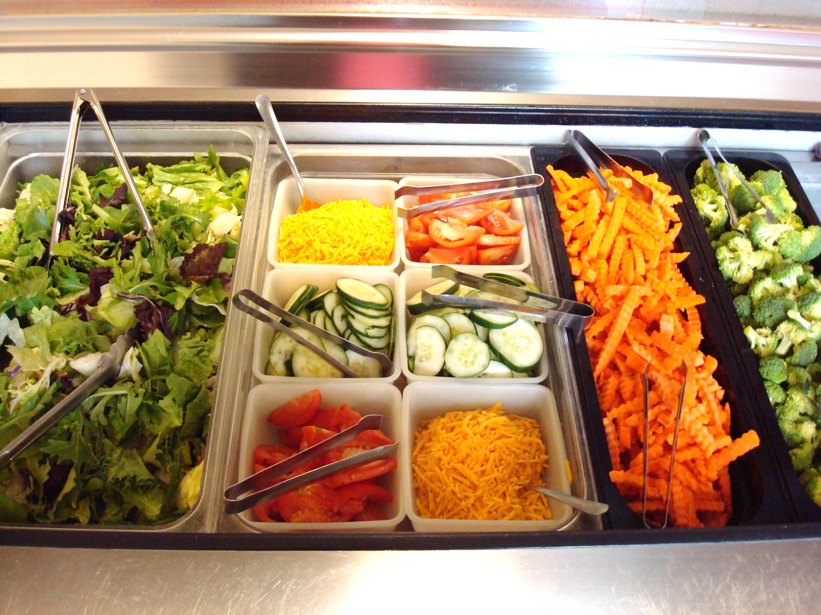
Colorful Serving Line 1

Slide 9
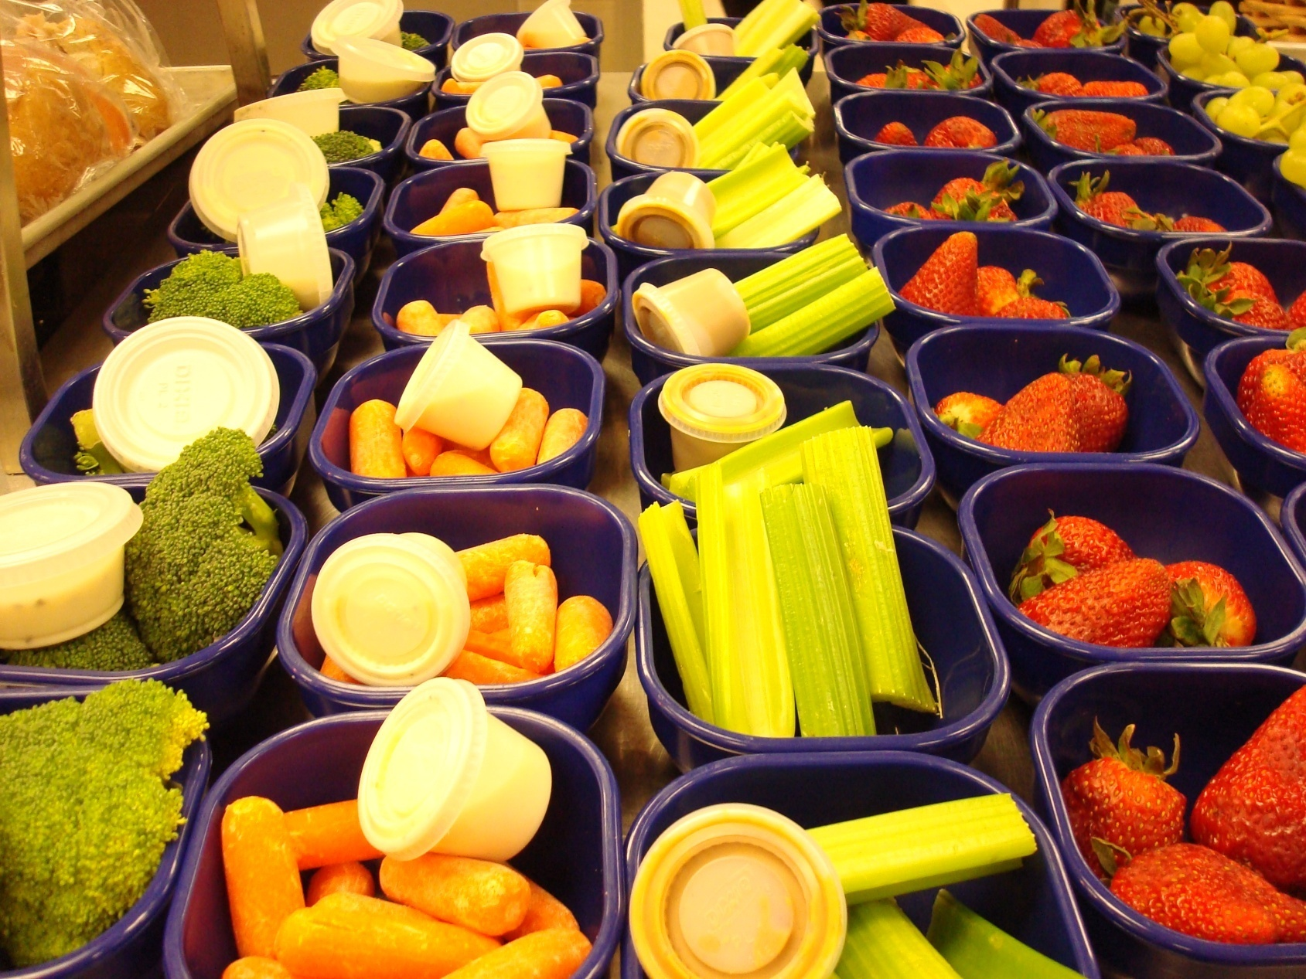
Colorful Serving Line 2

Slide 10
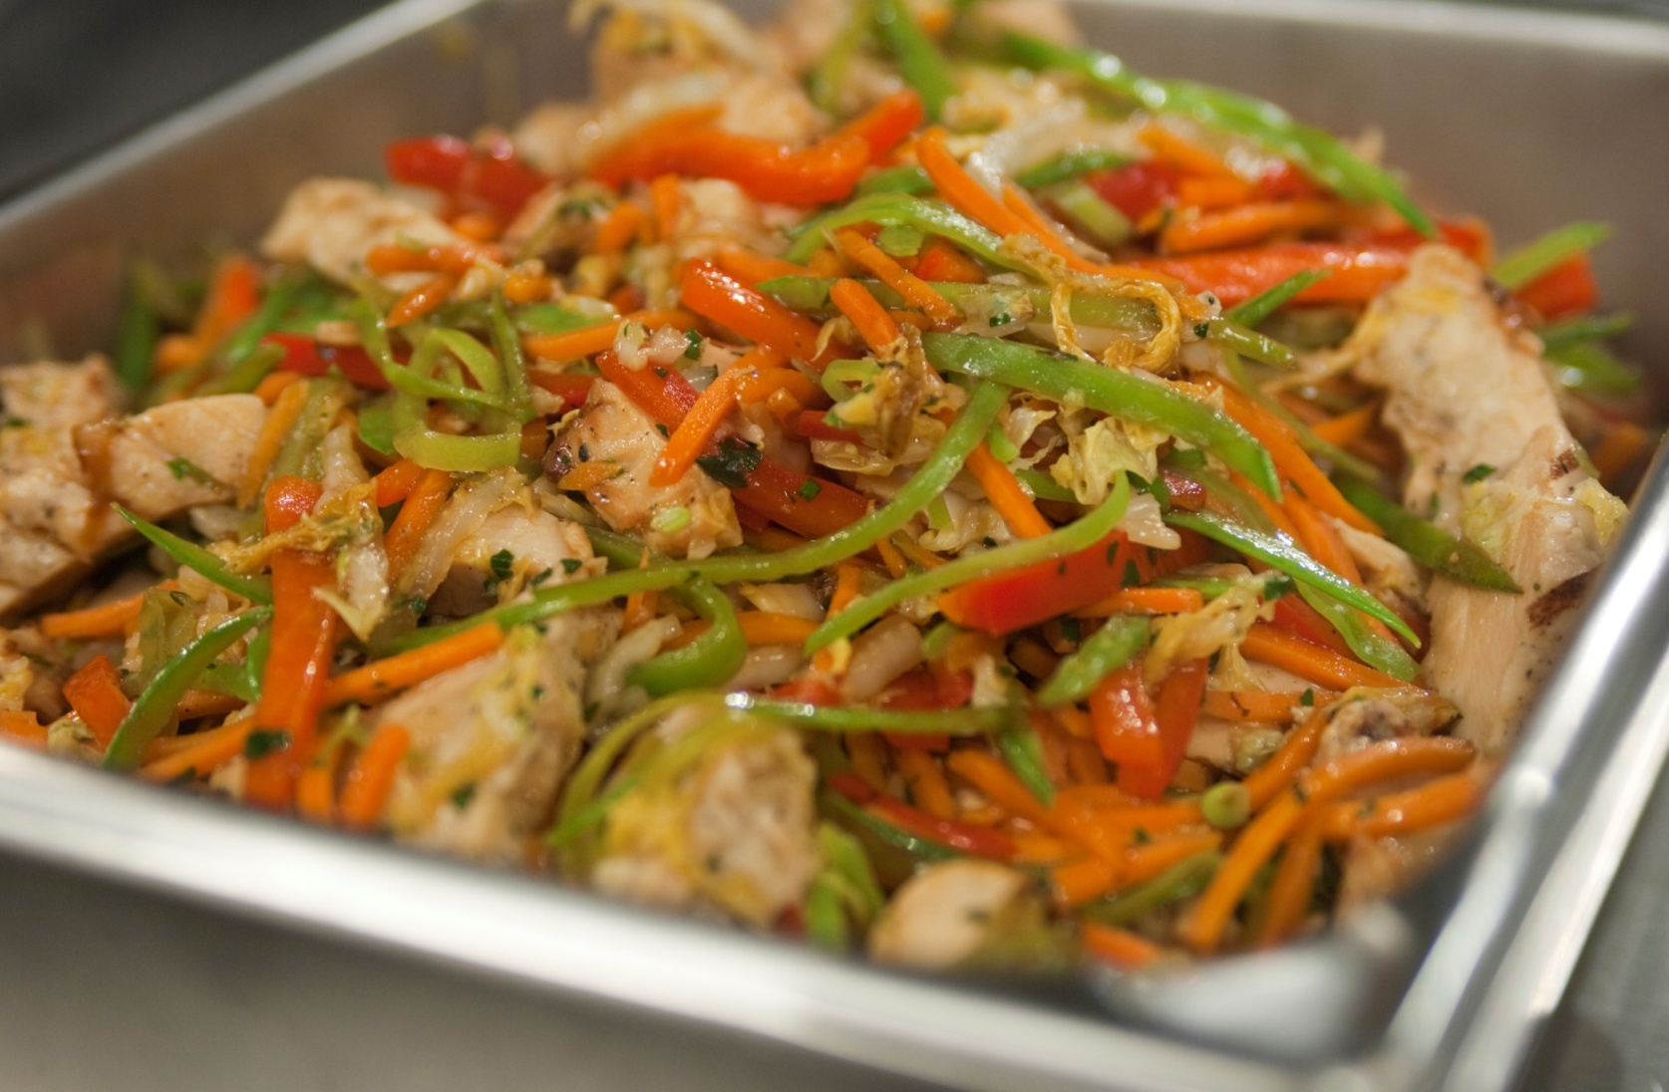
Colorful Serving Line 3

Slide 11
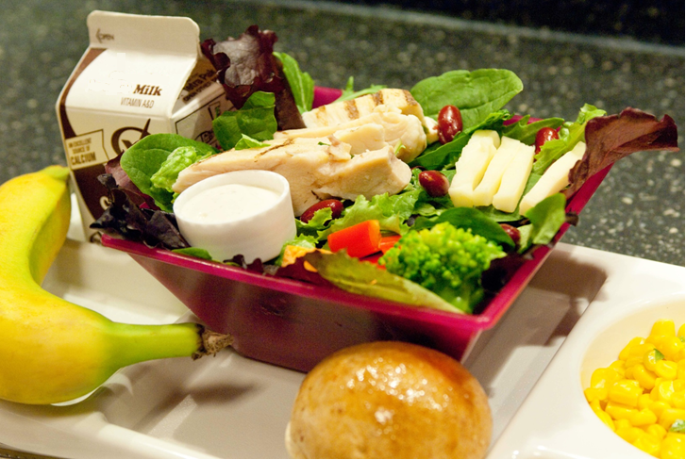
Color

Slide 12
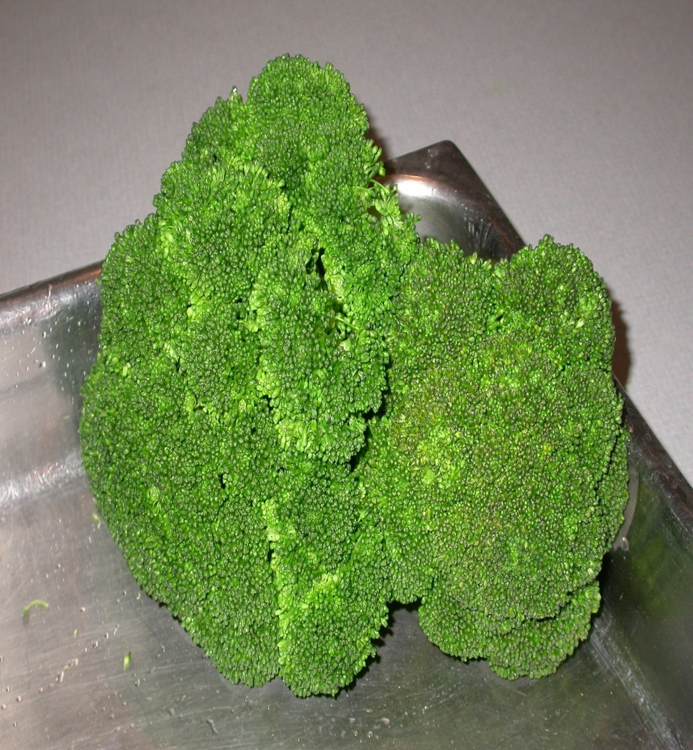
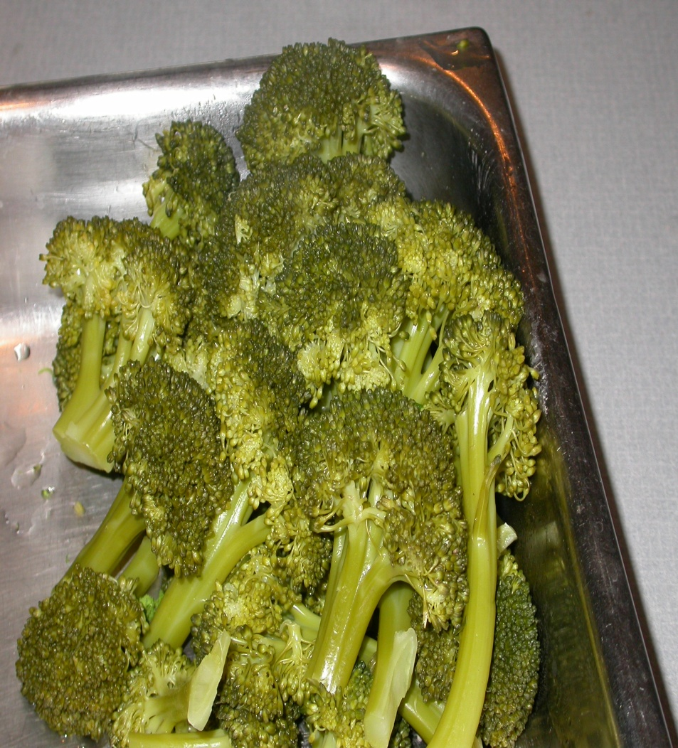
Color: Preparation Techniques

Slide 13
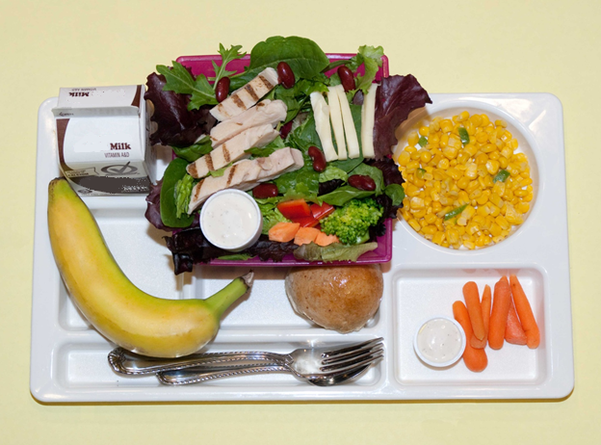
Texture

Slide 14
Texture Names
Grilled Chicken Strips
Mild Mozzarella Cheese
Crisp Mixed Greens
Hearty Red Kidney Beans
Creamy Dressing
Crunchy Baby Carrots
Tender Corn
Ripe Green Tip Banana
Crusty Whole Wheat Roll
Cold Chocolate Milk

Slide 15
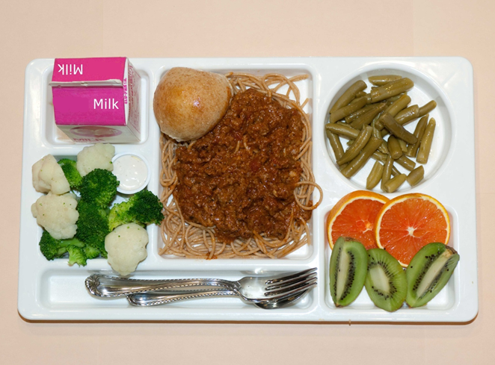
Shapes: Food Variety 1

Slide 16
Shapes: Food Variety 2
How many ways can you cut a sandwich?

Slide 17
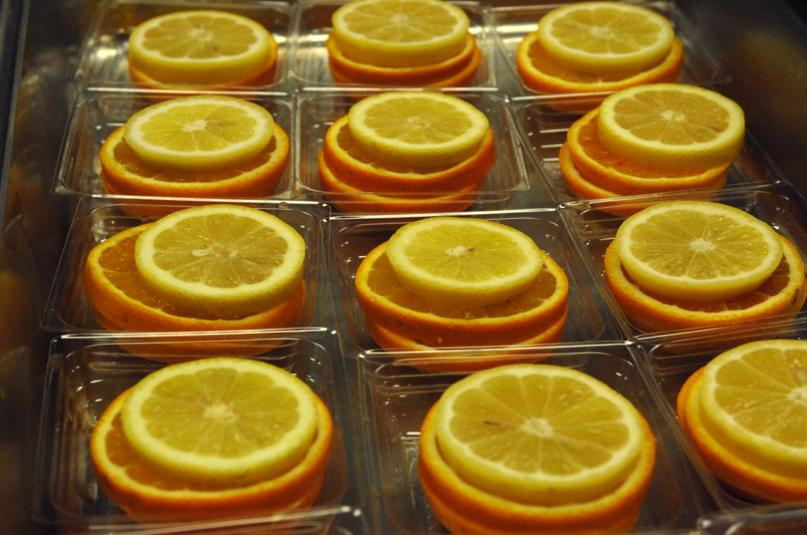
Shapes: Food Variety 3

Slide 18
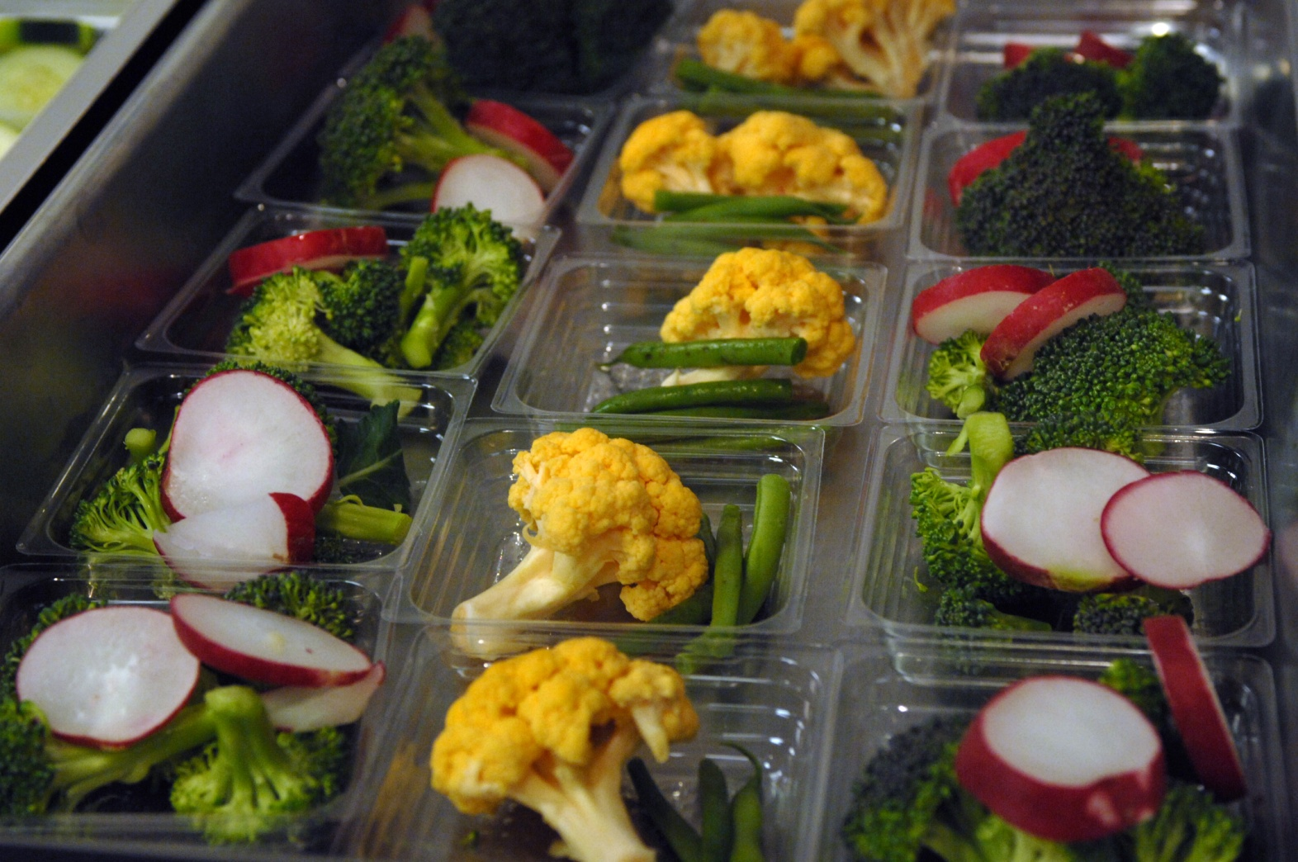
Shapes: Food Variety 4

Slide 19
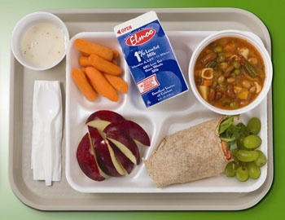
Simplicity

Slide 20
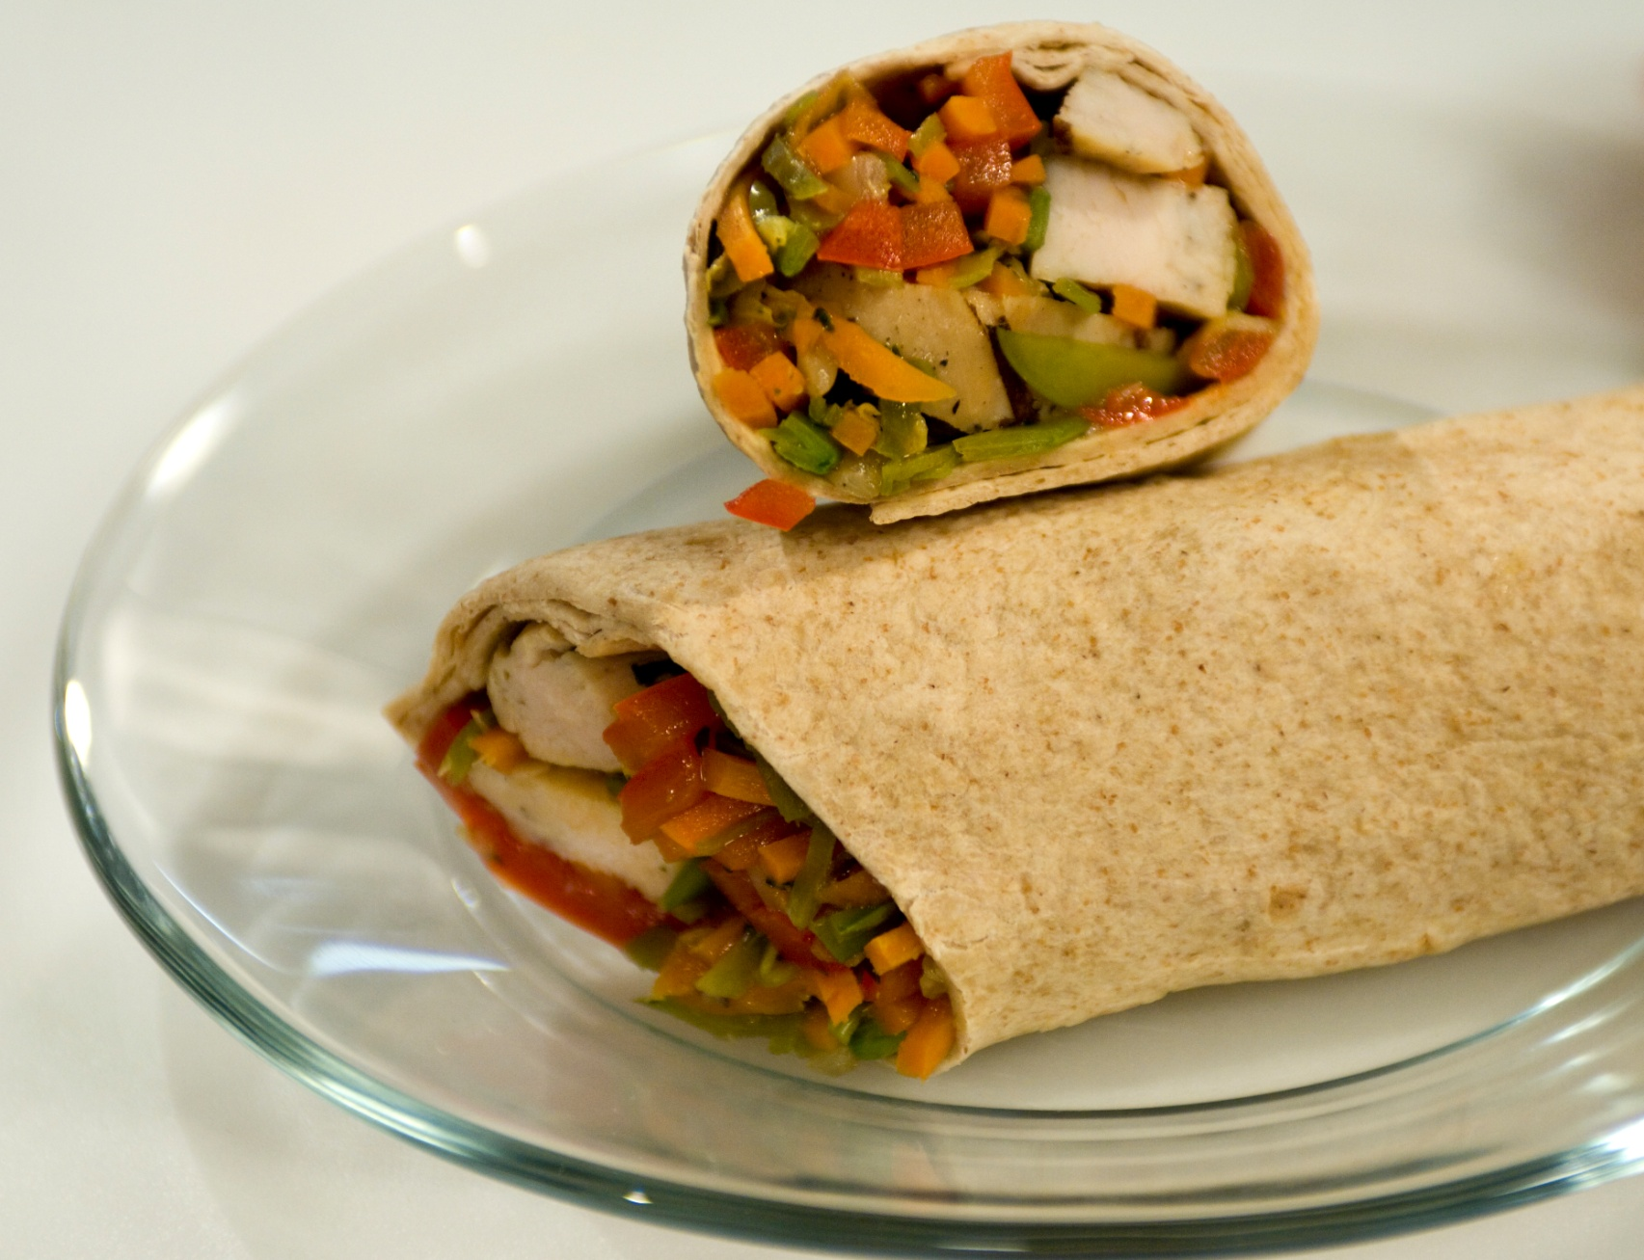
Height

Slide 21
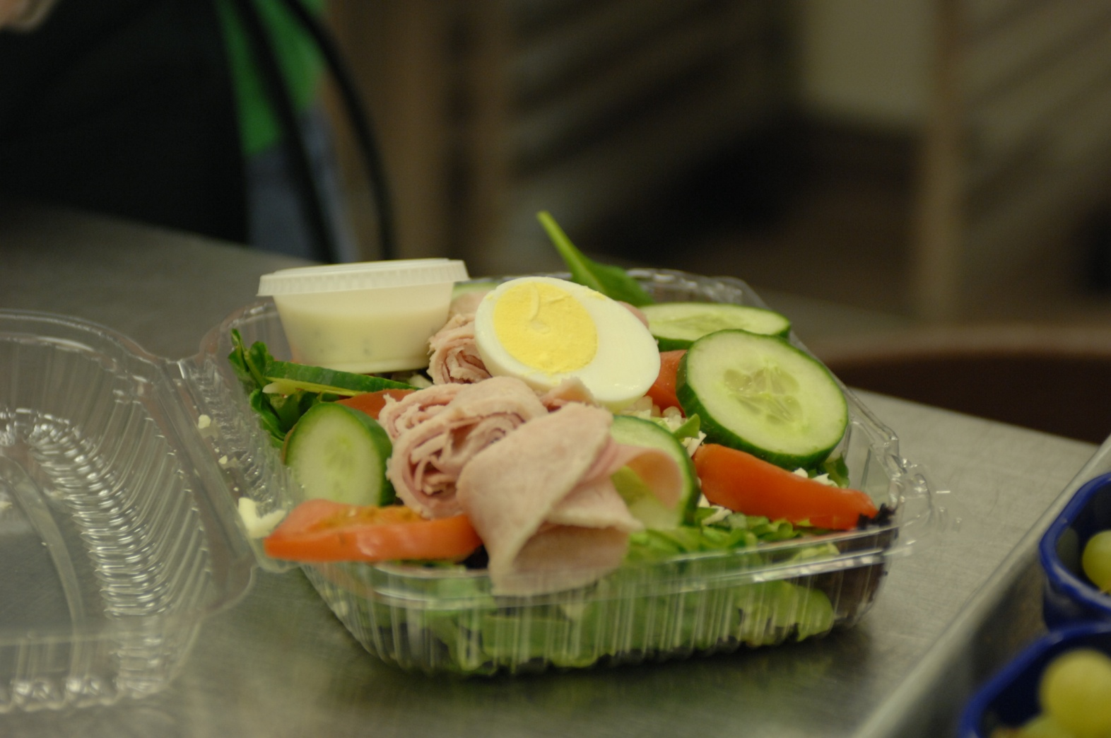
Self-Serve Packaging

Slide 22
Objective 3
Demonstrate how to use menus and meal themes as part of a merchandising effort to attract and influence the preferences of children.

Slide 23
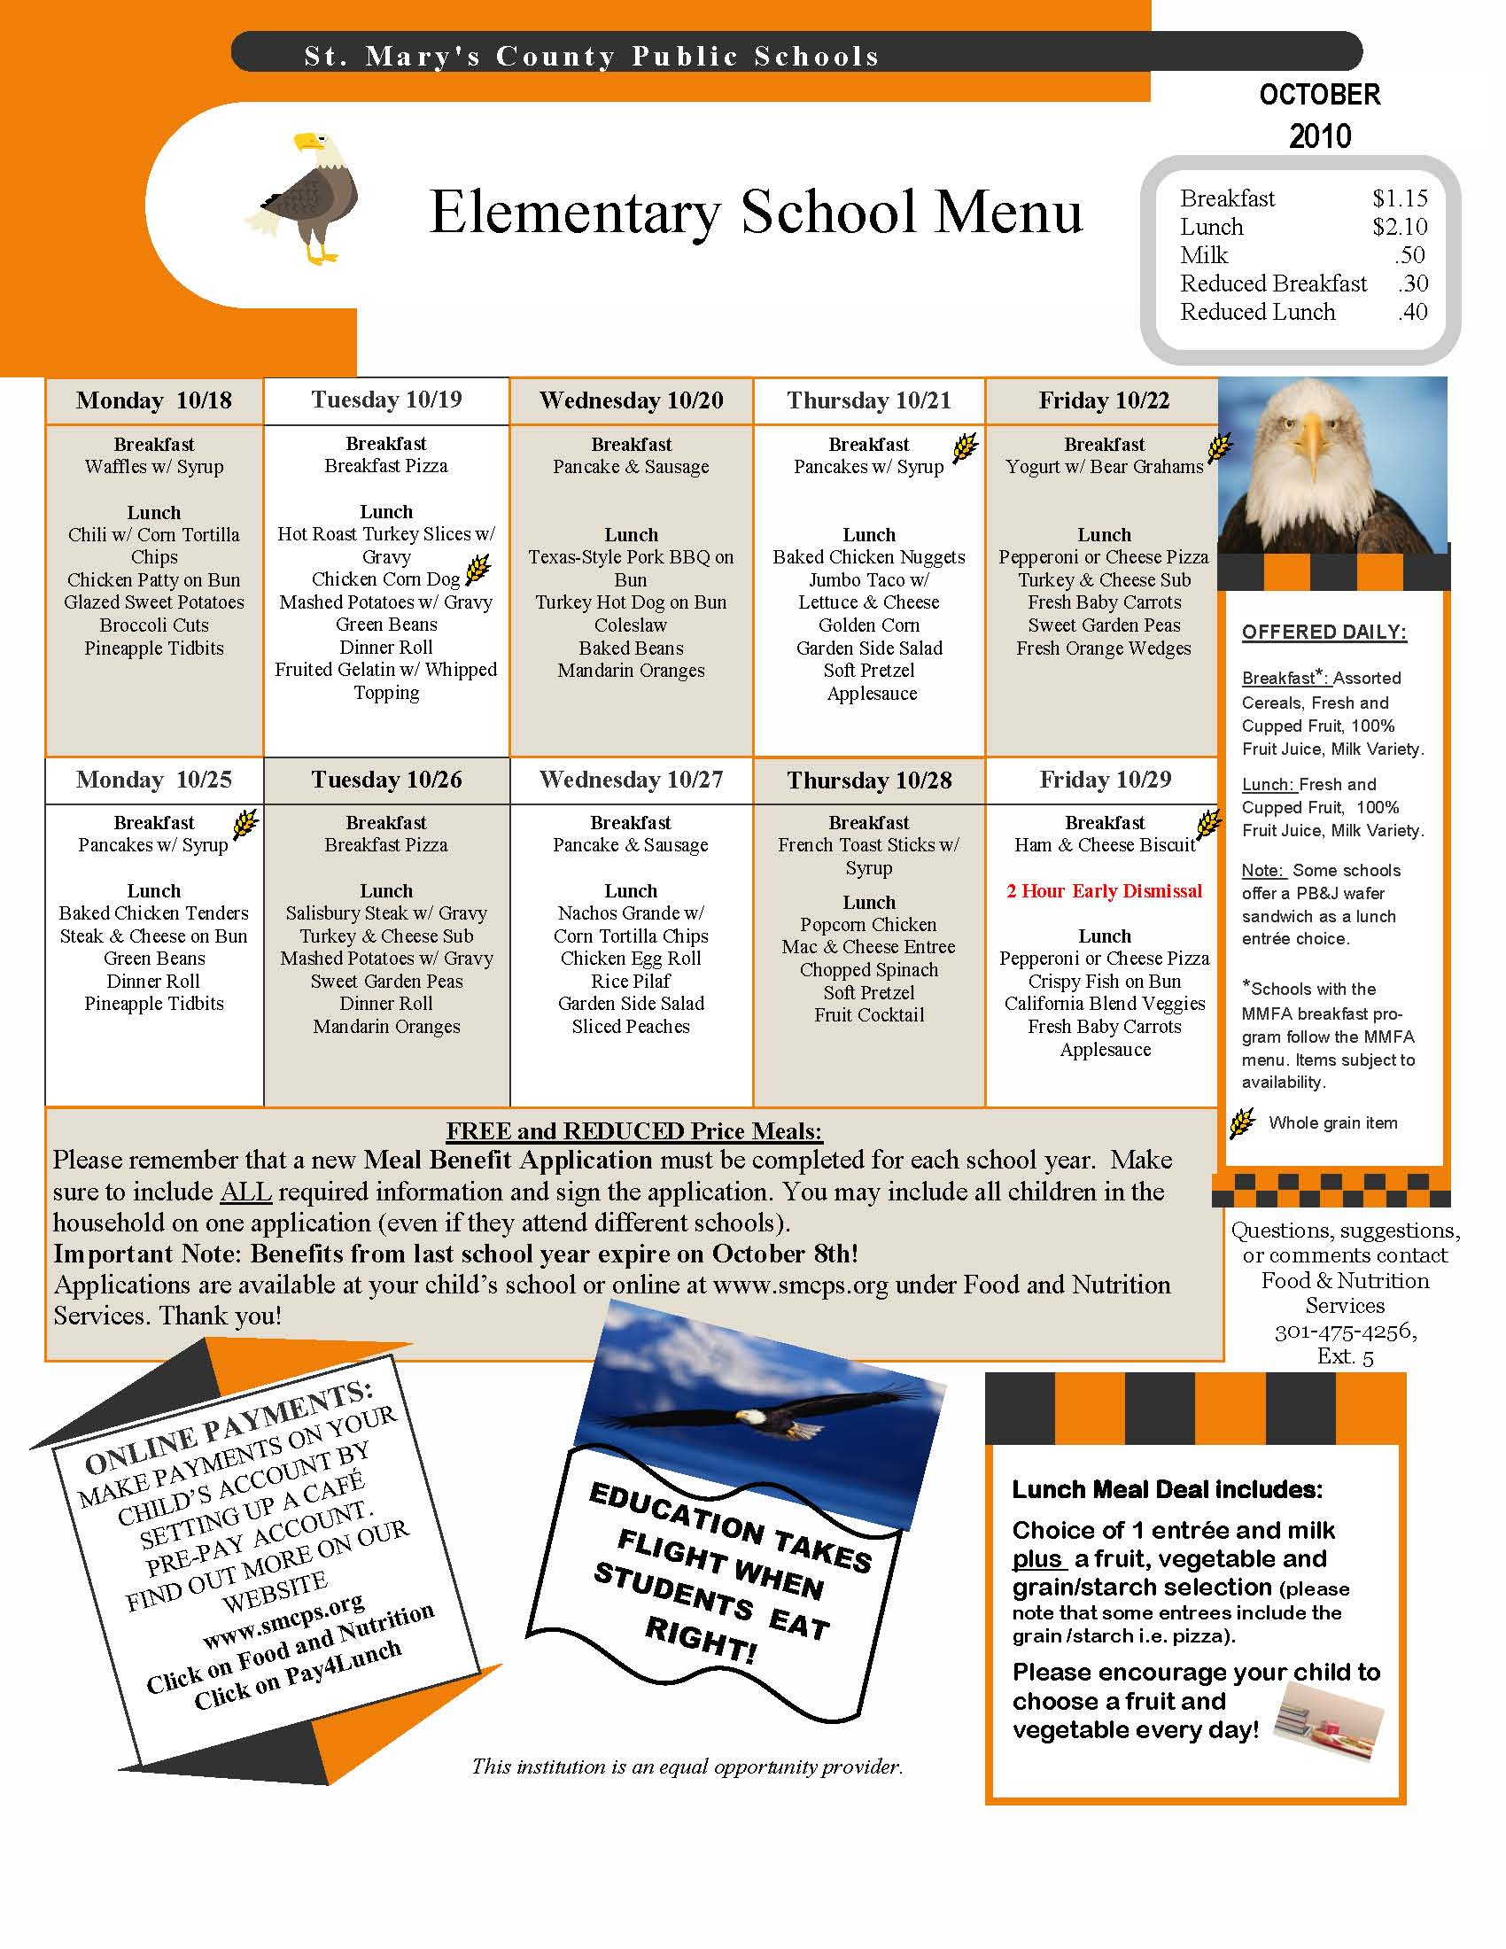

Slide 24
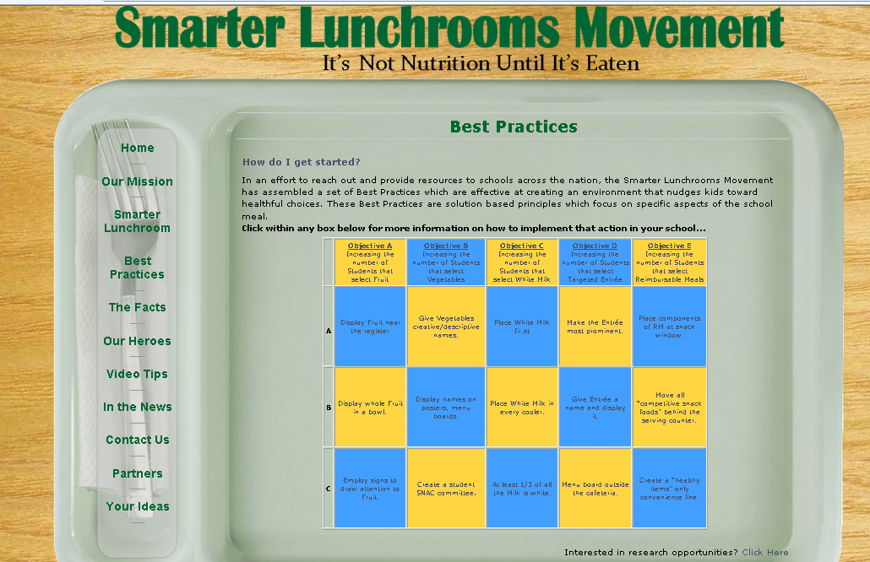
http://smarterlunchrooms.org/index.html
Notes:
Smarter Lunch Rooms—mission to find:
� Low cost/No-Cost Solutions
� Lunchroom Environment Focus
� Promotion of healthful eating behaviors
� Sustainability
Referenced in the latest HUSSC criteria
The Smarter Lunchrooms Movement was started in 2009 with the goal of creating sustainable, research-based lunchrooms that guide smarter choices. It is a grassroots movement of those concerned with the way children eat and wish to change these behaviors through the application of evidence-based, lunchroom focused principles that promote healthful eating.
In October 2010, a partnership between Dr. Brian Wansink and Dr. David Just produced the Cornell Center for Behavioral Economics in Child Nutrition Programs (the B.E.N. Center) as an experimental think tank devoted to child health, school environments, and the behavioral sciences (psychology, behavioral economics, and business).

Slide 25
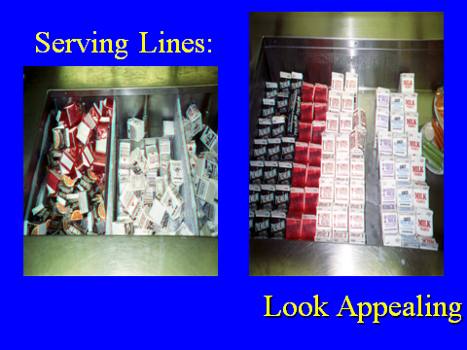

Slide 26
Objective 4
Develop a method for evaluating customer service.

Slide 27
Why Do We Evaluate Customer Service?
To know what our customers think of our service
To gain ideas and suggestions for improvement
To identify problems and solutions for solving problems

Slide 28
How Do We Evaluate Customer Service?
Focus on the Customer has some suggestions:
  Ask your customer and listen to answers.
  Keep asking your customer for feedback.
  Observe customer behavior and choices.
  Survey customers using age appropriate methods.
  Talk to customers.
Notes:
SAY: Remember local policy will affect any evaluation conducted on school premises. You may need to get permission to do a written survey.
Both formal and informal evaluations are useful. Examples of formal evaluations are surveys, focus groups, interviews, and guided discussions. Informal evaluations include taste tests, customer feedback cards, quality scorecards, and temperature checks.
Instructor’s Note: Refer to the workbook Sample Taste Test Form.
Do: (Workbook Activity) Sample Taste Test Form
SAY: The Sample Taste Test Form is one example of a form you can use to conduct taste tests with young children.
With this form, children can simply mark the sad or the happy face to signify their dislike or like of the food they are sampling.
This form will work well with kindergarten or first grade children.
You may have surveys and other taste test forms that you have used at your school.

Slide 29

Thank you!
The Institute of Child Nutrition
www.theicn.org
800-321-3054

Slide 30



ICN on Social Media
Come follow us!
facebook.com/ichildnutrition
@ichildnutrition
instagram.com/theicn
pinterest.com/theicn

Slide 31
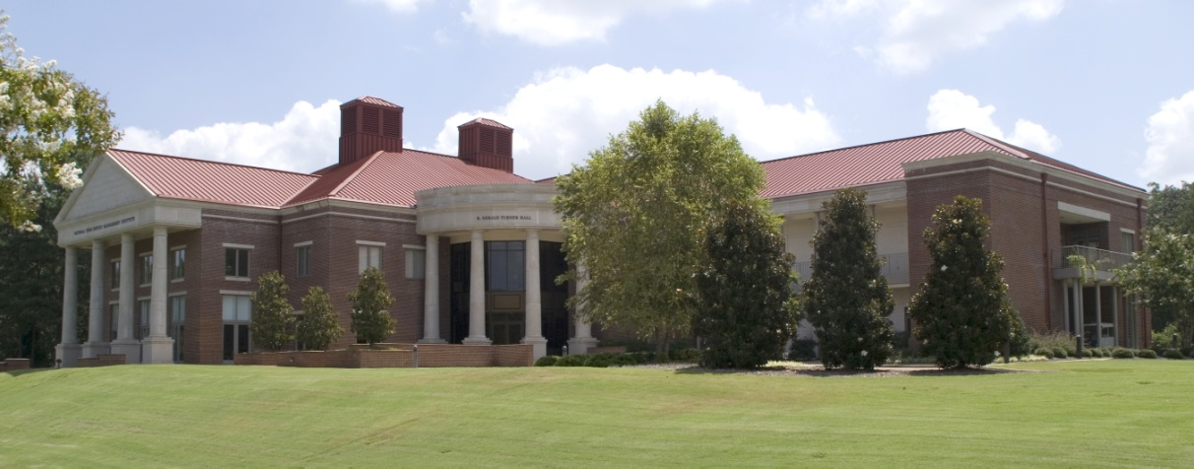
Institute of Child Nutrition
The University of Mississippi
Mission: To provide information and services that promote the continuous improvement of child nutrition programs
Vision: To be the leader in providing education, research, and resources to promote excellence in child nutrition programs

