Slide 1



Virtual ESTAR
Training and Facilitating

Slide 2

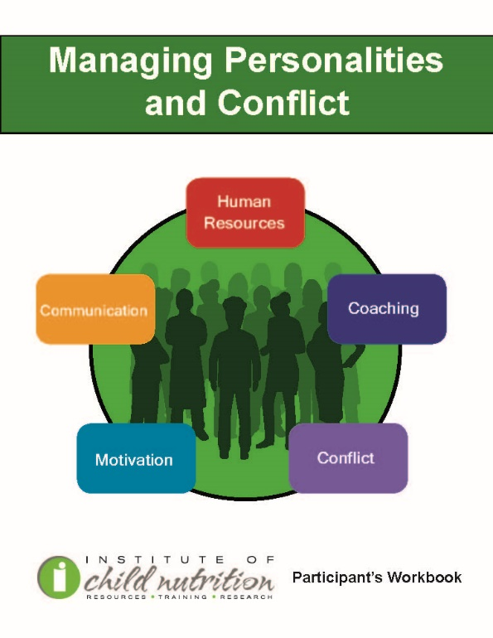

Other Related Resources from ICN
www.TheICN.org
Notes:
Enhanced
Strategies
Training
Action Plans
Resources

Slide 3
Key Area, Professional Standards and Objectives
Key Area: 3 Administration
USDA Professional Standards 3430 – Develop employee training plans, including a plan for tracking training.
ICN Competency
Competency 1.3: Conducts training sessions with staff that positively affect foodservice operations and meet local, state, and federal requirements.
Learning Objectives
Using the information provided in this training, participants will:
Identify skills of effective trainers.
Recognize skills of an effective facilitator.
Apply effective training and facilitation techniques.

Slide 4
ESTAR-Workshops
Helps school nutrition managers understand how to prepare and provide quality reimbursable school meals to students.
Allows the opportunity for participants to receive training that will enhance their culinary skills to prepare quality meals.
Provides the opportunity to learn from peers, identify best practices, and share success stories.

Slide 5

Manager’s Corner
Designed for Directors/Managers to train their staff.
Easy-to-use lesson plans on various topics.
Color-coded to identify Key Areas
  Nutrition (Blue)
  Operations (Red)
  Administration (Orange)
  Communications/Marketing (Green)
Notes:
Each about 15 minutes
Locate this in your material to discuss later

Slide 6


Introduction Ice Breaker
Qualities of successful and poor training events
Notes:
Some workshops and trainings are fantastic, some disappointing

Slide 7
Qualities of Effective and Ineffective Training Events
Effective
Ineffective
Notes:
Annotate examples from your experiences
+ Understand audience and topic, defines unfamiliar terms, prepares
Poor posture, head bowed, read word for word, no confidence, speak low, unclear, yell
Therefore, welcome participants as they arrive, ask for show of hands on various positions
Confirm all materials, sign in, exits, facilities, allow them freedom to be comfortable

Slide 8

Comfort Level
Trainers must be sensitive to:
  Participants’ cultural beliefs
  Personal preferences
  Physical capabilities
For more information, check out ICN’s Training Culturally Diverse Groups
Notes:
Might say: “During this training we encourage you to determine your level of participation based on your individual needs.
Good Resource

Slide 9
Set the Stage for Success
It is important to let participants know the purpose of the training and the anticipated outcomes.
Adult learners are more open to new information when they understand the “why” behind the training.
Example: “The intended audience of this ESTAR Training and Facilitating training are managers participating in the ESTAR program. This component of the training is designed to assist each manager in becoming a more effective trainer. This training will assist managers in assessing current skill levels and will encourage further professional development. It also provides training tools and resources to take back and use immediately.”
Notes:
An excellent ICN resource: Designing and delivering Training Programs – great tips on ensuring your training message STICKS

Slide 10
Lesson 1: Skills of Effective Trainers
Objective: Identify the skills of an effective trainer.

Slide 11
A Successful Trainer
All trainers have their own style.
Body language, interaction with participants, attitude, and inclusiveness are just a few parts of a trainer’s style.
Each of these items can improve with practice and self-awareness.

Slide 12
ACTIVITY: Tips for Effective Communication
Training Tips for Effective Communication handout
Notes:
Breakout 4 rooms for 5 minutes: Expertise, Empathy, Enthusiasm, Clarity
Note room number, pick reporter, review your word on handout, report 2 ways to make sure you incorporate the tips into your next training event.

Slide 13
Expertise
Behaviors include:
Refers to the material but is not dependent on it
Demonstrate a confident method of presentation; body language and eye contact are relaxed
Encourage group presentation; stay on time
Use creative and flexible teaching methods
Demonstrate confidence; use good communication skills
Be flexible, improvise, involve all learners
Be knowledgeable and credible
Having thorough knowledge of a topic before presenting the training gives a trainer confidence.
When the trainer is knowledgeable about the topic, it gives them the ability to focus on the needs of the participants.

Slide 14
Empathy
An empathetic trainer simply means that you consider the learner’s perspective and learning environment.
An empathetic trainer is aware of the learners’ needs, expectations, experiences, skills, and perspectives.
Behaviors include:
Start and end on time
Schedule breaks
Create a comfortable environment
Meet the needs of participants
Prepare user-friendly materials
Does not embarrass others

Slide 15
Enthusiasm
Behaviors include:
Smile
Use humor appropriately
Be animated
Use body language that shows energy
Vary voice, volume, and inflection
Work the room
Excite participants
Showing enthusiasm during a training communicates that the trainer is passionate and excited about the materials presented.
Smiling and using a varying voice, volume, and inflection when speaking are easy ways to communicate enthusiasm.

Slide 16
Clarity
Behaviors include:
Allow time for participants
Teach one skill at a time
Demonstrate role playing
Use a variety of instructional methods and materials
Speak clearly
Be yourself or better
Very important to provide clear instructions when teaching participants something new.
Notes:
Adults cannot learn what they cannot understand

Slide 17
ACTIVITY: Good Listening and Speaking Techniques
Notes:
Effective communication = effective listening, speaking skills, & effective materials. Use open-minded listening State ideas clearly and logically and non-judgmentally
Use green check or red X for the next statements.

Slide 18

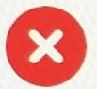
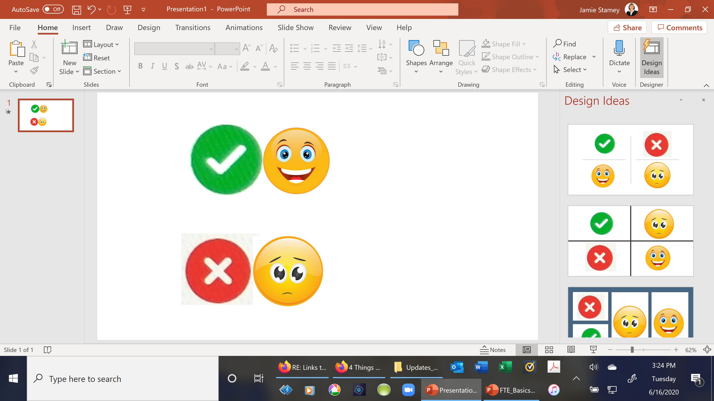

A Good Listener Always…. | YES | NO
Answers before hearing the full sentence or question
Uses positive non-verbal actions (nods, smiles, eye contact)
Checks text messages & multi-tasks while others speak
Rolls their eyes if they disagree with opinions
Gives their full attention while others speak
Keeps an open mind and uses empathy
Lesson 2

Slide 19
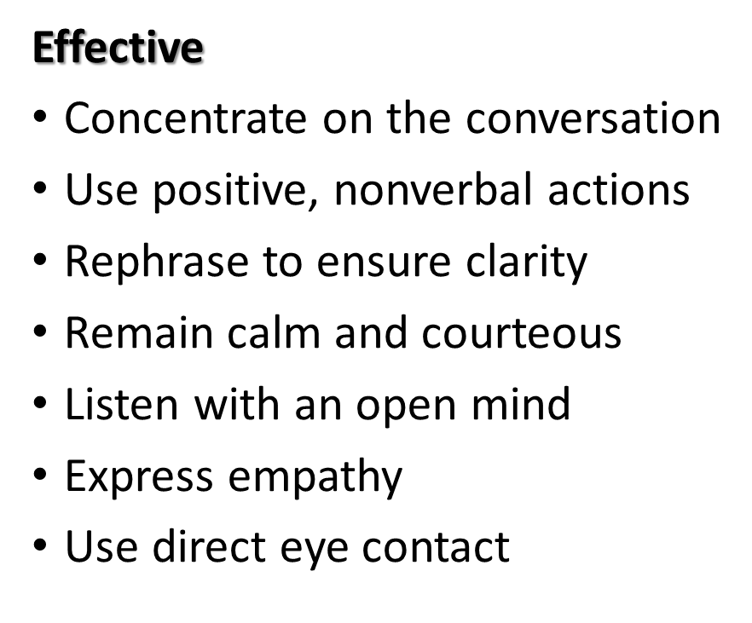

Listening Techniques
Ineffective
Multi-tasking, preoccupied
Checking text messages, answering emails or calls
Interrupting or responding before hearing the full message
Notes:
Good Job! Let’s move on to good listening techniques. Use green check or red X next.

Slide 20
A Good Speaker Tries To…. | YES | NO
Use clear, concise, logical language
Read word-for-word from the slides or script
Practice content out loud before the presentation
Use lots of acronyms and big, impressive words
Call people by name
Start every sentence with “so” or “and”
Lesson 2

Slide 21
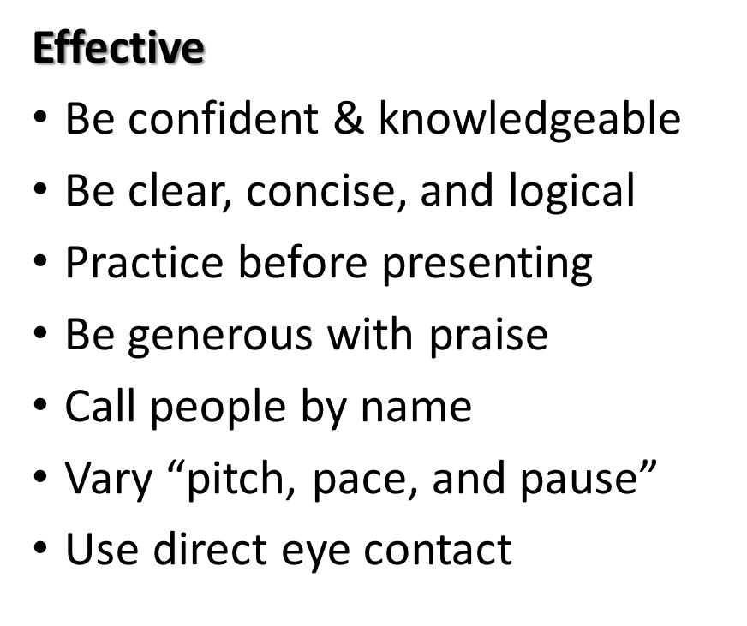
Speaking Techniques
Ineffective
Reading the slides or script
“Hiding” behind lectern
Taking things personally
Using slang or acronyms
Excess “filler” words
Notes:
Always make an effort to practice listening and speaking skills. See handout titled: Communication Skills

Slide 22
Lesson 2: Skills of an Effective Facilitator
Objective: Recognize the skills of an effective facilitator.

Slide 23
Facilitating Training
Cheerleader for the Session
Two-way communication
Positive energy
Provides “safe” environment
Great listener
Flexible & adaptive
  Keeps the session moving
  Encourages interaction & sharing of experiences
  Watches audience for non-verbal cues
  Customizes content for differing learner needs
  Leads attendees to self discovery of learning objectives
Notes:
Training should be very lively
Participants can gain a wealth of knowledge in a fun environment
Examples: “Do we need a break?” “Do we need to change groups?”

Slide 24
ACTIVITY: Skills of an Effective Facilitator
Skills of an Effective Facilitator handout
Notes:
4 BO rooms, 5 minutes
Each group has 6 tips
Give 2 examples you would use in your next training event

Slide 25
Lesson 3: Application of Effective Training Techniques
Objective: Apply effective training and facilitation techniques.
Notes:
Find Manager’ Corner handout
You will do 16 trainings with your frontline staff over the next 2 years.

Slide 26
Manager’s Corner
Each lesson plan contains:
Learning objective
Statement explaining the importance of the topic
List of materials
Instructions on how to present the information
Questions to ask staff
An activity to strengthen or refresh the knowledge of the staff
Notes:
4 colors for 4 key areas
Nutrition blue Operations red Administration Orange Communications/Marketing Green
Behind Mgr Corner tab is alphabetical list of all Mgr Corners related to ESTAR

Slide 27
Table of Contents
Provides an overview of what the resource contains:
  Professional Standards and Introduction
  Lesson Overview: Questions
  Activity: How Well Do You Know Your Customer?
  References
Notes:
Let’s look at “Knowing your Customer” handout
Let’s look at each section

Slide 28
Professional Standards
The professional standards code pertaining to the training topic has been identified and noted so school nutrition professionals can accurately track what areas they train or attend.
Notes:
Code is used to tract training

Slide 29
Introduction
Identifies the topic taught for the particular lesson in this section.
ICN has also outlined the lesson plan for all Manager’s Corner lessons.
Notes:
Volunteer read the objective in this lesson.
TorF: There are 2 reasons listed why it is important” section green check or red X
False: 3 listed and they are …
Thought provoking questions to engage the staff. Answers provided May not have a right or wrong answer
What page are the questions on? Ans page 8
TorF There are 8 questions in this lesson? False only 6

Slide 30

Lesson Overview: Questions
Since the Manager’s Corner is designed to provide a 15–20 minute training, there is only one objective.
Example: Manager’s Corner: Knowing Your Customer.

Slide 31
Activity: How Well Do You Know Your Customer?
The lesson includes handouts, worksheets, answer keys, and a list of supplies needed to complete the training.
Review the activity instructions.
Remember, a good trainer recognizes constraints such as time and resources and modifies accordingly to meet the needs of the operation.
Notes:
Tor F You will need at least 1 copy of “how Well Do you Know your Customer Assessment” and the answer key. Green check or red X
True, but better if each one has one
Look at the instructions for completing the assessment. TorF “Please answer each question in the HWDYKYCA to the best of your ability We will review the answer key together. Once everyone has completed the statement” green check or red X True

Slide 32
References
Identifies the references that support the content of the lesson.
Notes:
Last section
We’ve talked about training and facilitation skills and the format of manager corner resource
You will do an activity on day 3 to apply these skills.
So: choose a mgr corner lesson,
present to a small group of your peers (5)
give a 5 minute training event on learning overview question section ONLY
Use the checklist to give and receive feedback.

Slide 33
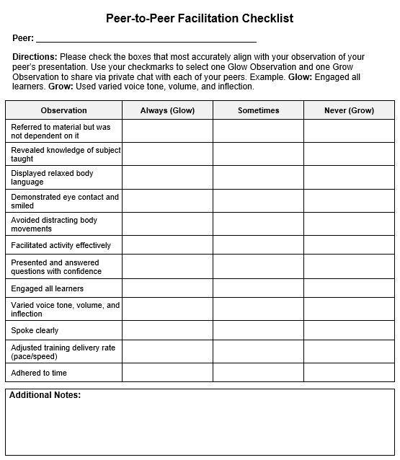
Peer-to-Peer Facilitation Checklist
Checklist to give and receive feedback on training presentations.
Notes:
Review
Pick a topic on page 29-30
One that you are likely to use with your staff

Slide 34
Activity: Demonstration of Manager’s Corner: Know Your Customer
Review and consider Manager’s Corner topics for Day 3 Presentation.
Mini presentations

Slide 35
Wrap Up Discussion
Was it challenging to present in front of your peers?
What pieces did you find the most challenging?
What are the lessons learned from this activity?
What actions will you do differently the next time you train using the Manager’s Corner?

