Slide 1



Virtual ESTAR
Practical Skills for Quality Meals: A Five Step Process

Slide 2
Objectives
Recall the definition of school meal quality and why it is important.
Recall the five-step process for preparing quality school meals.
Identify the benefits of using a cycle menu.
Discuss the importance of using a standardized recipe to prepare quality school meals.
Identify the components of a standardized recipe.
Identify how to make appropriate ingredient substitutions when using standardized recipes.
Identify the required information needed for documenting and evaluating amounts of food planned, prepared, and served.
Apply time standards to plan for batch cooking.
Discuss the benefits of practicing mise en place when following a standardized recipe.
Explain the purpose of using only approved, commercial grade equipment in school foodservice kitchens.

Slide 3
Objectives (cont’d)
Discuss the importance of measures and weight in recipes.
Describe the importance of organizing workspace, equipment, and ingredients to work smarter not harder.
Identify how colors, textures, and shapes contribute to positive school meal experiences.
List three common cooking methods.
Demonstrate how to properly hold a knife and food for fabrication.
Describe proper knife techniques.
Describe how the principles of food production impact food quality.
Demonstrate use of a quality scorecard to assess school meals.
Organize an appealing serving line during meal service periods.
Formulate strategies and activities related to improving meal quality and student perception of meal quality to create an action plan.

Slide 4
Lesson: Introduction
Objectives:
  Define quality school meals and state why they are so important.
  Recall the five-step process for preparing quality school meals.

Slide 5
Manager’s Corner
Culinary Topics | Manager’s Corners
Menus | Cycle Menus
Menu Quality and Acceptability | Meal Quality and Acceptability; Standardized Recipes; Student Taste Testing-Breakfast; Student Taste Testing-Lunch
Food Production | Cycle Menus; Ingredient Calculations; Preventing Excess Waste in Storage Areas; Production Records
Basic Culinary Principles | Common Large Cooking Equipment; Knife Skills: Knife Safety; Knife Skills: Knife Types; Mise En Place; Roasting Vegetables; Weights and Volume
Appetizing and Varied Food Presentation | Food Presentation; Serving Line Presentation

Slide 6
Research
Research has shown there is a connection between nutrition and proper brain development in children.
When children do not receive enough nutritious food to eat, it can impact their ability to learn.
YOU are in a unique position to aid in ensuring children receive the nutrients they need to grow and learn.

Slide 7
Quality School Meals
How would you define “quality school meals”?
In this training, School Meal Quality is defined as characteristics of food that affect its acceptability to consumers. This includes:
  Food appearance (size, shape, color, gloss, and consistency)
  Texture
  Flavor
  Nutritional value
  Freshness

Slide 8
Activity: Match the Definitions

Slide 9
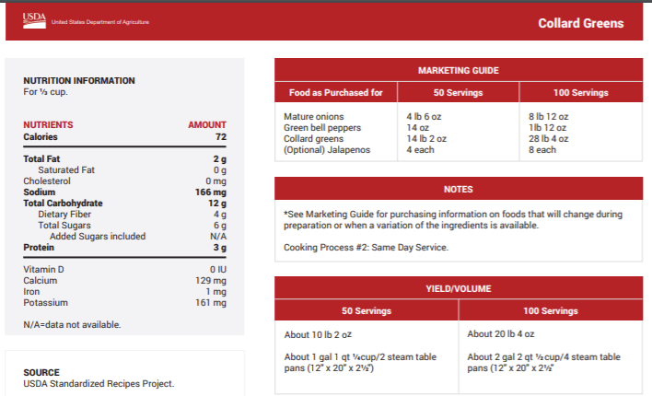
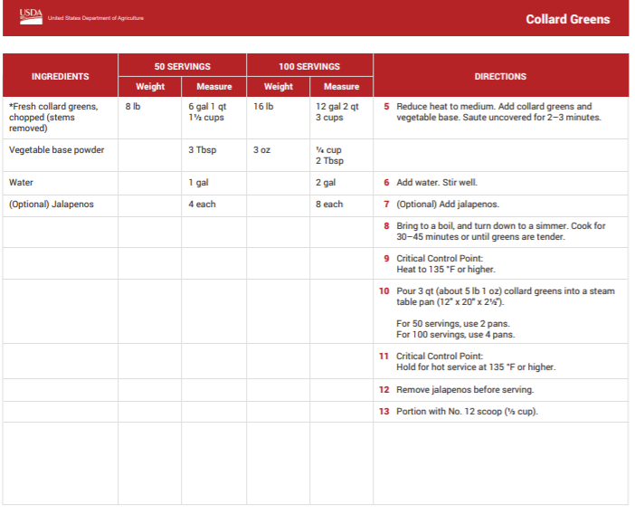
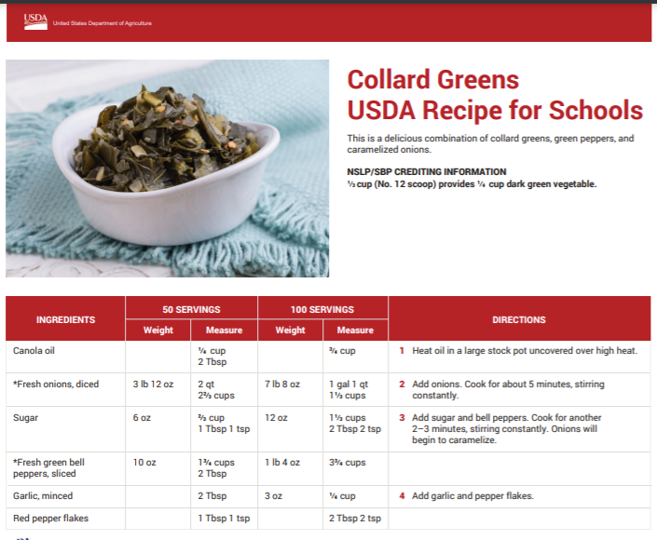
Food Production Record
Quality Scorecard
1.
Standardized
Recipe
2.
Recipe Category
Standardized Recipe
3.
4.
Food Production Record
Quality Scorecard
Recipe Category
Standardized Recipe

Slide 10
French phrase meaning “to put in place,” referred to by cooking professionals as the preparation and assembly of all necessary ingredients and equipment prior to food production.
Batch Cooking
Culinary Technique
Mise en Place
Tare
1.
2.
3.
Mise en Place
4.

Slide 11
To prepare a menu item in small amounts, so it will be at its peak of quality when placed on the service line.
Batch Cooking
Culinary Technique
Fabrication
Tare
1.
2.
3.
Batch Cooking
4.

Slide 12
Finely slice or shred leafy vegetables or herbs.
1.
Chiffonade
Fabrication
Serving Size
Yield
2.
3.
Chiffonade
4.

Slide 13
APPEARANCE
Color is bright, typical of fresh greens.
Color is bright, typical of other fresh ingredients (no discoloration).
Salad appears moist, not dry or excessively wet.
Salad ingredients are cut evenly.
Salad ingredients appear crisp, not limp.
Garnish is edible and appropriate for the salad.
TEXTURE OR CONSISTENCY
Salad ingredients are crisp, not soggy.
Meat or pasta/rice salads are tender but not mushy.
FLAVOR
Salad ingredients have a fresh, distinctive flavor.
Seasonings enhance the salad but are not too salty or too tart.
A variety of salad dressings are available.
SERVICE TEMPERATURE
Chilled – 34 °F – 38 °F
1.
Production Record
Quality Scorecard
Serving Size
Time Standard
2.
3.
4.
Quality Scorecard

Slide 14
The Five-Step Process
Lesson 1: Using Cycle Menus and Standardized Recipes
Lesson 2: Planning Food Production and Batch Cooking
Lesson 3: Organizing Workplace, Equipment, and Ingredients
Lesson 4: Using Culinary Skills to Create Quality and Appeal
Lesson 5: Delivering a Quality Product

Slide 15
Step 1: Using Cycle Menus and Standardized Recipes
How many of you have started preparing a recipe only to find that you made a mistake halfway through because you didn’t read the entire recipe?

Slide 16
Step 2: Planning Food Production and Batch Cooking
Batch cooking means to cook in small batches, as needed, throughout the service period.
To be successful at batch cooking, the school nutrition team must plan ahead, review the work schedule, and communicate effectively between the front and back of the house.

Slide 17
Step 3: Organizing Workplace, Equipment, and Ingredients
The French term for this is mise en place (meez-un-plahss), which means “to put in place.”
Step three includes all the “get ready steps” needed for food production to be well-organized.
Best Practice/Strategy: Organizing equipment and recipe ingredients save time and energy.

Slide 18
Step 4: Using Culinary Skills to Create Quality and Appeal
When the right equipment and the correct culinary techniques are utilized, food preparation efficiency is maximized.
Customers will notice the care taken to prepare and deliver a quality product.

Slide 19
Step 5: Delivering a Quality Product
The food on the serving line demonstrates the skill level of back-of-the-house school nutrition professionals. It also communicates pride in a job well done and care for the customer.
The five-step process should be used when preparing and serving safe, quality meals.
If you follow these five steps during preparation, you will be proud of the healthy, quality school meals you serve.

Slide 20

Virtual E-STAR
Practical Skills for Quality Meals: A Five Step Process

Slide 21
Lesson 1: Using Cycle Menus and Standardized Recipes
Objectives:
  Identify the benefits of a cycle menu.
  Discuss the importance of using a standardized recipe to prepare quality school meals.
  Identify the components of a standardized recipe.
  Identify how to make appropriate ingredient substitutions when using standardized recipes.

Slide 22
Cycle Menus
Cycle menus are a set of meal components and food items that are different for each day during a set period of time (cycle).
A cycle menu offers different daily menu items and repeats for a designated duration.
The menu planner has the flexibility to determine the cycle length.
In general, the length of the cycle repeats every two to five weeks and can be different for different age groups.

Slide 23
Benefits of Cycle Menus
What are some benefits of cycle menus?
  Cycle menus save time. Cycle menus save time because they reduce repetitive tasks such as menu planning.
  Cycle menus reduce labor. Cycle menus reduce labor because as the staff becomes more familiar with specific standardized recipes, they become more efficient in producing the recipes.
  Cycle menus control food costs. Cycle menus control food costs because information provided on the production record can contribute to accurate forecasting of specific menu items.
  Cycle menus support local agriculture. Cycle menus provide the opportunity to incorporate local agricultural products during the peak of their season.

Slide 24
Importance of Standardized Recipes
A standardized recipe is a recipe that has been tried, adapted, and retried several times for use by a given school nutrition operation.
Standardized recipes are important because:
  Ensure consistent quality
  Simplify the job for employees
  Provide a time standard
  Yield the same amount every time
  Provide safe cooking and holding temperatures
  Help determine how much food to order
  Ensure customers will receive a quality product

Slide 25
Components of a Standardized Recipe
The major components of a standardized recipe include:
  Recipe name
  Recipe category
  Ingredients
  Measures and weight
  Directions
  Equipment and utensils
  Food safety guidelines/Hazard Analysis Critical Control Point (HACCP)
  Serving size and recipe yield

Slide 26
Activity: Building a Grilled Chicken Salad Standardized Recipe
Work in mentoring groups in breakout rooms to determine the missing parts of a grilled chicken salad recipe.
You have approximately 7 minutes to fill in the blanks.

Slide 27
Important Points to Remember about Standardized Recipes
Each standardized recipe has a name or a descriptive title.
The recipe category makes it easier to sort recipes in a file box or on the computer.
  In USDA recipes, the recipe category usually represents a specific meal component such as the main dish or vegetable.
When reviewing a recipe, it is important to pay close attention to the ingredients.
  Types of ingredients (ex. fresh, frozen, or canned)
  Preparation techniques (ex. sliced carrots or diced onions)
  Ingredients are usually listed in order of use.
Best Practice/Strategy: Always review the recipe from beginning to end before preparation.

Slide 28
Additional Points to Remember about Standardized Recipes
Weights and/or measures are included for every ingredient in the standardized recipe. Weights and measures are not interchangeable.
  Weighing ingredients is more accurate, but always use measure for liquid ingredients.
Directions, or detailed instructions, are included with each standardized recipe.
  Directions are listed in the order the steps will be followed when preparing a recipe.
Standardized recipes also list equipment and utensils needed for production.

Slide 29
Final Points to Remember about Standardized Recipes
Standardized recipes include food safety guidelines/HACCP critical control points (CCPs).
  By following CCPs ensures the final product will be safe to eat and more appealing to students.
Standardized recipes also include serving size and recipe yield.
Time standard is the estimated total amount of time required to make the recipe, from preparation to clean up, and is used to plan batch cooking for quality meals.

Slide 30
Ingredient Substitutions
It is crucial to remember that during the preparation of a standardized recipe if any changes to the recipe are made, it can affect the yield, nutritional content, and product quality.
There are times you may need to make a substitution for an ingredient. Before you do so, make sure the substitution is appropriate for the recipe.
Best Practice/Strategy: During preparation, if you make any changes to the recipe, it could affect the yield, nutritional content and product quality. Any changes or recipe concerns should be discussed with your supervisor.

Slide 31

Lesson 1: Reflections
Using cycle menus and standardized recipes is crucial to creating and serving quality school meals.
Standardized recipes are the building blocks of quality food production.
By following detailed recipe instructions, a quality product can be produced every time it is prepared and served.

Slide 32
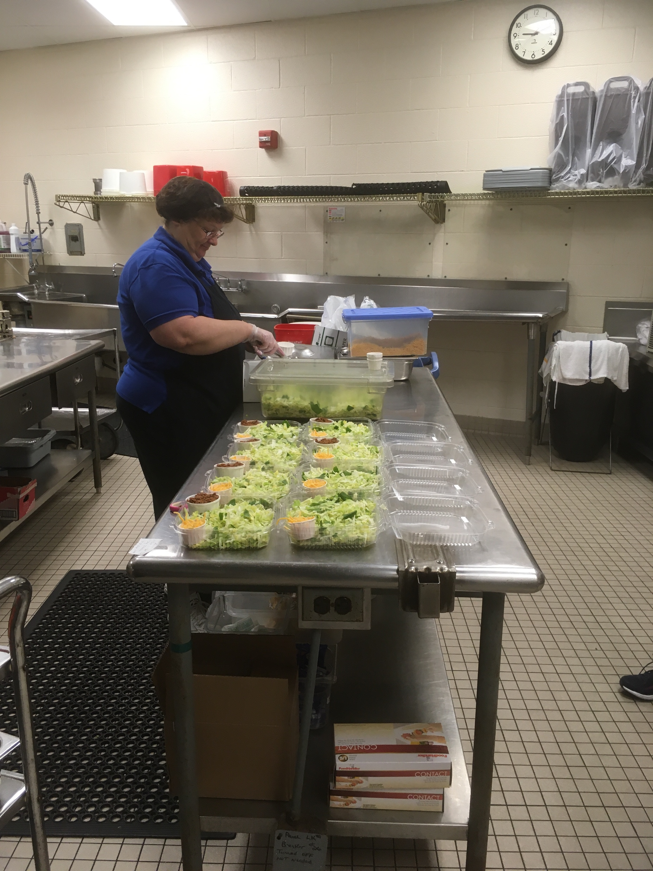
Lesson 2: Planning Food Production and Batch Cooking
Objectives:
  Identify the required information needed for documenting and evaluating amounts of food planned, prepared, and served.
  Apply time standards to plan for batch cooking.

Slide 33
Batch Cooking
Batch cooking means cooking food in small batches, as needed, throughout the service period.
Some school nutrition professionals use the phrases cooking-to-the-line and just-in-time for service to mean the same thing as batch cooking.
Batch cooking is ideal because it ensures the best appearance, temperature, and texture of food.

Slide 34

Planning
To be successful in preparing quality school meals, we must plan ahead.
Planning includes several steps—school nutrition professionals should review:
  the menu
  standardized recipes
  daily work schedule
  food production record
Food production is about preparing and serving quality meals in the most efficient way.

Slide 35
Characteristics of an Efficient, Cost-Effective Foodservice System
What are the characteristics of an efficient, cost-effective foodservice system?
  Adequate dry storage, refrigerated storage, and freezer space appropriately located
  Accessible handwashing sinks, soap, and paper towels
  Standardized recipes, quality ingredients, and accurate forecasting
  Sufficient utensils, food and storage thermometers, equipment, and supplies
  Trained staff that are empowered to maximize the use of their skills and the resources available
  Overall layout and design of the operation

Slide 36
Production Records
The production record provides documentation that supports meeting Federal regulations.
Production records also help staff identify the quantity to prepare, predict future production needs, and can help to reduce waste.

Slide 37
Accurate and Legible Production Record
It is important that the school nutrition staff understand the guidelines for completing food production records daily.
Best Practice/Strategy: A good practice is to cross-train several employees to complete food production records. Remember to stress in the training the importance of legible production records.

Slide 38
Activity: Daily Menu Production Record and Anatomy of a Production Record

Slide 39
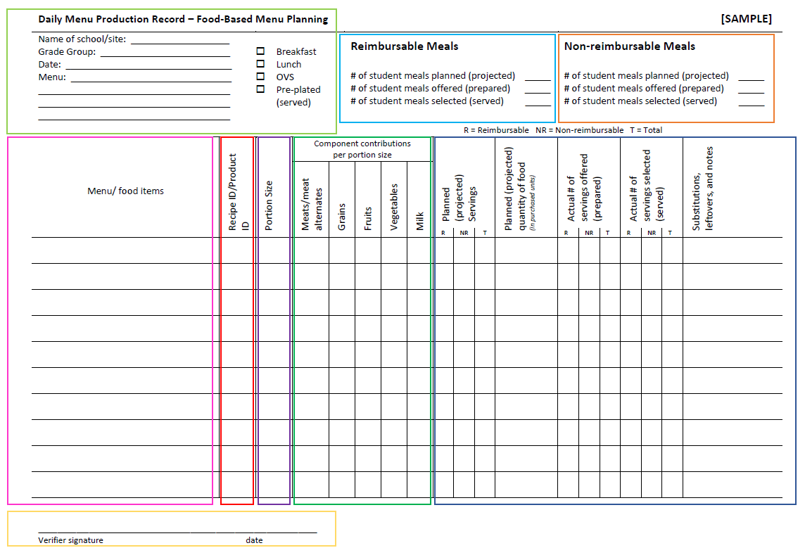

Slide 40
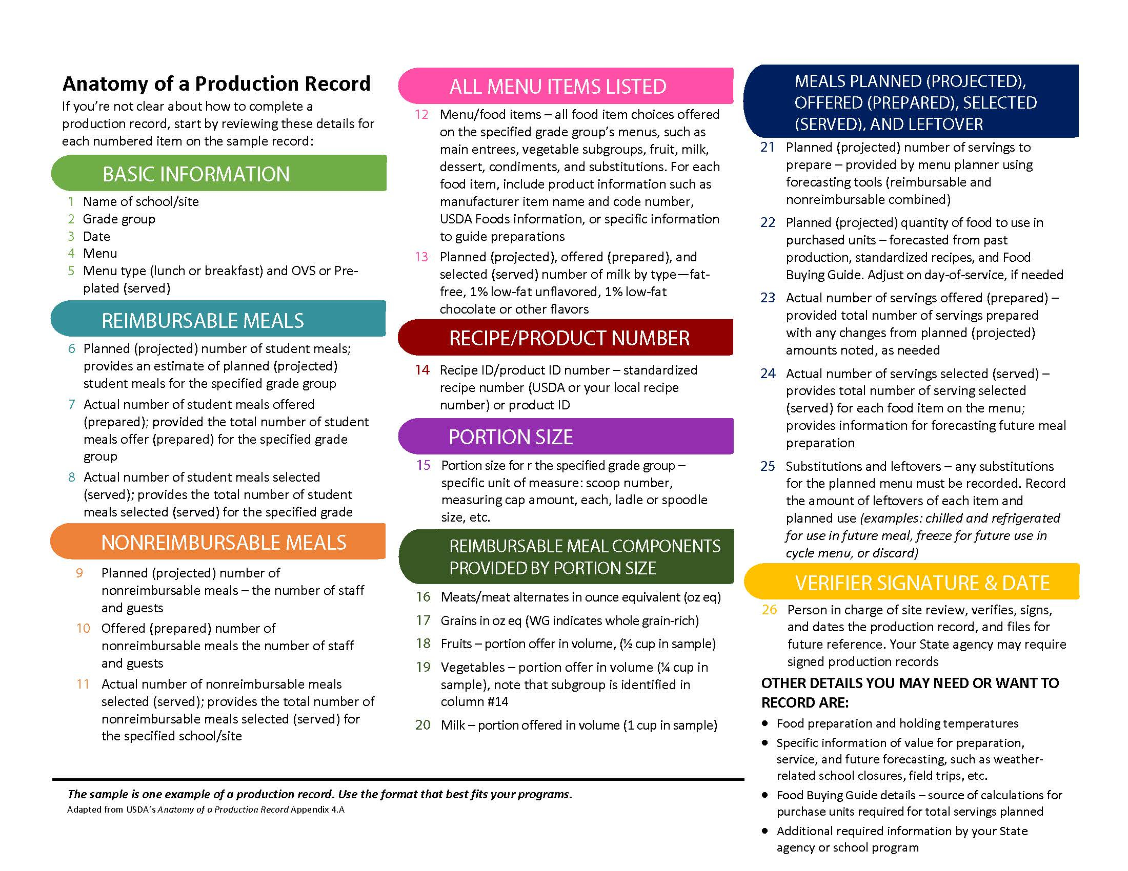

Slide 41
Activity: Required Information for School Meals Production Records

Slide 42
Applying Time Standards to Plan for Batch Cooking
Batch cooking can help protect food quality and reduce waste.
Although it takes a little more effort to batch cook, it is easy to develop and execute a production plan that includes time standards.
When it comes to batch cooking, scheduling time appropriately takes skill and practice. In years past, school nutrition teams would prepare foods in advance and place the foods in hot holding cabinets hours before service.
Best Practice/Strategy: Batch cooking is ideal because it ensures the best appearance, temperature, and texture of food.

Slide 43

Time Standard
A time standard is how long it takes for a food product to be prepared and cooked for service.
Unfortunately, most recipes do not include the time standard because it is unique to individual kitchens.
Time standards vary from kitchen to kitchen because of factors such as number of servings required, available equipment, and number of employees.

Slide 44
Activity: USDA Recipe: Eagle Pizza and the Time Standard Example

Slide 45
Activity: Put Time on Your Side
Video

Slide 46
Lesson 2: Reflections
To be successful at batch cooking, the school nutrition team must plan ahead, review the daily production schedule, and develop good communication skills between the front of the house and back of the house.
The back of the house cook needs to know how long it will take for the product to be cooked and prepared for service.
The front of the house server needs to notify the cook in advance if product levels are running low.
This shared task is key to successful batch cooking.

Slide 47
Lesson 3: Organizing Workplace, Equipment, and Ingredients
Objectives:
  Discuss the benefits of practicing mise en place when following a standardized recipe.
  Explain the purpose of using only approved, commercial grade equipment in school foodservice kitchens.
  Discuss the importance of using measures and weights in recipes.
  Describe the importance of organizing workspace, equipment, and ingredients to work smarter not harder.

Slide 48
Benefits of Practicing Mise en Place When Following a Standardized Recipe
A well-organized cook saves time and energy by assembling all ingredients and equipment before starting food preparation.
Professional chefs use the French term mise en place (meez-un-plahss), which means to put in place, to describe assembling ingredients and utensils.

Slide 49
Benefits of Practicing Mise en Place When Following a Standardized Recipe
It describes a series of meticulous steps in the food preparation process. Mise en place is a collection of good work habits. It takes planning, effort, and practice to develop any habit.
Best Practice/Strategy: A successful manager views the food preparation process as a whole and identifies the necessary steps for an efficient and organized approach.

Slide 50
Mise en Place
Mise en place also refers to a state of mind. Meaning, it is important to anticipate and plan for situations that could arise during food production.
Thinking ahead, knowing culinary techniques, and being a well-organized cook reduces stress in the kitchen and helps staff easily solve problems that could arise during food production.

Slide 51
Activity: Mise en Place: Grilled Chicken Salad Recipe

Slide 52

Approved, Commercial Grade Equipment
Having the proper equipment for food production is critical to a job well done.
Only commercial grade large and small equipment should be used in a commercial kitchen.
Best Practice/Strategy: Having the proper equipment for food production is critical to a job well done. Only commercial grade large and small equipment should be used in a commercial kitchen.

Slide 53
Importance of Measures and Weights in Recipes
To get the desired recipe results, ingredients must be weighed or measured correctly.
Recipes indicate the amount of each ingredient to use in two ways—by volume and weight.
Weighing is faster, easier, and more accurate than measuring ingredients by volume.
There is less chance for error if ingredients are weighed. This is why weighing ingredients is considered the more accurate measurement of the ingredient.

Slide 54
Importance of Using the Correct Volume or Weight
Another important reason for using the correct volume or weight is nutrition integrity. In other words, ensuring the nutrient analysis of the standardized recipe is accurate.
The nutrient analyses of school nutrition recipes and menus published for the community must be accurate. For the nutrient information on the recipe to be accurate, ingredients must be weighed or measured correctly each time the recipe is prepared.
Best Practice/Strategy: In order for the nutrient information on the recipe to be accurate, ingredients must be weighed or measured correctly each time the recipe is prepared.

Slide 55
Importance of Organizing Workspace, Equipment, and Ingredients
Taking time to plan and organize your overall workspace helps to improve:
  Workflow
  Streamline food production
  Increase efficiency which helps to eliminate any unnecessary steps

Slide 56
Ideas or Suggestions
What are some other ideas or suggestions for improving workflow, streamlining food production, and increasing efficiency in a kitchen?
Rearranging work tables
Increasing use of rolling bun pan racks and/or carts
Storing film wrap, aluminum foil, and parchment paper in easily accessible locations (e.g., parchment paper could be stored in a sheet pan located on top or bottom of rolling bun pan rack)
Removing unnecessary items from dry storage and table drawers
Using food processing equipment (e.g., sectionizers, slicers, food processors)
Reorganizing storage areas, including refrigerated and dry storage

Slide 57
Lesson 3: Reflections
Organizing your overall kitchen workspace to improve workflow, streamline food production, and increase efficiency is a major aspect of practicing mise en place in the kitchen.
Applying mise en place when following a standardized recipe and when organizing your overall workspace, equipment and ingredients will help ensure that quality and appealing meals are prepared in an efficient and cost-effective manner.
Organizing your workspace, equipment, and ingredients will help you work smarter, not harder.

Slide 58
Lesson 4: Using Culinary Skills to Create Quality and Appeal
Objectives
  Identify how colors, textures, and shapes contribute to positive school meal experiences.
  List three common cooking methods.
  Demonstrate how to properly hold a knife and food for fabrication.
  Describe proper knife techniques.

Slide 59
Colors, Textures, and Shapes Contribute to Positive Meal Experiences
Presenting food creatively can turn a dull-looking foodservice line into a bountiful marketplace of healthful and appetizing eating opportunities.
Think of food presentation as art.
Well-planned menus take into consideration the principles of food presentation such as color, texture, and shapes.
The final presentation is a critical last step.
Eye appeal is key.

Slide 60
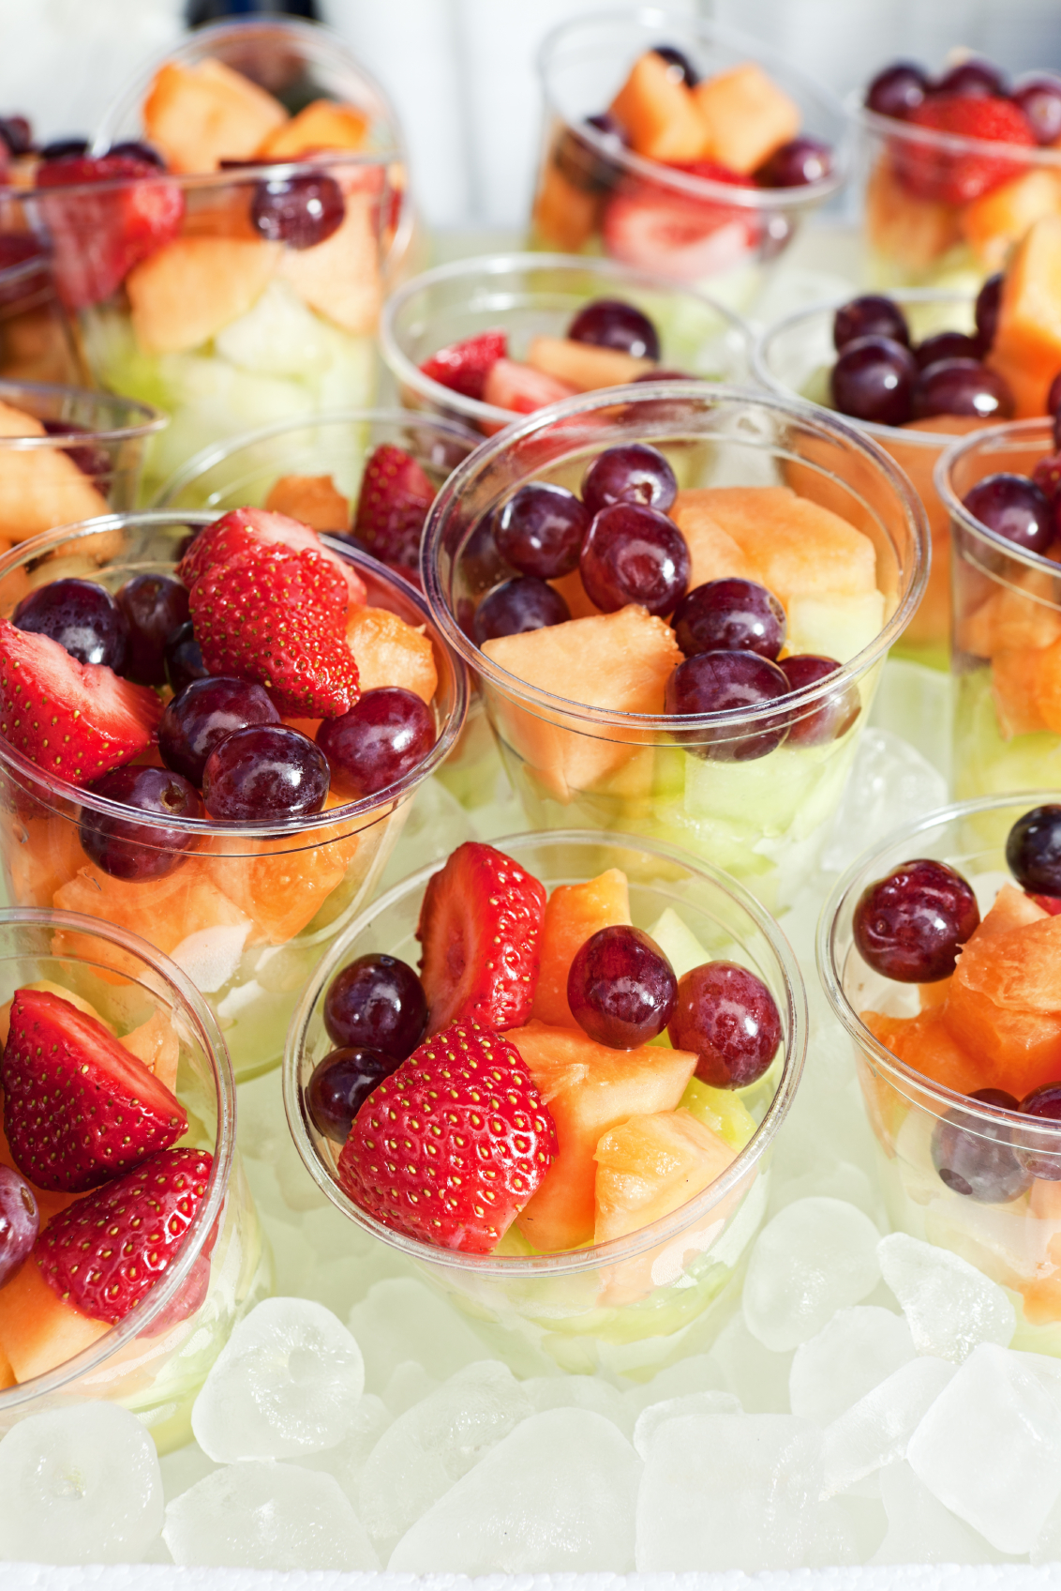
Colorful Serving
Best Practice/Strategy: Using color to increase eye appeal is one of the basic principles of menu planning.

Slide 61
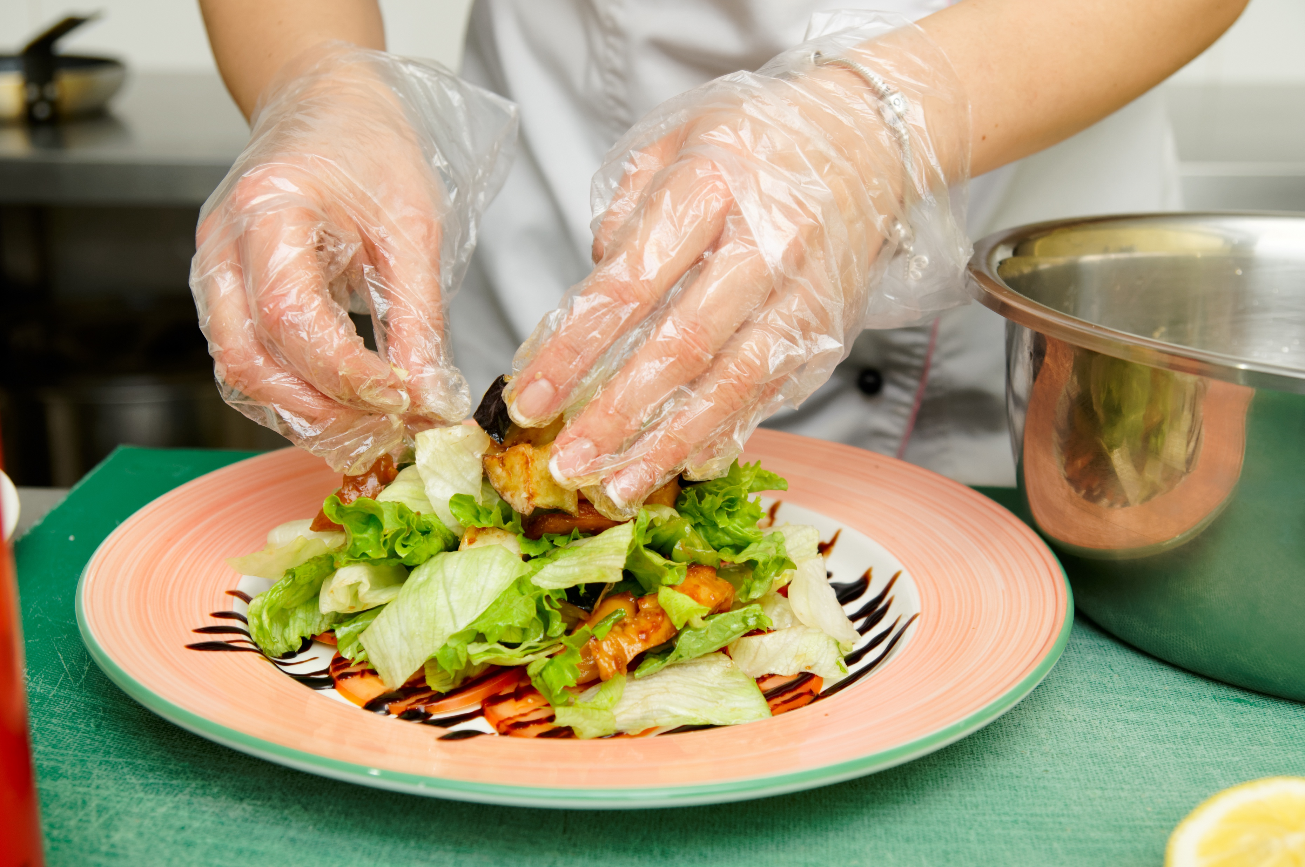
Texture
Texture is one of the most important attributes used by consumers to assess food quality.
Think about terms you can use to describe texture in menu times to help students perceive them as appealing.

Slide 62
Activity: Describe Menu Items
Menu Items:
Vegetable Wrap
Tofu Scramble
Fish
Sweet Potatoes
Crunchy Hawaiian Vegetable Wrap
Southwest Tofu Scramble
Herb Baked Fish with Lemon Slices
Locally Grown Sweet Potatoes with a dash of Cinnamon

Slide 63
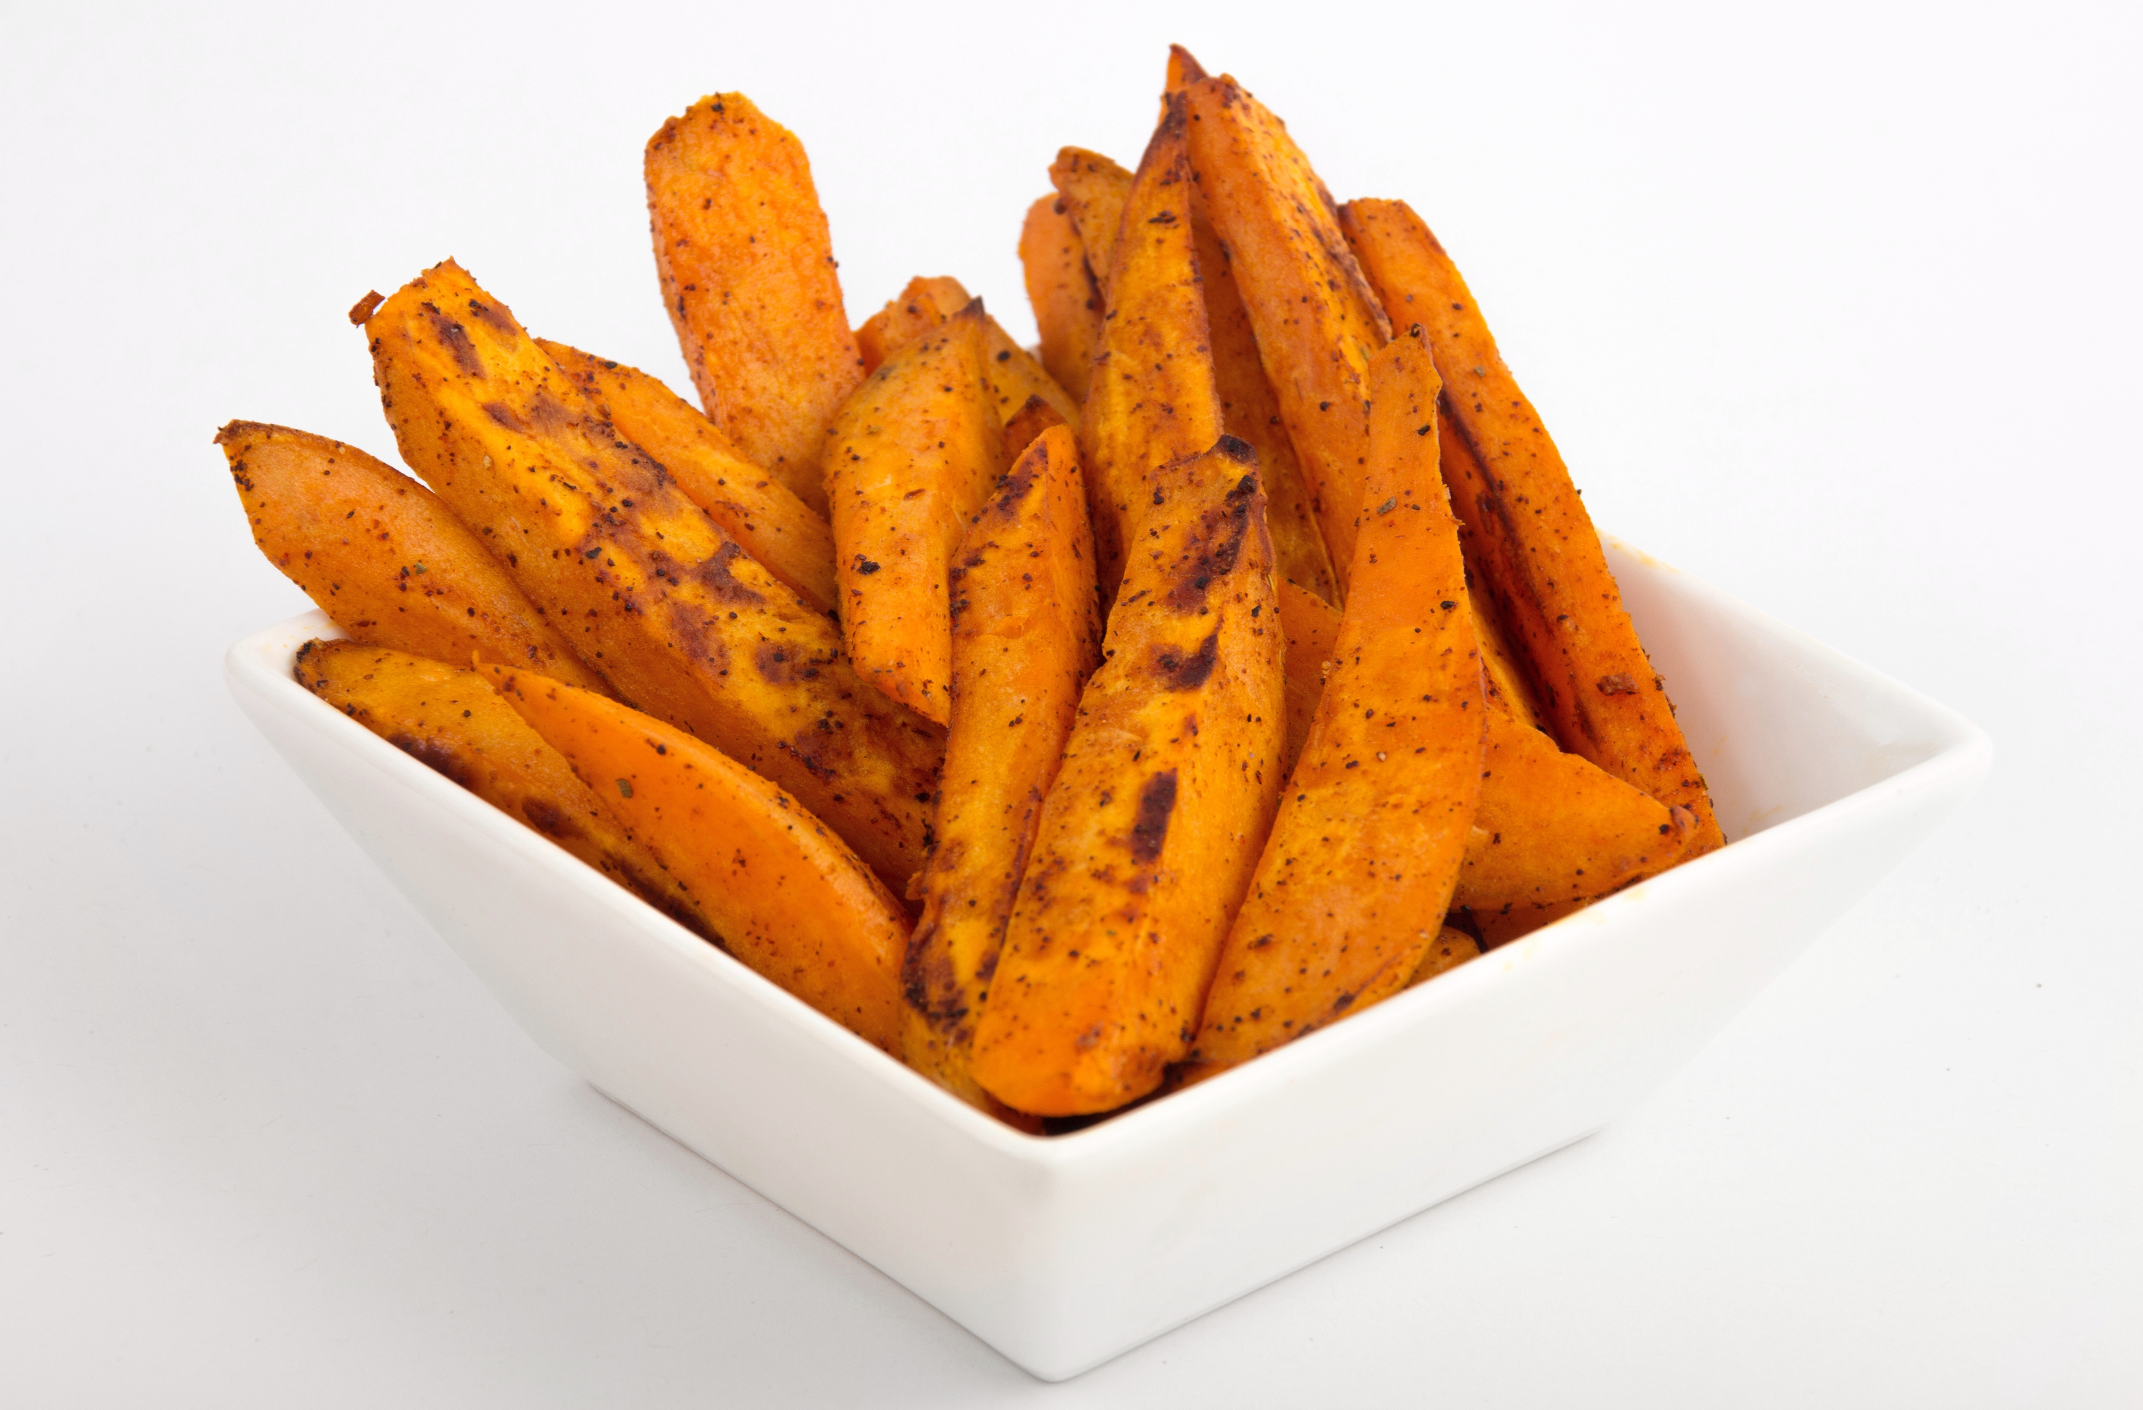
Shapes Variety
Have you ever thought about how combining shapes makes food more appealing?
We can add visual appeal by combining natural shapes or creating new shapes.
A variety of shapes gives the impression of a variety of foods.

Slide 64
Simplicity
Simple, clean lines and shapes are most pleasing to the eye.
Too much food on a plate or a tray that is too small causes the food to look messy and unappetizing.

Slide 65
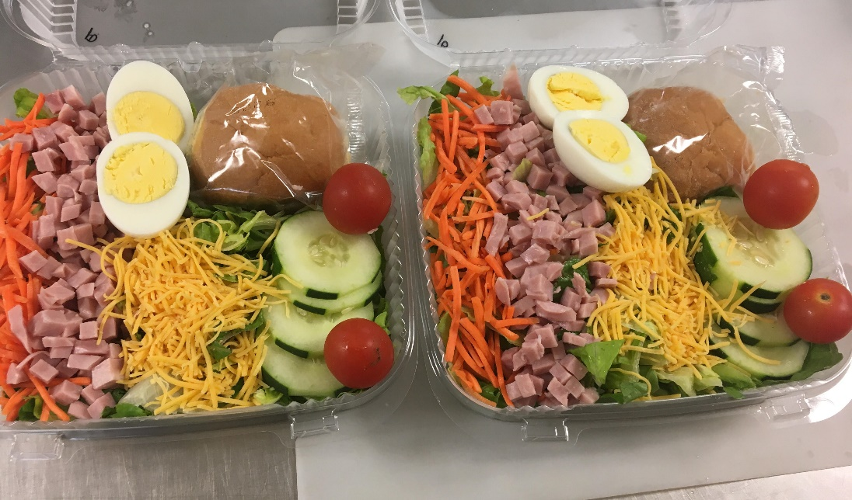
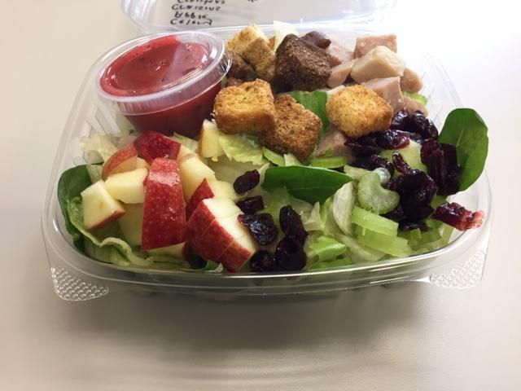
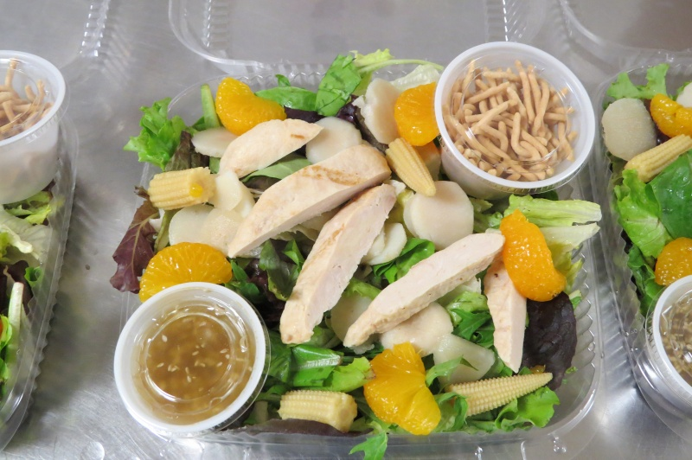
Self-Serve Packaging
Presentation makes a big difference in selling prepackaged meals.
Part of the challenge is to showcase food products in an appealing way.

Slide 66
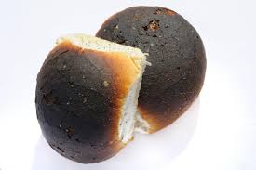
Overcooked Food
Overcooking can change the color and appearance of food.
Matching ingredients with the correct cooking method will help create a quality product.
Heat causes proteins and starches to thicken, sugars to caramelize, water to evaporate, and fats to melt.
Using the incorrect cooking method could spell disaster.

Slide 67
Three Cooking Methods
DRY-HEAT METHODS | MEDIUM | EQUIPMENT
Broiling | Air | Overhead broiler
Grilling | Air | Grill
Roasting | Air | Oven, combi oven
Baking | Air | Oven, combi oven
Sautéing | Fat | Fat tilt skillet (May sauté using sheet pan in an oven)
Stir-frying | Fat | Tilt skillet, steam-jacketed kettle, wok
Pan-frying | Fat | Stovetop, tilt skillet
Deep-frying | Fat | Deep fat fryer
MOIST-HEAT METHODS | MEDIUM | EQUIPMENT
Poaching | Water or other liquid | Stovetop, oven, steam-jacketed kettle, tilt skillet
Simmering | Water or other liquid | Stovetop, steam-jacketed kettle, tilt skillet
Boiling | Water or other liquid | Stovetop, steam-jacketed kettle, tilt skillet
Steaming | Steam | Convection steamer, combi oven
COMBINATION-HEAT METHODS | MEDIUM | EQUIPMENT
Braising | Fat, then liquid | Oven, combi oven, tilt skillet
Stewing | Fat, then liquid | Oven, combi oven, tilt skillet

Slide 68
Common Cooking Methods in School Nutrition
Most items on a school nutrition menu are:
  Baked
  Steamed
  Roasted
It is important we cook foods to safe internal temperatures and do not overcook products, which will make them tough, dry, and distasteful. This is especially true for items pre-cooked by the manufacturer.

Slide 69
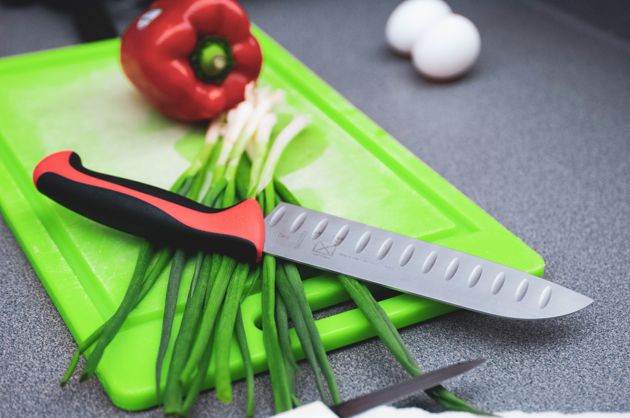
How to Accomplish Visual Appeal?
Visual appeal can be accomplished with a very important culinary technique—knife skills.

Slide 70



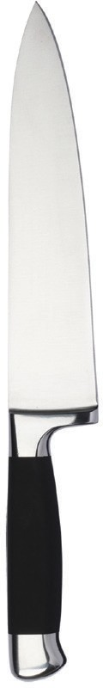

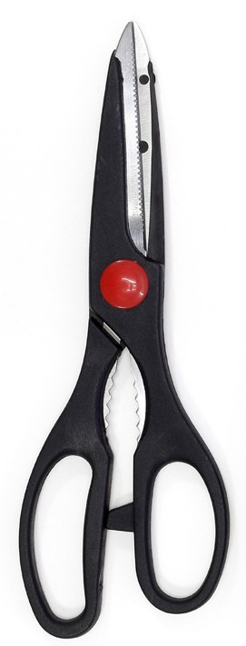


Choosing the Right Knife
BONING
Used to cut, section, and trim larger pieces of meat
BREAD
Used to slice breads and other items with thick, hard crusts
CARVING
Used to carve meats, such as roast and turkey
CHEF
Used to chop, dice, mince, and slice a wide variety of foods
CLEAVER
Used to chop thick cuts of meat or break down poultry
SHEARS
Used to snip herbs; cut fresh cuts of meat, poultry, or fish; and chop fruits and vegetables
PARING
Used to peel, core, slice, or mince smaller foods, such as fruits and vegetables
UTILITY
Used to chop, dice, slice, and mince a variety of foods

Slide 71
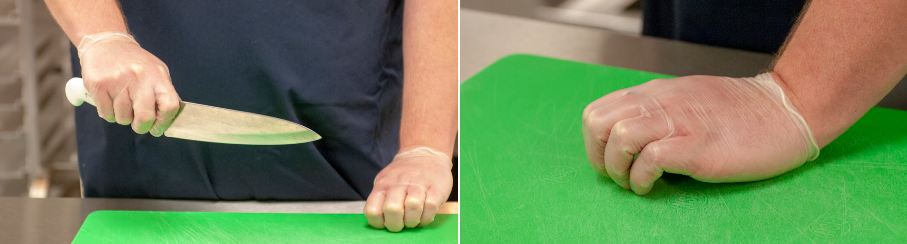
Knife Video, Part I
Best Practice/Strategy: The most common grip is to hold the handle with the last three fingers while gripping the blade between the thumb and index finger. Do not place your index finger along the top of the blade of the knife.

Slide 72
Cutting Boards
Best Practices/Strategies
Knives should always be used with a cutting board. It is important to never cut on stainless steel tables because you will dull your knife. | If your cutting board is not designed with rubber edges to hold it in place, be sure you secure your cutting board with a damp, sanitized terry or disposable cloth or rubberized shelf liner. | If you are using a color-coded cutting board system for food safety, be sure you have paired the correct color with the correct food. For example, a green cutting board should be used with fresh produce.

Slide 73
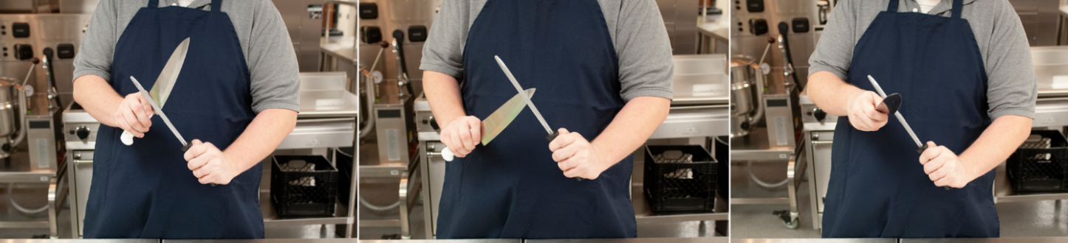

Knife Video, Part II
Best Practice/Strategy: After you sharpen and hone your knife, you should always wash it to remove debris. However, you should not clean or sanitize knives in a commercial dishwasher. The heat and chemicals may damage the handle and blade. Always clean and sanitize knives using the 3-compartment sink method. In fact, you should wash, rinse, and sanitize all utensils and cutting boards immediately after each use. It is also important to remember knives should never be left in the sink unattended because it an employee safety hazard.
Best Practice/Strategy: Wear single-use, disposable gloves when handling ready-to-eat foods, such as produce.
Best Practice/Strategy: The allergens (latex proteins) can be transferred from latex gloves to food. As a precaution, purchase non-latex containing single-use, disposable gloves.

Slide 74
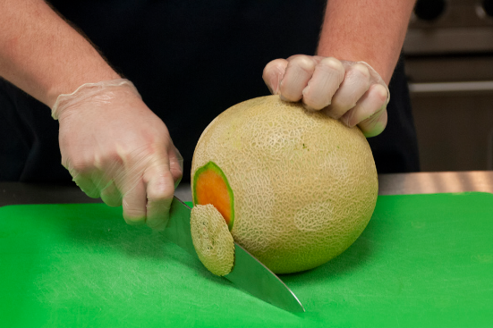
Cantaloupe Video
Best Practice/Strategy: Using garnishes are a great way to add color and increase the eye appeal of dishes served.

Slide 75
Chiffonade Video

Slide 76
Lesson 4: Reflections
Spend some time reflecting on the ideas and thoughts from Lesson 4 and what “take-aways” you want to recall later to assist with identifying a strategy or activity to improve meal quality or student perception.

Slide 77
Lesson 5: Delivering a Quality Product
Objectives:
  Describe how the principles of food production impact food quality.
  Demonstrate the use of a quality scorecard to assess school meals.
  Organize an appealing serving line during meal service periods.

Slide 78
Quality Meal Service
Quality is achieved by the actions we take during every step of preparation and service.
Quality meal service relates to the entire school nutrition program, starting with the time the food is received at delivery and continuing to the time the customer leaves the dining room.
To ensure the highest quality product, establish quality standards to evaluate each menu item.

Slide 79
Food Quality and Performance Acceptability
Establishing and implementing quality standards ensures:
  The menu is being followed
  High-quality meals that meet students’ nutrition needs and expectations are being served
  Fiscal accountability is maintained
Best Practice/Strategy: It is important to remember to use standardized recipes for accurate, portion sizes, and nutrition information applicable to your specific operation.
Best Practice/Strategy: It is important that managers determine in advance what is and is not an acceptable quality product and communicate the standards with the staff.

Slide 80
Food Quality Standards
Food quality standards are the characteristics of food that are acceptable to consumers. This include factors such as:
  Appearance (size, shape, and color)
  Texture or consistency
  Flavor and seasoning

Slide 81
Define Quality Scorecards
Using quality scorecards is an excellent way to evaluate food products for quality.
A quality scorecard identifies characteristics of a product based on an established quality standard. As managers, you are encouraged to work with your staff to develop district-wide scorecards and to identify quality standards.
It is the manager’s responsibility to ensure deviation from the standard does not occur.

Slide 82
Use of a Quality Scorecard
Quality scorecards present the quality standard targets you should aim to meet when determining how the finished product should look and taste.
  Appearance—how the food should look when it is prepared according to the recipe.
  Texture or consistency—how the food should feel in the mouth and how it cuts.
  Flavor—how the food tastes
  Service temperature—the ideal temperature for serving the food, which may be higher than the safe holding temperature for hot foods.

Slide 83
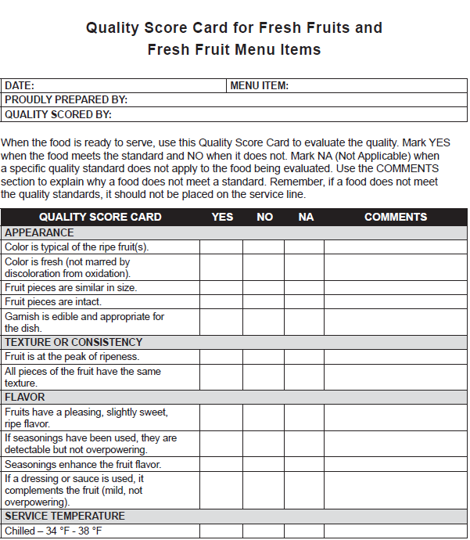
Activity: Using the Quality Scorecard for Cantaloupe

Slide 84
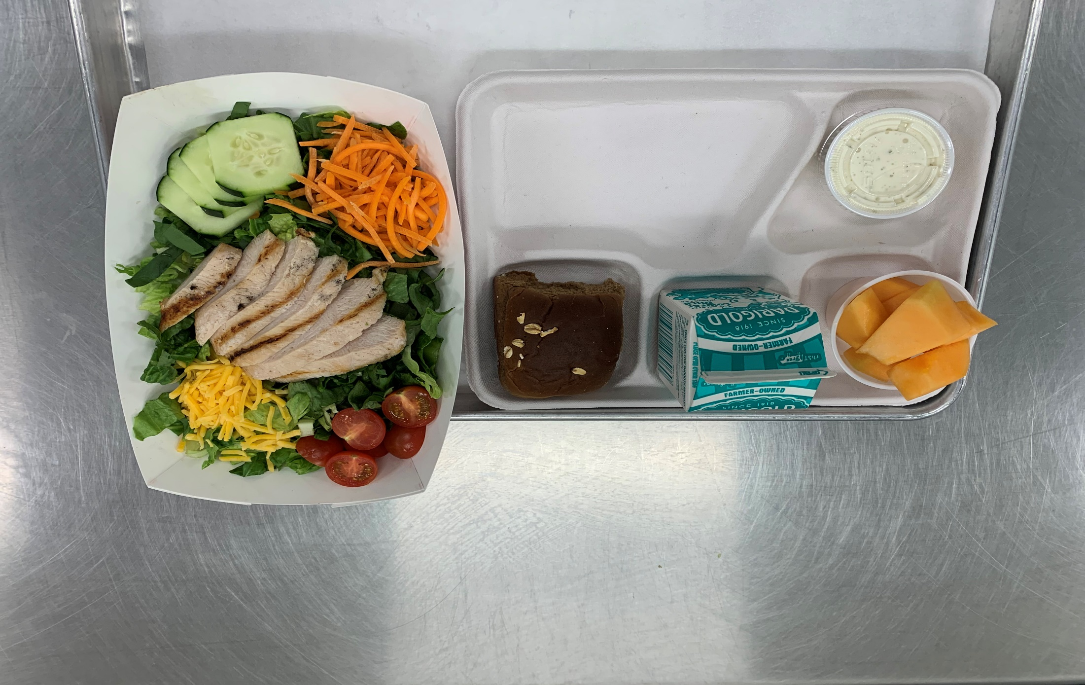
Picture of a Reimbursable School Meal with Salad and Cantaloupe

Slide 85
Activity: Grilled Chicken Salad Video
QUALITY SCORECARD | YES | NO | NA | COMMENTS
APPEARANCE
Color is bright, typical of fresh greens.
Color is bright, typical of other fresh ingredients (no discoloration).
Salad appears moist, not dry or excessively wet.
Salad ingredients are cut evenly.
Salad ingredients appear crisp, not limp.
Garnish is edible and appropriate for the salad.
TEXTURE OR CONSISTENCY
Salad ingredients are crisp, not soggy.
Meat or pasta/rice salads are tender but not mushy.
FLAVOR
Salad ingredients have a fresh, distinctive flavor.
Seasonings enhance the salad but are not too salty or too tart.
A variety of salad dressings are available.
SERVICE TEMPERATURE
Chilled – 34 °F – 38 °F

Slide 86
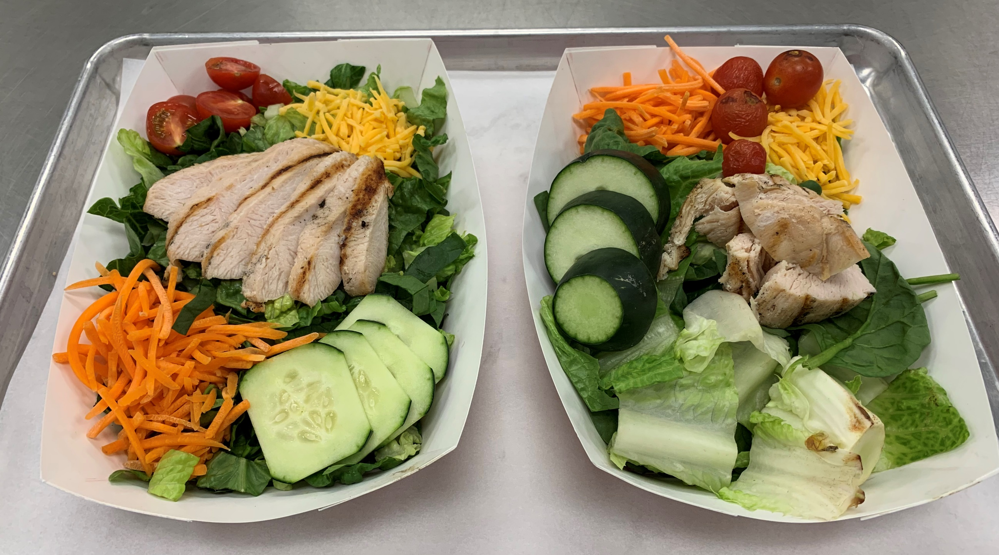
Pictures of Salads (High Quality vs. Not)

Slide 87
Picture of a Reimbursable School Meal with Salad and Cantaloupe

Slide 88
An Appealing Serving Line
Not only should foods be nutritious and appealing to the eye, but they should also be easy to see and reach.
When placing foods on the serving line, ask yourself the following questions:
  How does the food look from a customer’s point of view?
  Do the colors complement each other?
  Is the item attractive and eye-appealing?
  Would you want to eat this food?

Slide 89
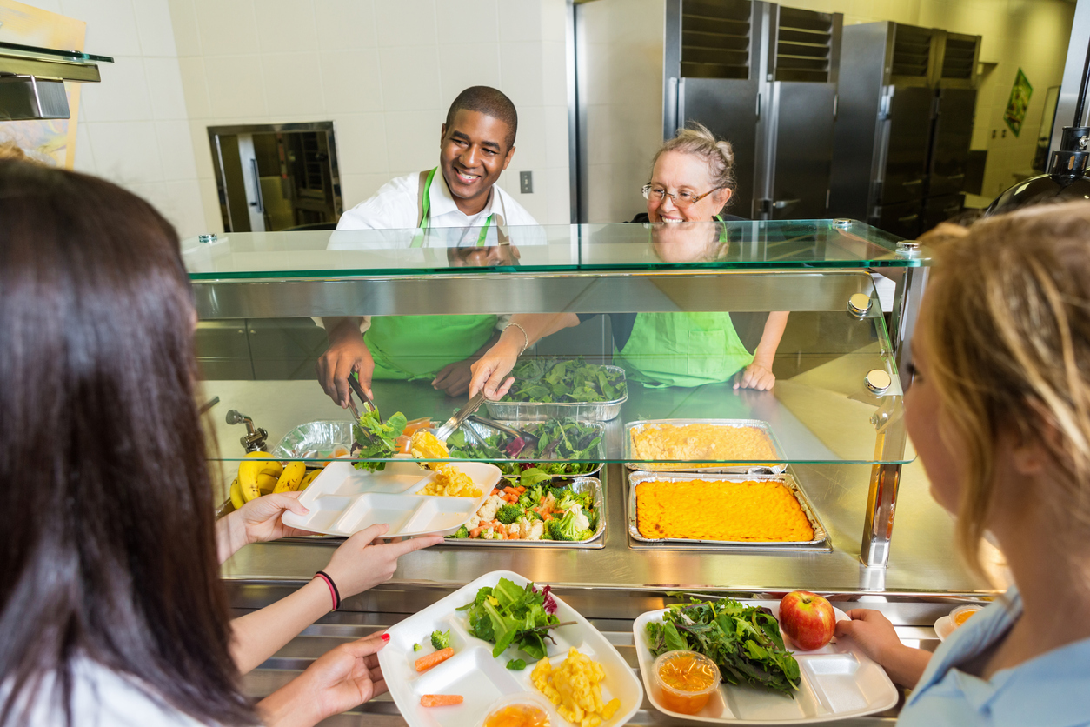
Serving Line Diagrams
Best Practice/Strategy: Planning how the serving line will be set up and what small equipment and/or supplies will be needed during service is critical. The best way to plan your service is through serving line diagrams. These diagrams should be posted for all staff to see on the day the menu will be served.

Slide 90
Activity: Serving Up Success

Slide 91
Lesson 5: Reflections
Spend some time reflecting on the ideas and thoughts from Lesson 5 and what “take-aways” you want to recall later to assist with identifying a strategy or activity to improve meal quality or student perception.

Slide 92
Lesson 6: Strategies and Activities Related to Improving Meal Quality and Student Perception
Objective:
Formulate strategies and activities related to improving meal quality and student perception of meal quality to create an action plan.

Slide 93
Activity: Review Lesson Reflection Sheets

Slide 94

Ideas for Strategies and Activities
Think about the strategies and activities you would like to implement in your program operation to improve meal quality and student perception of meal quality.

Slide 95
Meal Quality SMART Goal and Action Plan Template
Developed to help you customize your SMART Goals and identify appropriate strategies and activities to create successful action plans.
Step 1: Select 1 of the 3 Meal Quality Strategies.
Meal Quality Strategies:
  Strategy 1: Increase Menu Variety and Choices for Student Selections
  Strategy 2: Enhance Visual Appeal of Meals at Breakfast and Lunch
  Strategy 3: Enhance Culinary Preparation and Techniques

Slide 96
Meal Quality Strategy 1 and Corresponding Activities
Strategy 1: Increase Menu Variety and Choices for Student Selections
  Activity 1: Provide at least 1 (2 or 3) cultural menu option(s) a week (month) to provide students with menu variety and choices.
  Activity 2: Use food bars or salad bars to provide students with menu variety and choices of at least 2 (3, 4, or 5) fruit and/or vegetable offerings served each day (week).
  Activity 3: Make fruit available at all points of sale daily to provide students with menu variety and choices.
  “Other” activity option: This allows managers to include a different activity that is not listed above, but it should be related to the concept of the strategy.

Slide 97
Meal Quality Strategy 2 and Corresponding Activities
Strategy 2: Enhance Visual Appeal of Meals at Breakfast and Lunch
  Activity 1: The staff will use garnishes to add color and eye appeal to dishes served daily (weekly) to provide students with visually appealing meals.
  Activity 2: The manager will utilize quality scorecards daily (weekly) to identify acceptable quality products of each meal prepared to ensure meals meet a set of quality standards.
  Activity 3: The manager will ensure the staff does not serve brown, bruised, or otherwise damaged produce on serving lines or salad bars daily to maintain meal quality.
  “Other” activity option: This allows managers to include a different activity that is not listed above, but it should be related to the concept of the strategy.

Slide 98
Meal Quality Strategy 3 and Corresponding Activities
Strategy 3: Enhance Culinary Preparation Techniques
  Activity 1: The manager will incorporate batch cooking within the operation based on the menu offerings to ensure the best appearance, temperature, and texture of food are provided to maintain meal quality.
  Activity 2: The staff will prepare menu items using a different culinary technique (i.e., roasting, steaming, sautéing, etc.) each month (semester, etc.) to maintain meal quality and offer students a variety of menu options.
  Activity 3: The staff will incorporate the use of at least 1 (2 or 3) herb(s) and spice(s) to enhance flavor each week to a menu item to maintain meal quality.
  “Other” activity option: This allows managers to include a different activity that is not listed above, but it should be related to the concept of the strategy.

Slide 99
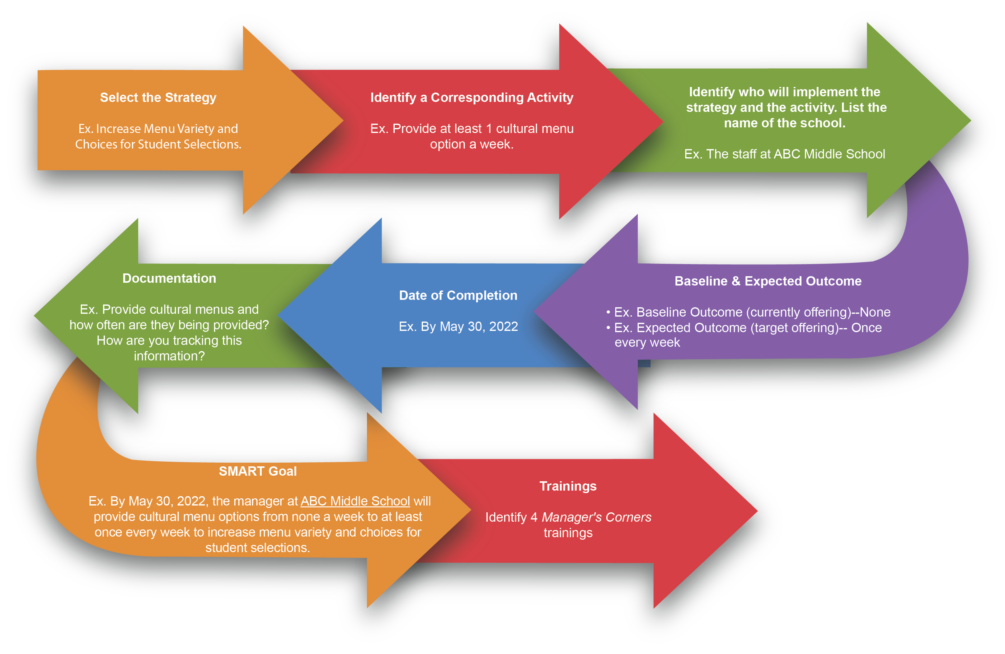
Meal Quality Improvement Goal and Action Plan Process

Slide 100
Student Perception of Meal Quality SMART Goal and Action Plan Template
Developed to help you customize your SMART Goals and identify appropriate strategies and activities to create successful action plans.
Step 1: Select 1 of the 3 Student Perception of Meal Quality Strategies
Student Perception of Meal Quality Strategies:
  Strategy 1: School Environment
  Strategy 2: Nutrition Education
  Strategy 3: Marketing Efforts

Slide 101
Student Perception of Meal Quality Strategy 1 and Corresponding Activities
Strategy 1: School Environment
  Activity 1: The staff will maintain a pleasant, safe, and clean physical environment daily in the school cafeteria to encourage student participation.
  Activity 2: The staff will display posters and signs in the cafeteria each year to promote healthy eating among students.
  Activity 3: The staff will upgrade one aspect within the cafeteria environment (i.e., painting walls, seating arrangements, serving dishes, baskets for displays, updated signs, etc.) each year to improve students’ perception of meal quality.
  “Other” activity option: This allows managers to include a different activity that is not listed above, but it should be related to the concept of the strategy.

Slide 102
Student Perception of Meal Quality Strategy 2 and Corresponding Activities
Strategy 2: Nutrition Education
  Activity 1: The staff will provide students with nutrition education each month (semester) to improve students’ perception of meal quality.
  Activity 2: The staff will work with the school/classes to incorporate food from classroom themes/lessons on the menus each month (semester) to improve students’ perception of meal quality.
  Activity 3: The staff will provide nutrition education messages on the website or on menus each week to promote healthy eating among students.
  “Other” activity option: This allows managers to include a different activity that is not listed above, but it should be related to the concept of the strategy.

Slide 103
Student Perception of Meal Quality Strategy 3 and Corresponding Activities
Strategy 3: Marketing Efforts
  Activity 1: The staff will provide teachers with promotional materials each month (semester) to improve students’ perception of meal quality.
  Activity 2: The manager will develop a student advisory committee each year to improve students’ perception of meal quality.
  Activity 3: The staff will host a student recipe competition each year to improve students’ perception of meal quality.
  “Other” activity option: This allows managers to include a different activity that is not listed above, but it should be related to the concept of the strategy.

Slide 104
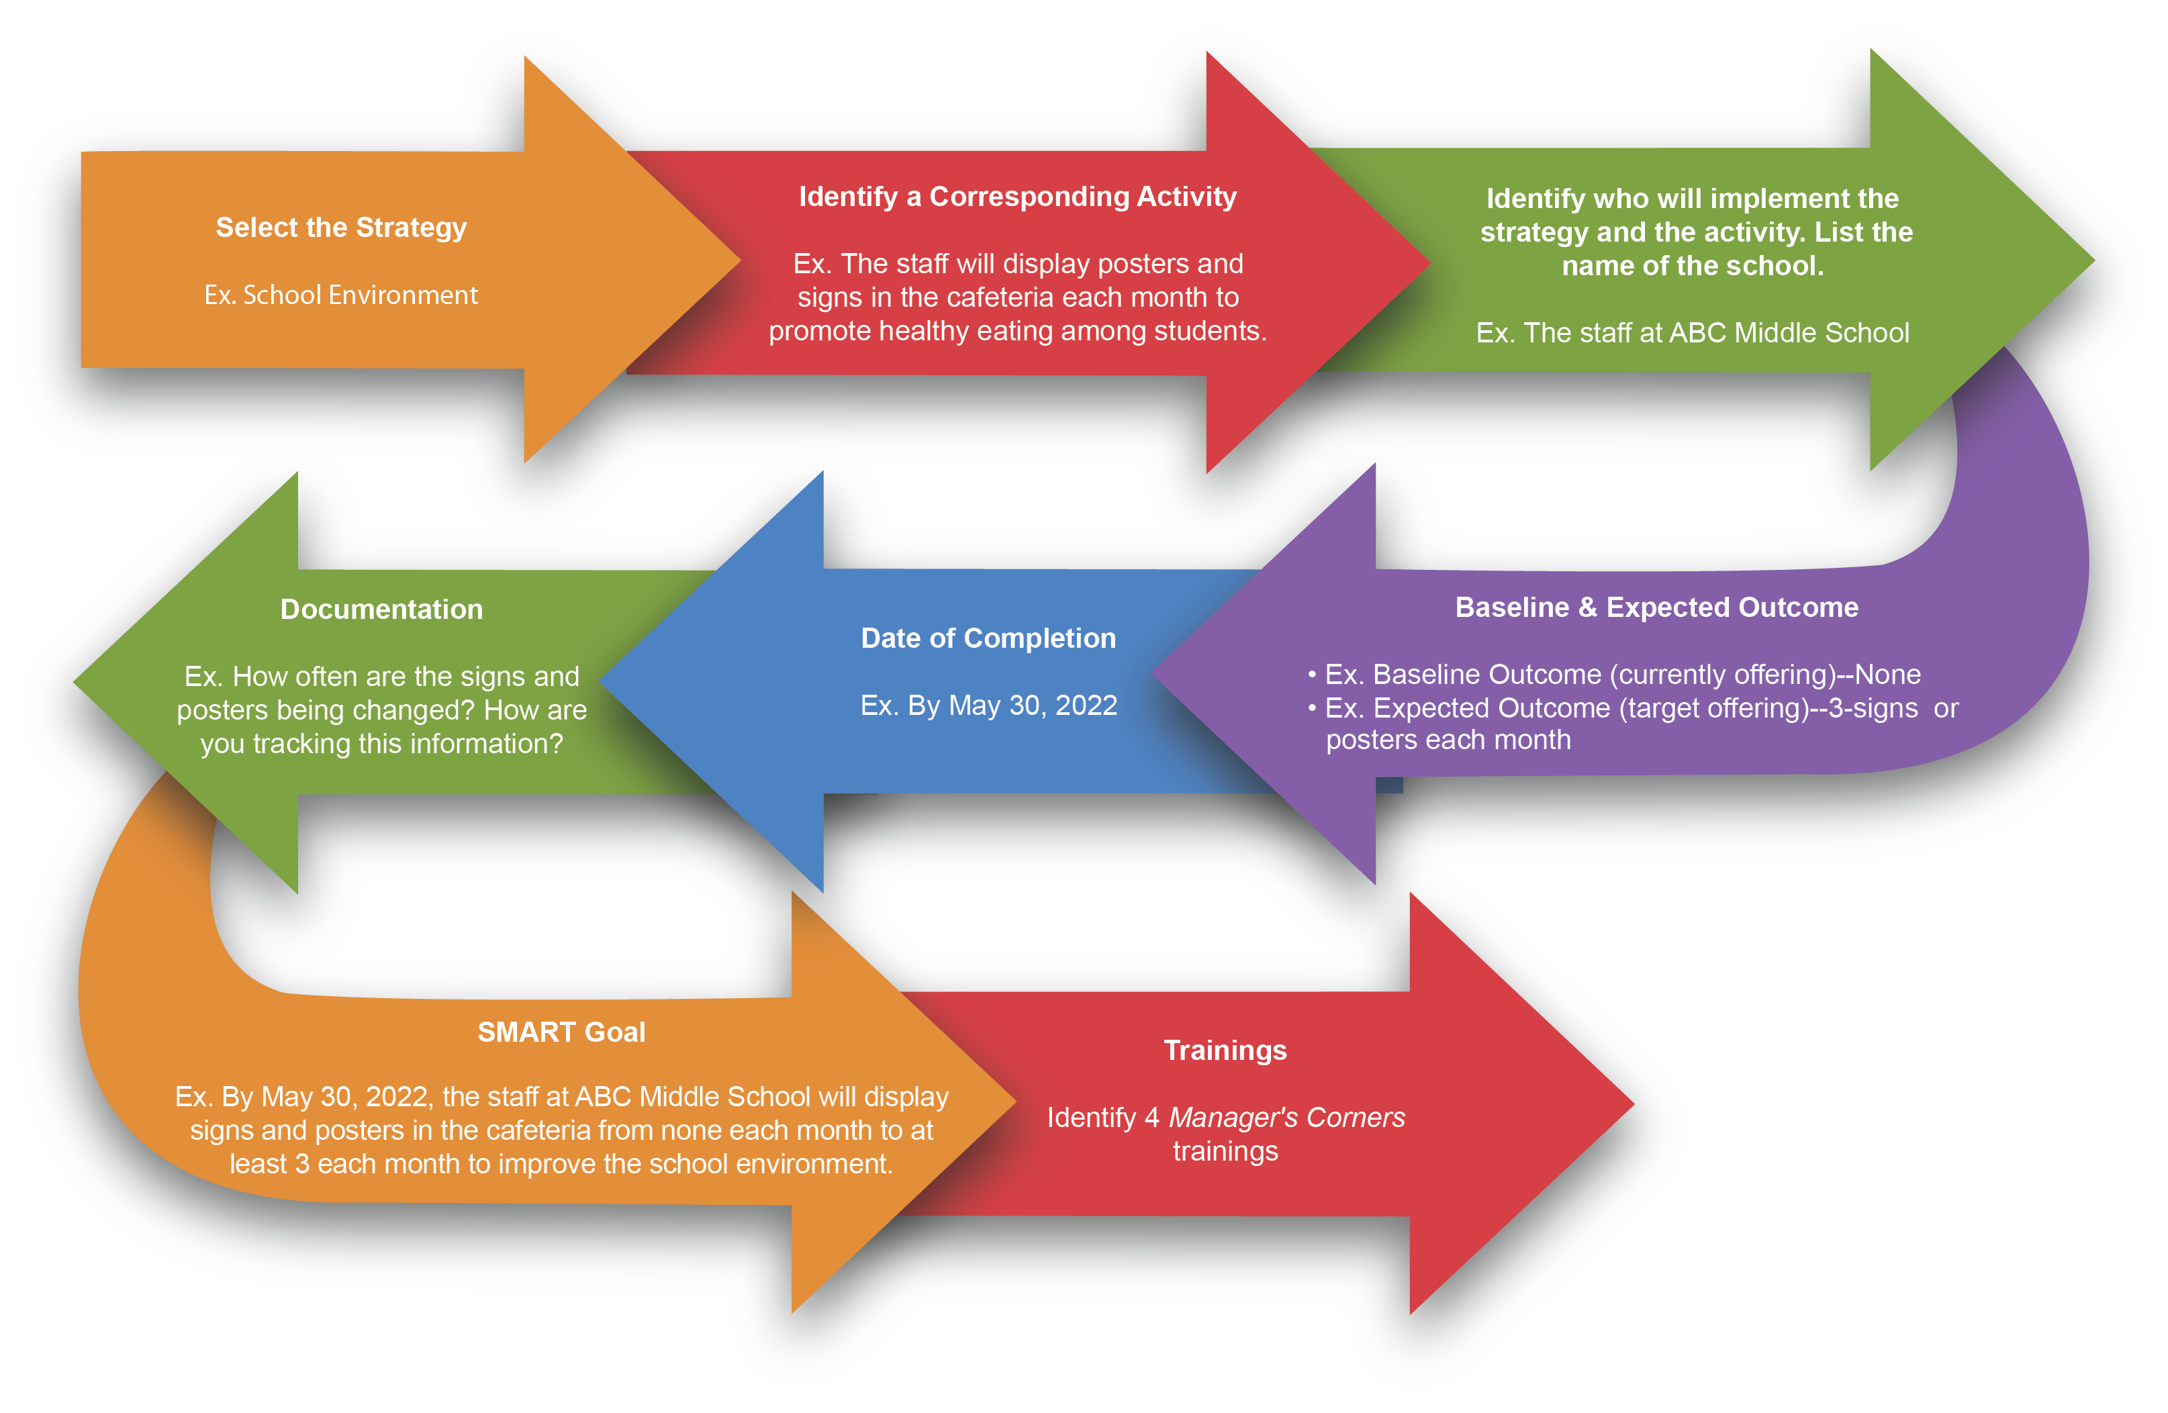
Student Perception of Meal Quality Goal and Action Plan Process

Slide 105
ACTIVITY: Review and Discuss Student’s Perception of Meal Quality Goals and Action Plan Processes
Review and discuss goals and action plans in breakout groups.

Slide 106
ACTIVITY: Review and Discuss Goals and Action Plan Processes
Review and discuss goals and action plans in breakout groups.

Slide 107
Wrap Up Discussion
What strategies and activities are you planning to implement over the next year?
Reflections

Slide 108






Follow ICN on Social Media!
facebook.com/ichildnutrition
@ichildnutrition
instagram.com/theicn
pinterest.com/theicn

