Slide 1

Menu Planning Basics for CACFP
CACFP iTrain
Simple Lesson Plan

Slide 2
Introduction
Trainer and Participant
Introductions

Slide 3
Welcome!

Slide 4
Review Current Knowledge
How many of you have experience planning meals for your child care program?
Notes:
Share core content: Good menu planning has several benefits, especially when participating in the Child and Adult Care Food Program (CACFP). Planning ahead can help operators identify nutritious, appealing, and winning food combinations that meet the CACFP meal pattern requirements.

Slide 5
Overview
Notes:
Share core content: The purpose of this training is to provide five steps for planning menus that will help you plan meals that meet the CACFP meal pattern requirements for children ages 3–5. Select food for meals that is varied, nutritious, and appealing to preschoolers.
At the end of this training, participants will plan nutritious menus that meet CACFP meal pattern requirements for children ages 3–5.

Slide 6
Lesson Objective
Use five steps for planning nutritious menus that emphasize variety, appeal, and good nutrition in the CACFP.

Slide 7
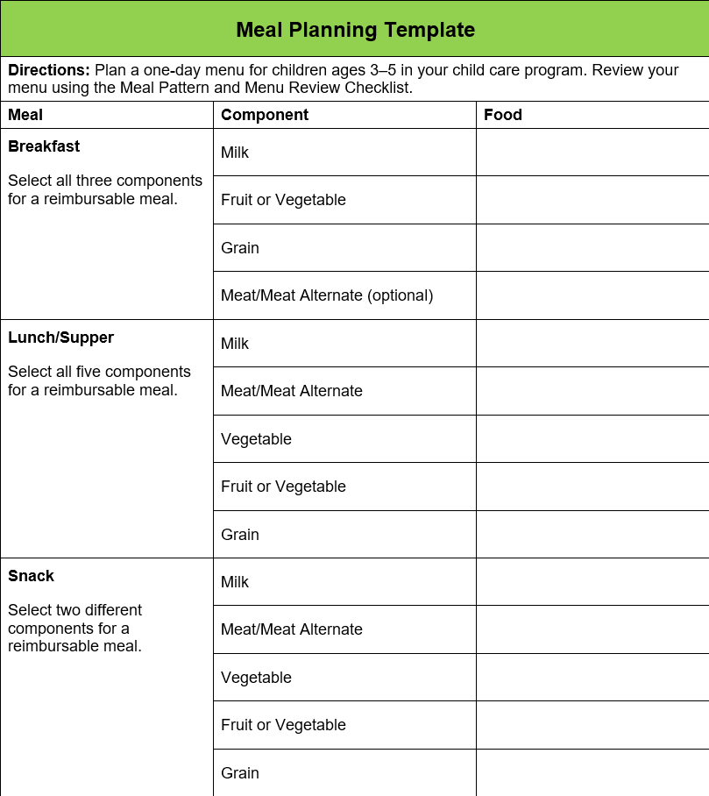
CACFP Meal and
Snack Requirements
Notes:
Share core content: Review the handout with the participants, emphasizing the requirements for meals and snacks. Highlight the Meal Planning Template handout, as it will be used throughout the remaining of the training.
Handout: Meal Planning Template

Slide 8
Step One: Select a Main Dish
Start by planning the main dish first.
  Usually the M/MA component
  Some mixed main dishes may include a grain
Include seafood, beans, peas, lentils, and tofu for variety
Notes:
Share core content: There are five steps for planning nutritious menus.
Start by planning the main dish first. The main dish serves as the focal point for the meal. In most cases, this is the meats/meat alternates component. However, some mixed main dishes may include a grain, such as rice or pasta, and a vegetable also.
In addition to lean meat and poultry choices for your main dish, try to include seafood, peas, beans, lentils, and tofu occasionally for variety.

Slide 9
Step Two: Select the Other Meal Components
Choose sides to satisfy the other meal components that are complementary to the main dish.
Cover all the components needed for a reimbursable meal.
Notes:
Share core content: Choose sides to satisfy the other meal components that are complementary to the main dish. Ensure to cover all the components needed for a reimbursable meal.

Slide 10
Step Three: Plan for Variety
Serve a variety of foods during the day and week
  Makes meals more interesting
  Helps preschoolers learn about different types of foods
Serve different foods throughout the day
Ensure foods are not repeated more than once a week
Notes:
Share core content: As you are planning the menus, plan to serve a variety of foods during the day and week. This helps make meals more interesting and helps preschoolers learn about different types of foods.
Serve different foods throughout the day. Check to make sure the same foods are not repeated more than once a week.

Slide 11
Step Four: Plan for Nutrition
Serve only unflavored low-fat (1%) or fat-free (skim) milk
Limit added sugars in yogurt – no more than 12 grams per 6 ounces
Serve only grains that are whole grain-rich or enriched
Serve at least one whole grain-rich grain each day
Limit added sugars of RTE cereals –no more than 6 grams per
dry ounce
Grain-based desserts not allowed as part of a reimbursable
meal
Notes:
Share core content: Preschoolers need a variety of nutrients for adequate growth and development. The CACFP has requirements to assure that meals served to preschoolers are more nutritious. These requirements include:
Serving only unflavored low-fat (1%) or fat-free (skim) milk
Limiting the sugar content of yogurt to no more than 12 grams of added sugars per 6 ounces
Serving only grains that are whole grain-rich or enriched
Serving at least one whole grain-rich grain each day
Limiting the sugar content of ready-to-eat cereals to no more than 6 grams of added sugars per 1 dry ounce
Not allowing grain-based desserts as part of a reimbursable meal

Slide 12
Step Four: Plan for Nutrition (continued)
Include foods that provide vitamin A, such as spinach and other dark leafy greens
Include foods that provide vitamin C, such as oranges and cabbage
Include iron-rich foods, such as beans, peas, and lentils
Limit number of high-fat foods offered (CACFP regulations prohibit deep-fat frying on-site)
Serve fewer high-salt (high-sodium) foods, such as luncheon meats
and processed foods
Notes:
Share core content: Other ways you can plan meals that are more nutritious include:
Including foods that provide vitamin A, such as spinach and other dark leafy greens
Including foods that provide vitamin C, such as oranges and cabbage
Including iron-rich foods, such as beans, peas, and lentils
Limiting the number of high-fat foods offered (it’s important to note that CACFP regulations prohibit foods that are deep-fat fried on-site)
Serving fewer high-salt (high-sodium) foods, such as luncheon meats and processed foods

Slide 13
Step Five: Plan for Child Appeal
Focus on variety:
  Shapes: square, rectangular, wedge-shaped
  Colors: yellow, orange, red, green, purple/blue, white, tan/brown
  Textures: soft, fluffy, crunchy, crisp, creamy, smooth
  Tastes: sweet, sour, tart, salty, spicy, mild
Introduce new foods along with familiar favorites
Notes:
Share core content: While planning nutritious meals is essential, it is equally important to plan meals that look and taste good. When foods are visually appealing and tasty, children are more likely to try and to like the food.
Here are some ways to plan meals that look and taste good.
Focus on variety by including different:
Shapes, including square, rectangular, and wedge-shaped
Colors, such as yellow, orange, red, bright green, purple/blue, white, tan, and brown
Textures, such as soft, fluffy, crunchy, crisp, creamy, and smooth
Tastes, including sweet, sour, tart, salty, spicy, and mild
Think about the likes and dislikes of the children as they relate to their cultures and what they might eat at home. Remember, it can take up to 10–15 exposures before children develop a preference for new foods.
Introduce new foods along with familiar favorites.

Slide 14
Activity
Developing a One-Day CACFP Menu
Notes:
Activity: Developing a One-Day CACFP Menu
Time: 10 minutes
Purpose: The purpose of this activity is to have participants apply the menu planning basics by developing a one-day CACFP menu for children ages 3–5 and to evaluate the menu to see if it meets CACFP meal requirements.
Materials Needed: Meal Planning Template worksheet, Meal Pattern and Menu Review Checklist handout, and Pen/Pencil
Instructions:
Distribute a copy of the Meal Planning Template worksheet to each participant. Divide the participants into small groups. Ask them to locate the Meal Planning Template worksheet and the Meal Pattern and Menu Review Checklist handouts.
Ask each group to plan a one-day menu for 3 to 5-year-olds. Following, have each group use the Meal Pattern and Menu Review Checklist handouts to determine if it meets the CACFP meal pattern requirements. Encourage them to make any adjustments to menus that do not meet the meal pattern requirements.
Allow 5–10 minutes for participants to complete the activity. Once they have finished, ask each group to share their menu.

Slide 15
Conclusion

Slide 16
Lesson Conclusion
This training focused on planning and evaluating menus that emphasize good nutrition, appeal, and compliance. It emphasized these five steps:
  Select the main dish
  Select the other meal components
  Plan for variety
  Plan for nutrition
  Plan for child appeal
Notes:
This training focused on planning and evaluating menus that emphasize good nutrition, appeal, and compliance. It emphasized the following five steps:
Select the main dish
Select the other meal components
Plan for variety
Plan for nutrition
Plan for child appeal

Slide 17
Activity
Speed Action Planning

Slide 18





The University of Mississippi
School of Applied Sciences www.theicn.org  800-321-3054 helpdesk@theicn.org
Thank You!
Follow ICN on Social Media!
facebook.com/ichildnutrition
@ichildnutrition
instagram.com/theicn
linkedin.com/company/theicn

