Slide 1

Planning Reimbursable
School Meals for Menu Planners

Slide 2

Ice Breaker
Notes:
https://www.vectorstock.com/royalty-free-vector/flat-introduction-label-vector-33677013

Slide 3
Reimbursable Meal Training for Menu Planning
Food Based Menu Planning (FBMP): Uses meal patterns and grade groups as planning tools.
Reimbursable Meal: A single meal unit that offers all of the USDA daily required meal pattern components for each age/grade group served in the minimum required amounts.

Slide 4
Training Objectives
Identify the fluid milk component choices, serving size requirements, and how to credit fluid milk toward meeting meal pattern requirements for the National School Lunch Program (NSLP).
Identify the fruits component choices, serving size requirements, and how to credit fruits toward meeting meal pattern requirements for the NSLP.
Identify the vegetables component choices, serving size requirements, and how to credit vegetables toward meeting meal pattern requirements for the NSLP.
Identify the grains component choices, serving size requirements, and how to credit grains toward meeting meal pattern requirements for the NSLP.
Identify the meats/meat alternates component choices, serving size requirements, and how to credit meats/meat alternates toward meeting meal pattern requirements for the NSLP.
Modify menu offerings for grade groups K–5 and 6–8 to meet meal pattern requirements for the NSLP.
Identify the meal components and serving size requirements to meet the School Breakfast Program meal pattern requirements.
Define nutrient standards in relation to the meal pattern requirements for the National School Lunch Program and School Breakfast Program.

Slide 5

Show up on time.
Be present.
Let everyone participate.
Listen with an open mind.
Think before speaking.
Attack the problem not the person.
GROUND

Slide 6
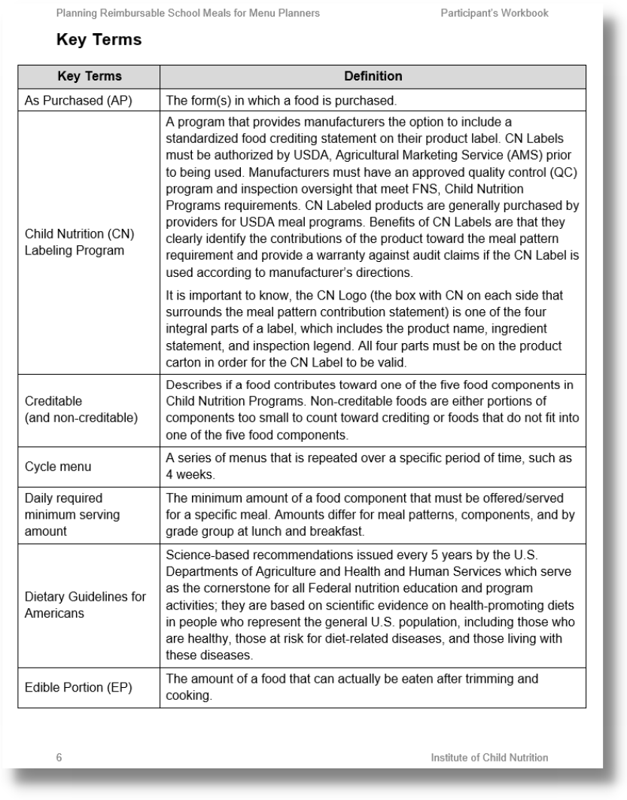
Key Terms
Refer to the key terms chart in your Participant’s Workbook

Slide 7
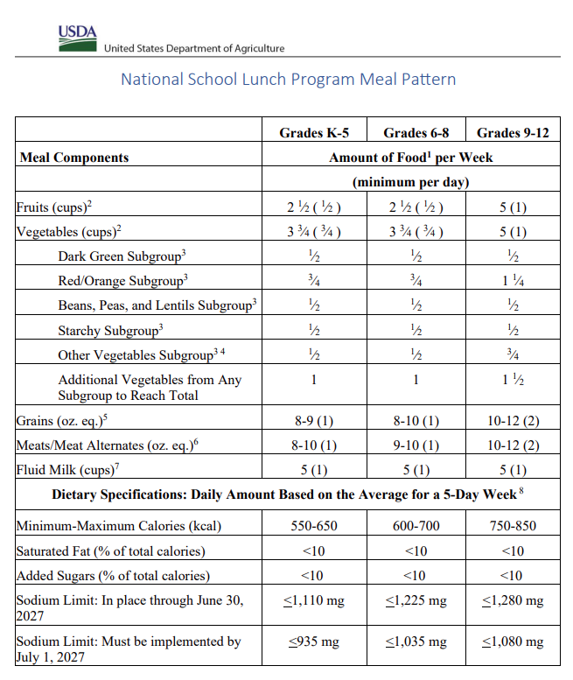
What Is the Meal Pattern?
Refer to the meal pattern charts in your Participant’s Workbook

Slide 8
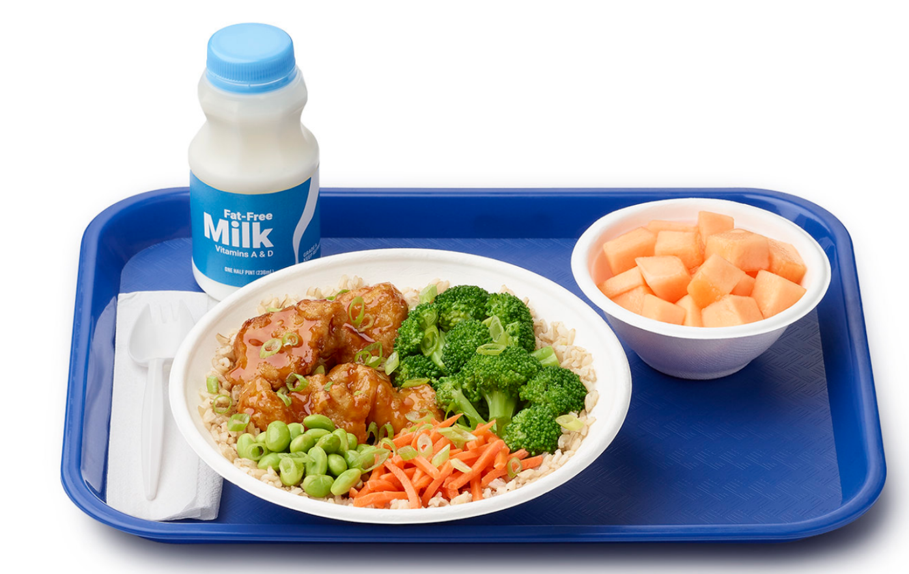
Meal Components
Milk
Fruits
Vegetables
Grains
Meats/Meat Alternates

Slide 9
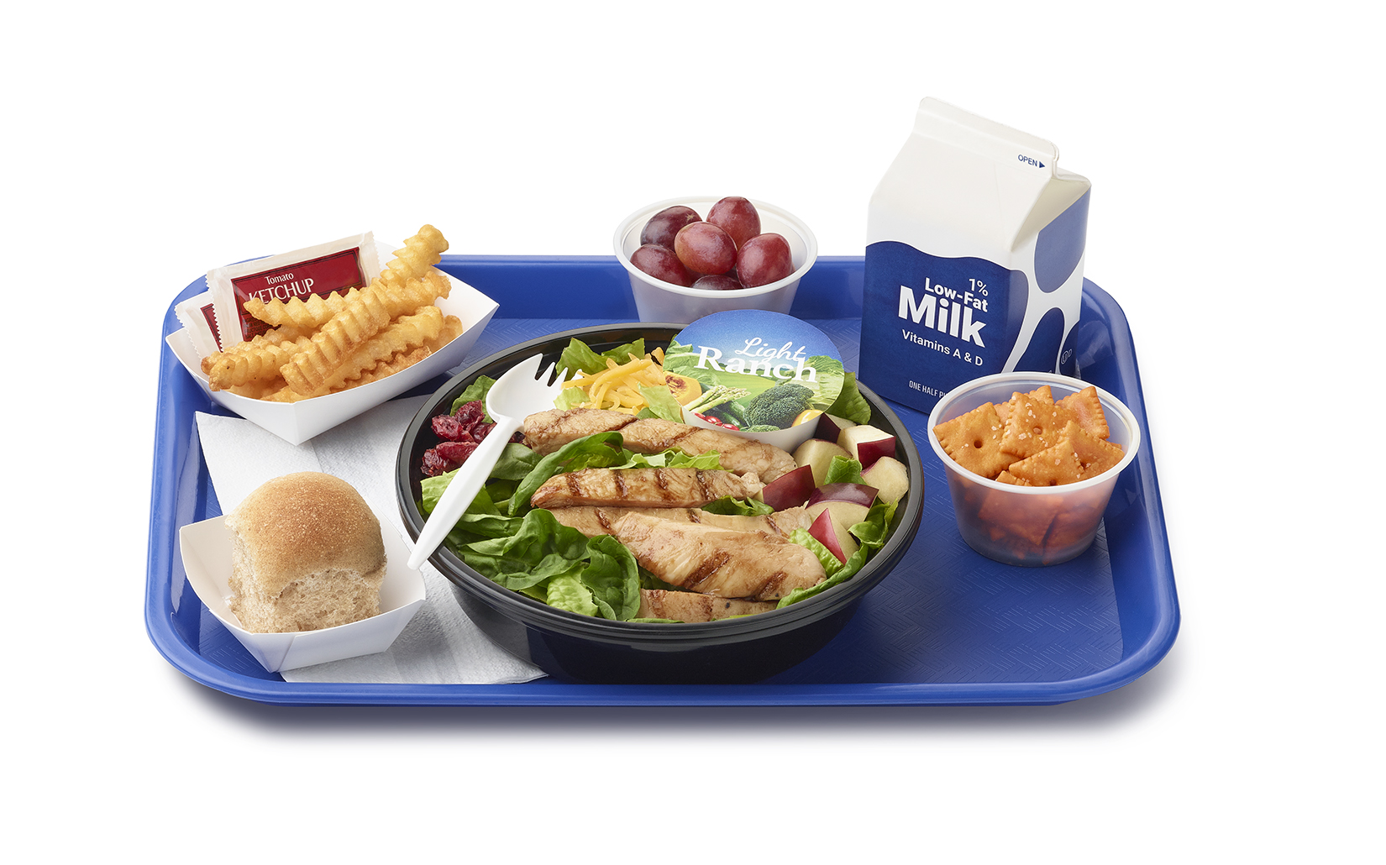
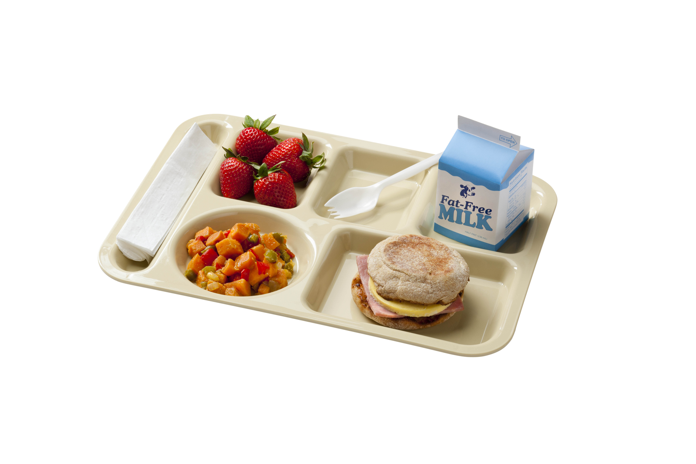
Recognizable Versus Unrecognizable Meal Components
Recognizable Food Item: a food item visible in the breakfast or lunch offered that allows students to identify the food groups and amounts recommended for consumption at mealtime

Slide 10

Dietary Guidelines for Americans, 2020–2025
Revised every five years
Meal patterns may continue to change to align with the guidelines

Slide 11
Overview of Offer Versus Serve (OVS)
A provision in NSLP and SBP that allows students to decline some of the food offered.
The goals are to reduce food waste in the school meals programs while permitting students to decline foods they do not intend to eat.

Slide 12
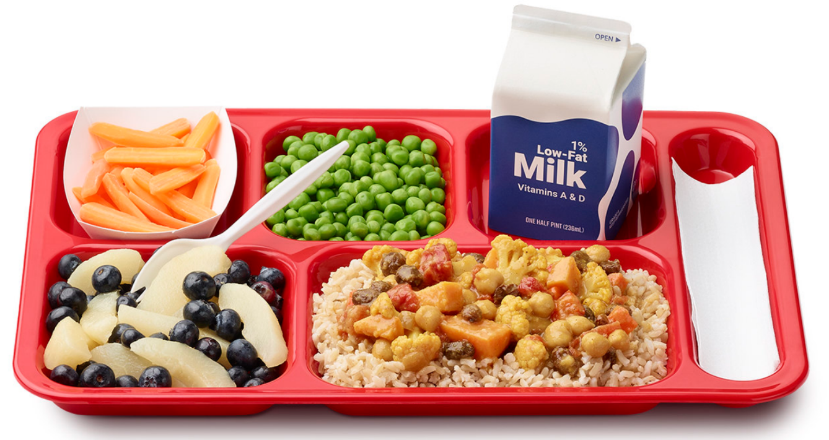
OVS at Lunch
Must offer students all 5 required food components in at least the minimum required amounts
Must take at least 3 components in the required serving sizes
One selection must be at least ½ cup from either the fruit or vegetable component
Required at the high school level
Notes:
https://esha.com/blog/plan-nutritionally-adequate-client-menus-with-myplate/

Slide 13
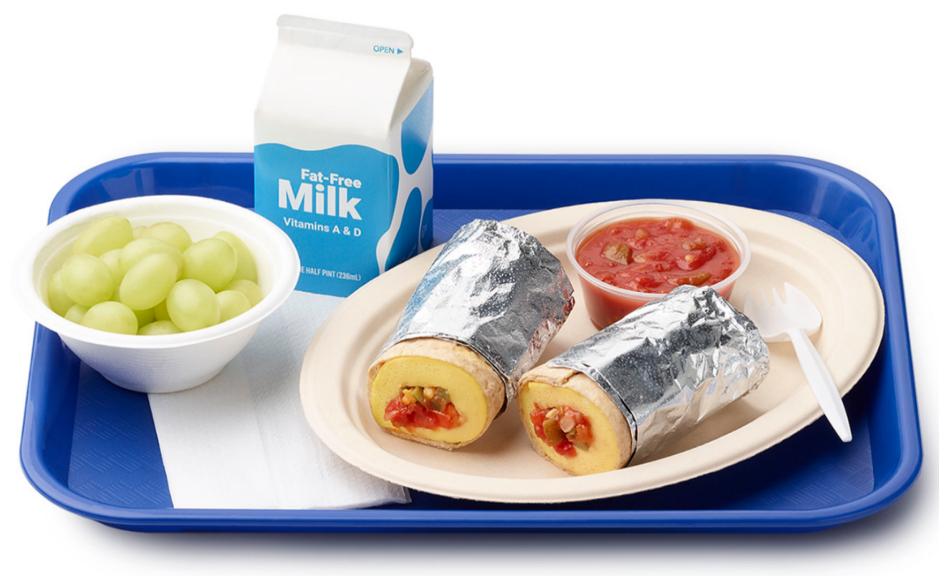
OVS at Breakfast
Must offer students all 3 required food components in at least the minimum required amounts
Must be offered at least 4 food items
Must select at least 3 food items, one of which must be ½ cup of fruit or vegetables for OVS
OVS is optional at all grade levels for breakfast
Notes:
https://esha.com/blog/plan-nutritionally-adequate-client-menus-with-myplate/

Slide 14
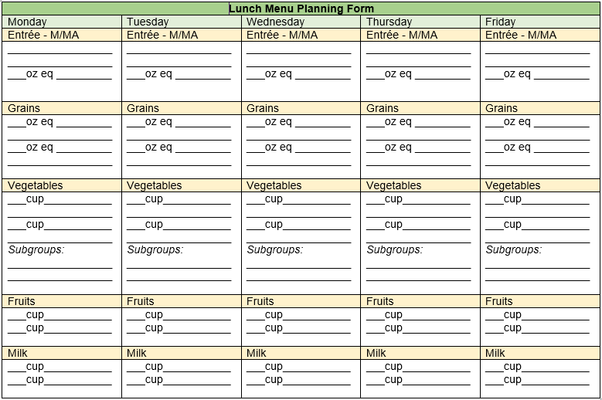
Training Activities–Menu Planning Form

Slide 15


Food Buying Guide
Website
App – Food Buying Guide for CNP
  Available on Google Play and Apple IOS

Slide 16
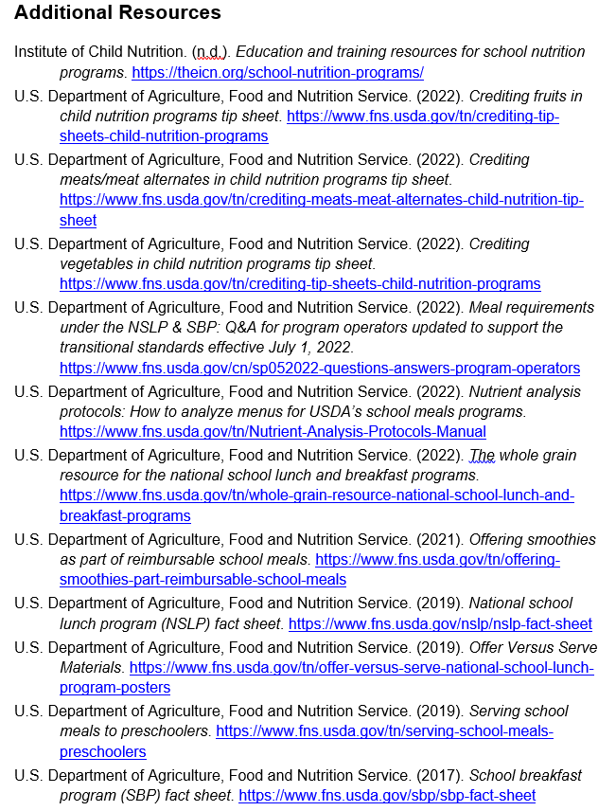
Additional Resources
Provides links to supplementary handouts, fact sheets, and more information on program details

Slide 17


Pre-Assessment

Slide 18

Lesson 1: Milk Component for the National School Lunch Program
Notes:
Suggested image: accurate photographic images of the portion size ½ pints, 1 cup and 8 fl oz plastic bottles
https://www.vecteezy.com/free-vector/milk-carton

Slide 19
Milk Component
Many health benefits
Important for building and maintaining strong bones
Provides nutrients including calcium, potassium, vitamin D, and protein
Notes:
https://www.shutterstock.com/search/objective+writing?image_type=photo

Slide 20

Lesson Overview and Objective
Identify the fluid milk component choices, serving size requirements, and how to credit fluid milk toward meeting meal pattern requirements for the NSLP.
Notes:
https://www.shutterstock.com/search/objective+writing?image_type=photo

Slide 21
Fluid Milk Requirements
Must have vitamins A and D at levels specified by the FDA
2 levels of milk fat are allowed as options for all grade groups:
  Fat-free milk (also called nonfat or skim)
  1% low-fat milk
Notes:
Suggested image:
Key words from content:
Fluid Milk,
Vitamins A and D (FDA levels) and
Any state or local standards (refer to State guidance for these standards).

Slide 22
Fluid Milk Requirements (cont’d)
Fat-free and 1% low-fat milk:
  Unflavored
  Flavored
2 different options must be offered
  1 is required to be unflavored
Notes:
Suggested image:
Key words from content:
Fluid Milk,
Vitamins A and D (FDA levels) and
Any state or local standards (refer to State guidance for these standards).

Slide 23
Milk Component Daily Required Minimum Serving Size
Grade Group | Daily Minimum | Weekly Minimum
K–5, 6–8, 9–12 | 1 cup (8 fl oz) | 5 cups
Notes:
http://loving2learn.com/Goals/Charts/MathCharts/CupsPintsQuartsandaGallonChart.aspx

Slide 24
Milk Component Requirements and Allowable Options
Unflavored 1% milk and flavored fat-free milk as standard options
Offering an unflavored option at every meal is required

Slide 25
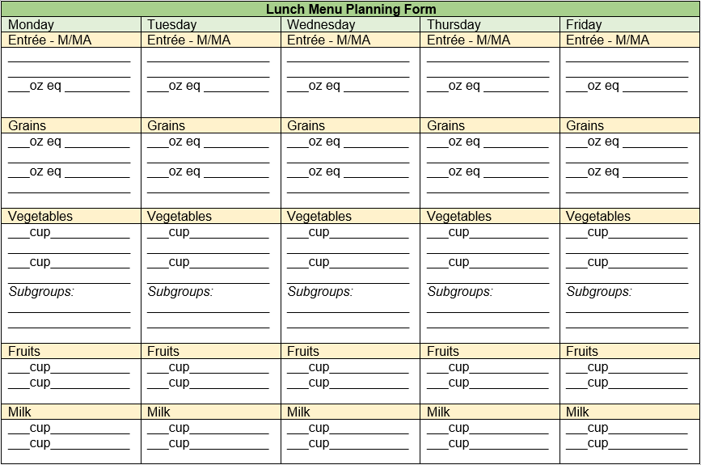
ACTIVITY: Milk Component – Menu Planning Form

Slide 26
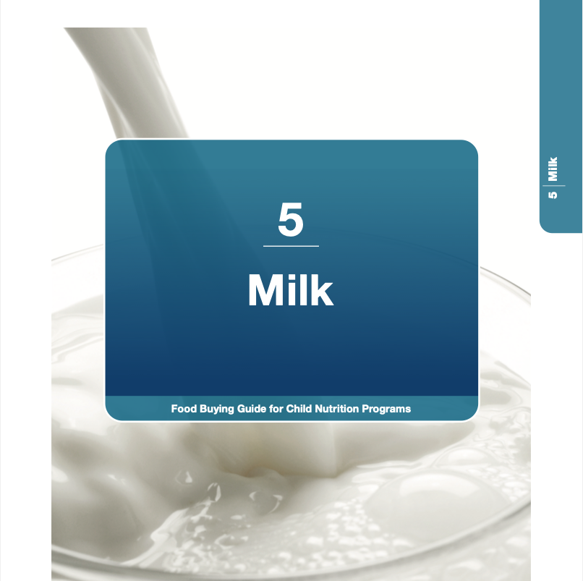
Milk Component Section of Food Buying Guide
Notes:
Suggested image is the FBG Milk page with the description of servings per gallon “popped” out to be easier to read. Showing the math would also be helpful. 16 * 3 = 48
https://foodbuyingguide.fns.usda.gov/Content/TablesFBG/USDA_FBG_Section5_Milk.pdf

Slide 27
Creditable Types of Milk
The Food Buying Guide lists other types of pasteurized milk, such as:
  Lactose-free
  Buttermilk
  Ultra-High Temperature (UHT) milk, both unflavored and flavored, fat-free and 1%

Slide 28
Nondairy Milk Substitutes MUST Be Nutritionally Equivalent
Nondairy beverages may be served in place of fluid milk
Must meet these specific nutrition requirements

Slide 29
Nondairy Milk Substitute Nutrition Standards
Nutrient | Requirement per Cup (8 fl oz)
Protein | 8 gm
Calcium | 276 mg
Vitamin A | 150 mcg
Vitamin D | 2.5 mcg
Magnesium | 24 mg
Phosphorus | 222 mg
Potassium | 349 mg
Riboflavin | 0.44 mg
Vitamin B12 | 1.1 mcg

Slide 30
Offering Nondairy Milk Substitutes
Offer nutritionally equivalent fortified soy milk with other fluid milk options without requiring a non-disability special dietary request for a milk substitute
  Other plant-based beverages, such as oat, rice, or pea, are usually not nutritionally equivalent for all the nutrients listed

Slide 31
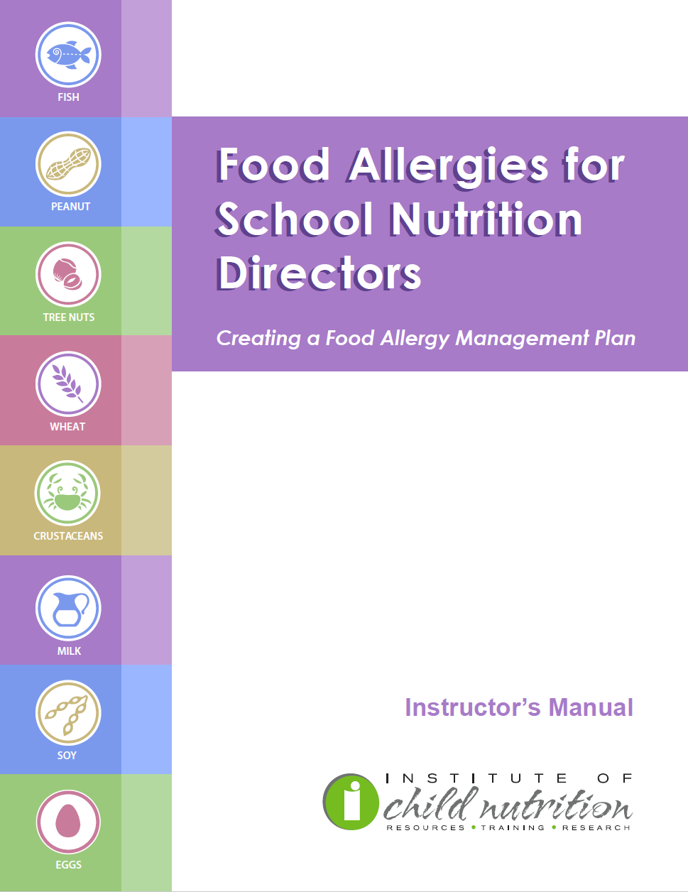
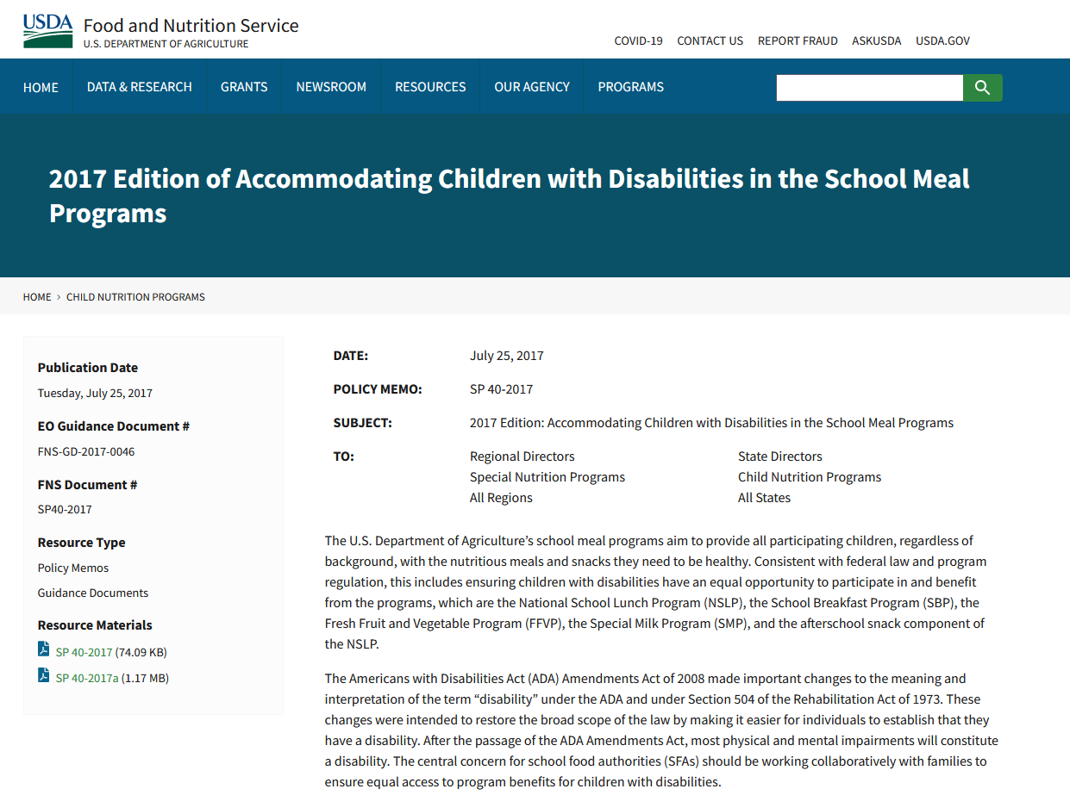
Resources for Accommodating Children with Special Dietary Needs

Slide 32

Milk Component Wrap Up
What did you learn about planning menus that meet the meal pattern requirements for the milk component?

Slide 33

Milk Component Summary
Provide 1 cup (8 fl oz) serving size for all grade groups, at both lunch and breakfast
Include at least two choices at each meal, at least one choice must be unflavored.
Choose from unflavored or flavored fat-free and 1% milk.
Follow the substitution instructions if milk alternates are offered for non-disability reasons.

Slide 34

Lesson 2: Fruits Component for the National School Lunch Program
Notes:
https://www.google.com/url?sa=i&url=https%3A%2F%2Fmagsimba.com%2Fjcss.asp%3Fiid%3D335943602%26cid%3D90&psig=AOvVaw1QBEamkFFNJCPIWwxoA-S_&ust=1654637674981000&source=images&cd=vfe&ved=0CAwQjRxqFwoTCKD3x_DjmfgCFQAAAAAdAAAAABAT

Slide 35
Benefits of Fruits
Fruits are sources of many essential nutrients such as:
  Potassium
  Dietary fiber
  Vitamin C
  Folate

Slide 36
Lesson Overview and Objective
Identify the fruits component choices, serving size requirements, and how to credit fruits toward meeting meal pattern requirements for the NSLP.
Notes:
https://www.shutterstock.com/search/objective+writing?image_type=photo

Slide 37
Favorite Fruits
Activity Time!

Slide 38
Fruits Component Requirements
Grade Group | Daily Minimum | Weekly Minimum
K–5, 6–8 | ½ cup | 2 ½ cups
9–12 | 1 cup | 5 cups

Slide 39
Crediting Fruits
Measured in volume
Must be adequate and recognizable to meet the meal pattern requirements
Minimum creditable serving size for fruits is ⅛ cup

Slide 40
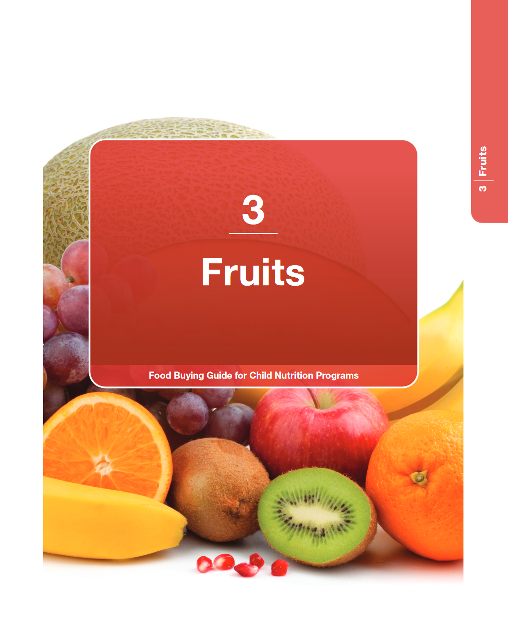
Types of Fruits
Fresh
Frozen
Canned
Dried
100% Juice
There are over 360 entries for fruits in the FBG.

Slide 41

Fresh Fruit
Comes in a variety of colors, shapes and sizes
Understand what a creditable serving size is and be able to communicate that to those who prepare and serve meals
Fresh fruit when possible is the best choice for students
Notes:
https://www.thekitchn.com/5-tips-for-picking-perfect-melons-tips-from-the-kitchn-63939
https://sugargeekshow.com/recipe/berry-wash/
https://www.spendwithpennies.com/fresh-summer-fruit-salad/

Slide 42

Canned Fruit
Select fruit canned in 100% fruit juice, water, or light syrup
Canned fruit may include the juice or liquid syrup in which the fruit is packed
Notes:
https://www.tasteofhome.com/article/canned-fruit/

Slide 43
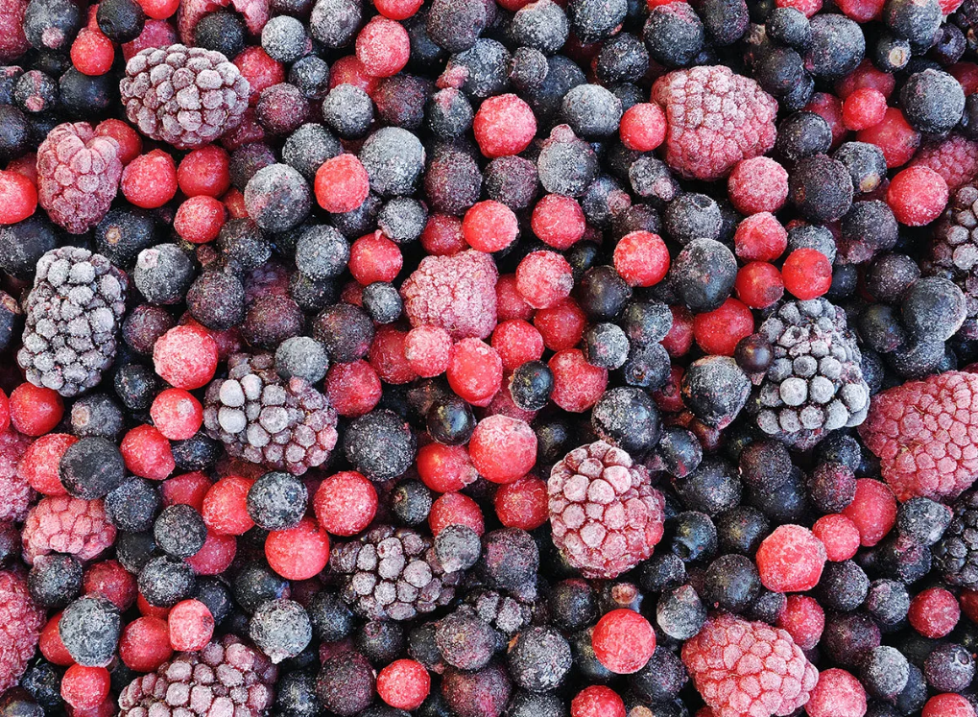
Frozen Fruit
A serving of thawed frozen fruit consists of fruit plus the juice or liquid that accumulated during thawing
Offer all year that may not grow in your region or are only available fresh when in season
Notes:
https://www.eatthis.com/cooking-frozen-foods-mistakes/

Slide 44
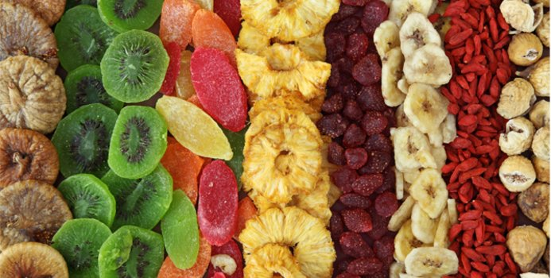
Dried Fruit
Whole dried fruit and whole dried fruit pieces credit at twice the volume served
For example:
  ⅛ cup of dried cranberries = ¼ cup fruit
Choose options with no added sugar
Notes:
https://www.fitday.com/fitness-articles/nutrition/healthy-eating/myth-or-fact-fresh-fruit-is-better-than-dried-fruit.html

Slide 45

Juice
To be creditable, juices must be pasteurized, 100% fruit juice
Fruit juice is limited to half or less of the fruits planned for the week
Juice cannot be credited when used as an ingredient in another food or beverage product with the exception of smoothies

Slide 46



Non-Creditable Fruit Products
Products that do not count as fruit:
  Snack-type foods made from fruits, such as fried banana chips
  Pickle relish, jam, or jelly
Notes:
https://commons.wikimedia.org/wiki/File:No-Symbol.png
https://www.cdc.gov/botulism/consumer.html
https://nuts.com/driedfruit/banana-chips/plantain.html
https://www.mashed.com/720337/strawberry-jelly-brands-ranked-worst-to-best/

Slide 47

Increasing Fruit Consumption
How can we incorporate more fruits into menu planning and increase student consumption?
Notes:
https://worqiq.com/2018/09/open-to-think-pure-thinking-power/

Slide 48
Activity: Fruits Component – Menu Planning Form

Slide 49
Fruits Component Wrap Up
What did you learn about planning menus that meet the meal pattern requirements for the fruit component?

Slide 50
Fruits Component Summary
At lunch, provide at least ½ cup daily for grades K-5 and 6-8, and 1 cup daily for grades 9-12.
The smallest creditable amount for the fruits component is 1/8 cup.
Credit dried fruits at twice the volume (1/8 cup credits as ¼ cup).
Limit 100% fruit juice to half or less of fruits component weekly, including fruits credited in smoothies.

Slide 51

Lesson 3: Vegetables Component for the National School Lunch Program
Notes:
https://www.google.com/url?sa=i&url=https%3A%2F%2Fmagsimba.com%2Fjcss.asp%3Fiid%3D335943602%26cid%3D90&psig=AOvVaw1QBEamkFFNJCPIWwxoA-S_&ust=1654637674981000&source=images&cd=vfe&ved=0CAwQjRxqFwoTCKD3x_DjmfgCFQAAAAAdAAAAABAT

Slide 52
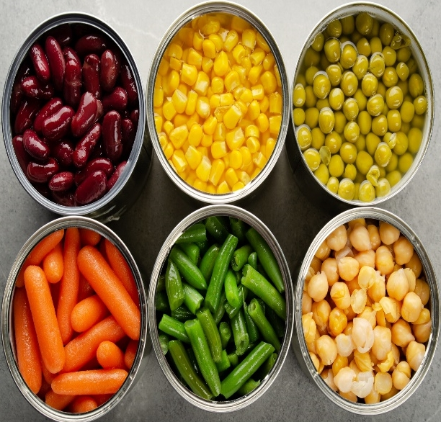
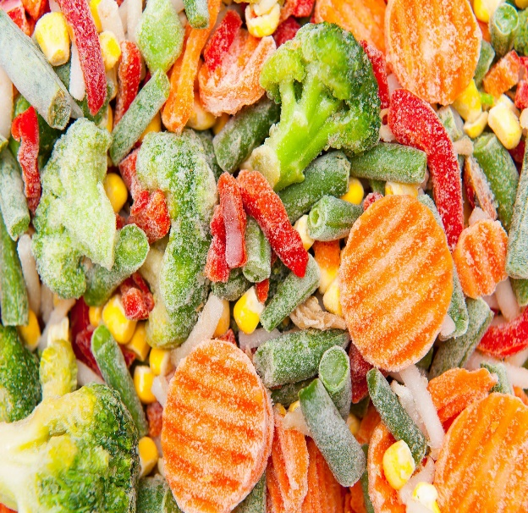


Benefits of Vegetables
Vegetables are important sources of many nutrients including potassium, dietary fiber, folate, vitamin A and vitamin C.
Notes:
https://www.gardeningknowhow.com/edible/vegetables/vgen/signs-of-fresh-veggies.htm
https://www.growveg.com/guides/cooking-with-dehydrated-vegetables/
https://www.southernliving.com/food/side-dishes/vegetables/best-frozen-vegetables
https://www.google.com/url?sa=i&url=https%3A%2F%2Fplantbasedjuniors.com%2Fhealthy-canned-plant-based-foods%2F&psig=AOvVaw2our6gSDimIf9I2cHWhj79&ust=1654697905092000&source=images&cd=vfe&ved=0CAwQjRxqFwoTCNDC8pjEm_gCFQAAAAAdAAAAABAE

Slide 53
Lesson Overview and Objective
Identify the vegetables component choices, serving size requirements, and how to credit vegetables toward meeting meal pattern requirements for the NSLP.

Slide 54
Favorite Vegetables
Activity Time!

Slide 55

Vegetables Component
Must be fresh, frozen, canned, dried (including dried legumes), or 100% full-strength vegetable juice
The FBG has over 630 entries for vegetables

Slide 56
Vegetables Component Serving Size
Minimum creditable amount is 1/8 cup
Grade Group | Daily Minimum | Weekly Minimum
K–5, 6–8 | ¾ cup | 3 ¾ cups
9–12 | 1 cup | 5 cups

Slide 57
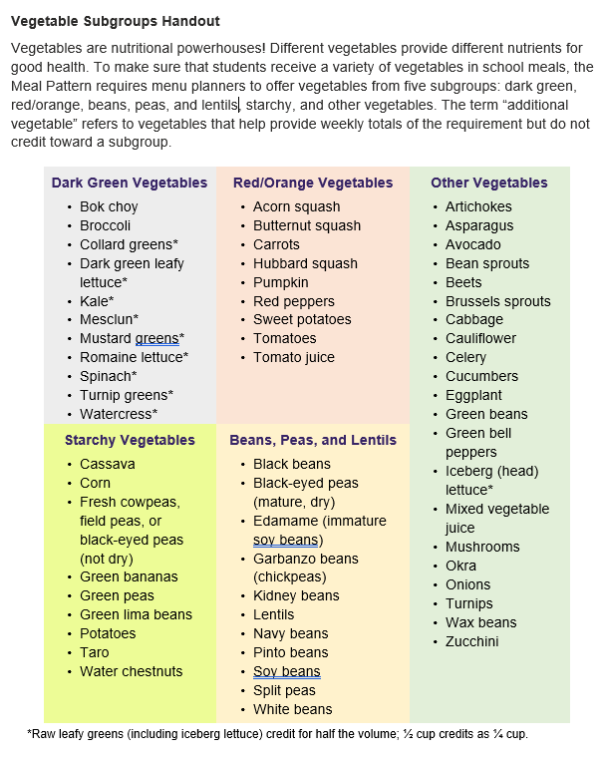
Vegetable Subgroups
Dark green
Red/orange
Beans and peas (legumes)
Starchy
Other vegetables

Slide 58
Weekly Vegetable Subgroup Requirements
Vegetable Subgroup | Weekly Minimum K–5, 6–8 | Weekly Minimum 9–12
Dark Green* | ½ cup | ½ cup
Red/Orange | ¾ cup | 1¼ cup
Beans, Peas, and Lentils | ½ cup | ½ cup
Starchy | ½ cup | ½ cup
Other** | ½ cup | ¾ cup
Subgroup Totals | 2 ¾ cups | 3 ½ cups
Additional Vegetables | 1 cup | 1 ½ cups
Total Weekly Requirement | 3 ¾ cups | 5 cups
*Raw leafy greens (including iceberg lettuce) credit for half the volume; ¼ cup credits as ⅛ cup.
**Other vegetable subgroup requirement may be met with any additional amounts from the dark green, red/orange, and beans and peas vegetable subgroups.

Slide 59
Crediting Vegetables
The Food Buying Guide is an essential resource for crediting fresh, frozen, canned, dried vegetables, and 100% vegetable juice
Helpful feature is the identification of vegetables by subgroup

Slide 60
Crediting Vegetables (cont’d)
Raw leafy greens credit at half the volume served
  For example, 1 cup of chopped romaine lettuce credits as ½ cup toward the dark green vegetable subgroup
Cooked leafy greens, such as collard greens, are credited by volume as served
  For example, ½ cup of cooked collard greens credits as ½ cup of dark green vegetables

Slide 61
Sample Menu for Vegetables
Daily & Weekly Required Serving Amounts
Monday | Tuesday | Wednesday | Thursday | Friday
½ cup Broccoli | ½ cup Carrots | ¾ cup Tossed Salad (½ c iceberg lettuce, ¼ c red pepper and tomato) | ½ cup Cauliflower | ½ cup Celery and Jicama Sicks
½ cup Acorn Squash | ½ cup Fries | ½ cup Refried Beans | ½ cup Green Beans | ½ cup Carrots

Slide 62
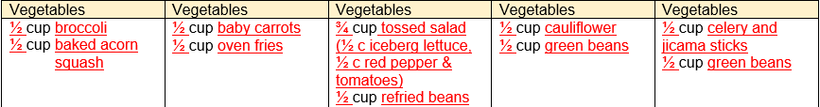
Activity: Vegetables Component – Menu Planning Form

Slide 63
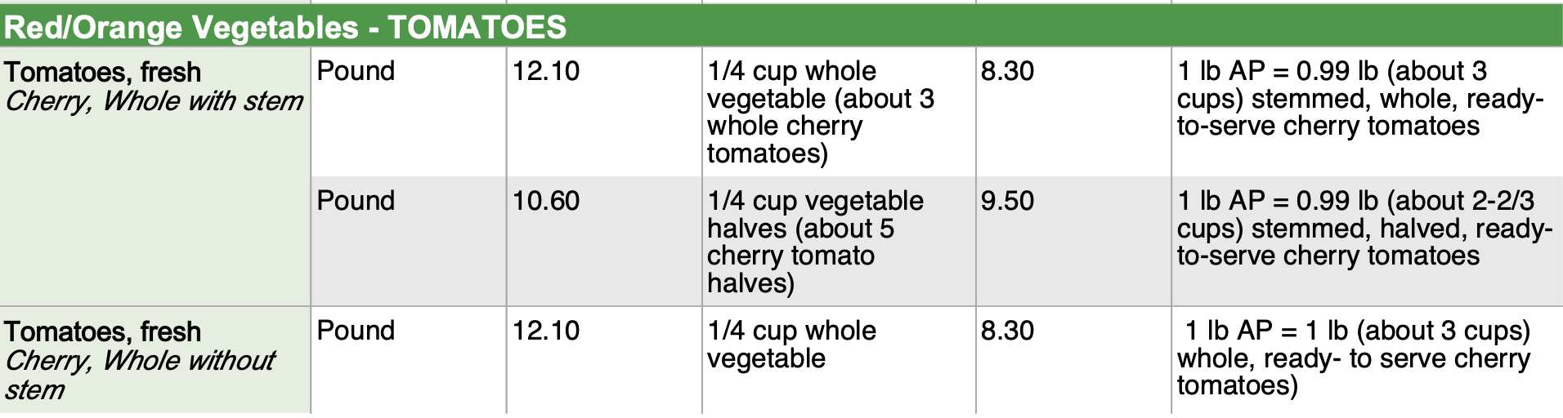
Food Buying Guide for Vegetables
Notes:
Suggested Image From Vegetables downloadable PDF - Bottom of page 2-39 showing Red/Orange Vegetables – TOMATOES with the first item, Tomatoes, Fresh Cherry, Whole with Stem and show math 3 whole = ¼ cup 3 halves = ⅛ cup
https://foodbuyingguide.fns.usda.gov/files/Reports/USDA_FBG_Section2_Vegetables_YieldTable.pdf

Slide 64
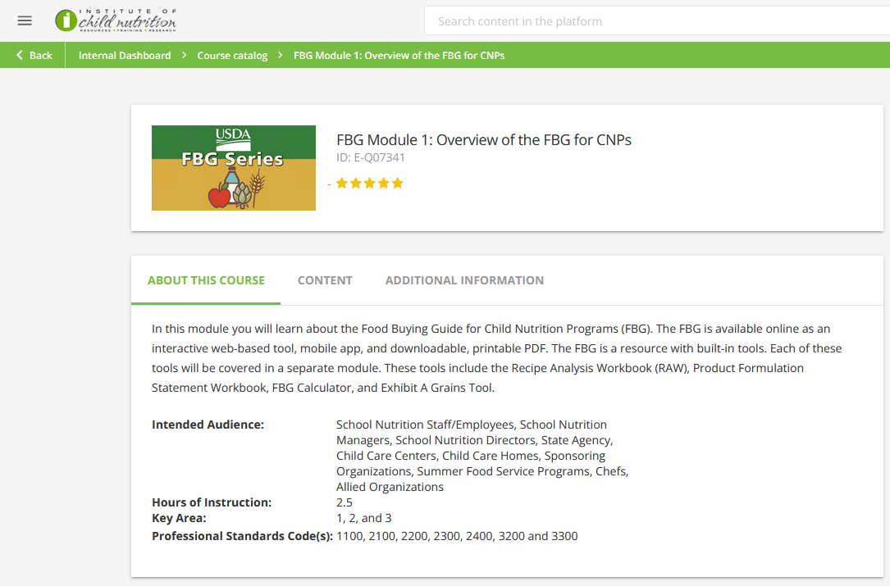
ICN’s iLearn Food Buying Guide Series

Slide 65
Crediting Specific to Vegetables
Beans, peas, and lentils refers to dry, mature beans, lentils, and split peas (canned, dried, or frozen)
  Credit toward the vegetables component OR meats/meat alternates component
  Only credit toward one food component in a menu item, not both

Slide 66
Crediting Specific to Vegetables (cont’d)
Vegetable juice must be pasteurized, 100% vegetable juice
  Blends containing vegetables from the same subgroup may contribute toward that vegetable subgroup
  Blends containing vegetables from more than one subgroup may credit as additional vegetables

Slide 67
Activity:Menu Sample for Vegetables Daily, Weekly, and Subgroup Weekly Required Serving Amounts
Monday | Tuesday | Wednesday | Thursday | Friday
½ cup Broccoli | ½ cup Carrots | ¾ cup Tossed Salad (½ c iceberg lettuce, ¼ c red pepper and tomato) | ½ cup Cauliflower | ½ cup Celery and Jicama Sicks
½ cup Acorn Squash | ½ cup Fries | ½ cup Refried Beans | ½ cup Green Beans | ½ cup Carrots
Subgroups:
½ c dark green, ½ c red/orange | ½ c red/orange, ½ c starchy | ¼ c other, ½ c red/orange, ½ c legumes | 1 c other | ½ c other, ¼ c starchy, ½ c red/orange

Slide 68
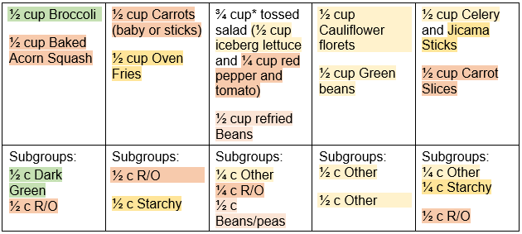
Activity: Vegetable Subgroups on Menu
*Raw leafy greens (including iceberg lettuce) credit for half the volume; ½ cup credits as ¼ cup.

Slide 69
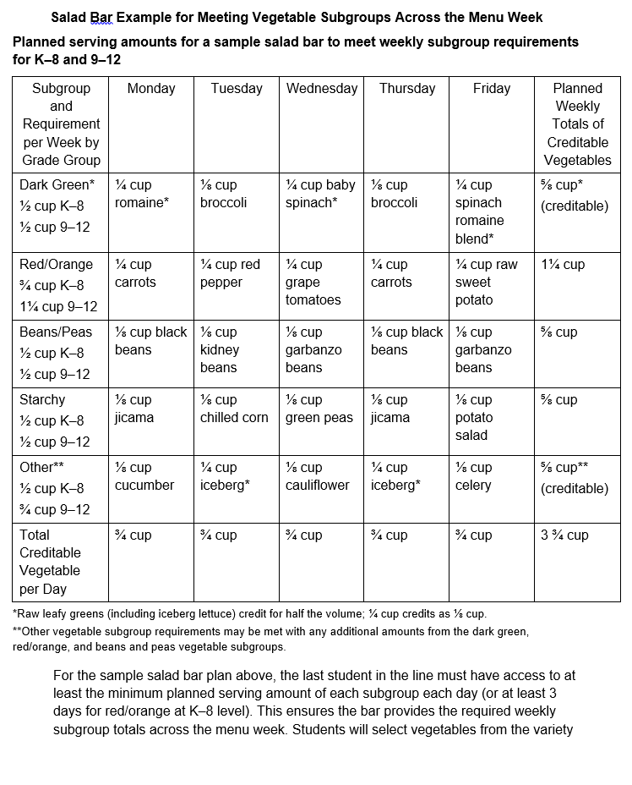
Salad Bar Example
Offering a salad bar that meets the daily and weekly minimum serving amounts

Slide 70
Vegetables Component Wrap Up
What did you learn about planning menus that meet the meal pattern requirements for the vegetables component?

Slide 71
Vegetables Component Summary
At lunch, provide ¾ cup daily for grades K–5, 6–8, and 1 cup daily for grades 9–12.
Meet the weekly subgroup requirements.
Credit raw leafy greens at half the volume.
Credit beans, peas, and lentils as vegetable subgroup or as meats/meat alternates, but not both for the same menu item.
Limit 100% vegetable juice to half or less of vegetables component weekly, including vegetables credited in smoothies.
The smallest creditable amount for the vegetables component is 1/8 cup.

Slide 72

Lesson 4: Grains Component for the National School Lunch Program
Notes:
https://www.google.com/url?sa=i&url=https%3A%2F%2Fmagsimba.com%2Fjcss.asp%3Fiid%3D335943602%26cid%3D90&psig=AOvVaw1QBEamkFFNJCPIWwxoA-S_&ust=1654637674981000&source=images&cd=vfe&ved=0CAwQjRxqFwoTCKD3x_DjmfgCFQAAAAAdAAAAABAT

Slide 73
Benefits of Grains
Contribute energy, dietary fiber, iron, B vitamins, and other nutrients
Whole grains are a source of nutrients, such as dietary fiber, iron, zinc, manganese, folate, magnesium, copper, thiamin, niacin, vitamin B6, phosphorus, selenium, riboflavin and vitamin A
Notes:
https://www.gardeningknowhow.com/edible/vegetables/vgen/signs-of-fresh-veggies.htm
https://www.growveg.com/guides/cooking-with-dehydrated-vegetables/
https://www.southernliving.com/food/side-dishes/vegetables/best-frozen-vegetables
https://www.google.com/url?sa=i&url=https%3A%2F%2Fplantbasedjuniors.com%2Fhealthy-canned-plant-based-foods%2F&psig=AOvVaw2our6gSDimIf9I2cHWhj79&ust=1654697905092000&source=images&cd=vfe&ved=0CAwQjRxqFwoTCNDC8pjEm_gCFQAAAAAdAAAAABAE

Slide 74
Lesson Overview and Objective
Identify the grains component choices, serving size requirements, and how to credit grains toward meeting meal pattern requirements for the NSLP.

Slide 75

Grains Component Requirements

Slide 76
Grains: Types of Ingredients
Whole grains
Enriched grains
Bran or germ

Slide 77
Grains: Food Examples
Breads, biscuits, bagels, rolls, tortillas, crackers, and cereal grains (cooked)
Ready-to-eat (RTE) breakfast cereals
Cereals or bread products
Macaroni, pasta, noodle products (cooked)
Grain-based desserts
Non-sweet snack food products

Slide 78
Grains: Daily and Weekly Required Minimums
Grade Group | Daily Minimum | Weekly Minimum
K–5 | 1 oz eq | 8–9 oz eq
6–8 | 1 oz eq | 8–10 oz eq
9–12 | 2 oz eq | 10–12 oz eq

Slide 79
Grain-Based Desserts
Can be included at lunch
May contribute up to 2 oz eq towards the grains requirement each week
Exhibit A denotes specific grain products that credit as grain-based desserts
May be whole grain-rich or made with enriched grains
Count toward the weekly dietary specifications

Slide 80
Crediting Criteria for Grains Component
Whole-grain flour
Whole-grain meal
Corn masa, masa harina, hominy
Enriched flour
Enriched meal, bran, germ,
Enriched product, such as enriched bread, or a fortified cereal

Slide 81
Crediting Criteria for Grains Component (cont'd)
Oz eq are used to determine the amount of creditable grains
¼ ounce equivalent (0.25 oz eq) is the smallest amount allowable to be credited toward the grains requirement

Slide 82
Crediting Criteria for Grains Component (cont'd)
At least 80% of the weekly grains offered must meet the whole grain-rich criteria
  100% whole grain
  Contain a blend of whole-grain ingredients and enriched grain ingredients of which at least 50% is whole grain

Slide 83
Crediting Criteria for Grains Component (cont'd)
Up to 20% of the grain items offered weekly can be made from grains that are enriched meal and/or flour
  Bran and germ can be used to meet the enriched grains requirements

Slide 84
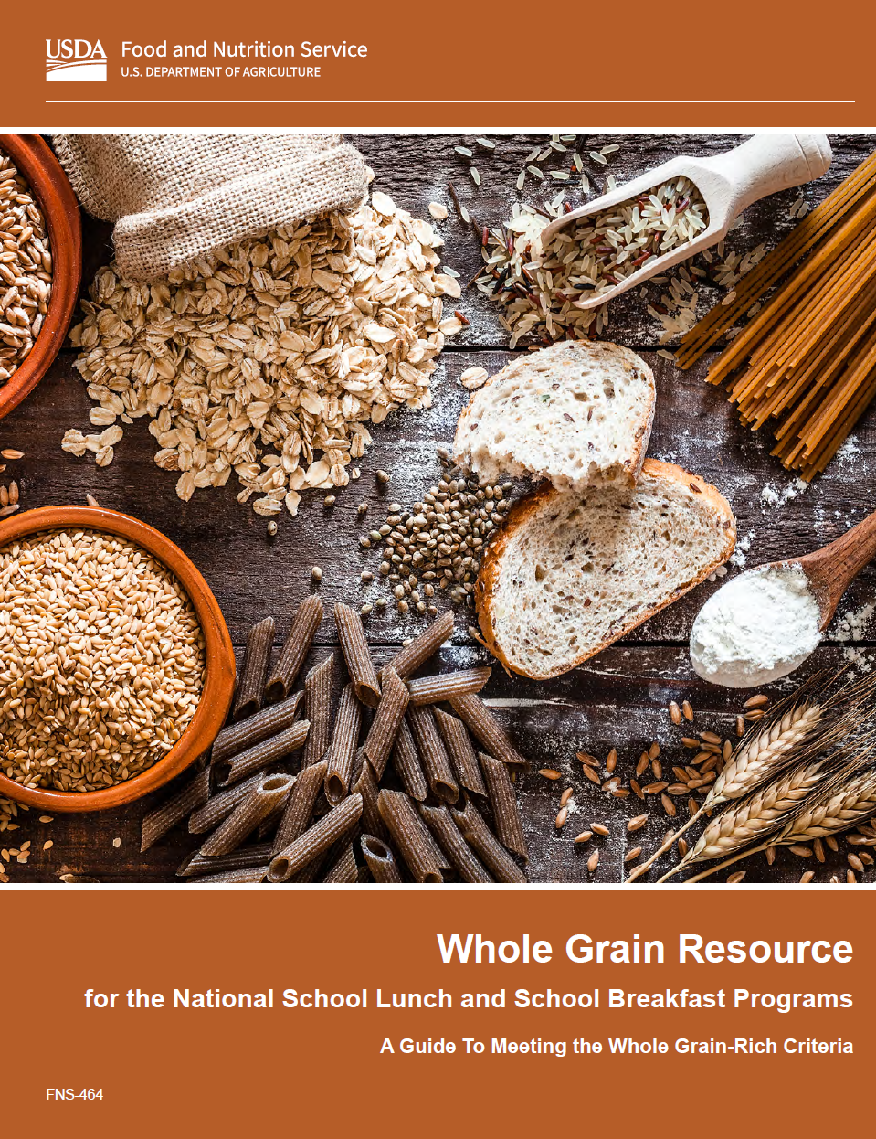
Crediting Grains Example
For the 9–12 grade group meal pattern, a minimum of 10 oz eq of grains per week are required.
If the minimum servings are offered on the menu, 8 of the 10 servings must be whole grain-rich. The other 2 servings must be enriched.

Slide 85
Food Buying Guide for Child Nutrition Programs Exhibit A
Breads, cereals, muffins, crackers, pasta, etc. all contribute differently to the grains requirement based on the weight of each product.
The Food Buying Guide for Child Nutrition Programs’ Exhibit A (Attachment A) provides a general guideline for crediting prepared grain items.

Slide 86
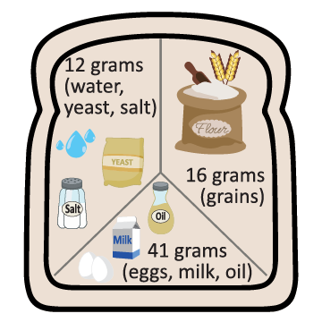
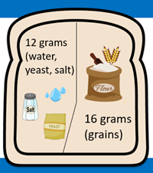
Exhibit A
Group B and Group E Examples

Slide 87
Exhibit A
Group H and Group I Examples
Volume measure is included for items usually served by volume
  Provides information on dry product yields for ounce equivalents for grains
For grain items in Group H of Exhibit A, the volumes or weights listed in the chart can be used to meet grains requirements.
Notes:
Suggested image Exhibit A with information about Bread in Group B and French Toast in Group E for the 1 ounce equivalent serving amount highlighted

Slide 88
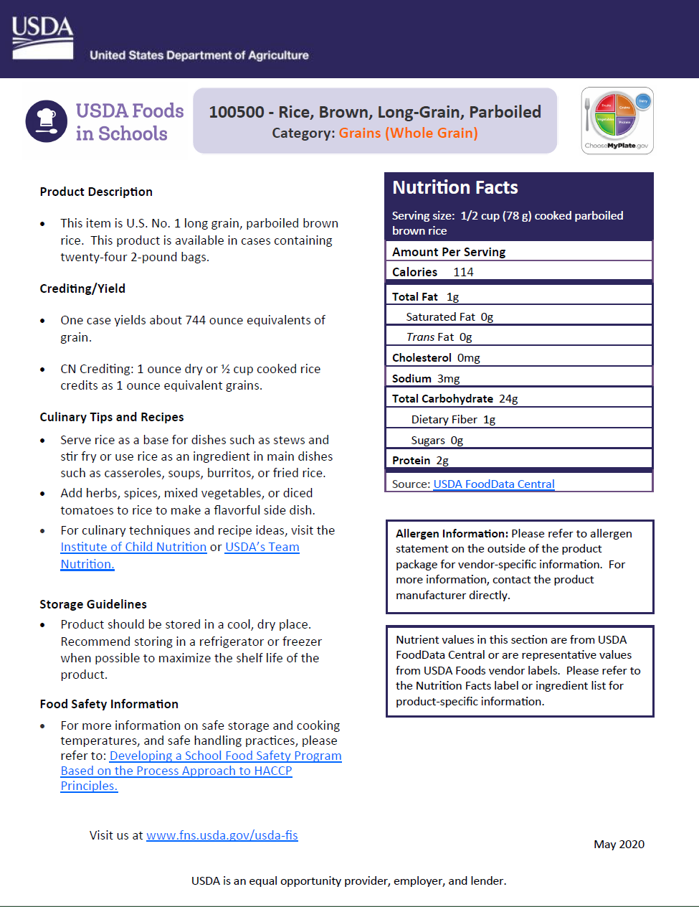
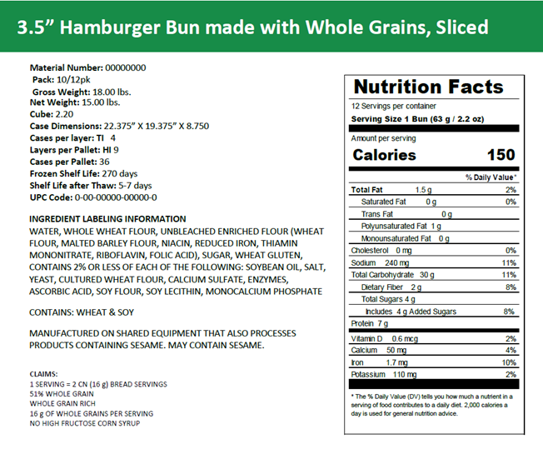
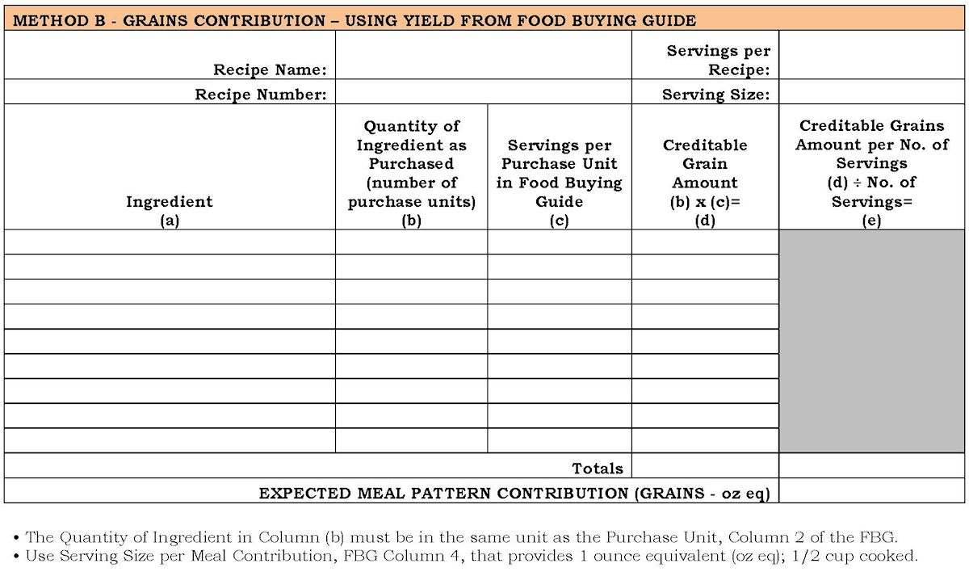
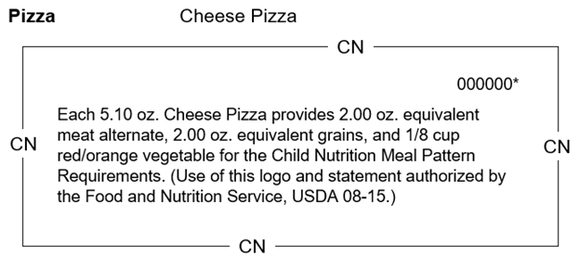
Other Crediting Information for Grains

Slide 89
Whole Grain-Rich Criteria
80% of the amount of grains served per week must be whole grain-rich
Contain 100% whole grain or at least 50% whole grain meal and/or flour
Any remaining meal/flour must be enriched, bran, or germ
Notes:
Suggested image Exhibit A with information about Bread in Group B and French Toast in Group E for the 1 ounce equivalent serving amount highlighted

Slide 90
Whole Grain-Rich Criteria (cont'd)
Groups A-G, the whole- grain content per oz eq must be at least 8.0 grams or more
Groups H and I, the whole-grain content must be at least half of the volume or weight listed in the chart
Child Nutrition (CN) label to indicate the oz eq of grains in a food product.
Notes:
Suggested image Exhibit A with information about Bread in Group B and French Toast in Group E for the 1 ounce equivalent serving amount highlighted

Slide 91
Whole Grain-Rich Criteria (cont'd)
  “Diets rich in whole grain foods and other plant foods, and low in total fat, saturated fat, and cholesterol, may reduce the risk of heart disease and certain cancers.”
  OR
  “Diets rich in whole grain foods and other plant foods, and low in saturated fat and cholesterol, may help reduce the risk of heart disease.”
Notes:
Suggested image Exhibit A with information about Bread in Group B and French Toast in Group E for the 1 ounce equivalent serving amount highlighted

Slide 92
Whole Grain-Rich Criteria (cont'd)
Whole grains are the primary grain ingredient by weight. Specifically:
  Non-mixed dishes (e.g., breads, cereals
  Mixed dishes (e.g., pizza, corn dogs)
Notes:
Suggested image Exhibit A with information about Bread in Group B and French Toast in Group E for the 1 ounce equivalent serving amount highlighted

Slide 93
Whole Grain-Rich Criteria (cont'd)
State agency’s Special Supplemental Nutrition Program for Women, Infants, and Children (WIC)-approved whole-grain food list
Notes:
Suggested image Exhibit A with information about Bread in Group B and French Toast in Group E for the 1 ounce equivalent serving amount highlighted

Slide 94

Activity: Grains Component – Menu Planning Form

Slide 95
Grains Menu Choices
Monday | Tuesday | Wednesday | Thursday | Friday
Pasta | Bun | Tortilla | Rice | Pizza Crust

Slide 96

Whole Grain-Rich Criteria – Special Circumstances
If you plan menus with additional grains, you must ensure the 80% criteria is maintained.
Notes:
https://cliparts.zone/plan-cliparts

Slide 97
Grains Component Wrap Up
What did you learn about planning menus that meet the meal pattern requirements for the grains component?

Slide 98
Grains Component Summary
Meet daily minimums for each grade group.
Determine that at least 80% of credited grains are whole grain-rich.
Meet weekly minimums for each grade group.
Limit grain-based desserts to 2 oz eq or less weekly for all grade groups (lunch).
The smallest creditable amount for the grains component is ¼ oz eq.

Slide 99

Lesson 5: Meats/Meat Alternates Component for the National School Lunch Program
Notes:
https://www.google.com/url?sa=i&url=https%3A%2F%2Fmagsimba.com%2Fjcss.asp%3Fiid%3D335943602%26cid%3D90&psig=AOvVaw1QBEamkFFNJCPIWwxoA-S_&ust=1654637674981000&source=images&cd=vfe&ved=0CAwQjRxqFwoTCKD3x_DjmfgCFQAAAAAdAAAAABAT

Slide 100
Benefits of Meats/Meat Alternates
Include animal and plant-based foods, which are good protein sources
Provide iron, zinc, magnesium, and B-vitamins.

Slide 101
Lesson Overview and Objective
Identify the meats/meat alternates component choices, serving size requirements, and how to credit meats/meat alternates toward meeting meal pattern requirements for the NSLP.

Slide 102
Meats/Meat Alternates Component
Measured in oz eq.
  Amount of the food that represents 1 ounce of edible portion of lean meat without the bone
Includes:
  Fresh and frozen meats
  Processed meats
  Canned meats
  Meat alternates

Slide 103
Meats/Meat Alternates Component Serving
Amount of Food per Week (minimum per day)
Grades K–5 | Grades 6–8 | Grades 9–12
8–10 (1) | 9–10 (1) | 10–12 (2)
Note: SFAs may exceed the weekly maximum for M/MA, provided that meals (on average) meet the weekly dietary specifications for calories, saturated fat, sodium, and added sugars.

Slide 104

Crediting Meats/Meat Alternates
Use manufacturer’s documentation of the product (i.e. CN label, signed product formulation statement, or USDA Foods Fact Sheet)
Use the Food Buying Guide
Note: The minimum creditable amount for meats/meat alternates is 0.25 oz eq.
Notes:
https://www.doublecheckcoaching.org

Slide 105
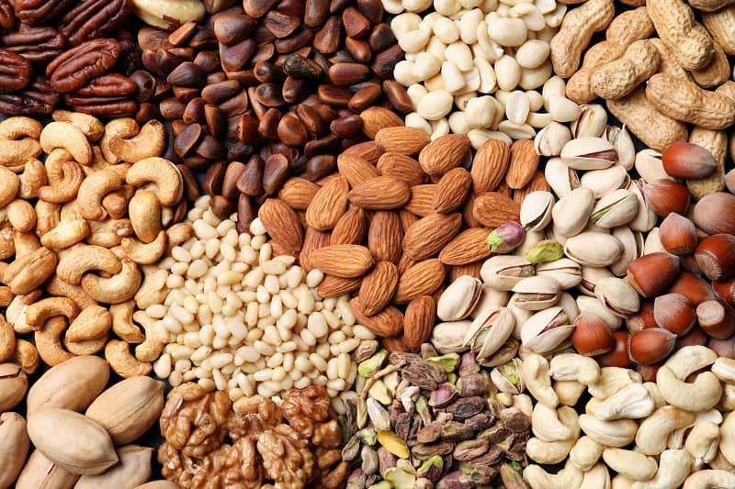
Crediting Nuts and Seeds
Operators can offer nuts and seeds to meet the full meats/meat alternates component
Or use them for only part of the component, paired with another meat/meat alternate

Slide 106
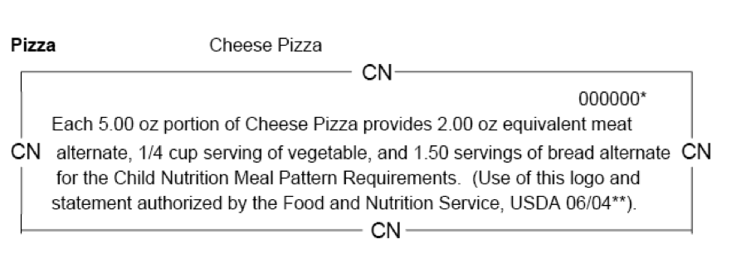

Child Nutrition (CN) Label
Notes:
https://www.thefoodtrainer.com/child-nutrition/

Slide 107
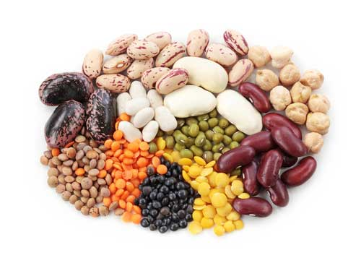
Beans, Peas, and Lentils
Credit towards the beans, peas, and lentils subgroup of the vegetables component OR M/MA component
Not both
Notes:
https://cathe.com/wonderful-healthy-world-beans-legumes/

Slide 108
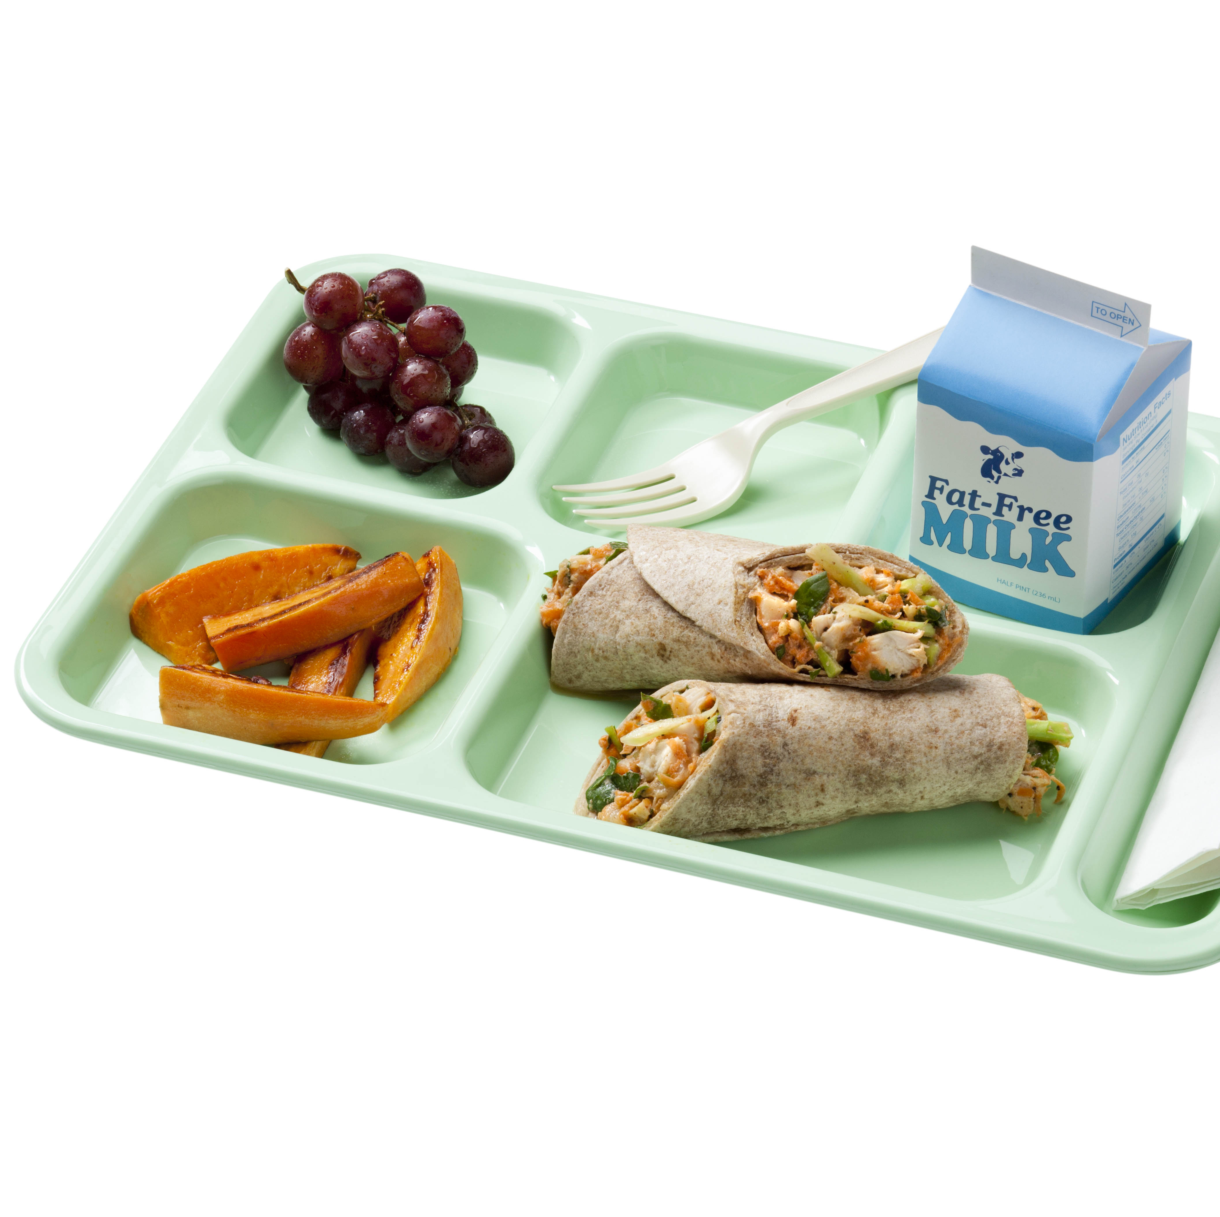
Combination Foods
Single serving that contains more than one food item from different food components that cannot be separated
  Pizza, soup, casseroles, burritos, sandwiches
Often featured as the entrée

Slide 109
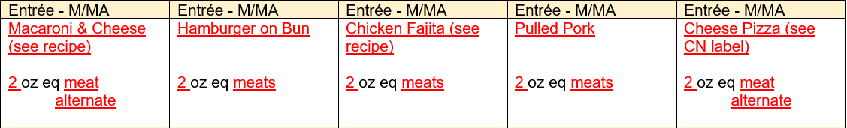
Activity: Meats/Meat Alternates Component –
Menu Planning Form

Slide 110
Meats/Meat Alternates Component Wrap Up
What did you learn about planning menus that meet the meal pattern requirements for the meats/meat alternates component?

Slide 111
Meats/Meat Alternates Component Summary
Meet daily and weekly minimums for each grade group.
Creditable servings are measured by weight using ounce equivalents.
Combination foods may be credited for up to three (3) different meal components (meats/meat alternates, grains, vegetables, or fruits).
The smallest creditable amount is 0.25 oz eq.

Slide 112
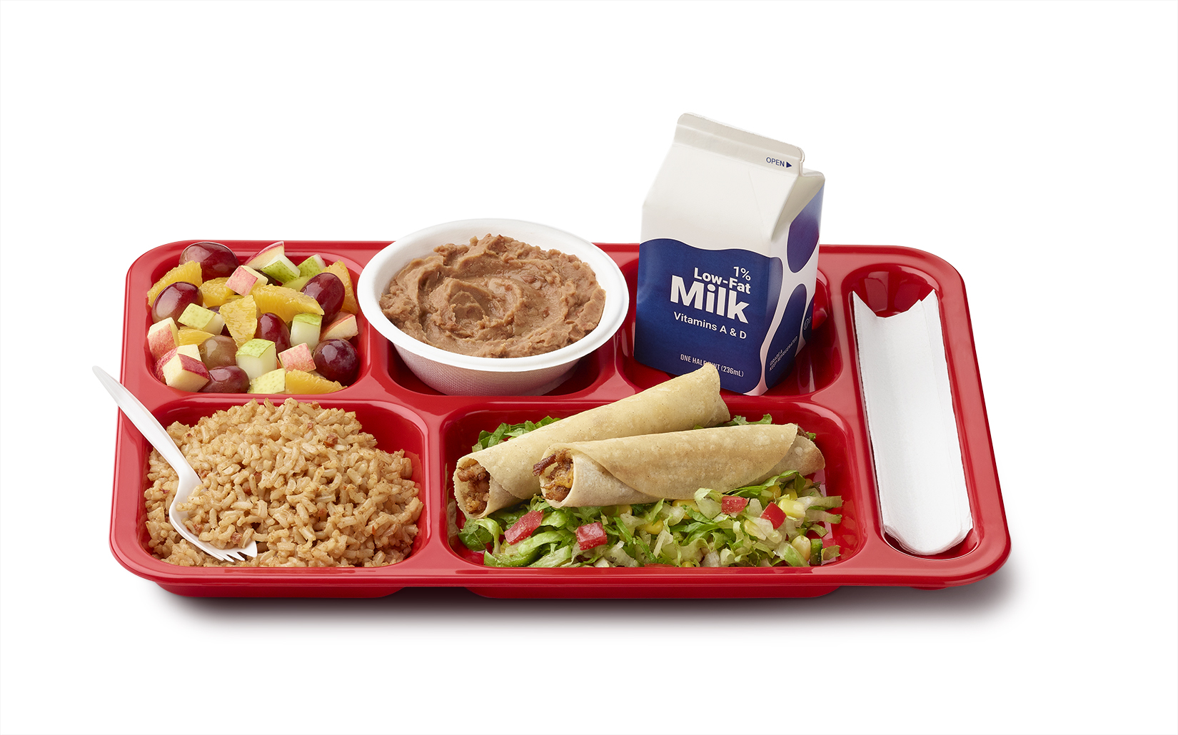
Lesson 6: Modifying Menu Offerings for Grade Groups to Meet Meal Pattern Requirements for the National School Lunch Program

Slide 113
Why Grade Groups?
All school lunches provide important nutrients that support learning, growth and overall health.
School lunches also have to meet average weekly amounts for calories (energy), saturated fat, and sodium (salt).
Different age groups have different nutrient needs. The meal patterns follow DGAs.

Slide 114
Lesson Overview and Objective
Modify menu offerings for grade groups K–5 and 6–8 to meet meal pattern requirements for the National School Lunch Program.

Slide 115

Grade Groups
Grades K–5
Grades 6–8
Grades 9–12

Slide 116
Activity: Milk Component
Grade Group | Daily Minimum | Weekly Minimum
K–5, 6–8, 9–12 | 1 cup (8 fl oz) | 5 cups

Slide 117
Activity: Fruits Component
Grade Group | Daily Minimum | Weekly Minimum
K–5, 6–8 | ½ cup | 2 ½ cups
9–12 | 1 cup | 5 cups

Slide 118
Activity: Vegetables Component
Grade Group | Daily Minimum | Weekly Minimum
K–5, 6–8 | ¾ cup | 3 ¾ cups
9–12 | 1 cup | 5 cups
Note the specific subgroup requirements

Slide 119
Activity: Grains Component
Grade Group | Daily Minimum | Weekly Minimum
K–5 | 1 oz eq | 8–9 oz eq
6–8 | 1 oz eq | 8–10 oz eq
9–12 | 2 oz eq | 10–12 oz eq

Slide 120
Activity: Meats/Meat Alternates Component
Grade Group | Daily Minimum | Weekly Minimum
K–5 | 1 oz eq | 8–10 oz eq
6–8 | 1 oz eq | 9–10 oz eq
9–12 | 2 oz eq | 10–12 oz eq

Slide 121
Over Versus Serve (OVS) in NSLP
Required for lunches served in high schools, but is optional in middle and elementary schools
The required five food components must be offered for school lunch.
  Must select at least three of the five required food components, including at least ½ cup of fruit and/or vegetable

Slide 122
OVS in NSLP (cont’d)
Use this simple checklist to determine if student lunches are reimbursable under OVS:
  Does the meal offered to students include the minimum required amounts of vegetables, fruits, grains, meats/meat alternates, and fluid milk?
  Does the meal selected by the student contain at least three components, including at least ½ cup fruit and/or vegetable?

Slide 123
Other Grade Groups Wrap Up
What questions do you have about applying the meal pattern requirements for the multiple grade groups?

Slide 124
Lesson 7: School Breakfast Program
Notes:
https://www.heb.com/recipe/recipe-item/sunny-side-egg-in-toast/1398895542662

Slide 125
SBP Compared to NSLP
SBP
Milk
Combined Grains and Meats/Meat Alternates
NSLP
Milk
Fruit
Fruit
Vegetables
Meats/Meat Alternates
Grains
Notes:
The biggest difference between the lunch and breakfast meal pattern is that the breakfast meal pattern requires only three meal components: Milk, Fruit and Grains

Slide 126
Lesson Overview and Objective
Identify the meal pattern component choices and serving size requirements that meet the School Breakfast Program meal pattern requirements.

Slide 127
School Breakfast Program
Similar process to planning menus for NSLP
Required meal components
Daily required minimum serving amounts to meet weekly averages
The main difference: only requires 3 meal components
  Milk, Fruits, & Combined Grains and Meats/Meat Alternates

Slide 128
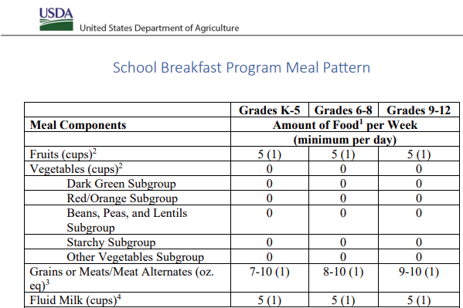
School Breakfast Program Meal Pattern

Slide 129
Planning a Breakfast Menu
Activity Time!

Slide 130
School Breakfast Program Menu Crediting Fruits
Menu shows ONE way to meet the fruit juice weekly limit of no more than 50% of fruit offered,
Vegetables may be substituted for fruits. If substituting vegetables at breakfast on one day per school week, any creditable vegetable, including starchy vegetables, can be offered.
  If substituting vegetables for fruits at breakfast on two or more days per school week, vegetables from at least two different subgroups must be offered.

Slide 131
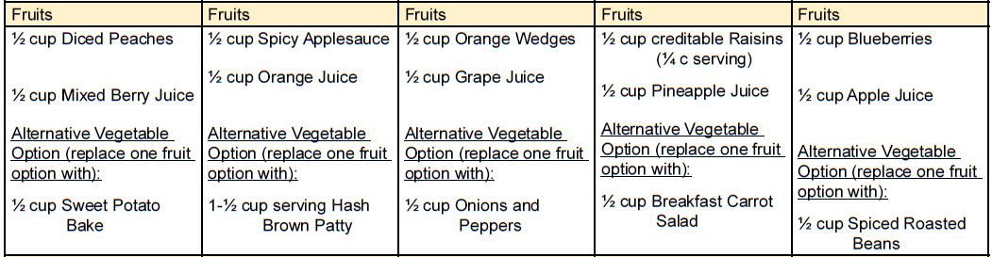
School Breakfast Program Menu Crediting Vegetables for Fruits

Slide 132
School Breakfast Program Menu Offering Vegetables as Extras
Some opt to include vegetables in their breakfast menu as “extras”
  Hashbrown.
Helps line staff recognize the reimbursable meal more easily

Slide 133
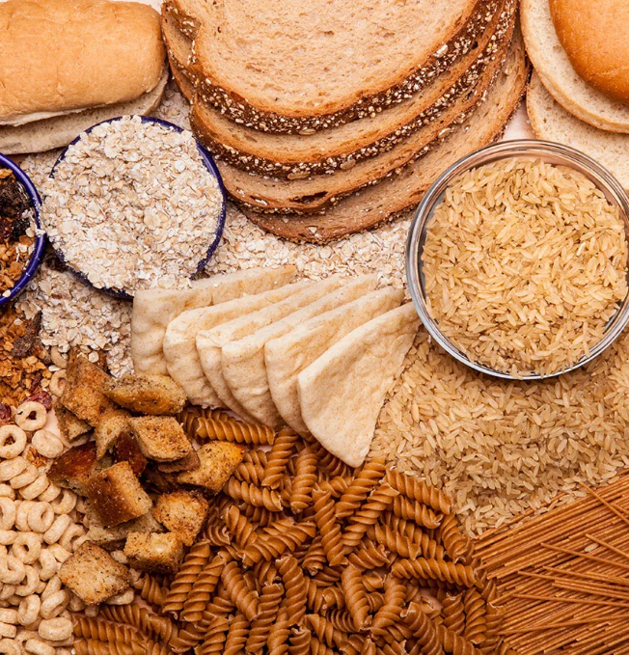
School Breakfast Program Combined Grains and Meats/Meat Alternates Component
Either plan another 1 oz eq of grains
OR
You can substitute 1 oz eq of meats/meat alternates for 1 oz eq of grains
Notes:
https://www.eatthis.com/effects-going-grain-free/

Slide 134

Grains and Meats/Meat Alternates Component Tip
Tip for meeting the 80% whole grain-rich criteria:
  Only one ounce equivalent of the daily planned menu items is an enriched product
Notes:
https://www.morningagclips.com/increasing-school-breakfast-participation/

Slide 135
School Breakfast Program Offer Versus Serve
Optional at all grade levels for breakfast
Must offer at least 4 food items from the three required meal components
Must select at least 3 of the 4 food items
  Including at least ½ cup of fruit and/or vegetable
Notes:
https://www.morningagclips.com/increasing-school-breakfast-participation/

Slide 136
School Breakfast Program Wrap Up
What did you learn about planning menus that meet the meal pattern requirements for the School Breakfast Program?

Slide 137
School Breakfast Program Summary
The main points to remember when writing menus for SBP:
  The breakfast meal pattern requires only three meal components: milk, fruits, and combined grains and meats/meat alternates.
  Meet daily and weekly minimums for each grade group.

Slide 138
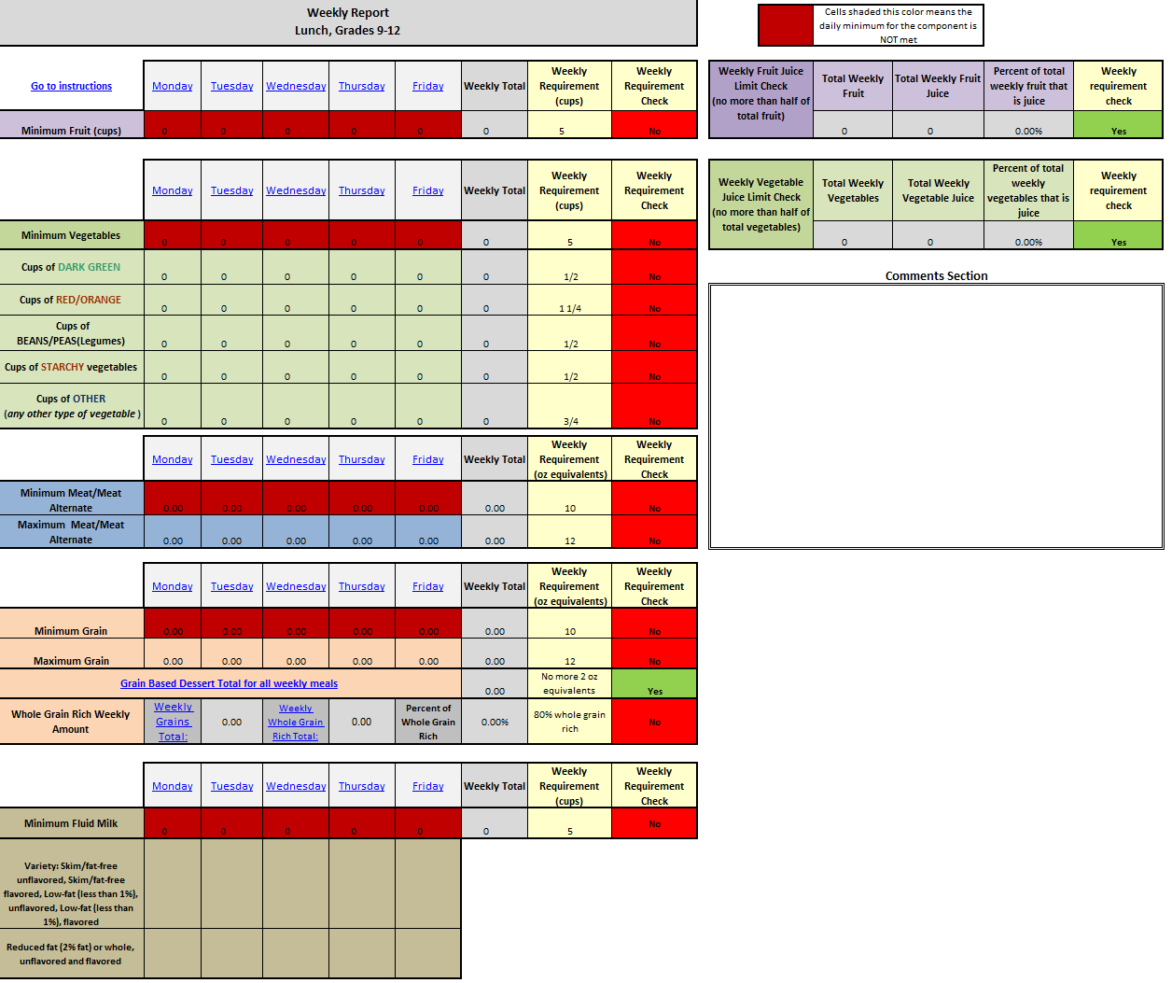
Lesson 8: Nutrient Standards
Notes:
https://www.heb.com/recipe/recipe-item/sunny-side-egg-in-toast/1398895542662

Slide 139
Nutrient Standards
Food-based approach ensures a variety of foods and nutrients are offered each week
The items to monitor include:
  Calories
  Saturated fat
  Sodium
  Added Sugars

Slide 140
Lesson Overview and Objective
Define nutrient standards in relation to the meal pattern requirements for the National School Lunch Program and School Breakfast Program.

Slide 141
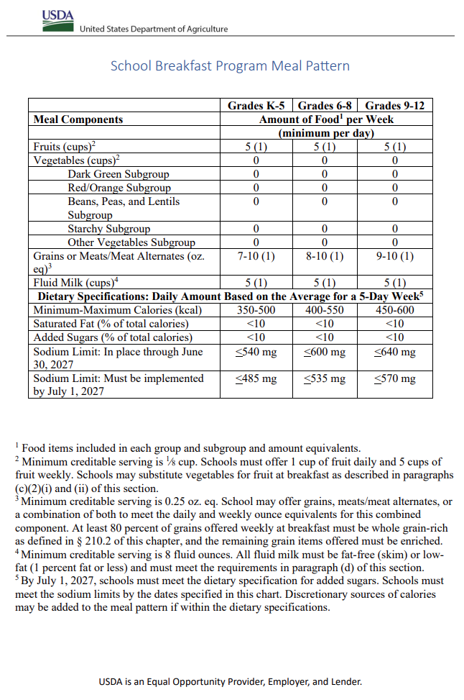
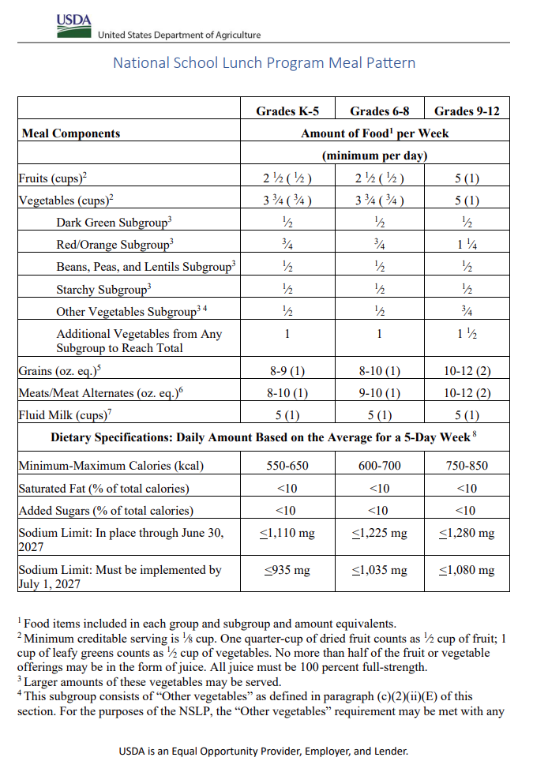
Meal Pattern Chart

Slide 142
Calories
Amounts listed are a range of calories to be offered each day when averaged over the 5-day week
No daily minimum or maximum, there is a weekly average minimum/maximum

Slide 143

Tips for Calorie Management
Choose lean meats
Choose fewer processed foods
Limit condiments, or use ones that are lower in calories
Substitute hummus for a high calorie dip
Offer a rainbow of vegetable and fruits with no added sugars
Limit grain-based desserts
Notes:
https://techbullion.com/tips-to-beat-the-writers-block-from-fireghostwriter/

Slide 144
Saturated Fat
Most come from animal products, like dairy, meat, and poultry
Choose lower-fat and lean options of dairy, meat, and poultry
  Skim milk, lean beef, and grilled chicken breast without the skin or serve plant-based proteins
Calories from saturated fat must average less than 10% of the total calories of the weekly menu.

Slide 145

Sodium/Salt
Essential in small quantities
Children (and most people) consume too much sodium

Slide 146

Tips for Sodium Management
Planning menus that are lower in sodium means choosing whole, minimally processed foods, incorporating the use of fresh or frozen vegetables, and the use of herbs, citrus, spices, and other flavors.
Select sauces and condiments with care. For example, soy sauce, bottled salad dressings, dips, ketchup, jarred salsas, capers, mustard, pickles, olives and relish can be high in sodium. Look for a reduced- or lower-sodium versions.
Choose recipes that enhance flavor with a variety of spices rather than salt.
Check out ICN’s Shaking It Up: Small Changes Lead to Big Flavors series of worksheets and online course for more sodium reduction strategies.

Slide 147
Added Sugars
Two-Step Approach to Reduce Added Sugars in School Meals
Step 1: Implement product-based limits for breakfast cereals, yogurt and flavored milk by SY 2025-2026 (effective date July 1, 2025).
Step 2: Implement a weekly dietary limit for added sugars to less than 10% of calories per week by SY 2027-2028 (effective date July 1, 2027).

Slide 148
Non-Creditable Foods
Non-creditable foods are foods and beverages that cannot credit in USDA’s meal patterns for Child Nutrition Programs
  Potato chips, pudding, ice cream, gelatin, cream cheese, bacon, condiments (e.g., syrup, jam, ketchup, mustard, mayonnaise, and butter), and water
Notes:
https://slidetodoc.com/child-and-adult-care-food-program-cacfp-the/

Slide 149
Non-Creditable Foods (cont’d)
SFAs may serve non-creditable foods in addition to the meal components to add variety, help improve acceptability in the meal, and satisfy appetites
Count toward the weekly dietary specifications (nutrition standards) for school meals
  Cannot cause the menu to exceed average weekly limits for calories, saturated fat, sodium and added sugars (Added sugars effective date July 1, 2027)
Notes:
https://slidetodoc.com/child-and-adult-care-food-program-cacfp-the/

Slide 150
Nutrient Standards Wrap Up/Summary
THINK–PAIR–SHARE Activity

Slide 151
Certification of Compliance Worksheets:
5-Day Schedule
This worksheet is provided by USDA. You can find it online, and most likely it is a link from your State agency’s webpage.
You will enter the daily menu, including additional or non-creditable foods, and it calculates all the requirements
It is color coded with green showing when certain specifications are met, and red showing that the menu is over or under in a required area.

Slide 152

Technical Assistance & Guidance
For technical assistance with food based menu planning contact your state agency.
Most have classes or webinars to explain how to use these tools that check for the calories and nutrients.
Notes:
https://dti.delaware.gov/state-agencies-portal/

Slide 153

Questions?
Notes:
https://www.schabell.org/2019/09/5-questions-everyones-asking-about-microservices-question4.html

Slide 154


Post-Assessment
Notes:
https://www.gov.uk/government/news/say-thank-you-to-someone-at-companies-house

Slide 155


