Slide 1
Identifying Low-Sodium Food Products and Menu Planning Strategies to Meet Meal Pattern Requirements
Sodium Reduction Virtual Workshop Series

Slide 2

Activity: Introductions

Slide 3

Logistics
ICN Ground Rules
  Show Up on Time
  Be Present
  Let Everyone Participate
  Listen With an Open Mind
  Think Before Speaking
  Attack the Problem Not the Person

Slide 4
Background
January 2012: Updated Nutrition Standards
  Reflect Dietary Guidelines for Americans
  Gradual sodium reduction
February 2022: Transitional Standards
  Support during pandemic recovery
  Gradual sodium reduction
Successful Approaches to Reduce Sodium in School Meals
  Examined barriers
  Identified successful strategies
April 2024: Final Rule, Child Nutrition Programs: Meal Patterns Consistent with 2020-2025 Dietary Guidelines for Americans

Slide 5

Sodium Reduction Virtual Workshop Series
Topics
  Menu Planning and Analysis
  Procurement
  Staff Training
  Student Satisfaction
Hands-on Learning
  Apply knowledge and skills
Action Plans

Slide 6

Identifying Low-Sodium Food Products and Menu Planning Strategies to Meet Meal Pattern Requirements
Finding sodium info on food labels
Recipe sodium reduction strategies
Resources for new recipes
Gradual sodium reduction while preserving flavor
Developing lower-sodium school menus

Slide 7
Activity: Pre-Assessment

Slide 8
Lesson 1: Sodium Basics

Slide 9
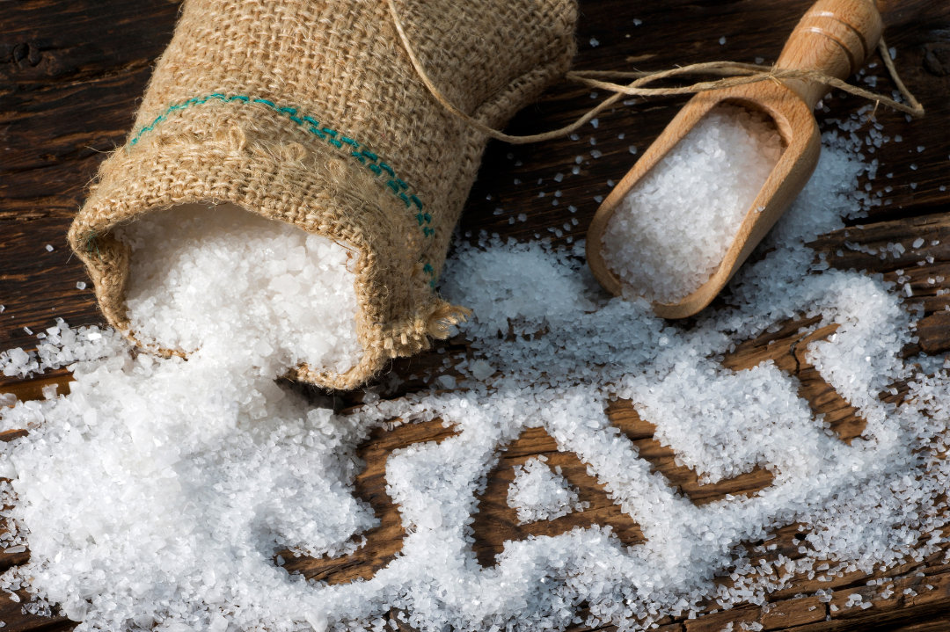
Is salt the same as sodium?
Sodium chloride
90% of sodium consumed is from salt
Not the same

Slide 10

How much sodium does the average person need each day?
Essential nutrient
Less than 2,300 mg per day-adults and high school-aged students
Young children even less

Slide 11
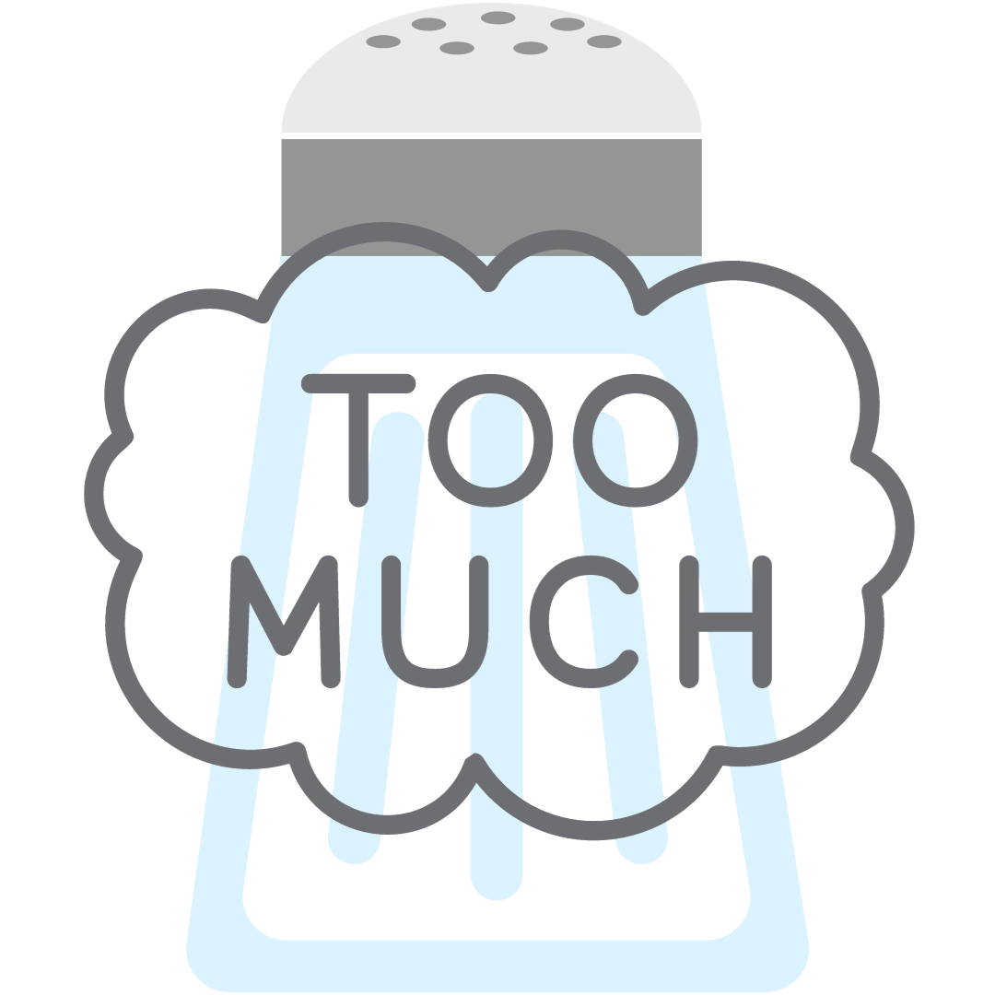
Do you think children consume too much sodium?
~ 90% of US children ages 6-18 years eat too much sodium daily (CDC)

Slide 12

Why is it concerning that children are consuming so much sodium?
9 in 10 children consume more sodium than recommended
Salt in processed foods
Too much can lead to high blood pressure
  1 in 6 children 8-17 years has raised blood pressure
Taste established at young age

Slide 13

Call to Action

Slide 14

Activity: Communicating “The Why” of Sodium Reduction
Reduced blood pressure
Reduced risk of cardiovascular disease, stroke, and coronary heart attack
Altering taste buds at a young age to prefer less “salty” tastes

Slide 15
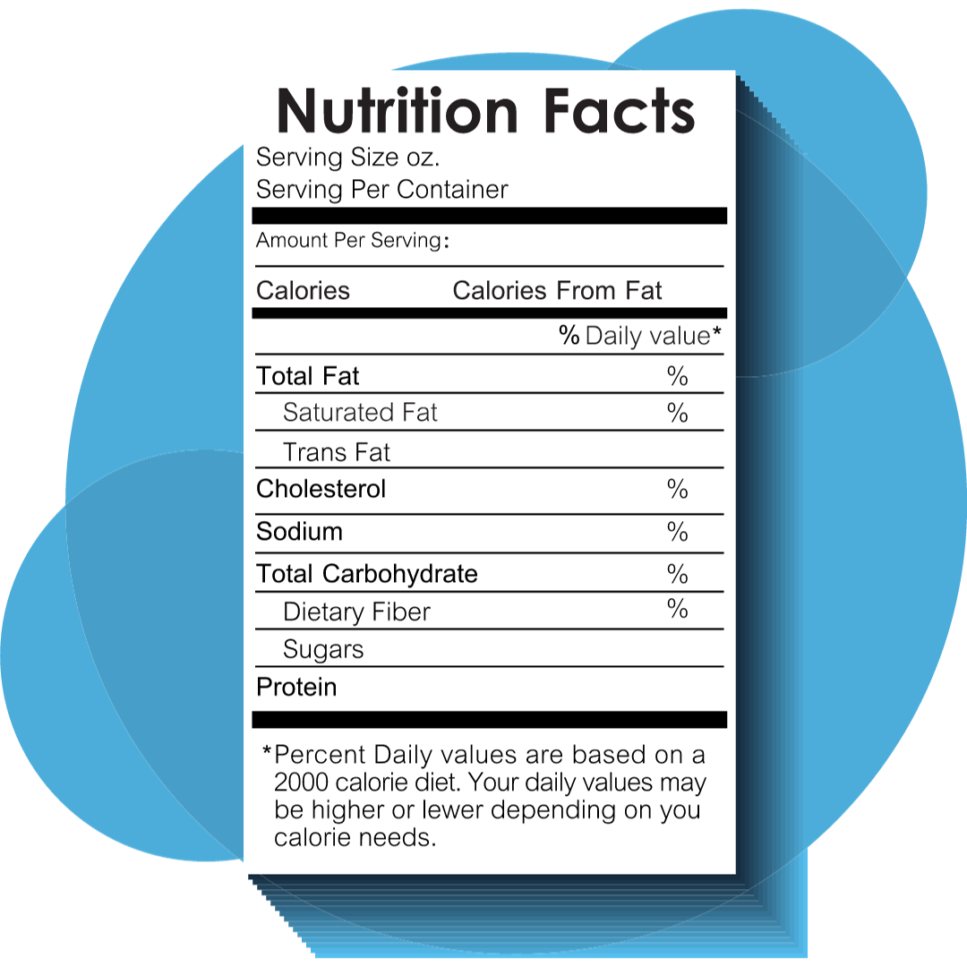
Where do I find the sodium amounts?
Nutrition Facts label

Slide 16
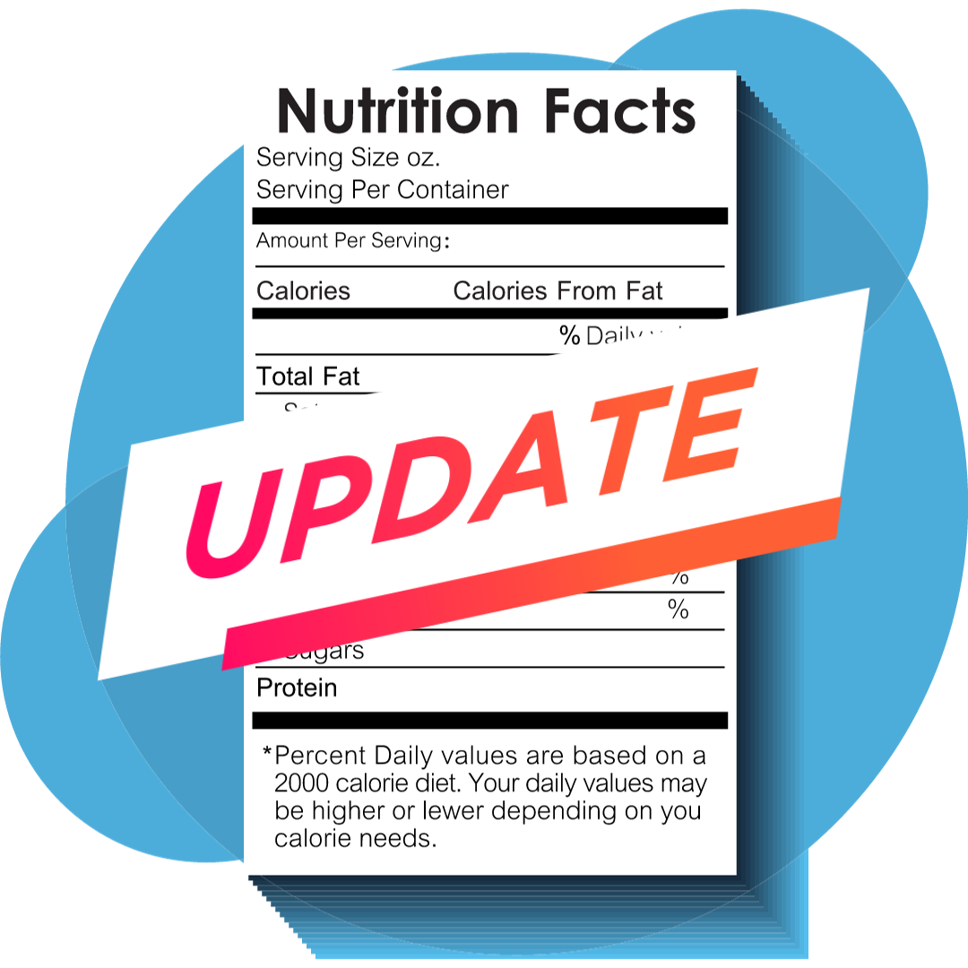
The Updated Nutrition Facts Label
Reflects updated scientific information
Incorporates public input
First major update in 20 years
Enhanced design and information

Slide 17
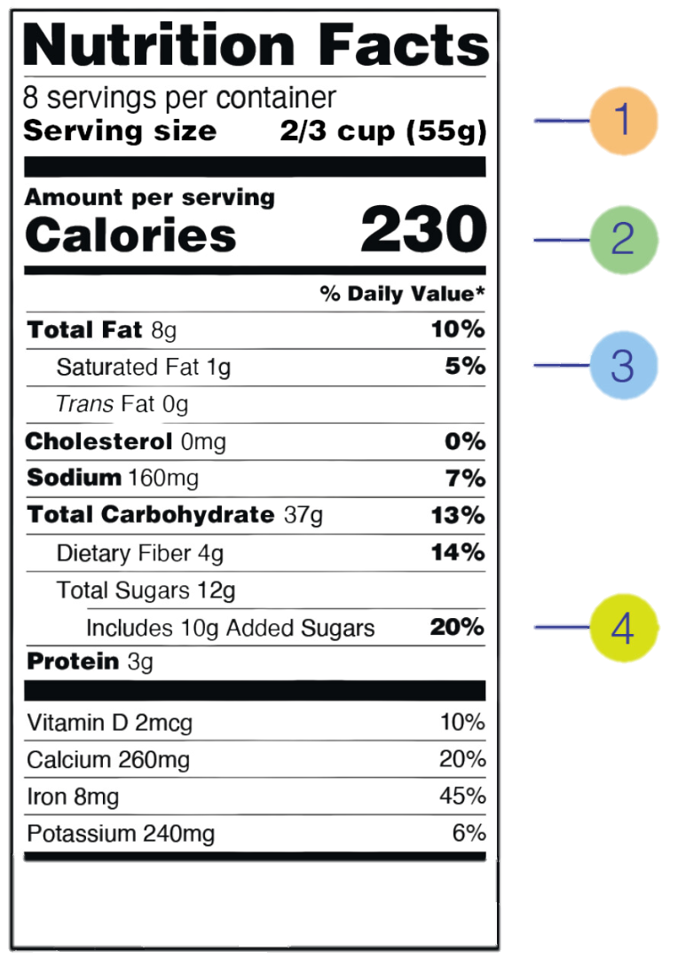
Nutrition Facts Label:
Overview

Slide 18
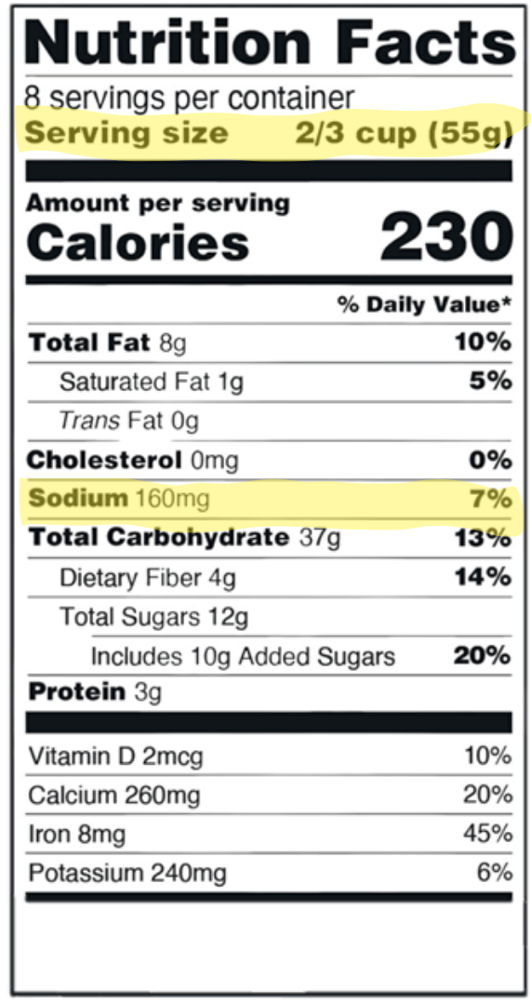
Looking at Sodium
Find Serving Size at the top
Locate Sodium in nutrients list
Sodium = mg per serving
Average daily need = 2300 mg

Slide 19
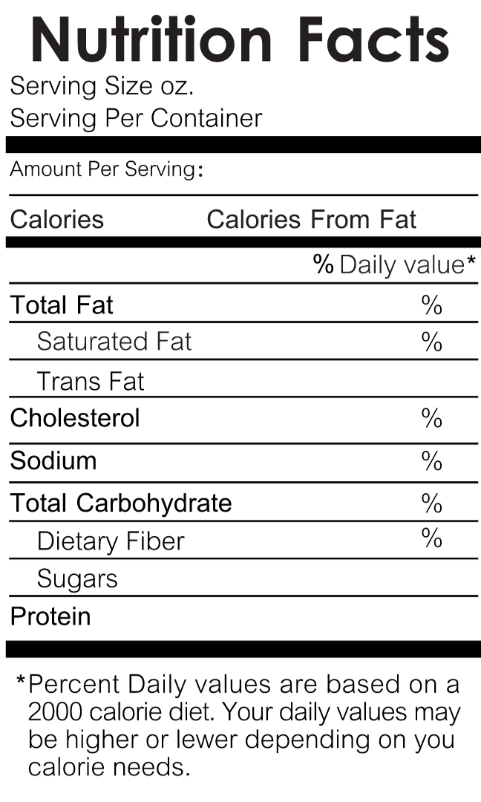
Activity: Labeling a Nutrition Facts Label

Slide 20
Serving Size Versus Portion Size
Serving Size (Nutrition Facts Label):
Manufacturer's standard portion
Allows for easy product comparison
Regulated by FDA
Based on consumption patterns
Portion Size (School Meal Programs):
Specific amount served in meals
Meets nutritional standards
Varies by age group and program
Designed for health and well-being

Slide 21

Assessing Sodium Content
Compare products
Calculate sodium amounts for different serving sizes when needed

Slide 22

What if the serving sizes are not the same?

Slide 23
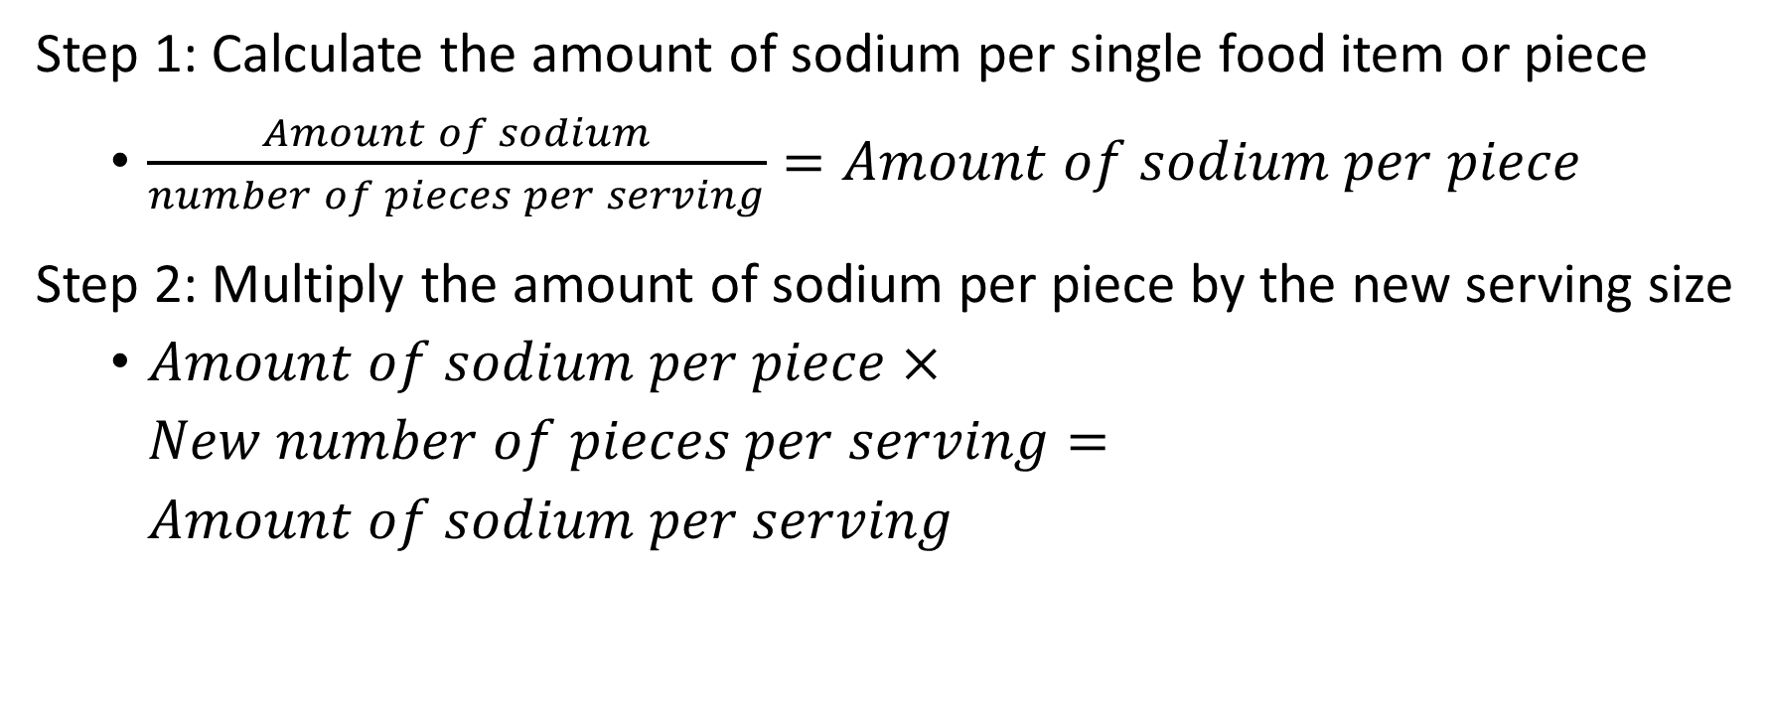
Calculating Sodium Content
Step 1: Calculate the amount of sodium per single food item or piece
  $\frac{Amount of sodium}{number of pieces per serving}=Amount of sodium per piece$
Step 2: Multiply the amount of sodium per piece by the new serving size
  $Amount of sodium per piece×New number of pieces per serving=Amount of sodium per serving$

Slide 24
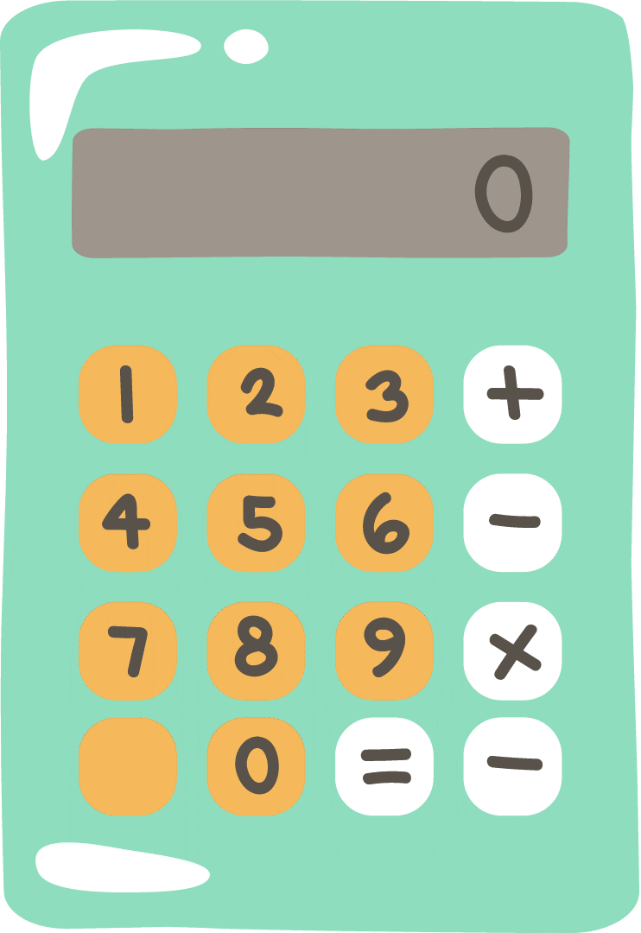
Activity: Calculating Sodium Content
Step 1: 250 mg sodium ÷ 5 nuggets = 50 mg of sodium per nugget
Step 2: 50 mg of sodium per nugget × 6 nuggets per serving = 300 mg of sodium per serving

Slide 25

Sodium Nutrient Claims
FDA-regulated labels for sodium content

Slide 26
FDA-Approved Sodium Nutrient Claims
What it says | What it means
Sodium Free/Salt Free | Less than 5 mg of sodium per serving
Very Low Sodium | 35 mg of sodium or less per serving
Low Sodium | 140 mg of sodium or less per serving
Reduced Sodium | At least 25% less sodium than the regular product
Light in Sodium/Lightly Salted | At least 50% less sodium than the regular product
No Salt Added/Unsalted | No salt is added during processing

Slide 27
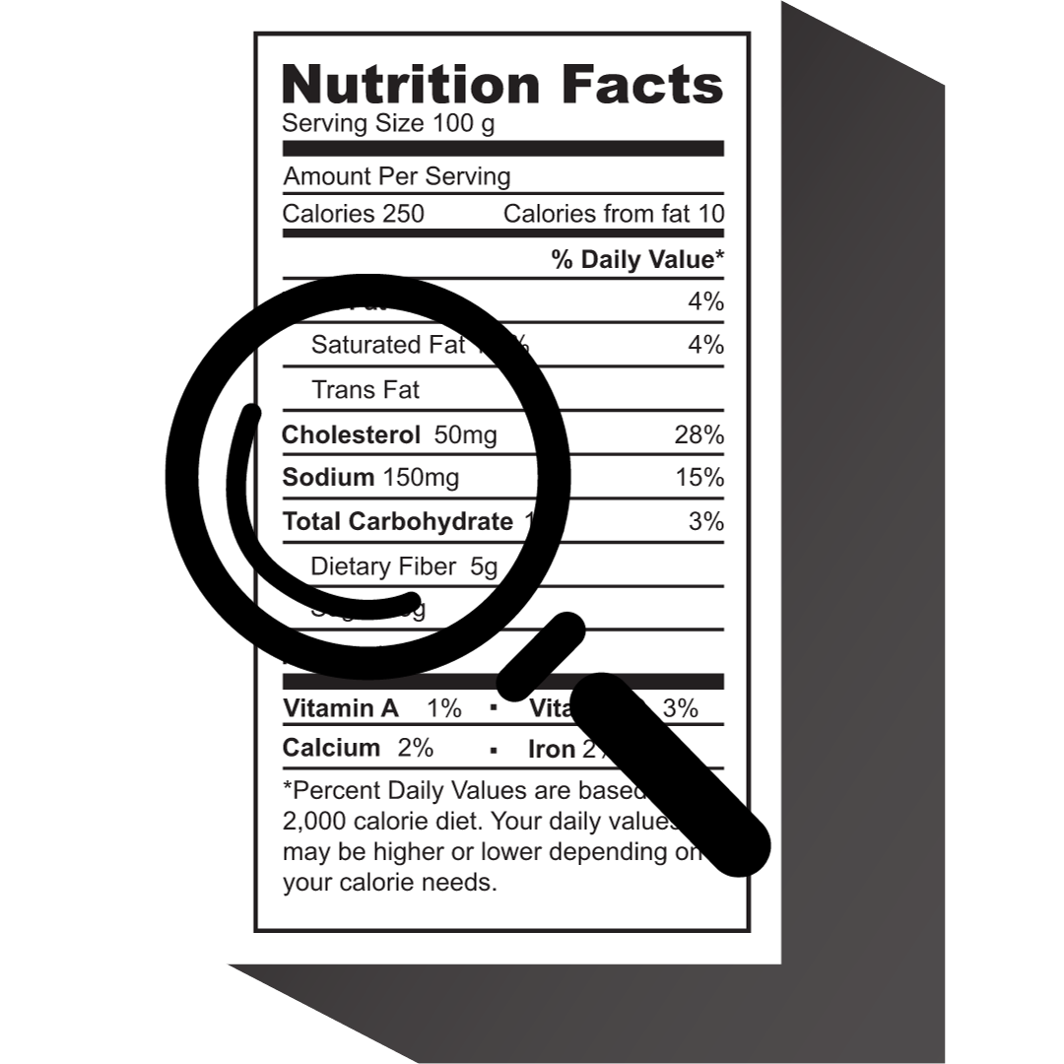
Don’t Be Fooled
Reduced Sodium ≠ Low Sodium
Verify sodium content for accuracy

Slide 28
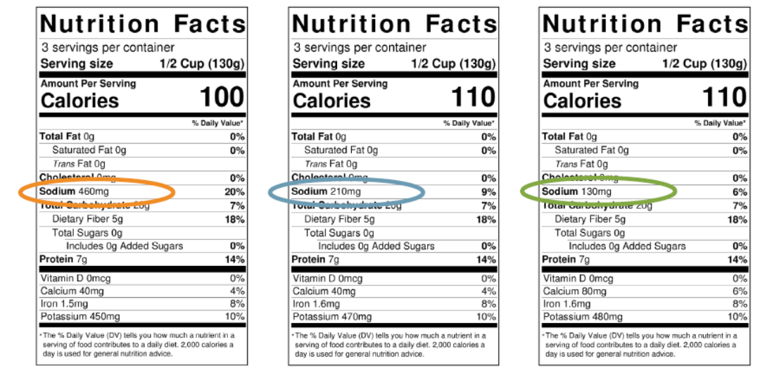
Activity: Finding the Lowest-Sodium Product

Slide 29

Lesson 1 Summary
Excessive salt/sodium intake raises health risks
Lower-sodium meals reduce health risks
Influence taste preferences early

Slide 30
Lesson 2: Sodium Reduction Strategies

Slide 31
Sneaky Sources of Sodium
Breads
Rolls
Tortillas
Burritos
Tacos
Cheese
Deli/cured meats (luncheon/sandwich meat, ham, and sausage)
Pizza
Poultry (chicken patties, nuggets, and tenders)
Sandwiches (hamburgers, hot dogs, and sub sandwiches)
Snack foods (crackers, chips, pretzels/snack mix, and popcorn)
Soups
Corn dogs
Flavored milk
Pickles and olives
Potato products (mashed potatoes, oven-baked fries, potato wedges, and tater tots)
Ready-to-eat cereals
Salad dressings (ranch, Italian, and French)
Mayonnaise
Soy/teriyaki sauce
Tomato-based sauces and condiments (spaghetti sauce, marinara sauce, ketchup, and salsa)

Slide 32

Mindful Menu Choices
Small amounts of sodium are naturally found in foods
Most sodium comes from salt added during food processing and preparation

Slide 33
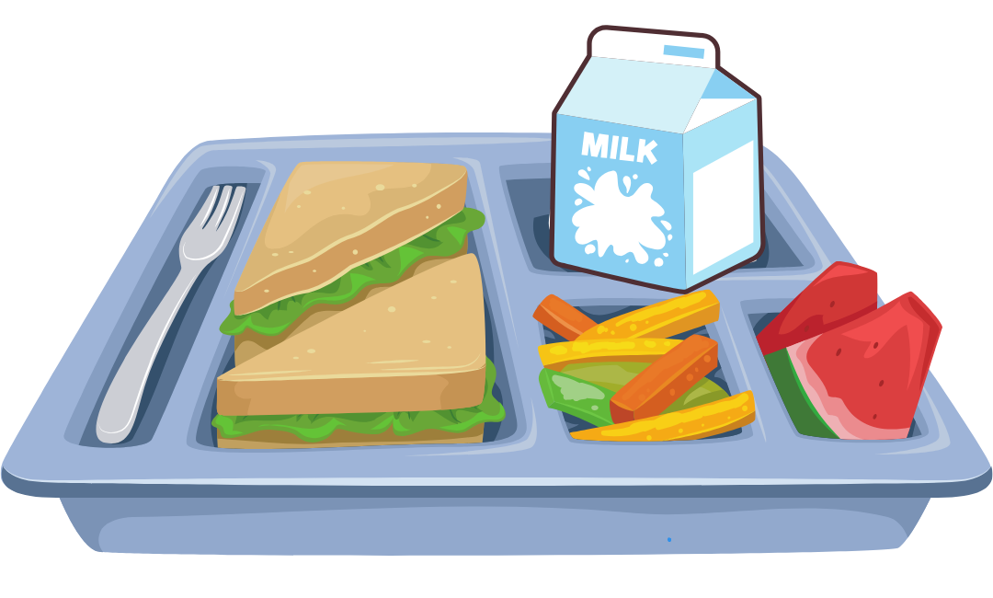
Lower-Sodium Foods by Meal Pattern Component
Fruits
Vegetables
Grains
Meats/Meat Alternates
Fluid Milk
Bonus: Condiments

Slide 34

Lower–Sodium Foods: Fruits
Naturally sodium-free or very low in sodium

Slide 35
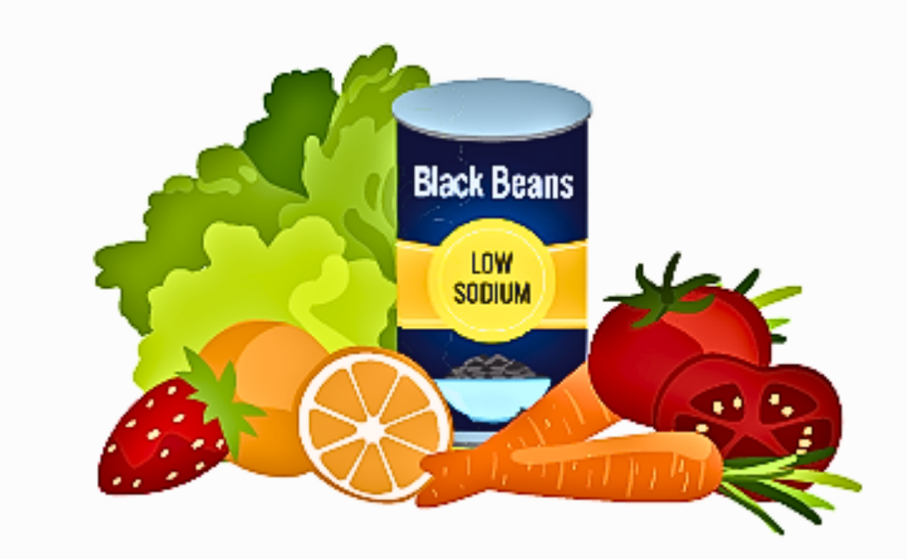
Lower–Sodium Foods: Vegetables
Fresh/frozen veggies = low sodium
Use lower-sodium seasonings
Choose canned: Low Sodium or No Salt Added
Avoid high-sodium prepackaged dishes

Slide 36
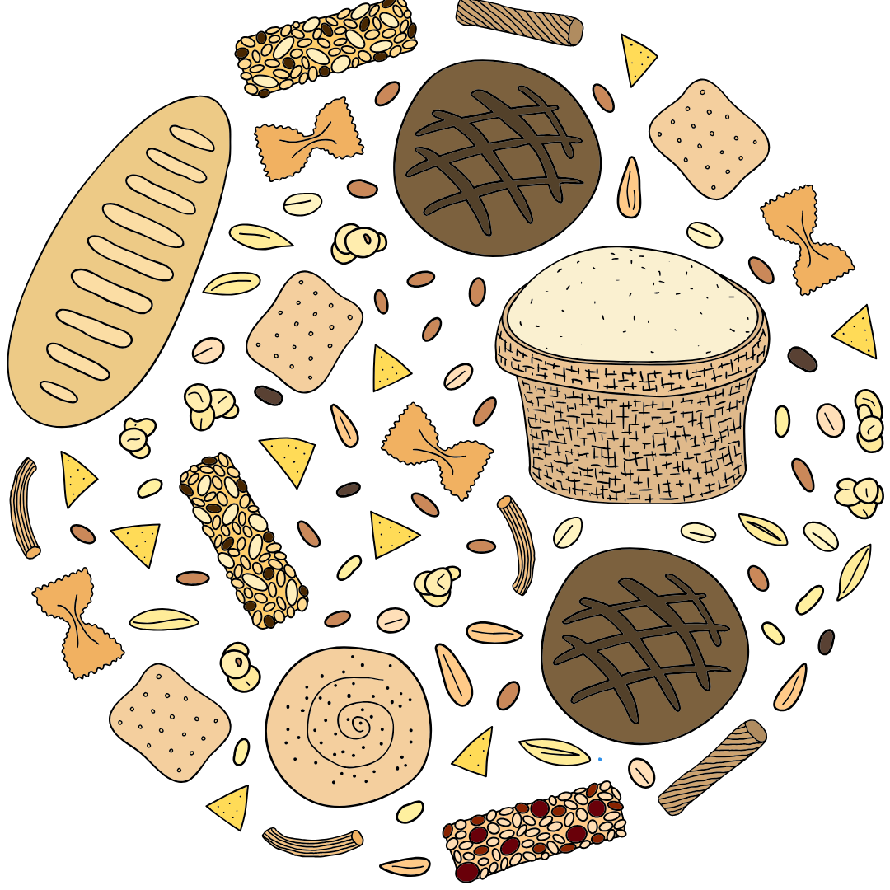
Lower-Sodium Foods: Grains
Choose whole grains (e.g., brown rice, barley, quinoa) and pasta
Be cautious of processed grains (e.g., bread, rolls, bagels)
Explore "No Salt Added" options

Slide 37
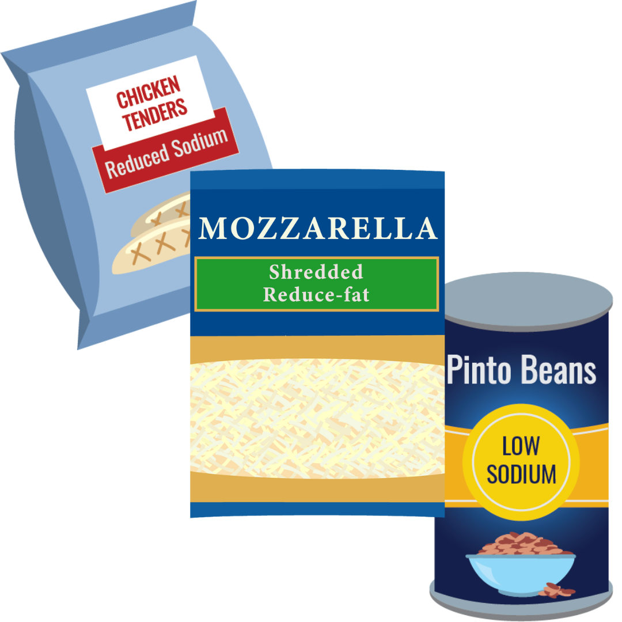
Lower-Sodium Foods: Meats/Meat Alternates
Fresh meat, no added saline
Boiled eggs without added salt
Canned beans: Low Sodium or No Salt Added
"Unbreaded" meat products
Lower-sodium cheese varieties

Slide 38
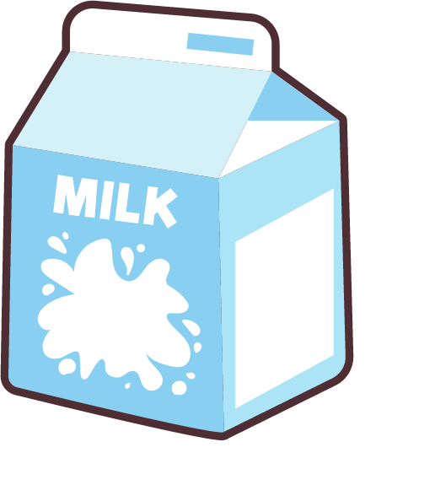
Lower-Sodium Foods: Fluid Milk
Plain, unflavored milk: lower in sodium
Flavored milk: extra sodium added

Slide 39
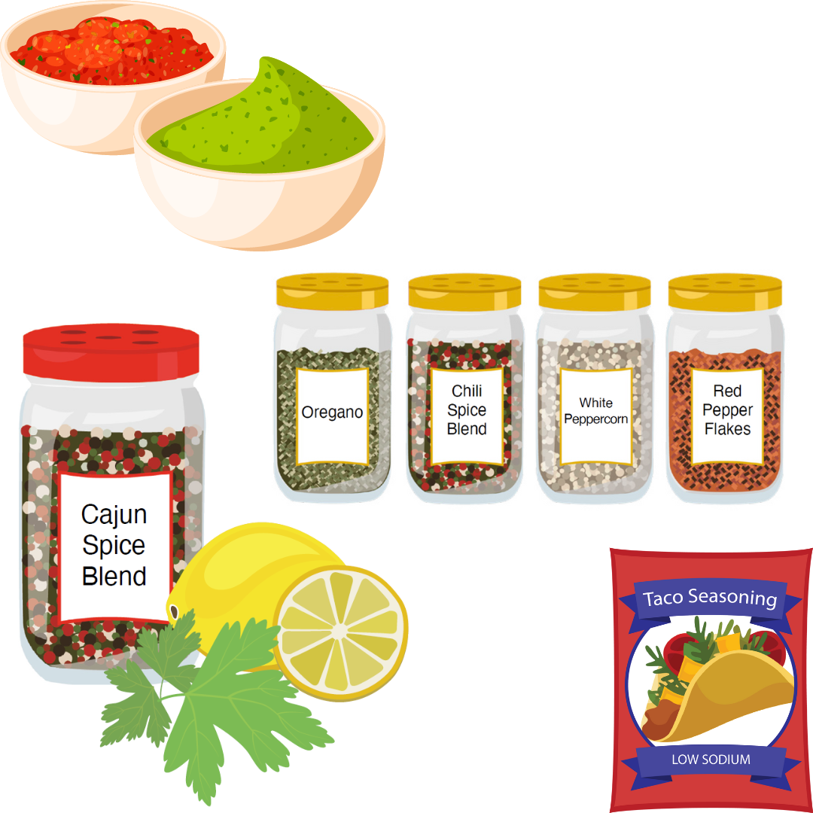
Lower-Sodium Condiments
Use herbs, spices, and low-sodium seasonings
Try fresh or dried herbs, and salt-free mixes
Add aromatic veggies, lemon/lime juice
Salad bar options: salsa, flavored vinegars, simple dressings

Slide 40
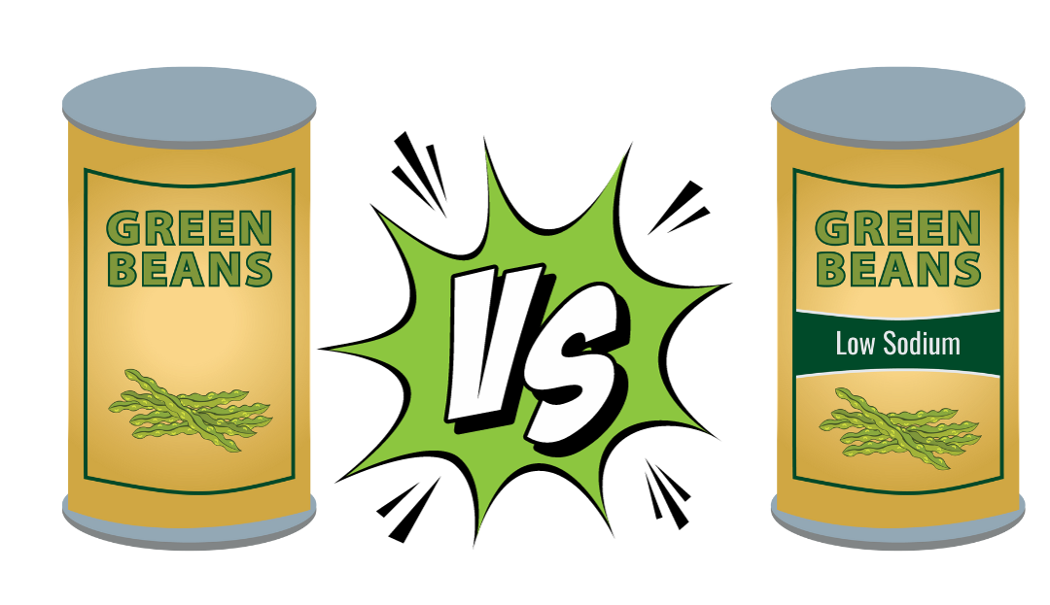
Product Substitution
Swap higher-sodium items
Within same meal component
Even small changes matter

Slide 41
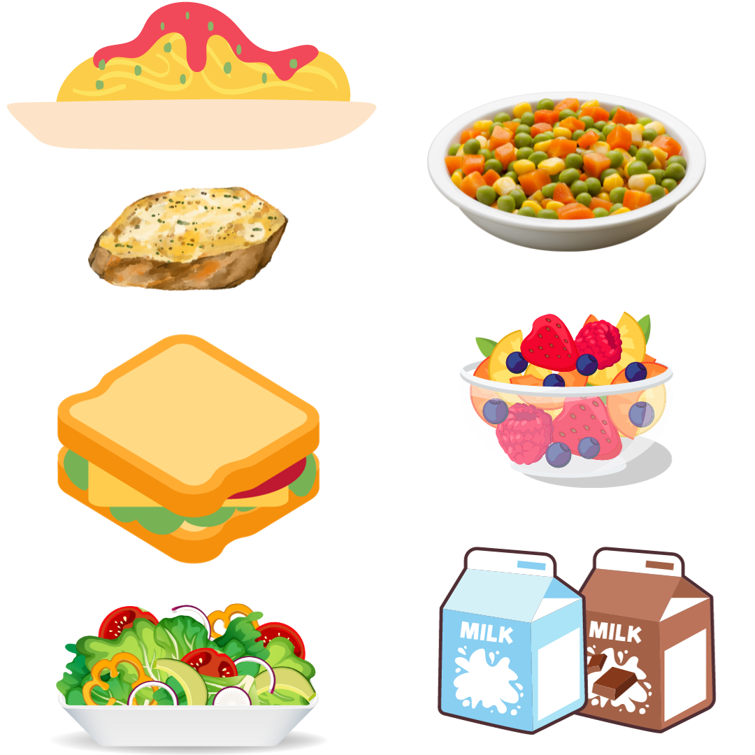
Activity: Practicing Product Substitution

Slide 42

Product Substitution Works
Start with manageable swaps
Seek lower-sodium versions
Plan gradual, bigger changes
Convert convenience to speed-scratch recipes

Slide 43
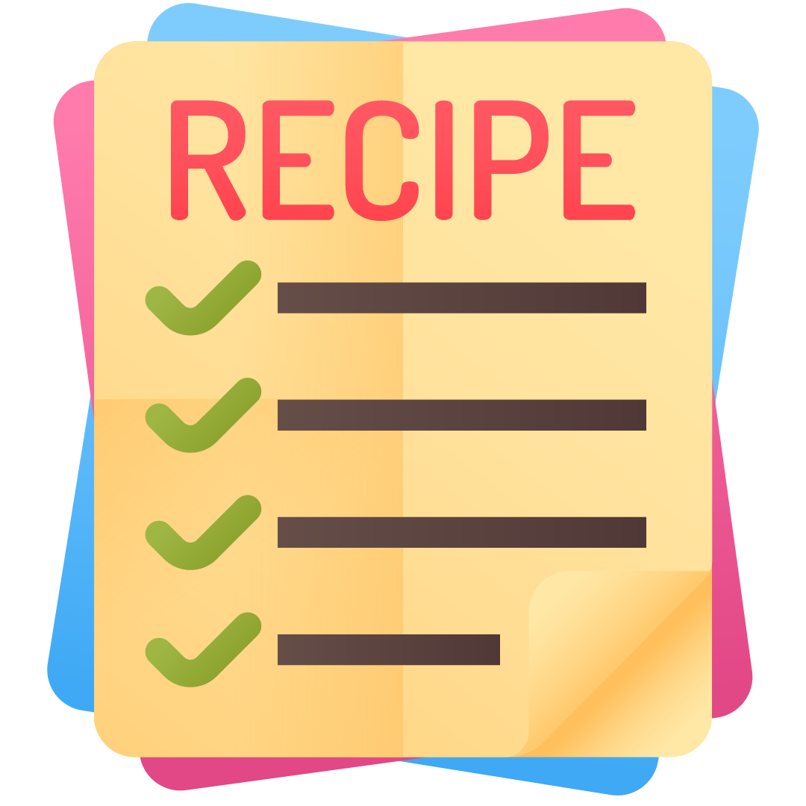
Lower-Sodium Recipes

Slide 44

Culinary Institute of Child Nutrition (CICN)

Slide 45
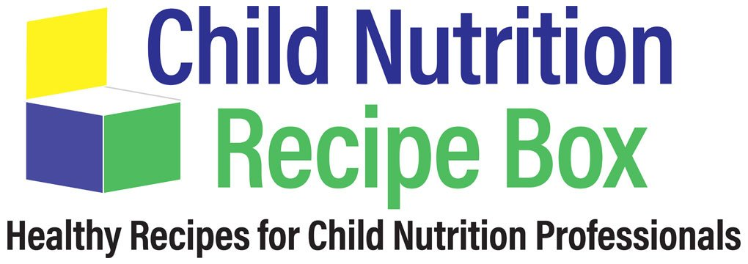
Child Nutrition Recipe Box (CNRB)

Slide 46

Team Nutrition Recipes

Slide 47
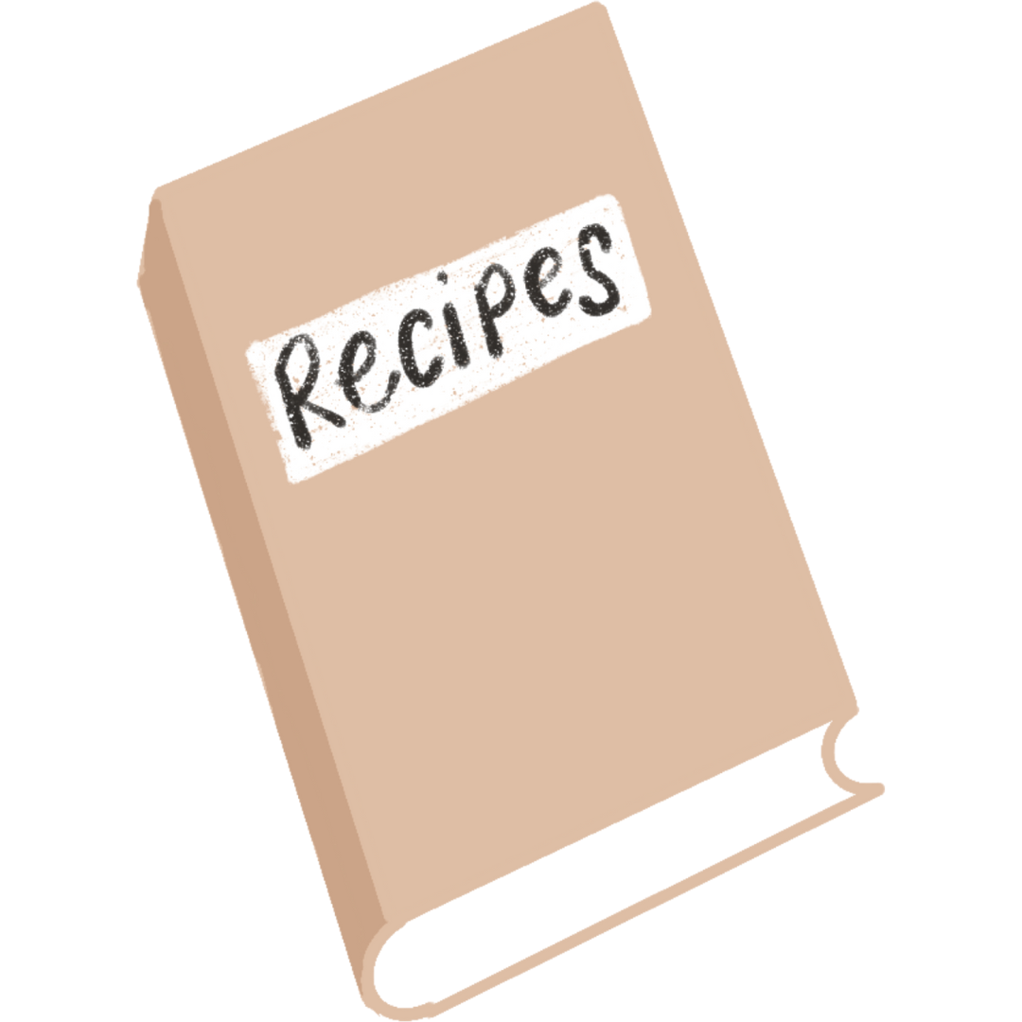
Activity: Recipe Resource Sharing
CICN
CNRB
Team Nutrition
State agencies
Industry
Other school districts

Slide 48
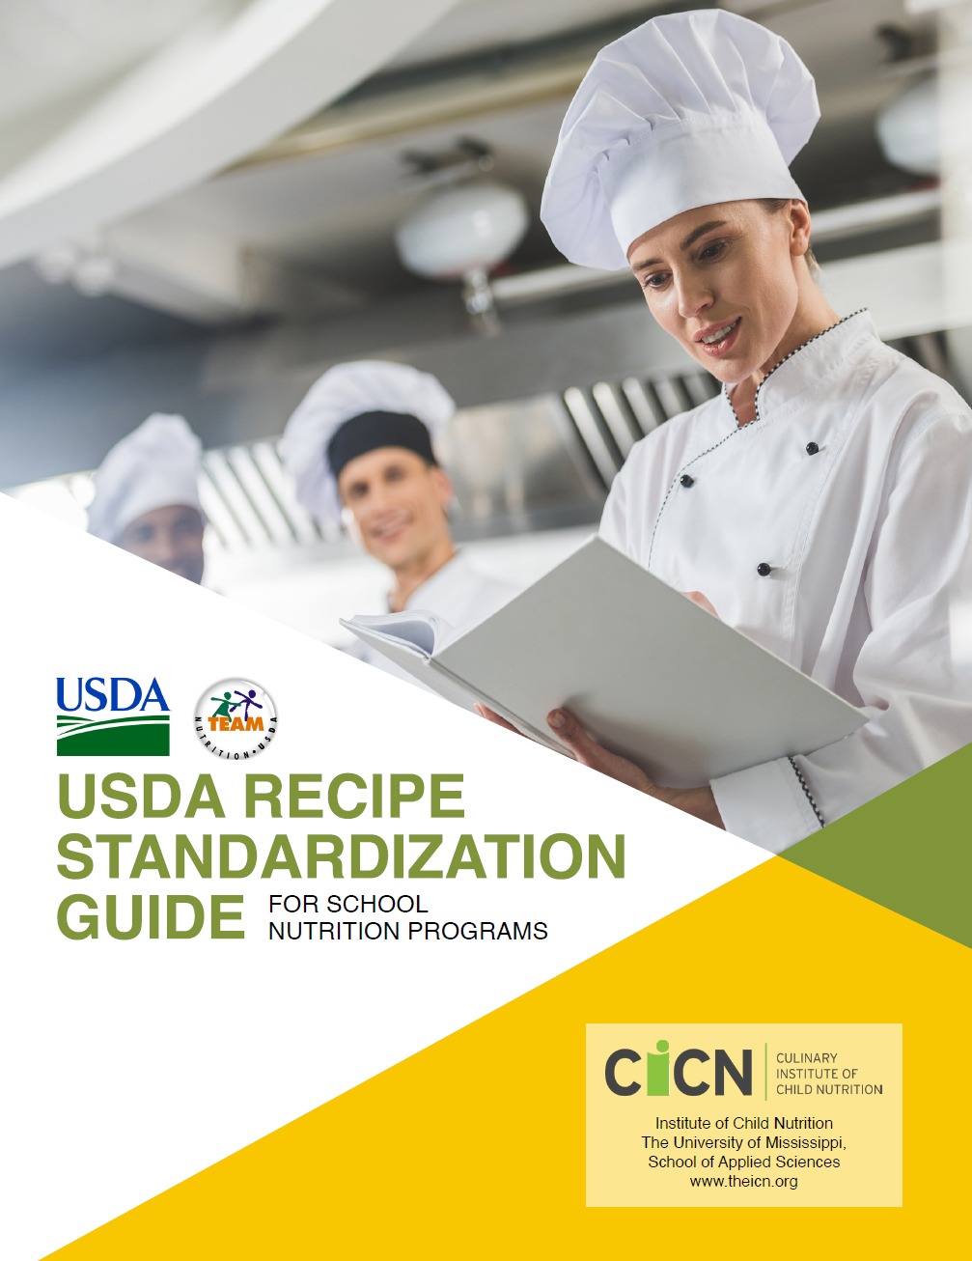
Recipe Reformulation
Improve nutrition
Keep flavors
Adjust ingredients & techniques
Reduce salt & replace with fresh foods
Add herbs & spices
Follow USDA Recipe Standardization Guide

Slide 49

Taste Matters
Students' preferences matter
Test with students, get feedback
Involve parents, teachers
Part of healthy meal improvement

Slide 50

Recipe Reformulation Strategies

Slide 51

Recipe Reformulation Strategies: Make Small Adjustments Gradually
Small adjustments over time
Use flavor enhancers, techniques
One step at a time

Slide 52
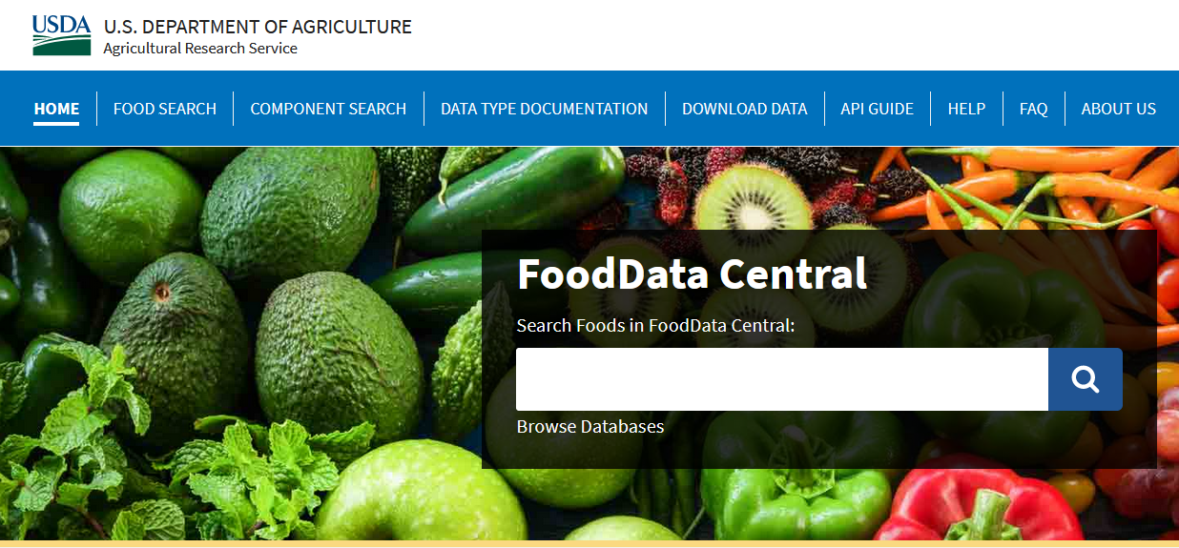
Recipe Reformulation Strategies: Identify Lower-Sodium Versions
Find lower-sodium alternatives
Broad sodium range in ingredients
Utilize vendor catalogs, databases
Choose lower-sodium canned foods
Use USDA FoodData Central for info

Slide 53
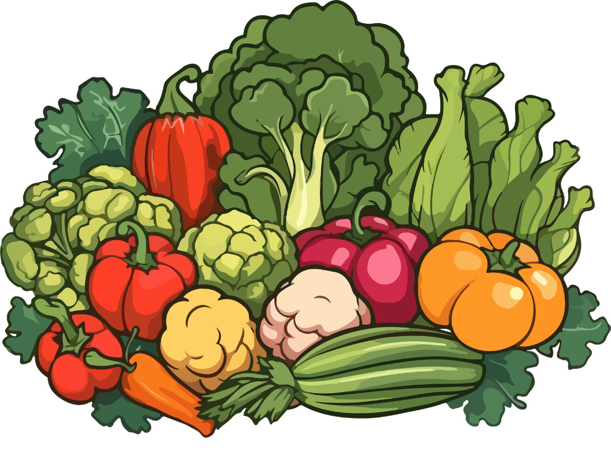
Recipe Reformulation Strategies: Incorporate More Fresh or Frozen Fruits and Vegetables
Add fresh or frozen produce
Use in mixed-dish recipes
Promote health and variety

Slide 54
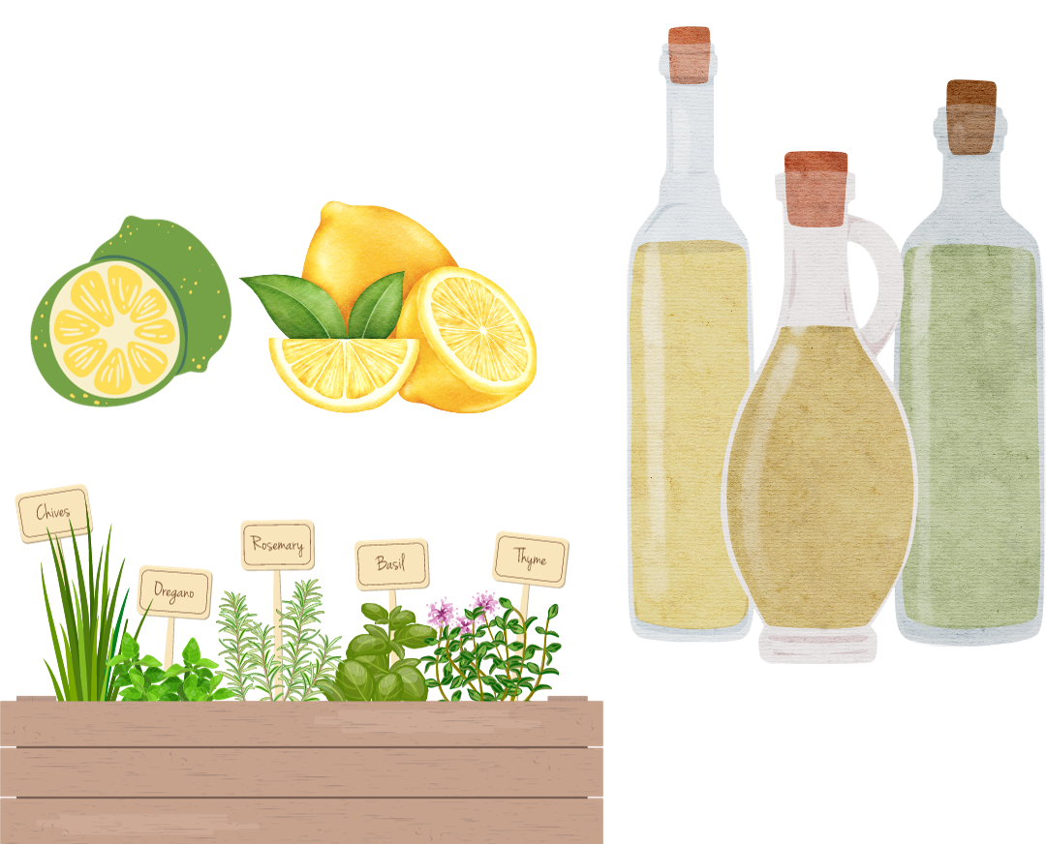
Recipe Reformulation Strategies:
Focus on Flavor
Keep taste with herbs, acids
Use unseasoned products
Add fresh herbs, like cilantro
Try vinegar, citrus for brightness

Slide 55
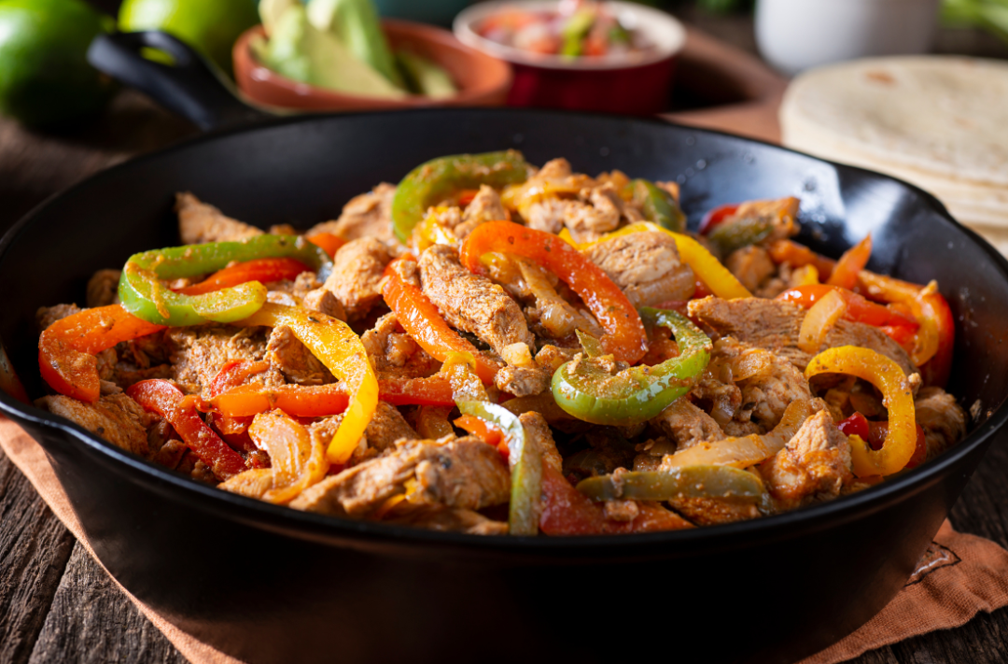
Activity: Slash the Salt and Focus on Flavor

Slide 56
Example Recipe
The recipe features lower-sodium, unseasoned chicken strips.
A sodium-free spice blend is used to season the chicken.
Frozen corn adds a fresh flavor without the salt.
No-added-salt tomatoes and low-sodium salsa keep the sodium in check.
Fresh squeezed lime juice adds a spritz of acid that brightens flavors.
Fresh peppers and onions are sautéed for added flavor.
Consider adding affordable fresh herbs, such as fresh cilantro, to increase presentation appeal and add flavor.

Slide 57

Strategies to Reduce Sodium
Gradual process
Evaluate, revise, replace
Maintain student acceptability

Slide 58
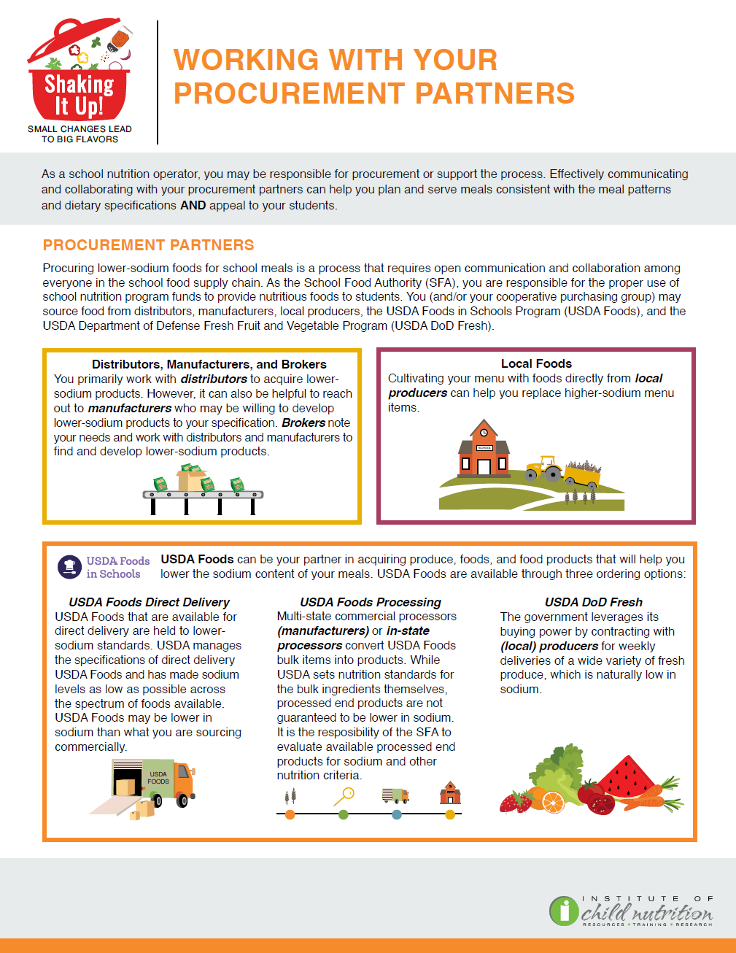
Product Substitution and Procurement
Seek lower-sodium options
Engage with brokers, vendors
ICN’s Working With Your Procurement Partners worksheet

Slide 59
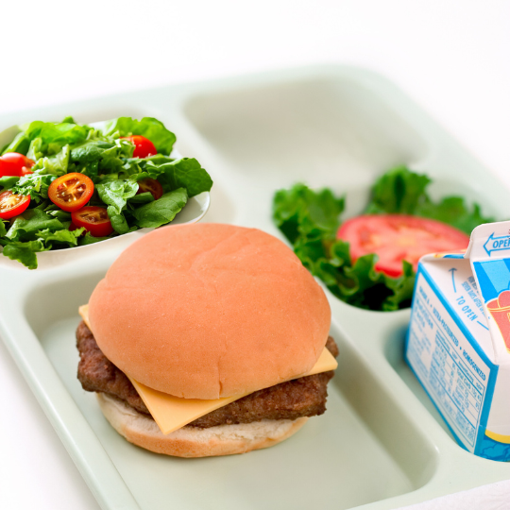
Serve Higher Sodium Items Less Frequently
Mindful of high-sodium ingredients
Offer choices (e.g., hamburger vs. cheeseburger)
Pair high-sodium items with fresh produce
Limit high-sodium options for weekly targets

Slide 60
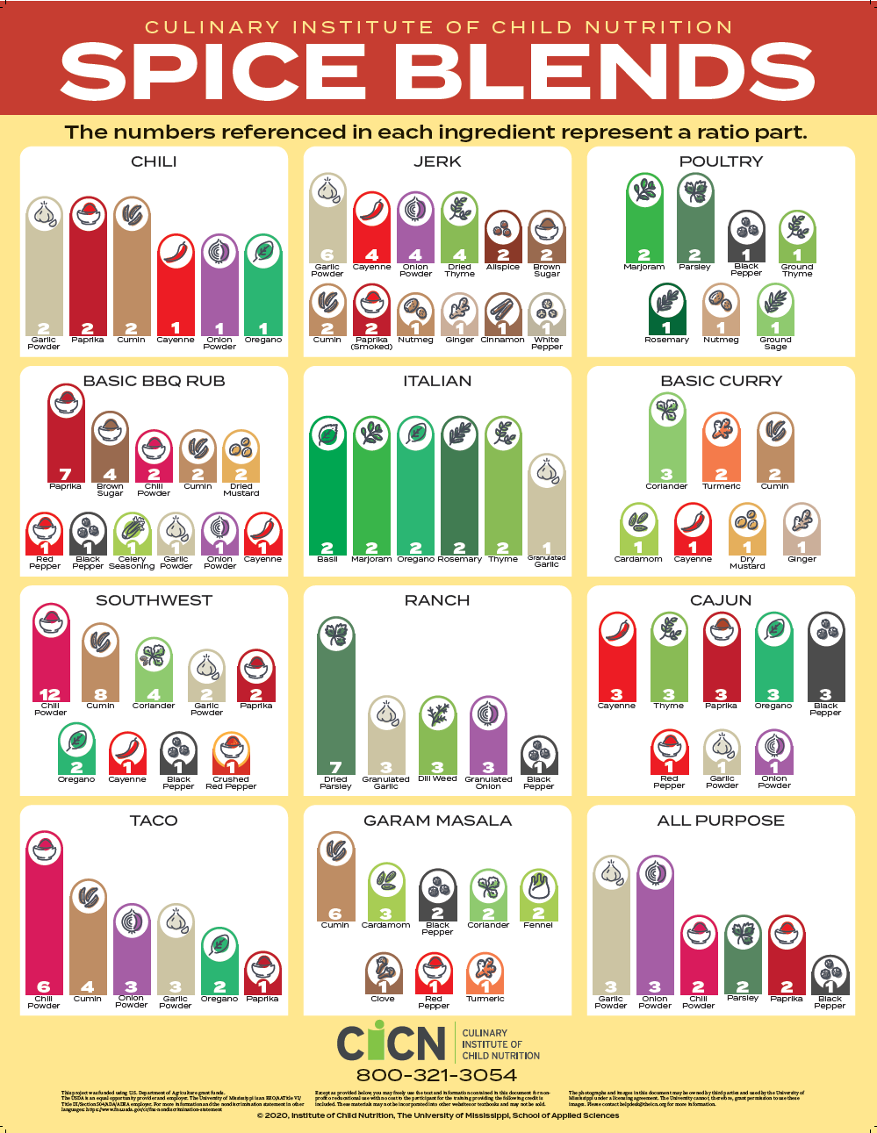
Use Herbs and Spice Blends
Buy lower-sodium seasonings
Create salt-free spice blends
Swap garlic salt with garlic powder
Swap onion salt with onion alternatives
CICN’s Herbs and Spices posters

Slide 61
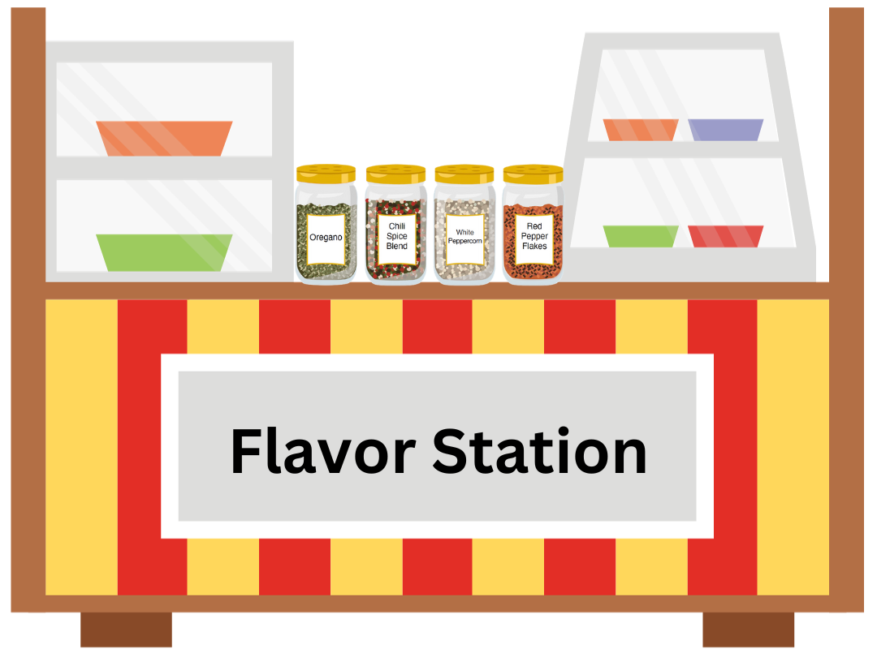
Flavor Station
Let students personalize flavors
Easy to create or buy
Place for students to access
Tailor to school level

Slide 62
Flavor Station (cont’d)
Dried Herbs & Spices: oregano, red pepper flakes, cinnamon
Spice Blends: BBQ, chili, jerk, ranch
Lower-Sodium Hot Sauces: chili, hot pepper vinegar, sriracha
Dipping Sauces: BBQ, buffalo, honey mustard, ranch
Fresh Ingredients: lime, lemon slices, herbs

Slide 63

Activity: Sharing Success

Slide 64
Lesson 2 Summary
A gradual process
Maintain student acceptability
Key strategies:
  Product substitution
  Serve high-sodium items less frequently
  Procure lower-sodium versions
  Use herbs and spices

Slide 65
Lesson 3: Sodium Standards

Slide 66
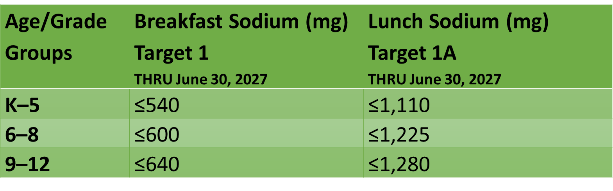
Sodium Targets

Slide 67
Activity: List the Sodium Targets and Timelines
Age/Grade Groups | Breakfast Sodium (mg) Target 1 THRU June 30, 2027 | Lunch Sodium (mg) Target 1A THRU June 30, 2027
K–5 | ≤540 | ≤1,110
6–8 | ≤600 | ≤1,225
9–12 | ≤640 | ≤1,280

Slide 68

Nutrient Analysis of Sodium
Purpose: Compliance & monitoring
Calculates nutritional content
Compares to regulatory requirements
Based on weighted averages
Accounts for portion sizes & frequency

Slide 69

Weighted Nutrient Analysis of Sodium
Small changes reduce sodium
Decrease daily and weekly averages
Balance sodium in daily and weekly menus
Pairing strategies:
  Fresh/frozen vs. canned produce
  Higher-sodium with lower-sodium options

Slide 70
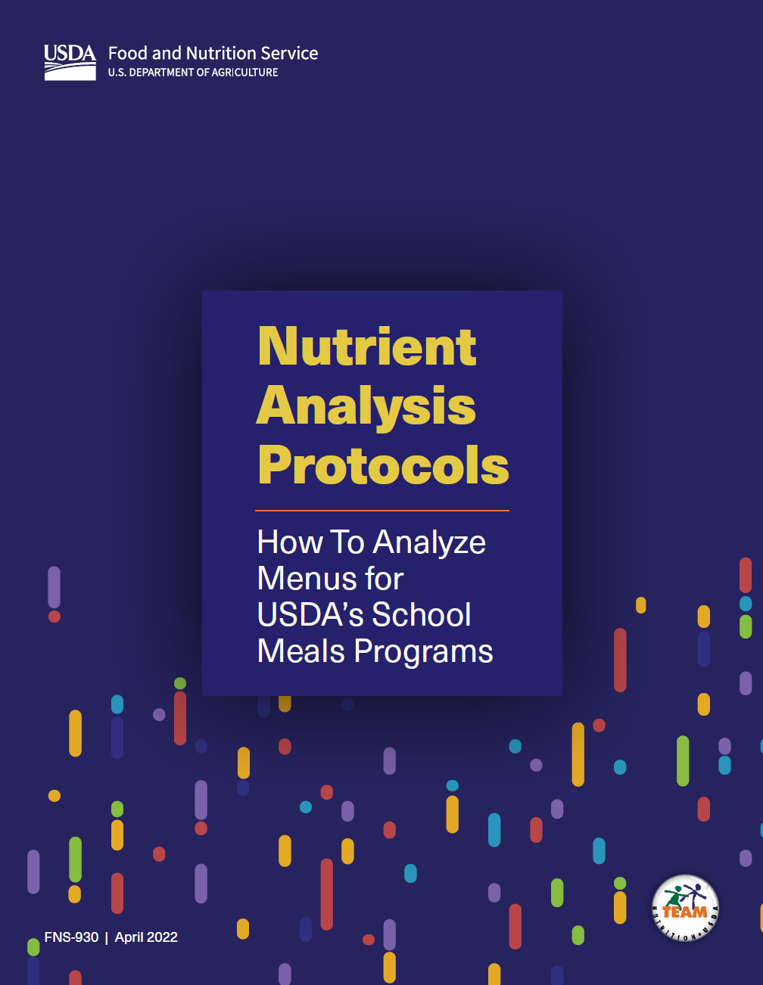
Daily Weighted Sodium Totals and Weekly Averages
Calculate current sodium totals
Daily weighted sodium
Weekly averages for breakfast & lunch
Use USDA's NAP Manual for guidance

Slide 71
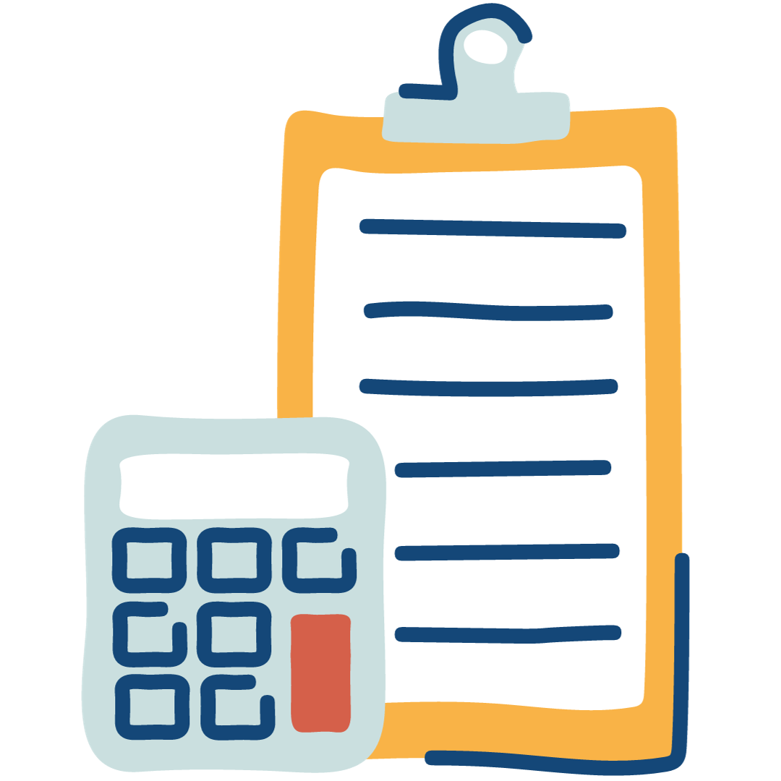
Calculating a Weighted Nutrient Analysis of a Weekly Menu
Estimated feeding figure
Servings & portion size for each menu item
Nutrient info for each item
Separate analyses for breakfast and lunch
Age/grade group-specific analyses

Slide 72
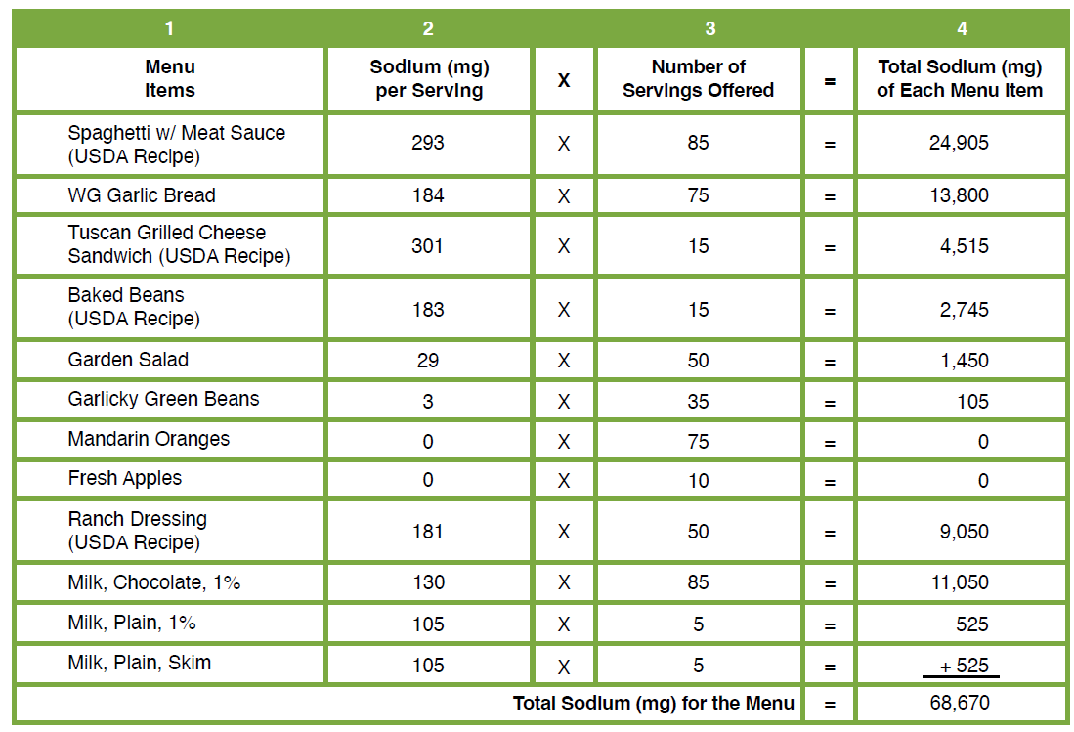
Step 1: Calculate the Daily Weighted Sodium Total

Slide 73
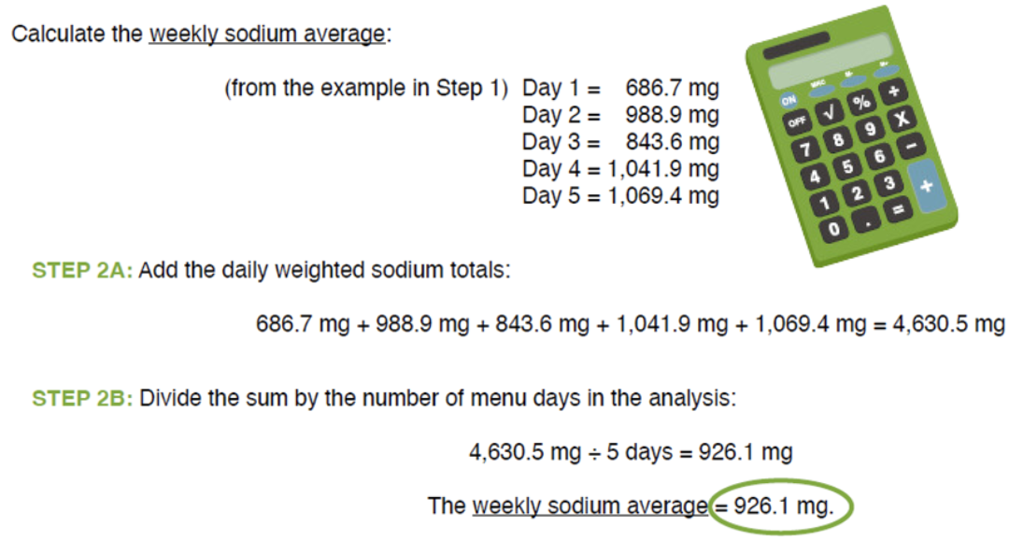
Step 2: Calculate the Weekly Weighted Sodium Average

Slide 74
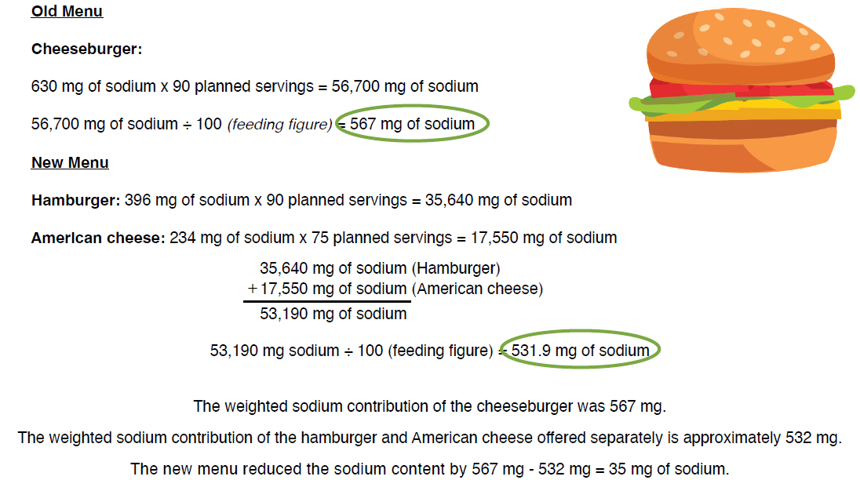
Activity: Weighted Analysis Practice

Slide 75

Weekly and Daily Sodium Goals
Compare to sodium target
Identify weeks above target
Evaluate daily sodium totals

Slide 76
Daily Sodium Total Goals
Examine daily menus above the target
Consider substitutions with lower-sodium products
Explore scratch or speed-scratch recipes
Incorporate fresh fruits, vegetables, and meats
Review necessity of all condiments
Use herbs, spices, and lemon/lime juice for flavor

Slide 77
Food Product Sodium Goals
Evaluate sodium content, unit price, meal contribution
Compare with lower-sodium alternatives
Procure lower-sodium products
Include sodium nutrition standards in specifications

Slide 78
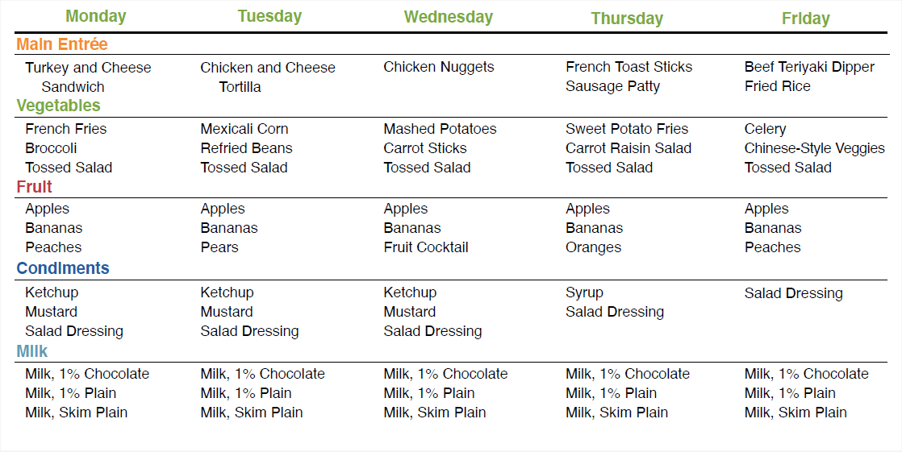
Activity: Sodium Reduction Practice

Slide 79
Lesson 3 Summary
Know sodium content
Small changes reduce sodium
Ensure NSLP & SBP compliance

Slide 80
Culminating Activity and
Action Plan

Slide 81
Activity: Independent Work Time

Slide 82

Activity: Sharing Strategies and Action Plans

Slide 83
Thank You!
Post-Assessment

