Slide 1
Maintaining Student Acceptability of Lower-Sodium Meals
Sodium Reduction VILT Series

Slide 2

Activity: Introductions

Slide 3

Logistics
ICN Ground Rules
  Show Up on Time
  Be Present
  Let Everyone Participate
  Listen With an Open Mind
  Think Before Speaking
  Attack the Problem Not the Person

Slide 4
Background
January 2012: Updated Nutrition Standards
  Reflect Dietary Guidelines for Americans
  Gradual sodium reduction
February 2022: Transitional Standards
  Support during pandemic recovery
  Gradual sodium reduction
Successful Approaches to Reduce Sodium in School Meals
  Examined barriers
  Identified successful strategies
April 2024:Final Rule, Child Nutrition Programs: Meal Patterns Consistent with 2020-2025 Dietary Guidelines for Americans

Slide 5

Sodium Reduction Virtual Workshop Series
Topics
  Menu Planning and Analysis
  Procurement
  Staff Training
  Student Satisfaction
Hands-on Learning
  Apply knowledge and skills
Action Plans

Slide 6
Activity: Pre-Assessment

Slide 7
Lesson 1: Student Acceptability of Lower-Sodium Meals

Slide 8

Why is student acceptability important?
Balancing sodium reduction
Student satisfaction
Importance for health & academics
Striking a balance

Slide 9

Engaging Students in Menu Development
Community involvement
Key stakeholders
Show value through feedback
Student participation

Slide 10

Menu and Taste-Test Surveys
Collecting feedback
Interest in future menu items
Testing new products and recipes

Slide 11
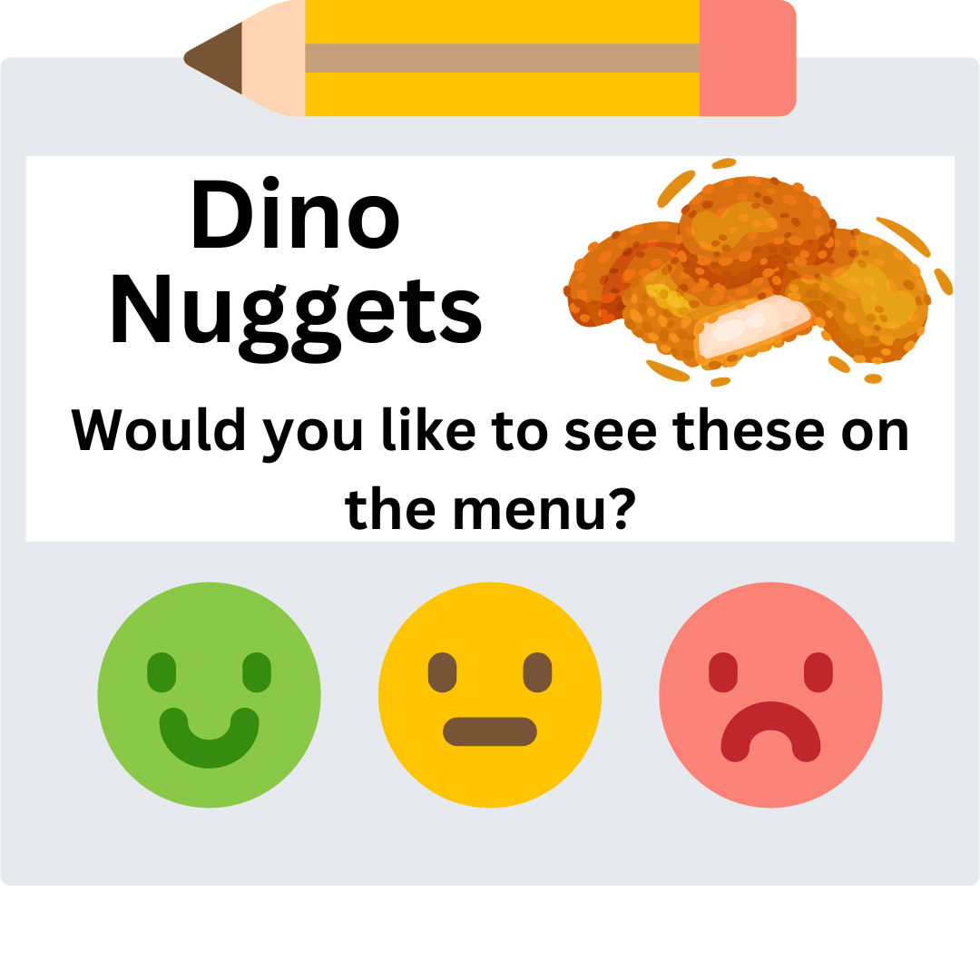
Taste-Test Surveys
Determine preferences
Feedback on menu items
Share with stakeholders
Convey student preferences
Decide menu additions

Slide 12
Planning Taste-Test Surveys
Determine the purpose of the taste test.
Ensure the potential menu items are appropriate for your program.
Plan to test no more than three or four items at a time.
Decide the specifics.
Develop a summary sheet to record the survey results.
Decide on an “acceptability” rate.

Slide 13

Determine the purpose of the taste test.
New menu item sample?
Compare student preferences for multiple item versions?

Slide 14

Ensure the potential menu items are appropriate for your program.
Meets nutrition standards?
Fits budget/price?
Available for delivery?
Have necessary equipment?
Staff capable of preparation?
Adequate storage?
Appealing (appearance & plate coverage)?
Holds well on the serving line?

Slide 15

Plan to test no more than three or four items at a time.
Limit tastings to 3-4 items
Prevents student fatigue and maintains focus
Reduces confusion for more accurate feedback
Improves decision-making for menu additions

Slide 16
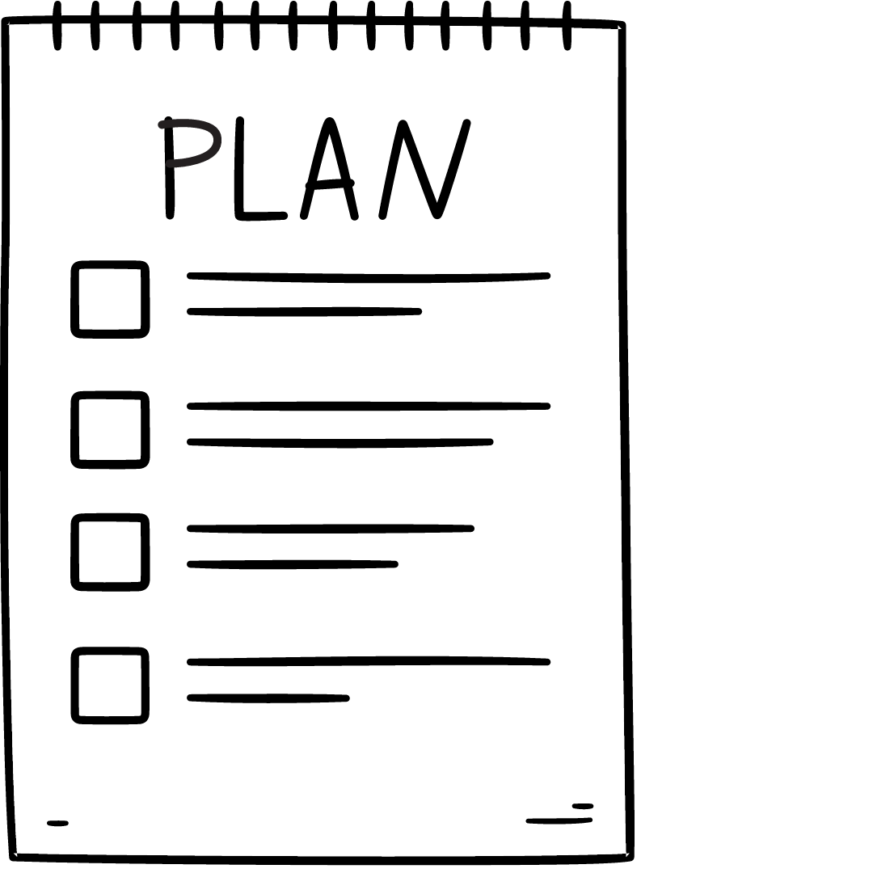
Decide the specifics.
Who participates
Testing time and location
Facilitator
Time available
Data collection method

Slide 17

Develop a summary sheet to record the survey results.
Tracks tested food and participation
Identifies preferred items for menus
Shares findings with school stakeholders
Organizes data for better food choices

Slide 18
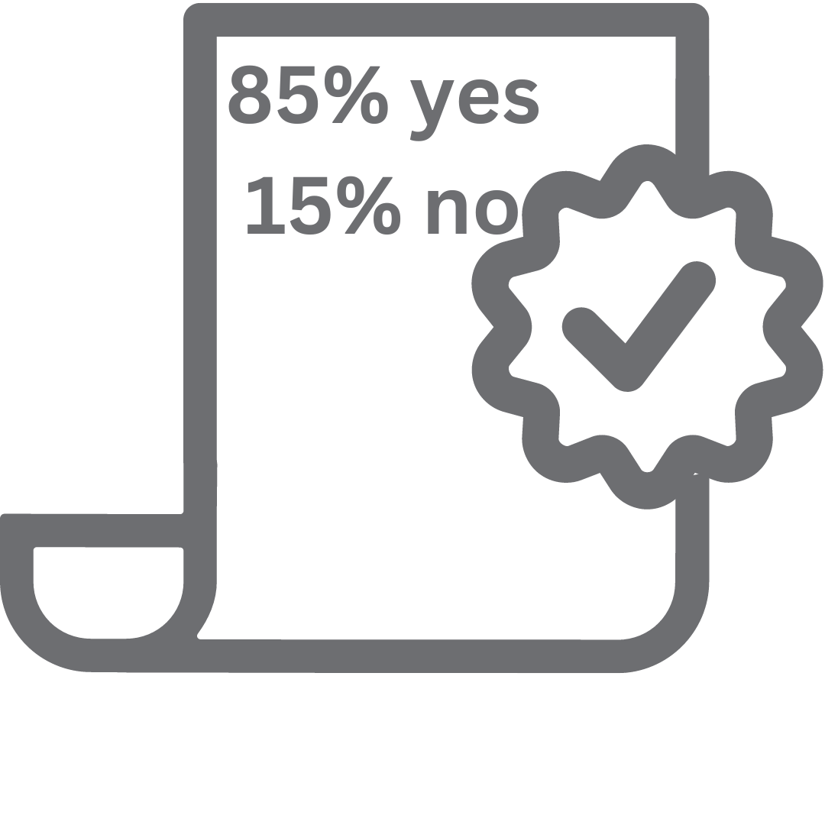
Decide on an “acceptability” rate.
Determine whether or not to offer or include the menu item

Slide 19
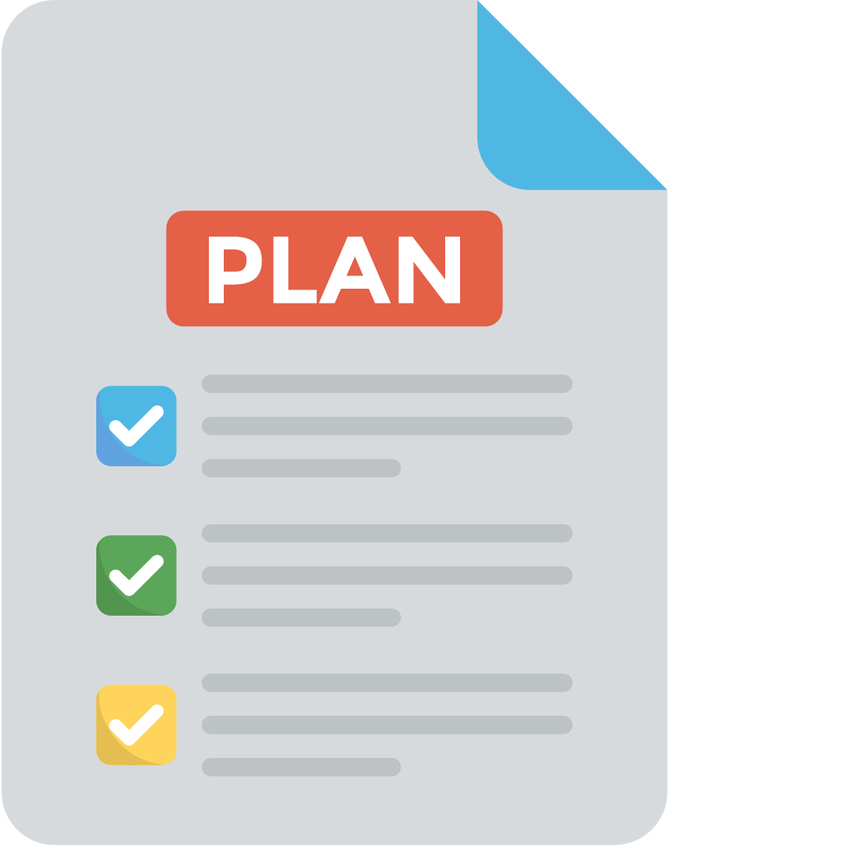
Implementing Taste-Test Surveys

Slide 20
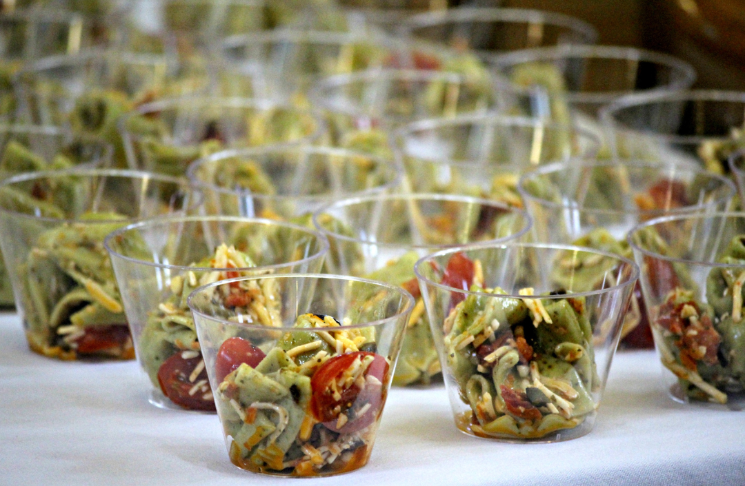
Use disposable soufflé cups or boats for the samples.

Slide 21
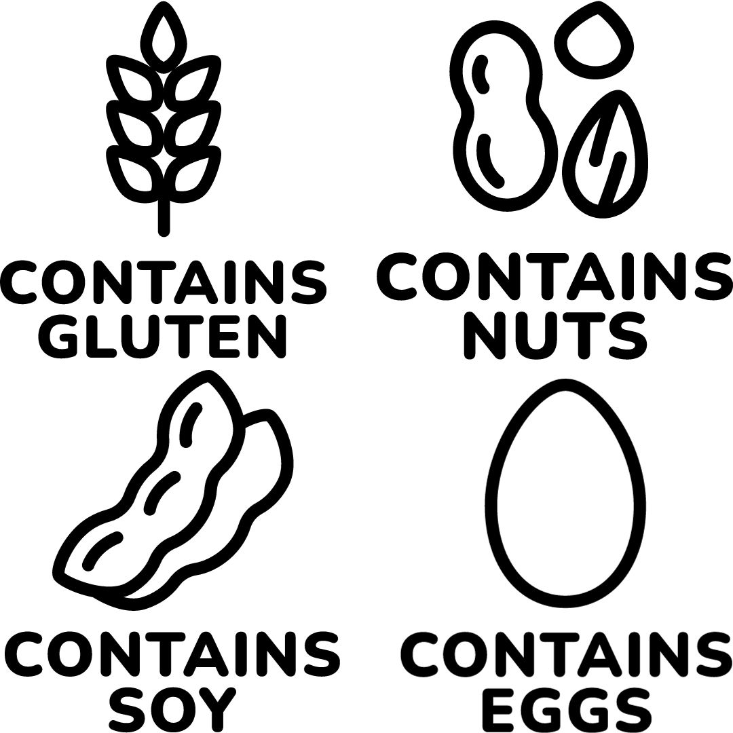
Follow food safety and sanitation standards.

Slide 22

Create a safe place for sharing.

Slide 23
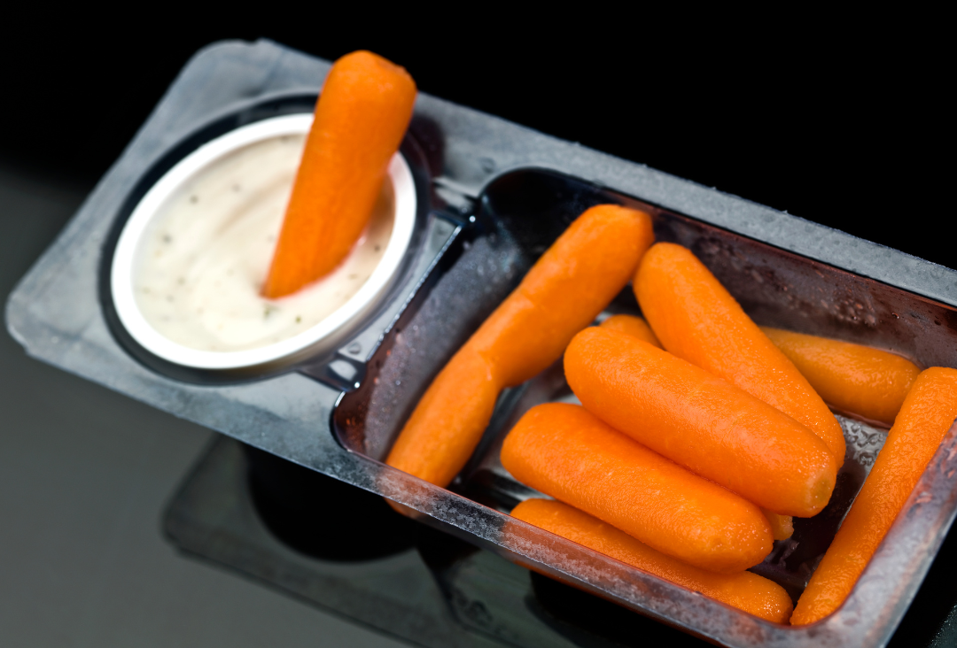
Promote customer acceptability.

Slide 24

Note verbal comments.

Slide 25
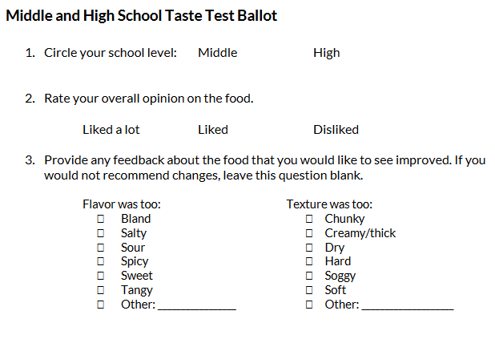
Activity: Taste-Testing Brainstorm

Slide 26

What now?
Assess the results

Slide 27

If the product or recipe is found acceptable …
Add it to the menu and assess it three times.
Adjust its frequency in the menu.
Keep an eye on production records and plate waste

Slide 28

If the product or recipe is not found acceptable …
Don't purchase the product
Revise the recipe and retest
Ensure the correct preparation of the recipe

Slide 29

Assessing Recipes
Refer to USDA Recipe Standardization Guide

Slide 30

Activity: Sharing Success

Slide 31

Developing & Implementing Menu Surveys
Collect student feedback with menu surveys
Design survey questions effectively
Consider grade levels for appropriate questions
Survey in various locations
Use survey responses for decision-making

Slide 32

Early Elementary Students (Pre K–3rd Grade)
Age-appropriate questions
Simplify surveys for early elementary students
Don't overwhelm with too many questions

Slide 33

Paper-and-Pencil
YES or NO
Graphics

Slide 34
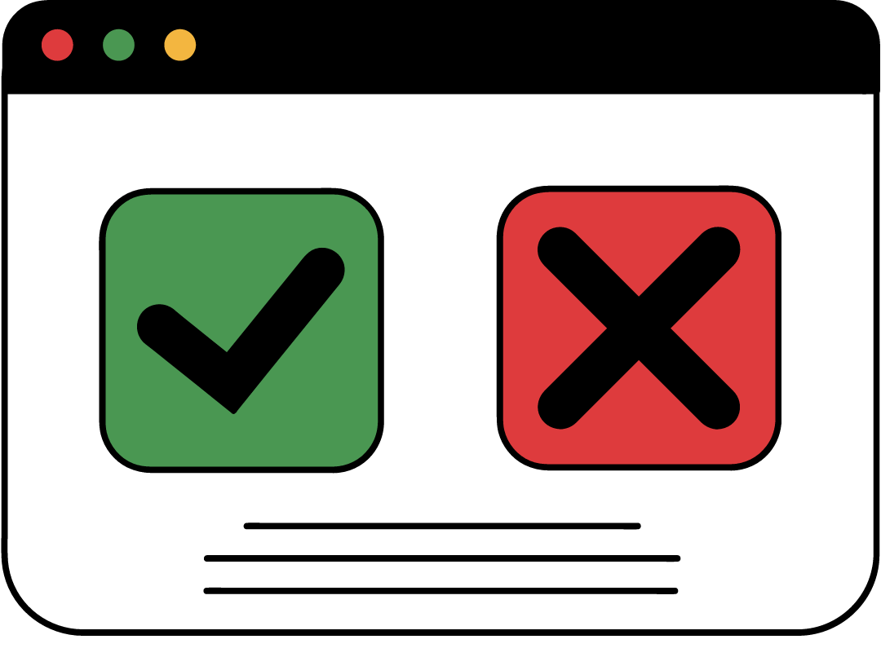
Technology
YES or NO
Graphics

Slide 35

Tokens
Engage fine motor skills
Easy-to-read question
Collection boxes with response options

Slide 36

Words/Graphics
Easy-to-read question
Printed words/graphics
Collection box
Select and drop graphic into box

Slide 37

Older Elementary (4th and 5th Grade) and Middle School Students
More than one question
Not more than four

Slide 38

Paper-and-Pencil 2
"Yes/No" questions
One to two open-ended questions

Slide 39

Technology 2
"Yes/No" questions
One to two open-ended questions

Slide 40

Consider This
Liked about [menu item]?
Disliked about [menu item]?
Changes to improve [menu item]?
Interest in [menu item]?
Suggestions for menu additions?

Slide 41

High School Students
Portion size, flavor, appearance, and texture
Accompanying products like sauces, dips, or toppings
Preferred fruit and vegetable sides
Favorite restaurant menu items

Slide 42

Paper and Pencil 3
Student leaders to interview and record comments
Teacher-recommended students
Student Nutrition Advisory Council (SNAC)

Slide 43

Technology 3
QR code in cafeteria
Smartphone surveys
Social media feedback

Slide 44

All Age/Grade Groups
Non-food prizes
Water bottles
Frisbees
Balls
Jump ropes
Movie passes
Local vendor incentives

Slide 45

Activity: Taste-Testing Brainstorm

Slide 46

Responses are Reputable
Review survey responses
Talk to students
Gather information
Teachers' assistance

Slide 47

Listen to Your Customers
Identify themes
Unfavorable feedback
Valuable feedback

Slide 48

Menu Preferences
Significant changes require many responses

Slide 49

Ideas
Menu improvements

Slide 50

Look at the Big Picture
Consider pairings

Slide 51
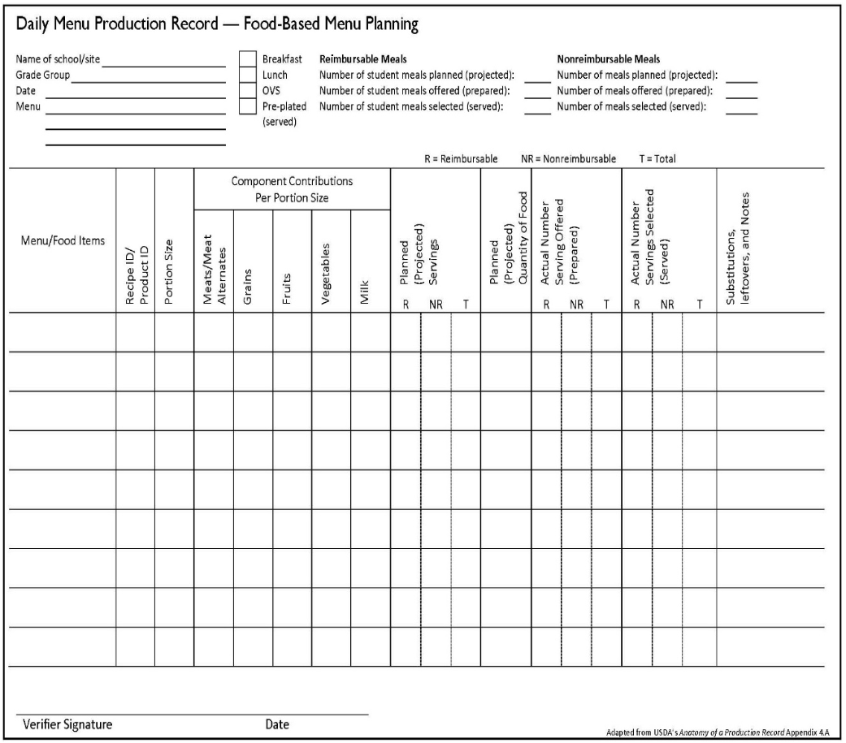
Production Records
Determine favorite items

Slide 52
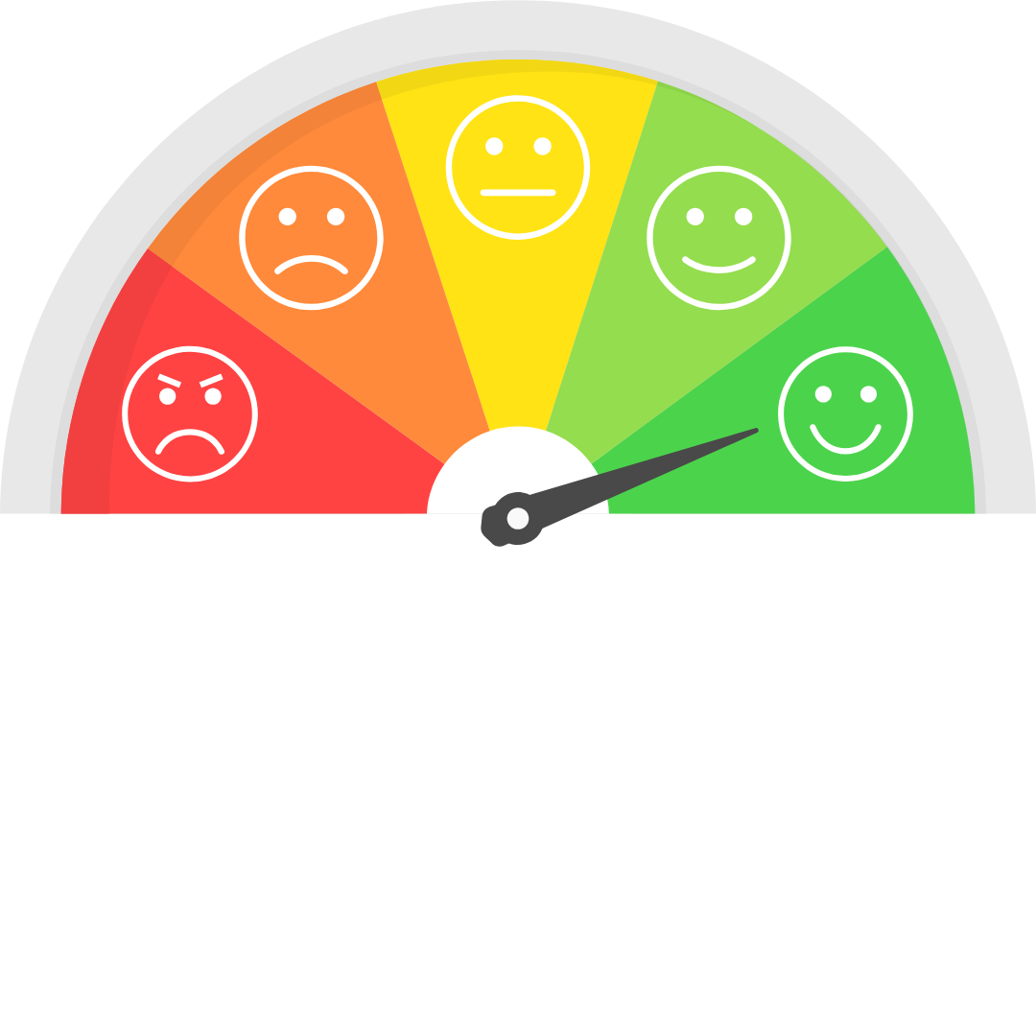
Incorporating Menu Survey Feedback
Use survey results to make menu decisions
Show customers their opinions matter

Slide 53

Appeal to the Senses
Menu modifications

Slide 54

Share Responses
Generate ideas
Foster buy-in

Slide 55

Presentation
Attractive
Appropriately plated

Slide 56
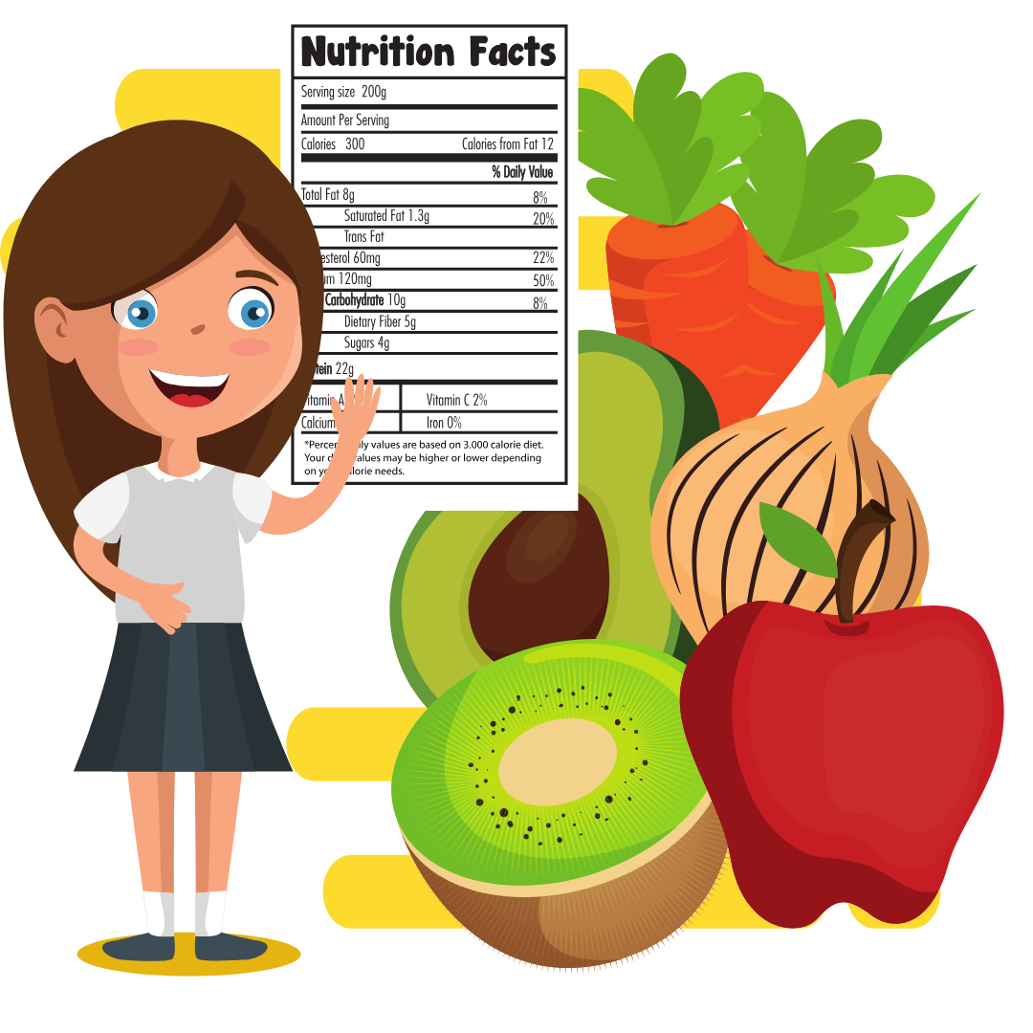
Nutrition Information
Advertise nutrition information
Use approved nutrient analysis software
Look for trends in reports

Slide 57
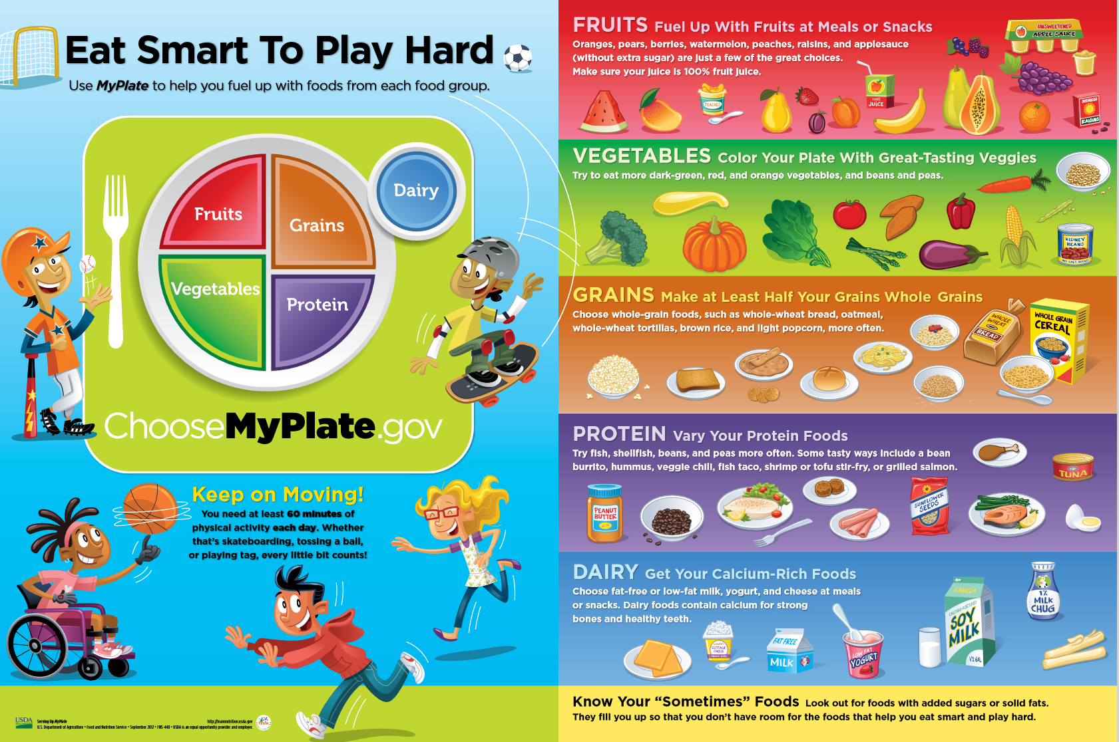
Nutrition Education
Fact sheets
Posters
Learning activities

Slide 58

Make Changes
Modify or try a new recipe
Procure a different variety or brand for heat-and-serve products
Ask for samples from the distributor
Collaborate with the school culinary community members

Slide 59

Continuous Evaluation
Monitor trends and production records
Regular schedule

Slide 60
Activity: Sharing Success 2

Slide 61

Lesson 1 Summary
Interact with many students
Menu surveys collect feedback and interest
Taste-test surveys test initial acceptability

Slide 62
Lesson 2: Strategies for Maintaining Student Acceptability

Slide 63

Student Nutrition Advisory Council
Group of students and school representatives
Advance wellness and evaluate school meal program
Improve meal acceptability
Encourage healthy choices

Slide 64

Assembling a Council
Identifying potential members
Involving teachers, staff, and parents
Ensuring representation of the entire student body
Targeting students in relevant classes

Slide 65

Managing a Council
Scheduling the first meeting
Setting goals and structure
Explaining the importance of participation
Influencing menu items and nutrition activities
Presenting information on meal patterns and dietary requirements

Slide 66

Interest and Goals
Sharing program goals
Increasing participation
Testing new menu items and recipes
Developing a new menu, service line, or style of service
Promoting good nutrition

Slide 67

Organization
Leadership
Note-taking
Meeting frequency and duration
Agenda
Meeting times and locations
Communication of activities and follow-up items

Slide 68
Activity: Student Nutrition Advisory Council Brainstorm

Slide 69
Student Engagement
Discuss menu options and preferences
Brainstorm creative menu names
Provide kitchen tours
Taste-test new products
Collect menu surveys
Review and adjust previous menus
Plan promotional events
Promote healthy choices
Engage in gardening and composting
Reduce plate waste
Community service projects
Nutrition-based assemblies

Slide 70
Lesson 2 Summary
Student-centered, nutritious menu
Improved meal acceptability
Encouragement of healthy choices

Slide 71
Culminating Activity and
Action Plan

Slide 72
Activity: Independent Work Time

Slide 73

Activity: Sharing Strategies and Action Plans

Slide 74
Thank You!
Post-Assessment

