Slide 1
Procurement of Lower-Sodium Foods
Sodium Reduction Virtual Workshop Series

Slide 2

Activity: Introductions

Slide 3

Logistics
ICN Ground Rules
  Show Up on Time
  Be Present
  Let Everyone Participate
  Listen With an Open Mind
  Think Before Speaking
  Attach the Problem Not the Person

Slide 4
Background
January 2012: Updated Nutrition Standards
  Reflect Dietary Guidelines for Americans
  Gradual sodium reduction
February 2022: Transitional Standards
  Support during pandemic recovery
  Gradual sodium reduction
Successful Approaches to Reduce Sodium in School Meals
  Examined barriers
  Identified successful strategies
April 2024: Final Rule, Child Nutrition Programs: Meal Patterns Consistent with 2020-2025 Dietary Guidelines for Americans

Slide 5

Sodium Reduction Virtual Workshop Series
Topics
  Menu Planning and Analysis
  Procurement
  Staff Training
  Student Satisfaction
Hands-on Learning
  Apply knowledge and skills
Action Plans

Slide 6

Procurement of Lower-Sodium Foods Overview
Focus on lower-sodium products
Emphasize local food sourcing
Pre-procurement steps
Utilizing USDA programs
Vendor collaboration
Reducing sodium in school meals

Slide 7
Activity: Pre-Assessment

Slide 8
Lesson 1: USDA Food Programs

Slide 9

Working With Procurement Partners
Open communication in the supply chain
SFA's responsibility for nutritious foods
Sourcing from various channels
USDA Foods and DoD Fresh programs

Slide 10

Where to start?
Vendors want your business
Share menu needs and preferences
Seek student input
Establish collaboration and feedback

Slide 11

Procurement Step 1: Prepare to Speak with Vendors Ahead of Time
Evaluate your menu
Set sodium goals
Conduct market research

Slide 12

Pre-Procurement Step 1: Prepare to speak with vendors ahead of time by: Evaluating Your Menu
Identify high-sodium contributors
Use a cycle menu for analysis
Assess item type, frequency, and similarities
See sodium impact in different menus

Slide 13

Pre-Procurement Step 1: Prepare to speak with vendors ahead of time by: Setting Sodium Limits
Set initial maximum sodium limits
Substituting high-sodium contributors
Gradual reduction over time
Minimizes taste differences for students

Slide 14

Pre-Procurement Step 1: Prepare to speak with vendors ahead of time by: Conducting Market Research
Sodium content in commercially processed foods
Challenges in obtaining product information
Varied product ingredients and formulations
Rapidly changing manufacturing processes
Identifying potential collaborators and their roles

Slide 15

Pre-Procurement Step 2: Discuss Your Menu Needs With Vendors
Share findings from market research
Ask for information about low-sodium products
Explore lower-sodium versions or alternatives
Compare sodium amount, serving size, unit price, and meal contribution

Slide 16

Product Substitution
Provide information for current products:
  Name
  Description
  Sodium amount
  Serving size
  Crediting information
Essential for analyzing and assessing differences

Slide 17

Pre-Procurement Step 3: Seek Student Input
Essential for menu substitutions
Student preferences matter
Conduct taste-testing activities
Use surveys for feedback
Engage vendors for support
Ensure student acceptance of new items

Slide 18
Activity: Procuring Lower-Sodium Products Checklist
Evaluate your menu
Familiarize yourself with sodium levels of all products and recipes in your menu
Identify the highest-sodium contributors
Set maximum sodium limits for all products
Identify a subset of your highest-sodium contributors to replace with lower-sodium versions
Conduct market research to familiarize yourself with potential lower-sodium substitutes
Discuss menu needs with vendors
Notify vendors of maximum sodium limits
Share which menu items or products you are looking to substitute with lower-sodium versions
Share findings from market research
Identify lower-sodium product options
Seek student input
Reach out to vendors to obtain samples
Implement taste-testing activities and surveys
Incorporate new products and recipes into menu
Set new maximum sodium limits

Slide 19

USDA Foods Program
Supports SFAs
Provides American-grown foods
Helps meet meal patterns and dietary specifications
Supports farm to school activities with grants

Slide 20

USDA Foods in Schools
Provides domestically produced food
Includes fruits, vegetables, meats, grains, dairy
Offers more than 200 products
Available through different ordering options

Slide 21
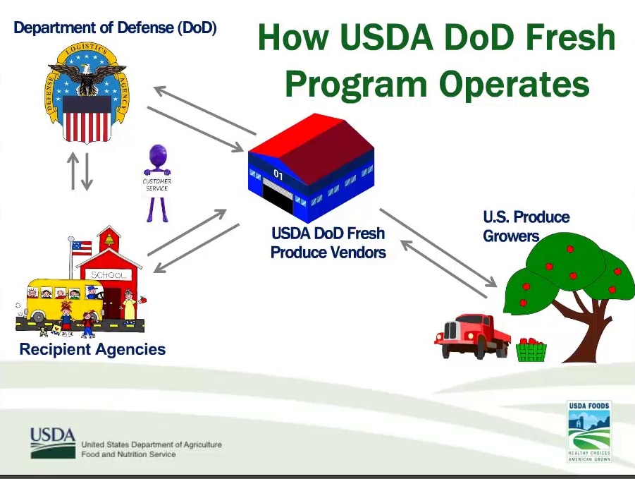
USDA DoD Fresh
Partnership between USDA and DoD
Provides fresh fruits and vegetables
Weekly deliveries to schools and more

Slide 22

Farm to School Grant Program
Supports farm-to-school programs
Provide agriculture and nutrition education
Available for schools in the NSLP
Two grant tracks: Turnkey and Implementation
Funding for equipment, partnerships, and education

Slide 23
Activity: USDA Foods Programs

Slide 24

How to Participate in USDA Foods Including USDA DoD Fresh
Contact your SDA
SDA sets funding (PAL)-based on last year's meals
Choose available products

Slide 25
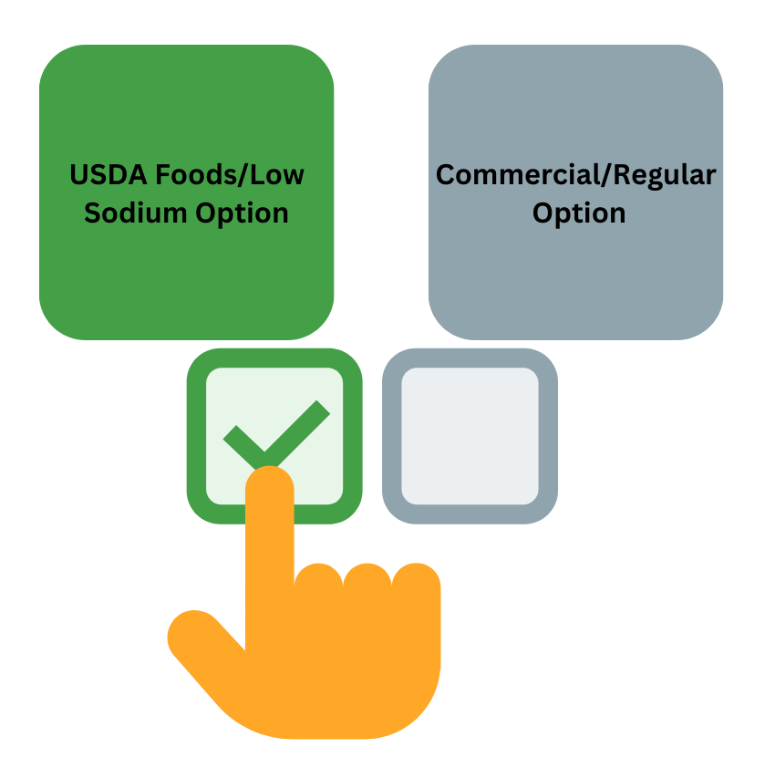
Using USDA Foods to Lower Sodium in School Meals
Swap commercial foods
Low sodium or none
Reduced sodium products-cheese, meat, poultry, fish

Slide 26
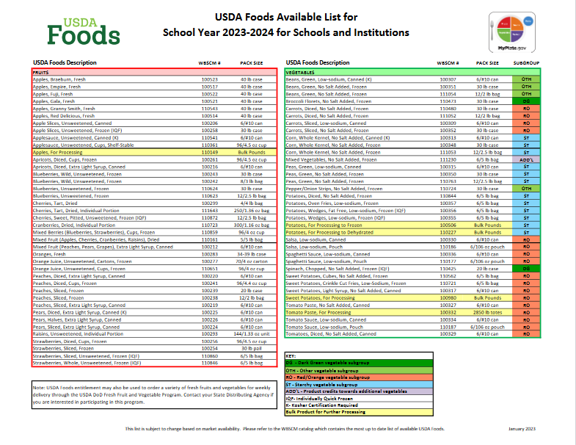
USDA Foods Available List
Lists products available
Categorized by food group
Highlights low sodium items

Slide 27
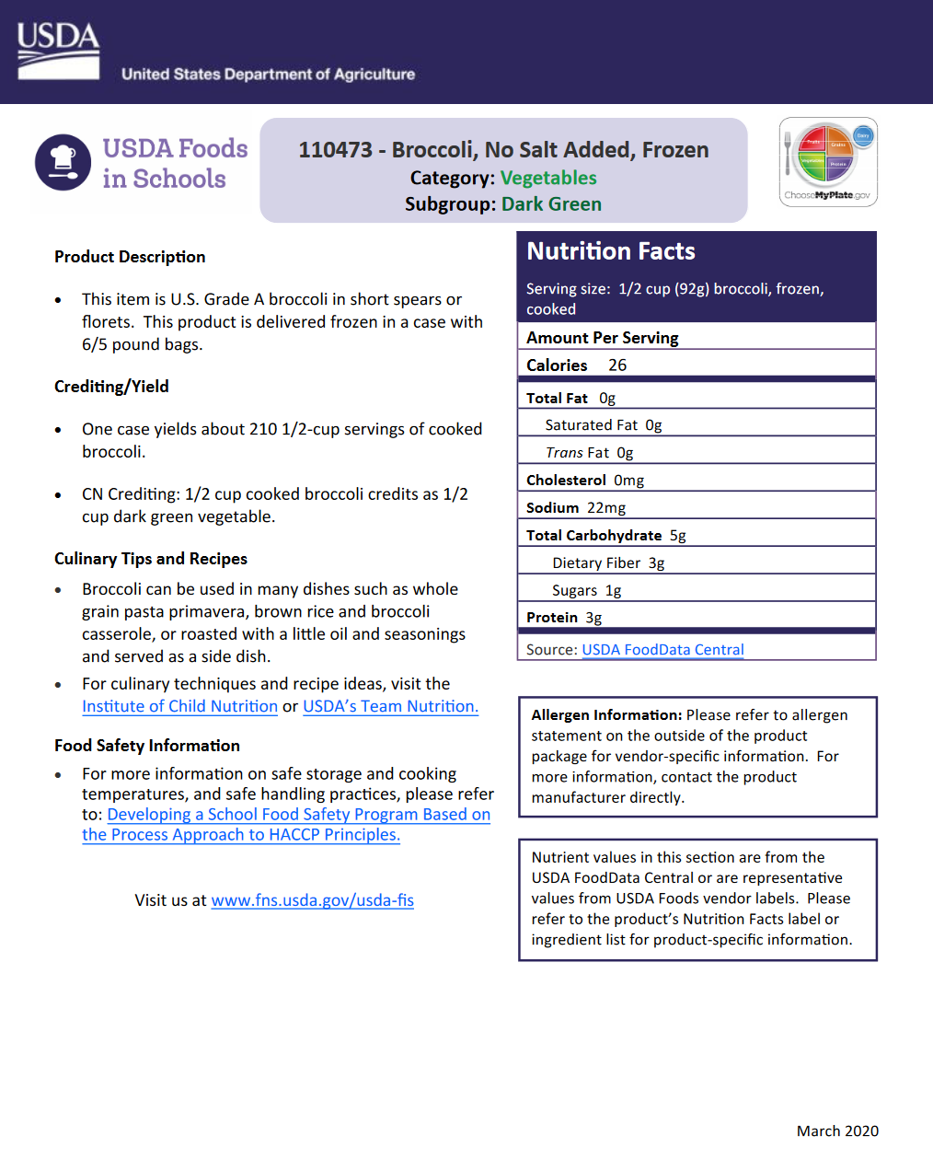
USDA Foods Product Information Sheets
Detailed product info
Categorized by food type
Compare sodium content

Slide 28
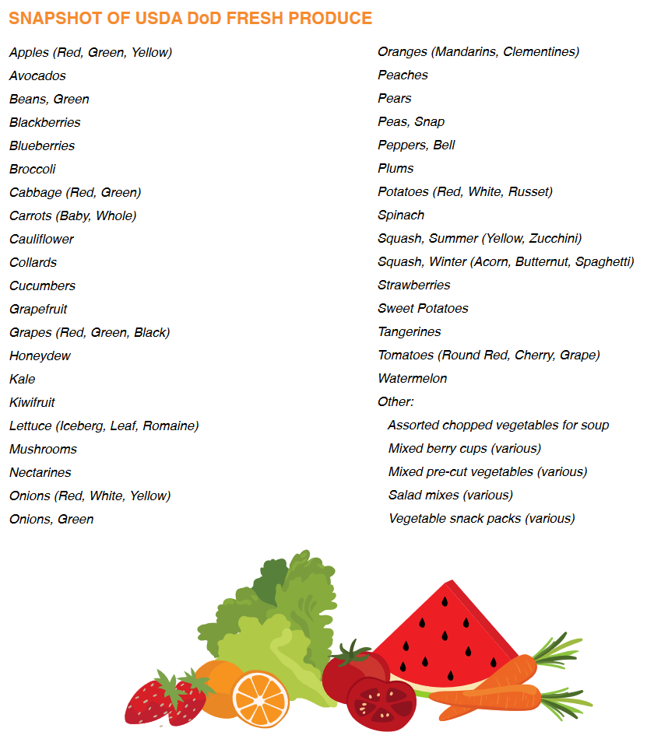
Using USDA DoD Fresh to Lower Sodium in School Meals
Fresh produce
Naturally low sodium
Use in various menu items

Slide 29

Activity: Food for Thought

Slide 30

Incorporating Local Foods in School Nutrition Programs
Fresh, minimally processed
Supports sodium reduction
Various procurement options
Strategies for menu inclusion

Slide 31
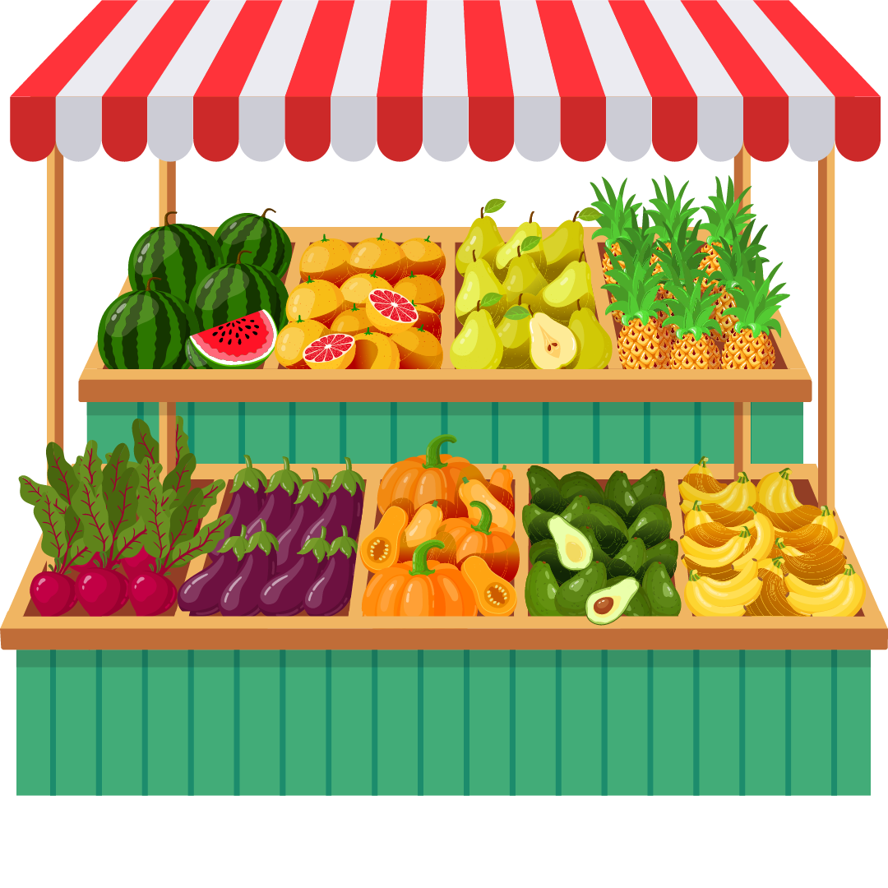
Before Incorporating Local Foods
Define "local"
Identify local products and their season

Slide 32

Defining Local
Mile radius
County
State
Varies by product and season

Slide 33
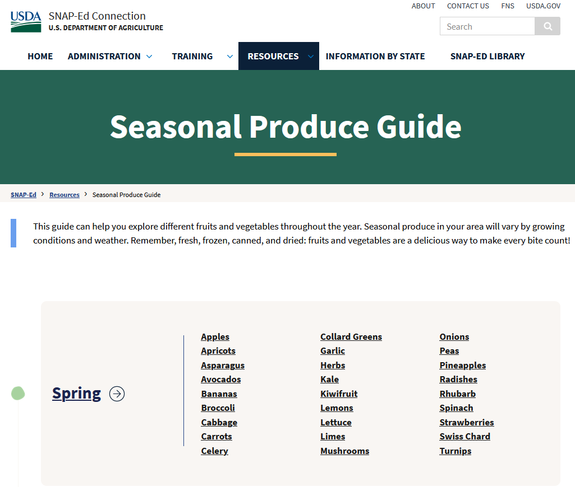
Local Availability Resources
Land-Grant University-Extension
State or Region-Specific Seasonality Charts
USDA Census of Agriculture
USDA Farm to School Census

Slide 34

Strategies to Grow Your Local Foods Menu
Fresh fruits and vegetables
Local meats
Replacing higher sodium items

Slide 35

Identify local foods that are already on the menu.

Slide 36

Look for local foods to replace what you already offer on the menu.

Slide 37
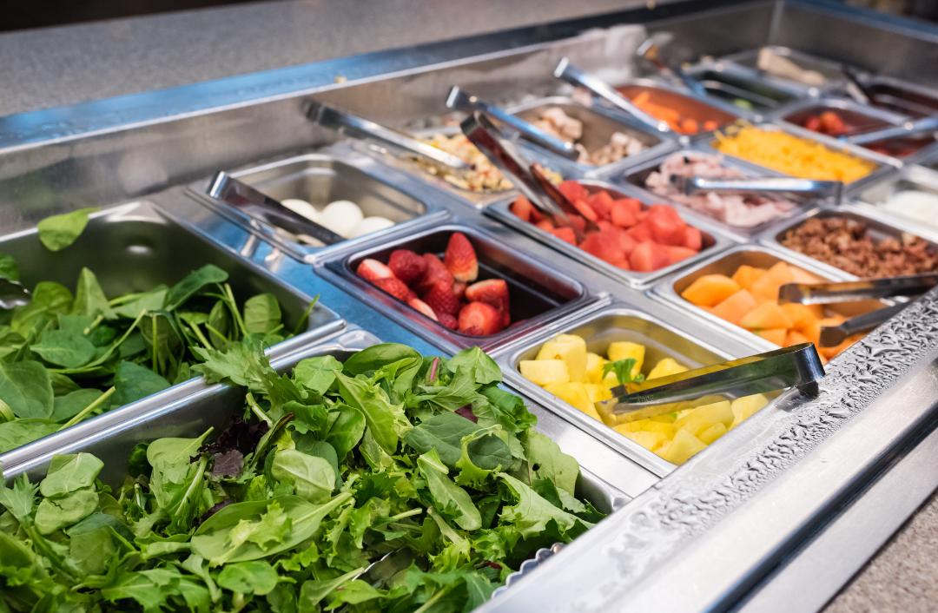
Adjust menus and recipes to incorporate local foods.

Slide 38

Develop new menus and recipes to highlight local foods and ingredients.

Slide 39

Activity: Grow Your Local Foods Menu Action Plan

Slide 40

Lesson 1 Summary
USDA Foods in Schools offers domestically produced food
DoD Fresh Fruit and Vegetable Program provides fresh produce
USDA Farm to School Grant Program funds farm-to-school initiatives
Using fresh local foods can help reduce sodium in school meals

Slide 41
Lesson 2: Cooperative Purchasing Groups

Slide 42

Purchasing Agreements
SFAs use different types of purchasing agreements
Consider joining a CPG

Slide 43

Cooperative Purchasing
Pooling purchasing power
Advantages for SFAs
Compliance with regulations

Slide 44

Form a Cooperative Purchasing Group
Review guidelines
Conduct research
Member-user survey
Analyze finances
Meet potential members
Develop a business plan

Slide 45
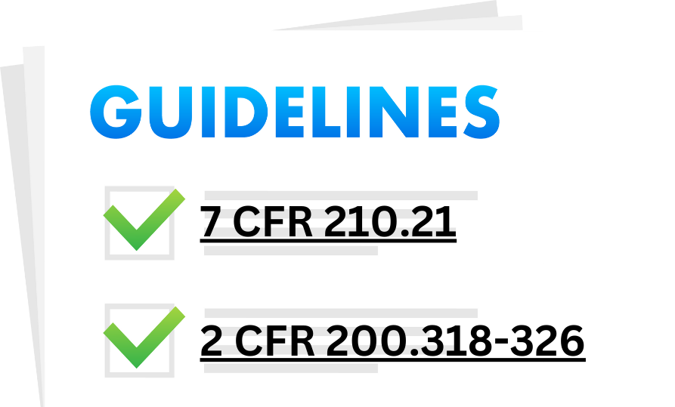
Review Federal Guidelines
Ensure full and open competition
Comply with Federal standards

Slide 46

Conduct Initial Research
Form a leadership group
Contact local directors
Discuss cooperative purchasing group
Hold a general meeting

Slide 47

Conduct Member-User Survey
Survey for potential group membership
Questions on product needs, business volume, financial commitment
Build trust through phone calls, meetings

Slide 48

Seek Advisors
Consider outside advisors
State agency, officers, legal/purchasing experts
Clarify fees and expenses

Slide 49

Analyze the Financial Needs of the Purchasing Group
Feasibility analysis
Identify costs
Market research
Business fluctuations

Slide 50

Conduct a Meeting with the Lead Committee
Vote to continue
Chairperson
Express procurement needs
Review survey results
Discuss operations, advantages, disadvantages, risks, benefits, limitations

Slide 51

Seek Assistance While in Preparation Stage
Economic need is fundamental
Seek help from State agency, legal experts
Start with limited services
Expand after successful operation

Slide 52

Develop an Agreement
Consider all member SFA needs
Develop quantities, specifications
Agree on product list based on menus
Establish governing policies
Maintain communication
Know Federal Procurement Regs

Slide 53
Activity: Tips for a Successful Meeting
Send meeting info early
Prepare agenda, handouts
Be well-prepared
Appoint a meeting leader
Start/end on time
Record detailed notes
Introduce participants
Encourage questions
Provide resources
Follow up on issues
Set next meeting details

Slide 54

Join a Cooperative Purchasing Group
Determine needs
Equal voice in decisions
Concessions for cost savings

Slide 55
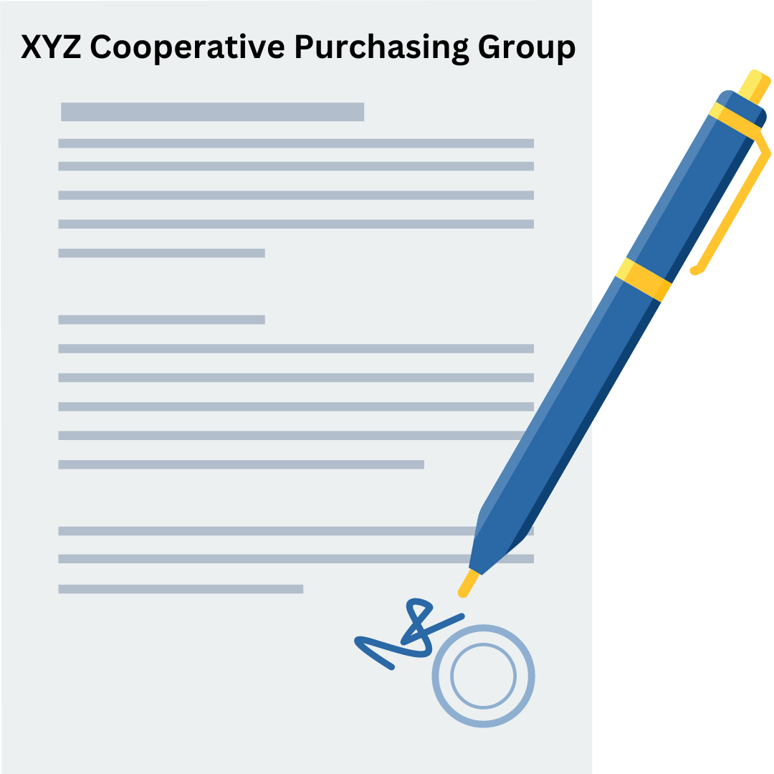
Purchasing Group Application
Request to become a member
SFA authorized signature
Group's acceptance
President and secretary signatures
Member's intent and duty statement

Slide 56

Factors to Consider Before You Join
Membership in good standing
Time commitments, money, and expertise
SFA's needs

Slide 57
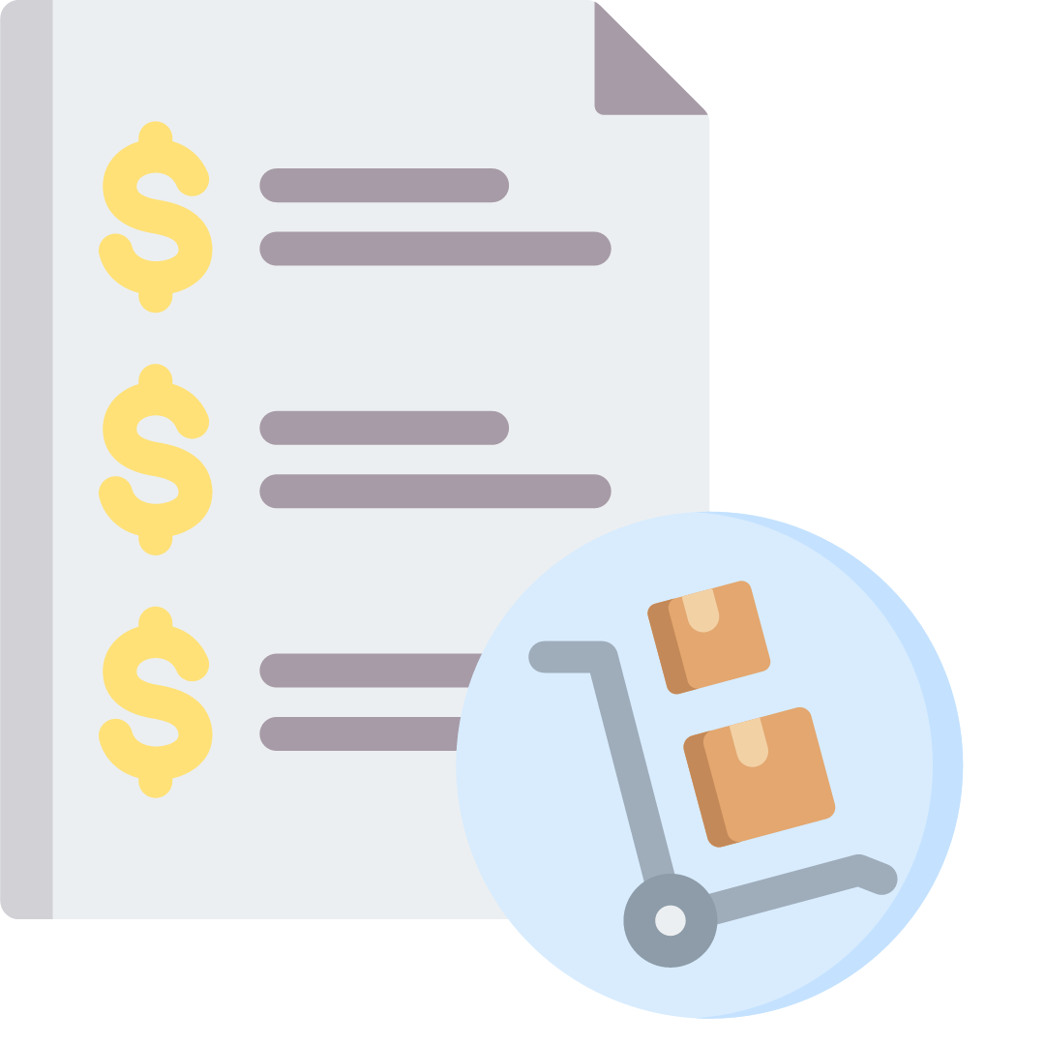
Costs
Consider current food costs
Evaluate the volume of purchases
Assess administrative fees
Calculate and compare costs

Slide 58
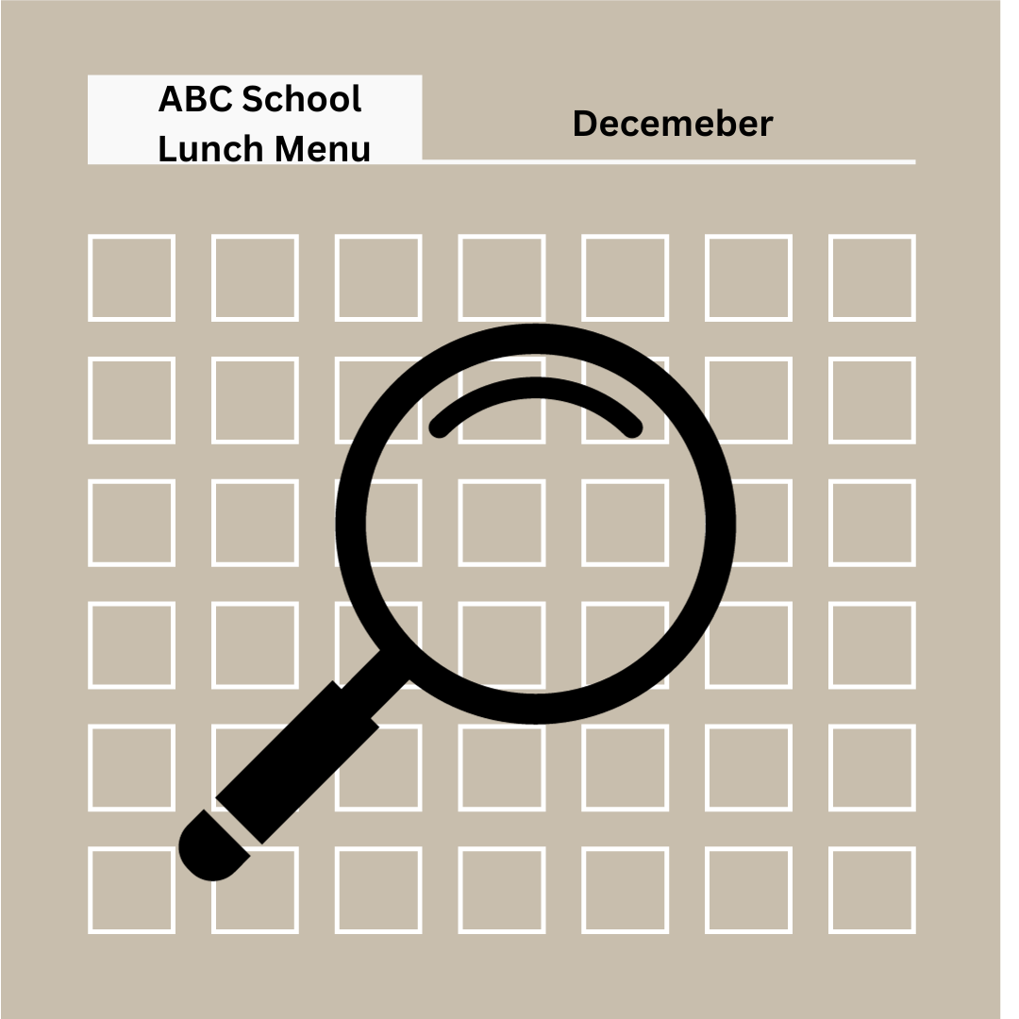
Menus
Review menu items
Forecast needs
Consider high-volume items
Evaluate cooperative purchasing

Slide 59

Delivery Schedules and Storage Capacity
Evaluate delivery schedules
Assess storage capacity
Consider larger, less frequent deliveries
Impact on pricing
Check storage space suitability

Slide 60

Local Regulations
Unique local regulations
Small purchase threshold
Compatibility with the group's practices
Consider any restrictions

Slide 61

Group Costs
Participation costs
Administrative fees
Membership fees
Additional delivery fees
Penalties
Comparison with existing costs

Slide 62

Legal Responsibilities
Binding agreements
Consult legal counsel
Termination conditions

Slide 63

Training
Contact group members
CN State agency
Local SNA chapter
Institute of Child Nutrition
Legal counsel & purchasing office

Slide 64

Farm to School/Local Foods
Consider geographic preference
Specify in solicitation & contract
Define local area

Slide 65

Rebates
Allocate based on purchase volume
Report to each SFA
Cost-reimbursement contracts

Slide 66

Small Vendors
Affirmative steps for small, minority, and women's businesses
Promote diversity and inclusion
Expand supplier opportunities
Align with government objectives

Slide 67

Menu Items
Procure new and varied menu items
Maximize full and open competition
Competitively procure new products

Slide 68

Legal Counsel
Seek legal counsel
Familiar with State statutes
Review agreements and contracts
Ensure legal compliance

Slide 69

Ask Questions
Reach out to organizations
CNP State agency
Local SNA chapter
SFAs in cooperative groups

Slide 70

Activity: Examine Your SFA’s Needs

Slide 71

Evaluate the Cooperative Purchasing Group
Identify existing CPGs
Determine SFA needs
Ensure compliance with regulations

Slide 72

Cooperative Purchasing Group Efforts
Benefits: savings, improved quality, efficiency
Drawbacks: fewer deliveries, product changes

Slide 73

Advantages and Disadvantages

Slide 74

Sodium Reduction Spotlight: Purchasing Power and Volume
More lower-sodium products
Lower prices
Volume purchases
Directly from manufacturers

Slide 75

Advantages
Increased purchasing power
Enhanced quality & availability
Reduced administrative burden
Direct manufacturer purchasing
Increased volume for SFAs
Networking opportunities
Centralized decision-making
Other benefits

Slide 76

Increased Purchasing Power
Negotiate contracts as one entity
Lower prices
Wider product range
Higher quality
Ability to purchase large-volume items
Demand for lower-sodium products
Lower prices for school-appropriate products

Slide 77

Enhanced Quality and Availability of Products
Knowledge sharing
Quality improvements
Variety in menu items
Enhanced customer satisfaction
Increased participation

Slide 78

Reduced Administrative Burden
Fewer deliveries
Fewer invoices
Less paperwork
Reduced administrative costs
Focused attention on core responsibilities

Slide 79

Direct to Manufacturer Purchasing
Benefits: direct discounts, rebates, and credits
Savings on vendor fees
Greater savings for high-volume items
Advantages for small and medium SFAs
Attract more vendors
Simplified procurement for smaller entities

Slide 80

Increased Volume for SFAs
Small to medium SFAs benefit
Suitable for rural SFAs
Larger SFAs have dedicated staff
Director serves multiple roles
Attracts vendors for multiple SFAs

Slide 81

Networking Opportunities
Exchange ideas
Learn from experienced directors
Share product and vendor information

Slide 82

Centralized Decision-Making
Consistent vendor communication
Group leadership for procurement problem-solving
Less individual vendor interaction

Slide 83

Other Benefits
Shared best practices
Labor savings
Increased cooperation
Group marketing
Promotion calendar
Menus and production records
Staff training
Branding
Specialty solicitations

Slide 84

Disadvantages of Cooperative Purchasing
Consensus among members
Deliveries
Food costs
Storage
Administrative costs

Slide 85

Consensus Among Members
Agreement on product details
Combine orders when you can
Stick to common products
Be ready to compromise

Slide 86

Deliveries
Consider fewer, larger deliveries
Discuss delivery frequency with your group
Ensure storage capacity for bulk deliveries

Slide 87

Food Costs
Potential for higher quality, higher-cost products
Adjust or compromise on product quality
Eliminate products
Purchase independently when cost increases aren't sustainable

Slide 88
Storage
Limited storage space in some SFAs
May need additional storage equipment or space
Compare savings to equipment or rental costs
Make informed decisions on storage capabilities

Slide 89

Administrative Costs
Membership fees required
Range from flat fee to per-student or per-case fee
Fees must be transparent
Included in cost analysis
May offset potential savings
Consider all costs for group participation
Deposit for timely payments

Slide 90

Activity: Benefits and Challenges

Slide 91
Lesson 2 Summary
How to form a CPG
How to join a CPG
Advantages and disadvantages of CPG

Slide 92
Lesson 3: Procurement Strategies

Slide 93

Use Your Network
Connect with neighboring districts
Learn about lower-sodium products
Informal surveys or formal plan
Discover what students enjoy

Slide 94

Identify the neighboring school districts
Identify neighbors
Use maps
Consult State agency

Slide 95

Create a list of products
List high-sodium foods
Include brands/types
Current usage

Slide 96

Develop a survey
Include product questions
Preparation and student feedback

Slide 97

Contact Neighboring School Districts
Reach out via email or phone
Explain the purpose of the survey
Request their participation
Provide a deadline for completion
Offer a contact for follow-up questions

Slide 98

Collect and analyze the data
Gather survey responses
Compile data
Analyze for common products

Slide 99

Consider changes
Adapt menu items
Include lower-sodium options

Slide 100

Activity: Sharing Success

Slide 101

Writing Specifications That Limit Sodium
Plan menus
Write product specifications

Slide 102
Product Specifications for Use in a Competitive Procurement Process
Product name
Product description
Brand name
Case pack and weight
Main ingredients
Other product ingredients
Prohibited ingredients
Minimum and maximum sizes and pieces
Unit on which award is made
Quality indicators
Meal pattern equivalents
Nutrition standards
Buy American

Slide 103
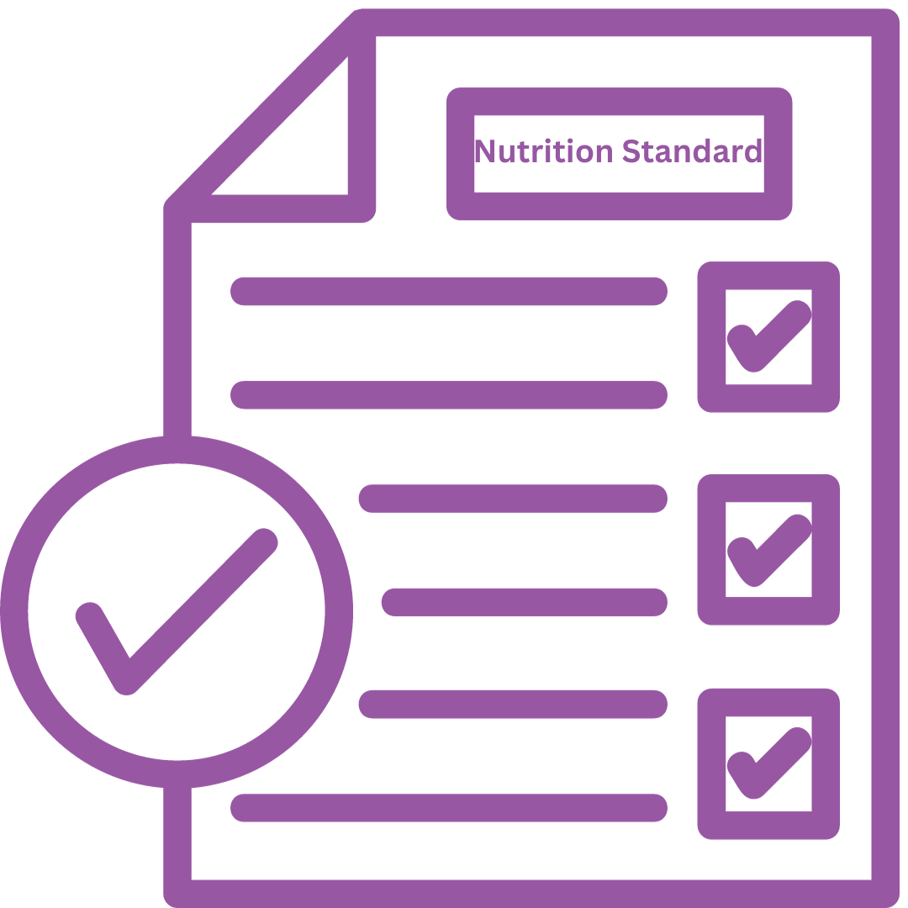
Nutrition Standard
Required for:
  Milk: Fortified with vitamins A and D, fat-free (skim), or low-fat (1%)
  Commercially processed, packaged, and prepared foods: Zero grams of trans fats per serving
Consider Nutrition Standards for Limiting Sodium in Specifications for:
  Bread products
  Canned vegetables and legumes
  Condiments
  Heat-and-serve entrées
  Potato products
  Processed meats
  Tomato-based products
  Seasoned/flavored vegetables

Slide 104

Writing Specifications that Limit Sodium Approaches
Sodium Nutrient Claims
Smart Snack Compliant
Maximum Sodium Limit

Slide 105

Sodium Nutrient Claims
Serving as Nutrition Standards
Inter-Brand Variation
Label Comparison
Consider Popularity

Slide 106

Smart Snacks Compliant
≤ 480 mg for entrées
≤ 200 mg for side items

Slide 107

Maximum Sodium Limit
Use when no sodium claim or specific limit needed
Determine limit via product and menu analysis

Slide 108

Examples of Product Specifications That Limit Sodium

Slide 109
Use Sodium Nutrient Claims
GREEN BEANS, Cut, Canned, Grade B or better, Low sodium.
CARROTS, Diced, Frozen, Grade A, No salt added.

Slide 110
Require Products to Meet Smart Snack Requirements
BAGEL, BLUEBERRY, Sliced. First and primary ingredient must be whole grain. The product must contain at least 50% whole grain content. Smart Snacks compliant (2.00 oz. equivalent Grains). Product Formulation Statement preferred.
GRANOLA, CINNAMON, Individually wrapped. First and primary ingredient must be whole grain. The product must contain at least 50% whole grain content. Smart Snacks compliant (1.00 oz. equivalent Grains). Product Formulation Statement preferred.

Slide 111
Define Maximum Sodium Limits
BURRITO, BEAN & CHEESE, Fully cooked, IQF. Pinto and black bean burrito on a whole grain-rich tortilla. Cannot contain beef, poultry, pork, or fish by-products or MSG. Must contain between 300-350 calories, less than 10% calories from saturated fat, zero trans fat, and may not exceed 500 mg of sodium per individual portion (1.00 oz. equivalent M/MA, 1.50 oz. equivalent Grains). CN label or Product Formulation Statement required.
CHICKEN NUGGETS, Breaded, Fully cooked, IQF. Maximum limit of 400 mg of sodium per 5 piece portion (2.00 oz. equivalent M/MA, 1.00 oz. equivalent Grains). CN label or Product Formulation Statement required.
PIZZA, CHEESE, Sliced, Frozen. Whole grain crust, 100% real cheese (no imitation). No more than 500 mg of sodium per portion slice (2.00 oz. equivalent M/MA, 2.00 oz. equivalent Grains, 1/8 cup R/O Veg). CN label or Product Formulation Statement required.
POTATOES, FRENCH FRIES, Seasoned, Frozen, Ovenable, 1/2” Crinkle cut, Low moisture, U.S. Grade A. Processed in vegetable oil. No more than 200 mg of sodium per 1/2 cup serving.
TOMATO, SAUCE, Marinara, Dipping cups. No HFCS. May not exceed 200 mg of sodium/2.5 oz individual portion cup. Minimum 9 months shelf life from production.
TORTILLA, FLOUR, 8”, Whole grain-rich. Maximum limit of 225 mg of sodium per portion (1.50 oz. equivalent Grains). Product Formulation Statement preferred.

Slide 112

Activity: Writing Nutrient Standards That Limit Sodium

Slide 113

Vendors and Procurement Partners
Talking to vendors
Communicating standards
Establishing partnerships

Slide 114
Potential Questions to Ask
Low-sodium product availability?
Cost and availability?
Special orders?
Product recommendations?
Interest in working together?
Manufacturing low-sodium products?
Specification, amount, pricing, timing, and delivery?
Competitive solicitations?
Replacing with kitchen-prepared recipes?
USDA Foods alternatives?

Slide 115
Activity: Sharing Success2

Slide 116

Comparing Products
Nutrition standards
Taste and student acceptance
Variety and diversity
Cost

Slide 117

Nutrition Standards
Essential nutrients
Limit saturated fats
Limit sodium
Limit added sugars
Evaluate vendor products
Ensure nutritional quality

Slide 118

Taste and Student Acceptance
Taste matters
Impact on student acceptance
Conduct taste tests
Gather student feedback
Balance nutrition and flavor

Slide 119

Variety and Diversity
Dietary needs
Vegetarian options
Cultural diversity
Inclusivity
Nutritional balance

Slide 120
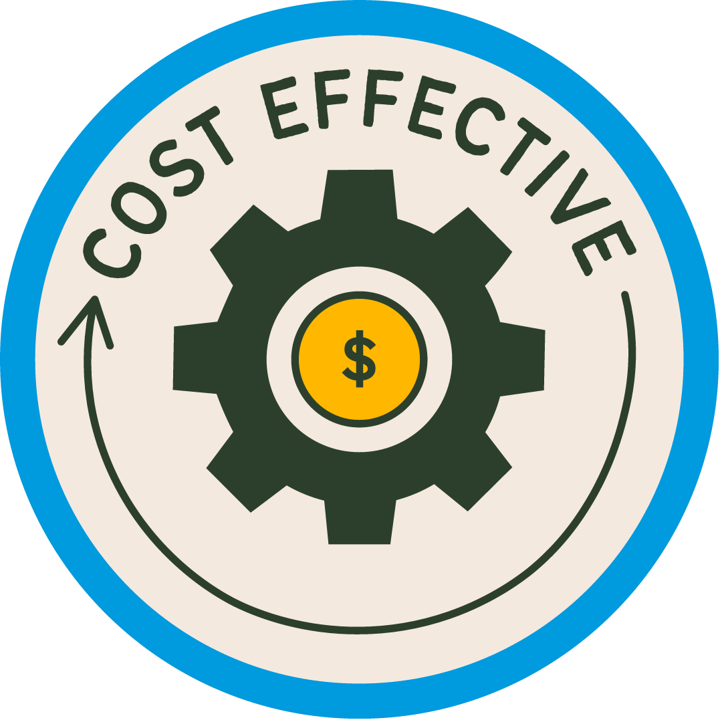
Cost
Affordable pricing
Total product cost
Cost-effective options
Balancing cost and nutrition

Slide 121

Activity: Comparing Vendor Products

Slide 122
Lesson 3 Summary
Networking for lower-sodium products
Collaboration with vendors
Criteria for product comparison

Slide 123
Culminating Activity and
Action Plan

Slide 124
Activity: Independent Work Time

Slide 125

Activity: Sharing Strategies and Action Plans

Slide 126
Thank You!
Post-Assessment

