Slide 1
Staff Training and Engagement for Sodium Reduction Success
Sodium Reduction Virtual Workshop Series

Slide 2

Activity: Introductions

Slide 3

Logistics
ICN Ground Rules
  Show Up on Time
  Be Present
  Let Everyone Participate
  Listen With an Open Mind
  Think Before Speaking
  Attach the Problem Not the Person

Slide 4
Background
January 2012: Updated Nutrition Standards
  Reflect Dietary Guidelines for Americans
  Gradual sodium reduction
February 2022: Transitional Standards
  Support during pandemic recovery
  Gradual sodium reduction
Successful Approaches to Reduce Sodium in School Meals
  Examined barriers
  Identified successful strategies
April 2024: Final Rule, Child Nutrition Programs: Meal Patterns Consistent with 2020-2025 Dietary Guidelines for Americans

Slide 5

Sodium Reduction Virtual Workshop Series
Topics
  Menu Planning and Analysis
  Procurement
  Staff Training
  Student Satisfaction
Hands-on Learning
  Apply knowledge and skills
Action Plans

Slide 6

Staff Training and Engagement for Sodium Reduction Success Overview
Assessing staff training needs
Evaluating kitchen staff skills
Identifying culinary skill improvement needs
Recognizing knowledge and skills for low-sodium recipes and menus
Sodium reduction resources

Slide 7
Activity: Pre-Assessment

Slide 8
Lesson 1: Staff Training and Engagement

Slide 9

Understanding Adult Learning Theory
Introduced by Malcolm Knowles in 1980
Also known as Andragogy
Acknowledges distinct ways adults learn
Identifies effective teaching methods

Slide 10

Assumptions of Adult Learning
Self-Concept
Adult Learner Experience
Readiness to Learn
Orientation to Learning
Motivation to Learn

Slide 11

Principles of Andragogy
Involvement
Past Experiences
Relevant Topics
Problem-Centric Learning

Slide 12

Principle 1: Involvement
Adult learners need involvement in planning and evaluation
Emphasizes self-direction
Control over what, when, and how of learning process

Slide 13

Principle 2: Past Experiences
Basis for future learning activities
Builds on previous experiences, successes, and mistakes
Adds greater context to new information

Slide 14

Principle 3: Relevant Topics
Focus on immediate relevance
Topics that interest adult learners
Enhances engagement and motivation

Slide 15

Principle 4: Problem-Centric Learning
Emphasizes problem-solving
Moves beyond memorization
Encourages reasoning and application
Engages adult learners effectively

Slide 16

The Importance of Continuous Learning
Stay updated with the latest research
Meet the changing needs of the field
Continually improve programs

Slide 17

ACTIVITY: Training Discussion

Slide 18

Why is staff training important?
Training ensures knowledge and skills
Boosts engagement and motivation
Prepares for challenges and success

Slide 19

What are some successes you have seen from staff training in the past?
Increased productivity
Improved work quality
Enhanced communication and collaboration
Higher job satisfaction and engagement
Benefits for the organization and stakeholders
Customer satisfaction, revenue, and efficiency

Slide 20

What are some challenges you have faced when it comes to staff training?
Limited time and resources
Measuring training effectiveness
Resistance to change and learning
Maintaining consistent standards

Slide 21

How do you ensure that staff training is effective and leads to positive outcomes?
Conduct thorough needs assessment
Deliver engaging and interactive training
Provide ongoing support and reinforcement
Measure effectiveness through evaluation and feedback
Make adjustments to improve outcomes

Slide 22
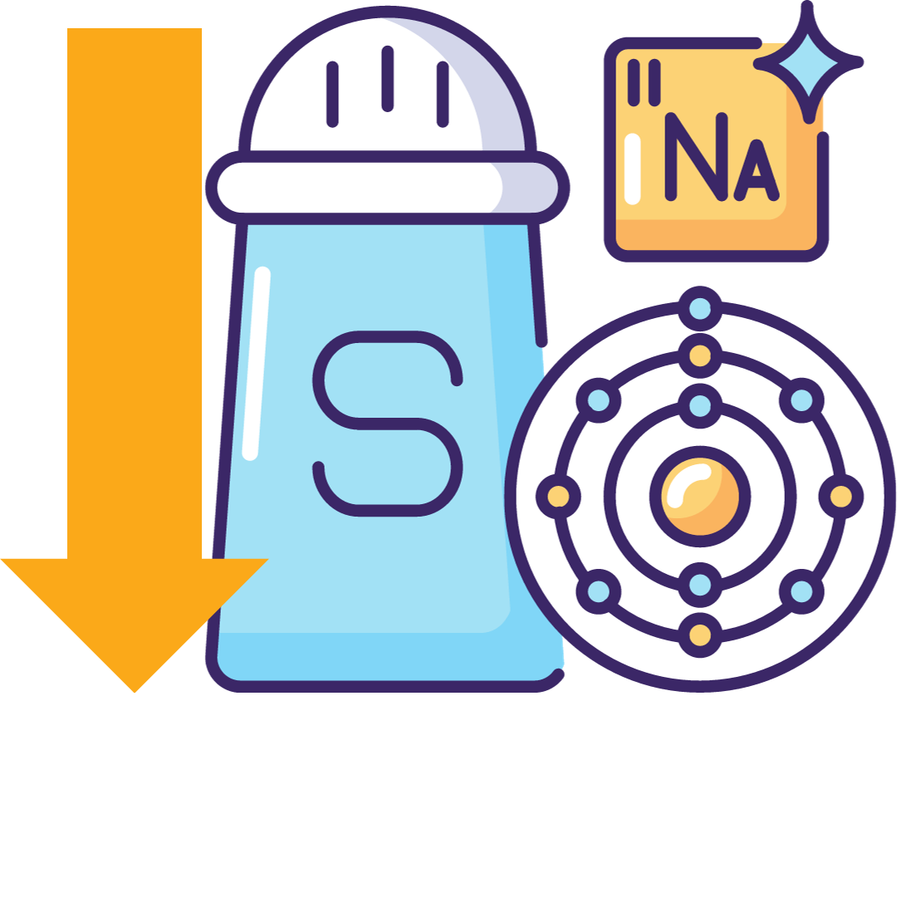
Why is staff training about sodium reduction important?
Role in children's health
Equipping staff with knowledge and skills
Staff buy-in for success
Understanding benefits of sodium reduction

Slide 23

Staff Training and Engagement
Conducting training needs assessments
Assessing labor and culinary skills
Identifying knowledge and skills requirements
Exploring available training resources

Slide 24

Where to start?
Identify knowledge and skill gaps
Essential for effective training
Analyze job requirements
Guide training focus/resources
Measure training effectiveness
Ensure relevant staff training

Slide 25

Training Needs Assessment
Consider school nutrition program goals
Five steps to a needs assessment:
  Define outcomes
  Identify challenges
  Specify knowledge and skills
  Set priorities
  Choose delivery method

Slide 26

Questions and Steps
Job Requirements Analysis
Skill and Knowledge Assessment
Training Resource Identification
Challenges and Concerns
Feedback from Supervisors
Goals and Objectives
Measurement of Training Effectiveness

Slide 27

Solution
Comprehensive training needs assessment
Consider unique needs of school nutrition professionals
Build skills and knowledge

Slide 28

Opportunities for Growth
Compliance with federal and state regulations
Create nutritious and appealing meals
Reduce food waste and manage costs
Technical skills: equipment, inventory, food costs
Develop effective communication and interpersonal skills
Foster positive relationships with stakeholders

Slide 29

Activity: Step-by-Step
Training Needs Assessment

Slide 30

Step 1: Determine desired outcomes.
Identify opportunities for growth and improvement
Define success
For example:
  Improve student satisfaction ratings
  Reduce food waste

Slide 31

Step 2: Identify specific challenges and areas of improvement.
Identify specific areas of improvement
  Observation
  Surveys
  Data evaluation
  Training assessments

Slide 32

Step 3: Determine desired behaviors, knowledge, and skills.
Training topics to the skill gaps

Slide 33

Step 4: Set training timeline and priorities.
Establish the timeline

Slide 34

Step 5: Select the training format and delivery method(s).
Training methods
  Online training
  Computer-based simulations
  Self-guided audio and video programs
  Virtual or in-person instructor-led sessions

Slide 35

Remember the WHY
School nutrition challenges
Benefits of a training plan
Training for engagement and productivity

Slide 36
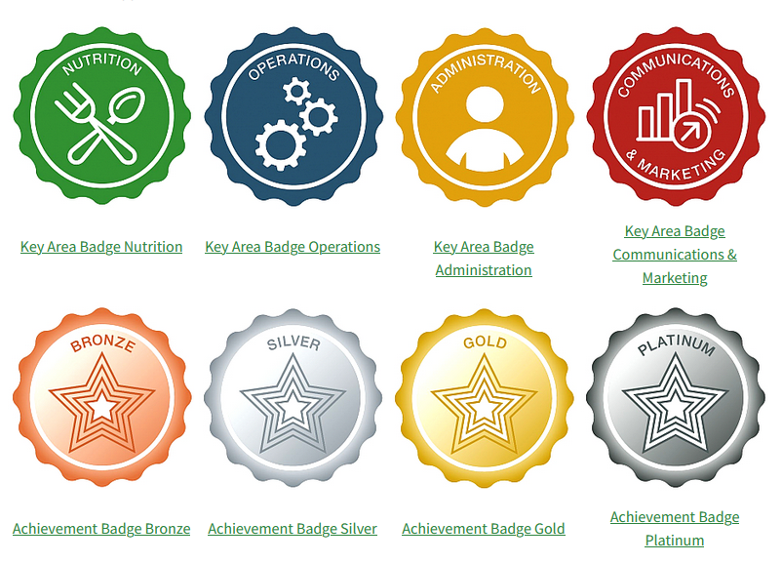
USDA Professional Standards
Annual training and hiring criteria
Applicability to all school nutrition employees
Categories: directors, managers, staff
Focus on job categories and standards

Slide 37

Knowledge and Skills
Four key domains:
  Nutrition
  Operations
  Administration
  Communications/marketing

Slide 38

Activity: Identifying Knowledge and Skills

Slide 39

Assessing Knowledge and Skills
Effective employee performance is essential
Periodic skill assessment
Tailor professional development
Improve nutrition programs and student health

Slide 40

Activity: Individual Skillset Assessment

Slide 41

Culinary Knowledge and Skills Focus
Assess kitchen staff labor skills
Crucial for efficient meal preparation
Balancing nutrition and taste is key

Slide 42
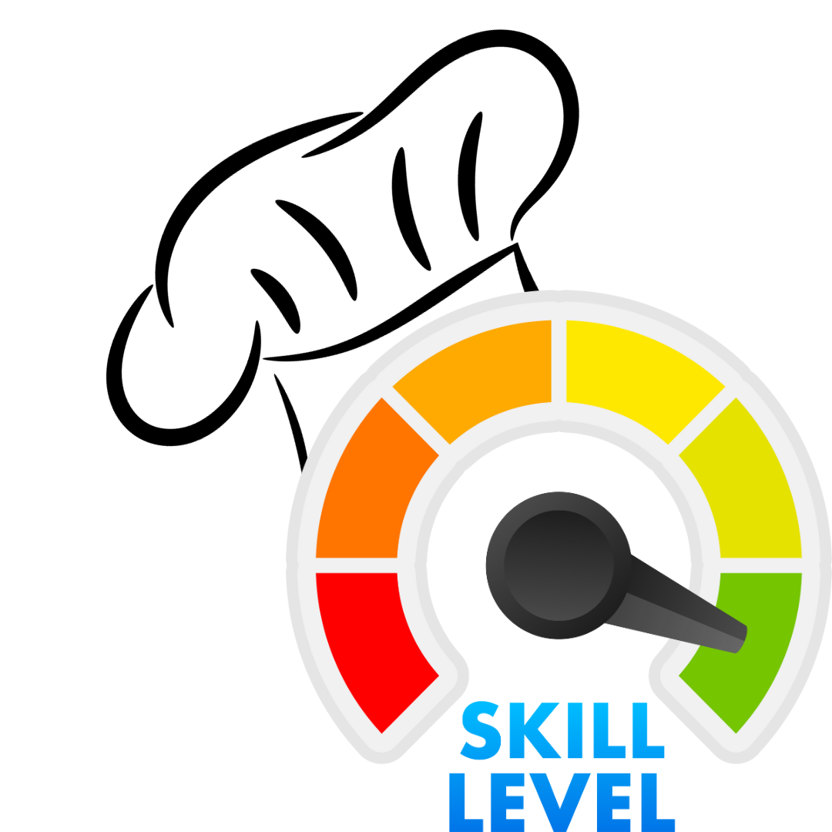
Assessing Culinary Skills of Kitchen Staff
Identify basic culinary skills needed
Evaluate skills through observation
Utilize self-assessment and surveys
Gather feedback from supervisors and colleagues

Slide 43

Developing a Training Plan
Utilize online resources for self-paced training
Consider in-person training for hands-on skills
Explore available training opportunities at ICN

Slide 44

Activity: Culinary Skills Self-Assessment

Slide 45

Training Resources and Sodium Reduction Resources

Slide 46

Institute of Child Nutrition
ICN offers sodium reduction resources
Shaking It Up! resource page for guidance
Manager's Corner provides short lesson plans

Slide 47

Culinary Institute of Child Nutrition (CICN)
Mission: Increase culinary skills
Provides culinary training and resources
Offers micro-trainings (Culinary Quick Bites)
Focus on basic culinary skills

Slide 48

Child Nutrition Sharing Site (CNSS)
Aids in sharing program resources
Collaboration between ICN and USDA/FNS
Supports Federal regulations and policies

Slide 49
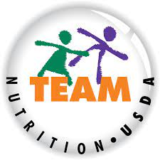
Team Nutrition
USDA initiative
Promotes healthy food choices
Improves nutrition practices
Provides resources for schools and child care
Includes recipes

Slide 50

Child Nutrition Recipe Box (CNRB)
Provides operators with recipes
Meets meal pattern requirements
Standardized with crediting information

Slide 51

Activity: Resource Sharing
ICN
CICN
CNSS
CNRB
Team Nutrition
State agencies
Industry
Allied Organizations

Slide 52

Lesson 1 Summary
Staff training ensures job effectiveness
Needs assessment identifies gaps
Resources: ICN, CICN, CNSS, Team Nutrition, State agencies

Slide 53
Lesson 2: Strategies for Staff Training and Engagement

Slide 54
Benefits
Improved staff morale and satisfaction
Increased buy-in and commitment
Boosted creativity and innovation
Enhanced nutrition knowledge
Improved communication and teamwork
Efficient menu planning
Increased customer satisfaction
Better understanding of students' needs
Effective program goal implementation

Slide 55

Improved staff morale and job satisfaction.

Slide 56

Increased staff buy-in and commitment to program goals.

Slide 57

Increased creativity and innovation in recipe and menu development.

Slide 58

Enhanced staff knowledge of nutrition and food preparation techniques.

Slide 59

Improved communication and teamwork among staff.

Slide 60

More efficient and effective menu planning and recipe development processes.

Slide 61

Increased customer satisfaction with the program.

Slide 62

Better understanding of students' preferences and needs.

Slide 63

More effective implementation of program goals and initiatives.

Slide 64
Strategies
Regular staff meetings for idea sharing
Taste-testing sessions for feedback
Recognition and rewards for contributions
Nutrition and food prep training
Showcase staff creations on social media
Promote a collaborative work environment
Conduct surveys and focus groups
Involve staff in decision-making

Slide 65

Conduct regular staff meetings to discuss menu planning and recipe development, and encourage staff to share their ideas and feedback.

Slide 66

Provide opportunities for staff to participate in taste-testing sessions and provide feedback on new recipes.

Slide 67

Recognize and reward staff for their contributions to menu planning and recipe development.

Slide 68

Offer training sessions on nutrition, food preparation, and menu planning to enhance staff knowledge and skills.

Slide 69

Use social media platforms to showcase staff creations and give them recognition.

Slide 70

Foster a collaborative work environment where staff feel comfortable sharing their ideas and suggestions.

Slide 71

Conduct regular surveys and focus groups to gather feedback from staff and make improvements to the program accordingly.

Slide 72

Involve staff in the decision-making process for menu planning and recipe development and provide them with a sense of ownership over the program.

Slide 73

Call to Action

Slide 74

Activity: Sharing Success 2

Slide 75
More Resources
USDA Professional Standards Training Database
USDA FNS Office of Food Safety
USDA FNS Team Nutrition
Institute of Child Nutrition
State agencies
Professional Organizations
Local In-Service Training
Food service Suppliers
Exhibits at Conferences
Universities and community colleges
Cooperative Extension

Slide 76
Lesson 2 Summary
Benefits of staff engagement include improved morale, creativity, knowledge, and more effective programs
Strategies for staff engagement include meetings, taste-testing, recognition, training, social media, collaboration, surveys, and involvement in decision-making

Slide 77
Culminating Activity and
Action Plan

Slide 78
Activity: Independent Work Time

Slide 79
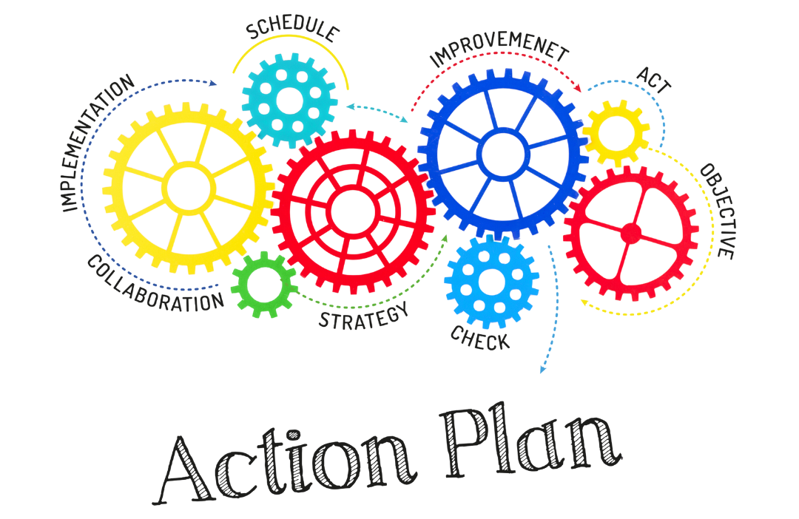
Activity: Sharing Strategies and Action Plans

Slide 80
Thank You!
Post-Assessment

