Slide 1




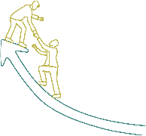






Inspire, Influence, and Innovate: Leadership Essentials

Slide 2







Sessions
Leadership Styles Overview
Effective Communication
Team Building and Collaboration
Time Management and Prioritization
Motivation and Inspiration
Adaptive Leadership
Emotional Intelligence

Slide 3
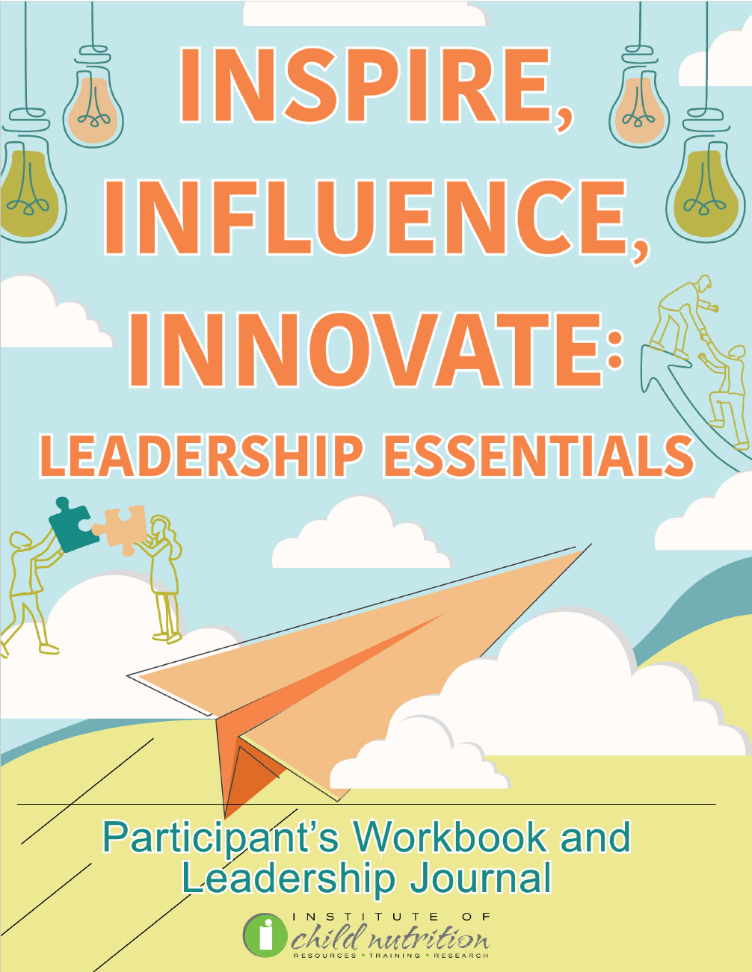
Participant’s Workbook
and Leadership Journal

Slide 4
Ground Rules
Show up on time.
Be present.
Let everyone participate.
Listen with an open mind.
Think before speaking.
Attack the problem, not the person.

Slide 5
Adaptive Leadership
ADAPTIVE LEADERSHIP

Slide 6
Learning Objectives
Discuss strategies to lead through change, such as staying informed, being flexible, and involving the team in decision-making to effectively manage change in school nutrition programs and support their teams during transitions.
Practice problem-solving and decision-making, such as weighing pros and cons, considering the impact on all stakeholders, and seeking input from the team to effectively address challenges in school nutrition programs and make informed decisions.
Explore strategies to lead by example by maintaining a positive attitude, demonstrating a strong work ethic, and showing commitment to continuous learning and improvement in the context of school nutrition.

Slide 7

ACTIVITY: ADAPTIVE LEADERSHIP DISCUSSION

Slide 8

Leading Through Change
Change is constant
Significant impact
Leader’s role:
  Setting a positive tone
  Providing support and guidance
  Leading by example

Slide 9

Navigating Change Strategies:
Staying Informed
Latest developments in school nutrition
New regulations, research findings
Best practices awareness

Slide 10

Navigating Change Strategies:
Being Flexible
Open to new ideas
Willing to adjust plans
Adaptability to circumstances

Slide 11

Navigating Change Strategies:
Team Decision-Making
Decision-making participation
Ensures understanding and commitment

Slide 12

Navigating Change Strategies:
Communicate Change
Explain reasons for change
Impact on the team
Provide clear instructions

Slide 13

ACTIVITY: LEADING THROUGH CHANGE ROLE-PLAYING EXERCISE

Slide 14
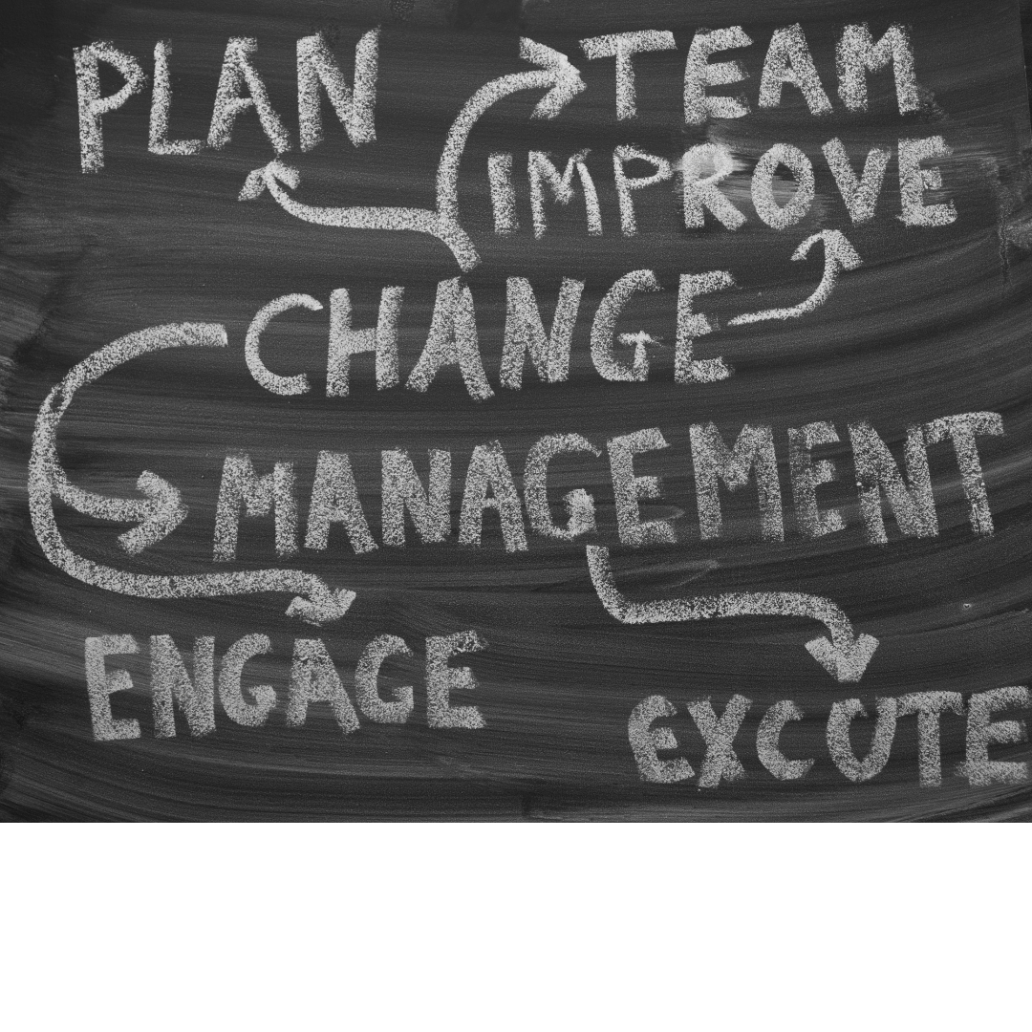
Problem-Solving and Decision-Making
Gather accurate information
Ask clarifying questions
Involve the team
Know the leader’s role

Slide 15

Decision-Making Strategies:
Weighing Pros and Cons
Consider advantages and disadvantages
Achieve balanced decisions

Slide 16

Decision-Making Strategies:
Consider Impact
Think about effects on all parties
Ensure fairness and benefit

Slide 17

Decision-Making Strategies:
Seek Input
Involve team in decisions
Gain valuable insights

Slide 18

Decision-Making Strategies:
Use Data and Evidence to Guide Decisions
Inform decisions with data
Ensure objectivity and effectiveness

Slide 19
ACTIVITY: PROBLEM-SOLVING AND DECISION-MAKING
ROLE-PLAYING EXERCISE

Slide 20

Leading By Example
Set tone for work environment
Demonstrate values and expectations
Treat others with respect
Foster positive culture
Inspire team and drive success

Slide 21

Strategies for Leading By Example
Maintaining a Positive Attitude
Demonstrating a Strong Work Ethic
Showing Commitment to Continuous Learning
Treating Everyone with Respect

Slide 22
ACTIVITY: LEADING BY EXAMPLE ROLE-PLAYING EXERCISE

Slide 23

Wrap Up and Q&A
Navigating Change
  Strategies
Problem Solving and Decision-Making
  Strategies
Leading By Example
  Strategies

Slide 24




Social Media Links
www.theicn.org 1-800-321-3054
Follow ICN on Social Media!
facebook.com/ichildnutrition
@ichildnutrition
instagram.com/theicn
linkedin.com/company/theicn

Slide 25
Disclosure
This training was developed by the
The University of Mississippi
School of Applied Sciences
www.theicn.org
1-800-321-3054

