Slide 1




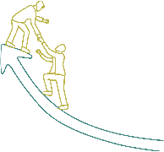






Inspire, Influence, and Innovate: Leadership Essentials

Slide 2
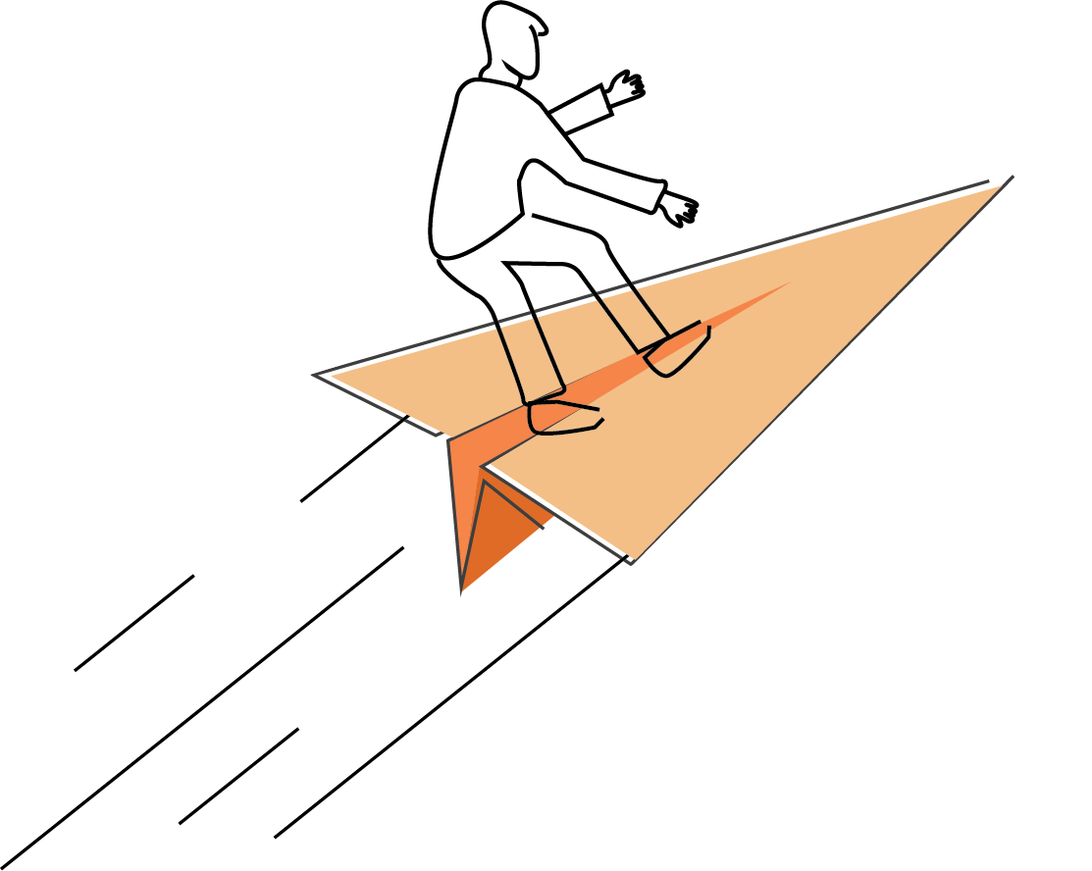






Sessions
Leadership Styles Overview
Effective Communication
Team Building and Collaboration
Time Management and Prioritization
Motivation and Inspiration
Adaptive Leadership
Emotional Intelligence

Slide 3
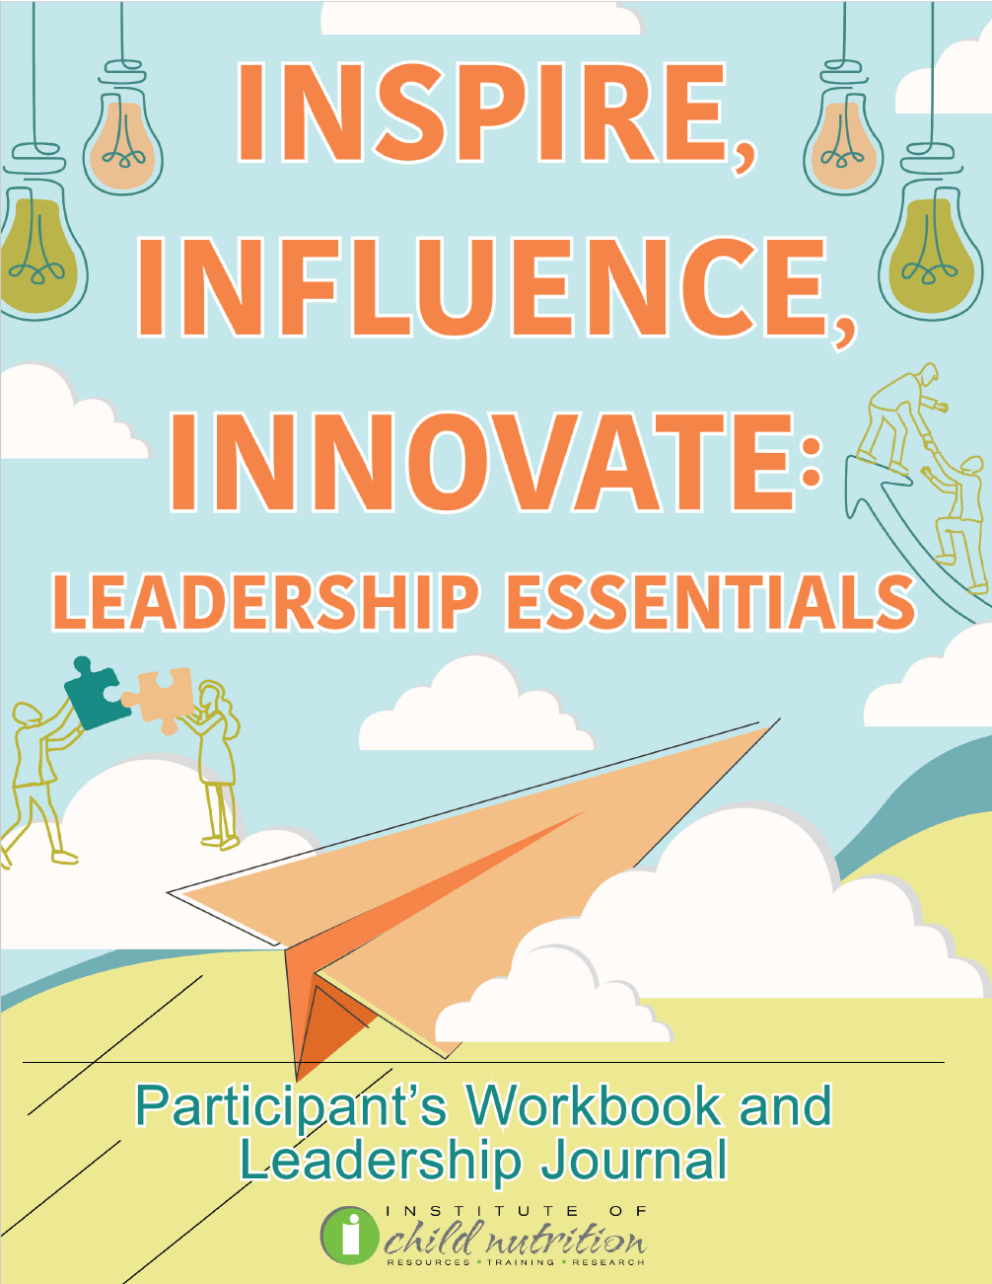
Participant’s Workbook
and Leadership Journal

Slide 4
Ground Rules
Show up on time.
Be present.
Let everyone participate.
Listen with an open mind.
Think before speaking.
Attack the problem, not the person.

Slide 5
EFFECTIVE COMMUNICATION SKILLS
EFFECTIVE COMMUNICATION SKILLS

Slide 6
Learning Objectives
Apply active listening strategies, such as paraphrasing, asking open-ended questions, and providing constructive feedback, in the context of school nutrition.
Identify examples of nonverbal communication, such as facial expressions, body language, eye contact, and proximity.
Practice providing and receiving constructive feedback techniques in the context of school nutrition.

Slide 7

ACTIVITY: EFFECTIVE COMMUNICATION SKILLS DISCUSSION

Slide 8

Active Listening
Communication technique beyond hearing
Full concentration on speaker
Thoughtful response required
Staff Engagement Benefits

Slide 9

Active Listening Strategies:
Paraphrasing
Restate in own words
Confirm understanding
Allow speaker clarification

Slide 10

Active Listening Strategies:
Open-ended Questions
Does not answer with yes/no
Encourages elaboration
Deepens understanding

Slide 11

Active Listening Strategies:
Feedback
Express understanding
Ask for clarification
Offer constructive thoughts
Foster positive environment

Slide 12

ACTIVITY: ACTIVE LISTENING ROLE-PLAYING EXERCISE

Slide 13

Nonverbal Communication
No words involved
Body language, expressions
Eye contact, gestures
Observing cues valuable
Staff Engagement Benefits
  Understand challenges, suggestions
  Improve workflow, teamwork
  Enhance job satisfaction

Slide 14

Nonverbal Communication:
Facial Expressions
Convey emotions
Smile indicates happiness
Frown shows displeasure

Slide 15

Nonverbal Communication:
Body Language
Includes posture, gestures
  Standing tall signals confidence
  Open body language, uncrossed arms

Slide 16

Nonverbal Communication:
Eye Contact
Shows attentiveness, interest
Too much or too little uncomfortable

Slide 17

Nonverbal Communication:
Proximity
Physical distance matters
Indicates intimacy, comfort
Influences relationship dynamics

Slide 18
ACTIVITY: NONVERBAL COMMUNICATION ROLE-PLAYING EXERCISE

Slide 19

Constructive Feedback
Specific, actionable, beneficial
Enhances performance, outcomes
Focuses on growth, improvement
Enhances performance, job satisfaction
Operational efficiency feedback
Improved workflows, increased productivity

Slide 20

Constructive Feedback Methods:
Direct Feedback
Straightforward, honest
Specific, objective
Focus on behavior

Slide 21

Constructive Feedback Methods:
360-Degree Feedback
Gathered from multiple sources
Holistic view of performance

Slide 22

Constructive Feedback Methods:
Stop, Start, Continue
Stop unproductive behaviors
Start new productive behaviors
Continue current productive behaviors

Slide 23

Constructive Feedback Methods:
SBI Method (Situation, Behavior, Impact)
Describe situation
Detail observed behavior
Explain impact

Slide 24

Constructive Feedback Methods:
Feedforward
Suggestions for improvement
Focus on future performance

Slide 25
ACTIVITY: CONSTRUCTIVE FEEDBACK ROLE-PLAYING EXERCISE

Slide 26

Wrap Up and Q&A
Active Listening
  Definition
  Importance
  Techniques
Nonverbal Communication
  Definition
  Impact
  Types
Constructive Feedback
  Definition
  Role
  Methods

Slide 27




Social Media Links
www.theicn.org 1-800-321-3054
Follow ICN on Social Media!
facebook.com/ichildnutrition
@ichildnutrition
instagram.com/theicn
linkedin.com/company/theicn

Slide 28
Disclosure
This training was developed by the
The University of Mississippi
School of Applied Sciences
www.theicn.org
1-800-321-3054

